Slide 1


Ionization of the drift gas volume of the TPC detector by UV nanosecond laser pulses
Julia Shafarevich, Alexander Fedotov, Sergey Movchan, Julia Fedotova
Speaker: Julia Shafarevich
Supervisor: Alexander Fedotov
Minsk, 2025

Slide 2
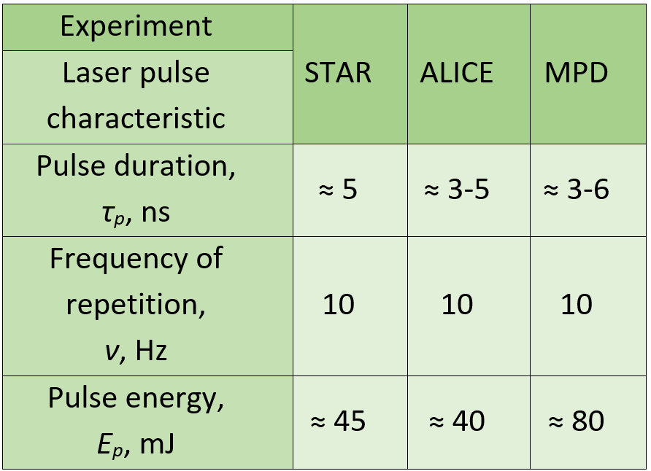
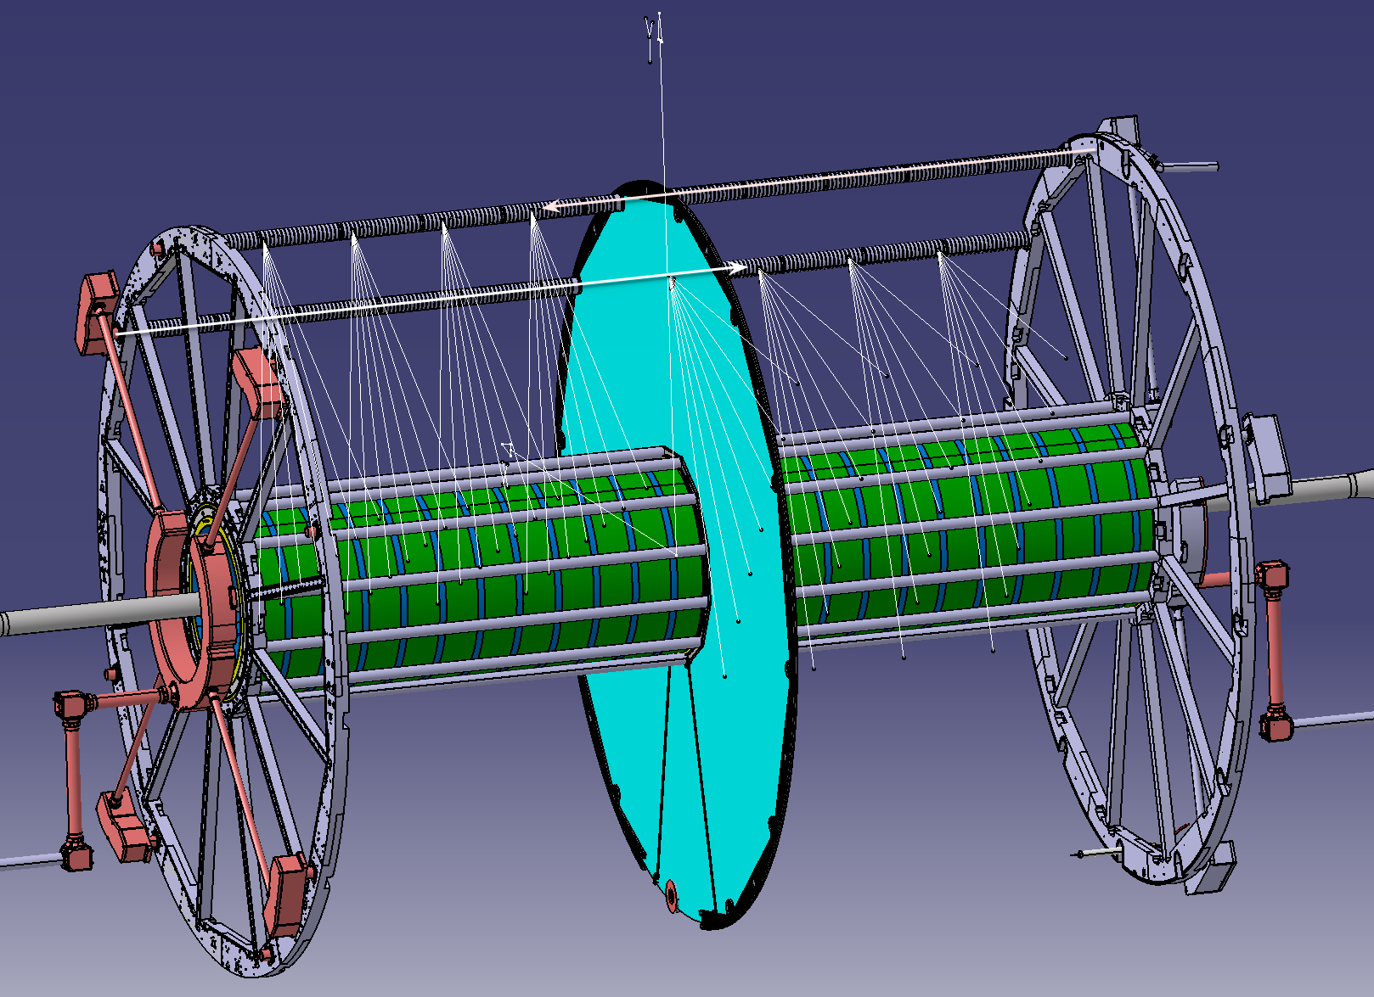
Relevance
To ensure measurement accuracy calibration of the TPC is necessary. This makes it possible to correct deviations caused by inhomogeneities of the electric and magnetic fields, temperature fluctuations.
Comparison of laser pulse characteristics in 3 experiments
Almost all TPC laser calibration systems use an Nd:YAG laser to generate the UV laser beam.
Laser calibration system TPC design (MPD, NICA)
Notes:
сравнение

Slide 3
Research objective
Investigate ray propagation and impurity ionization in the working gas volume of TPC
Research tasks
Creation ray tracing model of a laser pulse propagation in TPC calibration system;
Adjustment of the optical elements in the model and determination of the threshold rotation angles of the adjustable mirrors necessary for proper system functioning;
Estimation of the ionization electron concentration in the working gas volume resulting from impurity interactions under laser irradiation.

Slide 4
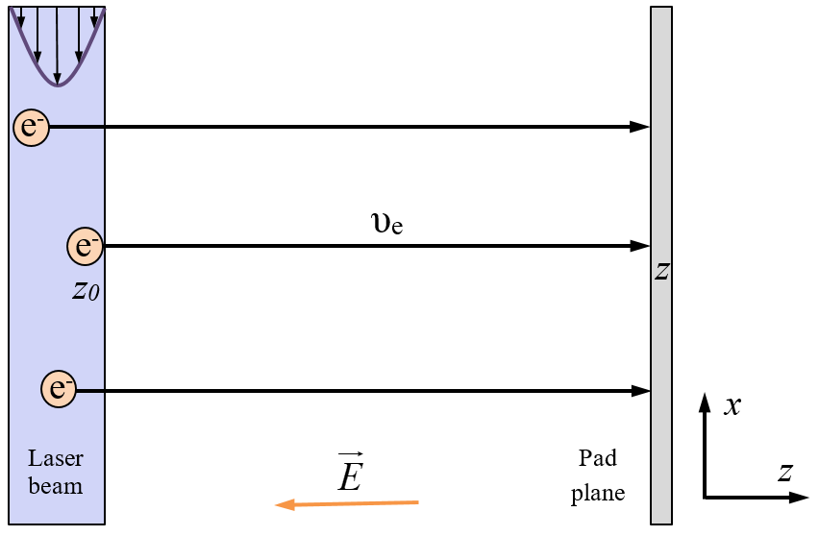
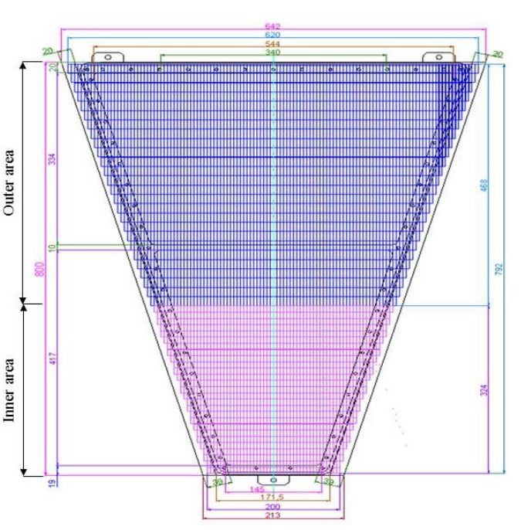
System description
Electrons of ionization drift to the pad plane
Schematic representation of a portion of the pad plane segmented by electrodes in the TPC of the NICA experiment
Notes:
нет

Slide 5
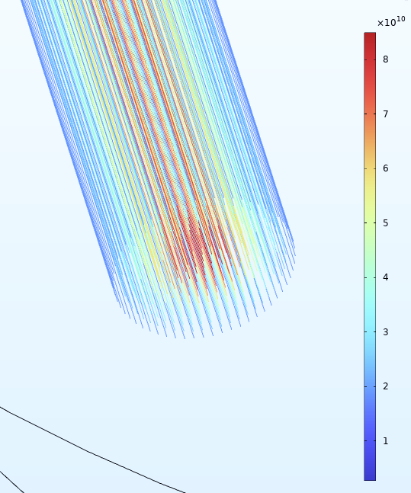
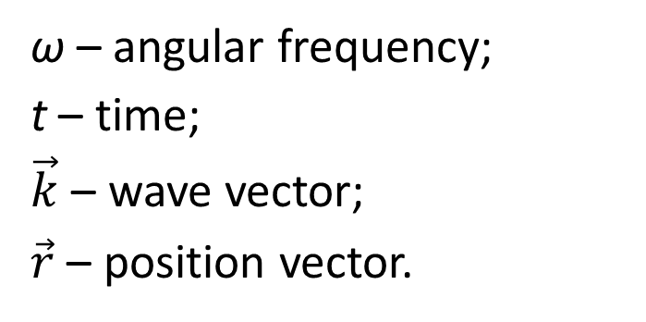
Ray tracing method
Gaussian beam
Set of discrete beams
ω – angular frequency;
t – time;
$\vec{k}$ – wave vector;
$\vec{r}$ – position vector.
The Time-Dependent Solver is applied to ODE. This allows to:
Set the time step;
Stop the calculation under specified conditions (boundary, beam attenuation, etc.);
Use implicit or explicit methods for solving (Runge-Kutta, Euler, BDF);
Approximate representation of a Gaussian beam
Notes:
BDF (Backward Differentiation Formula, метод обратных дифференцирующих формул)
Применяется, если уравнения становятся жёсткими (например, при резких изменениях n или в анизотропных средах).

Slide 6
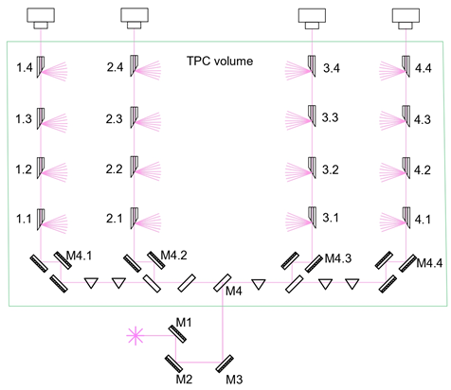
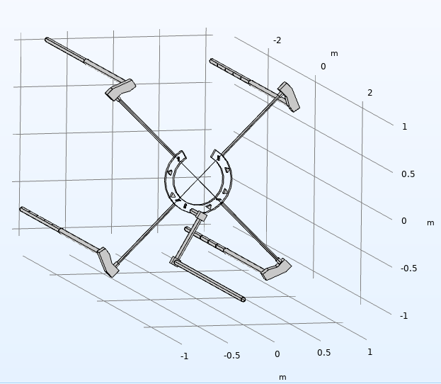
Optical scheme
C1
C2
C3
C4
C1
C4
C2
C3
A
Laser calibration system geometry
Optical scheme of the laser calibration system of the TPC of the MPD NICA experiment in AutoCAD
Notes:
Указать элементы

Slide 7
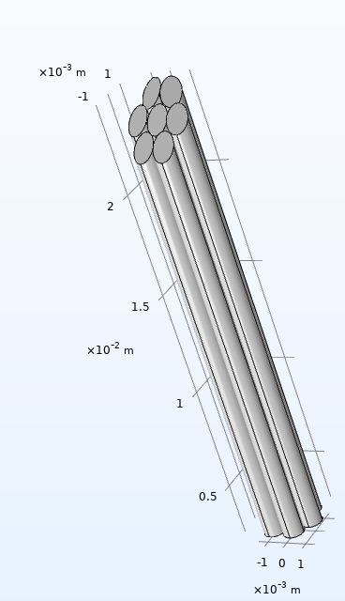
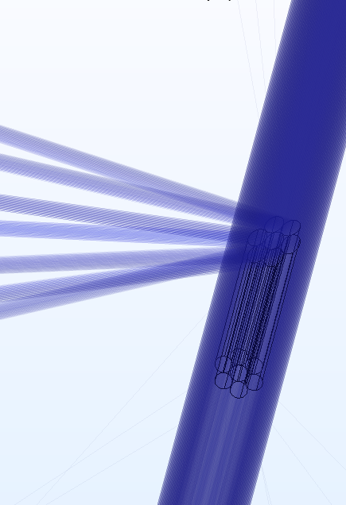
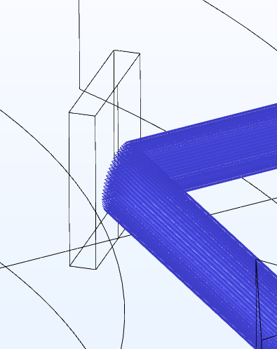
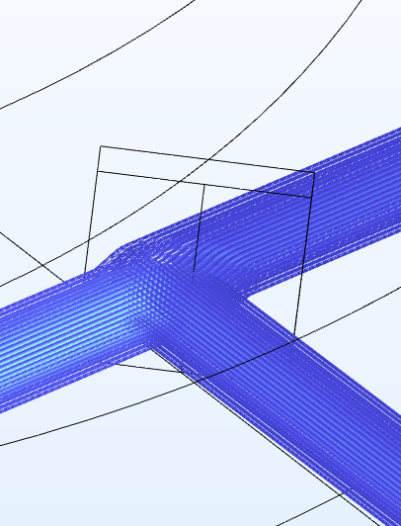
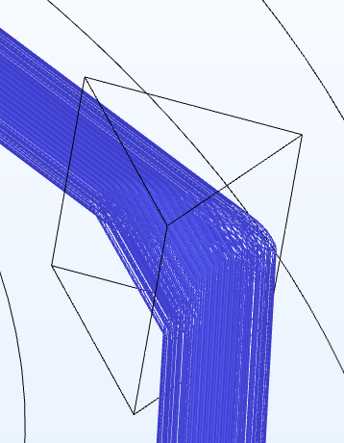
Optical elements
a)
b)
The trajectories of a laser beam through various optical elements:
a fully reflective mirror,
b) a translucent mirror,
c) a prism
a)
b)
a) Micromirrors in the bundle;
b) Reflection of laser beams from a band of micro-mirrors into the working gas volume
c)

Slide 8
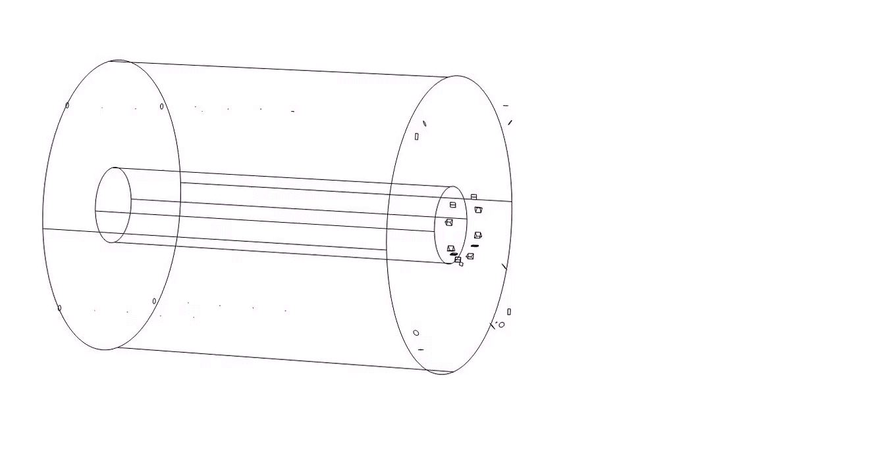
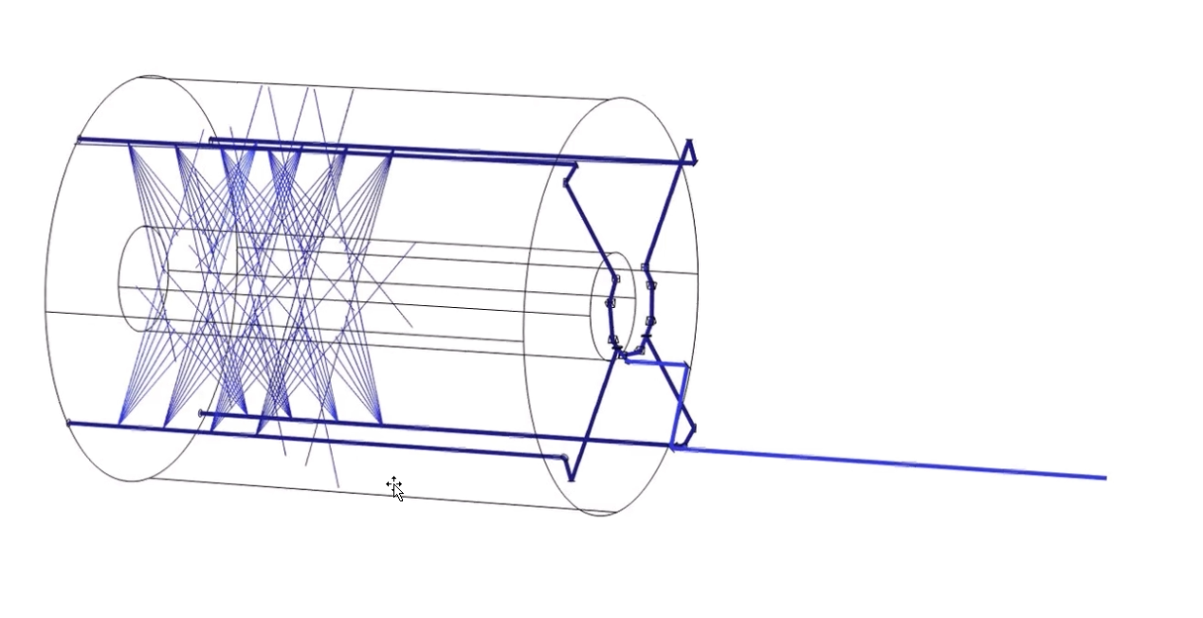
Simulation
d = 20 mm
λ = 266 nm
I0 = 8,49∙10¹⁰ W/m²
A model of beam propagation inside the calibration system of TPC of the MPD NICA experiment in Comsol Multiphysics
https://www.youtube.com/watch?v=qnAeO-Hv7Kk

Slide 9
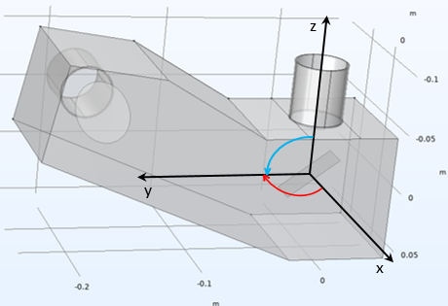
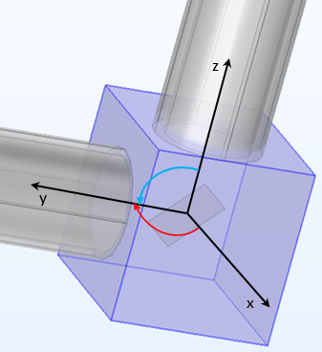
Adjusting mirrors
M4.4
M4.1
Adjusting mirrors M2.1 - M2.4
M3
M4.3
M4.2
M2
Laser calibration system geometry
Adjusting mirror M1.1
Notes:
Марки моторов
И диапазон вращения

Slide 10
Angle alignment error
a)
b)
Dependence of the number of beams injected into the working gas volume of the TPC on the angle adjustment error for the mirror M2 a) x-axis, b) z-axis

Slide 11
Angle alignment error
a)
b)
Dependence of the number of beams injected into the working gas volume of the TPC on the angle adjustment error for the mirror M4.1- M4.4
a) x-axis, b) z-axis

Slide 12

Ionization model
Impurity | Ionisation energy, eV | Absolute cross-section of two-photon absorption
1, 2, 3 - trimethylbenzene | 8,27 | 2,8∙10⁻²⁷
p-xylene | 8,44 | 5,8∙10⁻²⁷
$$n\left(t\right)=N_{0}\left(1−e^{−σ_{2}I^{2}t}\right)$$
N₀ ⁓ 10²⁰ molecule/m³
Dependence of the number of generated ionization electrons on the impurity concentration for 1,2,4 - trimethylbenzene and p - xylene at a pulse duration of 5 ns
Number of ionisation electrons along a single beam:
1, 2, 3 – trimethylbenzene ⁓ 200 - 300
p-xylene ⁓ 400 - 600
a)
b)
Dependence of the number of generated ionization electrons on the impurity concentration for a) 1,2,4 – trimethylbenzene, b) p - xylene at a pulse duration of 5 ns and 7 ns

Slide 13
Conclusions
A model of ultraviolet laser pulse propagation (λ = 266 nm, τ_{p} = 5-7 ns, d = 20 mm) in the optical chain of the calibration system has been developed based on the ray tracing method;
The permissible deviation from the ideal alignment angles for mirror M2 is Δθₓ ≤ ±0.01° and Δθz ≤ ±0.02°; for mirrors M4.1 – M4.4 – Δθₓ ≤ ±0.01° and Δθz ≤ ±0.02°, respectively.
A model of the two-photon ionization process in the Ar - CH₂ gas mixture with the addition of an organic impurity has been constructed. It was determined that the introduction of trimethibenzene and p-xylene in the amount of 1:10,000 allows for the generation of 10⁵- 10⁶ electrons in the working gas volume, which is sufficient for reconstructing tracks in the detector;

Slide 14
Thank you for attention!

Slide 15
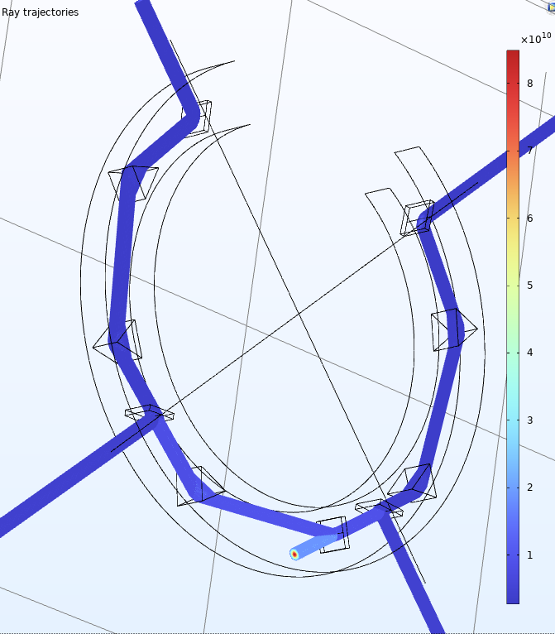
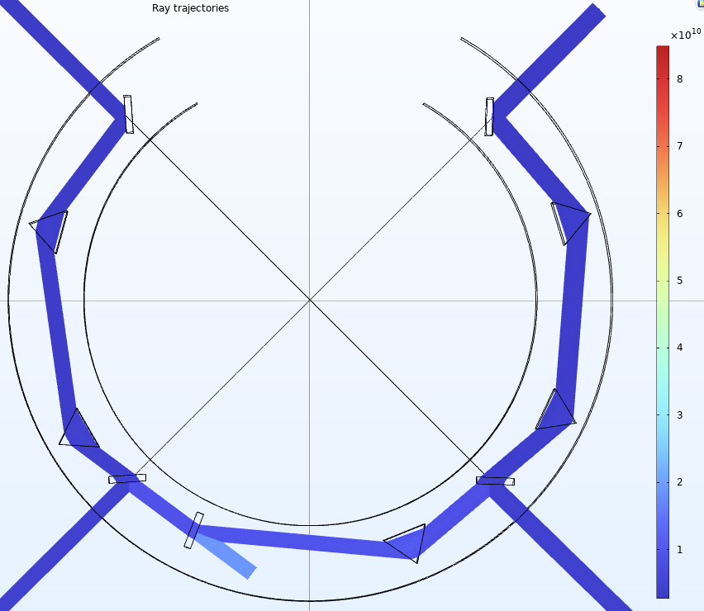
Распространение лазерного луча внутри большого бимсплитера

Slide 16
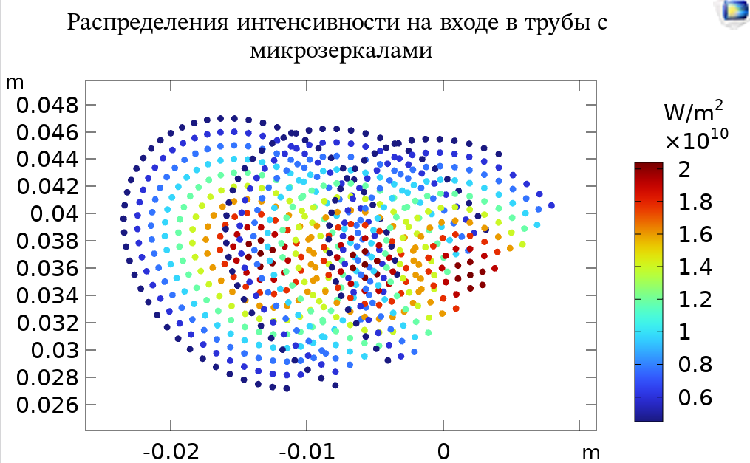
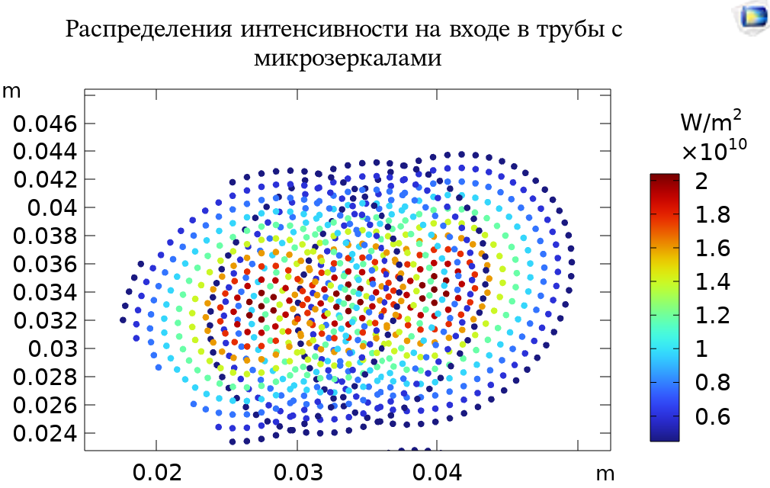
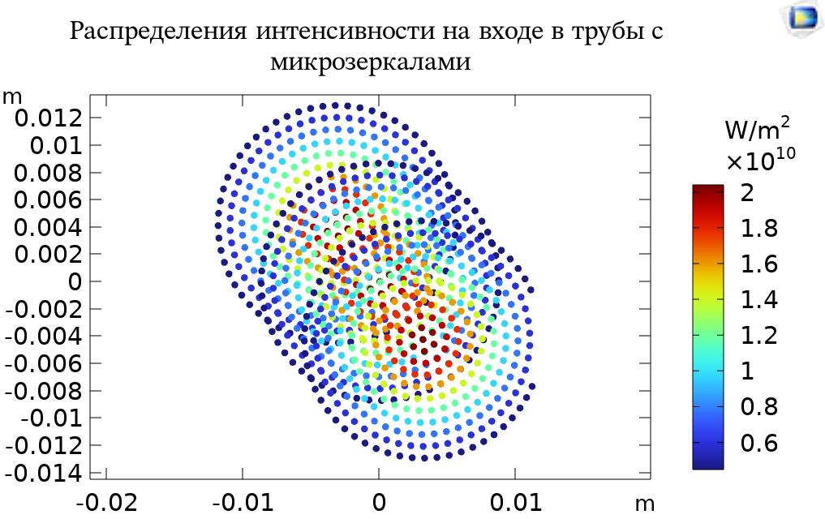
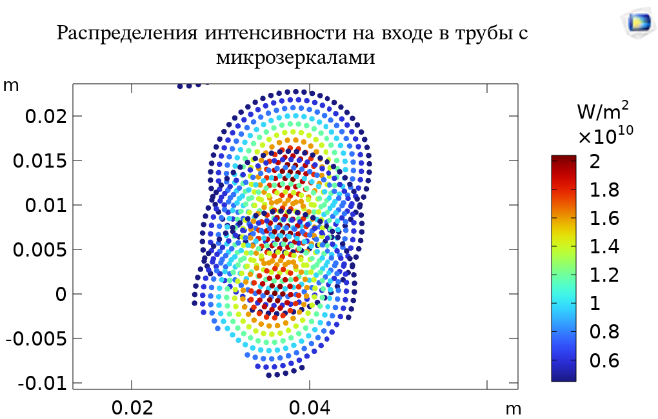
Пример влияния нарушения юстировки
Изменения профиля луча на выходе из делителя при отклонении зеркала на входе в TPC на 0.1°, 0.2°, 0.3°
Интенсивность сильнее теряют верхние каналы делителя с большим количеством элементов
Нижние каналы теряют интенсивность меньше

