Slide 1

“Microservices for event data handling in modern HEP experiments”
The XVI-th International School-Conference "The Actual Problems of Microworld Physics“
Minsk, Belarus, 24 – 31 August, 2025
V.Krylov
JINR/LHEP
Email: kryman@jinr.ru

Slide 2
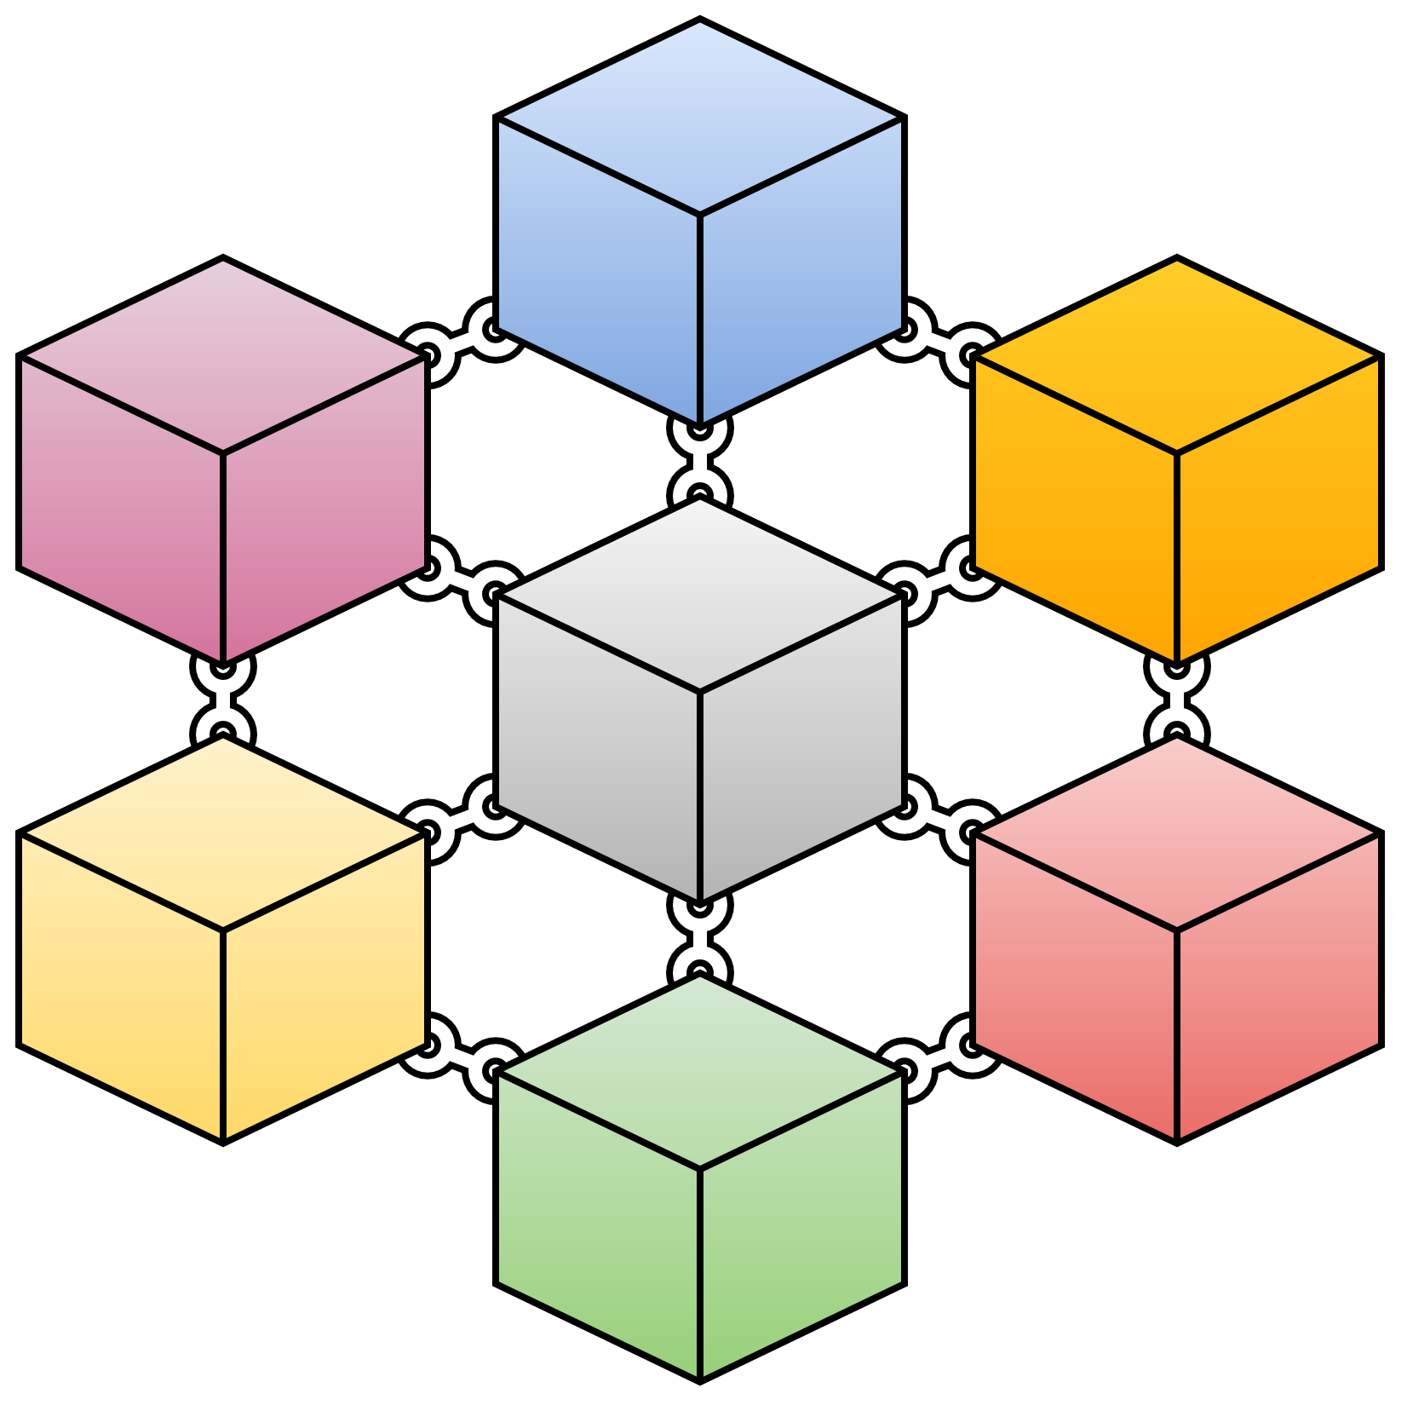
What the microservices are?
Microservices - also known as the microservice architecture - is an architectural pattern that organizes an application into a collection of loosely coupled, fine-grained services that communicate through lightweight protocols.
This pattern is characterized by the ability to develop and deploy services independently, improving modularity, scalability, and adaptability.
In contrast to the traditional monolithic approach of a large, tightly coupled application, microservices provide a cloud-native architectural framework.
However, it introduces additional complexity, particularly in managing distributed systems and inter-service communication, making the initial implementation more challenging compared to a monolithic architecture.
Microservices-based applications have been a game changer. This approach to building applications comes with its own set of tools, technologies and best practices. It has compelling advantages that are now indispensable!
Notes:
микросервисы это архитектурное решение которое позволяет разбить общую сложную задачу на мелкие независимые фрагменты, которые обмениваются данными друг с другом с помощью быстрых протоколов передачи данных.
Эта технология позволяет разрабатывать, тестировать и развертывать сервисы независимо друг от друга что значительно упрощает процесс разработки, отладки и тестирования больших и емких программных проектов.
По сравнению с монолитным приложением которое состоит из большого количества библиотек и функций, которые часто плохо совместимы друг с другом микросервисы работают каждый с минимальным набором необходимых библиотек и исходного кода, который редко превышает несколько сотен строчек кода для выполнения конкретной определенной задачи.
Тем не менее эта технология накладывает дополнительные условия и некоторые сложности связанные с архитектурными решениями, менеджментом распределенных систем и меж-сервисными коммуникациями по сравнению с монолитной архитектурой.
Но несмотря на это технология микросервисов все больше находит своих последователей и успещно развивается в том числе и в области экспериментальной физики.

Slide 3


Simulation vs Experiment Chain
Simulation
Experiment
Monte-Carlo
Physics Analysis
particles
particle PIDs
information
tracking
tracking
Offline
detector hits
detector hits
Online
clustering
clustering
digits
processing

Slide 4
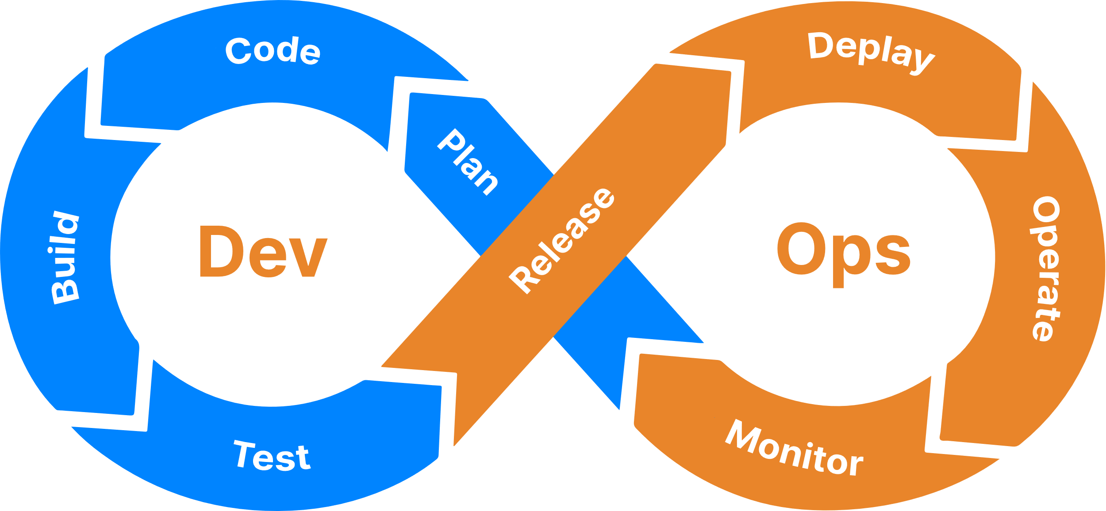
DevOps solution and CI/CD pipelines
DevOps is a philosophy, set of practices, and tools that combine software development (Dev) and IT operations (Ops) to improve software deployment and management.
DevOps may be one of the haziest terms in software development, but most of us agree that four basic activities make DevOps what it is:
CI/CD pipelines
Cloud infrastructure
Test automation
Configuration management
Some of these practices help accelerate, automate, and improve a specific phase. Others span several phases, helping teams create seamless processes that help improve productivity.
It brings both developers and operations together to form a smaller and active product development cycle. DevOps is a practice that every product should follow!
Notes:
DevOps это философия, набор соответствующих практик и инструментов которые комбинируют разработку программного обеспечения и информационных технологий, чтобы улучшить процесс написания программ и их менеджмента.
Основные направления деятельности и активность DevOps:
CI/CD pipеline
Облачная инфроструктура
Автоматизация тестирования и различных проверок
Конфигурация менеджмента
Некоторые и этих практик позволяют ускорять и автоматизировать разработку программного продукта другие облегчают фазу тестирования и развертывания систем внесения изменений в новых версиях..
На рисунке представлены последовательность и непрерывность процесса разработм и поддержки программных комплексов.

Slide 5
CI/CD pipeline for microservices architectures
Continuous Integration/Continuous Delivery and Deployment
Continuous Integration. Code changes are frequently merged into the main branch. Automated build and test processes ensure that code in the main branch is always production-quality. CI helps to catch bugs early in the development cycle, which makes them less expensive to fix.
Continuous Delivery. Any code changes that pass the CI process are automatically published to a production-like environment. The goal is that your code should always be ready to deploy into production.
Continuous Deployment. Code changes that pass the previous two steps are automatically deployed into production.
Notes:
CI/CD включает в себя несколько стадий или процессов при разработке программного продукта
CI/CD это подход в разработке программного обеспечения, который объединяет следующие практики:
CI - Continuous Integration непрерывная интеграция
Разработчики часто (несколько раз в день) кладут изменения в общий репозиторий.
После каждого коммита автоматически запускаются сборка и тесты.
Цель — быстро выявлять ошибки, интегрировать код без конфликтов и поддерживать проект в рабочем состоянии.
CD — Continuous Delivery
Любой код который прошел CI процесс автоматически доставляется в тестовую среду для дополнительной проверки и тестирования
Цель – всегда быть готовым для развертывания в экспериментальной среде.
CD — Continuous Deployment
Код прошедший обе предыдущие стадии разработки автоматически запускается.

Slide 6
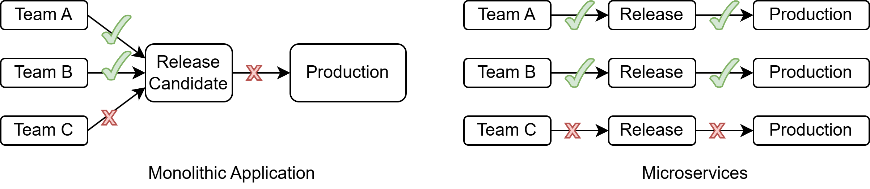
A robust CI/CD pipeline matters
In a traditional monolithic application, there is a single build pipeline whose output is the application executable.
Following the microservices philosophy, there should never be a long release train where every team has to get in line.
Notes:
Традиционная монолитное программное обеспечение имеет только один путь для реализации и при неготовности хотя бы одного функционального фрагмента конечный продукт находится в стадии разработки.
Если следовать философии microservices при готовности даже одиночного функционального фрагмента он сразу доставляется и программный продукт получает обновленный код без ожидания.

Slide 7
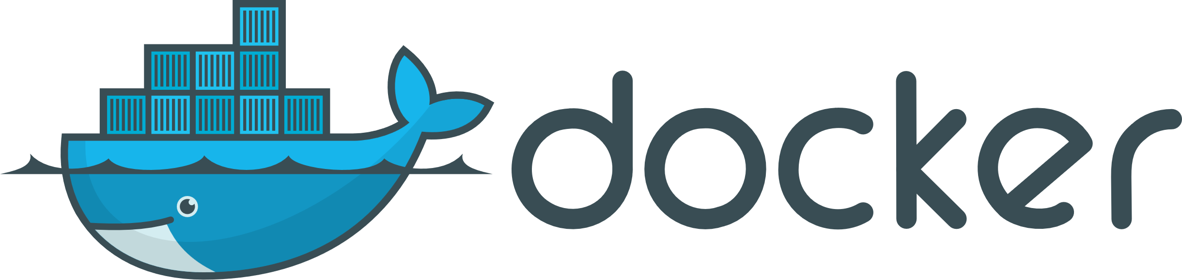
Microservices and Dockers
Microservices represent an architectural approach where an application is structured as a collection of small, independently deployable services. Each microservice focuses on a specific capability, runs in its own process, and communicates with other services via APIs.
Microservice is a software design pattern, while Docker is a tool for implementing and managing containerized applications.
Docker is a platform for developing, shipping, and running applications using containerization.
Docker is often used to deploy microservices. Each microservice can be packaged into its own Docker container, providing isolation and simplifying deployment and scaling.
Notes:
Таким образом микросервисы представляю собой архитектурное решение в котором программный продукт разбивается на мелкие независимые функциональные фрагменты каждый из которых нацелен на выполнение конретной задачи который работает в собственном отдельном процессе и может взаимодействовать с другими микросервисами для обмена данными.
Для того чтобы управлять разработкой и управлением микроссерсисами необходима платформа Docker.
Микросервисы упаковываются в так называемые Docker containers которые и полностью готовы к независимому развертыванию и масштабированию в любой программной среде.

Slide 8
Docker Ecosystem and Containerization
Docker is a relatively new technology, but it’s already well underway in DevOps.
The Docker ecosystem has grown quite a bit since Docker Engine launched in 2013 and now it includes tooling and frameworks to serve almost every aspect of container-based development and deployment.
Docker is an open-source platform that enables developers to build, deploy, run, update and manage containers.
Containers are standardized, executable components that combine application source code with the operating system libraries and dependencies required to run that code in any environment.
Containers simplify the development and delivery of distributed applications. They have become increasingly popular as organizations shift to cloud-native development and hybrid multicloud environments.
Each container is like a separate Linux system, so you have a complete operating system running within a single machine.
Notes:
Docker является относительно новой технологией которая полностью следует философии DevOps.
Впервые Докер как эко-система появилась в 2013 году и включала в себя основные инструменты для разработки и функционирования всех аспектов разработки контейнеров и их развертывания в рабочей среде.
Контейнеры – это стандартизованные и выполняемые компоненты которые комбинируют исходный код с операционной системой и необходимыми библиотеками и предназначены для выполнения в любом окружении как отдельный процесс.
Каждый контейнер выглядит как отдельная линукс система со своей файловой системой и мнинмальным набором необходимых библиотек.

Slide 9
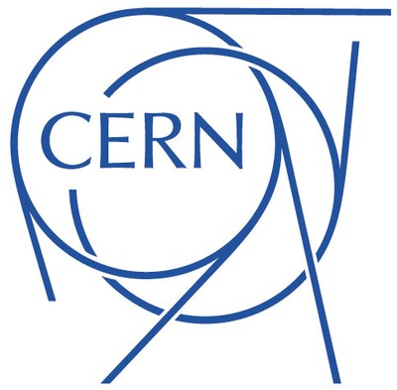
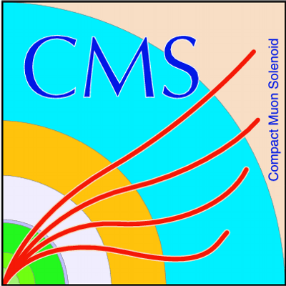



Examples of CERN's use Docker in experiments
CERN: At CERN we provide base Docker images for the supported Linux distributions. They can be found in both CERN's Docker registry or on https://hub.docker.com/u/cern. These images can be used as the base for your own images, by extending its content with all your requirements.
CMS: The CMS experiment provides guides and resources for running CMS analysis code using Docker, including mounting local file areas for data sharing. (https://opendata.cern.ch/docs/cms-guide-docker)
ATLAS: The ATLAS utilizes Docker for distributing its analysis software (Athena) and provides base images for analyses, published on CERN's GitLab container registry. (https://atlas‑software.docs.cern.ch/athena/containers/intro-docker)
DELPHI: The DELPHI experiment uses Docker containers to run its legacy software stack, including CERNLIB applications. (https://opendata.cern.ch/docs/delphi-guide-docker)
ALICE: CERN's ALICE experiment utilizes Docker containers to facilitate the execution of Grid jobs and provide a consistent software environment across various computing sites. (https://github.com/aphecetche/docker-alice-online)
and more…

Slide 10
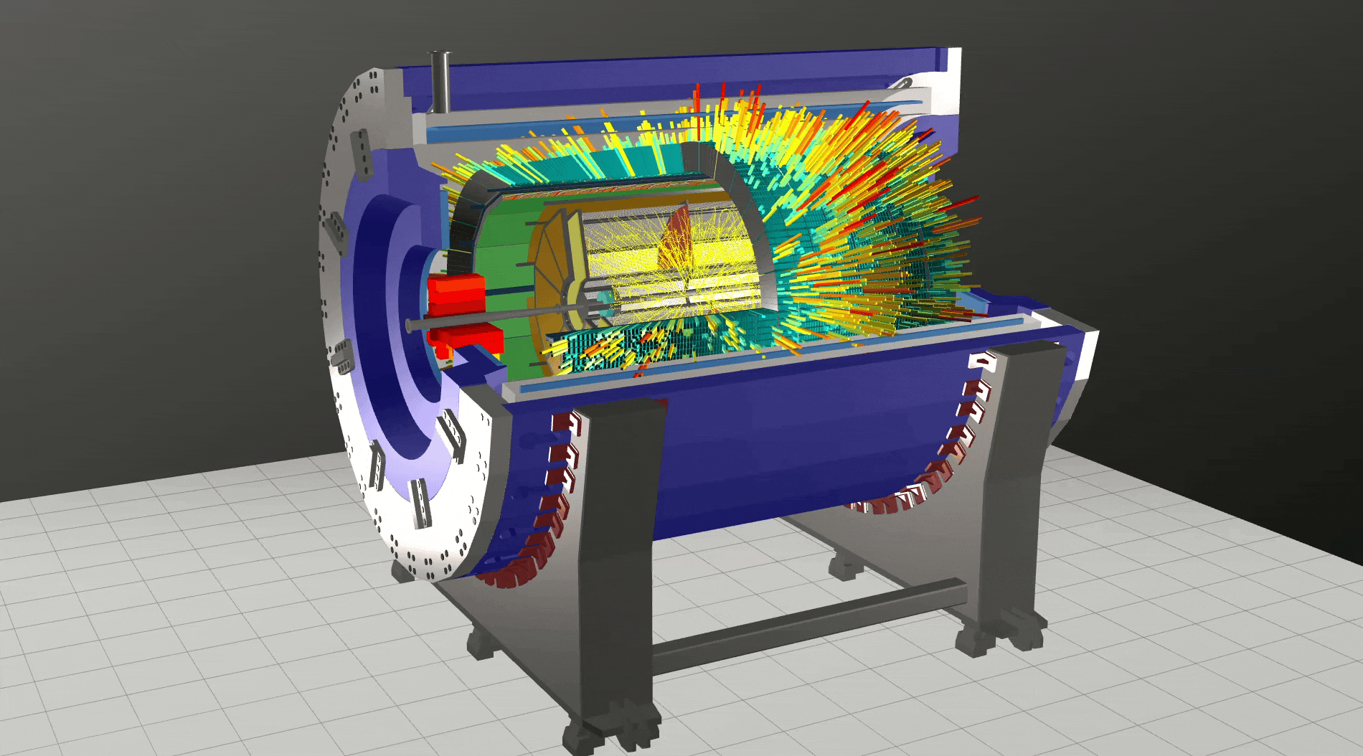
MPD Detector Event Visualization
Cryostat
Solenoid
MPD Detectors:
TOF - Time of Flight
TPC - Time Projector Chamber
ECAL - Electromagnetic Calorimeter
FFD – Fast Forward Detector
FHCAL - Forward Hadron Calorimeter
Beam Pipe
Magnet Poles
Yoke Cradles
Yoke Barrel
Web address of a prototype of the event display: https://mpd-edsrv.jinr.ru/

Slide 11
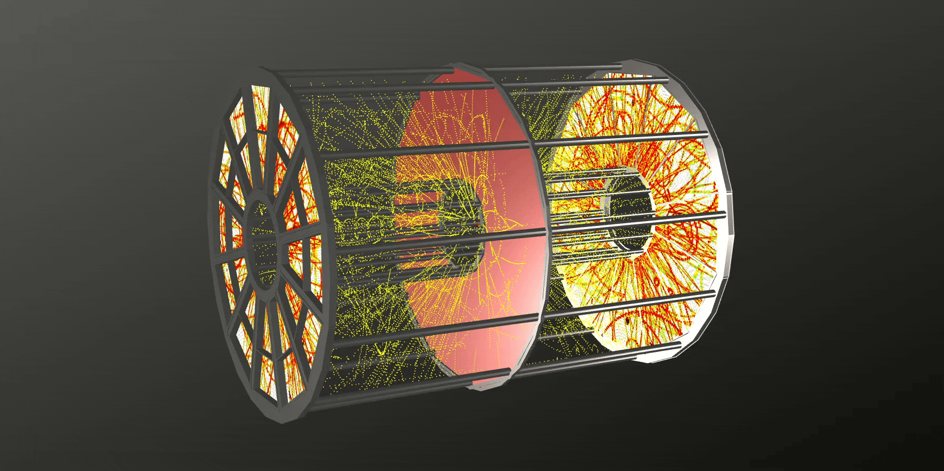
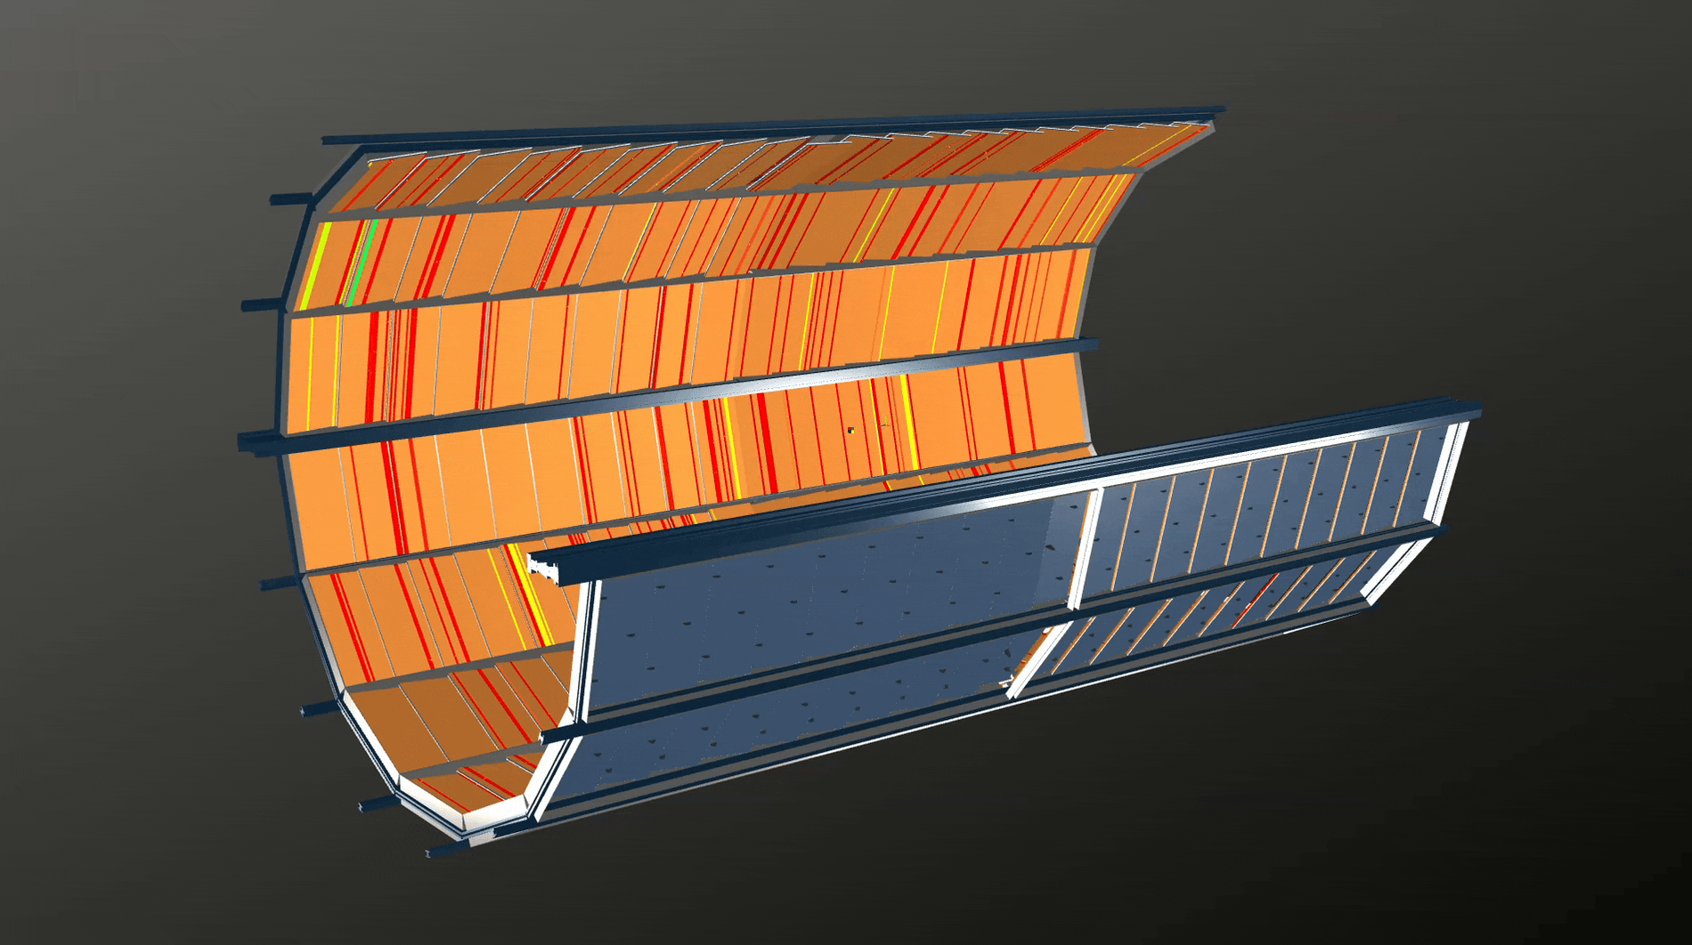
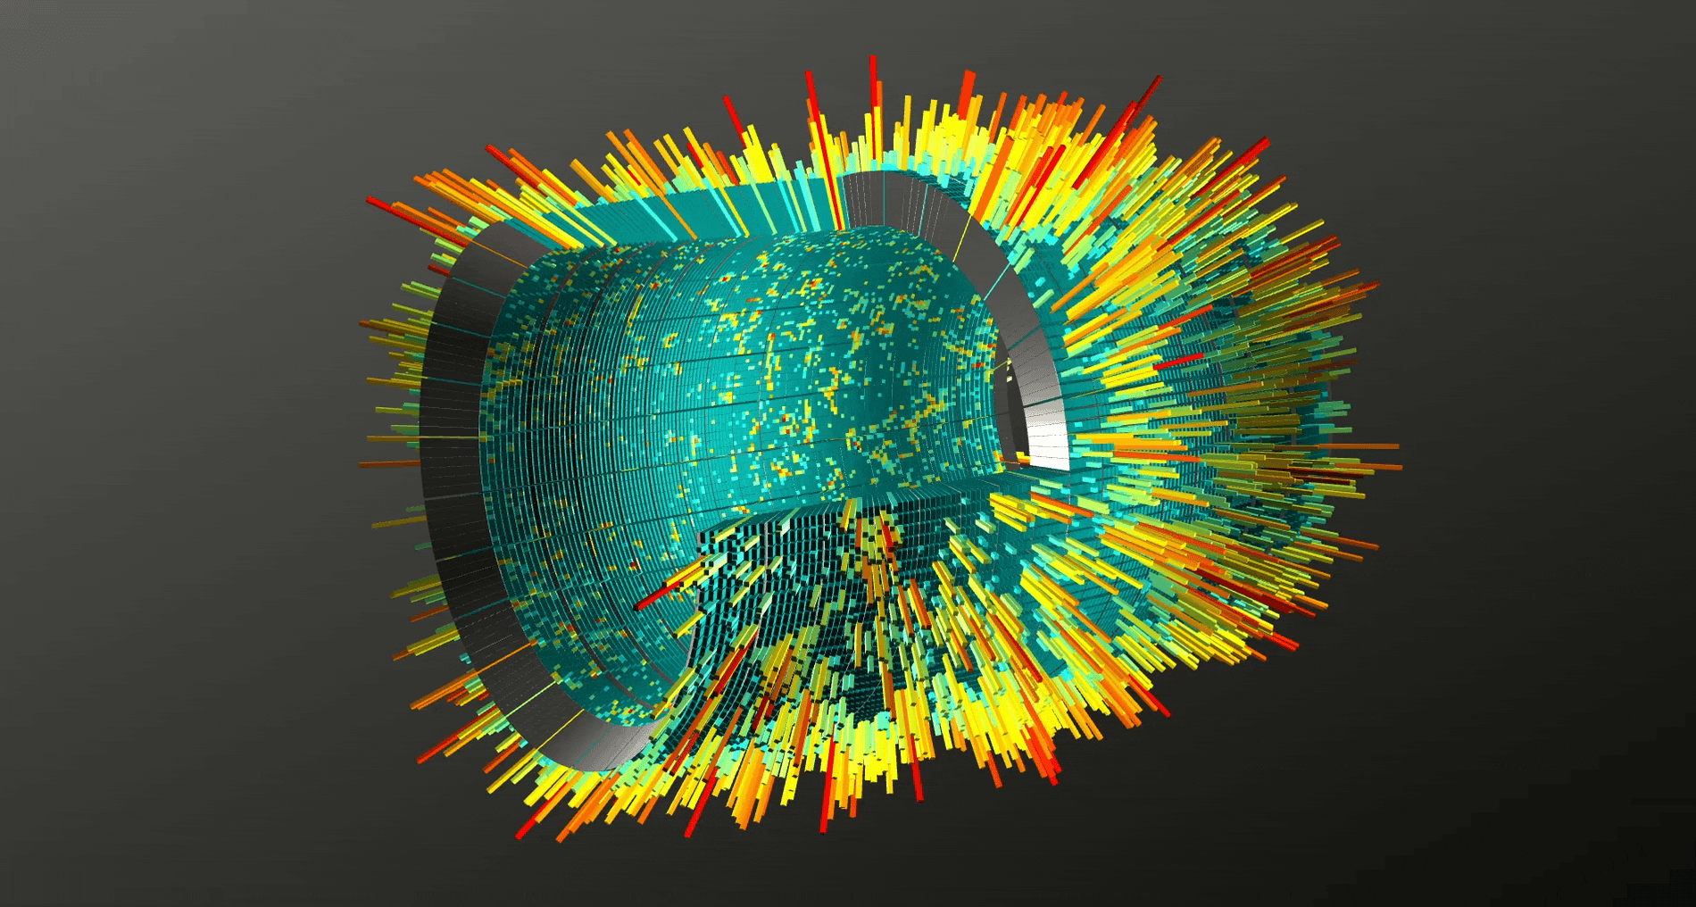
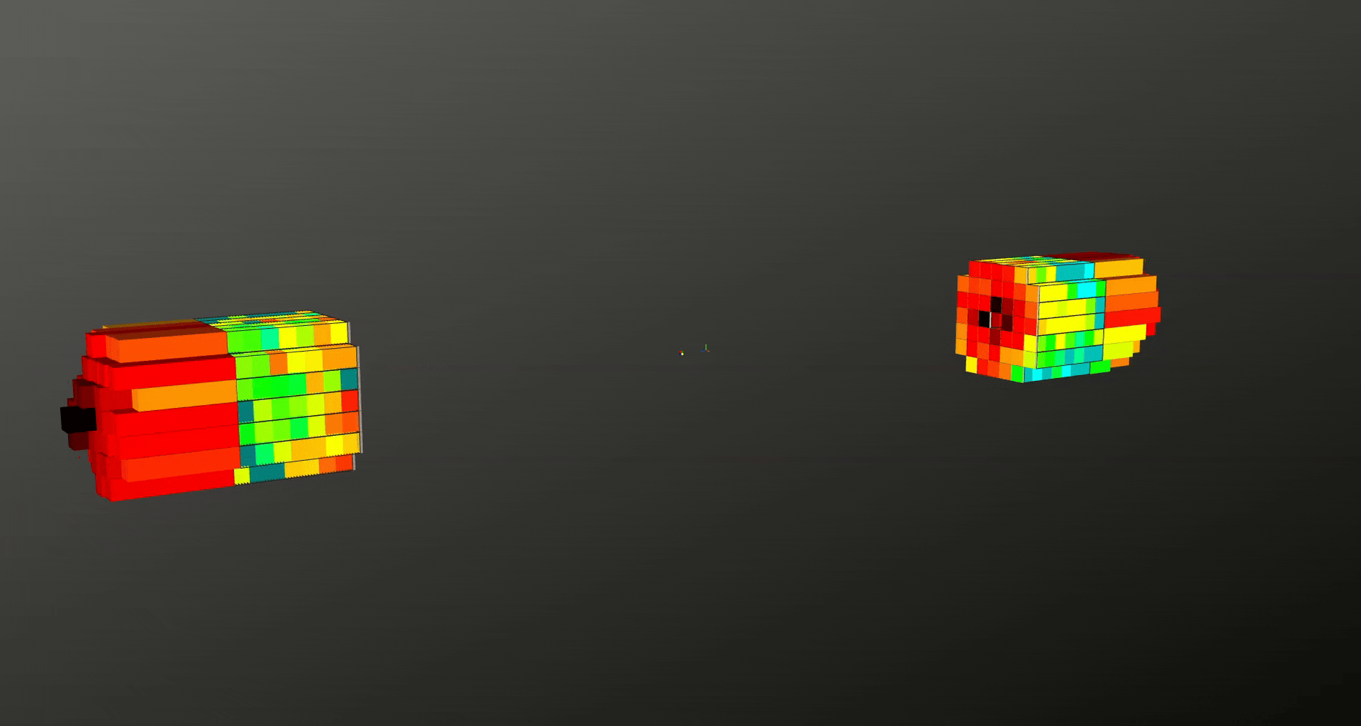
Main MPD Detectors
TPC
TOF
ECAL
FHCAL
Web address of a prototype of the event display: https://mpd-edsrv.jinr.ru/

Slide 12
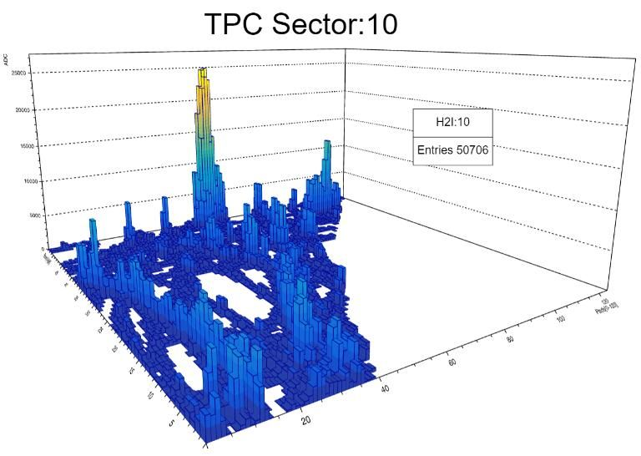
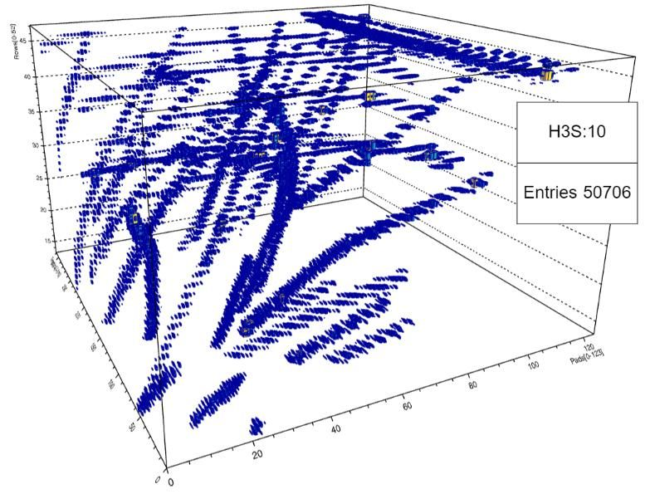
TPC Sector Digits before Clustering

Slide 13
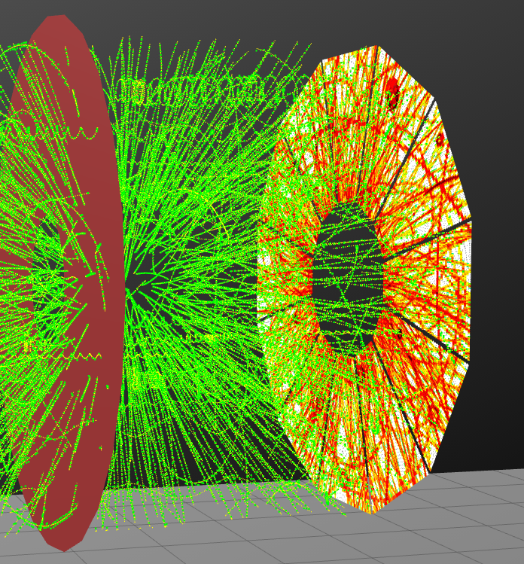
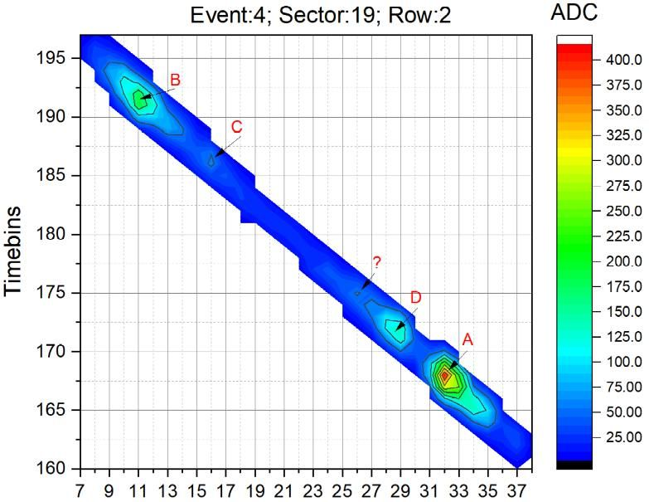
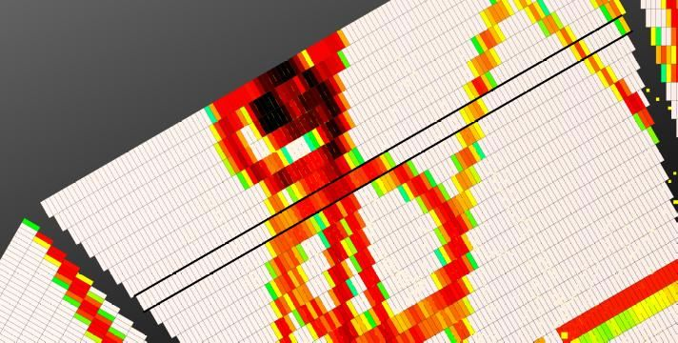
Online TPC Clustering

Slide 14
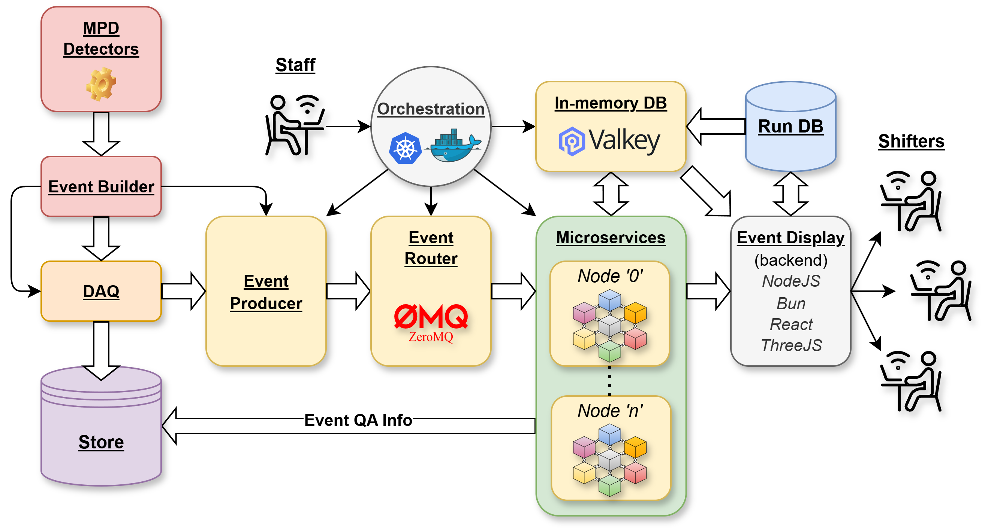
MPD Microservice Event Handling

Slide 15

ZeroMQ
ZeroMQ (also spelled ØMQ, 0MQ or ZMQ) is a high-performance asynchronous messaging library, aimed at use in distributed or concurrent applications.
ZeroMQ supports common messaging patterns (pub/sub, request/reply, client/server and others) over a variety of transports (tcp, ipc, in-process, multicast, websocket and more…)
The philosophy of ZeroMQ starts with the zero. The zero is for zero broker (ZeroMQ is brokerless), zero latency, zero cost (it’s free), and zero administration.
C
C++
C#
Erlang
Go
Java
Node.js
Zig
Perl
Python
Ruby
Rust
F#
Other…

Slide 16
ZeroMQ Messaging Patterns
Request-Reply (REQ/REP), which connects a set of clients to a set of services. This is a remote procedure call and task distribution pattern.
Publish-Subscribe (PUB/SUB), which connects a set of publishers to a set of subscribers. This is a data distribution pattern.
PIPELINE (Push/Pool), which connects nodes in a fan-out/fan-in pattern that can have multiple steps and loops. This is a parallel task distribution and collection pattern.
WebSocket (ZWS), which is starting after successful WebSockets handshake between the client and the server. ZWS message are binary websocket messages (the message opcode must be binary).
Exclusive Pair (EXPAIR), which connects two sockets exclusively. This is a pattern for connecting two threads in a process, not to be confused with “normal” pairs of sockets.
Radio-Dish, which used for one-to-many distribution of data from a single publisher to multiple subscribers in a fan out fashion (draft state).
and more …

Slide 17
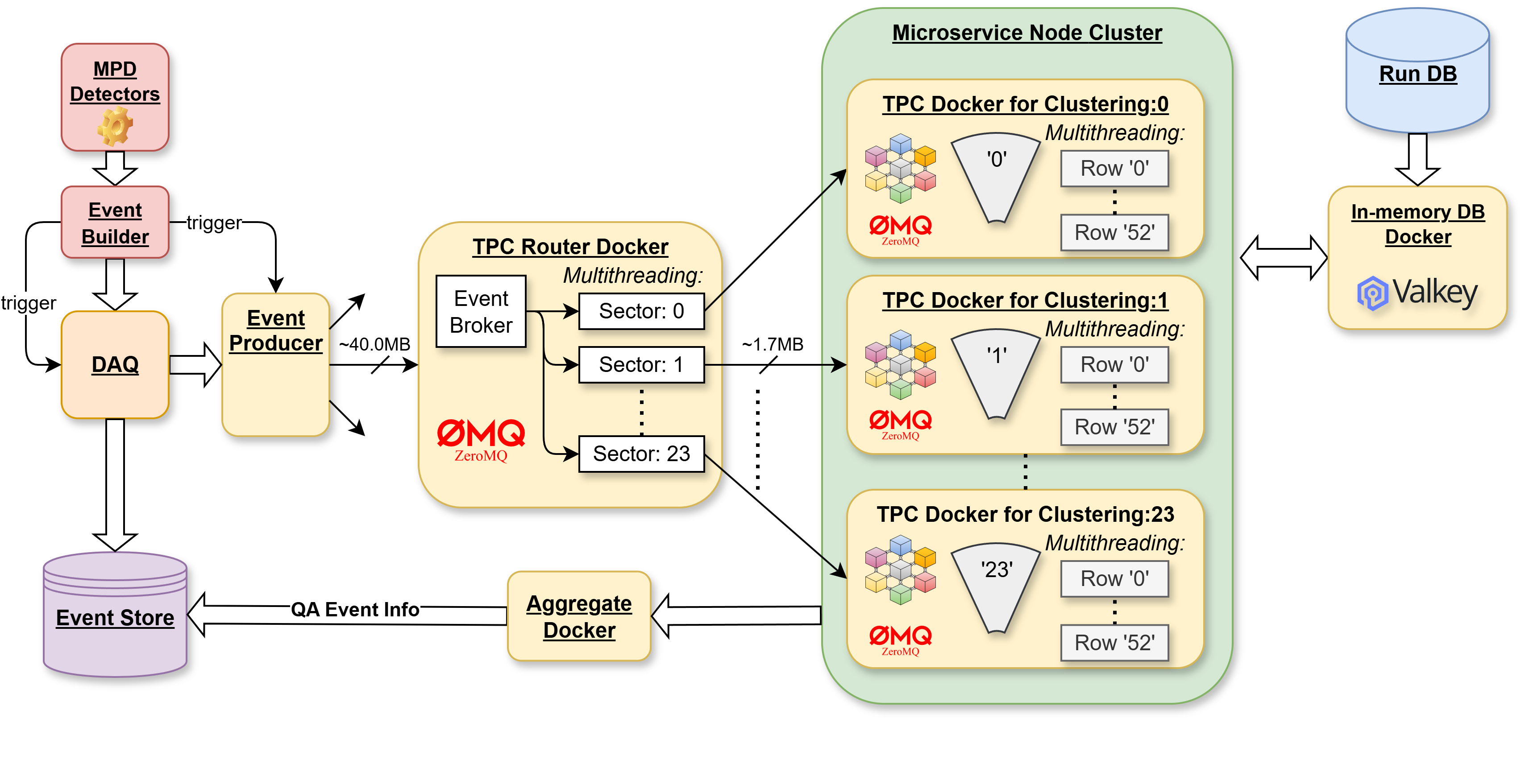
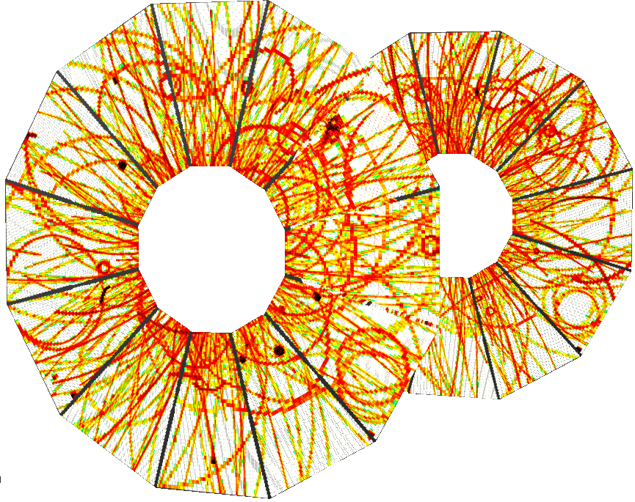
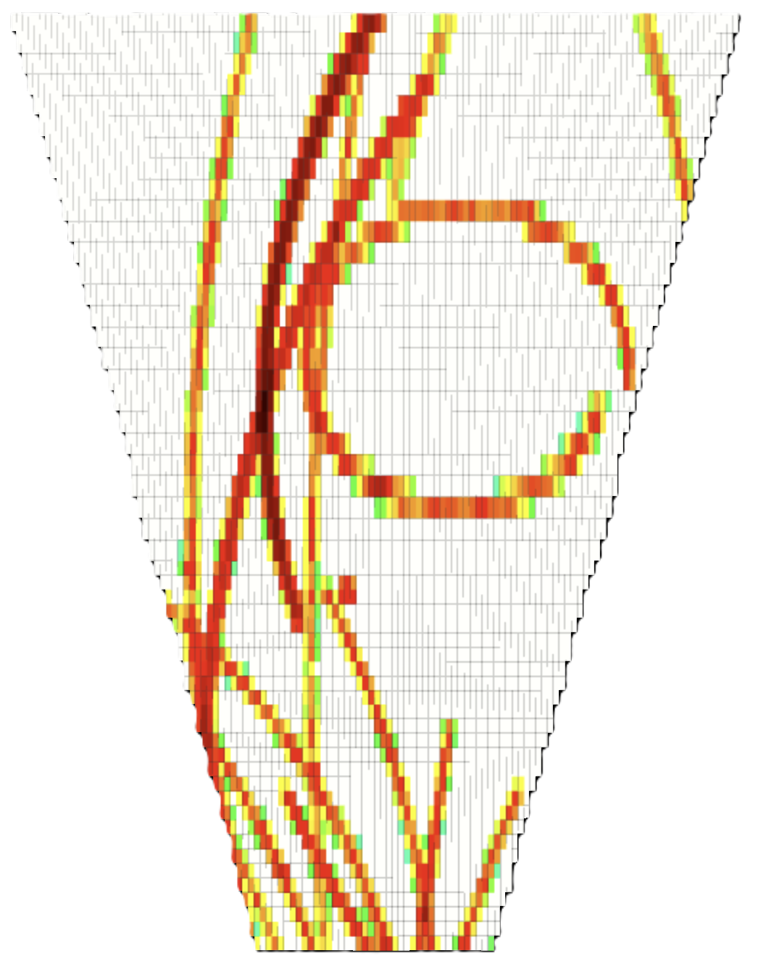
TPC Docker Event Processing
TPC sectors
Notes:
Malamute is a messaging broker and a protocol for enterprise messaging. Malamute helps to connect the pieces in a distributed software system. Before we explain what Malamute does, and why, let's discuss the different kinds of data we most often send around a distributed system.

Slide 18

Microservices Orchestration Platforms
Kubernetes, also known as K8s, is the most popular container orchestration platform, providing automation for deployment, scaling, and managing complex, multi-container workloads.
Docker Compose is a simple tool for defining and running multi-container applications. It is the key to unlocking a streamlined and efficient development and deployment experience.
Apache Mesos is an open-source platform that allows organizations to manage and orchestrate distributed systems and applications. It’s a powerful microservice orchestration tool that can deploy and manage complex microservice architectures in a highly efficient and scalable way.
Netflix Conductor is an open-source microservice orchestration engine that provides a workflow and coordination service for microservices-based applications.

Slide 19


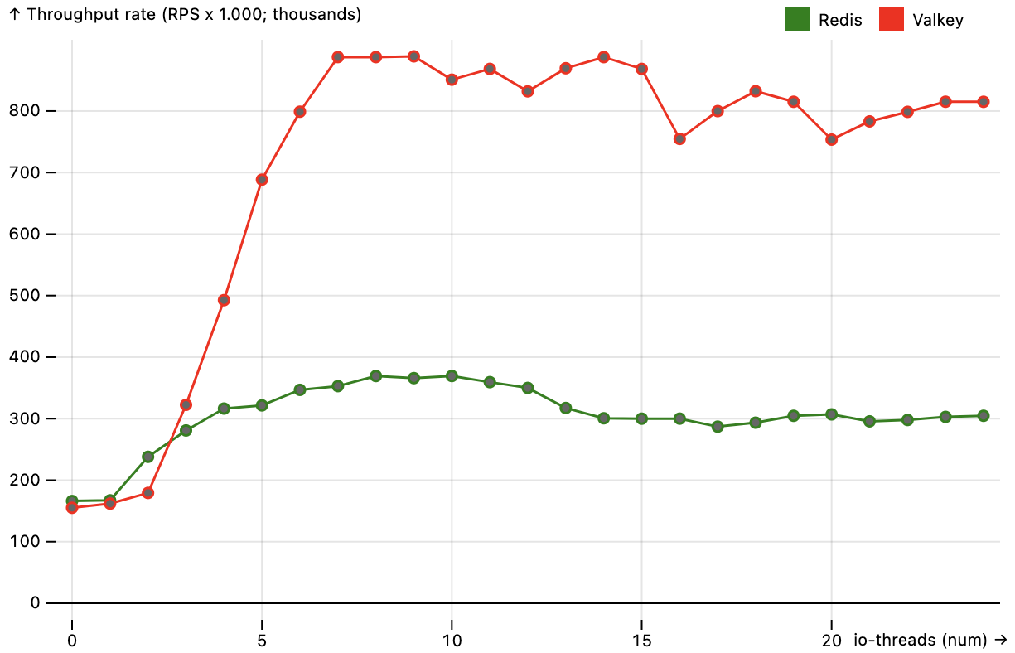
Valkey: in-memory key-value database for caching
Valkey is an open source (BSD-3 Clause License) high-performance key-value datastore that supports a variety of workloads such as caching, message queues, and can act as a primary database. It is an open-source fork of Redis version 7.2.4!
All of them both are an in-memory data structure that stores all the data served from memory and uses disk for storage. They offer a unique data model and high performance that supports various data structures like string, list, sets, hash, which it uses as a database cache or message broker. It is also called like Data Structure Server.
(R&D DevHands: https://habr.com/ru/articles/849264/)
Redis, which stands for REmote DIctionary Server, is an open-source (before April 2024!), key-value, NoSQL database. At the moment Redis has dual license agreement «Server Side Public License» (SSPL) and own license like «Redis Source Available License» (RSAL) and forbidden to use in Russia owing to sanctions since 2024.

Slide 20
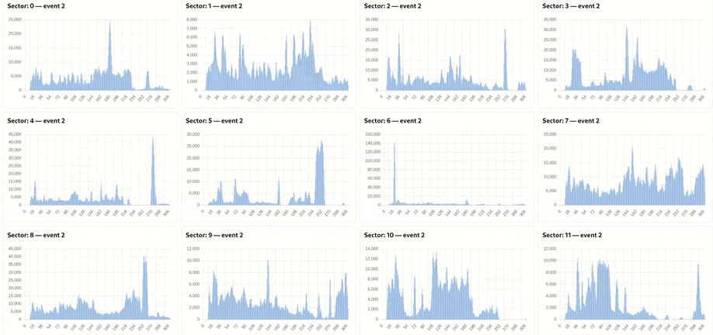
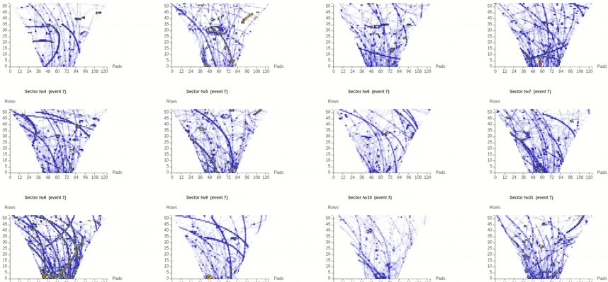
Quality Assurance Histograms for TPC run

Slide 21
Summary
In contrast to the traditional monolithic approach of a large, tightly coupled application, the Microservices provide a tiny cloud-native architectural framework.
All of the hundreds Microservices are controlled just by one container orchestration platform (Docker Compose or Kubernetes).
At the moment we are ready to implement the new Microservice architecture based on the Docker platform for online event MPD data handler.

Slide 22
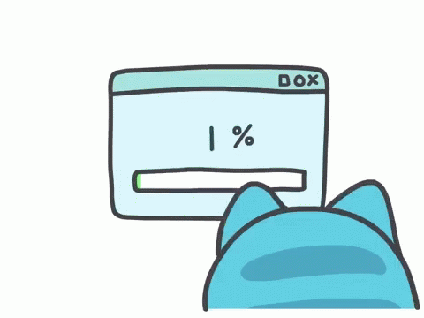
Thank you for your attention!

Slide 23
ZeroMQ Messaging Pattern Topology
Producer
PUSH
PUB
KILL signal
Router
PULL
SUB
PUSH
PUB
Sector: 0
PULL
SUB
PULL
SUB
PULL
SUB
Sector: 23
Sector: 1
0
1
23
PUSH
PUB
PUSH
PUB
PUSH
PUB
PULL
SUB
Aggregator

Slide 24
Summary
In contrast to the traditional monolithic approach of a large, tightly coupled application, the Microservices provide a tiny cloud-native architectural framework.
All of the hundreds Microservices are controlled just by one container orchestration platform (Docker Compose or Kubernetes).
At the moment we are ready to implement the new Microservice architecture based on the Docker platform for online event MPD data handler.
If the event processing time on our computing resources will be longer then expected we return back to hand made code based on ZeroMQ library only, without Docker platform.

Slide 25
Kubernetes Orchestration
Kubernetes, also known as K8s, is the most popular container orchestration platform, providing automation for deployment, scaling, and managing complex, multi-container workloads.
Kubernetes provides you with:
Service discovery, load balancing and scalability
Storage orchestration
Automated rollouts and rollbacks
Automatic bin packing
Self-healing for high availability
Designed for extensibility
and more…
The name Kubernetes originates from Greek, meaning helmsman.
K8s as an abbreviation results from counting the eight letters between the "K" and the "s".
Developed by Google and released in 2014, Kubernetes became one of the fastest-growing projects in open source software's history.

Slide 26
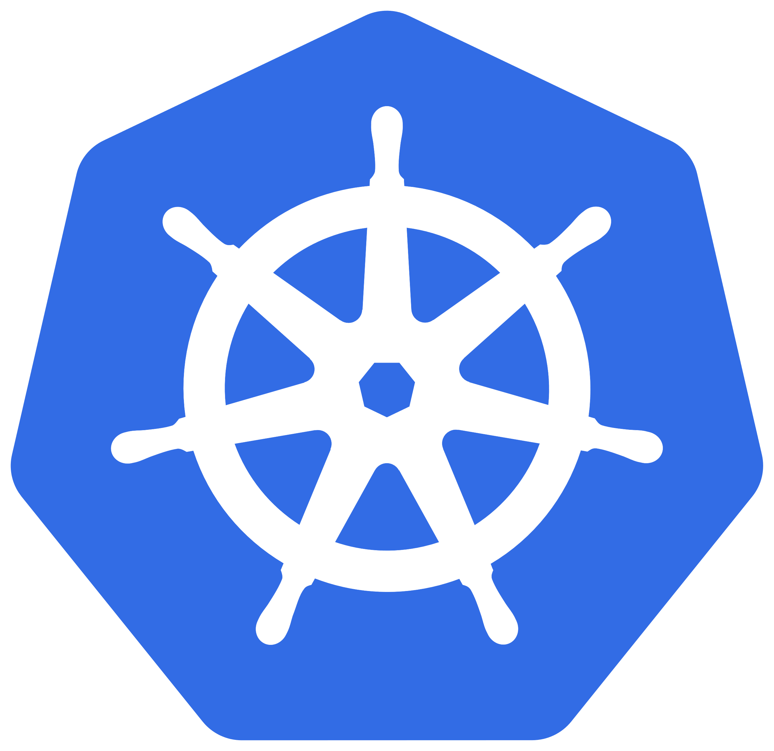
K0s vs K3s vs K8s
K0s, K3s and K8s are three different orchestration systems used to deploy and manage containers.
K0s is a container native platform based on distributed systems, such as Apache Kafka.
It has a strong focus on stream processing and data-driven applications.
K0s was developed by Google and is used in many of its products.
This container-native platform was engineered to efficiently run containerized applications in a distributed computing environment. It can manage millions of containers and provide a reliable and scalable platform to handle enterprise-level workloads.
K3s is a hybrid container orchestration platform that developed by CoreOS.
It is a lightweight platform that can deploy and run containers in any environment.
It is designed to run on bare metal, virtual machines or top of other cloud platforms
like Amazon Web Services (AWS) and Google Cloud Platform (GCP).
K8s is the most popular general-purpose container orchestration platform and the standard for modern containerized applications. It allows users to deploy and manage applications in various environments, including on-premise and cloud-based.
The choice between K0s, K3s and K8s depends on the user’s specific requirements.
They all provide similar functionality, so the main difference is in their design, deployment, and installation.

Slide 27
What Kubernetes is not?
Kubernetes:
Does not limit the types of applications supported
Does not deploy source code and does not build your application.
Does not provide application-level services, such as middleware, data-processing frameworks, databases, caches nor cluster storage systems as built-in services.
Does not dictate logging, monitoring, or alerting solutions.
Does not provide nor adopt any comprehensive machine configuration, maintenance, management, or self-healing systems.
Additionally, Kubernetes is not a mere orchestration system. In fact, it eliminates the need for orchestration.

Slide 28
5 common pitfalls of CI/CD
Balancing the frequency of running continuous integration jobs and resource utilization
Lack of coordination between continuous integration and continuous delivery
Lack of meaningful dashboards and metrics
Confusing continuous deployment for continuous delivery
Automating the wrong processes first

Slide 29
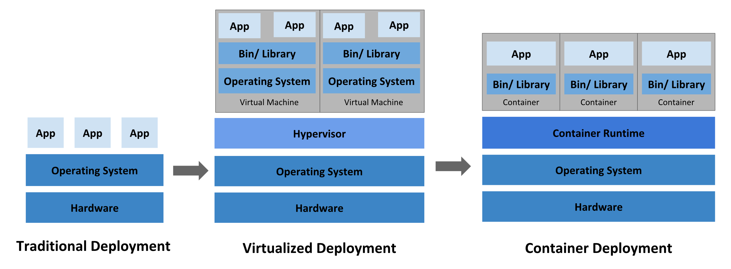
Historical context for Kubernetes

Slide 30

Integrating Memcached for High Performance Data Access
In modern distributed systems and microservices architectures demand low-latency, high-throughput data access to maintain performance and user experience.
Memcached, an in-memory key-value store, is a high-performance, distributed memory object caching system widely adopted as a caching layer to accelerate data retrieval and reduce load on backend databases.
Memcached will helps you by:
Reducing database hits: Frequently accessed data is cached in memory, minimizing expensive database queries.
Improving response times: Cached data access is orders of magnitude faster than disk-based storage.
Enhancing scalability: Caching offloads backend services, allowing better horizontal scaling.
Integrating Memcached with Microservices is a powerful approach to optimize data access performance in distributed applications. Memcached was originally developed by Brad Fitzpatrick for LiveJournal in 2003 and has BSD 3-Clause License.

Slide 31

Best Practices for Memcached Integration in Microservices
Integrating Memcached with microservices is a powerful approach to optimize data access performance in distributed applications:
Use asynchronous cache population: avoid blocking service responses on cache writes; consider background refresh tasks.
Secure your Memcached cluster: since Memcached does not provide built-in authentication, restrict network access using firewall rules and VPNs.
Automate scaling: use container orchestration platforms like Kubernetes with Memcached operators to automate scaling and failover.
Data Loss on Node Failure: Memcached is an in-memory cache without persistence. To mitigate loss, consider replicating sessions to a persistent store or using a distributed cache like Redis with persistence features.
Memcached empowers your microservices to deliver high throughput and low latency, essential for modern high-performance systems.
In modern web architectures, scalable session management is critical for delivering seamless user experiences across distributed environments.

Slide 32
Pogocache caching software
Pogocache is fast caching software built from scratch with a focus on low latency and CPU efficiency and published by Josh Baker (https://github.com/tidwall) in July 2025 (current release v1.0.2).
Pogocache is faster than Memcache, Valkey, Redis, Dragonfly, and Garnet. It has the lowest latency per request, providing the quickest response times. Pogocache stores entries (key-value pairs) in a sharded hashmap.
Optionally instead of running Pogocache as a server-based program, the self-contained pogocache.c file can be compiled into existing software, bypassing the network and directly accessing the cache programmatically.

Slide 33


