Slide 1
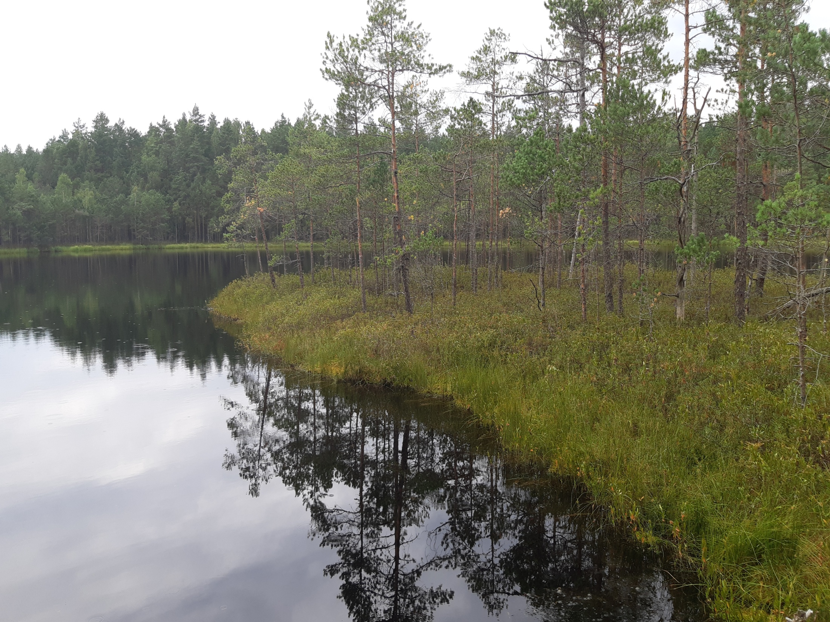
Some modifications of 16-channel and development of 32-channel readout electronics boards for the straw tracker of the COMET experiment
Kovalenko Maxim, Ponariadov Vladimir, Harunovich Anna, Evtoukhovitch Petr, Kokhnyuk Daria

Slide 2
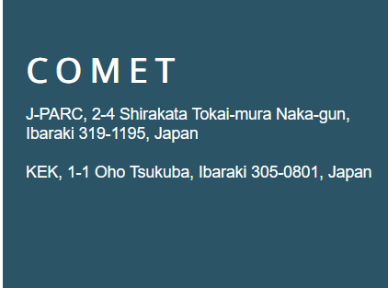

The COMET Collaboration

Slide 3
The COMET Collaboration
1-North China Electric Power University, Beijing, People’s Republic of China
2-Institute of High Energy Physics (IHEP), Beijing, People’s Republic of China
3-Peking University, Beijing, People’s Republic of China
4-Belarusian State University (BSU), Minsk, Belarus
5-B.I. Stepanov Institute of Physics, National Academy of Sciences of Belarus, Minsk, Belarus
6-Budker Institute of Nuclear Physics (BINP), Novosibirsk, Russia
****************************************************************
15-Institute for Theoretical and Experimental Physics (ITEP), Russia 16-Joint Institute for Nuclear Research (JINR), Dubna, Russia ***********************************************************************
36-TRIUMF, Vancouver, British Columbia, Canada
37-Technical University of Dresden, Dresden, Germany
38-University College London (UCL), London, UK
39-Utsunomiya University, Utsunomiya, Japan

Slide 4
Цель эксперимента COMET
Цель эксперимента COMET (COherent Muon to Electron Transition) на ускорительном комплексе J-PARC — поиск безнейтринной конверсии мюона в электрон в поле ядра µ + N(A,Z) à e + N(A,Z), процесса, в котором происходит нарушение лептонного числа в заряженном секторе Стандартной модели. Эксперимент по когерентному переходу мюона в электрон (COMET) нацелен на измерение преобразования мюона в электрон с беспрецедентной чувствительностью менее 1 из 10¹⁵.
Поскольку вероятность µ-e конверсии в Стандартной модели практически равна нулю, то наблюдение подобного события свидетельствовало бы о проявление эффектов так называемой Новой физики.

Slide 5
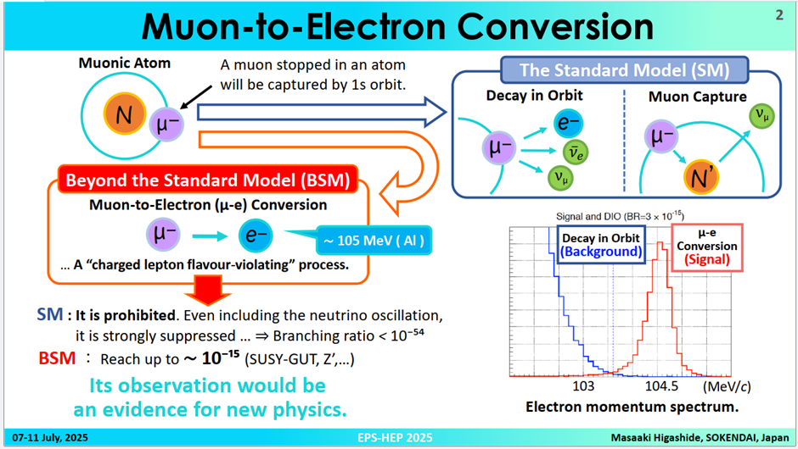
Эксперимент COMET (за пределами стандартной модели):

Slide 6
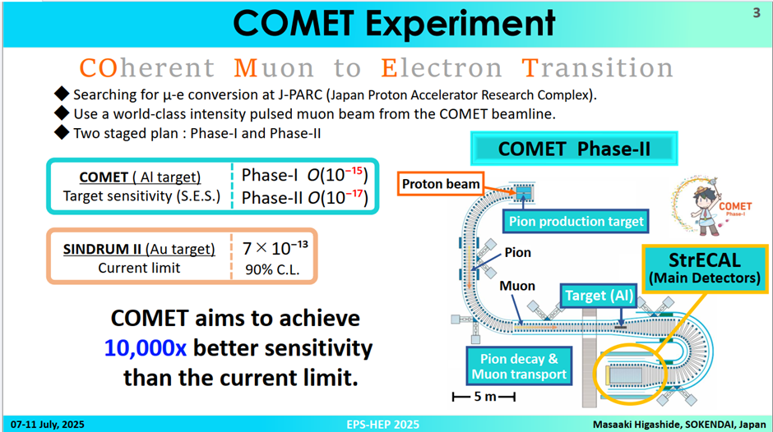

Slide 7
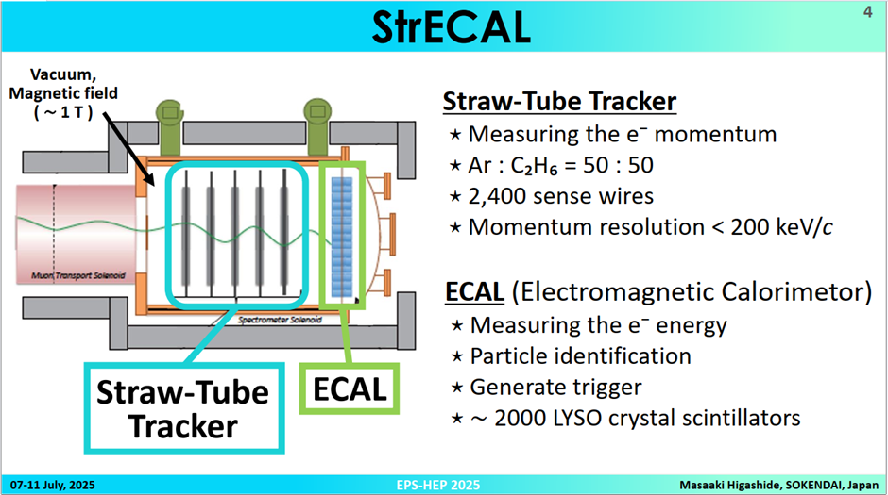


Slide 8
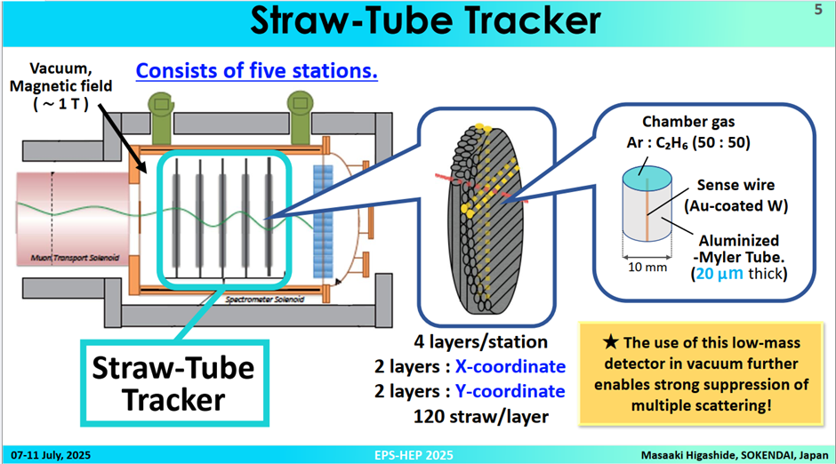

Slide 9
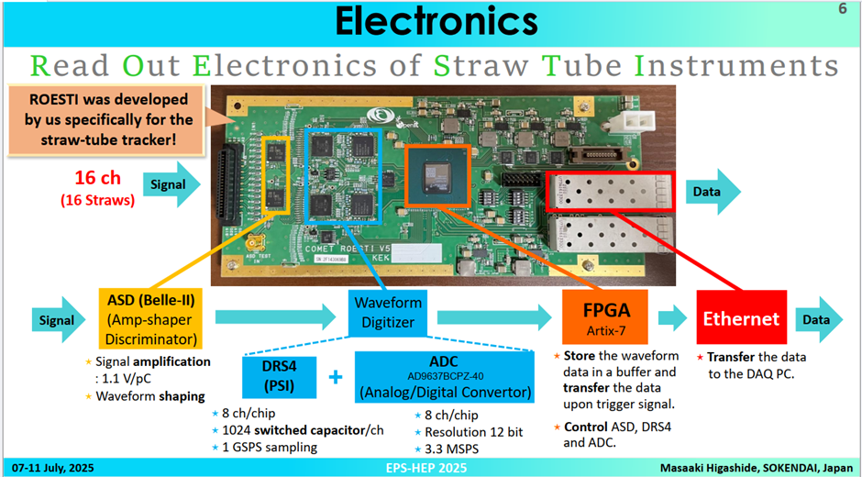

Slide 10
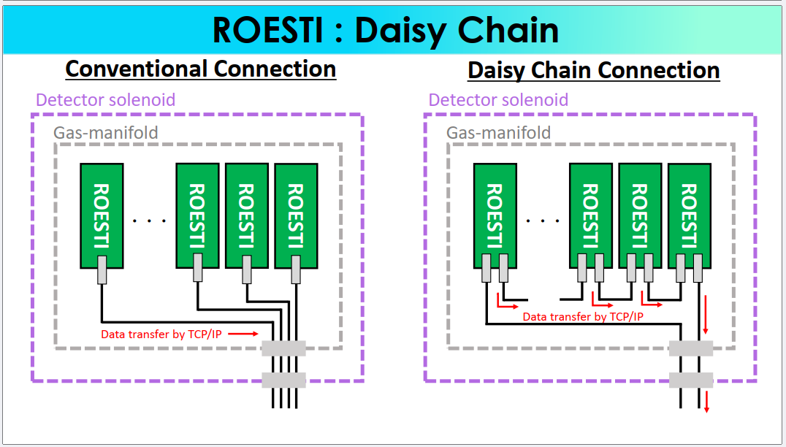
To minimize high-speed communication channels, a ROESTI connection is used in a chain of boards

Slide 11
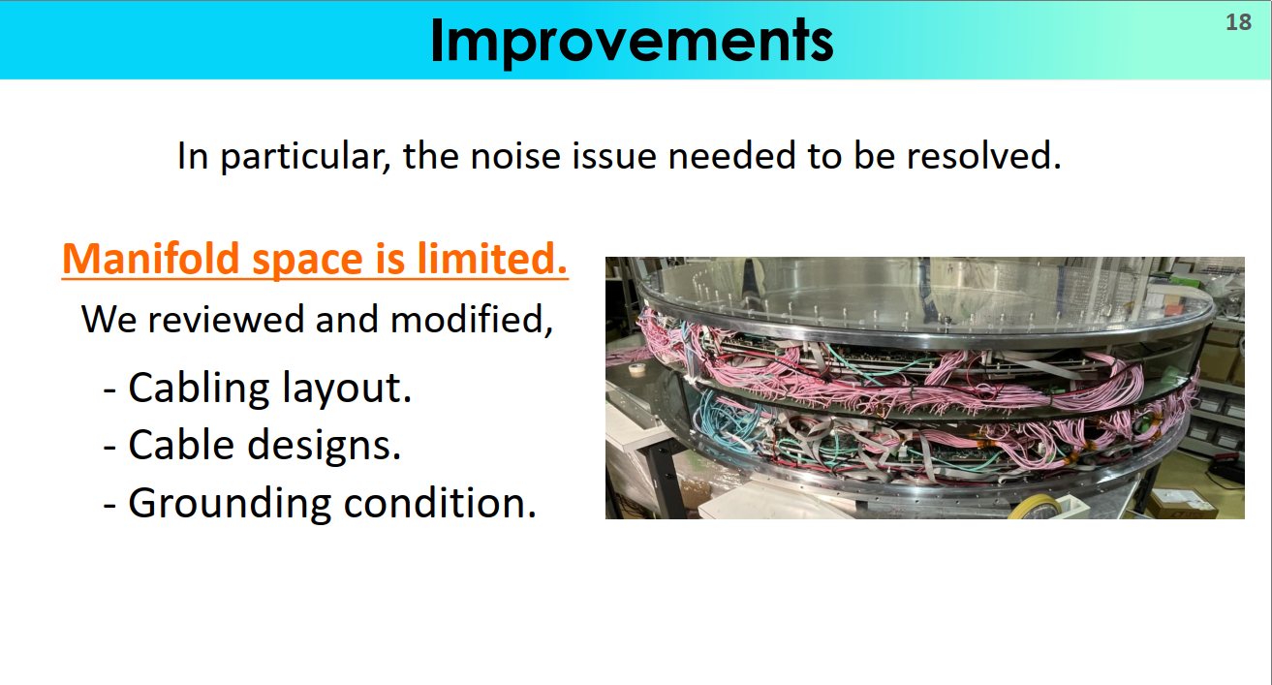

Slide 12
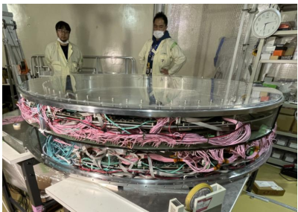
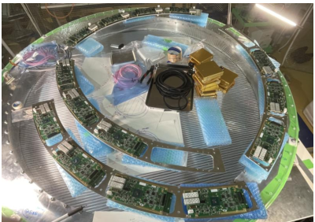
Tracker with a coordinate grid of 240 x 240 strow tubes, D=10mm.
30 electronic reading boards ROESTI (16 channels )
Very dense packaging of reading electronics for 480 strow!!!!

Slide 13
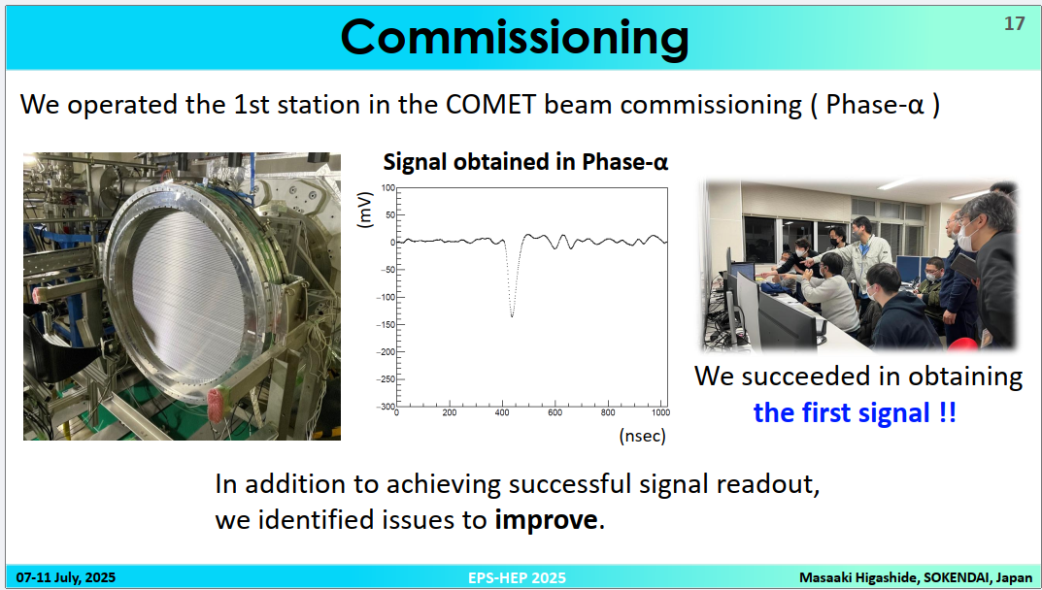

Slide 14
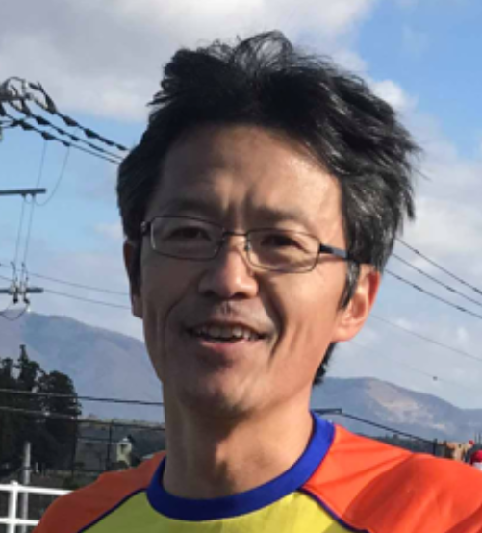
Начало работ в БГУ
Рабочее совещание Международной коллаборации по проведению эксперимента COMET с 16 по 20 мая 2016 года на физическом факультете БГУ
Satoshi Mihara
Professor (Full) at High Energy Accelerator Research Organization

Slide 15
Production and testing the ROESTI-16 slightly modified (2018 )
• BSU received ORCAD project of the ROESTI with comments and wishes for changes from the Japanese side.
• BSU, for its part, proposed some changes in ROESTI circuit and board design.
• The changes do not concern the functionality of ROESTI board.
• After agreement with the Japanese side BSU has developed the PCB design with all the changes and additions.
• The PCB project has been recreated on the base of saving the input-output and power connectors topology.
• Only PCB power supply of 5-36 volt is maintained.
• The work now is completed.
• Compliance ROESTI-M with the ROESTI functionality has to be considered.

Slide 16
Structural diagram ROESTI board (16 channels)
Signal from straw-tracker
ADA Single-ended-to-differential converters
AOUT
DRS4
ADC
ASD
Protection scheme
ASD & Trigger
Control signal
DOUT
FPGA
Ethernet 1G to PC LVDS Aurora 10/8B to other board
Reference Voltage

Slide 17
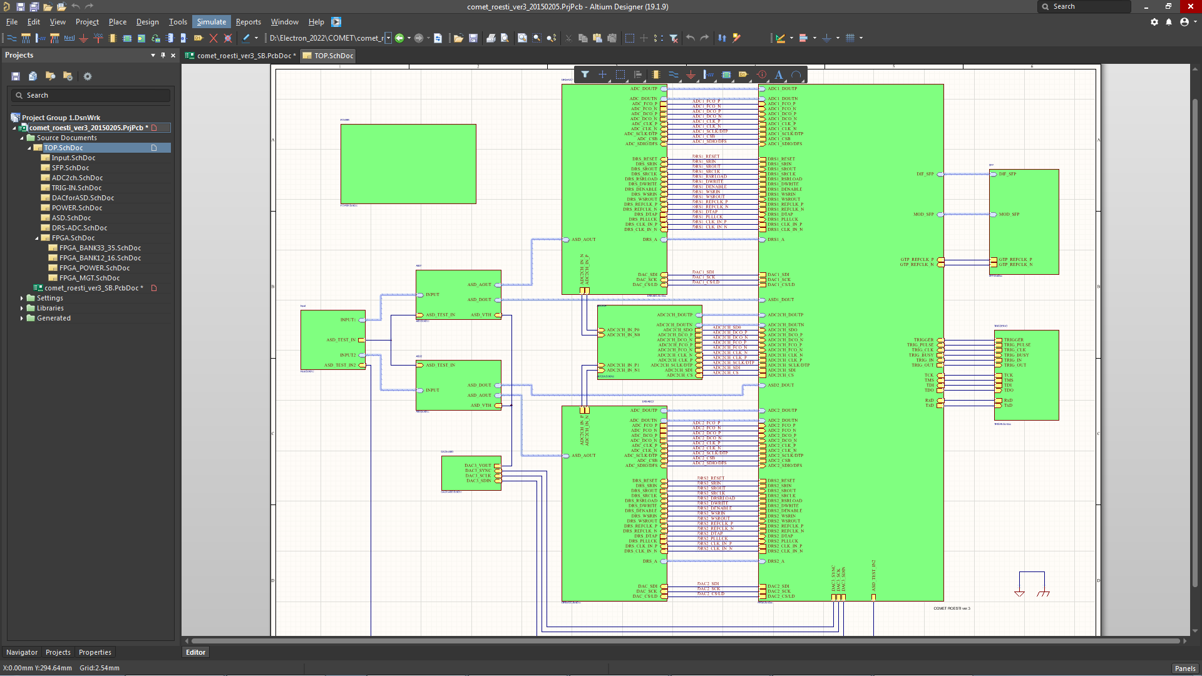
What has been changed
ROESTI-16 Project has been translated in Altium Designer.
All the Projects made in Altium are easy to place for production at our industry. Moreover, Altium is easily replenished by component libraries

Slide 18
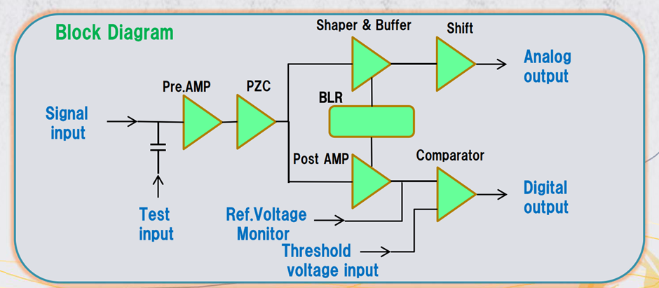

Amplifier - shaper and discriminator

Slide 19
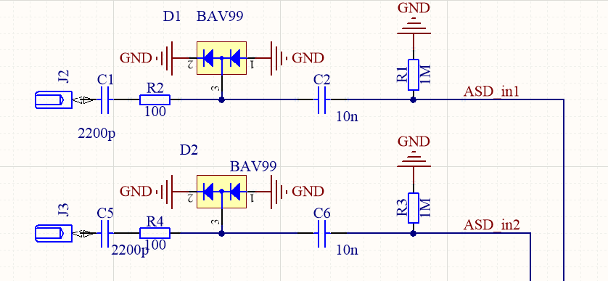
Input circuits for ROESTI with overvoltage protection

Slide 20
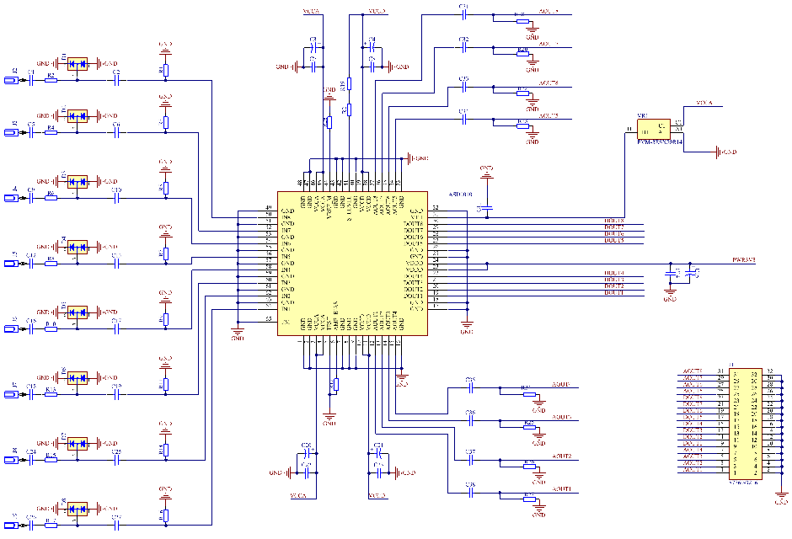
Input circuits for ROESTI-32

Slide 21
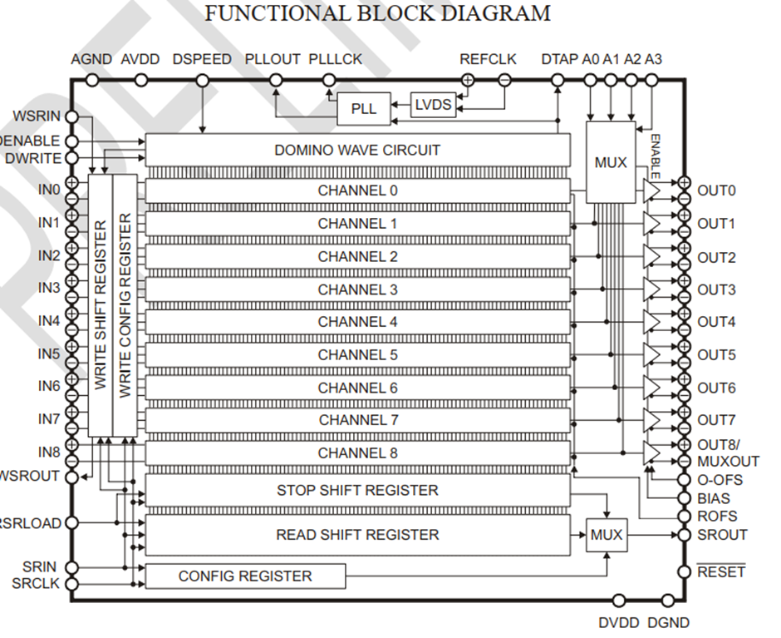
DRS4- 9-channel sample-and-hold device on arrays of storage capacitors (1024)
Best time resolution 100 ps
Read time for all data - 33 µs

Slide 22
Small corrections in the circuit
Circuit analyses of ASD – DRS4 has been conducted using PSPICE tool taking into account the bandwidth and impedance of DRS4.
The decision to remove RC circuits and to replace them on differential amplifiers DA4950 with adjustable offset has been taken . Initially the circuit looked like that:

Slide 23
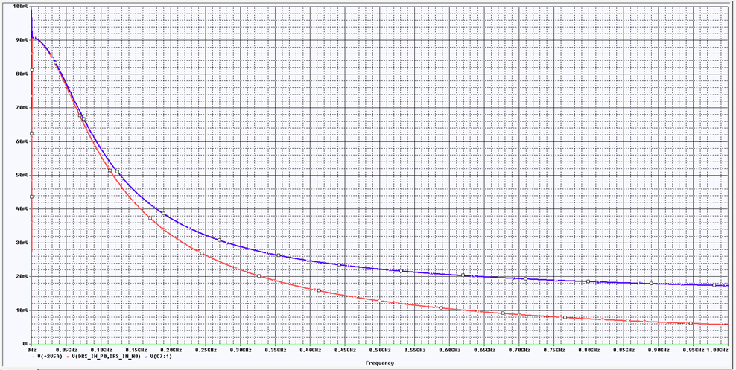
Equivalent input impedance of DRS4=6.3 kΩ
Bandwidth of the matching circuit taking into account output impedance of ASD and input capacitance of DRS4 was like that:
120 MHz полоса пропускания на уровне 0,5

Slide 24
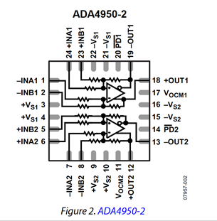
New input citcuit of DRS4 based on ADA4950-2
−3 dB bandwidth of 750 MHz, G = 1 0.1 dB
flatness to 210 MHz, VOUT, dm = 2 V p-p, RL, dm = 200 Ω
Slew rate: 2900 V/μs, 25% to 75%.

Slide 25
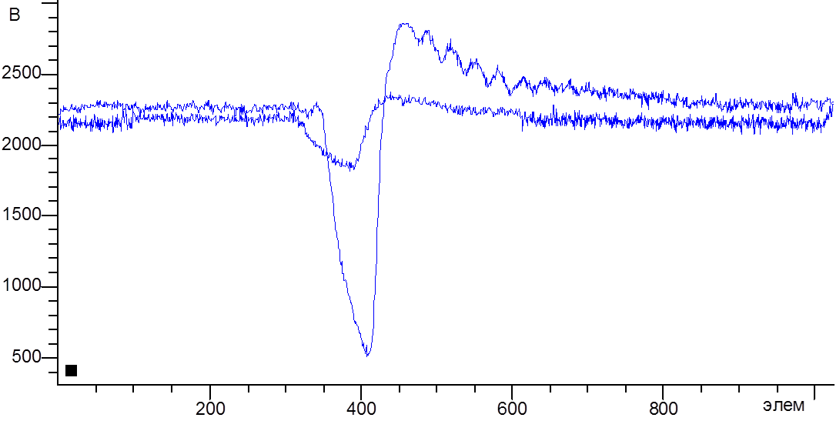
Comparative results
The results are obtained on ROESTI and ROESTI-M with signal source: Fe55
The same input signal gives 4 times greater signal for new version, the details of oscillation on unmatched load are seen.

Slide 26
New input citcuit of DRS4 based on ADA4950-2
Analogue chain contains differential amplifiers ADA4950-2 that have offset adjustment and input POWER DOWN. Offset adjustment is set from free chanel of DAC of every DRS4.
PD(power down) input is used for switching off input circuits of DRS4 during calibration and introduction of regime of hardware-controlled calibration (subtraction of background pedestal «in flight») of FPGA background memory.

Slide 27
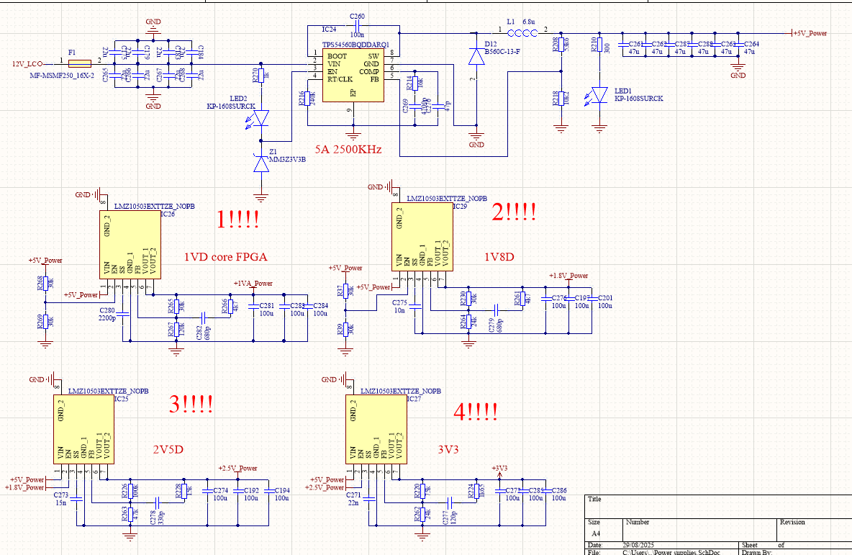
Changing the power supply of ROESTI PCB to +5–36 V.

Slide 28
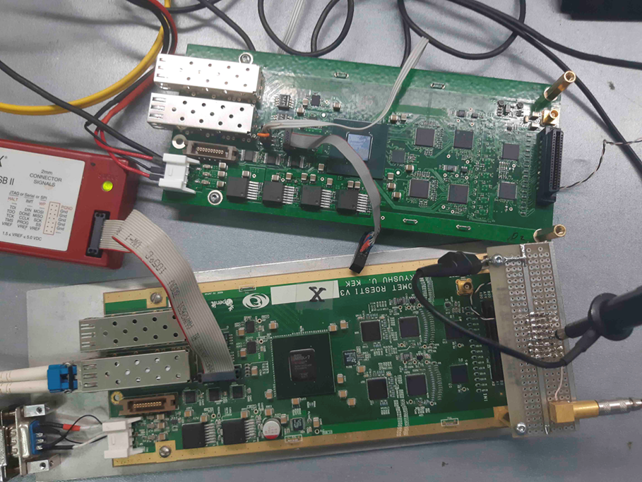
6-layer PCB with ROESTI dimensions is designed
Power supply is +5-36V. The current in working regime is 1,37A +/- 20 mA
FPGA crystal temperature in working regime without cooling is +58 С +/-2С.

Slide 29
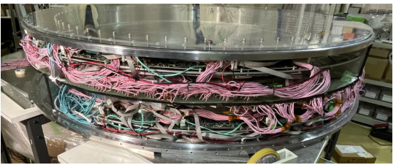
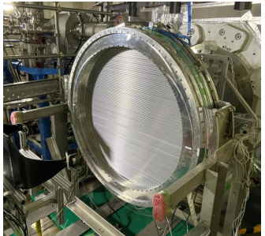

Slide 30
Strow tracker for Phase II
Tracker with a coordinate grid of 480 x 480 strow tubes (D=5 mm.)
30 x 32 channels electronic reading boards ROESTI

Slide 31
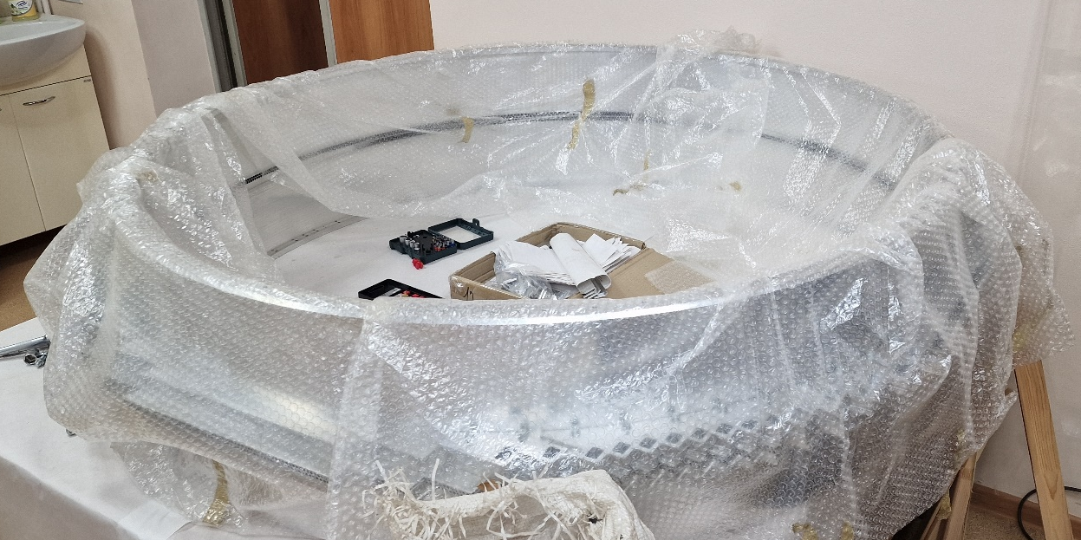
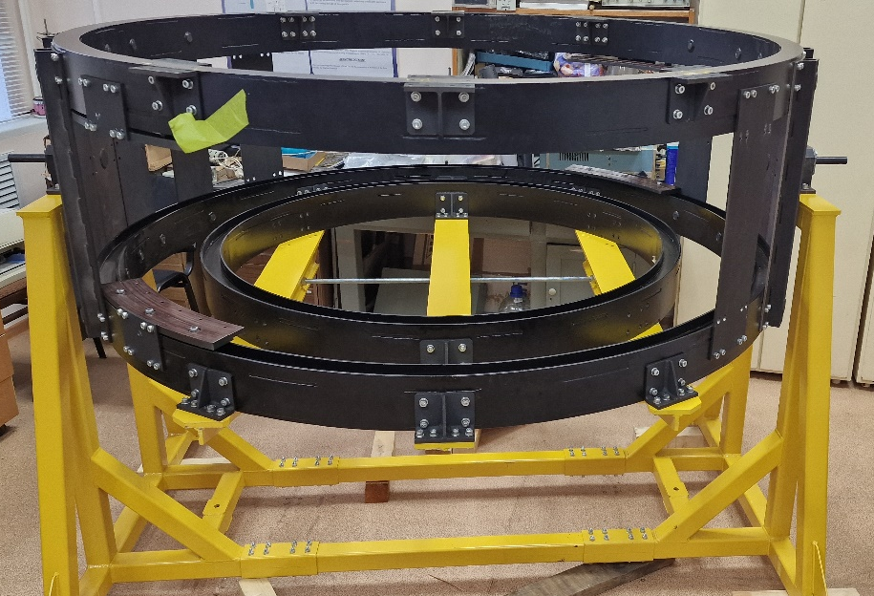
The tracker body for Phase II and the assembly table are ready

Slide 32
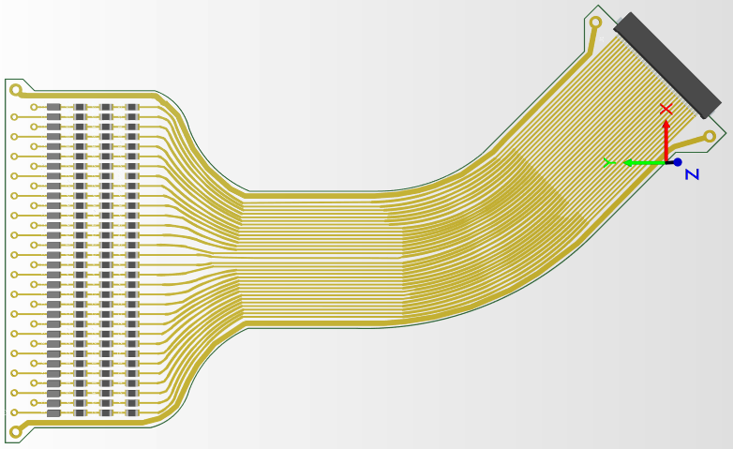
Flexible board for connecting 32 straw tubes

Slide 33
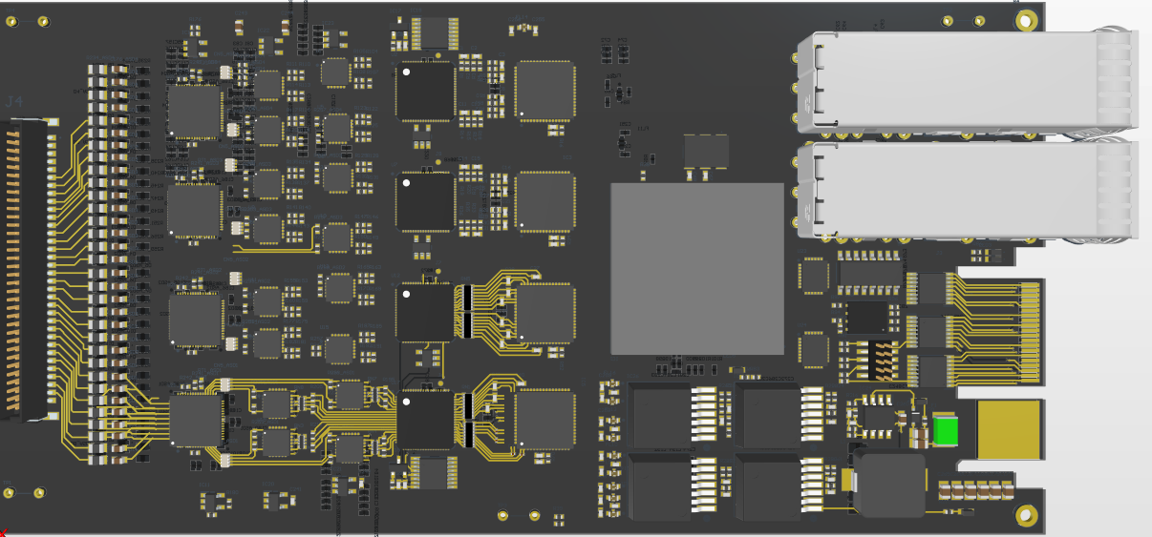
3D view of 32 channel board ROESTI-32

Slide 34
New in Software
ROESTI Project is retranslated in Vivado taking into account new wiring of PCB.
Verilog code of DAC modules is changed to exclude SCLK permanent generation (it leads to noise reduction).
For hardware testing Microblaze MCS (64 K RAM) is added in the Project (in FPGA firmware) with output to console (Serial – USB converter)
Initiation PCB utility is modified (for Windows).
Our software tool for working with spectrometers and linear matrix sensors (nVision) is working with ROESTI using its driver for reading and saving the signals registered. The soft is used for electronics testing.

Slide 35

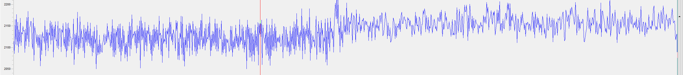
Hardware-controlled calibration
PD(power down) input ADA4950-2 is used for switching off input circuits of DRS4 during calibration and introduction of regime of hardware-controlled calibration (subtraction of background pedestal «in flight») of FPGA background memory.

Slide 36
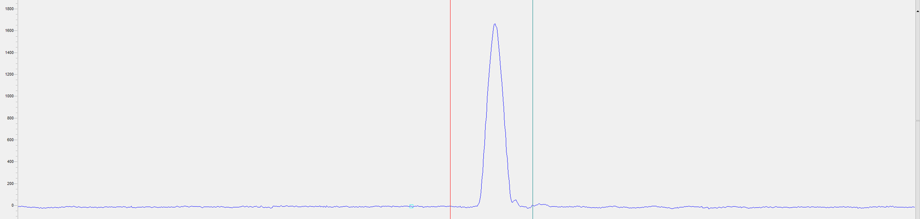
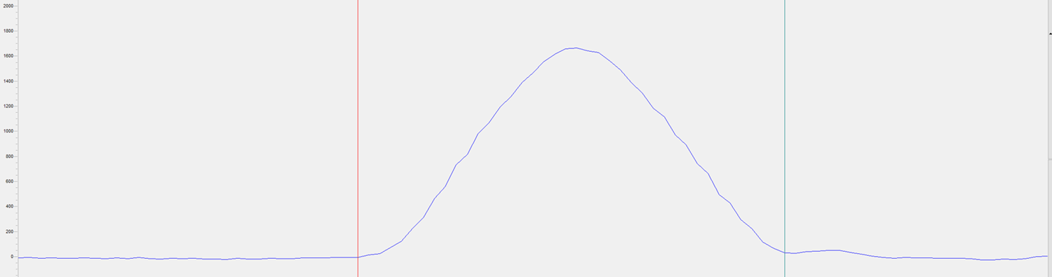
Test signal with a base duration of 10 ns was recorded in 40 channels. The time resolution was 250 ns Signal rise and fall 3 ns Amplitude 0.5 volts

Slide 37
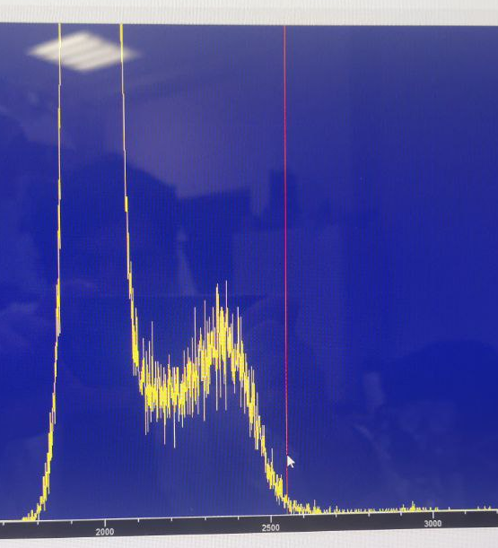
An amplitude analyser has been added to the FPGA project, which can be connected to each of the 32 channels.

