Slide 1
High Energy Nuclear Optics of polarized protons and nuclei: research at complex Nuclotron M- NICA
Vladimir Baryshevsky
Research Institute for Nuclear Problems,
Belarusian State University, Minsk 220050, Belarus

Slide 2
Light optics

Slide 3
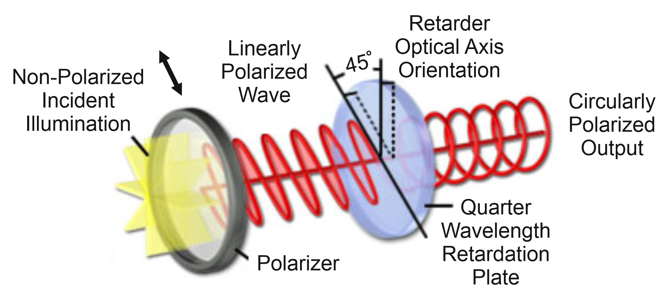
Birefringence effect
1669
E. Bartholin

Slide 4
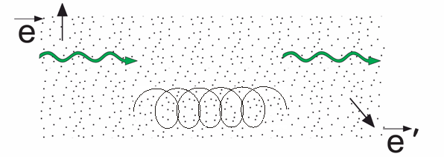
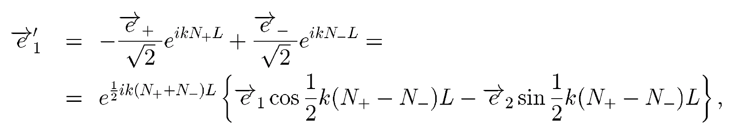
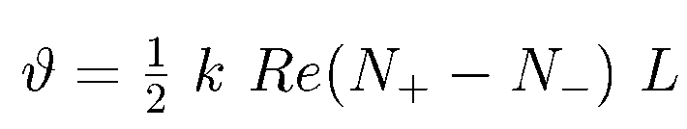
Natural optical activity
Linearly polarized photons in matter
Faradey effect (1845)
Polarization vector of a photon in matter
Polarization plane of a photon, which passes length L in matter, rotates at angle
N₊ and N₋ are the refraction indices.
corresponds to the right rotation of the light polarization plane (clockwise rotation)
corresponds to the left rotation (i.e. counter-clockwise rotation)
1811 D.F. Arago
1812 J.B. Biot
1817,1823 A. Fresnel

Slide 5
Gamma optics

Slide 6
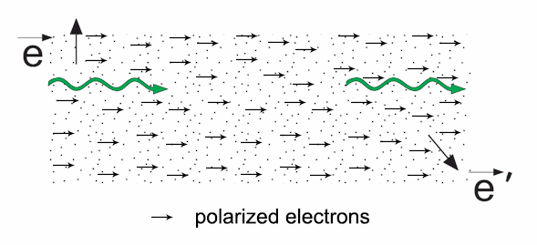
Gamma quanta polarization plane rotation
Belarusian State University, Minsk – JINR, Dubna
Scientific discovery N360
V.G. Baryshevsky, V.L. Lyuboshitz, Rotation of the polarization plain of gamma quanta in passing through a polarized electron target, Yad.Fiz., (1965)
350keV γ-quanta experiment: V.M. Lobashev (1971); P. Bock, P. Luksch (1971)

Slide 7
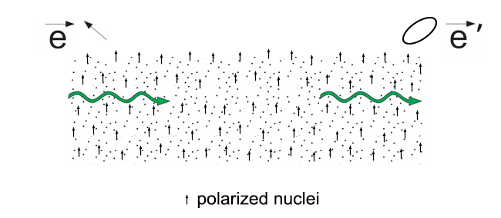
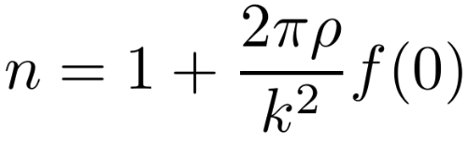
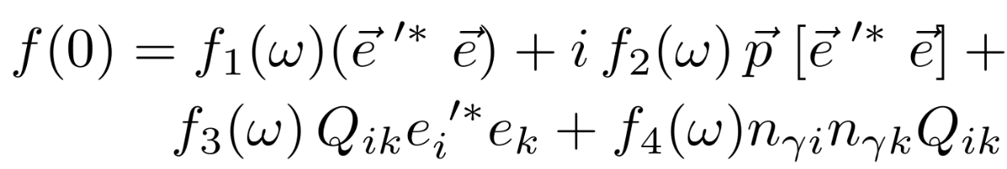
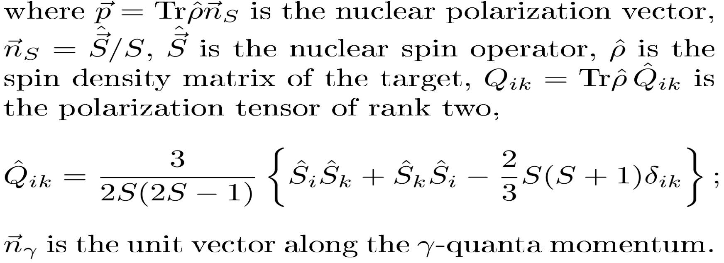
Birefringence of gamma quanta
J ≥ 1
When γ-quanta interact with matter, which comprises polarized nuclei with spin S≥1, the refractive index and the amplitude of coherent elastic forward scattering
is the polarization vector of nuclei, is the spin density matrix of matter, is the polarization tensor of rank two, is the unit vector along the γ-quanta momentum.
V.G. Baryshevsky, On the birefringence of gamma quanta in a polarized nuclear target , Yad.Fiz.,V.4 (1966)

Slide 8
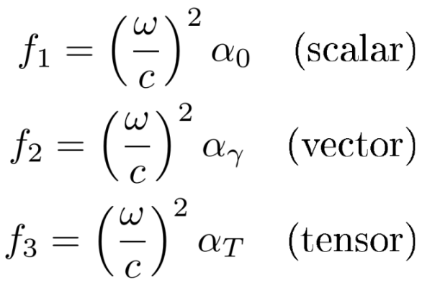

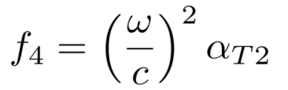
The coherent elastic forward scattering amplitude
α₀, α_{γ} and α_{T} are the polarizabilities of nuclei introduced by A.M. Baldin
A.M.Baldin, Optical Anisotropy of Atomic Nuclei, Soviet Phys.JETP, 10 (1960) pp.142-148 [ЖЭТФ 37 №10 (1959) стр.202-211].
A.M.Baldin and S.F.Semenko, On the Theory of the Optical Anisotropy of Atomic Nuclei, Soviet Phys.JETP, 12 (1961) pp.306-307 [ЖЭТФ 39 (1960) стр.434-437].
α_{T2} is the polarizability of nuclei introduced by V.G.Baryshevsky
В.Г. Барышевский, Ядерная оптика поляризованных сред, Энергоатомиздат, 1995
V.G.Baryshevsky, High–Energy Nuclear Optics of Polarized Particles, World Scientific, 2012

Slide 9
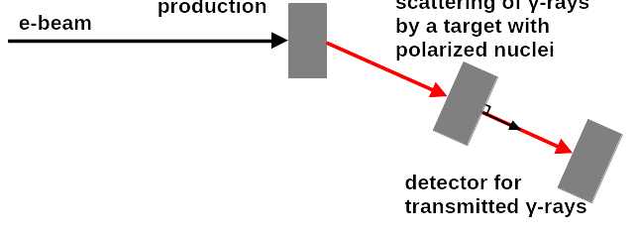
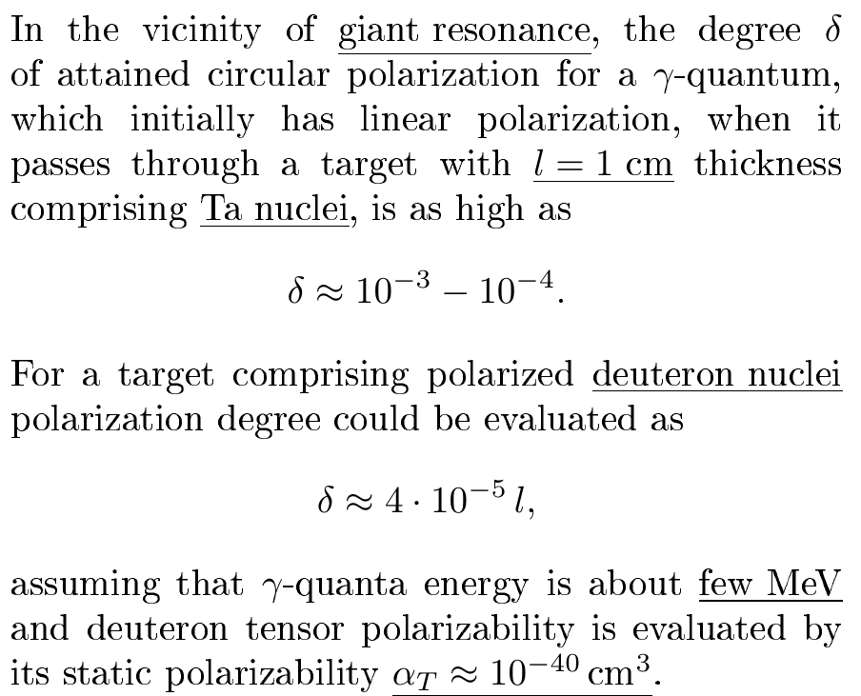
Transmission experiment @ LINAC-200 (800)
first target for polarized γ-ray
production (bremsstrahlung or coherent
bremsstrahlung in crystal)
target with polarized
nuclei or electrons
To be discussed at FLAP collaboration

Slide 10
Quasi-optical phenomena for low-energy particles

Slide 11
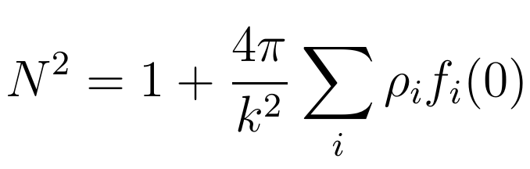
Neutron spin precession (nuclear pseudomagnetism)
Refraction of neutrons:
ρ_{i} is the density of particles of the i-th type (the number of particles in cm³)
f_{i}(0) is the amplitude of coherent elastic scattering in forward direction for particles of the i-th type
E. Fermi, Nuclear Physics, Course Notes Complied by Jay Orear, Rosenfeld and R. A. Schulter ,University of Chicago Press (1950)
M. Lax, Rev. Mod. Phys. 23, 287 (1951)
I.I. Gurevich, L.V. Tarasov, Low-energy neutron physics, ed. by R.I.Sharp, S. Chomet, Amsterdam: North - Holland Publishing Co. 1968.

Slide 12
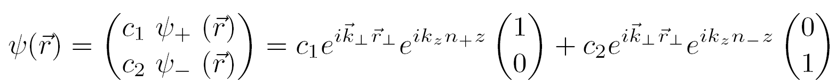
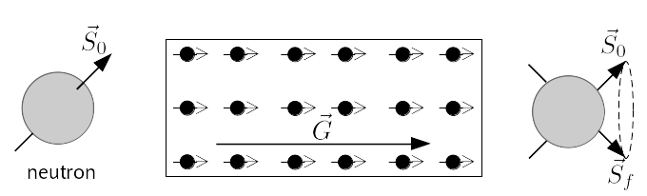
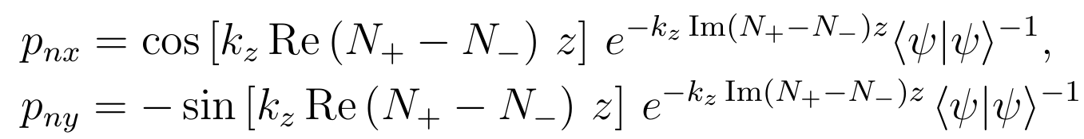
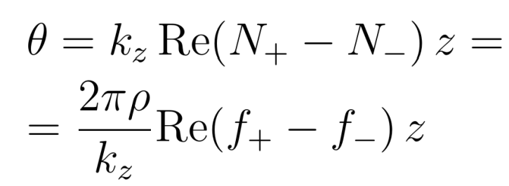
Neutron spin precession (nuclear pseudomagnetism)
Belarusian State University, Minsk – JINR, Dubna
Scientific discovery N 244 from April 3, 1964
V. G. Baryshevskii and M. I. Podgoretskii, Nuclear precession of neutrons,
ЖЭТФ (1964) 1050 (Sov.Phys. JETP, 20 (1965) 704)
Polarized target
θ
For neutron spin orthogonal to polarization vector of nuclei

Slide 13
Neutron spin precession (nuclear pseudomagnetism)
A. Abragam, G.L.Bacchella, H.Glattli, P. Meriel, J. Piesvaux, M. Pino, and P. Roubeau, C.R. Acad. Sci., (Paris) B274 (1972) 423.
M. Forte, Nuovo Cimento A18, v4 (1973) 726-736.
A. Abragam and M. Goldman, Nuclear Magnetism: Order and Disorder, Oxford University Press, 1982.
V.G.Baryshevsky, High–Energy Nuclear Optics of Polarized Particles, World Scientific, 2012.

Slide 14
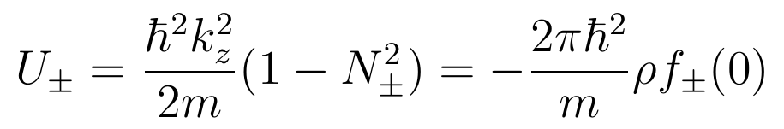
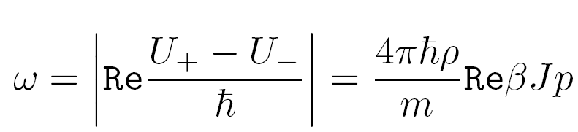
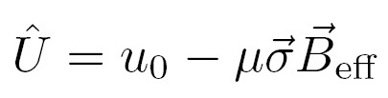
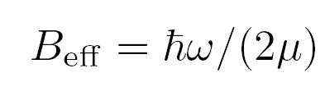
Neutron spin precession (nuclear pseudomagnetism)
Another view on spin precession phenomenon
In perfect analogy with spin behavior in a magnetic field, the non-zero difference U₊−U₋ leads to the neutron spin precession about the direction of the nuclear polarization vector with the frequency:
For a completely polarized proton target ω = 5·10⁸ s⁻¹, B_{eff} ≈ 3·10⁴ Gs = 3T (which exceeds by two orders of magnitude the ordinary magnetic field created by polarized magnetic moments of protons).
For thermal neutrons v = 2.2·10⁵ cm/s and the full turn of spin will occur over the length L ≈ 10⁻³ cm.

Slide 15
Quasi-optical phenomena for high-energy particles

Slide 16
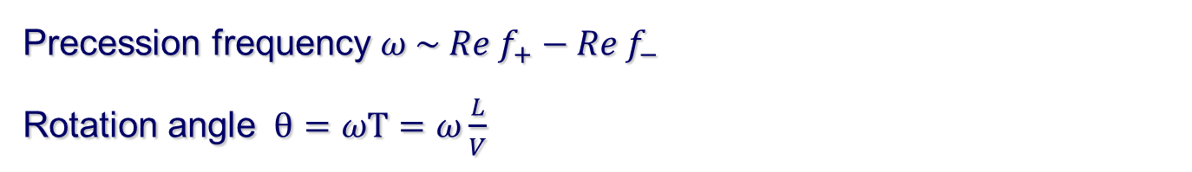
Neutron spin precession (nuclear pseudomagnetism)
Neutron spin precession at high energies
Precession frequency ${ω \sim Re f}_{+}−{Re f}_{−}$
Rotation angle $θ=ωT=ω\frac{L}{V}$
For thermal neutrons velocity v = 2.2·10⁵ cm/s and, thus, spin full turn occurs at length L ≈ 10⁻³ cm.
Velocity grows with the energy growth approaching speed of light c . Therefore, at the constant value of difference the length L, at which spin full turn occurs, increases 10⁵ times to be as long as 100 cm.
With particle energy growth the nuclear spin phenomenon becomes available for positively charged particles and nuclei (Coulomb repulsion does not prevent nuclear interactions in this case).

Slide 17
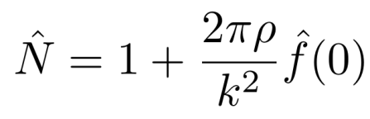


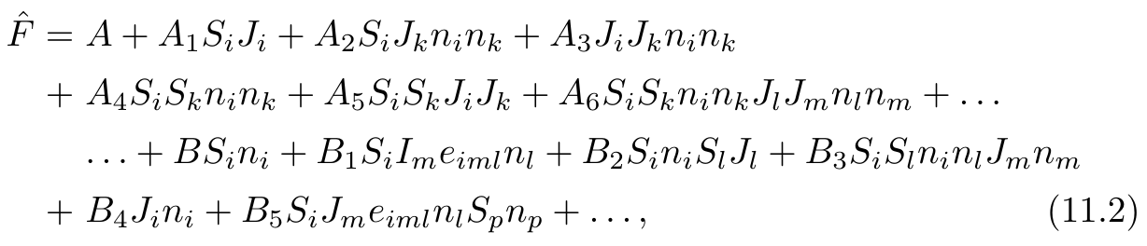
Forward scattering amplitude for a particle with spin S
Refractive index for particles with spin S:
where ; is the spin matrix of the scatterer; is the operator. Amplitude of forward scattering that acts in the spin space of the particle and the scatterer with spin J reads as follows:
terms containing products of S_{i} and J_{i} up to 2S and 2J
terms proportional to amplitudes A are P- and T-even;
those proportional to B, B₂, B₃, B₄ are P-odd and T-even;
one proportional to B₁ is P- and T-odd;
one proportional to B₅ is P-even and T-odd;
В.Г. Барышевский, Ядерная физика, т.38 (1983) стр.1162-1169.
V.G. Baryshevsky, Phys. Lett. B 120 (1983) pp.267-269.
В.Г. Барышевский, Ядерная оптика поляризованных сред, Энергоатомиздат, 1995.
V.G.Baryshevsky, High–Energy Nuclear Optics of Polarized Particles, World Scientific, 2012.

Slide 18
Experiments with polarized beams and targets
Polarized targets are required for experiments. Different nuclei are used now for polarized target creation. Such targets, for example, are used in experiments for investigation of polarized γ-quanta scattering by polarized protons and deutrons at Bonn accelerator facility ELSA and at the Mainz accelerator MAMI, namely:
¹⁴NH₃, butanol C₄H₉OH, ND₃, ⁶LiD
JINR participated in creation of such targets.
In accordance with «TOPICAL PLAN FOR JINR RESEARCH AND INTERNATIONAL COOPERATION 2025» project 02-1-1097-2-2010/2027 DSS (Project Leader V.P. Ladygin) modernization of the movable polarized target and development of both new polarimetry methods and methods of precise polarization control, analysis of the possibility of setting up new experiments with polarized proton beams and deuterons at the NICA complex.

Slide 19
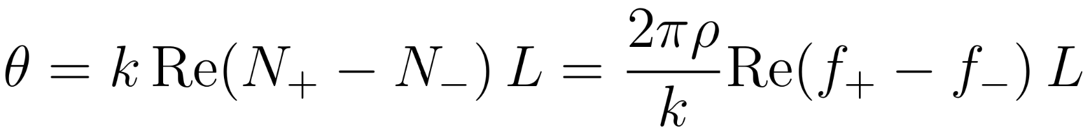
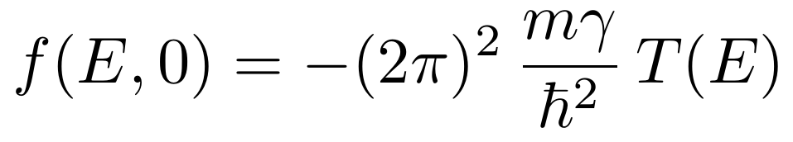
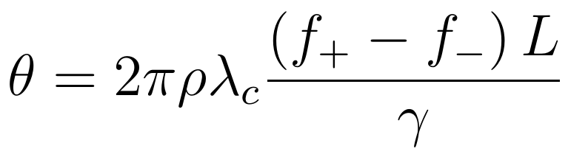
Evaluation for spin rotation effect
Scattering amplitude relates to scattering matrix T(E) as follows:
λ_{c} is the Compton wavelength of the
particle, f’=f/γ ~ T(E).
For example, for NH₃ target the density of polarized protons (the number of particles per cm³) is as high as ρ= 5 ⋅10²² cm⁻³. For protons with the use of evaluation for f’=f/γ ≈10⁻¹³ cm the value of spin rotation angle is as high as θ=3·10⁻³ rad for target thickness L=30 cm.

Slide 20
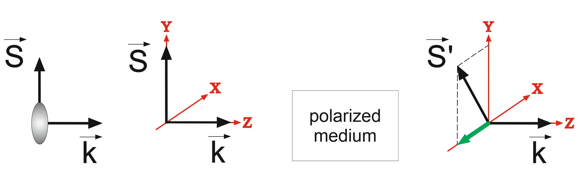
Nuclear precession (rotation in pseudomagnetic field)
Polarized particles (protons, deuterons, nuclei) moving in a polarized target
p_{x}=0
p_{x} ≠ 0
Effect evaluation for a polarized external target at Nuclotron
Part. | Target | Nb | σ, b | L, cm | Δσ/σ | Re(Δf)/Im(Δf) | |p_{x}| | T1%
p | NH3 | 10¹⁰ | 0.5 | 30 | 0.02 | ~0.5 | ~2·10⁻³ | 30 hours
p | ND3 | 10¹⁰ | 0.6 | 30 | 0.04 | ~0.5 | ~4·10⁻³ | 8 hours

Slide 21

Birefringence effect
Birefringence of light
Could the effect similar to birefringence of light exist for particles with nonzero mass ?
Unlike optical birefringence, the birefringence effect for particles appear in isotropic matter (and even the spin of matter nuclei is either zero or unpolarized !). Anisotropy is provided by the particle itself (a particle with the spin S ≥ 1 and mass M ≠ 0 has the intrinsic anisotropy).
V.G. Baryshevsky, Birefringence of particles (nuclei, atoms) of spin S≥1 in matter, Phys. Lett. A 171, 5-6 (1992) 431.
V.G. Baryshevsky, Spin oscillations of high-energy particles (nuclei) passingthrough matter and the possibility of measuring the spin-dependent part of the amplitude of zero-angle elastic coherent scattering, J. Phys. G 19, 2 (1993) 273.

Slide 22
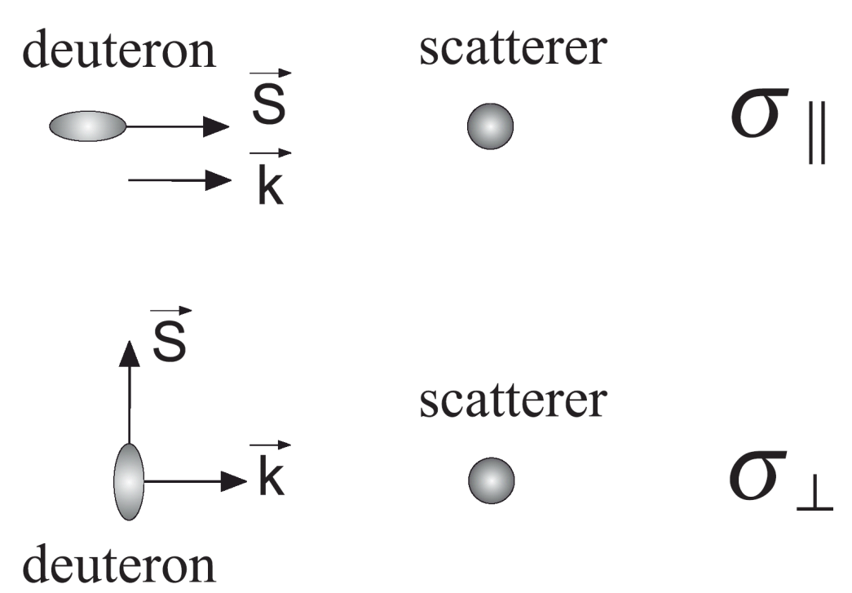
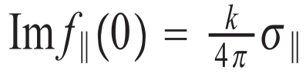
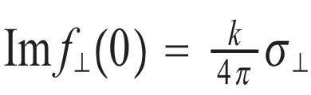
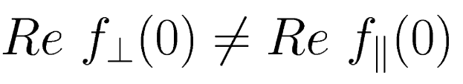
Birefringence phenomenon
Appearance of two refraction indices of deuteron can be easily explained
As the ground state of a deuteron is non-spherical, then the scattering cross-section depends on the angle between the spin and momentum of the deuteron
≠
According to the dispersion relation Re f(0) ~ Φ (Im f(0)), therefore

Slide 23
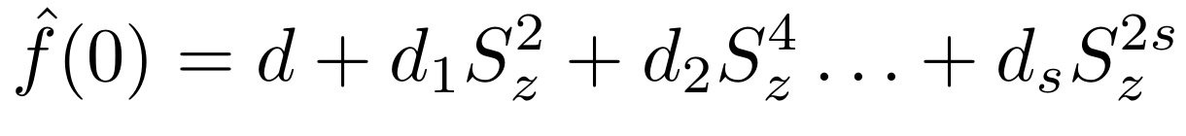
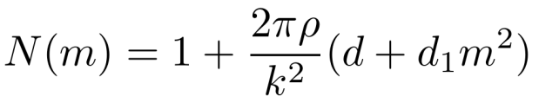
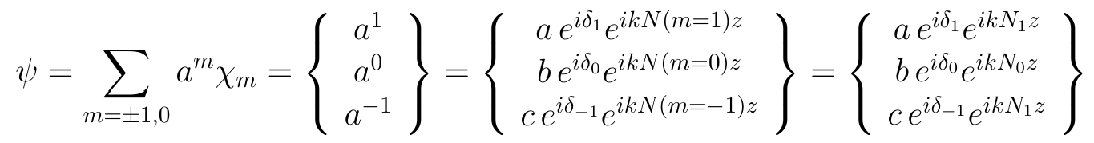
Birefringence phenomenon
Forward scattering amplitude of a particle in a nonpolarized target (oz || particle momentum, contribution of weak interactions is omitted) reads:
For particles with spin 1 and 3/2
index of refraction

Slide 24
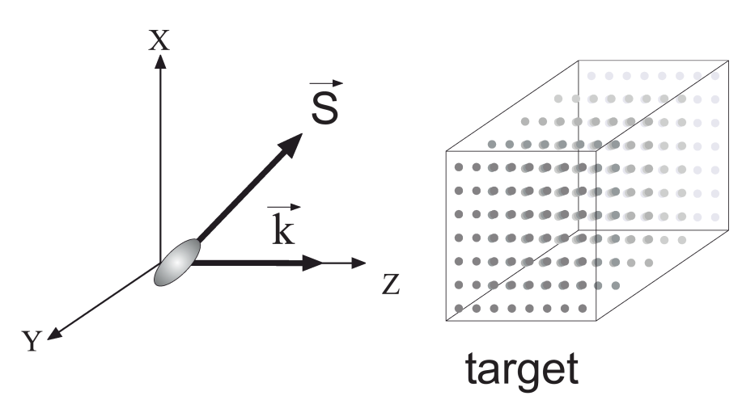



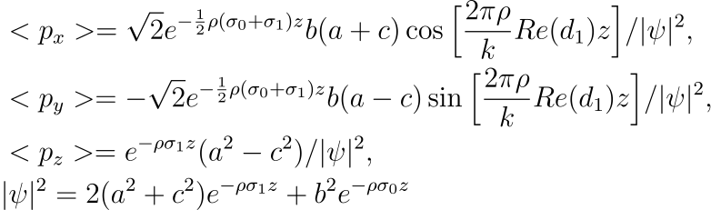
Deuteron (spin = 1) in nonpolarized target
Let us look for the mean value of the spin operator in state ψ.
Plane (xz) coincides with that formed
by polarization vector and deuteron momentum before entering the target
In this case δ₁- δ₀=0 at z=0, <p_{x}>≠0, <p_{y}>=0
z is the pathlength of particle inside medium.

Slide 25
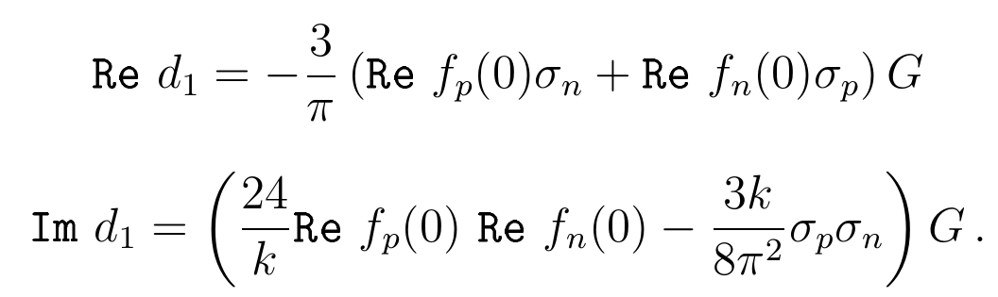
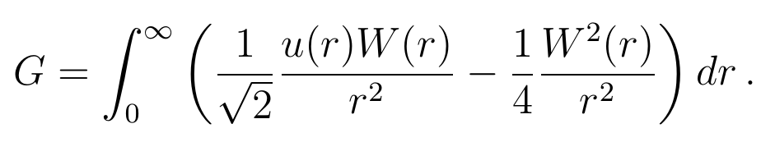
Nonpolarized deuterons in nonpolarized target
where is the total scattering cross section of a proton and a neutron by a nucleus, respectively,

Slide 26
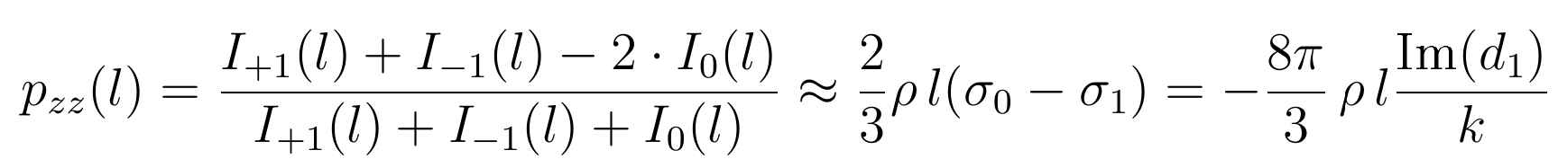
Nonpolarized deuterons in nonpolarized target
Tensor polarization p_{zz} after passing through a target with density ρ and thickness l is expressed via intensities I_{±1} and I₀ for deuterons with spin projection m=±1 and 0 as follows

Slide 27
Deuteron spin dichroism: experiments
First observation of spin dichroism with deuterons up to 20 MeV in a carbon target
V. Baryshevsky, A. Rovba, R. Engels, F. Rathmann, H. Seyfarth, H. Stroher, T. Ullrich, C. Duweke, R. Emmerich, A. Imig, J. Ley, H. Paetz gen. Schieck, R. Schulze, G. Tenckhoff, C. Weske, M. Mikirtytchiants, A. Vassiliev (LANL arxive: hep-ex/0501045)
Proceedings of the 17th Int. spin phys. symp.,SPIN 2006, Kyoto, Japan, 2–7 October 2006. / AIP Conf. Ser, v.915 (2007) 777-780
Production of a beam of tensor-polarized deuterons using a carbon target
Phys. Rev. Lett. 104, 22 (2010) 222501

Slide 28
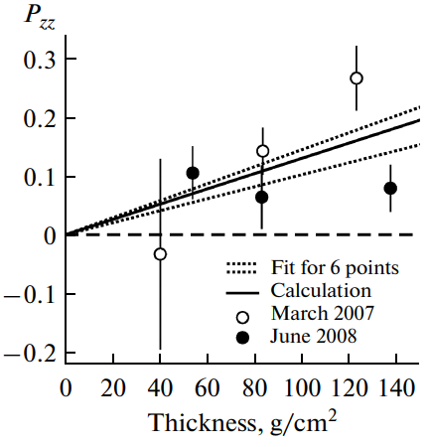
JINR experiments 5 GeV/c 2008-2010 years
Observation of Tensor Polarization of Deuteron Beam Traveling through Matter
L.S.Azhgirei, Yu.V.Gurchin, A.Yu.Isupov, A.N.Khrenov, A.S.Kiselev, A.K.Kurilkin, P.K.Kurilkin, V.P.Ladygin, A.G.Litvinenko, V.F.Peresedov, S.M.Piyadin, S.G.Reznikov, P.A.Rukoyatkin, A.V.Tarasov, T.A.Vasiliev, V.N.Zhmyrov, and L.S.Zolin,
Physics of Particles and Nuclei Letters 5, 5 (2008) 432.
Measurement of tensor polarization of a deuteron beam passing through matter
Phys. of Particles and Nuclei Lett. 7, 1 (2010) 27–32.
Tensor polarization of deuterons vs. thickness of target The dashed region shows the error corridor, the solid curve is the calculation result.

Slide 29
Experiments at Nuclotron M – NICA

Slide 30
Spin dichroism effects: evaluations for NICA
Collision of two initially non-polarized beam
pzz=0 pzz=0
Magnetic field
Siberian
snakes
Both beams acquire tensor polarization
pzz= -(pxx + pyy) ≠0
Particles | N per beam | σ, b | L, cm⁻²s⁻¹ | Δσ/σ | p_{zz} | T
d-d | 1.3·10¹³ | 0.2 | 4·10³¹ | 0.01 | 3·10⁻⁵ | 2 hours
Ne-Ne | 4.4·10¹⁰ | 1.4 | 10²⁷ | 0.1 | 6·10⁻⁵ | 10 hours
Ne-d | 4.4·10¹⁰ (Ne) | 0.7 | 2·10²⁹ | 0.1 | 1.2·10⁻³ (Ne) | 2 hours

Slide 31
Deuteron spin rotation and dichroism
There is no possibility to carry on experiments in the ring with colliding beams of polarized protons, deuterons and nuclei at NICA now.
Now it is reasonable to start from experiments at Nuclotron with a fixed target (either external or internal).

Slide 32
Internal nonpolarized fixed target@Nuclotron
Measurements of spin dichroism at the internal target is important for testing and verification of polarization measurements at NICA for colliding beams of nuclei (deuterons and other).
Evaluations and requirements for probable experiments are under discussion now with Vladimir Ladygin (in the framework of grant Belarus-JINR 234-8-2025).
S.V. Anischenko, V.G. Baryshevsky, A.A. Gurinovich, V.P. Ladygin, About possibility to observe spin dichroism effect (the effect of tensor polarization acquiring) for a nonpolarized deuteron beam passing through the nonpolarized internal target of Nuclotron, arXiv:2508.11718 [nucl-th]

Slide 33
Deuteron dichroism (internal nonpolarized target)
Magnetic field presents in the ring and it is parallel to y-axis. It rotates spin component, which is parallel to the particle motion plane (xz).
TOP VIEW
Internal nonpolarized target
Nonpolarized deuterons
(pzz=0)
Deuterons with nonzero
tensor polarization (pzz≠0)
N₊₁=N₋₁=N₀
N₊₁=N₋₁≠N₀
Particle | Target | E, MeV | N_{bunch} | σ, b | Δσ/σ | <p_{zz}> | T1%
d | CH2 | 270 | 10¹⁰ | 0.8 | 0.06 | 1·10⁻² | ~1 hour
d | CH2 | 270 | 10¹⁰ | 0.8 | 0.01 | 2·10⁻³ | 30 hours
d | C | 3700 | 10¹⁰ | 0.6 | 0.06 | 1·10⁻² | ~hours
d | C | 270 | 10¹⁰ | 0.6 | 0.06 | 1·10⁻² | ~hours

Slide 34
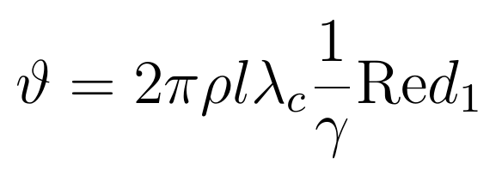
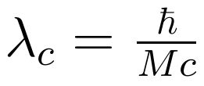

Nonpolarized external fixed target@Nuclotron
Deuteron spin rotation in nonpolarized target
Only spin dichroism for deuterons was observed in the first experiment at Nuclotron. Deuteron spin rotation is not measured yet.
Angle of rotation for polarization vector (polarization tensor) for a deuteron beam passing distance l in a target with density ρ (the number of nuclei per cm³) reads
, where
Analysis shows that for deuterons of several GeV energies passing through a carbon target with thickness of several nuclear interaction lengths angle of polarization vector (polarization tensor) rotation is about

Slide 35
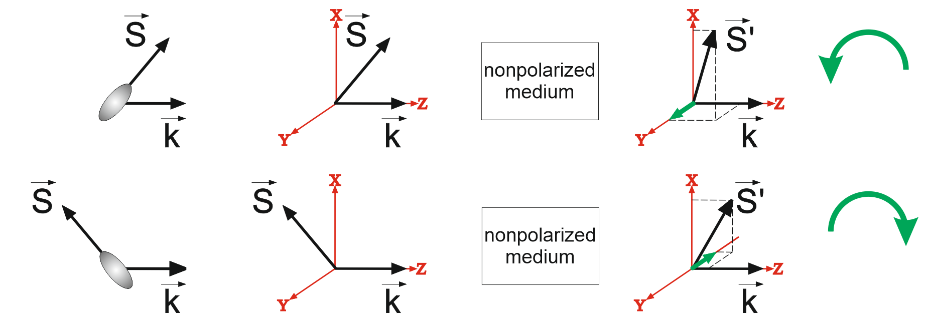
Deuteron (spin = 1) in nonpolarized target
Rotation for an acute and obtuse angles between spin and momentum occurs in opposite directions
p_{y}=0
p_{y}>0
p_{y}=0
p_{y}<0
p_{y}
Target | N _{bunch} | σ, b | ρl, g·cm⁻² | Δσ/σ | |Re(d1)/Im(d1)| | |p_{x}| | |pxz| | T1%
C | 10¹⁰ | 0.6 | 83 | 0.06 | 0.1 | 4·10⁻³ | 6·10⁻³ | 8 hours

Slide 36
External nonpolarized fixed target@Nuclotron
Initially nonpolarized beam of heavy nuclei with spin S≥1 passing through a nonpolarized external target at Nuclotron would acquire tensor polarization due to spin dichroism.
Effect evaluation: for nonpolarized heavy nuclei with high spherical asymmetry (for example, Ne or Eu) passing through the external carbon target of thickness about 40 g/cm² at Nuclotron the value of tensor polarization is as high as:
p_{zz} ≈ 0.5 ≡ 50%.
Great value of tensor polarization appearing due to spin dichroism for many nuclei, gave possibility to V.Lebedev and C.Shimansky to formulate an idea for application of nuclei, which acquire tensor polarization at low energies, for further acceleration and bringing into NICA ring. Therefore, one gains possibility to study reactions induced at collisions of tensor polarized nuclei beams.

Slide 37
Conclusion: options for Nuclotron
The following can be proposed as the first steps for investigation polarized nucleons and nuclei at the Nuclotron-M NICA complex :
Investigation of spin dichroism effect for deuterons at Nuclotron with the internal target.
Detection and study of rotation of spin and tensor polarization for deuterons passing through an unpolarized target with the use of the extracted beam at Nuclotron.
Observation of tensor polarization acquiring by heavy nuclei (for example, Ne) when passing through an external target at Nuclotron.

Slide 38
Conclusion: options for NICA
The first proposed step for NICA complex is observation of spin dichroism effect for deuterons during collisions of nonpolarized deuteron beams.
The nuclear optics effects for polarized particles should be taken into account when studying various reactions since they can reveal as systematic errors.
It would be beneficial to have an internal target at NICA.
Particles | N per beam | σ, b | L, cm⁻²s⁻¹ | Δσ/σ | p_{zz} | T
d-d | 1.3·10¹³ | 0.2 | 4·10³¹ | 0.01 | 3·10⁻⁵ | 2 hours

Slide 39

Thank you for attention!!

