Slide 1
Виктор Викторович Глаголев
30.10.1931 - 16.03.2025

Slide 2
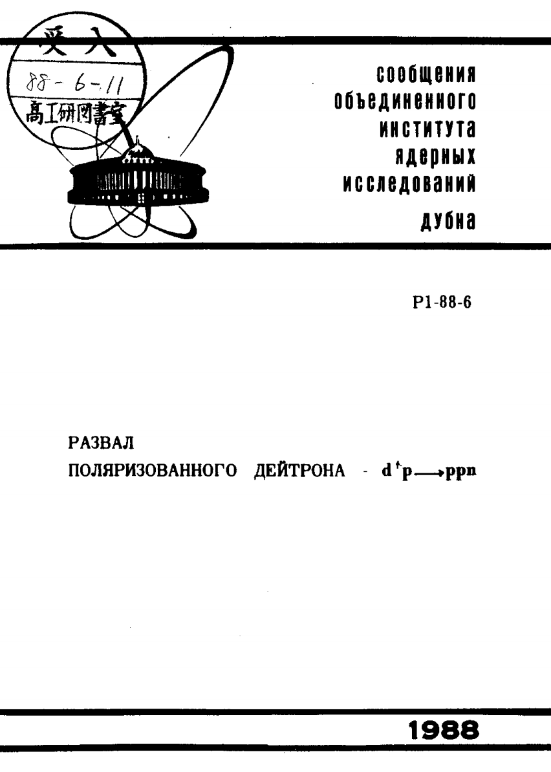
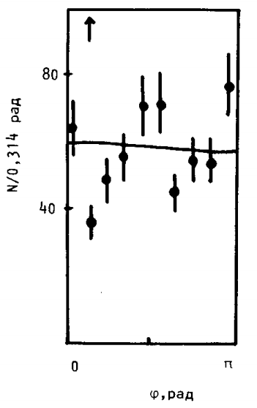

Slide 3
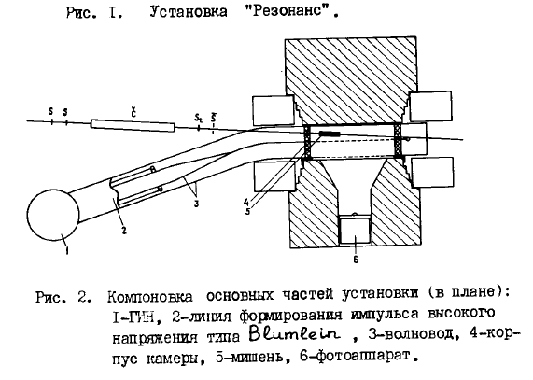
“The ‘Resonance' Facilities, Their Potentialities And Current Trends In Relativistic Nuclear Physics” A.A. Askarkhodzhaev, V.A. Belyakov, Yu.T. Borzunov, V.F. Vishnevsky, V.V. Glagolev, L.B. Golovanov, Yu.V. Kulikov, R.M. Lebedev, M. Maly, E.A. Matyushevsky A.P. Tsvinev, J. Cerny, I. Chumpelik, S.S. Shimansky
Proceedings, Investigations In The Field Of Relativistic Nuclear Physics, 92-97, Dubna 1982.

Slide 4
