Slide 1
Neural Operators for Physics Applications
Heinrich van Deventer
Google PhD Fellow
Department of Computer Science, University of Pretoria
SA-JINR workshop on theoretical and computational physics, June 2025, Dubna, Russia

Slide 2
Research Motivation
Improve the efficiency of machine learning systems
for useful computation

Slide 3
AI Resources for Physics Applications
Software
Python used as a high-level interface
Built on top of parallel processing systems such as GPUs
Underlying code is written in languages like C++
Multi-dimensional array-based computation with NumPy-like syntax
Applications
Regression
Classification

Slide 4
Physics in Machine Learning
Boltzmann Machines
Ising Models
Logistic or sigmoid activation function
Physics
Softmax Function
Partition Function
GPT models

Slide 5
Machine Learning in Physics
Physics-Informed Neural Networks
Neural Functionals and Operators
Density Functional Theory
Variational Methods
Solving PDEs

Slide 6
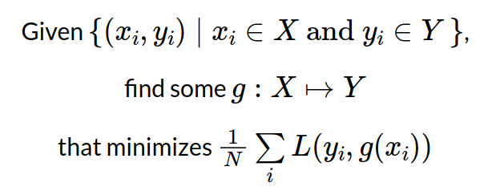
Supervised Machine Learning

Slide 7
Operators and Functionals

Slide 8
Classical Mechanics and Operators
Find a function f that minimizes the action:
For any given f find the function H such that:
How to approximate any (linear or non-linear) operator?

Slide 9
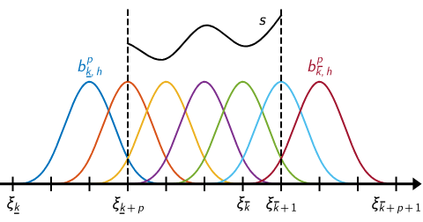
Generalisation to Infinite Dimensions
From the finite dimensional models used for MSc project

Slide 10
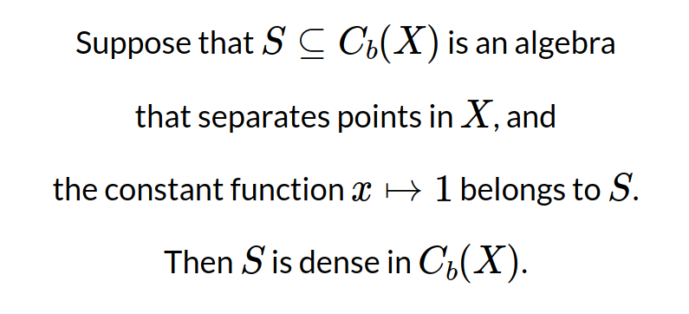
Stone-Weierstrass Approximation

Slide 11
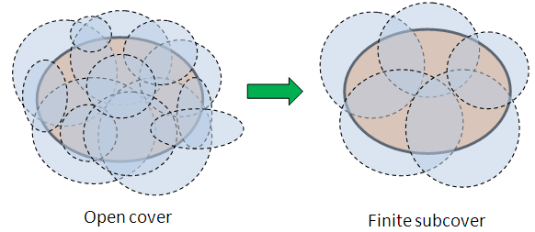
Compact Spaces in Finite Dimensions
If a set is closed and bounded,
then it is compact.

Slide 12
Compact Spaces in Infinite Dimensions
Corollary of the Arzelà–Ascoli theorem:
A set of functions is compact
If and only if it is
closed, bounded, and equicontinuous

Slide 13
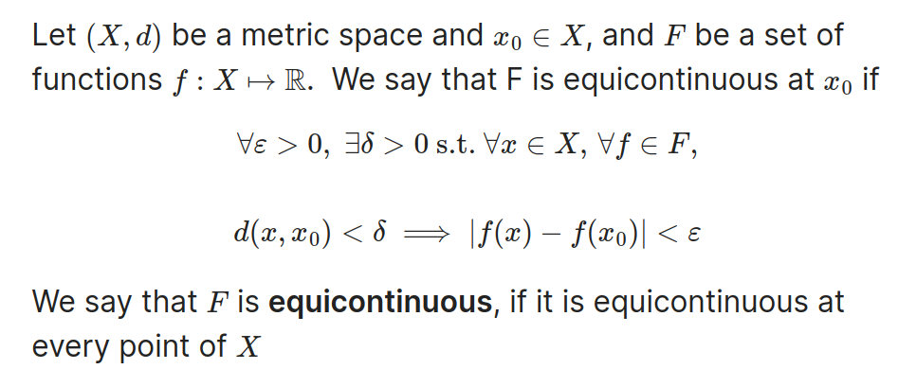
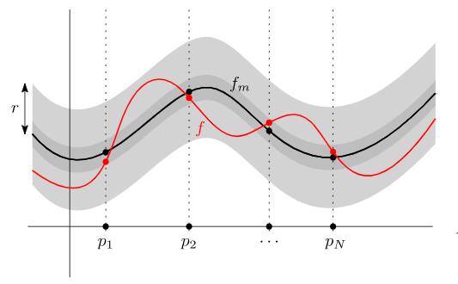
Equicontinuous Functions
Which functions or paths in physics have bounded gradients?

Slide 14
Examples of Non-Linear Functionals
Or something more familiar…

Slide 15
Computational Irreducibility
Which computational physics problems are irreducible?

Slide 16
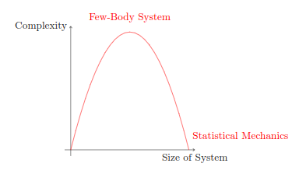
Complexity and N-Body Systems
Are N-body systems computationally irreducible, or is there a shortcut?

Slide 17
Schrödinger Equation for N-Electron System
Potential V is system dependent
Can be solved with Slater determinants and Hartree-Fock methods
Computational cost grows exponentially with N electrons

Slide 18
Density Functional Theory

Slide 19
Effective Potential and Exchange-Correlation

Slide 20
Approximating Exchange-Correlation with ML
Input-output examples
Equicontinuous electron densities
Exchange-correlation energies
This data is not normally saved or stored
Note: Last week Microsoft Research released a paper and data for this

Slide 21
Microsoft Research: Exchange-Correlation

Slide 22
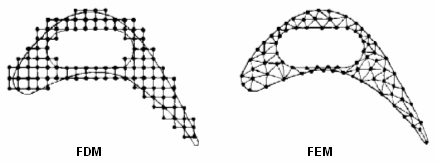
Older Partial Differential Equation Solvers
Finite difference methods and finite element methods are computationally expensive.
Are PDE solvers computationally irreducible, or is there a shortcut?

Slide 23
NVIDIA Researchers: PDE Solvers
Learning surrogate maps for the solution operators of PDEs

Slide 24
Neural Operators in Image Processing
Mesh-independent
Convergent Behaviour
Appropriate Symmetries
VS

Slide 25
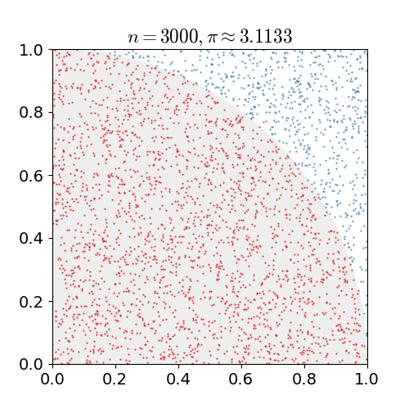
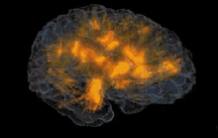
Stochastic Processes for Computation
If the activity of biological neurons resembles Monte-Carlo integration, how could one model it?

Slide 26
Regularity and Non-Linear Integral Equations
Urysohn Equation and recurrent models
Regularity
Conditions
Convergence
Regularity conditions are important to guarantee that our models and minds do not diverge.

Slide 27
Future Work
Benchmark against Microsoft exchange-correlation functional
Evaluate models for solving PDEs

Slide 28
Heinrich van Deventer
Email: HPDeventer@gmail.com

