Slide 1
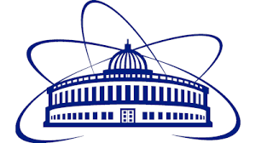
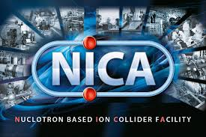
Model of experiments and a method of analysis of data for determination of absorbed dose of samples for applied research at the NICA facility
Nelli E. Pukhaeva
JINR
JINR, 17 April 2025

Slide 2
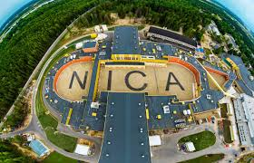
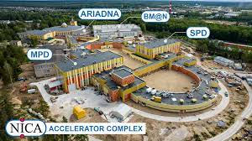
NICA complex

Slide 3
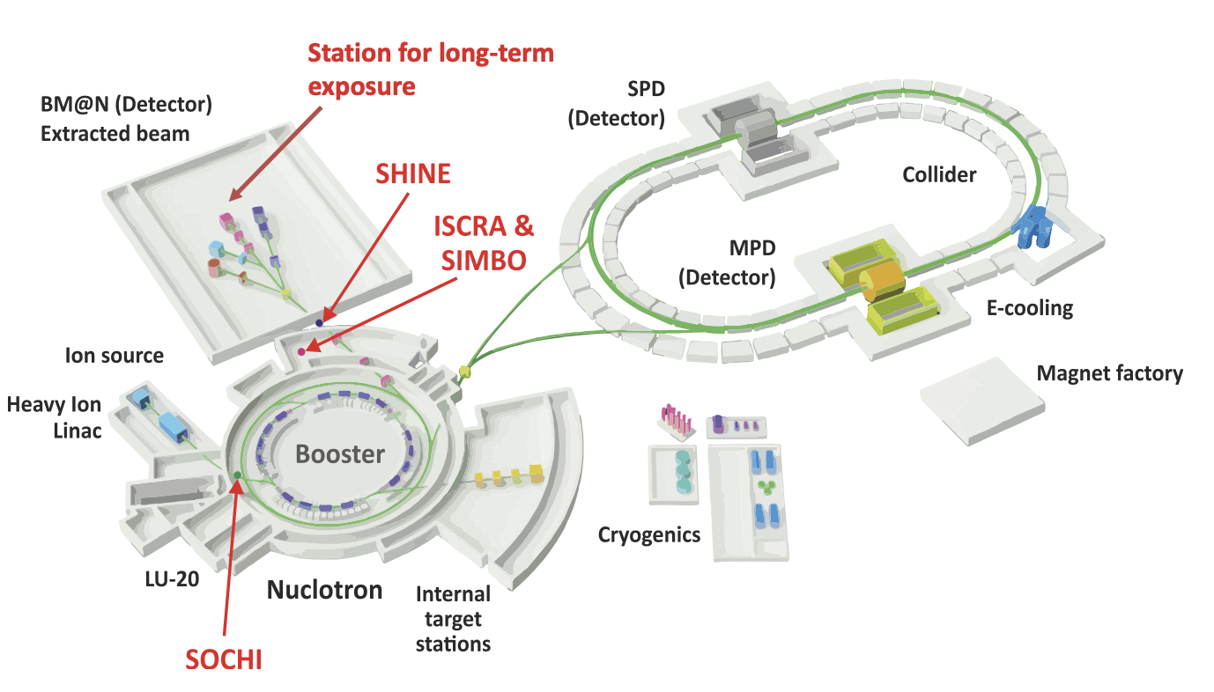
ARIADNA - apllied research at NICA
ARIADNA-LS – life science
ARIADNA-MSTE – radiation materials science and radiation testing
of electronics
ARIADNA-ADSR – study of accelerator driven subcritical reactors

Slide 4
ARIADNA long term irradiation station

Slide 5
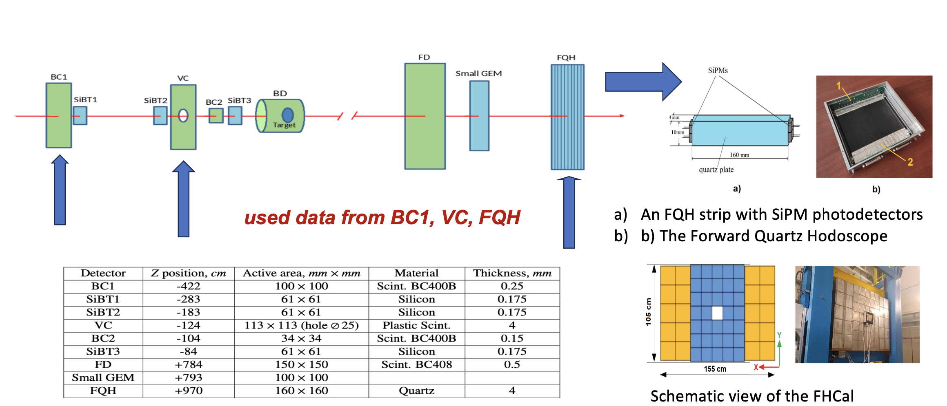
Method of analysis – first data taking

Slide 6
First results from miniDst

Slide 7
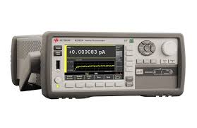
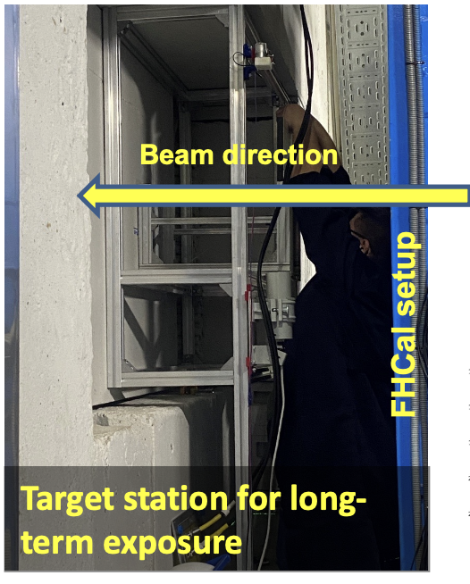
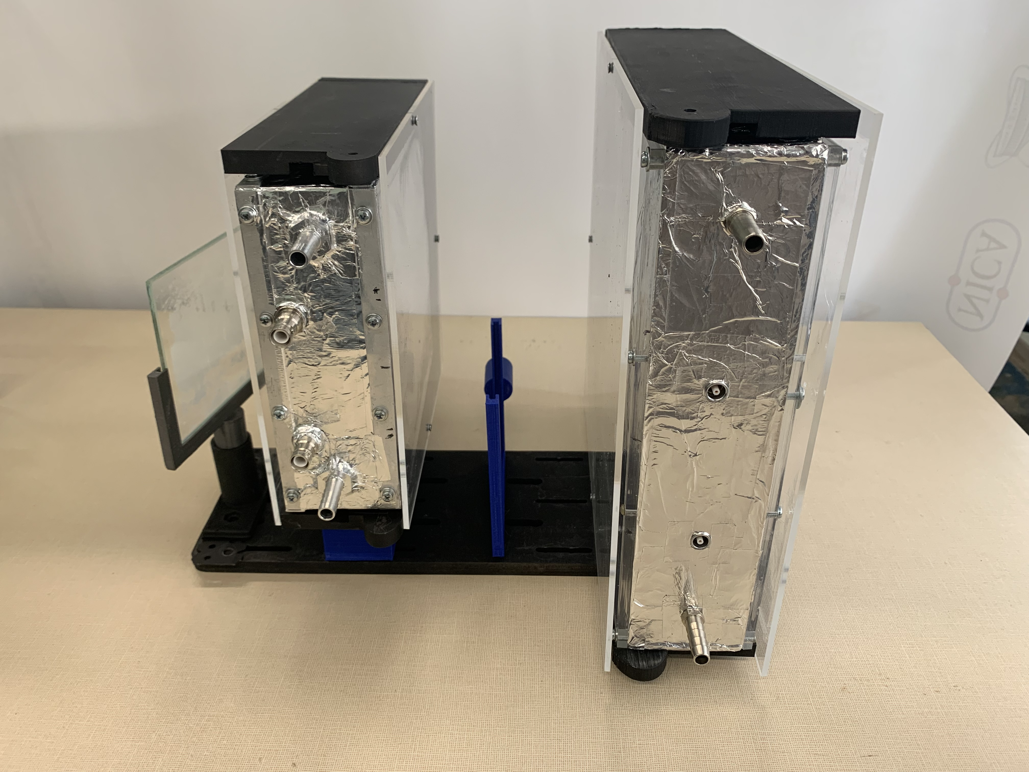
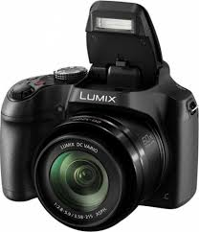
Experiments of SLTE
IK-1
IK-2
Profile-Lumi
Samples
Samples

Slide 8
Data for apllied research
BM@N data
BC1
VC
SLTE
KI-1
KI-2
FD
Small GEM
FQH
Profil-Limin
1 - Data from BM@N DST
2 – Data from SLTE
IK-1 – full charge before sample
IK-2 – full charge after sample
Profile from luminafore

Slide 9
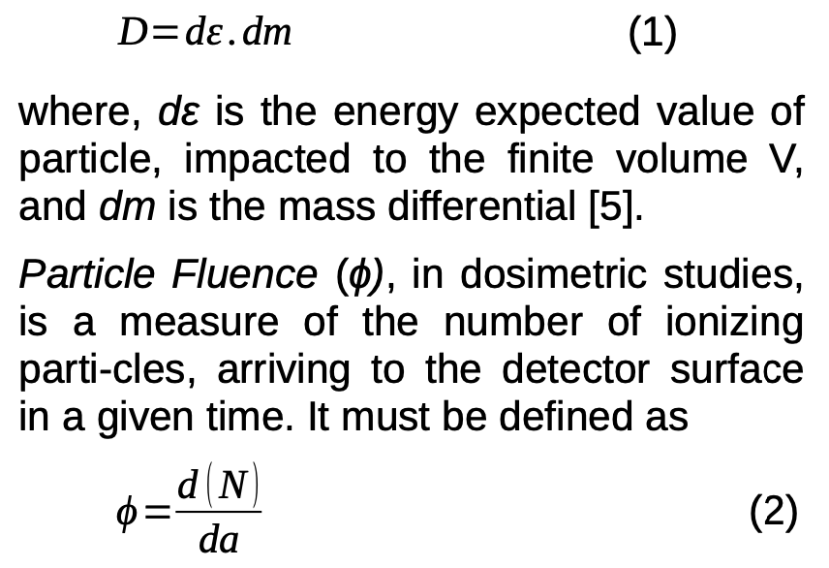
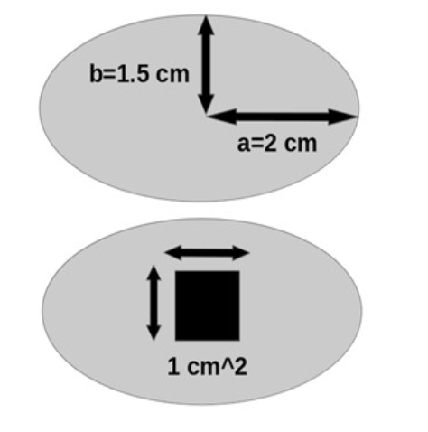
Study of beam for Dose and Fluence calculation

Slide 10
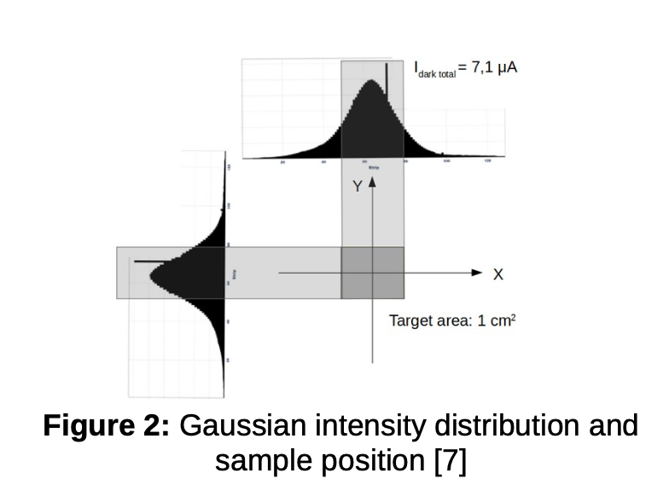
Study of beam for Dose and Fluence calculation
Distribution of the beam
70% of beam reaches the samples
After adding new chambers intensity and profile will be measured much better

Slide 11
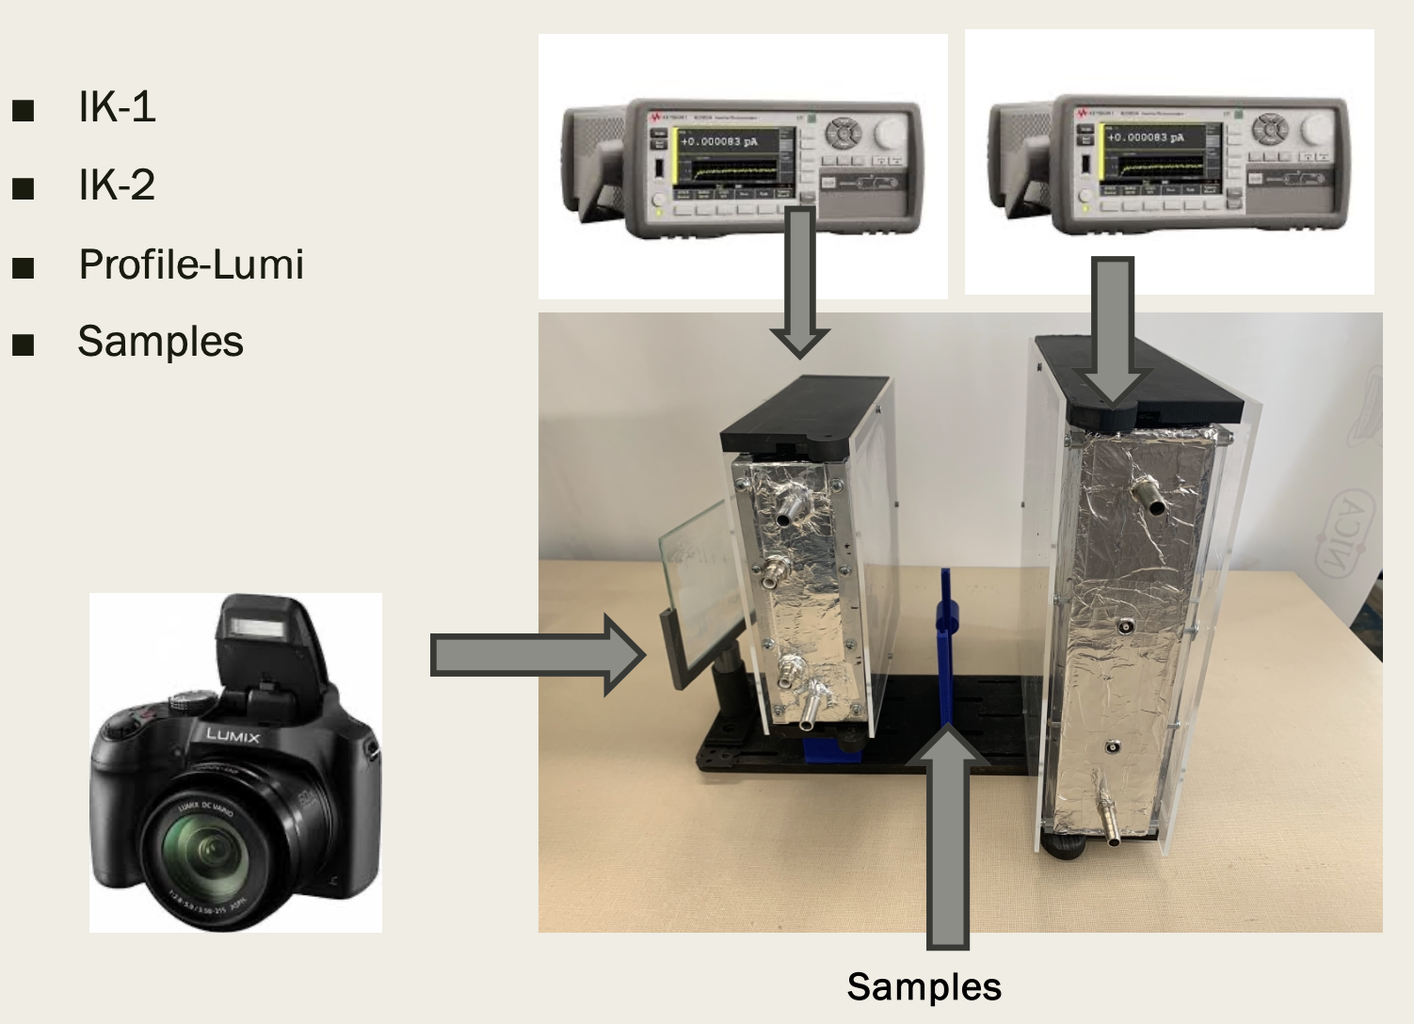
Experiments of SLTE
After adding the IK-1 , IK-2 and Lumi-profile we can compare results with BM@N data and get full information for beam
Full system will be team in Obninsk soon
Strip chamber under devepment

Slide 12
Thanks for your attentions !

Slide 13
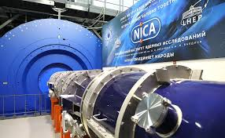
Конвенциональная дозиметрия оперирует в основном понятием макроскопической величины – поглащенной дозой
Микродозиметрический линейная передача энергии

Slide 15
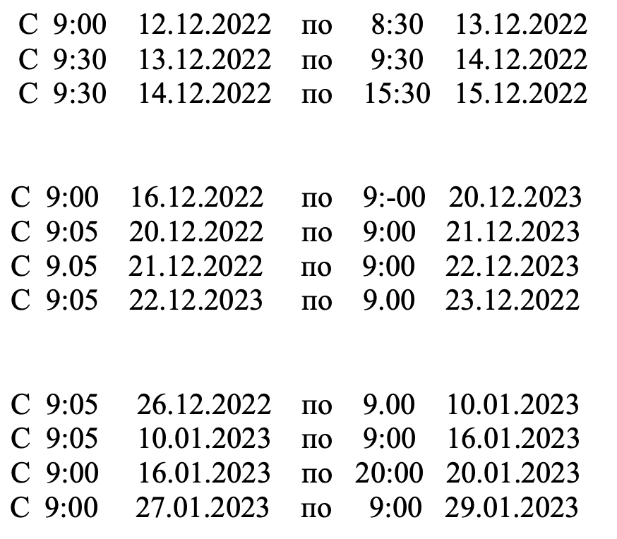
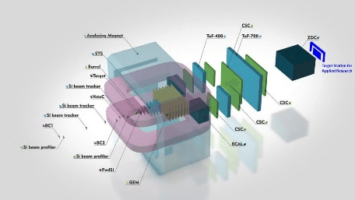
First ARIADNA experiments
Dates of radiation of samples from 12 of December 2022 up to 29 of January 2023

