Slide 1
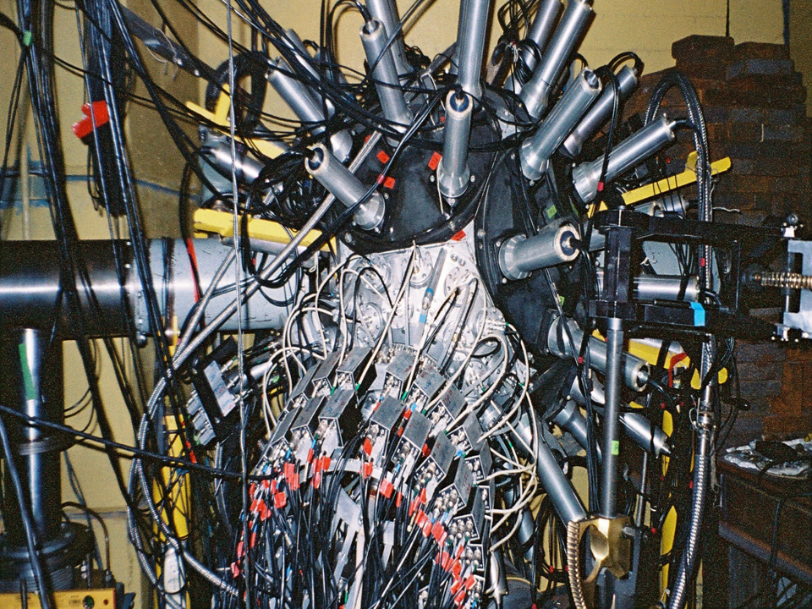

Hot nuclei in collisions of light relativistic beams
of the Nuclotron accelerator (JINR, Dubna)
with a heavy target.
S.P. Avdeyev^{1,2}, W. Karcz¹, Z.A. Igamkulov^{1,3}, G.D. Milnov^{1,2},
P.A. Rukoyatkin¹, V.I. Stegaylov¹, O.A. Strelkova¹, A.S. Botvina⁴.
¹Joint Institute for Nuclear Research, Dubna, Russia;
²Dubna State University, Dubna, Russia;
³JIZPI, Jizzakh, Uzbekistan;
⁴FIAS, Frankfurt am Main, Germany.

Slide 2
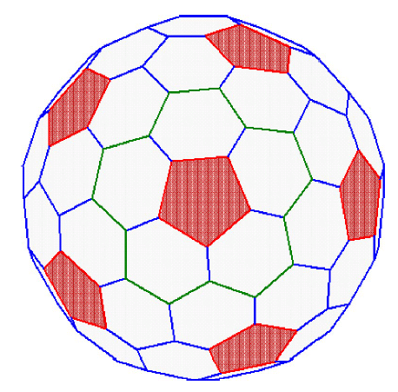
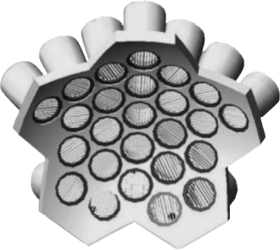
58 CsI(Tl) detectors
5 telescope-spectrometers
25 telescope-spectrometers
Notes:
заметка 3

Slide 4
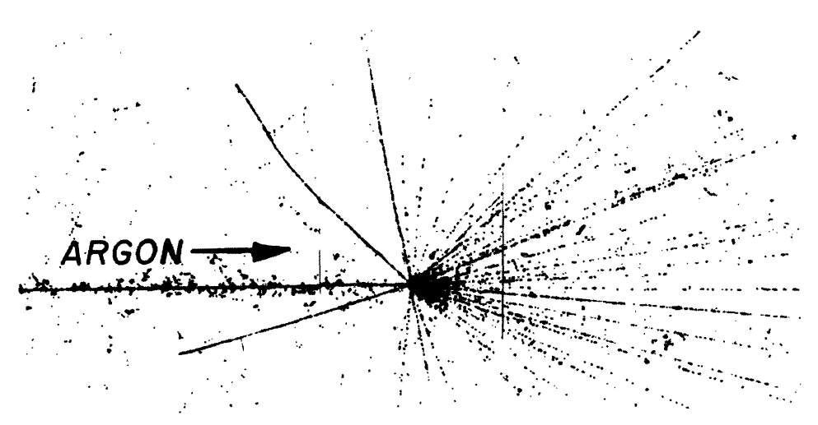
Heckman, Crawford, Greiner, Lindstrom, and Wilson
Physical Review C 17, 1651 (1978)
Photo-emulsions irradiated with a ⁴⁰Ar beam (1.8 GeV/A)
at the Bevalac Berkeley accelerator

Slide 5
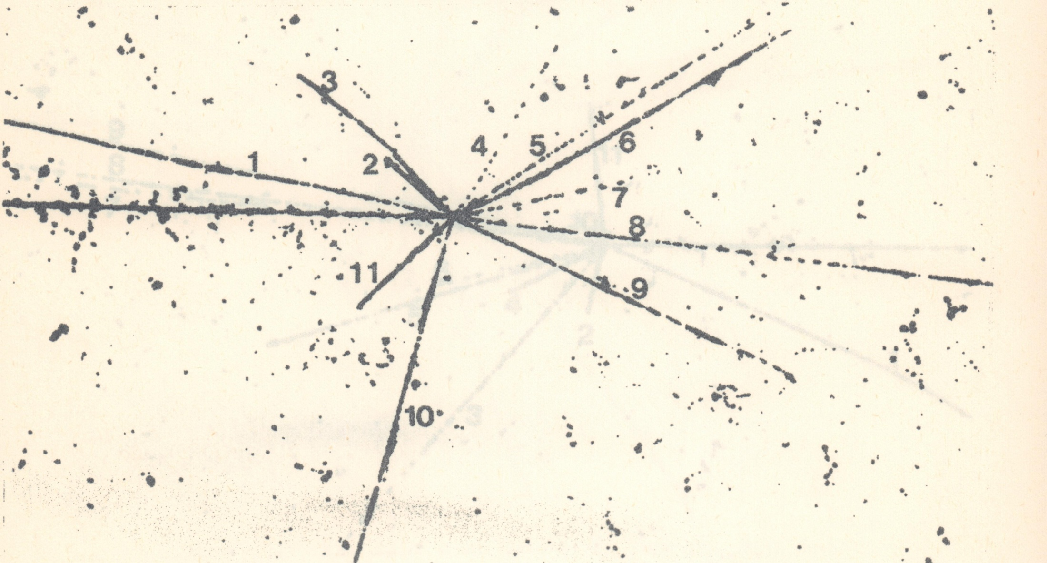
Bo Jacobsson, et al., Z. Phys. A 307, 293 (1982)
Photo-emulsions irradiated with a carbon beam (250 MeV/nucleus)
at the Bevalac Berkeley accelerator

Slide 6
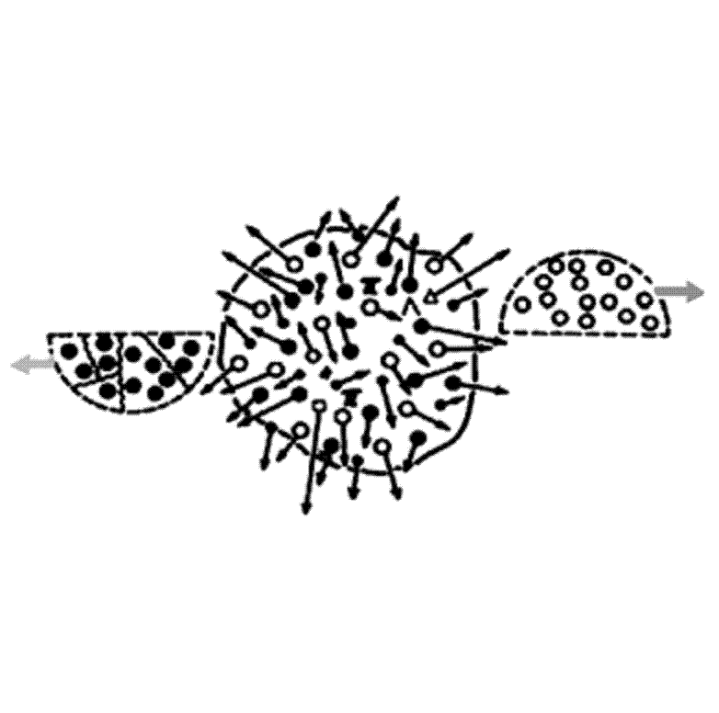
Spectator
Spectator
Hot and
compressed
region
Participants

Slide 7
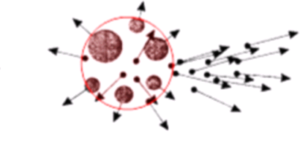
multi-fragmentation of heavy target
by the light relativistic projectiles
excitation energy comparable with the total binding energy
IMF-intermediate mass fragments: IMF=2<Z<20
E* = Eth > 400 MeV (T = 5 –7 MeV )
Model: INC*+SMM+ multybody Coulomb trajectory
(Heavy ion collisions: E* =Eth + Ecompr + Erot )

Slide 8
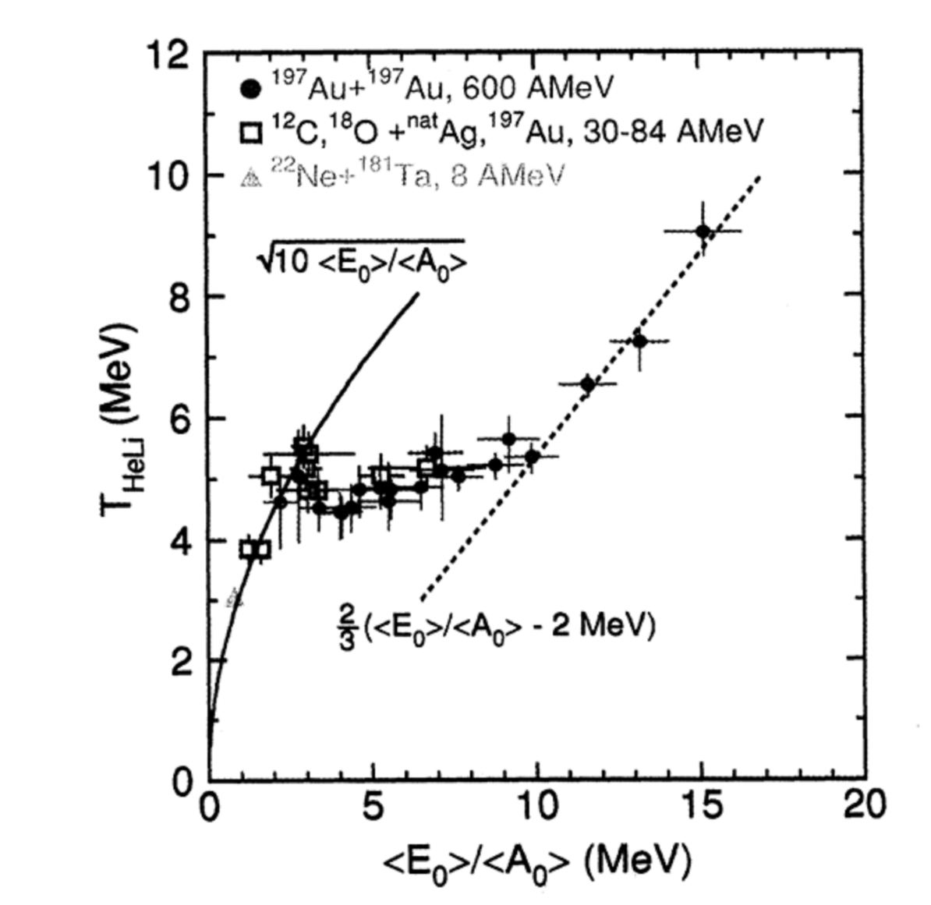
gas of classical
elementary particles
evaporation regime
Caloric curve of nuclei determined by the dependence
of the isotope temperature T_{HeLi} on the excitation energy per nucleon.
J. Pochodzalla et al., Phys. Rev. Lett. 75, 1040 (1995).

Slide 9
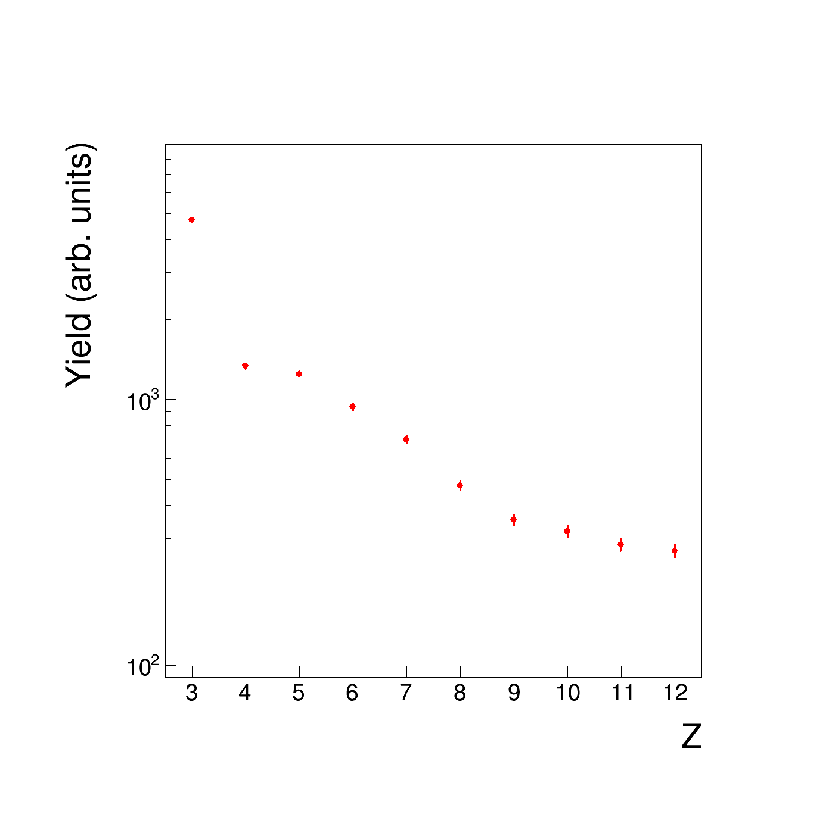
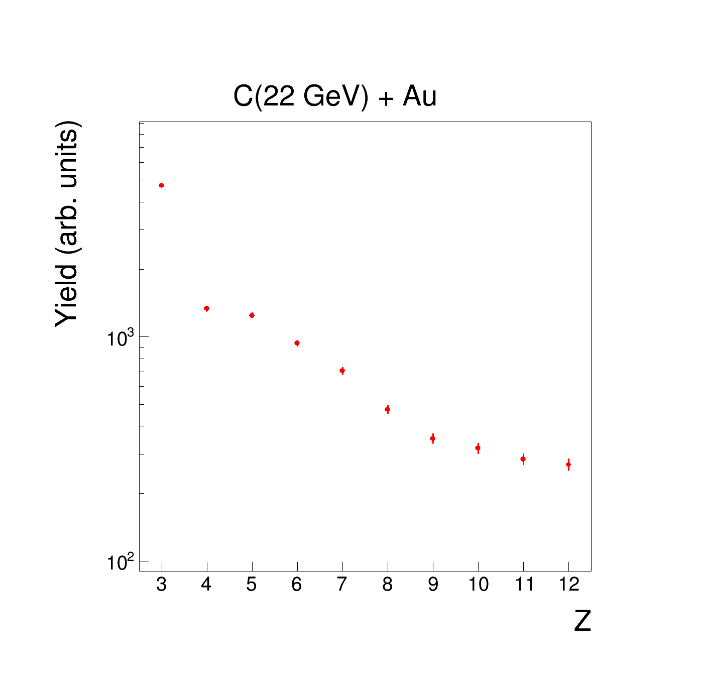
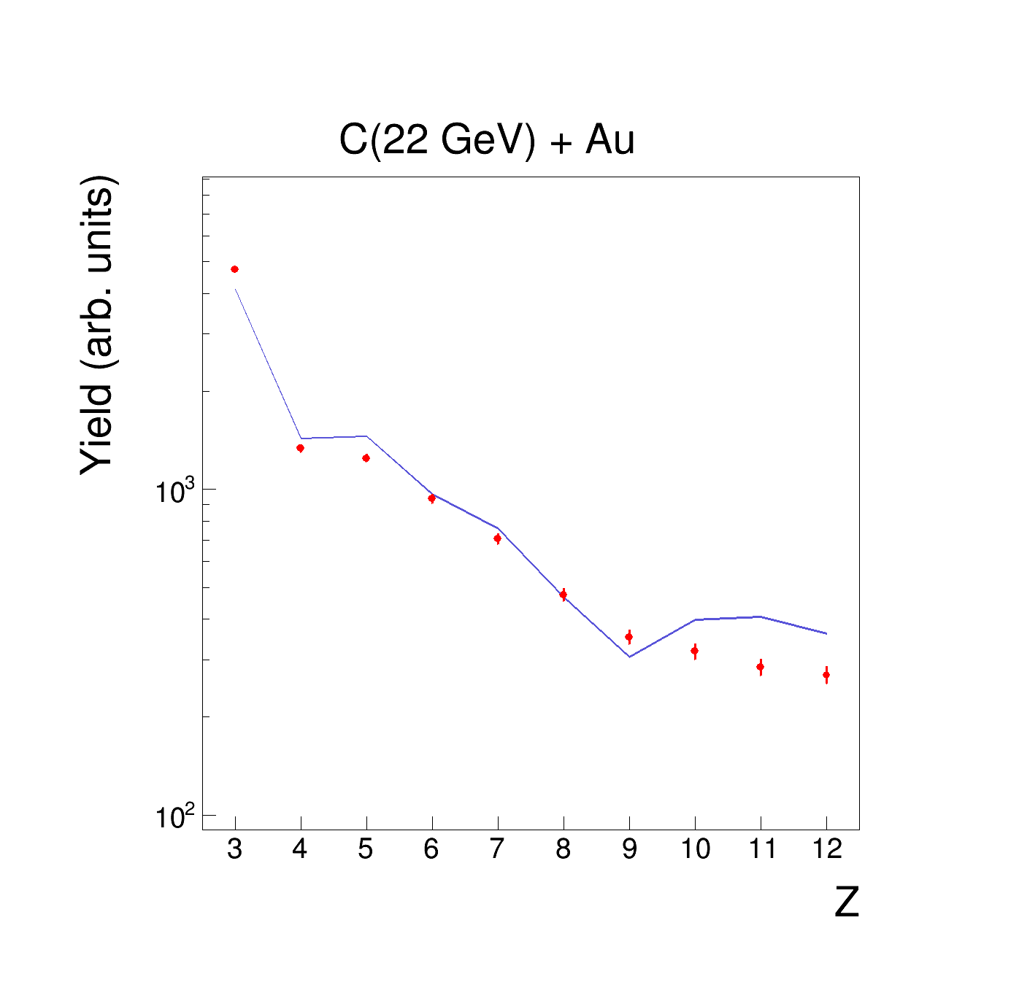

Slide 10
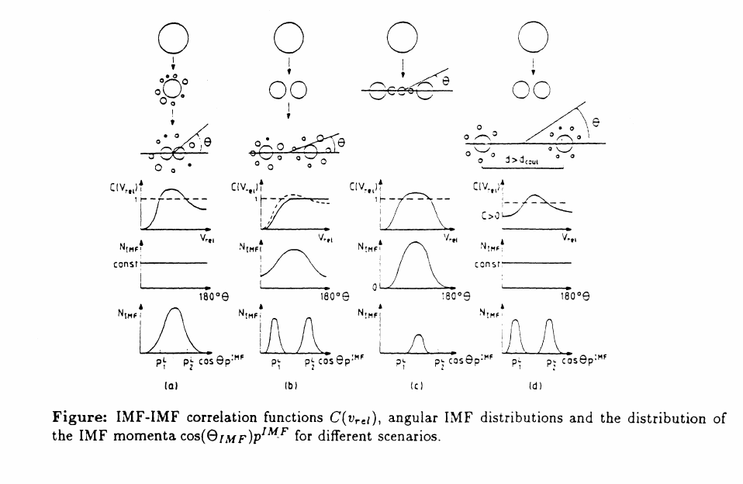
Corr. func. at different geometry. O.Shapiro & D.H.E.Gross
O. Shapiro, D.H.E. Gross,
Hahn-Meitner-Institut, HMI-B 527 (1994) 11.

Slide 11
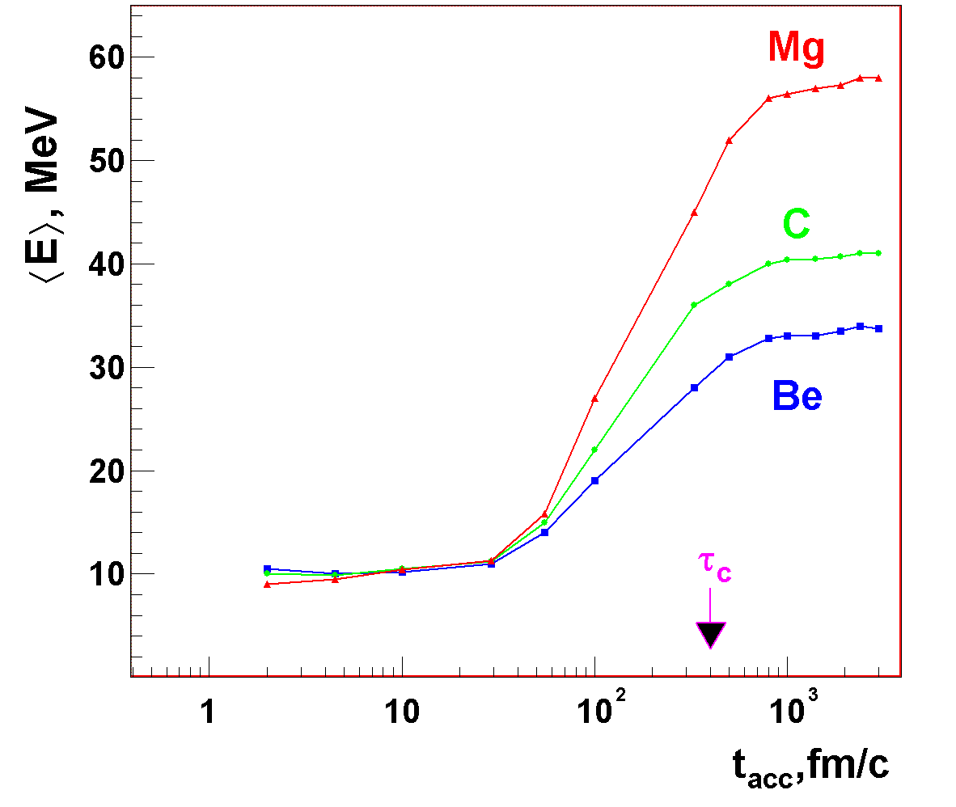
<E>=f(t_{acc})

Slide 12
The definition of two-fragment relative angle correlation function:
1 + R(Θ_{rel}) = C*N_{corr}(Θ_{rel})/N_{uncorr}(Θ_{rel})
where
N_{corr}(Θ_{rel}) is the measured coincidence yield.
N_{uncorr}(Θ_{rel}) is the uncorrelated yield constructed by mixing events.

Slide 13
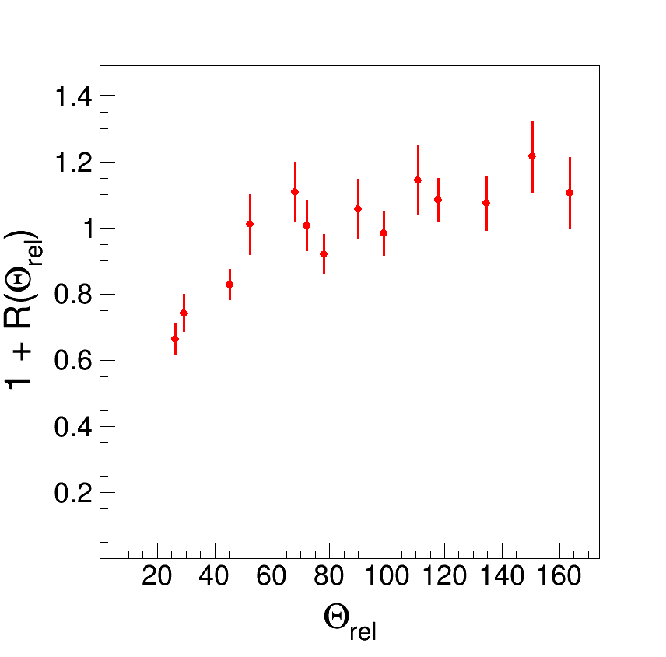
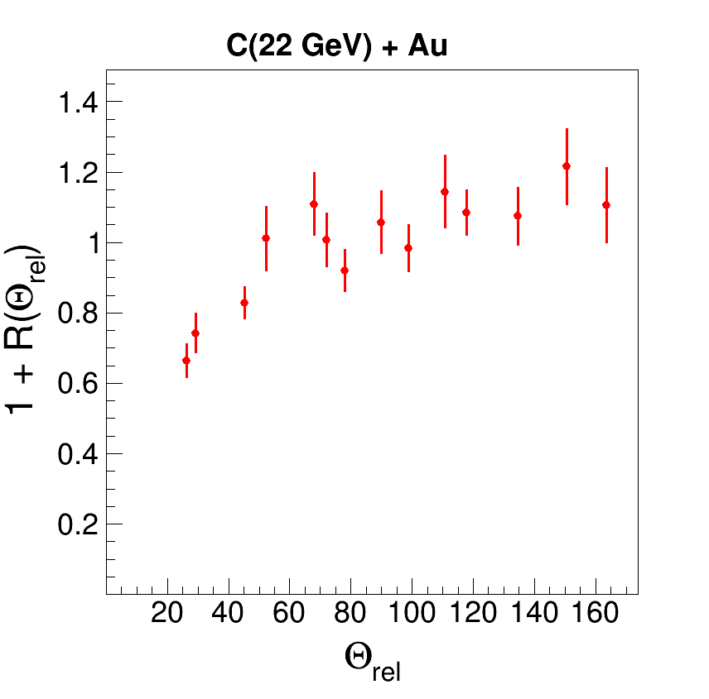
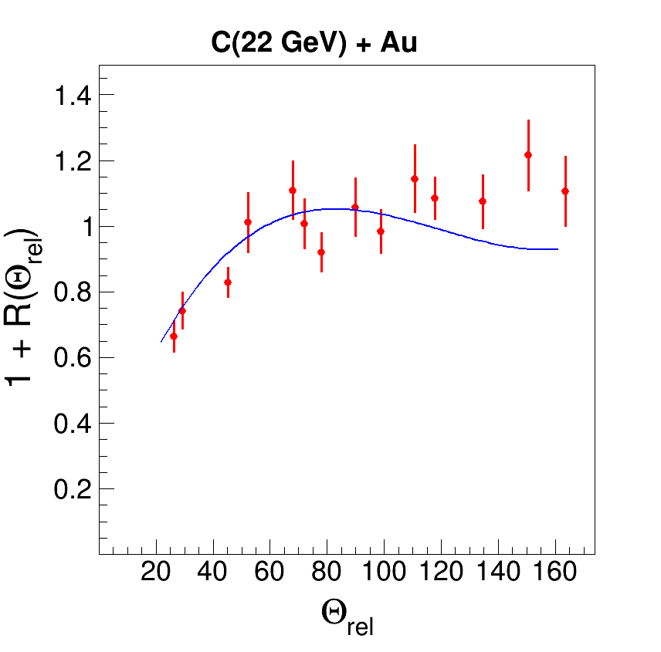
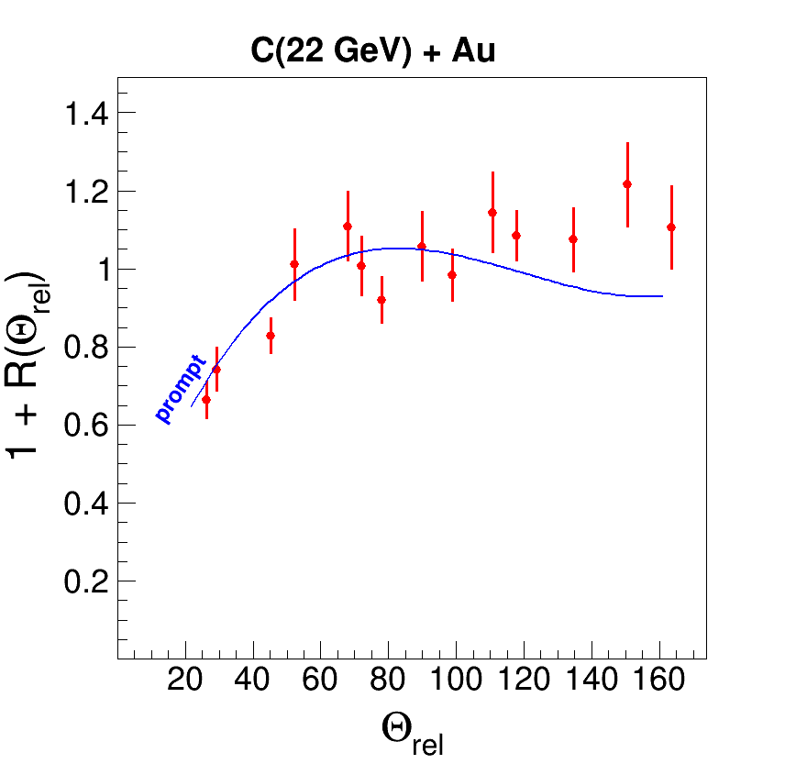
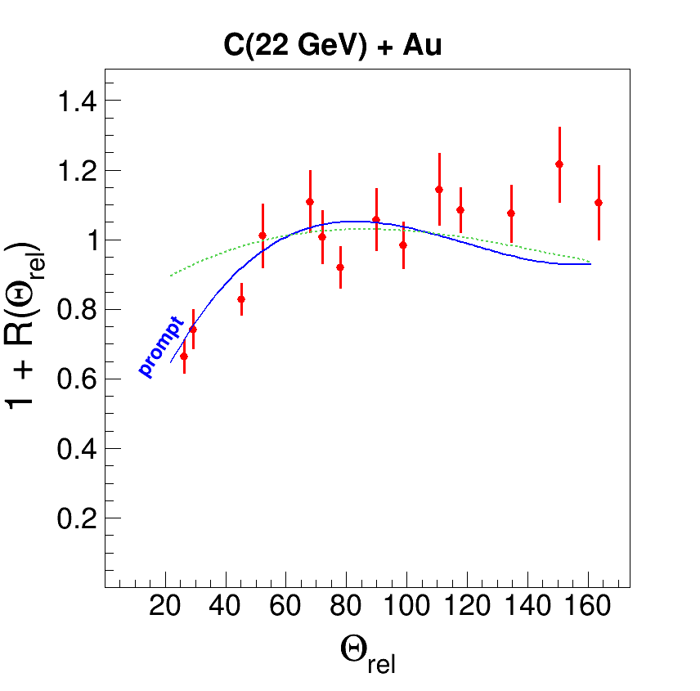
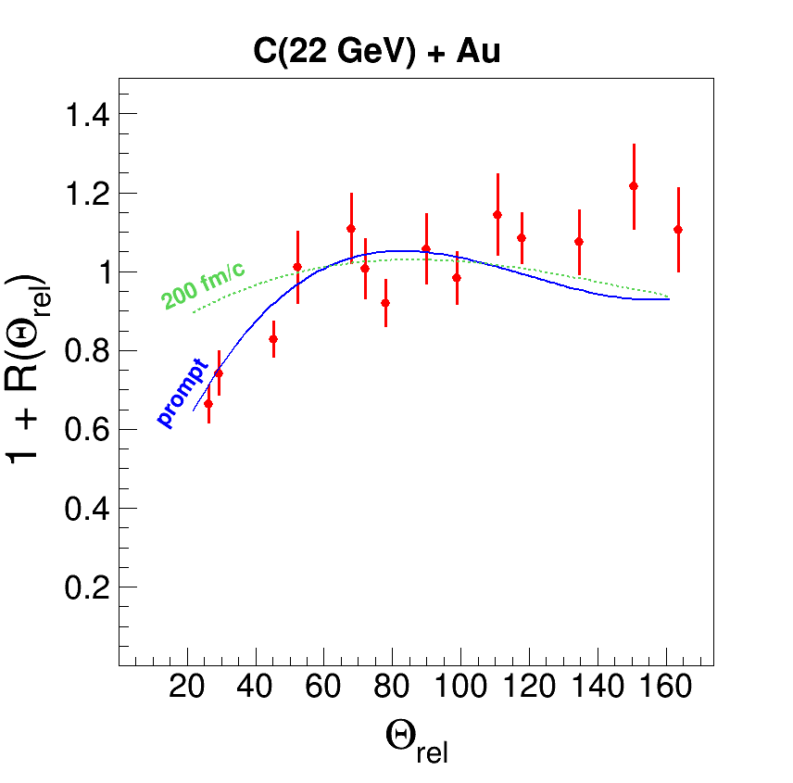

Slide 14
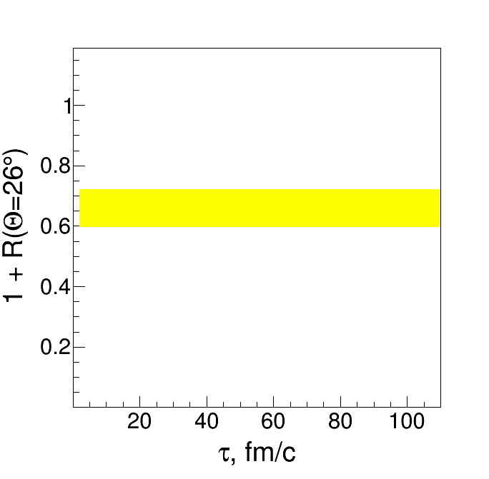
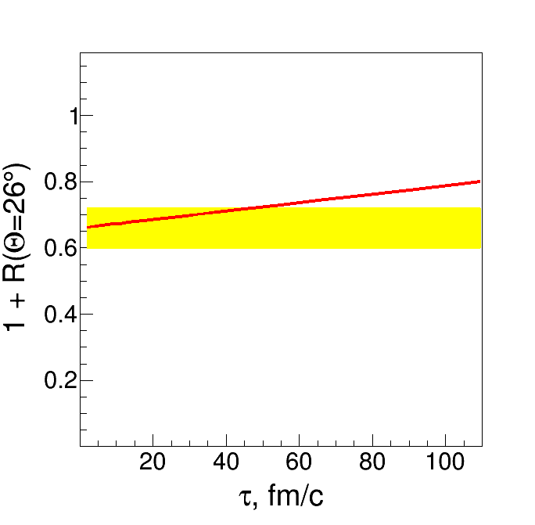
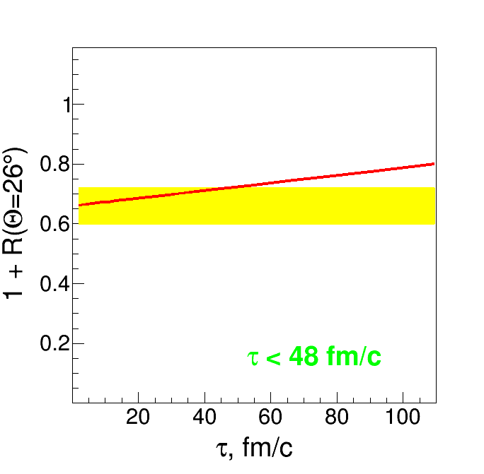
C(22 GeV) + Au

Slide 15
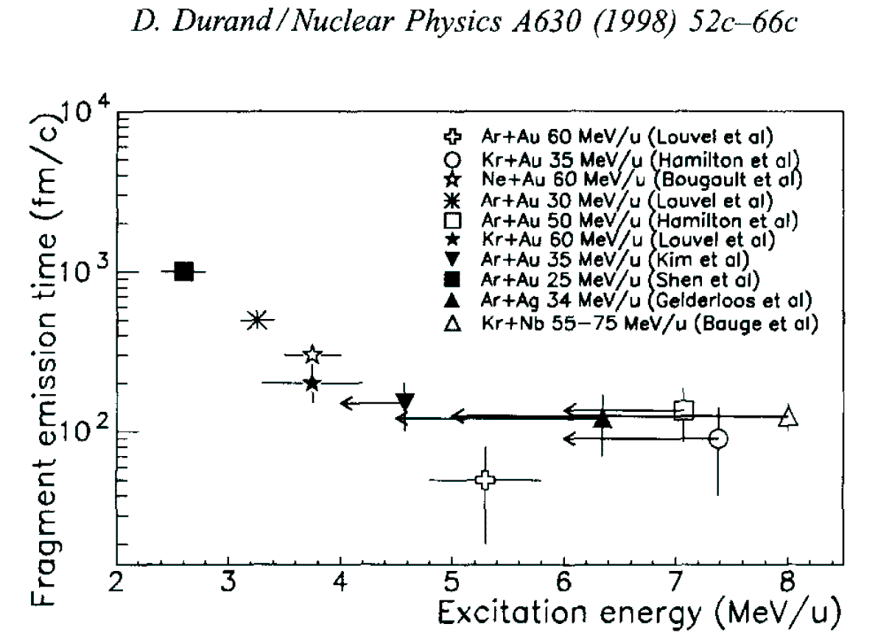
Notes:
заметка 3

Slide 16
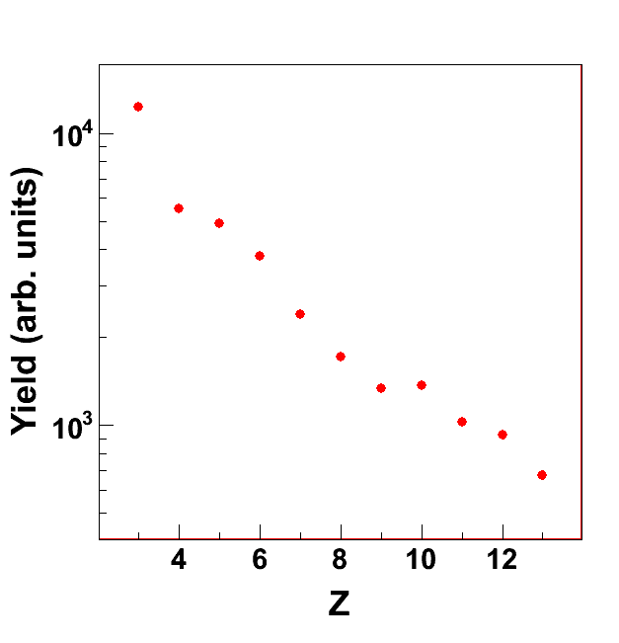
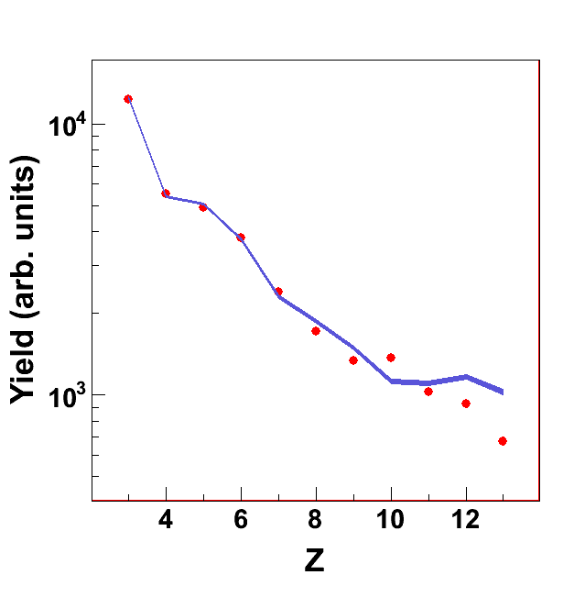
d(4.4 GeV) + Au

Slide 17
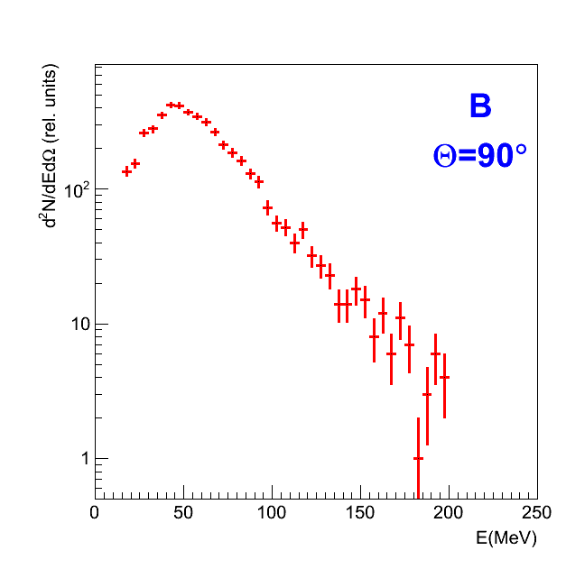
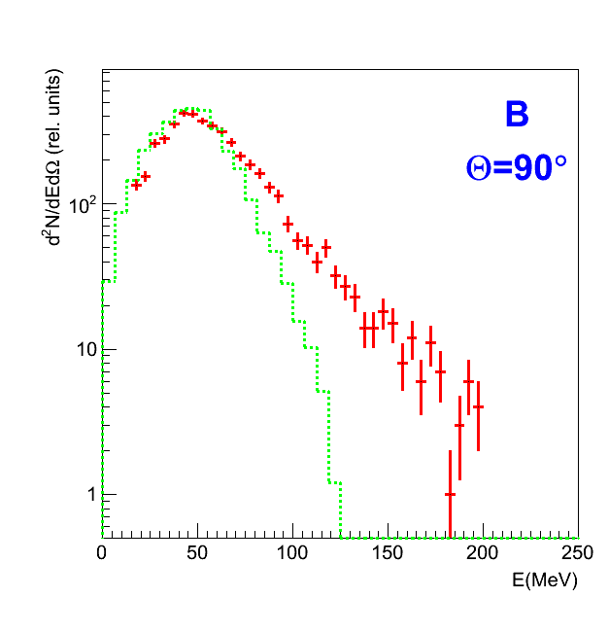
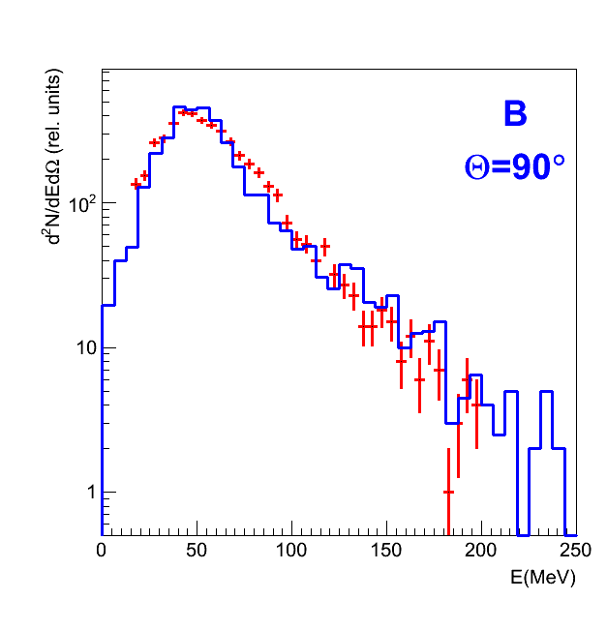
d(4.4 GeV) + Au

Slide 18
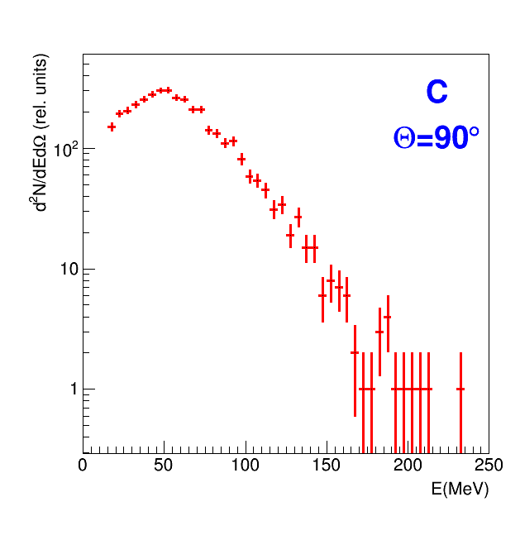
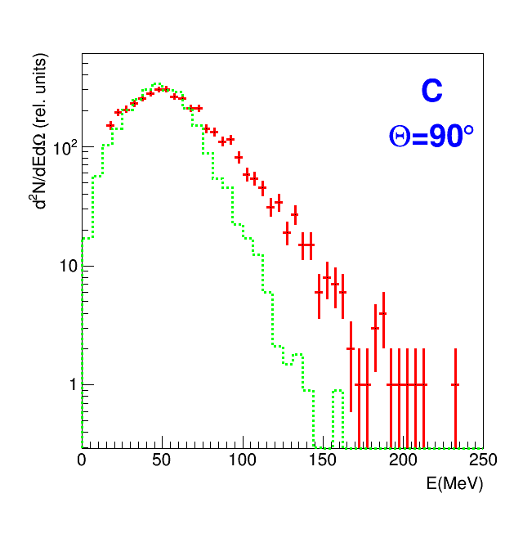
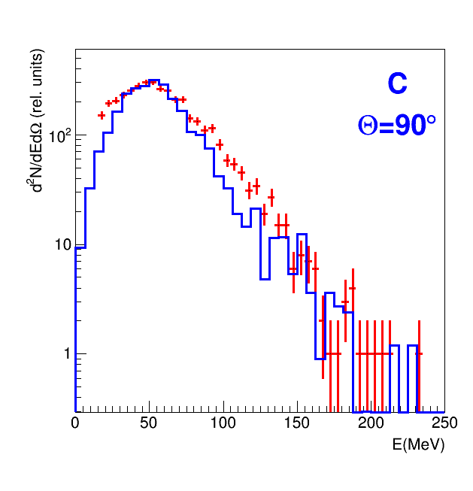
d(4.4 GeV) + Au

Slide 19
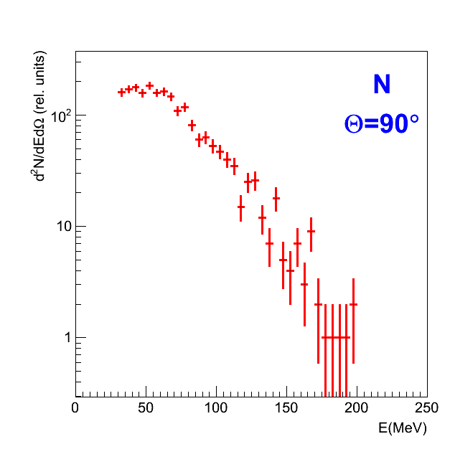
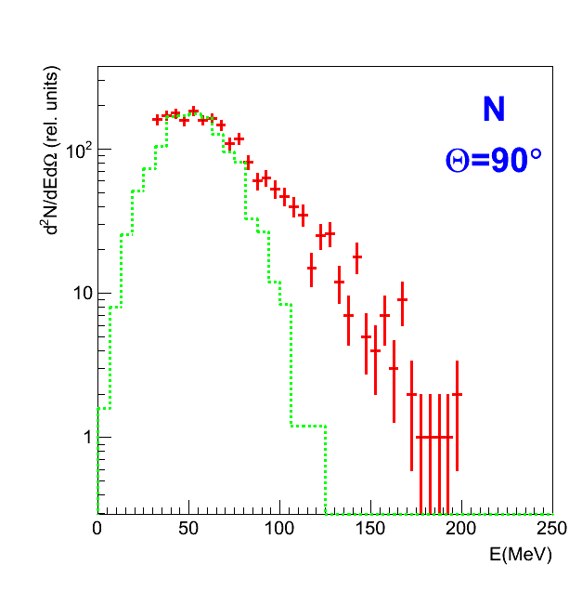
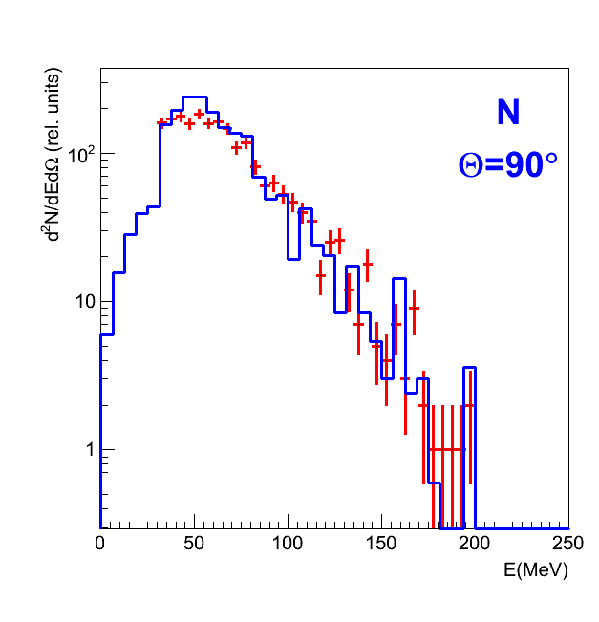
d(4.4 GeV) + Au
without flow

Slide 20
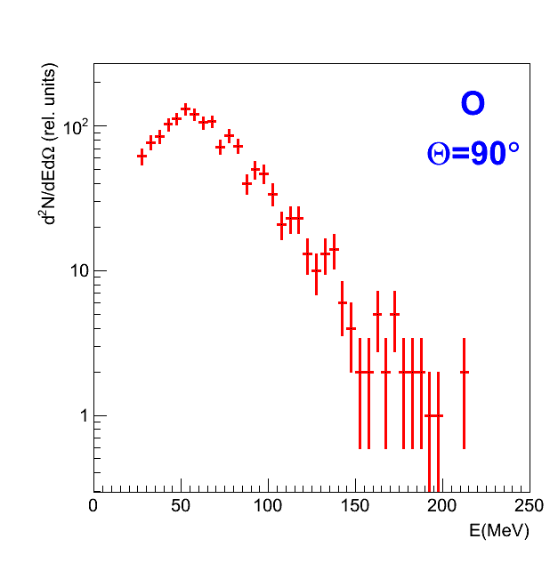
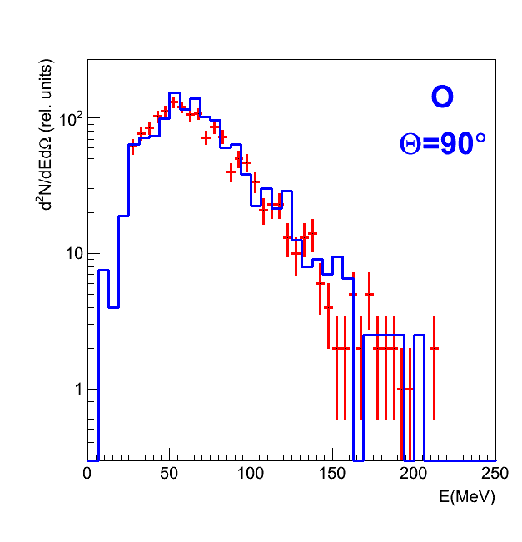
d(4.4 GeV) + Au
without flow

Slide 21
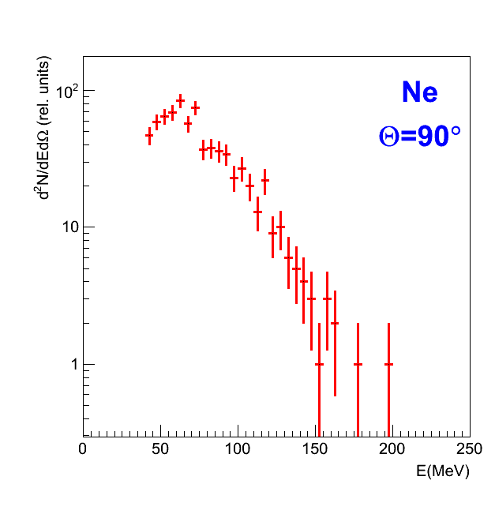
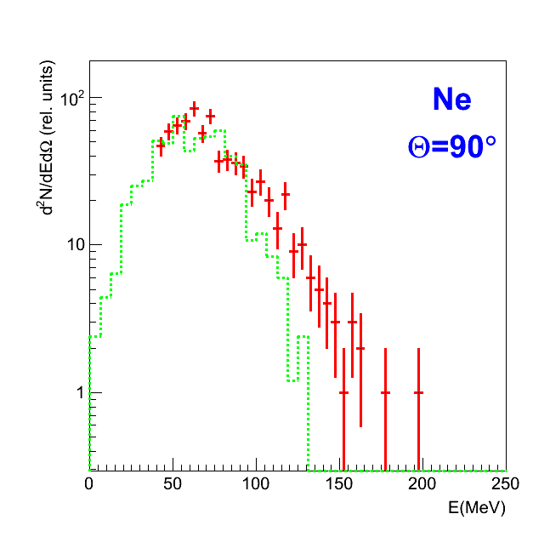
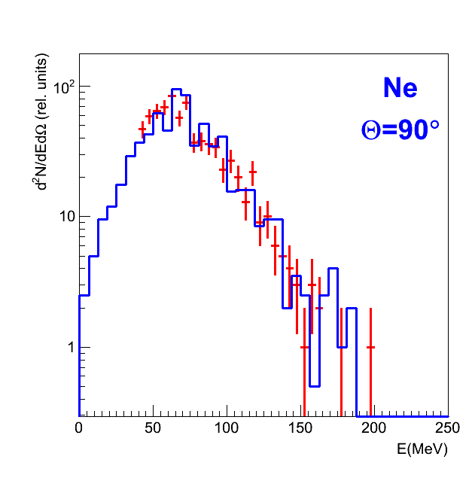
d(4.4 GeV) + Au
without flow

Slide 22
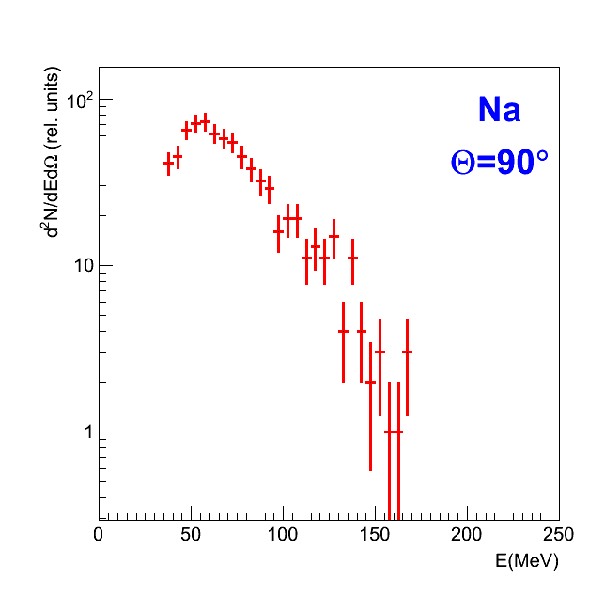
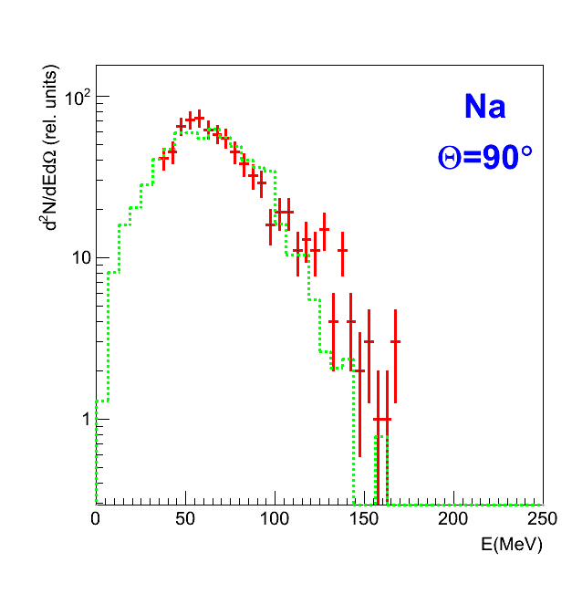
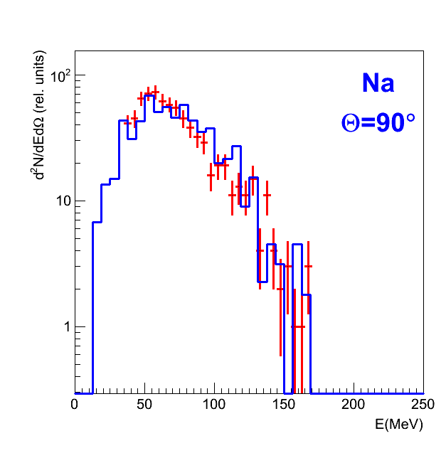
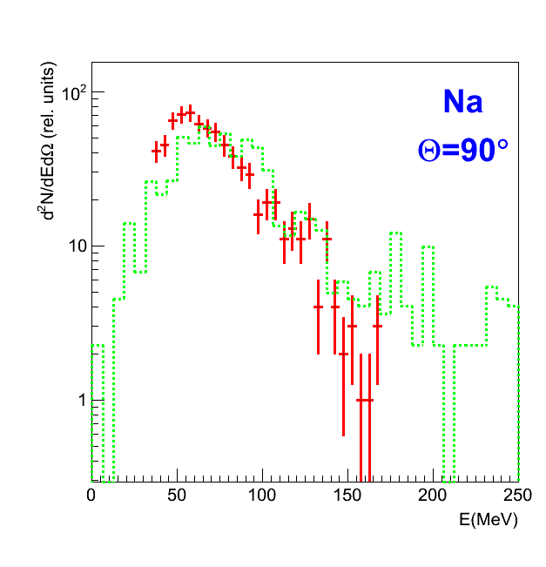
d(4.4 GeV) + Au
without flow

Slide 23
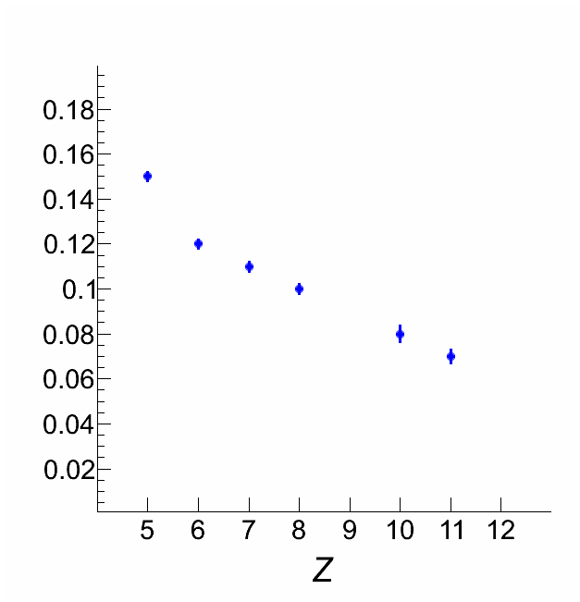
d(4.4 GeV) + Au

Slide 24
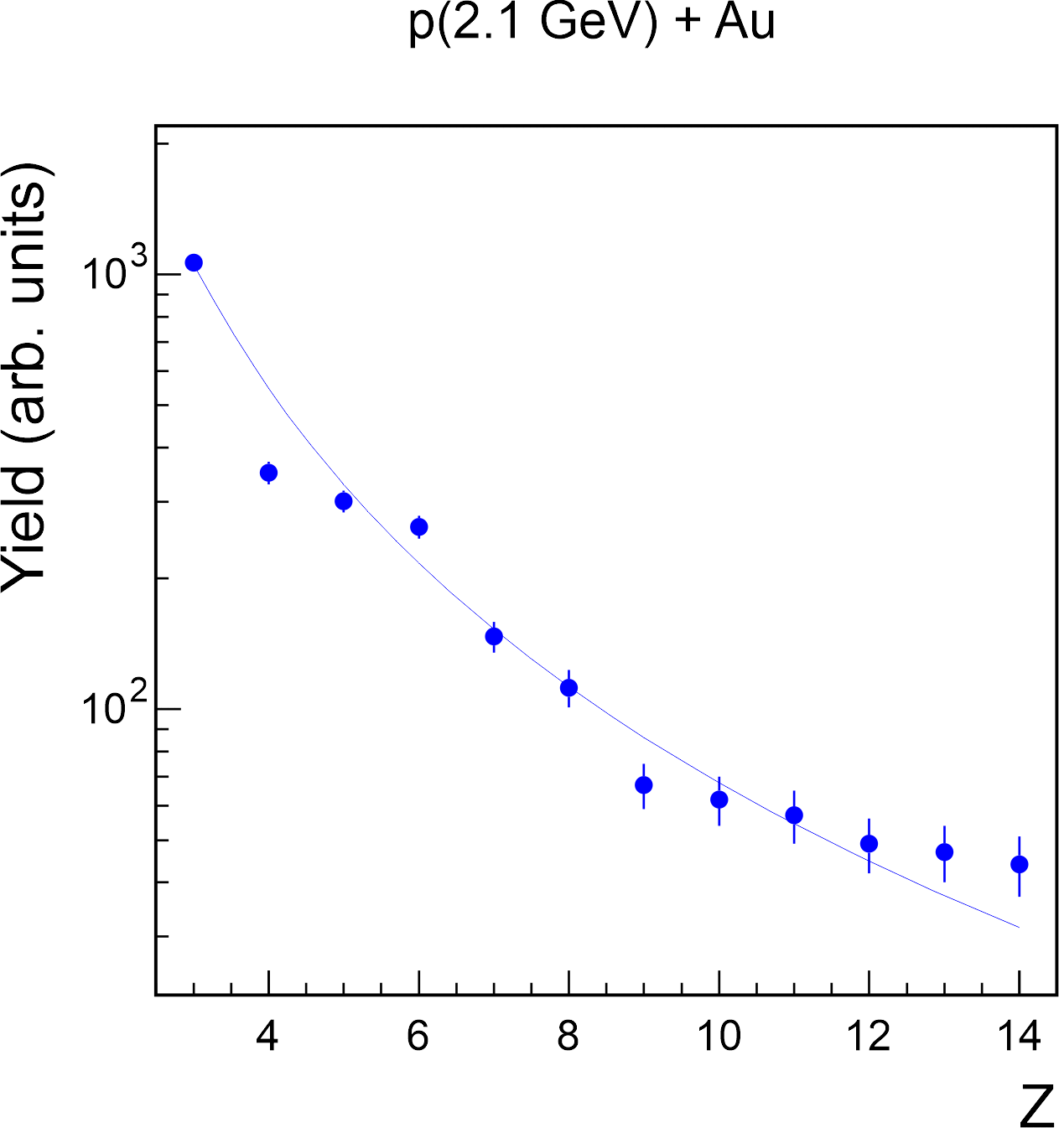
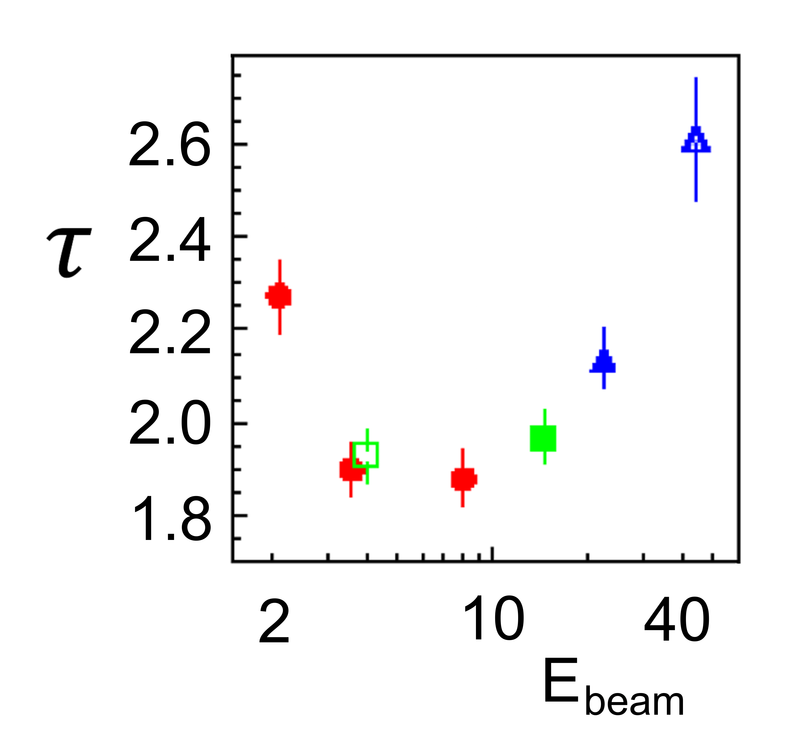

Slide 25
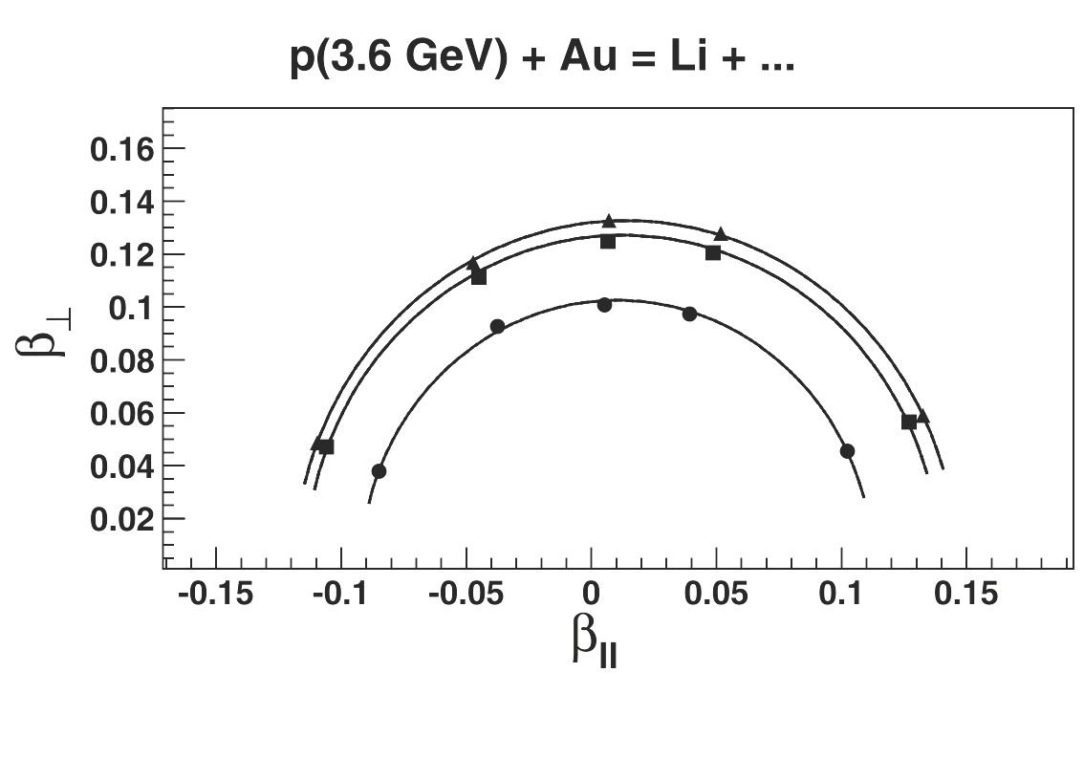

Slide 26
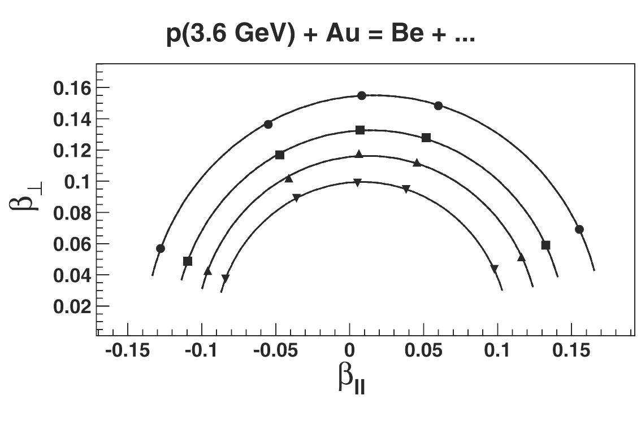

Slide 27
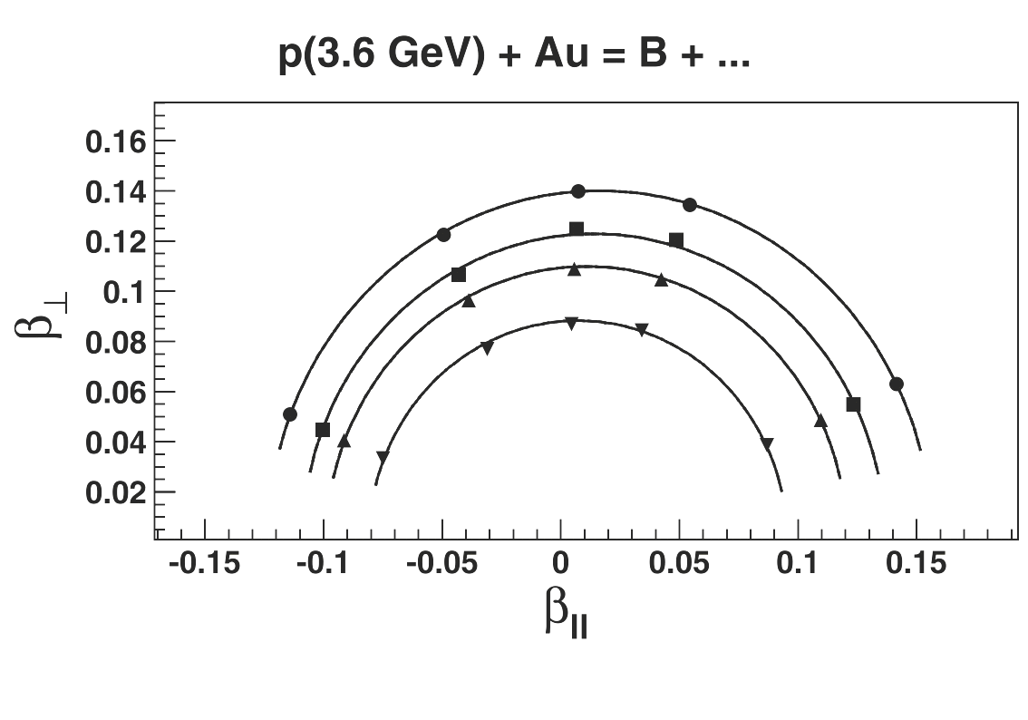

Slide 32
Conclusion
1. C(22 GeV) + Au
It was found a good agreement of measured and calculated correlation function for prompt breakup which is in accordance with the scenario of a simultaneous multibody decay of a hot and expanded nuclear system.
2. d(4.4 GeV) + Au
Good agreement was obtained between the measured and calculated kinetic energy spectra in the presence of a radial flow.
Heavier fragments are mainly born closer to the center of the system, indicating an inhomogeneous density distribution in highly excited nuclei.
3. p(3.6 GeV) + Au
“Kinetic equilibrium” of the system is achieved before fragmentation.
Notes:
32
заметка 3

