Slide 1
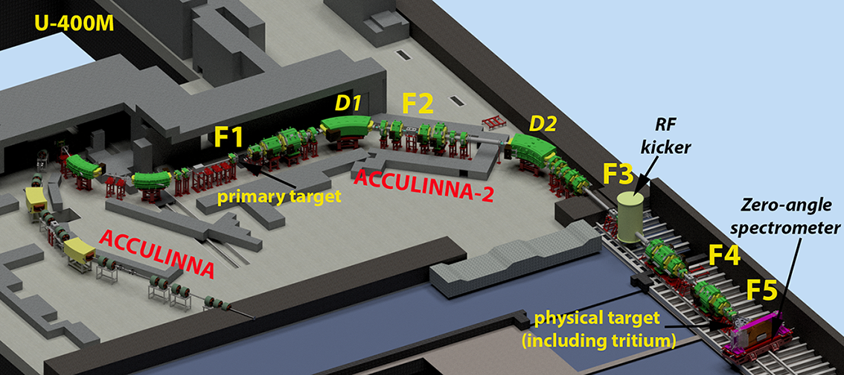
Реакции передачи на пучках ⁶He, ^{10,12}Be на комплексе АКУЛИНА-2@У-400М
Андрей Безбах
Flerov Laboratory of Nuclear Reactions
Joint Institute
for Nuclear Research, Dubna

Slide 2
Программа ПНР (2024-2025)
Отладка работы подсистем АКУЛИНА-2: производящая мишень - Be, щели, ToF, мониторирование пучка, криомишени - ⁴He, D₂, детекторные системы, DAQ)
Измерение выходов радиоактивных пучков ^{6,8}He, ^{10,12}Be, в реакциях фрагментации ¹⁵N (51 AMeV) и ¹⁸О(49 AMeV) на бериллиевой мишени (толщина 2 мм) в широком диапазоне энергий (E ~ 25 ÷ 55 AMeV) (отв. С.А. Крупко)
Тестовая реакции ⁴He(⁶He,⁶He)⁴He при E(⁶He) ~ 32 AMeV на пути к опыту ⁴He(⁸He,⁸He)⁴He (отв. А.С. Фомичев)
Исследование альфа-кластерной структуры основного состояния ^{10,12}Be в реакциях передачи (d,⁶Li) (отв. М.С. Головков)
Исследование кластерной структуры возбужденных состояний Be в реакции ⁶He(⁶Li,d)¹⁰Be в обратной кинематике (отв. М.С. Головков)
Измерение угловых распределений распада низколежайщих состояний изотопа ⁷Не заселяемых в реакции ⁶Не(d,p) (отв. А.А. Безбах)

Slide 3
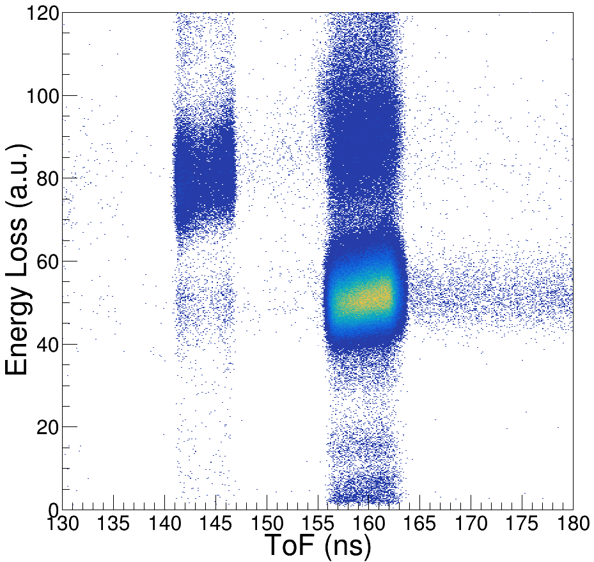
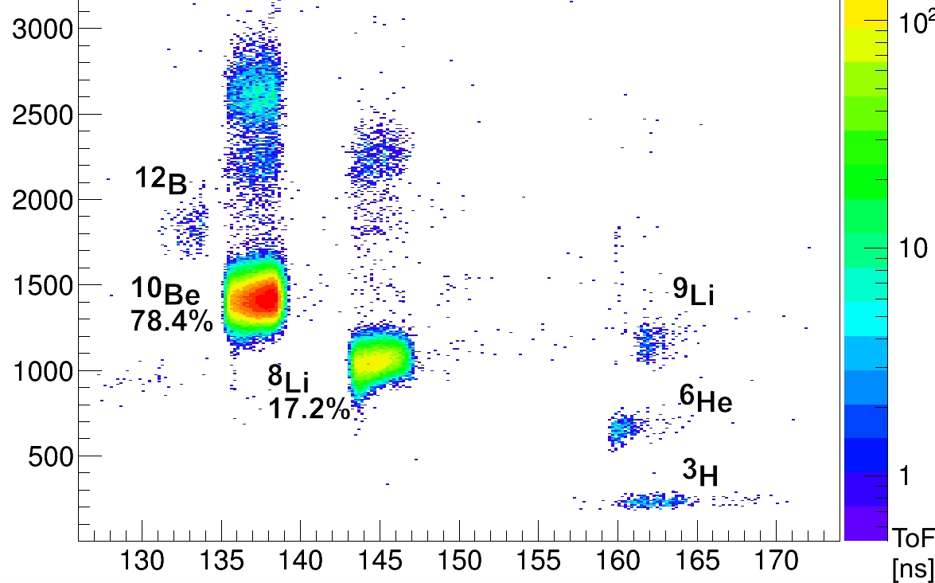
Измерение выходов пучков ¹⁵N&¹⁸O + Be(2 mm) →^{6,8}He, ¹²Be
RI | 2025
 | Y, pps | P, %
⁶He(¹⁵N) | 1.8*10⁶ | 95
⁸He(¹⁵N) | 2.5*10⁴ | 90
⁸He(¹⁸O) | 5.2*10⁴ | 95
¹²Be(¹⁵N) | 6*10⁴ | 85
¹²Be(¹⁸O) | 2.3*10⁵ | 94
¹⁴Be(¹⁸O) | 1.4*10³ | 20
HI | 2020 |  | 2025
 | E, AMeV | I, pμA | E, AMeV | I, pμA
⁷Li | 35 | 5 | 39 | 10
¹¹B | 33 | 3 | 34 | 7
¹⁵N | 47 | 0.5 | 51 | 2
¹⁸O | 36 | 0.5 | 49 | 1.3
^{20,22}Ne | 53 / 45 | 0.3 | 54 / 50 | 1
^{32,36}S | 51 / 40 | 0.2 | 52 / 44 | 0.2
Экспериментальные данные подтверждают расчётные значения
⁹Li
⁸Li
⁶He
~92%
⁸He
~94.5%
³H

Slide 4
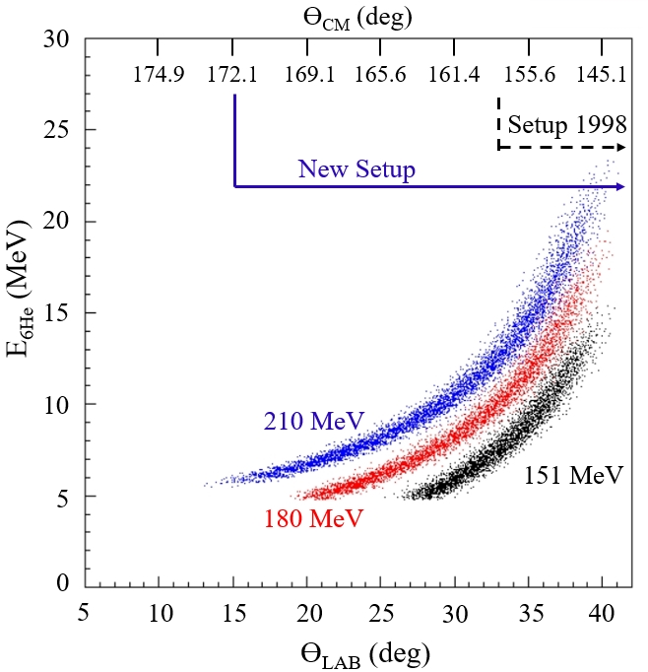
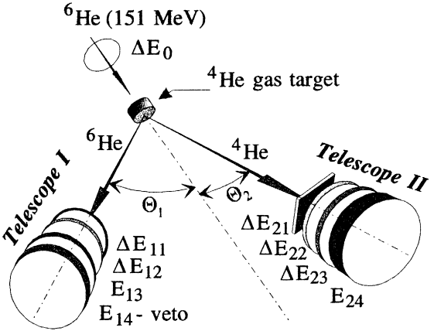
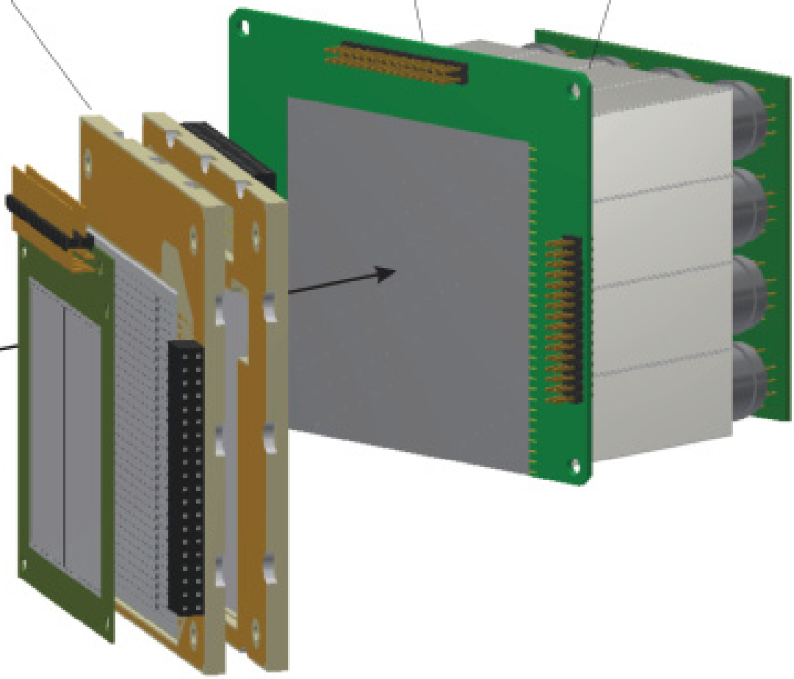
⁴He(⁶He,⁶He)⁴He at 32 AMeV: отладка аппаратуры, подготовка к ⁴He(⁸He,⁸He)⁴He
⁶He beam: I ~ 10⁵ s⁻¹ (6.5 mm beam spot, no tracking)
⁴He target: ~ 7.5*10²⁰ cm⁻² (5 atm @ 78K, 16 mm thick)
Detectors: two units with ~ 75 msr solid angle,
ΔE – Si 30 mkm (16 mm in diameter)
⁶He beam: I ≤ 3*10⁵ s⁻¹ (X,Y) ~ 1.5 mm, dE/E ~ 0.2 %
⁴He target: ~ 7.3*10²⁰ cm⁻² (2 atm @ 12K, 6 mm thick)
Detectors: two units ~ 200 msr solid angle,
ΔE – Si 25 mkm (50x50 mm, 16 strips)
<= f ~ 10 =>
T2:
DSSD ΔE 1.5 mm
4x4 CsI(Tl) E 50 mm
⁶He
⁴He
⁴He
⁶He
T1:
SSD ΔE 25 µm
SSD E 1000 µm
SSD E 300 µm
G.M. Ter-Akopian et al.,
Phys. Lett. B 426 (1998) 251.
Yu.Ts. Oganessian et al.,
Phys. Rev. C. 60 (1999) 044605.
L1 / ϴ₁ = 12 cm / 26⁰±12⁰
L2 / ϴ₂ = 30 cm / 10⁰±6⁰

Slide 5
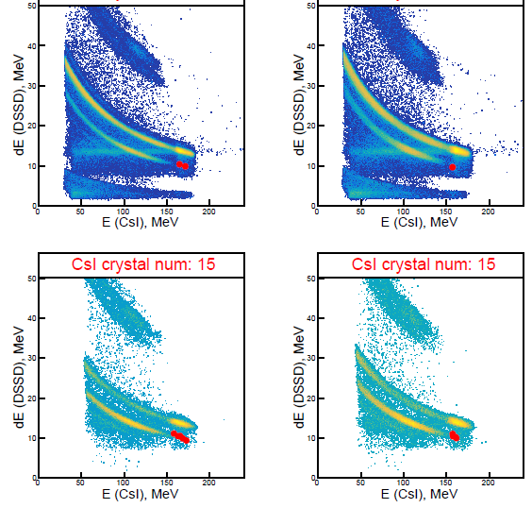
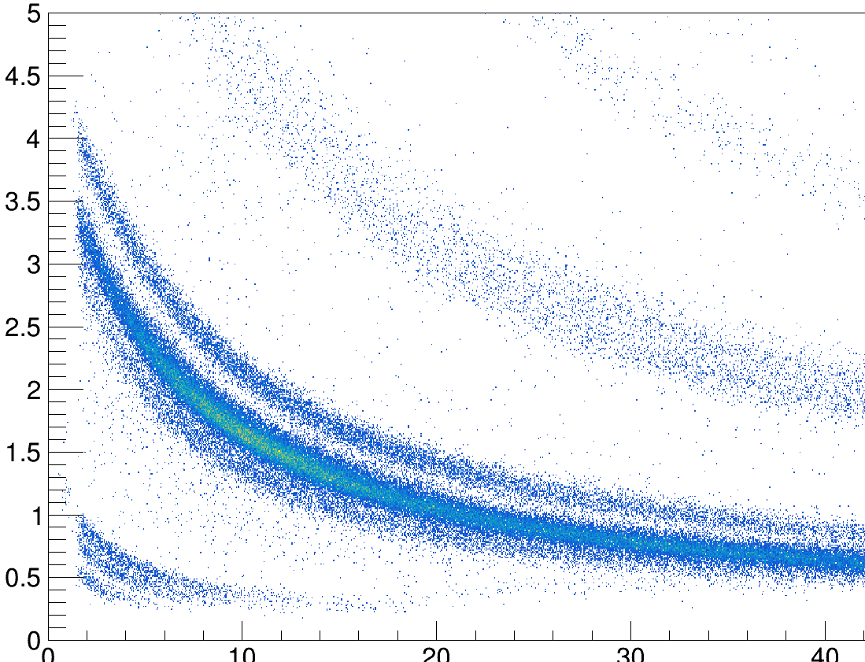
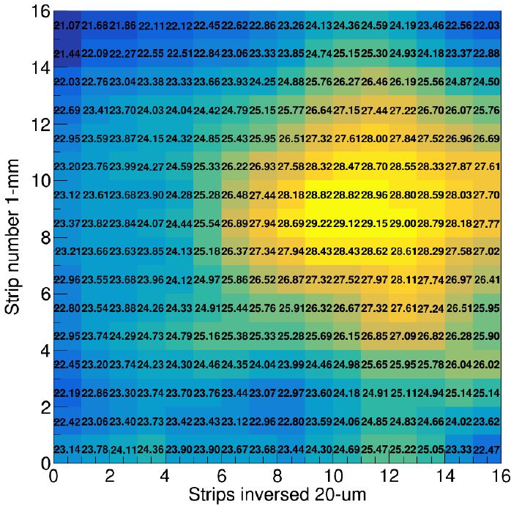
Предварительные результаты ⁴He(⁶He,⁶He_{g.s.})⁴He
23 / 1 совпадений ⁴He(fast) - ⁶He(slow)
Интеграл ⁶He = 2.49 / 1.27 * 10¹⁰ (эффект / фон)
DSSD ΔE 1.5 mm
4x4 CsI(Tl) E 50 mm
⁴He
⁶Hе
⁴He
⁶He
SSD ΔE 25 µm
SSD E 1000 µm
SSD E 300 µm
ΔE, MeV
(23÷29µ)
⁶He
⁴He
³He
p,d,t
E, MeV

Slide 6
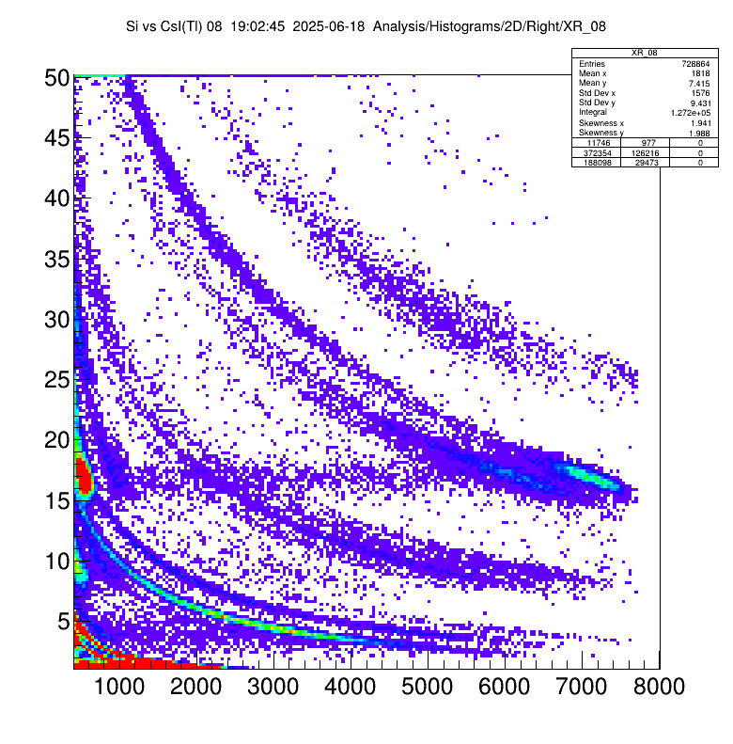
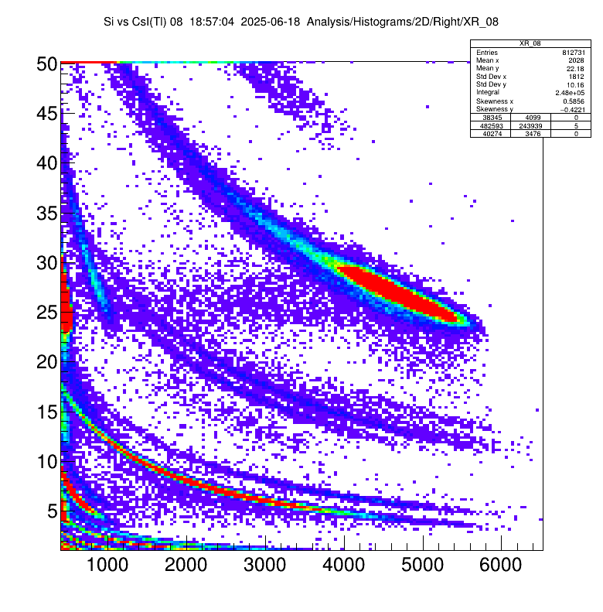
Исследование альфа-кластерной структуры ^{10,12}Be в реакциях передачи (d,⁶Li)
Left telescope
ΔE - DSSD_300 µm
E - 3x3 LYSO_30 mm
Cryogenic D₂ gas target
^{10,12}Be beam
Be
E_{10Be} ≈ 34 MeV A
Li
He
Right telescope
ΔE - DSSD_300 µm
E - 4x4 CsI(Tl)_50 mm
Be
Li
He

Slide 7
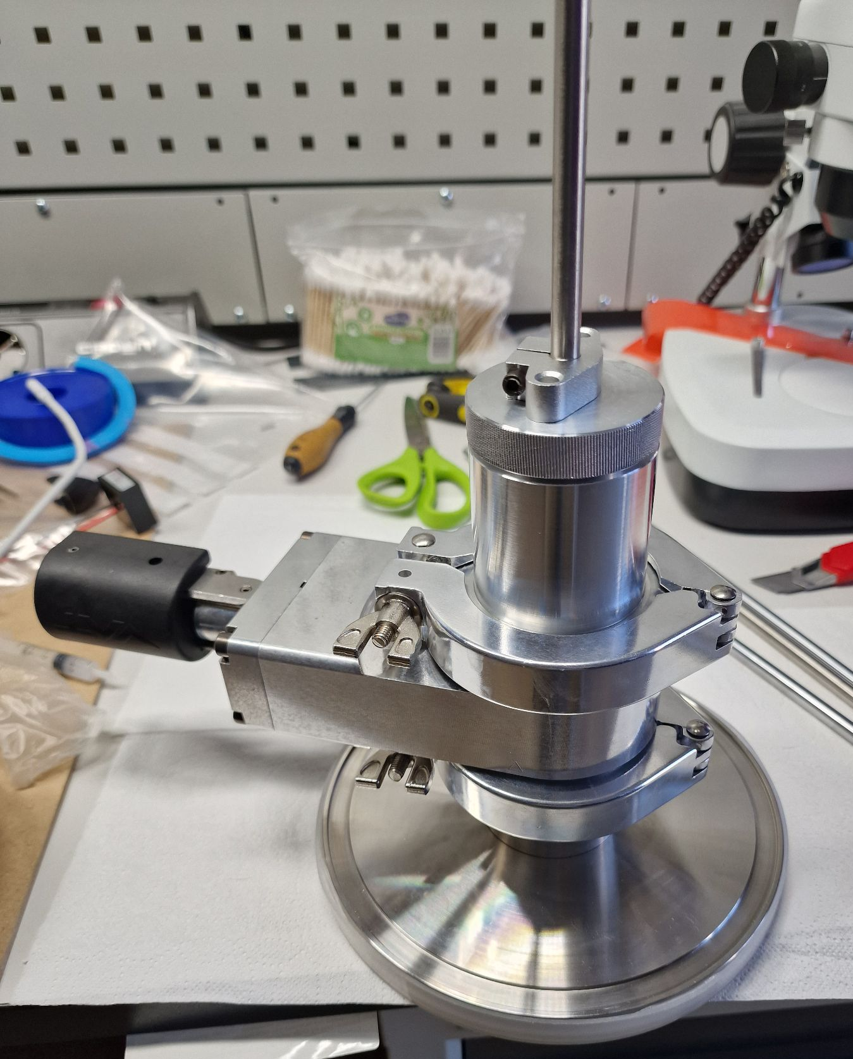
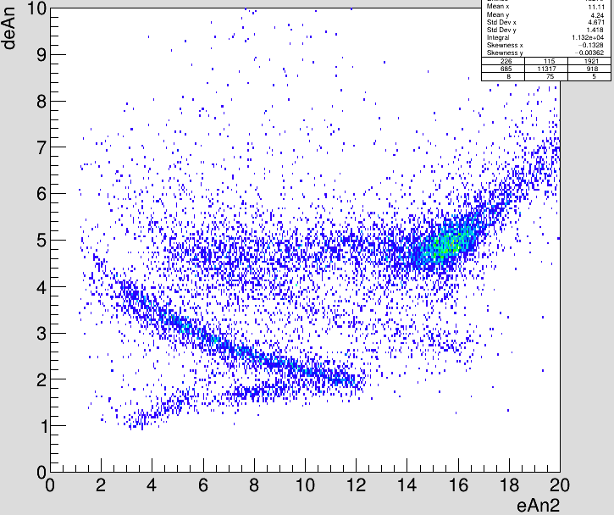
Исследование кластерной структуры возбужденных состояний Be в реакции ⁶He(⁶Li,d)¹⁰Be
Anular telescope
SSD_1 mm (veto)
DSSD_1 mm
DSSD_1 mm
Central telescope
ΔE - SSD_140 µm
ToF (plastic scintillator)
⁶Li target
⁶He beam
E_{6He} ≈ 30 MeV A
¹⁰Be
or decay products
d
t
⁶He
¹⁰Be*
d
⁶He
p
α
α
⁶Li
d

Slide 8
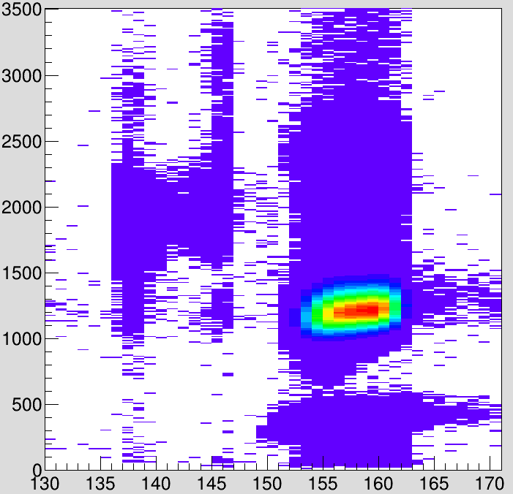
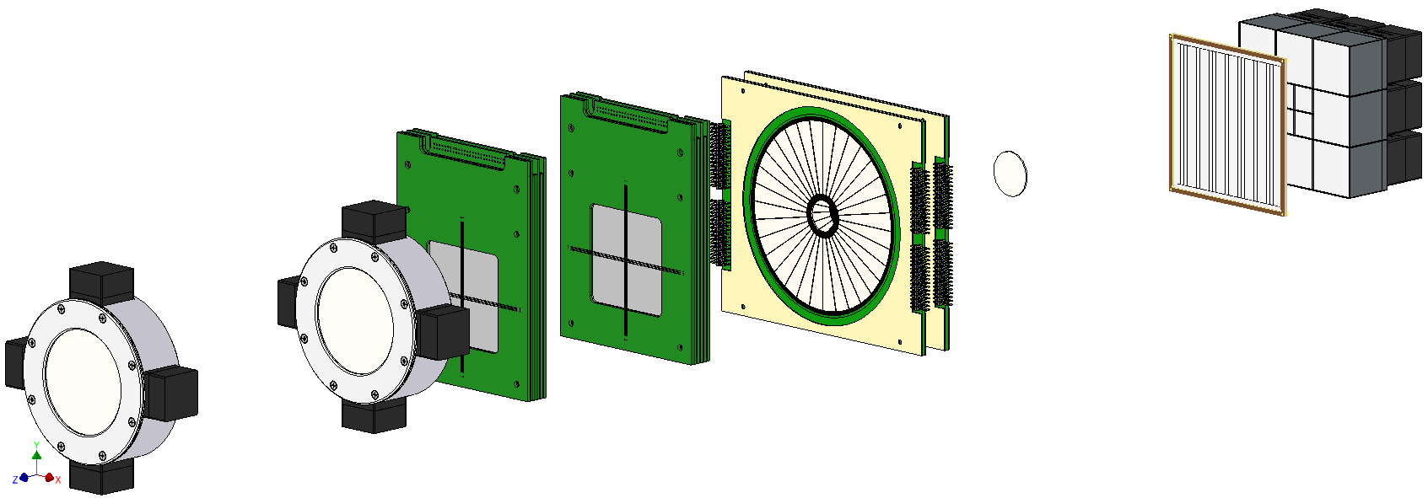
Исследование ⁷Не в реакции ⁶Не(d,p) (2025)
⁶He
M_{nHe,nHe}
⁶He
⁷He
n
n
ΔE (a.u.)
d
p
⁶He (~94%)
M_{d,pn}
MWPC-2
Cryogenic D₂ gas target
MWPC-1
ToF (ns)
^{4,6}Нe
ToF_F5
ToF_F3
p
Central telescope
ΔE_DSSD_1.5 mm
E_12 LYSO(Ce)_30 mm
p_telescope
DSSD _1 mm
SSD _1 mm
SSD (veto) _1 mm
⁶Нe
beam
(I~10⁶ 1/s,
E~33 AMeV)

Slide 9
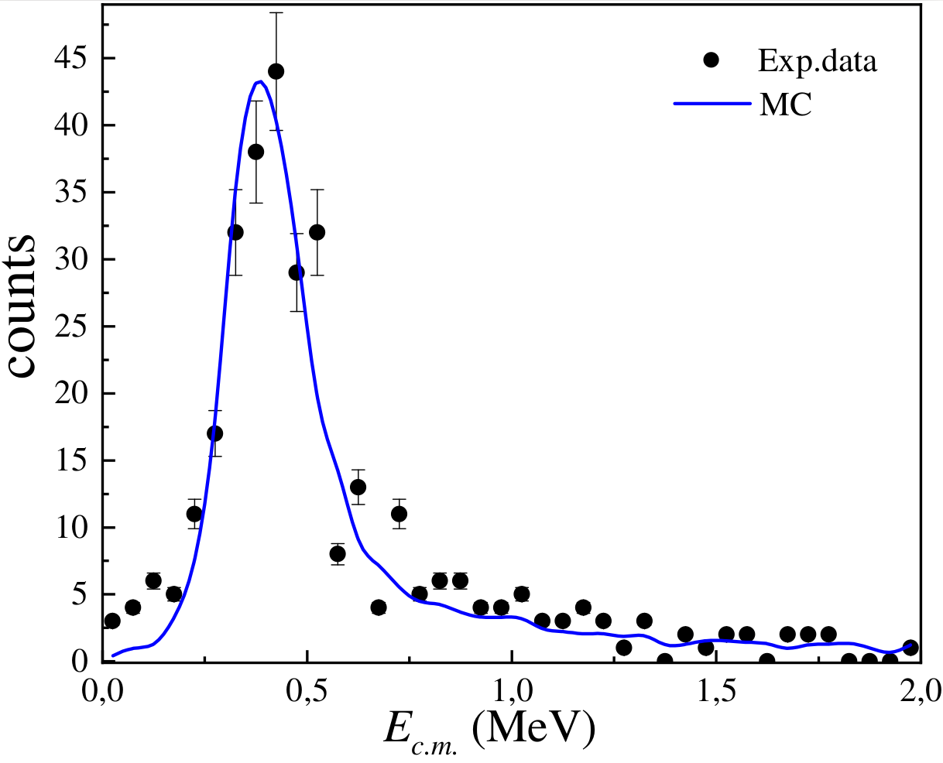
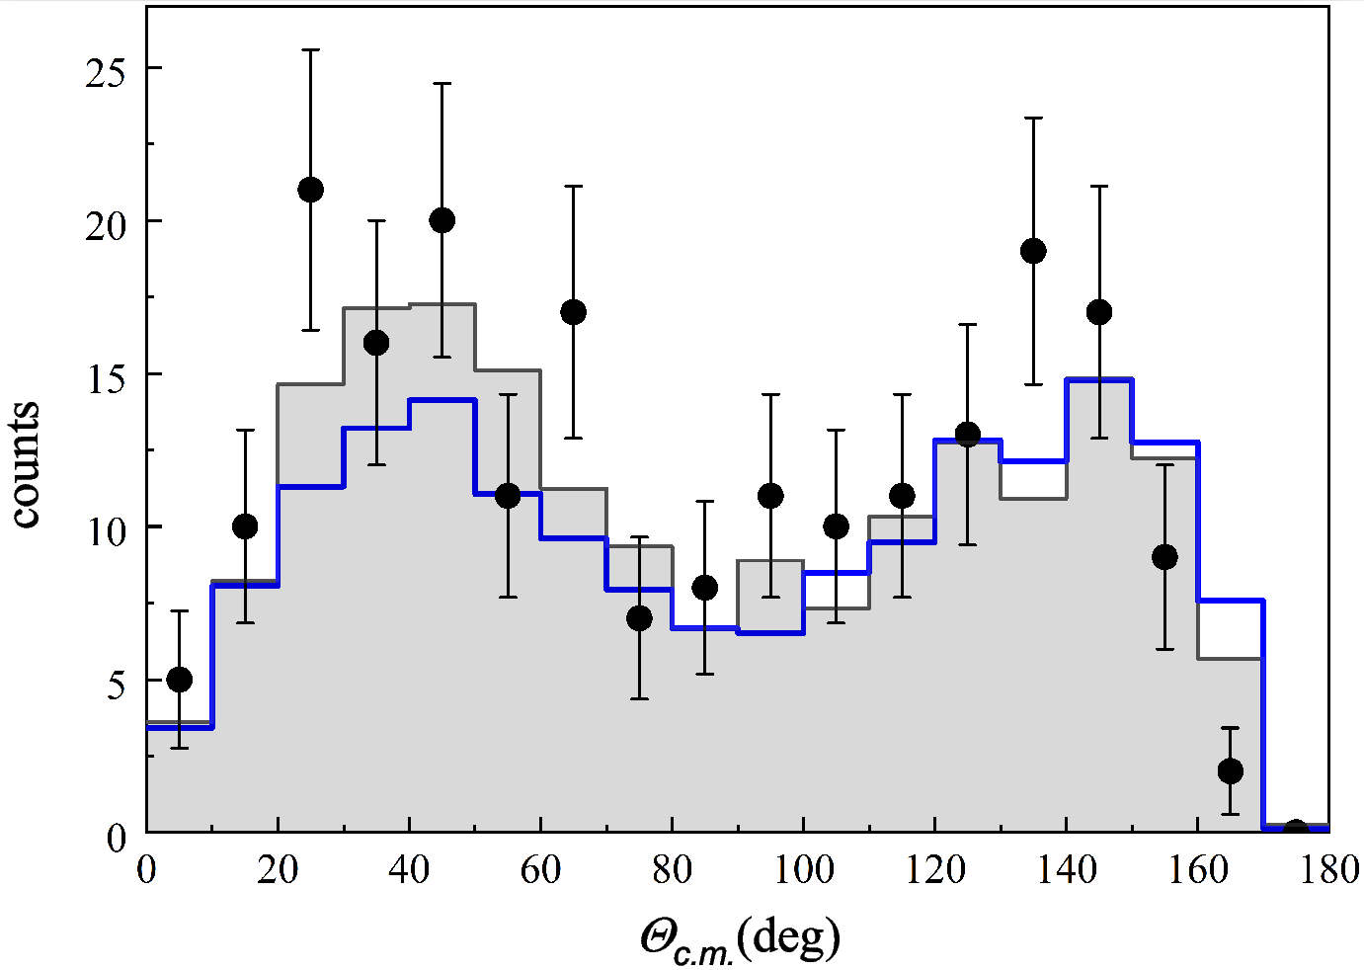
Исследование ⁷Не в реакции ⁶Не(d,p) (2020)
ΔE_{inst} ~ 140 keV
p-⁶He-n
coincidences
⁶He MM spectrum for events with
neutron coincidence
Neutron angular distribution dσ/dθ from the decay
of the ⁷He ground state.
A.A. Bezbakh et al.,
Int. J. Mod. Phys. E 33. (2023) 245002
M.S. Golovkov et al.,
Phys. Rev. C. 109, (2024) L061602
Notes:
The detection of decay neutrons in coincidence with recoil protons provided fully kinematic measurements that allowed record resolution to be achieved for the ground state of 7He.
And in the energy spectrum of 7He in the region of the ground state, a forward-backward asymmetry of the emission of decay neutrons was observed.
By registering neutrons we reconstructed the angular distribution in the c.m.m. An asymmetry was found with respect to the transferred moment, which within the framework of the direct transfer reaction mechanism will always be associated with the interference of waves of different parity. For this nucleus, this has not been observed before.

Slide 10
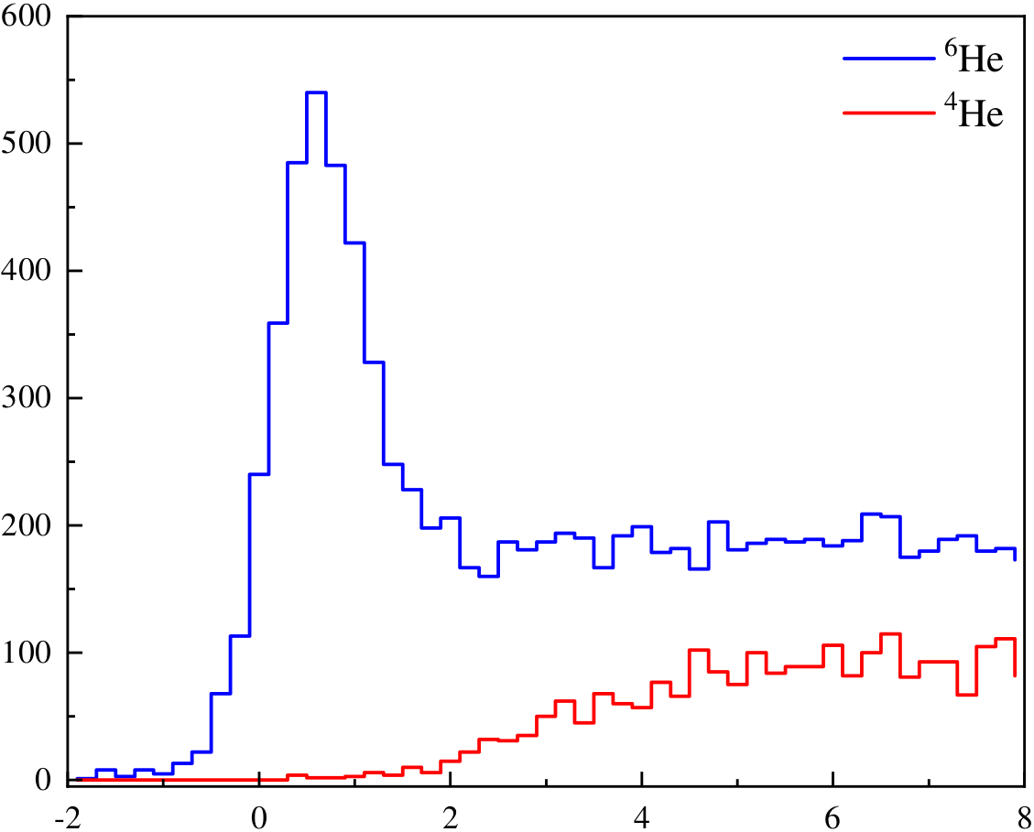
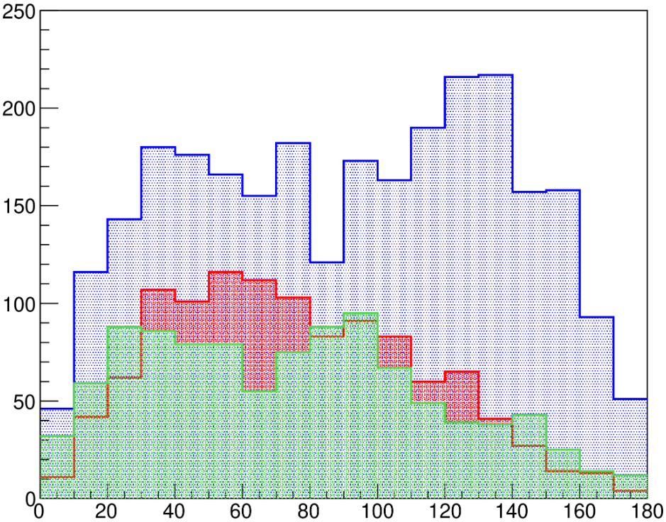
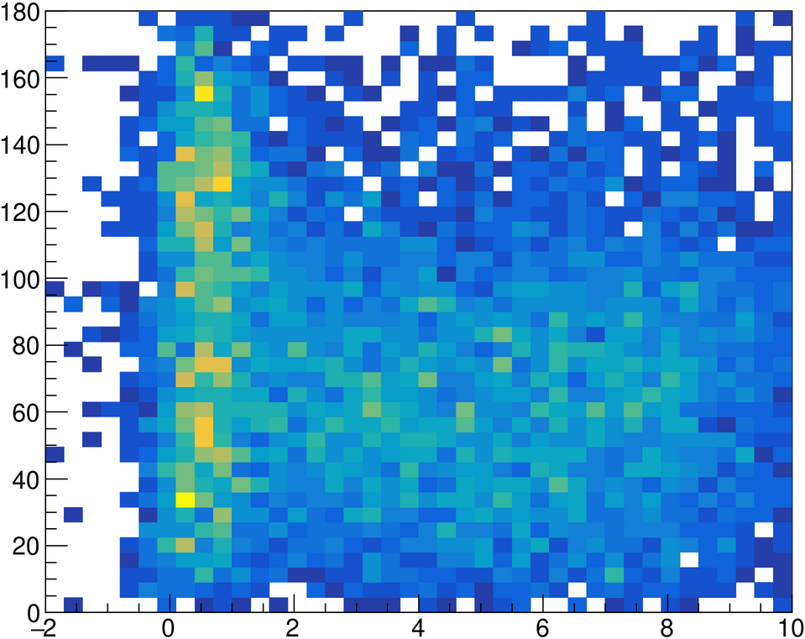
Предварительные результаты эксперимента ⁶Не(d,p)⁷He
0,5±1 МеV
3 ±1 MeV
5 ±1 MeV
counts
E_{ex}(⁷He)(MeV)
Θ_{c.m.}(⁶He)(deg)
Experimental spectrum of the missing mass of ⁷He with separation of decay channels into the ground and excited states of ⁶He
Angular distribution from the decay of ⁷He (g.s., at 3 MeV and 5 MeV)
Θ_{c.m.}(⁶He)(deg)
E_{ex}(⁷He)(MeV)

Slide 11
Спасибо за внимание!

Slide 13
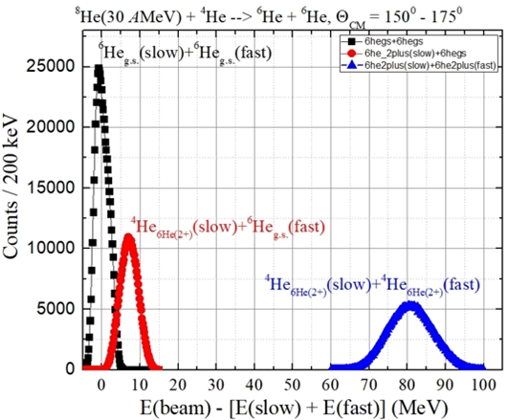
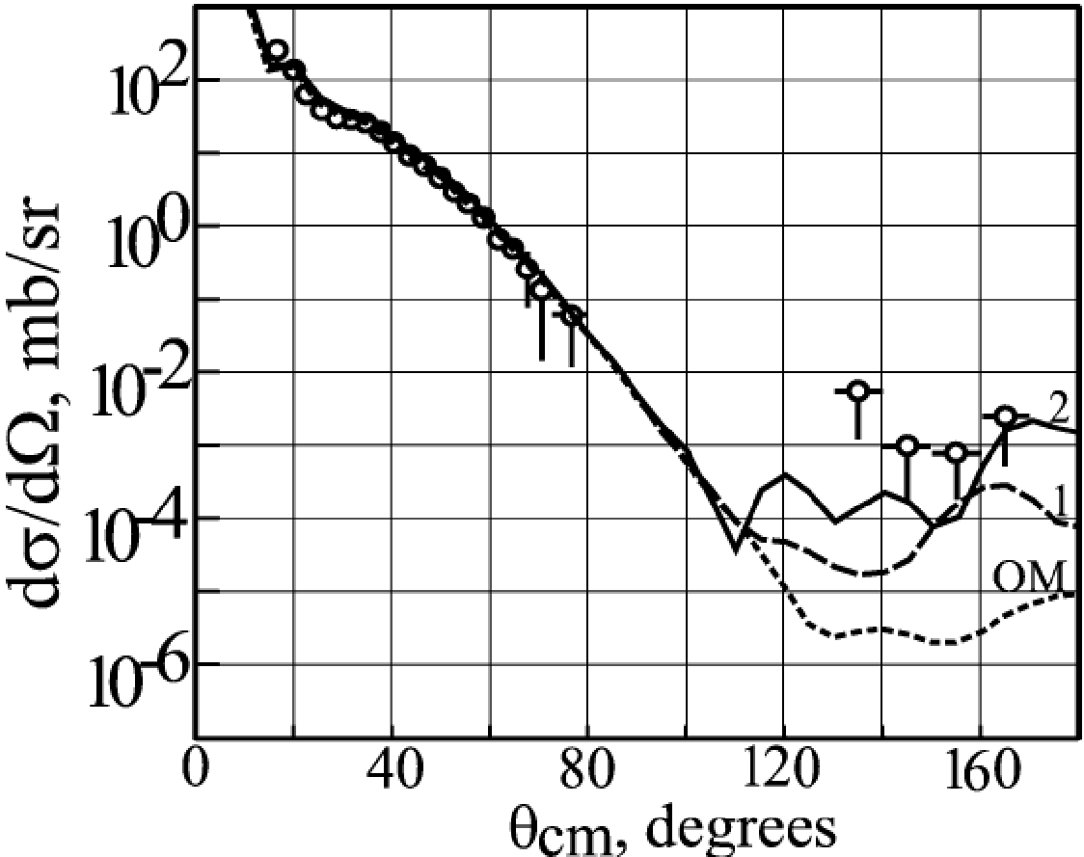
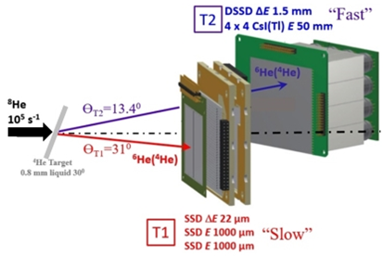
Оценка статистики
⁸He(30 AMeV) + ⁴He → ⁶He(g.s.) + ⁶He(g.s.), ⁶He(g.s.) + ⁶He(2⁺), ⁶He(2⁺) + ⁶He(2⁺)
⁴He(⁸He,⁸He)⁴He
~ 0.1 µb/sr ??
2 - two step ?
1 - one step ?
I(⁸He) ~ 10⁵ 1/s, dσ/dΩ ~ 3 µb/sr, ⁴He ~ 3.5*10²⁰ atom/cm² (12К, 1 атм, 6 мм):
ожидается ~ 1.5 совп./день → 4 недели ¹⁸О (>1 pµA@49 AMeV) / ¹¹B (3 pµA@34 AMeV)

Slide 14
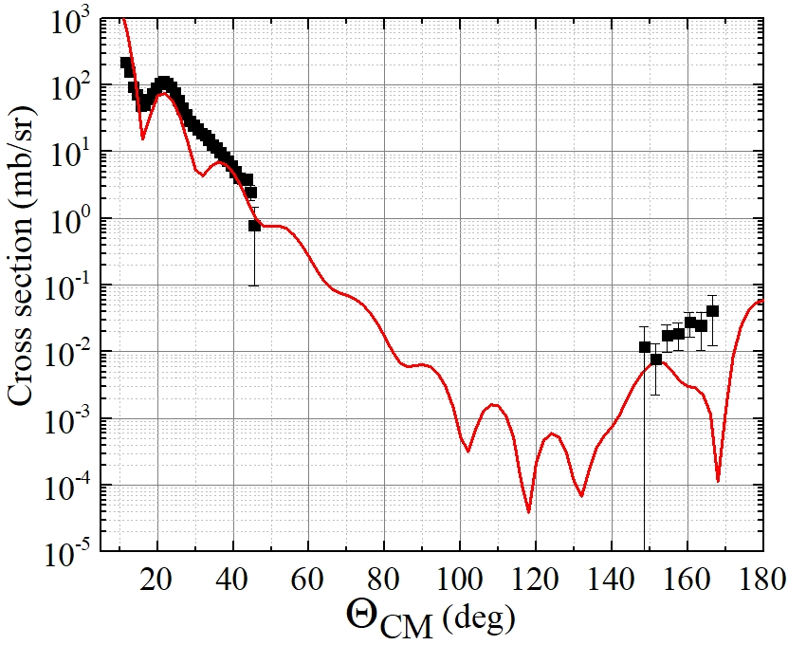
⁴He(⁶He,⁶He_{g.s.})⁴He @ Е(⁶Не)=192 MeV предварительные результаты:
для θ_{CM} ~ 11º ÷ 45º и θ_{CM} ~ 148º ÷ 168º
FRESCO /R. Wolski/

Slide 15
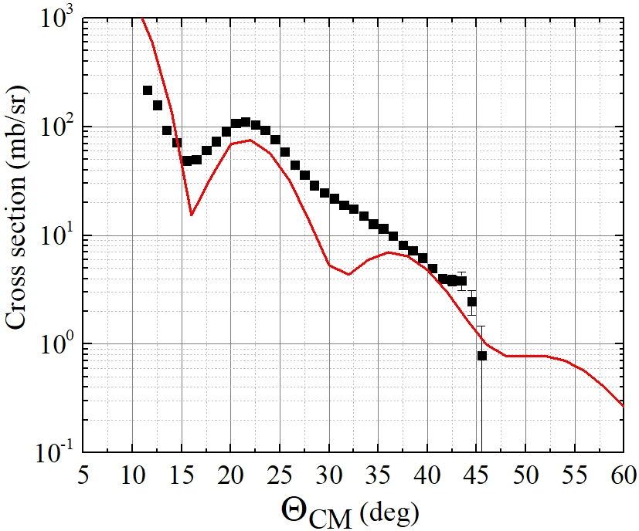
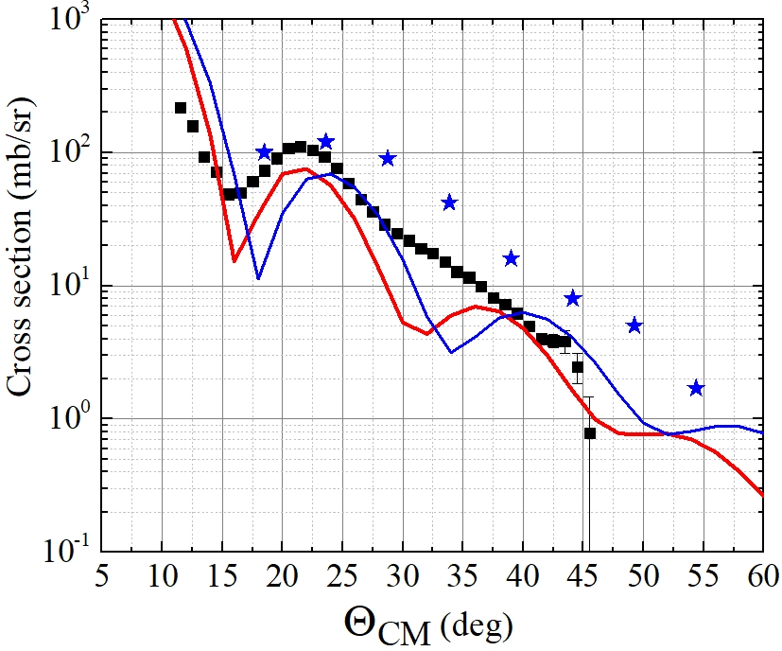
⁴He(⁶He,⁶He_{g.s.})⁴He @ Е(⁶Не) = 151 / 192 MeV предварительные результаты:
для θ_{CM} ~ 11º ÷ 45º
-- G.M. Ter-Akopian et al.,
Phys.Lett. B 426 (1998) 251
-- this work
--- experiment
(И. Музалевский / Е. Никольский)
--- 192 MeV
FRESCO (R. Wolski)
--- 192 MeV
--- 151 MeV
FRESCO (R. Wolski)
front view ∅25 mm, 4(6) mm thick,
Fe 6µ, 2 atm@12K, (X,Y) ~ 1.5 mm
front view 24x10 mm², 12(16) mm thick,
Fe 10µ, 5 atm@78K, ∅6.5 mm

Slide 16
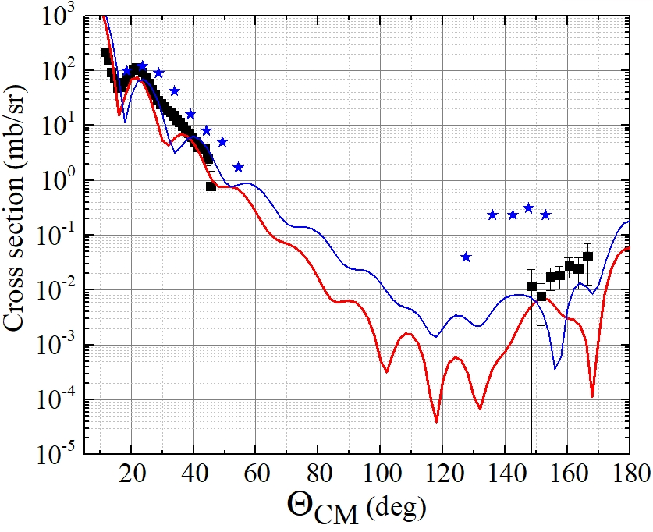
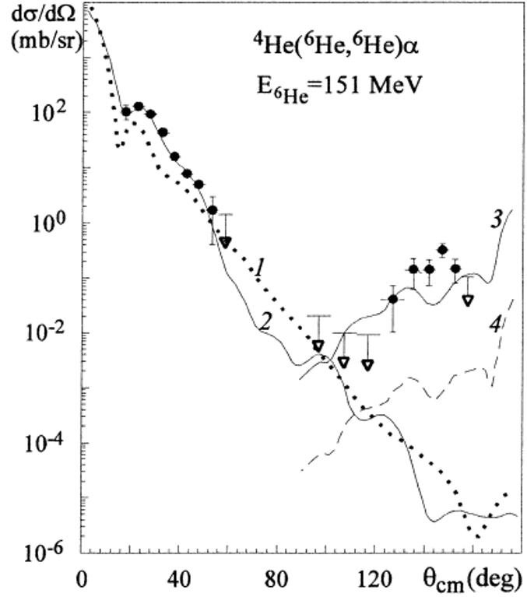
⁴He(⁶He,⁶He_{g.s.})⁴He @ Е(⁶Не)=192 MeV and Е(⁶Не)=151 MeV :
-- G.M. Ter-Akopian et al.,
Phys.Lett. B 426 (1998) 251
-- this work
FRESCO:
151 MeV / 192 MeV

Slide 17
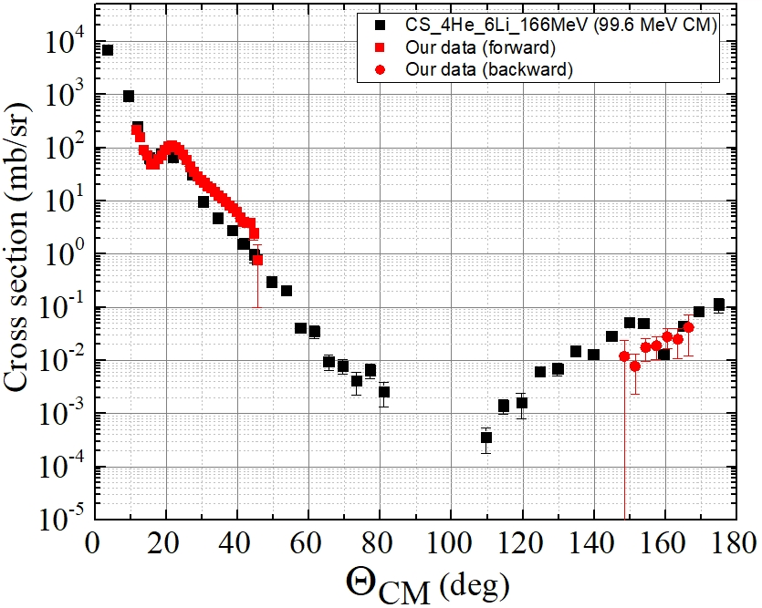
⁶Li(⁴He,⁴He)⁶Li at ⁴He energy of 166 MeV and ⁴He(⁶He,⁶He)⁴He at ⁶He energy of 192 MeV
→77 MeV CM
D. Bachelier et al.,
Nucl. Phys. A195 (1972) 361

Slide 18
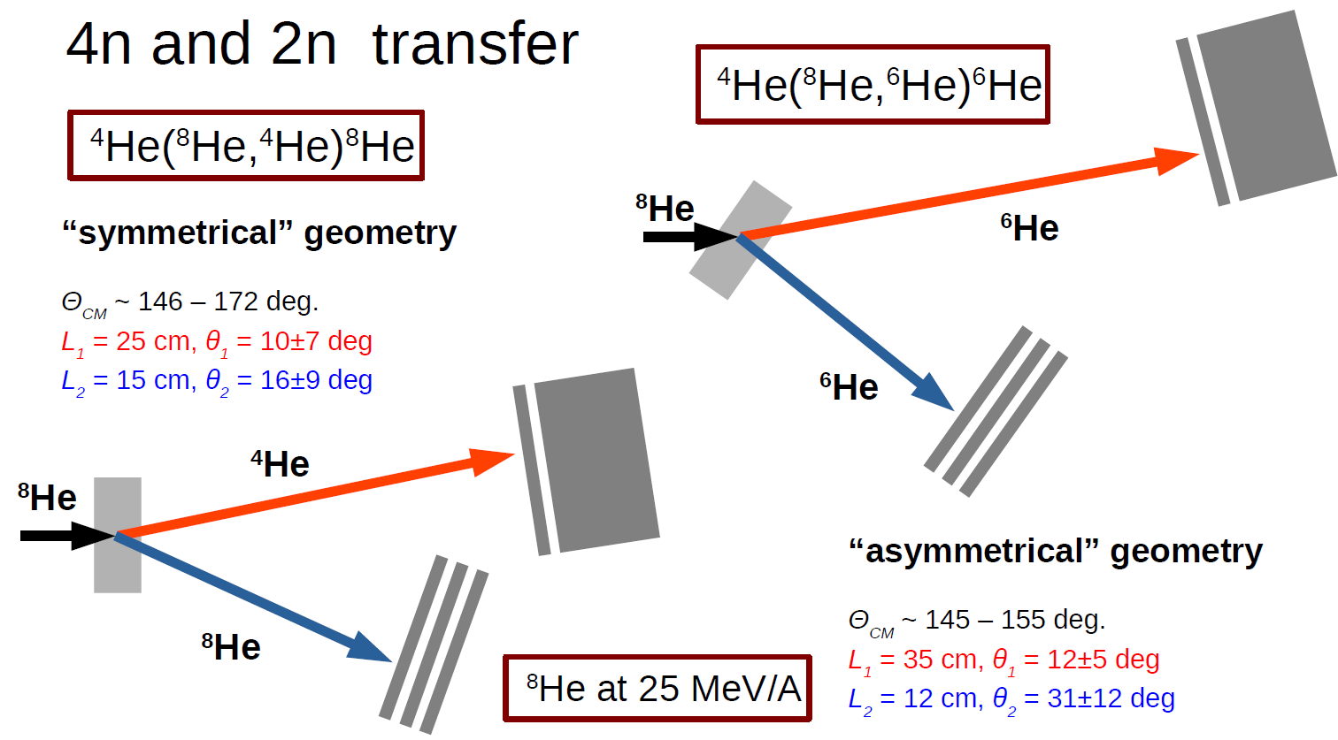
Setup for ⁸He (25÷35 AMeV) + ⁴He reaction
⁴He(⁸He,⁸He)⁴He
Е(⁸He) ~30 AMeV

Slide 19
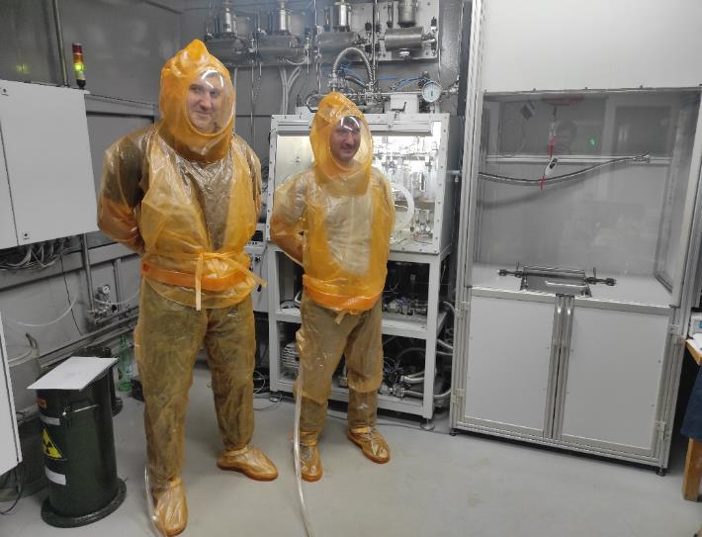
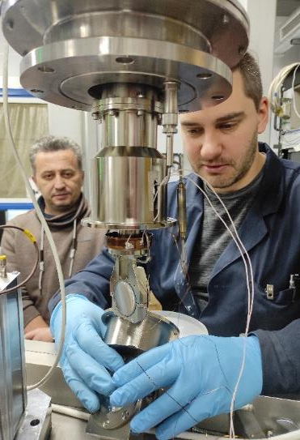
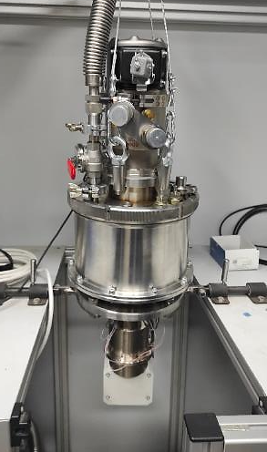
Сomplex of cryogenic targets including tritium (up to 2*10²¹ 1/cm² → 10¹⁴ Bq)
Technical specification:
1 kCi T₂;
Liquid (T⁓25 K): h=0.4 mm;
Gas: h=4 mm;
Three stages of radiation protection;
Radiation safety control;
Automatic control and parameter setting;
The cell can also be filled with H₂, D₂, ³He, ⁴He.
A "dry" launch of the tritium supply system was carried out
The project has been started jointly with VNIIEF (Sarov), DZHM (Dzerzhinsk) and VNIPIET (Sosnoviy Bor) in 2019. This world-unique component of ACCULINNA-2 heavy equipment will include a special gas-vacuum system for supply, cooling-heating, control and utilization of gases (all long-living isotopes of hydrogen and helium with a thicknesses in a wide range). Certificate for work in the 2nd class room - 2025.
Notes:
The main implemented experimental method is a cryogenic tritium target complex.
Leonid Grigorenko already talked about the tritium target. I will only show a newer status.
The project has been started jointly with Russian institutes in 2019. This world-unique component of ACCULINNA-2 heavy equipment will include a special gas-vacuum system for supply, cooling-heating, control and utilization of gases>Two weeks ago, the tritium supply system was launched in "dry" mode. At the moment, a contract for the supply of tritium is being prepared.

Slide 20
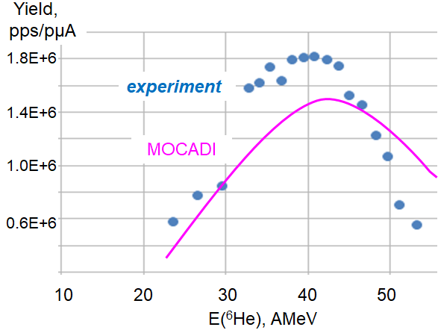
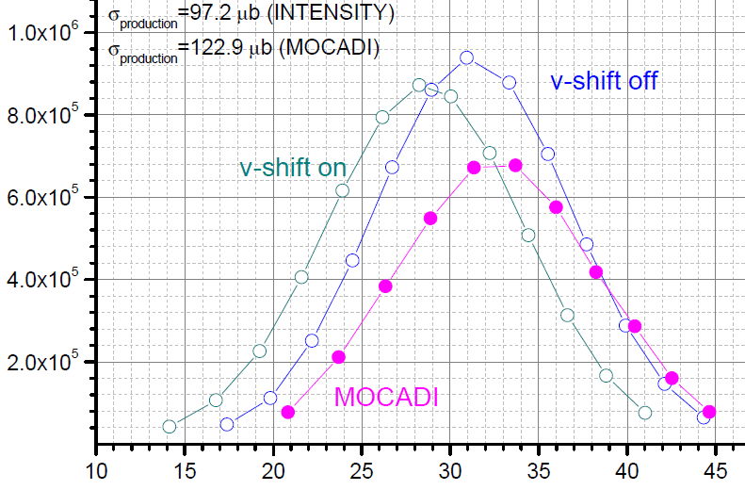
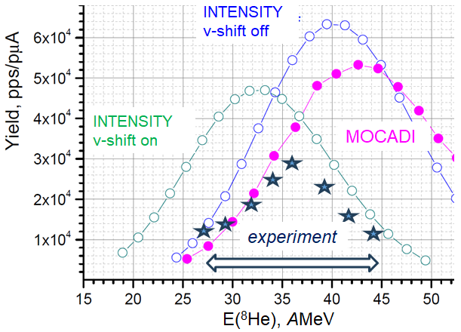
Измерение выходов радиоактивных пучков ^{6,8}He, ¹²Be
INTENSITY
v-shift off
INTENSITY
v-shift on
Yield, pps/pµA
MOCADI
experiment
Е(¹²Be), AMeV
 | ⁶He | ⁸He | ¹²Be
I_{max}, pps | 1.8*10⁶ | 2.5*10⁴ / 5.2*10⁴ | 6.2*10⁵
E, AMeV | 40 | 36 | 30
¹⁵N@51 AMeV/¹⁸О@49 AMeV

