Slide 1
Характеристики низкоэнергетического и спонтанного деления тяжелых и сверхтяжелых ядер
Совет РАН по физике тяжелых ионов
Александр Свирихин
ЛЯР ОИЯИ, Дубна
Санкт-Петербург, 2025

Slide 2
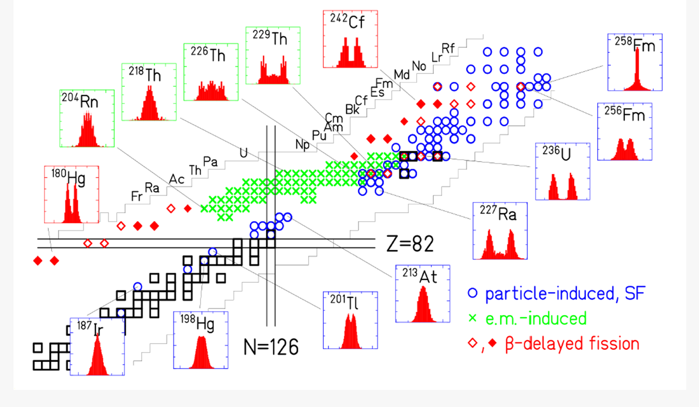
K.H. Schmidt, B. Jurado, Rev. Prog. Nucl. Fiss (2018)

Slide 3
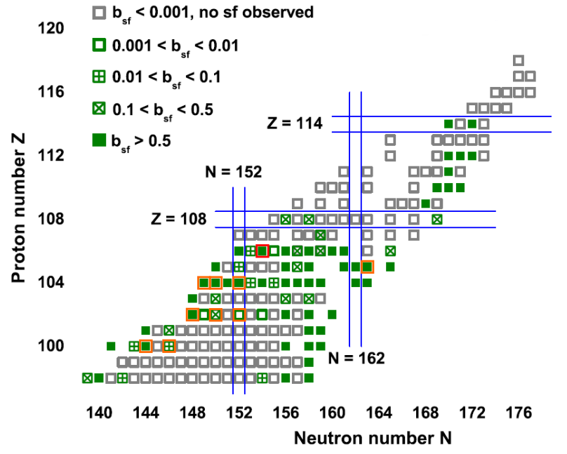
F.P. Hesberger - Eur. Phys. J. A (2017)53, 75

Slide 4
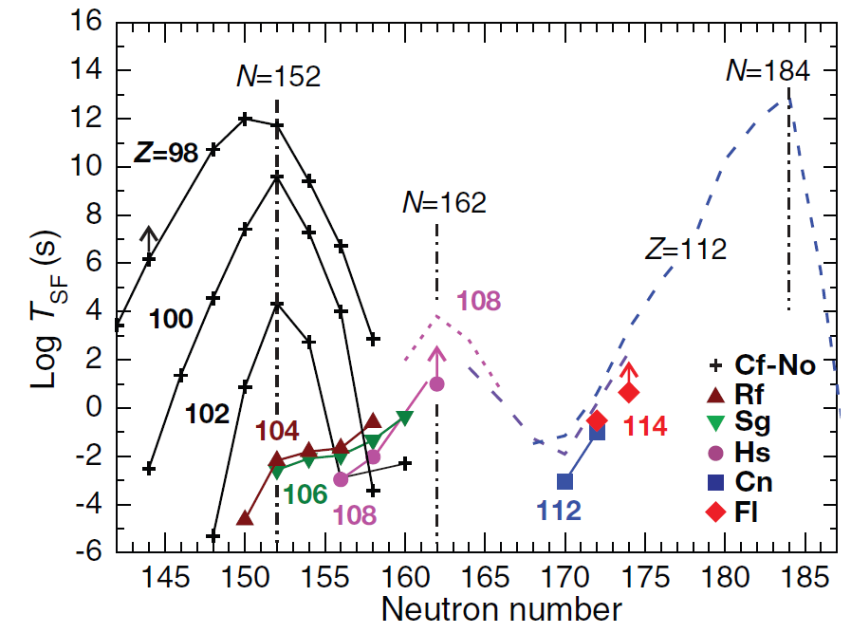
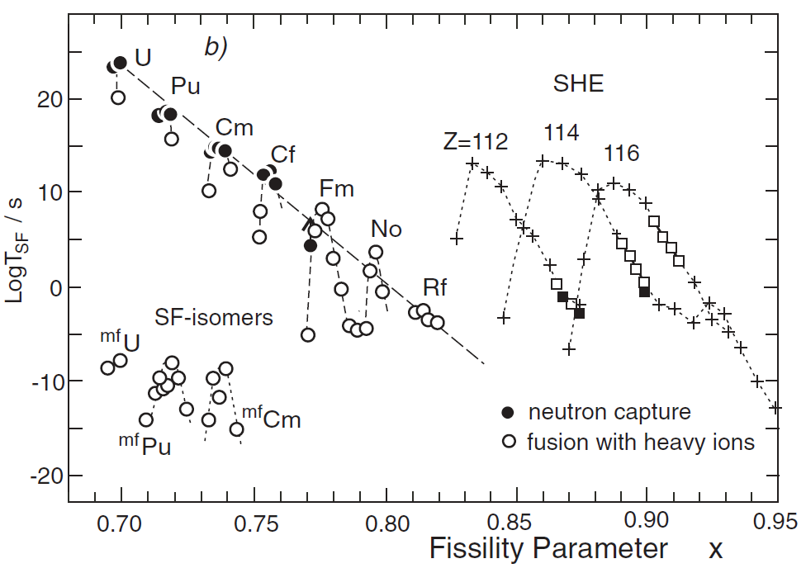
Common logarithm of partial spontaneous fission half-life
versus neutron number for even–even isotopes of elements
with Z = 98–114.
Half-lives with respect to SF as a function of the fissility parameter (Z²/A).

Slide 5
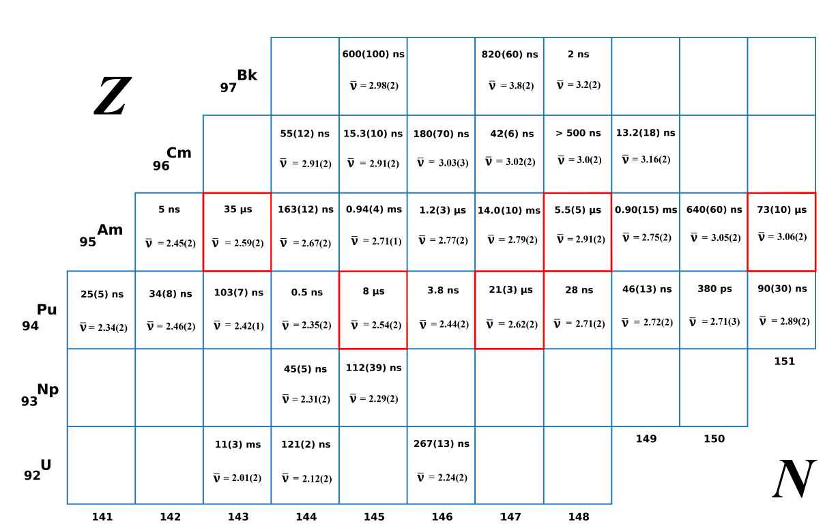
Half-lives with respect to SF as a function of the fissility parameter (Z²/A).

Slide 6
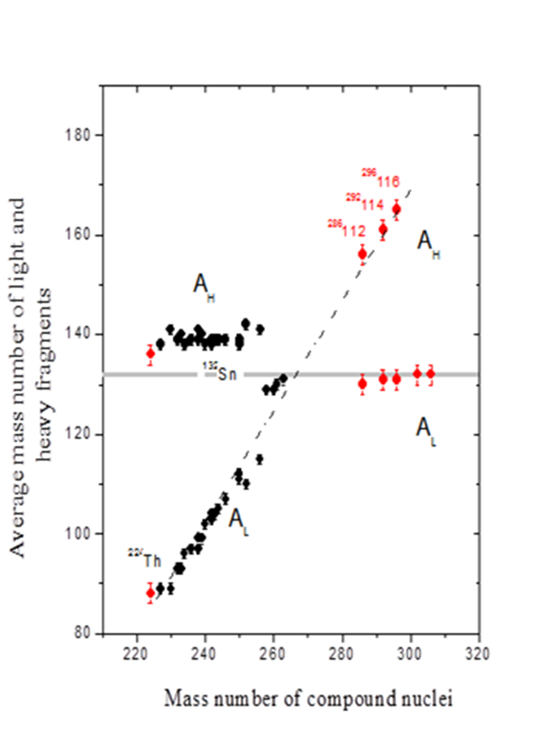
Notes:
Super-Short Mode (Brosa) manifests itself only when both light and heavy fission fragments are close in their nucleon composition to the double magic tin with A132.
The phenomenon of Bimodal fission was discovered in the 1980’s for the case of spontaneous and low energy fission of nuclei in the Fm-Rf region
Some spontaneously fissioning isotopes of Fm, Md, and No were found to exhibit symmetric fragment mass distributions, whose widths are changing very rapidly from nucleus to nucleus. For example, for spontaneous fission of 258Fm the mass distribution is unusually narrow, while for the neighboring nucleus 259Md with only one more proton it is rather broad. Even more spectacular are the distributions of TKE, which are double humped.
the high-energy mode is linked to a narrow mass distribution while the low-energy mode has a wide mass distribution.
By theory, bimodal fission is explained by the existence of two different paths on the potential energy surface leading to fission
One path is described by the LDM, while for the other path shell effects play an important role. The LDM path leads to elongated scission configurations while the shell effect path corresponds to compact configurations. Both paths result in symmetric (or nearly so) mass distributions, but the high TKE valley is narrower while the low TKE valley is much wider. This explains the difference in width of the mass distributions.

Slide 7
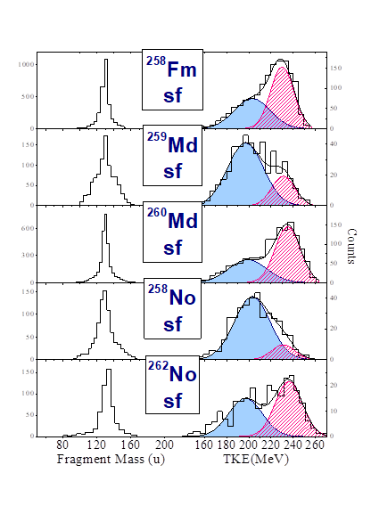
Notes:
Super-Short Mode (Brosa) manifests itself only when both light and heavy fission fragments are close in their nucleon composition to the double magic tin with A132.
The phenomenon of Bimodal fission was discovered in the 1980’s for the case of spontaneous and low energy fission of nuclei in the Fm-Rf region
Some spontaneously fissioning isotopes of Fm, Md, and No were found to exhibit symmetric fragment mass distributions, whose widths are changing very rapidly from nucleus to nucleus. For example, for spontaneous fission of 258Fm the mass distribution is unusually narrow, while for the neighboring nucleus 259Md with only one more proton it is rather broad. Even more spectacular are the distributions of TKE, which are double humped.
the high-energy mode is linked to a narrow mass distribution while the low-energy mode has a wide mass distribution.
By theory, bimodal fission is explained by the existence of two different paths on the potential energy surface leading to fission
One path is described by the LDM, while for the other path shell effects play an important role. The LDM path leads to elongated scission configurations while the shell effect path corresponds to compact configurations. Both paths result in symmetric (or nearly so) mass distributions, but the high TKE valley is narrower while the low TKE valley is much wider. This explains the difference in width of the mass distributions.

Slide 8
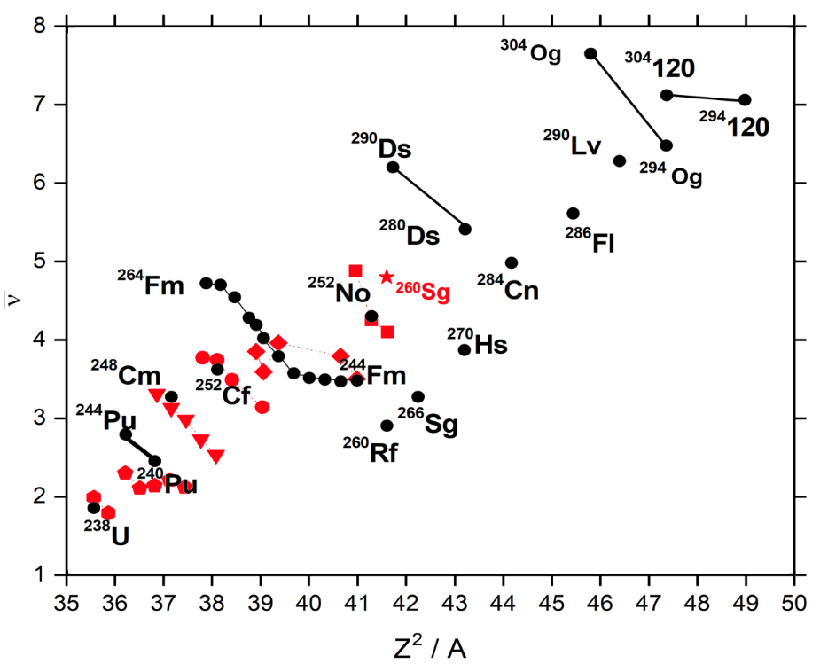
Rubchenya, V.A. Prompt neutron characteristics
in the spontaneous fission of heavy and superheavy nuclei.
LXV International Conference "Nucleus 2015" June 29-July 3, 2015, St. Petersburg

Slide 9
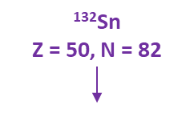
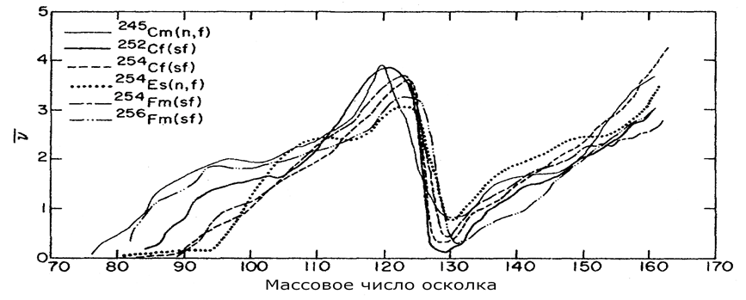
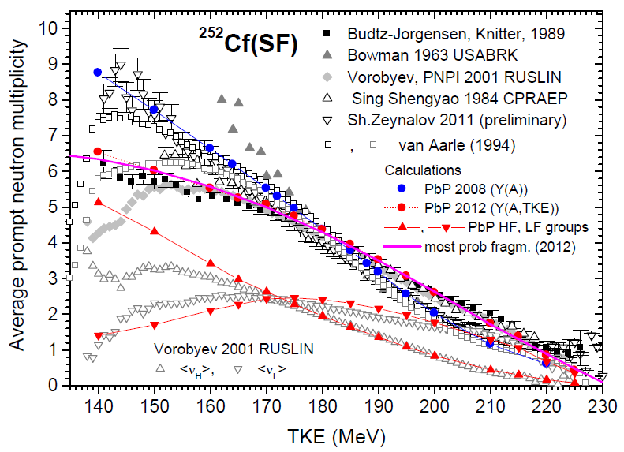
Dependence of neutron yield on fragment mass for several low-energy fissioning systems (“saw-tooth shape”)
Gindler J. PRC. (1979) – Vol. 19, issue 5.
Prompt neutrons vs TKE - ²⁵²Cf data (different black and gray symbols).
I.Visan et al. (2014) Rom. Journ. Phys., Vol. 59, No. 3–4

Slide 10
Оценка времени жизни > 5 распадов
Среднее число нейтронов деления > 20 делений
(ε_{n} > 45%)
Распр. множественности нейтронов > 100 делений
(ε_{n} > 45%)
Приближенная TKE (2 FF!) > 100 делений
Восстановление распределений
осколков по массам-энергиям > 10⁵ делений

Slide 11
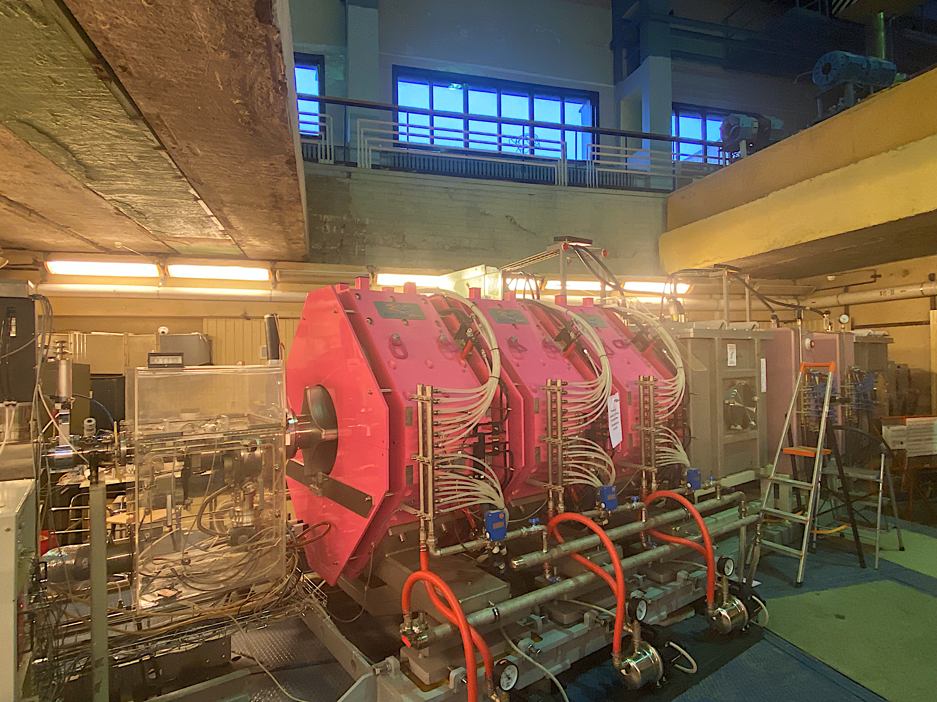
Separator for Heavy ELement Spectroscopy – SHELS
(U400 cyclotron FLNR)
Popeko A. G., et al.
NIM B. (2016).Vol. 376

Slide 12
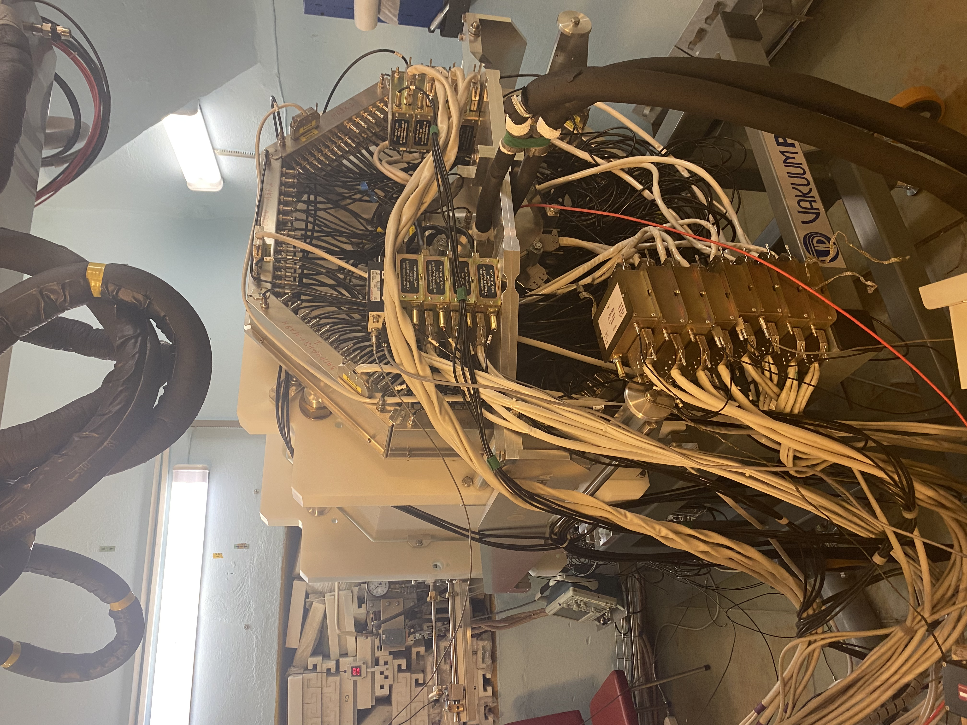
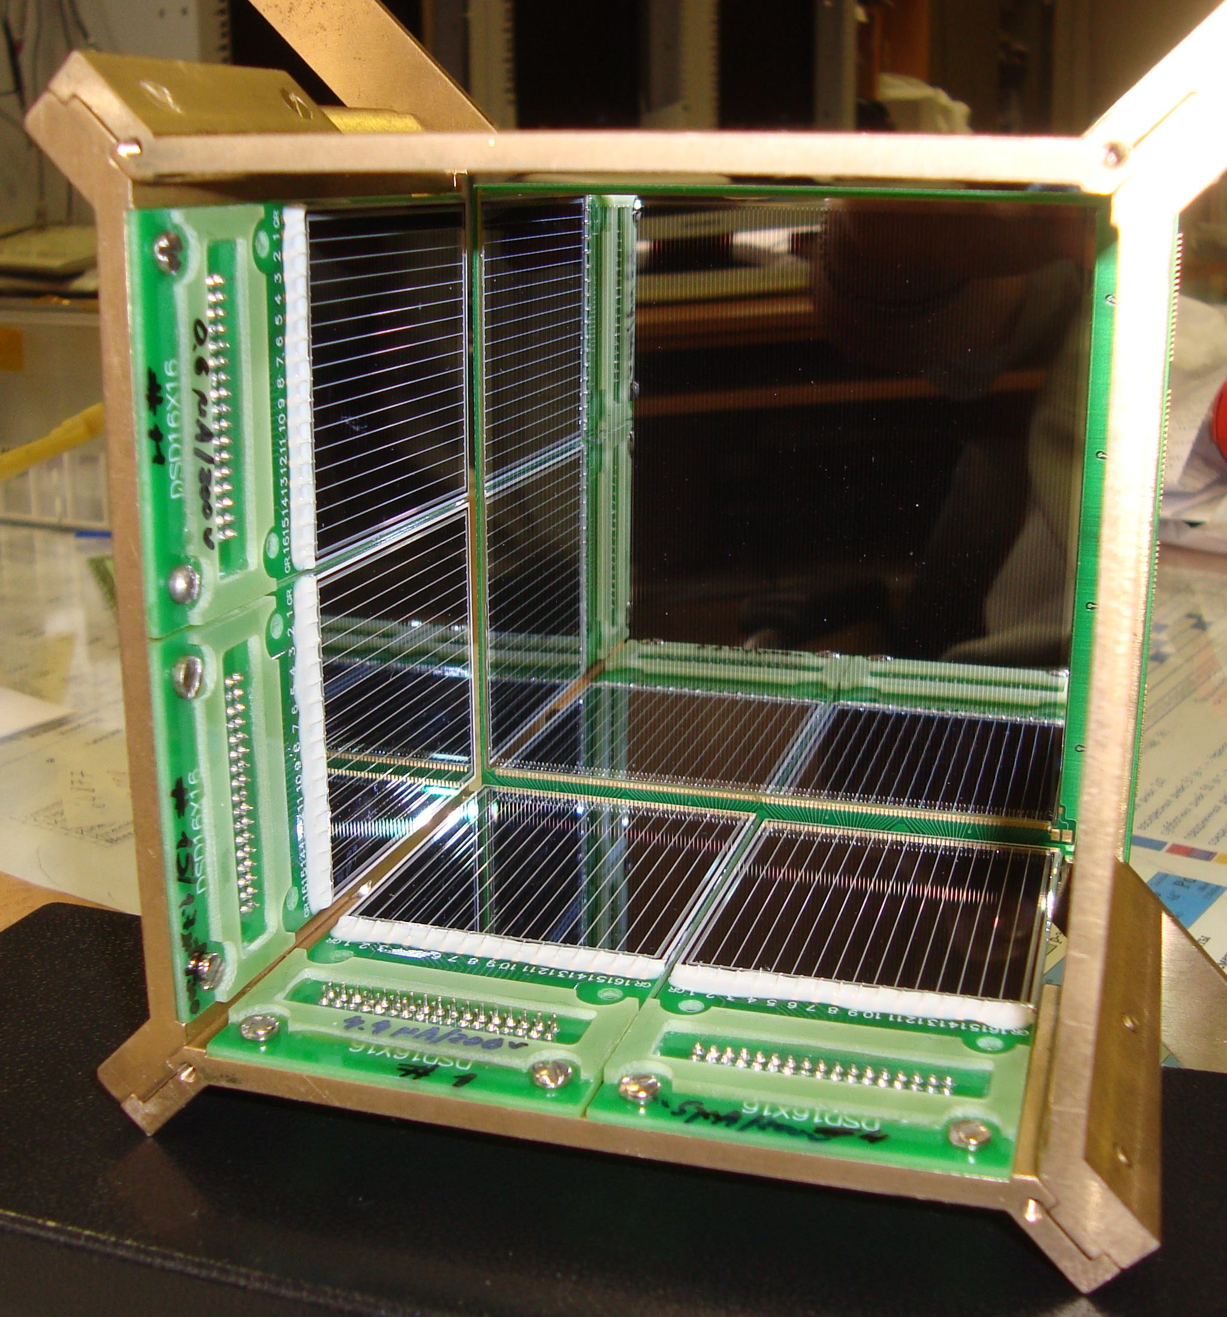
SFiNx – Spontaneous Fission, Neutrons and x-rays
 | Энергетическое разрешение (ПШПВ), кэВ | Пороги, кэВ
Фокальный DSSD детектор | 10.8±0.6 кэВ для энергии 320 кэВ (КЭ); 16.5±0.8 кэВ для энергии 7.92 МэВ (альфа) | 40-60
Боковые детекторы | 14.4±1.2 кэВ для 320 кэВ (КЭ); 120±11кэВ для энергии 7.92 МэВ (альфа) | 60-100
Isaev, A. V. et al.
The SFiNx detector system PEPAN Letters 19, 37–45 (2022)

Slide 13
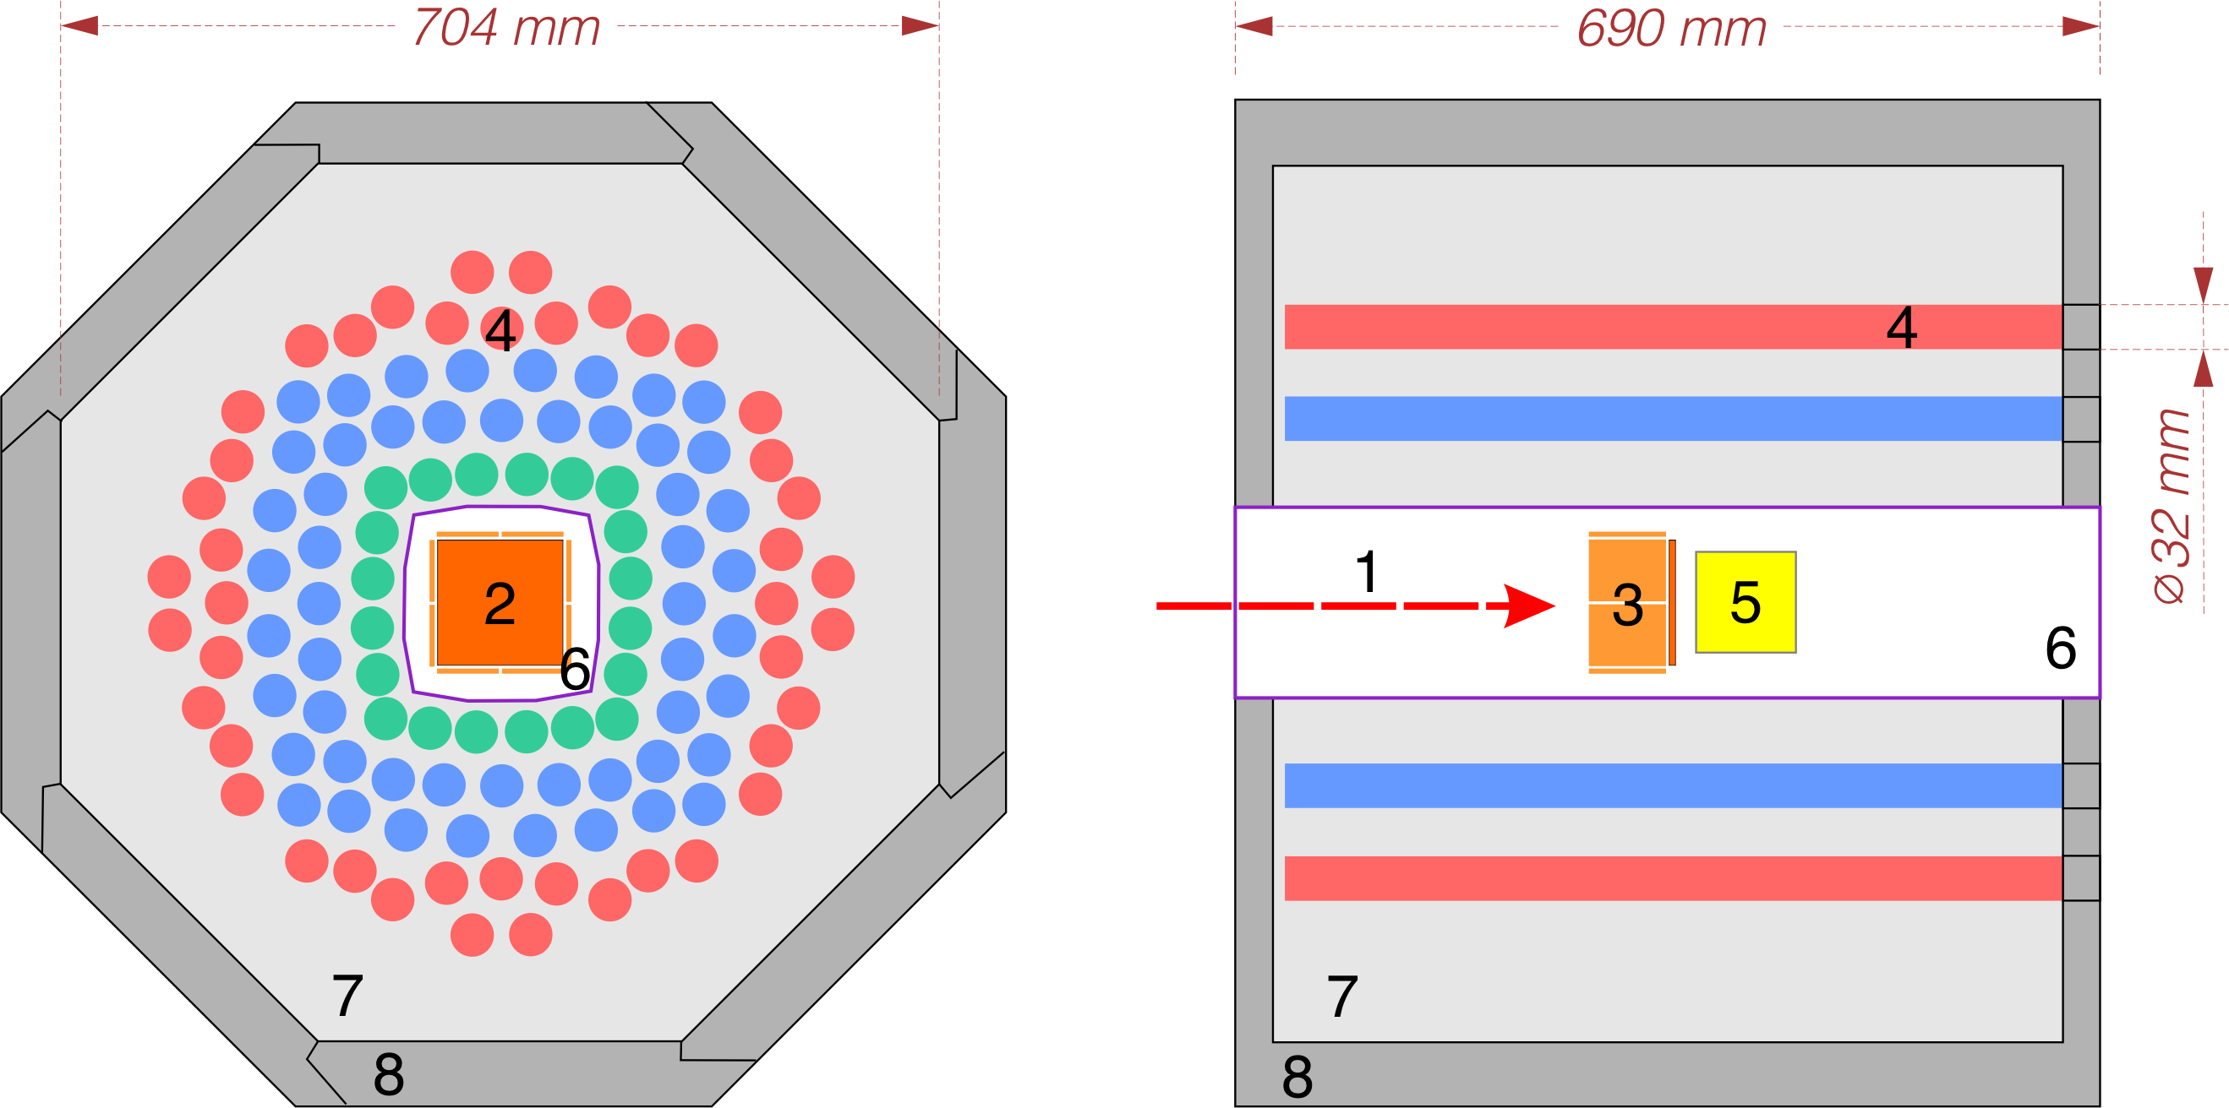
SFiNx – Spontaneous Fission, Neutrons and x-rays
1 – ER “beam”
2,3 – DSSSD box
4 - ³He-based N counters
5 – scintilator
6 – vacuum chamber
7 – neutron moderator
8 – neuron shield
ε_{n} = 55%
 | Энергетическое разрешение (ПШПВ), кэВ | Пороги, кэВ
Фокальный DSSD детектор | 10.8±0.6 кэВ для энергии 320 кэВ (КЭ); 16.5±0.8 кэВ для энергии 7.92 МэВ (альфа) | 40-60
Боковые детекторы | 14.4±1.2 кэВ для 320 кэВ (КЭ); 120±11кэВ для энергии 7.92 МэВ (альфа) | 60-100
Isaev, A. V. et al.
The SFiNx detector system PEPAN Letters 19, 37–45 (2022)

Slide 14
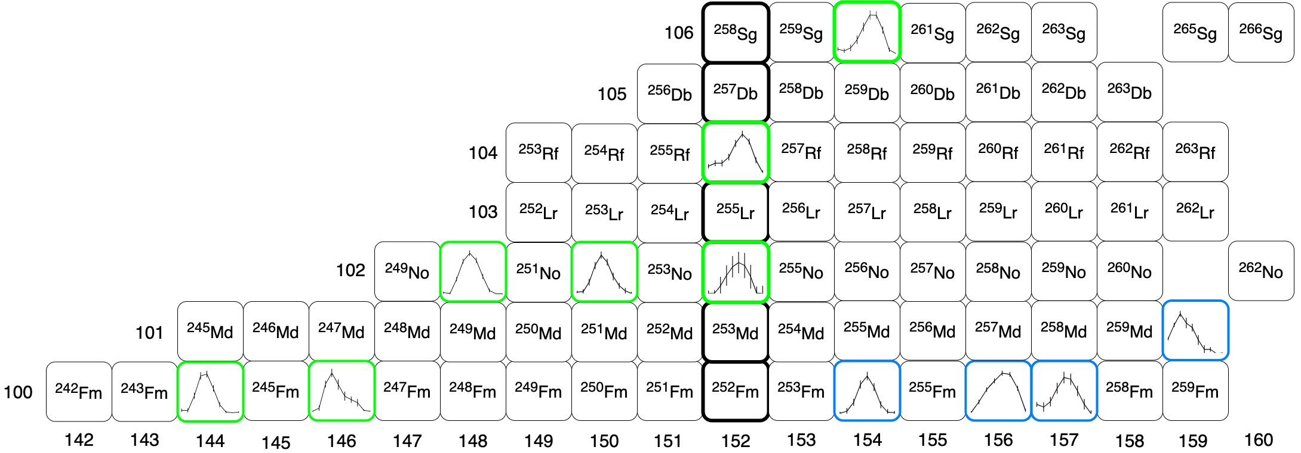
SHELS separator (FLNR)

Slide 15
VASSILISSA (SHELS) results
Rubchenya, V.A. Prompt neutron characteristics
in the spontaneous fission of heavy and superheavy nuclei.
LXV International Conference "Nucleus 2015" June 29-July 3, 2015, St. Petersburg

Slide 16
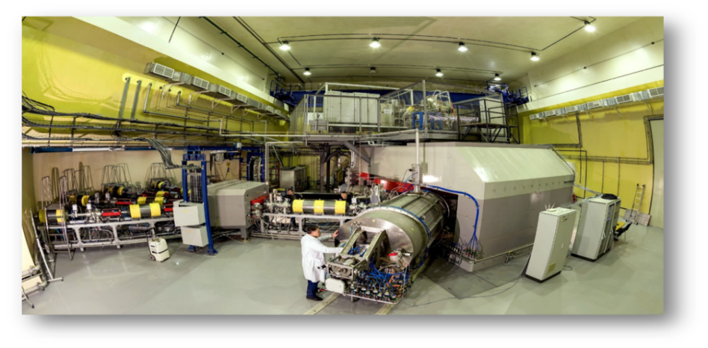
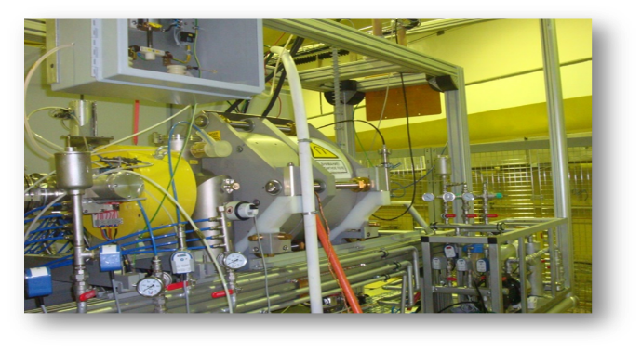
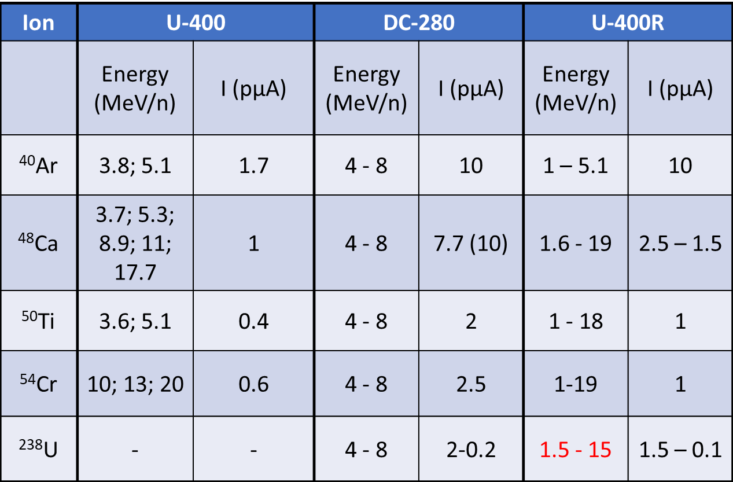
SHE Factory
DECRIS-PM
DC-280
3
5

Slide 17
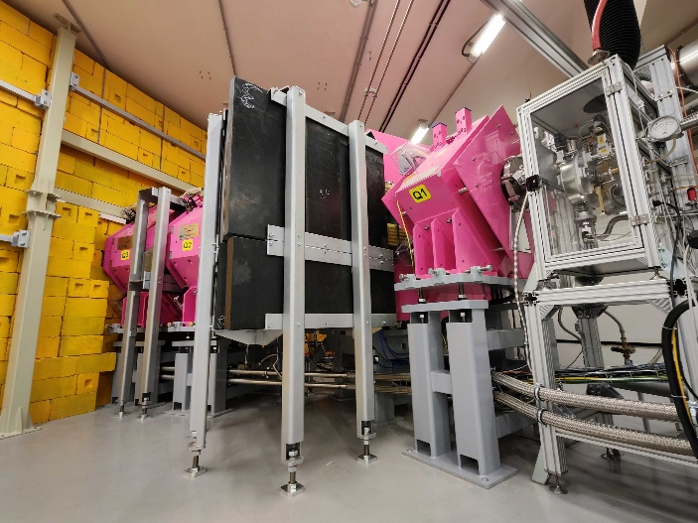
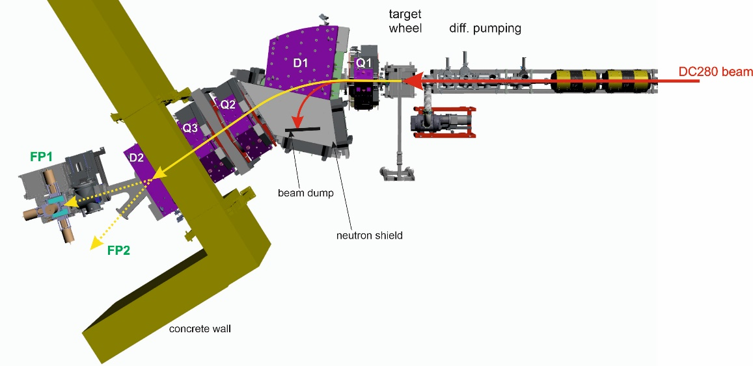
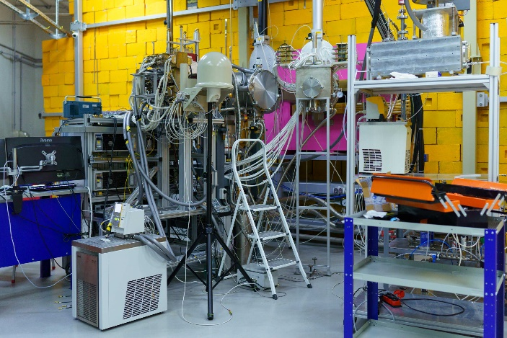
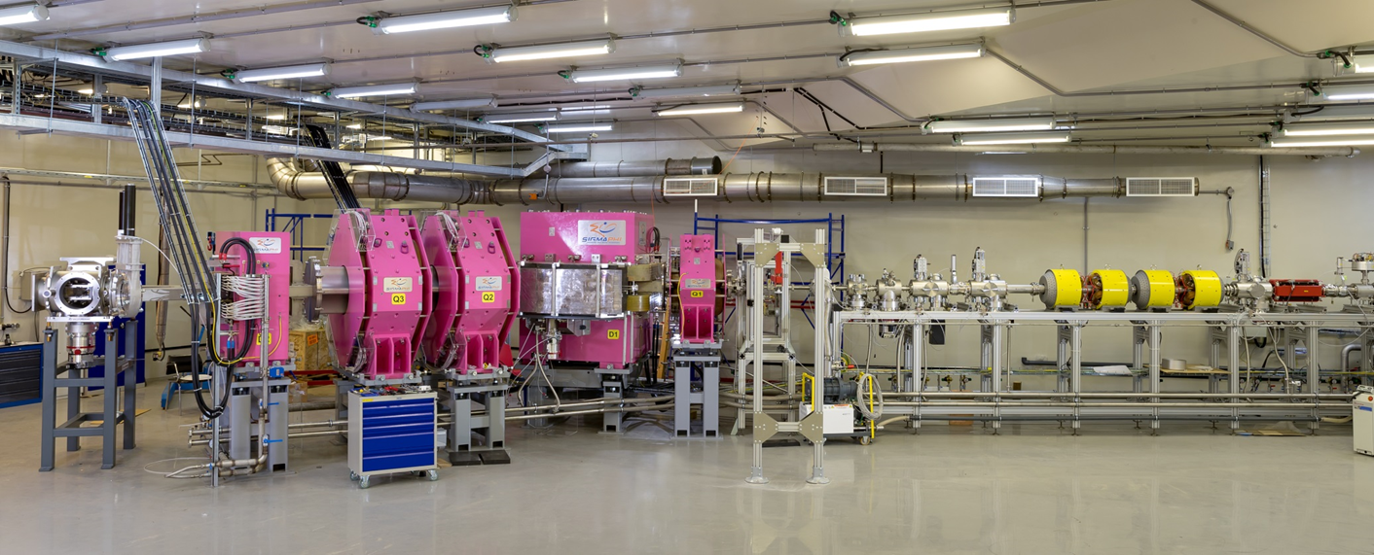
Separator GRAND
Gas-filled Recoil Analyzer and Nuclei Detector
PEPAN Letters, 2024, Vol. 21, No. 3, pp. 518–525

Slide 18
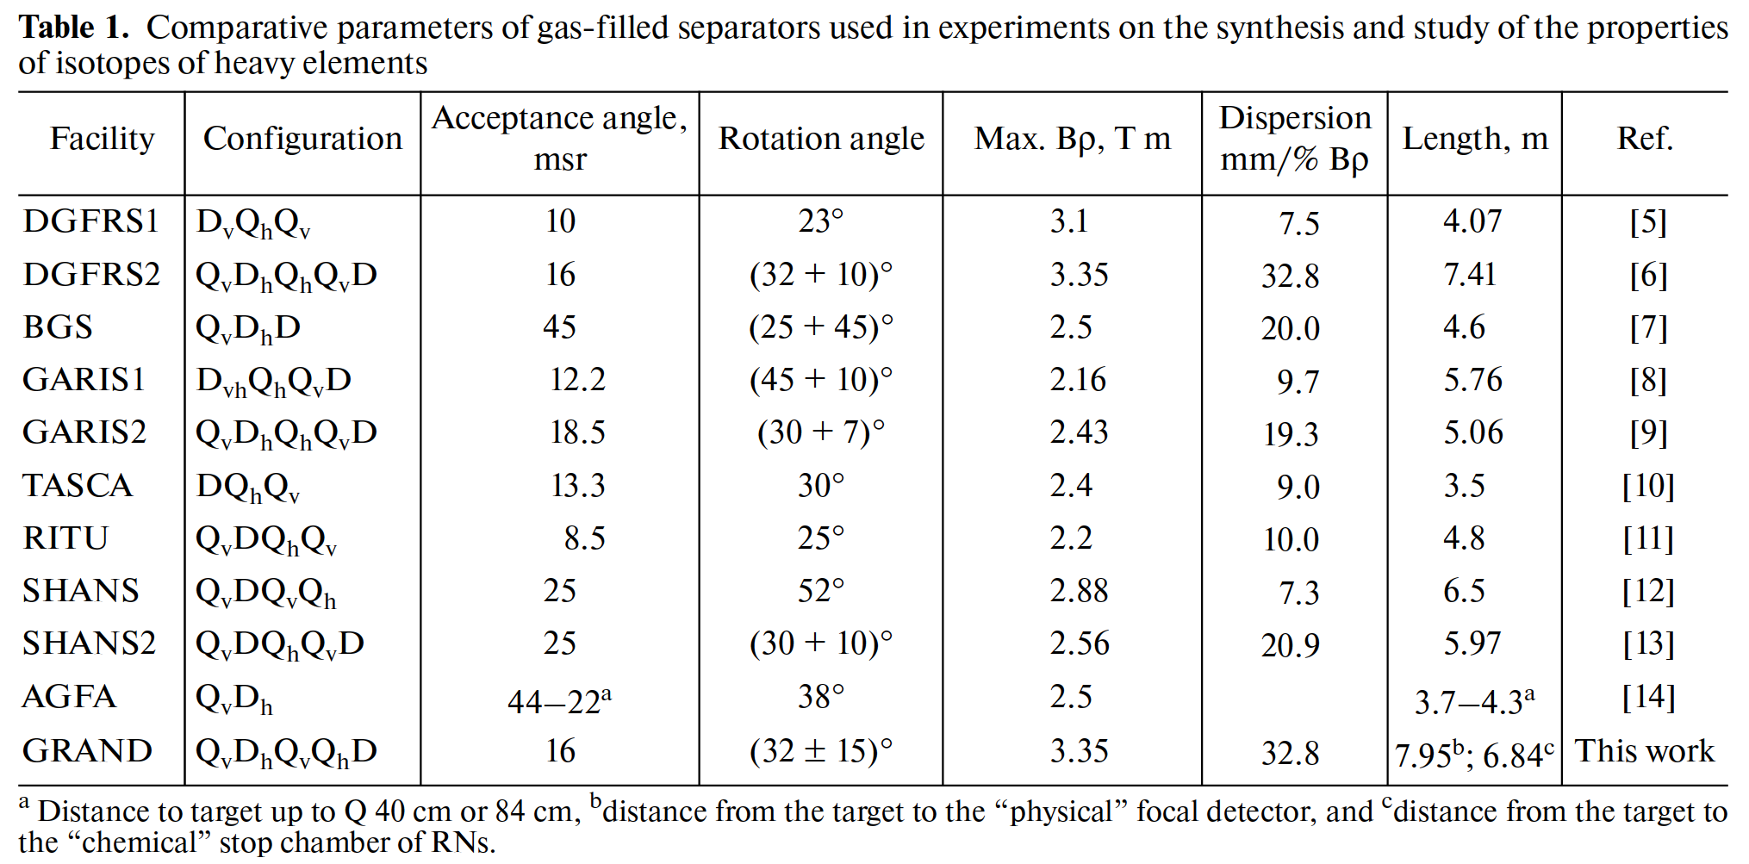
Separator GRAND
Gas-filled Recoil Analyzer and Nuclei Detector
PEPAN Letters, 2024, Vol. 21, No. 3, pp. 518–525

Slide 19
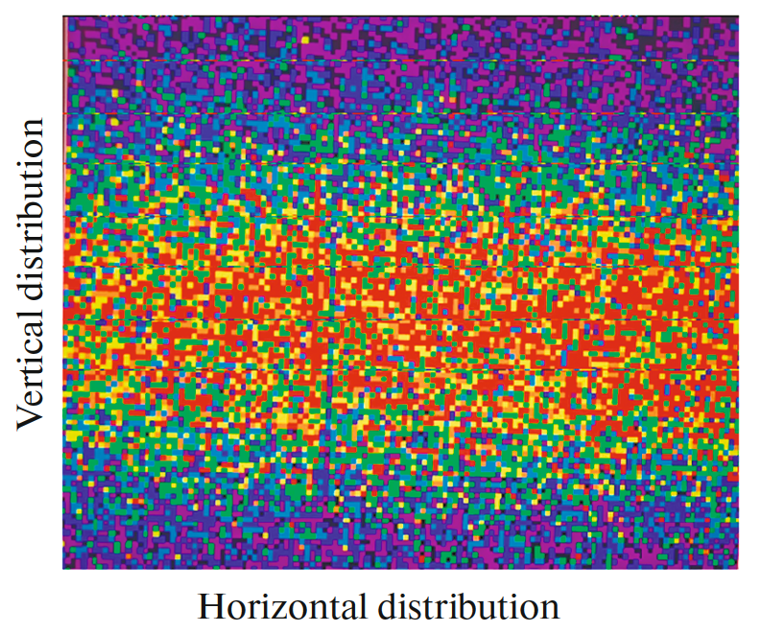
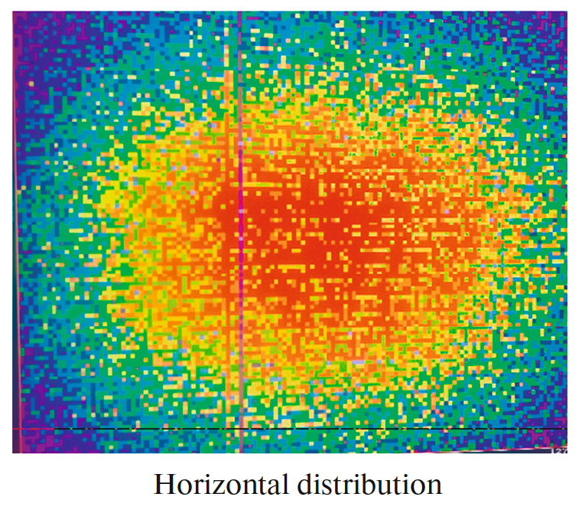
Tests of ion optics
⁴⁸Ca + ¹⁷⁰Er → 4n + ²¹⁴Ra
FP1 – 100x100 cm² DSSD
Separator GRAND
Gas-filled Recoil Analyzer and Nuclei Detector
Q_{v} D₃₀ Q_{h} Q_{v} D₁₅
PEPAN Letters, 2024, Vol. 21, No. 3, pp. 518–525
Q_{v} D₃₀ Q_{v} Q_{h} D₁₅

Slide 20
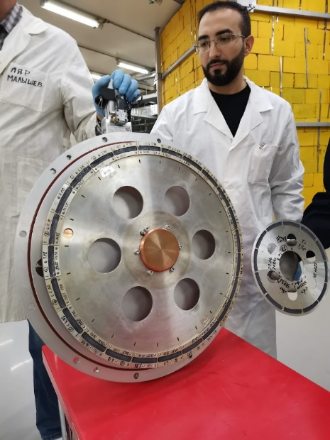
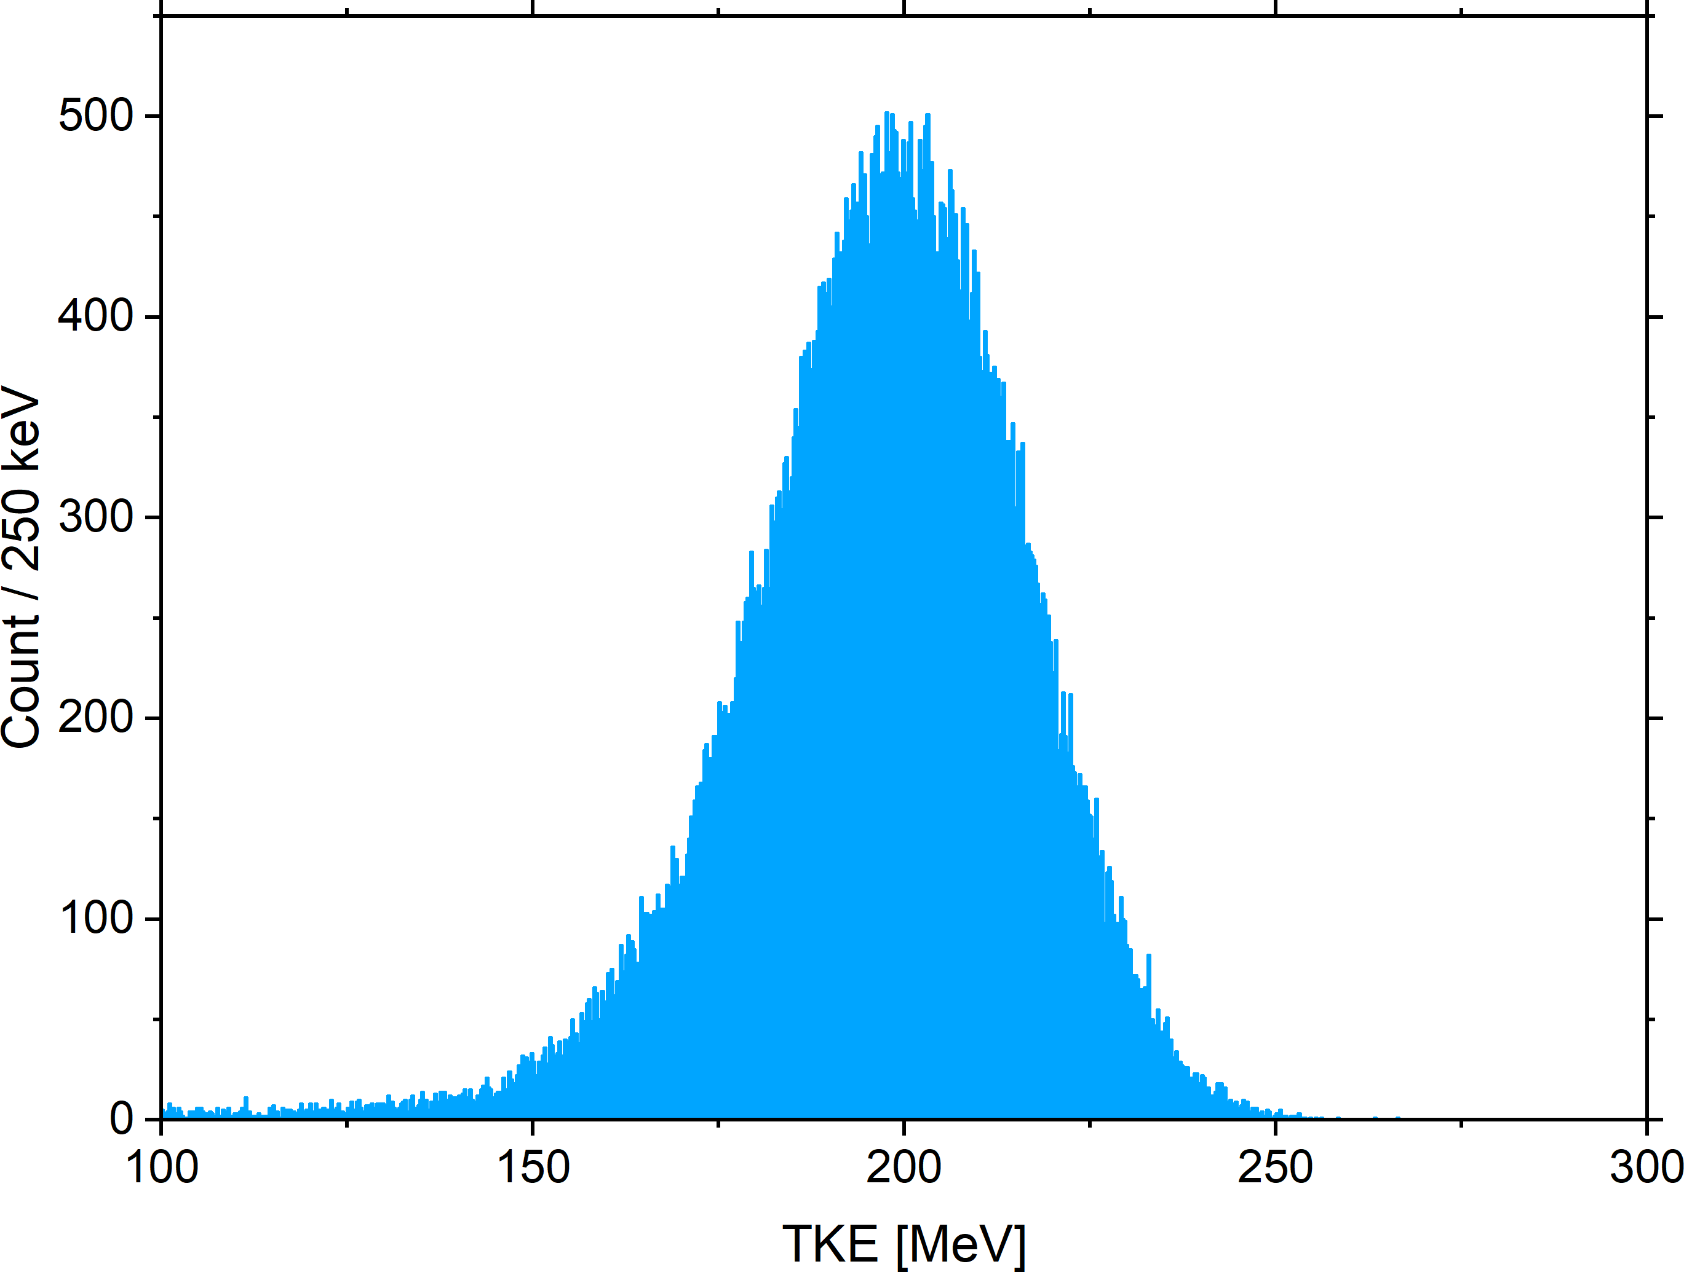
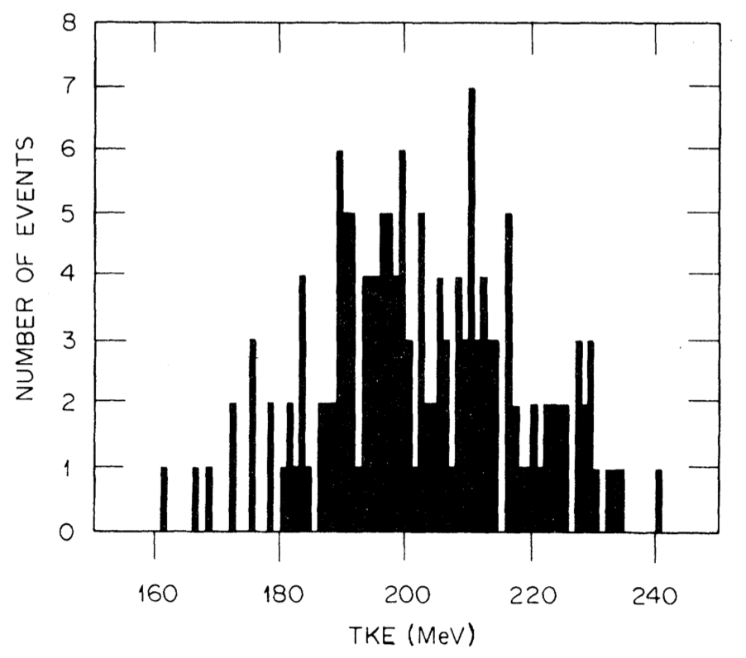
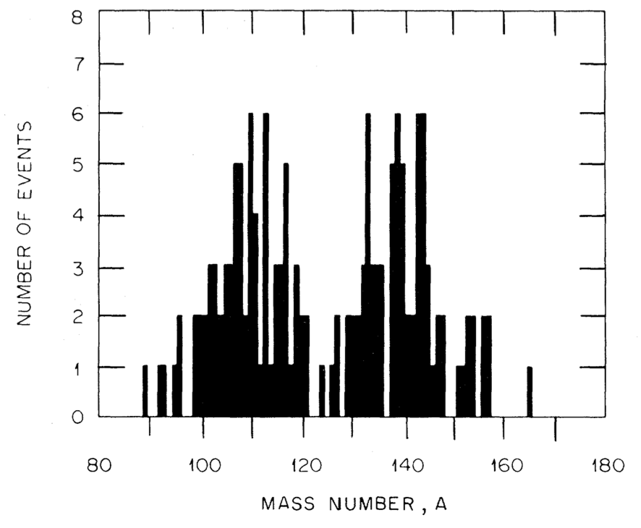
Spontaneous fission of ²⁵²No
GRAND 2024 ~85k SF of ²⁵²No
Bemis 1977, 176 SF
FF mass distribution !?
Bemis C.E. et al.
Fragment-mass and kinetic-energy distributions from the spontaneous fission of ²⁵²No.
Phys. Rev. C 15/2 (1977) P. 705-712.

Slide 21
Spontaneous fission properties of SHE
To create the correct mass distribution of fission fragments we need to register ≥ 10⁵ fission fragments !!!
 | ²⁵⁴No | ²⁵²No (April 2024)
Cross section of ER formation | 2000 nb | 186 nb
Branching ratio | b_{α}= 90% (b_{sf} = 0.17% ) | b_{SF} = 33%
Efficiency of detection | ε_{α} = 50% | ε_{SF} = 100%
I beam = 1 pμA of ⁴⁸Ca | 120 000 alphas from ²⁵⁴No per 24h | 25 000 fissions of ²⁵²No per 24h
I beam = 6 pμA of ⁴⁸Ca | 720 000 alphas from ²⁵⁴No per 24h 2500 fissions from ²⁵⁴No per 24h | 100 000 fissions of ²⁵²No per 24h

Slide 22
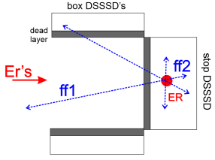
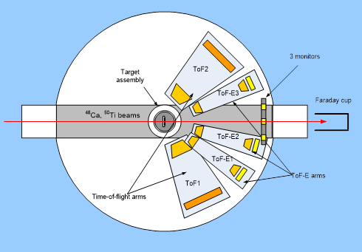
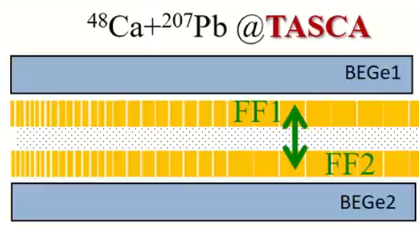
The implantation “box” detector | ε_{det} = 100 % 100 000 F1 or F2 events per 24h F1 and F2 ε_{det} = 50 % 50 000 F1+F2 events per 24h | 2E method (+ neutrons) TKE + neutrons! Mass measurements not supported
Recoil separator + CORSET-like detector | ε_{det} = 0.2 % 200 SF events per 24h | 2V, TOF-E methods TKE, fr. masses 2 < ΔM < 4 amu
ANSWERS-like setup | ε_{det} = 80-90 % ε_{tr} ≈ 50% (for nobelium!) 40 000 – 50 000 SF events per 24h | 2E methods TKE, fr. masses, neutrons 5 < ΔM < 10 amu

Slide 23
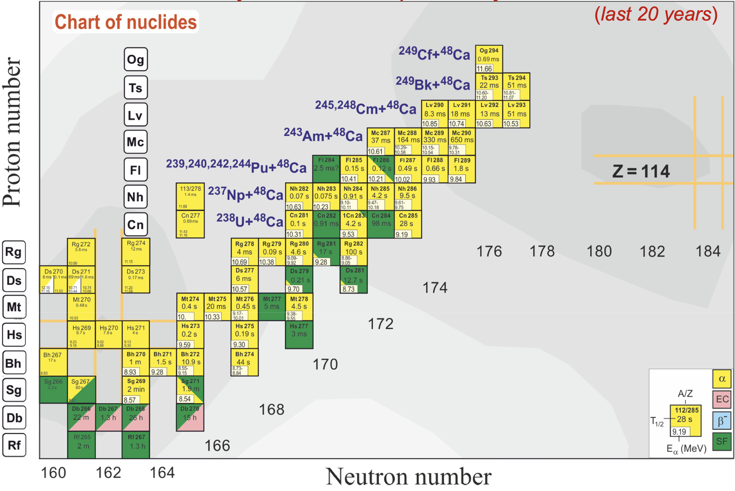

Spontaneous fission properties of SHE
SFiNx

Slide 24
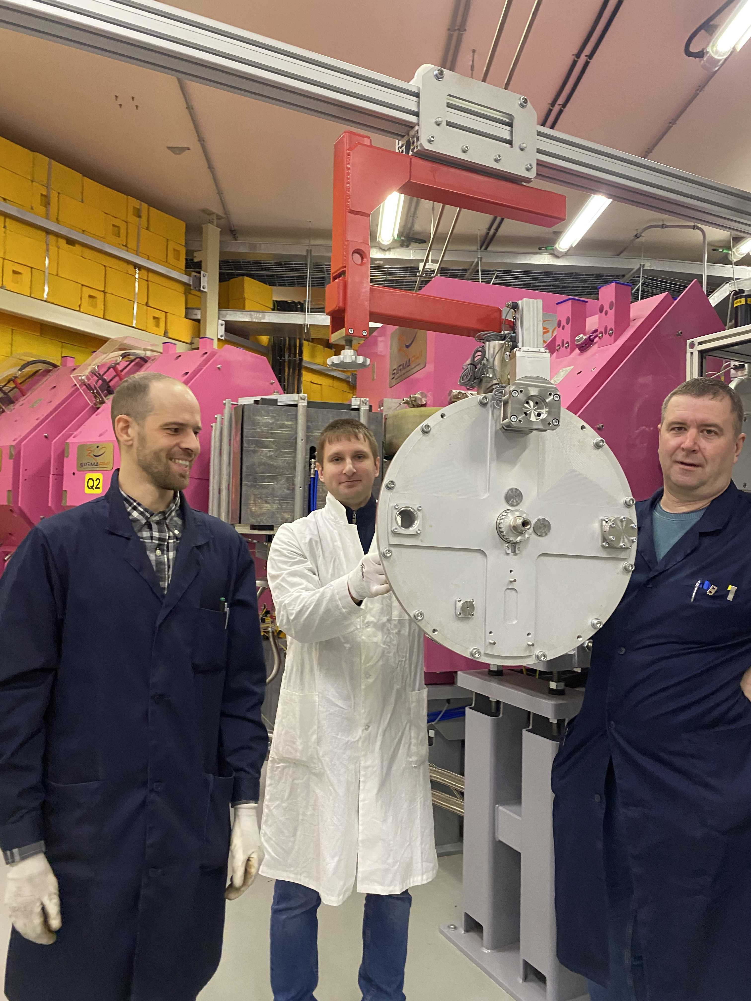
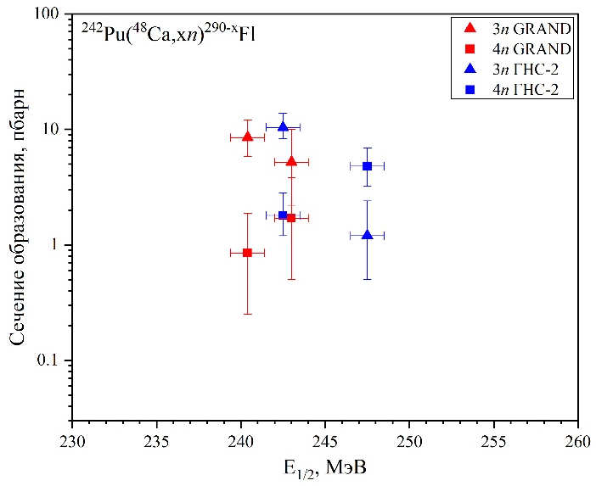
Spontaneous fission properties of SHE
⁴⁸Ca + ²⁴²Pu
4n 3n
Cross section [pb]
GRAND Dec. 2022
Achieved: 2 Flerovium decays per day!
E_{1/2} [MeV]
What statistics are needed?
100+ SF for neutron multiplicity and TKE
10+ SF for average number of neutrons
4-5 SHE-isotopes in the one experiment!!!
First tests of new rotating target
D = 480 mm and 6 p𝝁A of ⁴⁸Ca
SHE Factory, April 2024

Slide 25
288
Распад ²⁶⁸Db
²⁴³Am + ⁴⁸Ca → 115 + 3n
a
284
113
a
280
⁴⁸Ca-projectiles
111
a
276
109
a
272
Cold Fusion
²⁰⁹Bi-target
107
N = 153
N = 163
a
257
268
Off-line
268
²⁰⁹Bi + ⁵⁰TI → 105 + 2n
105
105
EC
a
253
T_{1/2}=1.5 s
T_{1/2}=30 h
a
268
103
264
104
a
103
EC
249
SF
α?
264
101
101
102
Super symmetric
SF Is expected
249
α?
SF
100
a

Slide 26

288
²⁴³Am + ⁴⁸Ca → 115 + 3n
a
284
113
a
280
⁴⁸Ca-projectiles
111
a
276
109
a
272
Cold Fusion
²⁰⁹Bi-target
107
N = 153
N = 163
a
257
268
Off-line
268
²⁰⁹Bi + ⁵⁰TI → 105 + 2n
105
105
EC
a
253
T_{1/2}=1.5 s
T_{1/2}=30 h
a
268
103
264
104
a
103
EC
249
SF
α?
264
101
101
102
Super symmetric
SF Is expected
249
α?
SF
100
a

Slide 27

288
²⁴³Am + ⁴⁸Ca → 115 + 3n
a
284
113
a
280
⁴⁸Ca-projectiles
111
a
276
109
a
272
N = 163
107
a
268
Off-line
268
105
105
EC
T_{1/2}=30 h
a
268
264
104
103
EC
SF
α?
264
Super symmetric
SF Is expected
102
α?
SF

Slide 28
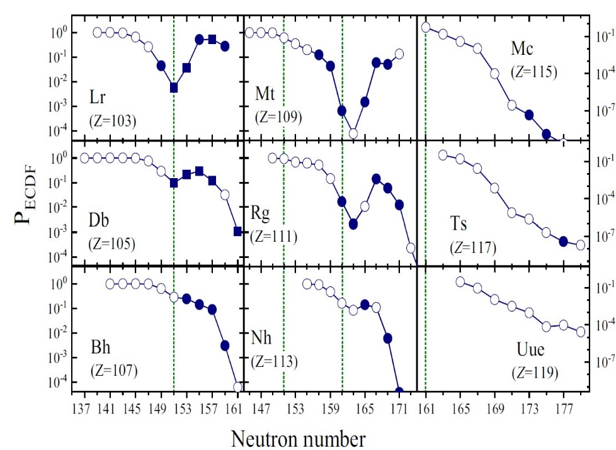
288
²⁴³Am + ⁴⁸Ca → 115 + 3n
a
284
113
a
280
⁴⁸Ca-projectiles
111
a
276
109
a
272
107
a
268
Off-line
268
105
105
EC
T_{1/2}=30 h
a
268
264
104
103
EC
SF
α?
264
102
J. Khuyagbaatar “β(EC) delayed fission in the heaviest nuclei” Eur. Phys. J. A (2019) 55: 134
α?
SF

Slide 29
²⁴³Am target:
0.5 mg/cm²
⁴⁸Ca beam intensity
6 pµA
Production
²⁶⁸Db ~ 50/d
288
²⁴³Am + ⁴⁸Ca → 115 + 3n
a
284
113
a
280
111
a
276
109
Rf isotopes
a
272
⁴⁸Ca-induced
reaction
Cold Fusion
²⁰⁹Bi-target
107
a
268
T_{EC} =30 h
105
254
268
T_{SF} ≈ 1 s
²⁰⁶Pb + ⁵⁰TI → 104 + 2n
T_{SF} = 23 µs
104
N = 150
N = 164
FF Z = 52, N = 82

Slide 30

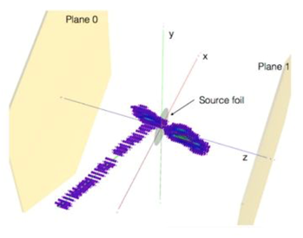
CORSET-like detector | ε_{det} = 2 % 1-2 Db-Rf-Lr SF events per 24h | 2V, TOF-E methods TKE, fr. masses 2 < ΔM < 4 amu
TPC | F1+F2 ε_{det} ~ 90 % 40-50 Db-Rf-Lr SF events per 24h | 2E + Bragg curves (Z !?) + prompt neutrons? TKE, fr. masses, neutrons ΔM ~ 7 amu bonus: triple fission observation!

Slide 31

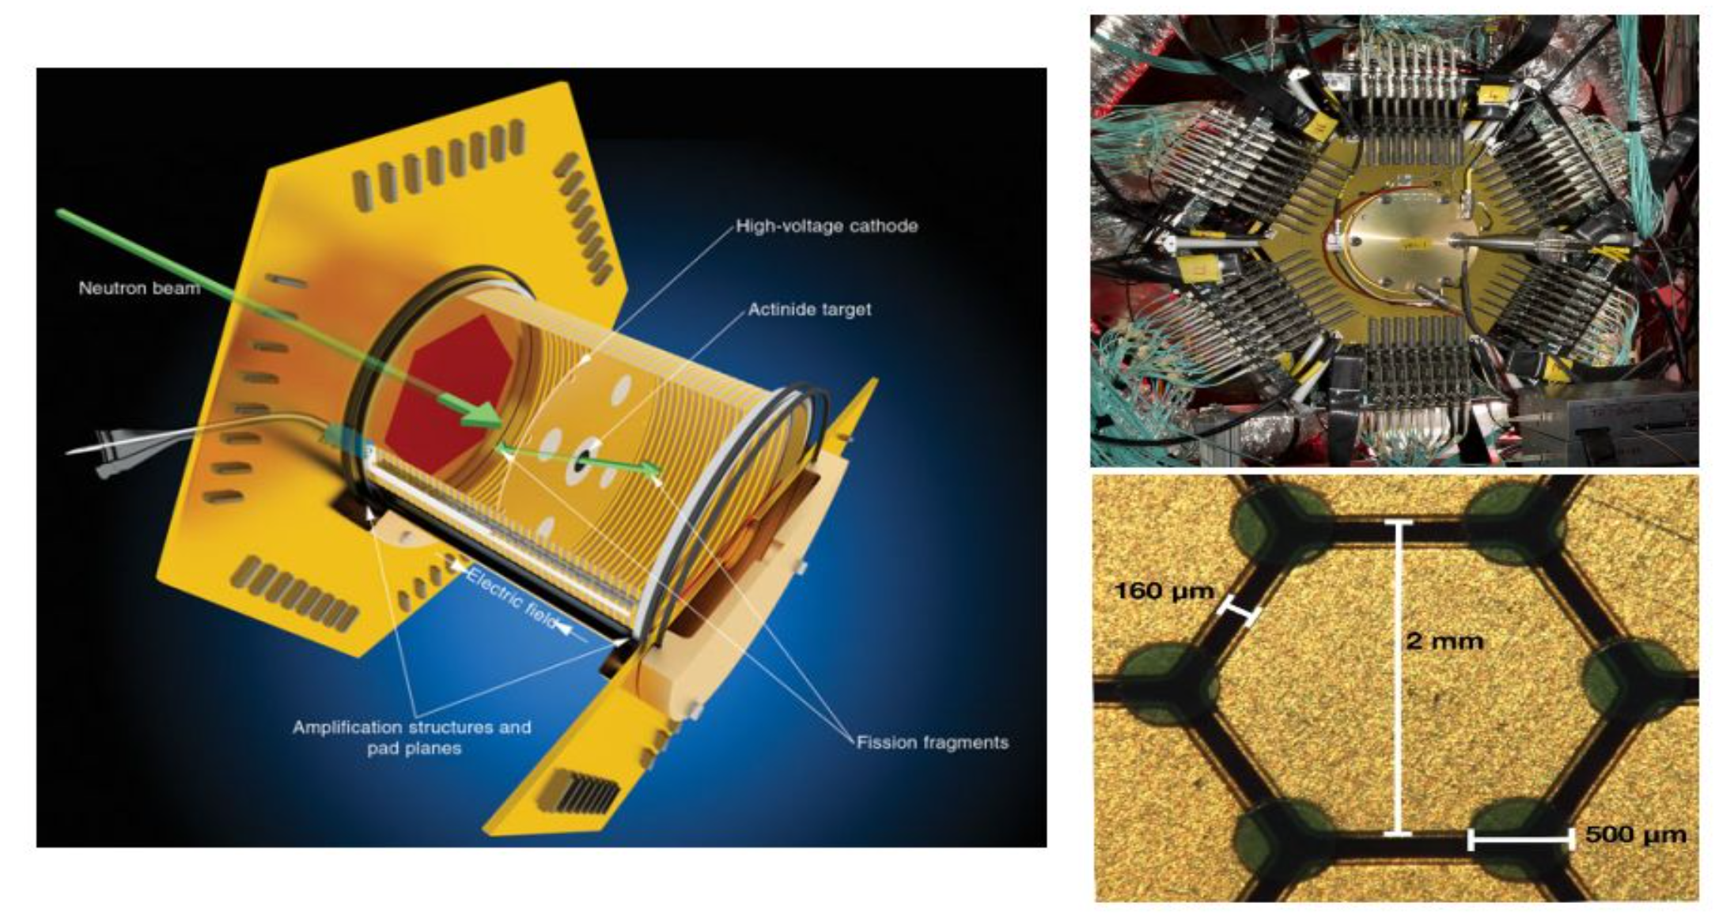
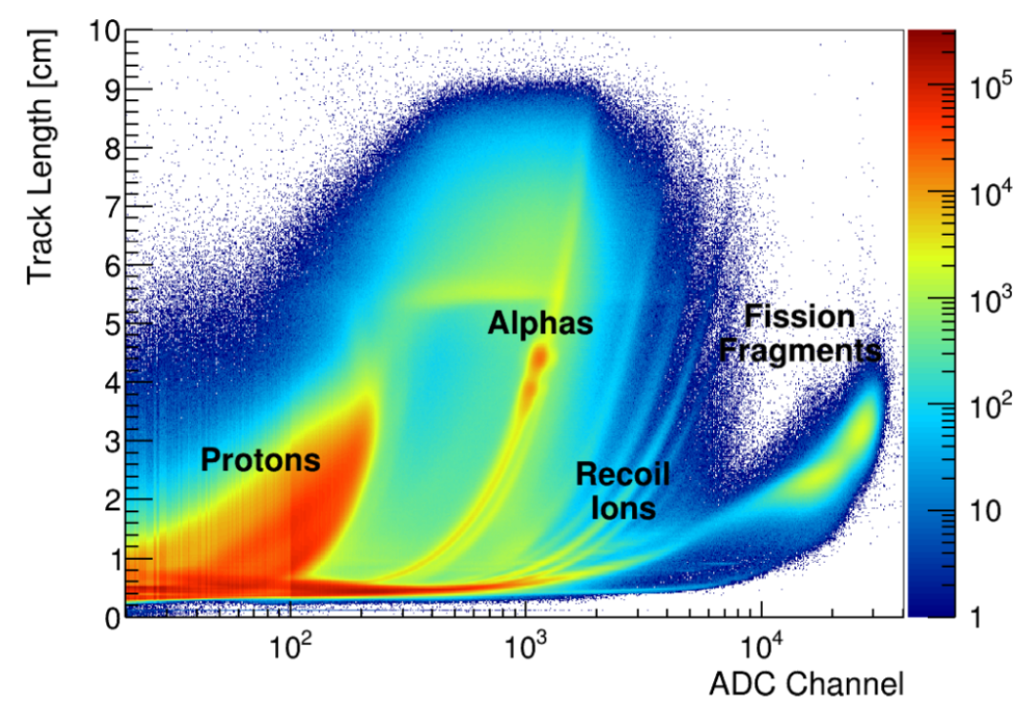
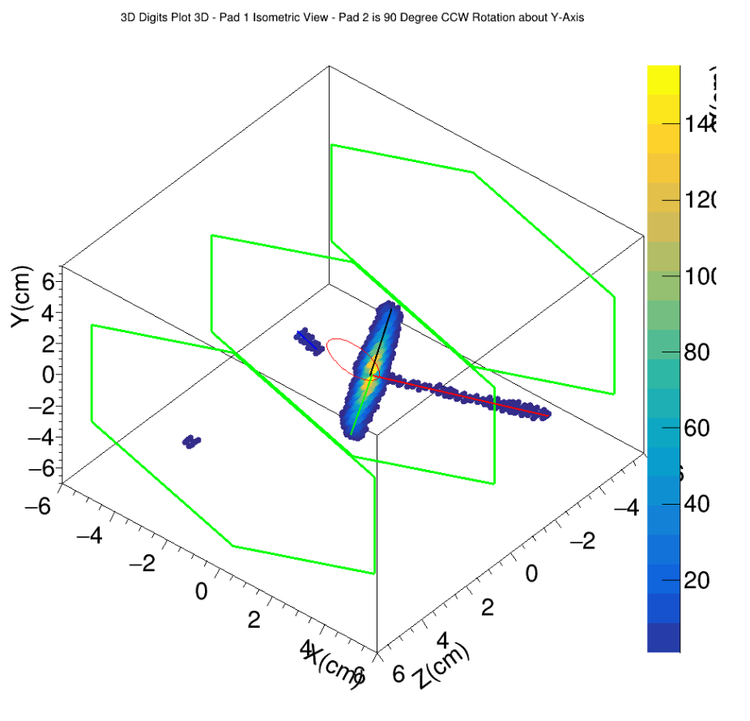
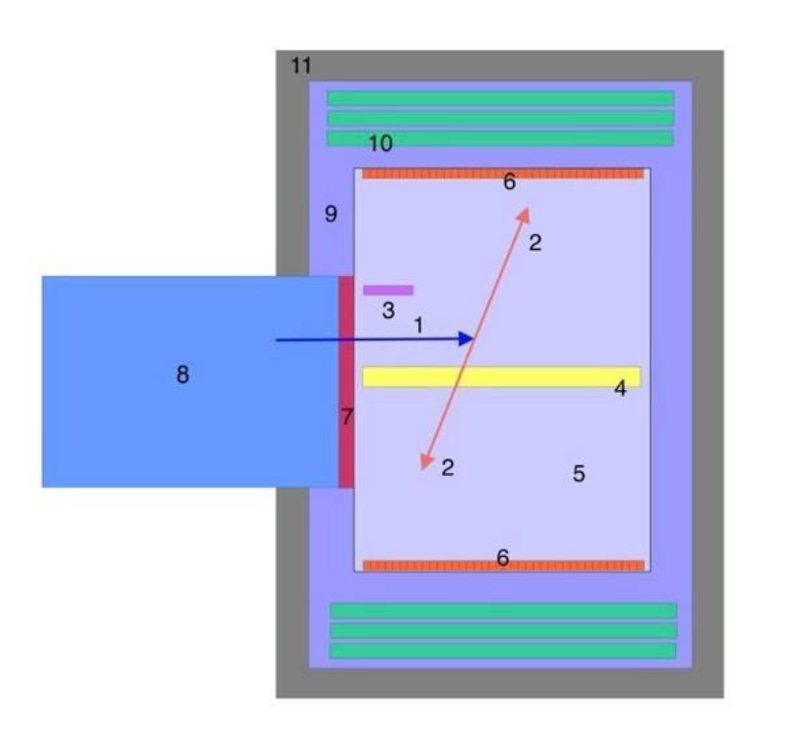
Time projection chamber (TPC)
Ruz J. et al.
The NIFFTE project.
Journal of Instrumentation 8/12 (2013)
TPC-concept for SF study of SHE

Slide 32
- Лидирующие позиции ЛЯР в изучении характеристик спонтанного деления трансфермиевых ядер находящихся под влиянием замкнутой нейтронной оболочки N=152: моды распада, коэффициенты ветвления, множественности нейтронов деления. Область реакций полного слияния с тяжелыми ионами от 0.1 до 1000 нанобарн.
- С вводом в эксплуатацию сепаратора ГРАНД (Фабрика СТЭ) – появляется возможность изучения свойств ядер, лежащих области влияния деформированной нейтронной оболочки N=162. Возможности «Фабрики» позволяют достичь области ядер близких к «острову стабильности», получаемых с сечениями слияния 5-10 пикобарн.
- Использование реакций синтеза СТЭ для изучения продуктов распада лежащих в глубоко-нейтроноизбыточной области. Поиск спектрометрических методов для изучения симметричного и супер-симметричного деления ядер 268Db, и его «соседей».

Slide 33

Спасибо за внимание!

