Slide 1
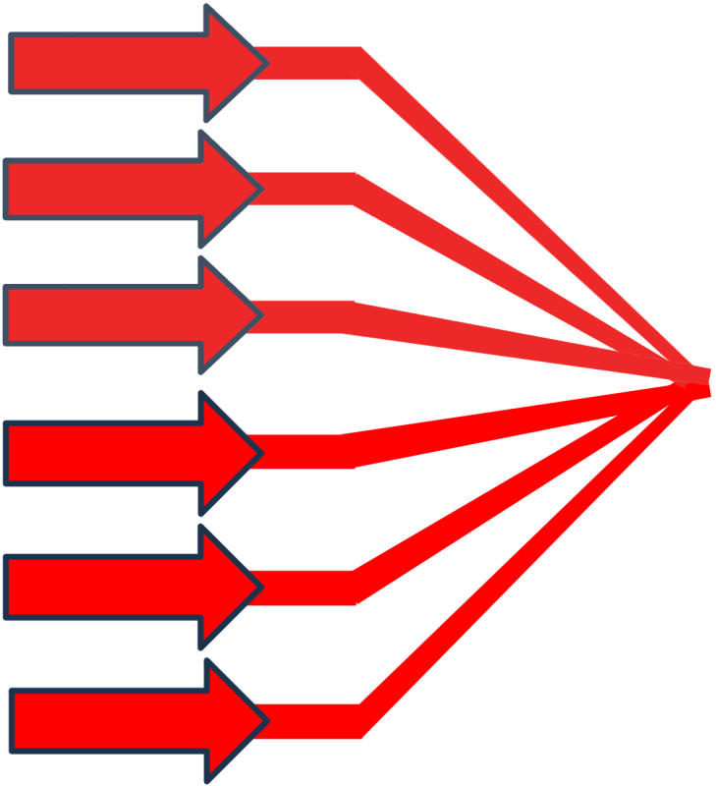
Физика экзаваттных
световых полей
А.М. Сергеев
Национальный центр физики и математики

Slide 2
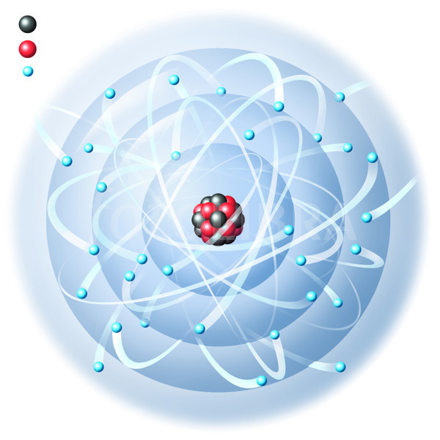
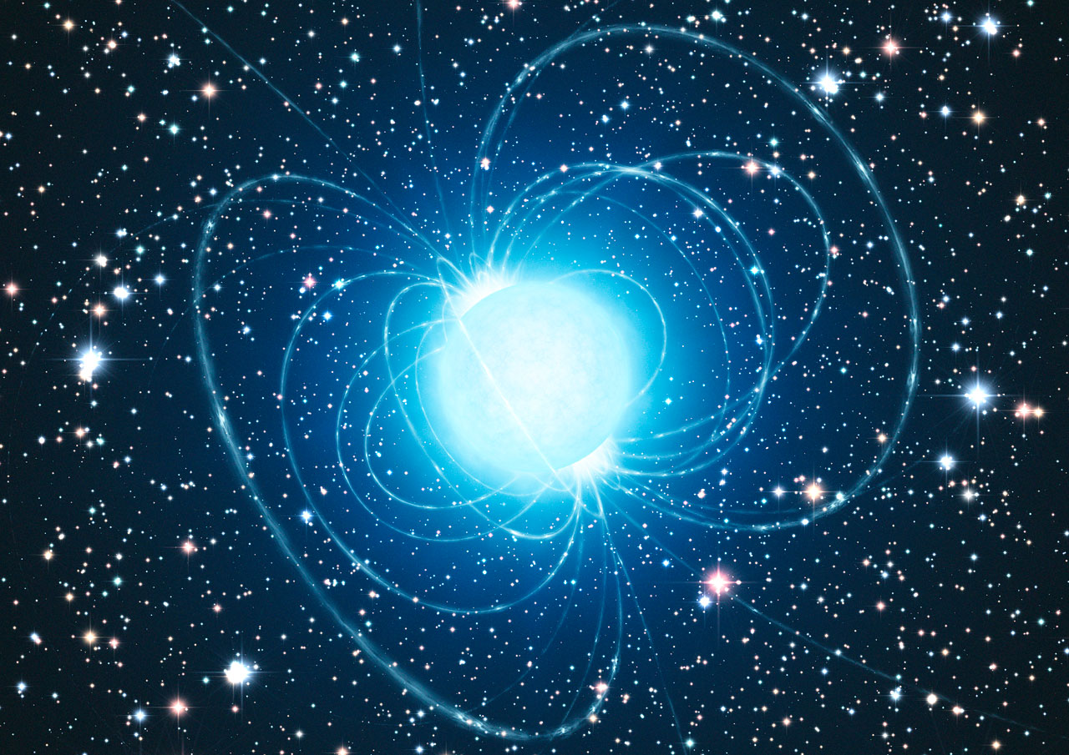
Strong electromagnetic fields in nature
Electric field near the nucleus of atoms of heavy elements
Electric and magnetic fields near the surface of neutron stars

Slide 3
Как достичь максимально возможное поле в лаборатории?
(«Экстремальное световое поле»)
Рубежи сегодняшнего дня
по мощности, интенсивности и длительности лазерных импульсов
W (Дж)
100 Дж
10¹⁶ Вт
E² ̴ I (Вт/см²) =
= 10²³ Вт/см²
=
=
τ (с) S (см²)
10⁻¹⁴с 10⁻⁷см²
10⁻⁷ см²
E ≈ 5 x 10¹² В/см
Фемтосекундные длительности импульсов
Мультипетаваттные пиковые мощности
Фокусировка в пятно с минимальным размером ( ̴ λ² )

Slide 4
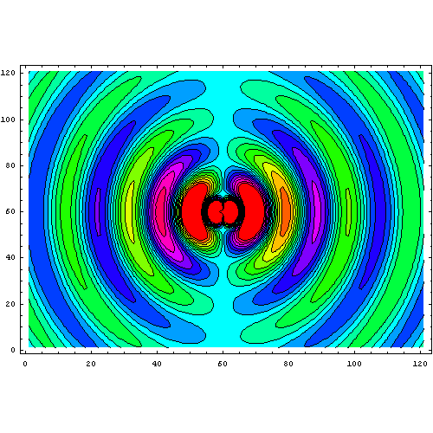
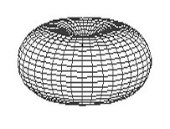
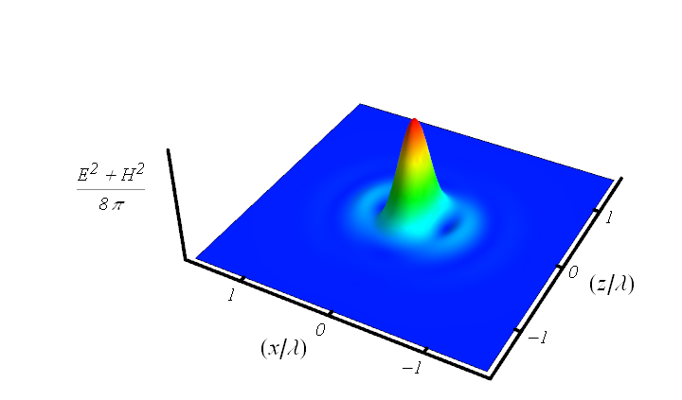


How to achieve the strongest possible field in laboratory?
Rule of thumb for coherent combining of several beams:
To maximize the electric field at focusing point,
radiation of several combining beams should reproduce
configuration of phase conjugated dipole radiation field
I. Gonoskov, A. Aiello, S. Heugel, and G. Leuchs, Phys. Rev. A (2012)
z
x
Minimum focusing volume:
Converging dipole wave as an exact solution of Maxwell equations:

Slide 5
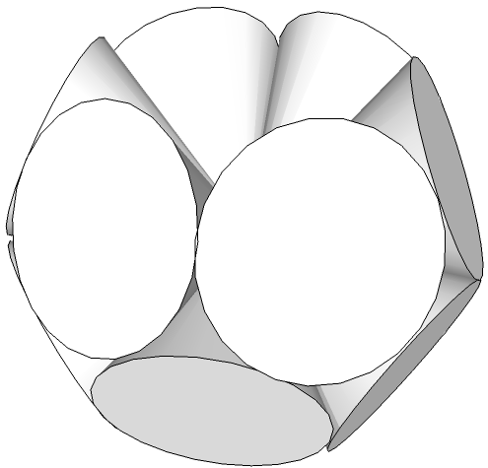
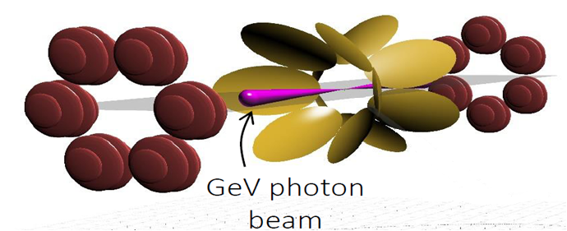
How to achieve intensity of 10²⁴-10²⁶ W/cm² ?
Geometry | Power per channel | Intensity, ×10²⁵W/cm² | I/I(f=1.2) | Equivalent power (f=1.2)
Single beam (f=1.2) | P₀=10 PW | 0.06 | 1 | 10 PW
Single beam (f=1.2) | P₀=200 PW | 1.2 | 1 | 200 PW
Dipole-Wave | P₀=200 PW | 16.7 | 13.9 | 2800 PW
Double-Belt-12 12× (f=0.96) | P₀/12 | 13.4 | 11.2 | 2200 PW
Double-Belt-12
XCELS design: Coherent combining to mimic a converging dipole wave
A. Gonoskov, A. Bashinov, I. Gonoskov,C. Harvey, A. Ilderton, A. Kim, M. Marklund, G. Mourou, A. Sergeev, PRL (2014)

Slide 6
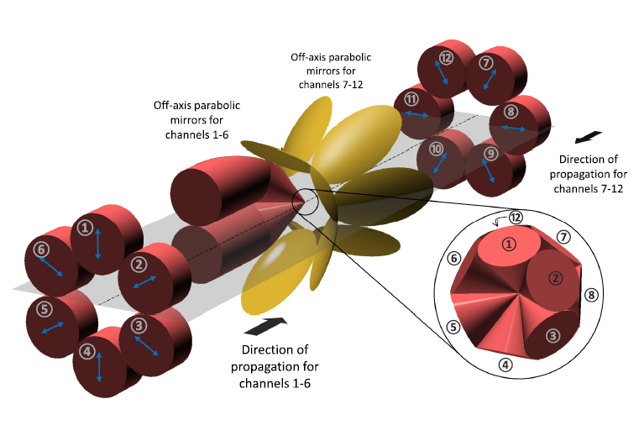
EXAWATT LASER XCELS
(eXawatt Center for Extreme Light Studies)
Vacuum ionization and generation of particles and antiparticles
Generation of ultra-dense ultra-relativistic electron-positron plasma and ultra-high brightness gamma radiation
Directional sources of gamma radiation with photon energies in the GeV range
Generation of attosecond pulses with fields approaching the Schwinger limit
Field holding electron-positron pairs in a quantum vacuum (Schwinger limit) E_{cr} = m²c³ / eħ
Study of the space-time structure of vacuum
Intraatomic field holding an electron in a hydrogen atom E_{a} = m²e⁵ / ħ⁴
Existing installations
XCELS
W/сm²
10¹⁴
10¹⁶
10¹⁸
10²⁰
10²²
10²⁴
10²⁶
10²⁸
10³⁰
E_{cr} / E_{a} ≈ 137 ³ ≈ 2.6 10 ⁶

Slide 7
Extreme Light Fields in Vacuum

Slide 8


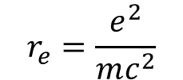

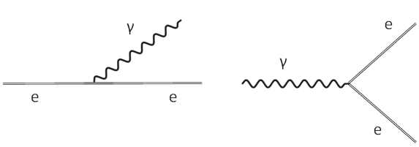


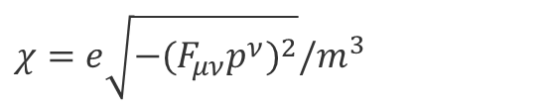

Basic parameters and elementary processes
normalized field strength
radiation reaction
photon emission (Compton scattering)
photoproduction пар
$χ=e\sqrt{−(F_{μν}p^{ν})^{2}}/m^{3}$
$$≈γ\frac{ E}{E_{cr}}$$
χ>1 – квантовый режим (эффект отдачи и зависимость от спина)
- relativistic plasma frequency

Slide 9
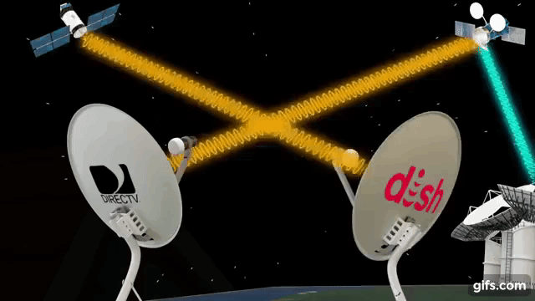
Nonlinear interaction of waves in vacuum
The uncertainty principle leads to the possibility of the birth of virtual particle-antiparticle pairs. The quantum vacuum is filled with virtual particles.
Classic vacuum
Quantum vacuum
In the framework of classical electrodynamics, corresponding to a low intensity of EM radiation, EM waves do not interact with each other.
According to quantum electrodynamics (QED), at high intensity, EM waves interact with each other.
E. Lundstrom et al., Phys. Rev. Lett. 96, 083602 (2006).

Slide 10
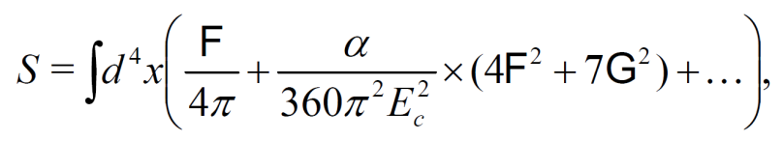
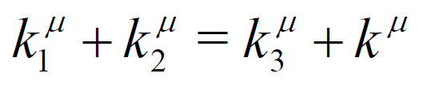
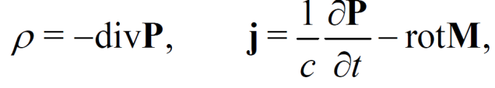
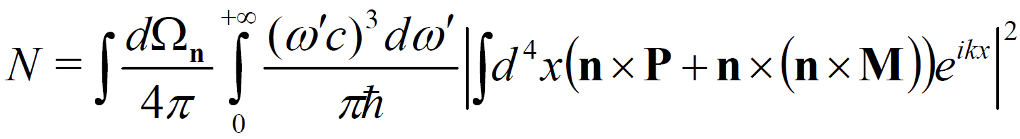
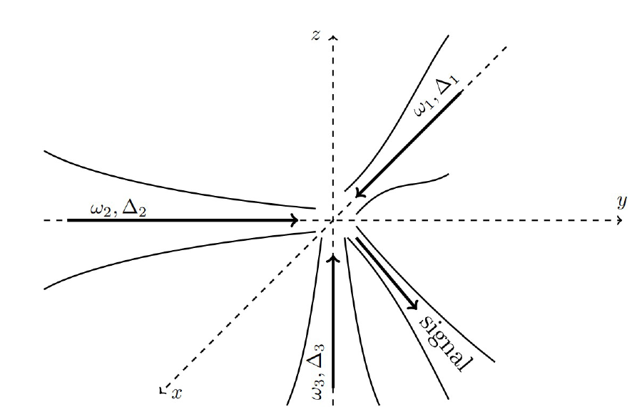
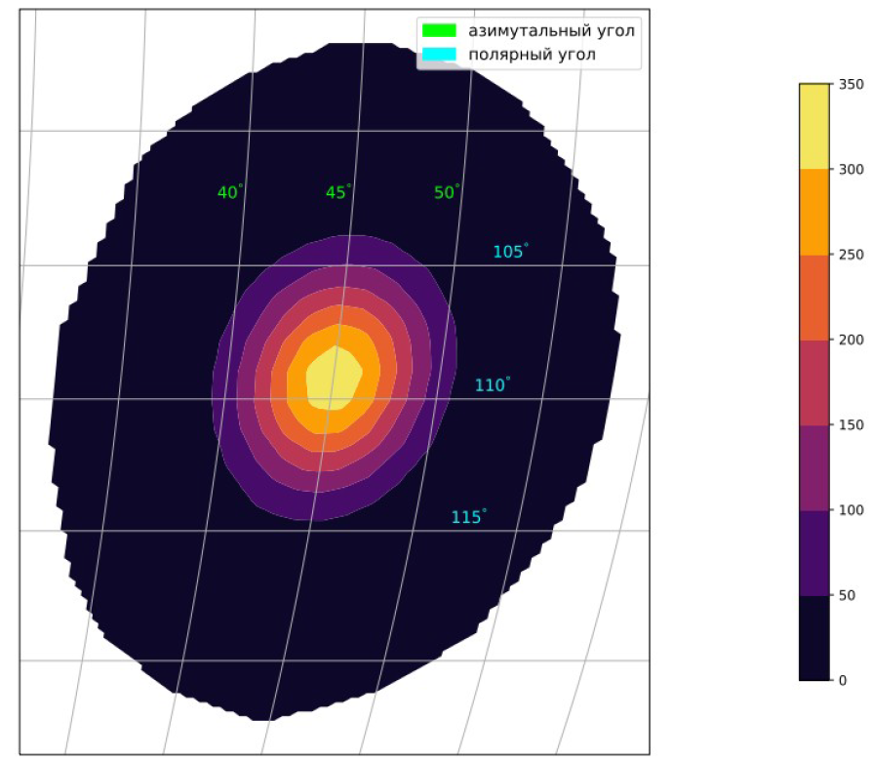
Nonlinear interaction of waves in vacuum
А.В. Березин, А.М. Федотов, Квантовая Электроника , т. 53, в. 2 (2023).
Experiments can be already carries out on the two-channel XCELS-100 prototype: one beam is transferred to the second harmonic and divided in half, the second beam is used at the main harmonic, the signal is collected at the third harmonic

Slide 11
Extraordinary particle dynamics in fields with intensity > 10²³ W/cm²
Radiation dominated regime:
Particles become efficient convertors of energy from optical to gamma range
Trajectories of particles
change dramatically;
no more relativistic Newton
mechanics
New sources of
gamma radiation:
controlled, brilliant,
collimated
New state of matter:
strongly coupled
optical fields, ultrarelativistic
electron-positron plasma and
gamma radiation
Advanced Instrument for Modeling: A.Gonoskov et al Phys. Rev. E92 (2015)

Slide 12
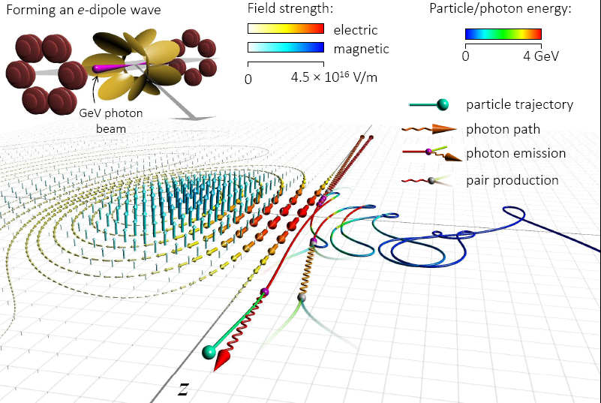
Radiative particle capture and gamma ray emission
A. Gonoskov, A. Bashinov, I. Gonoskov,C. Harvey, A. Ilderton, A. Kim, M. Marklund, G. Mourou, A. Sergeev, PRL (2014)

Slide 13
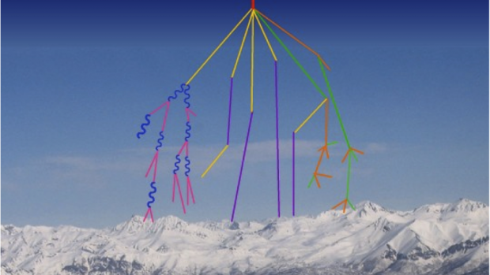
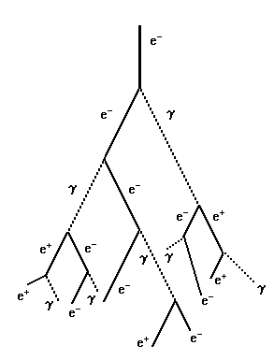
Quantum electrodynamics (QED) and processes in extremely strong fields
A.R. Bell and J. G. Kirk, Phys. Rev. Lett. (2008)
A.M. Fedotov, N. B. Narozhny, G. Mourou, G. Korn, Phys. Rev. Lett. (2010)
E. N. Nerush, I. Yu. Kostyukov, A. M. Fedotov, N. B. Narozhny, N. V. Elkina, and H. Ruhl,
Phys. Rev. Lett. (2011)
V.F.Bashmakov, E.N.Nerush, I.Yu.Kostyukov, A.M.Fedotov, N.B.Narozhny
Phys. Plasmas (2014)
Message: Vacuum behaves like a rather dense dielectric medium at ionization.
Cascades start at much lower fields (10²⁴-10²⁵ W/cm²) as compared to
Sauter-Schwinger limit (10²⁹ W/cm²)

Slide 14
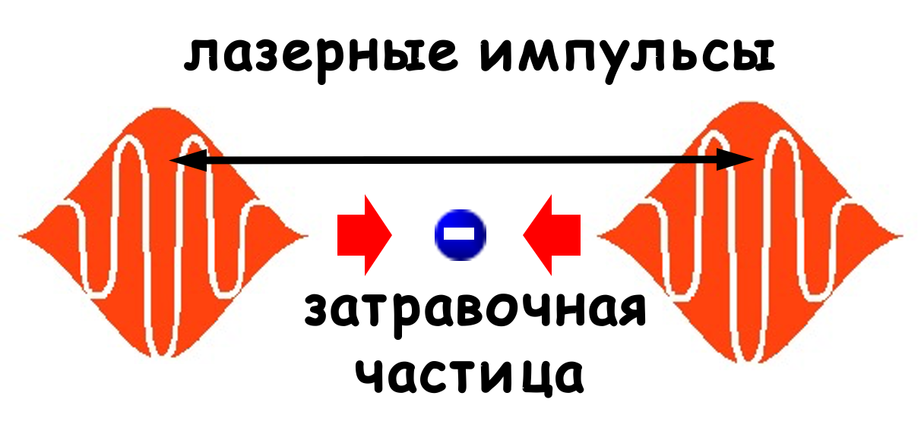

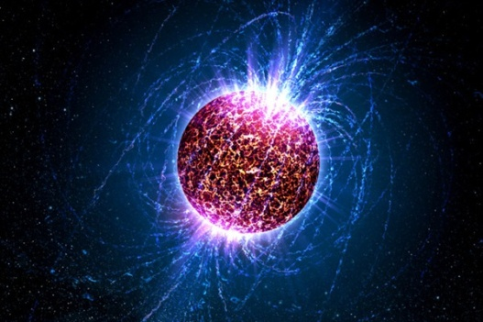
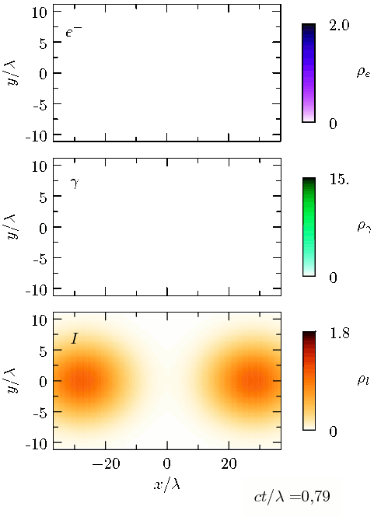
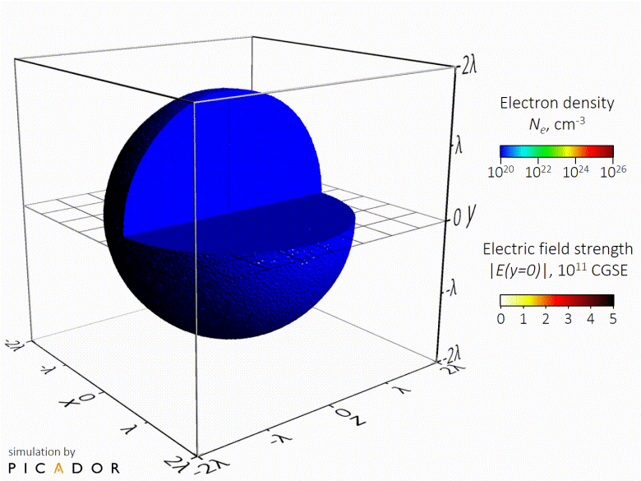
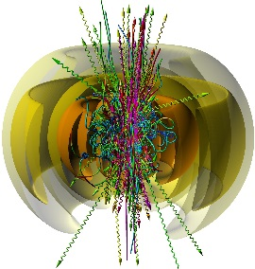
QED cascades: converting light into matter
laser impulses
seed particle
E.N. Nerush et al., PRL 106, 035001 (2011).
A. Gonoskov et al., Phys. Rev. X 7, 041003 (2017).

Slide 15
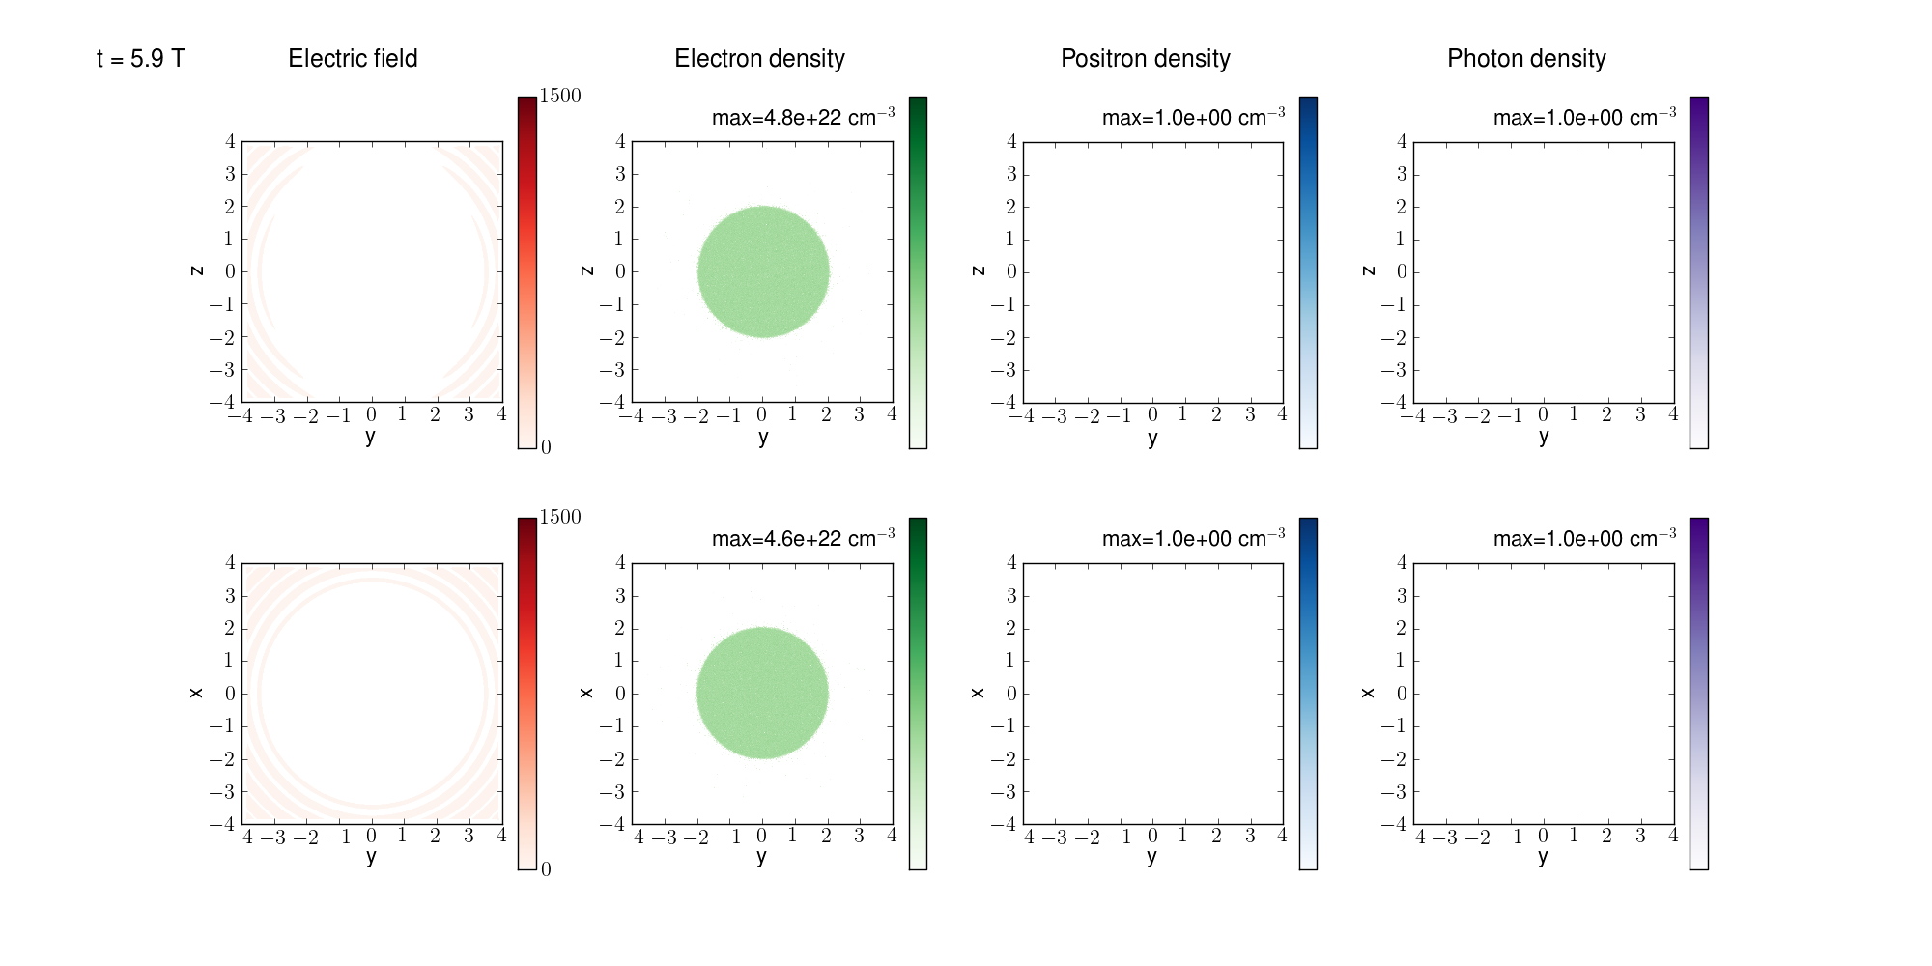
QED cascades in a converging dipole wave
P=100 PW, t=5.9 T

Slide 16
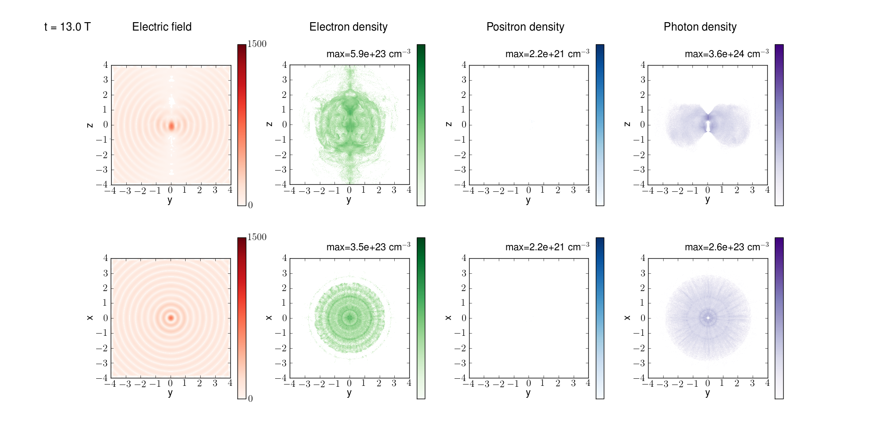
QED cascades in a converging dipole wave
P=100 PW, t=13 T

Slide 17
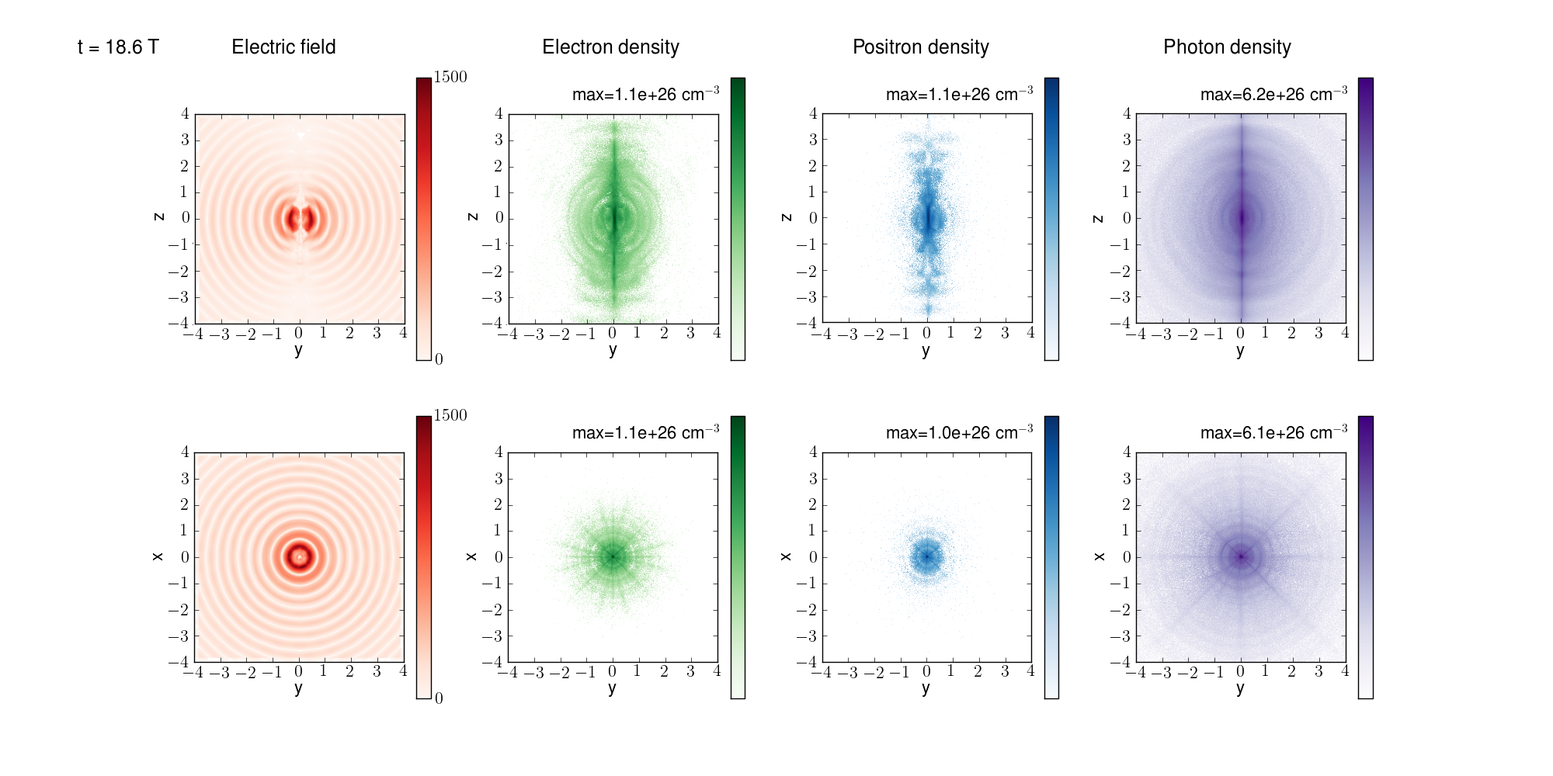
QED cascades in a converging dipole wave
P=100 PW, t=18.6 T

Slide 18
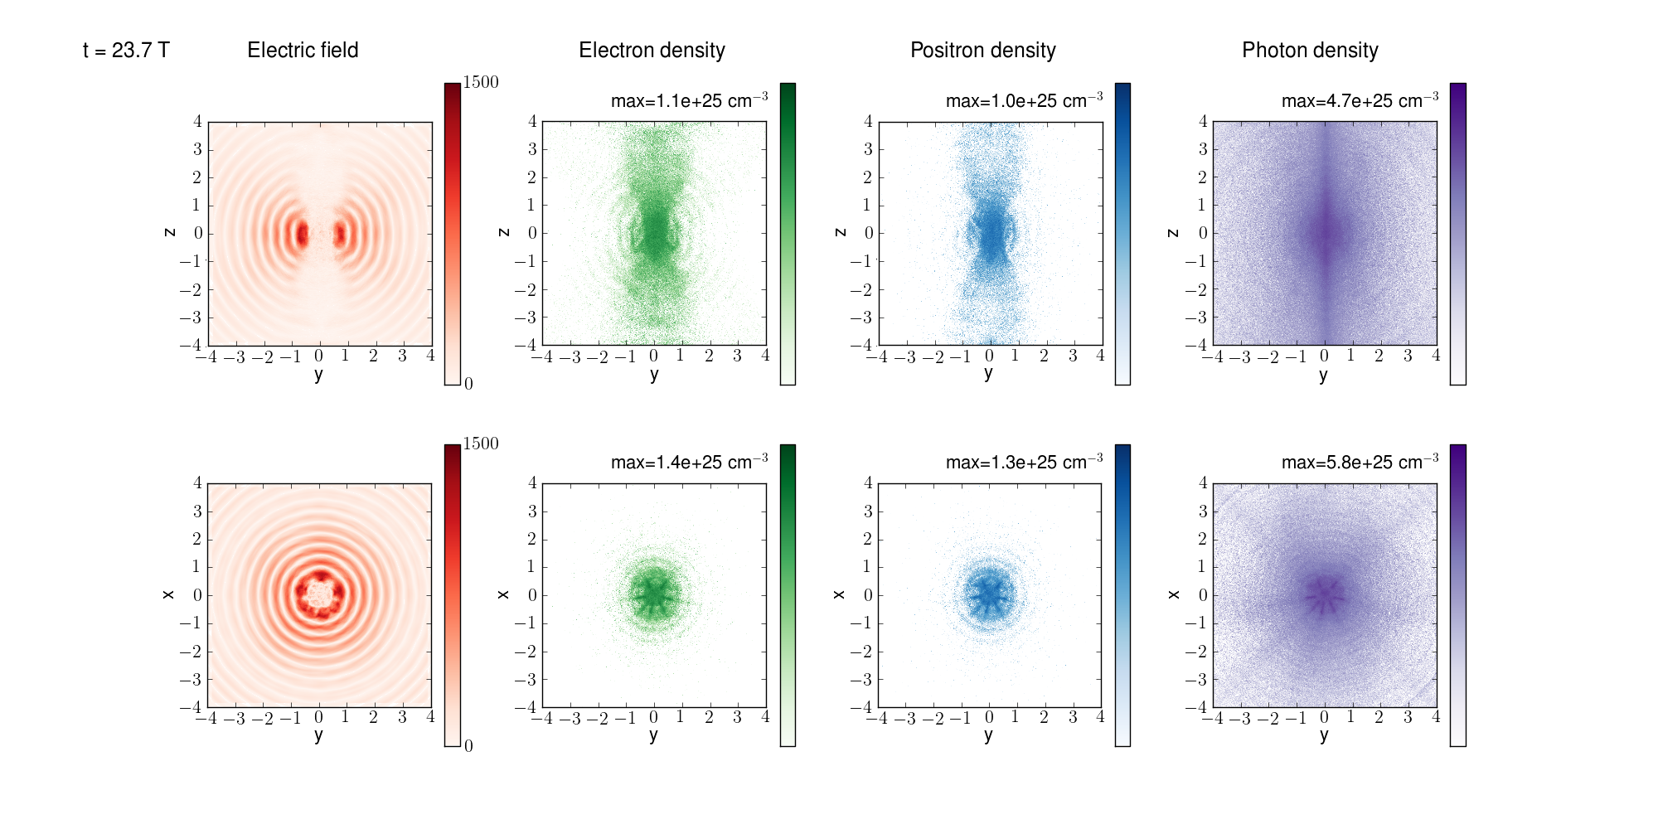
QED cascades in a converging dipole wave
Max electron density > 10 ²⁶ cm⁻³,
Max photon density 6 10 ²⁶ cm⁻³,
10¹³ photon/pulse (E>100 MeV), 10¹⁰ photon/pulse (E>1 GeV)
Limitation by optical pulse refraction from plasma
How nuclei behave in this environment? Can we observe γ-γ collision effects? …………?

Slide 19
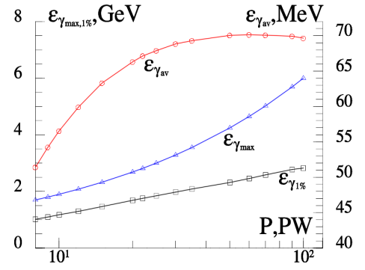
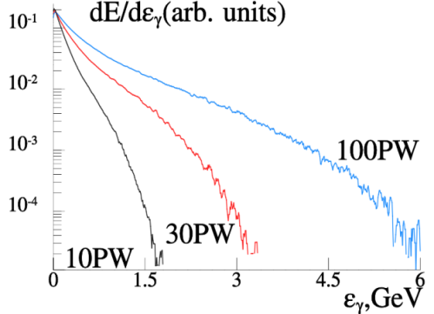
Characteristics of the gamma radiation source
Left. Dependence of average (red line with circles), maximal (blue line with triangles) photon energy and energy at the level 1% (black line with squares) on incoming power P.
Right. Normalized spectra of electron-positron plasma radiation for 10, 30 and 100PW.

Slide 20
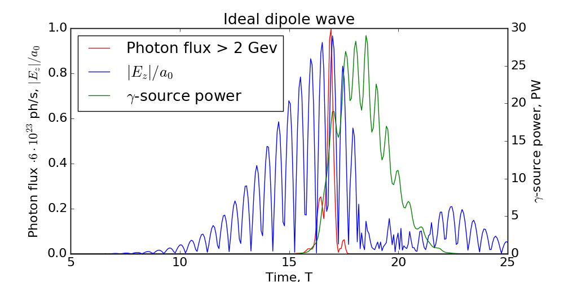
Gamma photon output for an ideal dipole wave
2 GeV photons are emitted only near the maximum of the laser pulse producing sub-period gamma burst
The rear part of the pulse is transformed to gamma quanta with the lower energies almost completely, resulting in overall 34% efficiency (40 PW laser power)

Slide 21
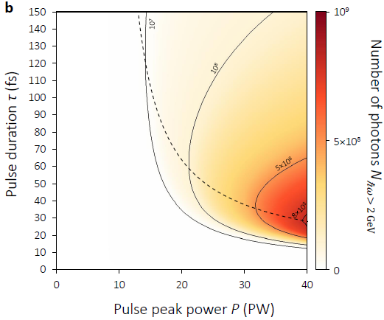
Optimization of GeV photon yield
Nonlinear stage begins at leading edge
Nonlinear stage begins at peak of pulse
There is no nonlinear stage, or nonlinear stage begins at rear front
Maximum photon number slightly vary for power P>40 PW

Slide 22
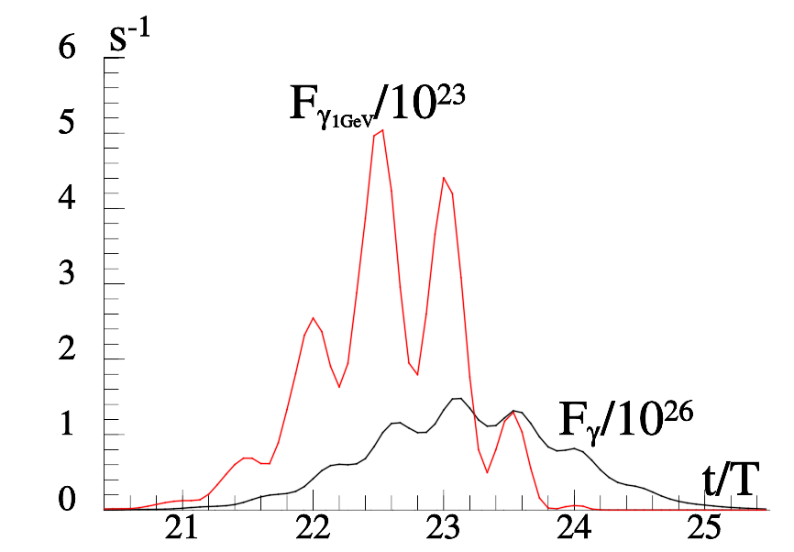
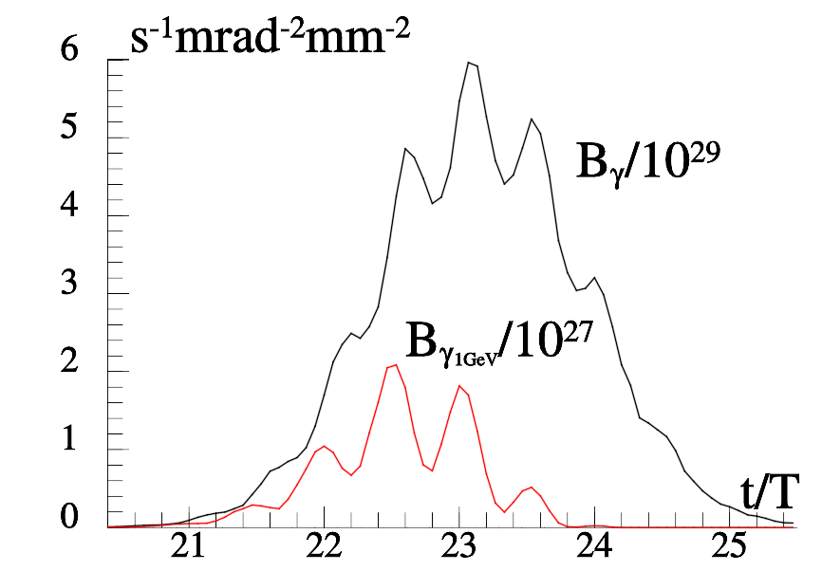
Optimizing the brightness of a GeV photon source
How to make the most brilliant gamma source?
Do not allow degradation of optical wave structure (shorter pulse)
In the case of particular experiments for the Gaussian pulse with the peak power P = 40PW, the duration of τ = 15 fs and the density of the target 10¹⁶cm⁻³. The measured flux and brilliance are shown as a function of time. The duration of the generated gamma pulse is 4.5 fs, maximal brilliance is 6 10²⁹ s⁻¹mrad⁻²mm⁻² , the number of photons for energies >100MeV is 10¹¹. The photon flux for energies greater 1 GeV is 510²³s⁻¹, number of photons is 10⁹.The beam width for the gamma photons is 2 mrad.
A.Gonoskov, A.Bashinov, E.Efimenko et al., PRX, 2017

Slide 23
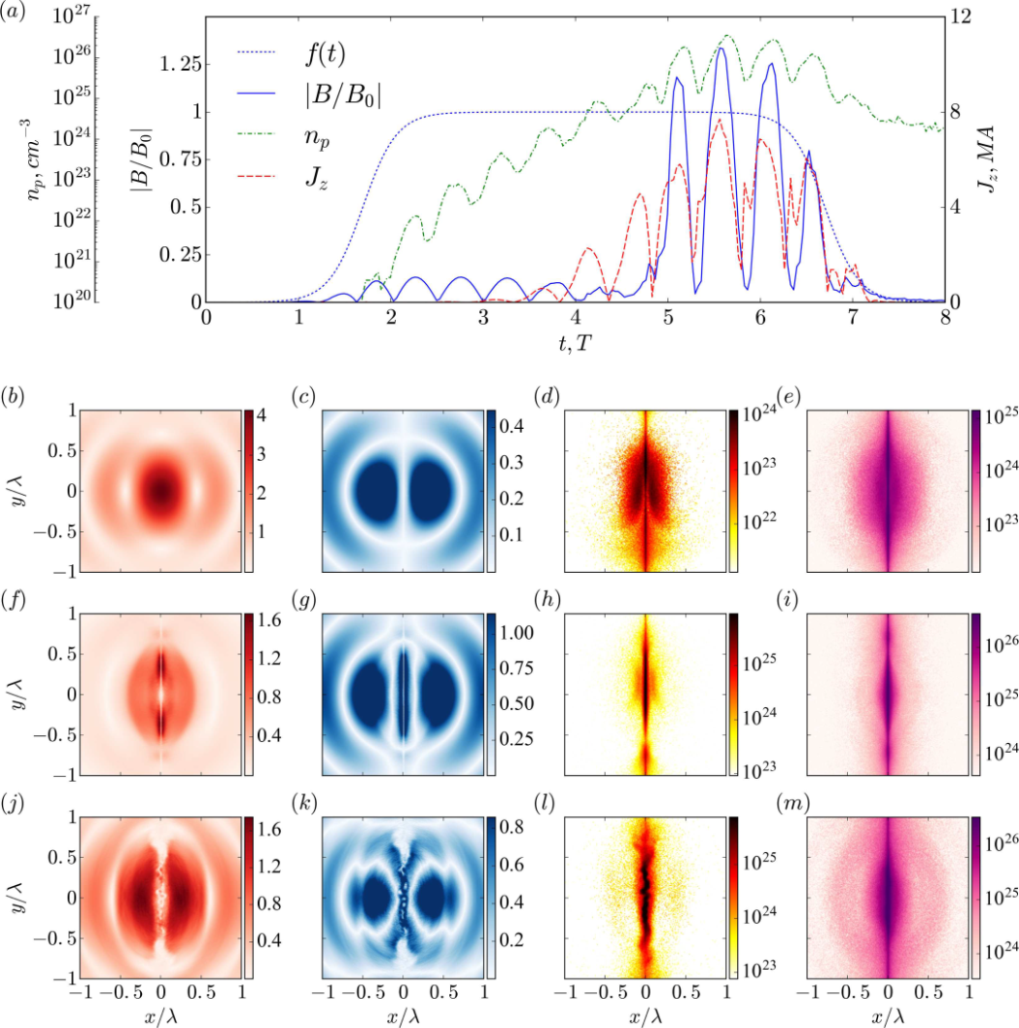
Plasma pinch in e-e+ cascade at pulse power >20 PW
Plasma-field dynamics for 27 PW. (a) Temporal evolution, f(t) - laser pulse envelope, B/B0 -magnetic field in the plane z = 0 at = 1/60, np – maximum pair density, Jz - current through the cylinder with radius 0.1. Electric (b,f,j) and magnetic (c,g,k) fields, positron (d,h,l)and photon (e,i,m) distributions at the stages of (b-e) linear QED cascade, (f-i) plasma column pinching and (j-m) pinch breakdown due to bending instability.
E.S. Efimenko et al “Laser-driven plasma pinching in e−e+ cascade” Phys.Rev. E (2019)

Slide 24
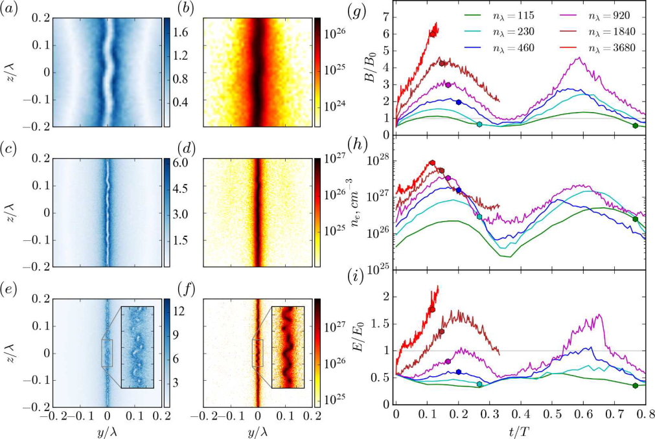
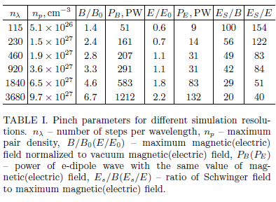
Plasma pinch in the e-e+ cascade and approach to the Schwinger field
B/Es =1/20 corresponds to 10 ²⁷W/cm²

Slide 25
Laser-Plasma Accelerators of
Charged Particles

Slide 26
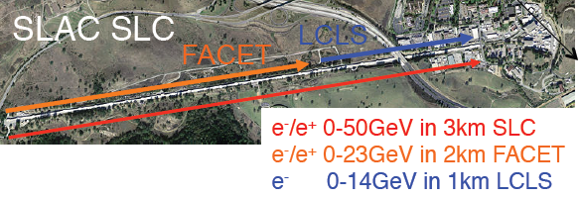
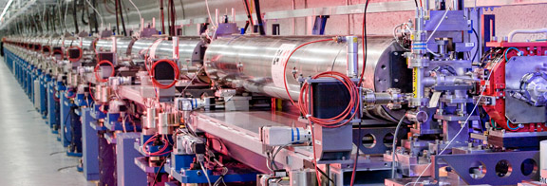
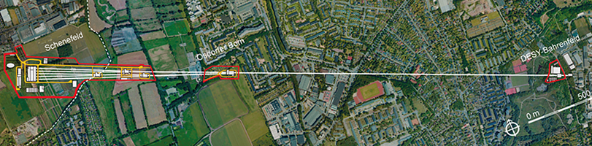
World’s largest linear accelerators
SLAC Linac Coherent Light Source (США)
Accelerating field E= 30 MeV/m
Maximum energy 14 GeV
Accelerator length 1 km
XFEL (Германия)
Accelerating field E= 23.6 MeV/m
Maximum energy 17.5 GeV
Accelerator length 1.7 km
Fields in microwave resonators of linear accelerators are limited to 50 MV/m,
which is related to the resistance of walls made of superconducting materials

Slide 27
Is it possible to accelerate electrons with a laser field?
Electric fields in petawatt laser pulses have enormous values
E (B/см) = 30 I (Вт/см²)^{1/2}
“Atomic fields" I = 3 10 ¹⁶ Вт/см² E = 5 10 ⁹ В/см
"Relativistic intensity" I = 3 10 ¹⁸ Вт/см² E = 5 10¹⁰ В/см
Maximum achieved intensity I = 3 10 ²² Вт/см² E = 3 10¹² В/см
Maximum field in accelerators in total Е = 5 10 ⁵ В/см
How to use laser pulses to accelerate electrons?
Accelerating electrons with a laser pulse in a vacuum is ineffective

Slide 28
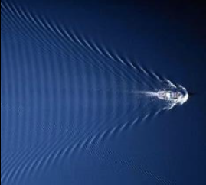
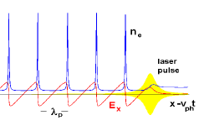

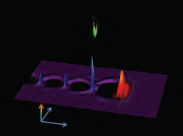
Wakewave generation in plasma
T.Tajima and J.M.Dawson
"Laser Electron Accelerator",
PRL, 43, 267 (1979)
Obtained in the experiment:
Accelerating fields ~ 1 GeV/cm
Electron energies ~ 5 GeV
Monoenergetic - several percent
Application prospects:
Tabletop X-ray FELs
Sources of Compton radiation
Surface wakewave behind a ship
Plasma wave behind a laser pulse
Surfer acceleration
Acceleration of an electron bundle

Slide 29
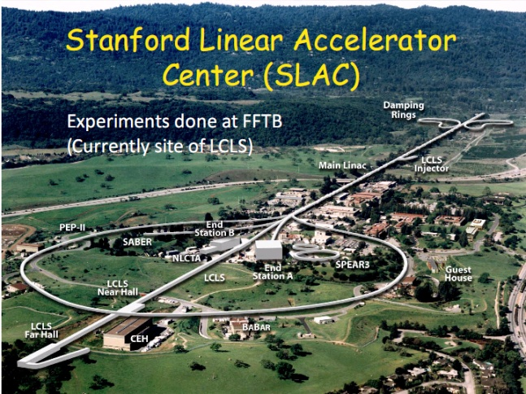
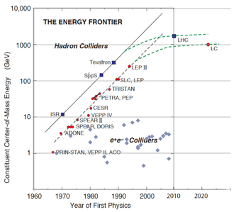
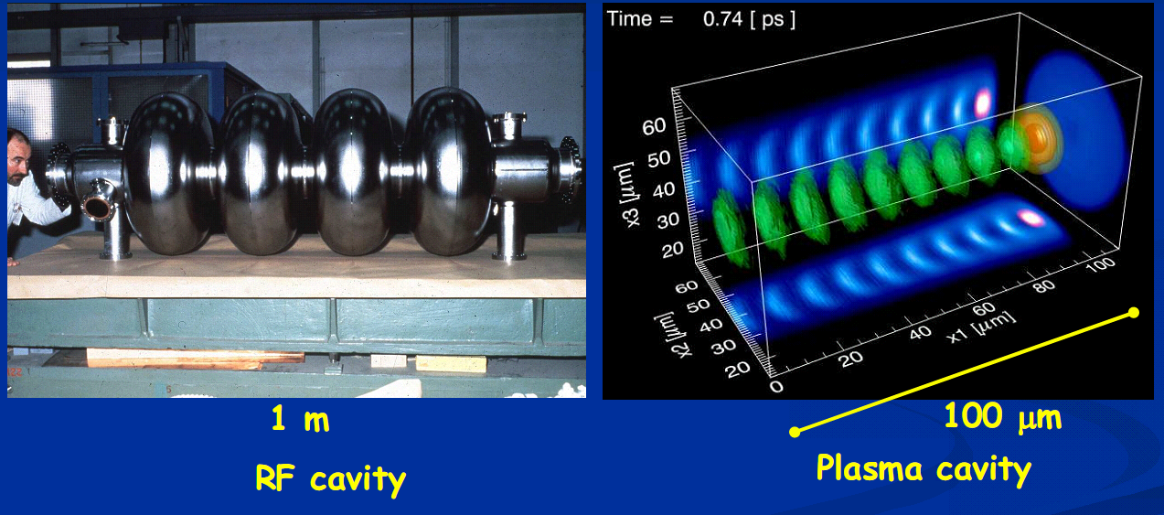
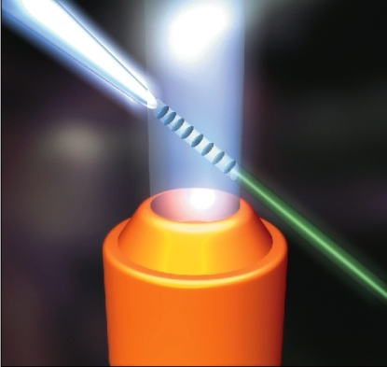
Laser acceleration of electrons
energy of accelerated particles on a time scale
accelerator structure
of radio frequency accelerator
accelerator structure of laser-plasma accelerator
focusing a laser pulse into a gas jet to generate accelerated electrons
High-energy electron accelerators are very large and expensive machines, which limits their widespread use in various fields of human activity. At the same time, laser fields are several orders of magnitude stronger than the accelerating fields in conventional accelerators, and the laser-plasma accelerating structure can be several orders of magnitude shorter than a conventional accelerating structure. This can be used to create compact accelerators.

Slide 30




Laser acceleration of electrons
3 см
laser system PEARL at IAP RAS
energy spectrum of accelerated electrons in laser acceleration experiments at the Institute of Applied Physics RAS
S.E. Perevalov et al., Plasma Phys. Contr. Fusion 62, 094004 (2020).

Slide 31




Laser acceleration of electrons with multi PW pulses
Wake-field acceleration
Max electron energy gain in 1D wake field
S. Gordienko, A. Pukhov, Phys. Plasmas 12, 043109 (2005).
W. Lu et al., Phys. Rev. ST Accel. Beams 10, 061301 (2007).
Low density plasma with an extended interaction region within a channel is promising for high-gain low-charge electron bunch acceleration. A large target chamber (10 m) installation can be used.
Q=50 pC, L=70 m
M.S. Dorozhkina et al, Laser Acceleration in Plasma Channel, vol. 53, 2 (2023).
Bubble regime acceleration
E =( 0.2 – 2) GeV , Q > 0.1 μC
Bubble regime is convenient for large-charge electron bunch acceleration to multi GeV particle energy. Few cm length dense plasma is required
V. Yu. Bychenkov, M. G. Lobok, Quantum Electronics, vol. 53, 2 (2023).
N.E. Andreev et al., Quantum Electronics, vol. 53. 3 (2023).

Slide 32



Multi-stage electron acceleration
C. B. Schroeder et al., Phys. Rev. STAB 13 101301 (2010).
S. Steinke et al., Nature 530, 190 (2016).
60-100 GeV at 3-5 accelerator cascades (effective acceleration length 6-10 m)
M.E. Weisman et al., Quantum Electronics, vol. 53, 2 (2023).
3-stage acceleration of electrons to an energy of 1 GeV with a beam charge of 400 nC is presented.
E.M.Starodubtseva et al., Quantum Electronics, vol. 53, 3 (2023).

Slide 33

Laser Ion Acceleration

Slide 34

Laser Ion Acceleration in the «Light Sail» Regime

Slide 35


Laser Ion Acceleration
Numerical calculations predict production of proton beams with proton energy above 100 MeV, the total beam energy above 30 J, and the energy conversion rate of a linearly polarized laser pulse to accelerated protons > 9%.
A.V. Brantov et al., Laser acceleration of ions using low-density targets, Quantum Electronics vol. 53, v. 2-3 (2023).
In the «Light Sail» regime with a circularly polarized laser pulse, generation of ion beam with particle energy 1.7 GeV/nuclon, conversion efficiency to ions up to 40%, and the beam charge above 50 nC for particle energy 500 MeV/nuclon is predicted
A.S. Samsonov, I.Yu. Kostyukov, Acceleration of ions by radiation pressure during the interaction of an extremely intense circularly polarized laser pulse with a solid target, Quantum Electronics, vol. 53, v. 2-3 (2023).

Slide 36
Laser Factories of Particles

Slide 37


Ultrabright Neutron Source
Generation of laser-heated particles (deuterons) of moderate energies and thermonuclear neutrons in a large volume of a cluster medium. An example of such a medium is a heavy water spray containing deuterium. The expected brightness of neutron burst exceeds 10¹⁸ particles/(сm² s) at total 4π-yield 10⁹ particles/sr for laser pulse energy 300 J, which is interesting for ultrafast neutron radiography.
D.A. Gozhev et al., Pulsed source of charged particles and neutrons based on a 10 PW laser system irradiating a micro-cluster medium, Quantum Electronics, vol. 53, N3 (2023).

Slide 38




Sources of Other Particles (pions, positrons, etc)
Required acceleration: 1) of electrons up to several GeV energy and subsequent gamma rays brehmstralung , 2) of ions up to several hundred MeV to achieve the threshold of pion excitation 140 MeV
Spectra of pions (π±-pions – black, π⁰– red) beyond Tantal convertor, by irradiation with laser accelerated electron beams (laser pulse 25 PW, 25 fs, 7 10²² W/сm²) or protons (dashed and solid lines, respectively). Calculations predict about 10⁸ pions per pulse.
A.V. Brantov et al., Laser meson factory, Quantum Electronics, vol. 53, N 3, (2023)
Electron bunches with several hundred MeV energy and several nC charge are required to initiate pair production due to photon generation in Bethe-Gaitler process and e– e+-decay in the Coulomb field of large Z ions of a Ta target.
Spectra of positrons at different thickness of Ta target. Calculations predict a record number 10¹²of positrons per laser pulse.
M.G.Lobok et al, Quantum Electronics, vol. 53, N 3, (2023)

Slide 39
Laboratory Astrophysics

Slide 40




Laboratory Astrophysics
лазер
z
поток плазмы
магнитное поле
x
y
Soloviev A.A., Burdonov K.F., Kotov A.V. et al. Radiophysics and Quantum Electronics 63, 876 (2021).
B. Khiar et al. PRL 123, 205001 (2019)
C. M. Huntington et al. Nature Physics 2015
Observation of relativistic reconnection of magnetic lines in colliding plasma clouds produced by several superstrong laser pulses
A.D.Sladkov, A.V.Korzhimanov, Quantum Electronics, v. 53, 4 (2023).

Slide 41
Laboratory astrophysics
лазер
z
поток плазмы
магнитное поле
x
y
Soloviev A.A., Burdonov K.F., Kotov A.V. et al. Radiophysics and Quantum Electronics 63, 876 (2021).
B. Khiar et al. PRL 123, 205001 (2019)
C. M. Huntington et al. Nature Physics 2015
A.D. Sladkov, A.V. Korzhimanov, Observation of relativistic magnetic reconnection in colliding plasma clouds generated by several high-power laser pulses, Quantum Electronics, vol. 53, v. 4 (2023).

Slide 42
Study of Fundamental Processes in Research Program of National Center of Physics and Mathematics

Slide 43




FUNDAMENTAL SCIENCE
Flagship projects of the “megascience” class
Photonic computing machine
with performance up to 10²² operations per second
Center for Extreme Light Field Studies
based on a laser complex with exawatt power
Multifunctional accelerator complex
with a Compton gamma radiation source of a record luminosity of 10¹¹ photons/s

Slide 44
EXAWATT LASER XCELS
(eXawatt Center for Extreme Light Studies)
Vacuum ionization and generation of particles and antiparticles
Generation of ultra-dense ultra-relativistic electron-positron plasma and ultra-high brightness gamma radiation
Directional sources of gamma radiation with photon energies in the GeV range
Generation of attosecond pulses with fields approaching the Schwinger limit
Field holding electron-positron pairs in a quantum vacuum (Schwinger limit) E_{cr} = m²c³ / eħ
Study of the space-time structure of vacuum
Intraatomic field holding an electron in a hydrogen atom E_{a} = m²e⁵ / ħ⁴
Existing installations
XCELS
W/сm²
10¹⁴
10¹⁶
10¹⁸
10²⁰
10²²
10²⁴
10²⁶
10²⁸
10³⁰
E_{cr} / E_{a} ≈ 137 ³ ≈ 2.6 10 ⁶

Slide 45




OPCPA technique - parametric amplification of frequency-modulated optical pulses in nonlinear wide-aperture crystals
Petawatt parametric femtosecond laser at IAP RAS
Power 1.5 PW, pulse duration 11 fs
DKDP Wide Aperture Water Soluble Crystal Factory
Size up to 40x40 сm²
12 channels
50 PW per channel
Duration up to 10 fs
Focusing to a spot of 1-3 microns
Coherent addition possible
Intensity > 10²⁵ W/сm ²
Pumping with a megajoule nanosecond laser

Slide 46



PHOTONIC COMPUTING MACHINE
The technological limit of performance using traditional electronic microchips has almost been reached. A new approach is needed that uses a different storage medium - PHOTONS INSTEAD OF ELECTRONS - to record, transmit and process information.
PHOTONIC COMPUTERS
Optical component base classical (non-quantum) states of light
Goals:
Creation of optical chips
Parallel calculations for different wavelengths, polarizations or optical pulses
Optoelectronic interfaces
SPECIALIZED COMPUTING DEVICES WITH HYBRID ARCHITECTURE
Solving special problems in the field of numerical modeling of complex systems, artificial intelligence and processing of large data sets
(for example, matrix multiplication and matrix-vector multiplication on an optical processor)
A hybrid optoelectronic computer will be created based on optical coprocessors with a performance of up to 10²¹ operations per second

Slide 47


MULTIFUNCTIONAL ACCELERATOR COMPLEX WITH A COMPTON RADIATION SOURCE
Nuclear photonics
(by analogy with atomic optics) has the task of studying nuclear matter using a quasimono-chromatic source of gamma rays with an energy of 5-200 MeV, including:
Nucleon physics
Nuclear fission upon photoexcitation
The structure of a giant dipole nuclear resonance
Exotic nuclear excitation modes and the structure of the “pygmy” resonance
Photodisintegration of nuclei and nucleosynthesis in nuclear astrophysics
The creation of a source of quasi-monochromatic gamma radiation of record brightness in the energy range 5-200 MeV with a flux of up to 10¹¹ photons per second and an angular divergence of the order of 1 mrad will make it possible to make a qualitative leap in photonuclear physics
A small storage ring will make it possible to create a source of Compton radiation with a quantum energy of 10-100 keV for various diagnostic applications

Slide 48




INIC (Intense Inverse Compton) NCPhM – a compton gamma radiation source of record brightness
Схема силового лазерного канала 1Дж/100 Гц
Схема лазерного канала
1кВт/40 МГц

Slide 49
Synergy of Space Research Institute (IKI) and XCELS installations
Single component base - ultrashort-pulse solid-state lasers with diode pumping
Shared use in experiments on nonlinear Compton radiation
Creation, study and application of unique gamma radiation sources

Slide 50
Выводы
На стыке физики высоких энергий и физики экстремальных световых полей рождается новое направление науки. В нескольких странах мира идет строительство крупных исследовательских инфраструктур на базе лазерных комплексов мультипетаваттной и субэкзаваттной мощности, позволяющих фокусировать лазерные импульсы с длительностью порядка 10 фемтосекунд до гигантских интенсивностей, превышающих 10²³ Вт/см². Состояния вещества и вакуума, возникающие в таких полях, являются пока предметом теоретических исследований, предсказывающих удивительные свойства и обещающих уникальные приложения.
Открываются возможности демонстрации нелинейных электродинамических свойств вакуума, создания сверхплотной электрон-позитронной плазмы и мощных источников жесткого гамма излучения высокой направленности, изучения пространственно-временной структуры квантового вакуума, достижения полей Швингера в лаборатории.
Создание установок мега-сайенс XCELS и ИКИ в НЦФМ позволит достичь рекордных рубежей в исследованиях фундаментальных взаимодействий. Можно ожидать, что исследования на этих инфраструктурах приведут к генерации новых знаний в других областях науки, таких как ядерная и нуклонная физика, ускорительная физика, физика состояний вещества с высокой плотностью энергии, астрофизика и т. д.

Slide 51
Спасибо
за внимание !

