Slide 1
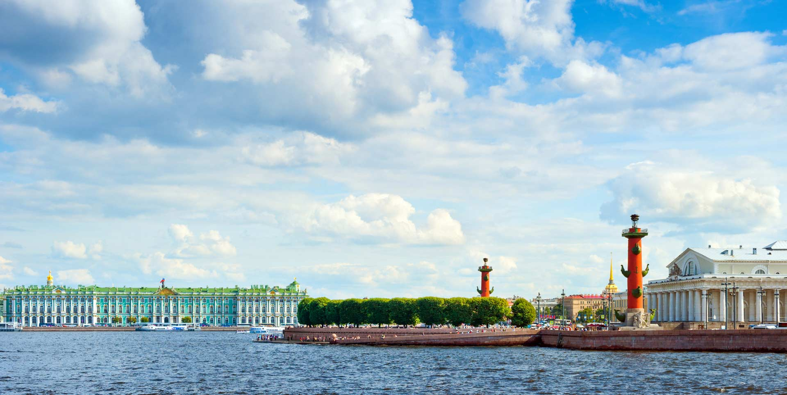



SCIENCE BRINGS NATIONS TOGETHER
Совещание по физике тяжелых ионов
Санкт-Петербург 2025
Совет РАН по физике тяжелых ионов
27 июня -- 2 июля 2025 г.

Slide 2
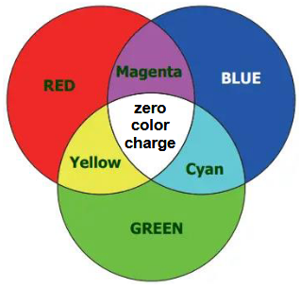
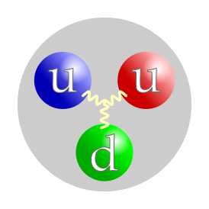


Рождение гипотезы Цветных Кварков
Дубненская модель кваркового мешка
Формулы кваркового счета
Мульти-кварковые системы и явление скрытого цвета
Роль кварковых степеней свободы в ядерной физике
Заключение

Slide 3
Some Important Contributions of JINR Scientists in Particle and Nuclear Physics (1956-2025)
Principle of Renormalizability and Microcausality in construction of S-matrix of the local Quantum Field Theory. (N.N. Bogolubov, D.V. Shirkov);
Transition of the principles and methods of Spontaneous Symmetry Breaking from Condense matter physics into the Particle and Nuclear Physics (N.N. Bogolubov);
Introduction in Particle Physics and Theory of Strong Interactions the principally new quantum number – the Quark Color (N.N. Bogolubov, B.V. Struminsky, A.N. Tavkhelidze);
Renormalization Group invariance as the basis of the Asymptotic Freedom phenomenon of the Quantum Chromodynamics (N.N. Bogolubov, A.A. Logunov, D.V. Shirkov, I. Todorov);
Hypothesis and theory of Neutrino Oscillation phenomenon (B.M. Pontecorvo, S. Bilenky);
Scale invariance and the Automodel asymptotic behavior in the local field theory and the Quark Counting Rules (N.N. Bogolubov, V.A. Matveev, R.M. Muradyan, A.N. Tavkhelidze);
Ideas and methods of the artificial synthesis of the new Superheavy Elements and the extension of the frames of the Mendeleev table (G.N. Flerov, Yu.Ts. Oganessian);
Ideas and methods of the Relativistic Nuclear Physics (V.I. Veksler, A.M. Baldin, D.I. Blokhintsev);
Supersymmetry in Quantum Field Theory and Particle Physics (V.I. Ogievetsky, E.A. Ivanov);
Theory of Superfluidity of Nuclear Matter (V.G. Soloviev);
Duality in hadron physics and the Dispersion Sum Rules (L.D. Soloviev, A.N. Tavkhelidze, D. Stoyanov);
Methods of the Analytic Calculations in the perturbative field theory (D.V. Shirkov);
Principle of the point-like behavior of the high energy deep-inelastic lepton-hadron processes (M.A. Markov);
Original Construction of the Impulse Neutron Reactor IBR and research with the cold and ultracold neutrons (I.M. Frank, F.L. Shapiro);
Principles and methods of the Nonlinear Field Theory (G.V. Efimov) and many other…

Slide 4
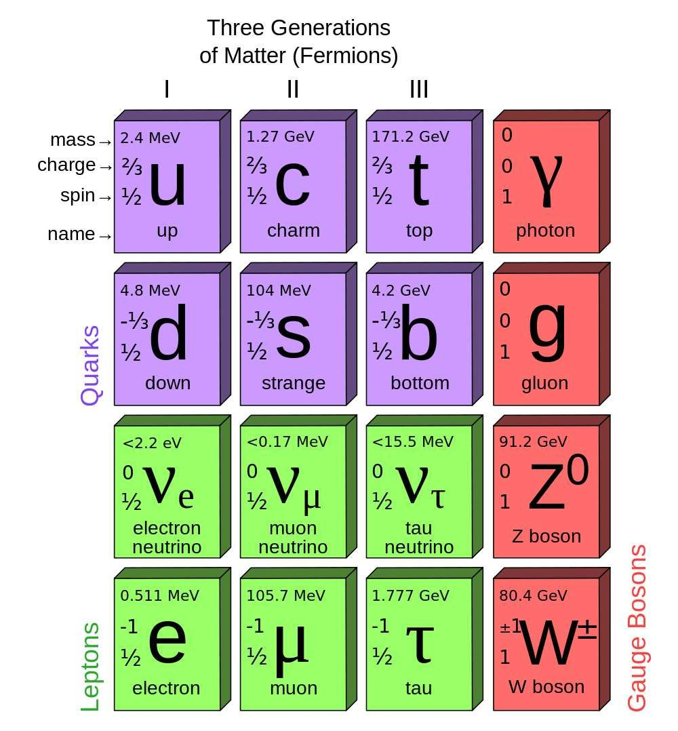

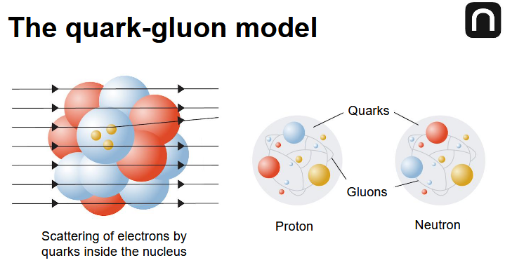
What is colored quarks?
Why they are so important?
What is the principally new in the idea of colored quarks as the fundamental constituents of elementary particles?
What the role the colored quarks are playing in understanding properties of the nuclear matter and the phenomena of phase transition between the hadron and the quark-gluon phases.
(confinement - deconfinement transitions)

Slide 5
XX Fundamental Problem of Particle Physics: XXI
The Dynamics of the Strong Interactions and the Systematics of Hadrons (mesons and baryons)
Major trends in attempts to understand the general principle of Physics of Hadrons:
Fermi-Yang (1949) >> Mesons as the bound states of baryons.
Sakata, Markov (1955) >> Composite models of elementary particles.
Necessity of choosing the paradigm:
Monogeneity principle – all hadrons consist of others as their bound states;
or
Hierarchia principle – an existence of the basic most elementary constituents of all hadrons.

Slide 6
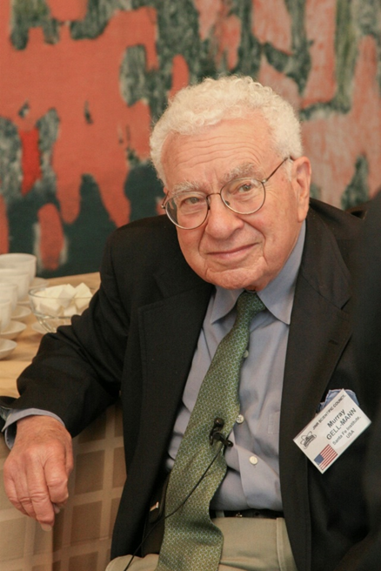
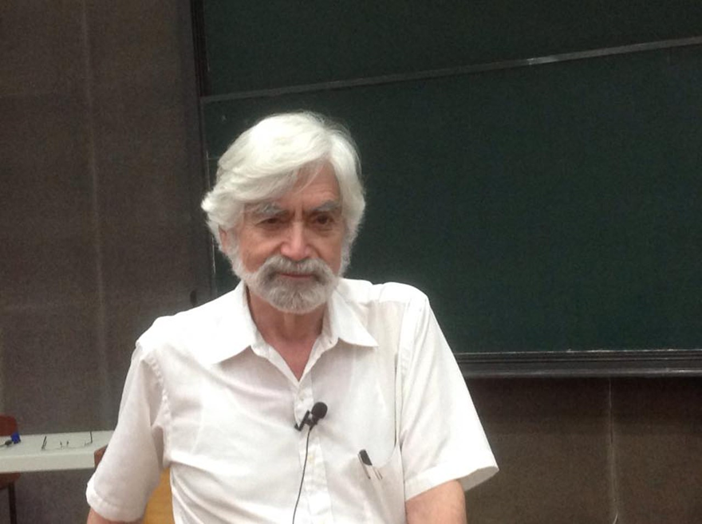


1964 M. Gell-Mann, G. Zweig
Model of Quarks as hypothetical hadron constituents

Slide 7
1965
N.N. Bogoliubov, B.V. Struminsky, A.N. Tavkhelidze
Han M.-Y., Nambu Y.,
Miyamoto Y.
Introduction of a New Quantum Number of Quarks
Hypothesis of Quarks Color
A way to resolve the contradiction of the naive quark model
to the fundamental Pauli principle of the relationship between the spin of particles and their statistics. Quarks as fundamental spin one-half fermions.

Slide 8
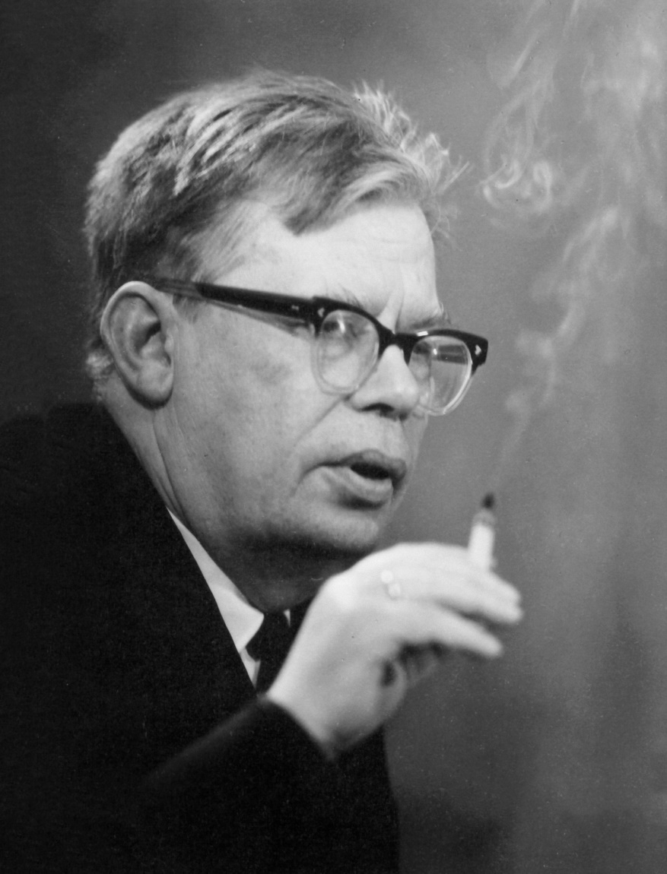
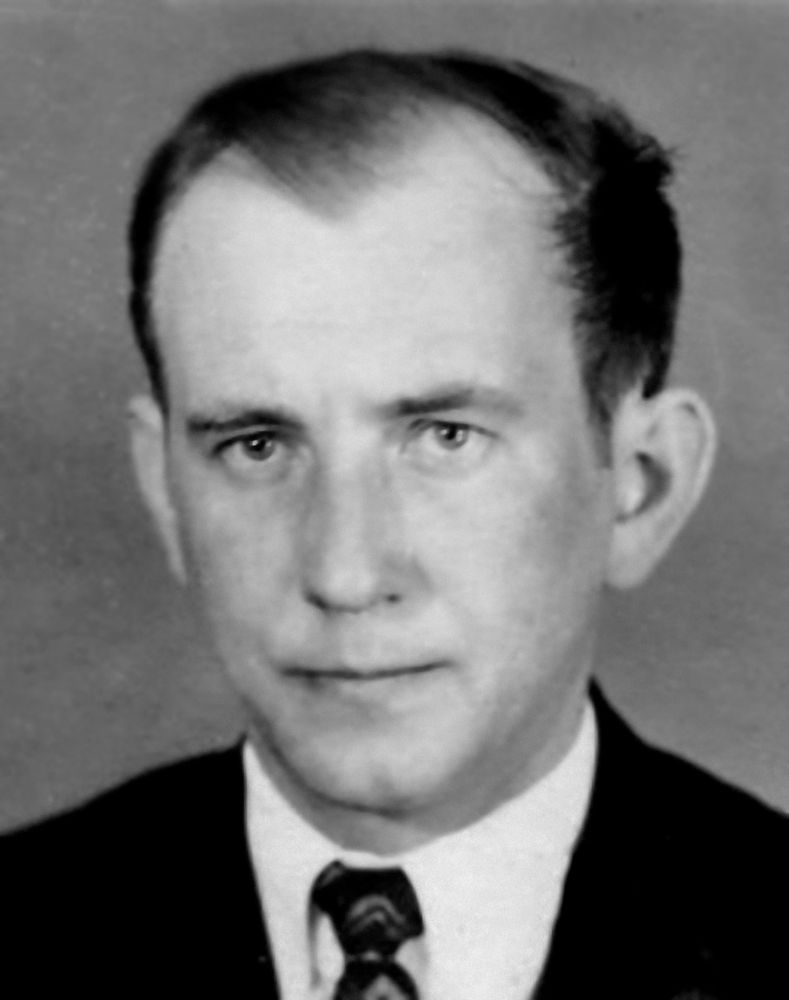
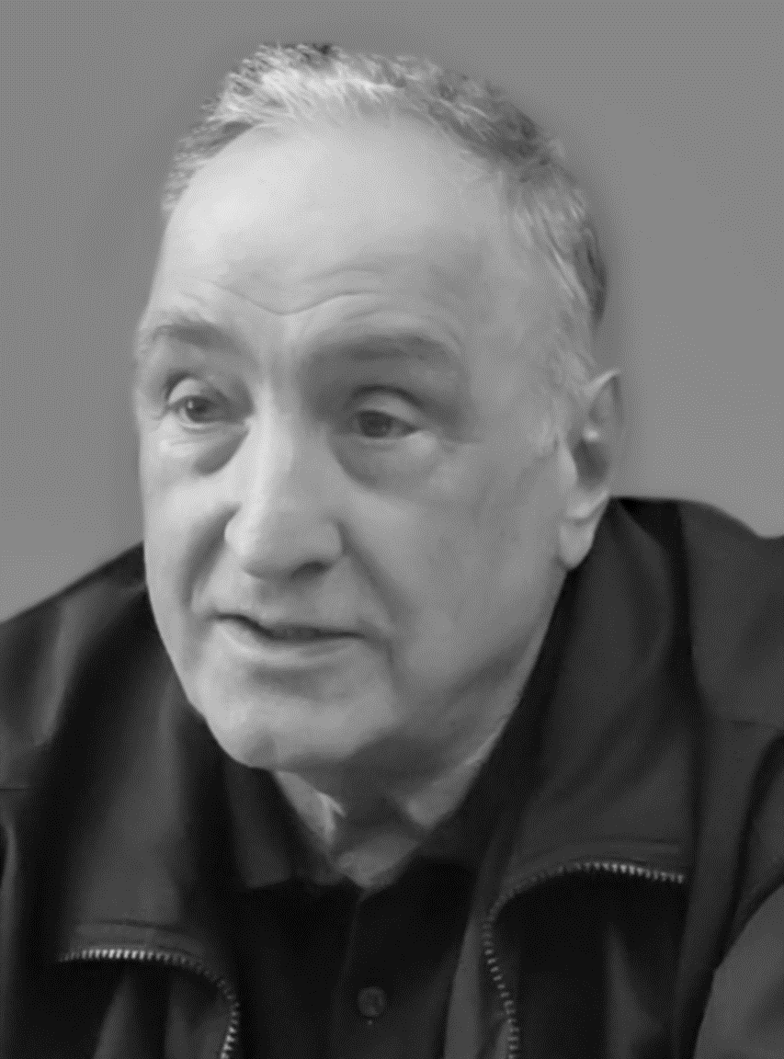
N.N. Bogoliubov
B.V. Struminsky
A.N. Tavkhelidze
Bogoliubov N.N., Struminsky B.V., Tavkhelidze A.N. // JINR Preprint D-1968, Dubna, 1965.
Struminsky B.V. Magnetic Moments of Barions in the Quark Model // JINR Preprint P-1939, 1965.
Tavkhelidze A.N. Proc. Seminar on High Energy Physics and Elementary Particles. Trieste, Vienna IAEA, 1965, p. 763.
Han M. Y. and Nambu Y. // Phys. Rev. 139, B1006. 1965.

Slide 9

Quark Model of Hadrons –
Challenge to Ideas and Notions of Particle Physics
I. Fractional electric chargies (e/3);
II. Contradiction to the Pauli Principle;
III. Absence of the reason not to be seen in experiments.
What are the quarks:
Hypothetical composites of hadron (“ases” or group theory elements)
or
Real physical objects – fundamental composites of hadrons.
?
The Dubna approach to the Quark Hadron Model (N.N. Bogoliubov et al):
Quarks are real physical objects – the point-like fundamental constituents of hadrons being fermions due to the existence of the new additional quantum number distinguishing three the unitary equivalent quark states.

Slide 10
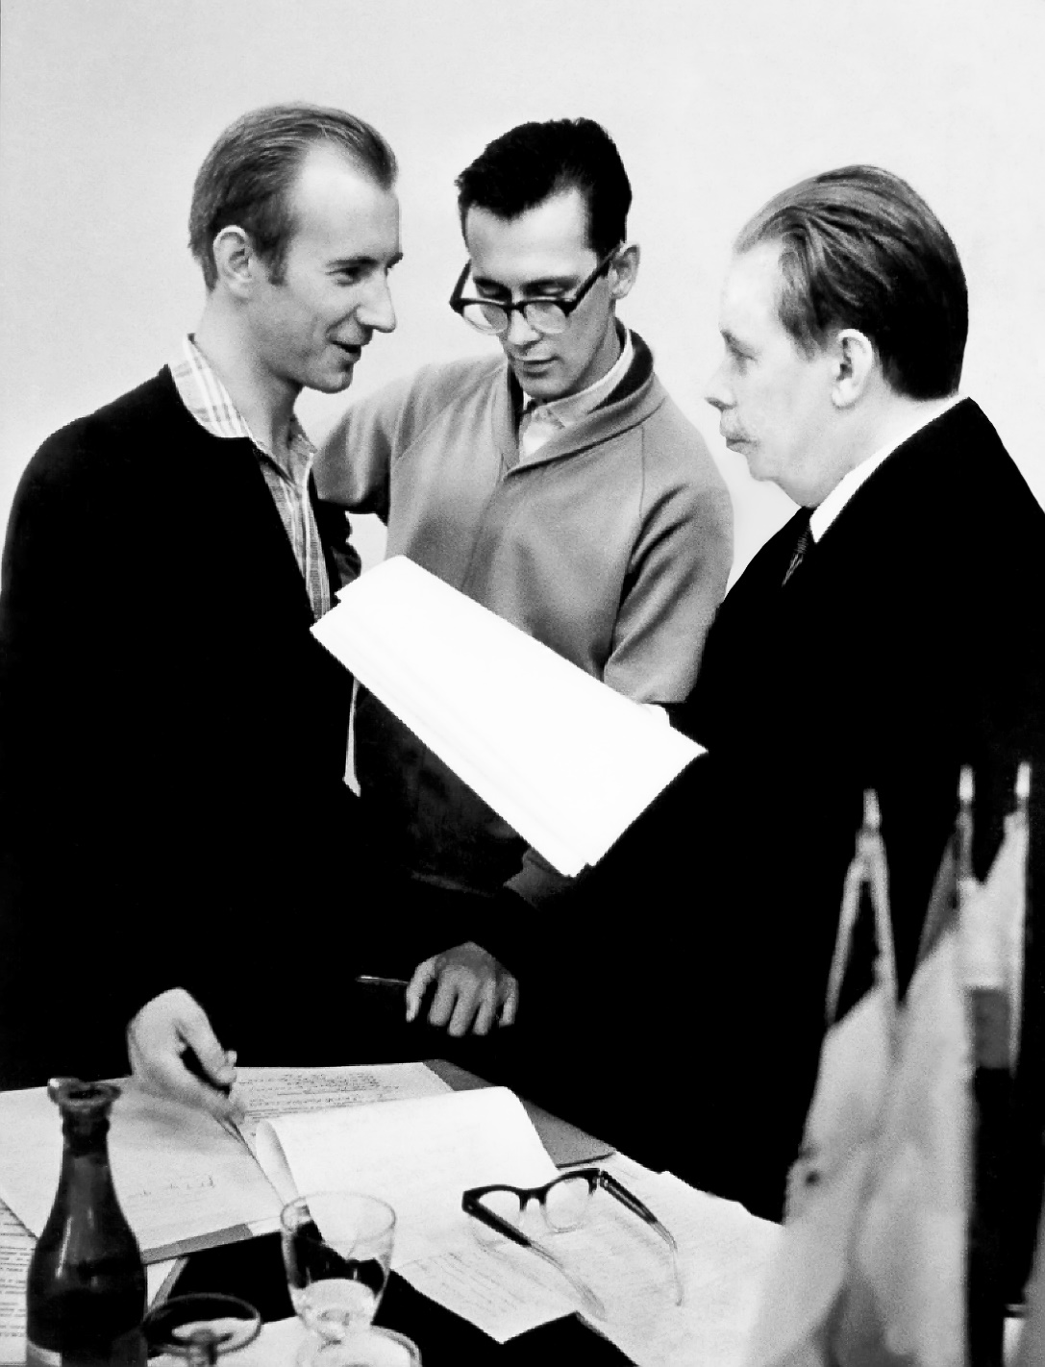
(My first publications on the Relativistic Composite Hadron Model based on the Hypothesis of Color Quarks)
1965
Bogoliubov N.N., Matveev V.A., Nguen Van Hieu, Stoyanov D.T., Struminsky B.V., Tavkhelidze A.N.,
Shelest V.P. // Problems of Elementary Particle Physics, Erevan Academy of Science of Armenia, p. 406‒420. Preprint JINR P-2141, Dubna, 1965.
Matveev V.A., Struminsky B.V., Tavkhelidze A.N. / Preprint JINR P-2524, Dubna, 1965.
Bogoliubov P.N., Matveev V.A., Struminsky B.V. // Relativistic Composite Model of Higher Meson and Baryon Resonances. Preprint JINR P-2442, Dubna, 1965.
N.N. Bogoliubov, V.A. Matveev, B.V. Struminsky

Slide 11
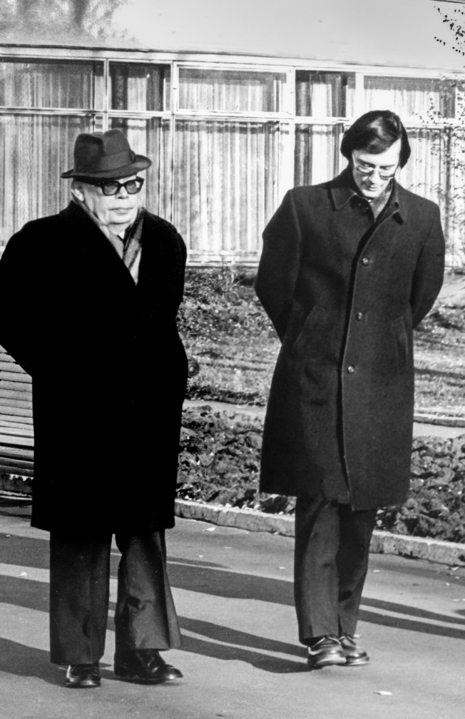
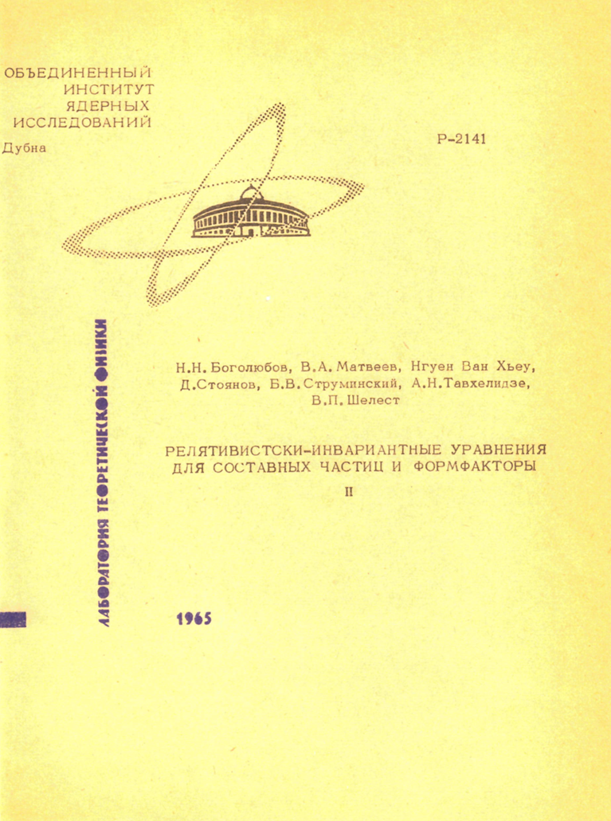
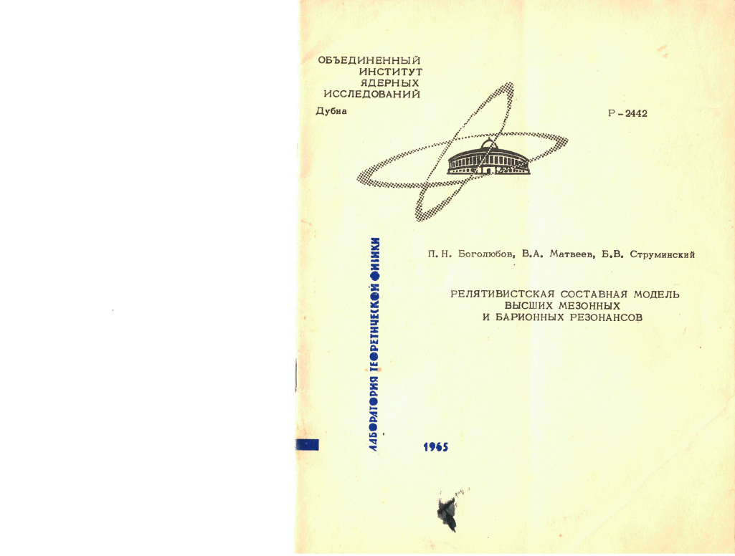
March, 1965. Dubna
1965
N.N. Bogoliubov
V.A. Matveev
1965

Slide 12

Dynamic Composite Hadron Quark Model (Dubna, 1965)
Principle of permanent confinement of the color quarks bound in the hadron.
Really observed hadron states are neutral with respect to the Color Charge.
“The Quark Bag Model” Dubna (1965)
N.N. Bogoliubov, B.V. Struminsky, A.N. Tavkhelidze,
V.A. Matveev, P.N. Bogoliubov, V. Weisskopf et al. (MIT)
Quarks inside the bag are quasiindependent at small distances (phenomenon of the asymptotic freedom of QCD)
but strongly interacting with the bag walls at large distances.
Ucr
Three quarks
of the proton
inside the bag
The mass of quarks outside the bag walls is considered to be effectively very large, what make impossible to see free quarks.
Notes:
ифп

Slide 13
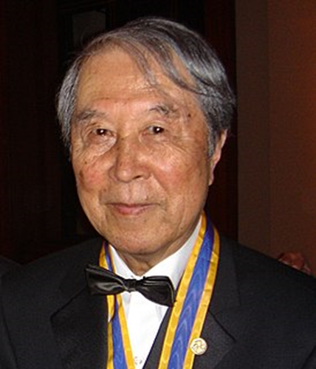
Quantum Chromodynamics as the Dynamic Theory of Hadrons Based on the Hypothesis of Color Quarks (1974)
The important step to the Dynamic theory of hadrons on the basis of hypothesis of colored quarks has been made by Yoichiro Nambu who introduced the idea of color interaction of hadrons and the vector gauge bosons named him gluons (1966).
By the way, he based on the model of quarks with the integer electric charges what is possible only in the framework of spontaneously broken unitary color symmetry.
(V.A. Matveev, B.V. Struminsky, A.N. Tavkhelidze, 1966)
Yoichiro Nambu
南部 陽一郎

Slide 14
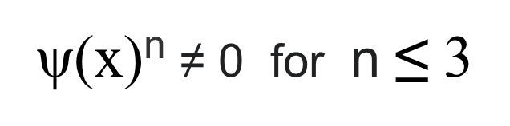

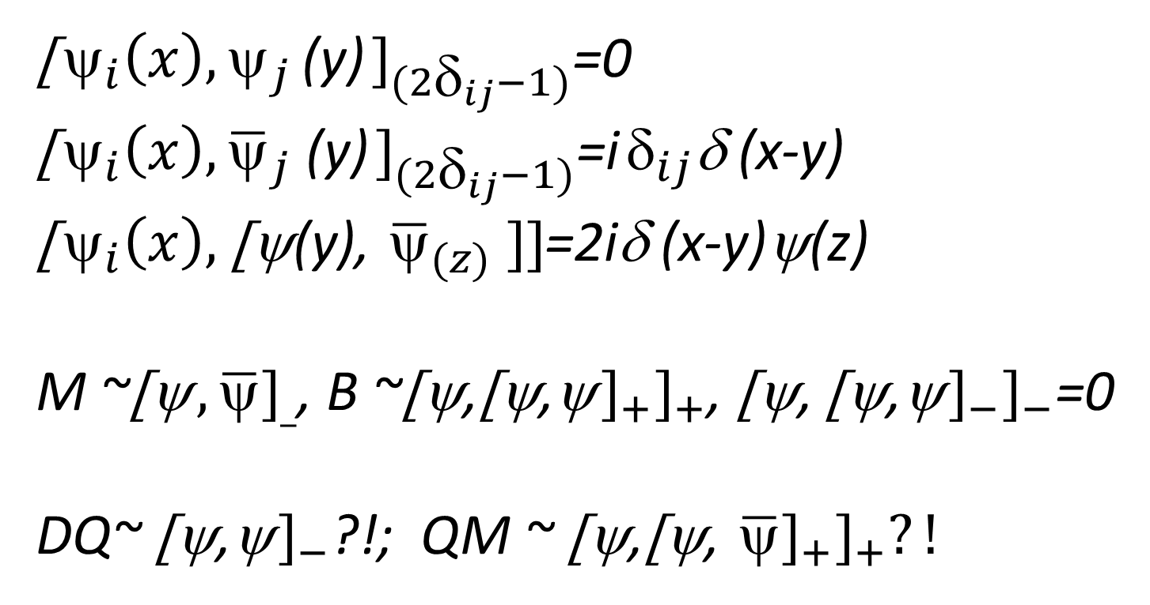
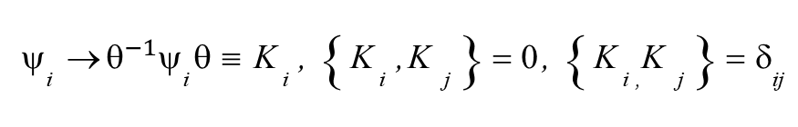
Quarks as the Parafermions of the Order р=3
Greenberg O.W. (1964)
Green H.S. (1953)
Volkov D.V. (1959), Chernikov N.A. (1962)
Kamefuchi, Takahashi (1962)
ψ₍x₎= ψ_{i(}x₎
p
Σ
( H.S. Green anzats )
Greenberg, Messiah, A.B. Govorkov (1966)
Klein transformation to the normal canonical permutation relations for the fermions:
i=1
Mesons Baryons
The orthogonal SO(3) degeneration (parastatistics)
The Untary SU(3) degeneration (color quarks and gluons) A.B. Govorkov, JINR, E2-7485, 1973.
Di-quarks ?! Quark-mesons ?!
Is the choice of the para-statistics for quark and gluon fields an alternative to existence of the additional quark degrees of freedom, corresponding to their SU(3) unitary equivalent states, whose group transformation generators play the role of the color charge of the chromodynamic interactions?

Slide 15
The concept of Color Quarks as the Real Physical Objects lie at the base of a Number of Principally Important Physical Phenomena
Point-like character of the total cross-sections of the lepton-hadron interactions at high energies and large transferred momenta what indicates the point-like Nucleon Structure. M.A. Markov, 1964.
Automodelity Principle and Power Scaling Laws in Particle and Nuclear Physics (MMT);
Di-muon Production in High Energy Hadron Collision (1969);
Quark Counting Rules (MMT, 1974);
Quark Degrees of Freedom in Nuclei (1975);
Deutron as the 6-quark System (1977);
Hidden Color in Hadrons (1977);
Physics of Multi-quarks Systems;
Chromo-hydro-dynamics Approach to the Physics of Nuclear Matter (1977).

Slide 16
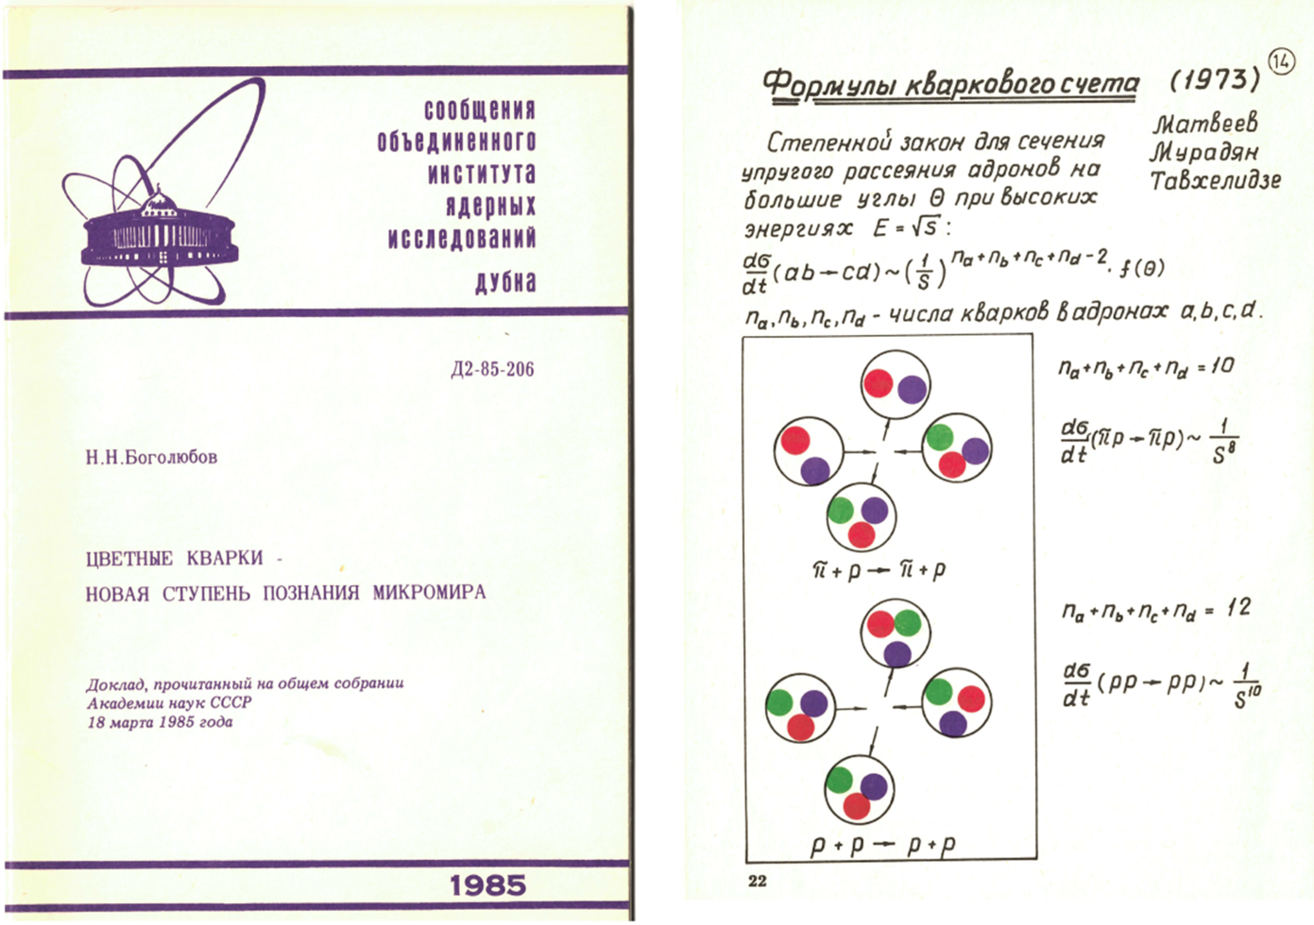
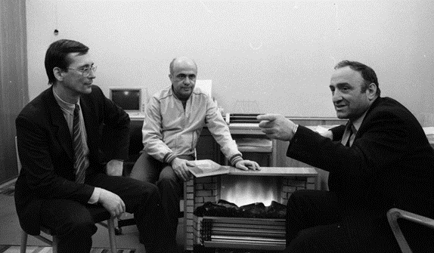
Доклад Н.Н. Боголюбова на Общем Собрании Академии наук СССР (1985)
В.А. Матвеев
Р.М. Мурадян
А.Н. Тавхелидзе
1974

Slide 17
Power Laws in Particle and Nuclear Physics
Quark Counting Rules
(1) Hadron Form Factors:
F(t)a =(t)^{-(na-1)}
(2) Large Angle Hadron Scattering:
(dσ/dt) ab⇒cd = (S)^{-(na+nb+nc-nd-2)}
ni - number of point-like constituents of hadrons, i – a, b, c, d.
(3) Application to the light nucleus form factors, e.g.
F(t)6q=(t)⁻⁵ Deuteron - 6 quark system?
1973
Matveev
Muradyan
Tavkhelidze
and
Brodsky
Farrar

Slide 18
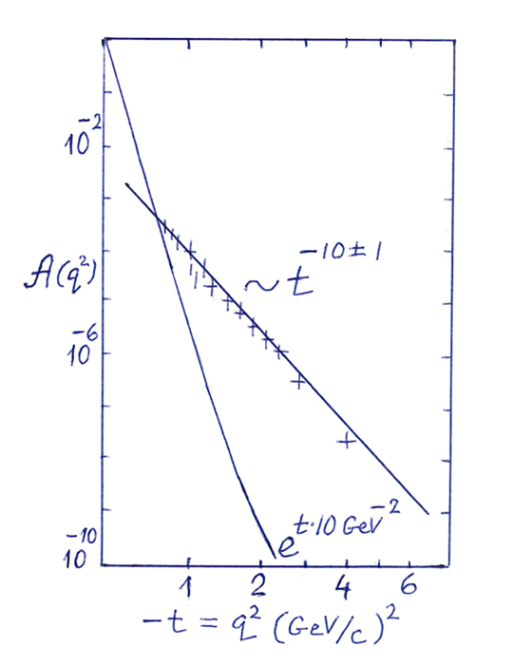
Deuteron form factor squared
( SLAC data, R. Arnold et al (1975) )
The Puzzle of the Deuteron electric charge
- 2 10
Goloskokov Kuleshov Koudinov Smondyrev
(1976)
Extrapolation of the power asymptotics of the Deuteron electromagnetic Form Factor to the zero transfer momenta gives the value less than 1.
Fd≈(1- α) exp(bt)+αF6q
α ≈ 7x 10⁻²
Soft or the external shape part
Quark core part
- the probability of the 6-quark component inside the deuteron
b ≈ 1/6〈 r² ⟩d ≈ 5(GeV)⁻²
〈 r² ⟩d ≈ (1.2f )²

Slide 19
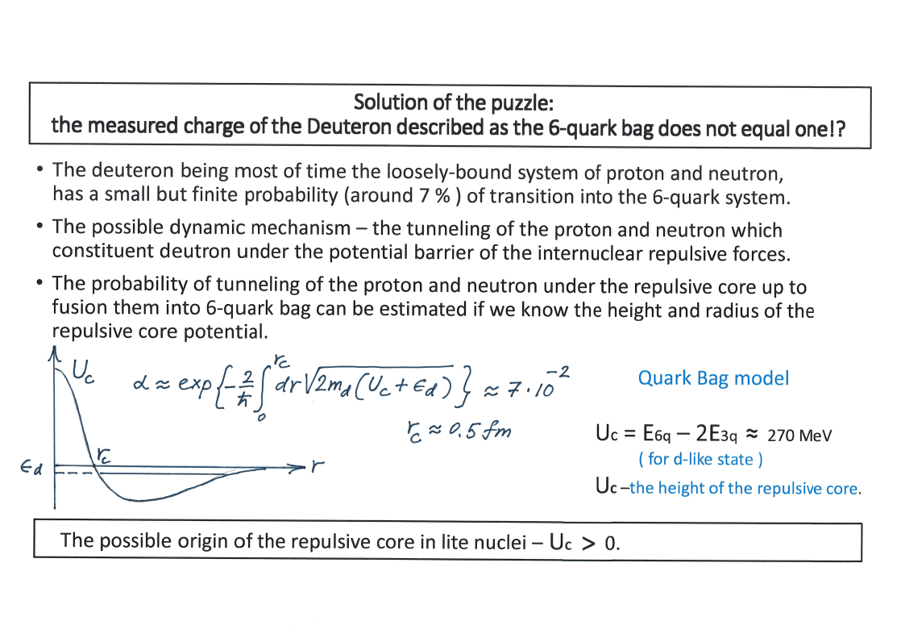

Slide 20
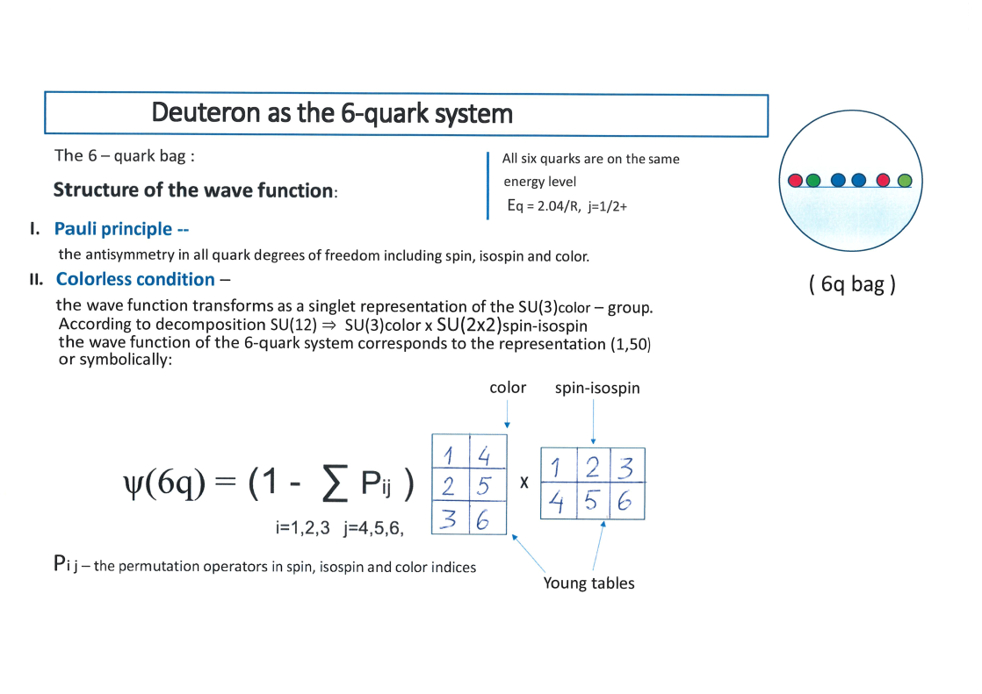

50 = (1,20) X (1,20) + (8,20`) X (8,20`)
20 =(2,2) + (4,4) (2J+1, 2I+1)
nucleon isobar
50 = (3,1) + (1,3) + (5,3) + (3,5) +
+ (7,1) + (1,7)
d –like sate

Slide 21

Content of the static (spherical symmetric) 6-quark bag with the quantum numbers of the Deuteron
Deuteron = [(uud)(ddu)] (C=0)
(J=1, I=0)
SUc(3) X SUsi(4)
(1,50)
6q quark bag
hidden color component 80%
proton-neutron 11%
isobar component 9%
[6q] B=2 [3q] B=1 + [3q]B=1
(1,20) X (1,20) 1/5 (20%)
(1,50)
(8,20`) X (8,20`) 4/5 (80%)
P. Sorba
V. Matveev
1977
The decomposition in terms of SU(3) color X SU(2x2) spin-isospin

Slide 22

Exotic content of the real Deuteron
Data on the power asymptotics of the Deuteron Form Factors
gives as a crude estimation for the Deuteron composition:
∣D⟩ = a∣pn⟩ + b∣6q⟩
loosely bound state
d-like 6-quark state
∣a∣² + ∣b∣² = 1, ∣a∣² = α ≈ 7x 10⁻²
So, the real Deuteron has the following composition including admixture of the exotic components:
PN – component 93.7 %
ΔΔ -- component 0.6 %
Hidden color component 5.7 %
Conclusion: The ordinary or the orthodox theory of the nuclear matter which does not taking into account the quark degrees of freedom is incomplete.

Slide 23
Colour analysis of multibaryonic states: SU(3) x SU(2x2) < SU(12)
2H Dibaryonic states (1,50) < 220 : (6q)
1-baryonic state x 1-baryonic state (3q) + (3q)
(1,20) x (1,20) 1/5
(8,20`) x (8,20`) 4/5
--------------------------------------------------------------------------------------------
3H, 3He Tribaryonic states (1,20*) < 220* (9q)
1-baryonic state x 2-baryonic state (3q) + (6q)
(1,20) x (1,50) 5/42
(10,4*) x (10*,10) 5/42
(8,20*) x (8,64) 32/42
A.P. Isaev, V.A. Matveev (2025)

Slide 24
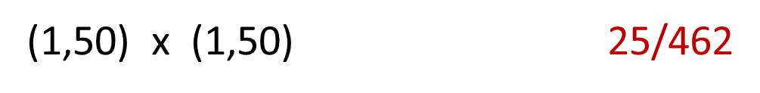
Colour analysis of multibaryonic states: SU(3) x SU(2x2) < SU(12)
4He Tetrabaryonic states (1,1) < 1 : (12q)
1-baryonic state x 3-baryonic state (3q) + (9q)
(1,20) x (1,20*) 1/11
(8,20`) x (8,20`) 8/11
(10,4*) x (10,4*) 2/11
2-baryonic state x 2-baryonic state (6q) + (6q)
(27,6) x (27,6) 81/462
(10,10) x (10*,10*) 50/462
(10*,10*) x (10,10) 50/462
) (8,64) x (8,64) 256/462

Slide 25





Quantum evolution of the multiquark bag
by the continuous deformation of the bag surface and consequent fission.
(C1)
B1
(C=0)
QB
(C=0)
B2
(C=0)
(C2)
There are different channels of Quark Bag fission having the different ratings:
C1 X C2 : 1 X 1; 8 X 8; 10 X 10*; 27 X 27; 64 X 64 etc

Slide 26
Surface of the quark bag as the boarder
separating confinement and deconfinement phases?
U
Quasi-independent quarks and gluon zone,
Deconfinement phase
Composite strongly interacting hadron zone,
Confinement phase
U
d
E2 – E1 = B > 0
Vacuum of
deconfinement
phase
$$E(quark bag)=BV$$
Vacuum of conf. phase
Evac(conf.ph.) = E1
Vacuum of conf. phase
Evac(conf.ph.) = E1
Evac(deconf.ph.)
= E2

Slide 27
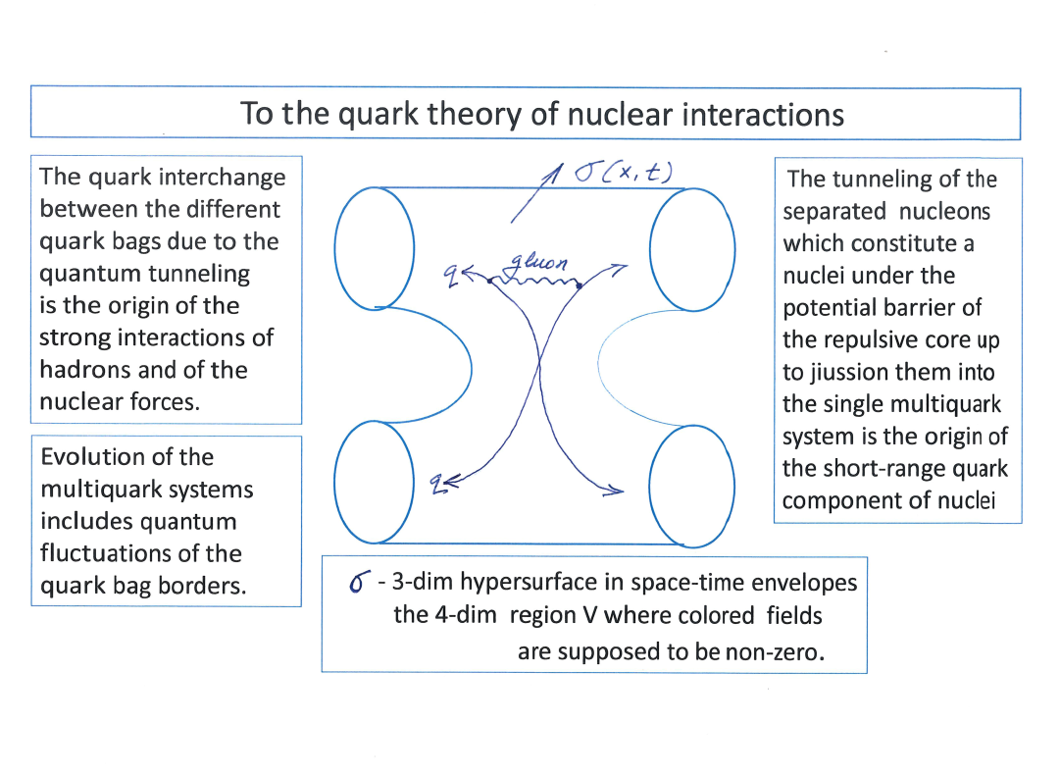
CERN-JINR SCHOOL of PHYSICS of 1981,
Hanko, Finland,
Proc., pp.305-326
V.A. Matveev

Slide 28
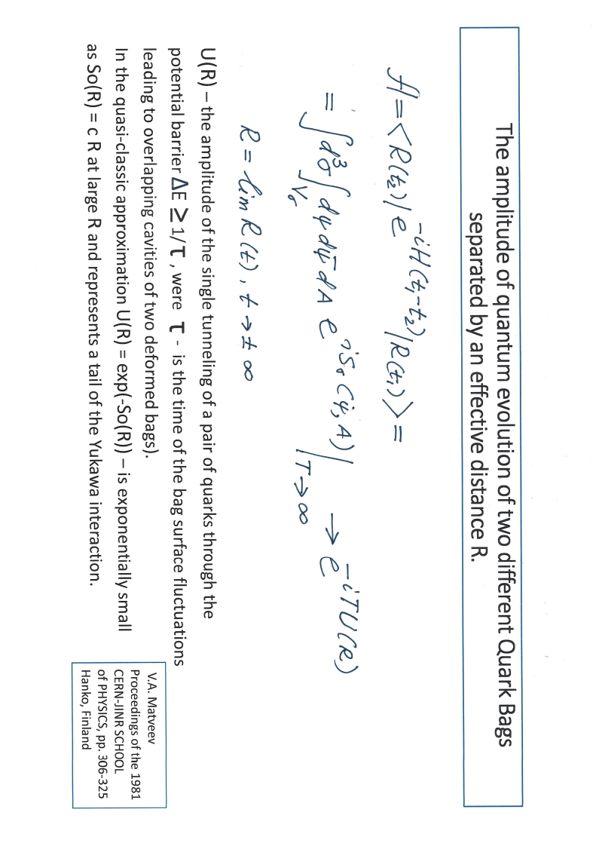

Slide 29
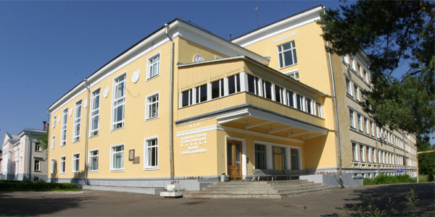
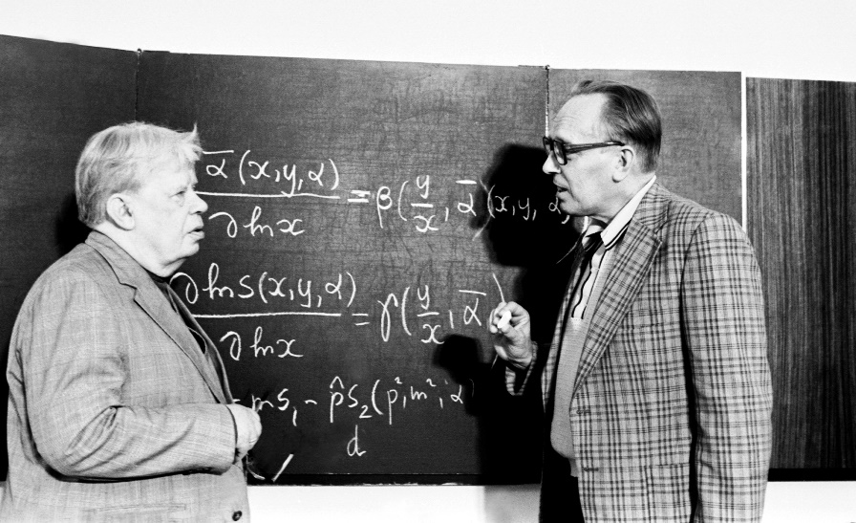
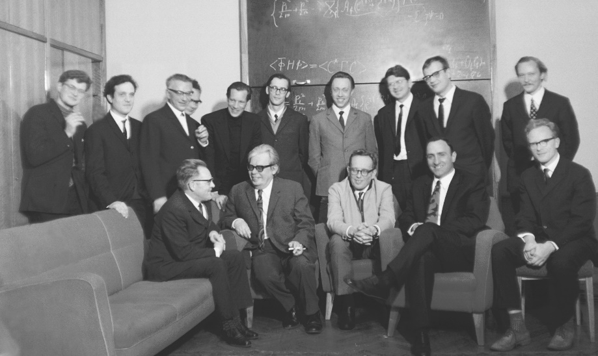
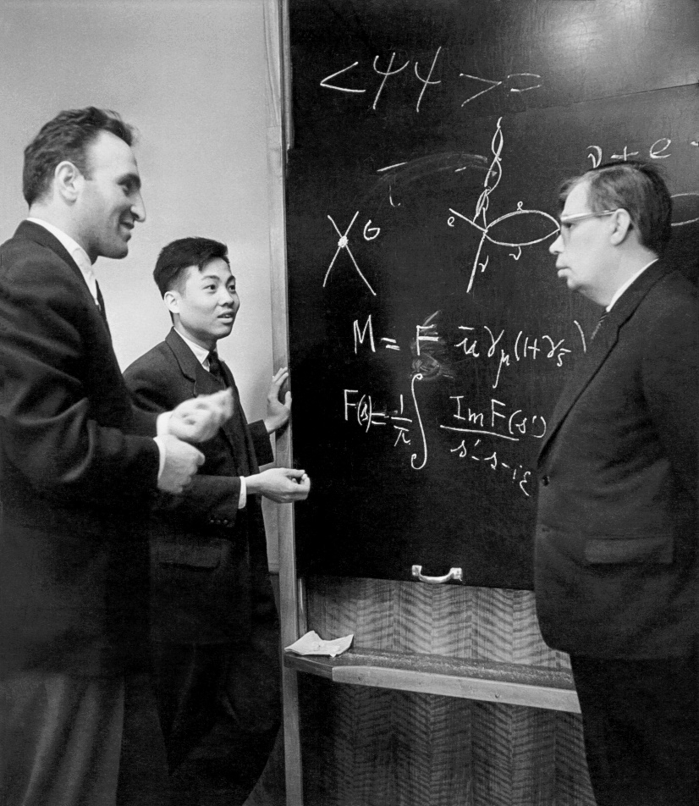
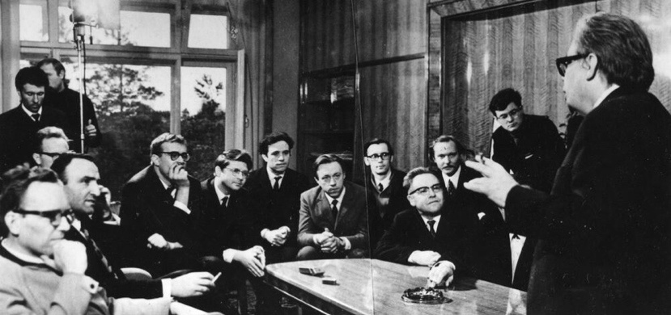
Н.Н. Боголюбов с коллегами и учениками

Slide 30
Церемония награждения лауреатов Ленинской Премии 1988 года за цикл работ
«Новое квантовое число – цвет и установление динамических закономерностей
кварковой структуры адронов и атомных ядер»
1988
Mocква
Кремль

Slide 31
1965–2025: What Do We Have After 60 Years?
Triumph of the Standard Model of Particle Physics (SM).
Hypothesis of Color Quarks and concept of color charge is a cornerstone of Quantum Chromodynamics (QCD).
Open Problems:
The QCD describes successfully strong interaction at short distances
(the perturbative theory approach);
Still faces problems in description of interactions at large distances
(the strong coupling problem).
We need to study the physics of the dense and hot nuclear matter,
in interplay at short and large distances,
the role of quark and gluon degrees of freedom,
the nature of the quark confinement and deconfinement phenomenon.

Slide 32


1965–2025: What Do We Have After 60 Years?
Triumph of the Standard Model of Particle Physics (SM).
Hypothesis of Color Quarks and concept of color charge is a cornerstone of Quantum Chromodynamics (QCD).
Open Problems:
The QCD describes successfully strong interaction at short distances
(the perturbative theory approach);
Still faces problems in description of interactions at large distances
(the strong coupling problem).
We need to study the physics of the dense and hot nuclear matter,
in interplay at short and large distances,
the role of quark and gluon degrees of freedom,
the nature of the quark confinement and deconfinement phenomenon.

Slide 33

Кратко подытоживая сказанное выше:
Дибарионы и другие многокварковые системы, предсказываемые моделью кварковых мешков классически нестабильны, по крайней мере в приближении сферической симметрии образования. Судьба этих состояний определяется длиннодействующей составляющей ядерных сил и ролью скрытого цвета.
Поиск компоненты скрытого цвета в легких ядрах крайне важен для понимания природы ядерных сил. Теория ядерной материи без учета цветовых степеней свободы кварков и глюонов неполна.
Изучение структуры ядерной материи на малых расстояниях и масштабах времени, в частности в процессах взаимодействия с большими передачами импульса и энергии, позволяющее наблюдать короткодействующие корреляции и дать информацию об отталкивающем потенциале ядер, крайне важно.
Было бы крайне интересно вскрыть возможную роль кварковых степеней свободы в процессах коллективного возбуждения ядерной материи и в динамике образования кварк-глюонной плазмы при столкновении тяжелых ядер.

Slide 34
Theoretical Studies:
Relativistic hydrodynamics
Quantum statistics approach
Nonperturbative Quantum Chromodynamics
QCD Lattice calculations
on the JINR supercomputer and others
Theory of the quantum strings and surfaces

Slide 35
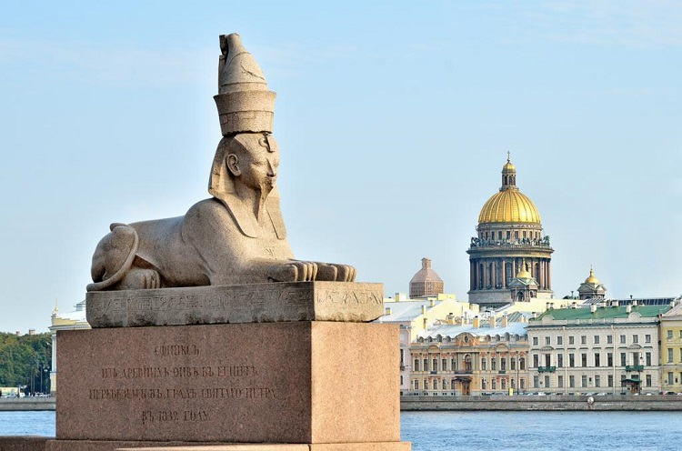
БОЛЬШОЕ СПАСИБО
ЗА ВАШЕ ВНИМАНИЕ!
Совет РАН по физике тяжелых ионов
27 июня -- 2 июля 2025 г.

Slide 36

On 27–29 September 2007 Murray Gell-Mann visited the Joint Institute for Nuclear Research on the invitation of the JINR Directorate (1969, Professor M. Gell-Mann was awarded the Nobel Prize in physics for the discoveries connected to the elementary particles classification and their interactions).
At JINR, the author of the “quark model” took the floor at the session of the international Scientific Council and spoke to its members about his scientific results and plans, including those on cooperation with the multidisciplinary institute established by him in Santa Fe (USA), where one of the main research domains is complex adaptable systems.
At the SC session, on 28 September, the title “Honorary Doctor of JINR” was conferred on M. Gell-Mann.

