Slide 1
Range (muon) System Status SPD TB, Dubna, 28.05.2025 G.Alexeev, A.Samartsev

Slide 2
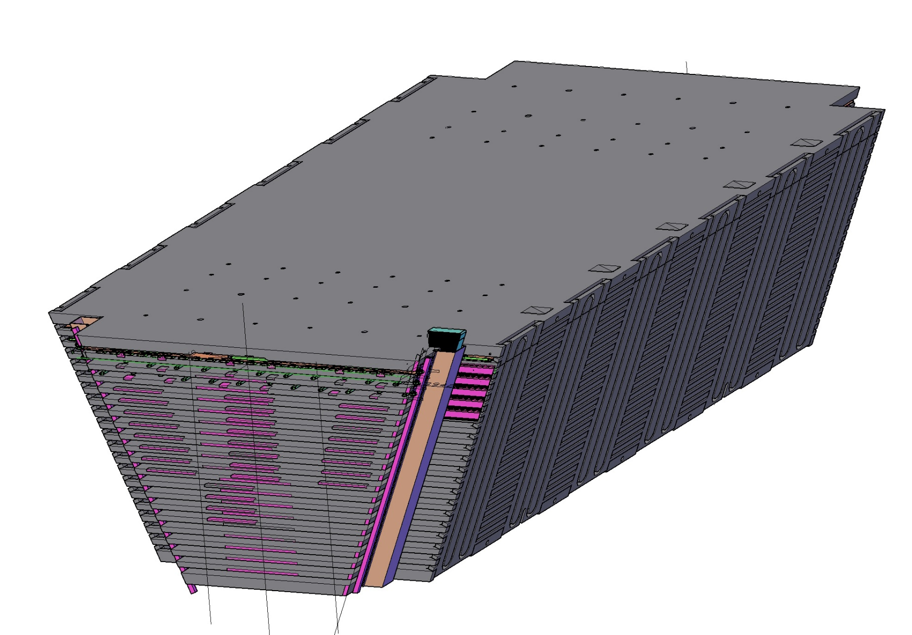
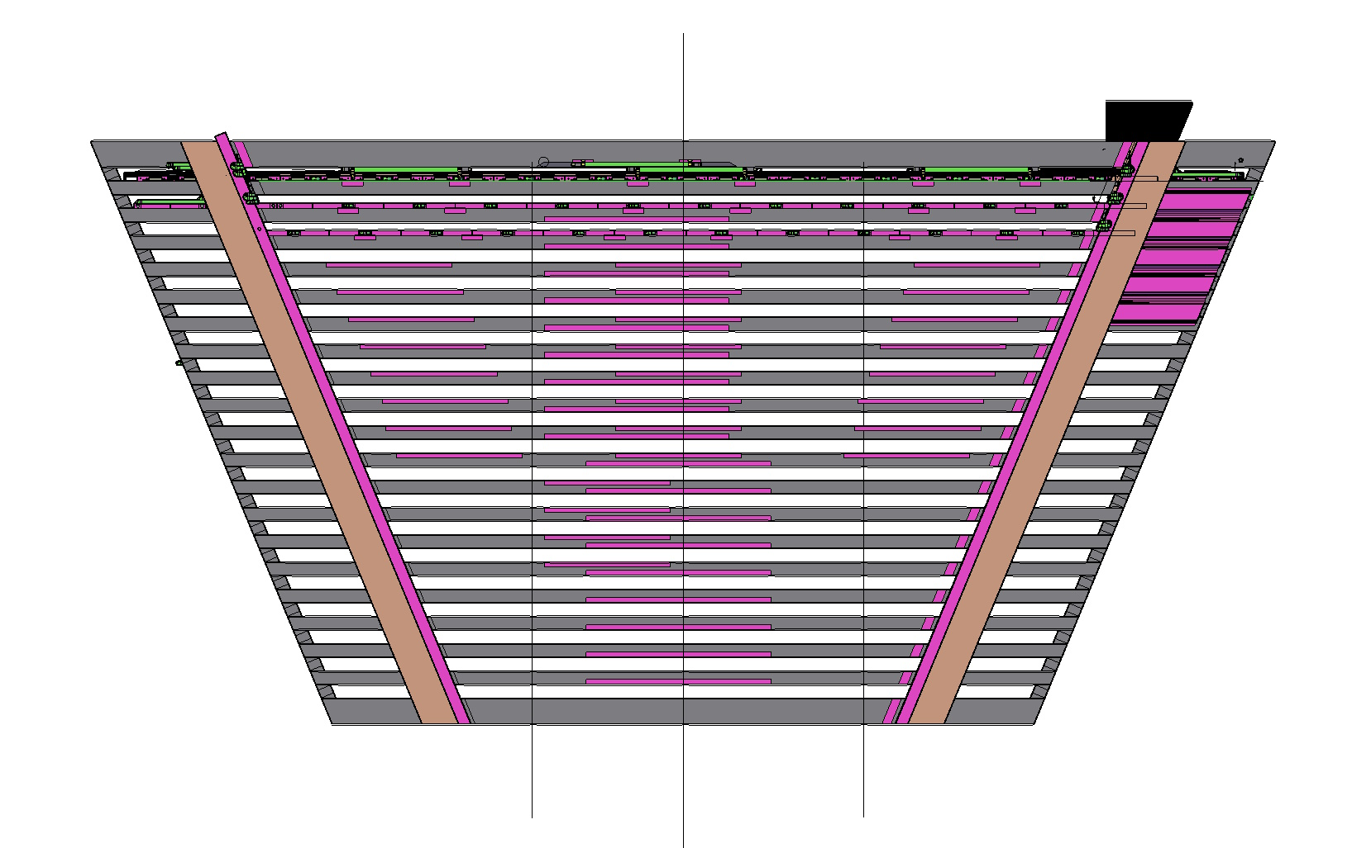
Final 3D engineering version of one (out of 6) “regular” Yoke/Barrel module
After delivery of 3D conceptual model of RS to VBLHEP (Design Bureau №2), we presently concentrate on developing 3D model(s) for all slots of RS (starting from “regular” Yoke/Barrel modules), including: MDT detectors, honeycomb strip board, analog FEE cards, cabling inside/outside, gas pipelines and inter-connections, etc. ---> important information on additional mechanical treatment of steel plates prior to the welding them into the Yoke modules.
Outer/biggest detecting plane
Batch of in/out cables
MDT protection plates
RS cables
Cable channels for inner subsystems

Slide 3
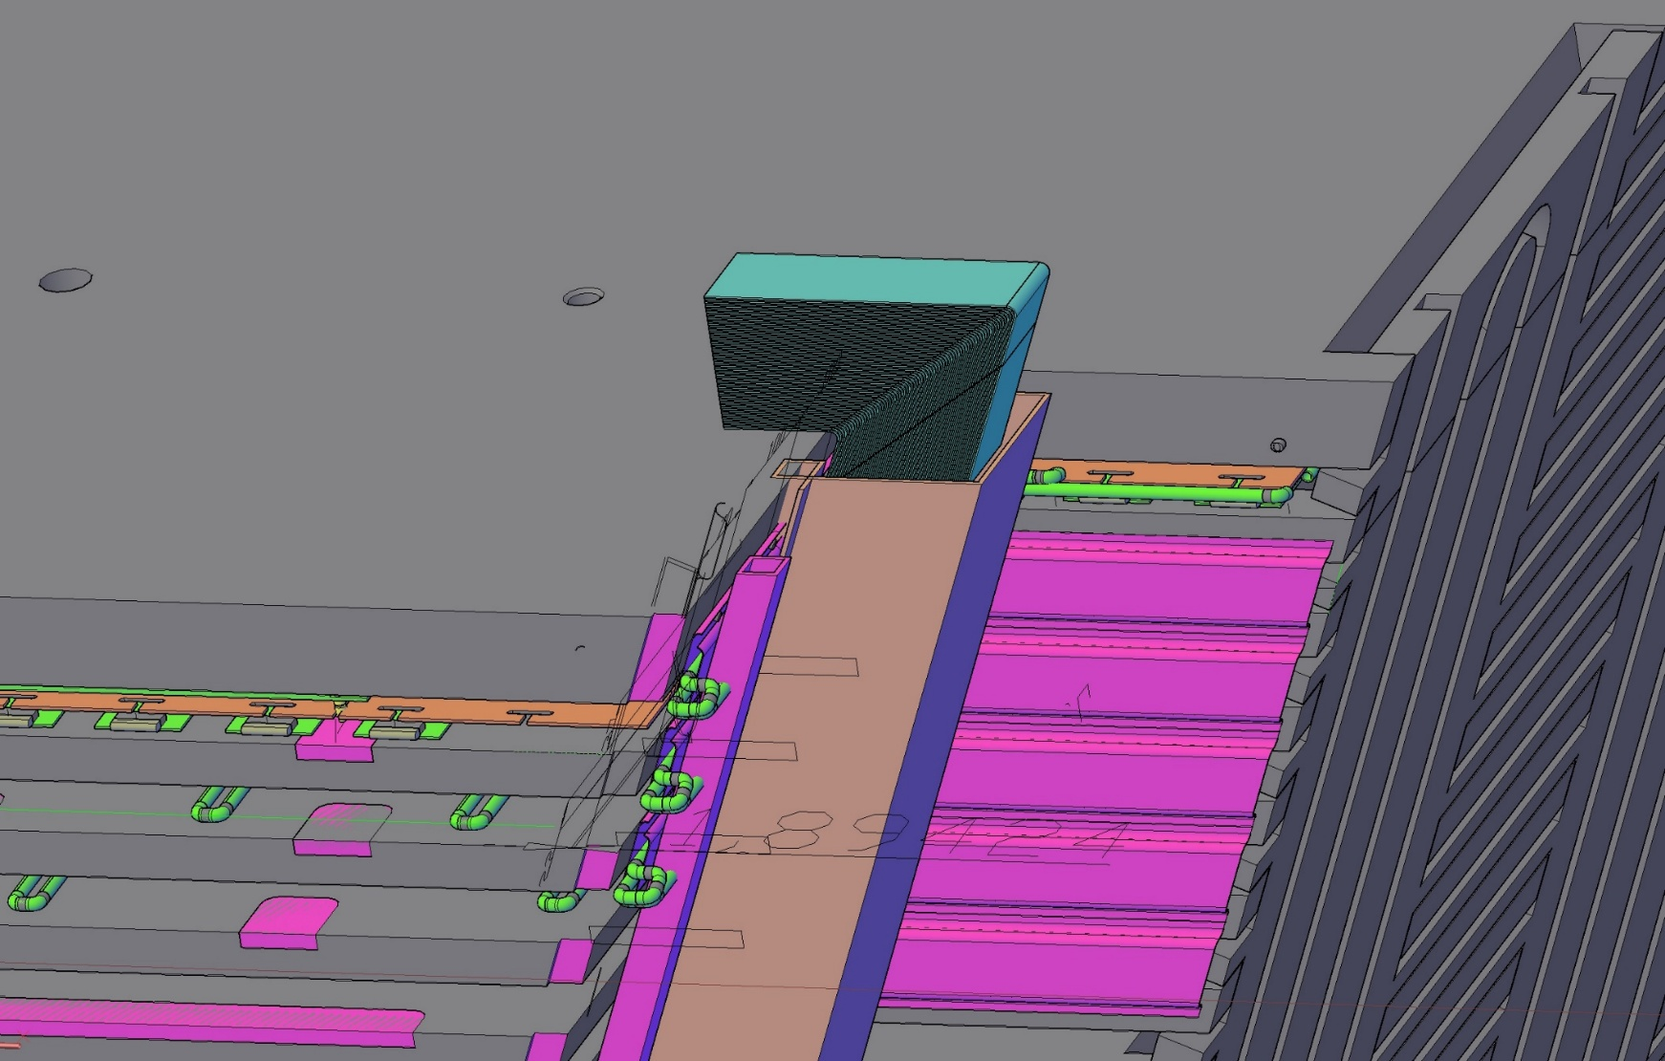
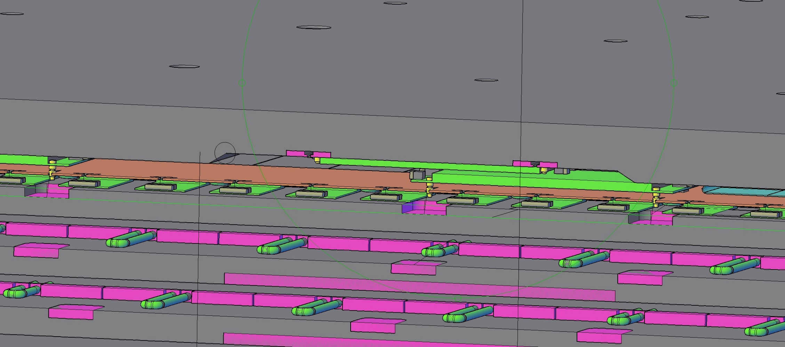
3D view of the outer layers (MDT detectors and electronics) in “regular” Yoke/Barrel module
Reading out the signals from detecting layer is based on three 8-channel chips (Ampl-8.53, Ampl-8.11R-G5, Disc-8.17) organized in three boards (High Voltage distributor + Amplifier + Discriminator -> HVAD-8, Preamplifier + Amplifier + Discriminator -> PAD-8, Commutation Board -> CB-64 (8 input cables/8-ch each/ from wires/strips -> 2 output cables /32-ch each/) -> serves 2 inputs of digital FEE module FDM-192 (6 inputs, 32-ch each).
Groove in Fe plate ~ 15 mm x 200 mm to accommodate two CB-64 cards
Cooling plate
HVAD-8
CB-64
MDTs
Gas interconnection tubes

Slide 4
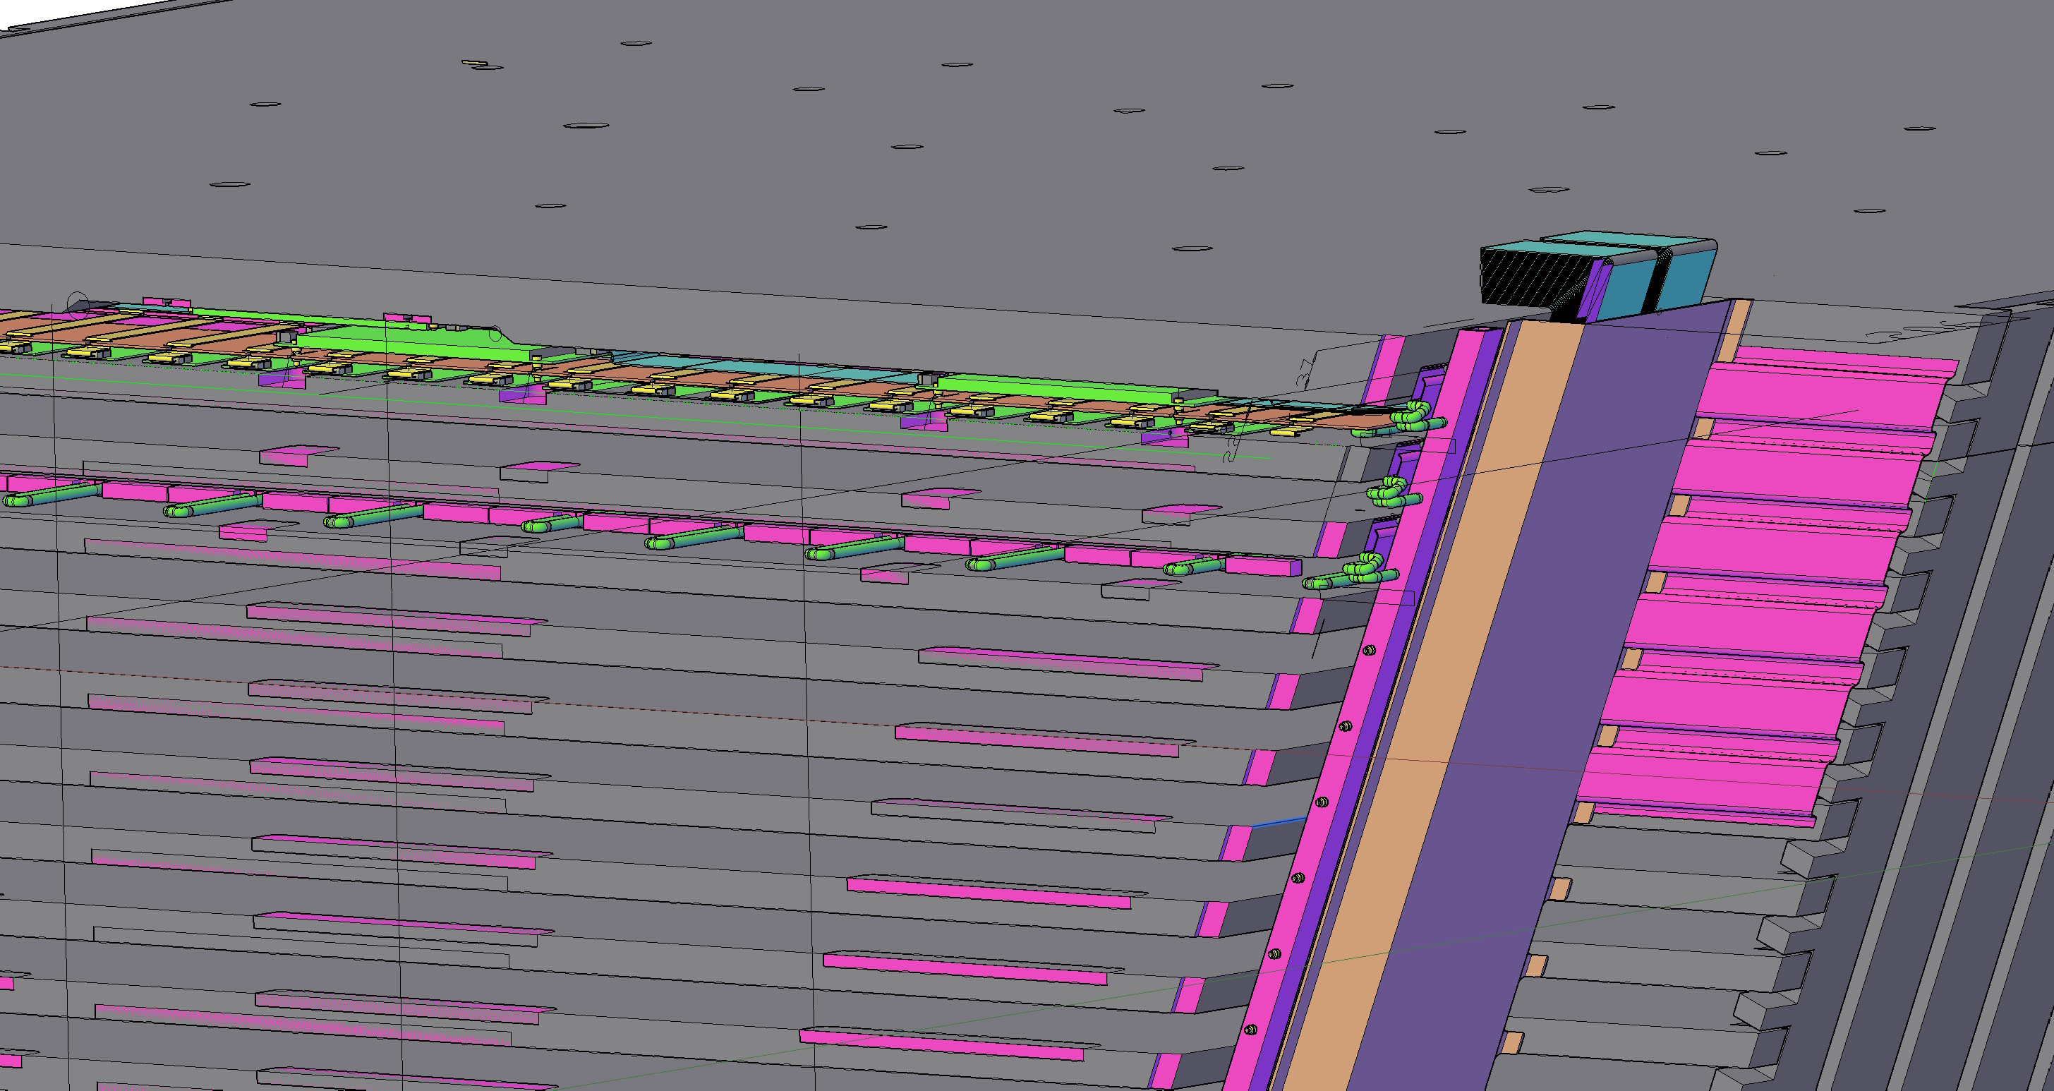
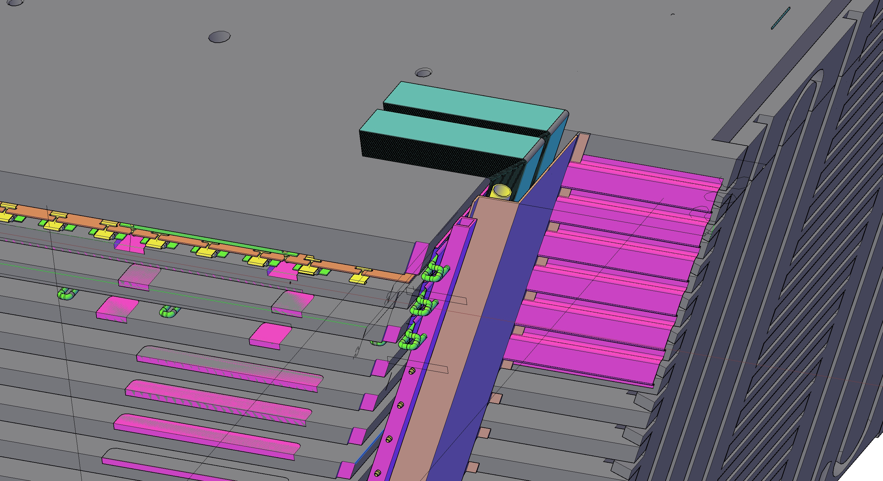

Slide 5
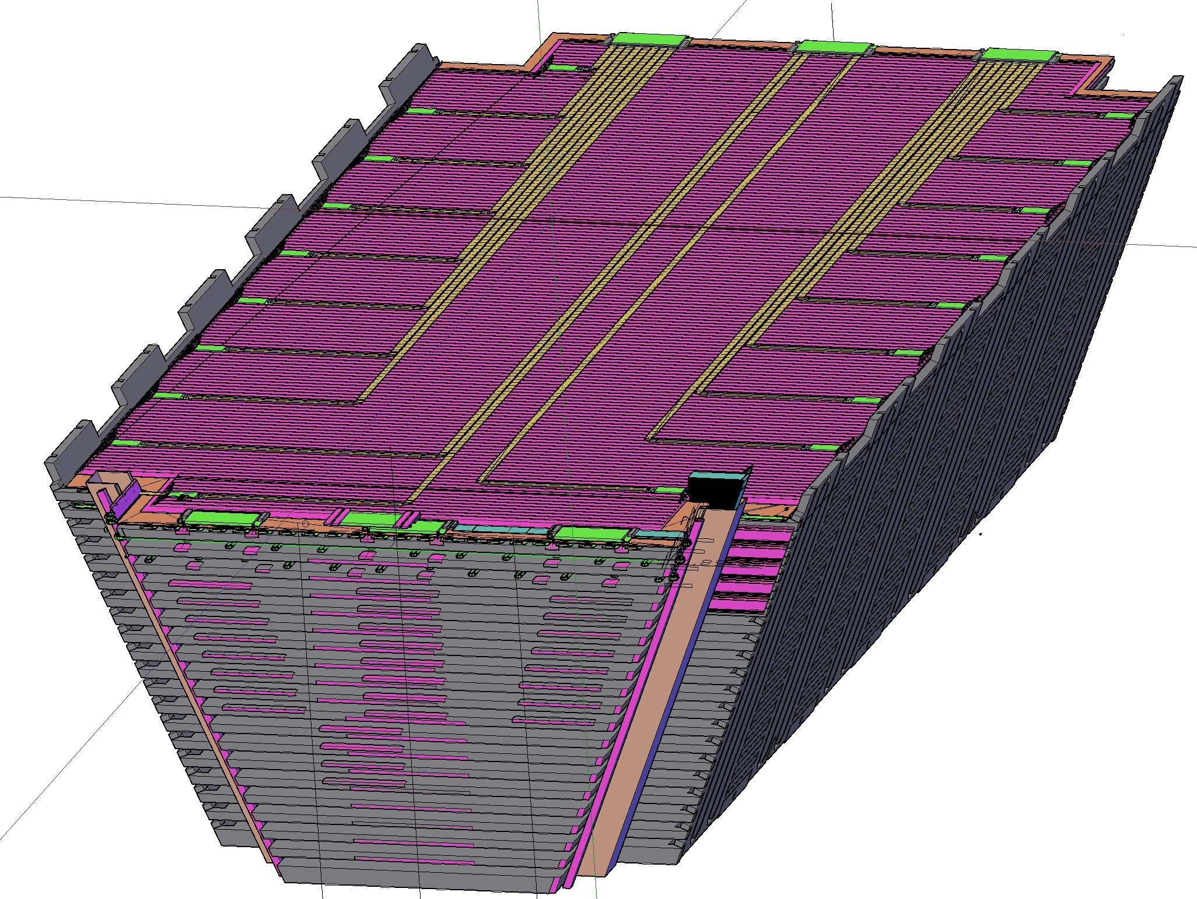
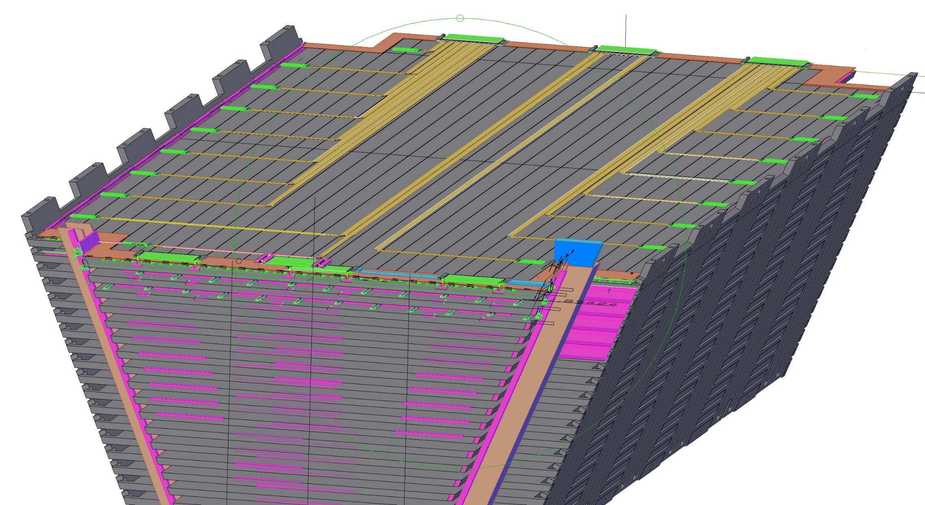
Barrel module (left: outer 60 mm Fe plate removed, right: 5mm honeycomb removed)
Wire signal cables go to the one edge, strip signals – to another
CB-64
Strip R/O cables
PAD-8
Strrip R/O side
Wire R/O side
Metallic screen on top of strip honeycomb
MDTs layer (strip cables are left)

Slide 6
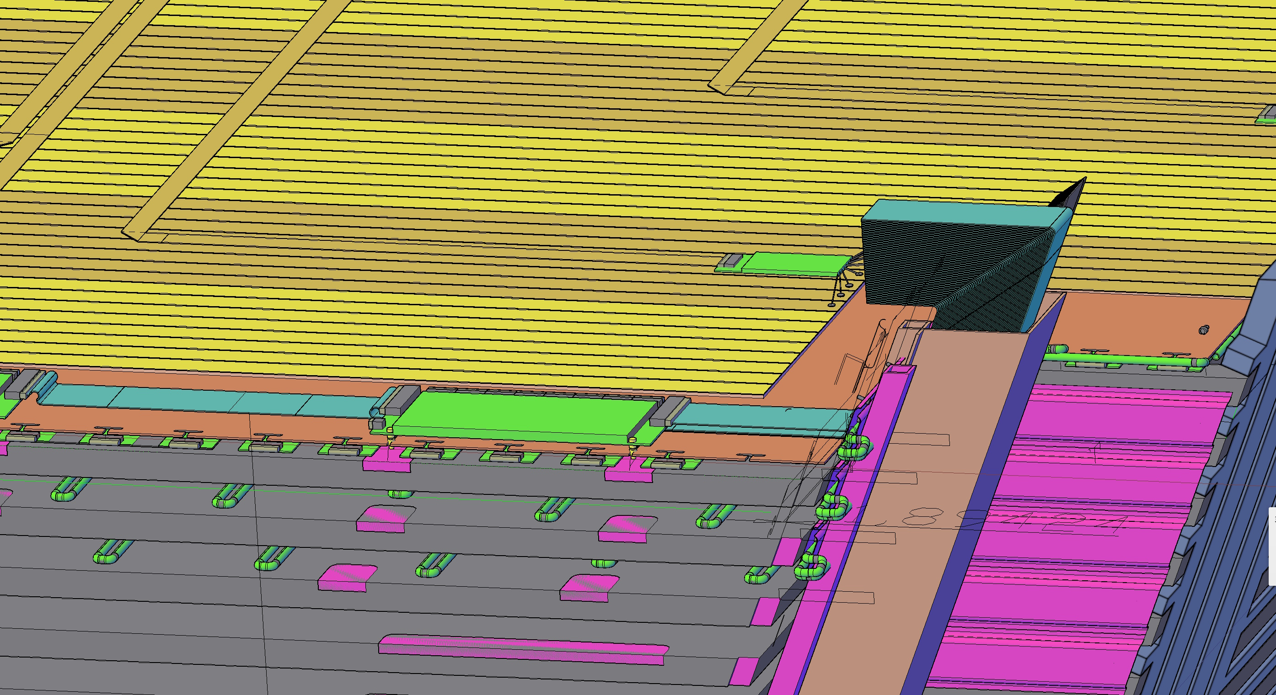
Magnified 3D view with removed 60 mm plate:
One PAD-8 board serves 8 strips 3 cm each, thus covering 24 cm of space along Z-axis
8 strips x 3 cm = 24 cm
8 –ch flat cable
PAD-8
RS cables cover
Gas manifold
Special small grooves in Fe plates for fixing CB-64 cards

Slide 7
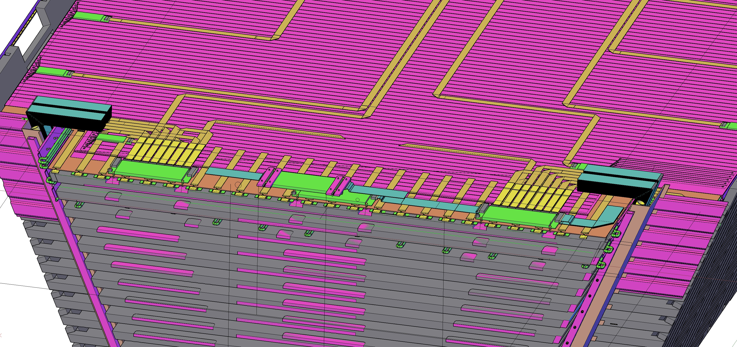
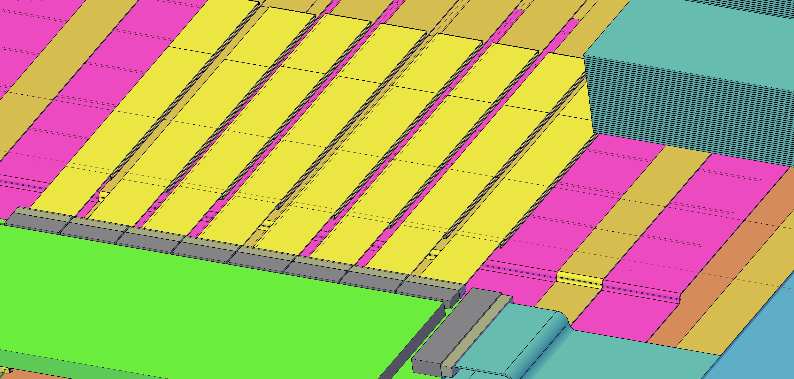

Slide 8
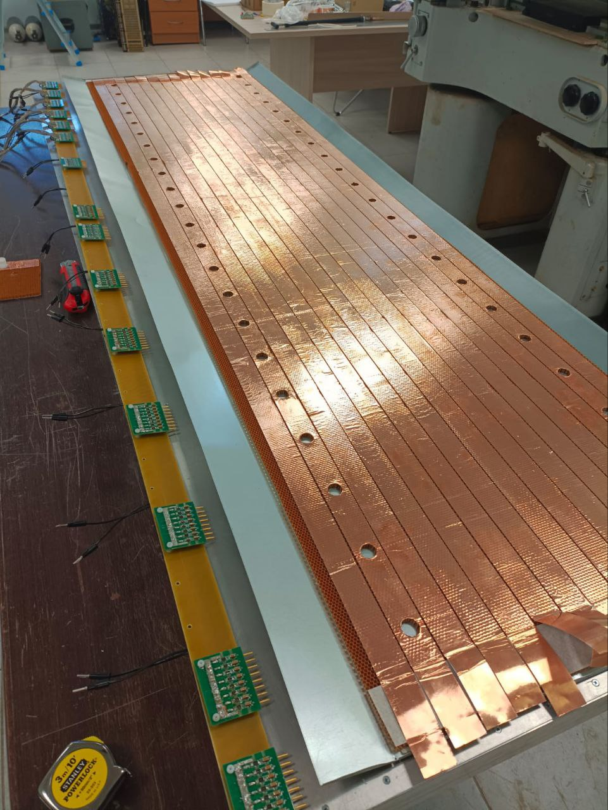
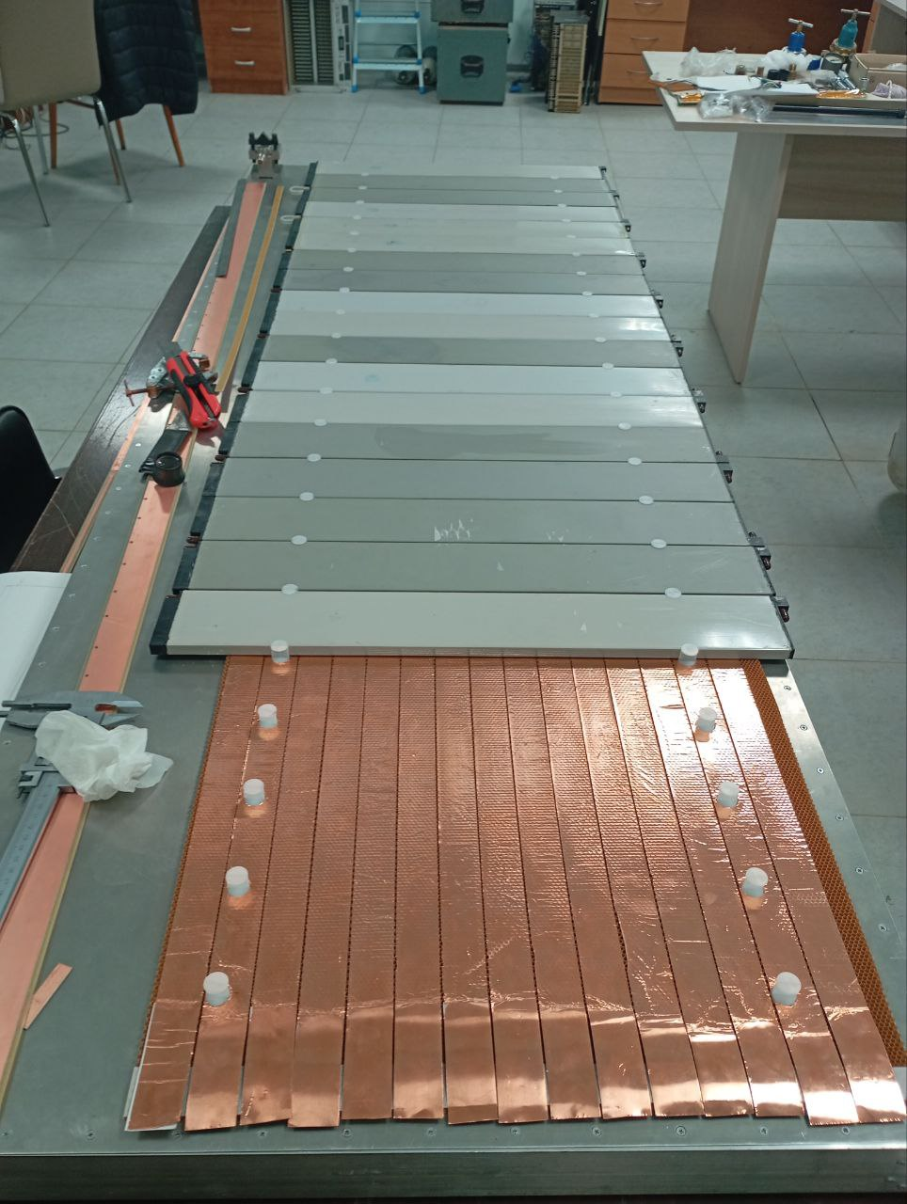
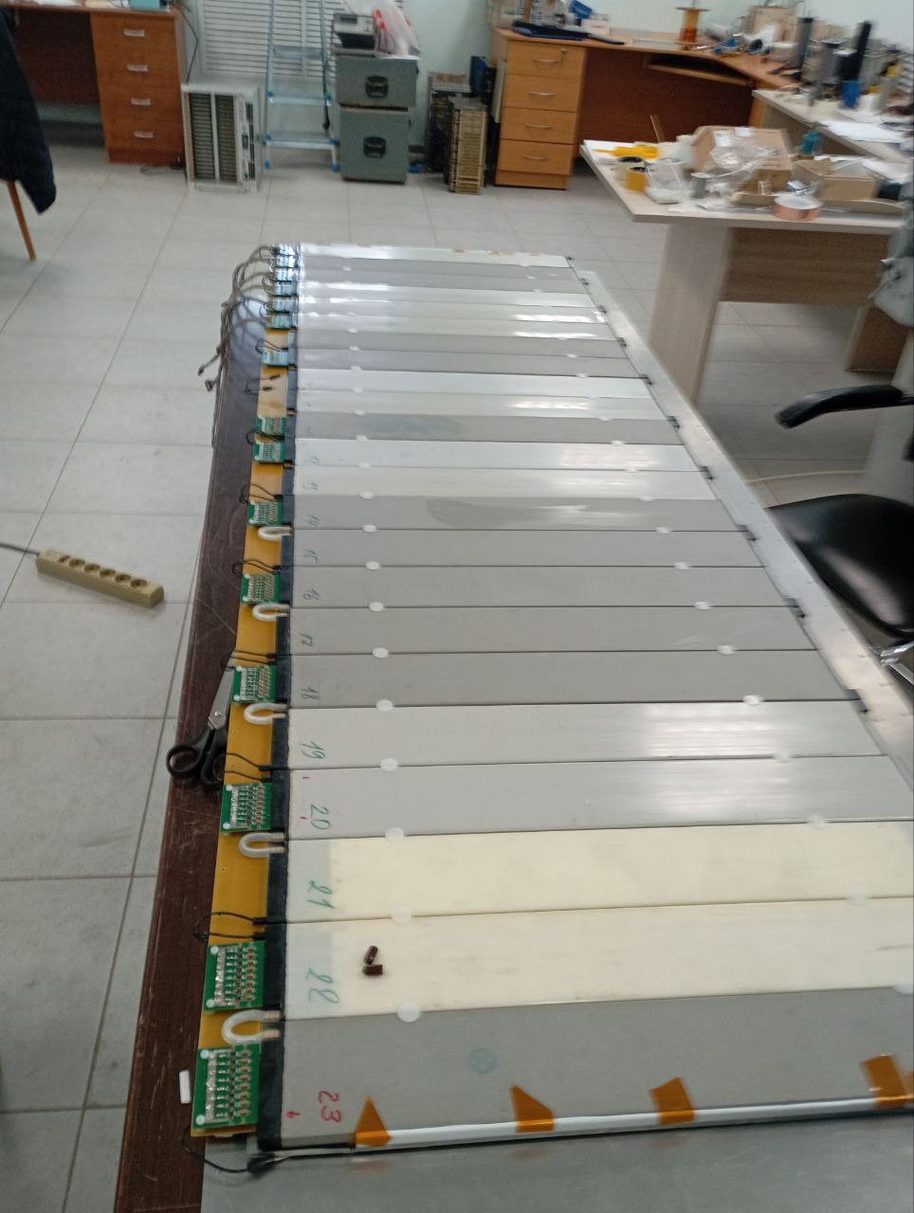
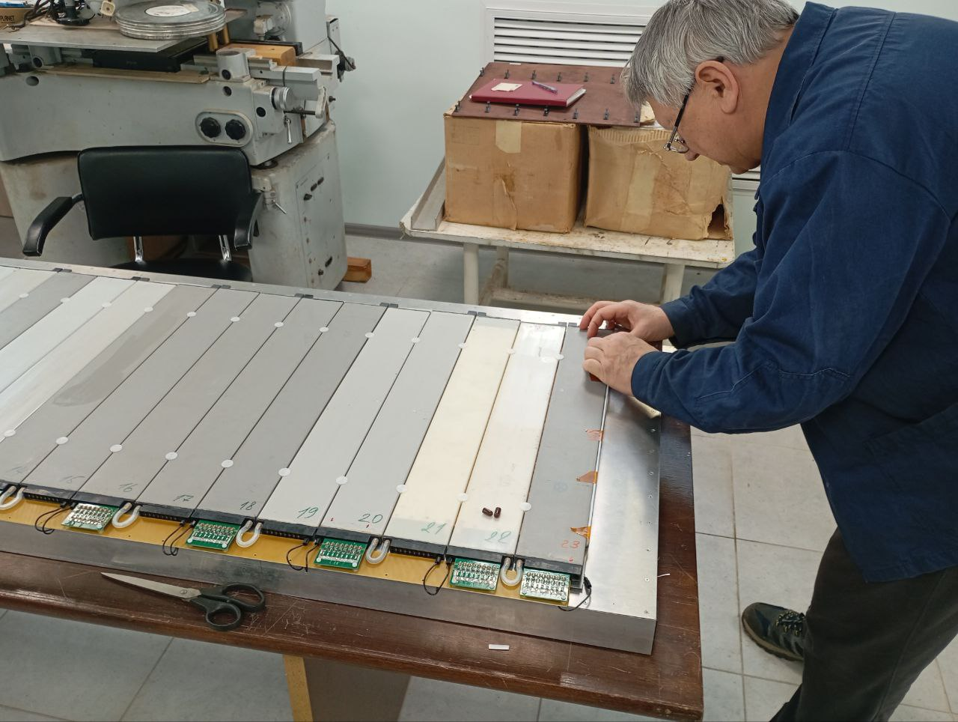
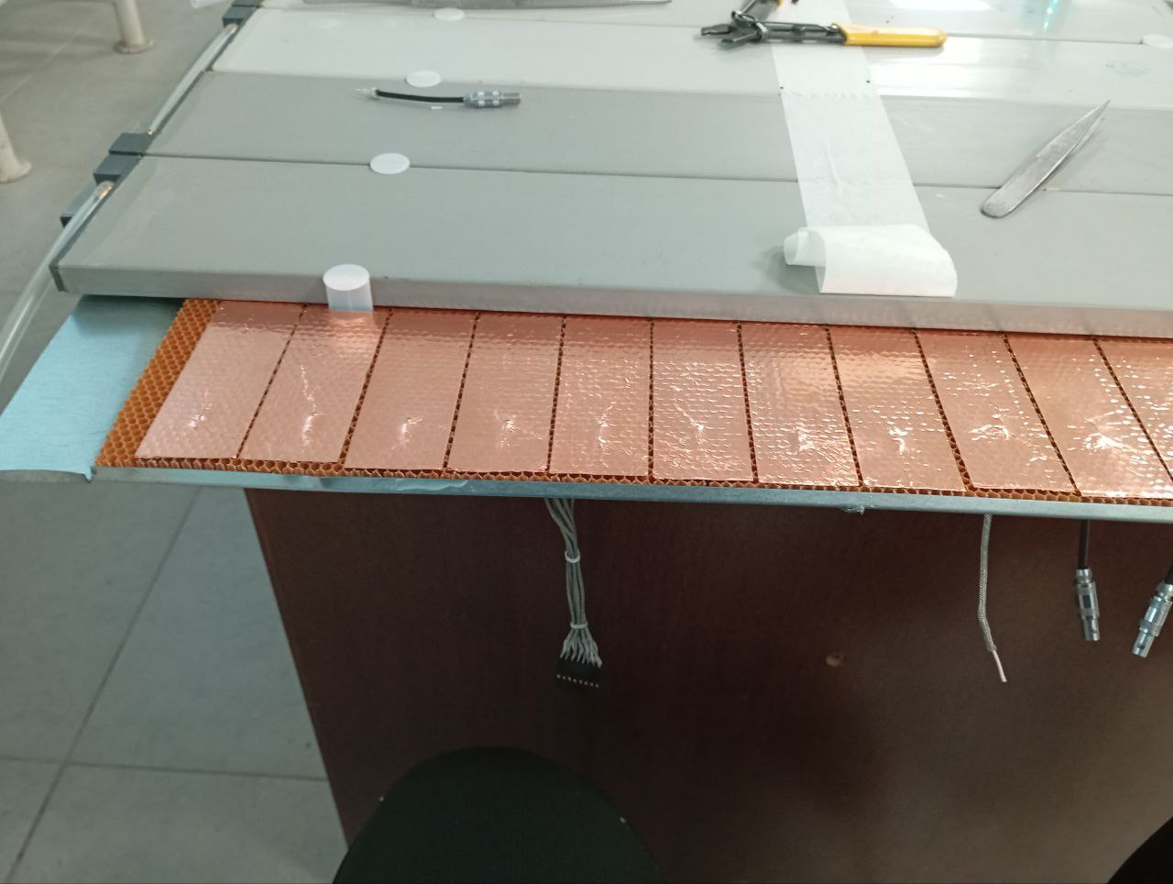
Detector Layer Prototype (DLP)
DLP recent assembly consists of 60 cm long MDTs, 2 m long strips (3cm width), 5mm thick honeycomb (air gap) with 3mm cells, new type of blades (cylindrical) and 0,3 mm thick iron (zinc plated) shielding cover. (corresponds to new concept of stirp board )
Shielding cover
MDT
Honeycomb
Strips
Fully assembled and ready for R&D tests

Slide 9
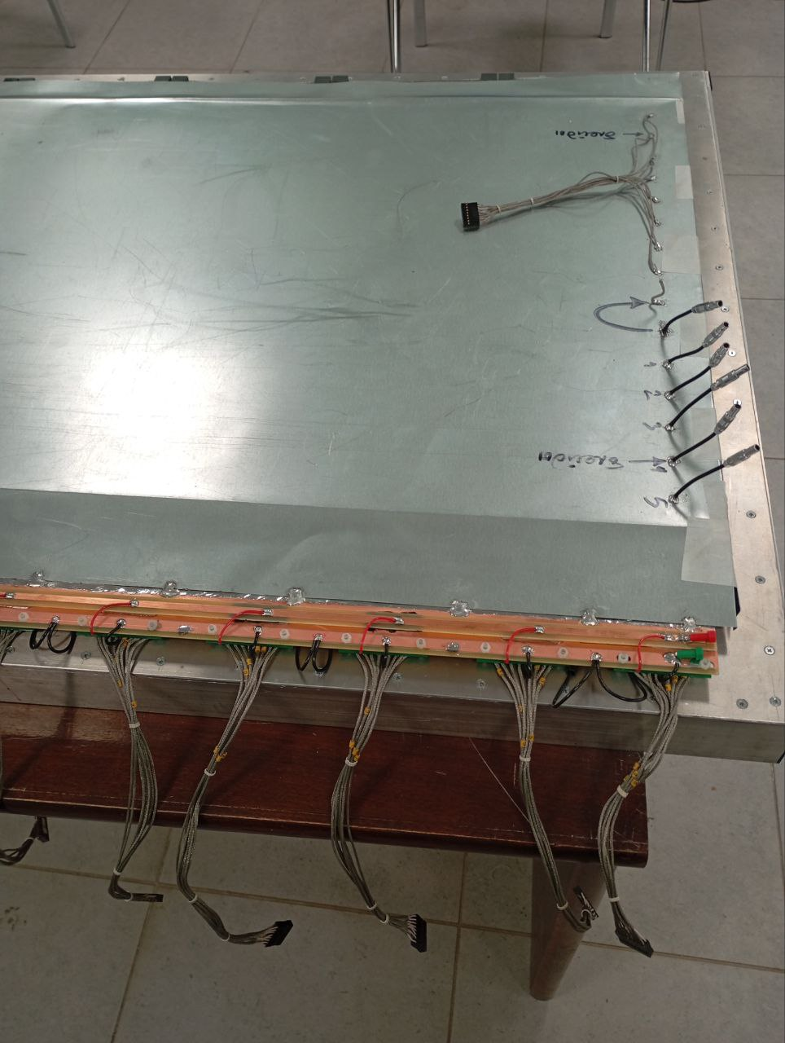
DLP General R&D Tasks
Shielding cover
Strips outputs for signal R/O tests
DLP is designed to:
study new “air” stripboard parameters and strip signal R/O
study influence of material choice and peculiarities of assembly technological process on strip R/O parameters
study shielding efficiency
develop optimal technological process of full scale detecting layer assembly
study strip registration efficiency
DLP
Strips outputs for parametric tests
HV buss
MDT R/O cables

Slide 10
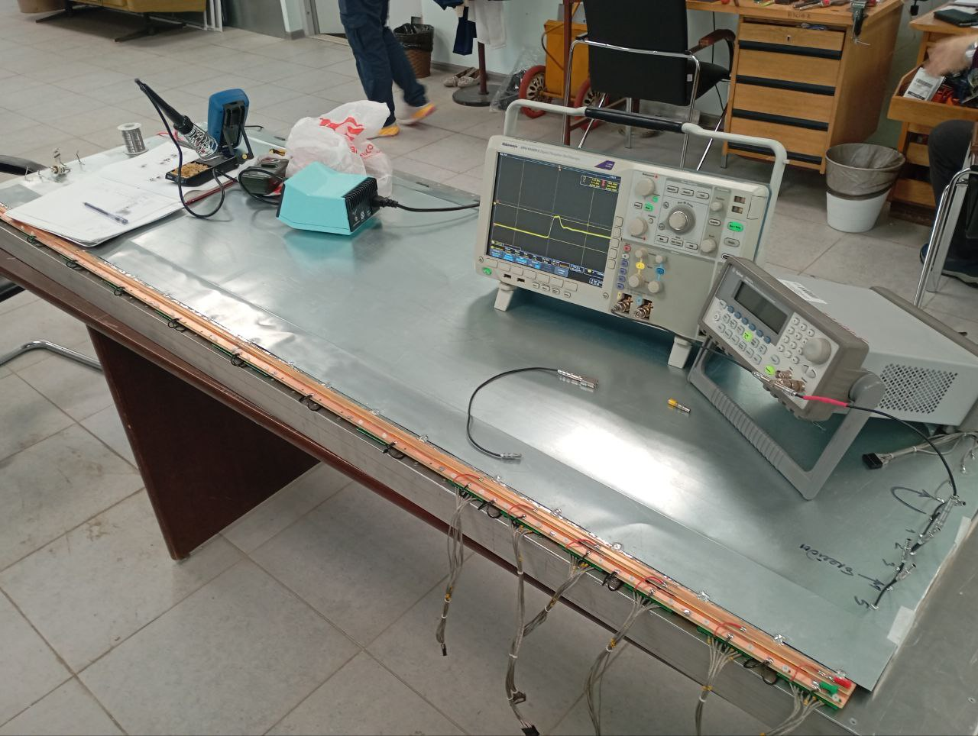
DLP: measurement of strip wave impedance and capacity
Results obtained using DLP:
Strip capacity =189pF/m (for max strip length - 491pF)
Strip wave impedance = 21 Ohm
The new concept of the "air" strip board provides a wave impedance of 21 Ohm - the matching resistors will form the corresponding voltage dividers with the input impedances of the amplifiers (5 Ohm Ampl-8.53 or 0.3 Ohm Ampl-8.11R.G-5), improving their high-voltage protection. The measured result is within the calculated range and can be slightly improved by adjusting the assembly technology.
Strip maximum capacity (491pF) fits Ampl-8.53 and Ampl-8.11R.G-5 detector capacity rating of 500pF.

Slide 11
CONCLUSION
Разработка типовой 3D-модели детекторной плоскости (для максимальной по ширине «щели» на стадии завершения.
Начато моделирование (тиражирование) индивидуально для
всех остальных «щелей» в 6-ти регулярных + Top, Bottom модулей
барреля.
Планируется доработка стенда для отработки сборки и
физического моделирования детекторных плоскостей.

