Slide 1

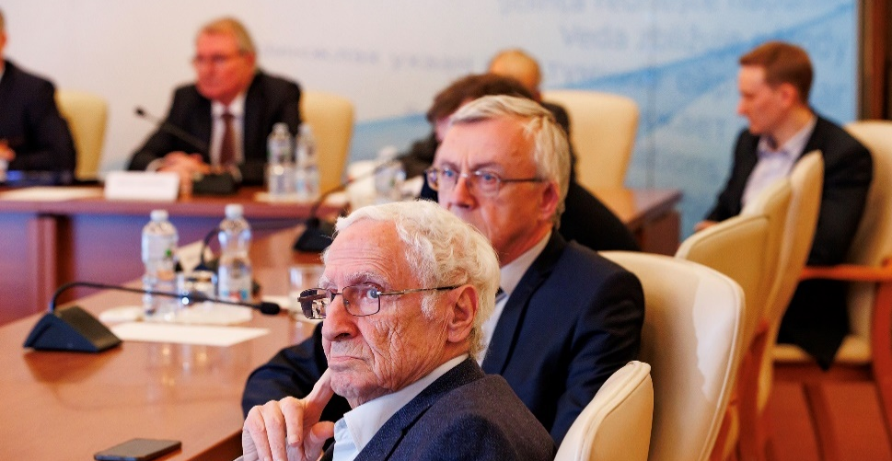
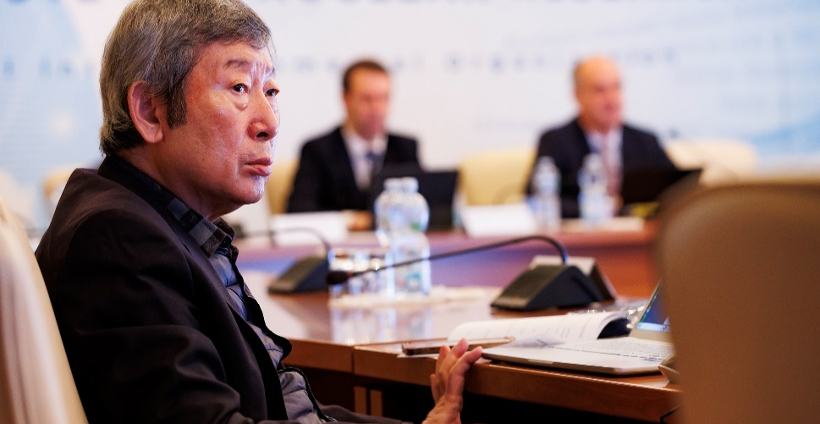
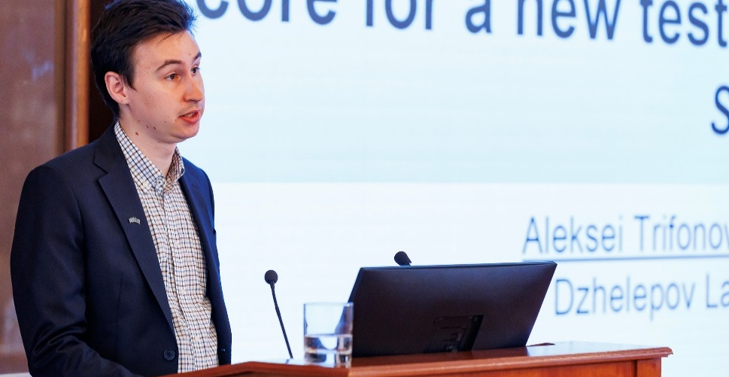
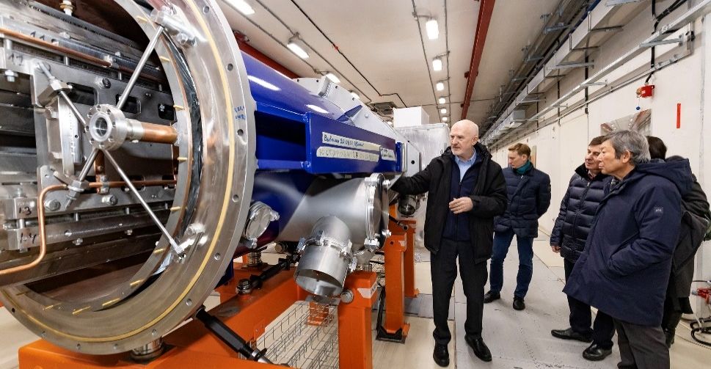
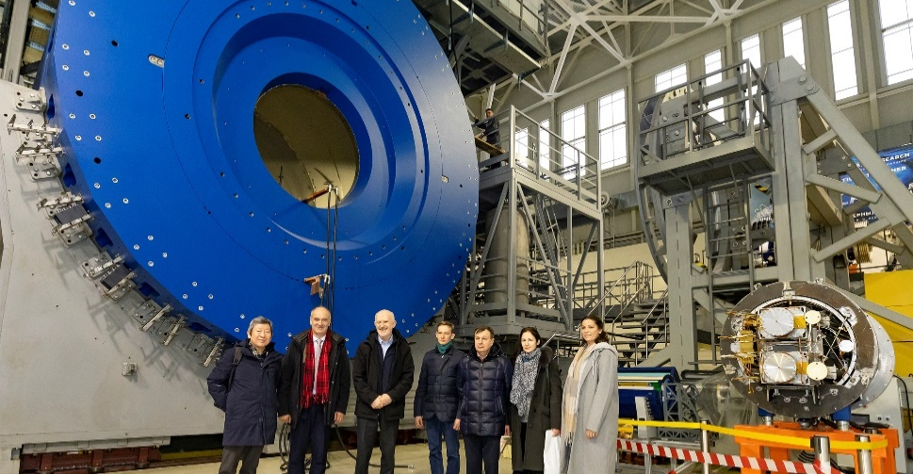
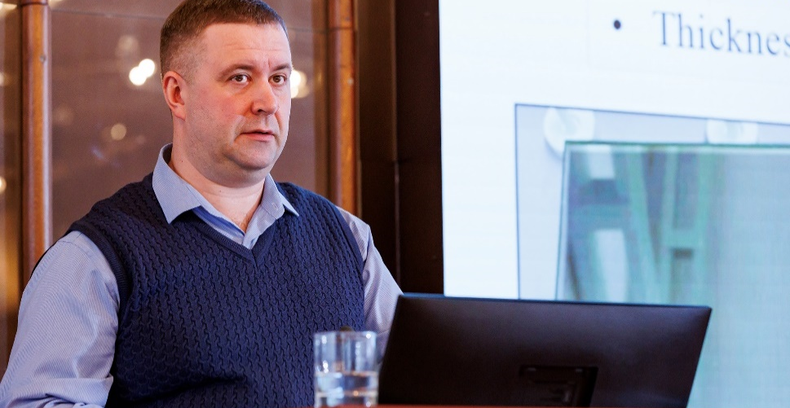
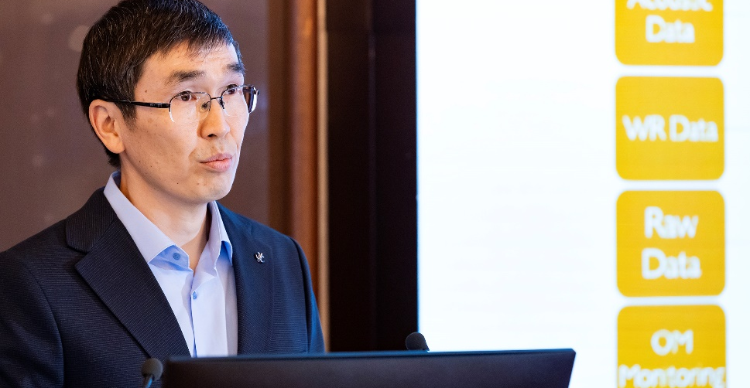
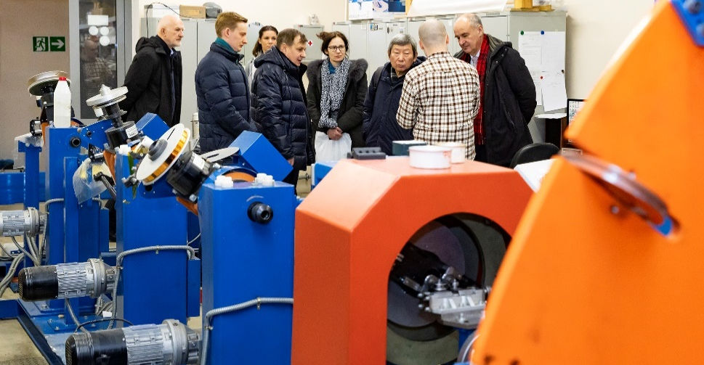
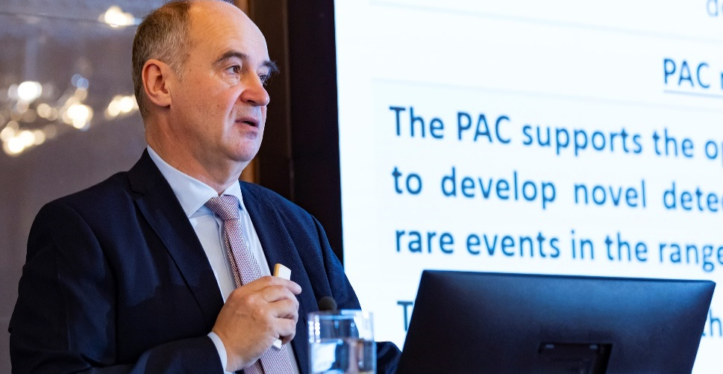
60
th
Meeting of the Programme Advisory Committee for Nuclear Physics
23-24 January 2025
Valery V. Nesvizhevsky

Slide 2
PAC for Nuclear Physics 60th meeting, 23 January 2025
1. | Opening of the meeting | V. Nesvizhevsky
2. | Implementation of the recommendations of the 59th PAC meeting | V. Nesvizhevsky
3. | Information on the Resolution of the 136th session of the JINR Scientific Council (September 2024) and on the decisions of the JINR Committee of Plenipotentiaries (November 2024) | Sergey Dmitriev
4. | Baikal-GVD Deep-Underwater Neutrino Telescope: status and results | Bair Shaibonov
5. | Linear electron accelerator LINAC-200 as a core for a new test beam facility at DLNP JINR | Alexey Trifonov
6. | Study of chemical and physical properties of superheavy elements at the SHE Factory | Alexander Svirikhin
7. | Brief information on establishing a new scientific journal at JINR | Alexander Nezvanov
8. | Visit to the Veksler and Baldin Laboratory of High Energy Physics
9. | Presentations of the new results and proposals by FLNR young scientists in the field of nuclear physics (6 reports)
10. | Closed discussion and voting for the best young scientists’ presentations

Slide 3
PAC for Nuclear Physics 60th meeting, 24 January 2025
11. | Scientific reports:
 | 11.1. Equivalence principle and acceleration effect | Alexander Frank
 | 11.2. JUNO experiment: status and results | Maxim Gonchar
 | Closed session:
12. | Meeting of the PAC members with the JINR Directorate
13. | Drafting the PAC recommendations including proposals for the agenda of the next PAC meeting
14. | Presentation of the PAC recommendations to the directorates of JINR and the laboratories
 | Closing of the meeting

Slide 4

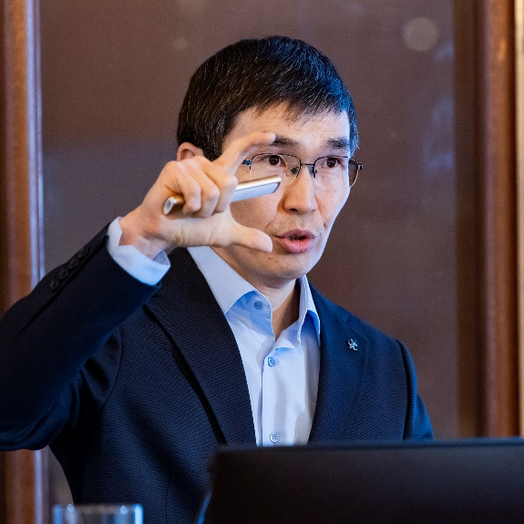
Baikal-GVD
Deep-Underwater Neutrino Telescope: status and results
The gigaton-scale neutrino telescope Baikal-GVD, the largest operating neutrino telescope in the Northern Hemisphere, is capable of investigating cosmic neutrinos and identifying their sources, searching for neutrinos from the dark matter annihilation and other rare phenomena.
For detection of neutrinos, the water of Lake Baikal is used.
Optical sensors are deployed deep under water, they detect Cherenkov radiation of secondary particles resulting from interactions of high-energy neutrinos within the observed volume.
Bair Shaibonov

Slide 5
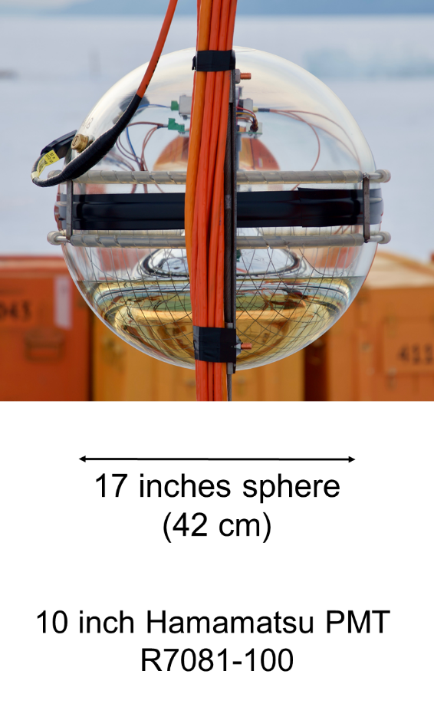
Baikal-GVD Status, April 2024
>0.6 km³
of water volume
4104
optical modules
placed on 114 garlands
13
fully functional clusters
Next Expedition Plans (2025)
Installation of new equipment's:
  Two new clusters: 14th and 15th
  Two bottom cable lines
  Full-scale string for the next-generation telescope
  Cluster Center for cluster 17
Repairing some parts
The completion of work on the design of 1 km³ Baikal-GVD detector with ~6000 OM is planned in 2027/2028

Slide 6
Partially installed telescope produces astrophysical results:
The analysis of data obtained in 2018–2023 confirms the diffuse astrophysical neutrino flux observed by the IceCube experiment with a significance of above 5σ.
PAC recommendations
The PAC deeply appreciates the scientific significance of the Baikal-GVD project and the leading role of JINR in its implementation.
The PAC recommends continuing the development of the detector with testing its possible next-generation components.
Also, the PAC notes the relevance of maintaining and developing both the shore infrastructure of the project and the production and research capabilities at the JINR sites.
The results of searching for events from the neutrinos with energies of above 200 TeV demonstrate an unexpectedly large contribution of events from the galactic plane to the observed diffuse flux, which contradicts the assumptions of many modern model-dependent predictions.
Moreover, the analysis indicates a possible correlation between radio-bright blazars as possible sources of both galactic and extragalactic high-energy neutrinos.

Slide 7

SC recommendation:
The Scientific Council notes an important outcome achieved by the analysis of data obtained in 2018–2023 –– confirmation of the diffuse astrophysical neutrino flux observed by the IceCube experiment with a significance of above 5σ.
The Scientific Council agreed that continued work on developing the detector with testing its possible next-generation components is necessary and relevant.
Also, the Scientific Council notes the importance of maintaining and developing both the shore infrastructure of the project and the production and research capabilities at the JINR sites.

Slide 8
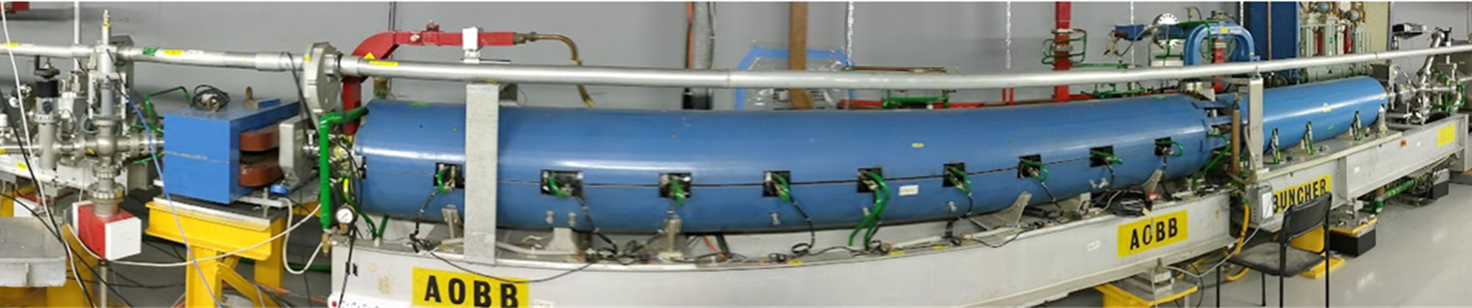
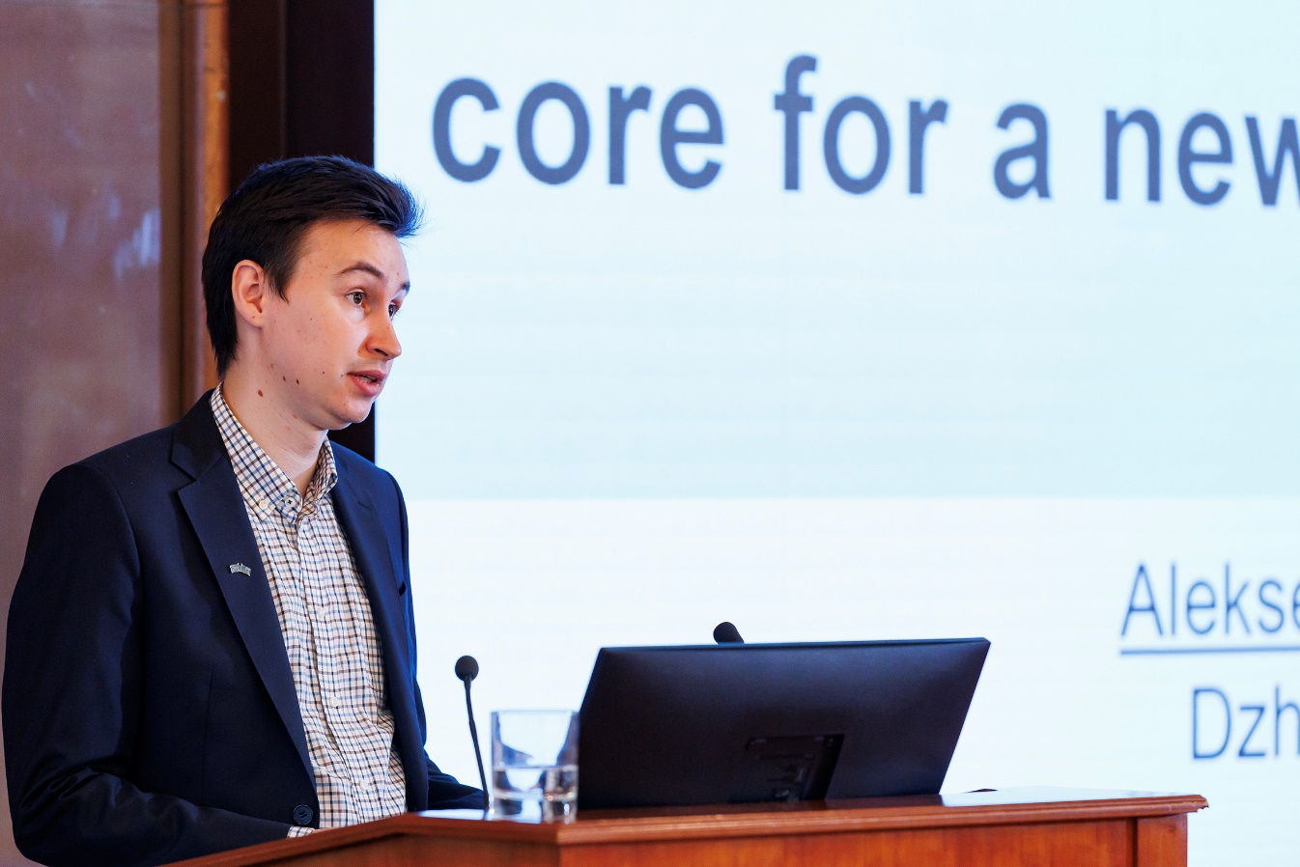
Linear electron accelerator LINAC-200 as a core for a new test beam facility at DLNP JINR
200 MeV
up to 800 MeV
The initial phase of the work involves launching the first stage of the installation
In the future, it is planned to gradually put into operation the accelerator structures
Aleksei Trifonov

Slide 9
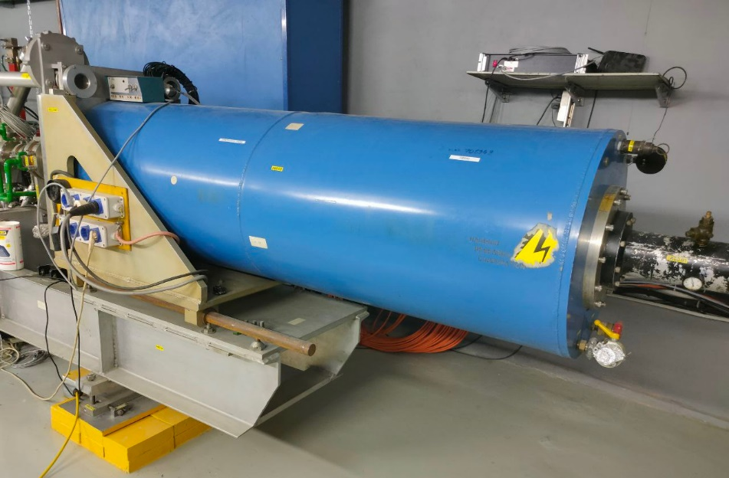
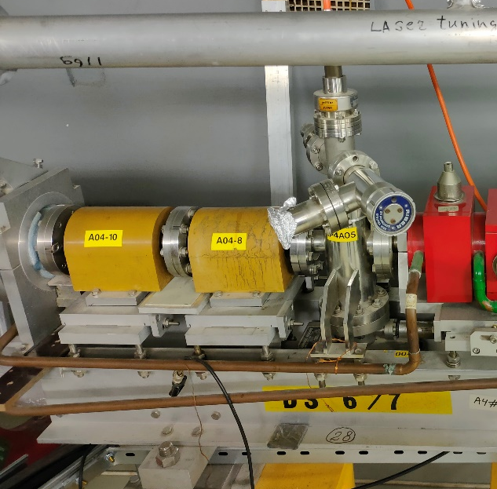
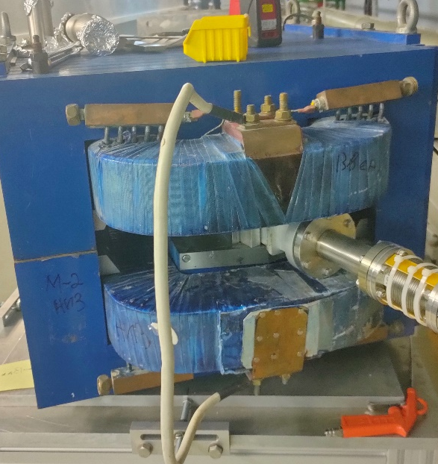
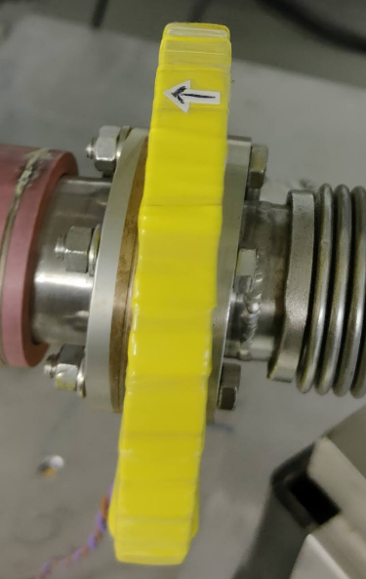
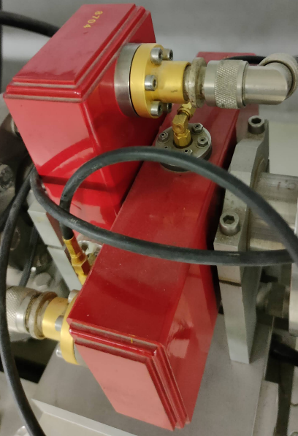
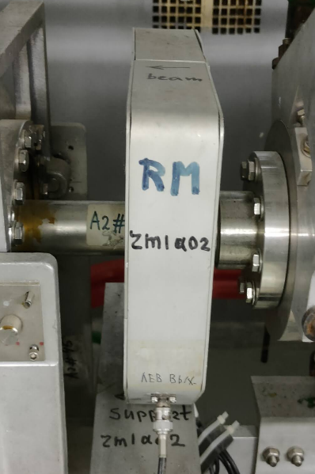
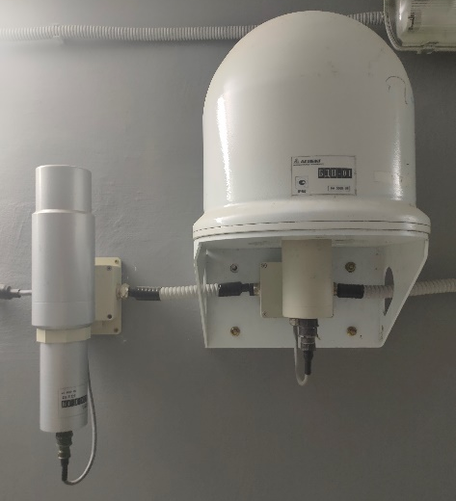
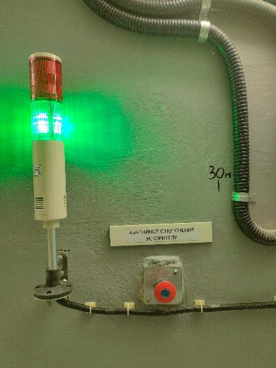
Main systems of the LINAC-200 accelerator
Electron Gun
Acceleration & RF
Magnetic system
Beam Diagnostics
Radiation safety system & Interlock and alarm system
The accelerator, which was transferred to JINR from NIIKHEF (Netherlands), underwent a deep modernization.
The key subsystems of the accelerator were designed anew.
Control system

Slide 10
Beam extraction channels
24 MeV
60 MeV
4
experimental beam extraction channels were designed and constructed
*
K
6
133 MeV
207 MeV
Each channel equipped with an individual beam absorber
10

Slide 11
Research program
Requests from the JINR Laboratories and research teams of JINR participating countries are the primary focus when forming the user research program at the accelerator.
Particle detectors R&D
Terahertz radiation source and beam diagnostics R&D
testing prototypes of electromagnetic calorimeters and coordinate detectors for the MPD and SPD experiments at the NICA collider
Research
program at the LINAC-200
Nuclear physics experiments
Applied research
in the field of radiation materials science, radiobiology and radiochemistry
Education and training

Slide 12

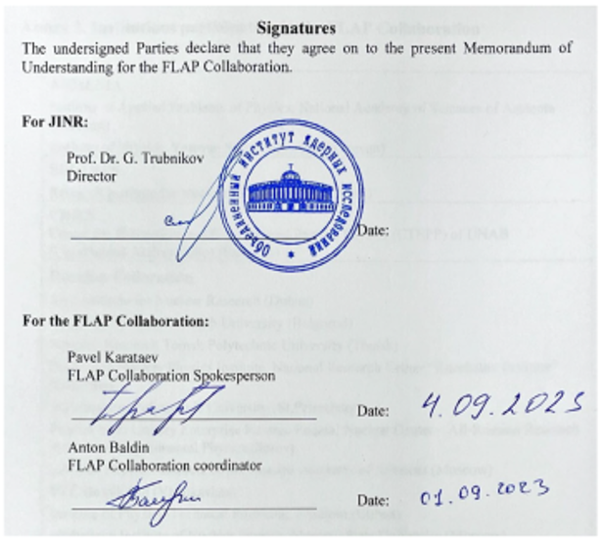
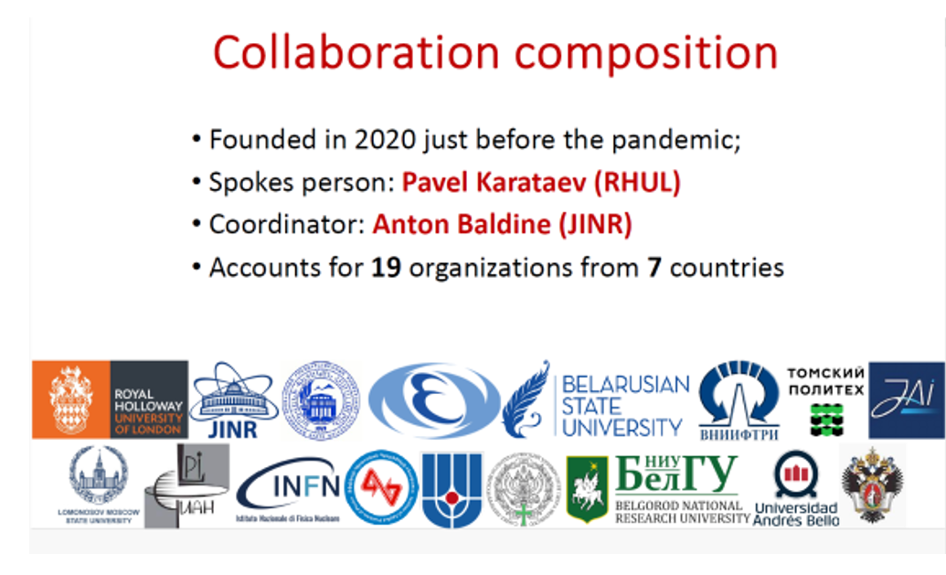
FLAP Collaboration
Memorandum of understanding
for the FLAP collaboration at JINR
Notes:
The high attractiveness of the LINAC-200 facility for scientific teams both in Russia and in other countries led to the creation of a new scientific collaboration FLAP (Fundamental and Applied Linear Accelerators Physics). The FLAP collaboration is aimed at studying the subtle effects of electromagnetic interaction with matter and new applications of controlled generation of electromagnetic radiation by relativistic electrons using functional materials. The FLAP collaboration program has been approved by the PAC for Particle Physics.

Slide 13
PAC recommendation:
The PAC notes the immense work to start the LINAC-200 facility at DLNP JINR, which is a part of the LINAC-800 accelerator, and wishes success with the LINAC-200 commissioning stage in 2025.
The PAC recommends that the DLNP Directorate should concentrate its efforts on preparing the first experiments at LINAC-200.
SC recommendation:
The Scientific Council wishes success with the LINAC-200 commissioning stage in 2025 and recommends that the DLNP Directorate should concentrate its efforts on preparing the first experiments at LINAC-200.

Slide 14
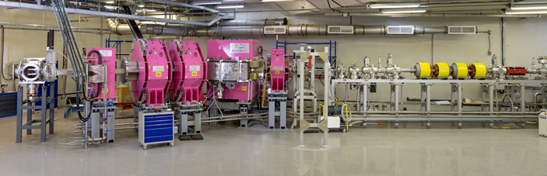

Study of chemical and physical properties of superheavy elements at the SHE Factory
During preparation for long-term experiments on the study of SHE properties, several experiments were conducted at the GRAND separator, commissioned in 2022, with the aim of investigating the capabilities of the setup.
The experiments were carried out with heavy ion beams of Mg, Ar, and Ca extracted from the DC-280 cyclotron. The separator was tuned using complete fusion reactions with Nd, Sm, Pb, and Pu targets.
Alexander Svirikhin

Slide 15
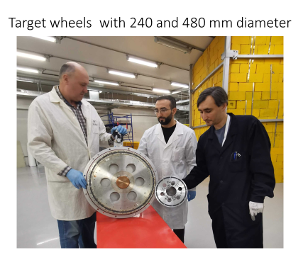
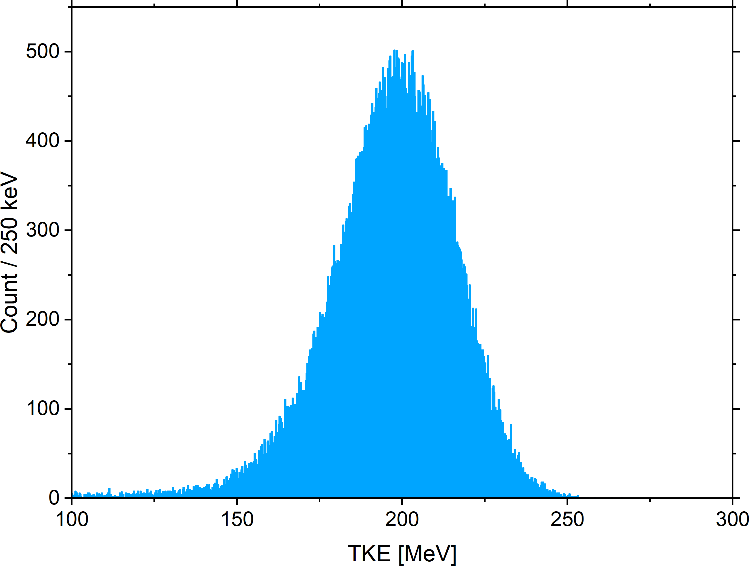
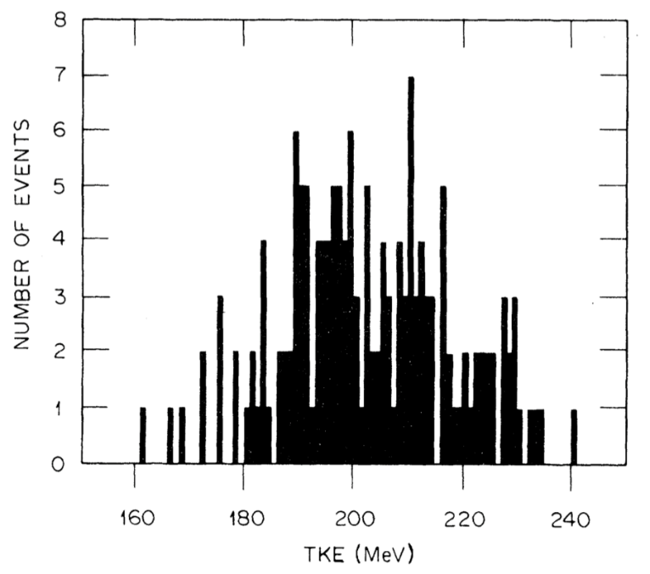
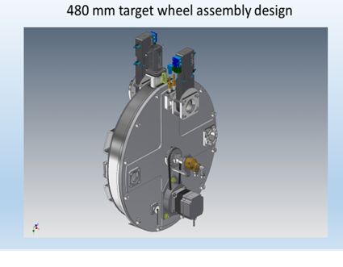
In 2024, the gas-filled GRAND separator was equipped with a new target with a diameter of 480 mm (previously 240 mm),
⁴⁸Ca + ²⁰⁶Pb = ²⁵⁴No* = 2n + ²⁵²No
Target: 690 µg/cm² PbS (480 mm in diam. wheel)
Beam: 4-6 pμA of ⁴⁸Ca
Result: 1-1.5 fissions/s from SF of ²⁵²No implanted to the GRAND focal DSSSD.
GRAND 2024 ~85k SF of ²⁵²No
Bemis 1977, 176 SF
(1)

Slide 16
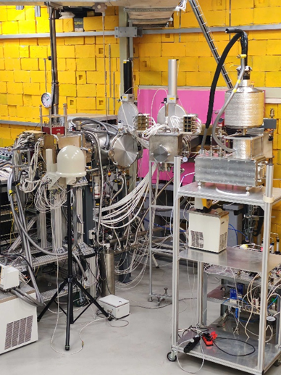
Results on previous experiments
A new plutonium isotope ²²⁷Pu was synthesized, and novel data were obtained on the radioactive decays of other yet-to-be-thoroughly investigated isotopes ²²⁸⁻²³¹Pu
Production cross sections for neutron-deficient nobelium nuclei were measured, and data were updated on the decay modes (²⁴⁹No) and the probability of isomeric state population (²⁵⁰No).
Short-lived isotopes ^{178,179,180}Hg produced in the ⁴⁰Ar + ¹⁴⁴Sm = ^{184-x}Hg + xn reaction were used for tuning the Cryodetector setup designed for experiments on the study of the chemical properties of SHE.

Slide 17
PAC recommendation:
The PAC acknowledges the tremendous efforts made to prepare for long-term experiments on spectroscopy of the isotopes of superheavy elements synthesized in the ⁴⁸Ca + ²⁴²Pu reaction.
The PAC greatly supports the proposed programme for studying the properties of the isotopes of superheavy elements. Given the unique and copious production of SHE at reach, the PAC advises exploring in more detail the possibility to design a station to detect the mass and TKE distributions of the fission fragments. This would greatly enhance the comprehension of the fission process in an unknown mass region.
The chemical properties of flerovium and copernicium should be studied using the ⁴⁸Ca + ²⁴²Pu reaction as well.
SC recommendation:
The SC greatly supports the proposed programme for studying the properties of the isotopes of superheavy elements. Given the unique and copious production of SHE within reach, the SC endorses the recommendations of the PAC for Nuclear Physics to explore in more detail the possibility of designing a station to detect the mass and TKE distributions of the fission fragments.

Slide 18
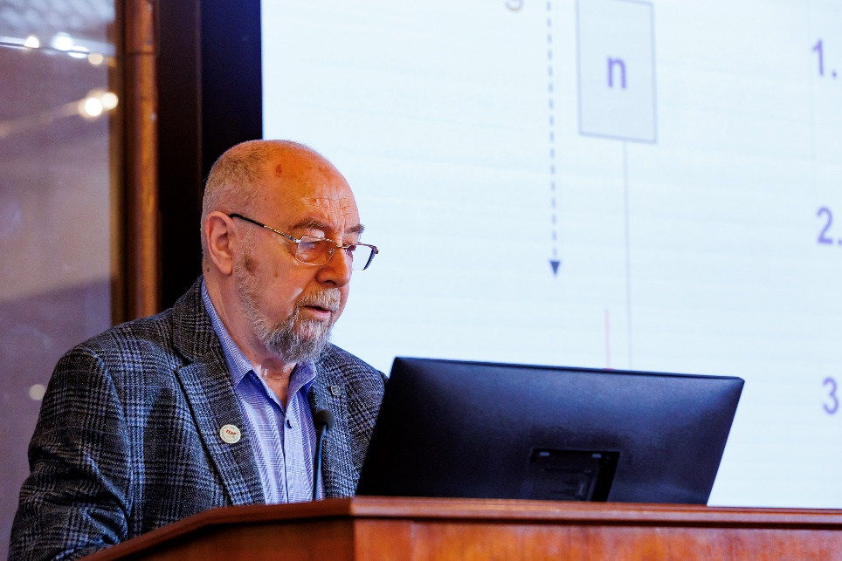
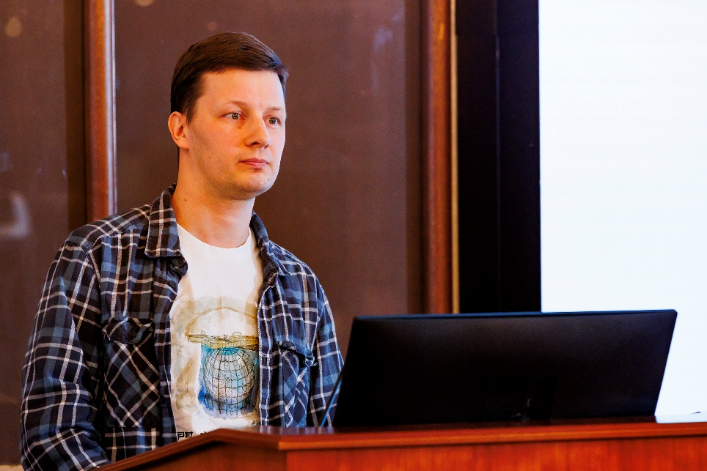
Scientific reports
“The equivalence principle and the acceleration effect”
“JUNO experiment: status and results”
Alexander Frank
Maxim Gonchar
18

Slide 19
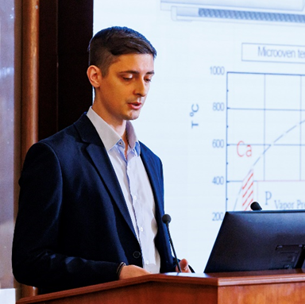
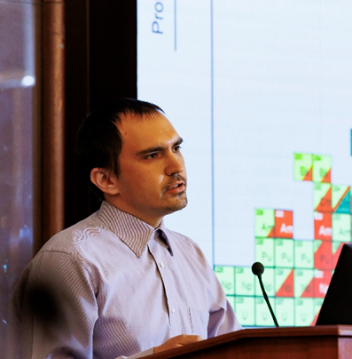
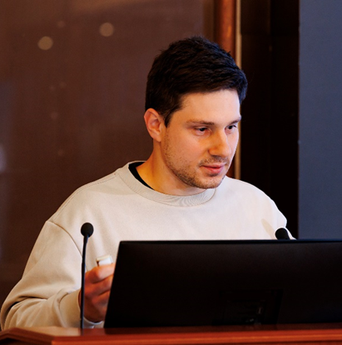
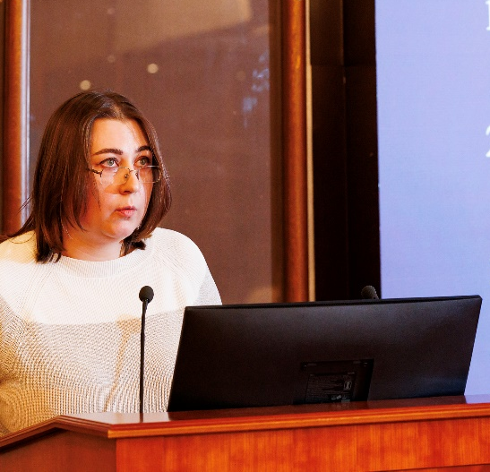
Presentations by young scientists
The PAC reviewed 6 short presentations in the field of nuclear physics research by young scientists from FLNR
1
2
3
Dmitriy
Pugachev
Igor
Vorobiev
Alexander Madumarov
Alena
Kuznetsova
Intense metallic ion beams for SHE synthesis
Experimental study of multi-nucleon transfer reactions in collisions of heavy nuclei at CORSET setup
Possibilities of producing medically relevant Auger electron emitter ^{195m}Pt
Study of the properties of elements with Z≥100

Slide 20
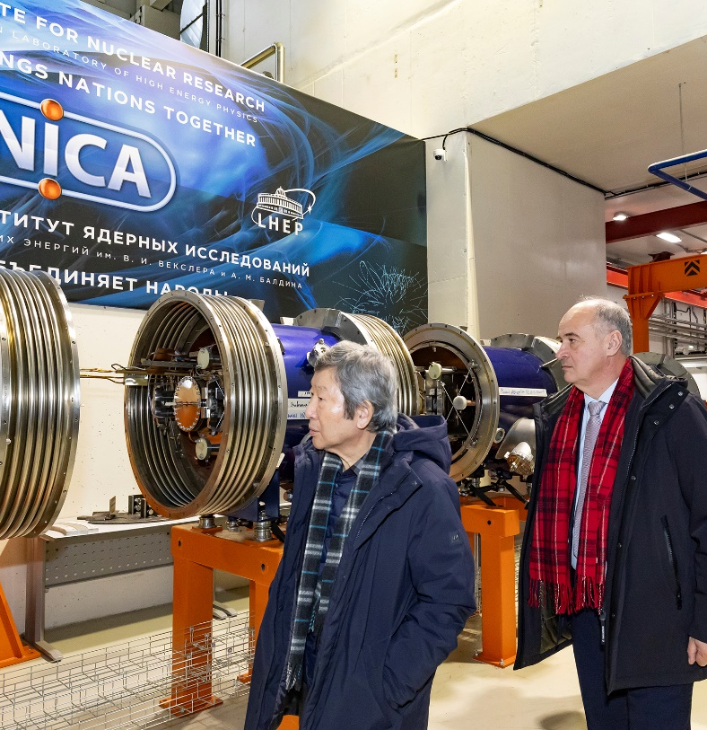
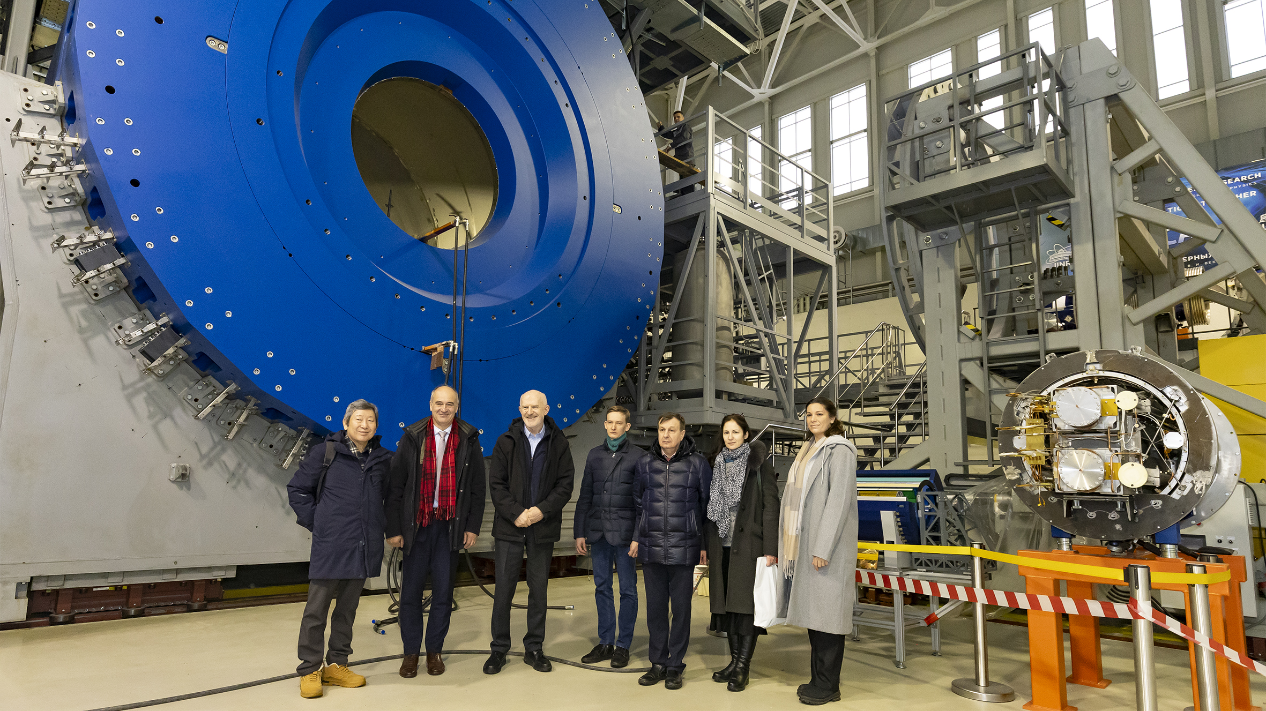
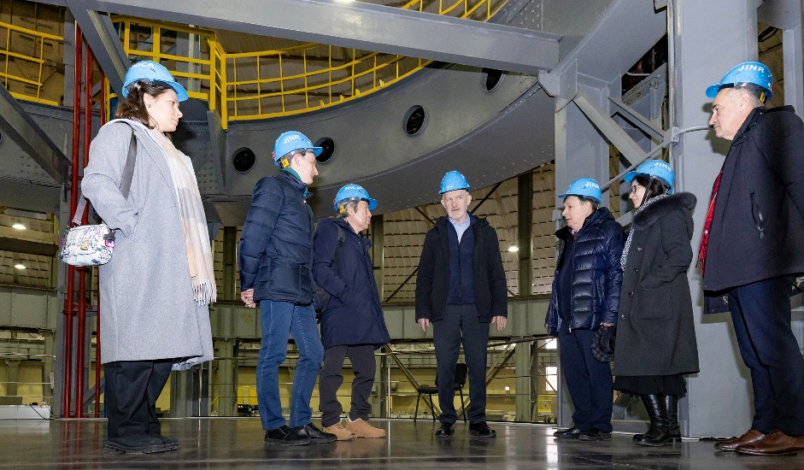
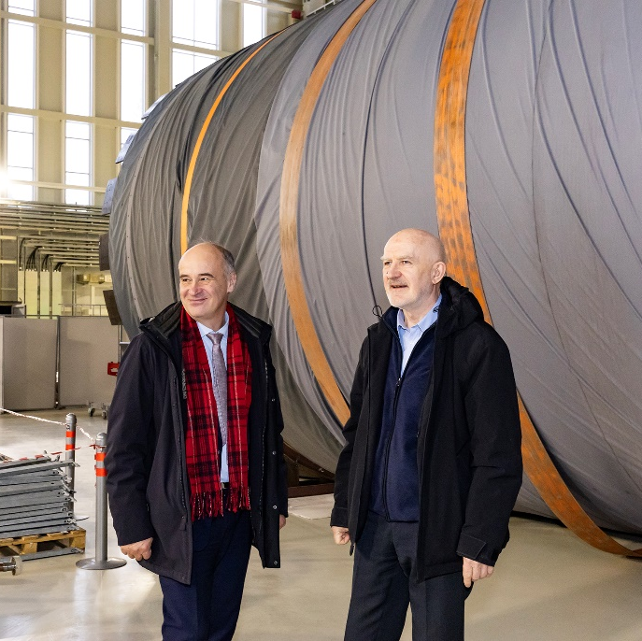
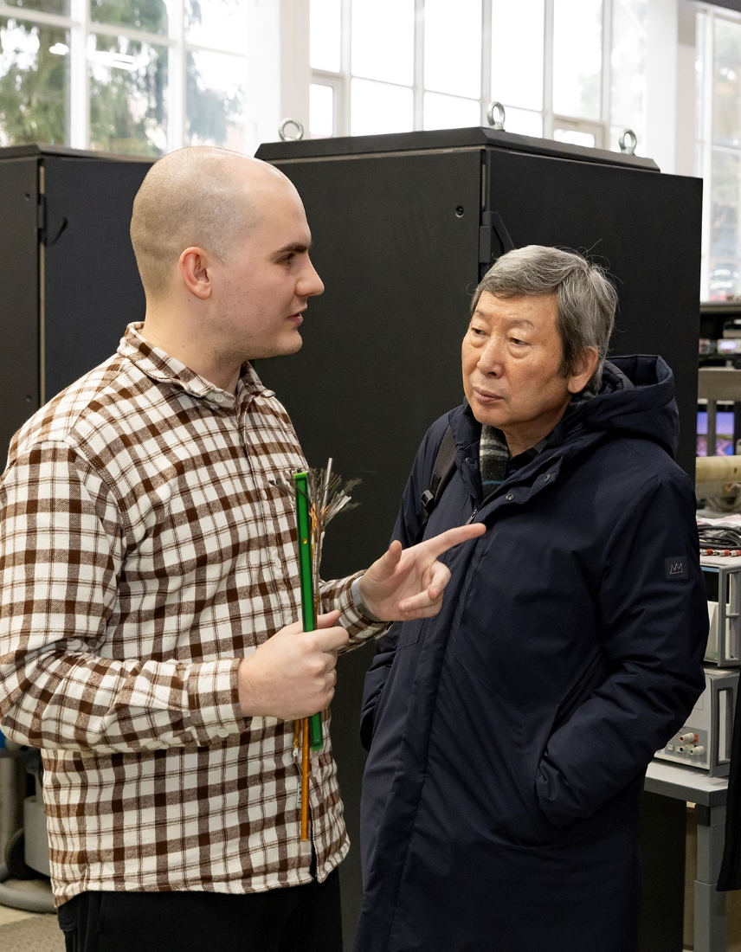
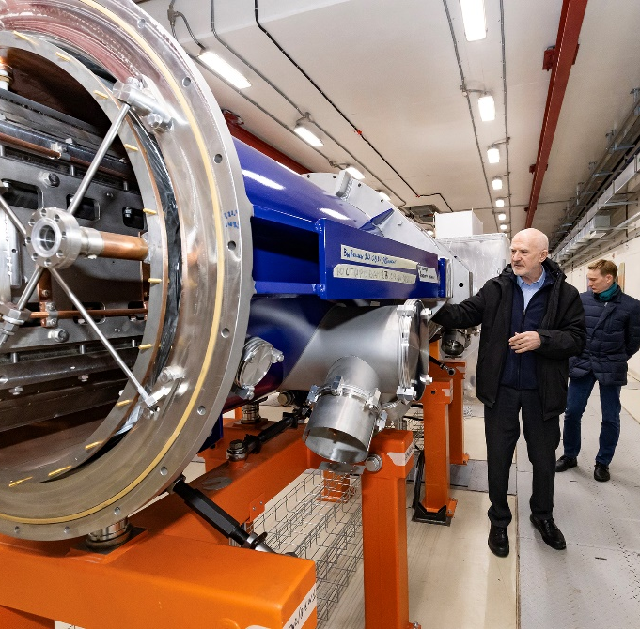
Visit to VBLHEP

Slide 21

THANK YOU FOR YOUR ATTENTION!

