Slide 1
Development of the concept of an ultracold neutron source at IBR-2 pulsed reactor
Project leaders: | V.N. Shvetsov, G.V. Kulin
Deputy leader (scientific supervisor): | A.I. Frank

Slide 2
Ultra Cold Neutrons
UCNs are important tools for:
Search for the neutron EDM
Measurement of the neutron lifetime
Measurement of angular correlation coefficients of neutron beta decay
Search for neutron-antineutron oscillations
Investigation of quantization of neutron states in a gravitational field and search for new interactions
Research in non-stationary quantum mechanics and neutron optics
…
General definition: UCNs are neutrons whose energy is so low that they are reflected under any angle of incidence can be contained in traps
 | E (eV) | T (K) | λ(Å)
Ultra cold | <10⁻⁷ | ≈ (<) mK | >800
Very cold | 10⁻⁷ – 10⁻⁴ | 10⁻² - 10 | 800 - 30
Cold | (0.1-10)×10⁻³ | 10-120 | 30-3
Thermal | (10-100) ×10⁻³ | 120-1000 | 4-1
Resonant | >1 |  | < 0.1

Slide 3
The FLNP contribution to world research with UCN

Slide 4
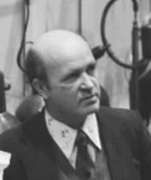
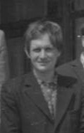
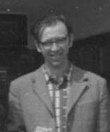
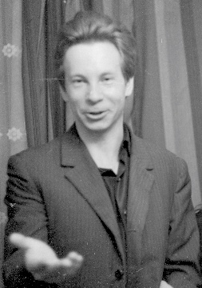
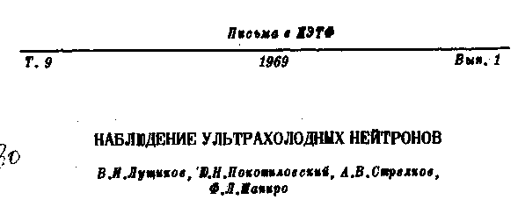
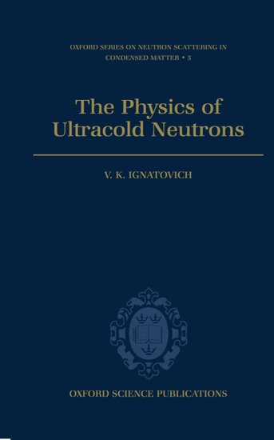
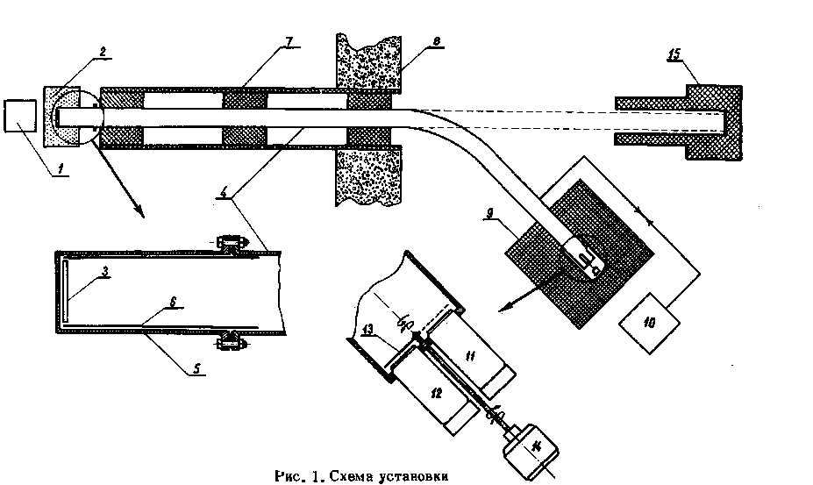
F.L. Shapiro, V.I. Lushchikov, A.V. Strelkov, Yu.N. Pokotilovski
V.K. Ignatovich
1969
1986

Slide 5
Quantization of the vertical movement of neutrons during their storage on a horizontal material mirror
Physics Today 30, 6, 42 (1977);
Nature 415, 42 (2002) 298
Nature Physics (2011)
Precise gravity spectroscopy at the level of ${10}^{−15}$ eV

Slide 6

Measurement of the betta decay constant (1990 – 1992)
Processes of small energy transfers during UCN storage
Geltenbort, Nesvizhevsky, Kartashov et al. JETP Letters, (1999),
Nesvizhevsky, Lychagin, Muzychka et al. Phys. Lett. B (2000)
Kartashov, Lychagin, Muzychka et al. Int. J. Nanoscience (2007)
Cherniavsky, Lychagin, Muzychka et al. Eur. Phys. J. C (2019)
Anomaly in the UCN storage inside beryllium traps - the nature of the anomalous absorption during reflection remains unnown
$$τ_{n}=888,4±3,3$$
Nesvizhevski et al. JETP, (1992)
The work served as the beginning of a new stage of precision measurements of the decay constant
Alfimenkov et al. JETP Letters, (1992)

Slide 7
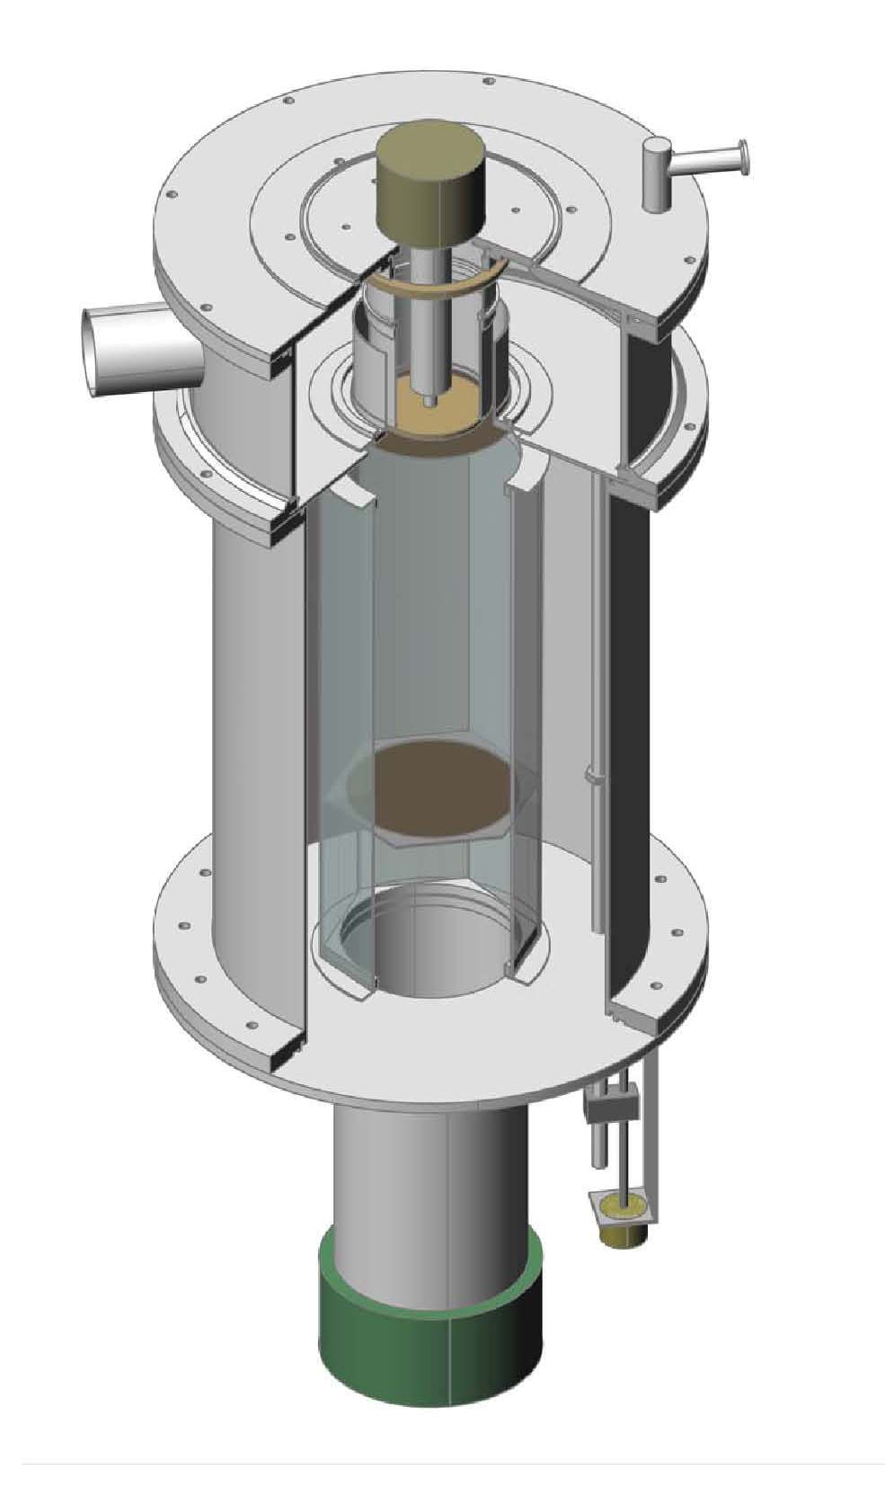
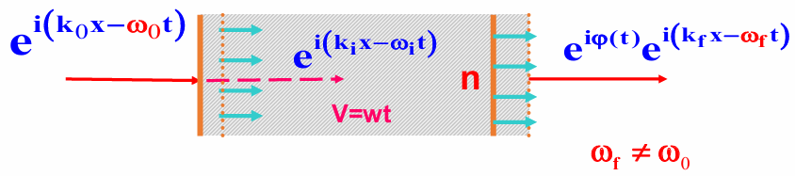
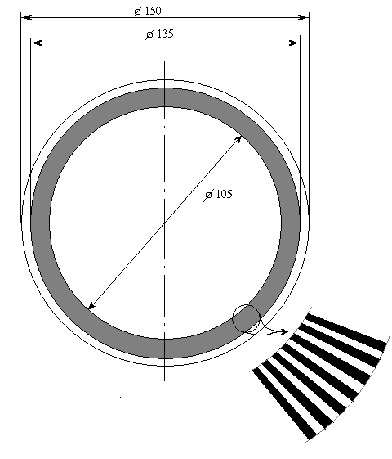
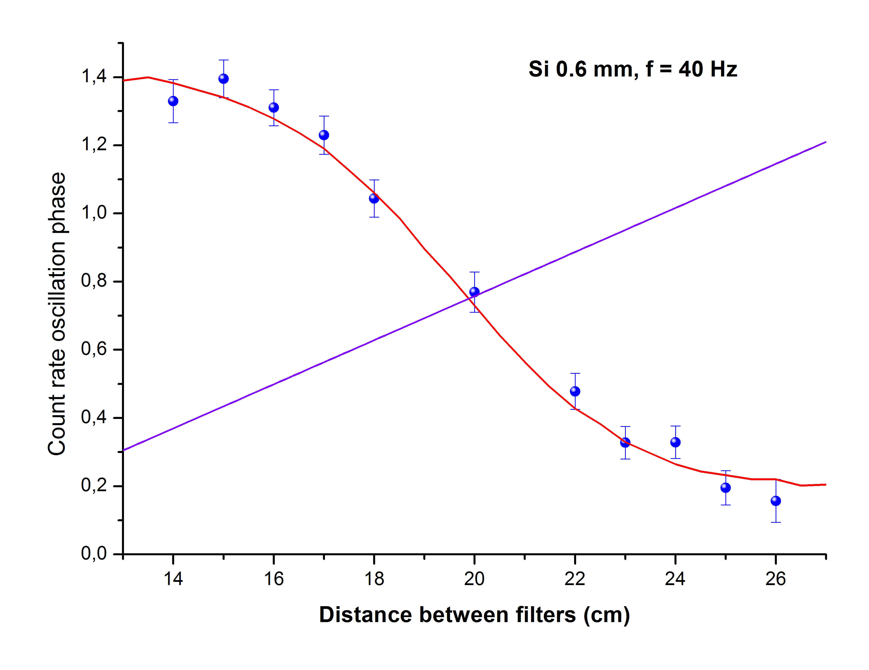
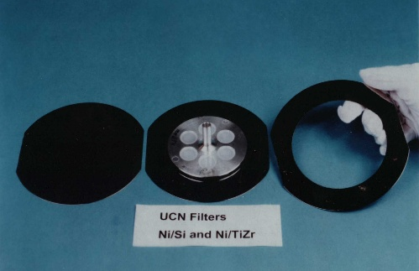




Nonstationary neutron diffraction at moving grating (1991 – 2019 )
Discovery of an accelerating matter effect
V
The change in neutron energy after passing through an accelerating sample
$$∆E=mad\left(\frac{1−n}{n}\right)$$
a is a sample acceleration
Kowalsky-Nosov-Frank
A.I.Frank, V.G.Nosov. Phys. Lett. A (1994)
A.I.Frank et al. Physics Letters A (2003)
G.V. Kulin et al. Phys. Rev. A (2016)
Г. В. Кулин, и др. ЖЭТФ (2019)
Count rate oscillation phase in the dependance on the position of the monochromator
m
Time focusing of neutrons
Balashov et. al . Physica B (2004)
s
$$V≅AΩ\cos{Ω}t$$
$$a≅−AΩ^{2}\sin{Ω}t$$
0.2 neV
t
t
a
Detector
a
L
X
A.I. Frank, P.Geltenbort, G.V.Kulin, et al, Phys. At. Nuclei, 71 (2008) 1656.

Slide 8
Scientific program on a future UCN Source

Slide 9
Scientific program based on development of the results obtained by FLNP JINR researchers in the previous years
Scientific program based on external proposals

Slide 10


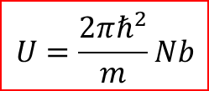

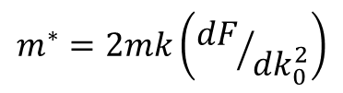

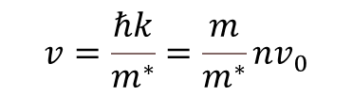
Neutron waves in matter and the dispersion law
$$U=\frac{2πℏ^{2}}{m}Nb$$
$$k^{2}=k_{0}^{2}−4πNb$$
??
L.Foldy,1945
Local-field corrections (cold neutrons)
$$n^{2}=1+\frac{4π}{k^{2}}ρfС, f=−b+ikb^{2}$$
V.F. Sears,1982
$$С={\left(1−J\right)}^{−1}≈1+J^{′}+J^{″}$$
M. Warner & J.E.Gubernatis,1985
The field of applicability of the potential dispersion law
$$k≫4πNba=k_{min}$$
V.G.Nosov & A.I.Frank, 1991
Inapplicability of the effective potential concepts for neutrons with energies significantly lower than UCN energies gives reason to expect small corrections to the current theory for UCNs.
View of dispersion law $k=F\left(k_{0}^{2}\right)$ is strongly related with the view of the dependance of the neutron velocity in matter and with the concept of its effective mass
$$v=\frac{ℏk}{m^{∗}}=\frac{m}{m^{∗}}nv_{0}$$
$$m^{∗}=2mk\left({dF}/{dk_{0}^{2}}\right)$$
A.I. Frank, Phys. Usp., 2018
A.I. Frank, G.V. Kulin, M.A. Zakharov, PEPAN Lett., 2025

Slide 11
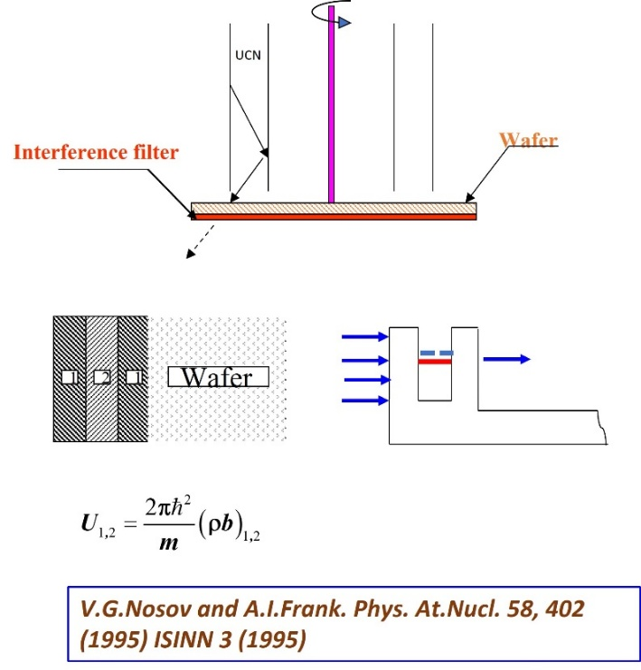
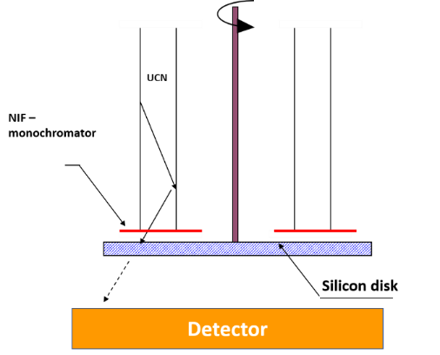

Experimental verification of the dispersion law with UCN
$U = V − iW$, simultaneous change $∆V=−∆W$ can lead to compensating effects.
A systematic has been foud that imitates the effect.
G.V. Kulin et al. Phys. Lett. A (2014)
I.V. Bondarenko, A. V. Krasnoperov, A. I. Frank at al. ISINN 7 (1997) JETP Letters, 67, (1998) 786.
The validity of the potential dispersion law for UCNs needs careful experimental verification.

Slide 12
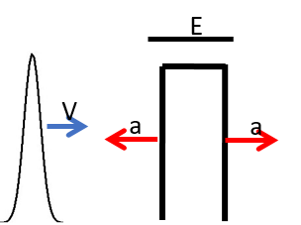
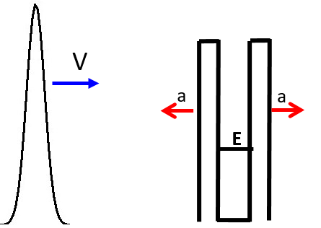
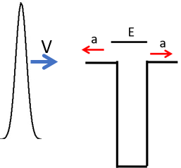
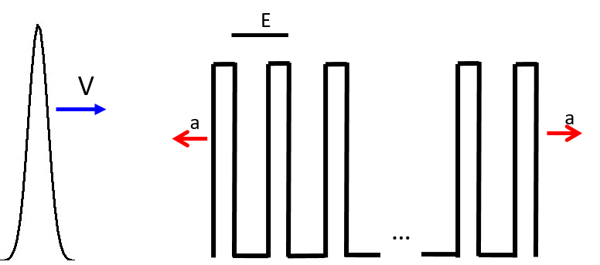



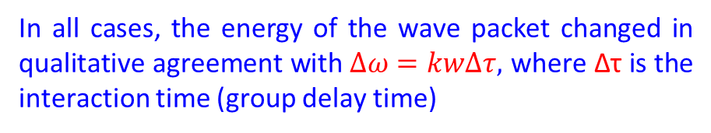
Verification of the theoretical prediction of the validity of the concept of Acceleration effect in the quantum sector
Acceleration Effect as a consequence of the equivalence principle
S
Δτ
Any object that scatters a wave or transmits a signal shifts wave frequency if it is moving with acceleration.
Detector
w=g
$$∆ω=kw∆τ$$
A.I. Frank. Physics-Uspeckhi, 63, 500-502 (2020)
U
In all cases, the energy of the wave packet changed in qualitative agreement with $∆ω=kw∆τ,$ where Δτ is the interaction time (group delay time)
E
$$U_{2}$$
$$U_{1}$$
The acceleration effect must occur in quantum phenomena, and this result is awaiting experimental confirmation.
E
d
M.A. Zakharov, G.V. Kulin, A.I. Frank. Eur. Phys. J. D (2021)

Slide 13
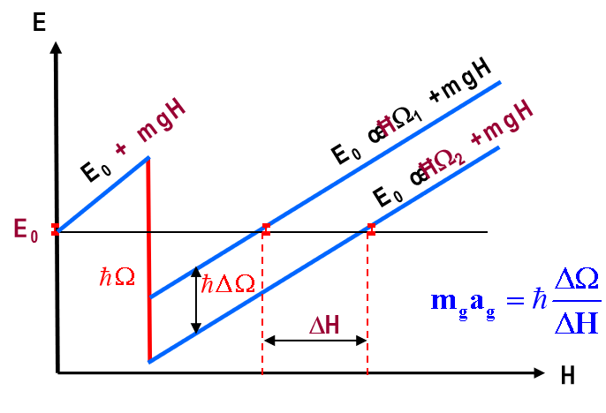

Test of weak equivalence principle for a neutron
Frank et. al . JETP Lett. (2007)
Compensation of the energy change due to gravity by the quantum of energy during nonstationary diffraction on the grating
$$g_{exp}=9.8120\left(18\right)m/s^{2}$$
The difference from the local value g 3.9σ
J. Micko et al. arXiv:2301.08583v1 [hep-ex]
The accuracy of neutron experiments is many orders of magnitude lower than that of experiments with macroscopic bodies and atoms
Gravitational spectrometry – measurements of the level structure during storage of UCN on a material mirror

Slide 14
Scientific program on a future UCN Source
Investigation of the propagation of neutron waves in matter in order to establish the true law of dispersion.
Verification of the theoretical prediction of the validity of the concept of Acceleration Effect in the quantum sector.
Development of a new approach to gravitational resonance spectroscopy with a greater sensitivity of the spectrum of states to the value of the free-fall acceleration than that of the current technique.

Slide 15
Scientific program at a future UCN Source
The methodic basis is resonance interferometry
Oscillating sample
Compensating sample
Polarizer
Detector
π/2 RF flipper
π/2 RF flipper
- RF flipper
Analyzer
A time beat of an intensity is recorded during the movement of the sample

Slide 16
Scientific program at a future UCN Source
The methodic basis is resonance interferometry
Oscillating sample
with quantum structure
Compensating sample
Polarizer
Detector
π/2 RF flipper
π/2 RF flipper
- RF flipper
Analyzer
A time beat of an intensity is recorded during the movement of the sample
It is possible to measure samples with a quantum structure and a delay time of less than 0.1 microseconds with registration of energy changes of ${10}^{−12}eV$

Slide 17
Scientific program at a future UCN Source
The methodic basis is resonance interferometry
Rotating sample
Compensating sample
Polarizer
Detector
π/2 RF flipper
π/2 RF flipper
- RF flipper
Analyzer
A change in intensity from the rotation speed of the sample is searched

Slide 18

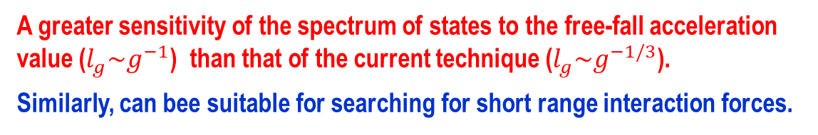
Development of a new approach to gravitational resonance spectroscopy
Storage on a magnetic mirror (levitating neutron)
Magnetic suspension condition
L
Characteristic length constant $l_{gm}=γ^{−1}$
A. I. Frank, V. G. Nosov. JETP Letters, 2004
A greater sensitivity of the spectrum of states to the free-fall acceleration value ($l_{g}\sim g^{−1}$) than that of the current technique ($l_{g}\sim g^{−1/3}$).
Similarly, can bee suitable for searching for short range interaction forces.

Slide 19
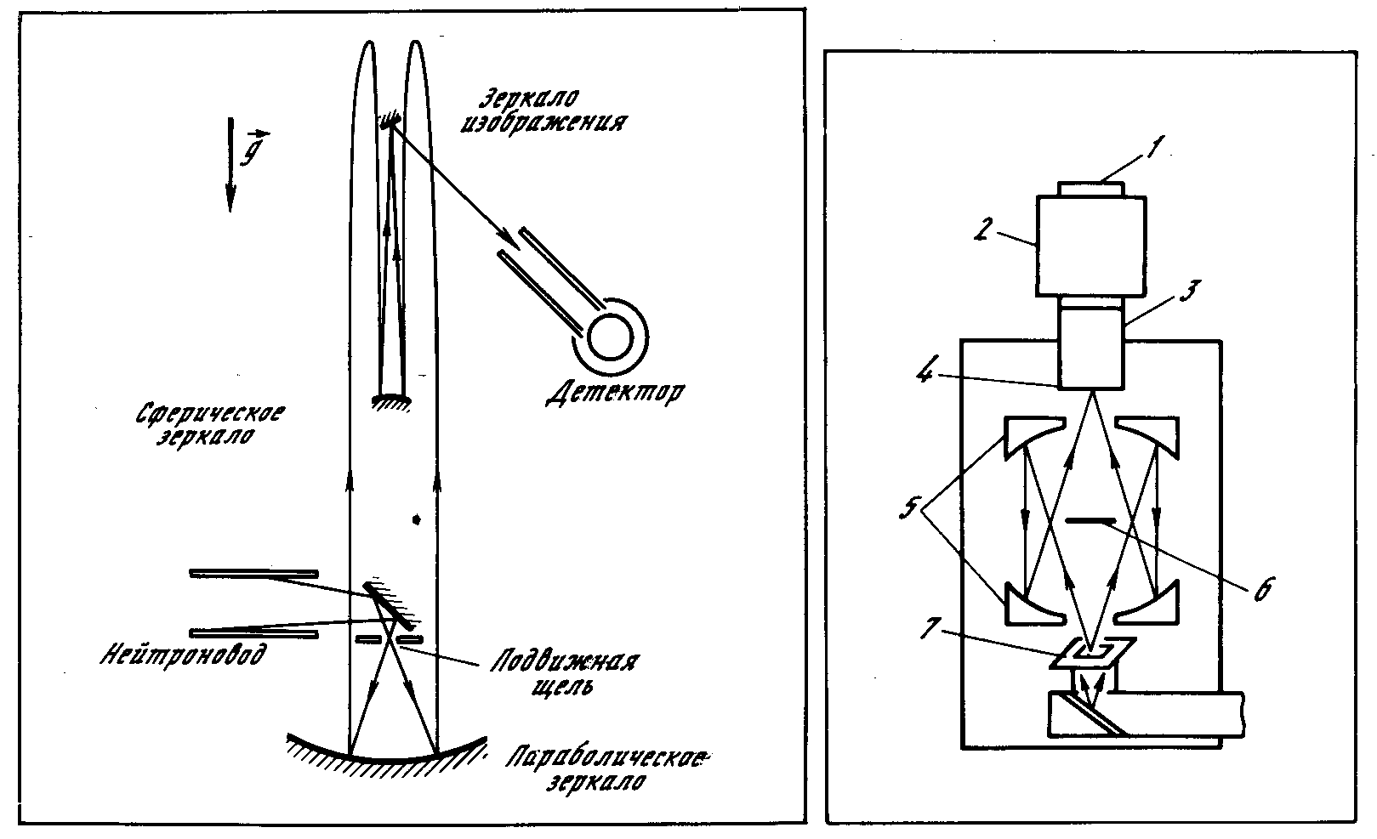
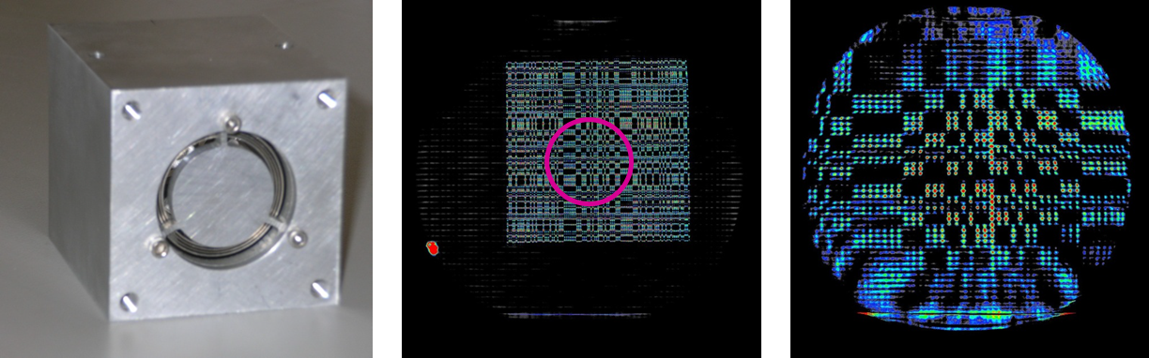
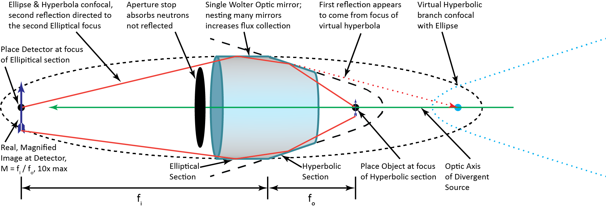
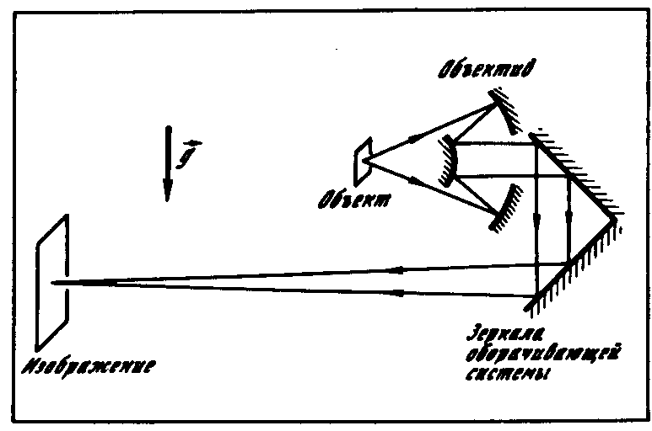
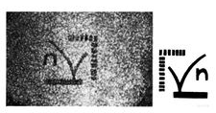
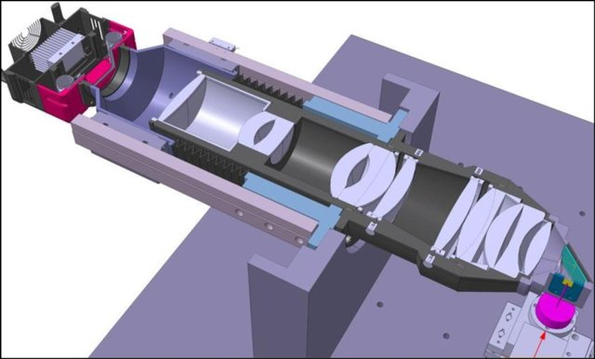
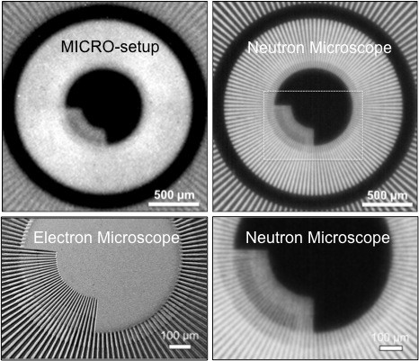
Neutron imaging with UCN as possible applied research program
Neutron microscopy with UCN
Neutron microscopy with cold neutrons
A.Steyerl et al, 1985
NIST, Wolter optics-based microscope
D. S. Hussey et al., 2021
Resolution ≈ 10 μ
Expected resolution ≈ 3 μ
A.Frank et al, 1986- 90
Resolution ≈ 15 μ
PSI, neutron microscope (neutron imaging)
Available for external users
Resolution ≈ 5 μ
Neutron imaging with UCNs gives sensitivity to weakly absorbing matter (biological objects …)

Slide 20
Project of the UCN Source at FLNP JINR

Slide 21

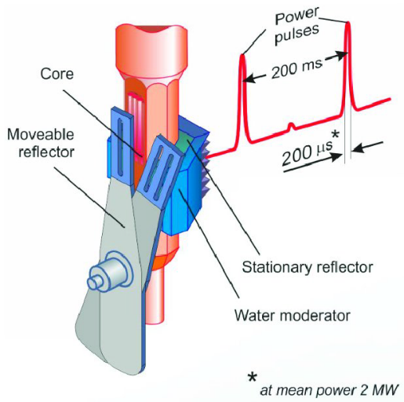
FLNP JINR pulsed source + pulsed accumulation of UCN in Trap
IBR-2 pulsed reactor
Valve
F.L. Shapiro, 1972
UCN source
τ
Trap
T
t
An approach is to fill the UCN trap only during the pulse and to efficiently isolate it the rest of the time.
In the case of relatively small losses, the equilibrium flux of UCNs in the trap can significantly exceed the time-averaged flux at its entrance.
Pulse frequency 5 Hz (Period 0.2 s)
Pulse duration 350-500 μs
Average thermal flux density ~ 10¹³ см⁻²·с⁻¹
Pulse thermal flux density ~ 10¹⁶ см⁻²·с⁻¹
Due to the biological shielding, the trap is distant from the moderator-convertor

Slide 22


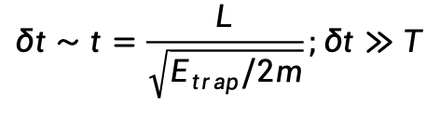


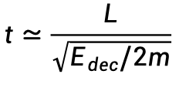

Time structure of the beam at the entrance to the UCN trap
$$δt∼t=\frac{L}{\sqrt{E_{trap}/2m}};δt≫T$$
$$0<E<E_{trap}$$
UCN
$$L$$
The spread of the UCN flight times will exceed the intervals between pulse
Convertor
UCN trap
$$E_{dec}<E<E_{dec}+E_{trap}$$
$$\frac{δt}{t}=\frac{δV}{V}=\frac{δE}{2E}=\frac{E_{trap}}{2E_{dec}}≪1$$
$$E_{dec}≫E_{trap}$$
$$0<E<E_{trap}$$
$$t≃\frac{L}{\sqrt{E_{dec}/2m}}$$
$$δt≪T$$
VCN
$$L$$
The flux of neutrons, which can be trapped after deceleration, has a pulsed struct
Decelerator
Convertor
UCN trap
During deceleration, all neutrons change their energy by the same value
Frank, A.I., Kulin, G.V., Zakharov, M.A. Phys. Part. Nuclei Lett. 20, 664–667 (2023)

Slide 23
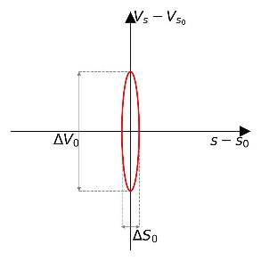
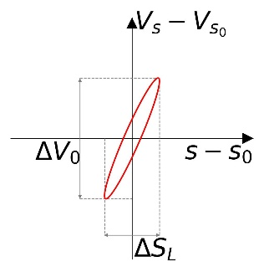
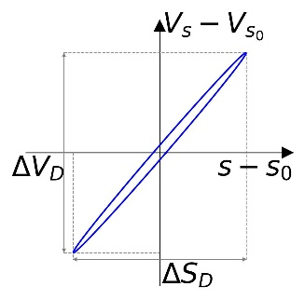
Time structure of the beam at the entrance to the UCN trap
Neutron pulse evolution phase portrait
Decelerator
Convertor
UCN trap
At the exit of the converter
At the trap entrance
The pulse duration at the entrance to the trap exceeds the initial one !
The deceleration process is not instant !
Then slower the neutrons, then more time they spend on deceleration
$δt_{trap}={δt}_{transp.}+{δτ}_{dec }$(deceleration time dispersion)

Slide 24
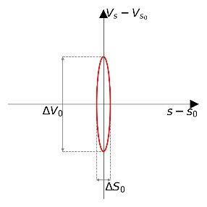
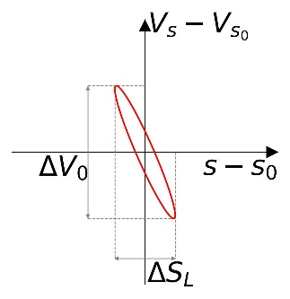
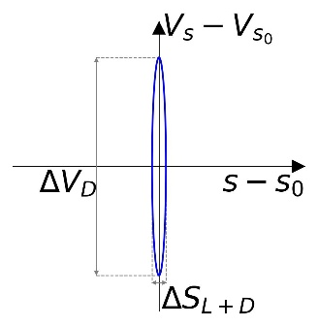


Time structure of the beam at the entrance to the UCN trap
Neutron beam phase portrait w/o compensation
Decelerator
Convertor
UCN trap
At the exit of the converter
At the trap entrance
$$δt_{trap}={δt}_{transp.}+{δτ}_{dec}$$
Neutron beam phase portrait in the ideal compensation case
Time lens
Convertor
Decelerator
UCN trap
At the exit of the converter
Before lens
After lens
At the trap entrance
$$δt_{trap}={δt}_{transp.}−{δτ}_{dec}$$

Slide 25


Schematic of the projected UCN source @ IBR-2 reactor
A.I. Frank, G.V. Kulin, M.A. Zakharov et al. PEPAN 56 (2025)
UCN trap
Pre-moderator
Time lens
Moderator
Flipper-valve
$$E$$
Thin converter
Neutron guide
Flipper-decelerator
$$E−ΔE→UCN$$
UCN Source @ IBR-2 reactor 3rd channel

Slide 26
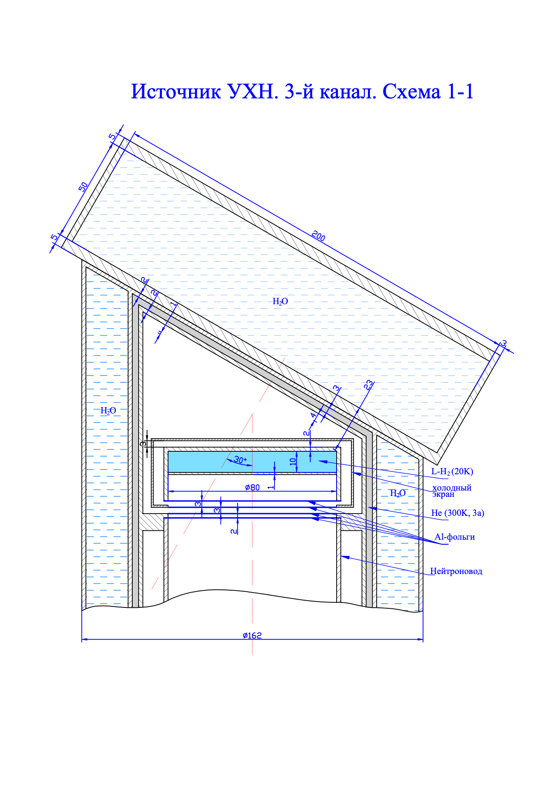
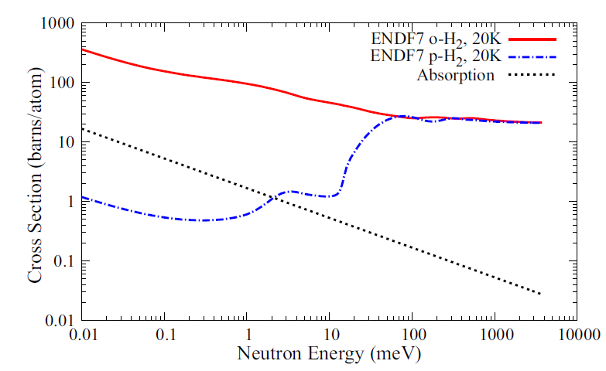
Convertor
The basic variant assumes that the convertor will be a thin chamber with LH2
Scattering cross section on H2
Designed by A.Yu. Muzychka
L-H2 (20K)
Cold shield
Al foils
He (300K, 3a)
Neutron guide
VCN flux gain factor: 40
LH₂ convertor volume: ≈ 50 – 70ml
LH₂ convertor weight: ≈ 3.5 - 5 g
Additional water moderator Increases thermal neutron flux at the convertor by 3 times

Slide 27
Neutron guide
Pre-moderator
Fast valve
UCN trap
Length: 13-15 m
Two bend sections with a curvature radius of about 20 m
S-shaped guide:
significantly reduce the background of neutrons with velocities higher than 200 m/s
geometry doesn’t affect to time pulse shape
Time lens
Moderator
Thin convertor
Neutron guide
DEcelerator
Rather high requirements to the neutron guide inner surface:
  The small micro-roughness should ensure transmittance at the level of tens of percent
  Permissible level of shape defects (waviness) should ensure equality of monochromatic neutron flight time at the level of 2-3 ms.
The choice of material and design of the neutron guide will be done by results of especially performed experiments

Slide 28
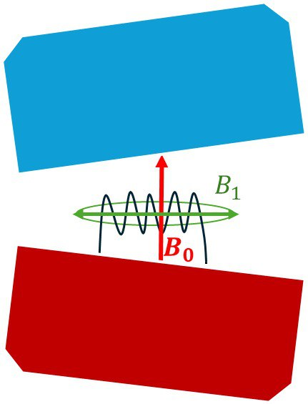
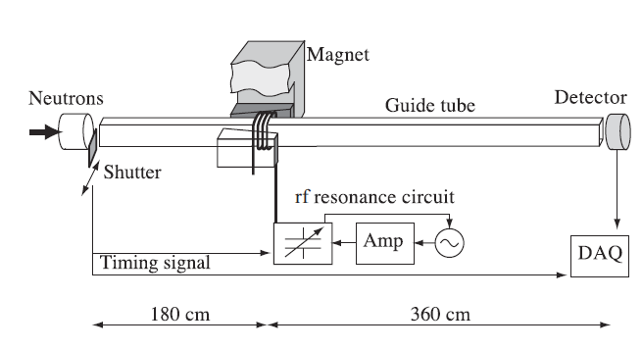

Decelerator — gradient spin-flipper
Nonstationary spin flip in a magnetic field as a method of producing "supercold" neutrons — G. M. Drabkin, R. A. Zhitnikov. Sov. Phys. JETP (1960)
Neutron energy change at resonant spin-flip - B. Alefeld et al., Zeit. für Phys. B (1981)
$$ΔE=±2μB=±ℏω$$
Gradient spin-flipper for UCN time focusing - Arimoto et al. Prys.Rev. A (2012)
V.I. Luschikov, Yu.V. Taran. NIM 228 (1984) 159
A.N. Bazhenov, V.M . Lobashev, A.N. Pirozhkov and V.N. Slusar. NIM A332 (1984) 534
S .V. Grigoriev, A.I. Okorokov, V.V. Runov. NIM A384 (1997) 451

Slide 29
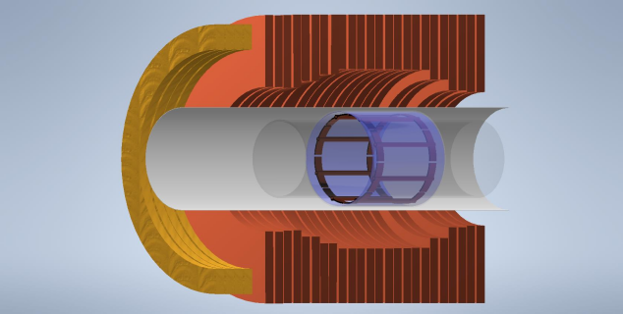

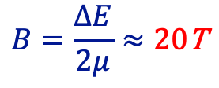

Decelerator — gradient spin-flipper
It is desirable that the magnetic system forming the stationary field, as well as the HF resonator, have cylindrical symmetry.
$$B=\frac{ΔE}{2μ}≈20\text{T}$$
$$f=\frac{ω}{2π}≈520\text{MHz}$$
$$ΔE≈2.4 μeV$$
It allows to slow down VCNs with velocities of 20 m/s to UCNs with velocities of 5 m/s

Slide 30

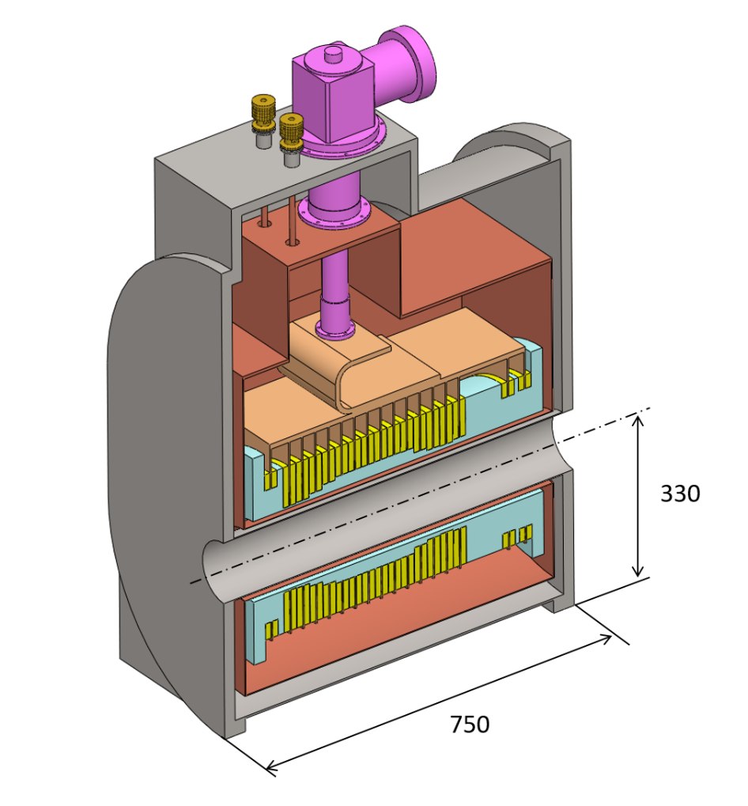
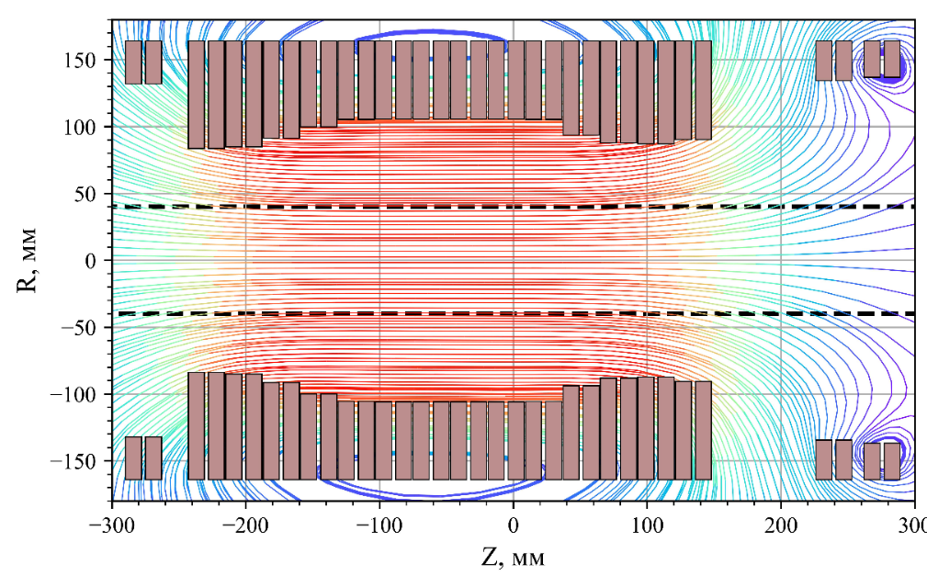

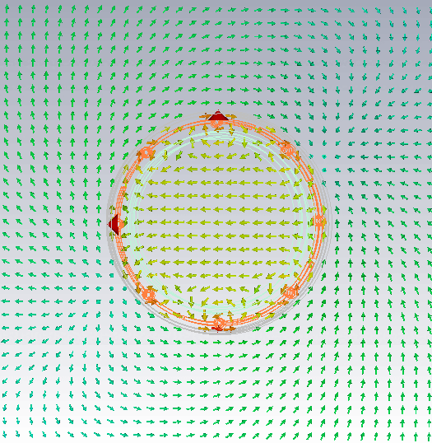
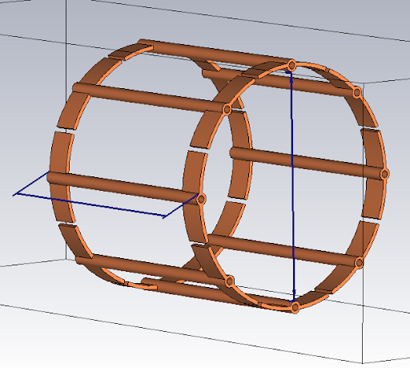


Decelerator — gradient spin-flipper
Cryogenic cooler head
Stationary gradient magnet
Magnetic field profile along Z-axis
Cooling bridges
Cryostat
Birdcage type HF resonator
Room temperature bore
A. A. Popov et. al. arXiv:2503.10878 [physics.ins-det]
Pancake made from HTS tape (a flat, double coil)

Slide 31


Decelerator — gradient spin-flipper
Cryogenic cooler head
Magnetic field profile along Z-axis
Cooling bridges
Cryostat
The valve is a gradient spin–flipper located in the area of decreasing of the flipper-decelerator field. Approximately in the 0.3-0.4T field
Flipper-valve
Room temperature bore
A. A. Popov et. al. arXiv:2503.10878 [physics.ins-det]
Flipper-decelerator
Pancake made from HTS tape (a flat, double coil)

Slide 32

Physics principals of time lens action
The functional principle of time lens is based on the magnetic field variation in a certain space region during the neutron time of flight in this region
L.Niel, H.Rauch, Acceleration, deceleration and monochromatization of neutrons in time dependent magnetic fields. Z. Phys.B. – Condensed Matter 74, 133 (1989)
Passing through stationary magnetic field.
Passing through homogenous in space magnetic field, which changed its strength during the time when neutron inside this field.
B
E
E
B
E_{k}
E_{k}
t
t
E_{pot}
E_{pot}
Z
Z
The energy transferred by the lens $ΔE = μΔB$ is defined by the variation value of the magnetic field $ΔB$during the time when the neutron inside this field.
In our case: $ΔB=1.5\text{T}$, $t≈8\text{ms}$

Slide 33
UCN density inside a spherical trap (convertor is LH2)
UCN volume density inside the trap in dependance on pulse duration at the trap entrance
Average thermal flux density at the convertor, cm⁻²s⁻¹ | 3×10¹³
Flux transmittivity coefficient due to phase volume transformation guide boundary velocity 5.35 m/s, limitation in longitudinal velocities after deceleration 3.5 m/s ≤V_{z} ≤ 5.5 m/s | 0.26
VCN transmission of 13 m neutron guide only losses due to roughness was taken into account | 0.6
Gain factor for LH₂ convertor | 40
Polarized neutrons | 0.5
Estimated UCN production rate: ~ 3×10⁵ s⁻¹ (at V_{z}< 7 м/с)

Slide 34
Scientific and technical challenges have to be solved during project
Design and selection of materials for the head section of the beamline with the converter.
The safety problem concerning the proposed use of a small volume liquid-hydrogen converter.
Design of the engineering infrastructure of the source on 3rd channel of IBR-2 reactor.
Design and selection of materials of the neutron guide providing the required time characteristics of VCN transport.
Design, selection of the material and coating of the UCN trap.
Design of compensating magnetic lens.

Slide 35



VCN test facility at 3rd channel of IBR-2 reactor as prototype of the UCN source
A cryogenic converter is based on mesitylene.
It will not use the decelerator.
An inner surface of the neutron guide will not need to meet as strict requirements as the neutron guide in the planned UCN source.
In main features, the design of the VCN test source will have many similarities with the design of the UCN source.

Slide 36
VCN test facility – Cold (20K) mesitylene converter
Thin mesitylene convertor
Pump
main moderator
Neutron guide
Additional water moderator
Increases thermal neutron flux density at the convertor by 3 times
VCN/UCN flux gain factor: ~10
Mesitylene thickness ~ 1-2 mm (~20ml)
The experience of creating this converter will be useful for creating the main source converter

Slide 37

VCN test facility – the neutron guide requirements
Massive movable shielding (stopper)
The neutron guide for VCN test facility must fit into existing bend tunnel of the movable shielding
An inner surface of the neutron guide will not need to meet as strict requirements as the neutron guide in the planned UCN source.

Slide 38
VCN test facility requrements
operating position
What we need to do:
Providing the possible moving of the source from the operating to the standby position with a closed shutter.
Calculations and designing radiation shielding of the head part of the beamline in the standby position
Design of the engineering infrastructure of the source (Cryogenics, Vacuum, …)
Design of the workplace
workplace
shutter open
Standby position
?
workplace
shutter closed

Slide 39


VCN test facility at 3rd channel of IBR-2 reactor as prototype of the UCN source
Monochromator
Mesitylene convertor (20K)
S-type neutron guide, 12 m
Chopper
In main features, the design of the VCN test source will have many similarities with the design of the UCN source.
The construction of VCN test facility will make it possible to verify the correctness of the technical solutions taken to create the projected source, as well as to conduct experimental studies necessary for the UCN Source implementation.
VCN test facility will provide the first practical experience of VCNs and UCNs for the youth part of the group.

Slide 40
List of publications on the subject of the project
A. I. Frank, G. V. Kulin, N. V. Rebrova, M. A. Zakharov, On the Possibility of Creating a UCN Source at a Periodic Pulsed Reactor. Physics of Particles and Nuclei 53 (1) (2022) 33–44
A.I. Frank, G.V. Kulin. On the duration of the pulse formed by a local time lens for ultracold neutrons. Nuclear Instruments and Methods in Physics Research. A 1053 (2023) 168370.
A. I. Frank, G. V. Kulin, M. A. Zakharov, On a New Possibility of Pulsed Accumulation of Ultra Cold Neutrons in a Trap. Physics of Particles and Nuclei Letters 20 (4) (2023) 664–667. doi:10.1134/S1547477123040295.
A.I. Frank, G.V. Kulin, M.A. Zakharov et al., To the UCN source with pulsed filling of a trap. arXiv:2412.06460 [physics.ins-det] (2024); Physics of Particles and Nuclei 56 (5) (2025) (in print).
A.A. Popov, K.S. Osipenko, V.I. Scherbakov et al., The concept of a superconducting spin flipper – neutron decelerator for a UCN source at a pulsed reactor. arXiv:2503.10878 [physics.ins-det] (2025); Natural Science Review (accepted for publication).

Slide 41
Human resources available
Category of employees | Division | Amount of FTE
research scientists | FLNP | 5.4
engineers | FLNP | 1.7
specialists | FLNP | 1.6
Total |  | 8.7
8 young (under 35 years old) and 15 more experienced. Many of them have PhDs and doctorates.

Slide 42
Project schedule
 | Year |  | 2025 |  |  |  | 2026 |  |  |  | 2027
 | Stages | Quarters | 1 | 2 | 3 | 4 | 1 | 2 | 3 | 4 | 1 | 2 | 3 | 4
VCN source (prototype) | Design of mesitylene converter, tests with prototypes in Lab
 | Design of the beamline
 | Purchase and preparation of the neutron guide tubes
 | Manufacturing of the beamline elements
 | Purchase of vacuum equipment and fittings
 | Design of experimental installations
 | Manufacturing of experimental installations
 | Assembling and preparing the beamline for operation
 | Commissioning
UCN source with pulse accumulation | Calculation of the magnetic environment of the spin-flipper on the 3rd beamline
 | Purchase of test samples of the main neutron guide
 | Experimental investigation with test samples of the main neutron guide
 | Hydrogen converter design, safety calculation
 | Design of the main beamline
 | Design of compensating magnetic lens
 | Design of the UCN trap, test investigation

Slide 43


Thank you for your attention!!!

Slide 44
Project schedule
 | Year |  | 2025 |  |  |  | 2026 |  |  |  | 2027
 | Stages | Quarters | 1 | 2 | 3 | 4 | 1 | 2 | 3 | 4 | 1 | 2 | 3 | 4
VCN source (prototype) | Design of mesitylene converter, tests with prototypes in Lab
 | Design of the beamline
 | Purchase and preparation of the neutron guide tubes
 | Manufacturing of the beamline elements
 | Purchase of vacuum equipment and fittings
 | Design of experimental installations
 | Manufacturing of experimental installations
 | Assembling and preparing the beamline for operation
 | Commissioning
UCN source with pulse accumulation | Calculation of the magnetic environment of the spin-flipper on the 3rd beamline
 | Purchase of test samples of the main neutron guide
 | Experimental investigation with test samples of the main neutron guide
 | Hydrogen converter design, safety calculation
 | Design of the main beamline
 | Design of compensating magnetic lens
 | Design of the UCN trap, test investigation
2026 | 2027
320 | 320
Total ≈ 640 k$

Slide 45
Scientific program at a future UCN Source
The methodic basis is resonance interferometry
Polarizer
Detector
π/2 RF flipper
π/2 RF flipper
- RF flipper
Analyzer
E_{tot}
E₊
E₊
E
B=0
B=0
E
z
E₋
E₋

Slide 46
Project schedule
 | Year |  | 2025 |  |  |  | 2026 |  |  |  | 2027
 | Stages | Quarters | 1 | 2 | 3 | 4 | 1 | 2 | 3 | 4 | 1 | 2 | 3 | 4
VCN source (prototype) | Design of mesitylene converter, tests with prototypes in Lab
 | Design of the beamline
 | Purchase and preparation of the neutron guide tubes
 | Manufacturing of the beamline elements
 | Purchase of vacuum equipment and fittings
 | Design of experimental installations
 | Manufacturing of experimental installations
 | Assembling and preparing the beamline for operation
 | Commissioning
UCN source with pulse accumulation | Calculation of the magnetic environment of the spin-flipper on the 3rd beamline
 | Purchase of test samples of the main neutron guide
 | Experimental investigation with test samples of the main neutron guide
 | Hydrogen converter design, safety calculation
 | Design of the main beamline
 | Design of compensating magnetic lens
 | Design of the UCN trap, test investigation
 |  | 2026 | 2027
Materials | 50 | 30 | 20
Equipment, third-party company services | 90 | 40 | 50
R&D contracts with other research organizations | 240 | 140 | 100
Software purchasing | 10 | 10
Design/construction | 250 | 100 | 150
Total | 640 k$

Slide 47





High frequency resonator
The birdcage resonator is a widely used in MRI
Ability to generate a homogeneous magnetic field over a large volume.
Allows for a high degree of control over the magnetic field's frequency and amplitude.
Birdcage of UCN spin-flipper (UCNA experiment)
$B_{1}=0.7\text{mT}$, $f=500\text{MHz}$, Input power $≈4\text{kW}$
The resonator will operate during the pulse only
A. T. Holley, L. J. Broussard, J. L. Davis, K. Hickerson, T. M. Ito et al. Rev. Sci. Instrum. 83, 073505 (2012)

Slide 48
VCN test facility – Cold (20K) mesitylene converter
Preliminary design
mesitylene
dispenser
Cold Plate (20К)
Thermal neutrons
VCN
+VCN
UCN
+UCN
He
Aluminium box
To vacuum system
Mesitylene drain
Necessary:
To estimate a heat load to the converter
To design system for preparation of the thin mesitylene converter and its evaluation at the end of the cycle
To design thin exit window
G-factor for VCN/UCN ~ 10
Mesitylene thickness ~ 1-2 mm (20 ml)
Separated vacuum volume
The experience of creating this converter will be useful for creating the main source converter

Slide 49

VCN test facility – the neutron guide design
Estimated flux density at the exit of the specular neutron guide (w/o roughness)
Mesitylene convertor (20K)
Ф`, cm⁻²s⁻¹
S-type neutron guide, 12 m
Longitudinal velocity V_{z}, m/s
Estimated VCN flux density with V_{z} = 20±1 m/s at the exit in ideal case ~ 1300 cm⁻²s⁻¹ (G=1)
Estimated UCN flux is ~ 500 s⁻¹ (G=1) at guide transmission about 0.03 with S ≈ 80 cm²

