Slide 1

Creating Test Benches to Check Individual Systems of the MSC-230 Cyclotron
Advanced Studies of Systems of New-Generation Accelerators and Colliders for Fundamental and Applied Research
08-2-1127-2016
Creating Test Benches to Check Individual Systems of the MSC-230 Cyclotron
08-2-1127-1-2025/2027
Sergey Yakovenko
Dzhelepov Laboratory of Nuclear Problems
61th meeting of the PAC for Nuclear Physics, June 19, 2025

Slide 2
Main tasks of the project
The project is aimed at creating the medical superconducting cyclotron MSC-230 to provide:
• proton beam therapy and biomedical research;
• study of the formation, acceleration and delivery of high-intensity beams of accelerated protons for irradiation;
• development and research of flash therapy techniques;
• training and advanced training of specialists in the field of radiation biology and medicine;
• preparation of serial production and care in clinical practice of the latest technological equipment for proton therapy of oncological diseases.
S.Yakovenko Creating Test Benches to Check Individua Systems of the MSC-230 Cyclotron

Slide 3
Outline
Proton therapy at JINR
The MSC-230 Description and Status
MSC-230 test benches
Infrastructure for radiobiological researches
Expected results
S.Yakovenko Creating Test Benches to Check Individua Systems of the MSC-230 Cyclotron

Slide 4
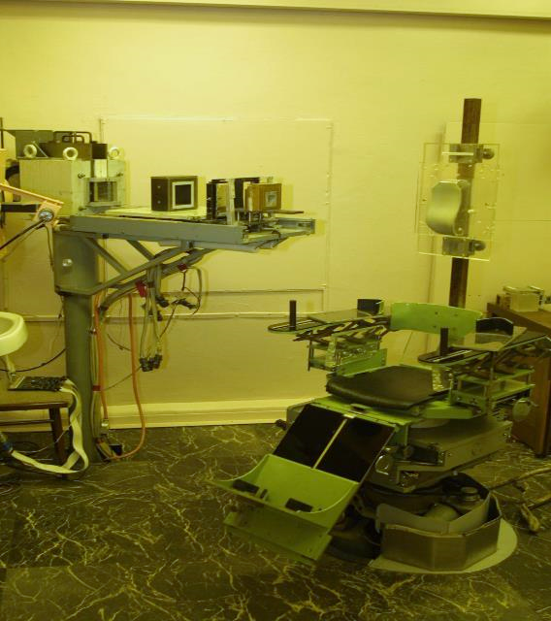
Proton therapy at JINR
Milestones of activity:
1967 – the beginning of the research on proton therapy;
1968 –1974 – first 84 patients treated with protons;
1975 –1986 – upgrading of the accelerator and construction of a multi-room Medico-Technical Complex for hadron therapy;
1987-1996 – treating of 40 patients with protons, mostly with uterine cervix cancer;
1999, December – inauguration of a Radiological Department of the Dubna hospital;
1999-2019, October - treating of about 1300 patients. Realization of a technique for 3D conformal proton radiotherapy.
Treatment room No 1 for 3D conformal proton therapy of tumors seated in the head, neck, and trunk
S.Yakovenko Creating Test Benches to Check Individua Systems of the MSC-230 Cyclotron
Notes:
Treatment room No 1 for 3D conformal proton therapy of tumors seated in the head, neck, and trunk

Slide 5
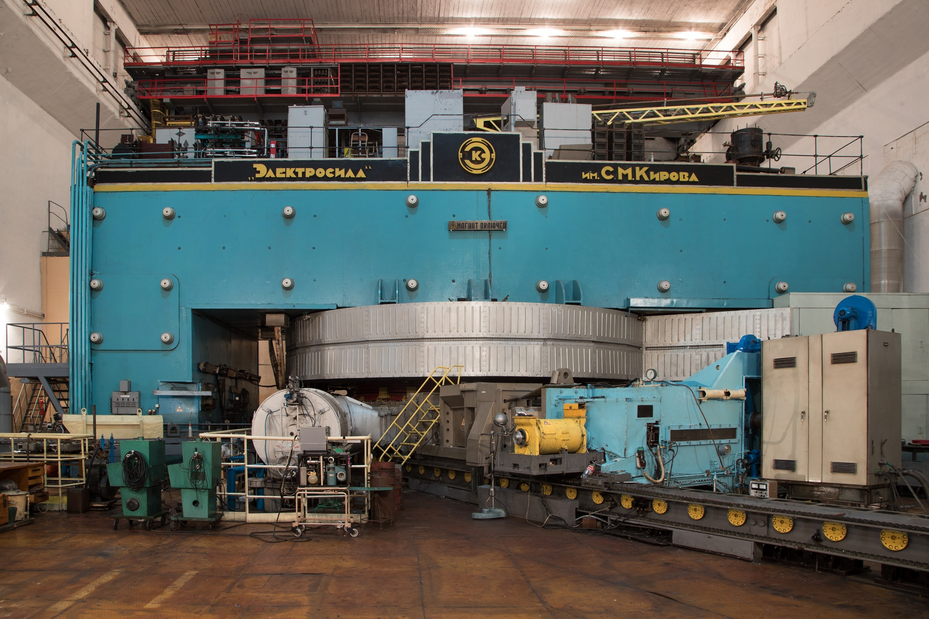
Proton therapy at JINR
Phasotron 1949-2023
S.Yakovenko Creating Test Benches to Check Individua Systems of the MSC-230 Cyclotron

Slide 6
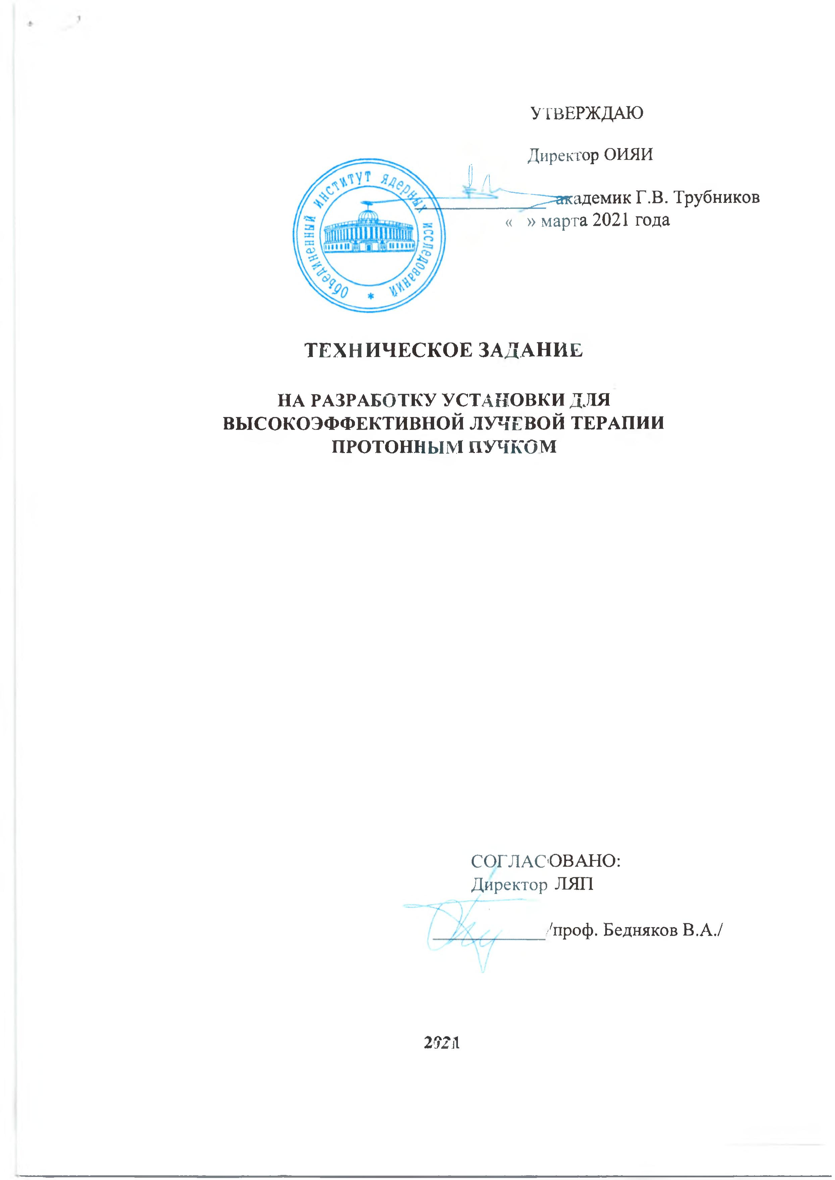
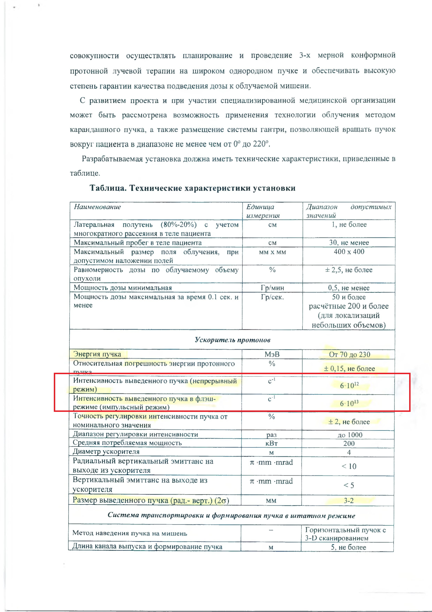
Proton therapy at JINR
FLASH is a new method of radio-therapy, requires delivery of high dose to the tumor.
100 Grey/second in a pulse shorter than 0.5 second.
In order to deliver 100 Grey/second, extracted beam current should be at least 10 µA.
The high effective proton therapy facility technical task
Extracted beam current,µA (continuous mode) | 1
Extracted beam current –1 µA (pulsed mode) | 10
S.Yakovenko Creating Test Benches to Check Individua Systems of the MSC-230 Cyclotron

Slide 7
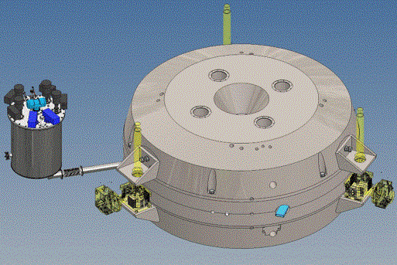
MSC-230 description and status
Main parameters
Magnet type | SC coil, warm yoke
Ion source | PIG
Final energy, MeV | 230
Weight, tonnes | 130
Dimensions (height×width), mm | 1900 × 3860
Мagnetic field (R₀/R_{extr} ), T | 1.7/2.15
A*Turn number | 290 000
RF frequency, MHz | 106.5
Harmonic number | 4
Number of RF cavities | 4
RF power, kW | 60
Number of turns | 500
Beam intensity, μA | 10
MSC-230 layout (3D-model)
S.Yakovenko Creating Test Benches to Check Individua Systems of the MSC-230 Cyclotron

Slide 8
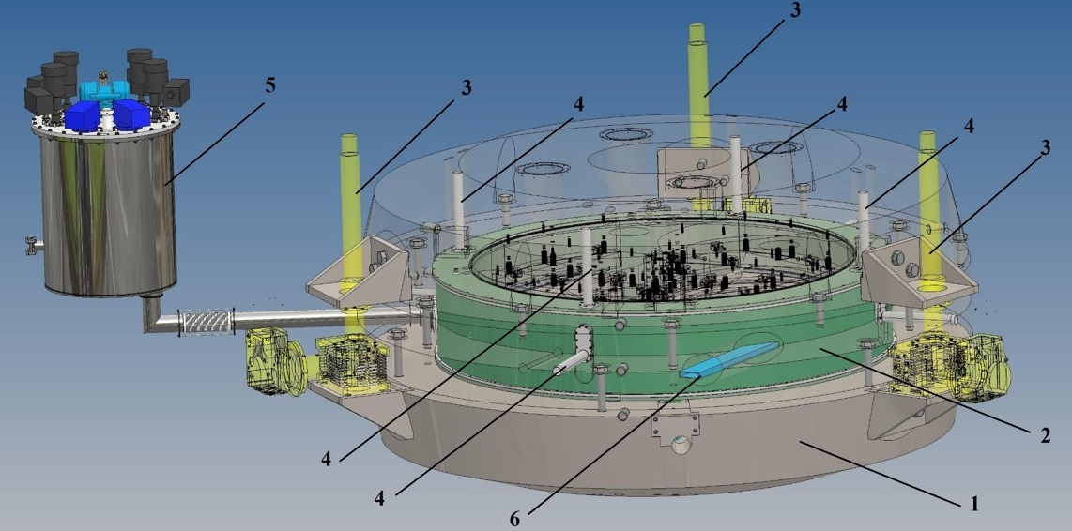
MSC-230 description and status
View of the MSC-230: 1- magnet yoke, 2 –superconducting coil and cryostat, 3 – lifting system, 4 – tie rods, 5 –refrigerator, 6 – beam extraction tunnel
S.Yakovenko Creating Test Benches to Check Individua Systems of the MSC-230 Cyclotron
Notes:
State-of-the-Art MSC 230 proton cyclotron
Low power consumption & Reasonable size;
Minimum engineering efforts and challenges;
Moderate conservativeness and reduced risks.
High quality of the beam
Extracted beam current – CW 1 µA in short pulse -10 µA
At least 5 Grey per 1 liter target in a pulse of about 50 ms
The technique developed for NICA will be applied to the manufacture of SC230 windings.

Slide 9
MSC-230 description and status
MSC-230 systems | Responsible
1. Magnet yok and lifting system | NIEFA
2. Cryogenic system and superconducting coils | JINR
3. RF system | CIM,NIEFA
4. Extraction system | CIM, NIEFA
5. Proton source | JINR, NIEFA
6. Power supply system | NIEFA
7. Vacuum system | JINR, NIEFA
8. Beam diagnostic system | NIEFA
9. Control system | JINR
10. Cooling system | NIEFA
11. Magnetic field measurement system | JINR
S.Yakovenko Creating Test Benches to Check Individua Systems of the MSC-230 Cyclotron
Notes:
and for educational projects.

Slide 10
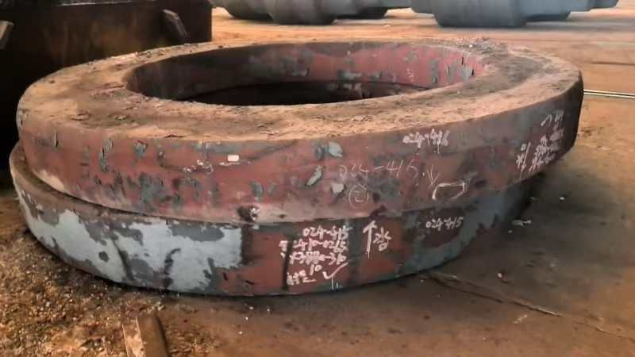
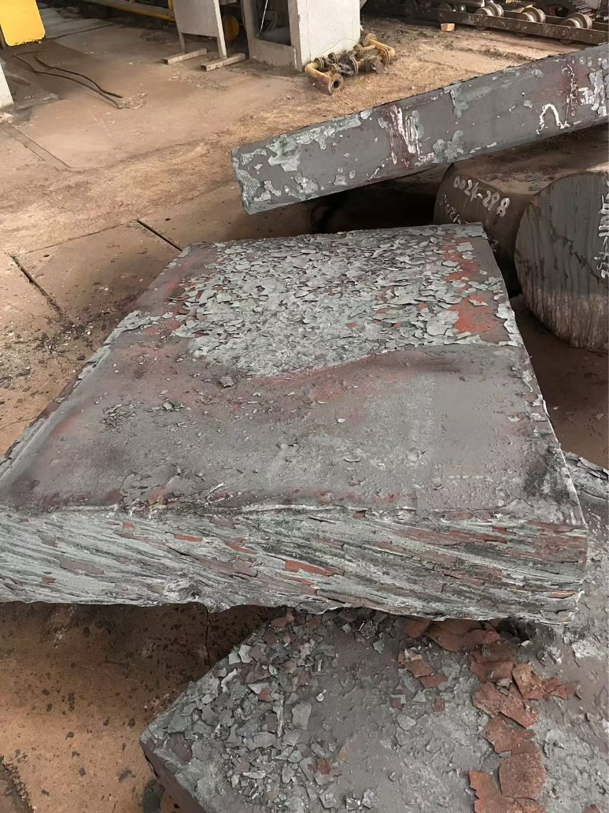
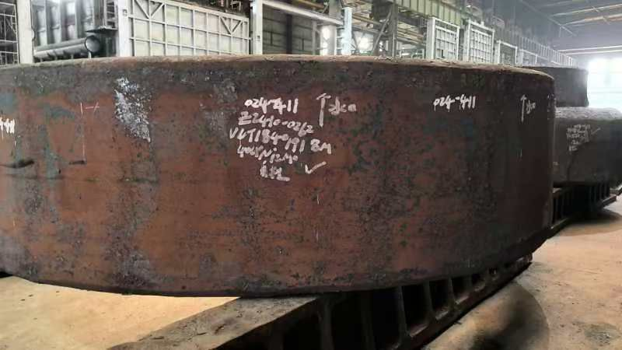
MSC-230 description and status
Magnet yok and lifting system are being manufactured. Will be completed in December 2025
S.Yakovenko Creating Test Benches to Check Individua Systems of the MSC-230 Cyclotron

Slide 11
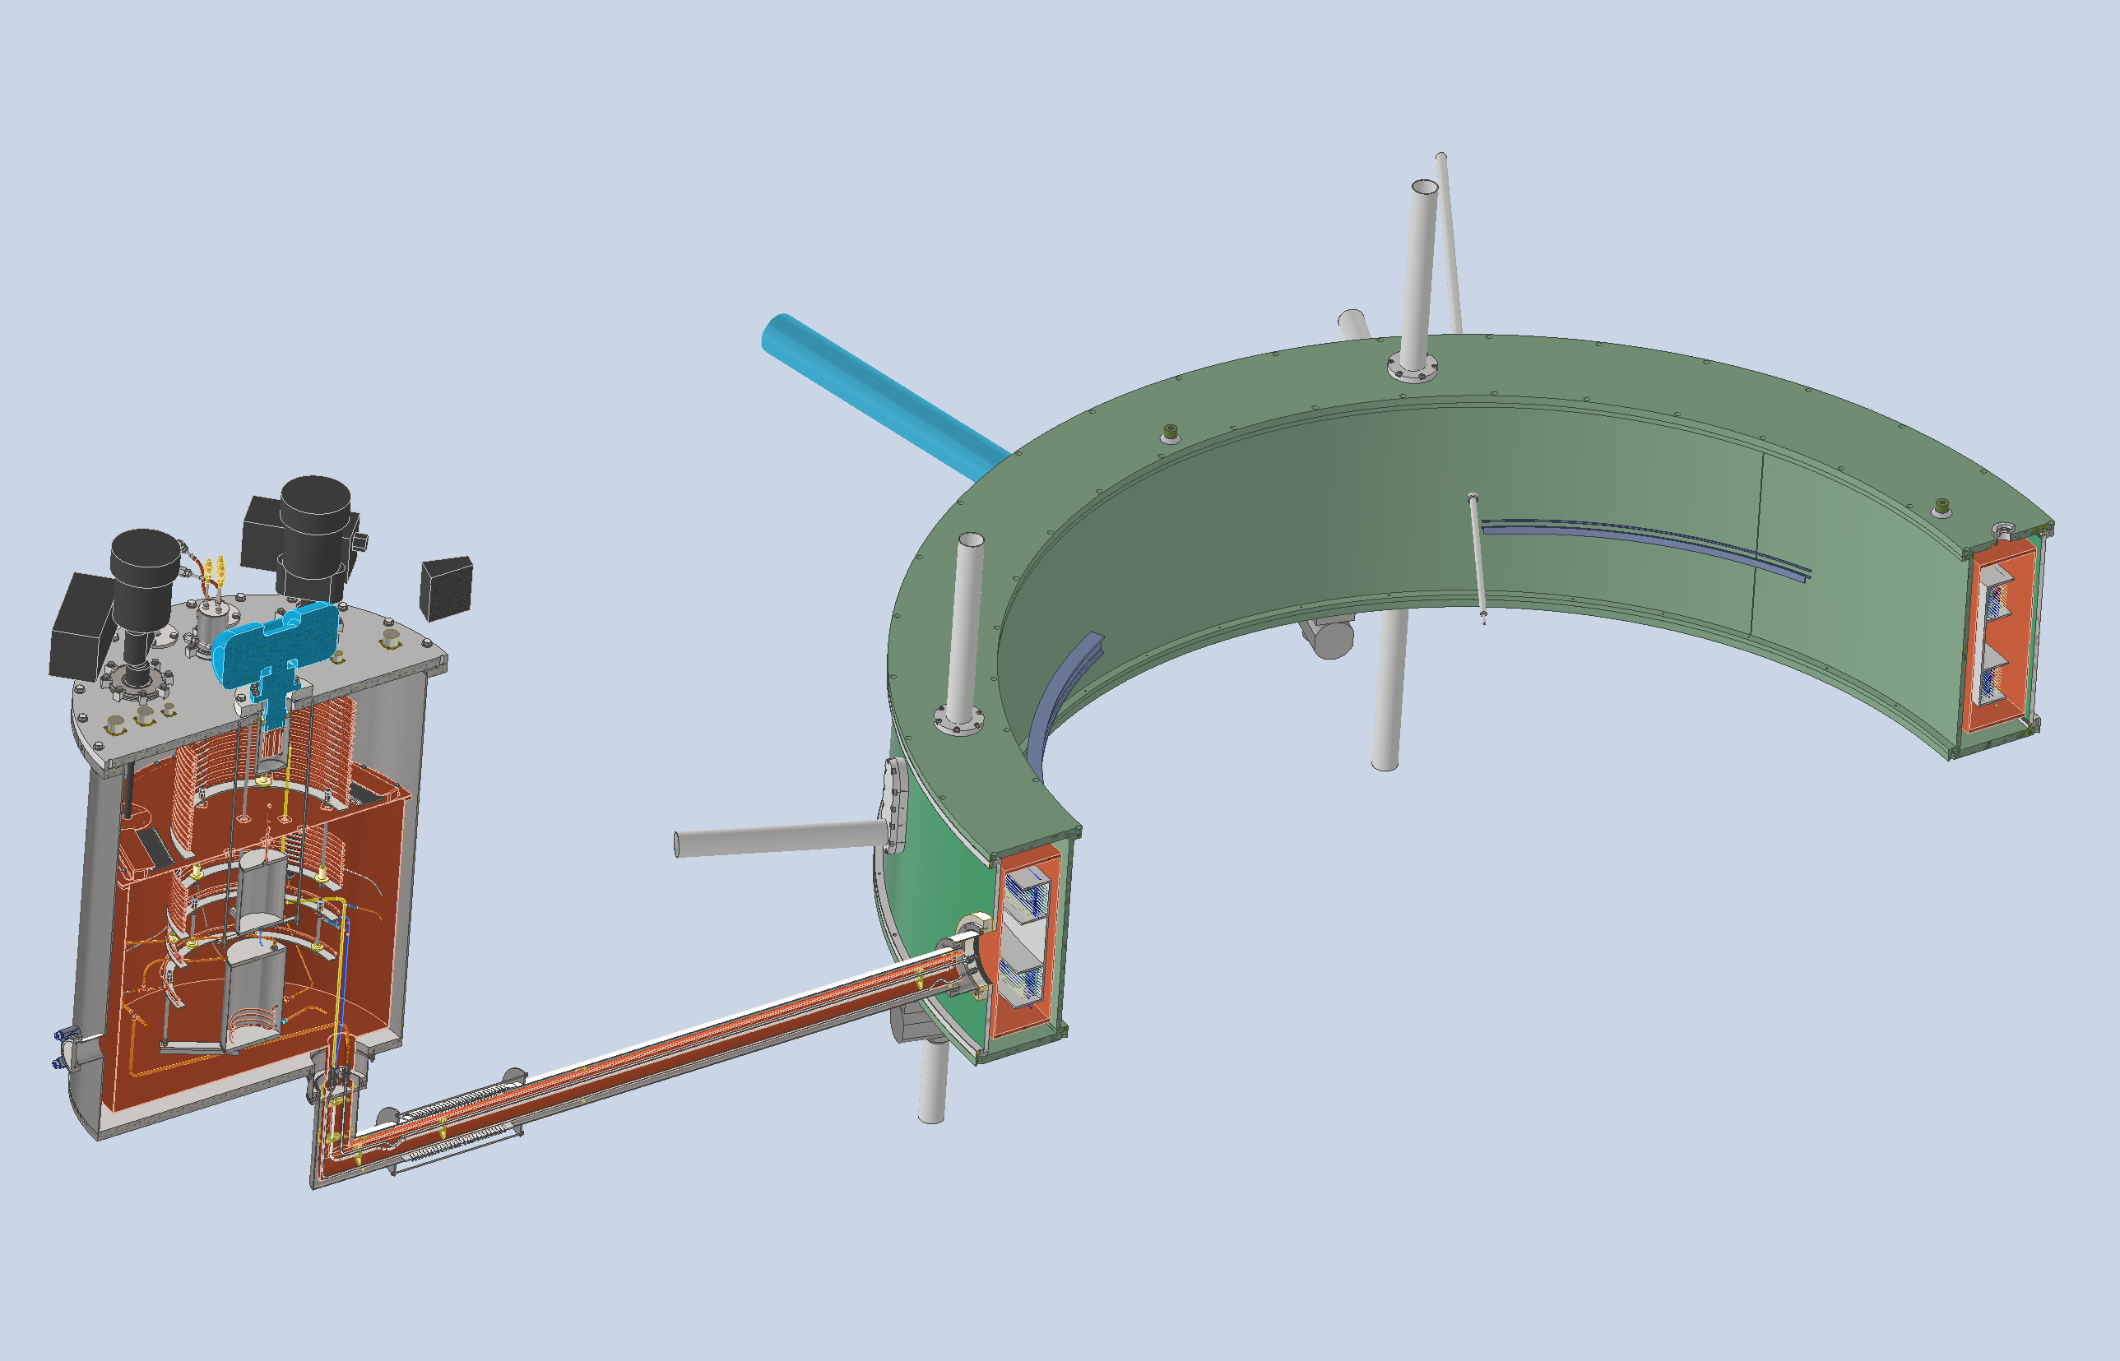
MSC-230 description and status
Cryogenic system and superconducting coils
1
3
2
6
4
1 – cryostat; 2 - superconducting coils; 3 – thermal shield; 4 – siphon; 5 – refrigerator
S.Yakovenko Creating Test Benches to Check Individua Systems of the MSC-230 Cyclotron
11

Slide 12
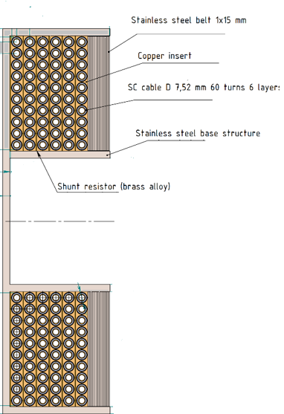
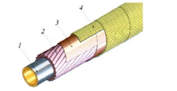
MSC-230 description and status
Cryogenic system and superconducting coils
The technology with the use of a hollow composite superconductor co proposed at the VBLHEP JINR and well-proven in the magnets of the Nuclotron synchrotron, was chosen as the basis for the manufacture of the coils.
The protection of the magnet from overheating during quench is solved by sectioning the solenoid and uniform energy release throughout the winding. For this, the winding is electrically divided into sections. The energy stored in the magnet is dissipated both on the external resistance and on 36 shunts - heaters located between the winding layers of the upper and lower coils. The time constant of the energy evacuation process will be 17.9 s.
1 - a tube with a channel for
cooling; 2 - superconducting wire;
3 - polyimide tape; 4 - glass fiber tape
S.Yakovenko Creating Test Benches to Check Single Systems of the MSC-230 Cyclotron
S.Yakovenko Creating Test Benches to Check Individua Systems of the MSC-230 Cyclotron
12

Slide 13
MSC-230 description and status
Cryogenic system parameters
Parameter name | Unit | Value
Solenoid inner diameter | m | 2.56
Solenoid outer diameter | m | 2.67
Number of coils | pcs | 2
Distance between coils | m | 0.14
Solenoid height | m | 0.35
Еmax | MJ | 3.3
VLHe | l | 7
L | H | 27.4
SC coil conductor | Cu + Nb-Ti
Insulating vacuum space pressure | Pa | ≤ 1 х 10⁻³
Operating current | A | 540
S.Yakovenko Creating Test Benches to Check Single Systems of the MSC-230 Cyclotron
S.Yakovenko Creating Test Benches to Check Individua Systems of the MSC-230 Cyclotron
13

Slide 14
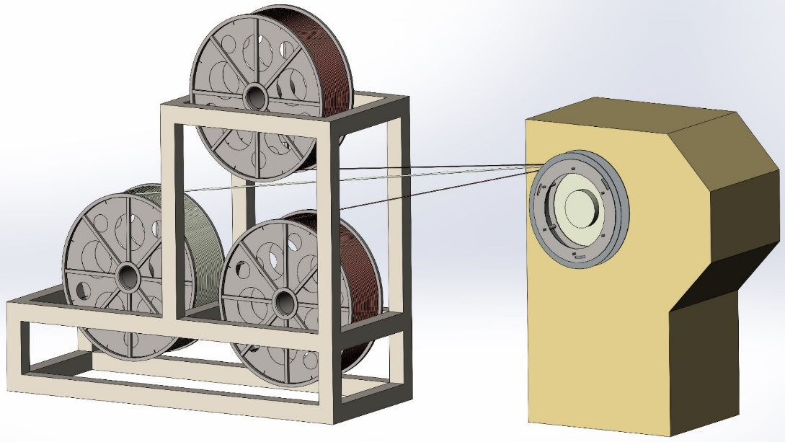
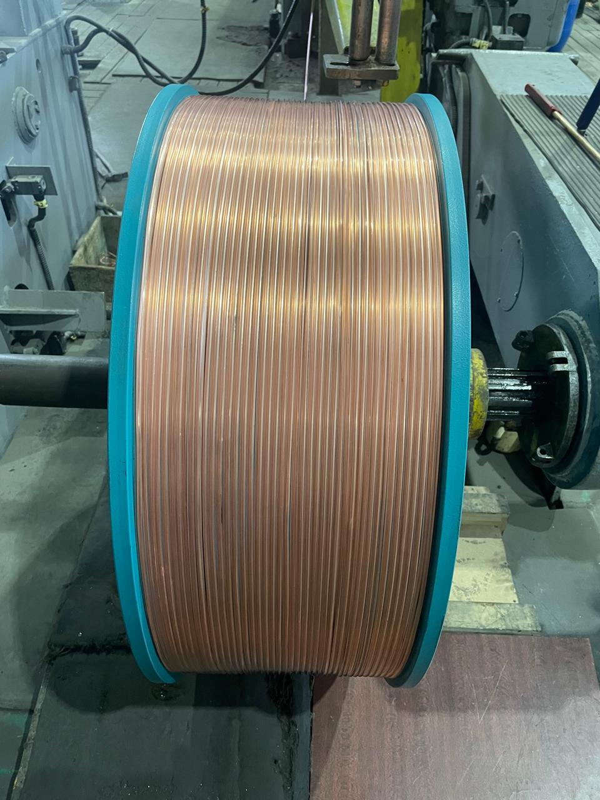
MSC-230 description and status
Cryogenic system and superconducting coils
Winding equipment are being manufactured.
Will be completed in Octomber 2025
S.Yakovenko Creating Test Benches to Check Single Systems of the MSC-230 Cyclotron

Slide 15
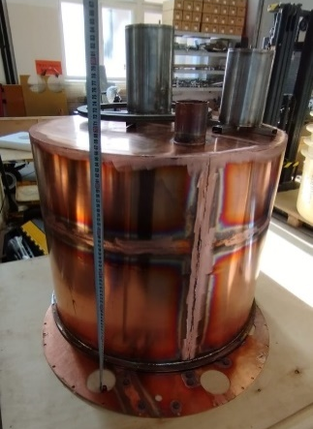
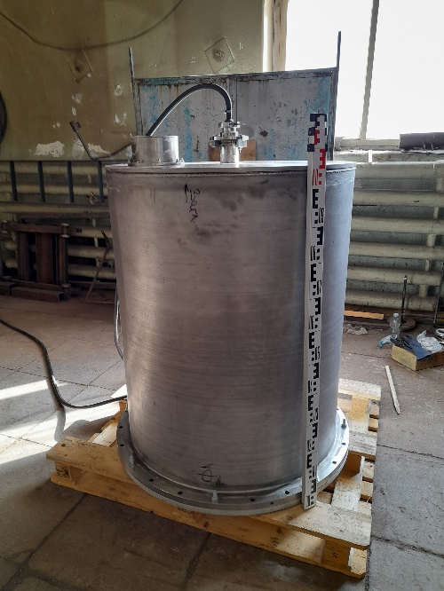
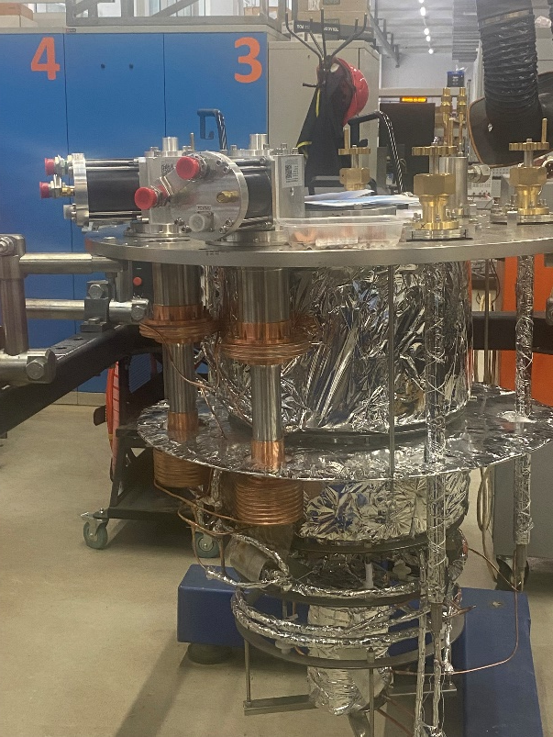
MSC-230 description and status
Cryogenic system and superconducting coils
The key element of cryogenic system - refrigerator is ready for testing
S.Yakovenko Creating Test Benches to Check Single Systems of the MSC-230 Cyclotron

Slide 16
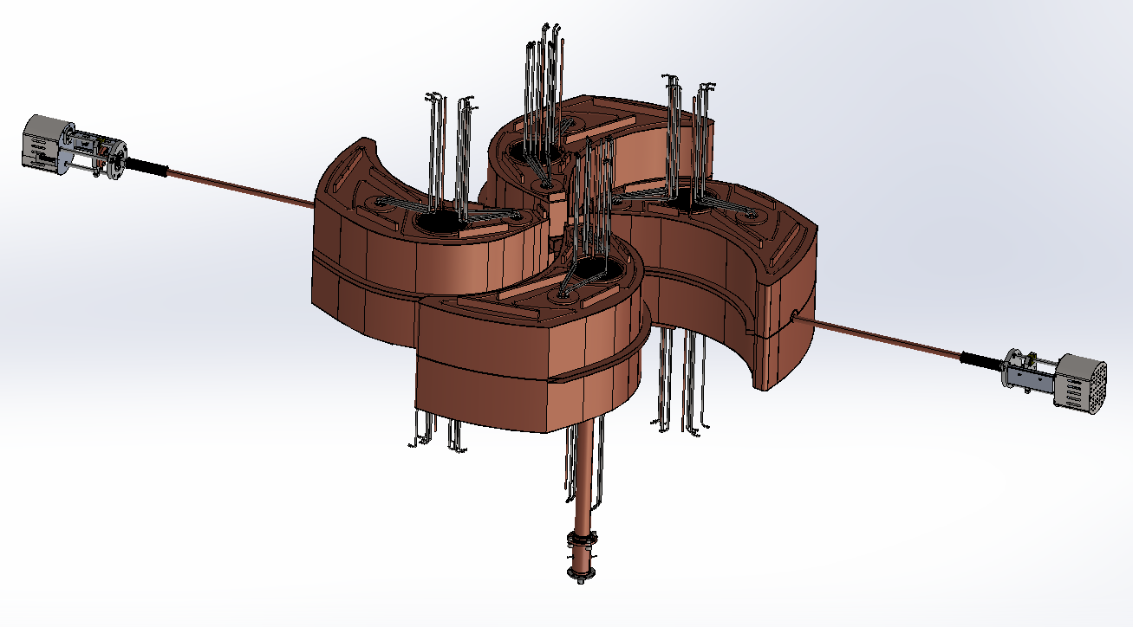
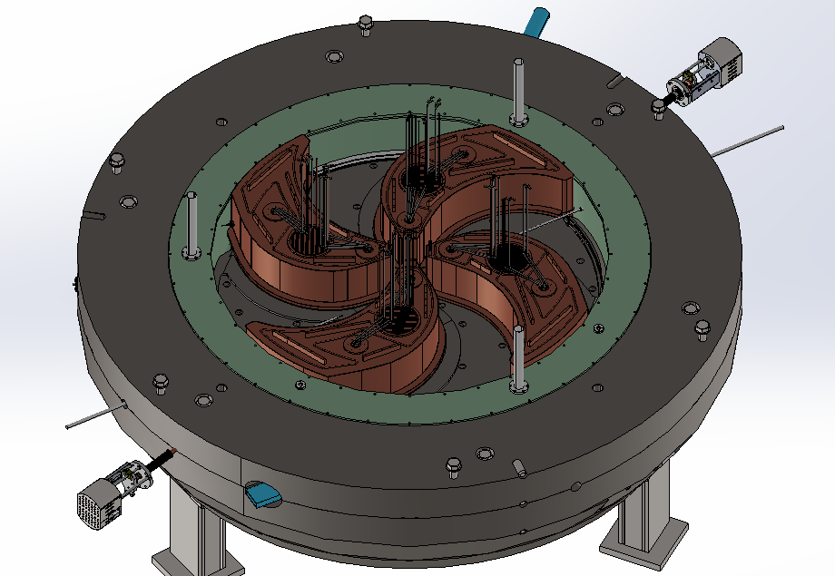
MSC-230 description and status
The design of the resonance system is being completed and the production of individual units has begun
S.Yakovenko Creating Test Benches to Check Individua Systems of the MSC-230 Cyclotron

Slide 17
MSC-230 description and status
RF generator
The high frequency generator is being manufactured by Hefei CAS Ion Medical and Technical Devices Co., Ltd.
Delivery date is December 2025.
S.Yakovenko Creating Test Benches to Check Individua Systems of the MSC-230 Cyclotron
17

Slide 18
Timeline of МSC-230 Construction
2023
2024
2025
2026
5 | 6 | 7 | 8 | 9 | 10 | 11 | 12 | 1 | 2 | 3 | 4 | 5 | 6 | 7 | 8 | 9 | 10 | 11 | 12 | 1 | 2 | 3 | 4 | 5 | 6 | 7 | 8 | 9 | 10 | 11 | 12 | 1 | 2
Final engineering design
Magnet yok and
lifting system
Cryogenic system
RF system
Proton source
Vacuum system
Beam diagnostic system
Extraction system
Control system
Magnetic field measurement system
Power supply and cooling systems
Final assembling
Commissioning
S.Yakovenko Creating Test Benches to Check Single Systems of the MSC-230 Cyclotron
S.Yakovenko Creating Test Benches to Check Individua Systems of the MSC-230 Cyclotron
18

Slide 19
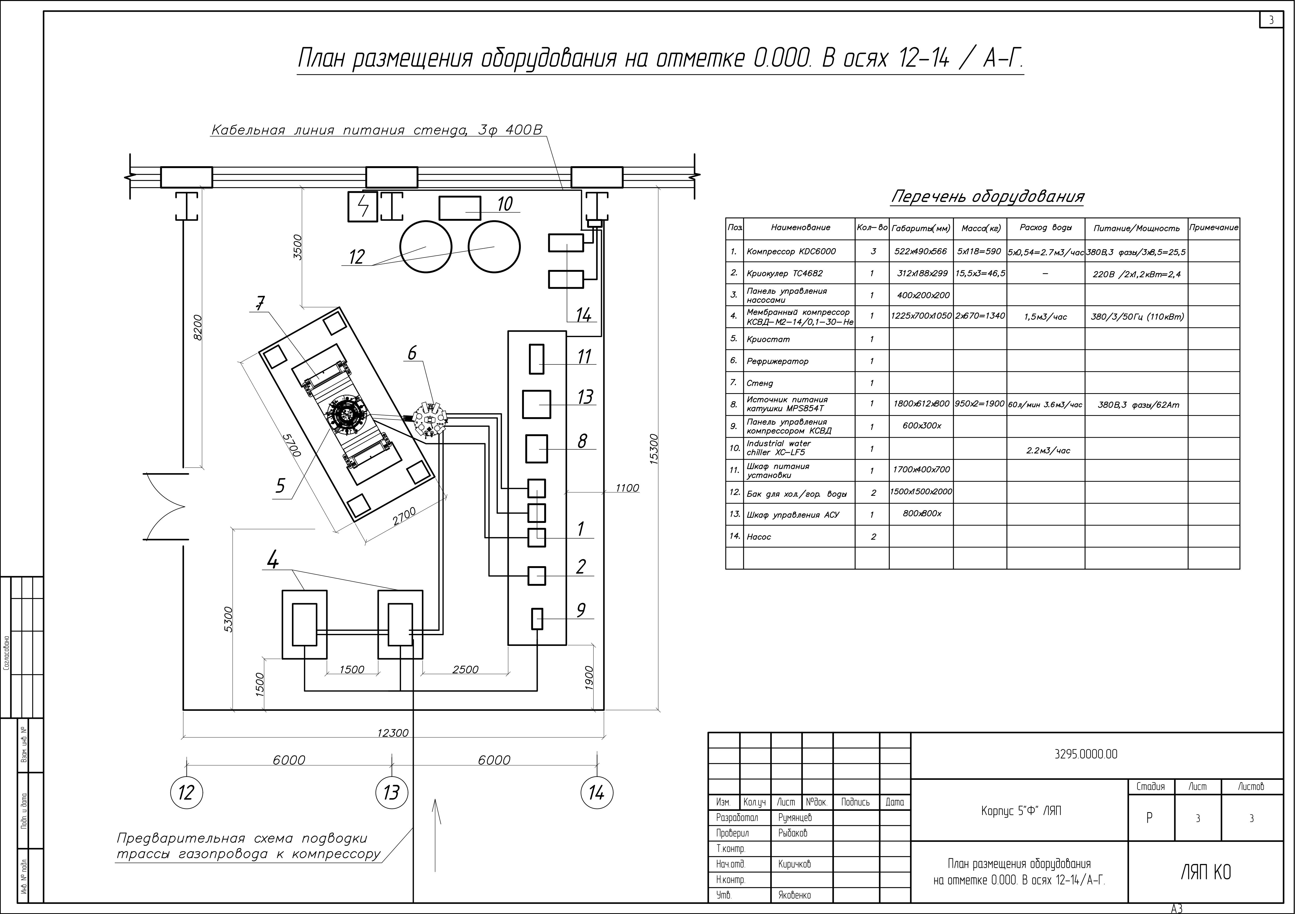
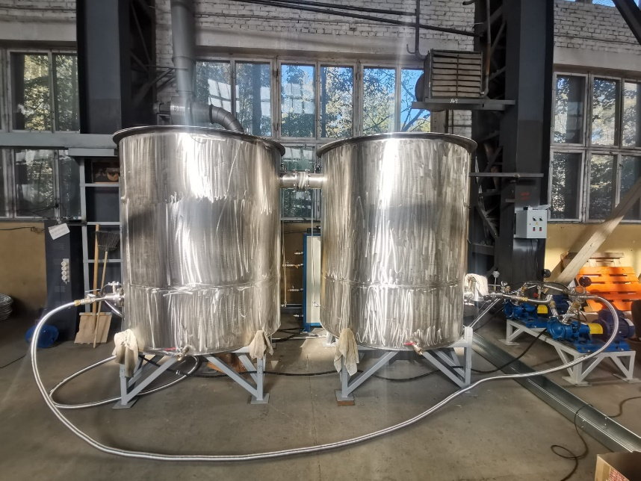
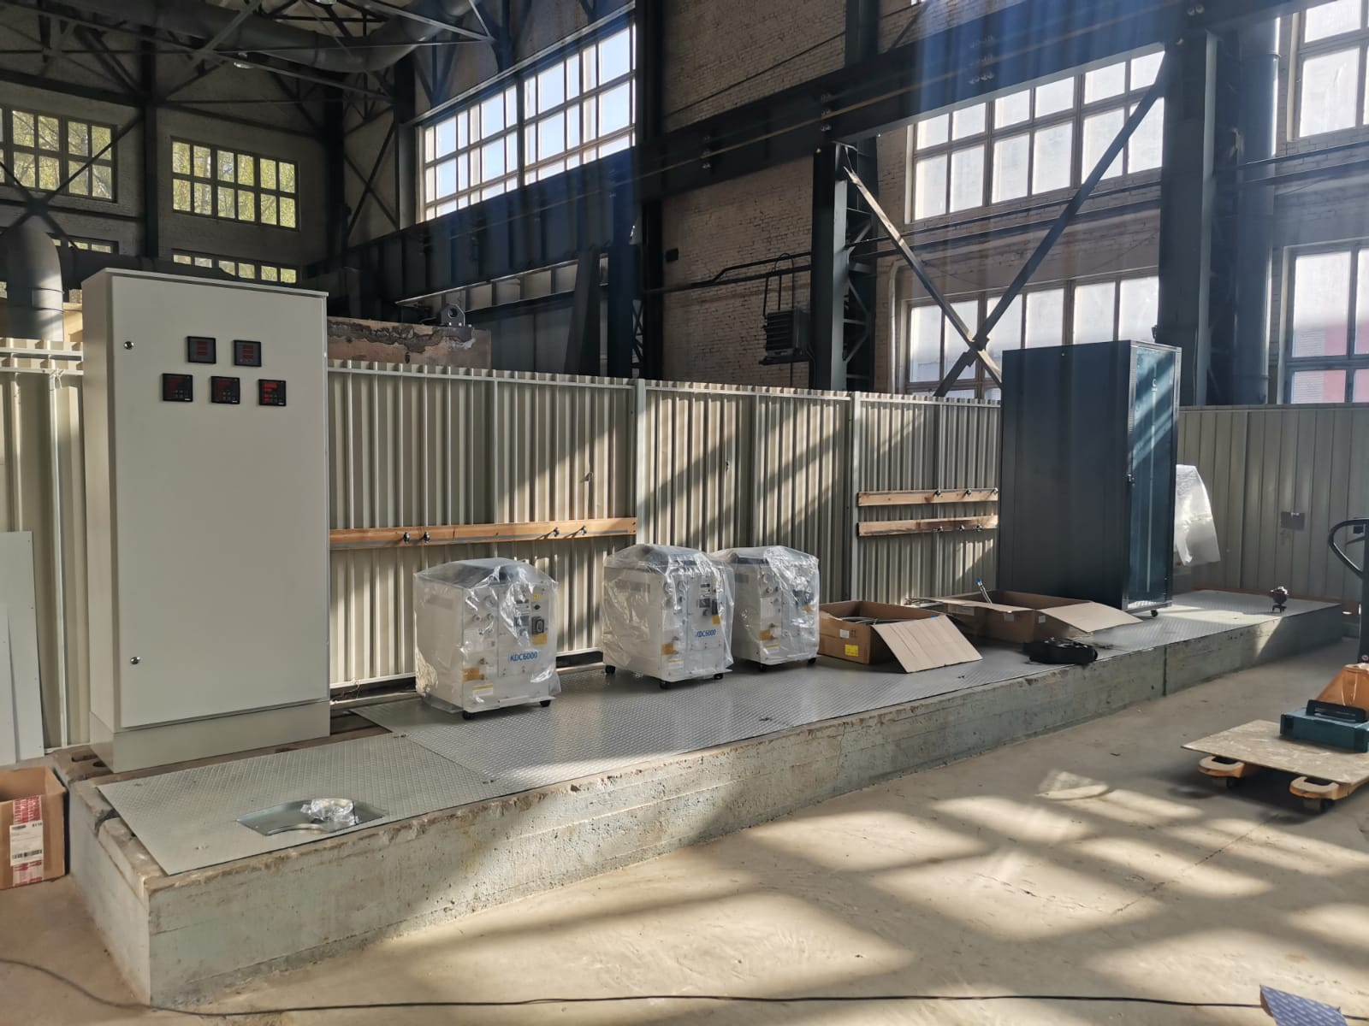
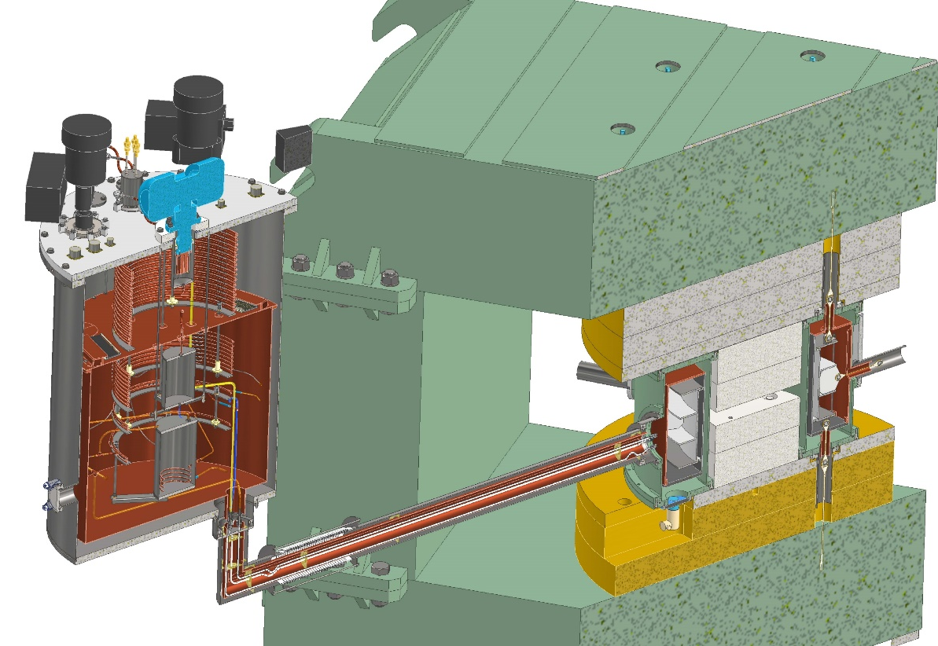
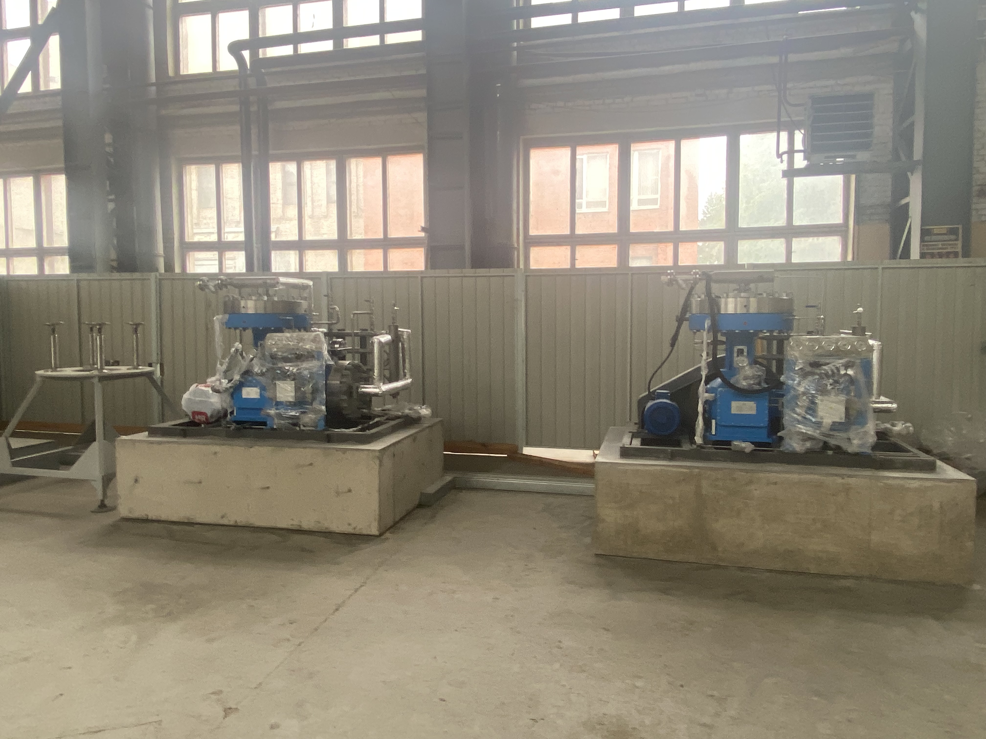
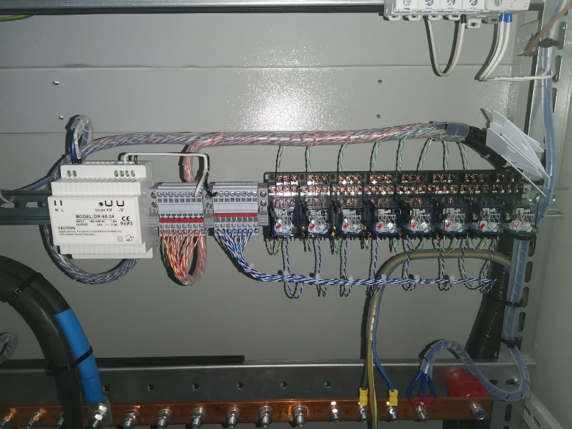
MSC-230 test benches
The cryogenic system test bench
S.Yakovenko Creating Test Benches to Check Individua Systems of the MSC-230 Cyclotron

Slide 20
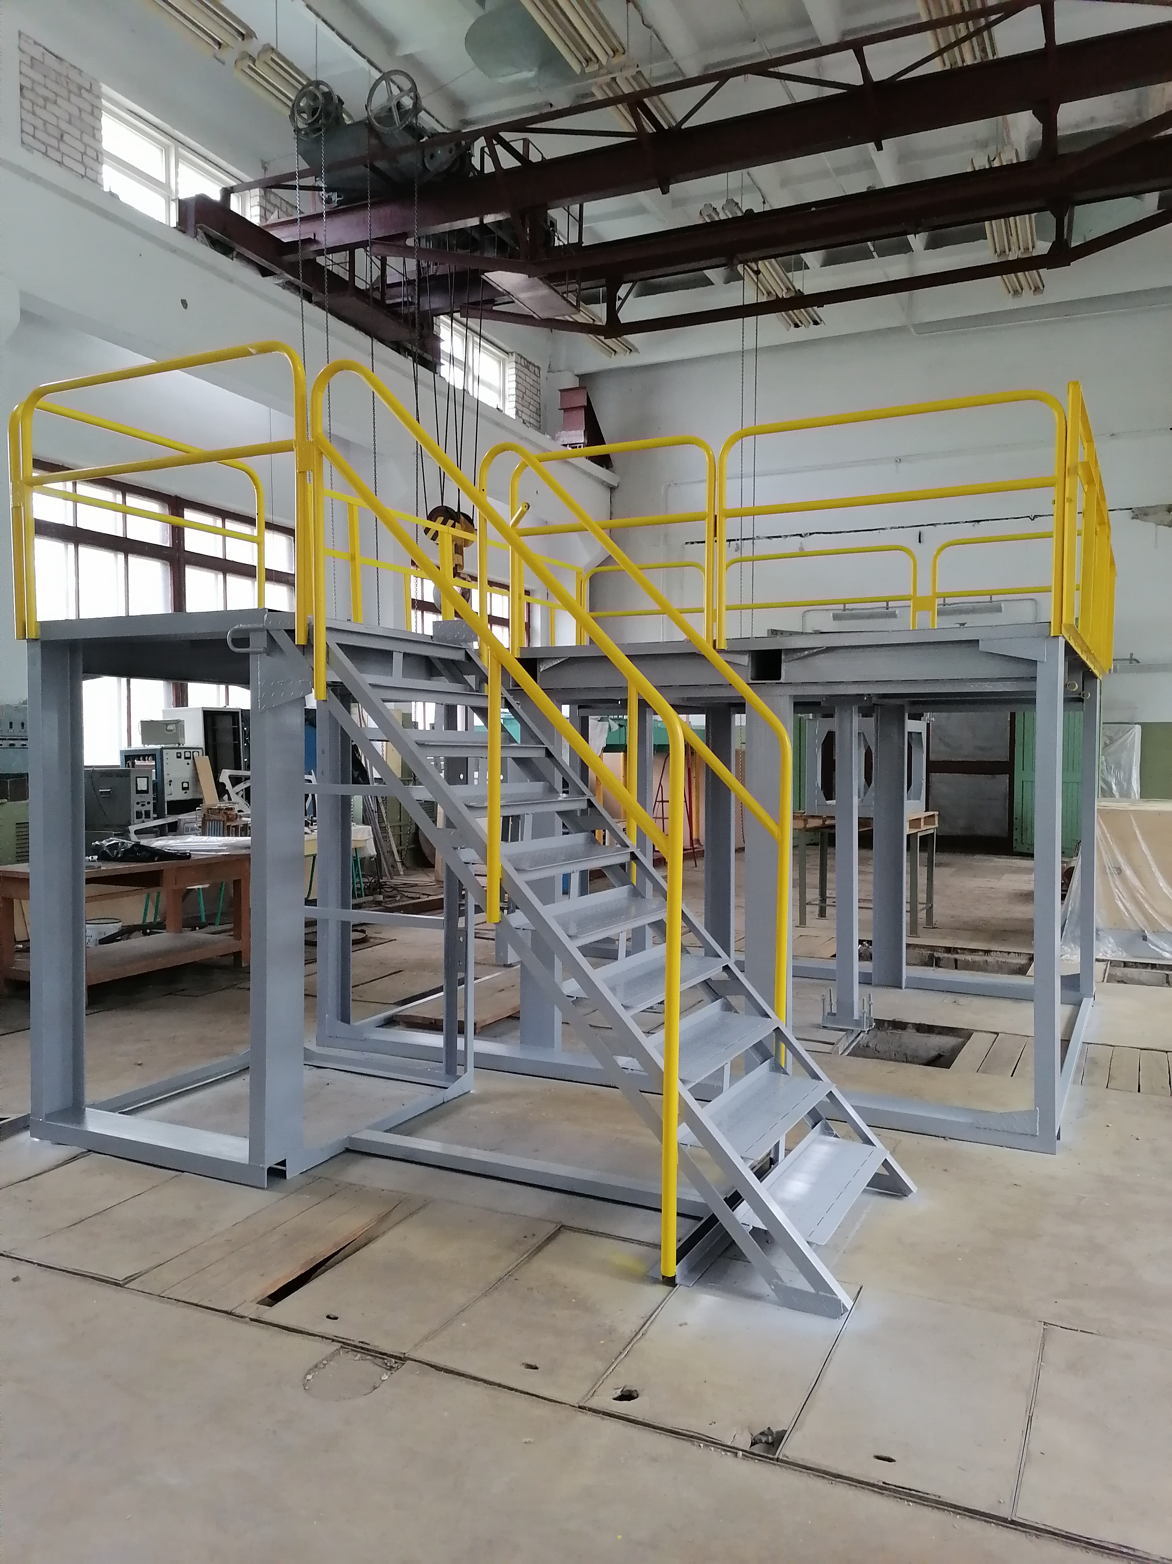
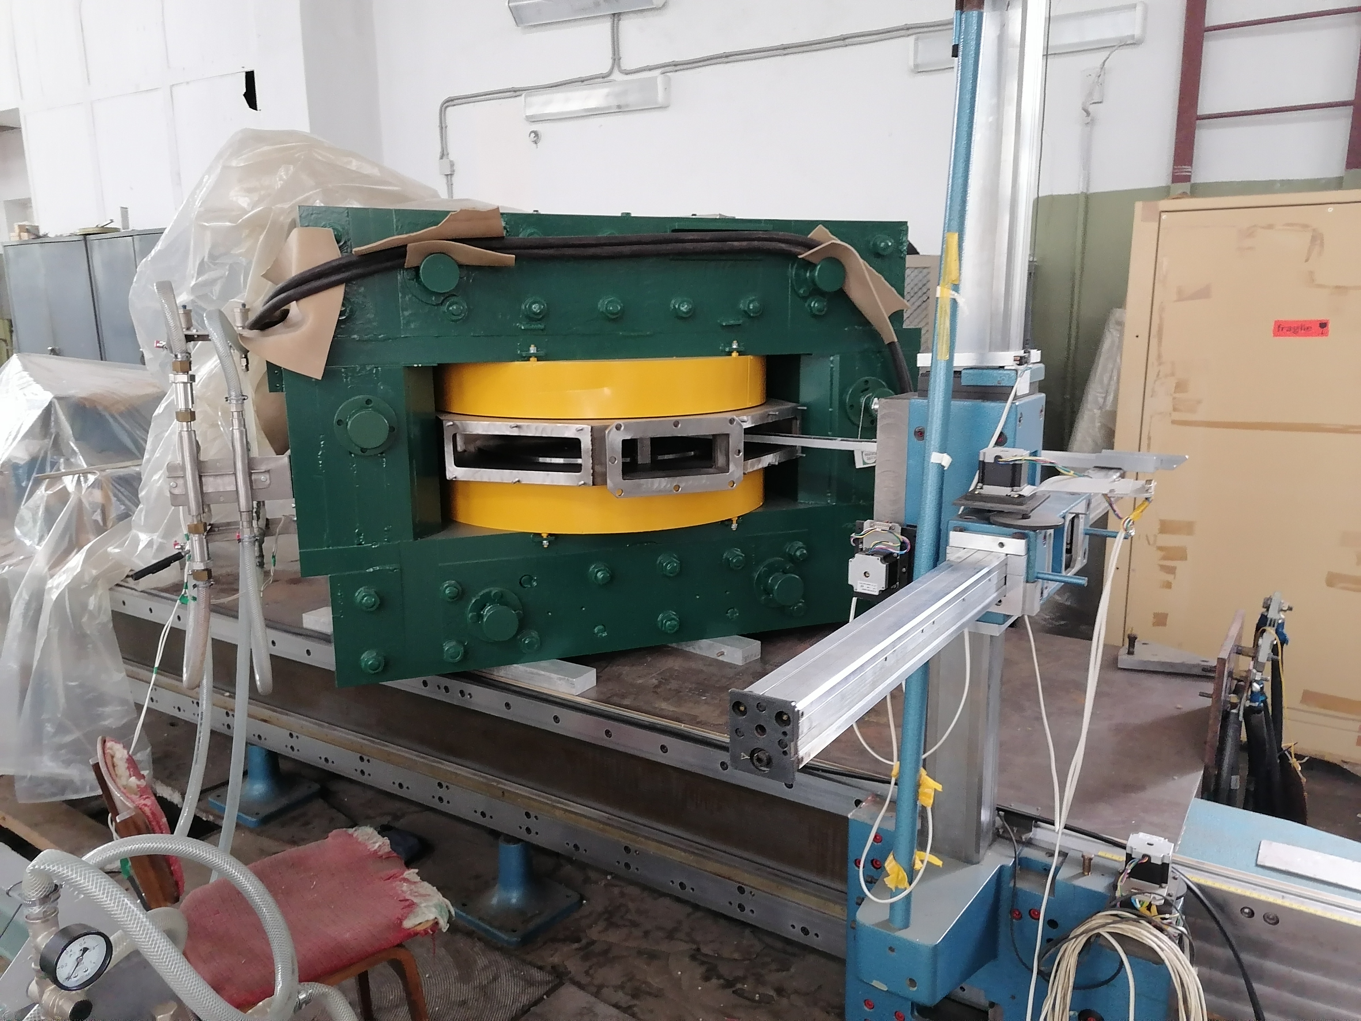
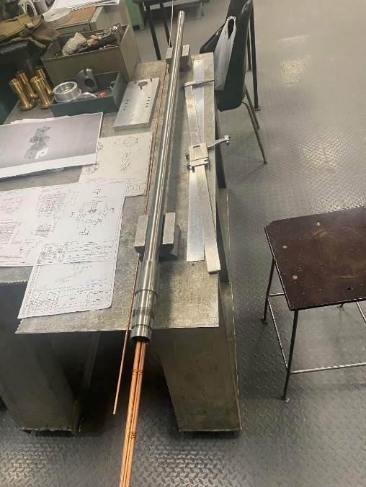
MSC-230 test benches
Proton source test bench
S.Yakovenko Creating Test Benches to Check Individua Systems of the MSC-230 Cyclotron

Slide 21
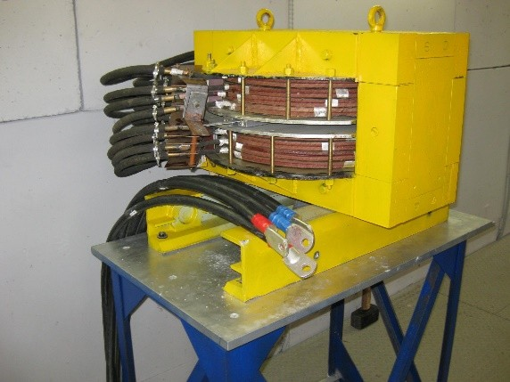
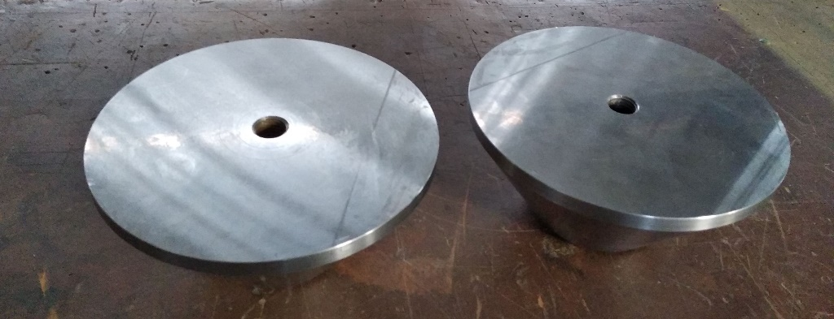
MSC-230 test benches
The hall sensor calibration test bench
New poles
Calibration magnet
Calculated magnetization curve of the calibration magnet of the DLNP with new poles and the measured magnetization curve of the calibration magnet of the LNR
S.Yakovenko Creating Test Benches to Check Individua Systems of the MSC-230 Cyclotron

Slide 22
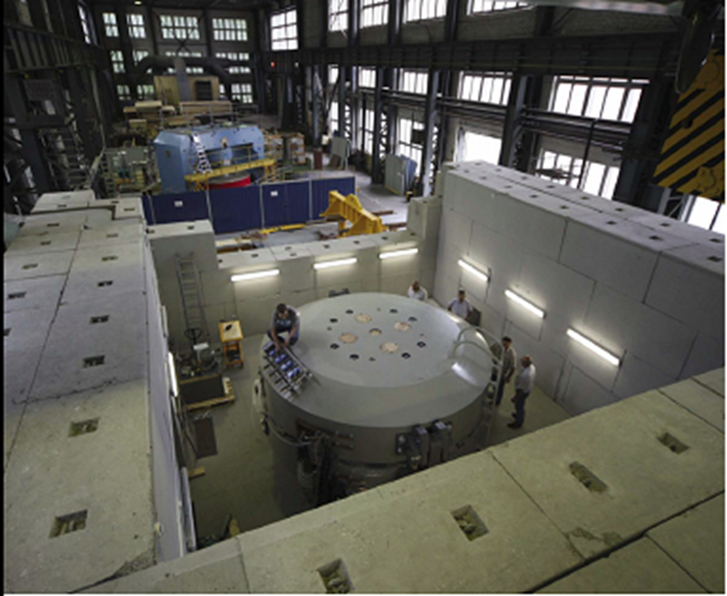
MSC-230 test benches
MSC-230 test bench
S.Yakovenko Creating Test Benches to Check Single Systems of the MSC-230 Cyclotron
S.Yakovenko Creating Test Benches to Check Individua Systems of the MSC-230 Cyclotron
22

Slide 23
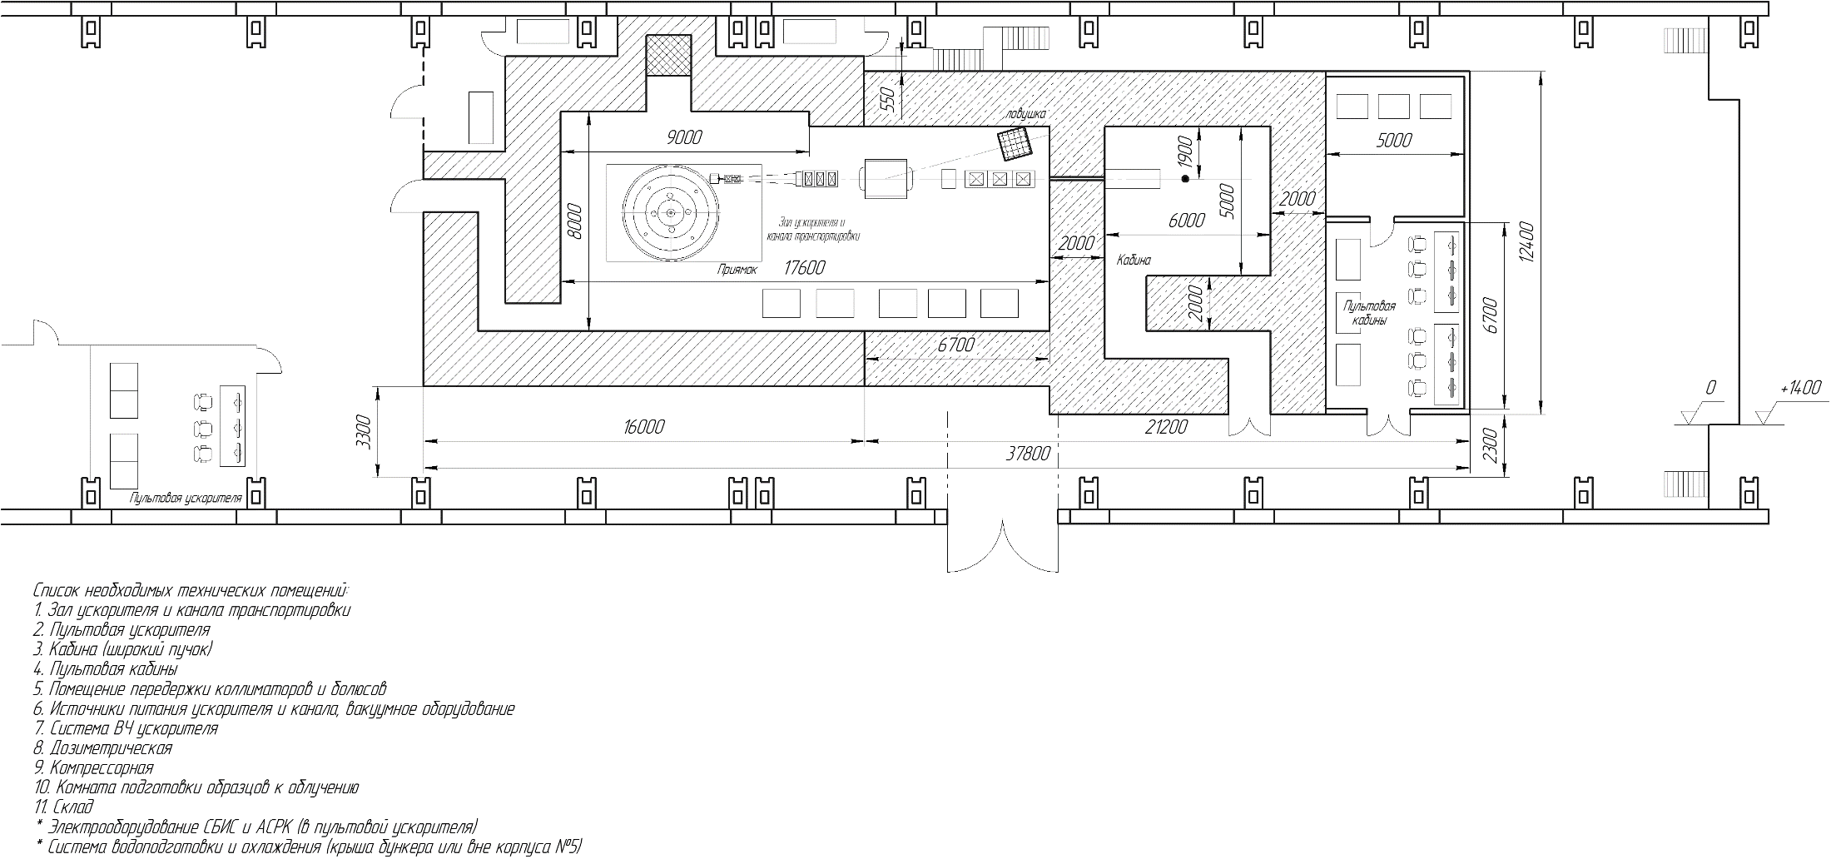
Infrastructure for radiobiological researches
MSC-230 layout (building 5 LNP)
S.Yakovenko Creating Test Benches to Check Individua Systems of the MSC-230 Cyclotron

Slide 24
Expected results
2025: Creation of the test benches for cyclotron elements test, design of the beam transport channel to the treatment room, design of the treatment room.
2026: The MSC-230 assembling and commissioning. Manufacturing of the transport channel and treatment room with a control panel.
2027: Radiobiological studies, medical certification of the proton beam and dosimetry equipment.
S.Yakovenko Creating Test Benches to Check Single Systems of the MSC-230 Cyclotron
S.Yakovenko Creating Test Benches to Check Individua Systems of the MSC-230 Cyclotron
24

Slide 25
Thank you for your attention.
S.Yakovenko Creating Test Benches to Check Single Systems of the MSC-230 Cyclotron
S.Yakovenko Creating Test Benches to Check Individua Systems of the MSC-230 Cyclotron
25

Slide 26
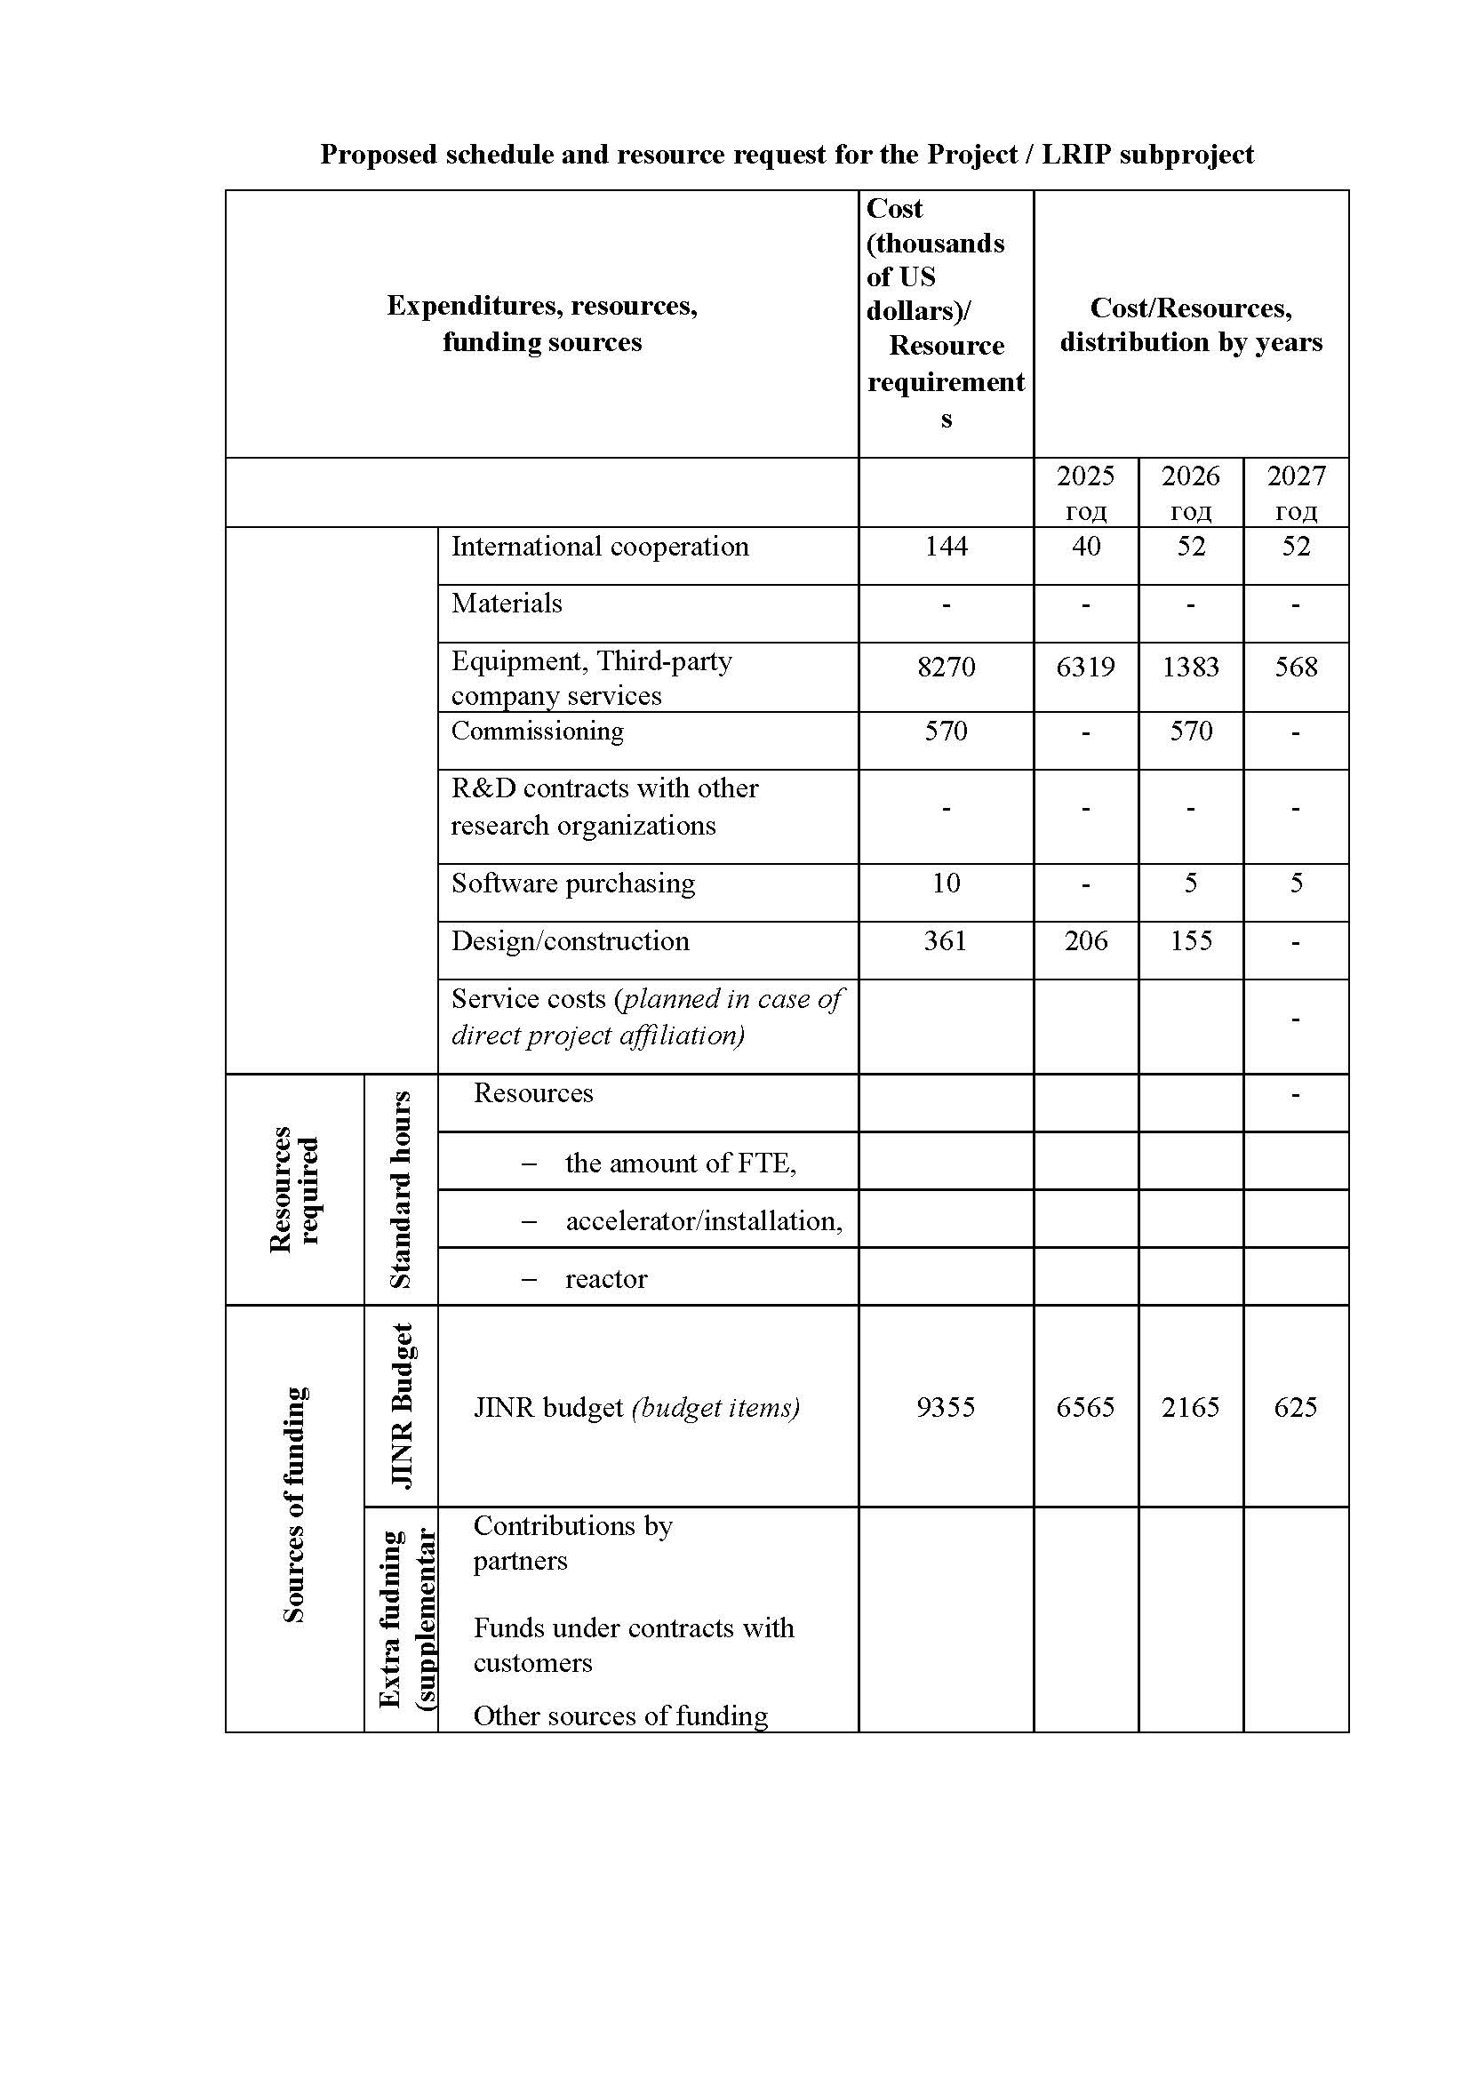
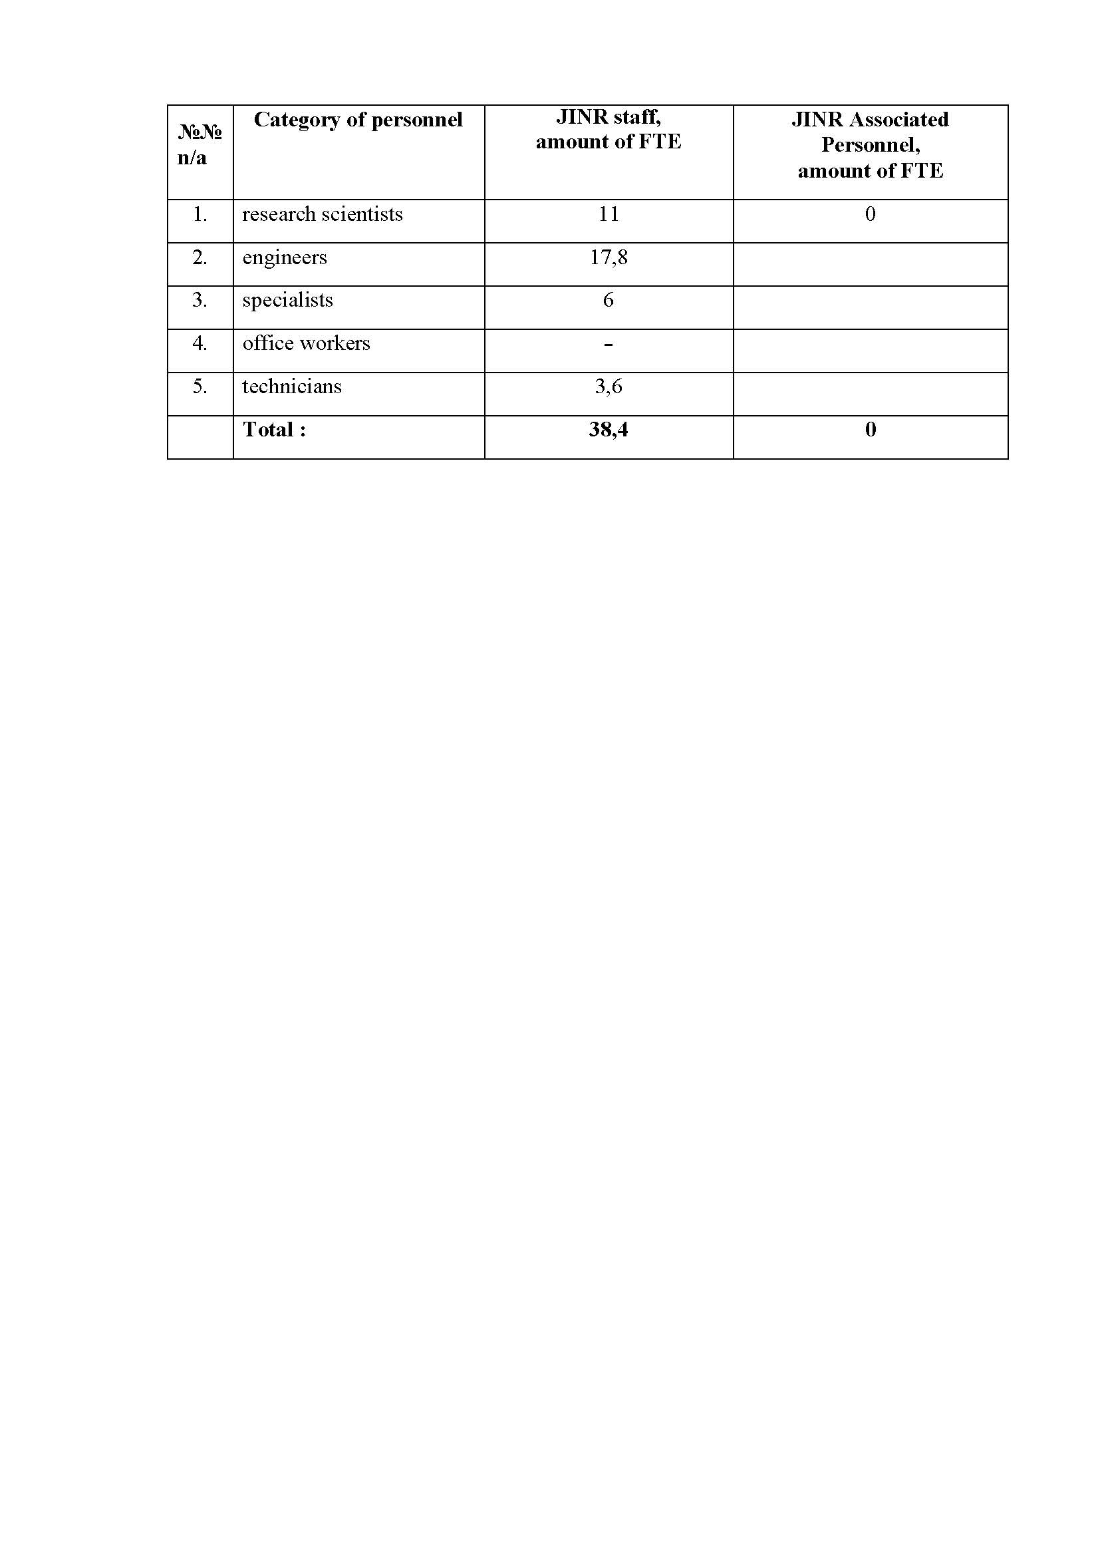
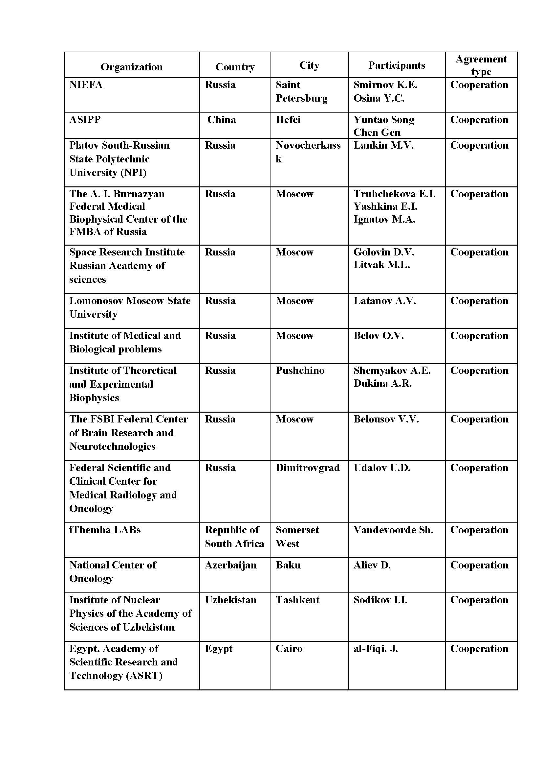
S.Yakovenko Creating Test Benches to Check Single Systems of the MSC-230 Cyclotron
S.Yakovenko Creating Test Benches to Check Individua Systems of the MSC-230 Cyclotron
26

