Slide 1
Collection and systematization of scientific publications for the JINR digital repository
Kondratyev A. O., Bondyakov A. S., Filozova I. A., Shestakova G. V., Zaikina T. N., Nekrasova I. K., Popova Ya. I.
2025. JINR. Dubna. 61st meeting of the PAC for Nuclear Physics

Slide 2
Why Digital Repositories?
Effective access to up-to-date information about the staff of scientific publications related to JINR
Reduce duplication and manual data entry in publications and improve the efficiency of its analysis
Integrates data from verified data sources into a single system
Provides long-term storage and convenient access to the Institute's information assets
JINR lacks a digital repository of publications
Don’t have a system for automated collection and systematization of publications

Slide 3




Digital Repository in JINR
External API’s
User Submission
Submission form
semi-automatic import via DOI, CrossReff etc.
JINR Digital Repository (Dspace)
External API’s
(in progress)
External Databases
Scopus with JINR affiliation(MEPhI)
JINR PIN
Import Publications from Dspace
Export employee metadata to Dspace

Slide 4
Complex of collection and systematization of scientific publications for the JINR digital repository
Complex of collection and systematization of scientific publications
Creates and updates user login for SSO authentication
Creates and updates Authors profiles from PIN Database (first name, last name, ids etc.)
Identifies authors for publications were imported
Moves publication from User submission collection to primary collection of publications
Imports publications from Unique Database, tries to find duplicates(by DOI, publication ids, publication titles) and identifies JINR authors (by ORCID, elibrary id, name variants, Levenshtein distance)
PIN
Inspire API
eLibrary API
JINR Digital Repository (Dspace)
Download .json (inspire)/.xml (eLibrary) from API’s using “Collectors” for each API’s
Dspace Developed Services
Dspace FrontEnd
Inspire Collector
eLibrary Collector
User profiles creation service
User profile
PIN
synchronization service
Store metadata & full text files in Data bases. Each External source has own database
Inspire Database
eLibrary Database
Author profile
Find Author service
Dspace Rest API
Creation of unique publication
Creation Unique publication with metadata from all external sources. Each publications has more than 60 metadata types.
Publication’s
Collection
Change Collection Service
Publication Import Service
Publication’s
Collection with User submission
Database with Unique publications
Store Unique publication in database

Slide 5
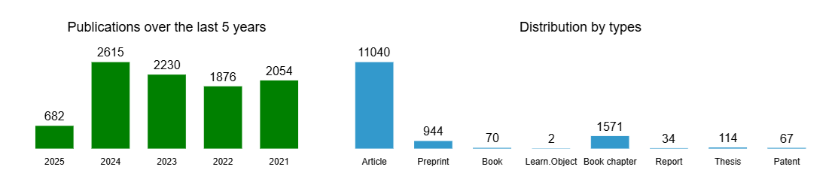
Results
Complex of collection and systematization of scientific publications and services for the JINR digital repository was developed;
Complex and developed services launches once a day to have actual statistic;
Publications imported to JINR Digital Repository starts from 2019.
InspireHEP | eLibrary | Scopus(MEPhI)
6489 | 10235 | 9360
Database with unique publications
13001
Dspace
13806
pubrepo.jinr.ru

Slide 6
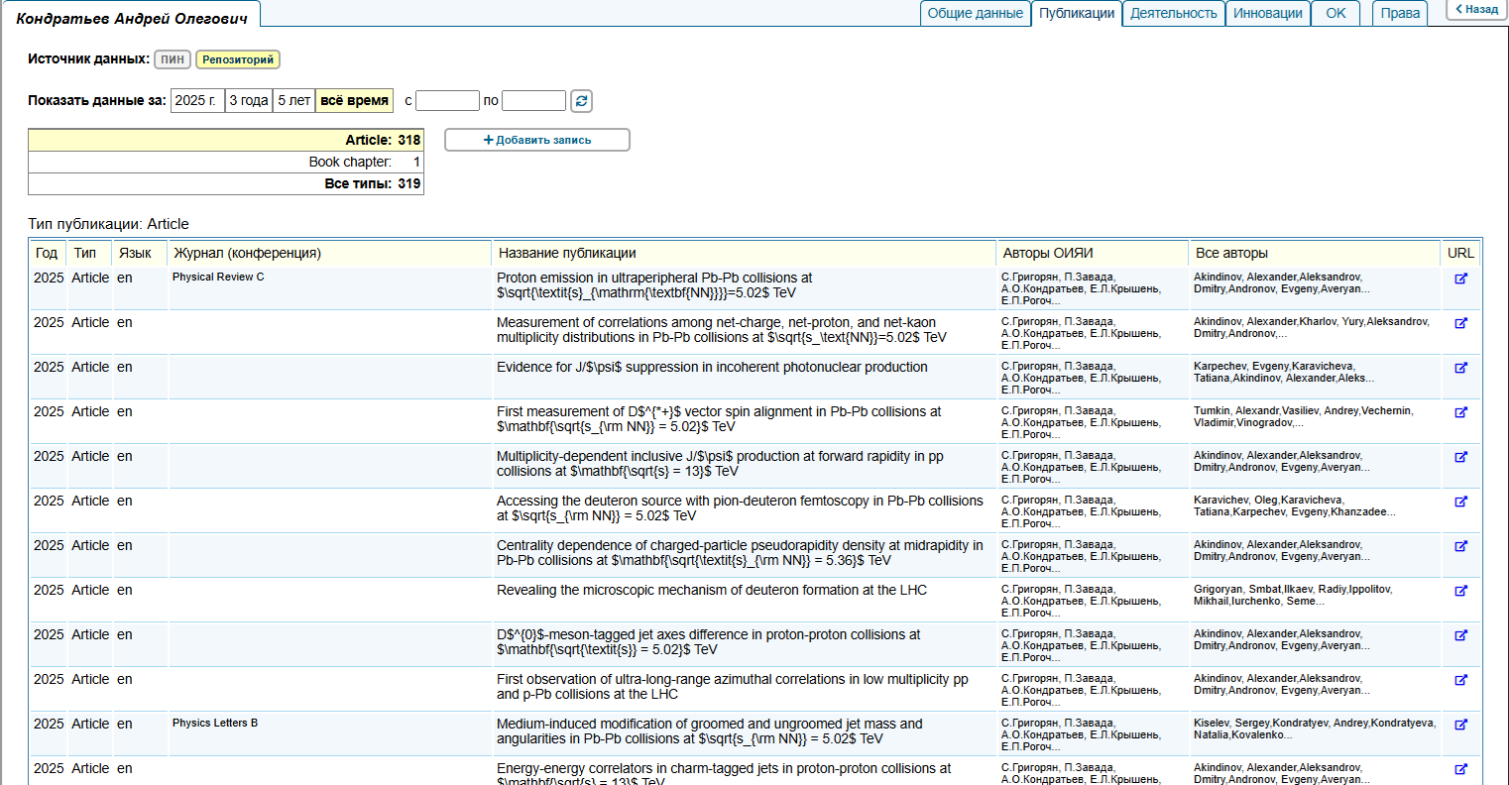
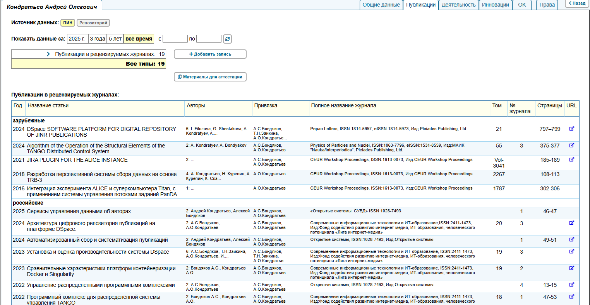
Results
Automated entry of publications into PIN from JINR Repository
Manual entry of publications into PIN

Slide 7
Thank you for your attention

