Slide 1


Investigation of spectral properties of ¹¹Be
in breakup reactions within quantum-quasiclassical approach
Dinara Valiolda^{1,2,} , D.M. Janseitov² , V.S. Melezhik¹
¹Joint Institute for Nuclear Research, Dubna, Russia
²Institute of Nuclear Physics, Almaty, Kazakhstan
61st meeting of the PAC for Nuclear Physics, Dubna, 19-20 June, 2025

Slide 2
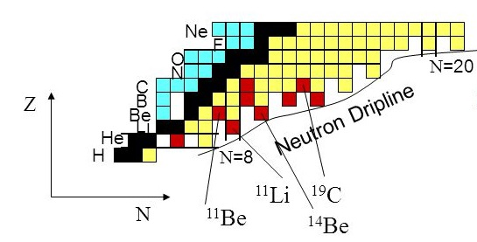
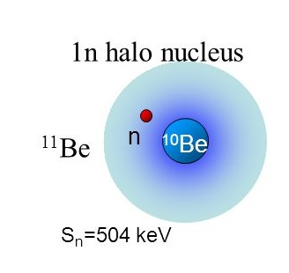
The aim of work is to investigate the breakup of ¹¹Be halo nuclei on a light (¹²C) and heavy (²⁰⁸Pb) targets from intermediate (67 MeV/nucleon) to low (5-30 MeV/nucleon) energies within non-perturbative quantum-quasiclassical approach.
The neutron halo effect is caused by the presence of weakly bound states of neutrons located near the continuum.
Among the halo nuclei, the ¹¹Be nucleus is of particular importance, since the relative simplicity of its structure allows accurate theoretical studies. In fact, the bound states of the ¹¹Be nucleus can be described quite well as a ¹⁰Be core and a weakly bound neutron.

Slide 3
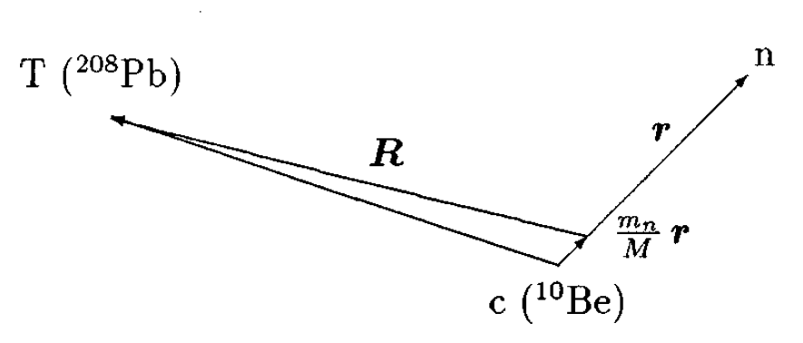
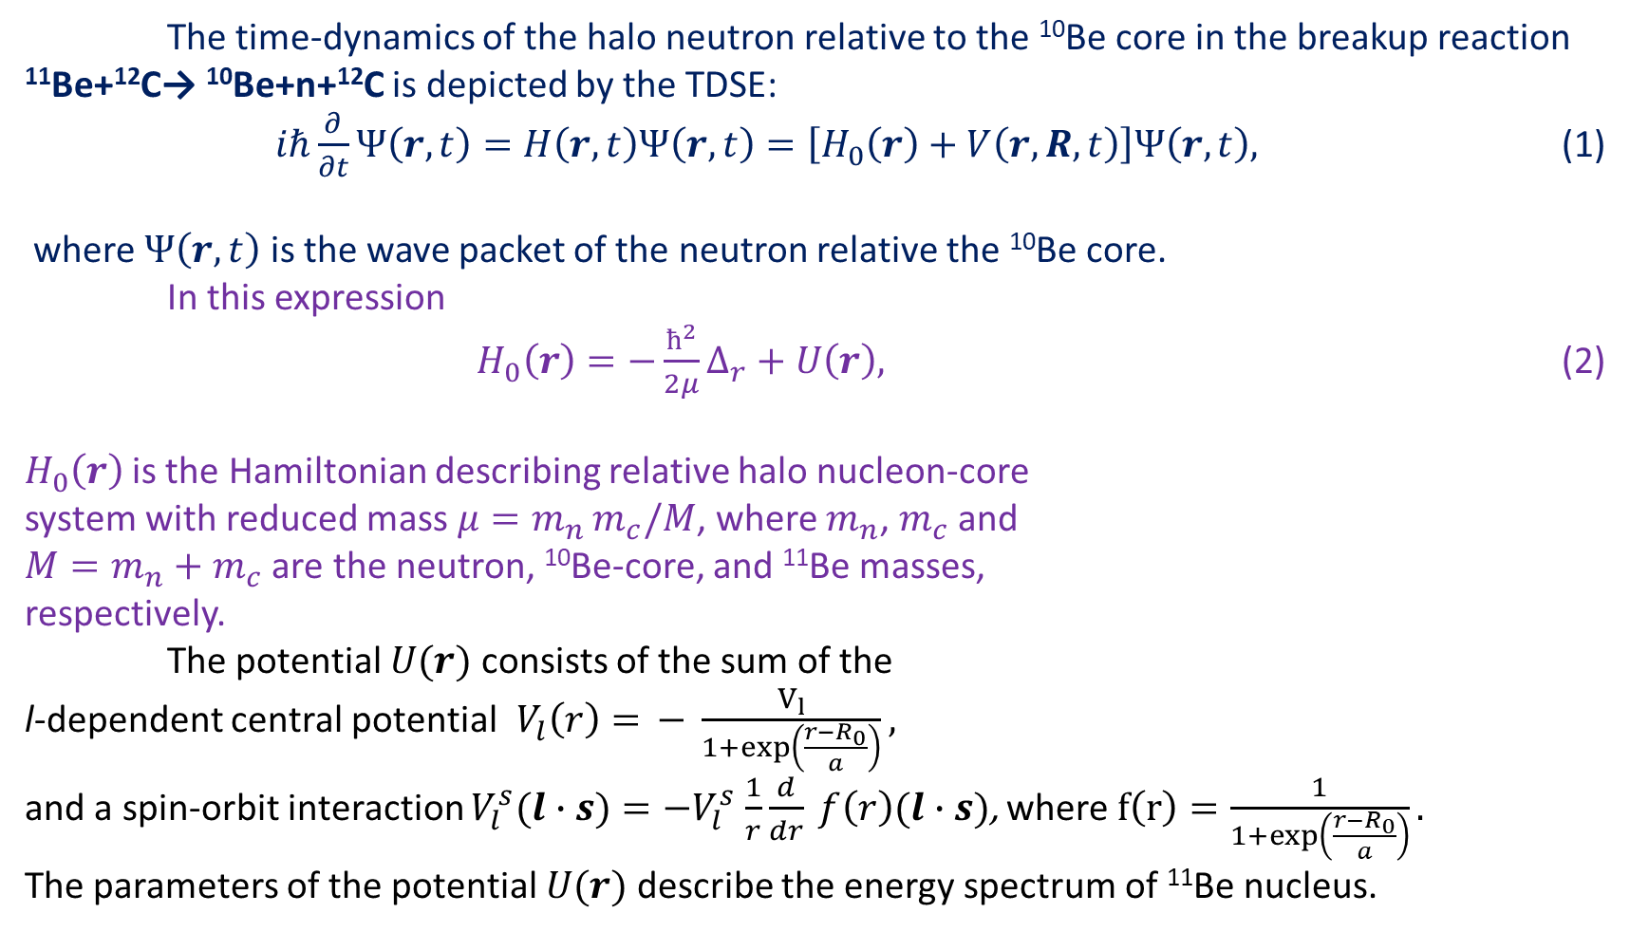
Time dependent Sсhrodinger equation
The time-dynamics of the halo neutron relative to the ¹⁰Be core in the breakup reaction
¹¹Be+¹²C→ ¹⁰Be+n+¹²C is depicted by the TDSE:
$iℏ\frac{∂}{∂t}Ψ\left(r,t\right)=H\left(r,t\right)Ψ\left(r,t\right)=\left[H_{0}\left(r\right)+V\left(r,R,t\right)\right]Ψ\left(r,t\right),$ (1)
where $Ψ\left(r,t\right)$ is the wave packet of the neutron relative the ¹⁰Be core.
In this expression
$H_{0}\left(r\right)=−\frac{ħ^{2}}{2μ}∆_{r}+U\left(r\right),$ (2)
$H_{0}\left(r\right)$is the Hamiltonian describing relative halo nucleon-core
system with reduced mass $μ=m_{n }m_{c}/M$, where $m_{n}$, $m_{c}$ and
${M=m_{n}+m}_{c}$ are the neutron, ¹⁰Be-core, and ¹¹Be masses,
respectively.
The potential $U(r)$ consists of the sum of the
l-dependent central potential$V_{l}\left(r\right)=$ $− \frac{V_{l}}{1+exp\left(\frac{r−R_{0}}{a}\right)},$
and a spin-orbit interaction $V_{l}^{s}(l∙s)=−V_{l}^{s}$ $\frac{1}{r}\frac{d}{dr} f\left(r\right)(l∙s)$, where $f\left(r\right)=\frac{1}{1+exp\left(\frac{r−R_{0}}{a}\right)}.$
The parameters of the potential $U(r)$ describe the energy spectrum of ¹¹Be nucleus.
T (¹²C)

Slide 4
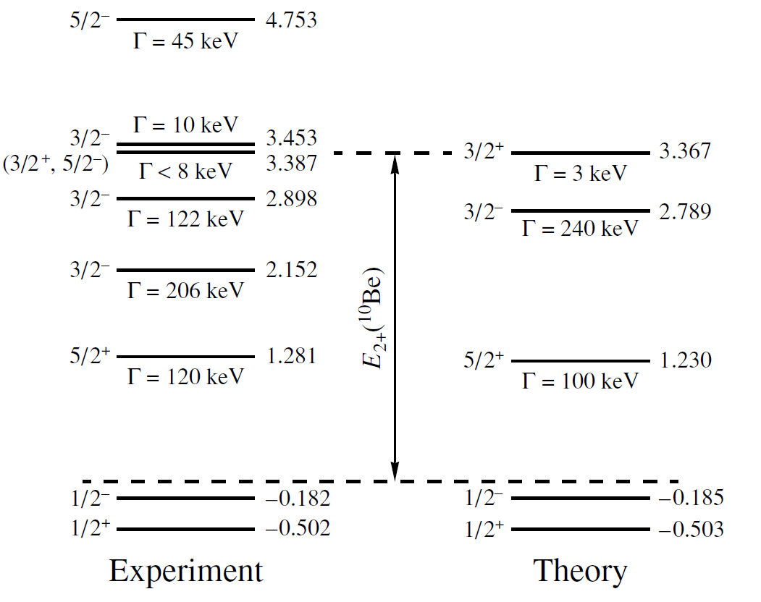
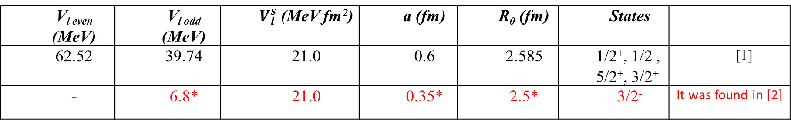
The parametrization of the interaction between the neutron and core
V_{l even} (MeV) | V_{l odd} (MeV) | $V_{l}^{s}$ (MeV fm²) | a (fm) | R₀ (fm) | States
62.52 | 39.74 | 21.0 | 0.6 | 2.585 | 1/2⁺, 1/2⁻, 5/2⁺, 3/2⁺ | [1]
- | 6.8* | 21.0 | 0.35* | 2.5* | 3/2⁻ | It was found in [2]
The energy position of low-lying resonances of ¹¹Be
 | 5/2⁺ | 3/2⁻ | 3/2⁺
 | E, MeV | E, MeV | E, MeV
Theory [3] | 1.230 | 2.789 | 3.367
Exp. [4] | 1.281 | 2.898 | 2.387
[1] P. Capel, G. Goldstein, and D. Baye, Phys. Rev. C 70, 064605 (2004).
[2] Valiolda D., Janseitov D., Melezhik V.S., EPJ A 58(2), 34 (2022).
[3] S.N. Ershov, J.S. Vaagen and M.V. Zhukov, Phys. of Atomic Nucl. 77(8), 989 (2014).
[4] National Nuclear Data Center, https://www.nndc.bnl.gov/
MeV
MeV

Slide 5
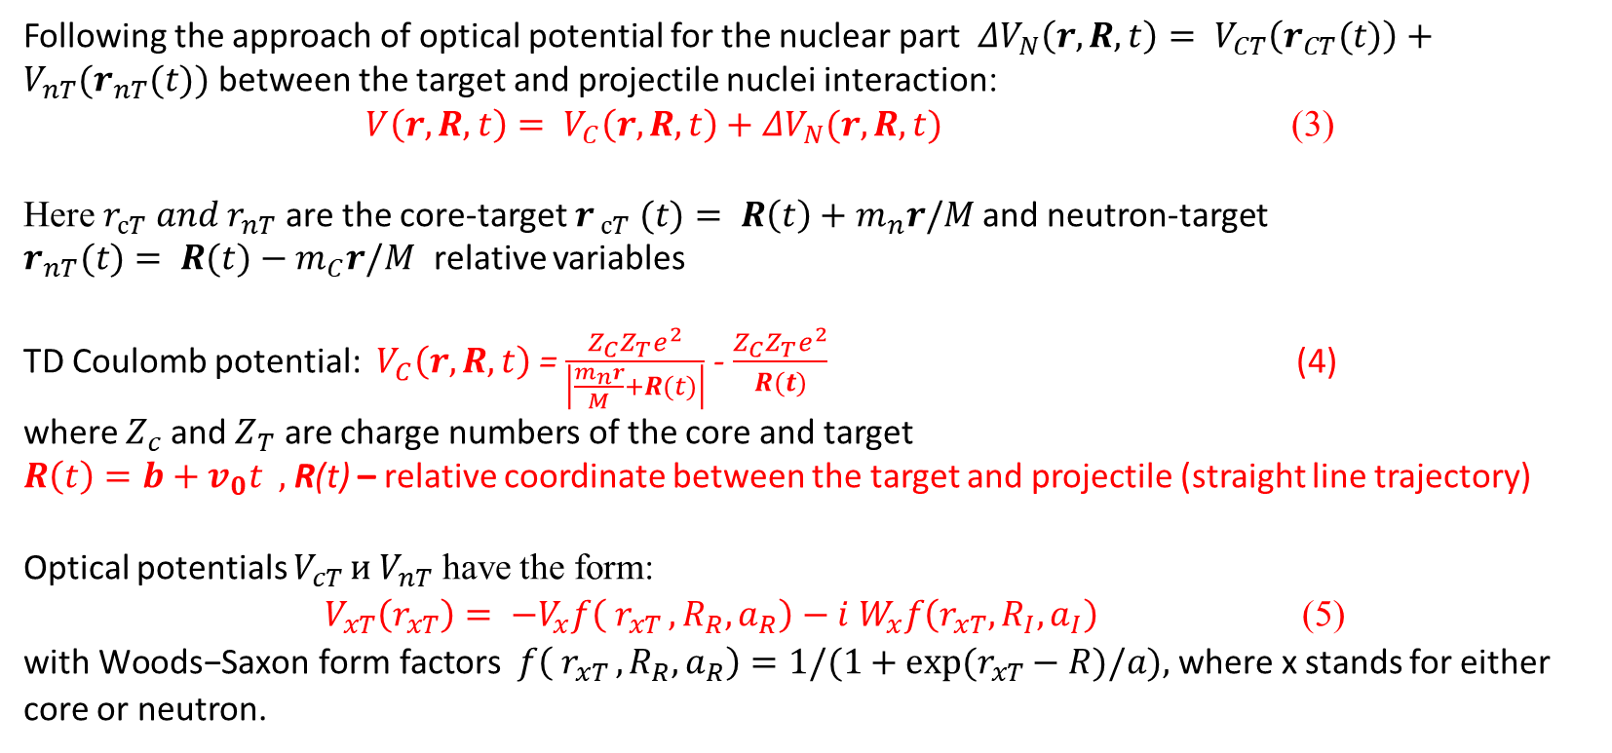
Following the approach of optical potential for the nuclear part$ΔV_{N}\left(r,R,t\right)= V_{CT}\left(r_{CT}(t)\right)+V_{nT}(r_{nT}(t))$ between the target and projectile nuclei interaction:
$V\left(r,R,t\right)= V_{C}\left(r,R,t\right)+ΔV_{N}(r,R,t)$ (3)
Here $r_{сT} and r_{nT}$ are the core-target$r_{ сT} (t)={ R\left(t\right)+m}_{n}r/M$ and neutron-target
$r_{nT}(t)={ R(t)−m}_{C}r/M$ relative variables
TD Coulomb potential: $V_{C}\left(r,R,t\right)$ = $\frac{Z_{C}Z_{T}e^{2}}{\left|\frac{m_{n}r}{M}+R(t)\right|}$ - $\frac{Z_{C}Z_{T}e^{2}}{R(t)}$ (4)
where $Z_{c}$ and $Z_{T}$ are charge numbers of the core and target
$R\left(t\right)=b+v_{0}t ,$R(t) – relative coordinate between the target and projectile (straight line trajectory)
Optical potentials $V_{cT }и V_{nT}$ have the form:
$V_{xT}\left(r_{xT}\right)= −V_{x}f\left( r_{xT }, R_{R}, a_{R}\right)−i W_{x}f\left(r_{xT}, R_{I}, a_{I}\right)$(5)
$\text{with} \text{Woods}\text{−}\text{Saxon} \text{form} \text{factors} f\left( r_{xT }, R_{R}, a_{R}\right)=1/(1+exp⁡(r_{xT}−R)/a),$ where x stands for either core or neutron.
Parameters of the core-target [1] and neutron-target [2] optical potentials at 67 MeV/nucleon for breakup reaction ¹¹Be+¹²C→ ¹⁰Be+n+¹²C
c or n | V_{x} (MeV) | W_{x} (MeV) | R_{R}(fm) | R_{I}(fm) | a_{R}(fm) | a_{I}(fm)
¹⁰Be | 123.0 | 65.0 | 3.33 | 3.47 | 0.80 | 0.80
n | 34.54 | 13.4 | 2.68 | 2.88 | 0.75 | 0.58
[1] J.S. Al-Khalili et al., Phys. Rev. C 55, R1018 (1997).
[2] F.D. Bechetti, G.W. Greenless, Physical Review 182, 1190 (1969).

Slide 6
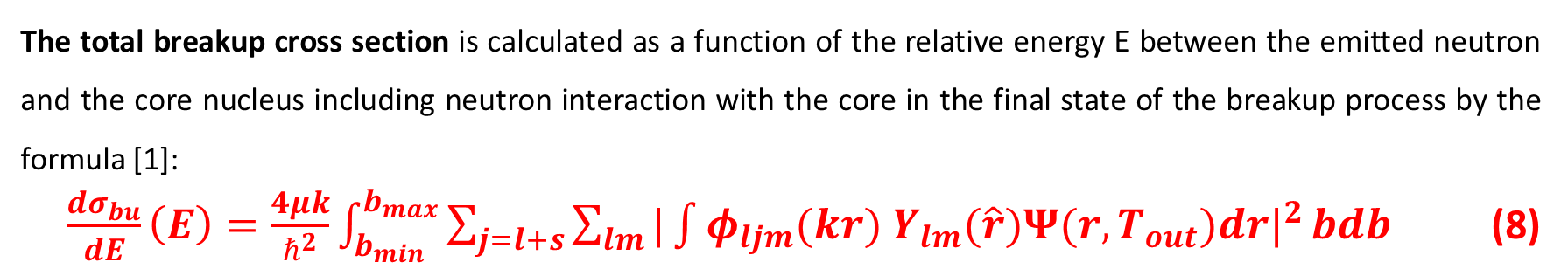
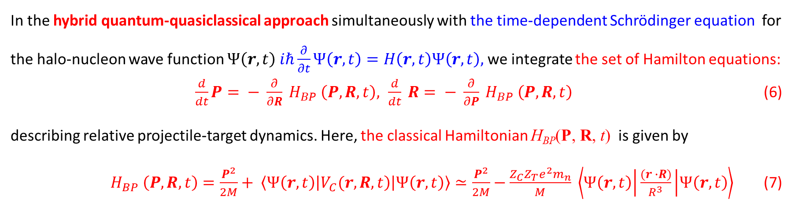
Quantum-quasiclassical approach with “real” trajectories of ¹¹Be
In the hybrid quantum-quasiclassical approach simultaneously with the time-dependent Schrödinger equation for the halo-nucleon wave function $Ψ\left(r,t\right)$ $iℏ\frac{∂}{∂t}Ψ\left(r,t\right)=H\left(r,t\right)Ψ\left(r,t\right),$we integrate the set of Hamilton equations:
$\frac{d}{dt}P= − \frac{∂}{∂R} H_{BP} \left(P,R, t\right), \frac{d}{dt} R= − \frac{∂}{∂P} H_{BP} \left(P,R, t\right)$(6)
describing relative projectile-target dynamics. Here, the classical Hamiltonian H_{BP}(P, R, t) is given by
$H_{BP} \left(P,R, t\right)=\frac{P^{2}}{2M}+ \left\langle Ψ\left(r,t\right) | \left.V_{C}(r,R,t\right) | Ψ\left(r,t\right)\right\rangle ≃\frac{P^{2}}{2M}−\frac{Z_{C}Z_{T}e^{2}m_{n}}{M} \left\langle Ψ\left(r,t\right) | \frac{(r ∙R)}{R^{3}} | Ψ\left(r,t\right)\right\rangle$ (7)
The total breakup cross section is calculated as a function of the relative energy E between the emitted neutron and the core nucleus including neutron interaction with the core in the final state of the breakup process by the formula [1]:
$\frac{dσ_{bu}}{dE}\left(E\right)=\frac{4μk}{ℏ^{2}}\int_{b_{min}}^{b_{max}}{\sum_{j=l+s}{\sum_{lm}{|\int{φ_{ljm}(kr){ Y}_{lm}(\hat{r}){Ψ(r,T_{out})dr|}^{2}}}}}bdb$ (8)
Valiolda D., Janseitov D., Melezhik V.S., EPJ A 58(2), 34 (2022)

Slide 7
Results: breakup cross sections of ¹¹Be on a ¹²C target
The comparison of theoretical [1] and experimental [2] breakup cross sections with results, computed with quantum quasiclassical approach [3], including bound (1/2⁺,1/2⁻) and resonance (5/2⁺, 3/2⁺, 3/2⁻) states of ¹¹Be at 67 MeV/nucleon.
[1] P. Capel, G. Goldstein, D. Baye, Phys. Rev. C 70, 064605 (2004).
[2] N. Fukuda et al., Phys. Rev. C 70, 054606 (2004).
[3] D. Valiolda, D. Janseitov, V.S.Melezhik, Chinese Physics C V.49 5, (2025).

Slide 8
Results: breakup cross sections of ¹¹Be on a ¹²C (²⁰⁸Pb) target
¹¹Be+¹²C → ¹⁰Be+n+¹²C at 67 MeV/nucleon
¹¹Be+²⁰⁸Pb → ¹⁰Be+n+²⁰⁸Pb at 69 MeV/nucleon
The comparison of theoretical [1] and experimental [2] breakup cross sections with results, computed with quantum quasiclassical approach [3], including bound (1/2⁺,1/2⁻) and resonance (5/2⁺, 3/2⁺, 3/2⁻) states of ¹¹Be
Breakup cross sections calculated with straight
line trajectory approach including only bound states (1/2⁺ , 1/2⁻ ), adding one 5/2⁺ , two 3/2⁻ and 5/2⁺ and three resonances (5/2⁺, 3/2⁻, 3/2⁺) of ¹¹Be [4] in comparison with experimental data [5].
[1] P. Capel, G. Goldstein, D. Baye, Phys. Rev. C 70, 064605 (2004).
[2] N. Fukuda et al., Phys. Rev. C 70, 054606 (2004).
[3] D. Valiolda, D. Janseitov, V.S.Melezhik, Chinese Physics C V.49 5, (2025).
[4] Valiolda D., Janseitov D., Melezhik V.S., EPJ A 58(2), 34 (2022)
[5] N. Fukuda, et. al., Phys. Rev. C 70, 054606 (2004).

Slide 9
Investigation of spectral structure of ¹¹Be in breakup reactions
Breakup cross sections of ¹¹Be impinging on light (¹²C) (multiplied by 10) and heavy (²⁰⁸Pb) targets at 5 MeV/nucleon calculated within
quantum-quasiclassical approach
Valiolda D., Janseitov D., Melezhik V.S., Chinese Physics C V.49 (5), 2025,
DOI 10.1088/1674-1137/adb2fb

Slide 10
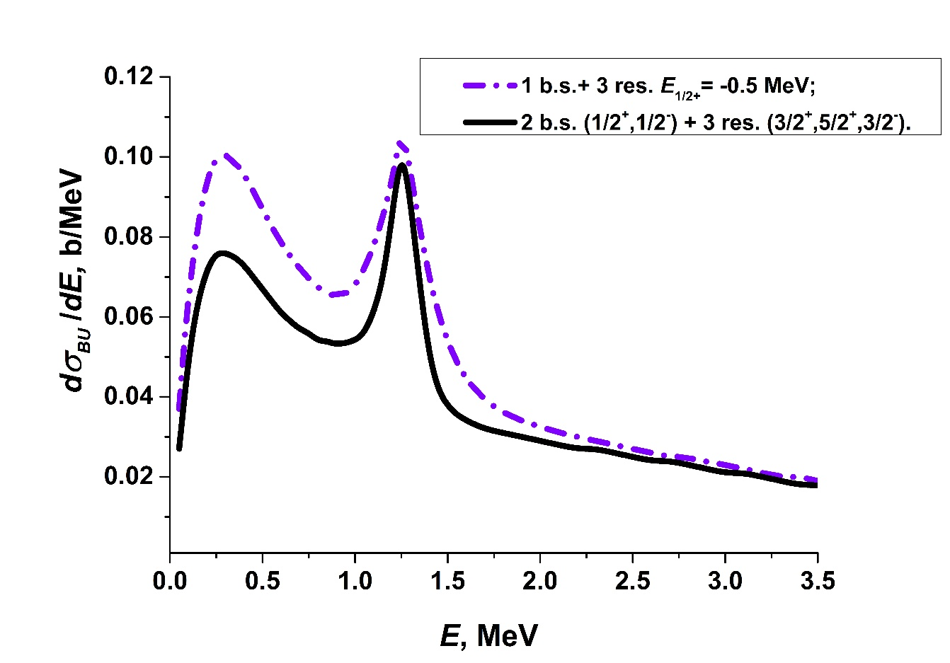
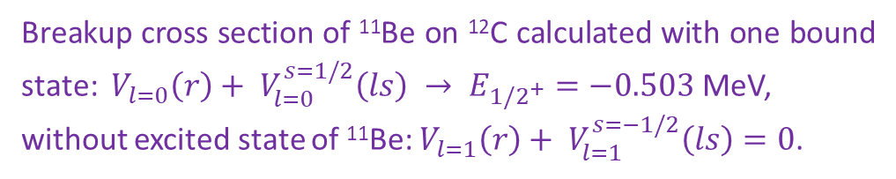
Investigation of spectral structure of ¹¹Be in breakup reactions
Breakup cross sections of ¹¹Be impinging on
light (¹²C) (multiplied by 10) and heavy (²⁰⁸Pb) targets at 5 MeV/nucleon calculated within
quantum-quasiclassical approach
Breakup cross section of ¹¹Be on ¹²C calculated with one bound state: $V_{l=0}\left(r\right)+ V_{l=0}^{s=1/2}\left(ls\right) → E_{{1/2}^{+}}=−0.503$ MeV,
without excited state of ¹¹Be: $V_{l=1}\left(r\right)+ V_{l=1}^{s=−1/2}\left(ls\right)=0$.
Valiolda D., Janseitov D., Melezhik V.S., Chinese Physics C V.49 (5), 2025,
DOI 10.1088/1674-1137/adb2fb

Slide 11
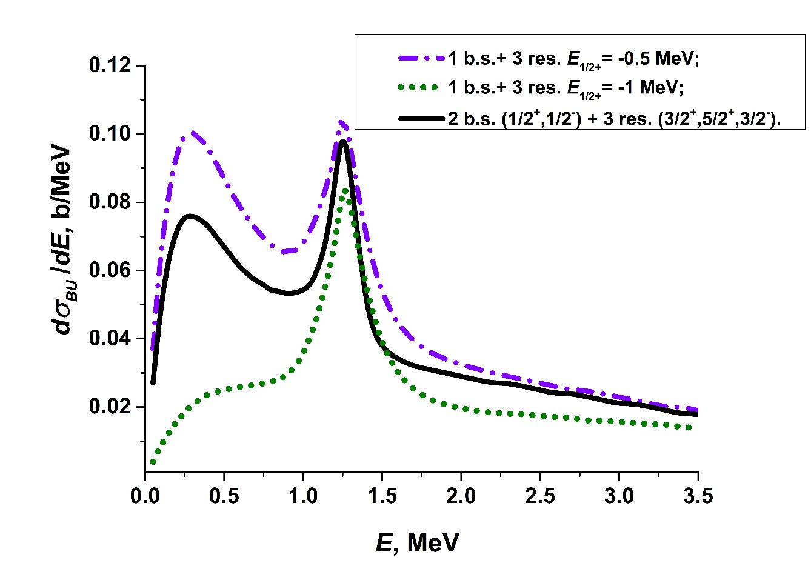
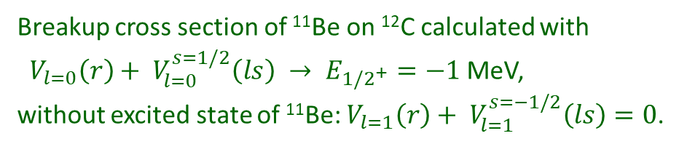
Investigation of spectral structure of ¹¹Be in breakup reactions
Breakup cross sections of ¹¹Be impinging on
light (¹²C) (multiplied by 10) and heavy (²⁰⁸Pb) targets at 5 MeV/nucleon calculated within
quantum-quasiclassical approach
Breakup cross section of ¹¹Be on ¹²C calculated with
$V_{l=0}\left(r\right)+ V_{l=0}^{s=1/2}\left(ls\right) → E_{{1/2}^{+}}=−1$ MeV,
without excited state of ¹¹Be: $V_{l=1}\left(r\right)+ V_{l=1}^{s=−1/2}\left(ls\right)=0$.
Valiolda D., Janseitov D., Melezhik V.S., Chinese Physics C V.49 (5), 2025,
DOI 10.1088/1674-1137/adb2fb

Slide 12
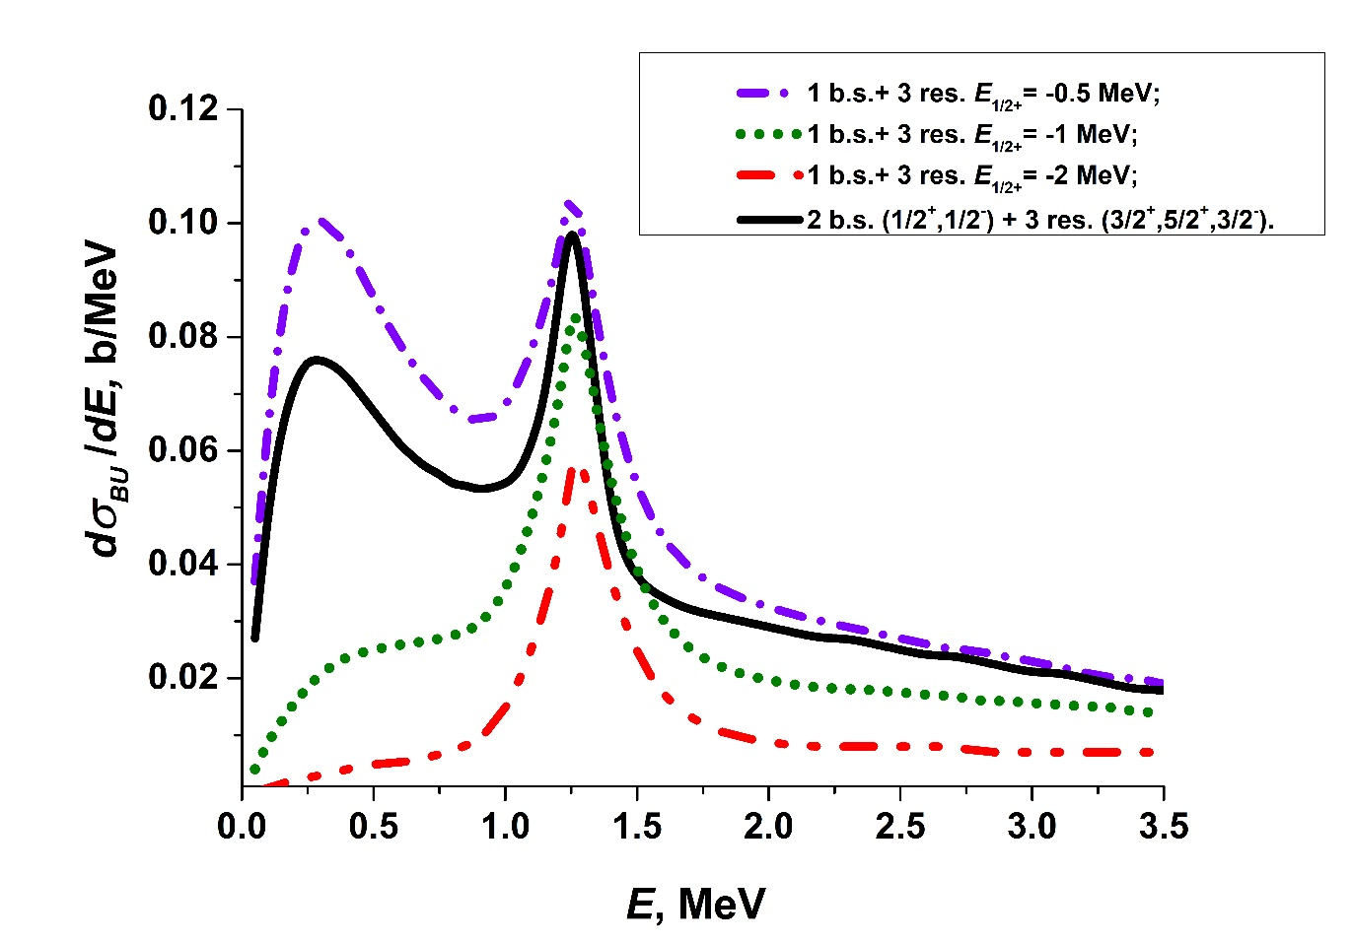
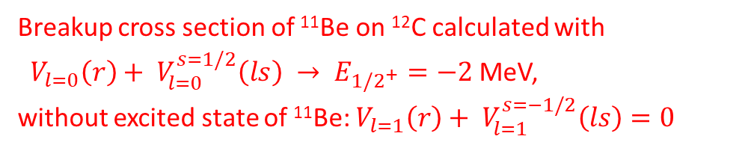
Investigation of spectral structure of ¹¹Be in breakup reactions
Breakup cross sections of ¹¹Be impinging on
light (¹²C) (multiplied by 10) and heavy (²⁰⁸Pb) targets at 5 MeV/nucleon calculated within
quantum-quasiclassical approach
Breakup cross section of ¹¹Be on ¹²C calculated with
$V_{l=0}\left(r\right)+ V_{l=0}^{s=1/2}\left(ls\right) → E_{{1/2}^{+}}=−2$ MeV,
without excited state of ¹¹Be: $V_{l=1}\left(r\right)+ V_{l=1}^{s=−1/2}\left(ls\right)=0$
Valiolda D., Janseitov D., Melezhik V.S., Chinese Physics C V.49 (5), 2025,
DOI 10.1088/1674-1137/adb2fb

Slide 13
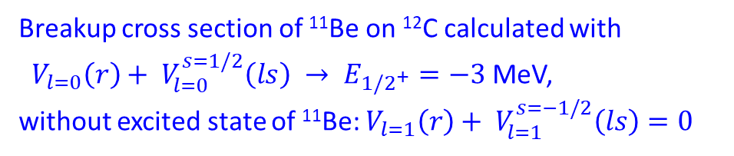
Investigation of spectral structure of ¹¹Be in breakup reactions
Breakup cross sections of ¹¹Be impinging on
light (¹²C) (multiplied by 10) and heavy (²⁰⁸Pb) targets at 5 MeV/nucleon calculated within
quantum-quasiclassical approach
Breakup cross section of ¹¹Be on ¹²C calculated with
$V_{l=0}\left(r\right)+ V_{l=0}^{s=1/2}\left(ls\right) → E_{{1/2}^{+}}=−3$ MeV,
without excited state of ¹¹Be: $V_{l=1}\left(r\right)+ V_{l=1}^{s=−1/2}\left(ls\right)=0$
Valiolda D., Janseitov D., Melezhik V.S., Chinese Physics C V.49 (5), 2025,
DOI 10.1088/1674-1137/adb2fb

Slide 14
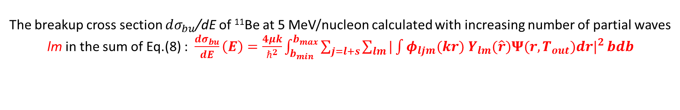
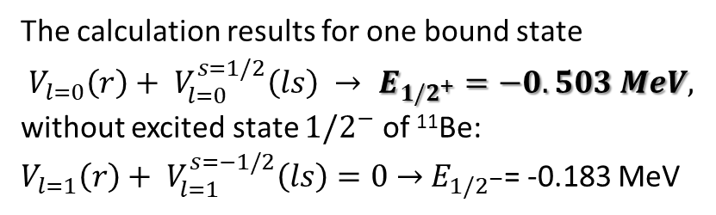
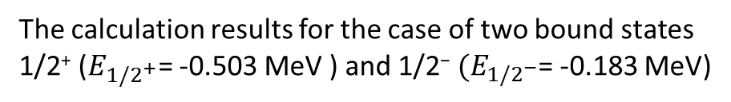
The breakup cross section $dσ_{bu}$/dE of ¹¹Be at 5 MeV/nucleon calculated with increasing number of partial waves lm in the sum of Eq.(8) : $\frac{dσ_{bu}}{dE}\left(E\right)=\frac{4μk}{ℏ^{2}}\int_{b_{min}}^{b_{max}}{\sum_{j=l+s}{\sum_{lm}{|\int{φ_{ljm}(kr){ Y}_{lm}(\hat{r}){Ψ(r,T_{out})dr|}^{2}}}}}bdb$
The calculation results for one bound state
$V_{l=0}\left(r\right)+ V_{l=0}^{s=1/2}\left(ls\right) → E_{{1/2}^{+}}=−0.503 MeV,$
without excited state ${1/2}^{−}$ of ¹¹Be:
$V_{l=1}\left(r\right)+ V_{l=1}^{s=−1/2}\left(ls\right)=0$ $→{ E}_{{1/2}^{−}}$= -0.183 MeV
The calculation results for the case of two bound states 1/2⁺ ($E_{{1/2}^{+}}$= -0.503 MeV ) and 1/2⁻ ${(E}_{{1/2}^{−}}$= -0.183 MeV)
Valiolda D., Janseitov D., Melezhik V.S., Chinese Physics C V.49 (5), 2025, DOI 10.1088/1674-1137/adb2fb

Slide 15
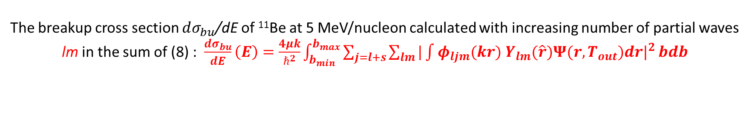
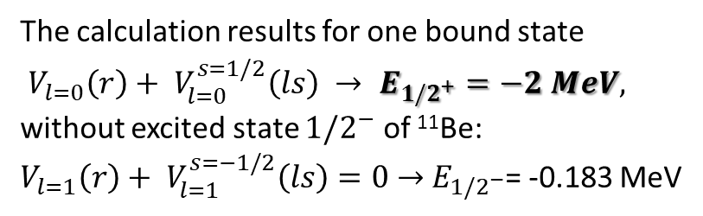
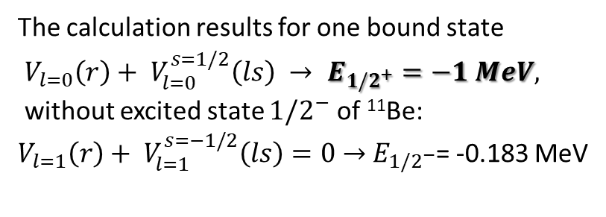
The breakup cross section $dσ_{bu}$/dE of ¹¹Be at 5 MeV/nucleon calculated with increasing number of partial waves lm in the sum of (8) : $\frac{dσ_{bu}}{dE}\left(E\right)=\frac{4μk}{ℏ^{2}}\int_{b_{min}}^{b_{max}}{\sum_{j=l+s}{\sum_{lm}{|\int{φ_{ljm}(kr){ Y}_{lm}(\hat{r}){Ψ(r,T_{out})dr|}^{2}}}}}bdb$
The calculation results for one bound state
$V_{l=0}\left(r\right)+ V_{l=0}^{s=1/2}\left(ls\right) → E_{{1/2}^{+}}=−1 MeV,$
without excited state ${1/2}^{−}$ of ¹¹Be:
$V_{l=1}\left(r\right)+ V_{l=1}^{s=−1/2}\left(ls\right)=0$ $→{ E}_{{1/2}^{−}}$= -0.183 MeV
The calculation results for one bound state
$V_{l=0}\left(r\right)+ V_{l=0}^{s=1/2}\left(ls\right) → E_{{1/2}^{+}}=−2 MeV,$
without excited state ${1/2}^{−}$ of ¹¹Be:
$V_{l=1}\left(r\right)+ V_{l=1}^{s=−1/2}\left(ls\right)=0$ $→{ E}_{{1/2}^{−}}$= -0.183 MeV
Valiolda D., Janseitov D., Melezhik V.S., Chinese Physics C V.49 (5), 2025, DOI 10.1088/1674-1137/adb2fb

Slide 17
Conclusion and further research
In the frame of the quantum-quasiclassical approach we evaluated the breakup cross sections of ¹¹Be on a lead and carbon target at energies 5 – 67 MeV/nucleon. The obtained results are in good agreement with existing experimental data. We have shown that the analysis with quantum-quasiclassical approach allows to investigate spectral properties of ¹¹Be nuclei from the breakup reactions.
Summarizing, the region around 20-10 MeV/nucleon is of great interest, since this is the energy range of HIE-ISOLD at CERN and the future ReA12 at MSU, it has hardly been investigated theoretically so far.
Prospectives:
Including excitation of ¹⁰Be- core;
Including nuclear motion in nuclear photonics: d(γn)p ,⁹Be(γn)2α, ¹¹Be(γn) ¹⁰Be.
The breakup cross section of ¹¹Be on a ¹²C , calculated by quantum-quasiclassical approach at beam energies of 67-5 MeV/nucleon.

Slide 18

Thank you for your attention!

Slide 19
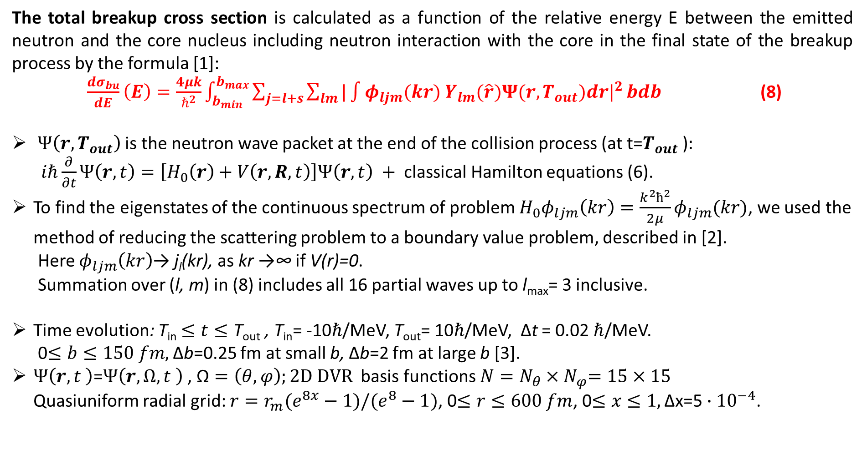
The total breakup cross section is calculated as a function of the relative energy E between the emitted neutron and the core nucleus including neutron interaction with the core in the final state of the breakup process by the formula [1]:
$\frac{dσ_{bu}}{dE}\left(E\right)=\frac{4μk}{ℏ^{2}}\int_{b_{min}}^{b_{max}}{\sum_{j=l+s}{\sum_{lm}{|\int{φ_{ljm}(kr){ Y}_{lm}(\hat{r}){Ψ(r,T_{out})dr|}^{2}}}}}bdb$ (8)
$Ψ\left(r,T_{out}\right)$ is the neutron wave packet at the end of the collision process (at t=$T_{out}$ )$:$
$iℏ\frac{∂}{∂t}Ψ\left(r,t\right)=\left[H_{0}\left(r\right)+V\left(r,R,t\right)\right]Ψ\left(r,t\right) +$ classical Hamilton equations (6).
To find the eigenstates of the continuous spectrum of problem $H_{0}φ_{ljm}\left(kr\right)=\frac{k^{2}ħ^{2}}{2μ}φ_{ljm}(kr)$, we used the method of reducing the scattering problem to a boundary value problem, described in [2].
Here $φ_{ljm}\left(kr\right)$→ j_{l}(kr), as kr →∞ if V(r)=0.
Summation over (l, m) in (8) includes all 16 partial waves up to l_{max}= 3 inclusive.
Time evolution: T_{in} $≤t≤\text{T}\text{out}$ , T_{in}= -10$ℏ$/MeV, T_{out}= 10$ℏ$/MeV, Δt = 0.02$ℏ$/MeV.
0$≤b≤150 fm,$Δb=0.25 fm at small b, Δb=2 fm at large b [3].
$Ψ\left(r,t \right)$=$Ψ\left(r, Ω, t \right)$ , $\text{Ω}=\left(θ,φ\right);2D DVR$ basis functions ${N=N}_{θ}{×N}_{φ}=15×15$
Quasiuniform radial grid: $r=r_{m}(e^{8x}−1)/(e^{8}−1)$, 0$≤r≤600 fm$, 0$≤x≤1,\text{Δ}\text{x}\text{=5}∙{10}^{−4}$.
[1] D. Valiolda, D. Janseitov, V.S. Melezhik, Eur. Phys. Jour. A 58(2), 34 (2022).
[2] V.S. Melezhik, Phys. Lett. A 230, 203 (1997).
[3] D. Valiolda, D. Janseitov, V.S. Melezhik Eurasian Jour. of Phys. and Func. Mater. 7, 155 (2023).

Slide 20
Results: breakup cross sections of ¹¹Be on a ¹²C target
The comparison of breakup cross sections calculated by time-dependent approach with linear trajectories of the projectile and with quantum-quasiclassical approach with realistic trajectories of the projectile
for a beam energies of 5 and 67 MeV/nucleon
Valiolda D., Janseitov D., Melezhik V.S., Chinese Physics C V.49 (5), 2025,
DOI 10.1088/1674-1137/adb2fb

