Slide 1


Low-energy spectra of nobelium isotopes: Skyrme random-phase-approximation analysis
M.A. Mardyban^{1,2}, V. O. Nesterenko^{1,2}, R.V. Jolos^{1,2},
P.-G. Reinhard³, A. Repko⁴, A. A. Dzhioev¹
¹Laboratory of Theoretical Physics, Joint Institute for Nuclear Research, Dubna, Moscow Region 141980, Russia
² Dubna State University, Dubna, Moscow Region 141982, Russia
³ Institut für Theoretische Physik II, Universität Erlangen, D-91058, Erlangen, Germany
⁴Institute of Physics, Slovak Academy of Sciences, 84511 Bratislava, Slovakia
2025

Slide 2
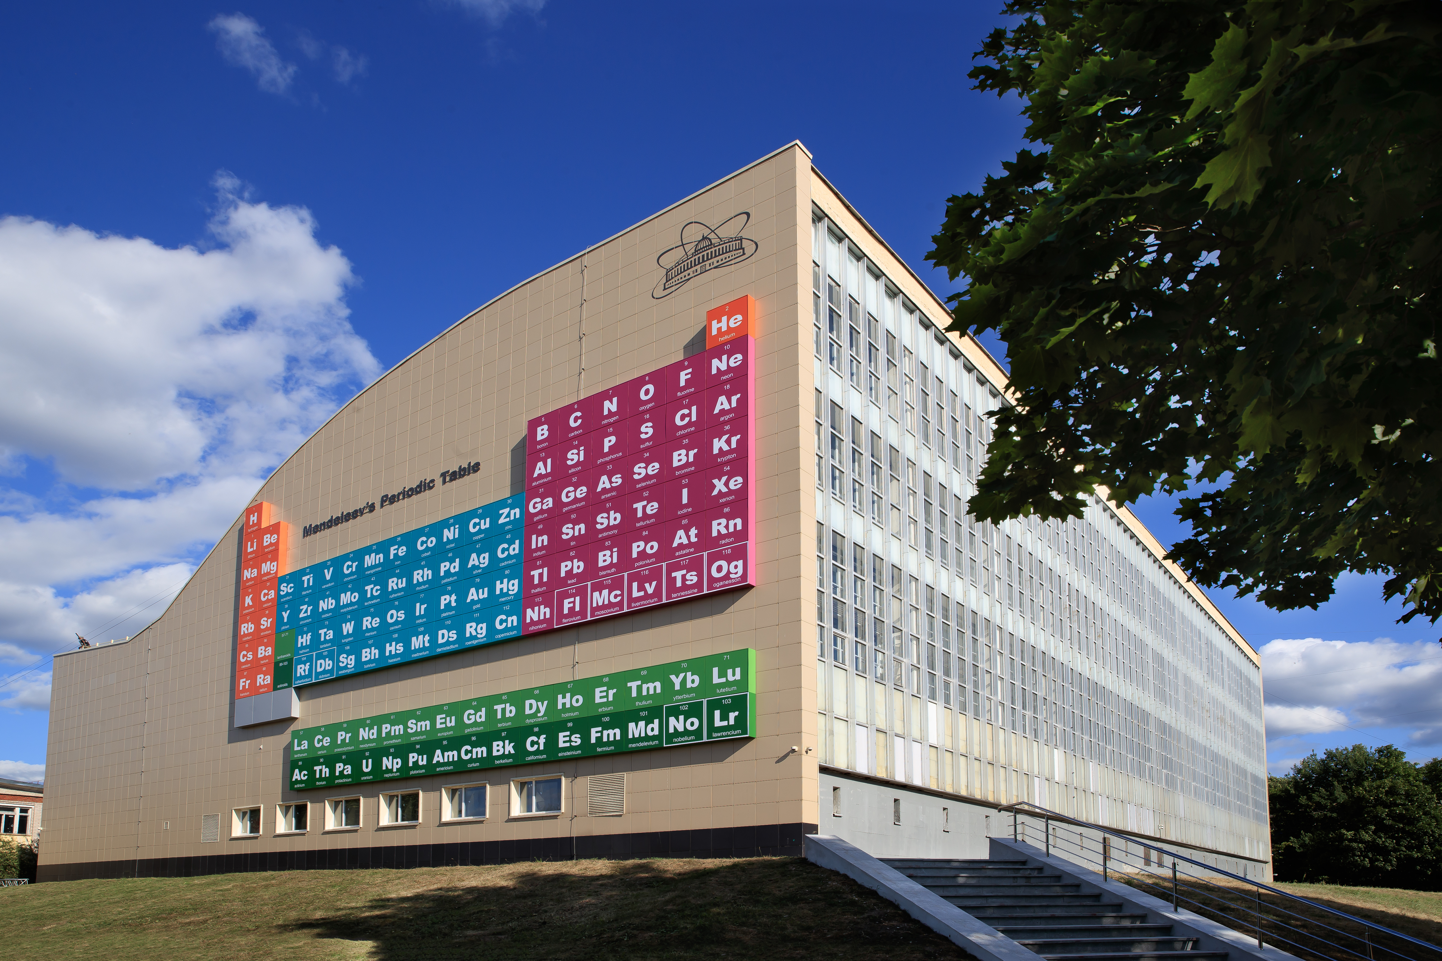
Spectroscopy of superheavy nuclei is hot research area
The largest periodic table in Europe(Dubna)
Perhaps, the most extensive experimental data are collected for transfermium region, in particular for nobelium isotopes

Slide 3
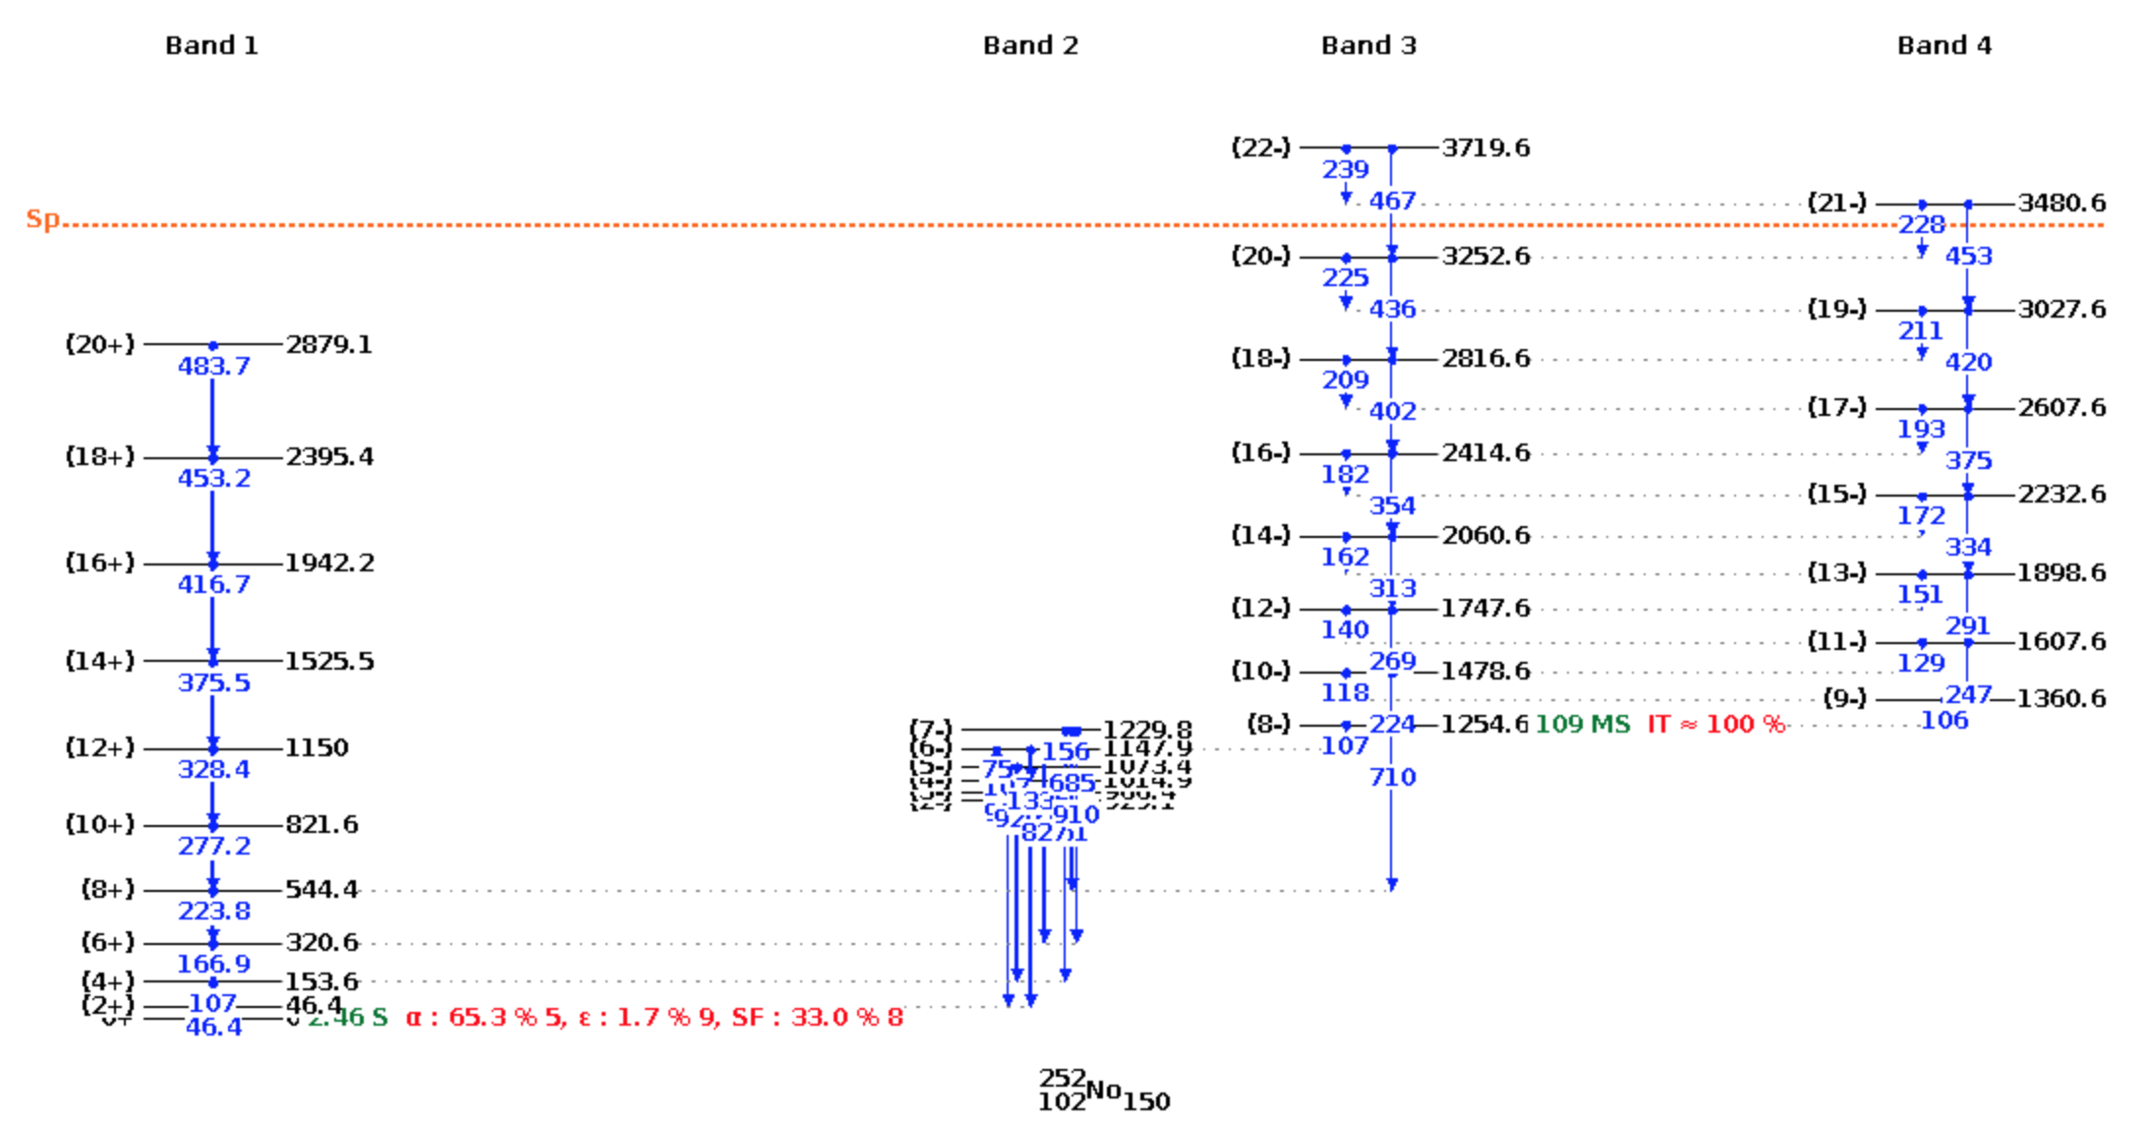
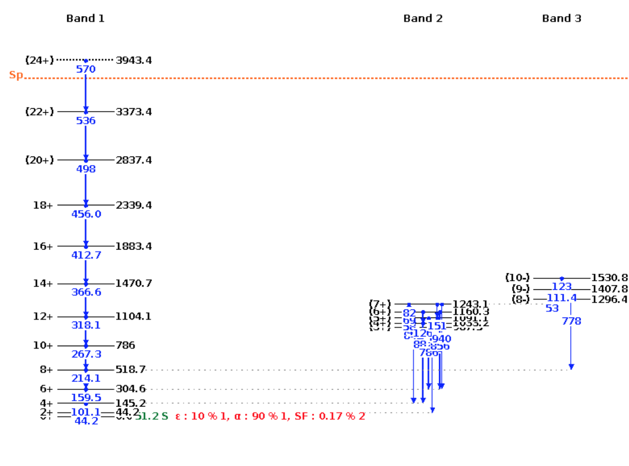
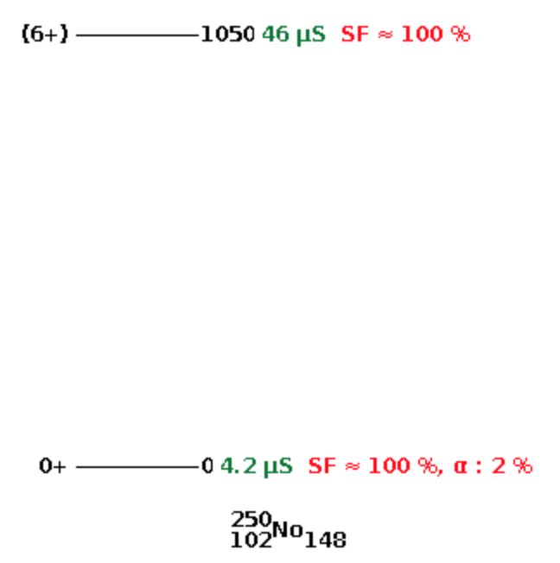

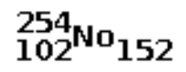
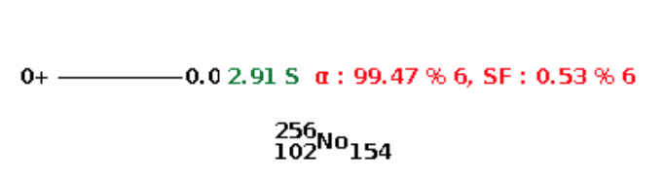
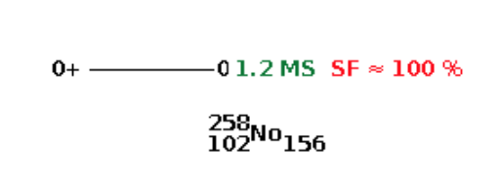
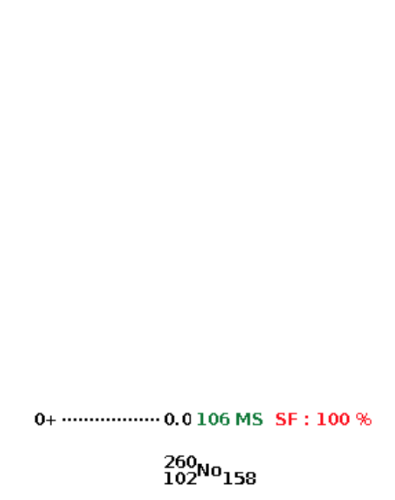
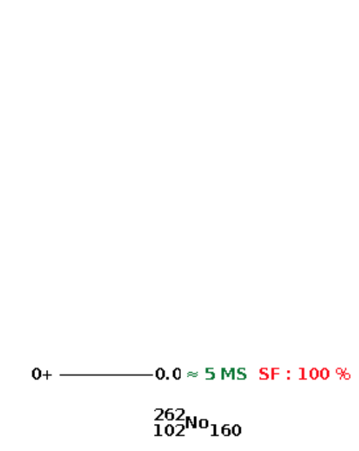
At the moment, there are experimental* spectroscopic data only for 3/7 nuclei: ^{250,252,254}No
>> | >
* NNDC data base

Slide 4
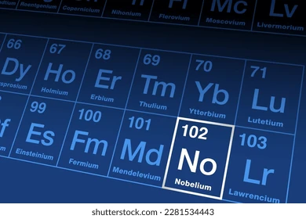
The chain of even-even Nobelium nuclei is one of the most studied superheavy nuclei:
The low-lying spectrum of ^{250,252,254}No;
Quadrupole moment of ^{252,254}No
Dipole giant resonance in ^{252,254}No;
The scissors mode of ²⁵⁰⁻²⁵⁶No;
Single-particle properties
and rotational bands in the ^{252,254}No;
Spontaneous fission for the nuclei ²⁵⁰⁻²⁶⁰No
But, despite the great interest in these nuclei, the characteristics
of the ground state of these isotopes are still poorly studied…

Slide 5
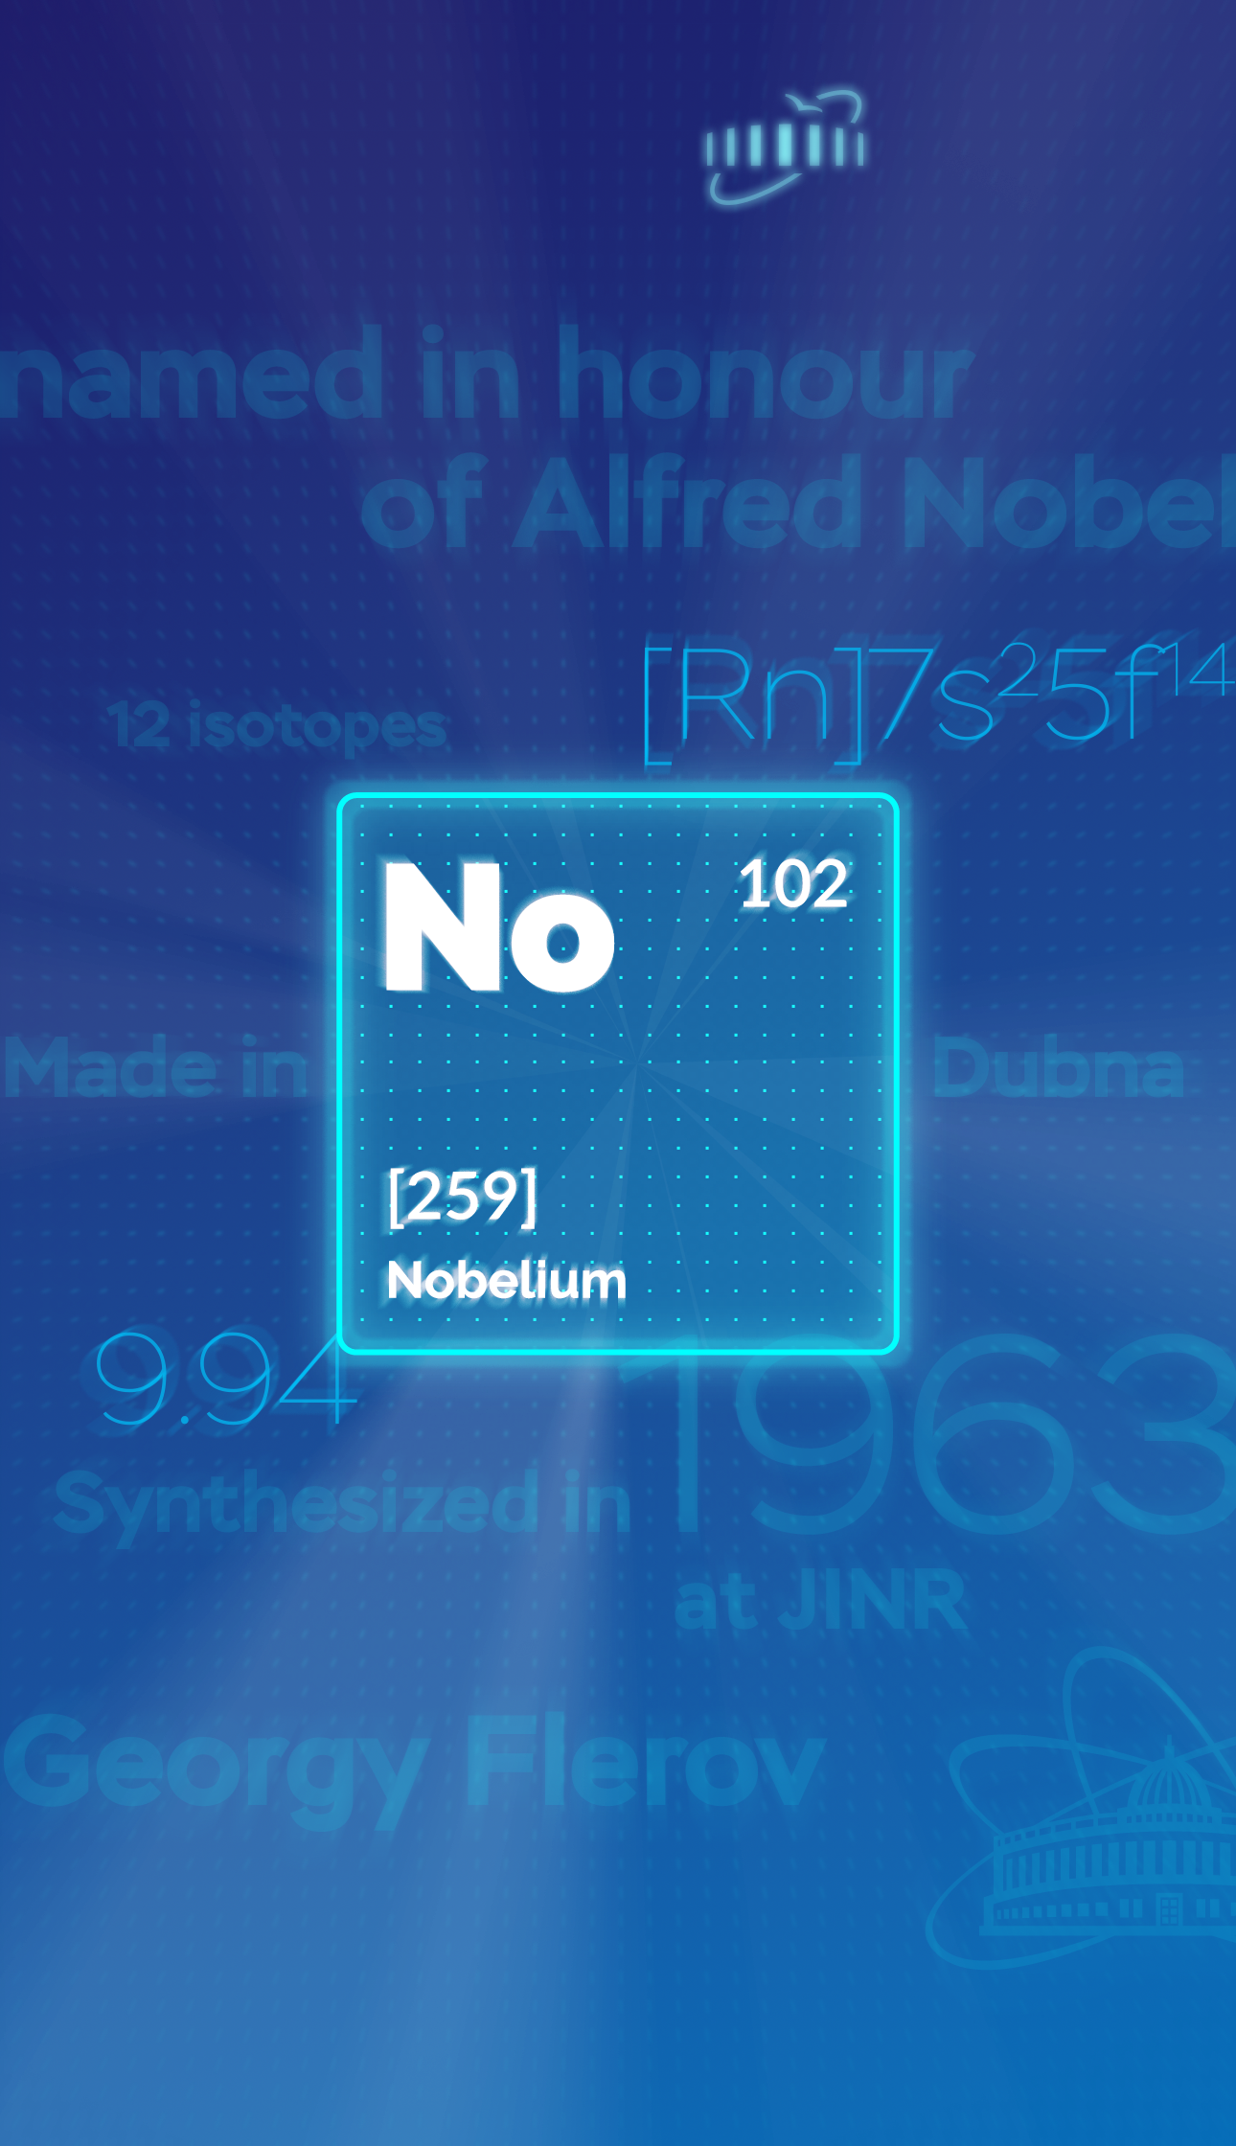
Despite an impressive theoretical effort:
Even modern self-consistent models still
give rather different results and exhibit troubles in description of shell structures and other features seen in experiment
This work was partly done within QPM, IBM, double nuclear system, and cluster models
(however, the above models are not self-consistent)
It is worth to enlarge the scope of calculated characteristics of superheavy nuclei and inspect, within the same self-consistent theory,
a full set of low-energy vibrational states of main multipolarities:
K^{π} = 0⁺, 2⁺, 3⁺, 0⁻, 1⁻, 2⁻, 8⁻

Slide 6
The main attention is paid to ^{252,254}No where calculated:
K^{π}= 8⁻ isomers
(at 1.361 MeV in ²⁵²No and 1.747 MeV in ²⁵⁴No)
Pairing vibrations K^{π} = 0⁺
States K^{π}=2⁺
Hexadecapole states with K^{π} = 3⁺ and 4⁺
Octupole states with K^{π} = 0⁻, 1⁻, 2⁻ and 3⁻

Slide 7
The main attention is paid to ^{252,254}No where calculated:
K^{π}= 8⁻ isomers
(at 1.361 MeV in ²⁵²No and 1.747 MeV in ²⁵⁴No)
Pairing vibrations K^{π} = 0⁺
States K^{π}=2⁺
Hexadecapole states with K^{π} = 3⁺ and 4⁺
Octupole states with K^{π} = 0⁻, 1⁻, 2⁻ and 3⁻

Slide 8
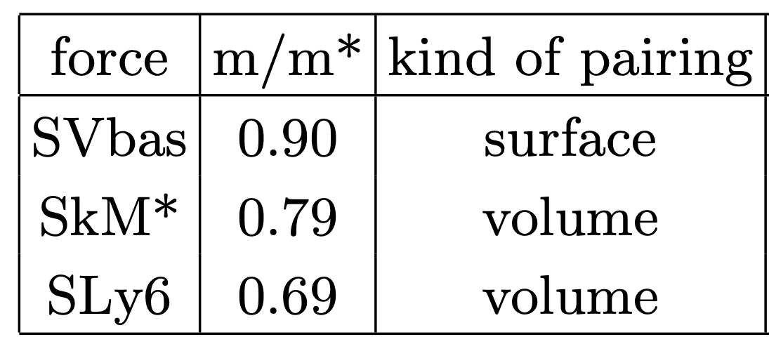
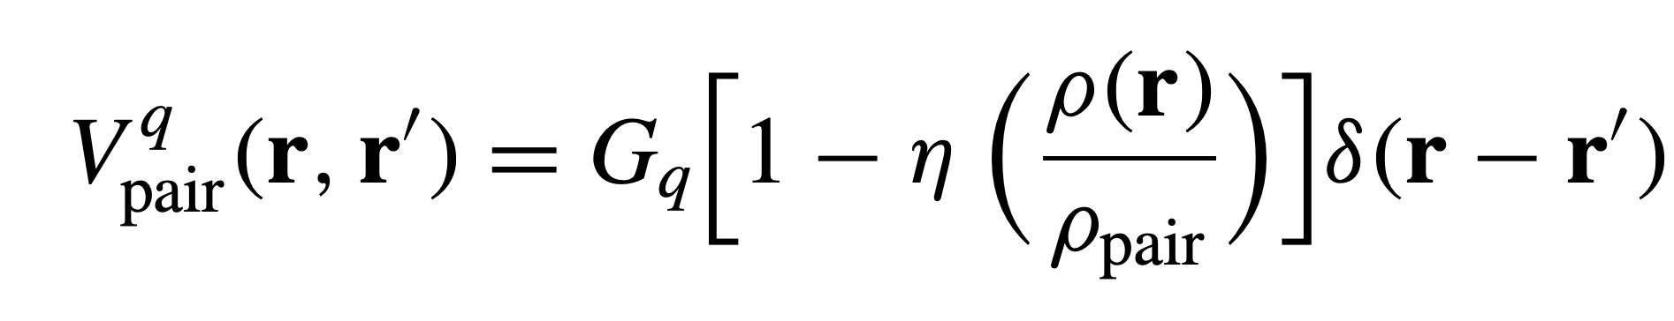
Skyrme forces
[P. Klupfel et al, PRC 79 034310 (2009)]
[J. Bartel et al, NPA 386, 79 (1982)]
[E. Chabanat et al, NPA, 635 231 (1998)]
Where Gq are pairing strength constants (q = p,n).
We get so-called density-dependent surface pairing for η = 1 and
volume pairing for η = 0
Calculation details:
Codes – SkyAx [P.-G. Reinhard et al, Comp. Phys. Communic. 258, 107603 (2021)]
QRPA [A. Repko et al, arXiv:1510.01248 (nucl-th), 2015]
Accurate extraction of spurious admixtures
[V. O. Nesterenko et al, Eur. Phys. J. A 55, 213 (2019)]
2D grid in cylindric coordinates
All proton and neutron s-p levels up to +40 MeV

Slide 9

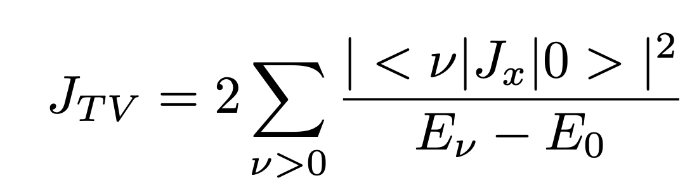

The characteristics of the ground states of ²⁵⁰⁻²⁶²No
with increasing number neutrons
Initially it was assumed that these characteristics would evolve monotonically, but we see irregularity at ^{252, 254}No
SLy6

Slide 10
The characteristics of the ground states of ²⁵⁰⁻²⁶²No
with increasing number neutrons
Initially it was assumed that these characteristics would evolve monotonically, but we see irregularity at ^{252, 254}No
SLy6

Slide 11
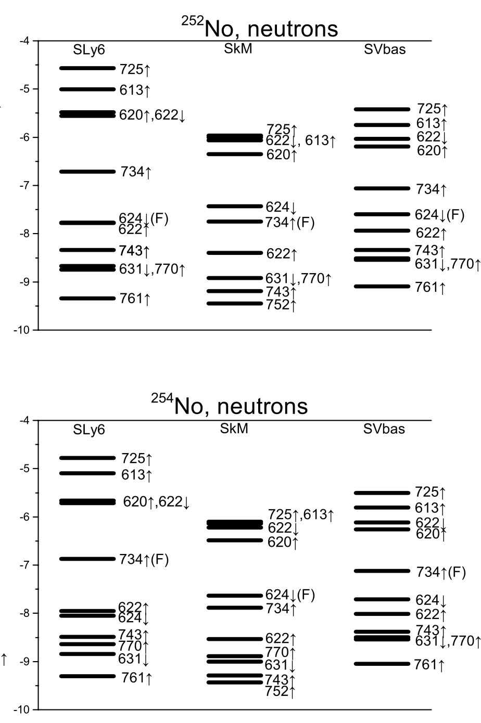
Does this irregularity (decline in neutron pairing)
depend on the chosen Skyrme force?
SLy6
SVbas
SkM
SLy6
SVbas
SkM
All 3 Skyrme forces support this irregularity;
For ²⁵⁴No the Fermi level isolated, so neutron pairing almost disappears;
For ²⁵²No the Fermi level is also quite far from neighboring levels, so pairing is also poorly developed

Slide 12
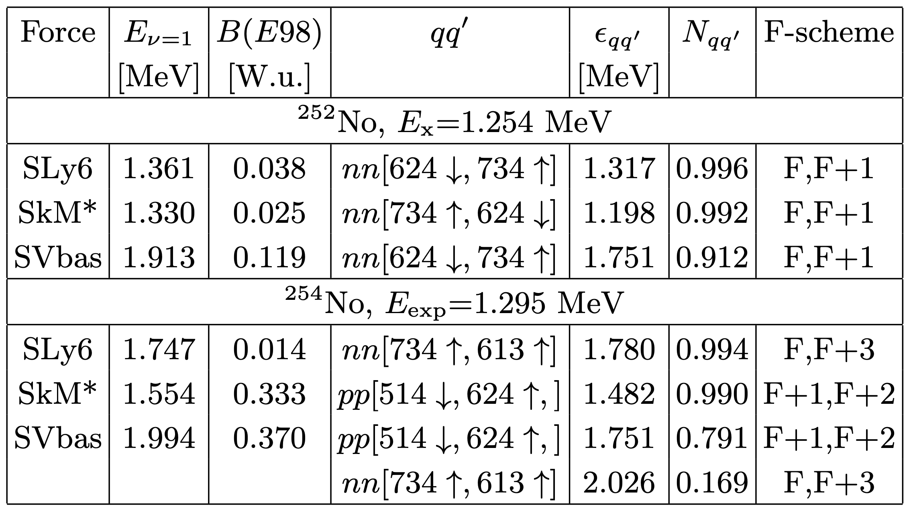
K^{π}= 8⁻ isomers
²⁵²No: the 8⁻ state is usually assigned as neutron 2qp configuration
nn[734 ↑, 624 ↓]
R.-D. Herzberg and P.T. Greenlees, Prog. Part. Nucl. Phys. 61, 674 (2008)
F.P. Heßberger, arXiv:2309.10468v2[nucl-ex].
B. Sulignano et al, Eur. Phys. J. A 33, 327 (2007).
Features of calculated 8⁻ states in ^{252,254}No:
QRPA excitation energies E_{ν} =1,
reduced transition probabilities B(E98),
the main 2qp component qq′, its energy ε_{qq′} , contribution to the state norm N_{qq′} and F-scheme of 2qp excitation.

Slide 13
K^{π}= 8⁻ isomers
²⁵²No: the 8⁻ state is usually assigned as neutron 2qp configuration
nn[734 ↑, 624 ↓]
R.-D. Herzberg and P.T. Greenlees, Prog. Part. Nucl. Phys. 61, 674 (2008)
F.P. Heßberger, arXiv:2309.10468v2[nucl-ex].
B. Sulignano et al, Eur. Phys. J. A 33, 327 (2007).
²⁵⁴No: forces predict different 2qp configurations
nn[734 ↑, 613 ↓] and pp[514 ↓, 624 ↑]
V.G. Soloviev, A.V. Sushkov, A.Yu. Shirikova, Sov. J. Nucl. Phys. 54, 748 (1991)
R.M. Clark et al, Phys. Lett. B690, 19 (2010)
R.V. Jolos, L.A. Malov, N.Yu. Shirikova and A.V. Sushkov, J. Phys. G: Nucl. Part. Phys. 38, 115103 (2011).
Xiao-Tao He, Shu-Young Zhao, Zhen-Hua Zhang and Zhong-Zhou Ren, Chines Physics C 44, 034106 (2020)
G.G. Adamian, N.V. Antonenko, anf W. Scheid, Phys. Rev. C 81, 024320 (2010)
F.P. Hessberger et al, Eur. Phys. J A43, 55 (2010)
Features of calculated 8⁻ states in ^{252,254}No:
QRPA excitation energies E_{ν} =1,
reduced transition probabilities B(E98),
the main 2qp component qq′, its energy ε_{qq′} , contribution to the state norm N_{qq′} and F-scheme of 2qp excitation.

Slide 14
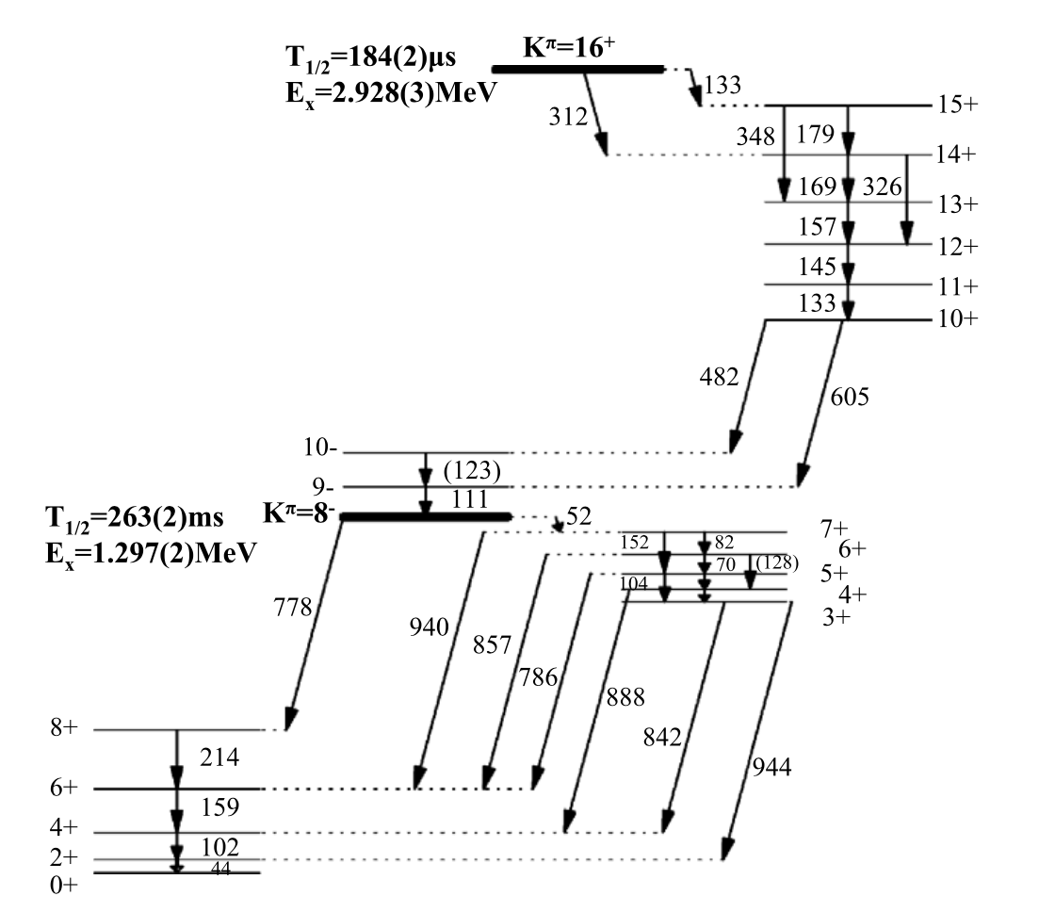
K^{π}= 8⁻ isomers
²⁵²No: the 8⁻ state is usually assigned as neutron 2qp configuration
nn[734 ↑, 624 ↓]
R.-D. Herzberg and P.T. Greenlees, Prog. Part. Nucl. Phys. 61, 674 (2008)
F.P. Heßberger, arXiv:2309.10468v2[nucl-ex].
B. Sulignano et al, Eur. Phys. J. A 33, 327 (2007).
²⁵⁴No: forces predict different 2qp configurations
nn[734 ↑, 613 ↓] and pp[514 ↓, 624 ↑]
V.G. Soloviev, A.V. Sushkov, A.Yu. Shirikova, Sov. J. Nucl. Phys. 54, 748 (1991)
R.M. Clark et al, Phys. Lett. B690, 19 (2010)
R.V. Jolos, L.A. Malov, N.Yu. Shirikova and A.V. Sushkov, J. Phys. G: Nucl. Part. Phys. 38, 115103 (2011).
Xiao-Tao He, Shu-Young Zhao, Zhen-Hua Zhang and Zhong-Zhou Ren, Chines Physics C 44, 034106 (2020)
G.G. Adamian, N.V. Antonenko, anf W. Scheid, Phys. Rev. C 81, 024320 (2010)
F.P. Hessberger et al, Eur. Phys. J A43, 55 (2010)
Features of calculated 8− states in ^{252,254}No:
QRPA excitation energies E_{ν} =1,
reduced transition probabilities B(E98),
the main 2qp component qq′, its energy ε_{qq′} , contribution to the state norm N_{qq′} and F-scheme of 2qp excitation.
R.M. Clark et al, Phys. Lett. B690, 19 (2010)

Slide 15
K^{π}= 8⁻ isomers
²⁵²No: the 8⁻ state is usually assigned as neutron 2qp configuration
nn[734 ↑, 624 ↓]
R.-D. Herzberg and P.T. Greenlees, Prog. Part. Nucl. Phys. 61, 674 (2008)
F.P. Heßberger, arXiv:2309.10468v2[nucl-ex].
B. Sulignano et al, Eur. Phys. J. A 33, 327 (2007).
Look more reasonable for us
since they are argued by the measured γ-decay
from the neutron isomer K^{π} = 10⁺
[nn(734 ↑, 725 ↑)]
²⁵⁴No: forces predict different 2qp configurations
nn[734 ↑, 613 ↓] and pp[514 ↓, 624 ↑]
[nn(734 ↑, 725 ↑)]
V.G. Soloviev, A.V. Sushkov, A.Yu. Shirikova, Sov. J. Nucl. Phys. 54, 748 (1991)
R.M. Clark et al, Phys. Lett. B690, 19 (2010)
R.V. Jolos, L.A. Malov, N.Yu. Shirikova and A.V. Sushkov, J. Phys. G: Nucl. Part. Phys. 38, 115103 (2011).
Xiao-Tao He, Shu-Young Zhao, Zhen-Hua Zhang and Zhong-Zhou Ren, Chines Physics C 44, 034106 (2020)
G.G. Adamian, N.V. Antonenko, anf W. Scheid, Phys. Rev. C 81, 024320 (2010)
F.P. Hessberger et al, Eur. Phys. J A43, 55 (2010)
Features of calculated 8− states in ^{252,254}No:
QRPA excitation energies E_{ν} =1,
reduced transition probabilities B(E98),
the main 2qp component qq′, its energy ε_{qq′} , contribution to the state norm N_{qq′} and F-scheme of 2qp excitation.
R.M. Clark et al, Phys. Lett. B690, 19 (2010)

Slide 16
K^{π}= 8⁻ isomers
²⁵²No: the 8⁻ state is usually assigned as neutron 2qp configuration
nn[734 ↑, 624 ↓]
R.-D. Herzberg and P.T. Greenlees, Prog. Part. Nucl. Phys. 61, 674 (2008)
F.P. Heßberger, arXiv:2309.10468v2[nucl-ex].
B. Sulignano et al, Eur. Phys. J. A 33, 327 (2007).
Look more reasonable for us
since they are argued by the measured γ-decay
from the neutron isomer K^{π} = 10⁺
[nn(734 ↑, 725 ↑)]
²⁵⁴No: forces predict different 2qp configurations
nn[734 ↑, 613 ↓] and pp[514 ↓, 624 ↑]
[nn(734 ↑, 725 ↑)]
V.G. Soloviev, A.V. Sushkov, A.Yu. Shirikova, Sov. J. Nucl. Phys. 54, 748 (1991)
R.M. Clark et al, Phys. Lett. B690, 19 (2010)
V.O. Nesterenko,
M.A. Mardyban, A. Repko,
R.V. Jolos, P.-G. Reinhard
and A.A. Dzhioev
R.V. Jolos, L.A. Malov, N.Yu. Shirikova and A.V. Sushkov, J. Phys. G: Nucl. Part. Phys. 38, 115103 (2011).
Xiao-Tao He, Shu-Young Zhao, Zhen-Hua Zhang and Zhong-Zhou Ren, Chines Physics C 44, 034106 (2020)
G.G. Adamian, N.V. Antonenko, anf W. Scheid, Phys. Rev. C 81, 024320 (2010)
F.P. Hessberger et al, Eur. Phys. J A43, 55 (2010)
Features of calculated 8− states in ^{252,254}No:
QRPA excitation energies E_{ν} =1,
reduced transition probabilities B(E98),
the main 2qp component qq′, its energy ε_{qq′} , contribution to the state norm N_{qq′} and F-scheme of 2qp excitation.
R.M. Clark et al, Phys. Lett. B690, 19 (2010)

Slide 17
Pairing vibrations K^{π} = 0⁺
²⁵² No:
Force | E (MeV) | B(E20) (W.u.) | qq’
SLy6 | 0.774 | 0.02 | nn[734↑, 734↑]
SkM* | 0.838 | 1.12 | pp[521↓, 521↓]
SVbas | 1.249 | 6.41 | pp[514↓, 514↓]
²⁵⁴ No:
Force | E (MeV) | B(E20) (W.u.) | qq’
SLy6 | 0.224 | 0.002 | nn[734↑, 734↑]
SkM* | 0.767 | 0.17 | nn[624↓, 624↓]
SVbas | 1.236 | 6.36 | pp[514↓, 514↓]
Recent shell-model calculations with the projection after variation
also predicts K^{π} = 0⁺ state with E=0.86 MeV as the lowest non-rotational state of ²⁵⁴No
[D.D. Dao and F. Nowacki, Phys. Rev. C 105, 054314 (2022)]
[M. Forge et al., J. Phys.: Conf. Ser. 2586 012083 (2023)]
also predicts K^{π} = 0⁺ state with E=0.89 MeV
(shape coexistence and superdeformations)
So, excited 0+ states below 1 MeV in superheavy nuclei are quite possible

Slide 18
At the moment, there are experimental* spectroscopic data only for 3/7 nuclei: ^{250,252,254}No
>> | >
* NNDC data base

Slide 19
Pairing vibrations K^{π} = 0⁺
²⁵² No:
Force | E (MeV) | B(E20) (W.u.) | qq’
SLy6 | 0.774 | 0.02 | nn[734↑, 734↑]
SkM* | 0.838 | 1.12 | pp[521↓, 521↓]
SVbas | 1.249 | 6.41 | pp[514↓, 514↓]
²⁵⁴ No:
Force | E (MeV) | B(E20) (W.u.) | qq’
SLy6 | 0.224 | 0.002 | nn[734↑, 734↑]
SkM* | 0.767 | 0.17 | nn[624↓, 624↓]
SVbas | 1.236 | 6.36 | pp[514↓, 514↓]
Recent shell-model calculations with the projection after variation
also predicts K^{π} = 0⁺ state with E=0.86 MeV as the lowest non-rotational state of ²⁵⁴No
[D.D. Dao and F. Nowacki, Phys. Rev. C 105, 054314 (2022)]
[M. Forge et al., J. Phys.: Conf. Ser. 2586 012083 (2023)]
also predicts K^{π} = 0⁺ state with E=0.89 MeV
(shape coexistence and superdeformations)
So, excited 0+ states below 1 MeV in superheavy nuclei are quite possible

Slide 20
Hexadecapole states with K^{π} = 3⁺ and 4⁺
²⁵²No
3⁺: 3⁺:
Force | E (MeV) | B(E43) (W.u.) | qq’
SLy6 | 1.10 | 3.04 | pp[521↓, 514↓]
SkM* | 1.00 | 3.61 | pp[521↓, 514↓]
SVbas | 1.19 | 2.73 | pp[521↓, 514↓]
4⁺: 4⁺:
SLy6 | 1.16 | 5.5*10⁻⁴ | pp[521↓, 514↓]
SkM* | 1.00 | 3.61 | pp[521↓, 514↓]
SVbas | 1.19 | 2.73 | pp[521↓, 514↓]
All the forces predict for this state the proton 2qp configuration pp[521 ↓, 514 ↓]
The calculated 4+ states in ^{252,254}No have the energies and structure
very similar to 3⁺ states.
This is not surprising since both kinds of states are basically formed by the same proton
2qp configuration pp[521↓, 514↓] with |K1 − K2|=3 and K1 + K2=4.

Slide 21
Hexadecapole states with K^{π} = 3⁺ and 4⁺
²⁵²No
²⁵⁴No
3⁺: 3⁺:
Force | E (MeV) | B(E43) (W.u.) | qq’
SLy6 | 1.10 | 3.04 | pp[521↓, 514↓]
SkM* | 1.00 | 3.61 | pp[521↓, 514↓]
SVbas | 1.19 | 2.73 | pp[521↓, 514↓]
Force | E (MeV) | B(E43) (W.u.) | qq’
SLy6 | 1.11 | 2.41 | pp[521↓, 514↓]
SkM* | 1.01 | 3.24 | pp[521↓, 514↓]
SVbas | 1.17 | 3.00 | pp[521↓, 514↓]
4⁺: 4⁺:
SLy6 | 1.16 | 5.5*10⁻⁴ | pp[521↓, 514↓]
SkM* | 1.00 | 3.61 | pp[521↓, 514↓]
SVbas | 1.19 | 2.73 | pp[521↓, 514↓]
SLy6 | 1.16 | 0.07 | pp[521↓, 514↓]
SkM* | 1.01 | 3.24 | pp[521↓, 514↓]
SVbas | 1.17 | 3.00 | pp[521↓, 514↓]
All the forces predict for this state the proton 2qp configuration pp[521 ↓, 514 ↓]
The calculated 4+ states in ^{252,254}No have the energies and structure
very similar to 3⁺ states.
This is not surprising since both kinds of states are basically formed by the same proton
2qp configuration pp[521↓, 514↓] with |K1 − K2|=3 and K1 + K2=4.

Slide 22
Hexadecapole states with K^{π} = 3⁺ and 4⁺
²⁵²No
²⁵⁴No
Eexp=0.987 MeV
3⁺: 3⁺:
Force | E (MeV) | B(E43) (W.u.) | qq’
SLy6 | 1.10 | 3.04 | pp[521↓, 514↓]
SkM* | 1.00 | 3.61 | pp[521↓, 514↓]
SVbas | 1.19 | 2.73 | pp[521↓, 514↓]
Force | E (MeV) | B(E43) (W.u.) | qq’
SLy6 | 1.11 | 2.41 | pp[521↓, 514↓]
SkM* | 1.01 | 3.24 | pp[521↓, 514↓]
SVbas | 1.17 | 3.00 | pp[521↓, 514↓]
4⁺: 4⁺:
SLy6 | 1.16 | 5.5*10⁻⁴ | pp[521↓, 514↓]
SkM* | 1.00 | 3.61 | pp[521↓, 514↓]
SVbas | 1.19 | 2.73 | pp[521↓, 514↓]
SLy6 | 1.16 | 0.07 | pp[521↓, 514↓]
SkM* | 1.01 | 3.24 | pp[521↓, 514↓]
SVbas | 1.17 | 3.00 | pp[521↓, 514↓]
All the forces predict for this state the proton 2qp configuration pp[521 ↓, 514 ↓]
The calculated 4+ states in ^{252,254}No have the energies and structure
very similar to 3⁺ states.
This is not surprising since both kinds of states are basically formed by the same proton
2qp configuration pp[521↓, 514↓] with |K1 − K2|=3 and K1 + K2=4.

Slide 23
Octupole states with K^{π} = 0⁻, 1⁻, 2⁻ and 3⁻ (SLy6)
In agreement with the experimental analysis, all three Skyrme forces
suggest for the first 2⁻ state in ²⁵²No -→ nn[734 ↑, 622 ↑]
In ²⁵⁴No, our calculations for the first 2⁻ state give rather high energies (1.80-2.12 MeV) and essentially different structure and collectivity.
The difference in the excitation energy is caused by different neutron chemical potentials:
λ_{n}=-7.09 MeV in ²⁵²No and -6.35 MeV in ²⁵⁴No.
²⁵²No
²⁵⁴No
K^{π} | E (MeV) | B(E3K) (W.u.) | qq’
0⁻ | 1.24 | 9.1 | pp[514↓, 633↑]
1⁻ | 1.41 | 1.5 | nn[734↑, 624↓]
2⁻ | 0.95 | 11.5 | nn[622↑, 734↑]
3⁻ | 1.35 | 0.1 | pp[633↑, 521↓]
K^{π} | E (MeV) | B(E3K) (W.u.) | qq’
0⁻ | 1.25 | 11.2 | pp[514↓, 633↑]
1⁻ | 1.54 | 8.4 | nn[734↑, 613↓]
2⁻ | 2.12 | 0.6 | nn[622↑, 734↑]
3⁻ | 1.28 | 0.03 | pp[734↑, 622↓]

Slide 24
Octupole states with K^{π} = 0⁻, 1⁻, 2⁻ and 3⁻ (SLy6)
In agreement with the experimental analysis, all three Skyrme forces
suggest for the first 2⁻ state in ²⁵²No -→ nn[734 ↑, 622 ↑]
In ²⁵⁴No, our calculations for the first 2⁻ state give rather high energies (1.80-2.12 MeV) and essentially different structure and collectivity.
The difference in the excitation energy is caused by different neutron chemical potentials:
λ_{n}=-7.09 MeV in ²⁵²No and -6.35 MeV in ²⁵⁴No.
²⁵²No
²⁵⁴No
K^{π} | E (MeV) | B(E3K) (W.u.) | qq’
0⁻ | 1.24 | 9.1 | pp[514↓, 633↑]
1⁻ | 1.41 | 1.5 | nn[734↑, 624↓]
2⁻ | 0.95 | 11.5 | nn[622↑, 734↑]
3⁻ | 1.35 | 0.1 | pp[633↑, 521↓]
K^{π} | E (MeV) | B(E3K) (W.u.) | qq’
0⁻ | 1.25 | 11.2 | pp[514↓, 633↑]
1⁻ | 1.54 | 8.4 | nn[734↑, 613↓]
2⁻ | 2.12 | 0.6 | nn[622↑, 734↑]
3⁻ | 1.28 | 0.03 | pp[734↑, 622↓]

Slide 25
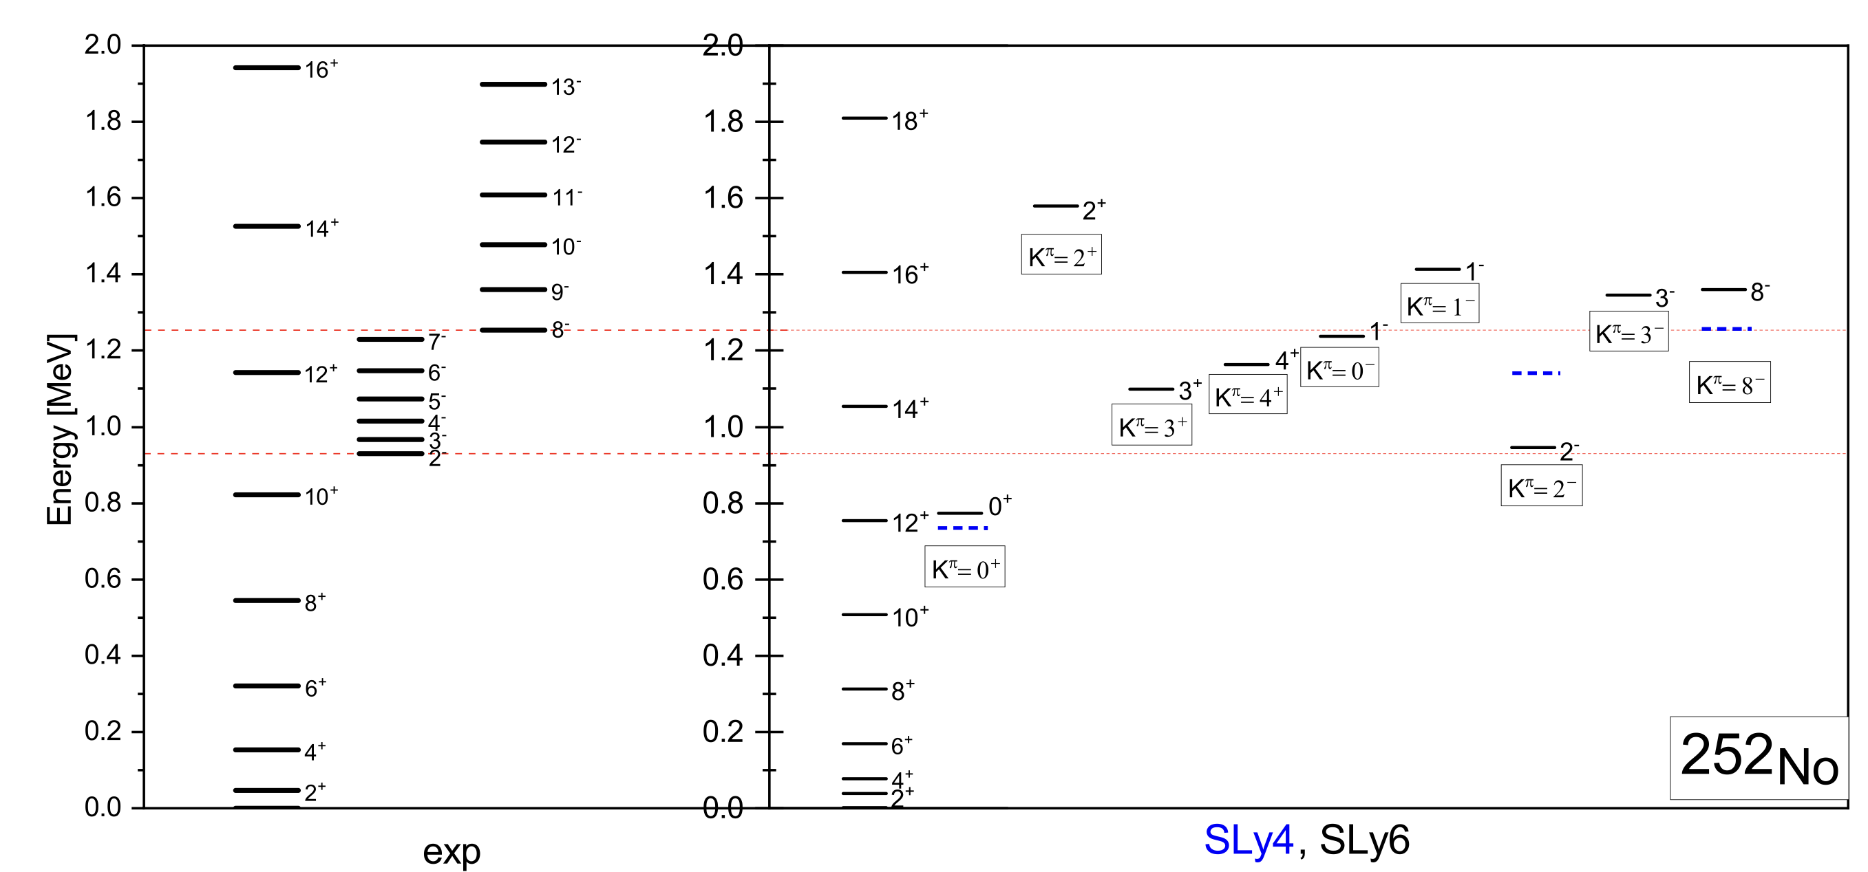
The band of the ground state is slightly compressed
The band, which built on state 2⁻ is described well and the two others bands are also described satisfactorily

Slide 26
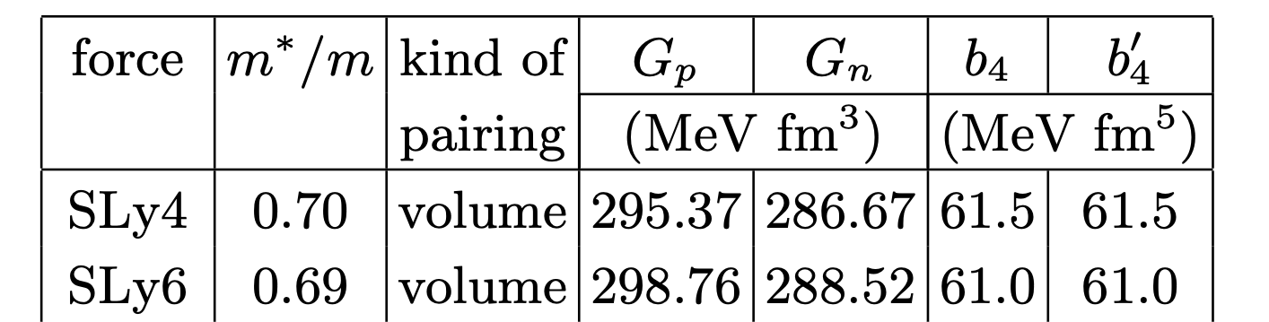
As compared with SLy4, the parameters of SLy6 were fitted with
an additional two-body center-of-mass correction
in the energy functional.
The band of the ground state is slightly compressed
The band, which built on state 2⁻ is described well and the two others bands are also described satisfactorily

Slide 27
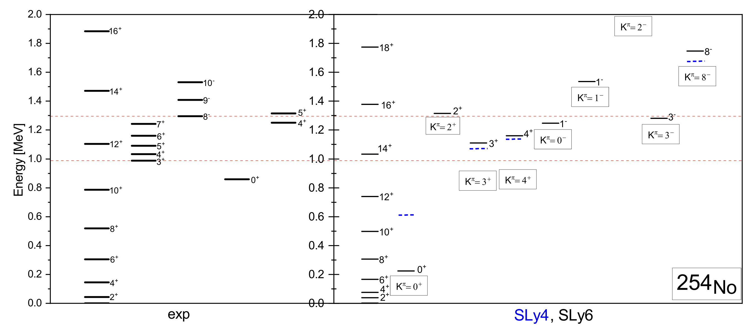
We also describing the 3 experimental bands quite well and working to carry out the more detailed analyzes about the band starting with 8⁻

Slide 28
Conclusion
The low-energy spectra of the nobelium chain were studied within the framework
of three Skyrme forces (SLy6, SkM*, SVbas) with different types of pairing
All three Skyrme forces support this irregularity,
despite different types of neutron pairing (volume/surface)
For ^{252,254}No isotopes this irregularity associated with
pairing effect and evolution of the single-particle spectrum
The theoretically obtained bands for the lower spectrum for ^{252, 254}No are
in good agreement with experiment
We also make the predictions about low-energy bands of different multipolarity
(K^{π} = 0⁺, 2⁺, 3⁺, 0⁻, 1⁻, 2⁻, 8⁻), some of then can be found experimentally

Slide 29

Thank you for your attention!
_______
Low-energy spectra of nobelium isotopes: Skyrme random-phase-approximation analysis
Authors: V. O. Nesterenko, M. A. Mardyban, A. Repko, R. V. Jolos, P. -G. Reinhard and A. A. Dzhioev
(29.05 accepted in PRC)

Slide 31
Backup slides

Slide 32
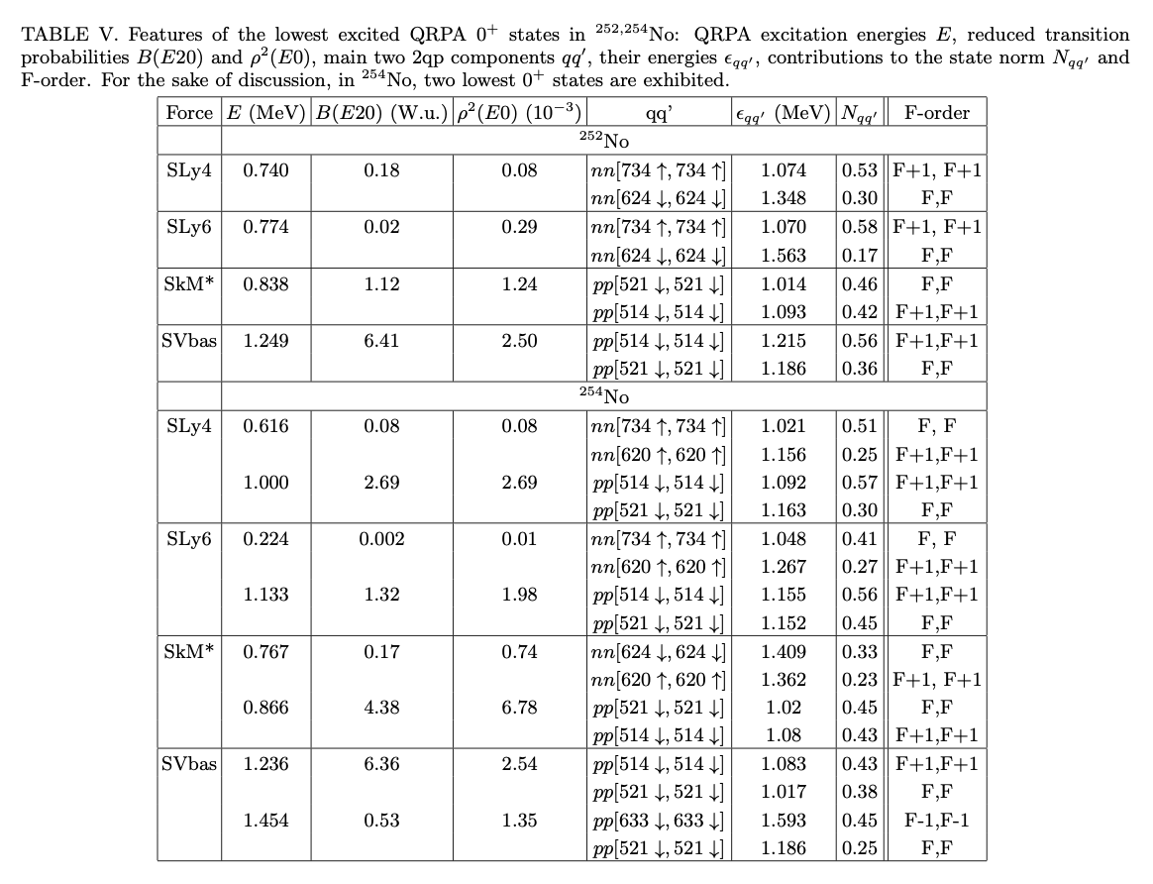
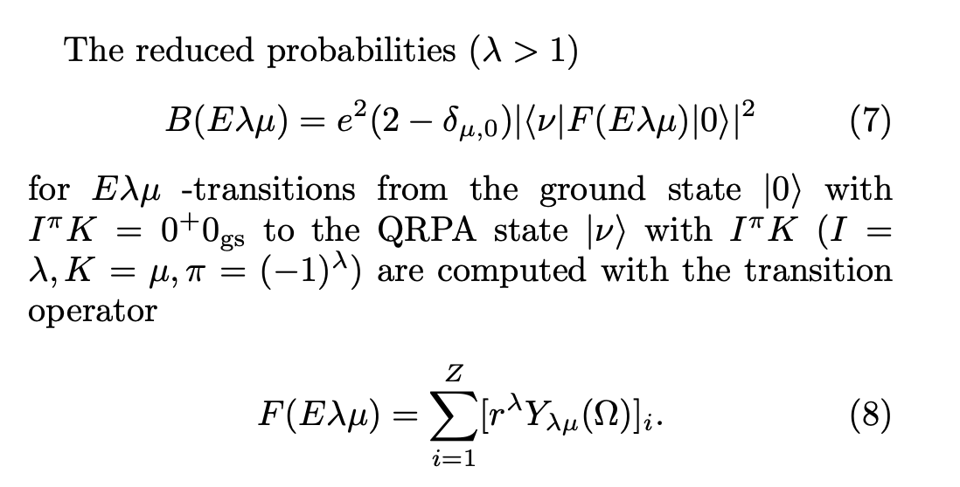
Obviously, so low energy is an artifact of the BCS description of a weak pairing.
In this connection, SLy4 energy 0.611 MeV for 0⁺₁ state is more realistic
(here we have a drop but not collapse of the neutron pairing).

Slide 33
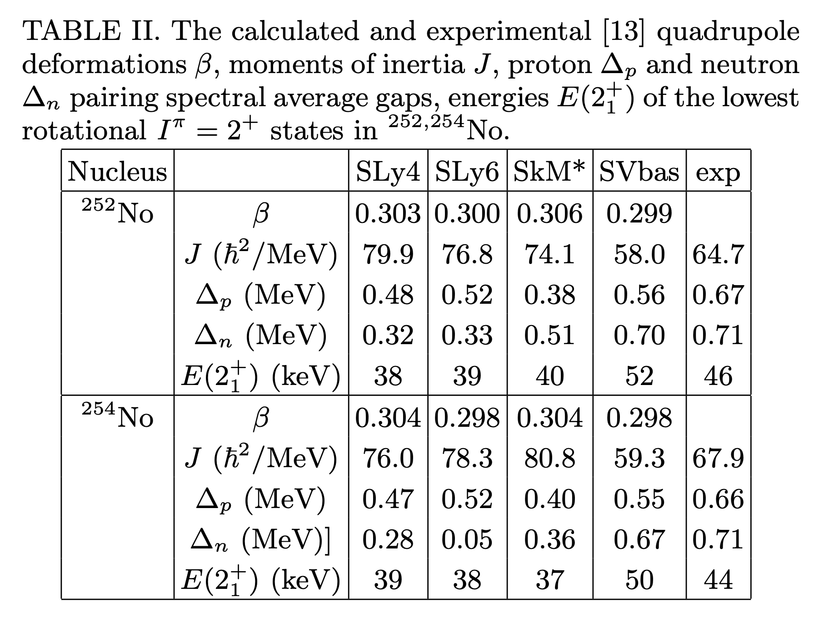

Slide 34
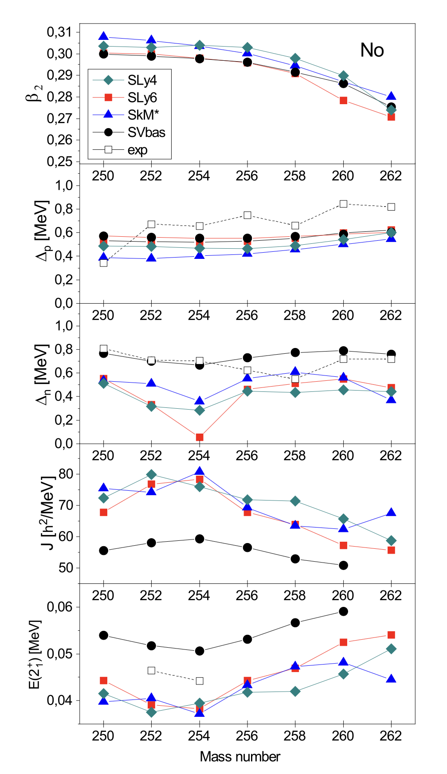
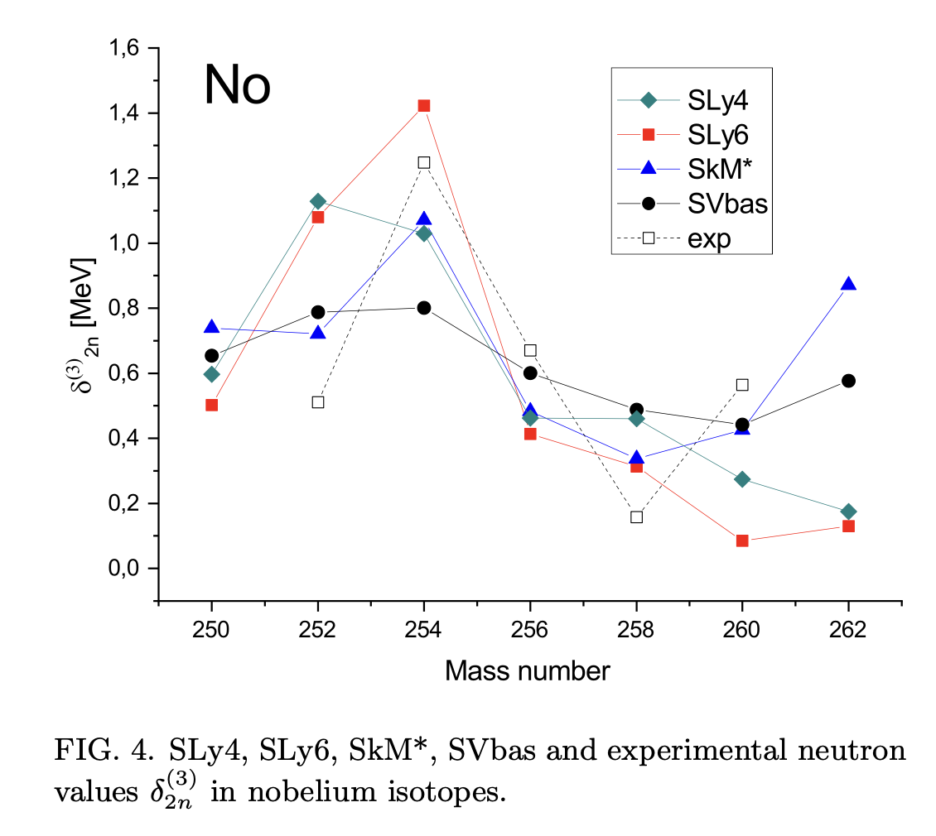
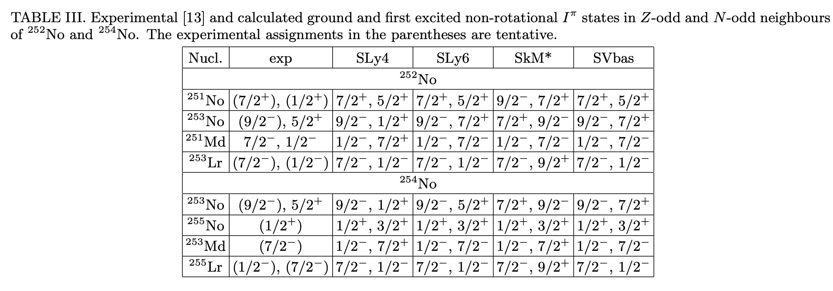

Slide 35
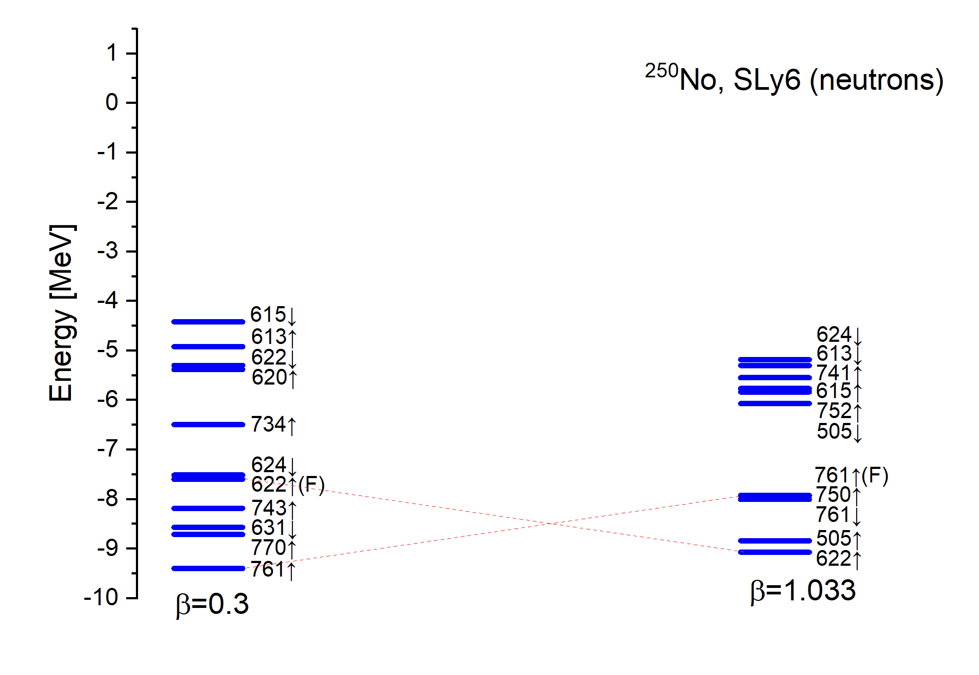
Dynamic of neutron spectrum with
𝛽=0.3 (equilibrium deformation) and 𝛽=1
There is a gap near the Fermi level (in both case)
which can give strong pairing effects

Slide 36
Our tasks are:
- to analyze the occurrence of the irregularity for ^{252,254}No
- to make predictions not only for the ground state energy band, but for other bands too
The irregularity in ²⁵²No and ²⁵⁴No at low-energy spectrum

Slide 37
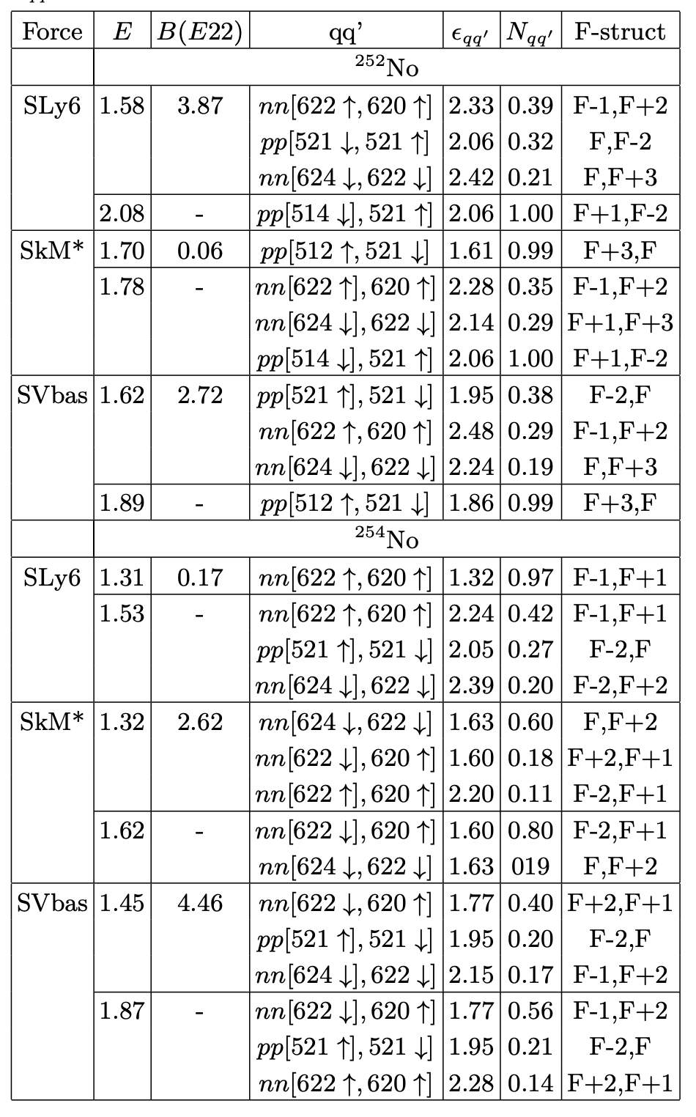
States K^{π} = 2
In most of the cases, if the first state is collective, then the next one is 2qp and vice versa, but:
The first K^{π} = 2⁺ - states are γ-vibrational collective in ²⁵²No (SLy6, SV-bas) and in ²⁵⁴No (SkM*, SV-bas)
Instead, the first 2⁺ states are purely 2qp in ²⁵²No (SkM*) and in ²⁵⁴No (SLy6)
Anyway, all the calculated 2+ lie above the observed 2⁻ (²⁵²No) and 3⁺ (²⁵²No) K-isomers
We know only IBM calculations
[A. D. Efimov and I. N. Izosimov, Phys. Atom. Nucl. 84, 660 (2021)];
[A. D. Efimov and I. N. Izosimov, JINR-E6-2022-19 (2022)]
In contrast to our results, calculations predict K^{π} = 2⁺ states at 1.09 MeV (²⁵²No) and 0.94 MeV (²⁵⁴No).
To estimate the true relevance of various theoretical results for No isotopes, the experimental data are necessary.

Slide 38
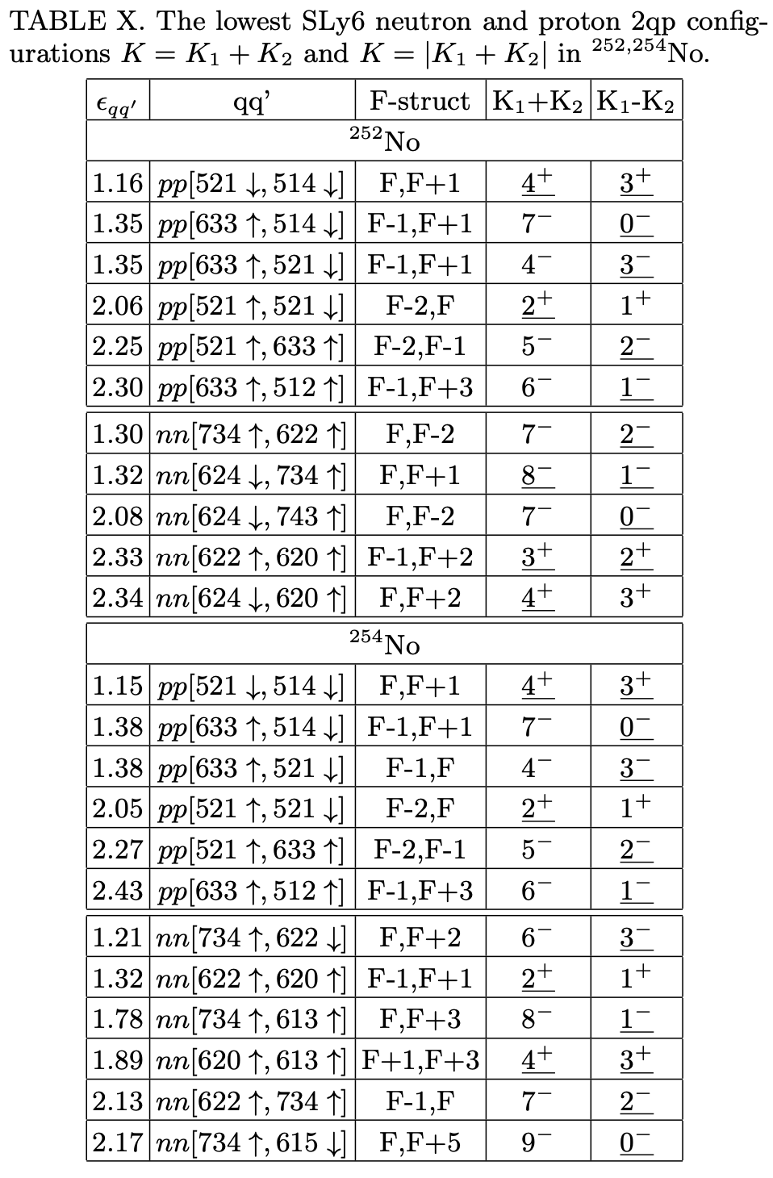
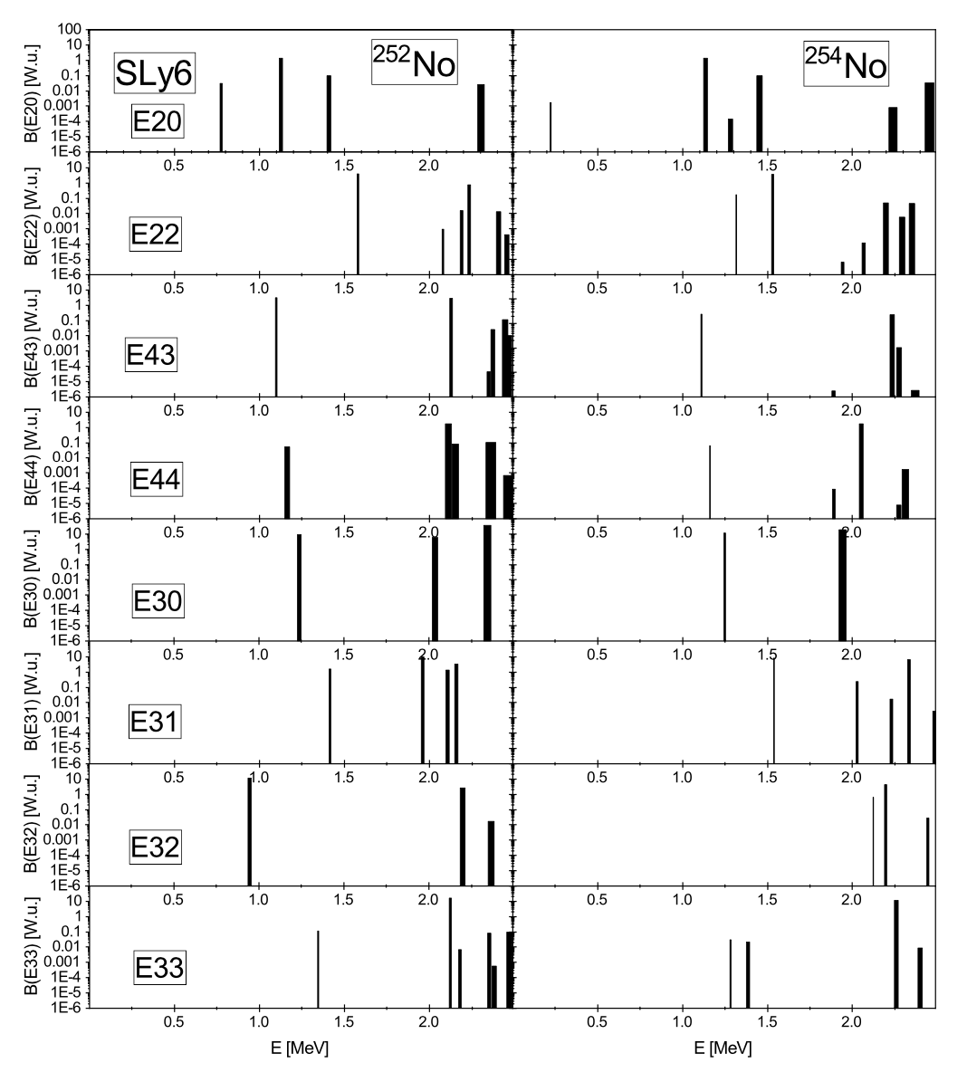

Slide 39
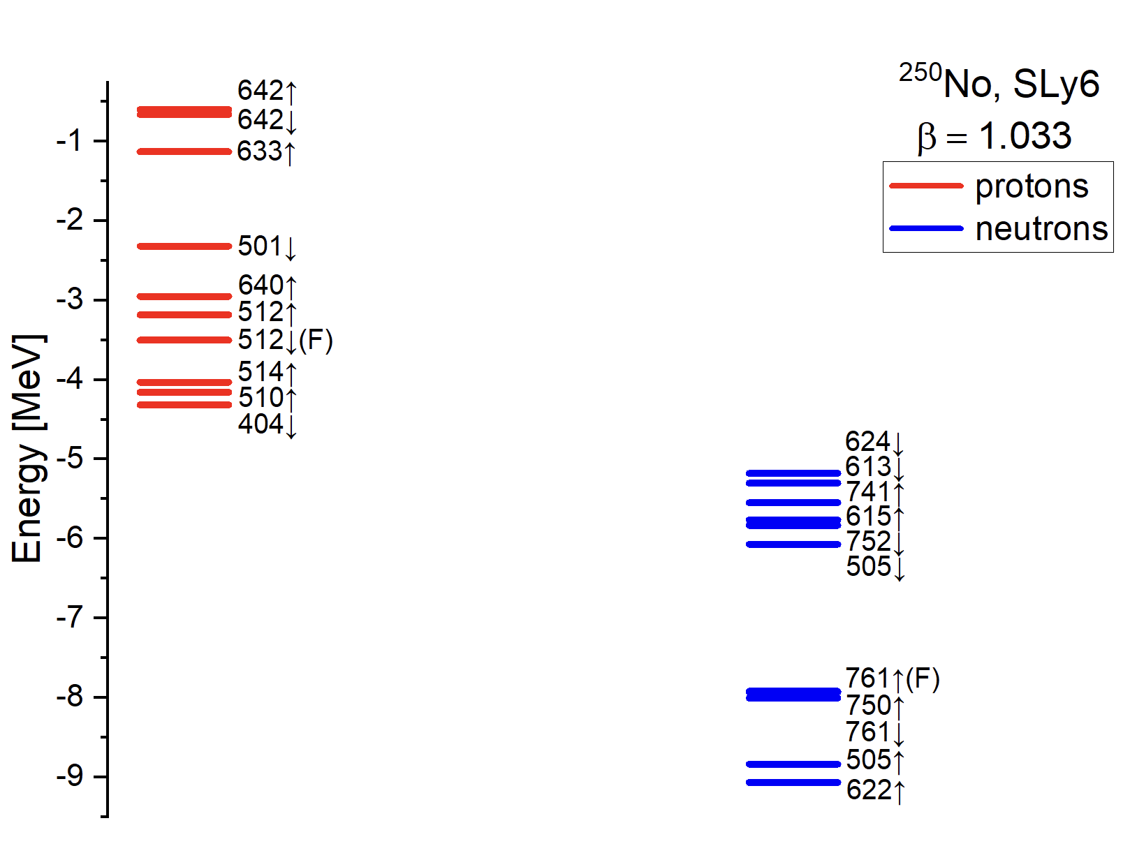

Slide 40
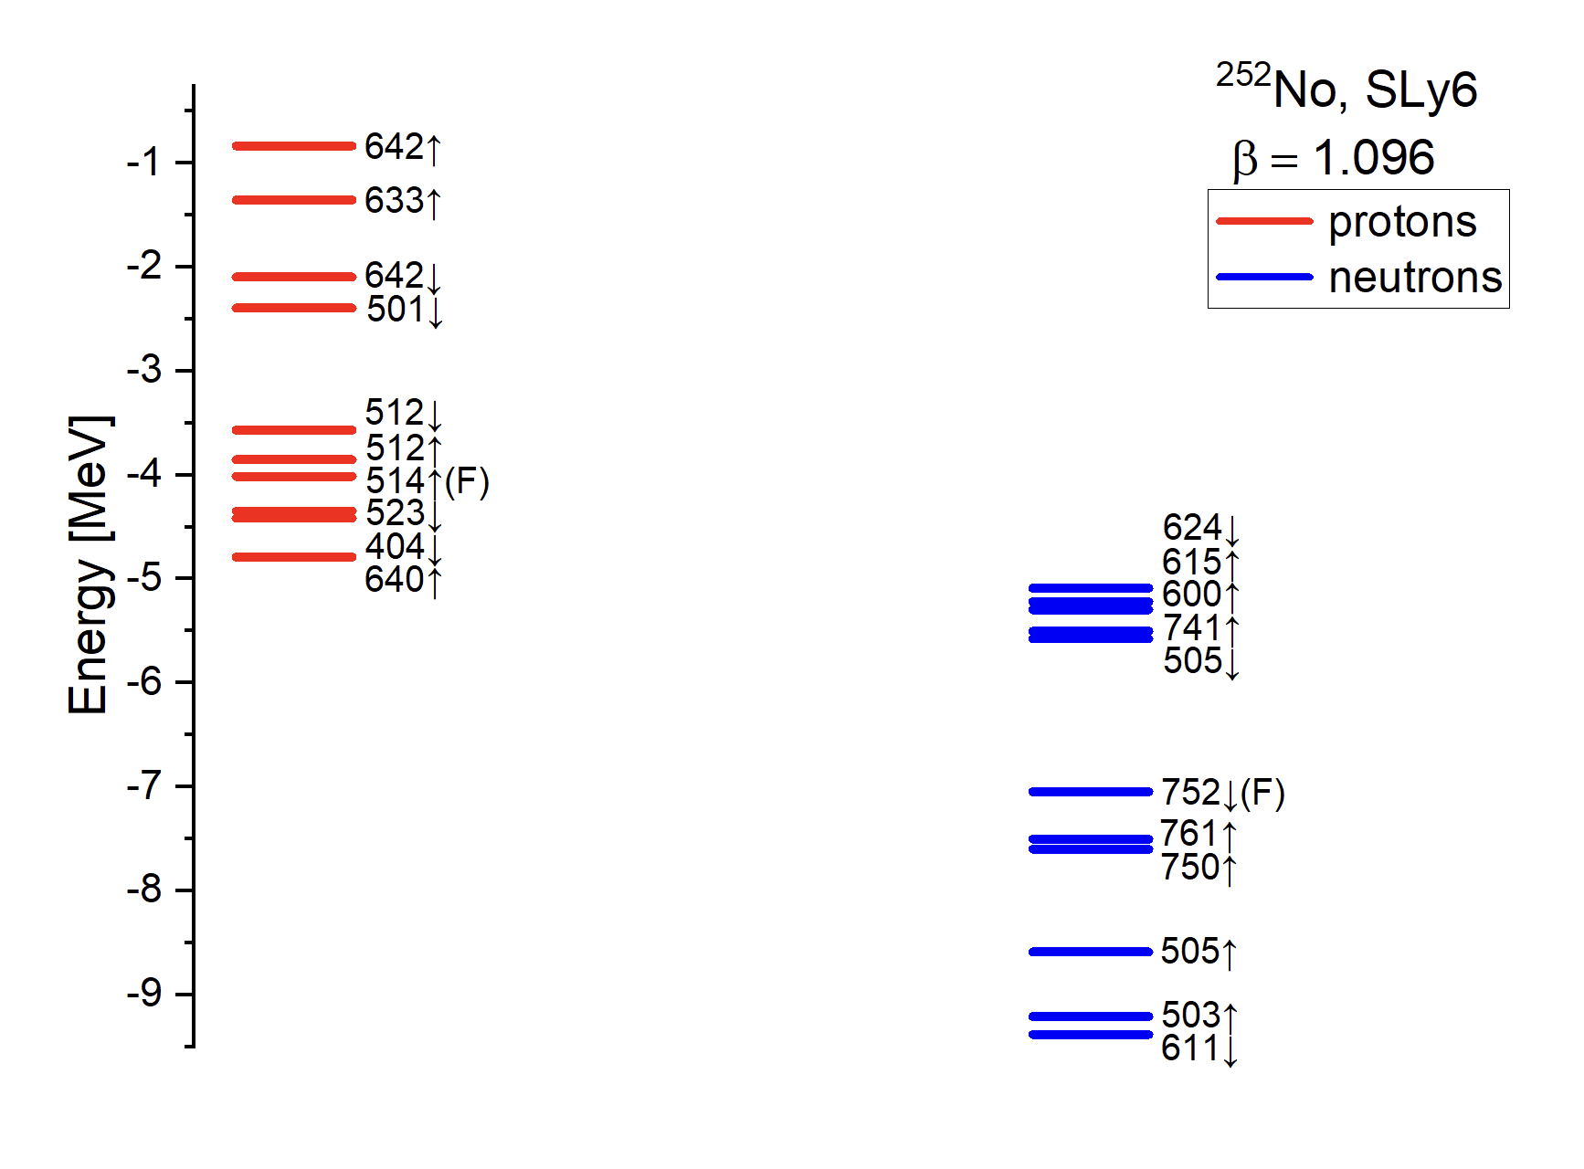

Slide 41
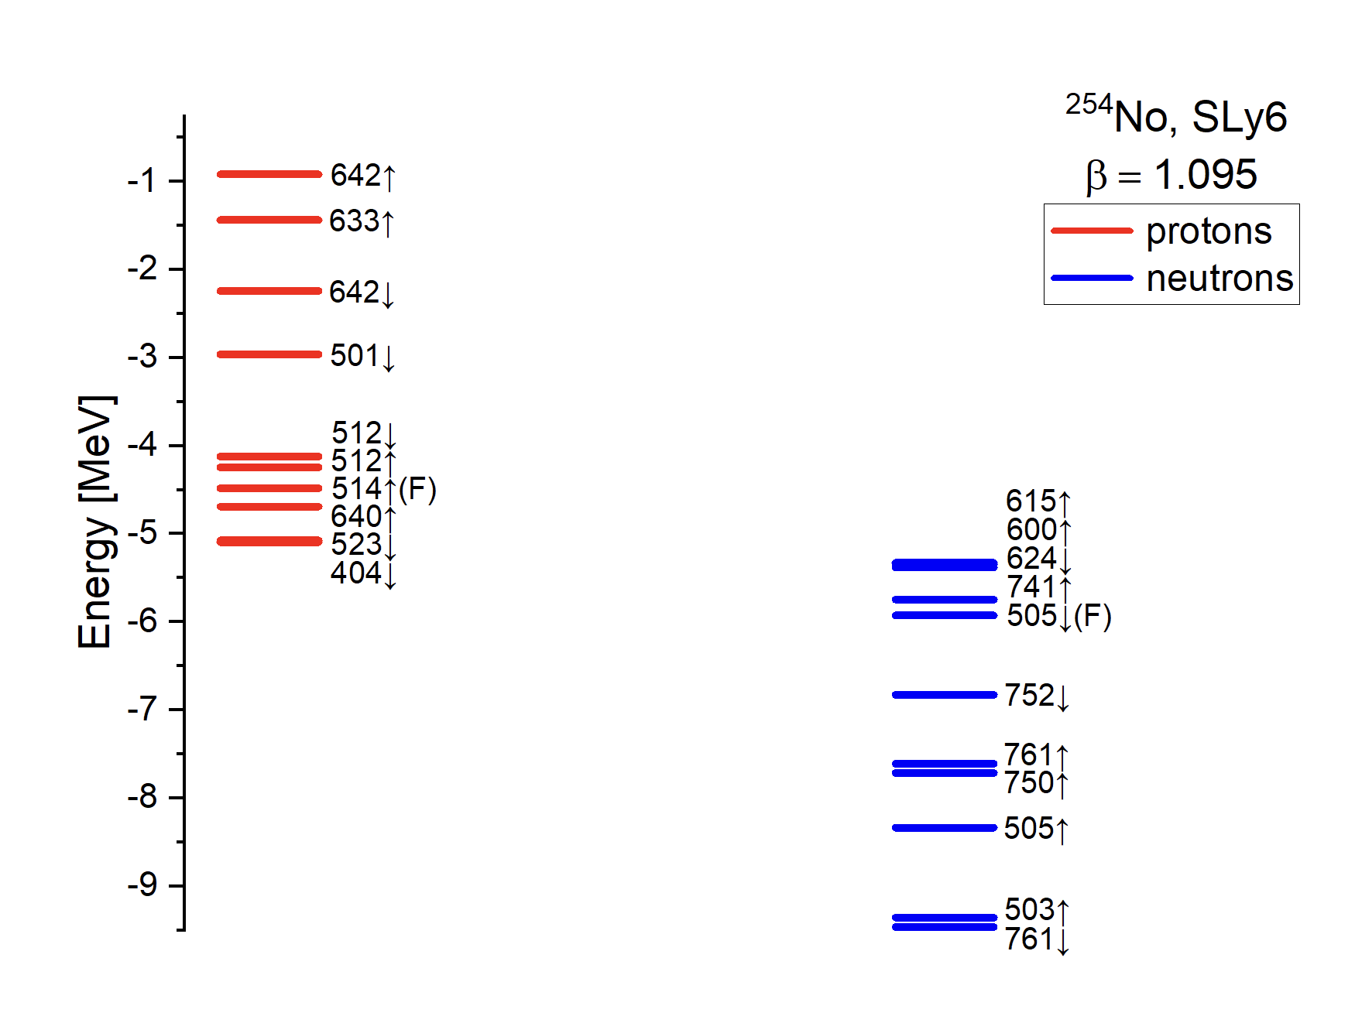

Slide 42
