Slide 1

62nd PAC on Particle Physics
JINR, June 23, 2025
Implementation of recommendations
Itzhak Tserruya

Slide 2
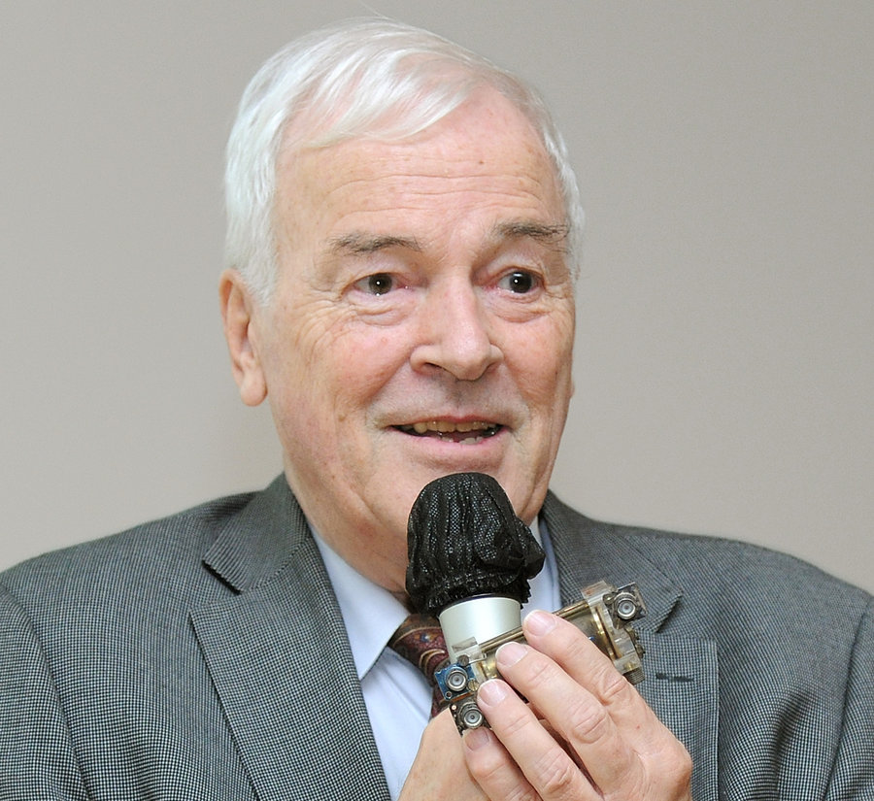
Hans Gutbrod (1942-2025)
Strong supporter of the NICA project
Member of the PAC-PP since 2000
Chair of the MPD DAC
Member of the BM@N DAC
Pioneer of relativistic heavy-ion physics
BEVALAC – Plastic Ball first 4π detector for HI
Spokesperson of the WA80/90/93 experiments at the CERN SPS.
Deputy spokesperson of ALICE
Director SUBATECH, Nantes
Leader of the FAIR Joint Core Team
His enthusiasm, imagination and optimism will be sorely missed.

Slide 3
Outline
137th Scientific Council meeting (February 13-14, 2025)
Agenda

Slide 4
Scientific Council (I)
Excerpts from the Resolutions of the 137th session of the SC held on February 13-14, 2025:
General considerations related to the PAC-PP:
The Scientific Council appreciates recent achievements of the Institute, in particular:
– progress in preparation for the NICA collider commissioning, …and preparation of a detailed program for the physical launch of the complex in the summer of this year;
– successful cooling of the MPD solenoid down to the LHe temperature of 4.5 К, preparation of the MPD detector for the analysis of the first data sets in fixed-target mode;
– progress in the analysis of Xe+CsI experimental data at an energy of 3.8 A GeV recorded by the BM@N experiment;
– development of the ARIADNA collaboration and its research programme, the launch of several channels for applied research, successful operation of the SOCHI chip irradiation station;
– successful participation in the most advanced neutrino experiments, including experiments with reactor neutrinos (JUNO), neutrinos from accelerators (NOvA, T2K), and COMET;
– contribution of the Institute in the work of CERN collaborations at the LHC on the second phase of upgrading the ATLAS, CMS, and ALICE detectors, as well as obtaining new results in the CERN-SPS experiments;

Slide 5
Scientific Council (II)
Recommendations in connection with the PAC-PP:
The Scientific Council acknowledges the significant progress achieved in preparation for the NICA collider commissioning, including the installation of the collider magnetic cryostat system, RF stations and final focusing lenses. A high-level of readiness of the collider’s cryogenic supply system has been achieved. A detailed programme for the physical launch of the complex has been developed that foresees first collisions in the summer of this year. Several channels for applied research are ready for operation; 5 runs have already been conducted at the SOCHI chip irradiation station. The SC joins the PAC in congratulating the NICA team on these achievements.
The Scientific Council notes that the main elements of all detector subsystems of the Phase-I MPD are produced. Their assembly, testing and calibration are currently underway. A test cooling of the MPD superconducting magnet to LHe temperatures was successfully performed at the end of 2024. The SC joins the PAC in congratulating the team on successfully achieving this significant milestone. The MPD experimental facility is in the final stage of construction, with the detector commissioning expected in late 2025. The SC shares the PAC’s concern about a significant delay in the readiness of the MPD detector compared to the anticipated timeline of the NICA collider, and urges the MPD Collaboration to speed up the construction and installation tasks.

Slide 6
Scientific Council (III)
Recommendations in connection with the PAC-PP:
The Scientific Council appreciates the progress in the implementation of the BM@N project: ongoing physics analyses of the Xe-CsI collisions at an energy of 3.8 A GeV and preparation for the next physics run with a Xe beam at an energy of 2–3 A GeV.
The Scientific Council notes with satisfaction that having finalized the Technical Design Report, the SPD team has started work on the first stage of the detector. Manufacturing the elements of the main detector systems has started, and progress has been achieved in establishing the computing infrastructure of the project.
The Scientific Council supports the PAC’s recommendation to open a new project “Study of neutrino properties in accelerator experiments”, comprising JINR’s participation in the ongoing accelerator neutrino experiments NOvA, T2K, FASER, and DsTau, for three years with ranking A. The main objectives of the project are measurements of the neutrino masses ordering and lepton CP violation, searches for neutrinos from supernovae and exotic signals, as well as measurement of cross-sections and development of neutrino interactions models. The presented project combines the participation of JINR in experiments with neutrinos from accelerators into one project, which will make it possible to use the complementary experience of the participating groups.

Slide 7
62nd PAC-PP agenda June 23, 2025
Highlights of today's meeting:
Update reports on NICA, BM@N and SPD
Revised proposal: Development of a physics program and detectors for experiments at CEPC
(old title - "Development of a particle registration technique in future
experiments with the participation of JINR")
Extension of projects: ALICE, ATLAS, CMS
Scientific report: Theoretical сalculations for future electron-positron colliders: status and prospects
Posters from Young Scientists

Slide 8
Thank you!

