Slide 1
62-nd Session of the
Program Advisory Committee in Particle Physics
23 June 2025, Dubna
V. Kekelidze

Slide 2
Information on the Resolution of the JINR Scientific Council 137th session, 13–14 February 2025 and on the decisions of the JINR Committee of Plenipotentiaries
25 March 2025, Dubna

Slide 3
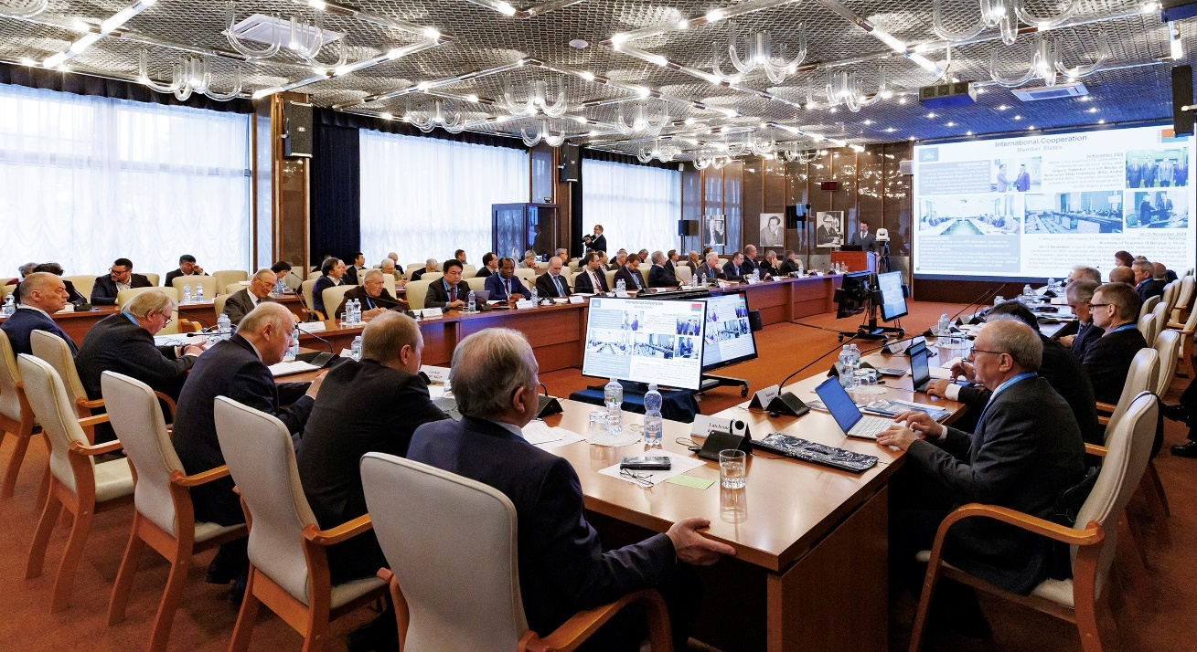
Information on the Resolution of the JINR Scientific Council
137th session, 13–14 February 2025, hybrid mode
Co-chaired by Grigory Trubnikov and by Sergei Kilin

Slide 4
PROGRAMM: 137th Session of the JINR Scientific Council 13–14 February 2025
February 13
Report by the JINR Director (G.Trubnikov)- The most notable scientific results and events of 2025
PAC recommendations of at the meetings in Jan. 2025: ( I.Tserruya, V.Nesvizhevsky, D.L.Nagy)
Election of Director of FLNR & endorsement of appointments of Deputy Directors of LRB
Announcement of vacancies of positions in the directorates of FLNR
Visit to the Dzhelepov Laboratory of Nuclear Problems for the festive opening of new base facility,
the LINAC-200 accelerator
February 14
Reports by young scientists as recommended by the PACs
Jury’s recommendations on the award of JINR prizes for best papers in theoretical & experimental research, methodology & technology research, & applied technology research (S. Dmitriev)
Proposal for awarding the title "Honorary Doctor of JINR“ (G.Trubnikov)
General discussion. Adoption of the Resolution of the Scientific Council

Slide 5
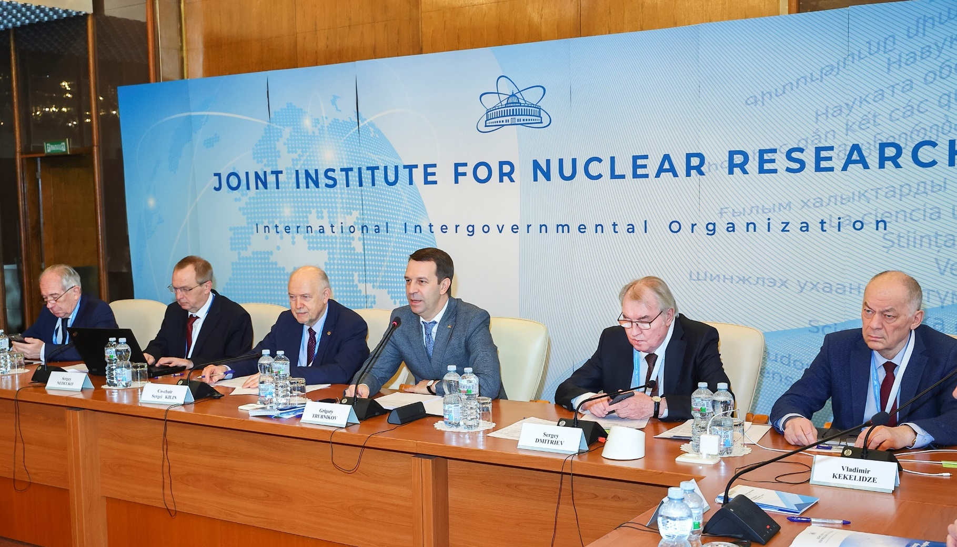
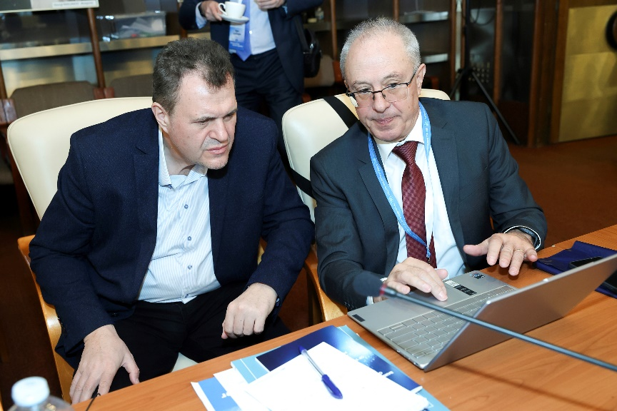
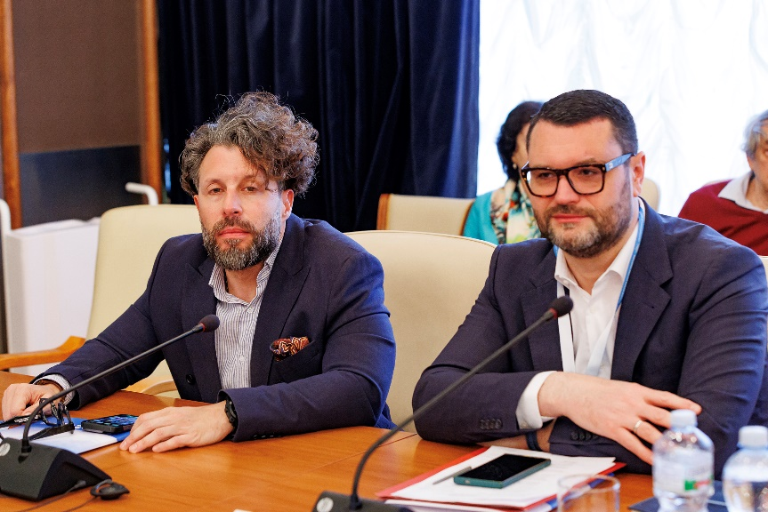
137th Session of the JINR Scientific Council 13–14 February 2025
G. Trubnikov reported on the implementation of the JINR 7-Year Plan for 2024–2030, on the progress in the project realizations for 2024, & on the recent events in JINR’s scientific activities & international cooperation.
Sergey Kilin (Belarus) was re-elected the SC Co-Chair for the next 3 years. SC welcomed its new members Raghunath Sahoo (India) & Song Yuntao (China).
.
S. Sidorchuk was elected as FLNR Director for 2-nd term
of 5 years, vacancies for the positions of FLNR Deputy Directors were announced
SC endorsed the appointments of A. Boreyko & I. Padrón Díaz as Deputy Directors of the LRB until the completion of the term of the LRB Director.
SC approved Director’s proposal to award the title “Honorary Doctor of JINR” to M. Sakr for his great contribution to enhancing the role of the ARE in JINR’s scientific life, strengthening scientific cooperation between the ARE & JINR.
Jury’s recommendations were presented by S. Dmitriev on awarding the JINR annual prizes for best scientific, methodological, technological, & applied research papers were approved.

Slide 6
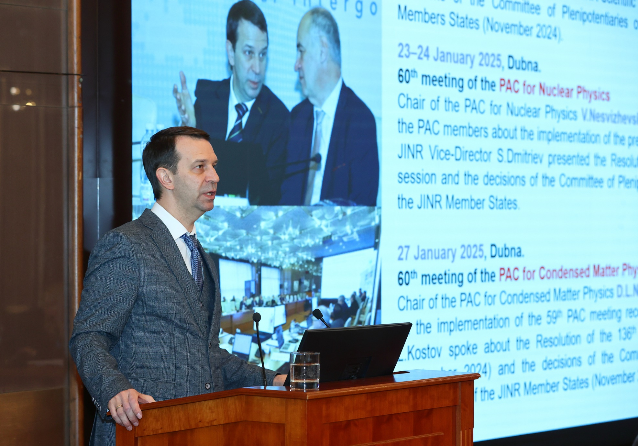
137th Session of the JINR Scientific Council 13–14 February 2025
SC appreciated recent achievements reported by G. Trubnikov:
preparation to launch the NICA accelerator complex;
MPD solenoid cooling down to t = 4.5 К, preparation for the data analysis of the fixed-target mode experiment with MPD;
progress in the analysis of Xe+CsI interactions at 3.8 AGeV in BM@N.
progress in the development of the Baikal-GVD telescope - the installation of two clusters;
successful participation in advanced neutrino experiments: JUNO, NOvA, T2K & LEGEND.
contribution to the second phase of upgrading the ATLAS, CMS, & ALICE, & obtaining new results in the CERN-SPS experiments;
launch of the new facility LINAC-800 in commissioning mode with an e energy of up to 200 MeV;
SHE Factory achieved project parameters; preparation for certification of SHE Factory experimental halls for the 1-st class of radiation safety; the synthesis of element 116 were performed using ⁵⁰Ti beams; experiment with ⁵⁴Cr in preparation for the synthesis of elements 119 and 120.
New experimental facilities of the U-400R are being designed. The launch of the DC-140 accelerator complex for applied research with heavy ion beams is scheduled for the second half of this year.

Slide 7
The research pulsed reactor IBR-2 in FLNP started again its operation, many reactor’s engineering systems were thoroughly modernized.
MLIT continued actively work for JINR experiments & continues to develop the JINR Digital Ecosystem by updating its administrative services.
LRB scientists published papers on combined proton therapy with pharmaceuticals that promote efficient repair of double stranded DNA break.
BLTP scientists achieved significant progress in theoretical, mathematical, nuclear, particle, relativistic heavy ion, & solid-state physics as well as materials science; 11 conferences were organized with the active participation of BLTP, including the Nucleus-2024 & a session of the Nuclear Physics Section of the PD of the RAS.
Last year, > 900 people participated in the educational programs of JINR University Centre.
JINR dissertation councils have successfully worked to improve the qualifications of researchers from the Institute & organizations in the Member States.
The first issue of the new online journal of JINR “Natural Science Review” was published.
A competition of innovative activities at JINR started, laboratories collected & discussed requests

Slide 8
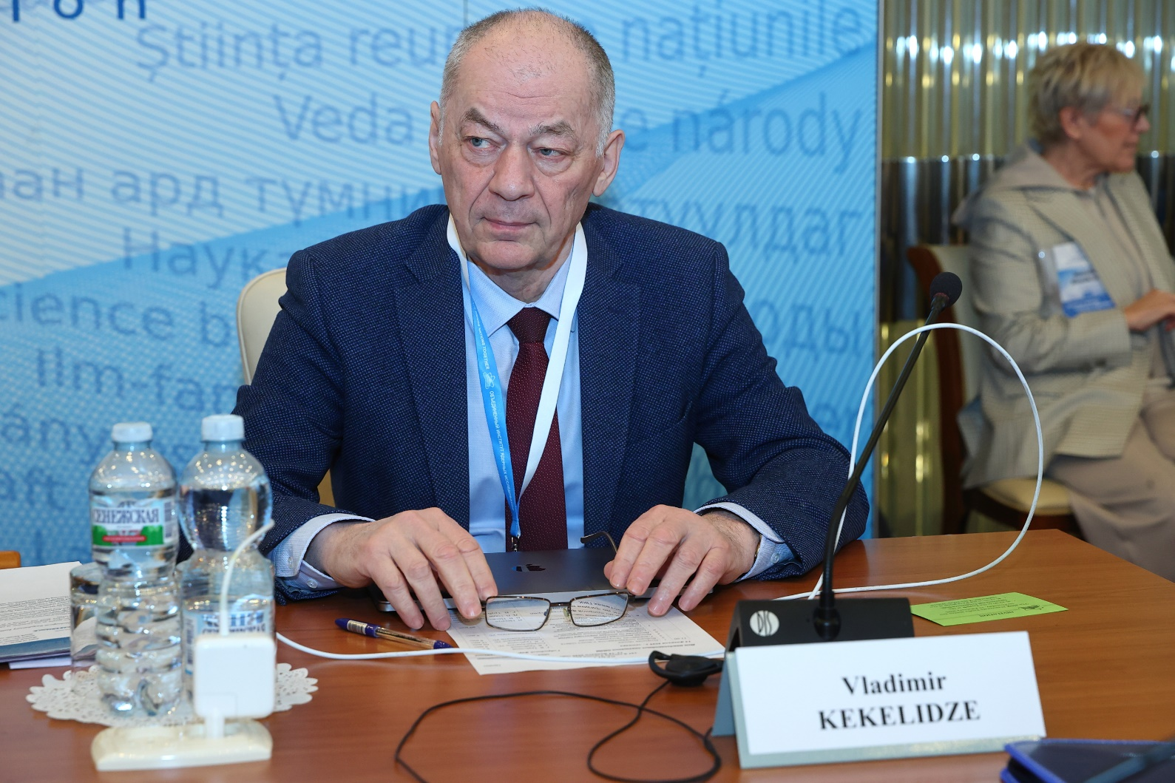
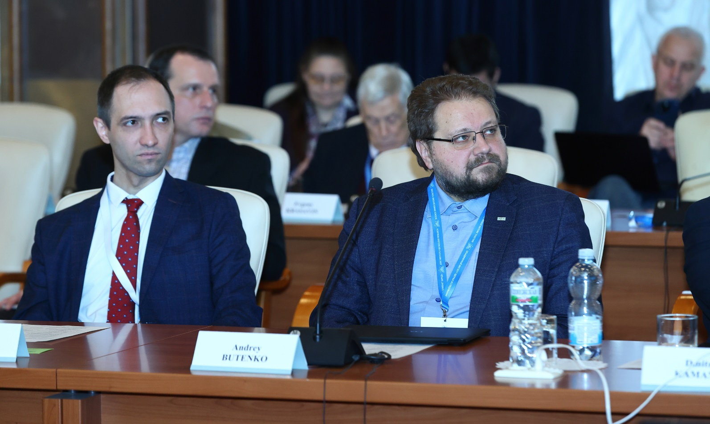
SC took note of the recommendations of PACs at Jan. ‘25 meetings
Particle physics.
The Scientific Council:
appreciated the PAC’s support for the signing of a high-level agreement between JINR & Ministry of Science & Technology (China) on the beginning of joint projects implementations;
acknowledged the significant progress in the NICA collider commissioning;
noted that the main subsystems of the Phase-I MPD are produced;
appreciated the progress in the implementation of the BM@N project;
noted with satisfaction, that SPD team finalized the TDR & started detector main system manufacture & preparation of computing infrastructure;
supported the PAC’s recommendation to open a new project “Study of neutrino properties in accelerator experiments”, comprising JINR’s participation in the ongoing accelerator neutrino experiments NOvA, T2K, FASER, and DsTau;
appreciated the contributions of the JINR teams participating in the LHC experiments in physics analyses & detector upgrades.

Slide 9
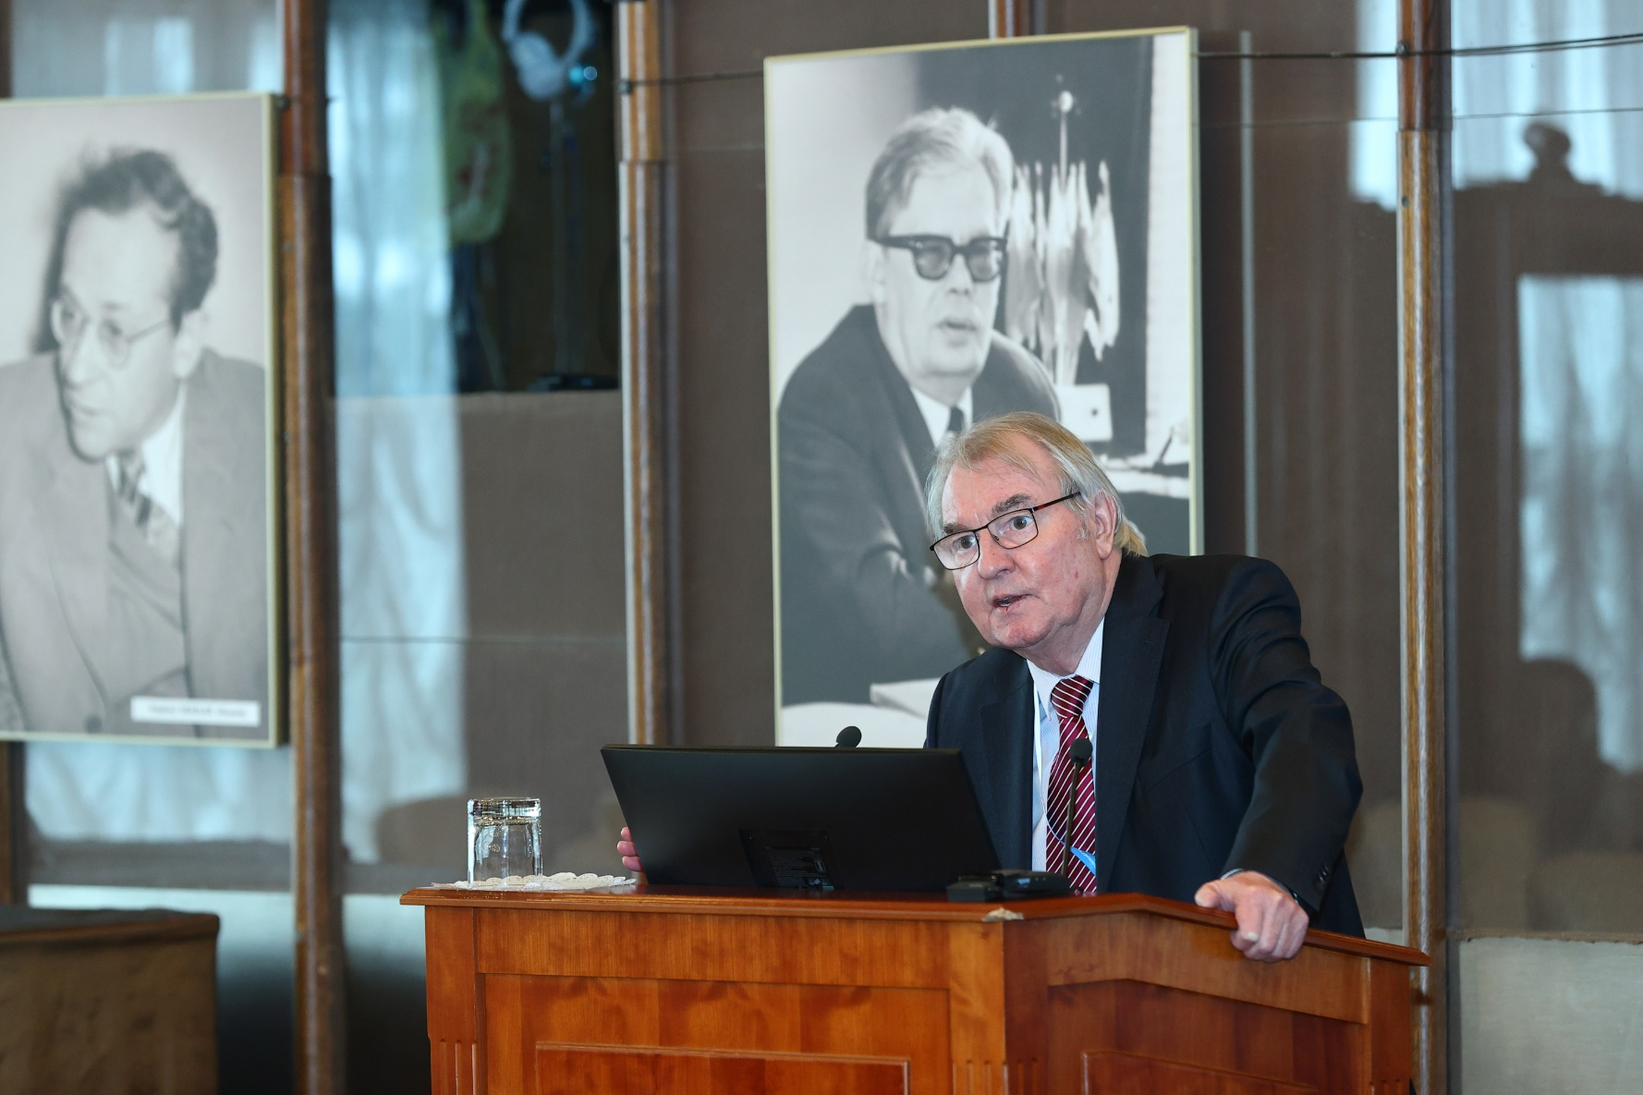
Nuclear physics.
The Scientific Council:
appreciated the significance of the Baikal-GVD project & the leading role of JINR in its implementation & noted an important outcome achieved by the analysis of 2018–2023 data –– confirmation of the diffuse astrophysical neutrino flux observed by the IceCube experiment with a significance of above 5σ;
noted extensive work underway to start the LINAC-200 facility at DLNP, which is part of the future LINAC-800 accelerator, indicated that requests from the Laboratories & research teams of JINR participating countries are the primary focus in the user research program, & recommended to concentrate efforts on preparing the 1-st experiments at LINAC-200;
acknowledged tremendous efforts to prepare for long-term experiments on the spectroscopy of the isotopes of superheavy elements synthesized in the ⁴⁸Ca + ²⁴²Pu reaction;
greatly supported the program for studying the isotopes of superheavy elements; endorsed the PAC recommendations to explore the possibility of designing a station to detect the mass & TKE distributions of the fission fragments; this would greatly enhance the comprehension of the fission process in an unknown mass region.

Slide 10
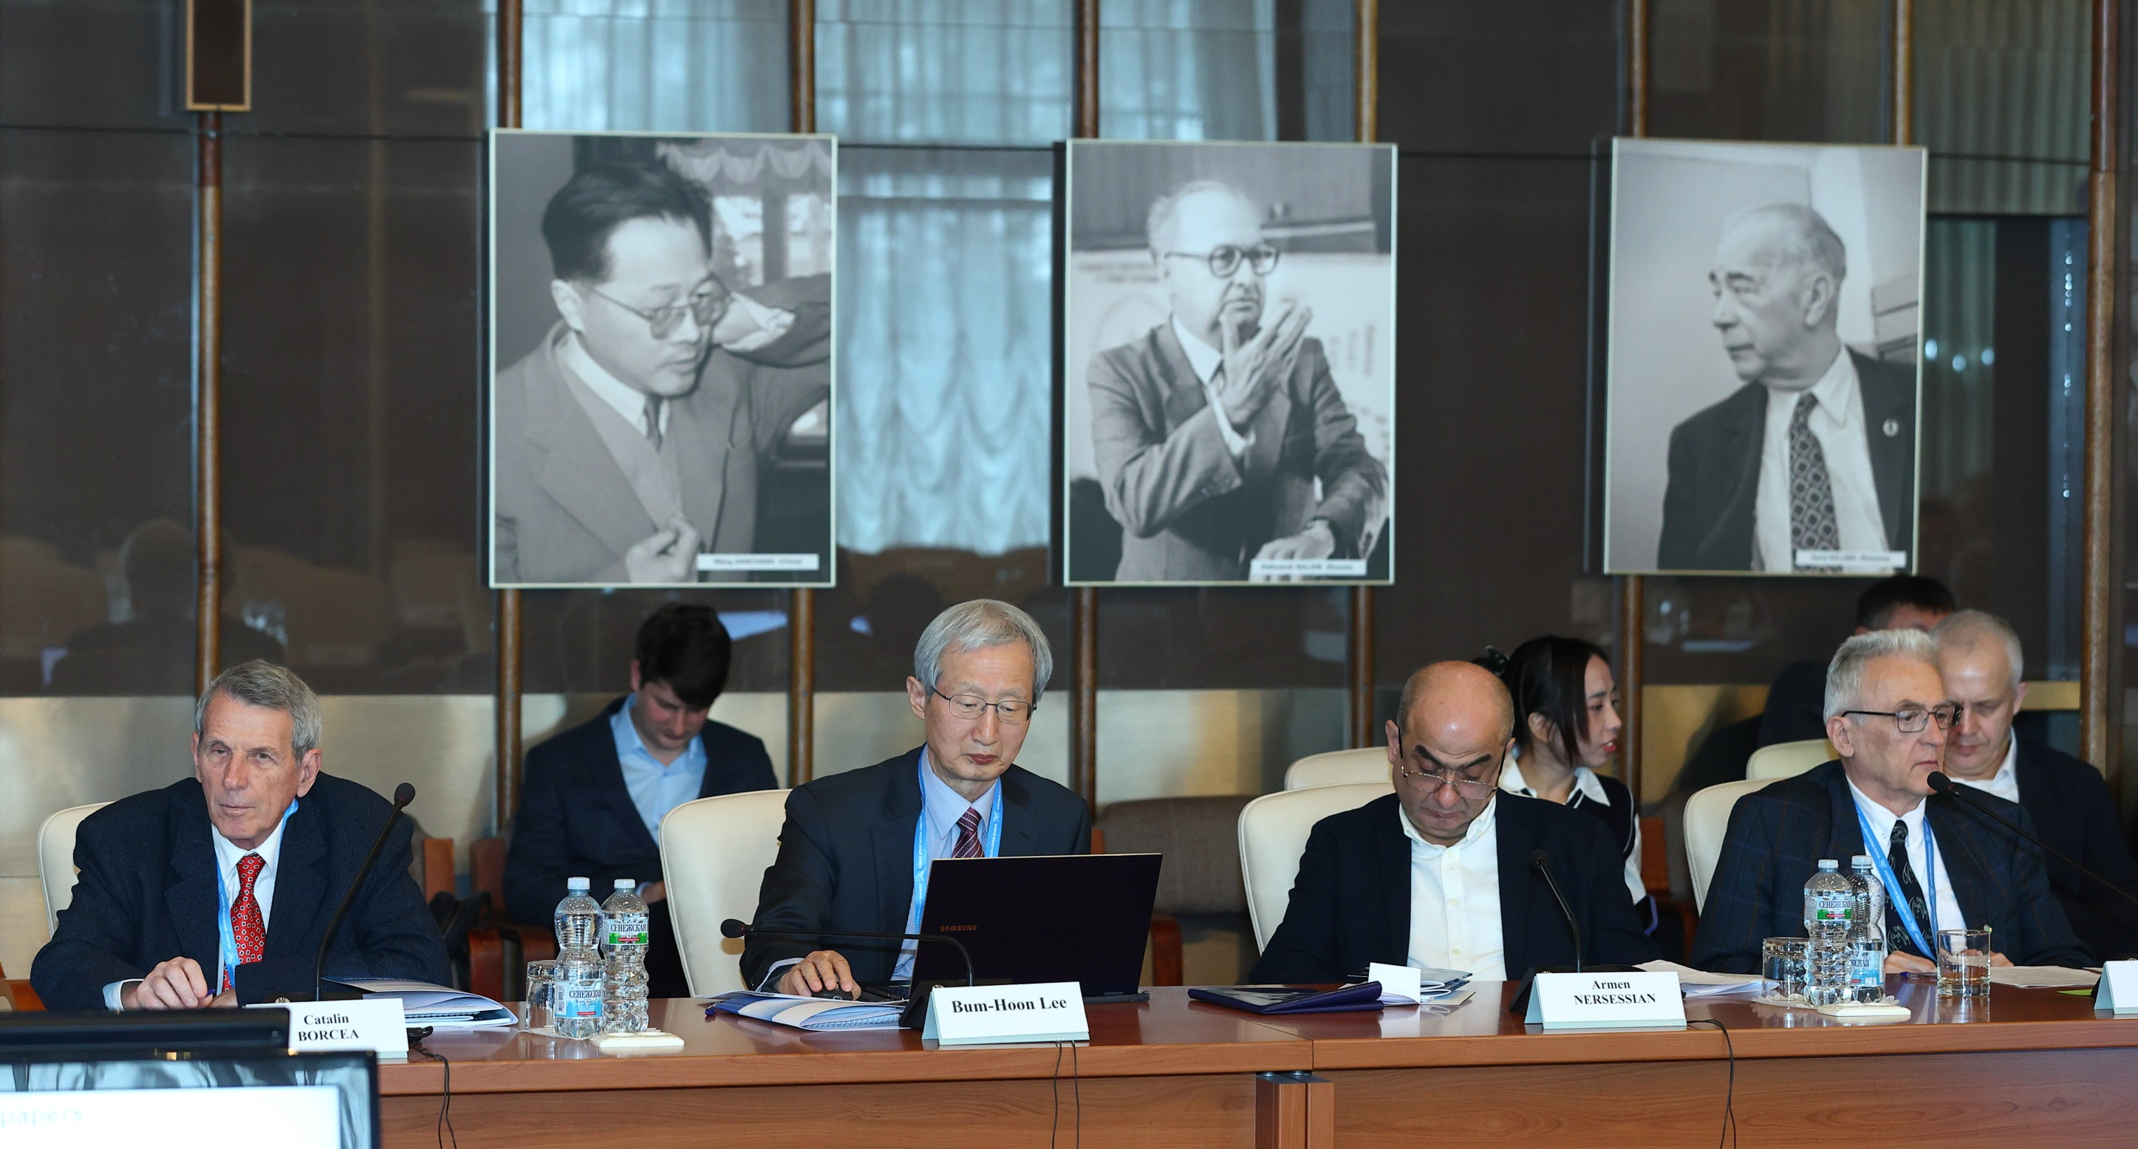
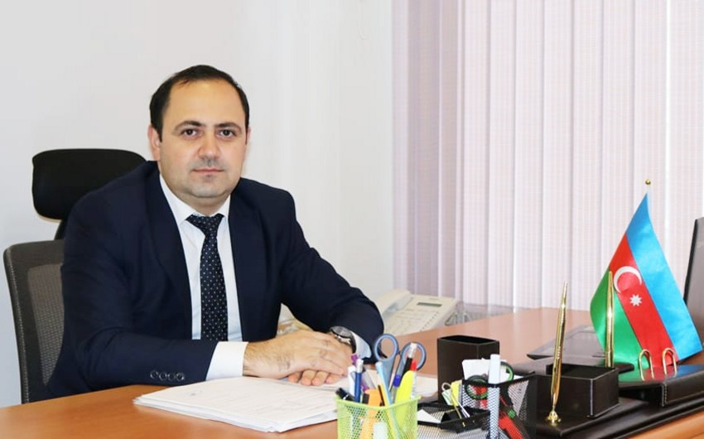
Condensed matter physics.
The Scientific Council:
appreciated the progress in resuming IBR-2 operation & highly appreciates the Directorate efforts to resume regular cycles for users & plans to extend the operation with high-performance parameters by loading new fuel;
supported PAC’s recommendations to strengthen its work with potential users to attract the maximum number of
researchers, primarily from the MS.
welcomed the permanent attention of the PAC to the new neutron source project & the developing new advanced devices & technologies for cryogenic moderators of the new neutron source.
noted the progress in the IBR-2 instrumentation development during the technical shutdown & considered these activities important for the successful realization of the FLNP scientific program & the user program at a competitive level.
SC appointed S. Jabarov (Supreme Attestation Commission under the President of the Republic of Azerbaijan, Baku, Azerbaijan) as a member of the PAC for Condensed Matter Physics for a term of 3 years.

Slide 11
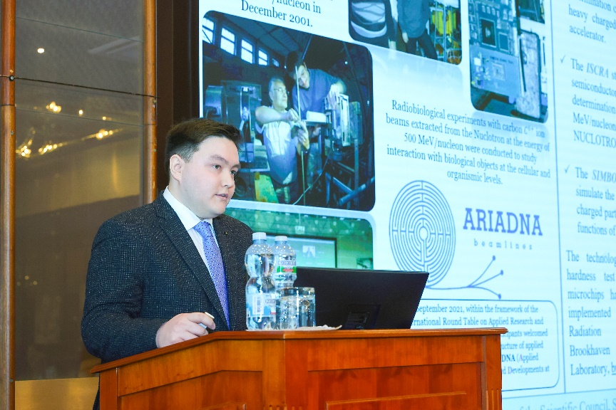
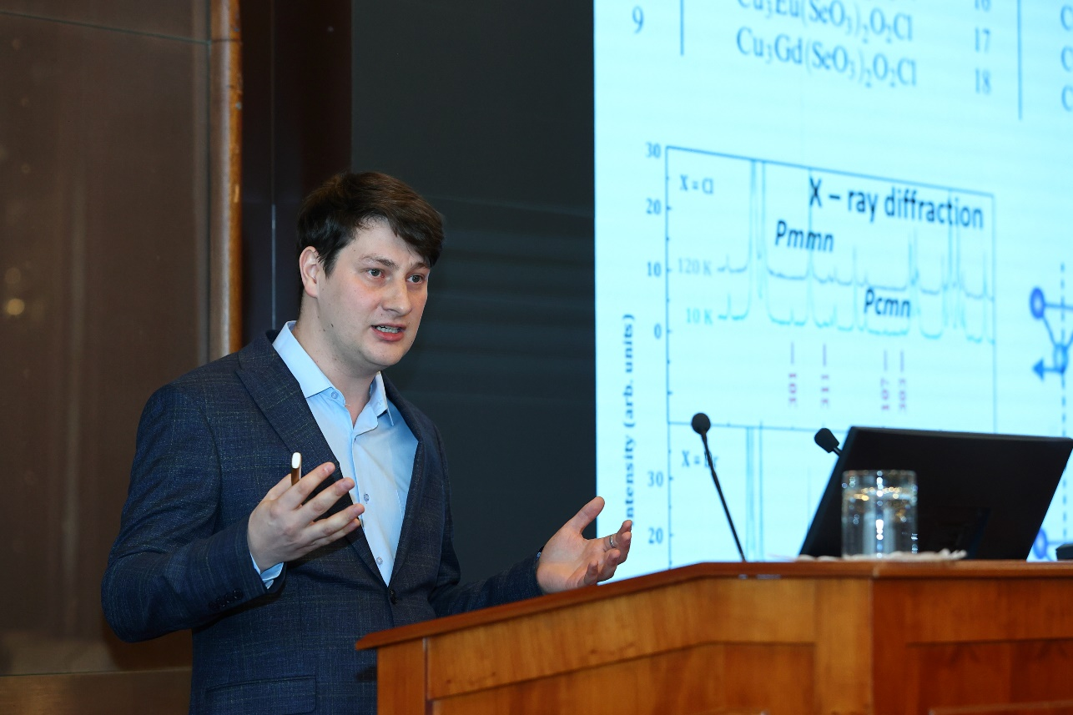
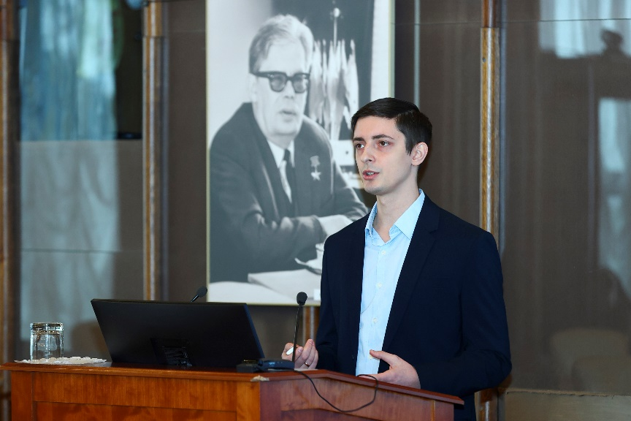
Reports by young scientists
SC followed with interest the reports by young scientists (selected by PACs) : “Construction of the ISCRA & SIMBO stations for applied research on high-energy ion beams. Radiation hardness testing of microchips by low energy pulsed ion beams at the SOCHI station” by A. Slivin (VBLHEP), “Intense metallic ion beams for SHE synthesis” by D. Pugachev (DLNP), and “Structural and vibrational properties of the Cu3Bi(SeO3)2O2Cl francisite at high-pressure” by A. Rutkauskas (FLNP).
SC thanked the speakers and welcomed such selected reports in the future.

Slide 12
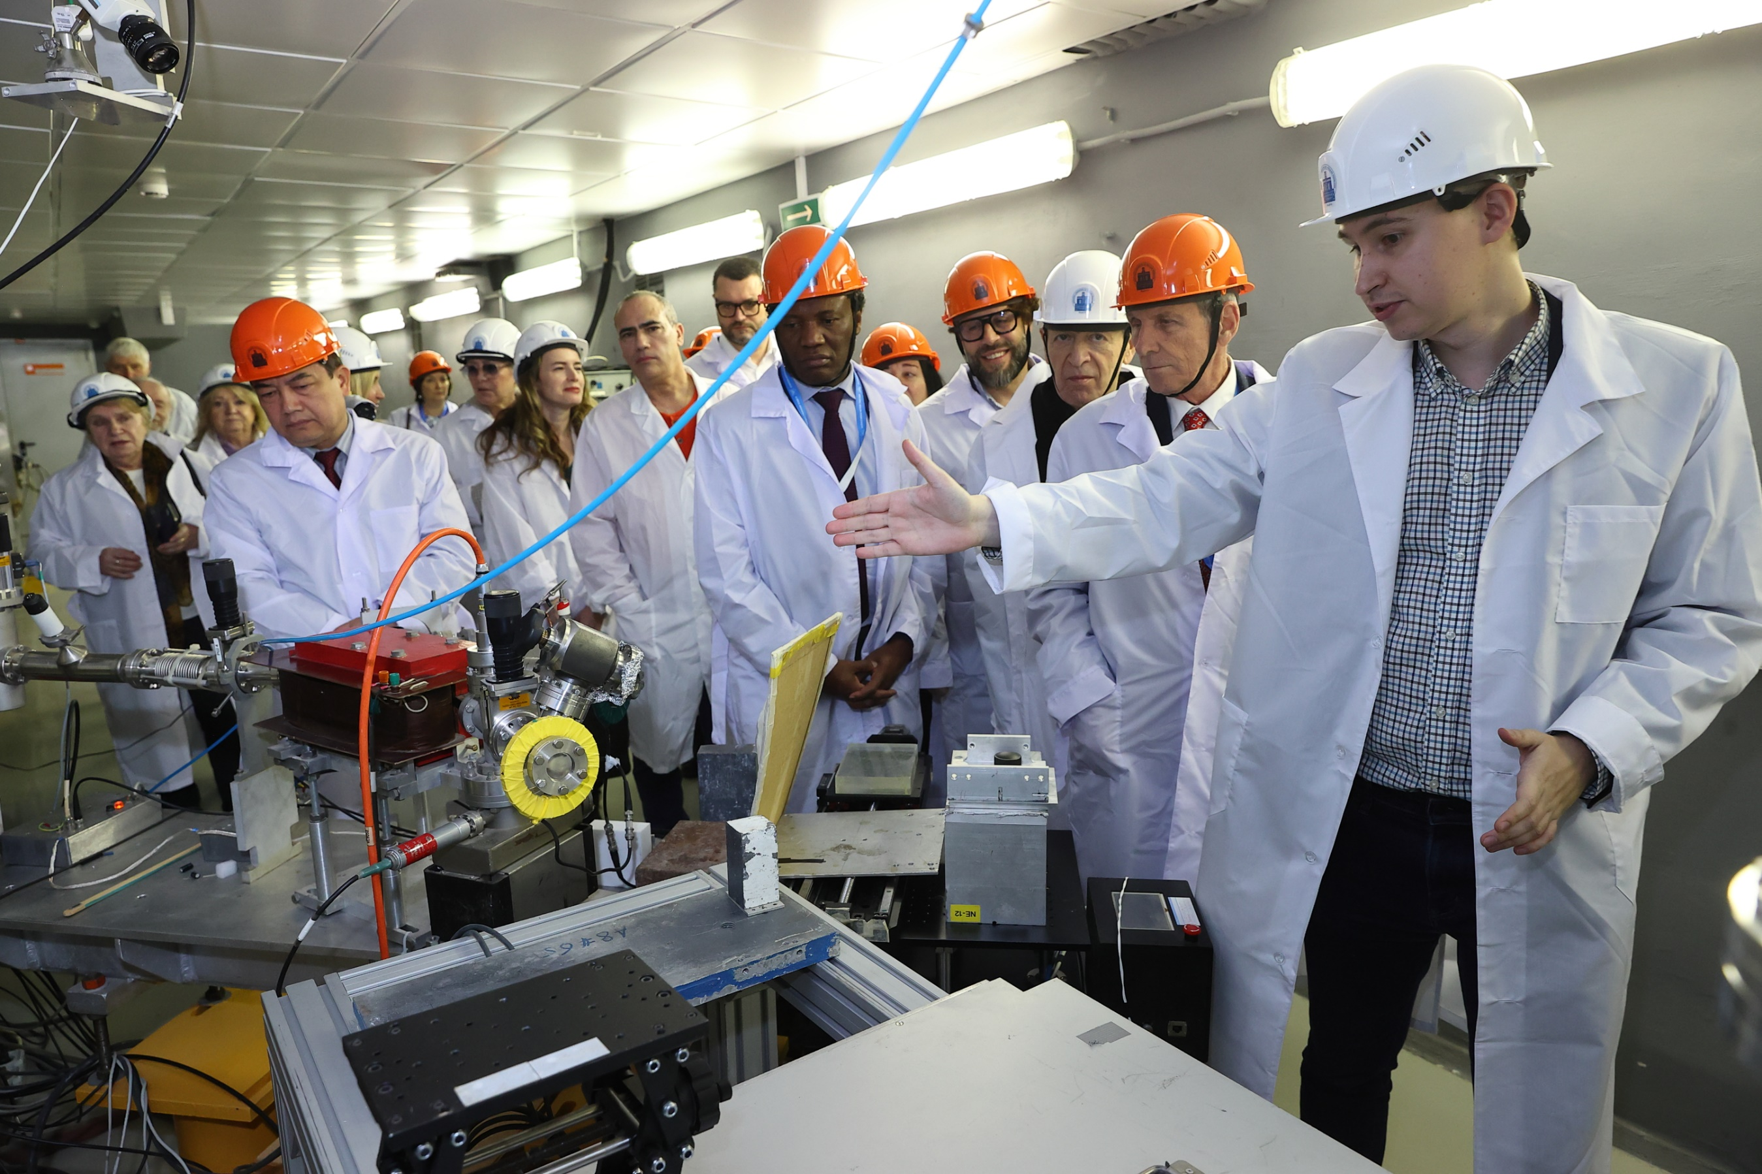
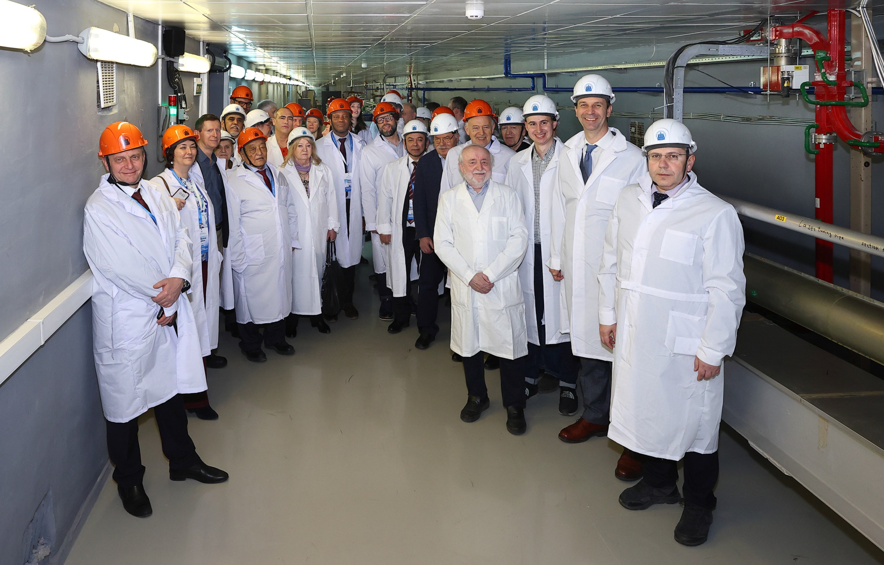
Festive Opening of the JINR New Basic Facility — the LINAC-200 Accelerator
13 Feb. marked the ceremony to launch new base facility of DLNP - LINAC-200
On 12 Feb. 24 MeV e test beam was successfully launched; it is planned in future to gradually put the accelerator structures into operation at 400 & 800 MeV.
Before commissioning the accelerator an extensive work in repairs of building №118 was done. This accelerator, transferred to JINR from NIKHEF (Netherlands), underwent extensive upgrades.
A user program at LINAC-200 is being developed, primarily focused on the requests of Labs & scientific groups from the JINR MS. The beams will be used for testing of MPD & SPD detector prototypes, applied work in radiation materials science, radiobiology, & radiochemistry, nuclear physics experiments, & University Centre’s internships for students & specialists from the MS. Specialists from Vietnam are planning to study photonuclear reactions at 133 & 207 MeV with extracted beams. DLNP, VBLHEP & FLNP jointly implemented the project.

Slide 13
Monitoring Performance Indicators
Number of University Centre programmes participants
> 60 years
35 – 60 years
< 35 years
staff with academic degrees
Breakdown of number of basic facilities by age
Total amount of data in the JINR storage system (PB)
 | 2021 | 2022 | 2023 | 2024
N publications by Scopus | 1454 | 1352 | 1418 | 1443

Slide 14
Actual Amounts of Income and Expenditure for 2024
Expenditure
(by consolidated items)
Income
170 M$
Contributions
of the MS
(85%)
91 M$
Personnel
(42%)
79 M$
Material costs for scientific research
(36%)
200 M$
216 M$
30 М$ Other
revenues
(15%)
10 M$
Service costs
(5%)
28 M$
Material costs for infrastructure
(13%)
8 M$
International cooperation
(4%)

Slide 15
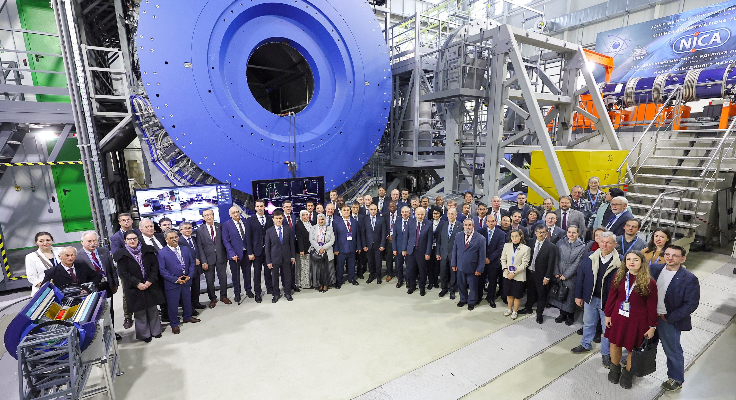
On the Resolution of the Session of the JINR Committee of Plenipotentiaries 25 March 2025, Dubna
Chair of the Committee of Plenipotentiaries ― representative of Georgia A. Khvedelidze

Slide 16
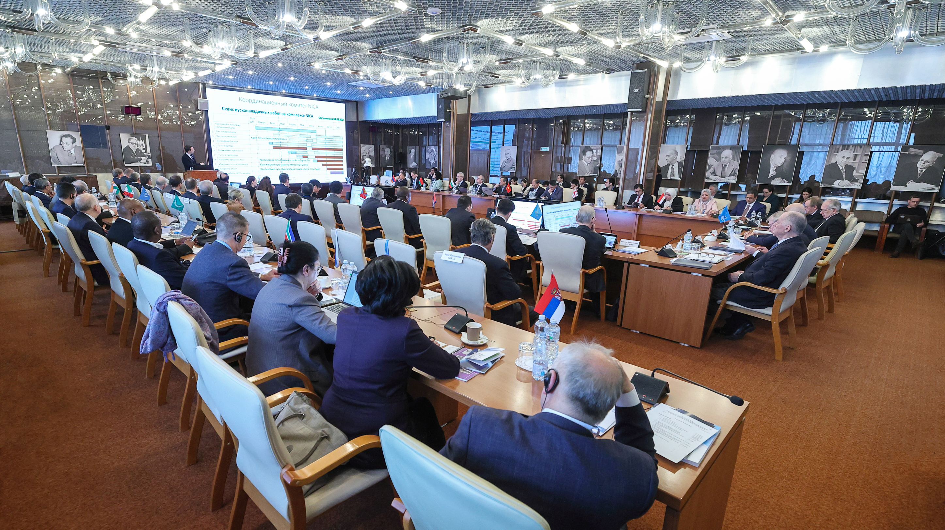
Session of the JINR Committee of Plenipotentiaries, 25 March 2025
AGENDA
G. Trubnikov: Report by the JINR Director
V. Kekelidze: On the first run at the NICA Accelerator Complex
N. Kalinin: Execution of the JINR budget for 2024 and draft of the revised budget of JINR for 2025
A. Omelchuk: Results of the meeting of the JINR Finance Committee held on 24 March 2025
5. A. Khvedelidze: On the call of elections & nomination of candidates for the position of JINR Director
6. V.Matveev: Scientific report: “To the 60th anniversary of the hypothesis of colored quarks and the Dubna model of hadrons”
7. S.Nedelko: On preparing and holding the events dedicated to the 70th anniversary of JINR

Slide 17
Session of the JINR Committee of Plenipotentiaries, 25 March 2025
The Committee of Plenipotentiaries:
approved the progress in implementing the current plan for research and development of the large scientific infrastructure of JINR, the successful participation of the Institute in international collaborations, & achievements in strengthening international cooperation.
noted with satisfaction the publication of the first issue of the new JINR scientific journal “Natural Science Review” in December 2024.
noted the high efficiency of the support program of the Ministry of Education & Science of RF for organizations collaborating in the framework of research at the NICA complex, & to consider it as an example of efficient assistance from a JINR MS in expanding the Institute’s cooperation with national research organizations & universities to projects based at JINR.

Slide 18
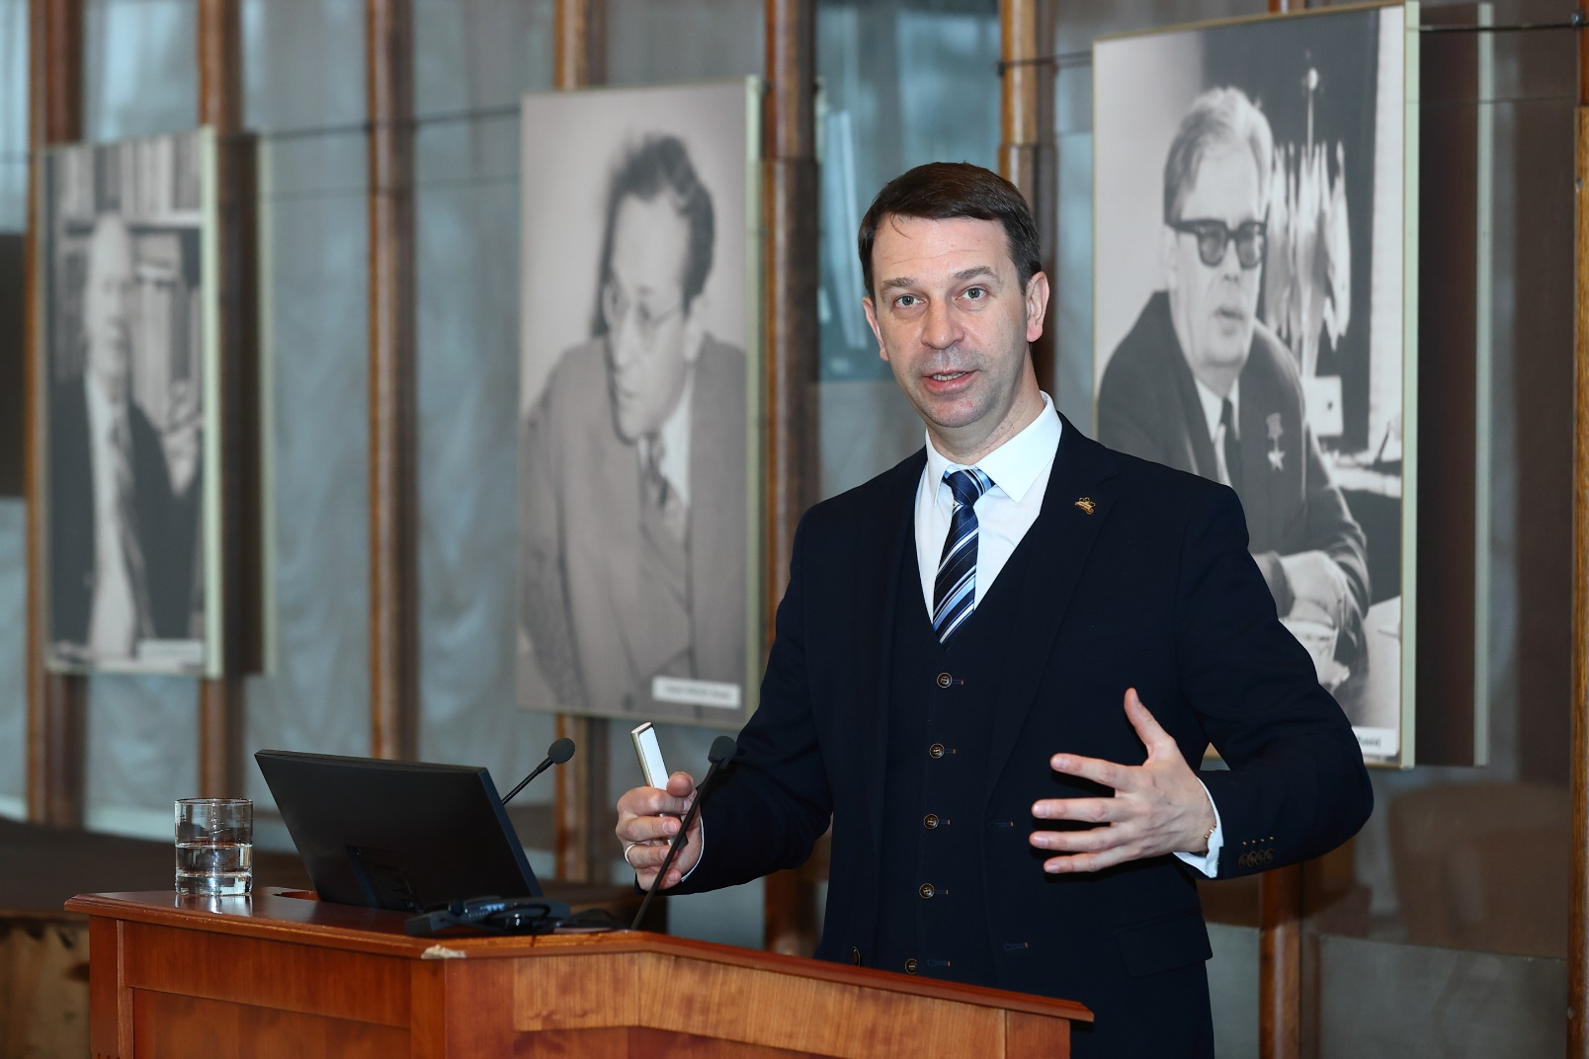
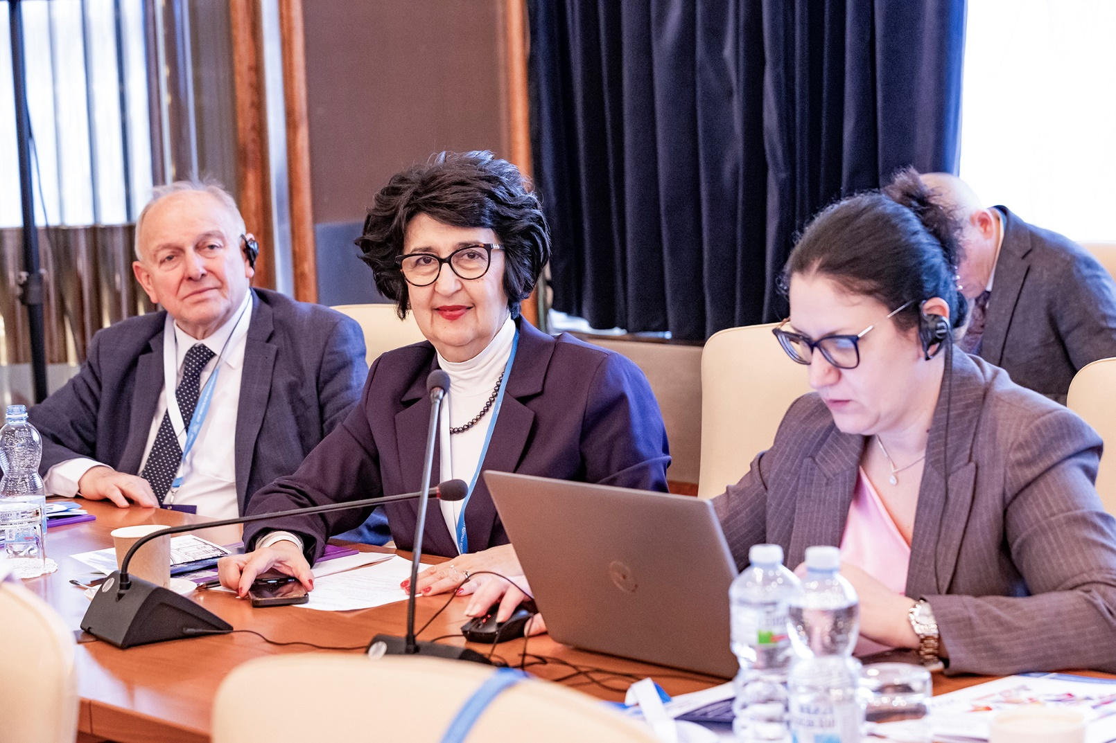
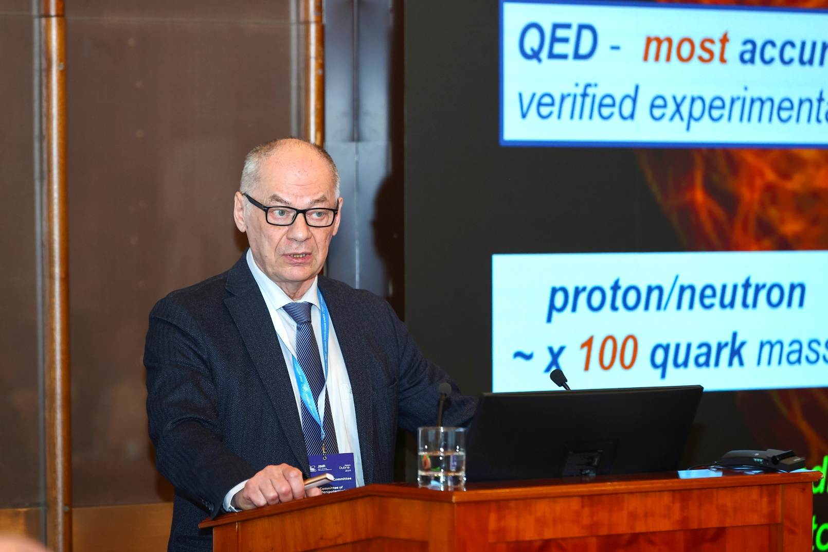
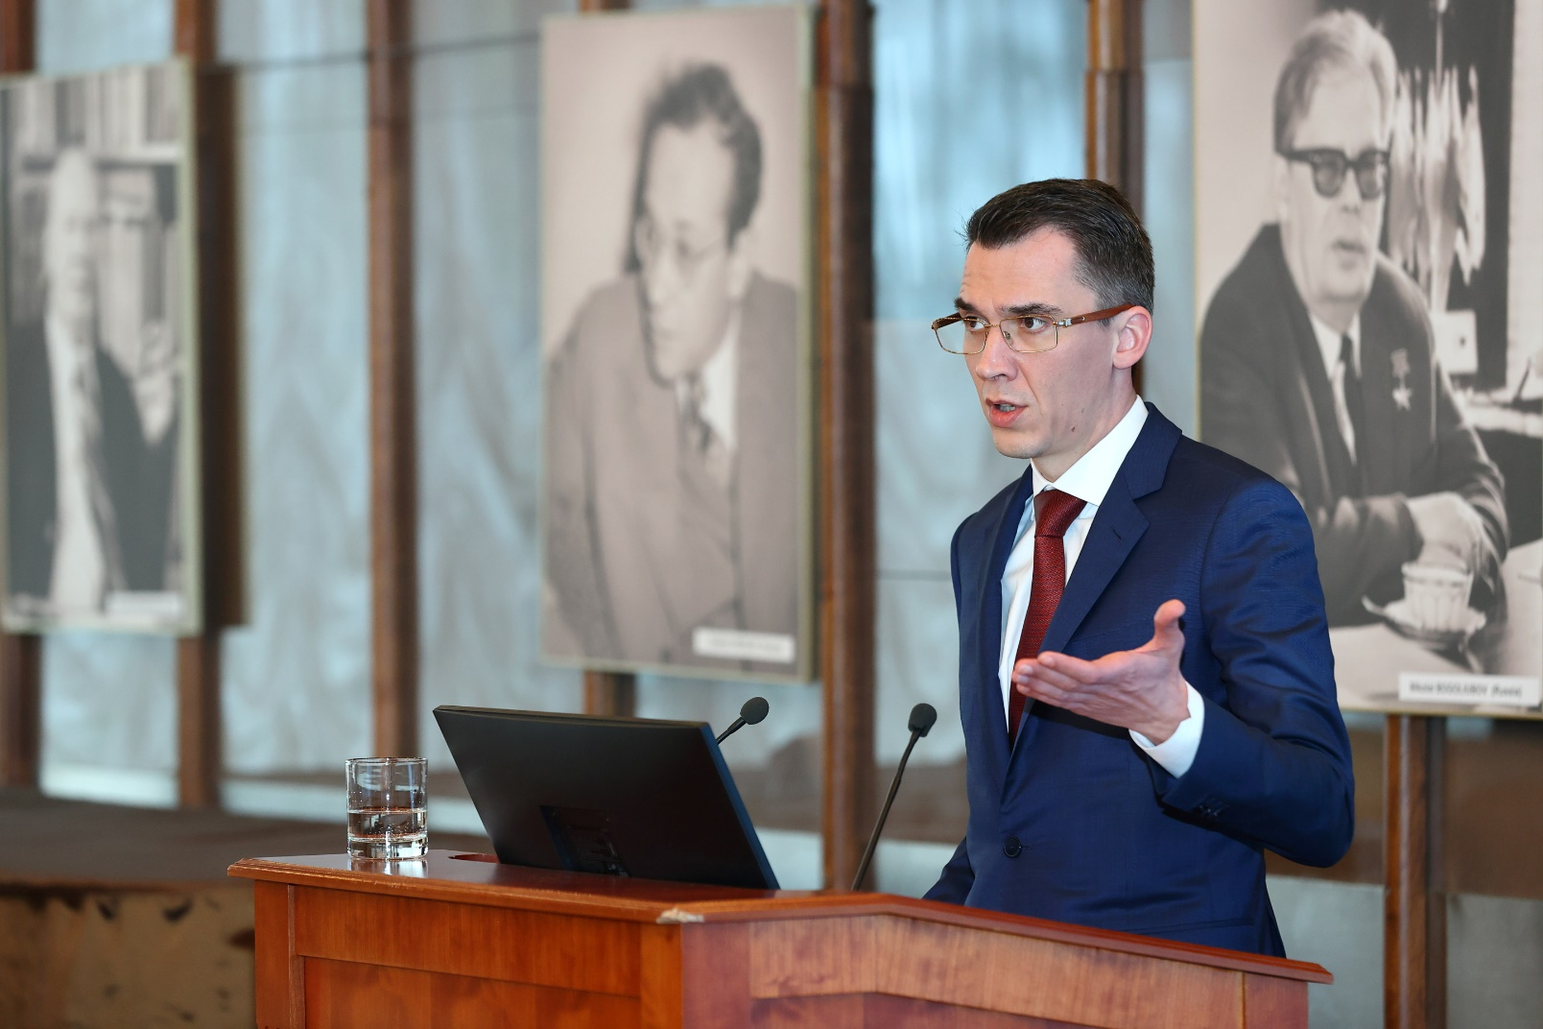
approved the organizational & financial decisions made by the JINR Directorate to minimize the risks of non-implementation of NICA project in 2022–2025, to find ways to reduce costs, & the presented updated cost of the project in the amount of M RUB 34 000. Commissioned the JINR Directorate to continue this work and to ensure the adoption of decisions & measures for maintaining the project implementation schedule to achieve the main parameters of the complex, as well as to continue active claims work with unfair suppliers.
approved the revised budget of JINR for 2025 with the income amounting to kUS$ 234 017.7 & the expenditure amounting to kUS$ 315 465.3, taking into account the positive opening balance amounting to kUS$ 40 170.2.
commissioned the JINR Directorate & Working Group for JINR Financial Issues to work out the possibility of indexation of the Incentive Fund for highly qualified employees, & to analyze the competitiveness of the salary level of scientific workers.

Slide 19
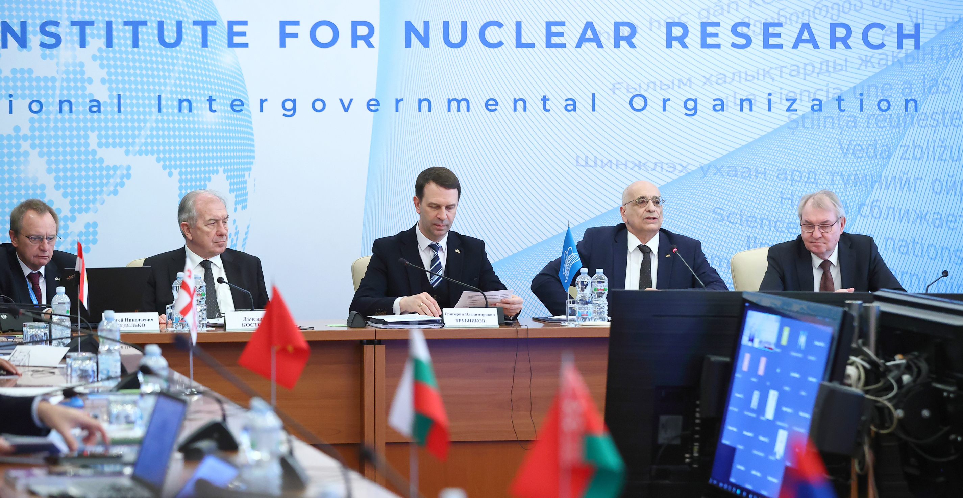
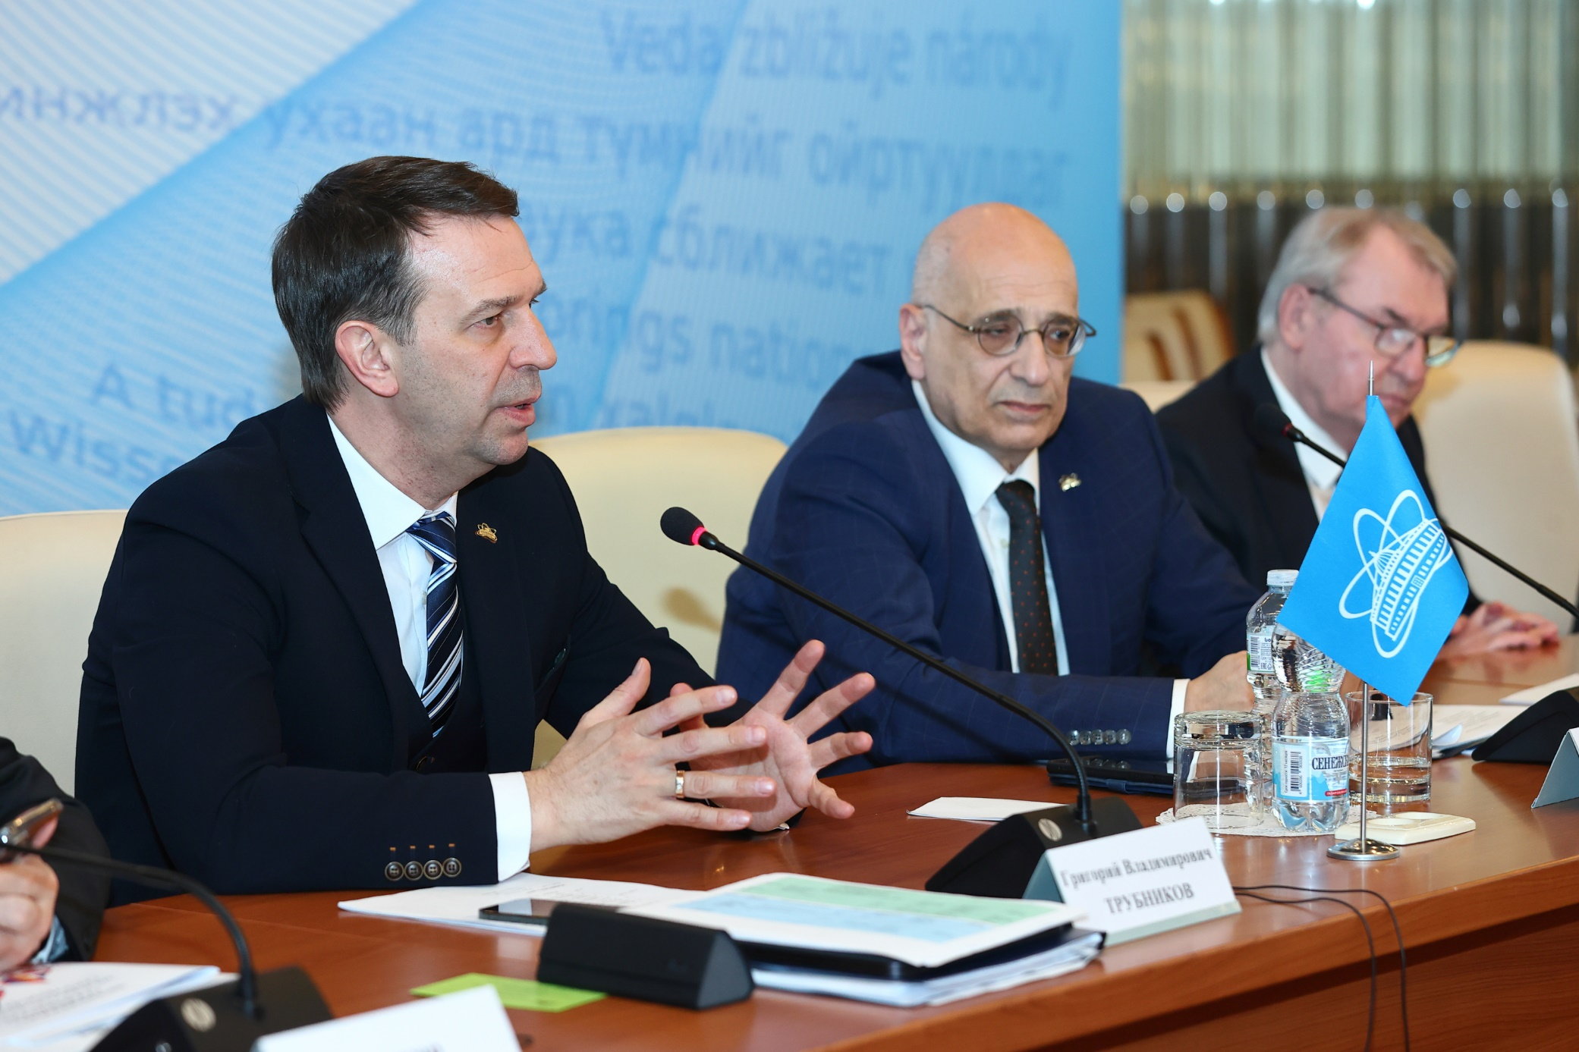
Session of the JINR Committee of Plenipotentiaries, 25 March 2025
Election of the Institute Director
The election of the Insitute Director, whose powers expire on 31 Dec. ‘25, was the central items on the agenda. The Chairman, A.Khvedelidze, announced the rules for calling elections & nominating candidates. The CP members proposed to hold elections at the current meeting.
Having discussed the report “On the call of elections & nomination of candidates for the position of JINR Director” by A. Khvedelidze, taking into account the unanimous decision of the PP to nominate G.Trubnikov as the only candidate for the position of Director, as well as the consent of G. Trubnikov to be nominated, based on the results of open voting, in accordance with the JINR Charter & Regulation, G.Trubnikov was unanimously elected to the position of JINR Director for a term of 5 years taking office on 1
January 2026.
G.Trubnikov expressed gratitude to the JINR member countries' plenipotentiaries for their trust & appreciation of the work of both the Directorate & entire staff of the Institute.

Slide 20
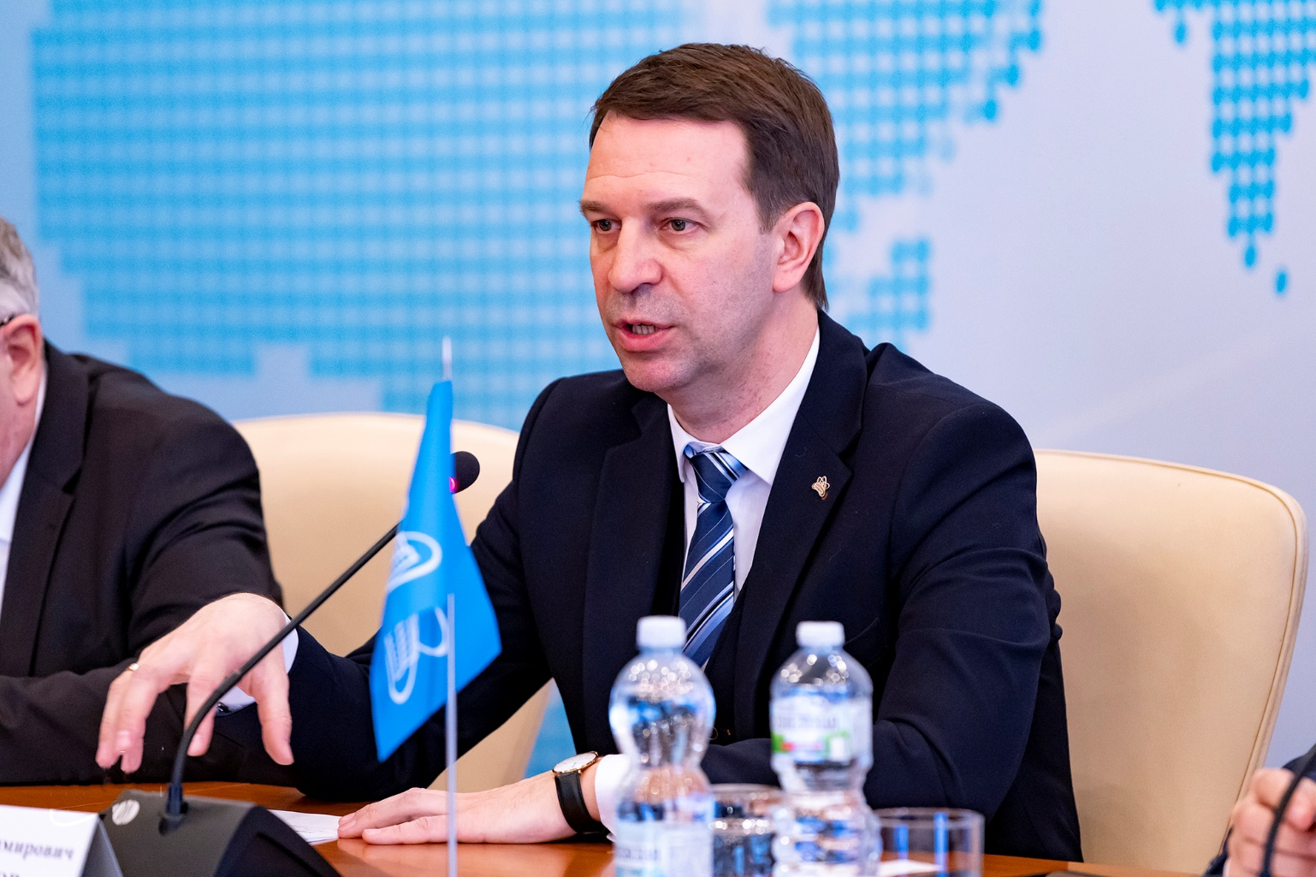
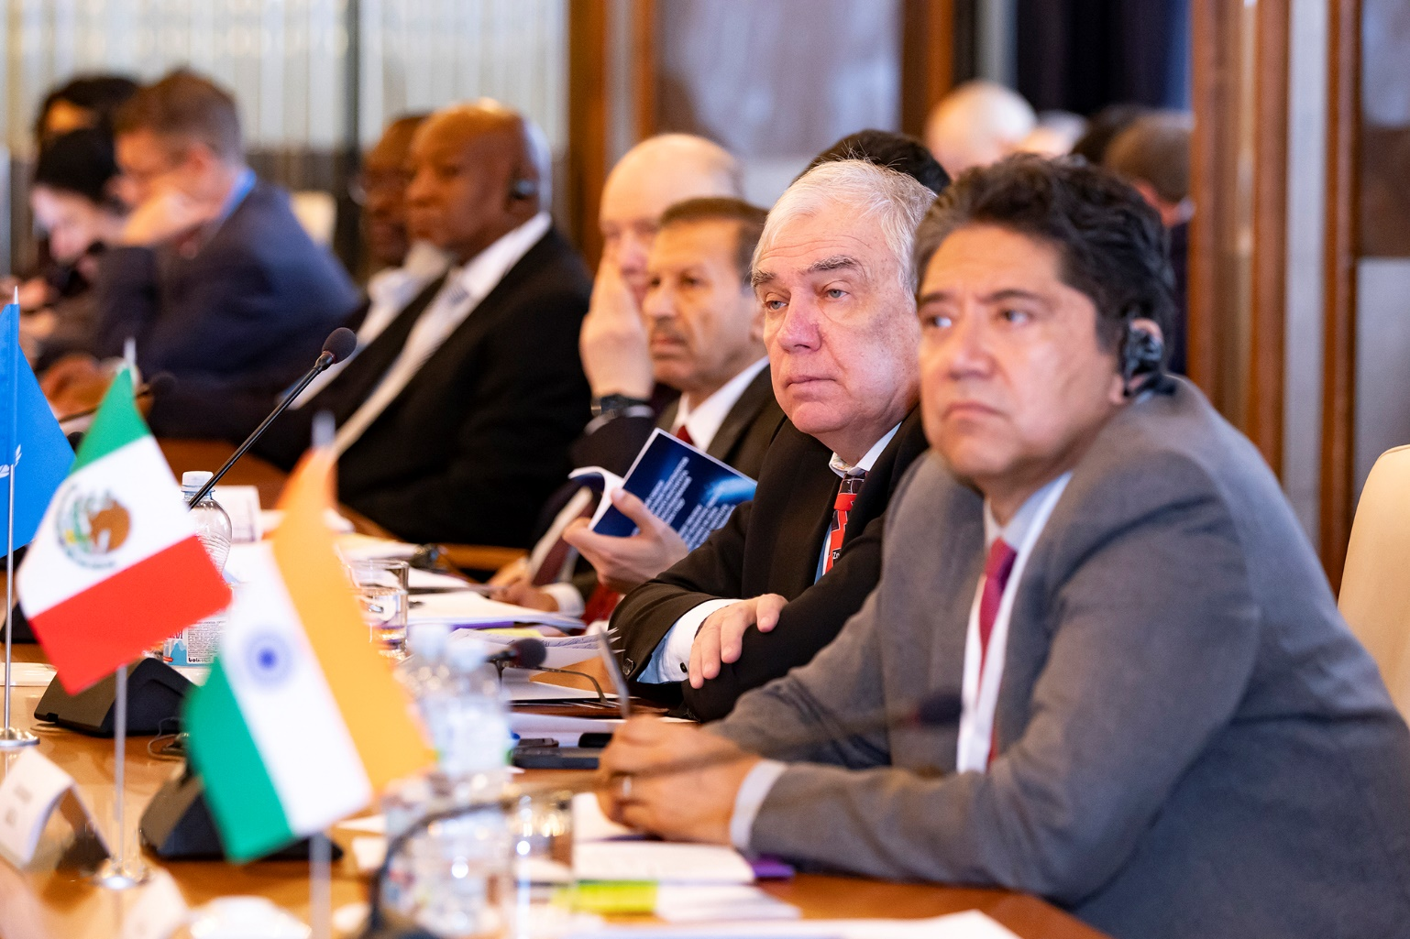
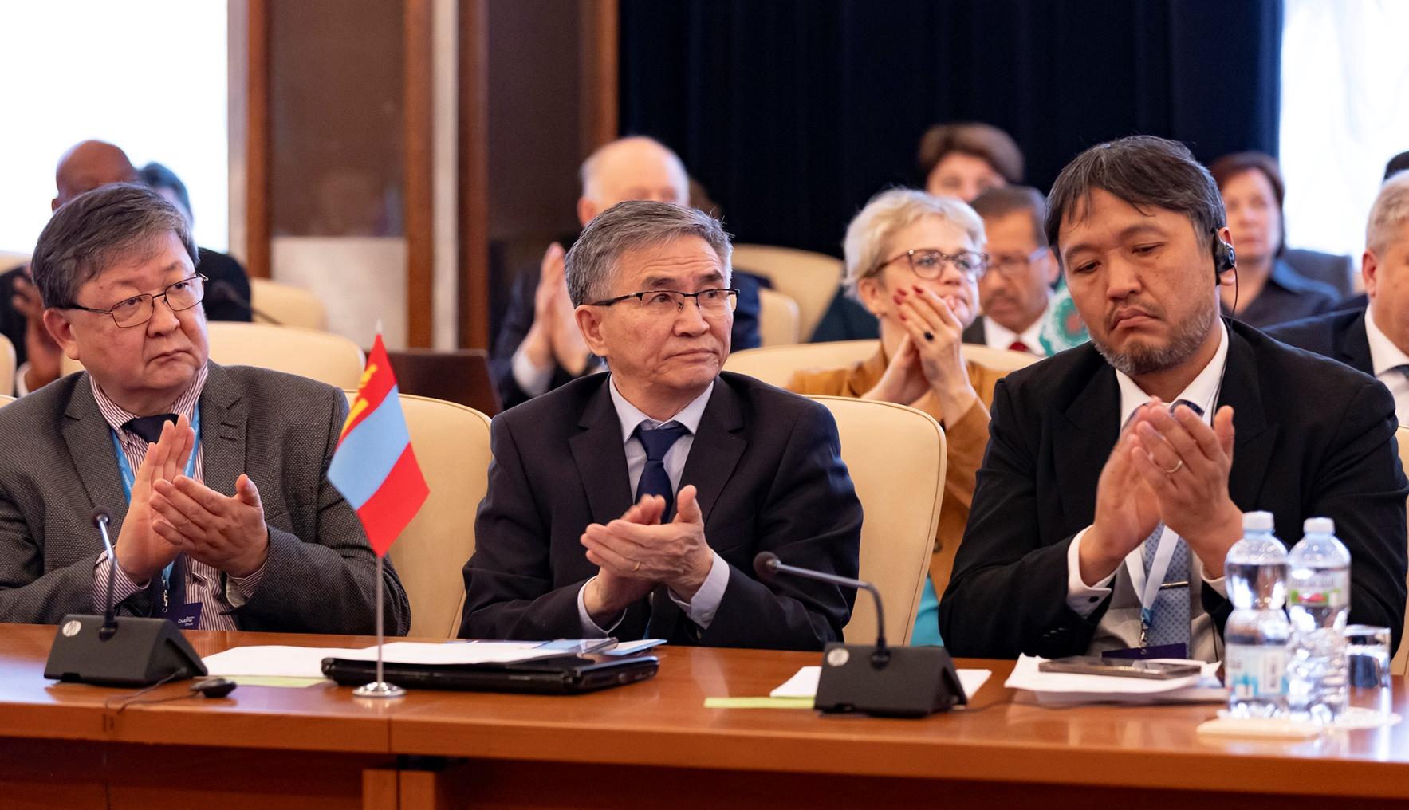
Session of the JINR Committee of Plenipotentiaries, 25 March 2025
The Committee of Plenipotentiaries:
thanked Scientific Leader of JINR, V.Matveev for his interesting & informative report “To the 60th anniversary of the hypothesis of colored quarks and the Dubna model of hadrons”.
approved the Plan of events dedicated to the 70th anniversary of JINR proposed by the Organizing Committee & reported by S. Nedelko, which includes holding JINR Days in MS, major scientific conferences, exhibitions, cultural & sporting events, as well as the preparation & publication of a book about the history of JINR. The Committee decided to hold a ceremonial meeting dedicated to the 70th anniversary in March 2026 in Dubna.
invited all JINR MS to send their national delegations to participate in this event & commissioned the JINR Directorate to organize a meeting of the Working Group under the CP Chair for JINR Financial Issues in June–July 2025, in Armenia.

Slide 21
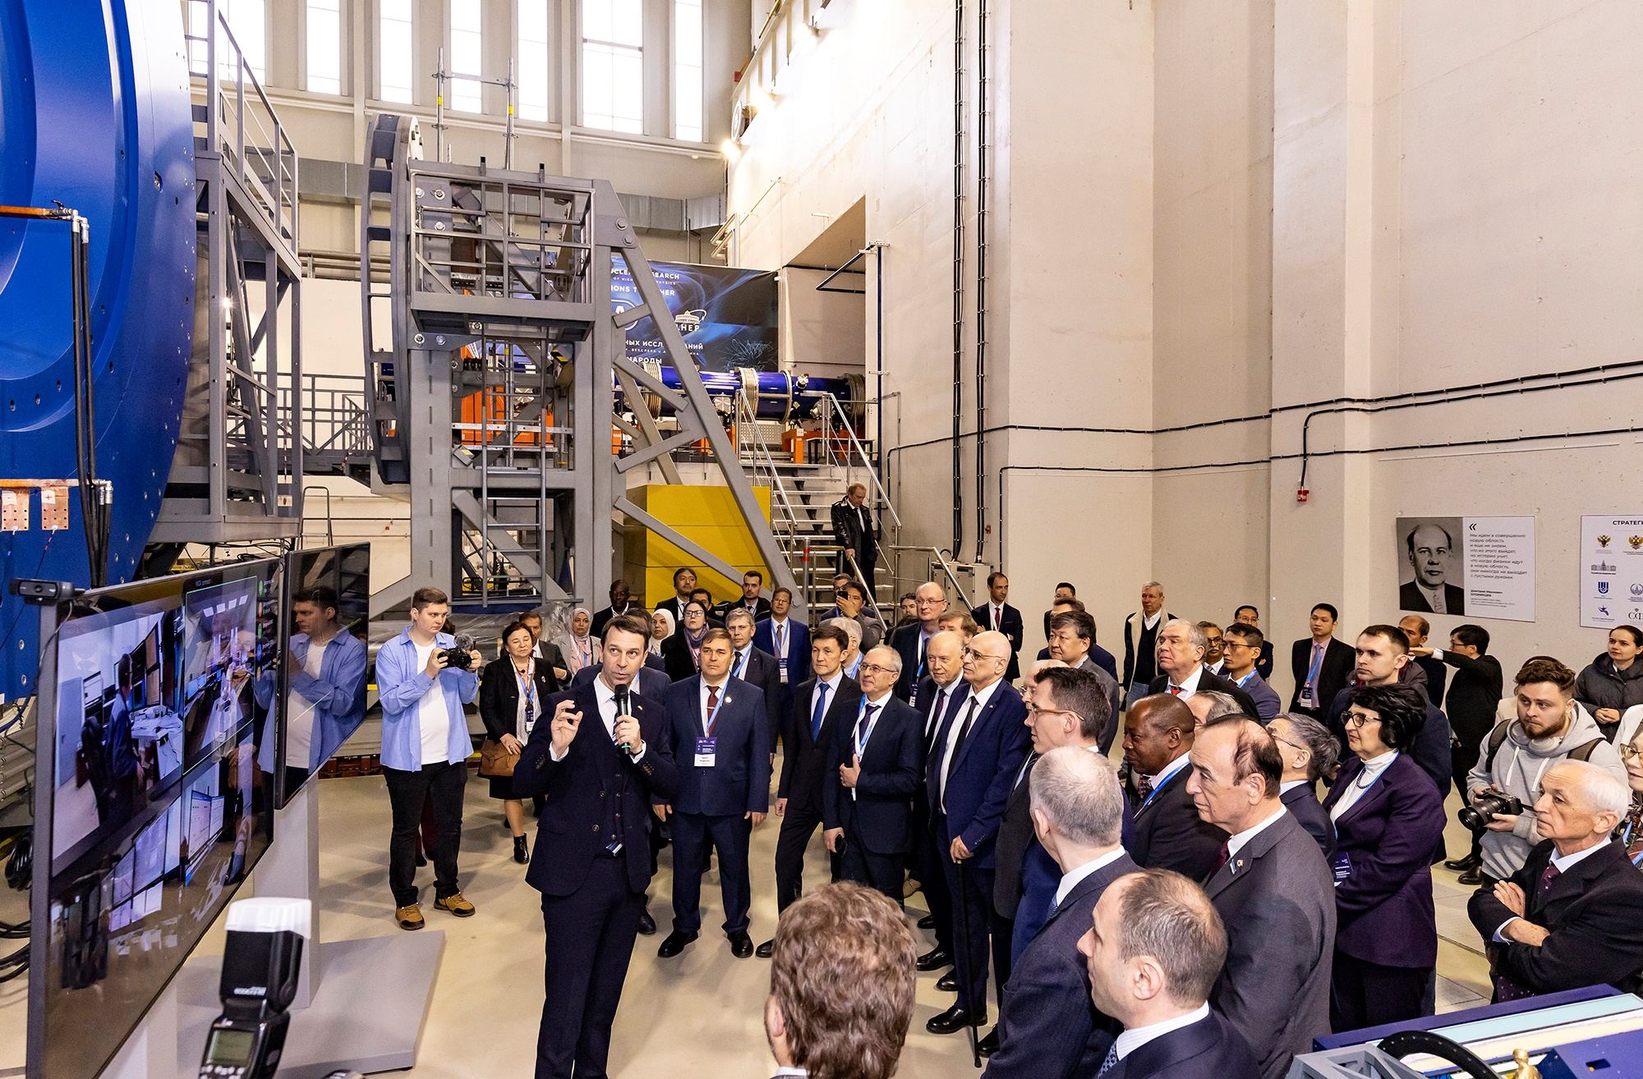
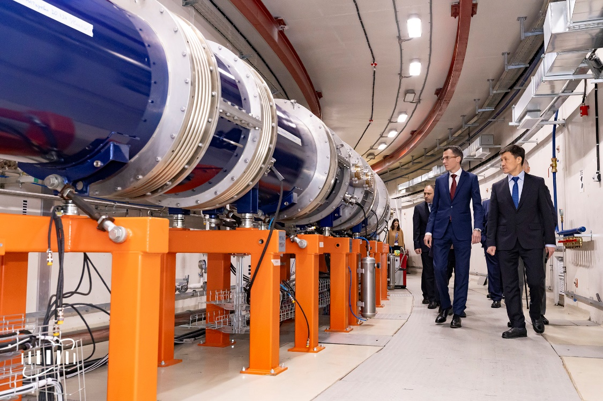
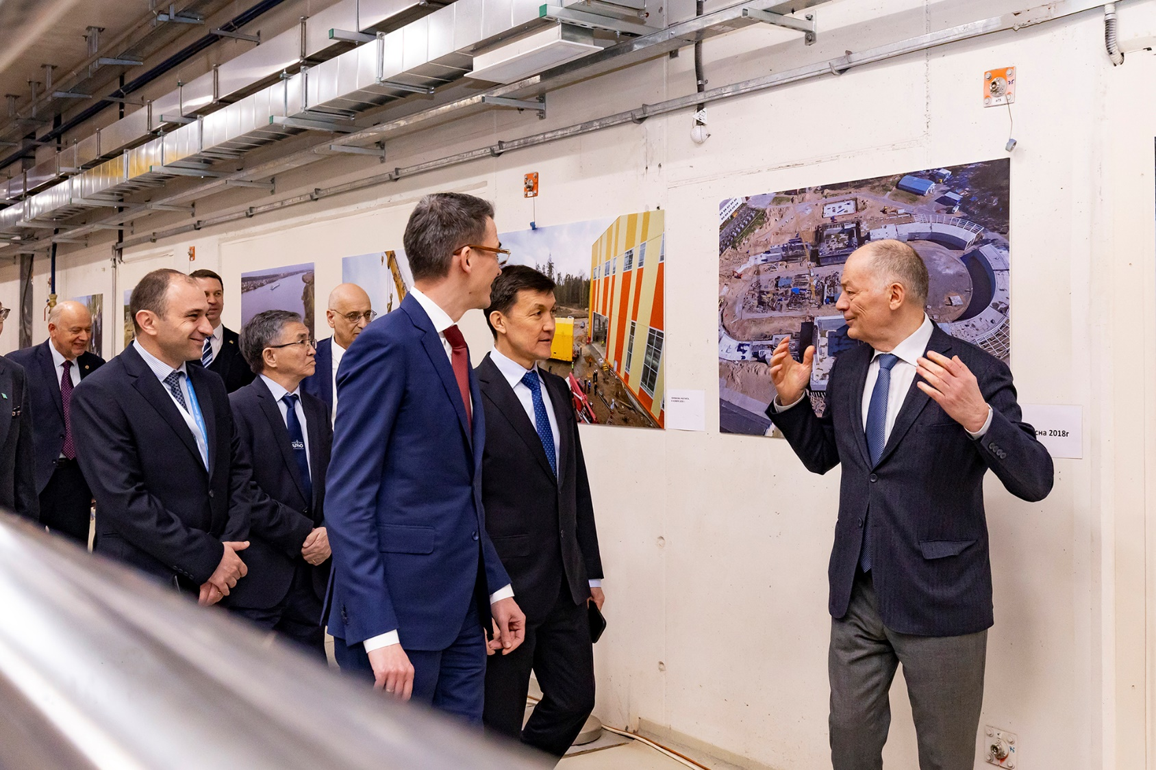
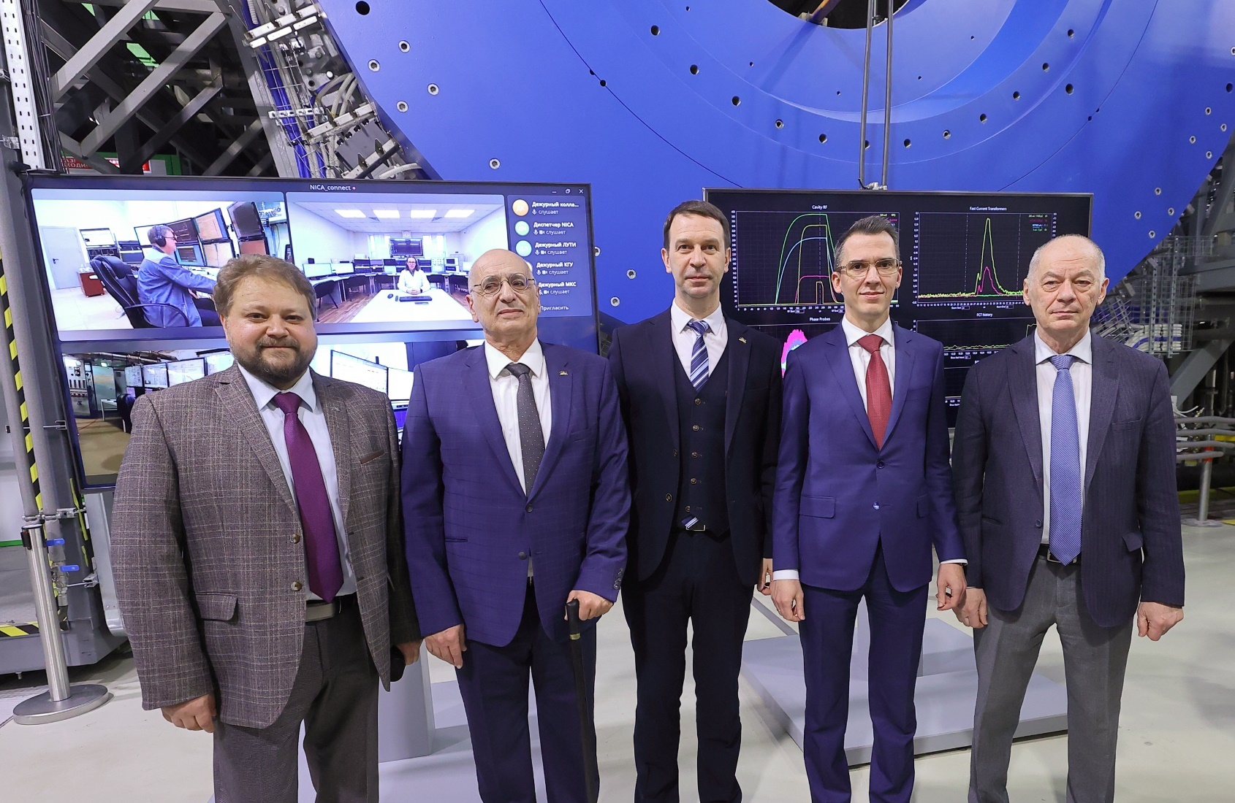
Run #1 at the NICA Accelerator Complex has been Launched
On 25 March 2025, run #1 at the NICA accelerator complex was started. The ceremony took place alongside a CP session in the presence of representatives of 20 Member States & Associate Members, as well as partners of the JINR.
The event took place in the MPD hall in a hybrid format, as the main control room is located ~ 0,5 km from the MPD hall. VBLHEP Acting Director A.Butenko, CP Chair A.Khvedelidze, & Deputy Minister of SHE RF A.Omelchuk, together with G.Trubnikov, shared the honor to give the command to start. After the dispatcher in the control room confirmed that all systems are ready, the cold gas started to fill the accelerators, & a Xe beam of ~ 300 microamperes, was injected.

Slide 22
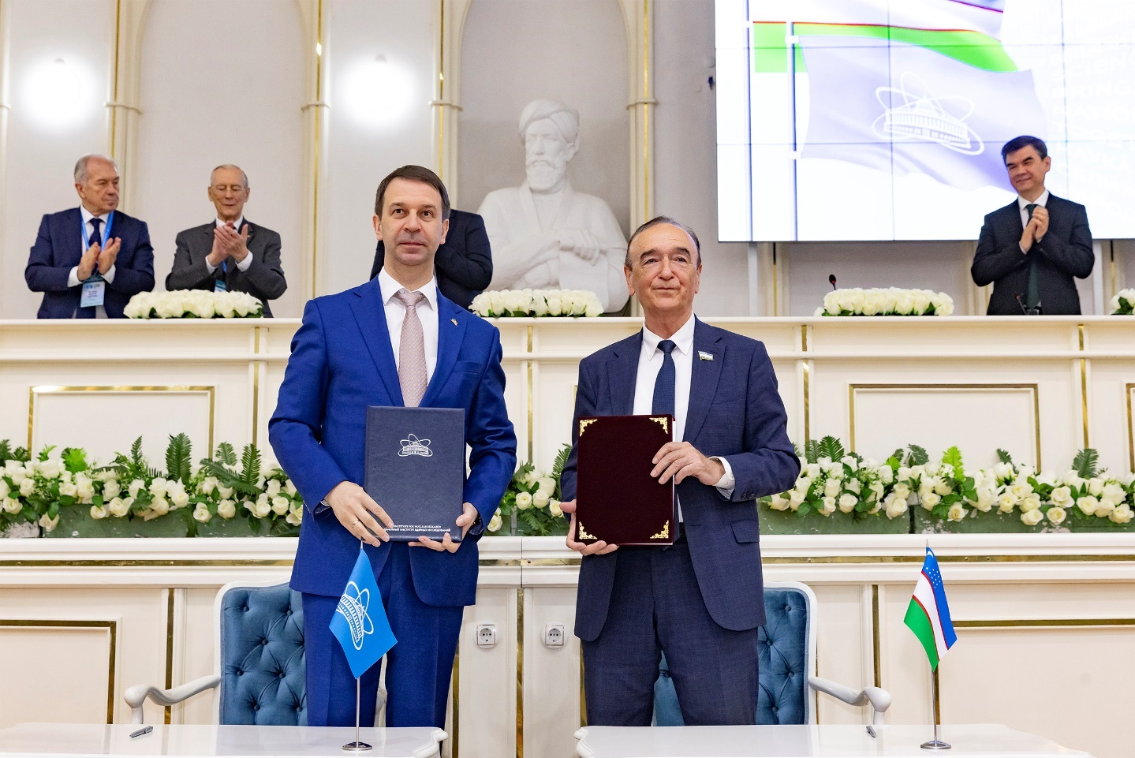
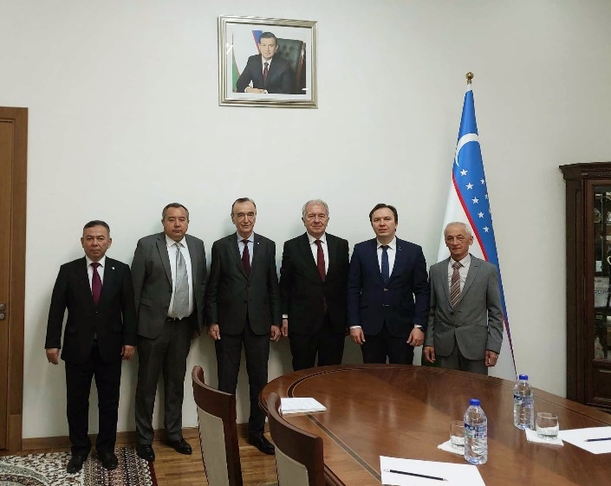
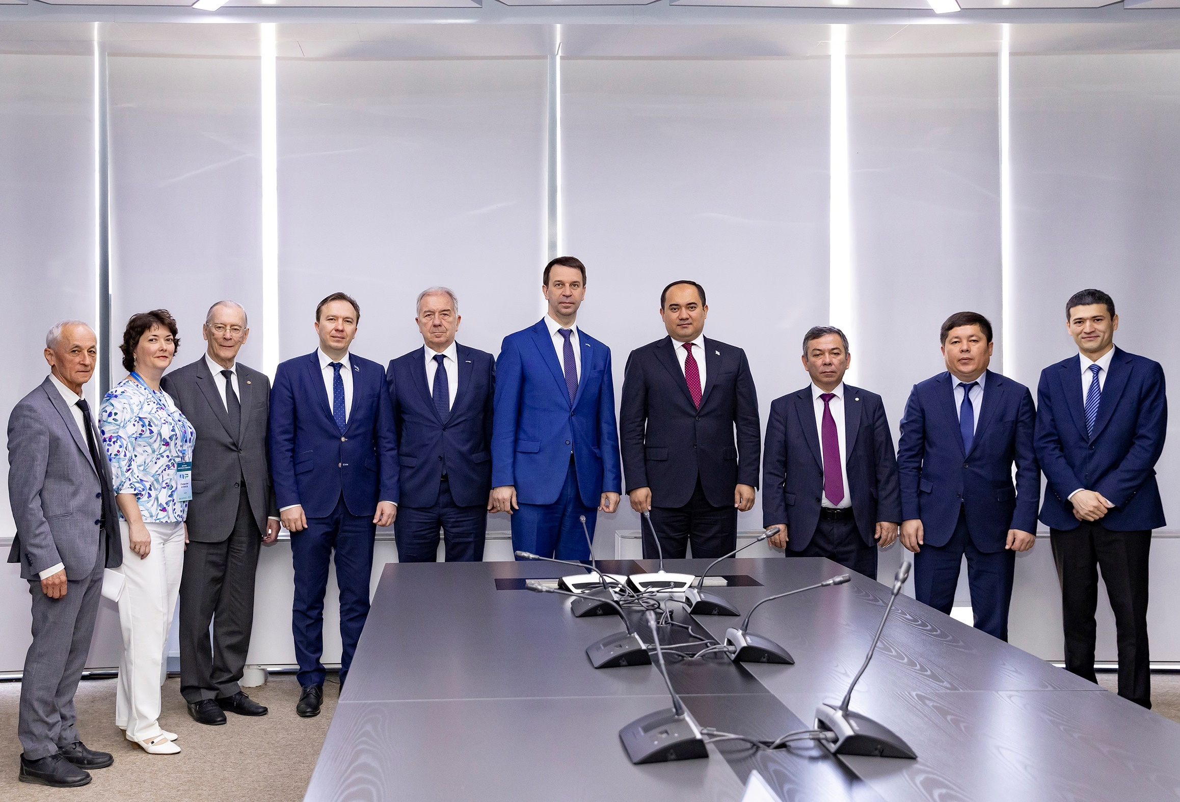
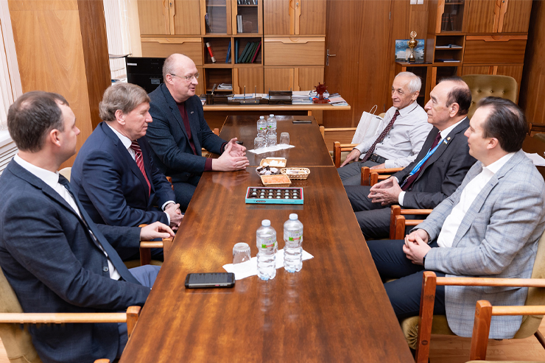
International Cooperation
Member States
24–26 Feb. ‘25 JINR delegation led by Vice-Dir. L. Kostov visited the AS RUz, Institute of Nuclear Physics & met with President of the AS Shavkat Ayupov. The parties discussed expansion of the cooperation & agreed on the meeting in April 2025.
On 22-24 Apr. ‘25 JINR Days in Uzbekistan took place. JINR & AS RUz signed a scientific & technical cooperation agreement. G.Trubnikov was awarded the “80 years of the AS” honorary medal. JINR delegation met with First Deputy Minister of Higher Education, Science & Innovation Shaxrukh Daliyev
24‒26 Mar. ’25 President of the AS RUz Shavkat Ayupov paid a visit to JINR, participated in the FC & CP meetings, & met with JINR Director.
The AS Presidium hosted interactive exhibition dedicated to JINR’s activities.
The ceremony participants laid flowers on the grave of Acad. B.Yuldashev, a long-time AS President, Plenipotentiary Representative of the Government of Uzbekistan at JINR.

Slide 23
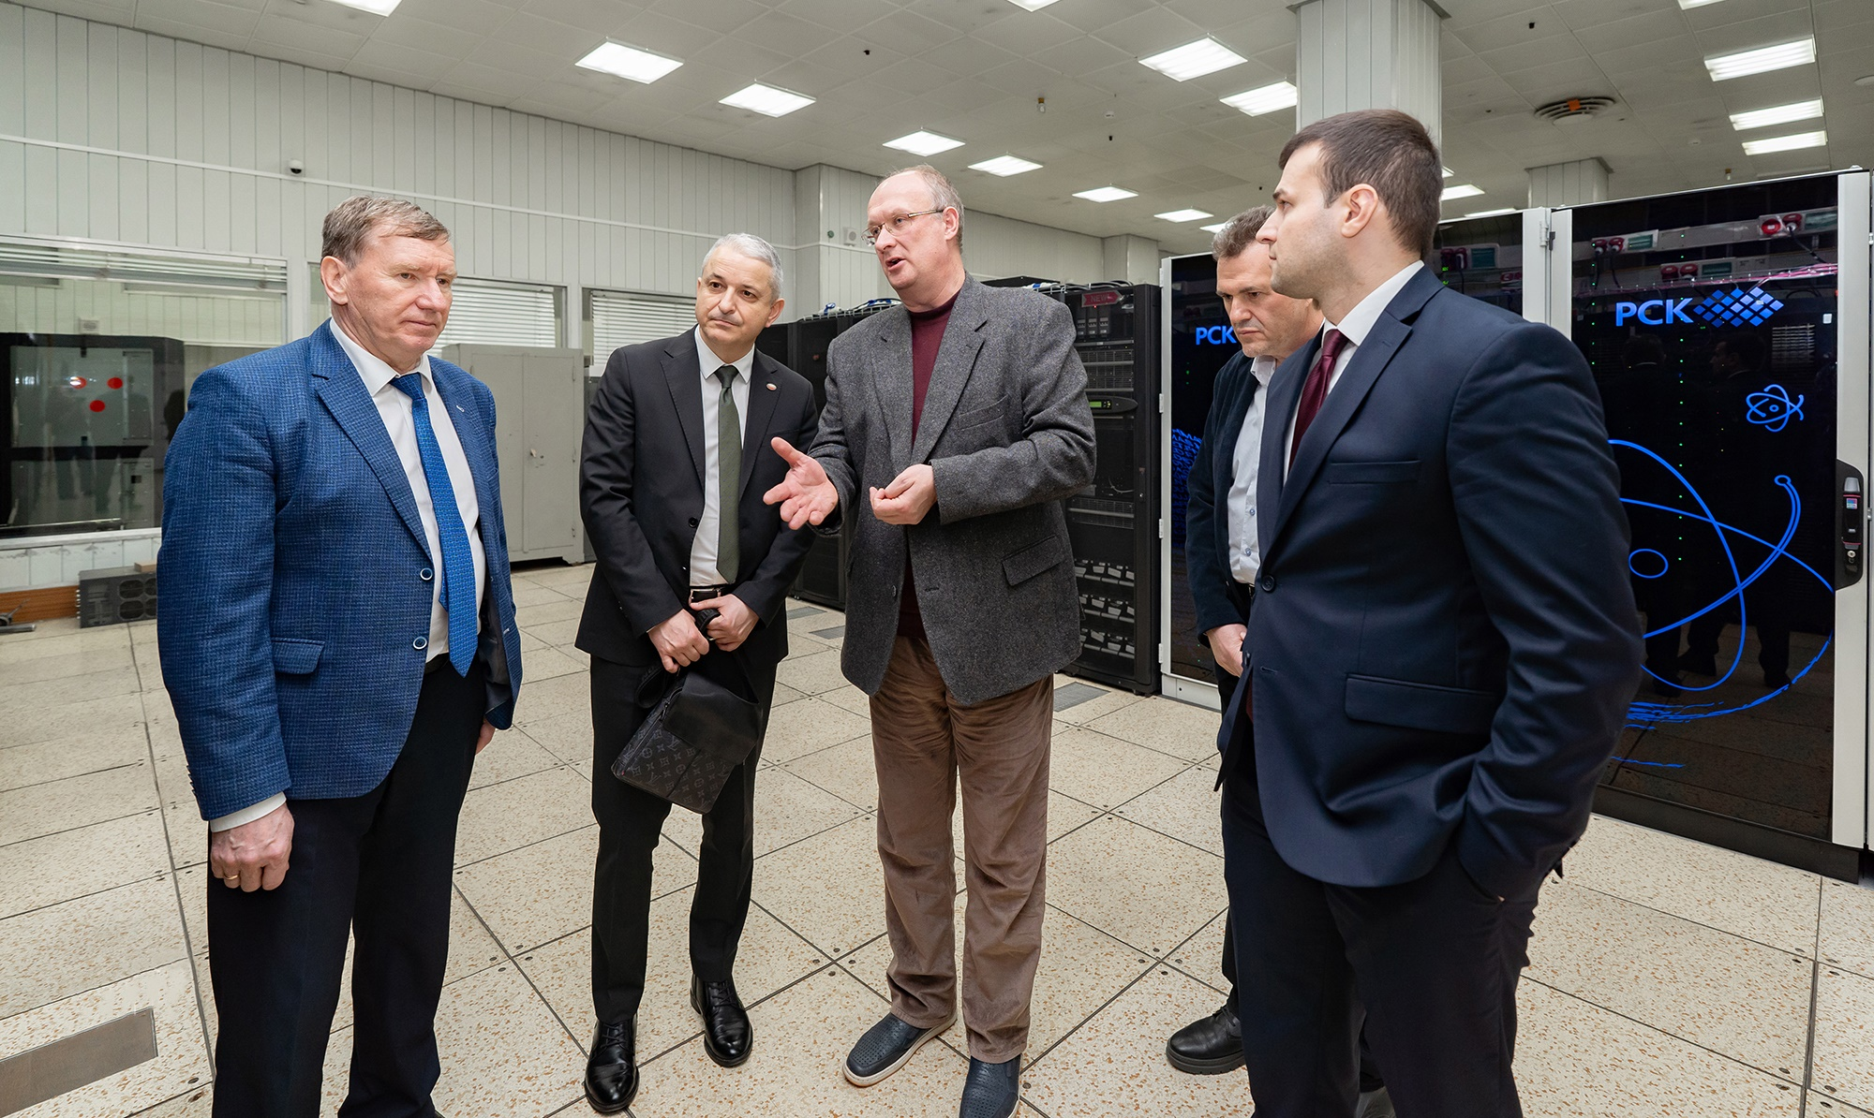
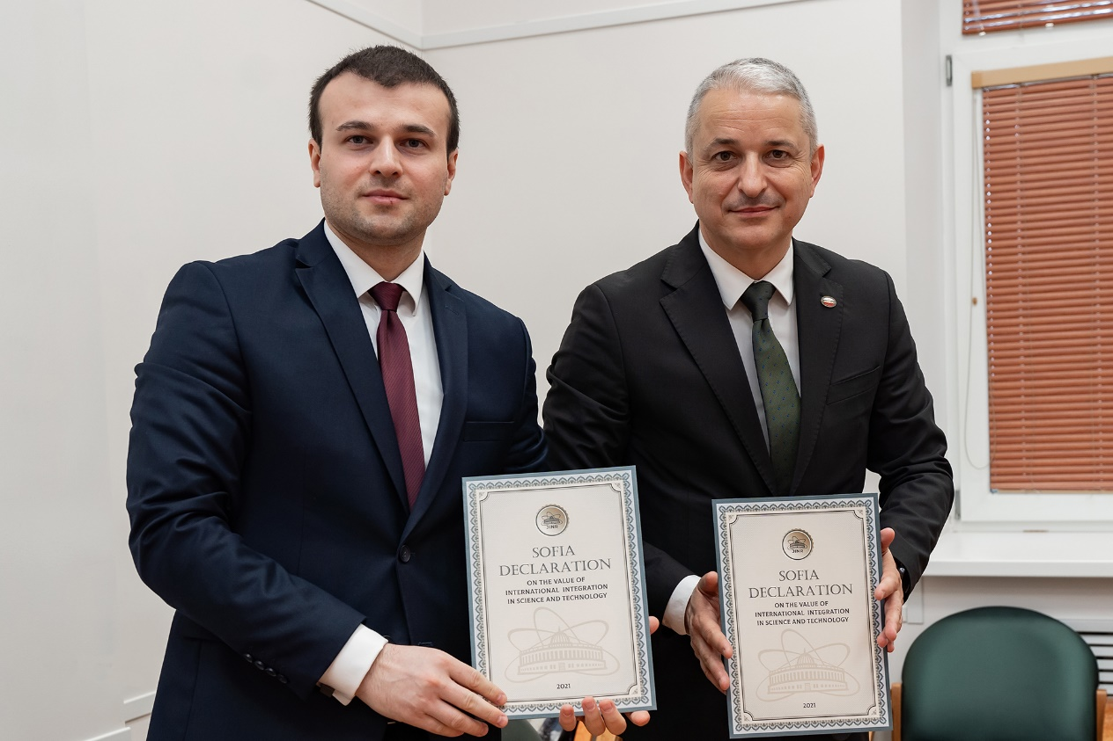
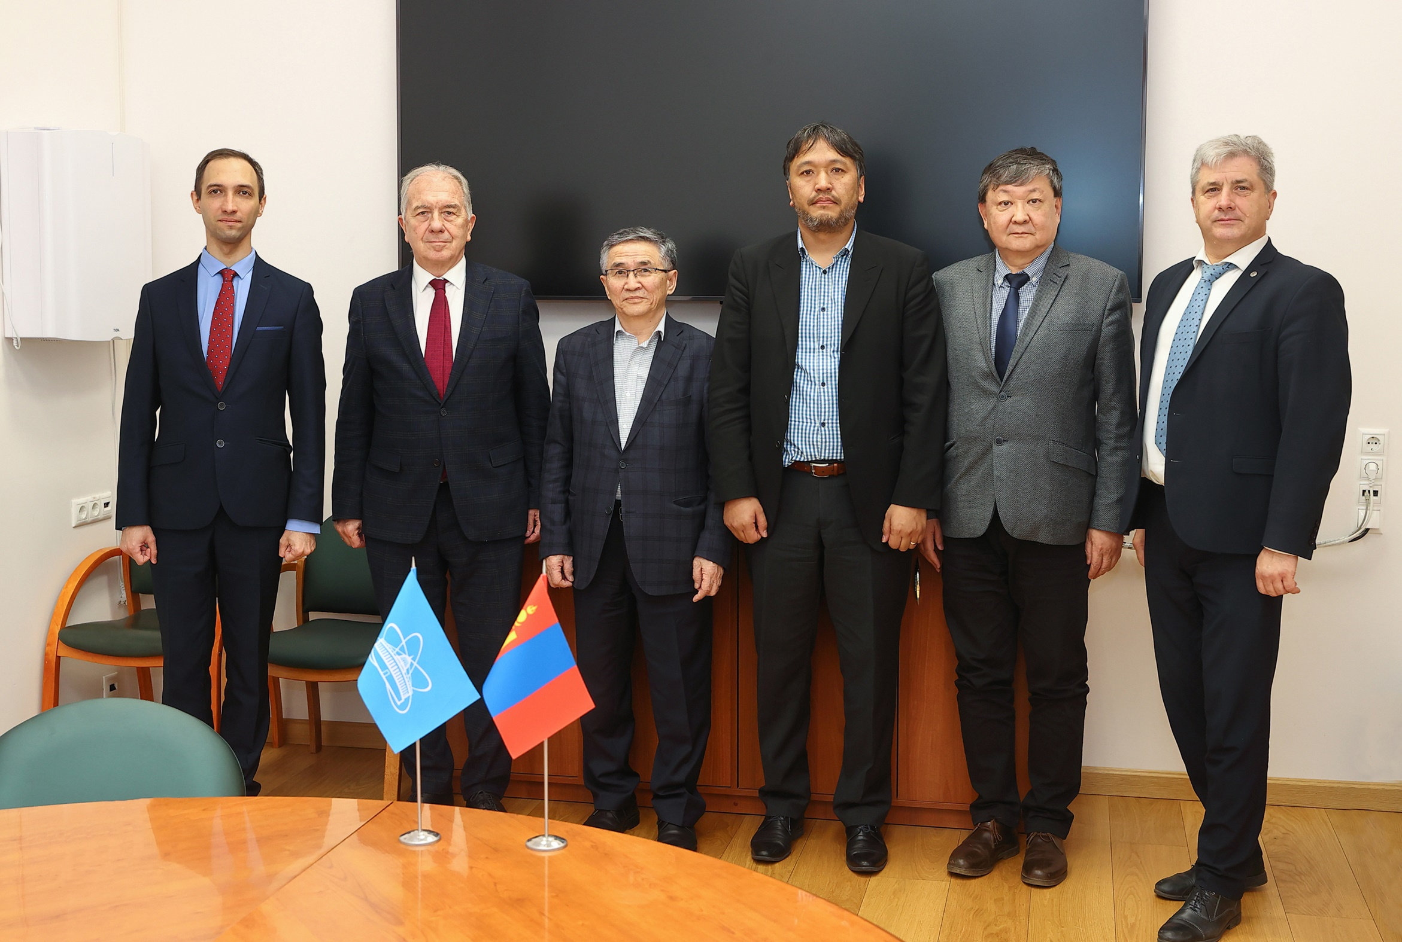
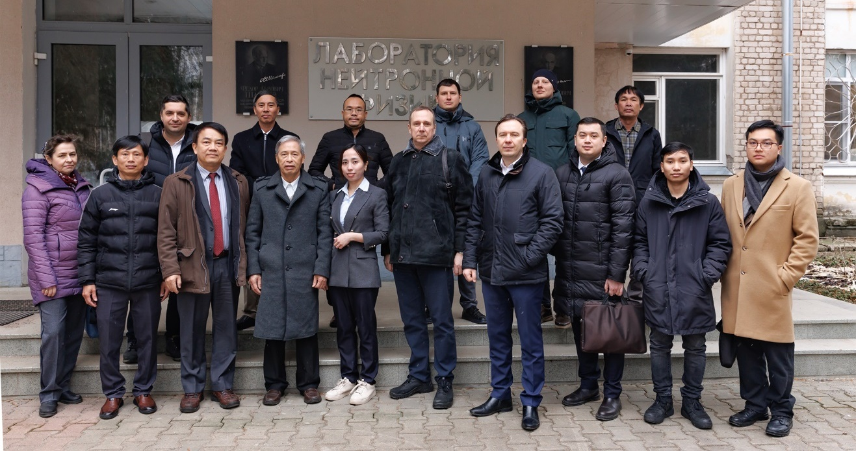
International Cooperation
Member States
7–8 April 2025 Members of the National Assembly of the Republic of Bulgaria, Yordan Todorov & Angel Yanchev, visited the JNR & got acquainted the JINR laboratories & main facilities.
27 Mar. ‘25 Plenipotentiary of Mongolia Suren Davaa & Director NRC at the National University of Mongolia Byambajav Munkhbat visited JINR.
The delegates met with JINR Directorate & Mongolia national group. It was agreed to hold the 2025 NUMAR-Gobi International School on Nuclear Methods & Applied Research in Ulaanbaatar this summer.
11 Feb. ‘25 VINATOM delegation, headed by President Tran Thi Thanh, & representatives of the Rosatom, visited the FLNP at JINR & got introduced to IBR-2M pulsed reactor & facilities using extracted neutron beams. Parties discussed FLNP specialists’ participation in
research reactor being designed in Vietnam, & agreed to involve
Vietnam scientists in the activities at the IBR-2M
10–16 May ‘25 In Hanoi, representatives of VBLHEP, FLNP, FLNR, MLIT, & the University Centre participated in a number of meetings on education & personnel training with universities & scientific centres of Vietnam.

Slide 24
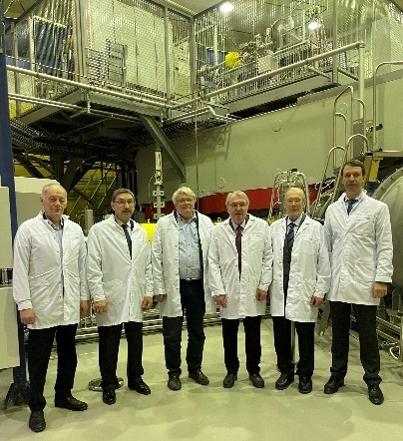
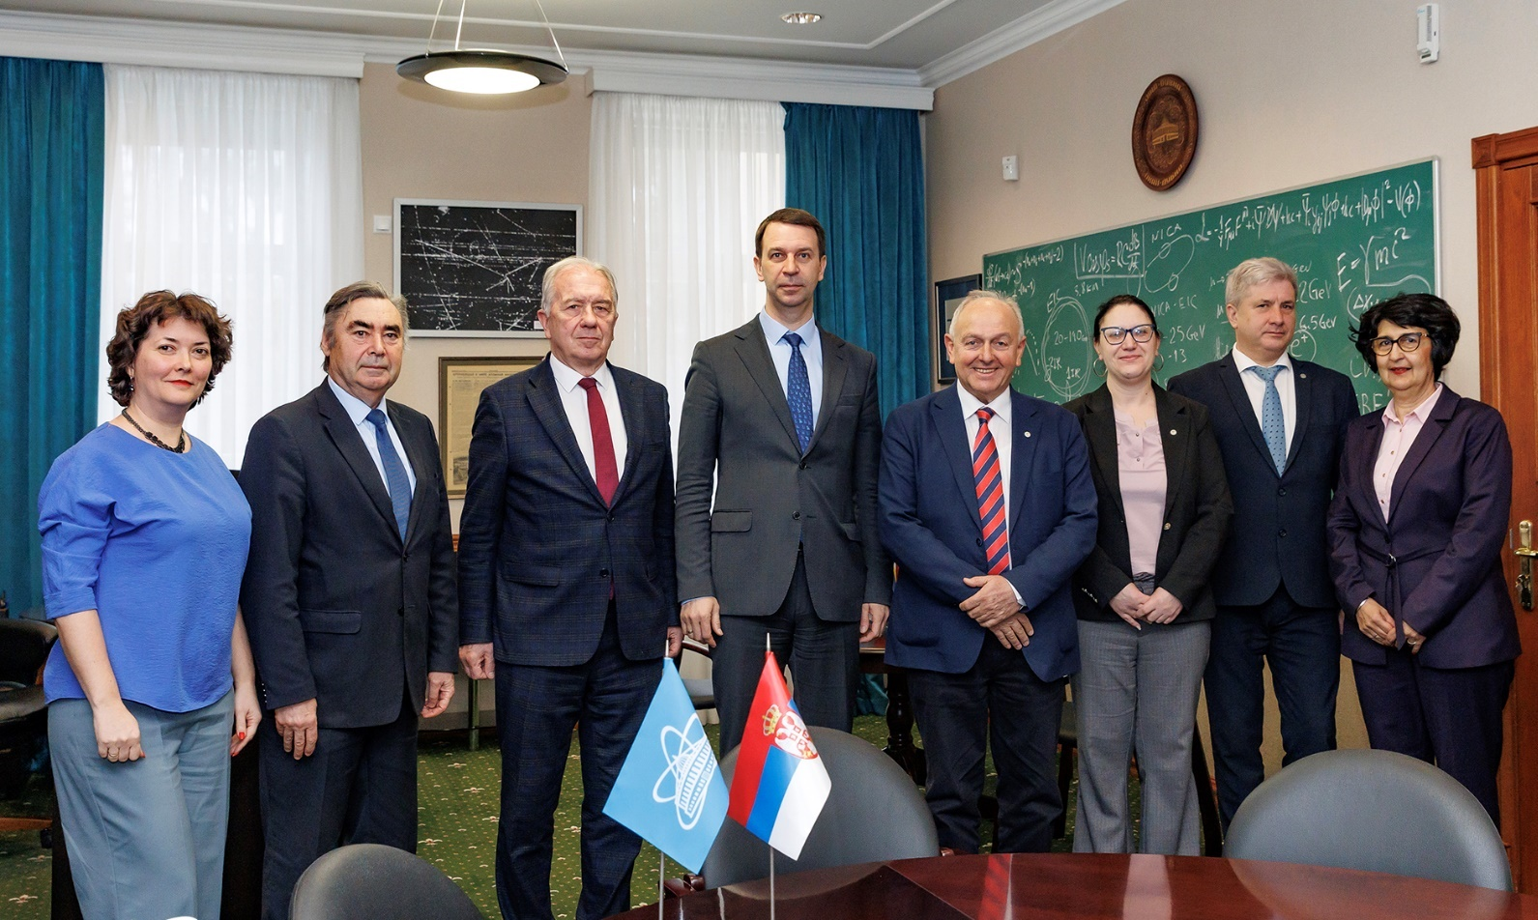
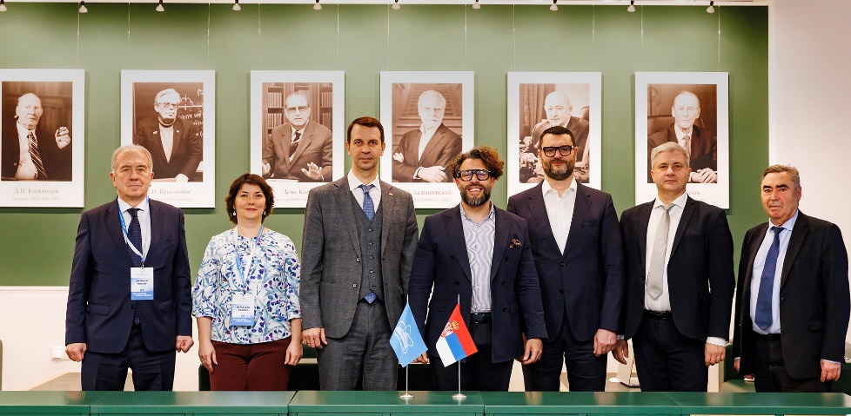
International Cooperation
Member States
31 Jan. ‘25 Academician-Secretary of the Physics Department of RAS Vitaly Kveder & Director of the Solid State Physics institute Alexander Levchenko visited JINR, met with the Directorate & Yuri Oganessian, discussed Russian federal program “Fundamental properties of matter”.
International Cooperation
Associated Members
13 Feb. ’25 JINR hosted a meeting with Director of the Vinča Institute of Nuclear Sciences (Serbia) Slavko Dimović. The parties discussed cooperation prospects and potential new projects.
27 Mar. ’25 State Secretaries of the Ministry of Science, Technological Development & Innovation of Serbia, Miroslav Trajanović, met with the JINR Directorate. The parties discussed the prospects of JINR–Serbia cooperation & outlined the next steps to implement joint initiatives and projects.

Slide 25
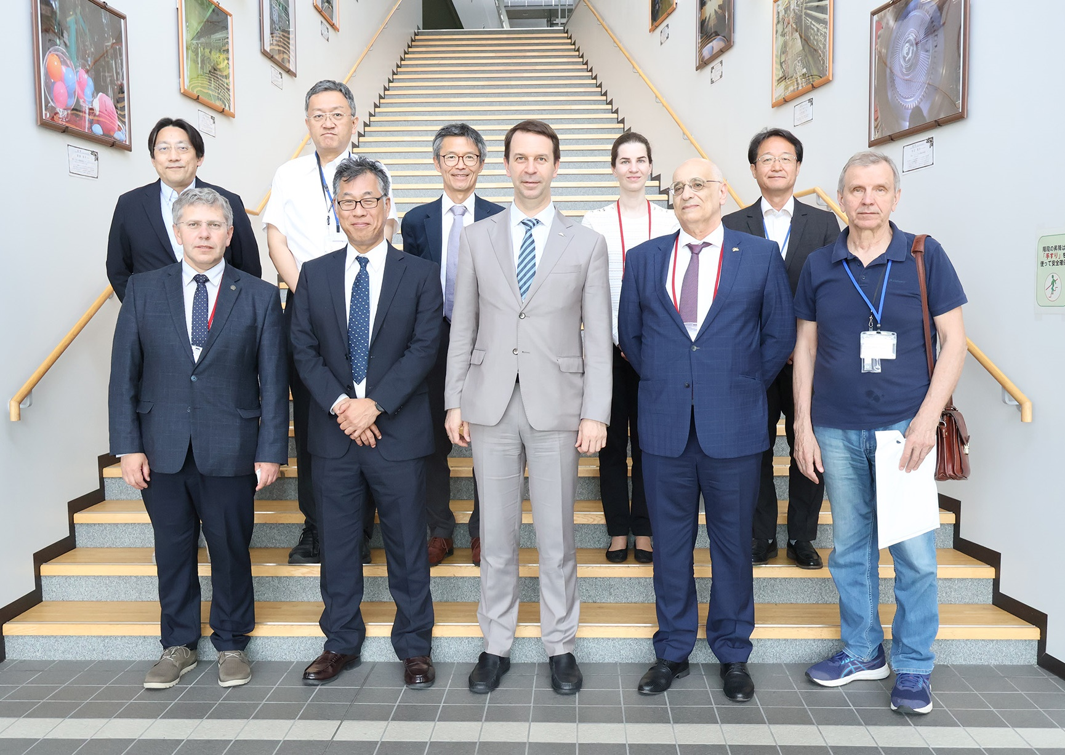
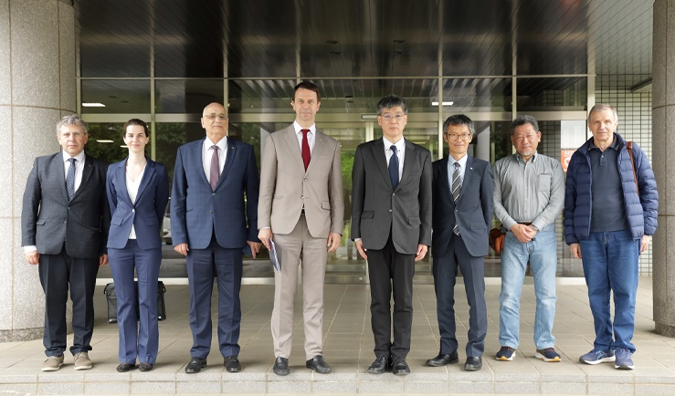
International Cooperation
JINR Delegation in Japan
19‒21 May ’25 JINR delegation led by G.Trubnikov visited Japan & took part in working meetings at major national research centres: KEK (High Energy Accelerator Research Organization) & J-PARC (Japan Proton Accelerator
Research Complex).
JINR scientists are actively involved in the
the COMET & T2K experiments at J-PARC , making a significant contribution to detector systems & data analysis. The KEK & J-PARC leadership highly appreciated the achievements of the JINR specialists & noted the potential for their participation in the future Hyper-Kamiokande Project. The parties expressed mutual interest in involving Japanese scientists in experiments at JINR’s main facilities, & hlighted the importance of academic mobility for physicists..
The parties discussed opportunities for cooperation in JINR, KEK, and J-PARC projects, expressed mutual interest & noted were willing to update the current MoU.

Slide 26
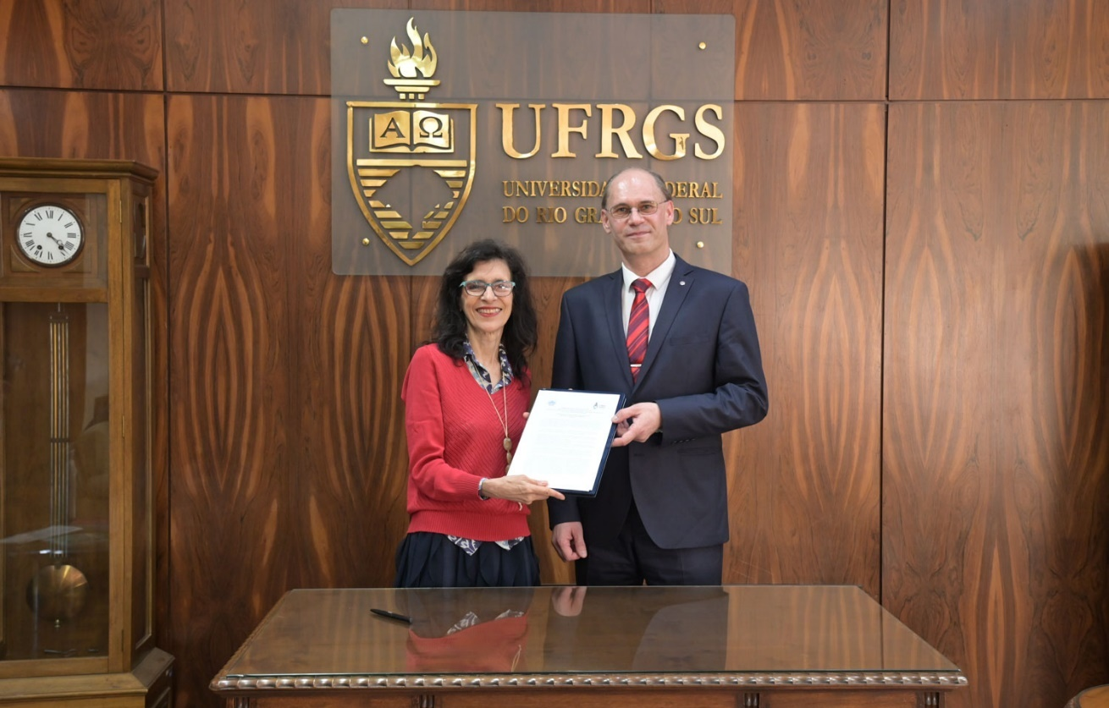
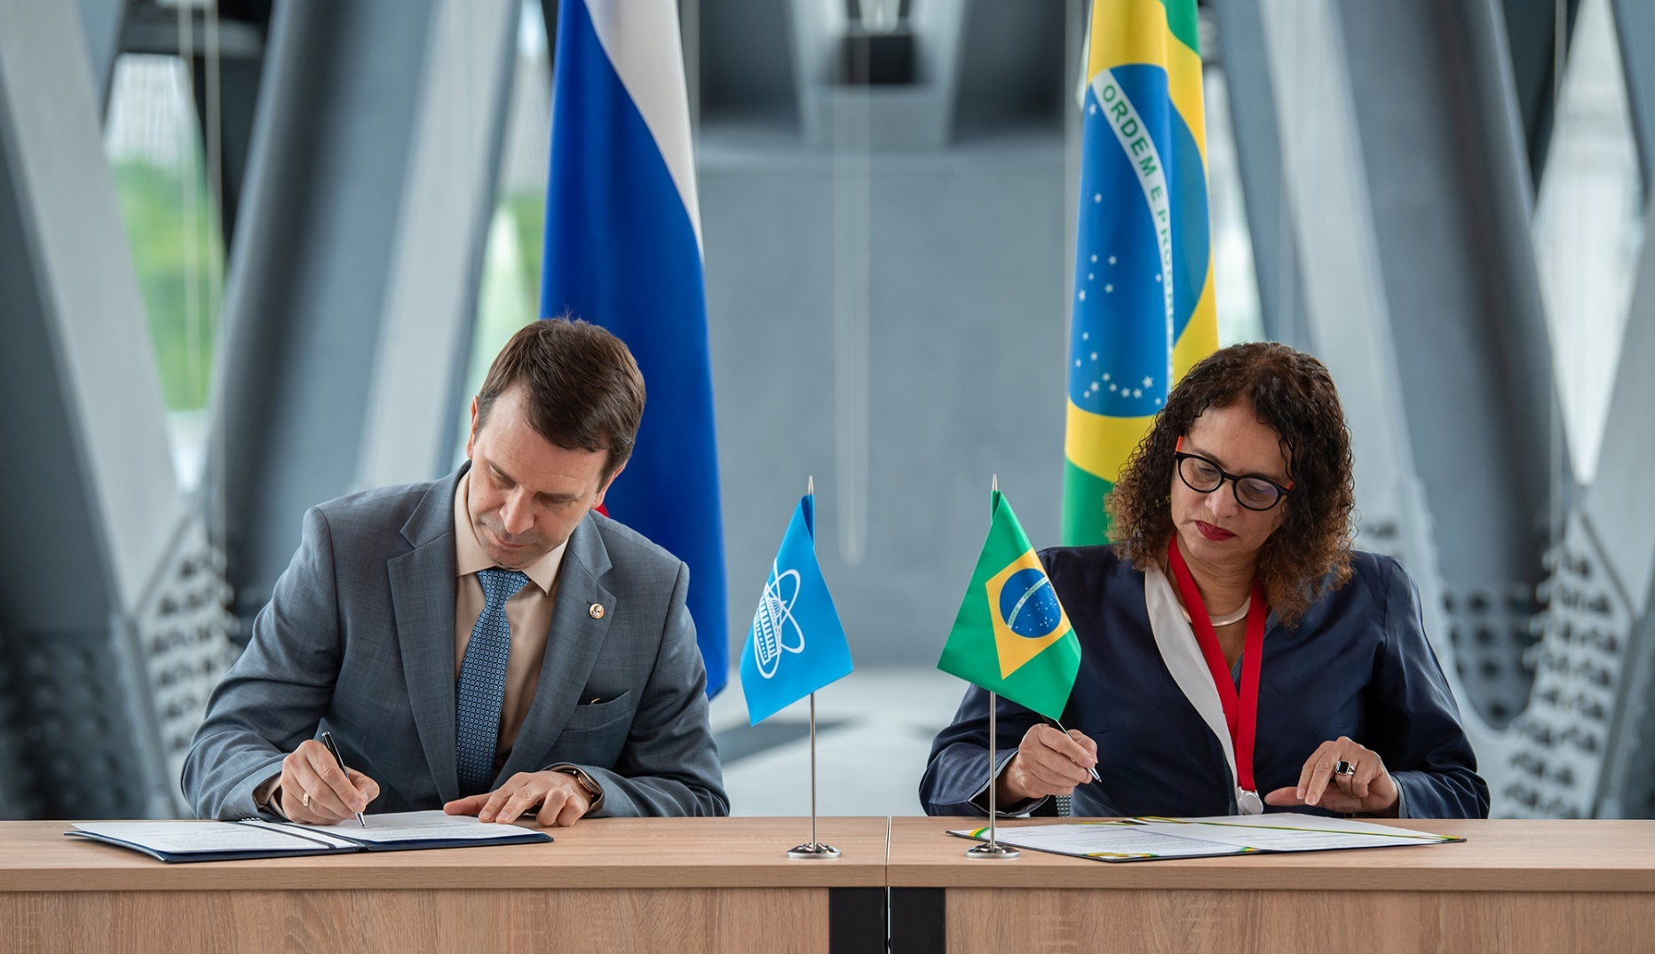
International Cooperation
Deepening Ties with Latin America
8 May ’25 JINR & the Ministry of Science, Technology and Innovation (MCTI) of the Federative Republic of Brazil signed a MoU aimed at strengthening cooperation in fundamental & applied research
12 May ‘25 JNR & Federal University of Rio Grande do Sul signed a MoU in Porto Alegre, Brazil.
JINR & educational organizations of Brazil established a partnership in fundamental & applied research & made a step in developing scientific cooperation.
On 13 May, the delegation from Dubna visited several scientific & educational departments of the University of Rio Grande do Sul. The parties discussed areas for joint research & noted the complementarity of the existing scientific infrastructure. Representatives of the UFRGS Institute of Geoscience expressed interest in collaborating with JINR in climate studies.
Parties agreed to create a JINR–Brazil JCC at governmental level. The JCC is designed to establish a method of selecting & implementing collaborative usage of JINR & Brazil research infrastructures for scientific & technological development of Brazil & the JINR MS

Slide 27
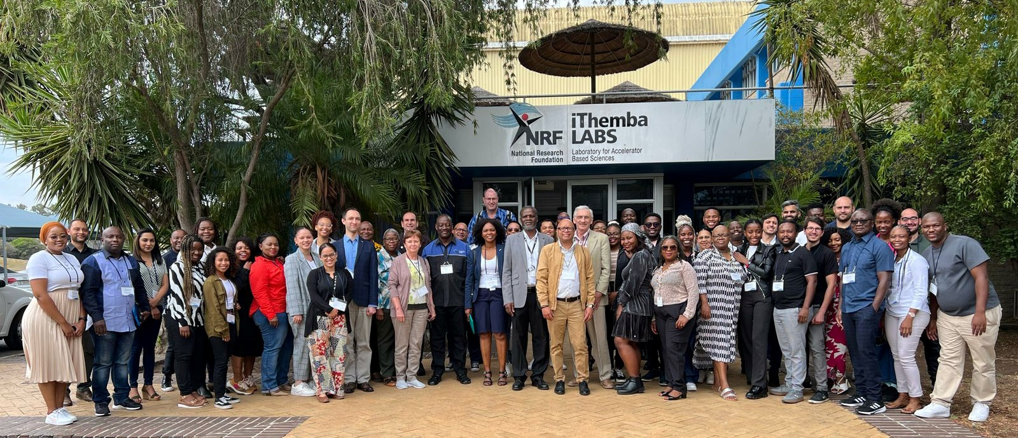
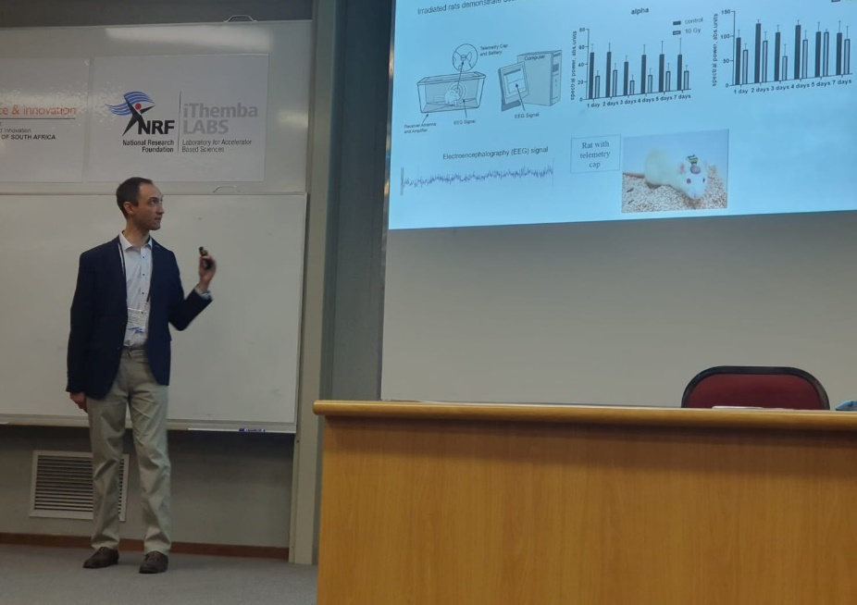
International Cooperation
Scientific Cooperation with South Africa
The meeting brought together > 50 specialists in radiobiology, medical physics, & radiation therapy from JINR & SA. The event was attended by experts from the SA Nuclear Energy Corporation (NECSA), the Nuclear Medicine Research Infrastructure (NuMeRI), & medical centres specialising in radiation medicine,
& representatives of leading universities from four provinces of South Africa.
19‒20 Mar.’ 25 An international radiobiology meeting organized by the Republic’s accelerator centre, NRF: iThemba LABS, & JINR took place in Cape Town, SA.
The participants decided to create a consortium that will use infrastructure of SA research centres a& JINR to promote medical radiobiology research.

Slide 28
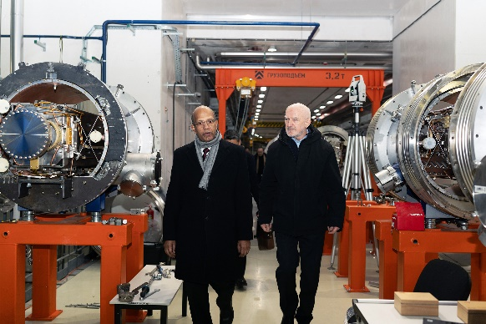
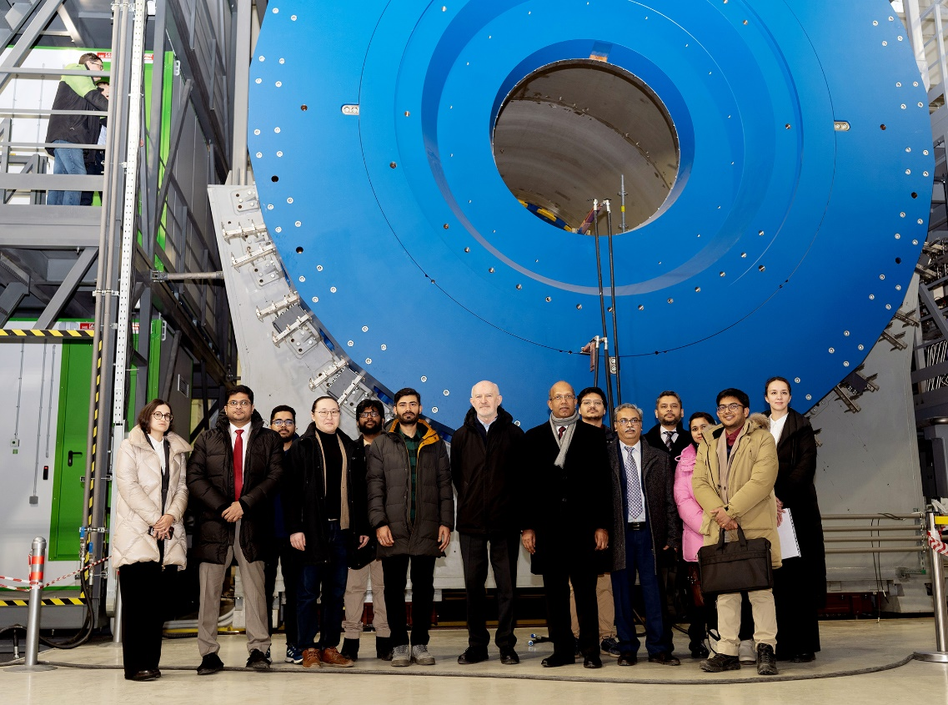
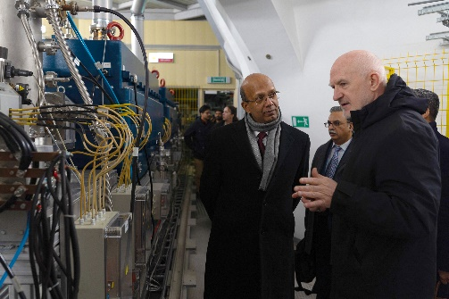
International Cooperation
Strengthening Partnerships
23 Jan. ’25 The Ambassador of the Republic of India Vinay Kumar visited JINR, met with the group of Indian employees & attended NICA accelerator complex. Plans to further strengthen the JINR–India relations were discussed JINR Directorate.
A.Kamavisdar, Adviser to the Department of Science and Technology of the Embassy of India, took part in the JINR CP session on 25 March

Slide 29
Thank you

