Slide 1
Physics studies at the CMS experiment and the second phase of detector upgrade for operation in high luminosity conditions
(2026-2030)
JINR Theme 02-1-1083-2009
Project Leader: V.Yu. Karjavine
Project Deputy Leader: S.V. Shmatov
Project Scientific Leader: V.A. Matveev
Current projects
CMS. Physics research at the LHC. 02-1-1083-1-2010/2025
CMS detector upgrade. 02-1-1083-2-2010/2026
62nd Meeting of the Programme Advisory Committee
June 23 2025

Slide 2
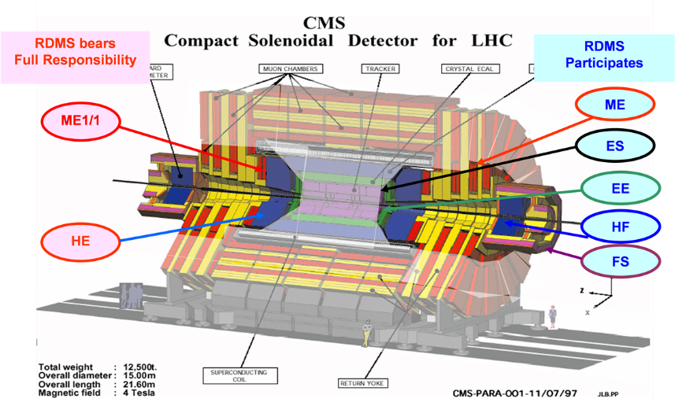
JINR in CMS
The research program was performed within RDMS Collaboration, bringing together physicists from more than twenty institutes from Russia and Member States of Joint Institute for Nuclear Research
This days: JINR + Armenia, Belarus, Georgia, Uzbekistan (DMS)
JINR has been actively involved in the CMS project during more then 30 years
carrying out the CMS physics research program
design, construction, operation and upgrade of the detectors for the CMS endcap region
maintaining the efficient operation of the CMS detector and participating in experimental data taking
The main contribution of JINR was focused on
Endcap Hadron Calorimeter (HCAL)
Forward Muon Station (ME1/1)
Two periods of CMS upgrade during LHC technical long stops:
2013–2015 (Long Stop 1, LS1)
2019–2022 (Long Stop 2, LS2)
the goal is – to ensure efficient operation of all systems at the LHC luminosity up to 2 х10³⁴см⁻²с⁻¹ with a design value of proton-proton collision energy up to 13.6 TeV
2

Slide 3
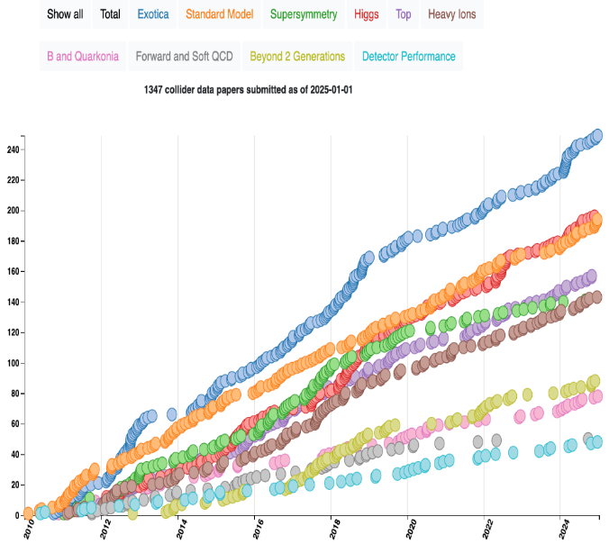
JINR Publications in 2020-2025
The full list of CMS collaboration publications for 2010-2025, authored by JINR representatives (42 authors for this days), includes 425 scientific CMS papers.
JINR physicists made a defining contribution to the preparation of 93 scientific papers including:
14 papers published by CMS in refereed journals
45 paper in refereed journals (non-CMS papers related with the Project)
5 chapters in monographs
The results of the work were presented in more than 115 reports at various conferences, workshops, and seminars:
LHCP (2020, 2025), ICHEP (2020), Conference of SNP NPD RAS (2020, 2024, 2025), Lomonosov Conference on Elementary Particle Physics (2021, 2023), NUCLEUS (2021, 2022, 2024), PANIC (2021), QFTHEP (2022), GRID (2021, 2023), CHEP-Yerevan (2023), LHC Days in Split (2024), SILAFAE (2024), etc
2 doctoral dissertations, 1 candidate dissertation
CMS publications statistics
1373 papers based on collision data (RUN-1/RUN-2/RUN3) submitted so far.
30 papers published so far in 2025
~40 talks were presented by young scientists
3

Slide 4
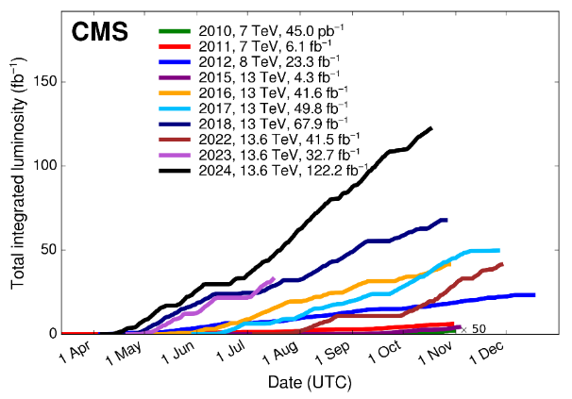
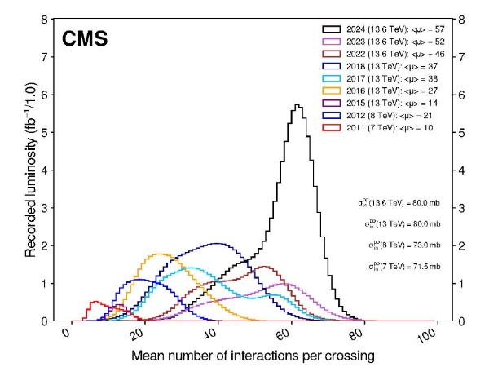
LHC Timeline and Data That We Have
Σ ≈ 390 fb⁻¹
L_{inst} = 2.1×10³⁴ cm⁻²s⁻¹
L_{iinst} = 7×10³⁴ cm⁻²s⁻¹
We are here
CMS Dataset RUN2
~163 fb⁻¹ of proton-proton collisions @ 13 TeV is delivered
151.78 fb⁻¹ is recorded by CMS (data-taking efficiency ~93% )
CMS Dataset RUN3
196.35 fb⁻¹ is already delivered @ 13.6 TeV during the RUN3
180.84 fb⁻¹ is recorded by CMS (data-taking efficiency ~92% )
number of pp interactions per beam crossing: ⟨PU⟩ = 57 for 2024
~260 fb⁻¹ it is expected @ 13.6 TeV for the end of the RUN3 (450 fb⁻¹, in total for RUN1/2/3)
pPb and PbPb Runs
CMS Data Quality Information
https://twiki.cern.ch/twiki/bin/view/CMSPublic/DataQuality
4

Slide 5
Goals and Tasks of the Project
The main goals of the project
development and implementation of a research program for precision testing of the Standard Model (SM) and searches for new physics beyond SM (BSM)
maintenance and upgrade of the CMS experiment to ensure its efficient operation in HL–LHC mode, including participation in the construction of High Granularity Calorimeter (HGCal) and upgrade of the CMS endcap muon station ME1/1
Main five tasks which are define the project structure
development and realization of the CMS physics research program focused on searches for new physics beyond the Standard Model, studies of Higgs boson properties, and other SM tests
CMS detector upgrades for HL–LHC operation, including participation in the construction of the High-Granularity Calorimeter (HGCal) and continued upgrades of the CMS Endcap Muon system detector
operation and maintenance of detectors, providing of their operational reliability and experimental data taking quality
development of methods and algorithms for physical object reconstruction and event selection
development of software for the distributed data processing and analysis system based on grid technologies, ensuring reliable and uninterrupted operation of JINR grid infrastructure for the CMS experiment (Tier-1 and Tier-2 centers)
5

Slide 6
JINR Team Obligations
Participants: 60 from JINR; 12 from JINR member-states (DMS)
11 young researchers: 6 PhD Students from JINR, 5 PhD Students from DMS.
Authors: 23 from JINR and 3 from DMS (21 paid by JINR and 5 unpaid PhSt. )
16 from RF Institutions - ex CMS members
Participation in CMS upgrade
Phase1 upgrade of HCAL and Endcap Muon system
Phase2: Construction of the High Granularity Calorimeter. Endcap Muon system upgrade.
Participation in physics analysis and software development
CMS duties executed by JINR physicists
HCAL Technical Coordination
Co-convening the CMS Generator group
CMS data managers for Tier-1 and Tier-2 sites.
Deputy Chairman of the CMS Conference Committee
Participation in Analysis Review Committee (ARC)
and Institutional publication review (IR).
Members of institution and collaboration boards.
JINR team obligations in 2025
Detectors maintenance and operation
JINR Tier-1 and Tier-2 centers robust operation
Experimental Physics responsibilities (EPR), due for an author is 4.0 months tasks (including shifts), 165.5 FTE-months in 2025, central shifts – 9.51
JINR EPR 2024 results
Work Due: 96.91, Work + Shifts: 109.88
Central Shifts – 11.55, EPR Shifts – 6.881
EPR Works – 103.0
Ratio done/expected: 1.13
6

Slide 7
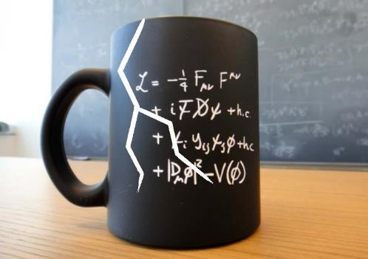
JINR Activity in the CMS Physics Analysis
Searching for Physics Beyond the Standard Model
Channels with a pair of leptons (extended gauge models, scenarios with additional spatial dimensions, models with dark matter, testing of lepton universality, search for LFV processes, etc.)
Channels with a pair of leptons/b-quarks and missing transverse energy ET
(dark matter, extended Higgs sector)
Multiple jet/lepton/photon production (microscopic black hole scenarios)
Testing the predictions of the Standard Model (EWK and QCD processes)
Precision measurements of the characteristics of the Drell-Yan process
(cross-sections, angular characteristics)
Discovery and study of the properties of the Higgs boson (4l, 2b)
Study of the characteristics of QCD jets (cross-sections, fragmentation functions, etc.)
B-physics
Heavy Ion Physics
Multiple particle production
Algorithms and Software
Development of algorithms for high-momentum muons reconstruction. Muon hit reconstruction and segment builder.
7

Slide 8
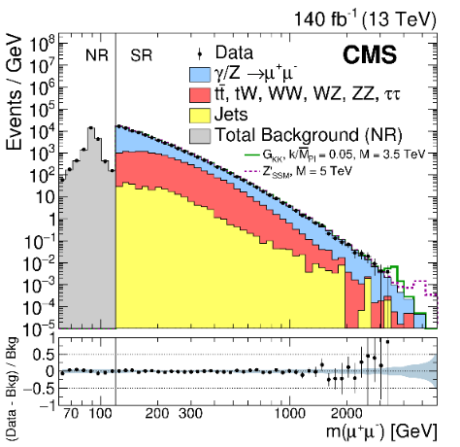
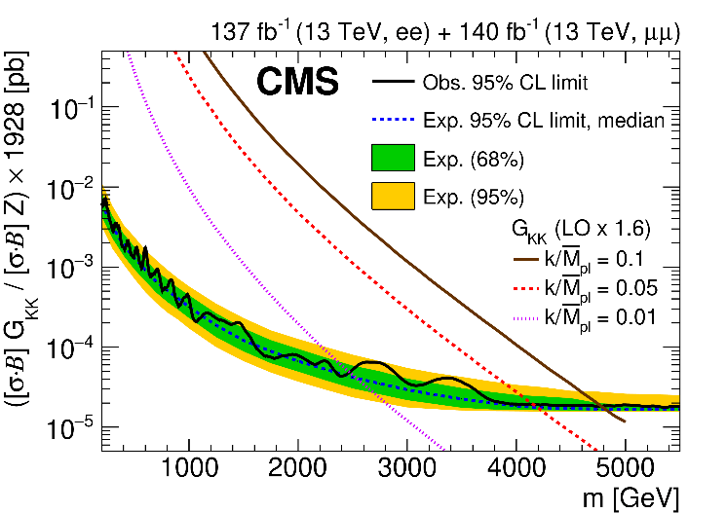
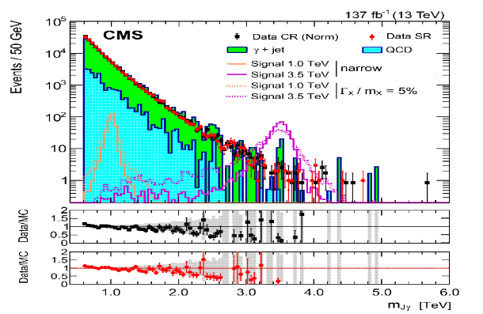
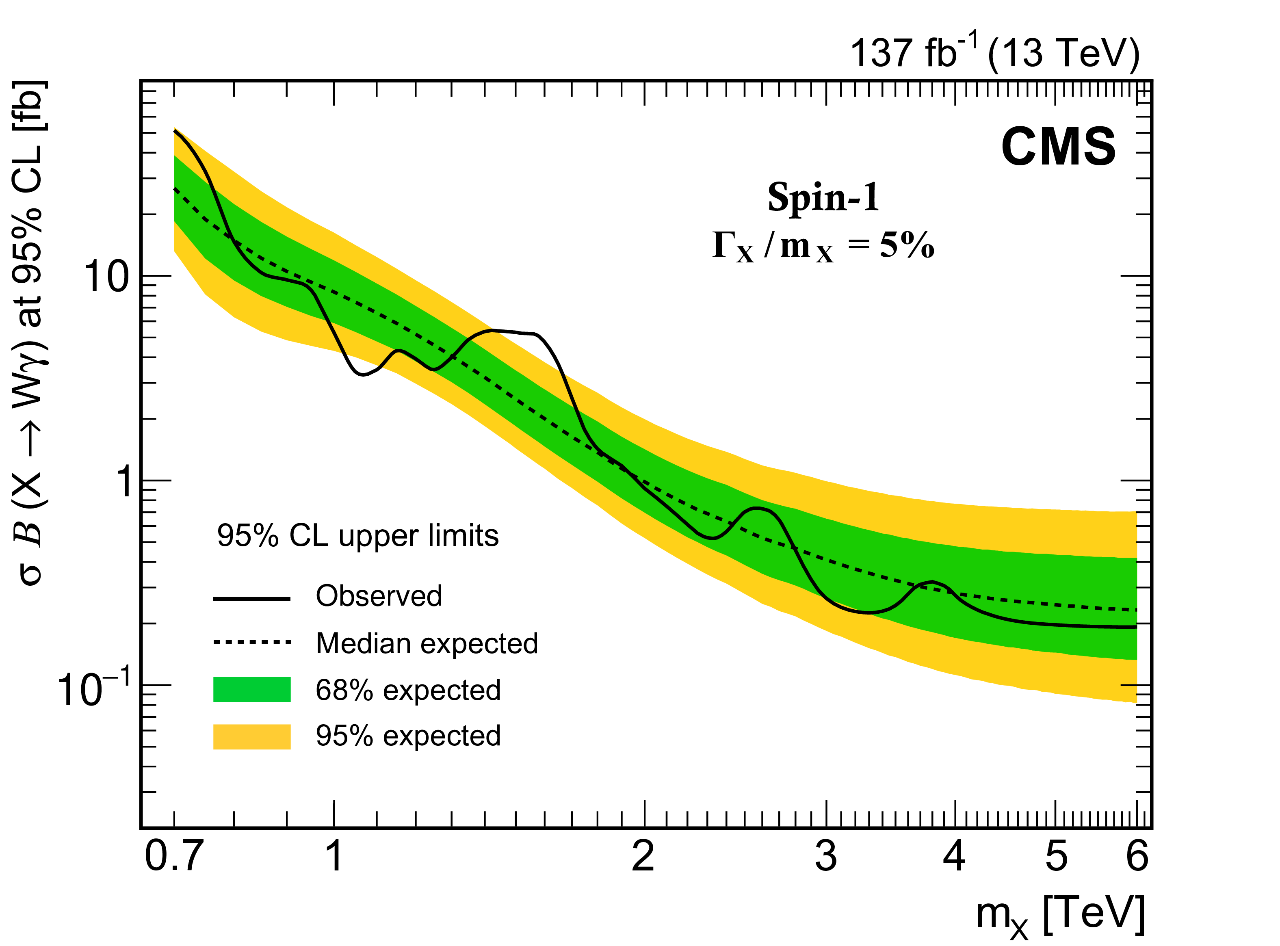
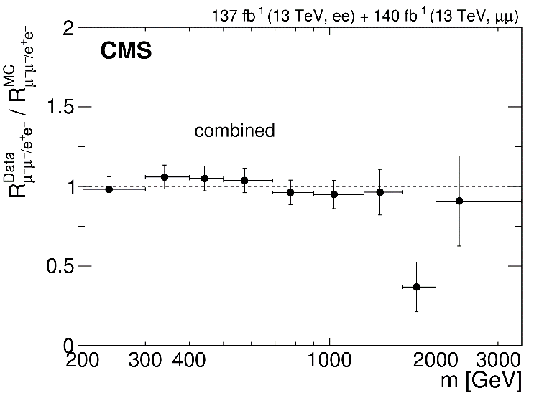
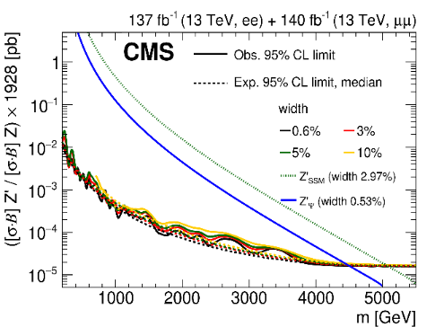
Searches for Heavy Resonances
New Physics (Z′/Z_{KK}/G_{KK}) contributions to SM processes
Dileptons, full RUN2 data
JHEP 07 (2021) 208
PLB 826 (2022) 136888
Wγ, full RUN2 data
RS1 graviton
Lepton flavor universality
Z’ boson
Benchmark heavy scalar (vector) triplet bosons with masses between 0.75 (1.15) and 1.40 (1.36) TeV are excluded at 95% CL
8

Slide 9
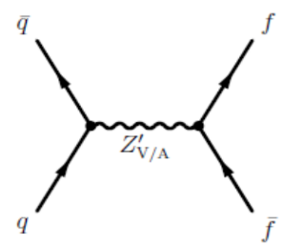
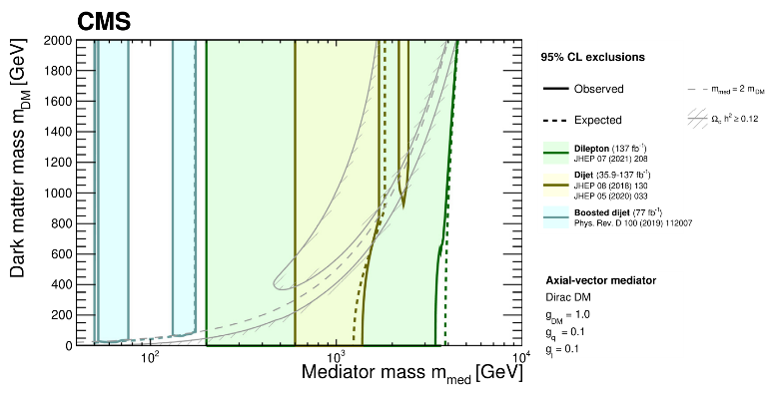
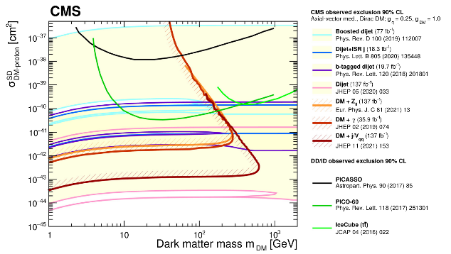
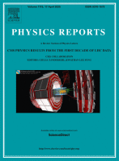
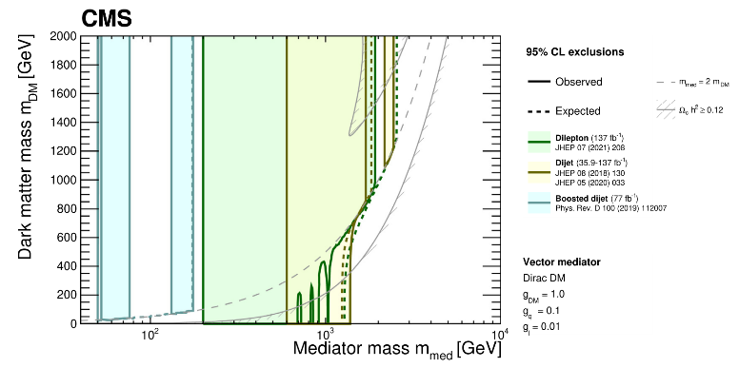
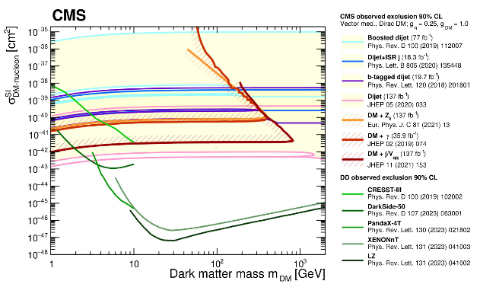
Dark Matter Searches in Dijets+Dileptons
We consider a model that assumes the existence of a single DM particle that interacts with the SM particles through a spin-1 mediator, which can be either a vector or axial-vector boson.
V/VA
vector mediator with small couplings to leptons, g_{DM} = 1.0, g_{q} = 0.1, g_{l} = 0.01
axial-vector mediator with equal couplings to quark and leptons: g_{DM} = 1.0, g_{q} = g_{l}= 0.1
g_{q}
g_{q}
CMS physics results from the first decade of LHC data
Physics Report, 1115, 1-772 (17 April 2025)
9

Slide 10
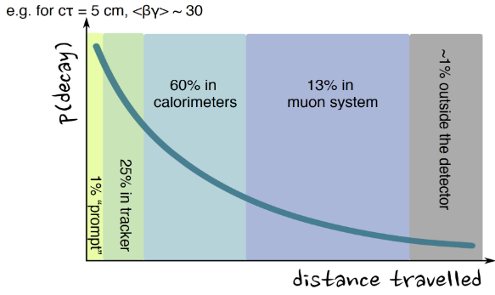
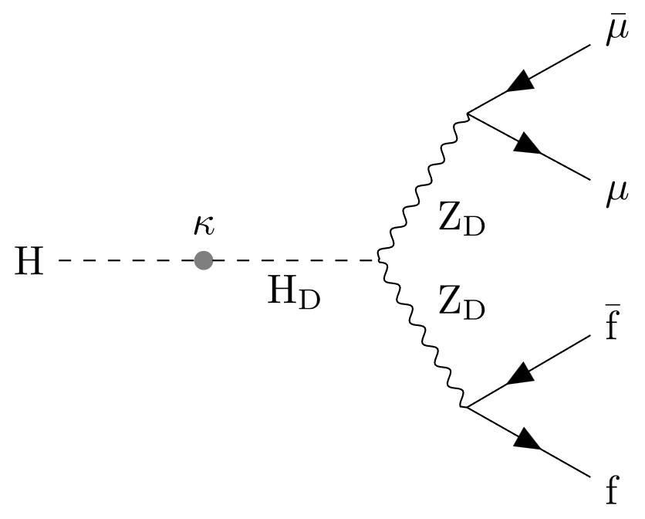
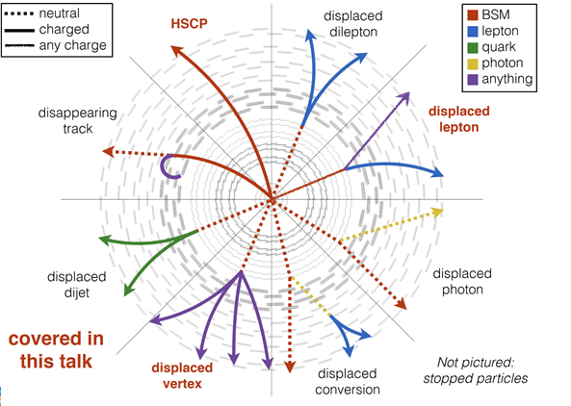
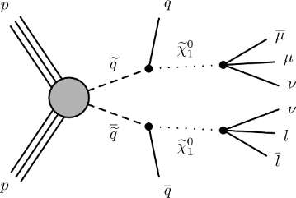
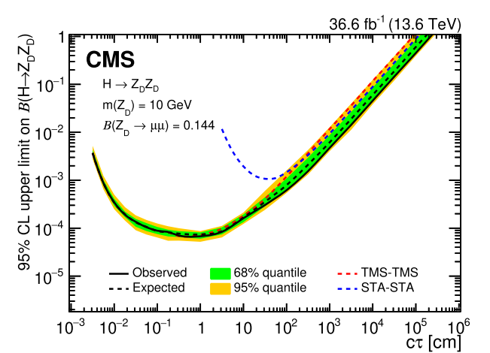
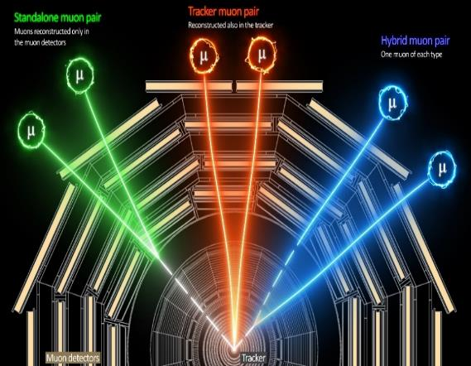
Long-lived Particles with Dimuons (Displaced Dimuons)
New (unconventional) topologies!
Ex., dark photon and long-lived neutralinos decays
LLP neutralinos decays
Dark photon
RPV
SM Higgs boson mixes with the dark-sector Higgs boson
a proper lifetime cτ₀ is greater than or comparable to the characteristic size of the (sub)detectors
The first RUN3 results
Long-lived particles (LLP) may have decay lengths up to several meters
⇒ traveling through the inner detector layers without leaving any trace
JHEP05 (2024) 047
10

Slide 11
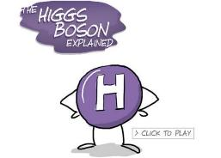
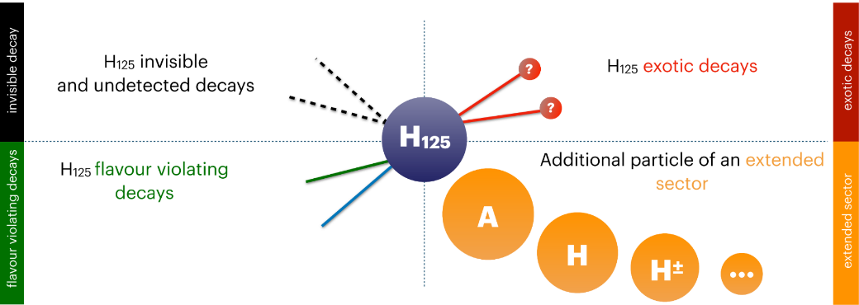
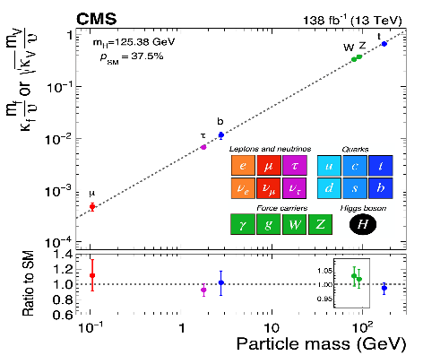
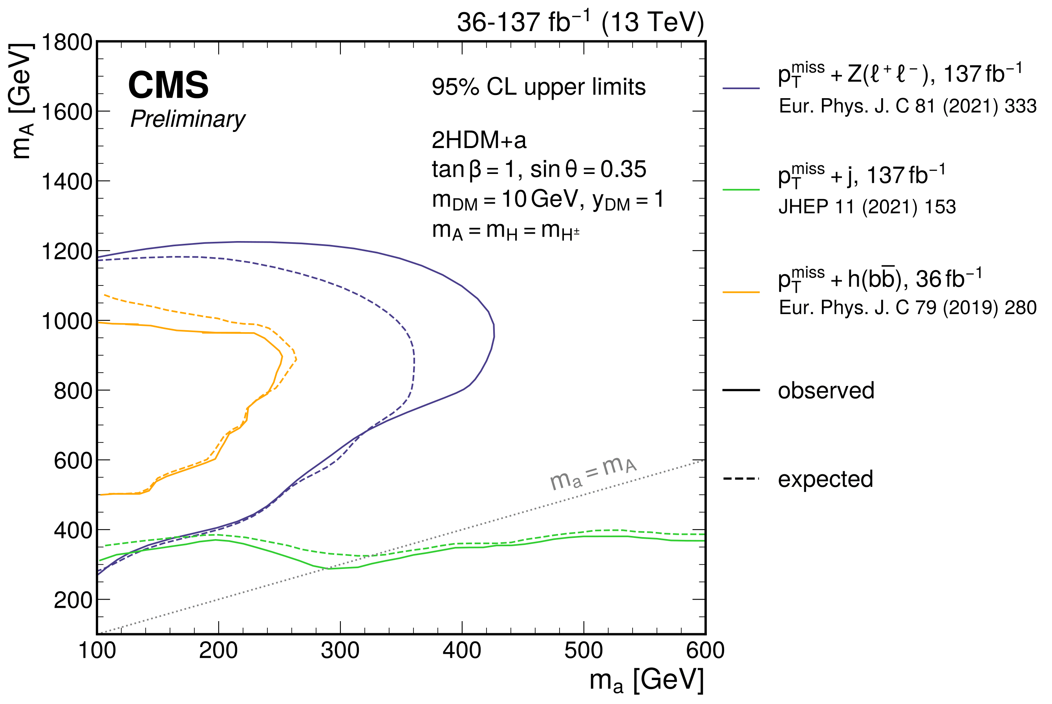
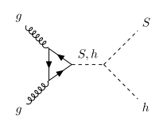
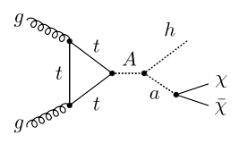
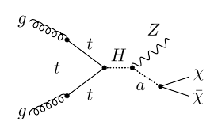
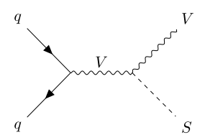
Higgs Boson as a Tool to Search for the New Physics
Universality is a powerful test of the validity of the underlying physics
“New“ physics objects ⇒ new decay channels!
combinations of physics objects (leptons/photons/jets) and Missing Transverse Energy (MET)
h (→ bbar) + a (→ χχ) = bbar + MET
Z + a (→ χχ) = Z (→ ll) + MET
The most stringent limits on mass parameters of non-minimal Higgs scenarios, ex. 2HDM+s
11

Slide 12
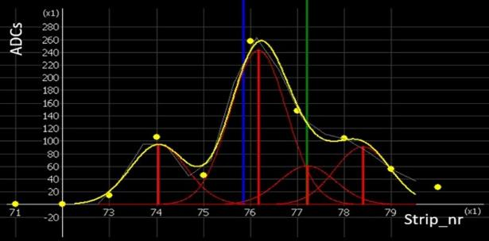
New Algorithms and Selection Methods
Muon reconstruction and Selection
high-momentum muons reconstruction and triggering, including AI methods
muon tracks reco for HGCal testing and study of an efficiency of HGCal sensor elements
Hits and track segments in Cathode Strip Chambers, CSC
HGCal based algorithms
particle-flow algorithms for reconstruction of energy flows (information
from all detector systems) ⇒ MET reco
jet structure, charged particle multiplicity inside jets
Simulation of Physics Processes and Detector Facility
data cards of model parameters for the number of physics generators (EGM, dark matter scenarios, extended Higgs sector, Drell-Yan production, etc)
full chains of MC mass production
HGCal test facilities
HGCal working release in CMSSW
12

Slide 13
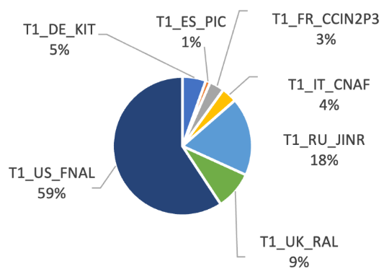
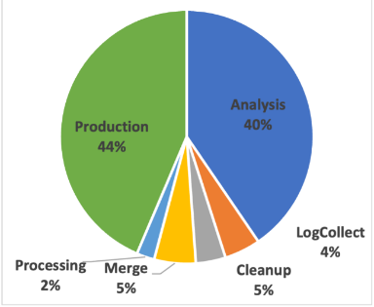
JINR in WLCG/CMS Computing
Events processed by Tier-1 world centers
Completed jobs ratio by JINR Tier-2 center
JINR grid Tier-1 and Tier-2 centers extensively used for processing and storing CMS data, ensuring 100% availability and reliability of services.
More than 2.1 billion events were successfully processed by JINR Tier-1 in 2024.
The JINR Tier-1 is ranked the second place among all Tier-1 world centers for CMS (with 18.0%).
More than 1.2 million CMS jobs, above all Monte-Carlo production and analysis
Resources pledged in 2025
13

Slide 14
JINR contribution to CMS Phase 1 Upgrade
CMS Phase-1 upgrade task: to ensure reliable work of detectors in the LHC design operation mode at the energy of 13.6 TeV and instantaneous luminosity L= 1÷2х10³⁴см⁻²с⁻¹
- Phase-1 upgrade completed during periods of long shutdowns LS1 and LS2
- JINR contribute to the Muon Endcap and HCAL subsystems
14

Slide 15
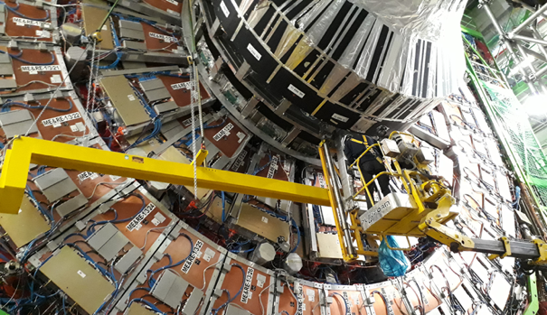
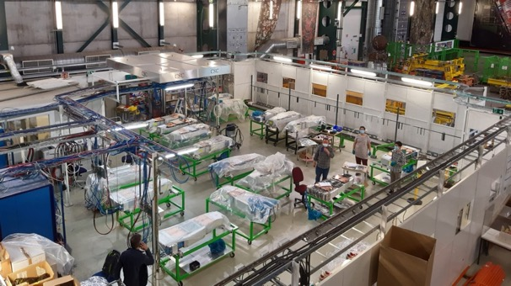
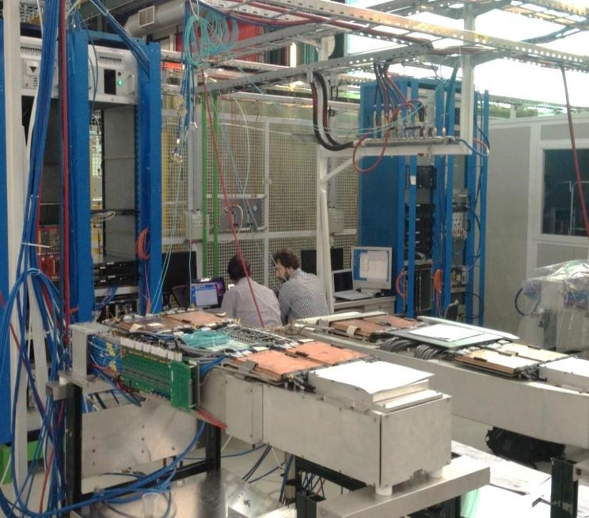
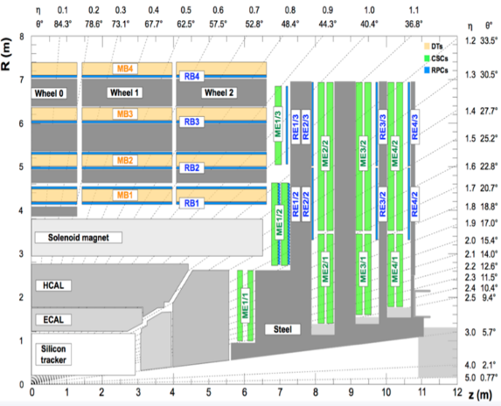
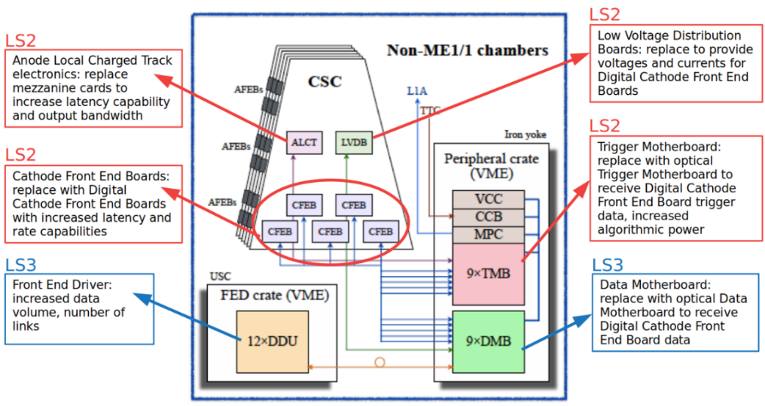
Upgrade of the Endcap Muon system
LS1 period – restoring number of ME1/1 FE cards (were reduced on construction staging).
72 ME1/1 were disassembled, refurbished,
tested and reinstalled
New digital FE boards (DCFEBs) installed on the ME1/1 station - minimize dead time
3 DCFEBs instead of 1 at the bottom part of CSCs to restore the trigger up to η =2.4
ME1/1 CSC installation
CSC upgrade infrastructure
CSC test stand
LS2 period - CSC electronics was replaced on detectors of the inner rings Endcap stations.
180 chambers of inner rings were upgraded with the new electronics to sustain HL-LHC conditions
72 ME1/1 CSCs were equipped with the new on-chamber cooling systems.
Inner rings stations:
ME1/1,
ME2/1,
ME3/1,
ME4/1
Total 180 CSCs
Major part of CSC Phase-2 upgrade completed in LS2.
15

Slide 16
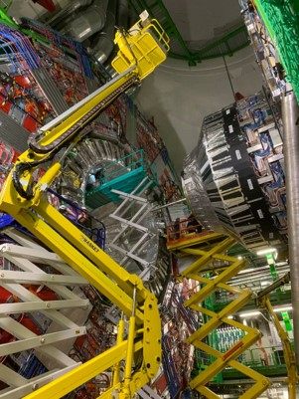
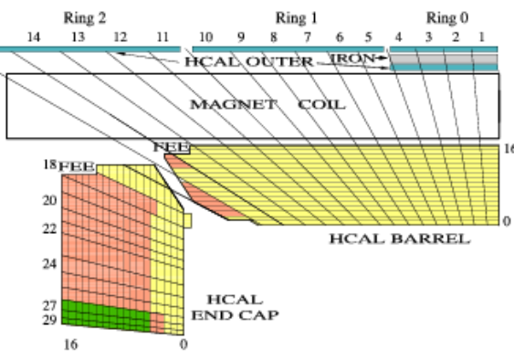
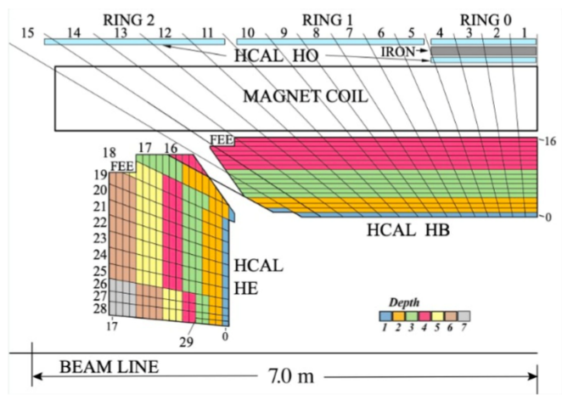
Upgrade of the Hadron Calorimeter, HCAL
HCAL upgrades LS1, LS2 periods
Hybrid photodetectors(HPD) replaced with new silicon multipliers (SiPM)
- 3 times higher photon detection efficiency, 200 times higher gain
- Increase dynamic range, rate capability, sub-ns timing, muon ID
Finer depth segmentation 4 in barrel, up to 7 in endcap
- Number of channels increase by factor ~2.5;
- Depth dependent calibration.
Endcap upgrade before 2018
Barrel upgraded for RUN 3 (2023)
New front-end and back-end electronics
- increase Particle Flow capability and 1-level trigger.
- Enable new triggers (e. g. long lived particles).
- Better timing information (0.5ns resolution);
- Encoding an energy value into 8 bits instead of 6 bits as now;
- Increase a bandwidth of data transfer from 1.6 Gbit/s to 4.8 Gbit/s.
Commissioning of HCAL electronics
16

Slide 17
JINR contribution to CMS Phase 2 Upgrade
CMS Phase-2 upgrade task: to ensure reliable work of detectors in the High Luminosity LHC operation mode (HL-LHC) at the energy of 13.6 TeV and instantaneous luminosity L= 5-7×10³⁴сm⁻²с⁻¹
The Phase-2 upgrade will be done during LS3 long shutdown
JINR will contribute in High Granularity Calorimeter (HGCal) project.
Design and construction of the HGCAL silicon and scintillator cassettes test facility
Development of the HGCAL LV power supply system prototype
JINR will Participate in the Endcap Muon system upgrade.
ME1/1 CSC upgrade and maintenance
Design and construction of the new ME1/1 Patch Panel
Design and construction of new tooling for ME1/1 CSC assembly and installation
CSC longevity study and searches for eco friendly gas mixtures R&D.
17

Slide 18
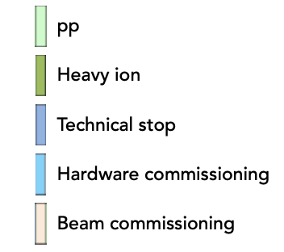
New LS3 Schedule
Three identified risks for CMS
๏ readiness of detectors for installation
๏ readiness of infrastructures to commission the detectors
๏ very dense LS3 program and with high person-power needs
18

Slide 19
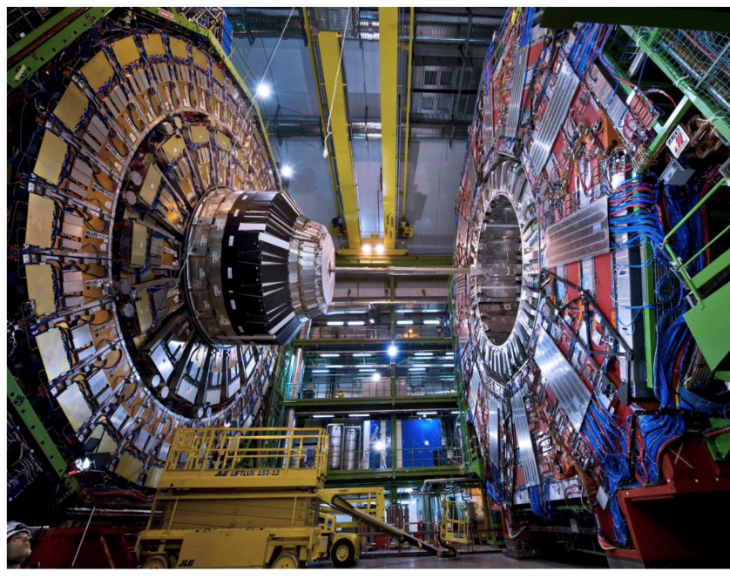
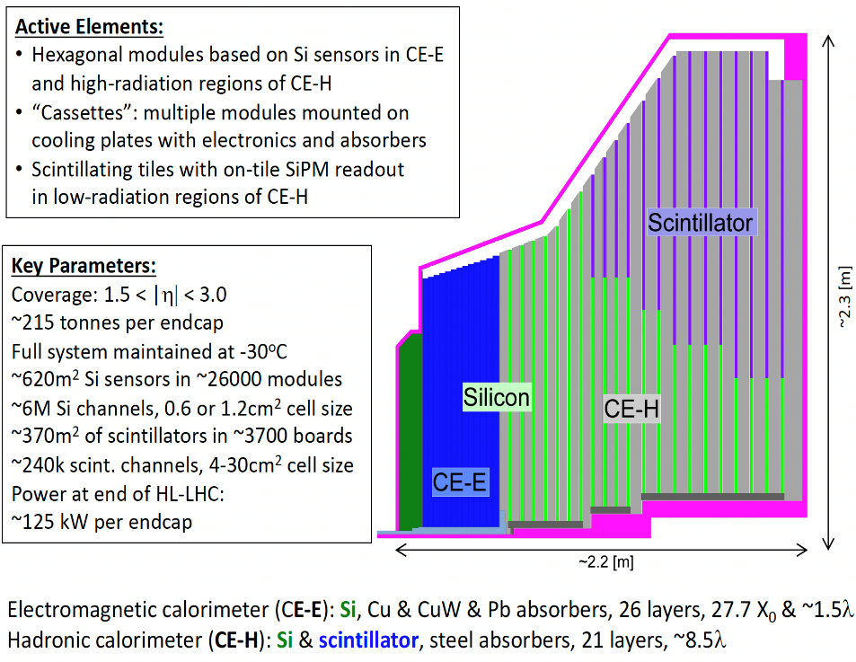
High Granularity Calorimeter (HGCal)
HGCal will replace the present Endcap Calorimeter (ECAL and HCAL) and Preshower sub-systems
Installation during next Long Shutdown (LS3) of LHC (lowering Q3 2027)
19

Slide 20
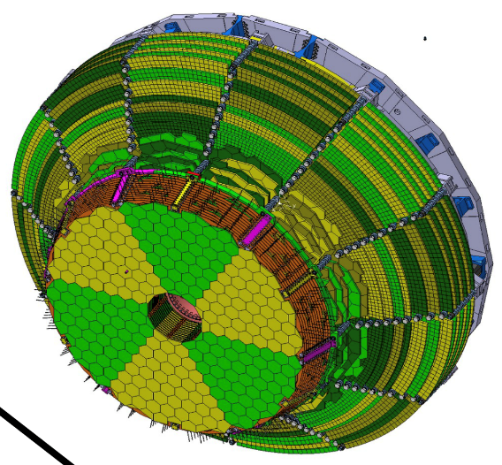
HGCal Main Active Elements (Cassettes)
Cassettes: 30- or 60-degree segments, integrating module and ancillary electronics on a copper cooling plate
3 different sensors thickness: 300um, 200um and 120um to optimize radiation hardness in the range from 5x10¹³n/cm² for the Silicon-Scintillator cassettes (CE-H) up to 1x10¹⁶n/cm² - the inner radius of the all-silicon cassettes
20

Slide 21
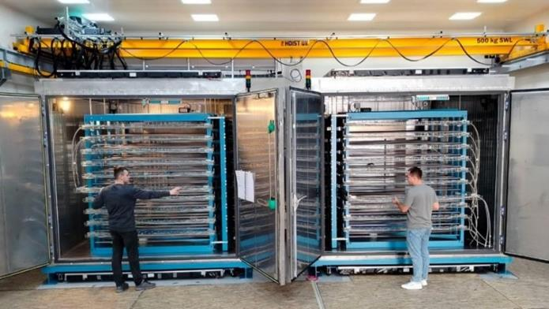
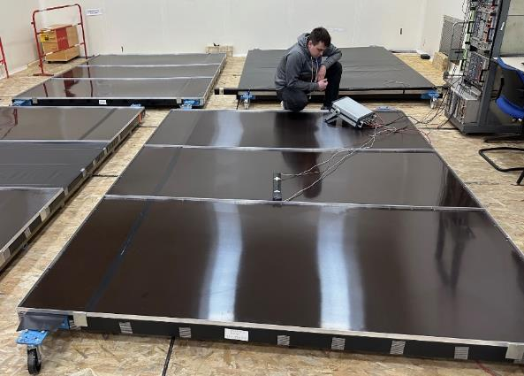
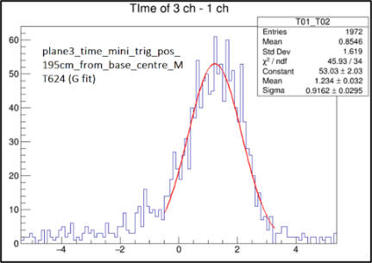
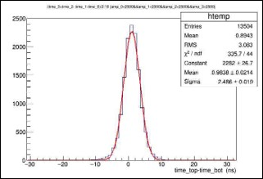
Setup for HGCal Cassettes Testing
2 Cold rooms were assembled at SX5 CERN
Commissioning of the scintillation trigger planes.
σ_{1 plane}~0.9 ns
Cassette on the supporting frame
Test setup includes:
Racks for cassettes
(inside cold rooms)
Supporting frames for cassettes
Scintillation trigger planes
(on top and bottom of rooms)
Readout electronics
Plane efficiency of ~98%.
1 plane time resolution ~0.9 ns.
Time resolution of 2 planes ~3ns.
σ_{2 plane}~2.4 ns
Triggers frequency in the fourfold coincidence mode: 130-160 Hz
- corresponds to ~3000 triggers per 1cm² in 10 days
- matches with the simulation: 10 days cassettes test cycle
required minimum 1000 triggers per 1cm²
Plan to have the test facility is ready for operation by the middle of 2025
21

Slide 22
Preparation to the Phase-2 ME1/1 CSC Upgrade in LS3
ME1/1 Patch panel
3d model
Prototype
ME1/1 Patch Panel redesigned to fit more rigid envelope for endcap detectors cables and services in the CMS Phase-2 configuration
80% parts for 36 ME1/1 PP have been constructed
Loading machines
ME1/1 two loading machines for extraction/installation of ME1/1 CSCs were constructed
22

Slide 23
Cathode Strip Chamber Performance Study @ HL-LHC
Cathode Strip Chamber Longevity Study @ GIF++
Irradiation setup: ME1/1 and ME2/1 CSCs exposed with the 12 TBq ¹³⁷Cs gamma source
at the GIF++ Facility (HV-ON on 4 layers and HV-OFF on 2 layers kept as reference).
CSCs spatial resolution as a function of the accumulated charge
¹³⁷Cs
ME1/1
ME2/1
2023 Test Beam at GIF++
ME CSCs irradiation setup at GIF++
No aging effects observed so far
Study of the CSC Parameters with new gas mixtures (Mini CSCs 30 x 30 cm² were constructed )
Motivation: CSC use CF4 to protect anode wire from Si deposits, but it’s Global Warning Potential (GWP) is too high: ~ 7000 x CO₂.
23

Slide 24
Plan for 2025
Continue RUN-2 and RUN-3 data analysis.
Dimuons, Z + MET, bbar + MET, dimuons + MET to search for the new physics and test the SM.
Continue optimization of the hadronization model for the q/g jet fractions measurement.
Participation in 2025 RUN-3 data taking within JINR responsibilities.
- Participation in shifts.
- Detectors operation and maintenance.
- Detectors performance study.
Participation in Phase-2 HGCAL project.
- Launching of the HGCAL cassettes test facility.
- Powering of the cassette's assembly facilities.
Participation in Phase-2 upgrade of Muon Endcap System.
Preparation to the ME1/1 CSC upgrade during LS3.
Continue of the CSC detectors ageing effects study at GIF ++ facility.
Development and test of algorithms for reconstruction of the muon track segments.
24

Slide 25
Staffing Resources
LHEP – 32 (23.3 FTE), LIT – 22 (10 FTE), LTP – 5 (1.9 FTE), JINR Management – 1 (0.1 FTE)
№№ п/п | Category of employees | Core staff Amount of FTE | Associated Personnel Amount of FTE
1. | scientific staff | 24,5 | 15,2
2. | engineers | 7,9 | 0
3. | professionals | 2,5 | 0
4. | employees | 1 | 0
5. | workers |  | 0
 | Total: | 34,5 | 15,2
A part of Associated personals will be reassigned as the JINR staff
LHEP: | Aleksakhin V.Yu., Afanasyev S.V., Budkovsky D.V., Bunin P.D., Golunov A.O., Gorbunov I.N., Gorbunov N.V., Golova N.S., Ershov Yu.V., Kamenev A.Yu. Karzhavin V.Yu., Kilchakovskaya S.V., Kobylets L.G. Kozlov D. N., Kurenkov A.M., Kutinova O.V., Lanev A.V., Makankin A.M., Malakhov A.I., Milnov G.D., Perelygin V.V., Sakulin D.G., Smirnov V.A., Sukhov E.V., Ustinov V.V., Shalaev V.V., Shulga S.G., Zarubin A.V., Zhizhin I.A., Zaitsev A.A.
LIT: | S.V. Shmatov, V.V. Korenkov, A.O. Golunov, A.G. Dolbilov, I.A. Kashunin, A. Khvedelidze, O.L. Kodolova, Yu.V. Korsakov, V.V. Mitsyn, A.N. Moibenko, A.N. Nikitenko, N.N. Voytishin, G.A. Ososkov, D.A. Oleynik, V.V. Palchik, A.Sh. Petrosyan, R. Semenov, I. Satyshev, K. Slizhevsky, T.A. Strizh, E.N. Tolochko, V.V. Trofimov
LTP: | Kazakov D.I., Kozlov G.A., Savina M.V., Teryaev O.V., Zykunov V.A.
JINR Management: | Matveev V.A.
25

Slide 26
Cost Estimate of the Project
Based on the official commitments of JINR
MoU on the creation of the CMS detector (CERN-RRB-2024-039) and the corresponding addendums Addendum No. 10 (CERN-MoU-2024-010)
Addendum No. 13 (CERN-MoU-2019-008)
Addendum No. 14 (CERN-MoU-2019-009)
Addendum No. 15 (CERN-MoU-2019-036)
MoU on the participation of JINR in the HGCal CMS project (CMS2020-010).
Main cost items
Common funds
Category A payment (M&O cat. A) for 24 authors: 1300 kUSD (260 kUSD per year)
Category B payment (M&O cat. B): 365 kUSD (73 kUSD per year)
Deliverables
Equipment deliverables cost: 962 kUSD (792 kUSD for Front-end tileboards and DAQ - contribution to CORE and 170 kUSD for HV cables production for ME1/1 CSCs – In-Kind category B contribution)
Materials cost for Phase-2 upgrade of the muon system and HGCal: 500 kUSD (80 kUSD per year)
Visits
Visits expenses for 5 years: 3450 kUSD (690 kUSD per year). Including 565 kUSD - will be accounted as In-Kind CORE for the HGCal, 1070 kUSD - will be accounted as In-Kind category B and 825 kUSD – upgrade works (2460 kUSD in total)
Full estimated cost of the project: 6577 kUSD
Full amount of contribution in CORE, M&O cat.A, M&O cat.B: 1357 kUSD, 1300 kUSD, 1605 kUSD
26

Slide 27
Proposed schedule.
Required resources.
and
Cost estimate
27

Slide 28
28

Slide 29
We ask JINR PAC for Particle Physics
to support the project
Physics studies with the CMS experiment and the second phase of detector upgrade for operation in high luminosity conditions
for 2026-2030
Thank you for your attention!!!
29

