Slide 1
Development of a GUI interface for the cooling and thermal stabilization systems of the Time Projection Chamber “TPC” and Electromagnetic Calorimeter “ECAL” detectors of the Multi-Purpose Detector “MPD” in the Master-SCADA 4D framework
Full name
Youmna Ghoneim , Vladimir Senkevich

Slide 2
Agenda
📌 System Architecture
- GUI built with TIA Portal + Master-SCADA
- Enables integrated control and monitoring
🛠️ Control Capabilities
- Continuous instrumental & logical control
- Supports diagnostics and case analysis
🗄️ Data Management
- Archiving of measured data
- Event messages (warnings & errors)
📊 Monitored Parameters
- Temperature
- Pressure
- Coolant flow rate
- Coolant level
- Vacuum in water vessels
- Other key indicators
🧩 GUI Development Status
- Presentation of the current design stage
-integration from TIA Portal Scada to Master Scada

Slide 3
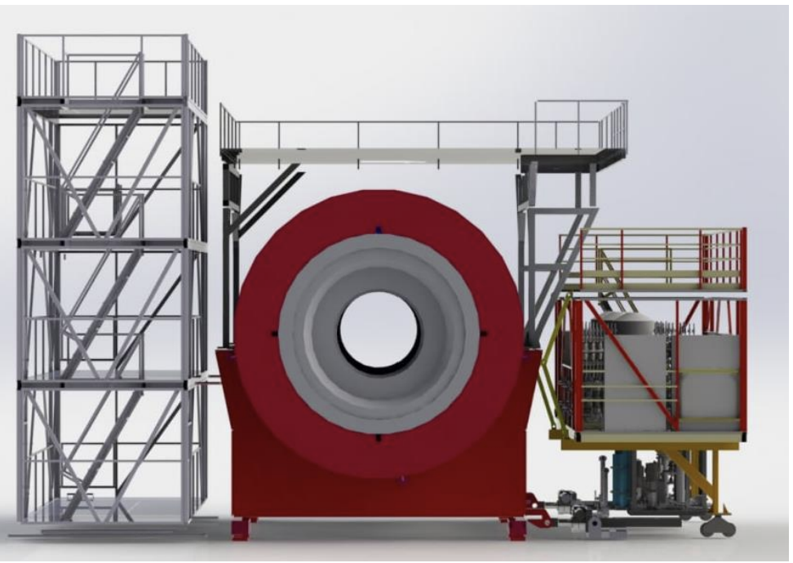
Introduction
Cooling System – Time Projection Chamber (TPC)
A graphical user interface (GUI) was developed for the control, monitoring, and data logging of the cooling and thermal stabilization systems of the TPC and ECAL detectors in the MPD experiment.
The system is built using Master-SCADA 4D software and communicates via the OPC protocol with TIA Portal Tool.
All cooling systems are designed as “leakless”, ensuring coolant pressure remains below atmospheric pressure to prevent water leakage inside the detector.
Platform concept for MPD detector cooling system

Slide 4
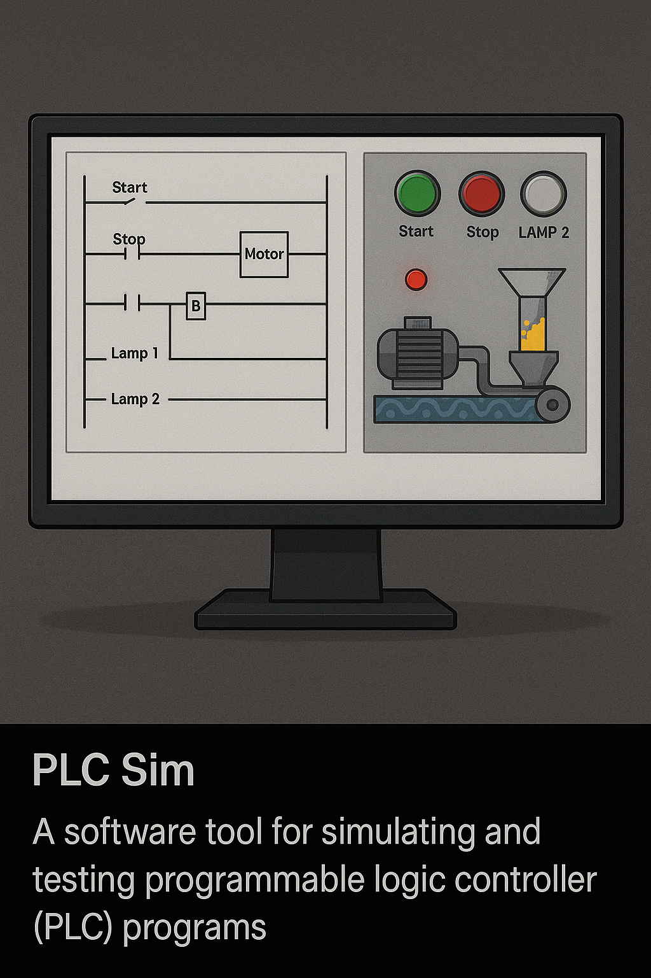
Cooling System – Time Projection Chamber (TPC)
The system includes ~110 channels, with 76 dedicated to thermal stabilization.
Each channel comprises:
A water pressure reducer
An electric heater
Temperature and pressure sensors
A flow meter
A network of 250 temperature sensors on the TPC enables multi-zone PLC-based temperature control across all channels.

Slide 5
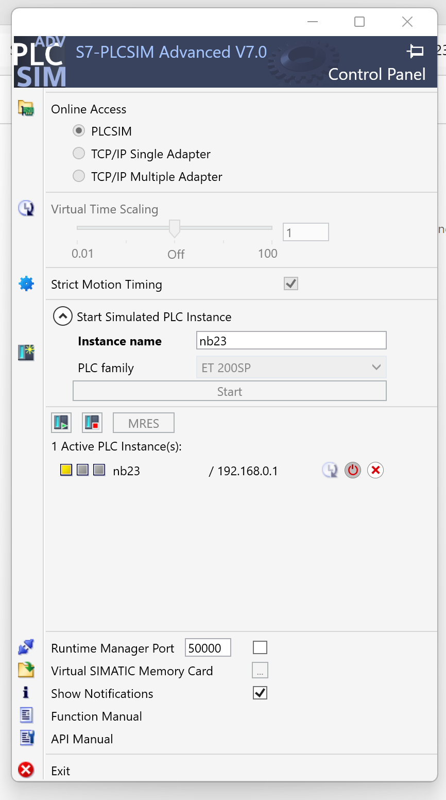
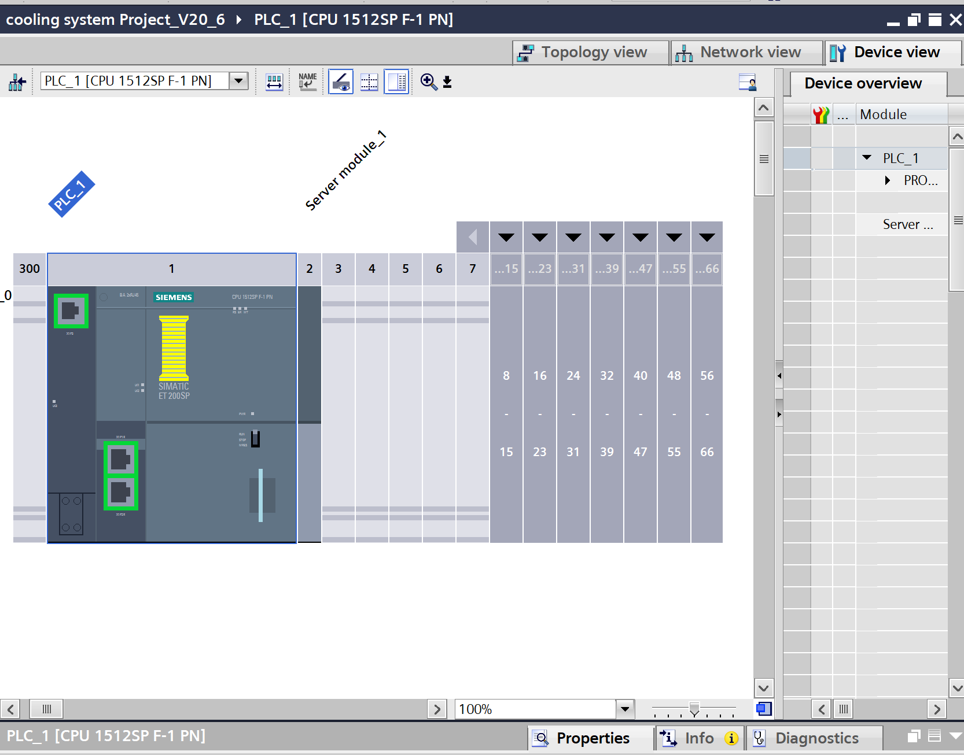
PLC Simulator & TIA Portal Integration
PLC-SIM allows virtual testing of PLC programs in TIA Portal, enabling real-time logic simulation, HMI interaction, and system verification—without physical hardware.

Slide 6
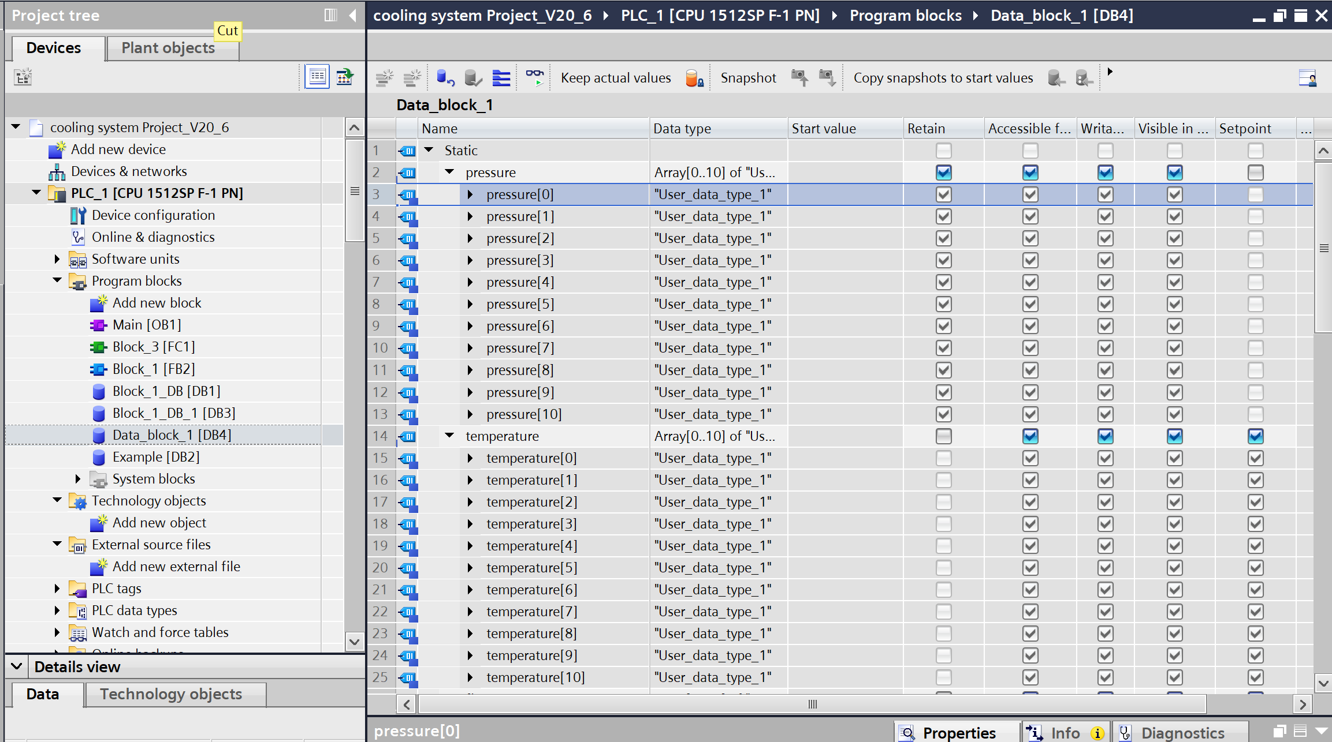
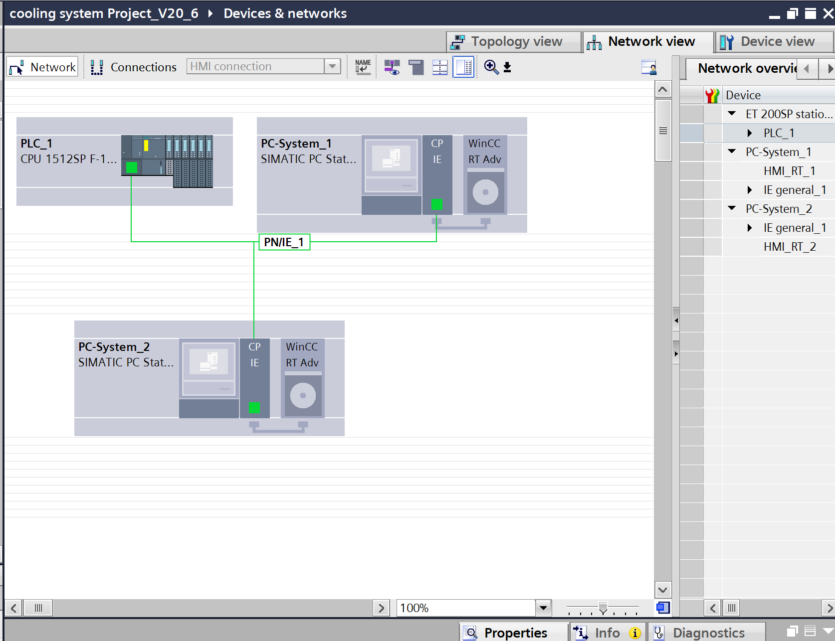
PLC Simulator & TIA Portal Integration “Device &Networks”

Slide 7
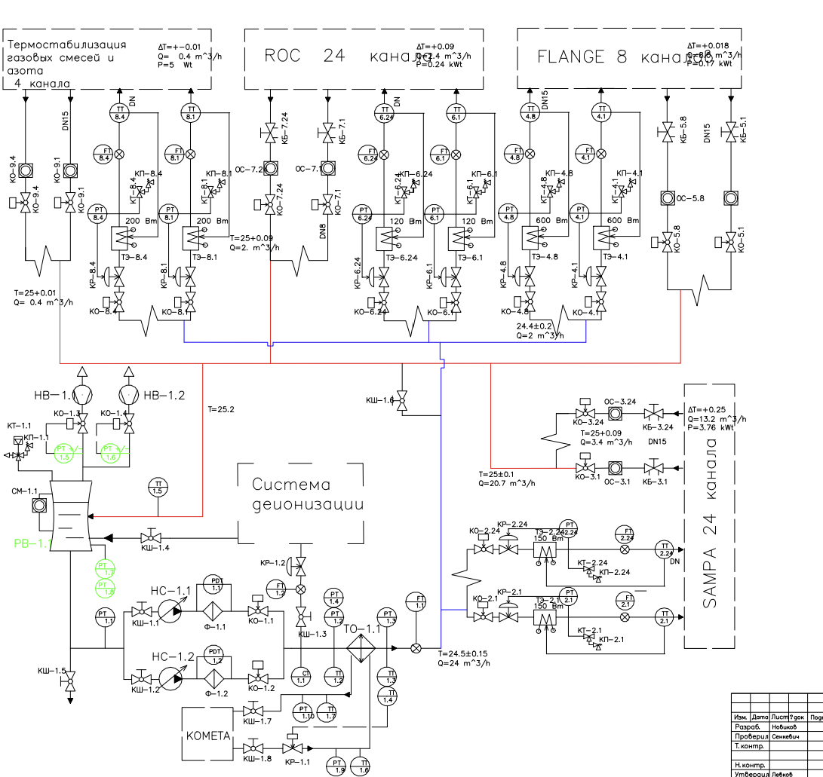
Copper Thermal Stabilization Scheme

Slide 8
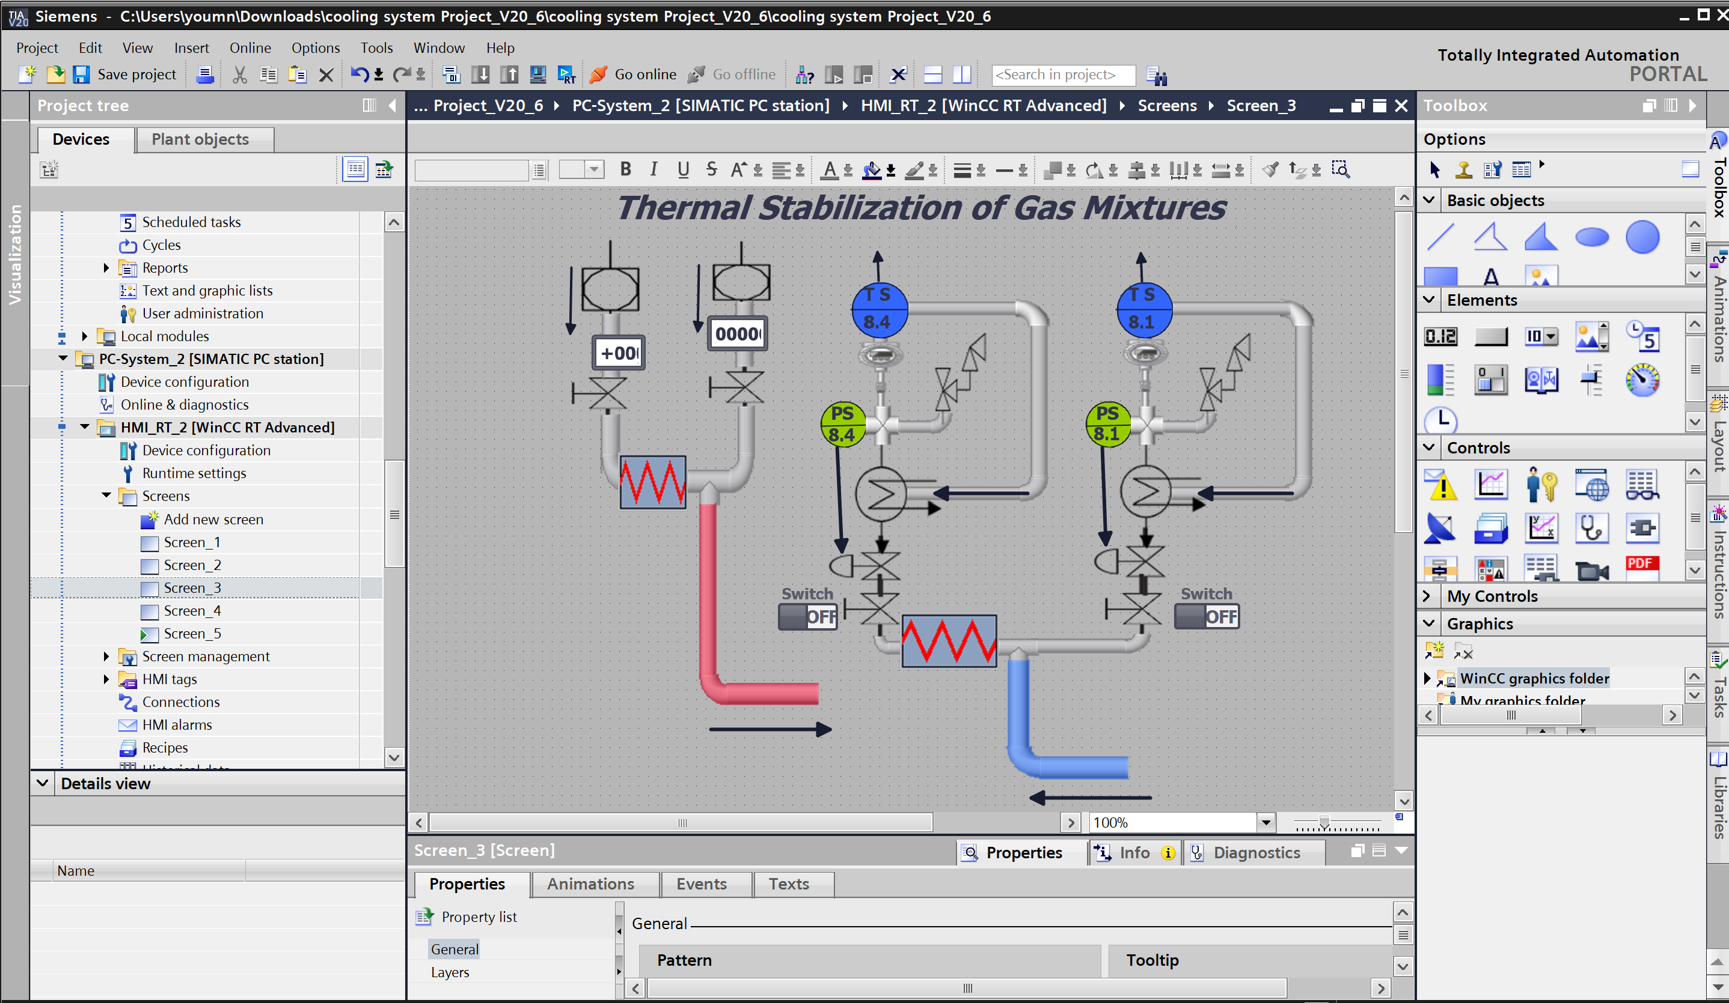
GUI Interface screen using TIA Portal

Slide 9
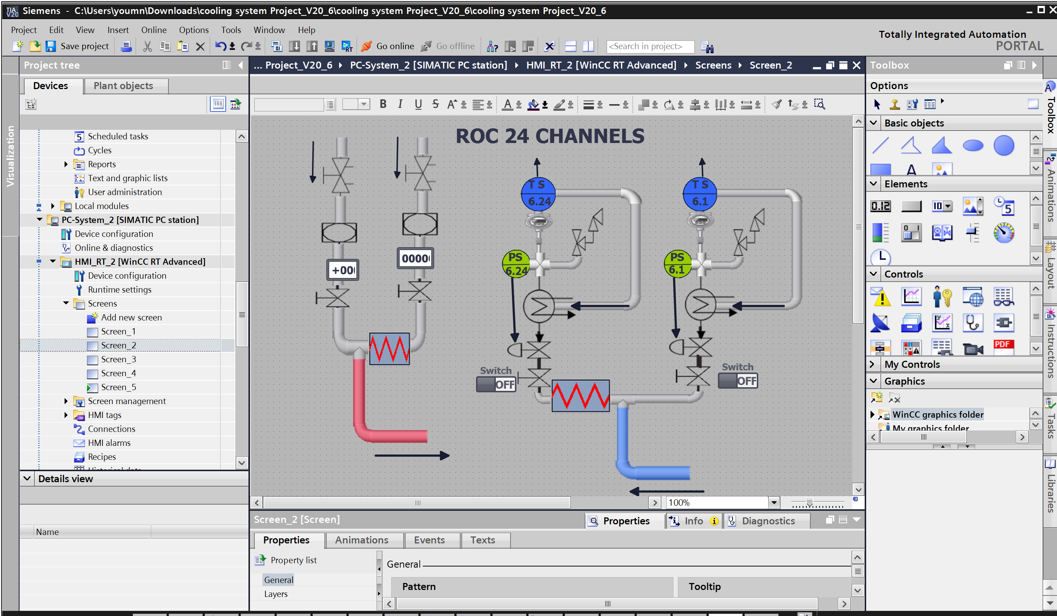
GUI Interface screen using TIA Portal

Slide 10
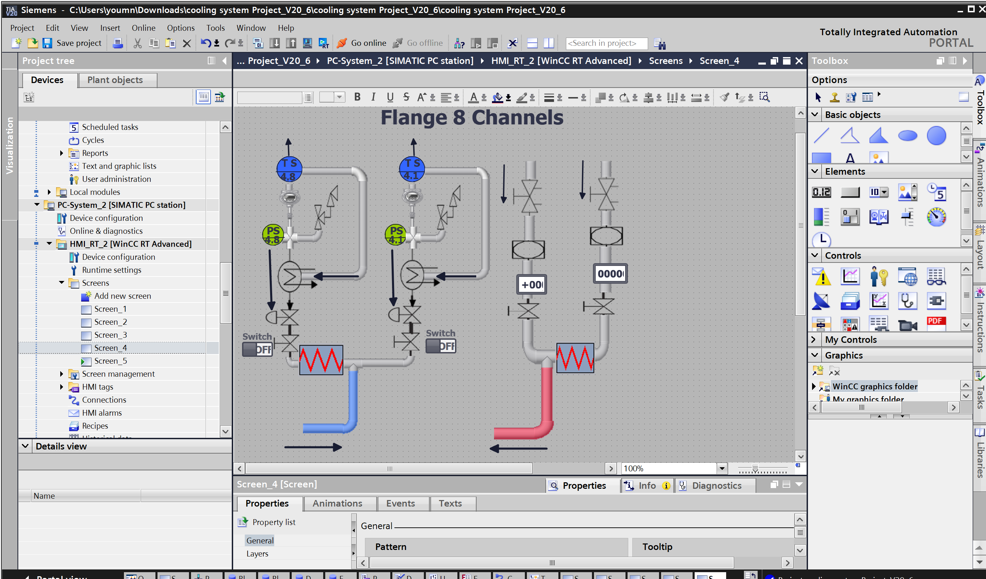
GUI Interface screen using TIA Portal

Slide 11
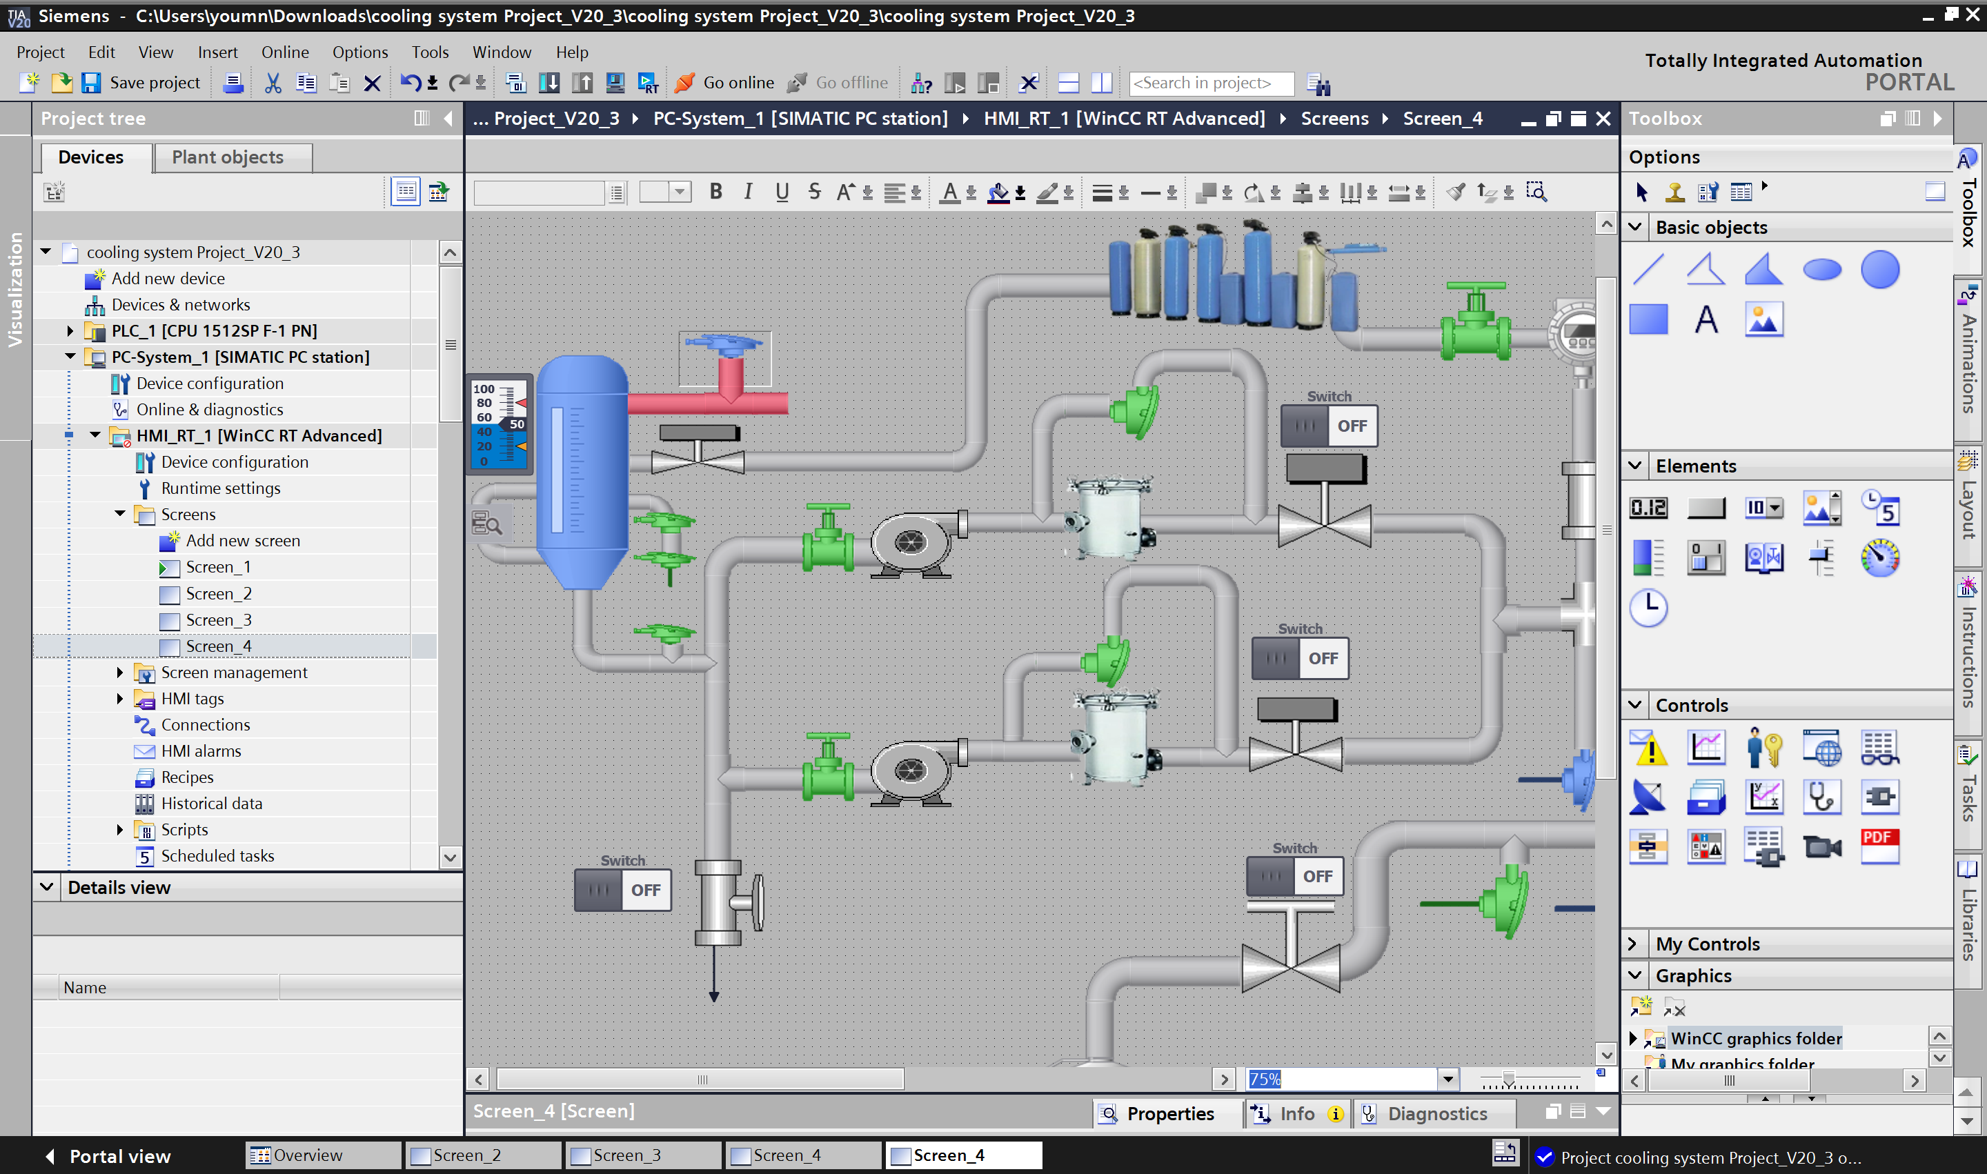
GUI Interface screen using TIA Portal

Slide 12
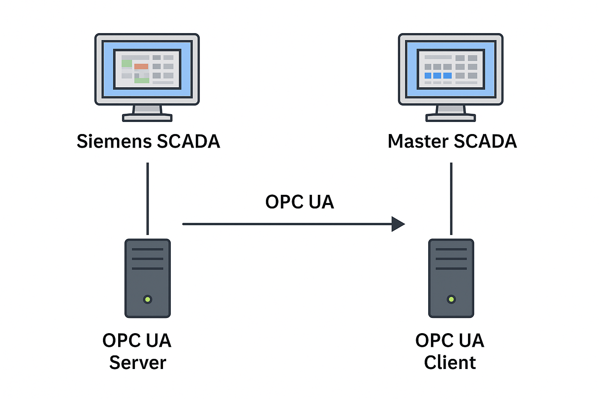
Integration of TIA Portal SCADA into Master SCADA
Utilize OPC UA or Modbus TCP for seamless communication.
Configure WinCC (TIA Portal) as an OPC UA Server.
Master SCADA connects as an OPC UA Client to read/write data.
Share and map key process tags (e.g., alarms, setpoints, status).
Implement security settings: authentication, access control, encryption.
Perform real-time testing and validation to ensure proper integration.

Slide 13
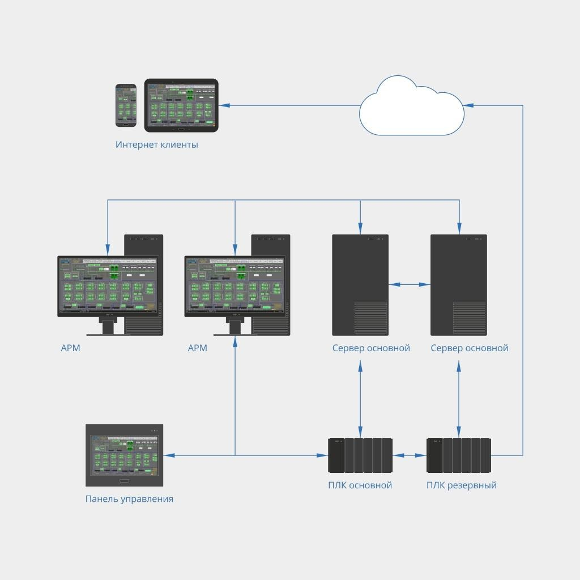
Master SCADA 4D – New Generation of SCADA
Next-gen SCADA system by MPS Software with enhanced support for IoT and large distributed systems.
Enables full integration across all management levels:
PLC controllers
Local HMI panels
Operator workstations
Servers
Cloud services

Slide 14
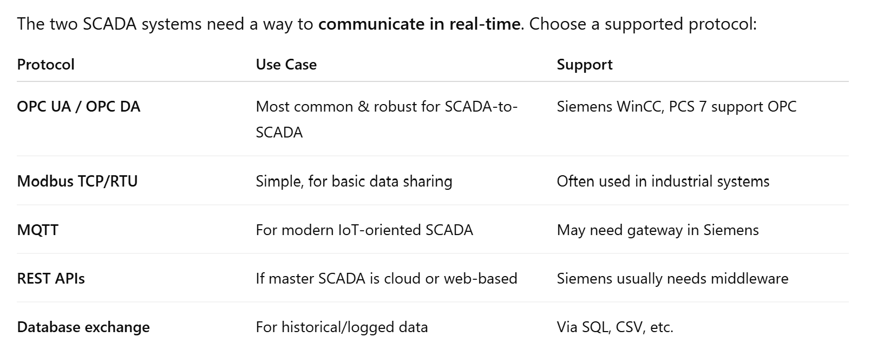
Integration Strategy Overview
Goal: Connect Siemens SCADA (WinCC/PCS 7) to a Master SCADA system
Key Protocols:
- OPC UA / DA: Standard for SCADA integration
- Modbus TCP: Lightweight and widely used
- MQTT / REST: For IoT or cloud-based systems
Use Siemens SCADA as a Data Server
Use MasterSCADA as the OPC UA Client
- In MasterSCADA, add Siemens as OPC UA data source
- Connect to Siemens OPC UA server (IP, Port 50000)
- Browse and import tags
- Assign tags to screens, trends, alarms, etc.

Slide 15
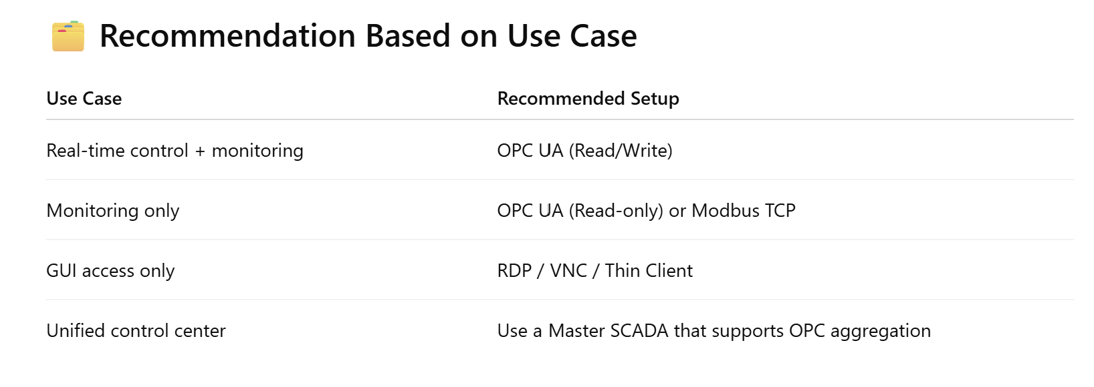
GUI-Level Integration Methods
- Remote Desktop / VNC: Directly launch Siemens SCADA interface
- Hyperlink Launcher: Button in MasterSCADA opens Siemens HMI
- Thin Client: Host Siemens SCADA on terminal server for browser access
- Embedded HMI Web Page: Use iframe if web-enabled HMI is available

Slide 16
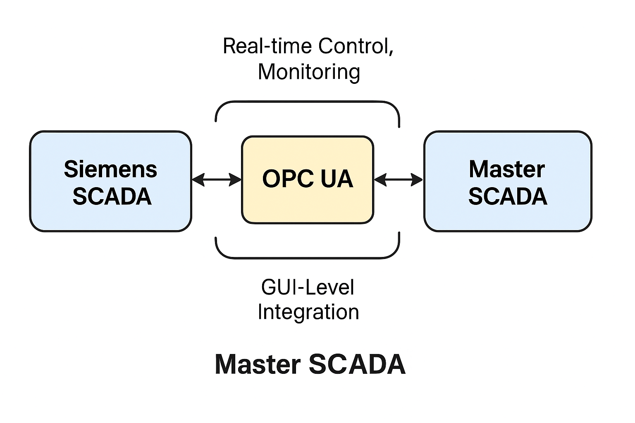
Integration Layers Overview
1. Real-Time Control: OPC UA Read/Write
2. Monitoring: OPC UA Read-only / Modbus TCP
3. GUI Integration: RDP, VNC, Thin Clients

Slide 17
Conclusion
A GUI interface was developed using Master-SCADA 4D and TIA Portal, enabling full control, monitoring, and data logging for the cooling and thermal stabilization systems of the MPD experiment.
The system manages 110 leakless cooling channels, with 76 dedicated to thermal stabilization, ensuring safe operation below atmospheric pressure.
Real-time monitoring of key parameters (temperature, pressure, flow, conductivity, vacuum, etc.) is integrated via multi-zone PLCs and OPC communication.
The interface supports continuous control, diagnostics, and data archiving, ensuring reliability and efficient system analysis.
Current status: GUI design completed, with performance and diagnostic tools in place.
- Configure Siemens SCADA OPC UA server
- Setup Master-SCADA OPC UA client
- Secure and validate all communication
Optionally enable GUI-level integration
Test and document the full integration

Slide 18
Thanks for your Attention
Full Name
Youmna Ghoneim
Telegram Contact
Tel.: +7 (923) 40 80 895
E-mail: youmnasami24@gmail.com, Ghoneim@jinr.ru
15.05.2025

