Slide 1
61
st
Meeting of the Programme Advisory Committee for Condensed Matter Physics
26 June 2025

Slide 2
Members of the PAC
Pavel Alekseev | — | NRC “Kurchatov Institute”, Moscow, Russia
Latchezar Avramov | — | IE BAS, Sofia, Bulgaria
Hartmut Fueß | — | IMS, TU Darmstadt, Germany
Alexandre Ivanov | — | ILL, Grenoble, France
Sakin Jabarov | — | IP MSE RA, Baku, Azerbaijan
Ravi Kumar N V | — | IIT Madras, Chennai, India
Alexei Kuzmin | — | ISSP UL, Riga, Latvia
Dénes Lajos Nagy | — | Wigner RCP, Budapest, Hungary (Chair)
Raffaele Saladino | — | Tuscia University, Viterbo, Italy
Sangaa Deleg | — | IPT MAS, Ulaanbaatar, Mongolia
Mannab Tashmetov | — | INP NUUz, Tashkent, Uzbekistan
Dmitrii Tayurskii | — | KFU, Kazan, Russia
Igor Ushakov* | — | SRC – FMBC, Moscow, Russia
Nicolae Verga | — | UMPCD, Bucharest, Romania
* Excused absence

Slide 3
Ex officio members appointed by the JINR
Pavel Apel | — | Head of Centre for Applied Physics, FLNR
Oleg Belov | — | Scientific Secretary of the PAC
Alexander Belushkin | — | Head of Division, FLNP
Ochbadrakh Chuluunbaatar | — | Deputy Director, MLIT
Michal Hnatič | — | Head of Sector, BLTP
Latchesar Kostov | — | Vice-Director, JINR
Evgeny Krasavin | — | Scientific Leader, LRB

Slide 4
Members of the JINR Directorate
Grigory Trubnikov | — | Director of JINR
Victor Matveev | — | Scientific Leader of JINR
Sergey Dmitriev | — | Vice-Director of JINR
Vladimir Kekelidze | — | Vice-Director of JINR
Latchesar Kostov | — | Vice-Director of JINR
Sergey Nedelko | — | Chief Scientific Secretary of JINR
Boris Gikal | — | Chief Engineer of JINR

Slide 5
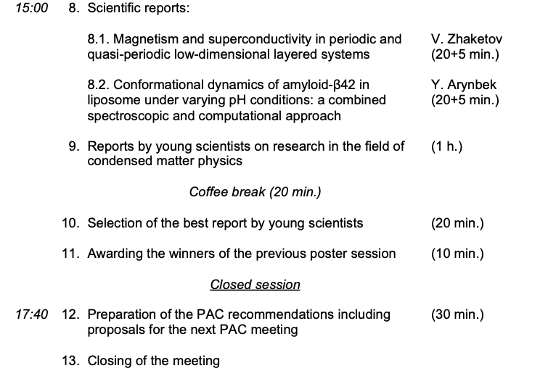
Draft Programme of the PAC meeting
Thursday, 26 June 2025

