Slide 1
Programme Advisory Committee for Condensed Matter Physics
Follow-up after
60th meeting, 27 January 2025
Dénes Lajos Nagy
61st Meeting of the PAC for Condensed Matter Physics, 26 June 2025

Slide 2
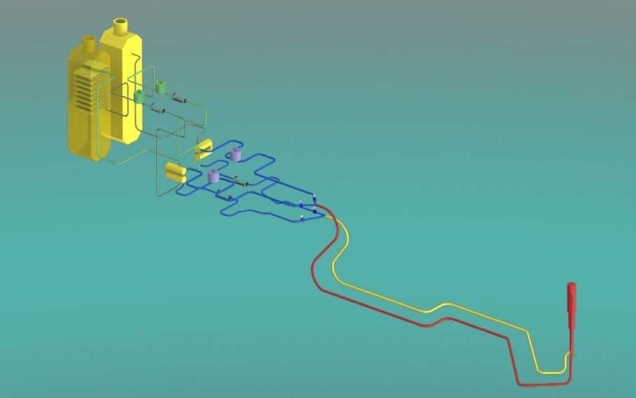
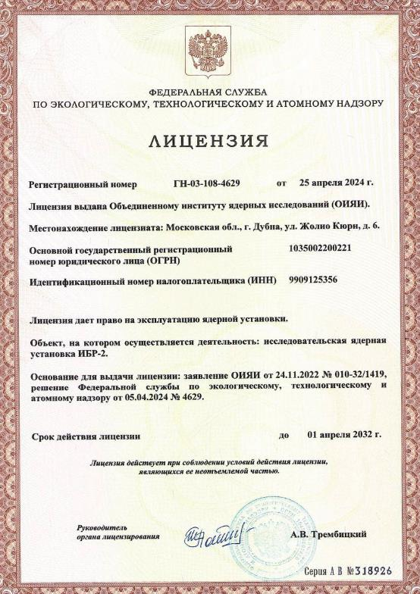
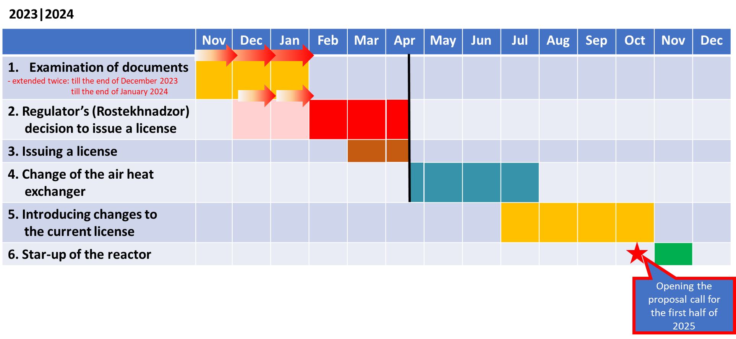
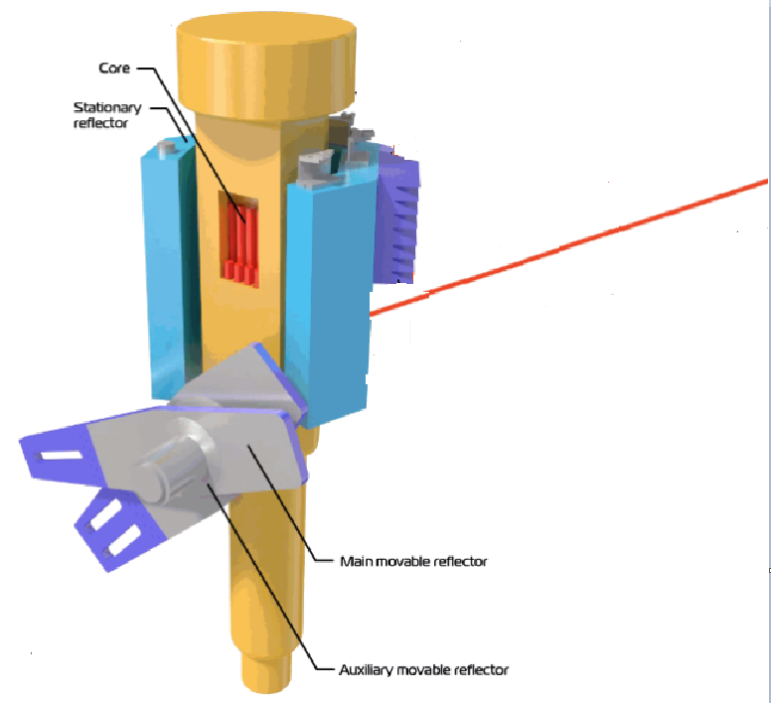
Progress of work at IBR-2 in preparation for the resuming
of operation of the reactor
The PAC took note of the information on the completion of repair work at IBR-2 and the receipt of authorization for resuming of operation of the reactor, presented by Egor Lychagin.
October 16, 2021 – reactor shutdown due to a leak in the secondary cooling circuit of the air heat exchanger (HE)
Repair of the faulty HE (safety regulations require operation of 2 HE) was carried out in April 2021;
On April 25, 2024, a license was received from ROSTEKHNADZOR for the operation of the IBR-2 research nuclear facility until April 1, 2032;
April 25 2024
Primary circuit
Core
Secondary circuit
Plan at the beginning of 2024
and the previous PAC.
By the end of the summer, it became clear that the technical work could only be completed by the end of the year.

Slide 3
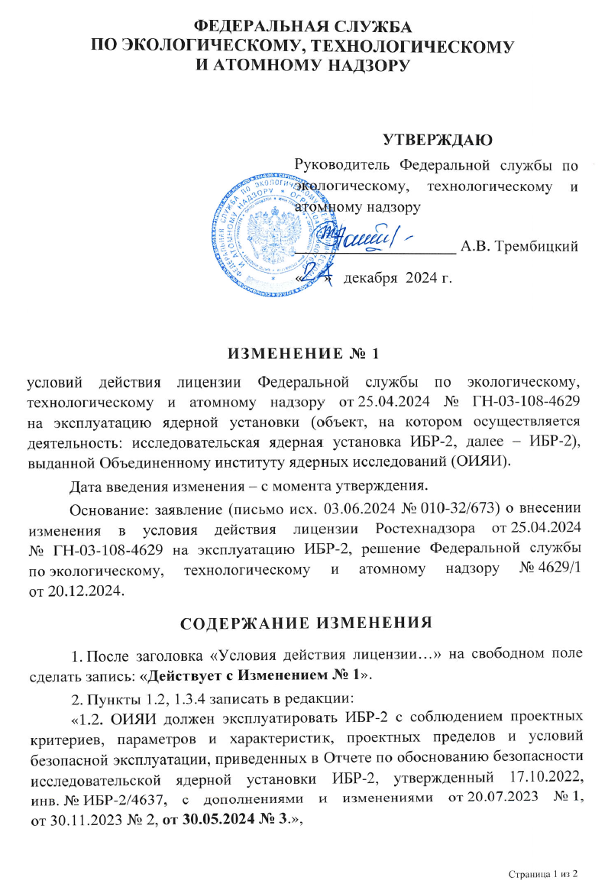
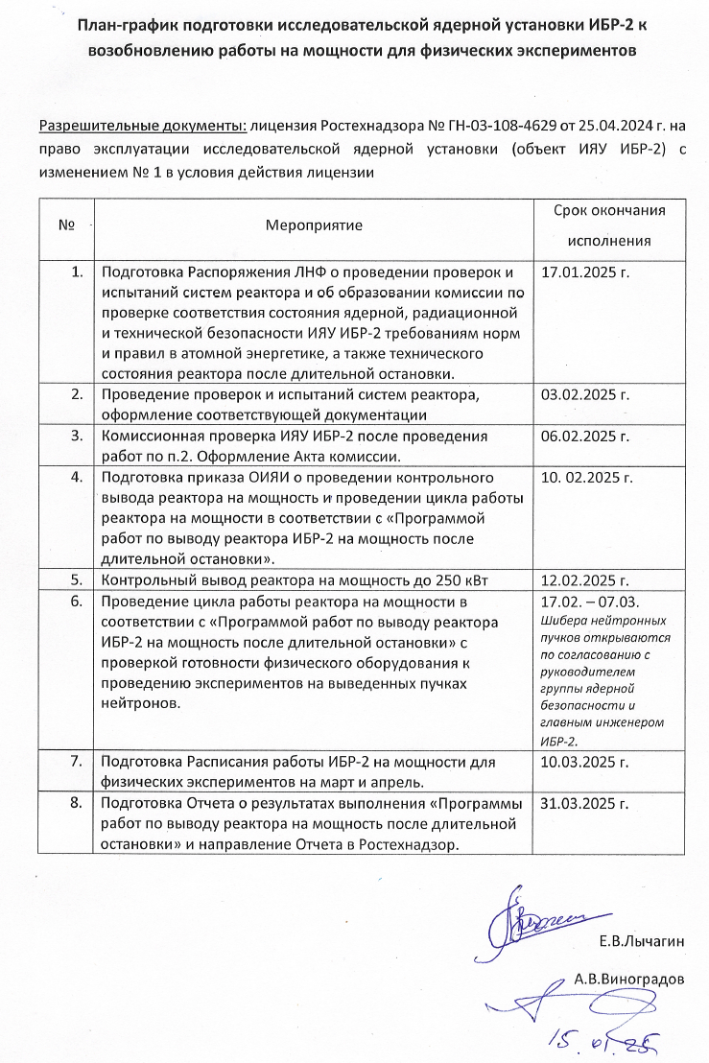
Progress of work at IBR-2 in preparation for the resuming
of operation of the reactor
On December 24, 2024, an addendum to the license was received from Rostekhnadzor. It permits bringing the IBR-2 to power.
A plan was prepared to resume the operation of IBR-2 nuclear facility at power.
Test cycle of the reactor operation with a gradual increase in power and first experiments are planned for February 17, 2025.
In spring 2025, beam time in operation cycles will be allocated to JINR researchers and for fast-access requests. The reactor operation power for these cycles will be chosen based on the test cycle results.
Resumption of the User Program is scheduled for autumn 2025.

Slide 4
Progress of work at IBR-2 in preparation for the resuming
of operation of the reactor
Resolution of JINR Scientific Council
The Scientific Council was pleased with the progress of work at IBR-2 in preparation for resuming the operation of the reactor and highly appreciateed the efforts of the JINR Directorate to resume regular cycles for users, as well as its plans to extend the operation of the reactor with high-performance parameters by loading new fuel.
The Scientific Council supported the PAC’s recommendations that in the time remaining until the resumption of regular cycles, work with potential users should be intensified in order to attract the maximum number of researchers to JINR, primarily from the Member States.

Slide 5
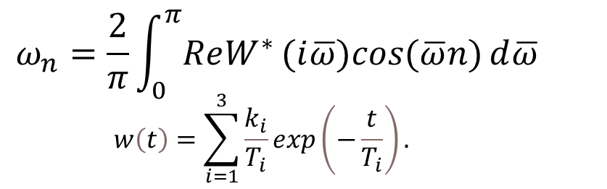
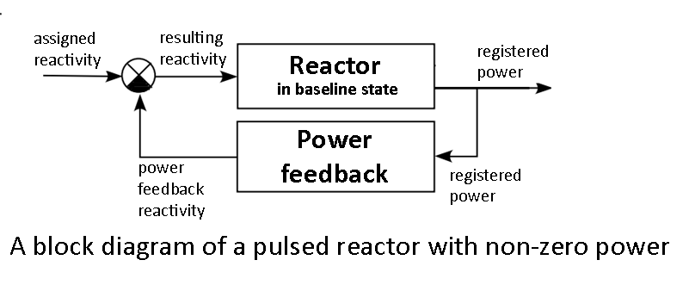
Development of a mathematical model for the dynamics of pulsed fast reactors
The PAC took note of the results and prospects for the development of a mathematical model of pulsed fast reactor dynamics, presented by Maksim Bulavin.
Impulse response of power feedback (IRPF) of the IBR-2/IBR-2M
The three-exponential approximation of the IBR-2 reactor

Slide 6
Development of a mathematical model for the dynamics of pulsed fast reactors
Resolution of JINR Scientific Council
The Scientific Council noted the FLNP activities on modelling the dynamics of pulsed fast reactors, which indicate that exceeding the stability limits of a pulsed reactor may be caused by at least two factors: thermal expansion of the fuel and dynamic bending of the fuel rods, or bending of the fuel assemblies during a pulse.
The Scientific Council shared the PAC’s opinion on the continuation of activities on modelling the dynamics of pulsed fast reactors and considered this work essential both for the operation of IBR-2 and the development of the new neutron source at JINR.

Slide 7
Status of work on the project of the new neutron source
The PAC took note of the implementation of the recommendations of the previous PAC meeting concerning work on the project of the new neutron source, presented in written form.
The PAC was satisfied with the recent progress made in the development of a mathematical model for reactor dynamics.
The PAC noted the continuation of developing new advanced devices and technologies for cryogenic moderators of the new high-flux neutron source.
Resolution of JINR Scientific Council
The Scientific Council welcomed the constant attention of the PAC to the status of the project of the new neutron source at JINR. It also noted the continuation of developing new advanced devices and technologies for cryogenic moderators of the new neutron source.

Slide 8
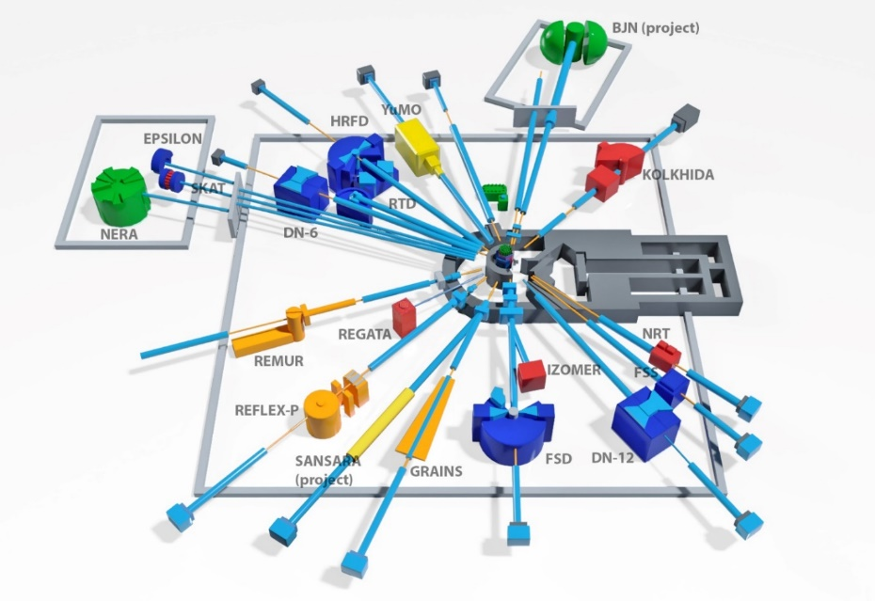
Current state and recent developments of FLNP instruments
The PAC was informed by Denis Kozlenko about progress in the IBR-2 instrumentation development during the technical shutdown of the IBR-2 reactor. These activities are important for the successful realization of the FLNP scientific programme and the User programme at a level competitive with other world neutron centres.
SPECTROMETER COMPLEX OF IBR-2
Diffractometers:
HRFD, DN-6, RTD, DN-12, FSD, SKAT, Epsilon, FSS
Reflectometers:
REMUR, REFLEX, GRAINS
Small Angle Scattering Spectrometer: YuMO
Inelastic Neutron Scattering Spectrometer:
NERA
Radiography and Tomography Spectrometer:
NRT
New Instruments in development:
Small Angle Neutron Scattering and Imaging (Radiography and Tomography) Spectrometer
BJN (INS in inverted geometry)
14 instruments for condensed matter research,
2 in development stage
Schematic of the large-aperture backscattering detector.

Slide 9
Current state and recent developments of FLNP instruments
Resolution of JINR Scientific Council
The Scientific Council noted with satisfaction the progress in the IBR-2 instrumentation development during the technical shutdown of the IBR-2 reactor and considered these activities important for the successful realization of the FLNP scientific programme and the user programme at a level competitive with other world neutron centres.
Schematic of the large-aperture backscattering detector.

Slide 10
Scientific reports
The PAC heard with interest the scientific reports
“Neutron tomography for structural analysis of cement materials, rocks and meteorites” (by Ivan Zel)
“Analysis of the Aβ42 conformational dynamics in lipid membrane mimetics: spectroscopic and atomistic study” (by Heba Esawii)
The PAC thanked the speaker for the excellent reports.

Slide 11
Virtual presentations by young scientists
The PAC reviewed 14 virtual presentations made by young scientists in the field of condensed matter physics and related fields. The virtual poster presentation “Structural and vibrational properties of the Cu₃Bi(SeO₃)₂O₂Cl francisite at high-pressure” made by Anton Rutkauskas was selected as the best presentation of the session.
The PAC also noted two more virtual poster presentations of a high level: “The influence of phospholipid composition on membrane interaction with amyloid beta peptides within molecular dynamics simulations” by Dina Badreeva and “Polymer brushes synthesized by the “Grafting-through” approach: characterization and scaling analysis” by Mikhail Avdeev.
The Scientific Council followed with interest the reports by young scientists, selected by the PACs for presentation at it’s session. The Scientific Council thanked the speakers and welcomes such selected reports in the future.
Resolution of JINR Scientific Council

Slide 12
Thank you for your attention

