Slide 1

61st meeting of the
JINR Programme Advisory Committee for Condensed Matter Physics
June 2025, Dubna

Slide 2
Information on the Resolution of the JINR Scientific Council
137th session, 13–14 February 2025
and
on the decisions of the JINR Committee of Plenipotentiaries
25 March 2025, Dubna

Slide 3
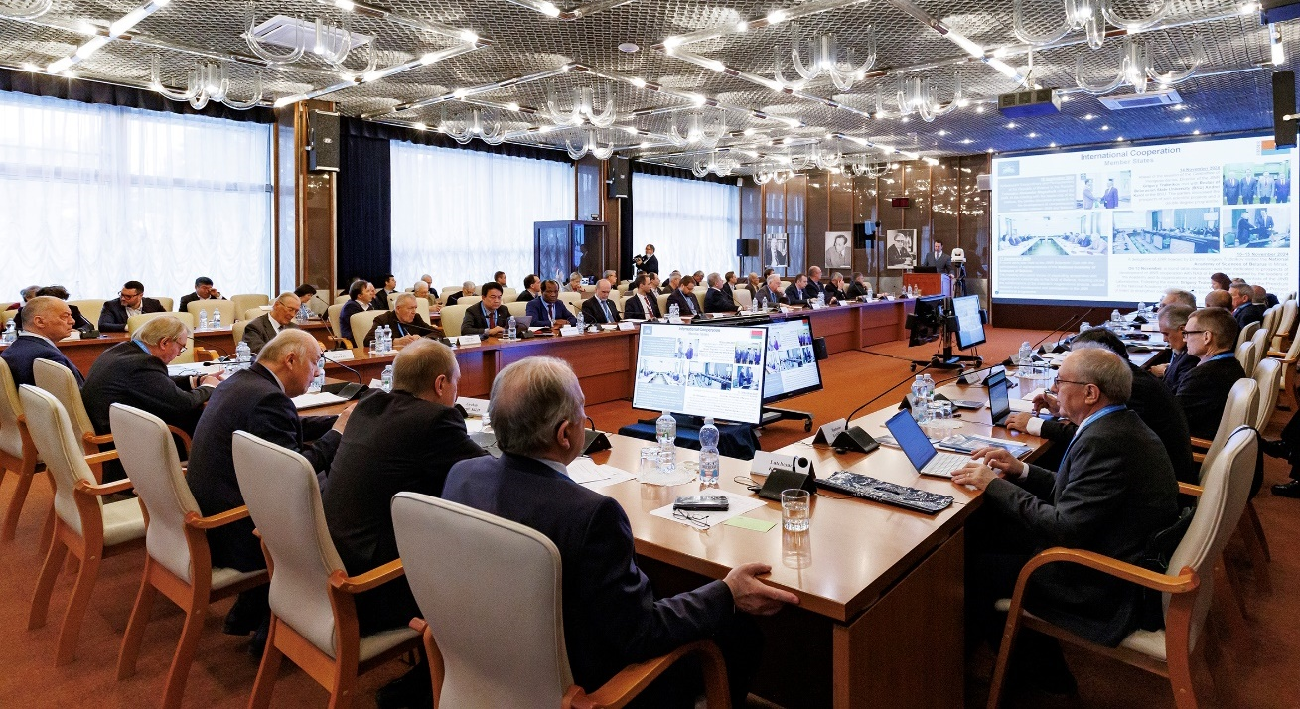
Information on the Resolution of the JINR Scientific Council
137th session, 13–14 February 2025, hybrid mode
Co-chaired by Grigory Trubnikov and by Sergei Kilin

Slide 4
PROGRAMME: 137th Session of the JINR Scientific Council 13–14 February 2025
February 13
Report by the JINR Director (G.Trubnikov)
Recommendations of the Programme Advisory Committees taken at the meetings in January 2025: ( I.Tserruya, V.Nesvizhevsky, D.L.Nagy)
Election of Director of FLNR and endorsement of the proposal for Deputy Directors of LRB
Announcement of vacancies for the positions of FLNR Deputy Directors
Visit to the Dzhelepov Laboratory of Nuclear Problems for the festive opening of a new JINR base facility - the LINAC-200 accelerator
February 14
Reports by young scientists as recommended by the PACs
Jury’s recommendations on the award of JINR annual prizes for best papers in the fields of theoretical and experimental research, methodology and technology research, and applied technology research (S. Dmitriev)
Proposal for awarding the title "Honorary Doctor of JINR“ (G.Trubnikov)
General discussion. Adoption of the Resolution of the Scientific Council

Slide 5
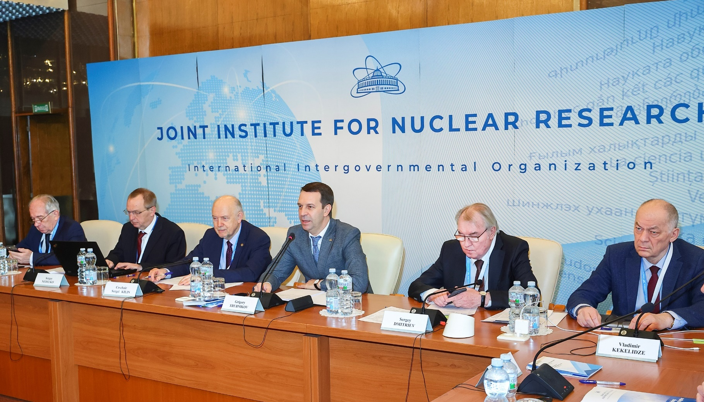
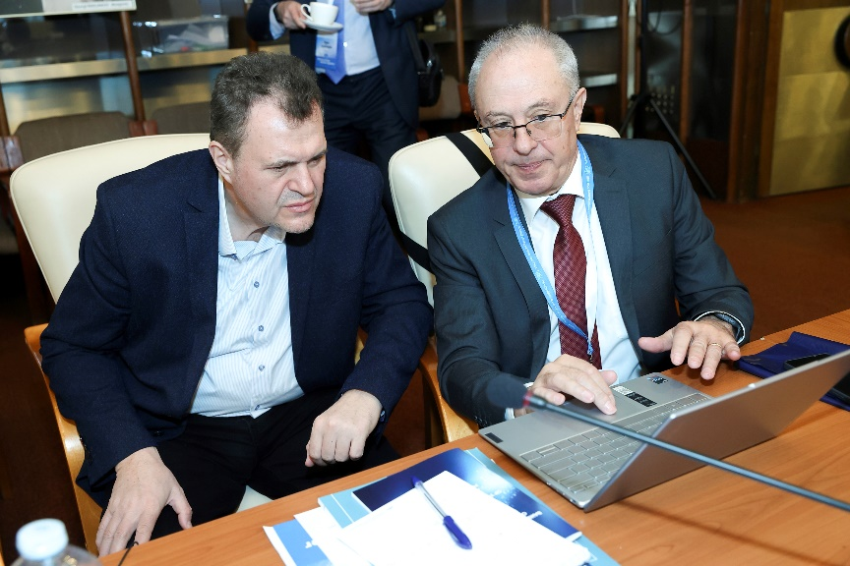
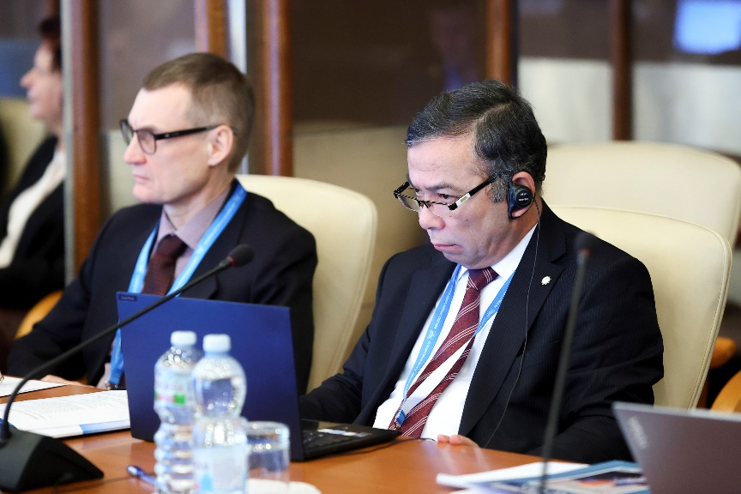
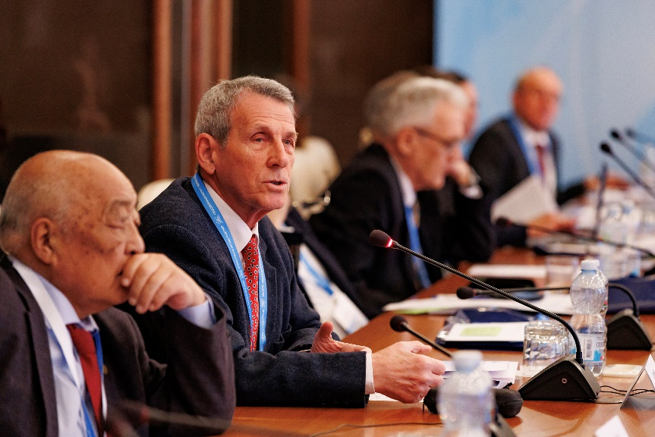
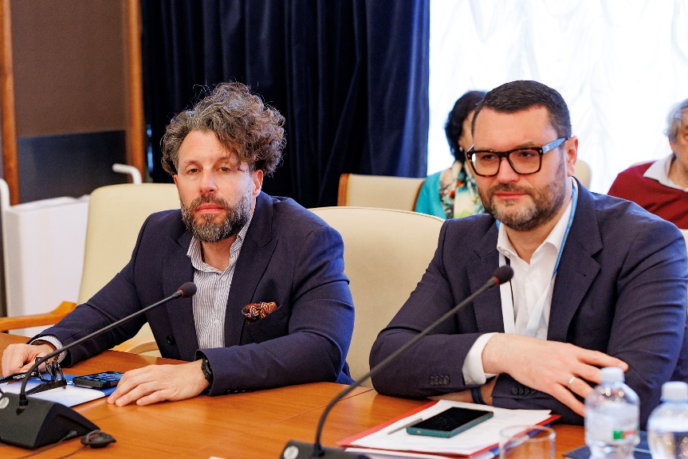
137th Session of the JINR Scientific Council 13–14 February 2025
Report by the JINR Director, G.Trubnikov, covering the results of the implementation of the Seven-Year Plan for the Development of JINR for 2024–2030, the progress in the realization of the projects included in the Topical Plan for 2024 as well as recent events in JINR’s scientific activities and international cooperation were presented.
Sergey Kilin (Belarus) was re-elected the SC Co-Chair for the next three years. The Scientific Council greeting new SC members Raghunath Sahoo (India) and Song Yuntao (China).
S. Sidorchuk was elected as FLNR Director for a second term of five years, vacancies for the positions of FLNR Deputy Directors were announced.
The Scientific Council endorsed A. Boreyko and I. Padrón Díaz as Deputy Directors of the Laboratory of Radiation Biology (LRB) until the completion of the term of service of the current LRB Director, A.Bugay.
The reports of young scientists recommended by the PAC were heard.
The Scientific Council approved the proposal of the JINR Director, to award the title “Honorary Doctor of JINR” to M. Sakr (Arab Republic of Egypt) for his great personal contribution to enhancing the role of the Arab Republic of Egypt in JINR’s scientific life, strengthening scientific cooperation between the Arab Republic of Egypt and JINR.
The Jury’s recommendations presented by Vice-Director S.Dmitriev on awarding the JINR annual prizes for best scientific, methodological, technological, and applied research papers were approved.

Slide 6
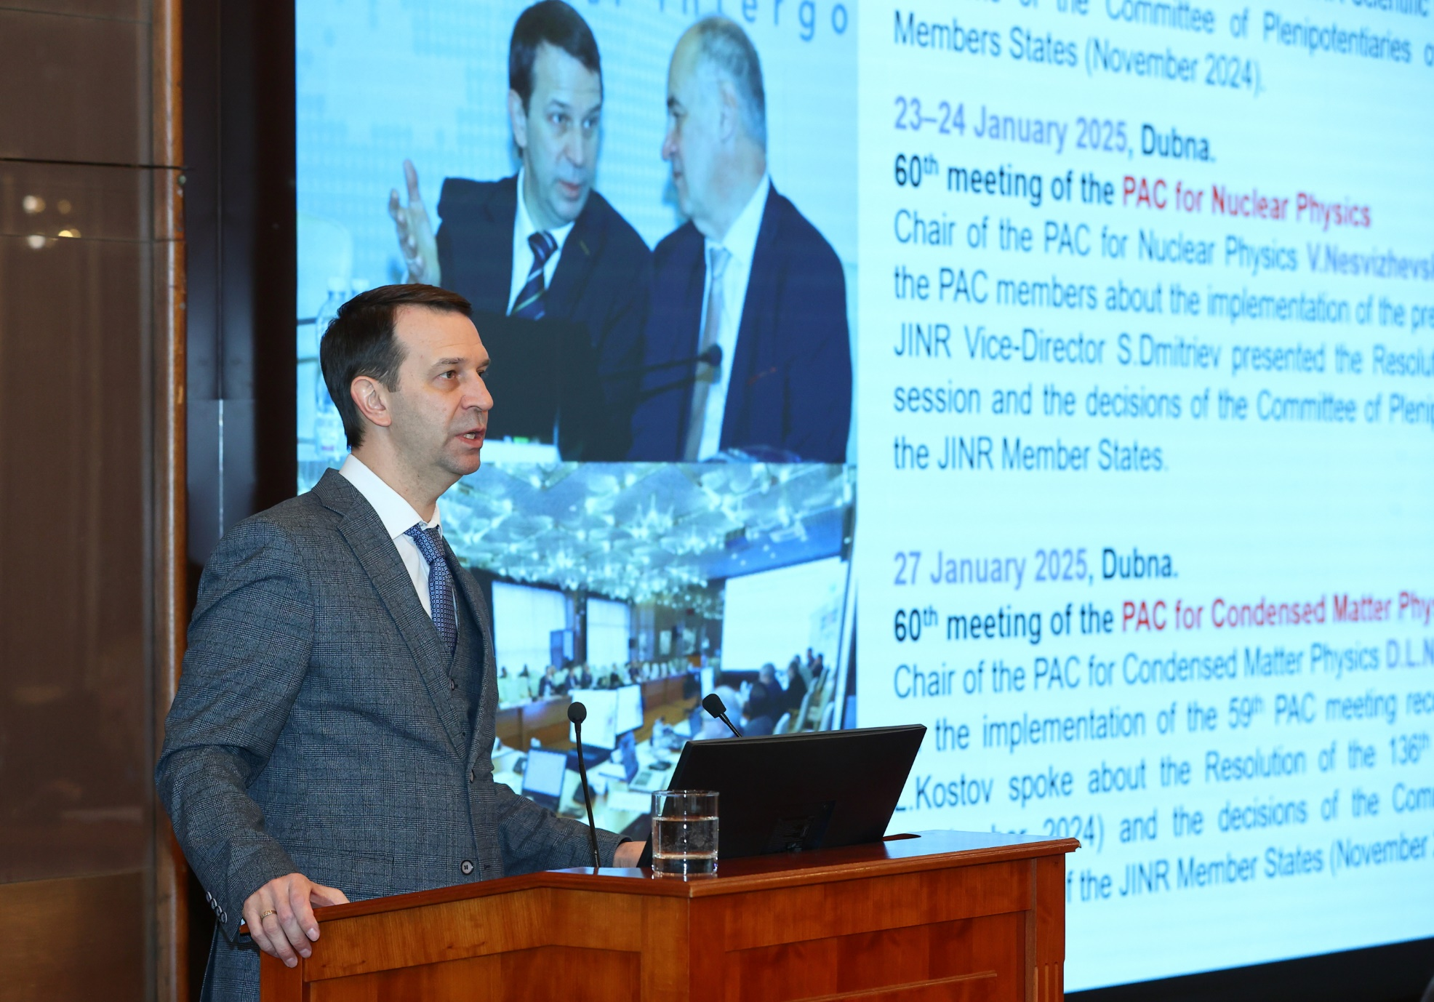
137th Session of the JINR Scientific Council 13–14 February 2025
According to the report by the JINR Director, G. Trubnikov, the Scientific Council appreciated with satisfaction recent achievements of the Institute, such as:
Active preparation to launch the NICA accelerator complex was done at VBLHEP.
Successful cooling of the MPD solenoid down to the liquid He temperature of 4.5 К, preparation of the MPD detector for the analysis of the first data sets in fixed-target mode.
Progress in the analysis of Xe + CsI experimental data at an energy of 3.8 GeV/A recorded by the BM@N experiment.
Development of the ARIADNA collaboration and its research programme, the launch of several channels for applied research, successful operation of the SOCHI chip irradiation station.
Progress in the development of the Baikal-GVD deep-water neutrino telescope, as well as the installation of additional two clusters planned by the collaboration during the 2025 campaign.
Successful participation in the most advanced neutrino experiments, including experiments with reactor neutrinos (JUNO), neutrinos from accelerators (NOvA, T2K), search for neutrinoless double beta decay (LEGEND), as well as results of the first joint analysis carried out by the NOvA and T2K collaborations.
Contribution of the Institute in the work of CERN collaborations at the LHC on the second phase of upgrading the ATLAS, CMS, and ALICE detectors, as well as obtaining new results in the CERN-SPS experiments.
Launch of the Institute’s new basic facility LINAC-800 in commissioning mode with an electron energy of up to 200 MeV.
The FLNR Superheavy Element Factory achieved project parameters. Work underway to prepare for certification of the SHE Factory experimental halls for the first class of radiation safety. Experiments on the synthesis of element 116 were performed at the SHE Factory using beams of ⁵⁰Ti and ⁵⁴Cr in preparation for the synthesis of elements 119 and 120.
New experimental facilities of the U-400R are being designed. The launch of the DC-140 accelerator complex for applied research with heavy ion beams is scheduled for the second half of this year.
The research pulsed reactor IBR-2 in FLNP started again its operation, many reactor’s engineering systems were thoroughly modernised.
MLIT continued actively work for the purposes of JINR experiments and continues to develop the JINR Digital Ecosystem by updating its administrative services.
Staff members of LRB received new results in investigation of molecular mechanisms of action of new classes of compaunds and their combinations to increase the efficiency of tumor radiation therapy.
Scientists from the BLTP had maintained high publication activity and achieved significant progress in theoretical, mathematical, nuclear, particle, relativistic heavy ion, and solid-state physics as well as materials science. Eleven major scientific conferences were organized with the active participation of BLTP, including the Nucleus-2024 International Conference, a session of the Nuclear Physics Section of the Physics Division of the Russian Academy of Sciences.
Last year, more than 900 people participated in the educational programmes of the JINR University Centre.
JINR dissertation councils have successfully worked to improve the qualifications of researchers from the Institute and organizations in the Member States.
The first issue of the new online journal of JINR “Natural Science Review” was published.
A competition of innovative activities at JINR started, laboratories collected requests and discussed them.

Slide 7
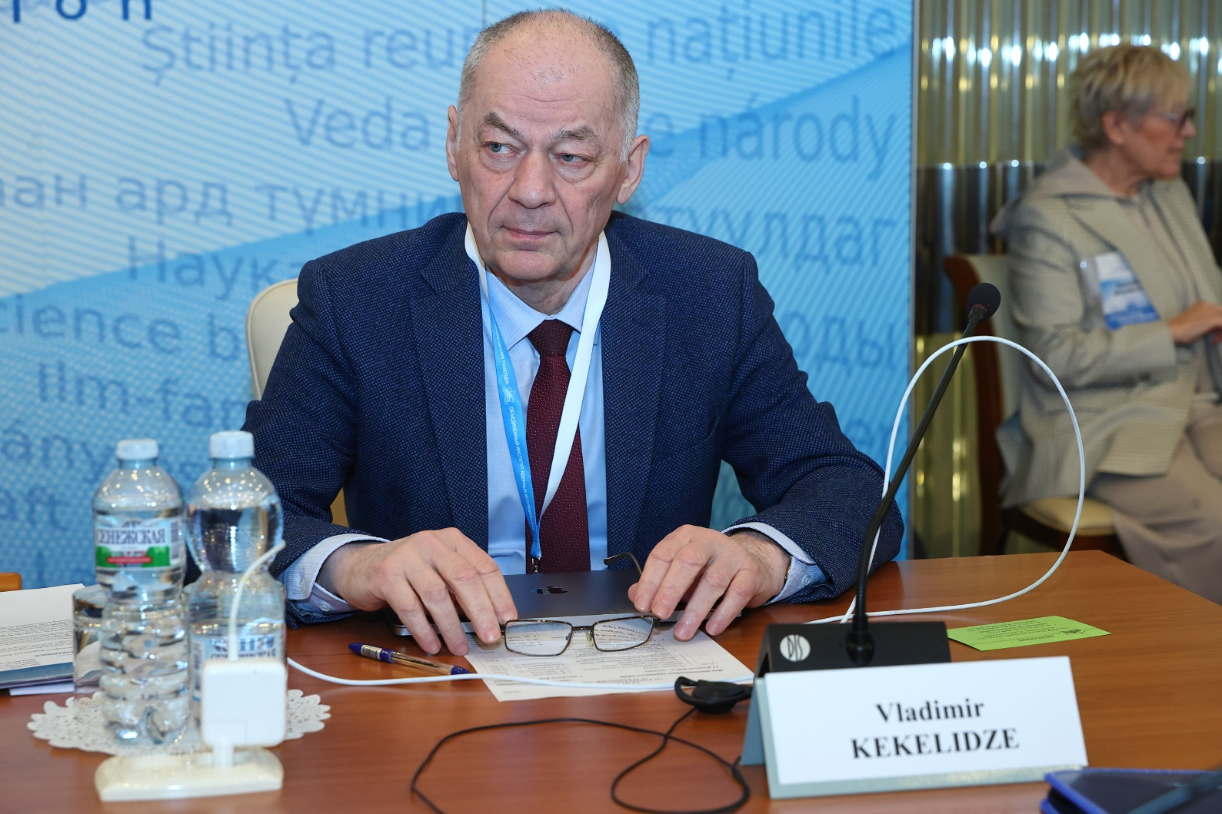
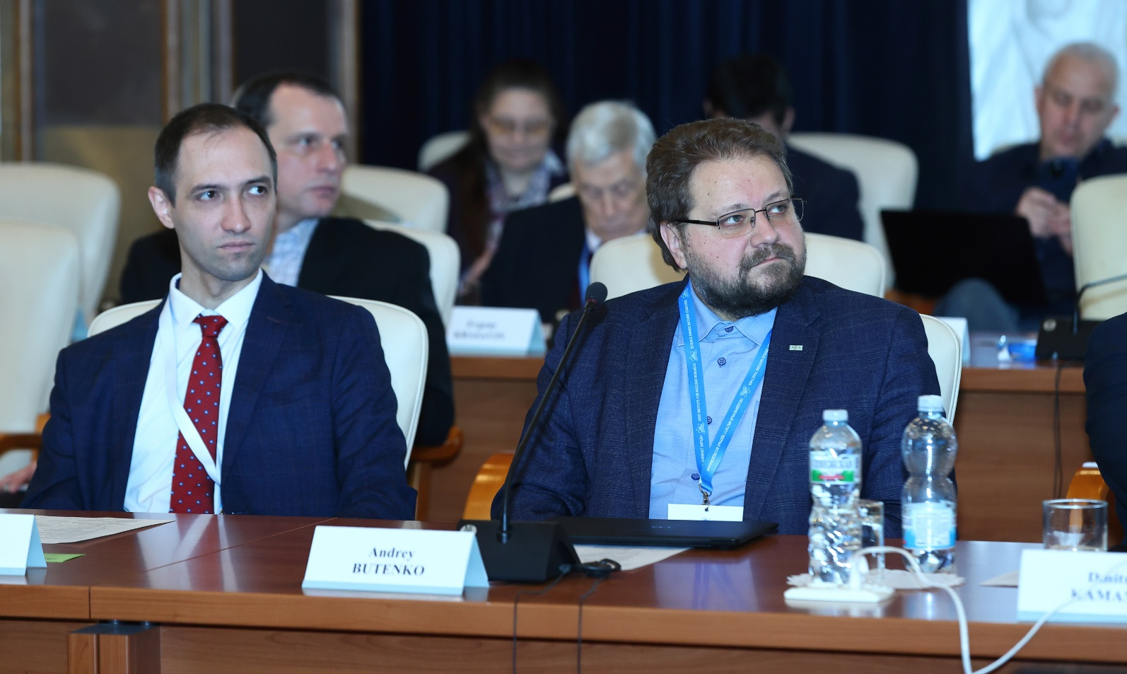
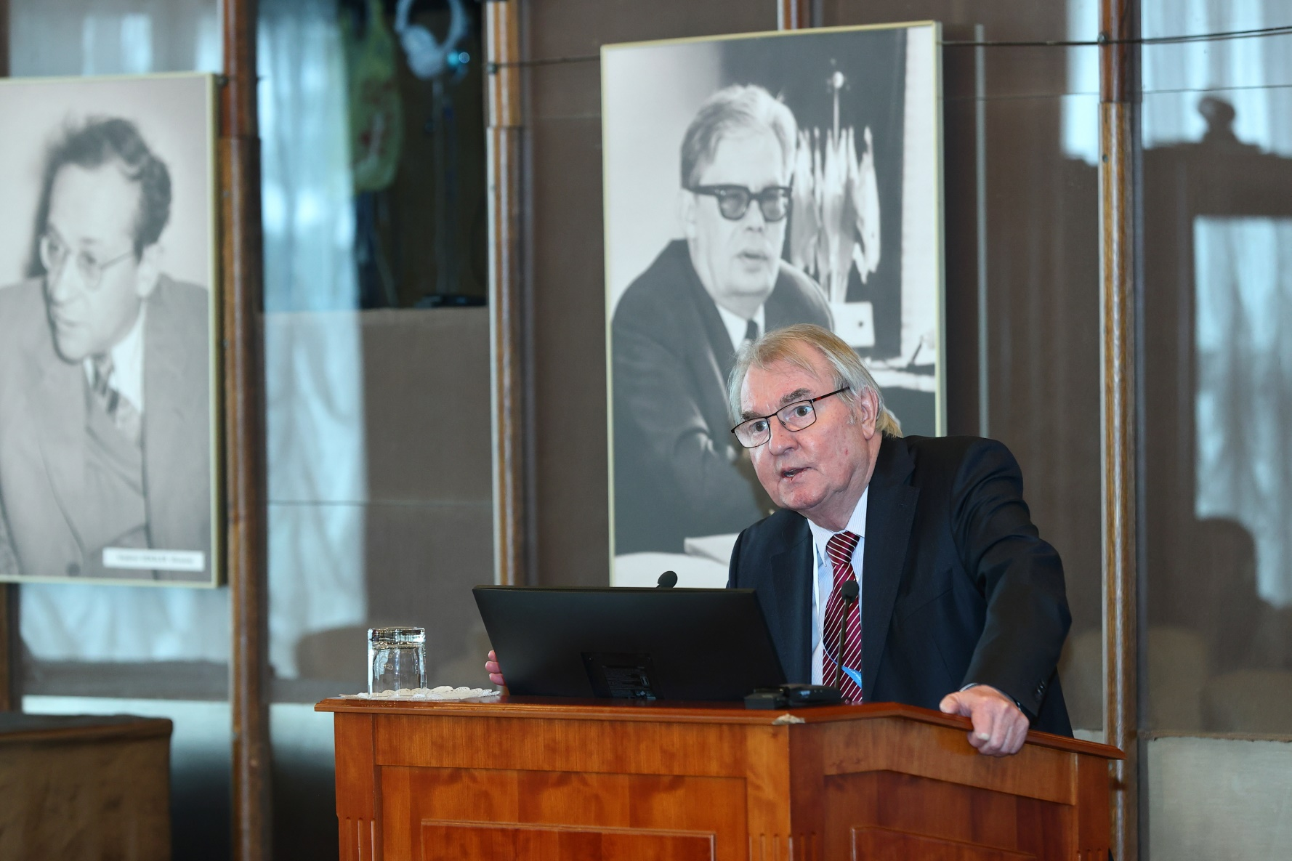
The Scientific Council took note of the recommendations made by the PACs at their meetings in January 2025.
Particle physics. The Scientific Council appreciated the PAC’s support for the signing of a high-level agreement between JINR and the Ministry of Science and Technology of the People’s Republic of China (MOST) on the beginning of the implementation of joint projects.
The Scientific Council:
acknowledged the significant progress achieved in preparation for the NICA collider commissioning;
noted that the main elements of all detector subsystems of the Phase-I MPD are produced;
appreciated the progress in the implementation of the BM@N project;
noted with satisfaction that having finalized the Technical Design Report, the SPD team has started work on the first stage of the detector. Manufacturing the elements of the main detector systems has started, and progress has been achieved in establishing the computing infrastructure of the project;
supported the PAC’s recommendation to open a new project “Study of neutrino properties in accelerator experiments”, comprising JINR’s participation in the ongoing accelerator neutrino experiments NOvA, T2K, FASER, and DsTau;
appreciated the contributions of the JINR teams participating in the LHC experiments in physics analyses and detector upgrades.
Nuclear physics. The Scientific Council appreciated the scientific significance of the Baikal-GVD project and the leading role of JINR in its implementation and noted an important outcome achieved by the analysis of data obtained in 2018–2023 –– confirmation of the diffuse astrophysical neutrino flux observed by the IceCube experiment with a significance of above 5σ.
The Scientific Council noted extensive work underway to start the LINAC-200 facility at DLNP, which is part of the future LINAC-800 accelerator. Requests from the JINR laboratories and research teams of JINR participating countries are the primary focus when forming the user research programme at the accelerator. The Scientific Council recommended that the DLNP Directorate should concentrate its efforts on preparing the first experiments at LINAC-200.
The Scientific Council acknowledged tremendous efforts to prepare for long-term experiments on the spectroscopy of the
isotopes of superheavy elements synthesized in the ⁴⁸Ca + ²⁴²Pu reaction.
The Scientific Council greatly supported the proposed programme for studying the properties of the isotopes of superheavy elements. Given the unique and copious production of SHE within reach, the Scientific Council endorsed the recommendations of the PAC for NP to explore in more detail the possibility of designing a station to detect the mass and TKE distributions of the fission fragments. This would greatly enhance the comprehension of the fission process in an unknown mass region.

Slide 8
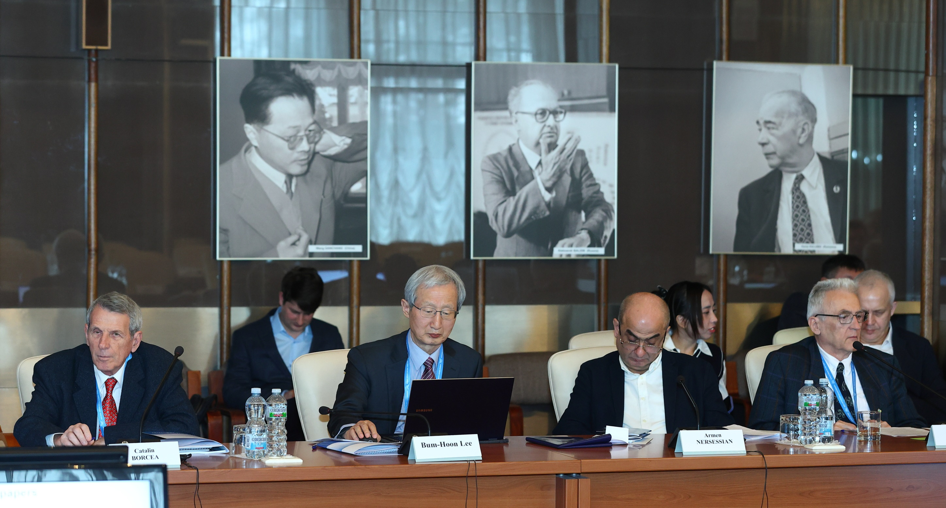
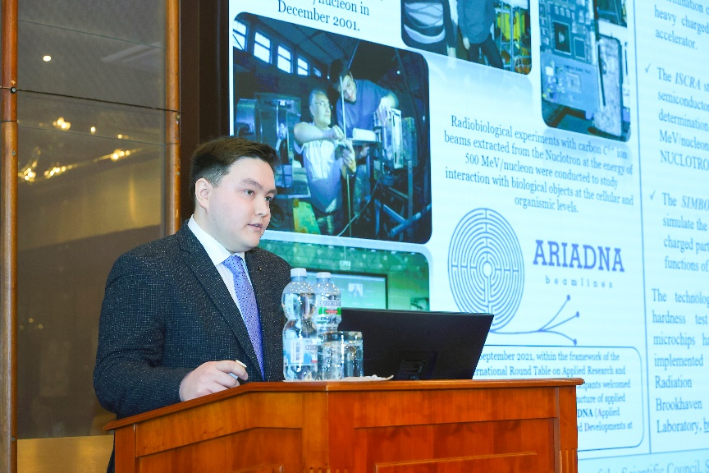
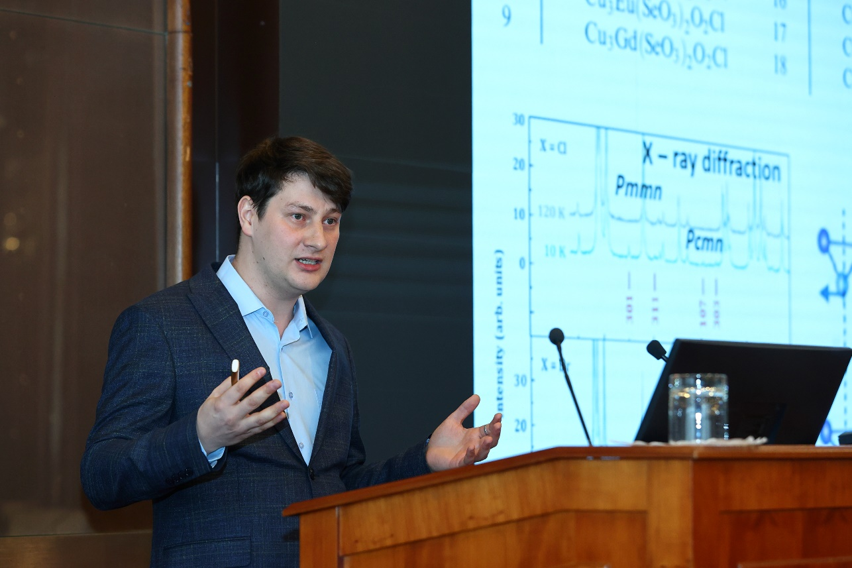
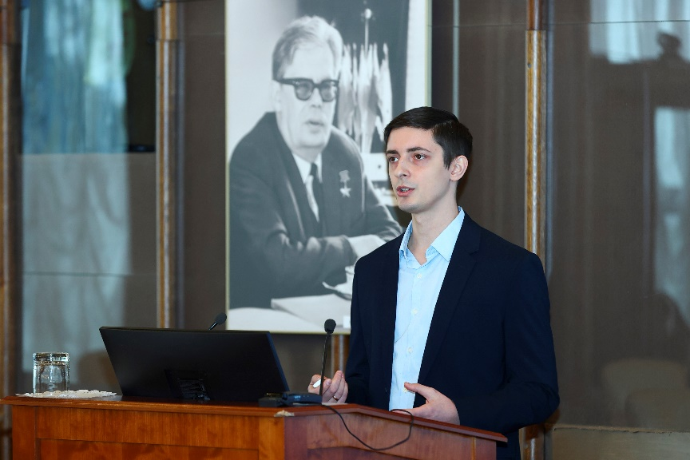
Condensed matter physics. The Scientific Council appreciated with satisfaction the progress of work at IBR-2 in preparation for resuming the operation of the reactor and highly appreciates the efforts of the JINR Directorate to resume regular cycles for users, as well as its plans to extend the operation of the reactor with high-performance parameters by loading new fuel. The Scientific Council supported the PAC’s recommendations to strengthen its work with potential users in order to attract the maximum number of researchers to JINR, primarily from the Member States.
The Scientific Council welcomed the constant attention of the PAC to the status of the project of the new neutron and the continuation of developing new advanced devices and technologies for cryogenic moderators of the new neutron source.
The Scientific Council noted with satisfaction the progress in the IBR-2 instrumentation development during the technical shutdown of the IBR-2 reactor and considered these activities important for the successful realization of the FLNP scientific programme and the user programme at a level competitive with other world neutron centres.
Reports by young scientists
The Scientific Council followed with interest the reports by young scientists, selected by the PACs for presentation at this session: “Construction of the ISCRA and SIMBO stations for applied research on high-energy ion beams. Radiation hardness testing of microchips by low energy pulsed ion beams at the SOCHI station” by A. Slivin (VBLHEP), “Intense metallic ion beams for SHE synthesis” by D. Pugachev (DLNP), and “Structural and vibrational properties of the Cu3Bi(SeO3)2O2Cl francisite at high-pressure” by A. Rutkauskas (FLNP). The Scientific Council thanked the speakers and welcomed such selected reports in the future.

Slide 9
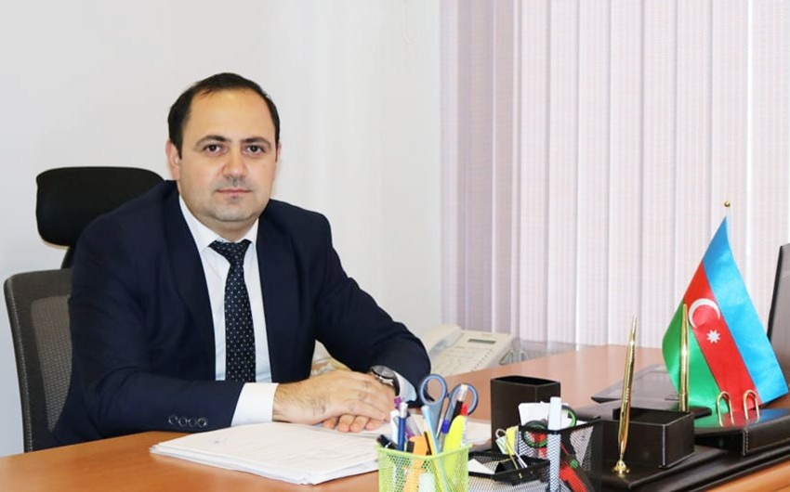
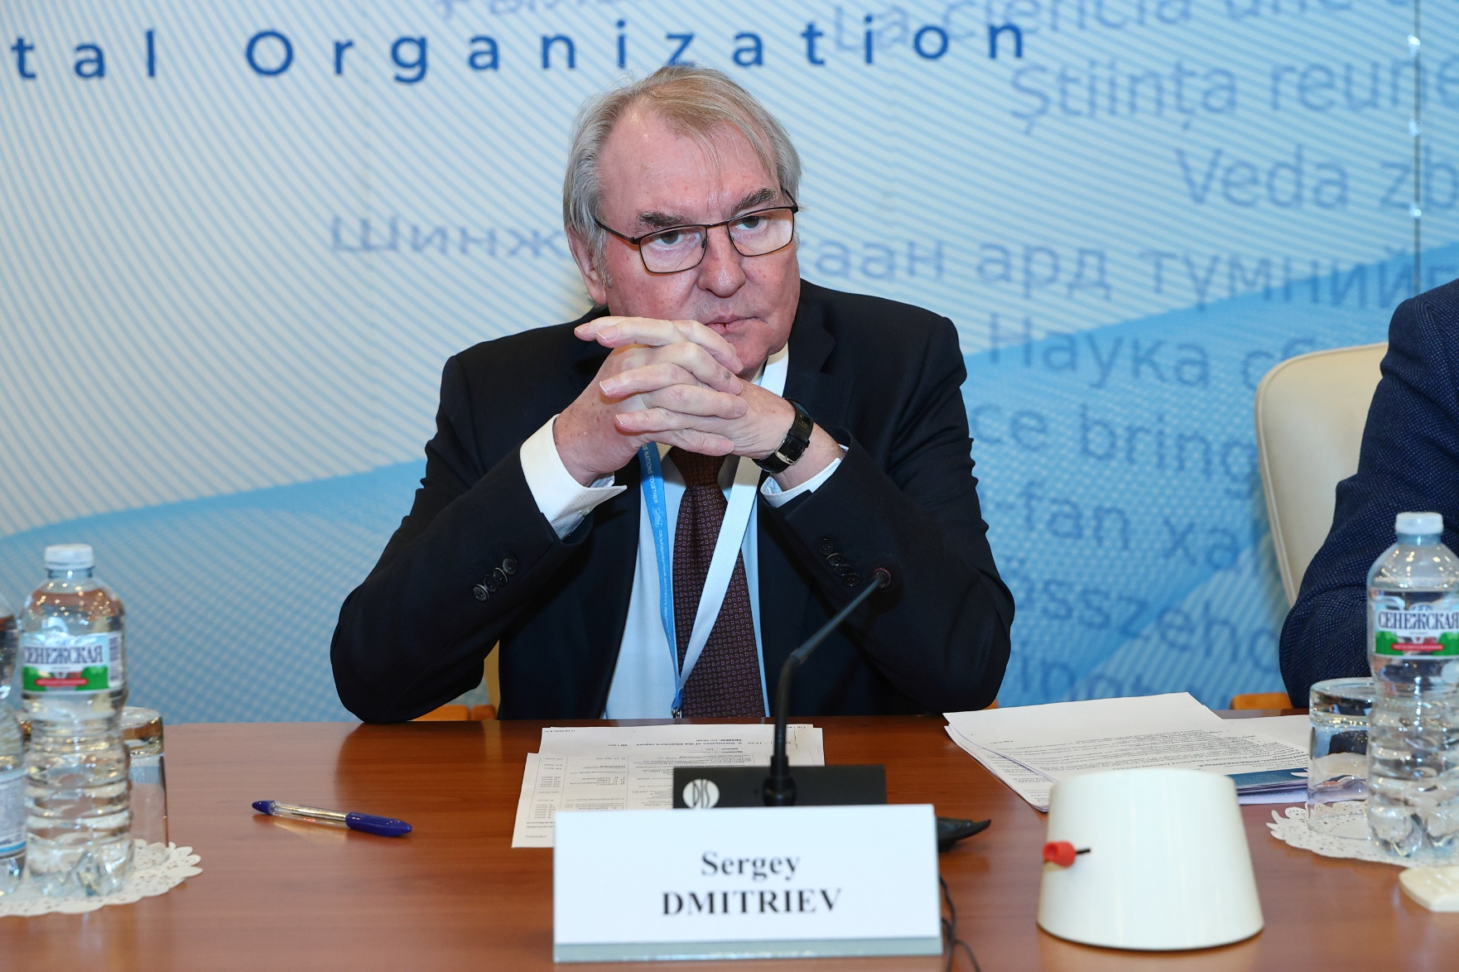
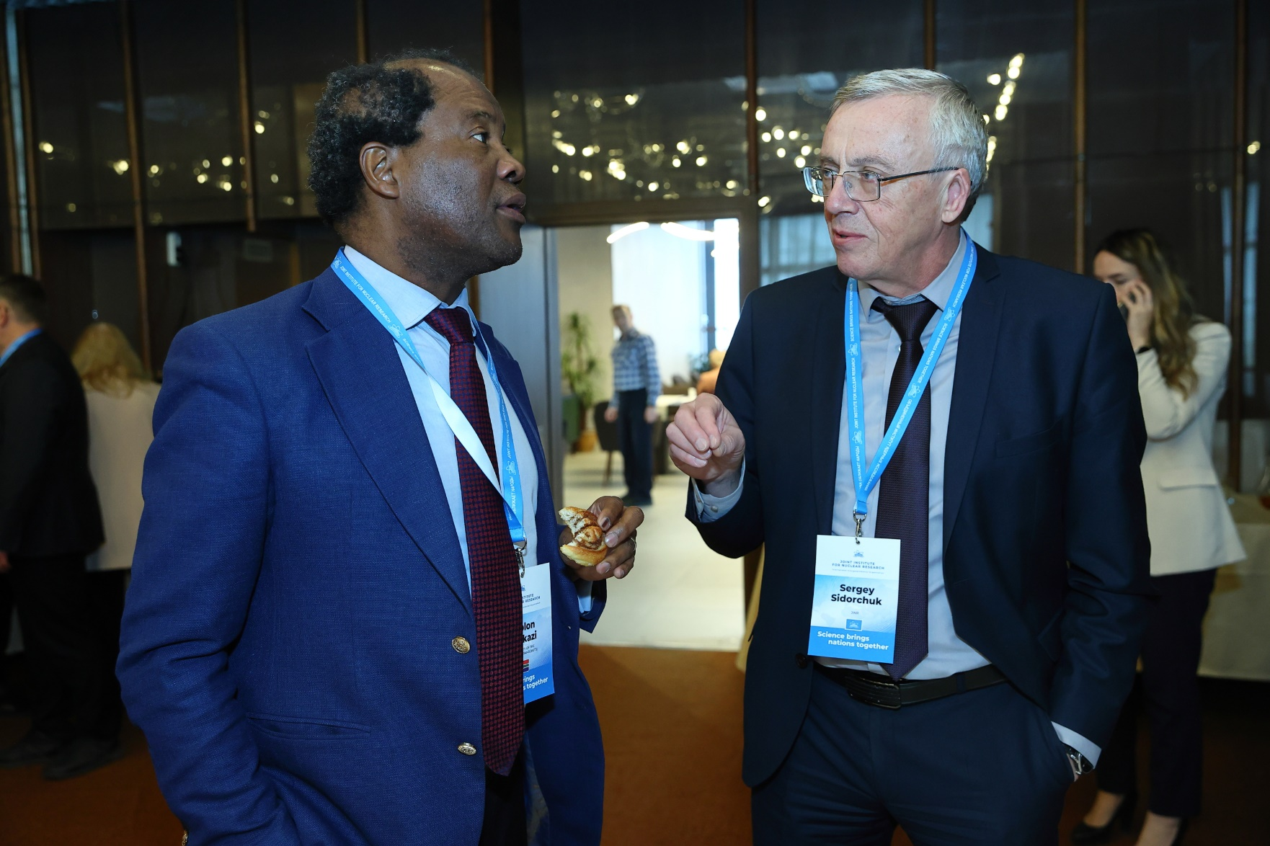
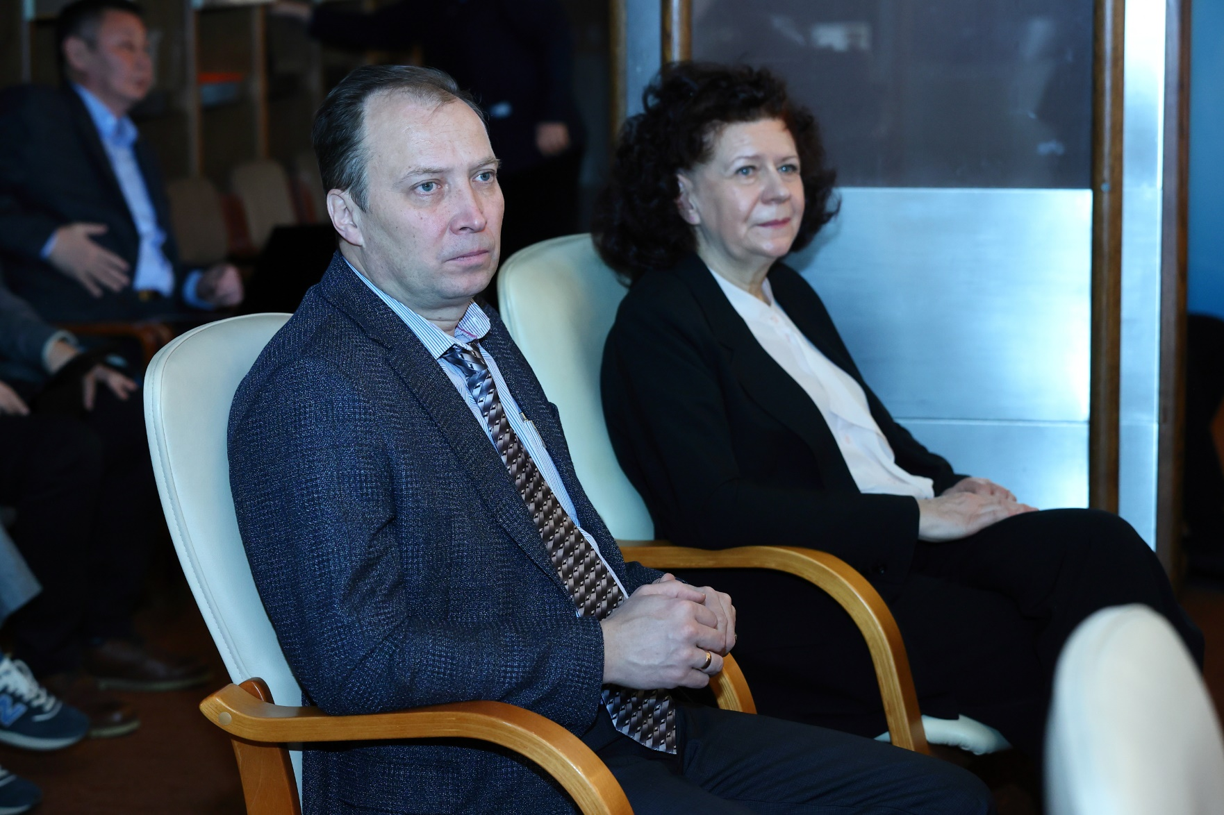
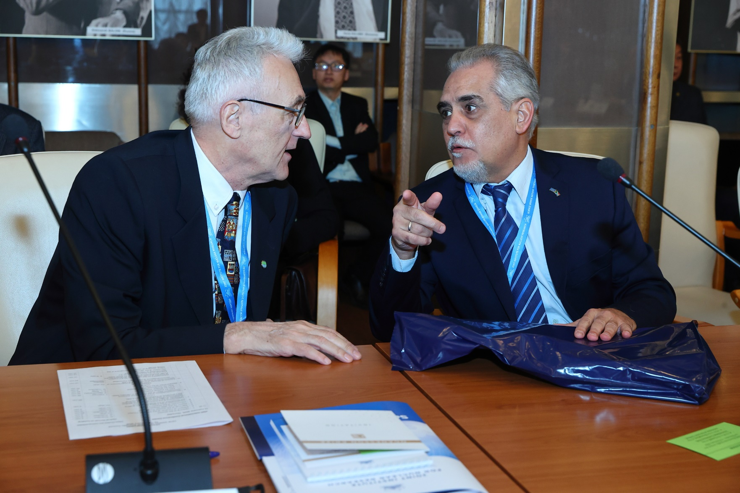
Memberships of the PACs
The Scientific Council appointed S.Jabarov (Supreme Attestation Commission under the President of the Republic of Azerbaijan, Baku, Azerbaijan) as a member of the PAC for Condensed Matter Physics for a term of three years.
Awards and prizes
The title of Honorary JINR Doctor was awarded to Mahmoud Sakr, Culture and Science Counsellor, Head of the Education Mission of the Embassy of Egypt in Japan, former President of the Egyptian Academy of Scientific Research and Technology, first Plenipotentiary Representative of the Arab Republic of Egypt to JINR, for his great personal contribution to increasing the participation of the Arab Republic of Egypt in JINR’s scientific activities and strengthening scientific cooperation.
The Scientific Council approved the Jury’s recommendations presented by Vice-Director S.Dmitriev on awarding the JINR annual prizes for best papers in the fields of theoretical and experimental research, methodology and technology research, and applied technology research.
Election and announcement of vacancies in the directorates of JINR Laboratories
The Scientific Council elected S. Sidorchuk as FLNR Director for a second term of five years. The Scientific Council appreciated the quality and diversity of all the applicants.
The Scientific Council endorsed the appointments of A. Boreyko and I .Padrón Díaz as LRB Deputy Directors until the completion of the term of service of the current LRB Director, A. Bugay.
The Scientific Council announced the vacancies of positions of FLNR Deputy Directors. The endorsement of appointments will take place at the 138th session of the Scientific Council in September 2025.

Slide 10
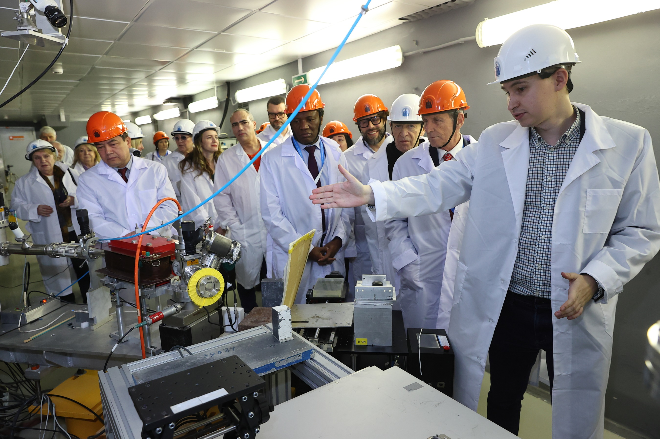
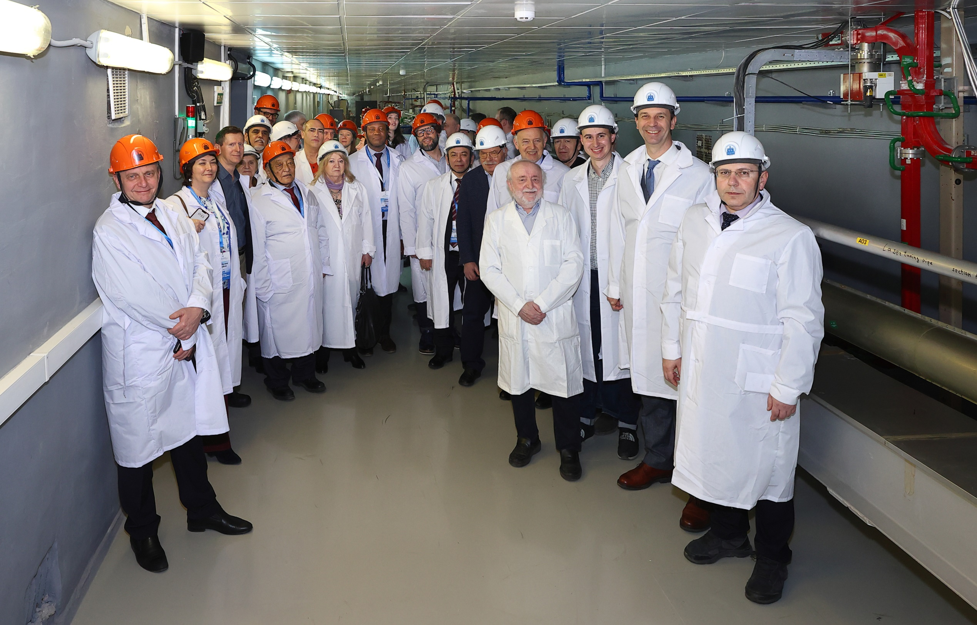
Festive Opening of the JINR New Basic Facility — the LINAC-200 Accelerator
13 February marked the ceremony of the launch of a new base facility of the Dzhelepov Laboratory of Nuclear Problems, the LINAC-200 Linear Accelerator. The Scientific Council members and the JINR Directorate representatives attended the event.
On 12 February, a test electron beam launch at 24 MeV was successfully carried out. In the future, it is planned to gradually put the accelerator structures into operation at 400 and 800 MeV.
Before commissioning the accelerator, the laboratory’s employees carried out extensive varied work. Preparations included major repairs of building No. 118. The accelerator, transferred to JINR from the National Institute for Subatomic Physics (NIKHEF, the Netherlands), underwent extensive upgrades.
A user programme for research at the accelerator is being developed, primarily focused on the requests of the Joint Institute’s laboratories and scientific groups from the JINR Member States. The extracted LINAC-200 beams will be used for testing of prototypes of electromagnetic calorimeters and coordinate detectors for the MPD and SPD experiments at the NICA collider, applied work in radiation materials science, radiobiology, and radiochemistry, nuclear physics experiments, and the JINR University Centre’s internships for students and specialists from the Member States. Specialists from Vietnam are planning to implement a scientific programme to study photonuclear reactions at the 133 and 207 MeV beam extraction channels. DLNP, VBLHEP, and FLNP at JINR jointly implemented the project.

Slide 11
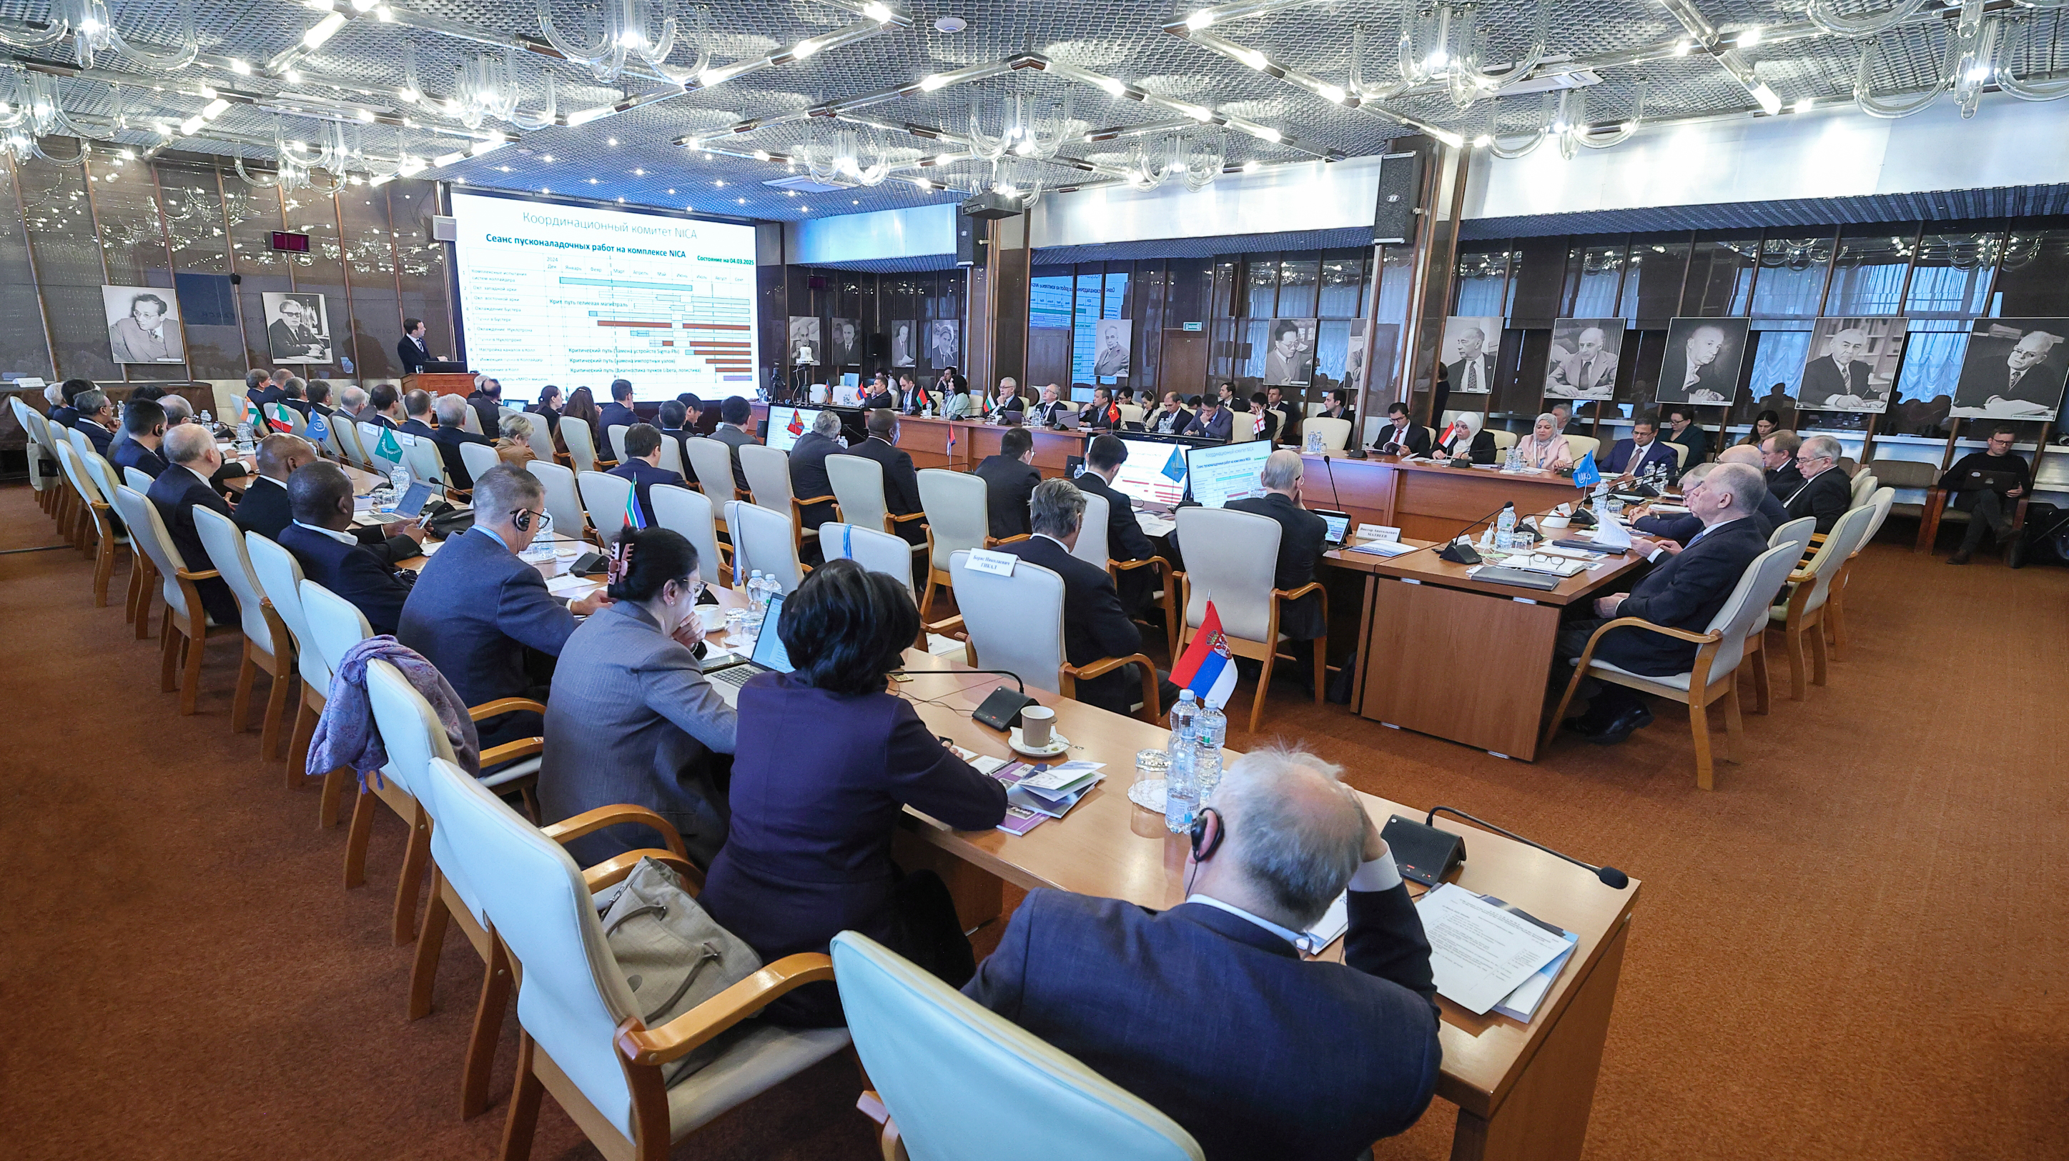
Session of the JINR Committee of Plenipotentiaries
25 March 2025 chaired by A. Khvedilidze
AGENDA
1. Report by the JINR Director
Speaker — G. Trubnikov
2. On the first run at the NICA Accelerator Complex
Speaker — V. Kekelidze
3. Execution of the JINR budget for 2024 and draft of the revised budget of JINR for 2025
Speaker — N. Kalinin
4. Results of the meeting of the JINR Finance Committee held on 24 March 2025
Speaker — A. Omelchuk
5. On the call of elections and nomination of candidates for the position of JINR Director
Speaker — A. Khvedelidze
6. Scientific report: “To the 60th anniversary of the hypothesis of colored quarks and the Dubna model of hadrons”
Speaker — V. Matveev
7. On preparing and holding the events dedicated to the 70th anniversary of JINR
Speaker — S. Nedelko

Slide 12
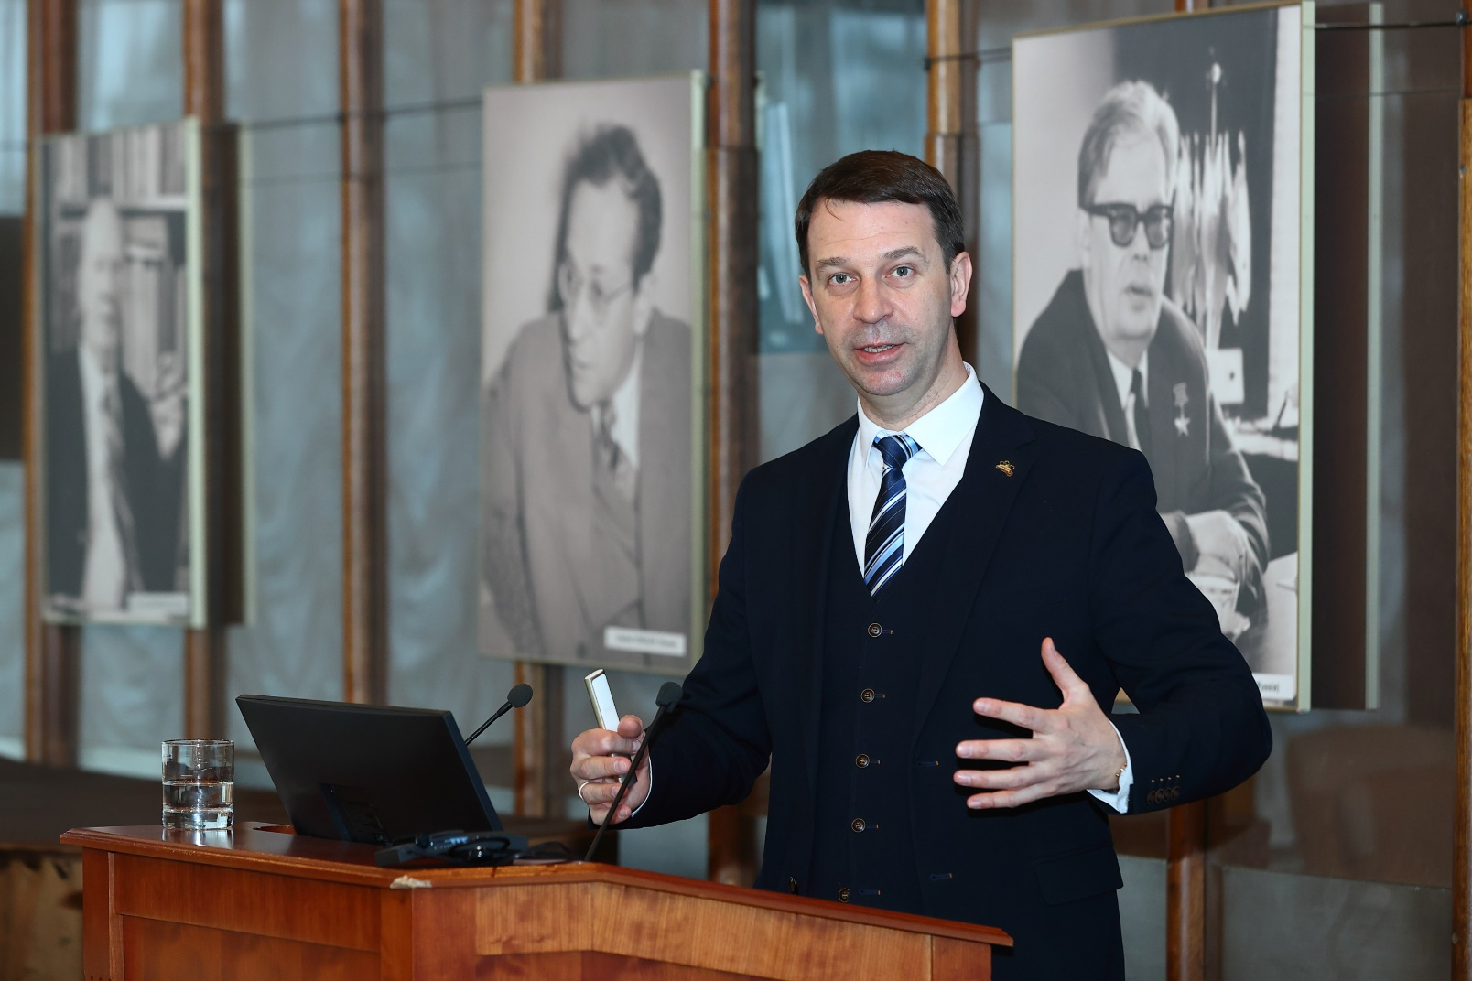
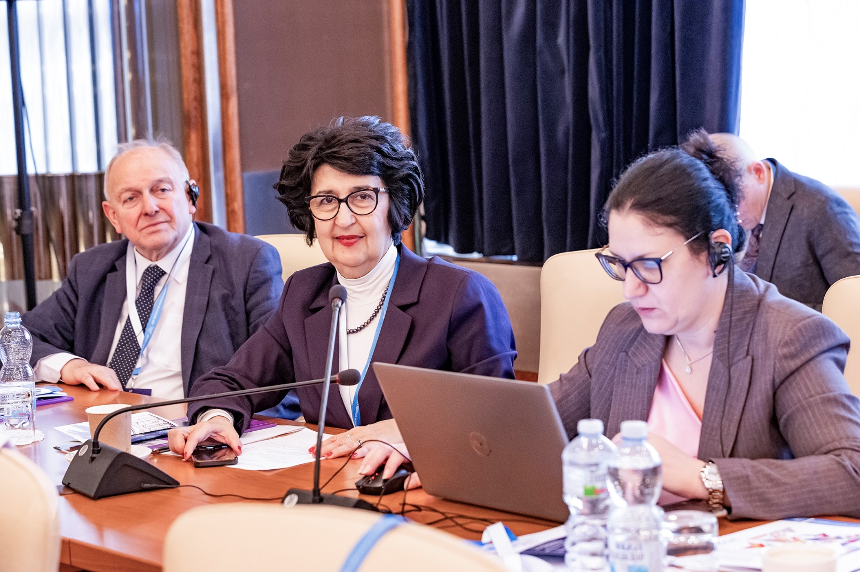
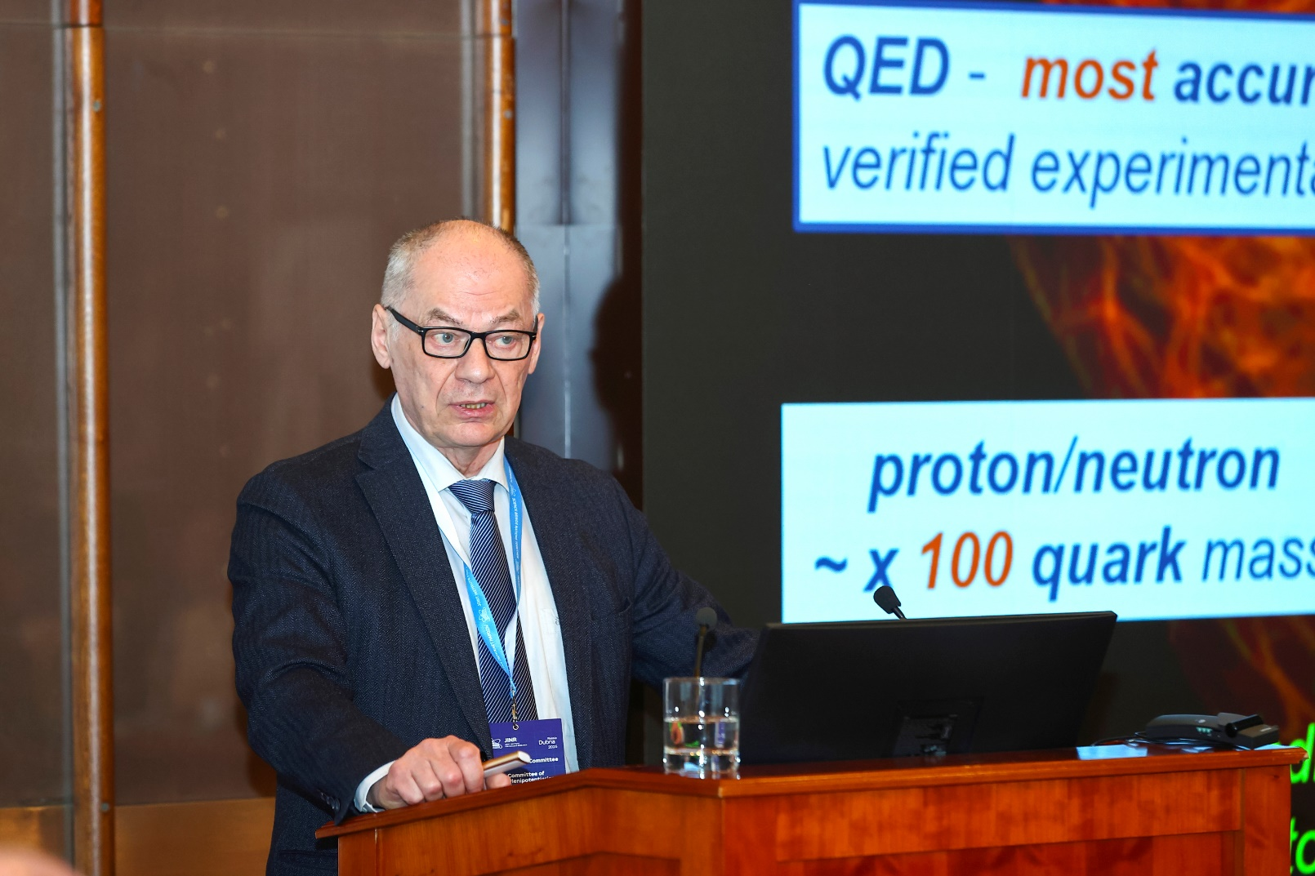
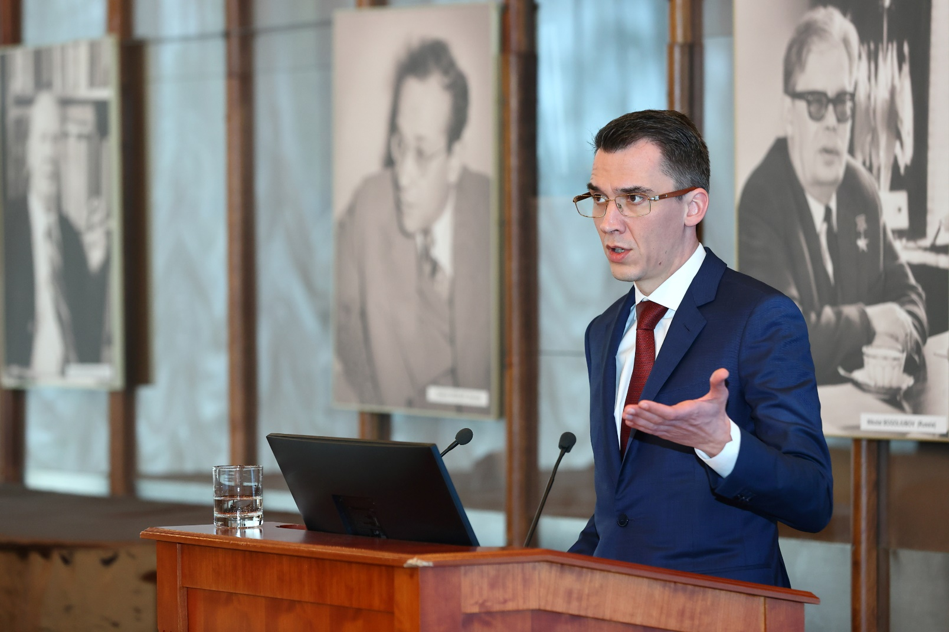
Session of the JINR Committee of Plenipotentiaries
25 March 2025
The Committee of Plenipotentiaries approved the progress in implementing the current plan for research and development of the large scientific infrastructure of JINR, the successful participation of the Institute in international collaborations, and achievements in strengthening international cooperation.
The CP noted with satisfaction the publication of the first issue of the new JINR scientific journal “Natural Science Review” in December 2024.
The CP noted the high efficiency of the support programme of the Ministry of Education and Science of Russia for organizations collaborating with JINR in the framework of research at the NICA complex, and to consider it as an example of efficient assistance from a JINR Member State in expanding the Institute’s cooperation with national research organizations and universities to megascience projects based at JINR.
The CP approved the organizational and financial decisions made by the JINR Directorate to minimize the risks of non-implementation of the NICA complex project in 2022–2025, to find ways to reduce costs, and the presented updated projected cost of the project in the amount of RUB 34 000 000.0 thousand. Commissioned the JINR Directorate to continue this work and to ensure the adoption of decisions and measures for maintaining the project implementation schedule to achieve the main parameters of the complex, as well as to continue active claims work with unfair suppliers.
The CP approved the revised budget of JINR for 2025 with the income amounting to US$ 234.0 millions and the expenditure amounting to US$ 315.5 millions, taking into account the positive opening balance amounting to US$ 40 170.2 thousand.
The CP commissioned the JINR Directorate and the Working Group under the CP Chair for JINR Financial Issues to work out the possibility of indexing the Incentive Fund for highly qualified employees, as well as to make an analysis of the competitiveness of the salary level of scientific workers.

Slide 13
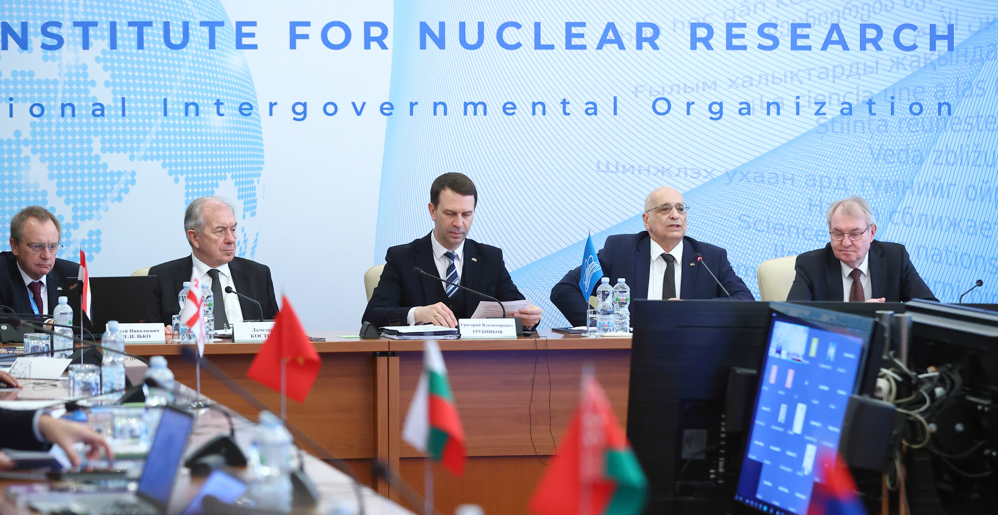
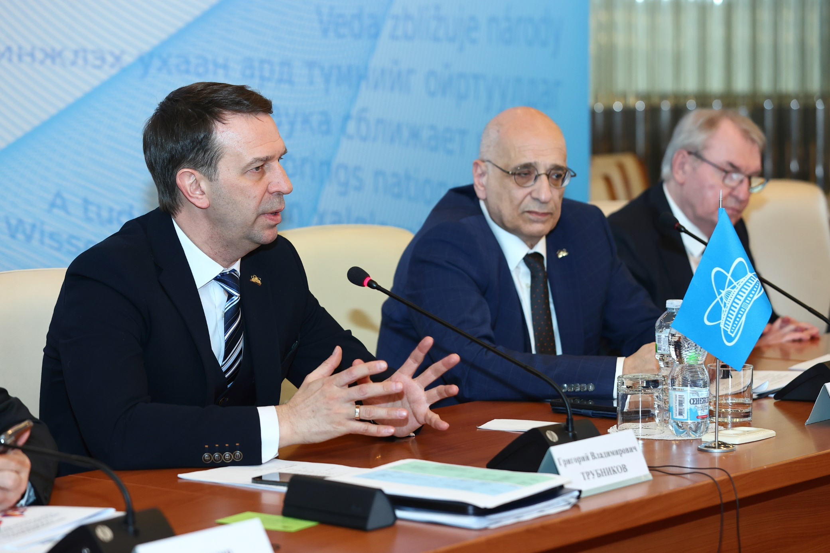
Session of the JINR Committee of Plenipotentiaries
25 March 2025
Election of the Director of the Institute
One of the central items on the agenda of the session was the appointment of the election of the Director of the Institute, whose powers expire on 31 December, 2025. The CP Chairman, A. Khvedelidze, made an announcement on the rules for calling elections and nominating candidates. The members of the CP made a proposal to hold elections at the current meeting.
Having heard and discussed the report “On the call of elections and nomination of candidates for the position of JINR Director” by the Chair of the CP, A. Khvedelidze, taking into account the unanimous decision of the Plenipotentiaries of the Governments of the JINR Member States to nominate G. Trubnikov as the only candidate for the position of JINR Director, as well as the consent of G. Trubnikov to be nominated as a candidate for this position, based on the results of open voting, in accordance with the JINR Charter and the Regulation for the JINR Director, G. Trubnikov was unanimously elected by the CP to the position of JINR Director for a term of five years taking office on 1 January 2026.
G. Trubnikov expressed gratitude to the JINR member countries' plenipotentiaries for their trust and appreciation of the work of both the Directorate and the entire staff of the Institute.

Slide 14
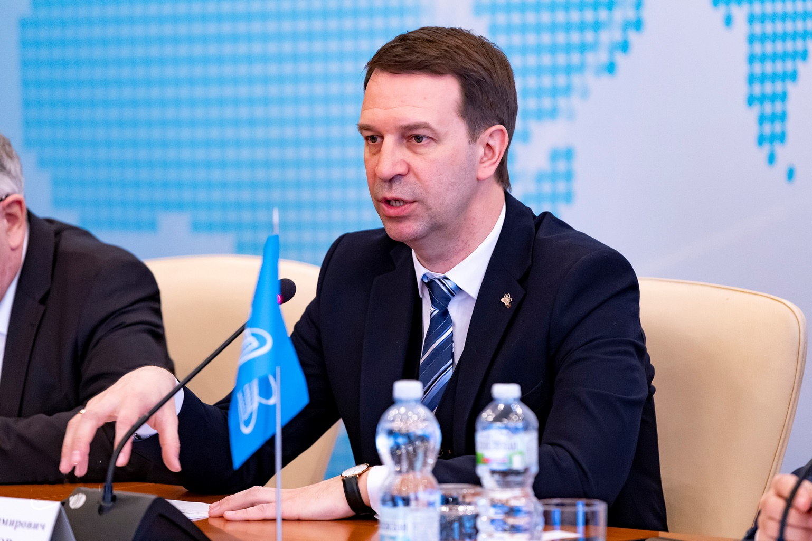

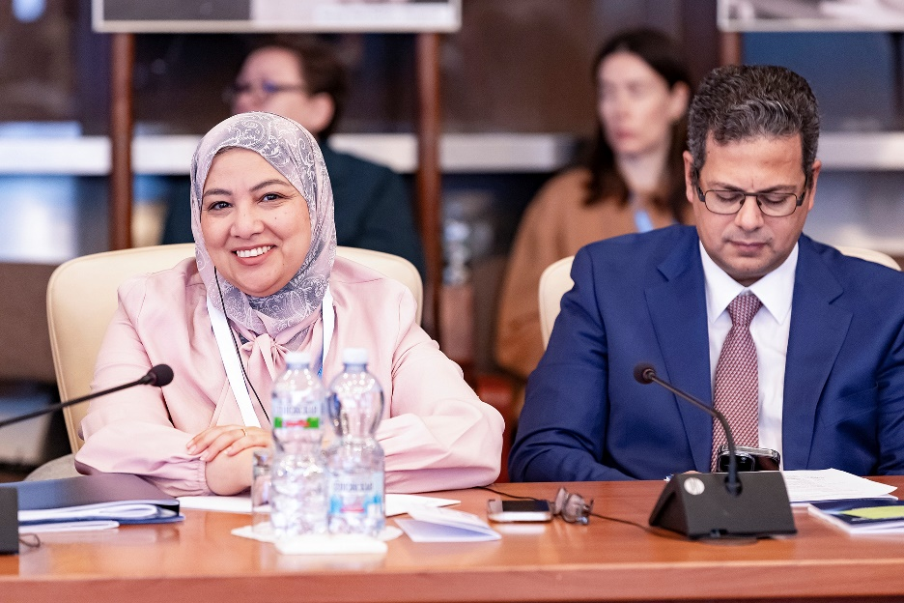
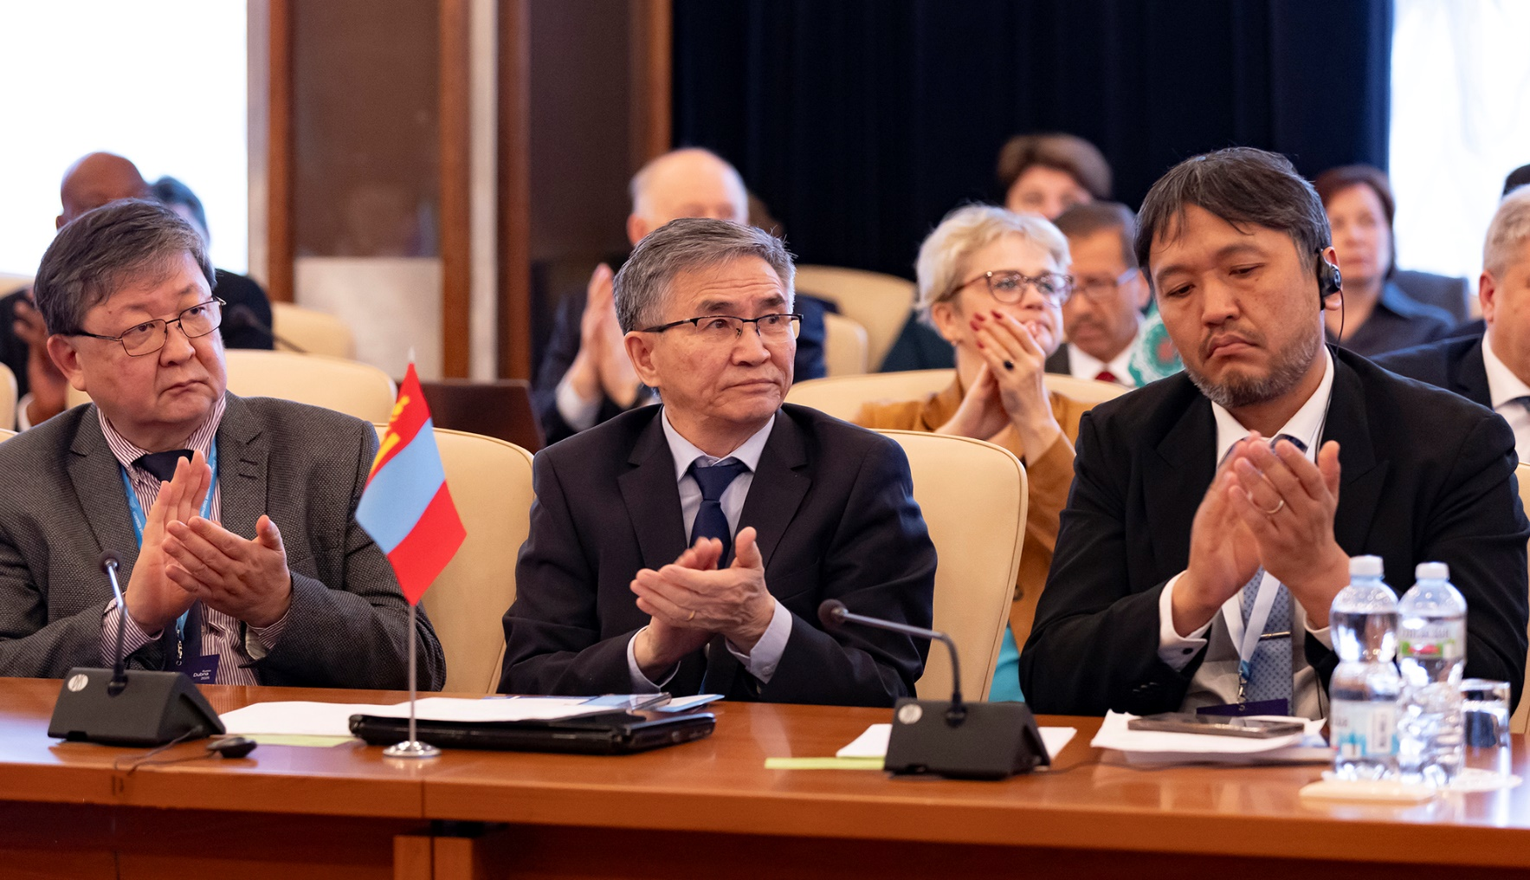
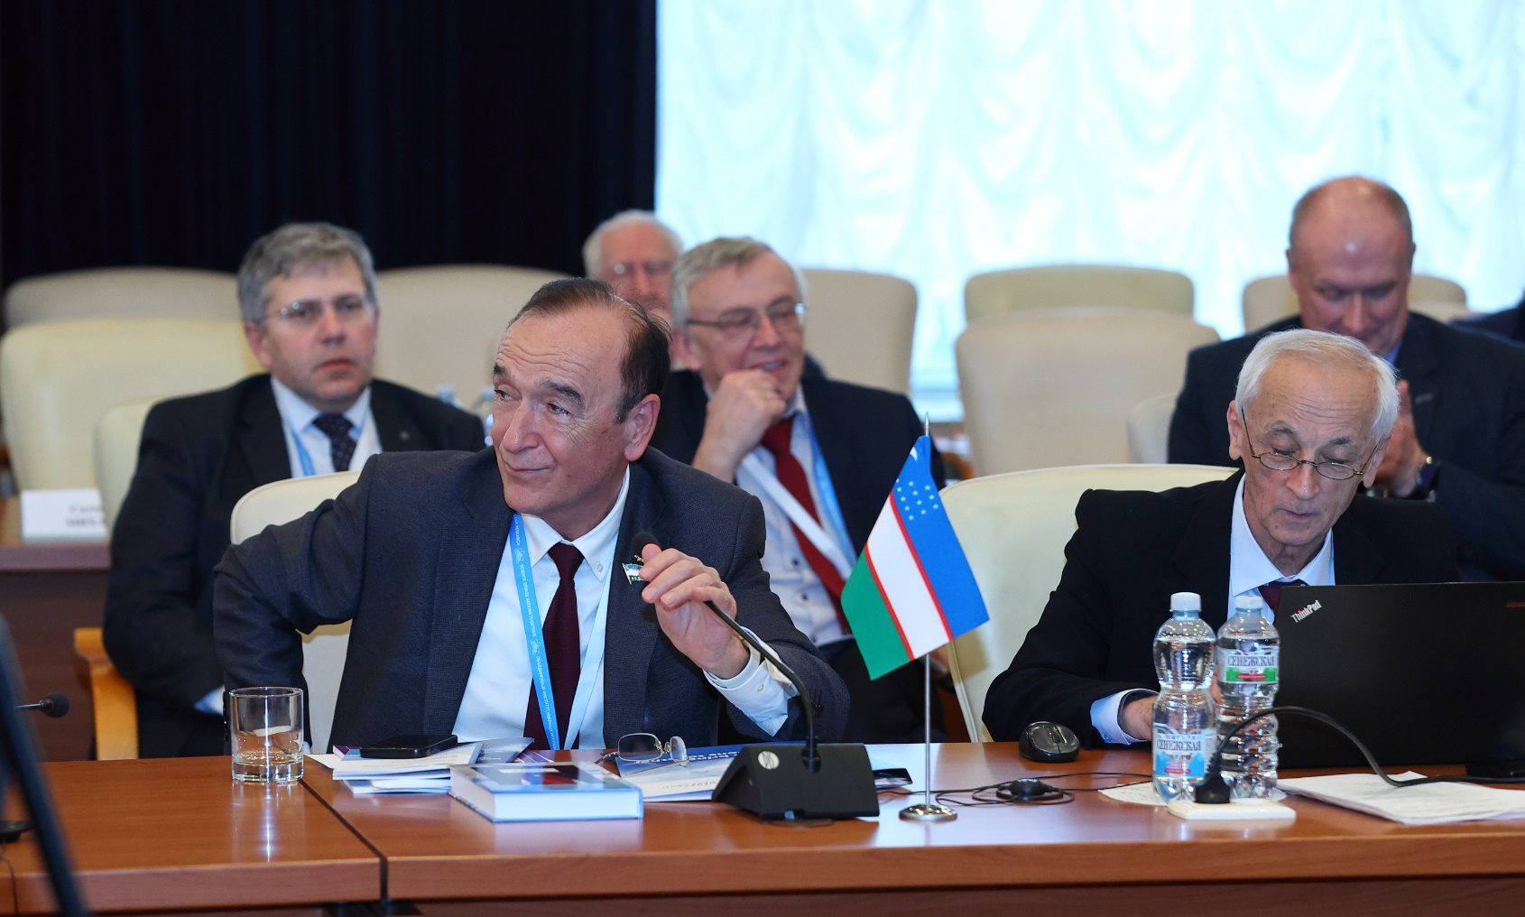

Session of the JINR Committee of Plenipotentiaries
25 March 2025
Having heard the scientific report by Scientific Leader of JINR, V. Matveev, “To the 60th anniversary of the hypothesis of colored quarks and the Dubna model of hadrons”, the Committee of Plenipotentiaries thanked the speaker for his interesting and informative report.
Having heard and discussed the report “On preparing and holding the events dedicated to the 70th anniversary of JINR” presented by Chief Scientific Secretary of JINR, S. Nedelko, the Committee of Plenipotentiaries approved the Plan of events proposed by the Organizing Committee, which includes holding JINR Days in Member States, major scientific conferences, exhibitions, cultural and sporting events dedicated to the anniversary of the Institute, as well as the preparation and publication of a book about the history of JINR. The Committee decided to hold a ceremonial meeting dedicated to the 70th anniversary of JINR in March 2026 in Dubna.
The CP invited all JINR Member States to send their national delegations to participate in this event at the level of senior representatives of governments, relevant ministries and national academies of sciences.

Slide 15
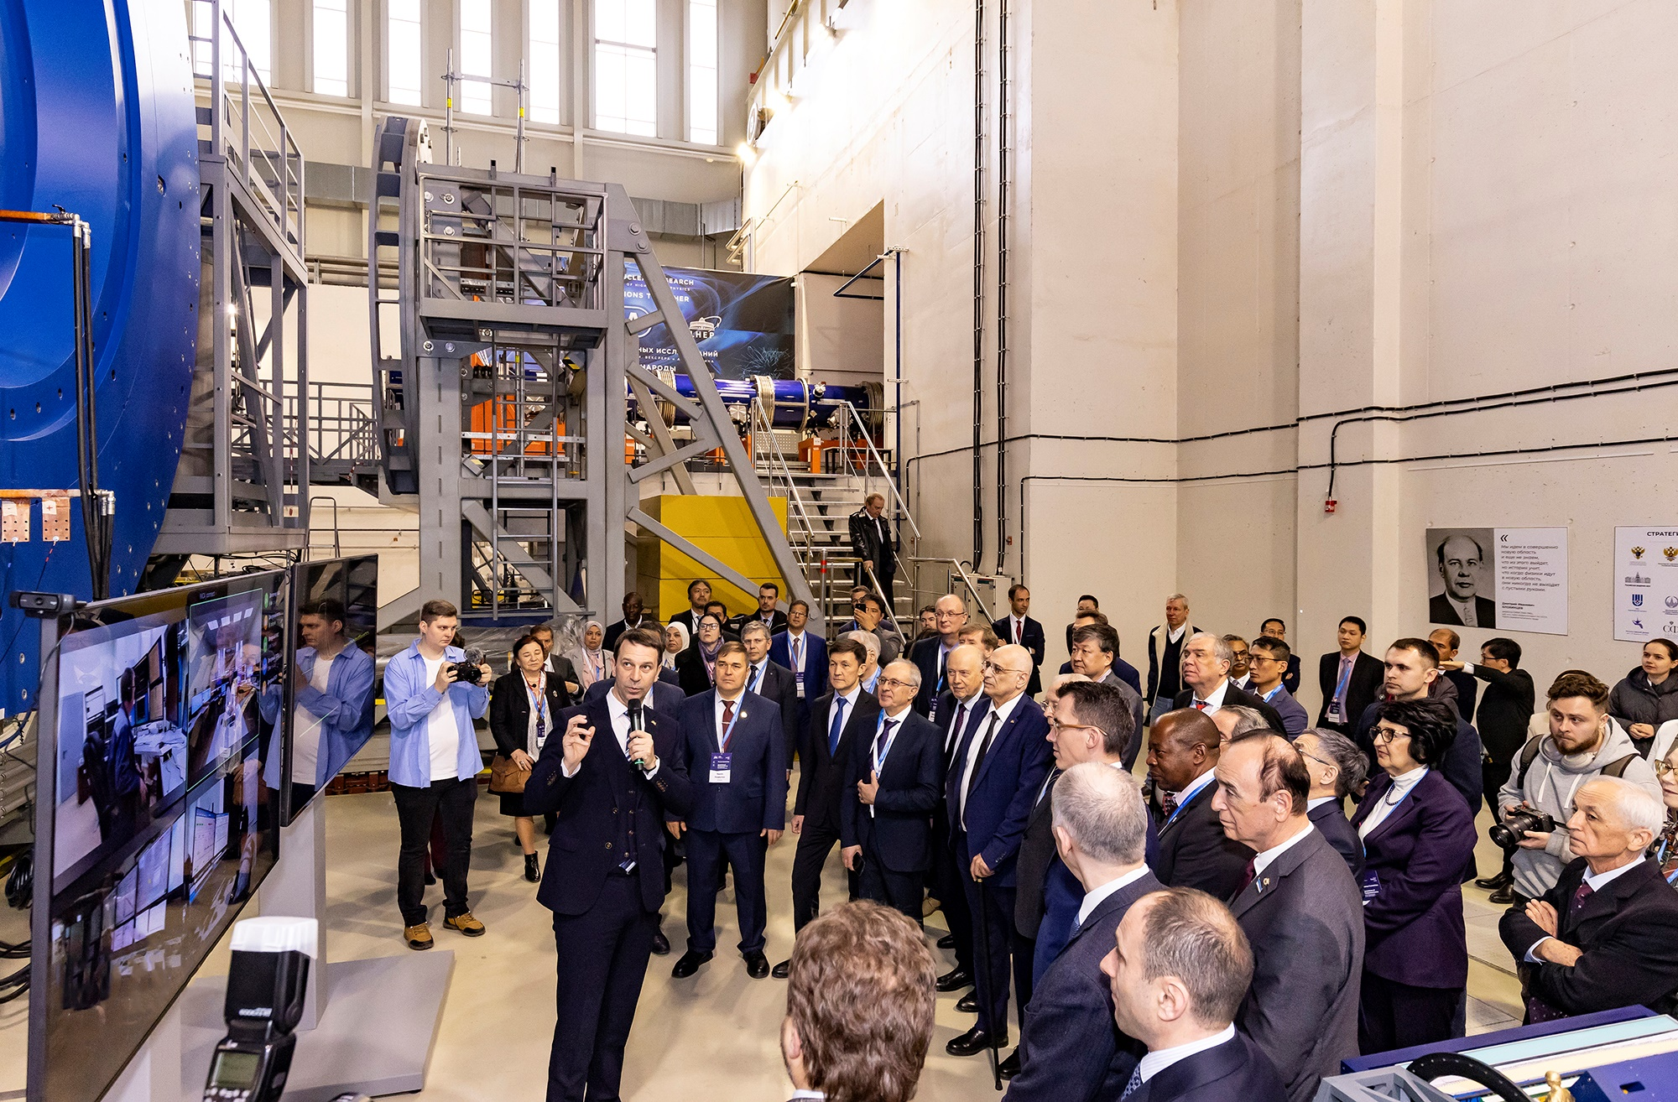
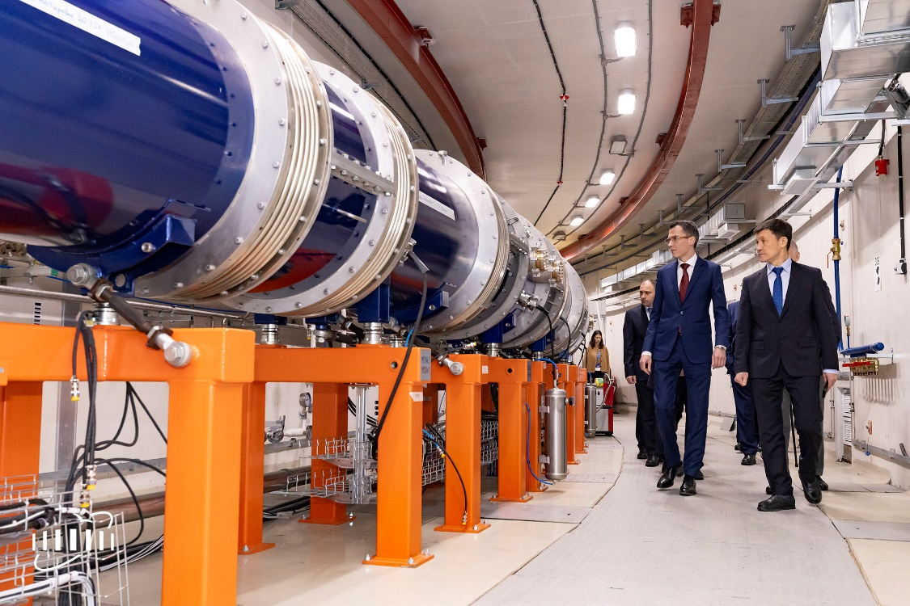
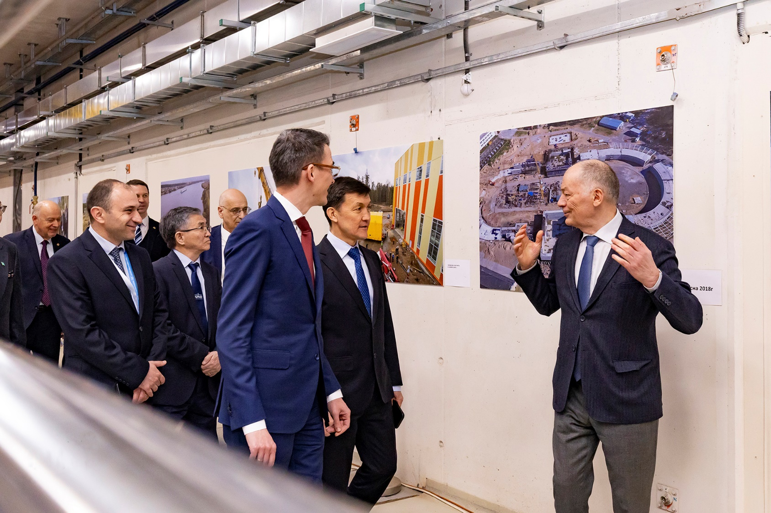
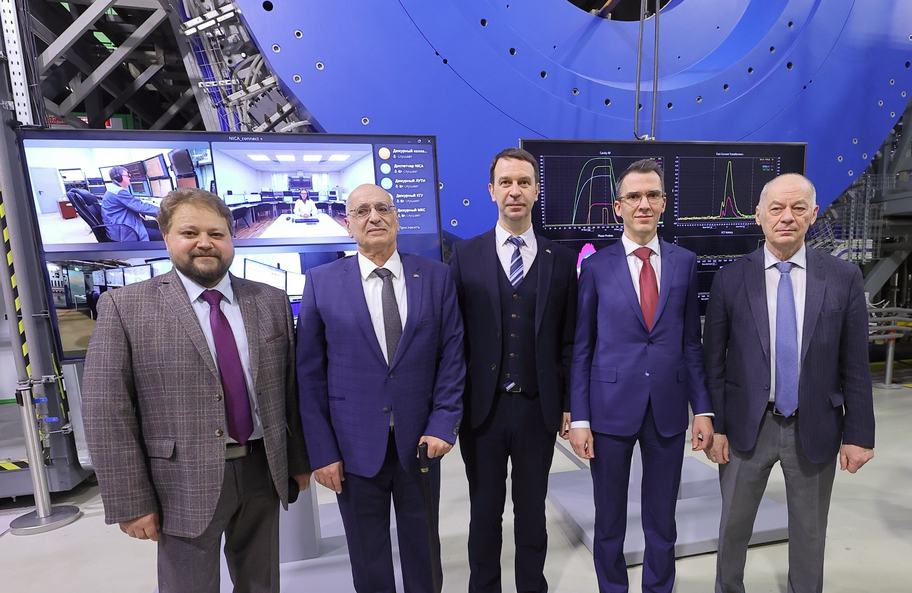
First Session at the NICA Accelerator Complex has been Launched
On 25 March 2025, run 1 at the NICA accelerator complex was initiated at the Veksler and Baldin Laboratory of High Energy Physics at the Joint Institute for Nuclear Research.
The ceremony took place alongside a session of the Committee of Plenipotentiaries of the Governments of the JINR Member States in the presence of representatives of 20 Member States and Associate Members, as well as partners of the Joint Institute.
The event took place in the MPD experimental hall in a hybrid format, as the main control room of the accelerator complex, from where all NICA’s technological systems and accelerators are remotely controlled, is located half a kilometer from the MPD building. VBLHEP JINR Acting Director A. Butenko, CP JINR Chair A. Khvedelidze, and Deputy Minister of Science and Higher Education of the Russian Federation A. Omelchuk, together with G. Trubnikov, shared the honor to give the command to start. After the dispatcher in the control room confirmed that all systems of the complex are ready, the cold gas started to fill the accelerators, and a beam of xenon ions, with a beam current of about 300 microamperes, was injected.

Slide 16
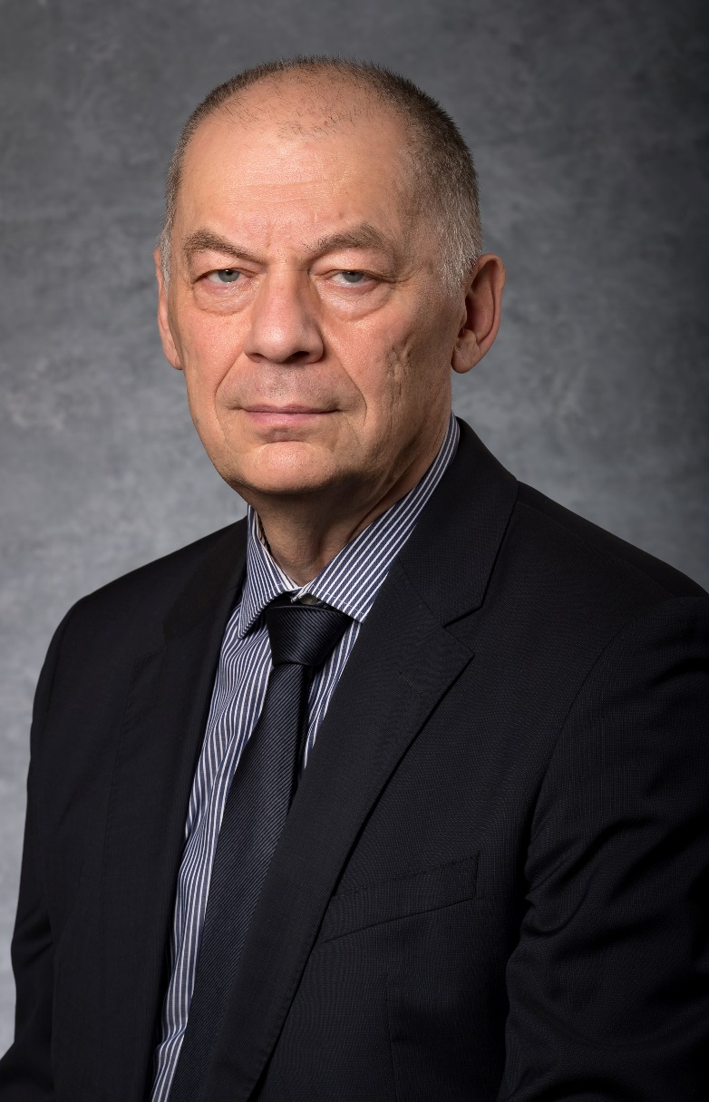
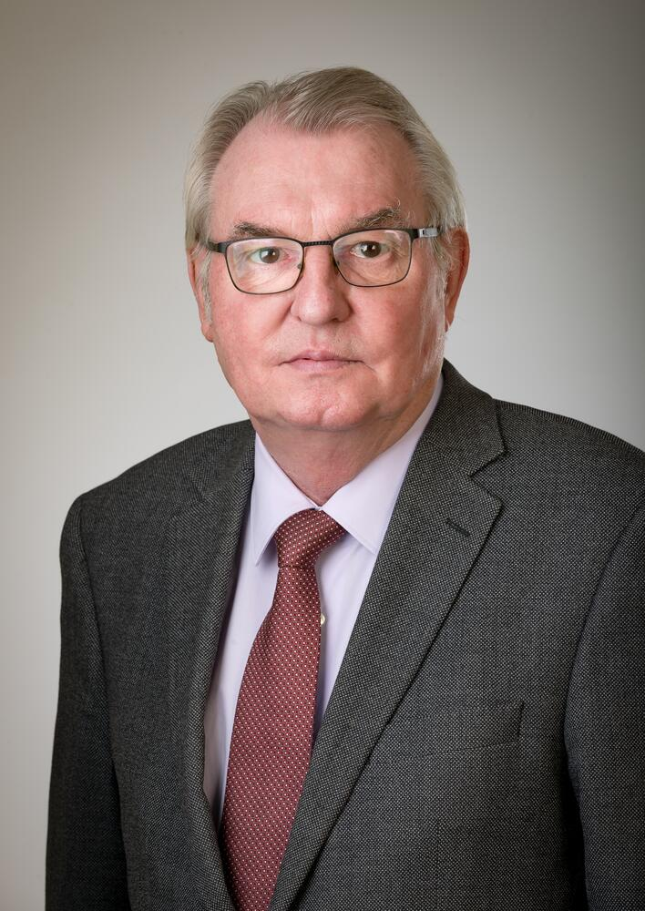
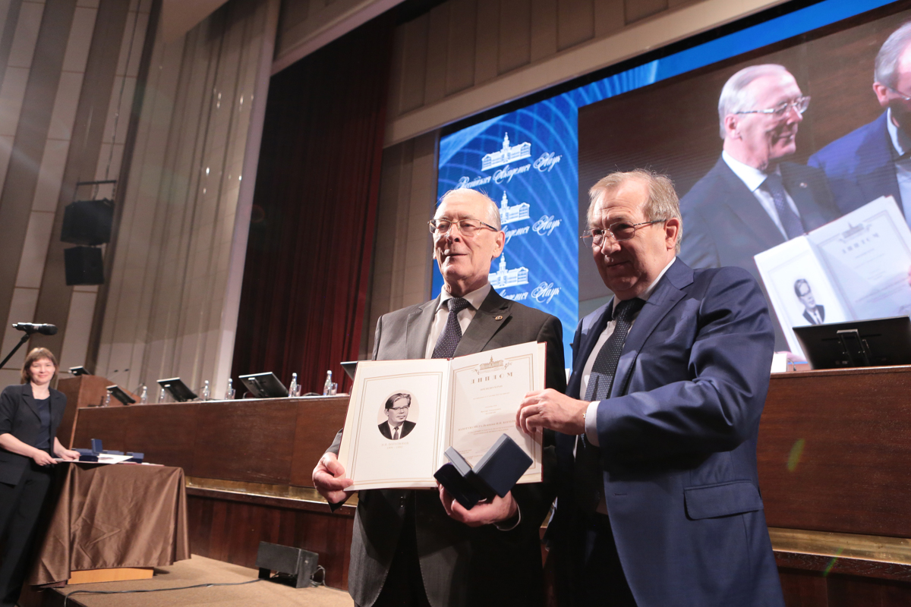
Vladimir Kekelidze and Sergey Dmitriev Elected Academician and Corresponding Member of Russian Academy of Sciences
30 May 2025
The General Meeting of members of the Russian Academy of Sciences (RAS) finished. According to the results of an election, scientists of the Joint Institute for Nuclear Research were elected RAS Academician and Corresponding Member.
JINR Vice-Director, Doctor of Physics and Mathematics Vladimir D.Kekelidze became a RAS Academician with an honorary degree in nuclear physics.
JINR Vice-Director, Doctor of Physics and Mathematics Sergey N.Dmitriev was elected a RAS Corresponding Member with an honorary degree in nuclear physics.
In addition, a ceremony took place at the Great Hall of the Russian Academy of Sciences to present gold medals named after eminent researchers – the Academy’s highest awards for outstanding scientific studies, discoveries, or innovations that made a significant impact on theoretical and applied research.
The N.N.Bogoliubov Gold Medal was given to JINR Scientific Leader, Doctor of Physics and Mathematics, RAS Academician Victor A. Matveev.
Congratulations to the employees of the Joint Institute for Nuclear Research on the titles and awards! We wish them new achievements and successes for the benefit of global science!

Slide 17

Thank you for your attention!

