Slide 1
Current state of the IBR-2 reactor and final report on the project “Development of the IBR-2 nuclear facility with a complex of cryogenic moderators” and subproject “Construction of a complex of cryogenic moderators at the IBR-2 facility”
Egor Lychagin
Joint Institute for Nuclear Research

Slide 2
Outline:
Current state of the IBR-2 reactor
Final report on subproject “Construction of a complex of cryogenic moderators at the IBR-2 facility”
Closing the project “Development of the IBR-2 nuclear facility with a complex of cryogenic moderators”

Slide 3
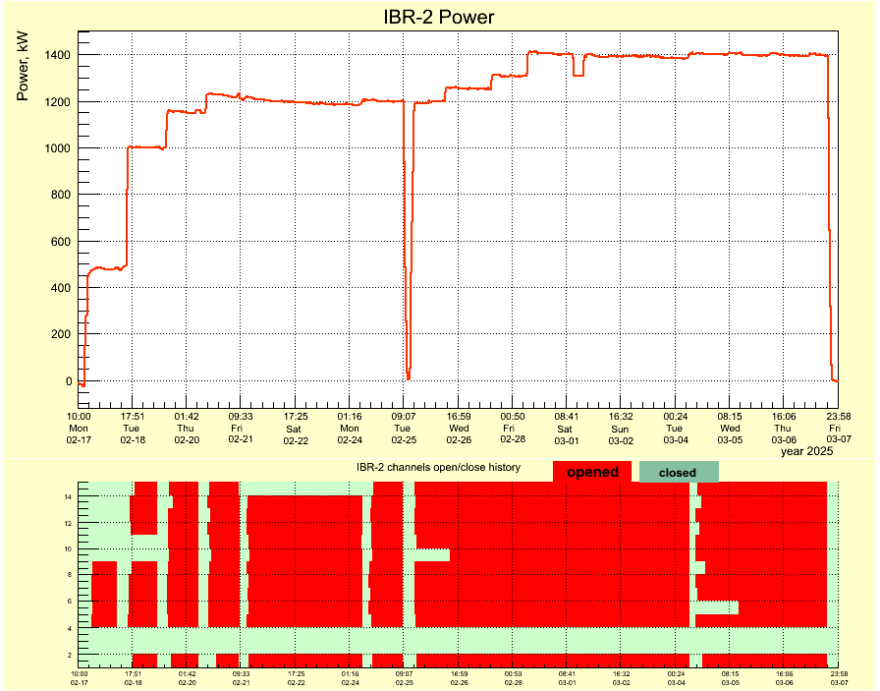
Reactor operation
The results of the study of the dynamics of the IBR-2M reactor obtained during the first start-up of the reactor after a long shutdown was presented at FLNP Seminar, 22.05.25
"Start-up of the IBR-2M reactor after a long stop. Reactor dynamics“
Pepelyshev Yu.N., Dolgikh A.V., Rogov A.D., Davaasuren S., Tsogtsaikhan Ts.
I cycle 2025: February, 17 - March, 7 2025
The main conclusions are:
the reactor is stable at a power of up to 1.5 MW,
the possibility of increasing the power above 1.5 MW requires further study.

Slide 4
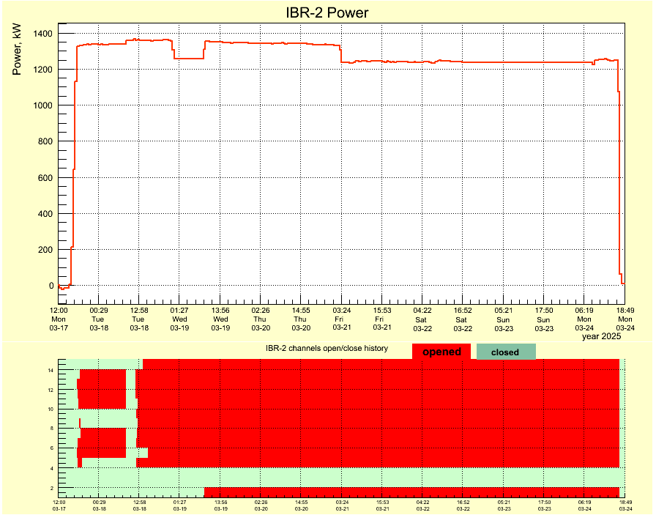
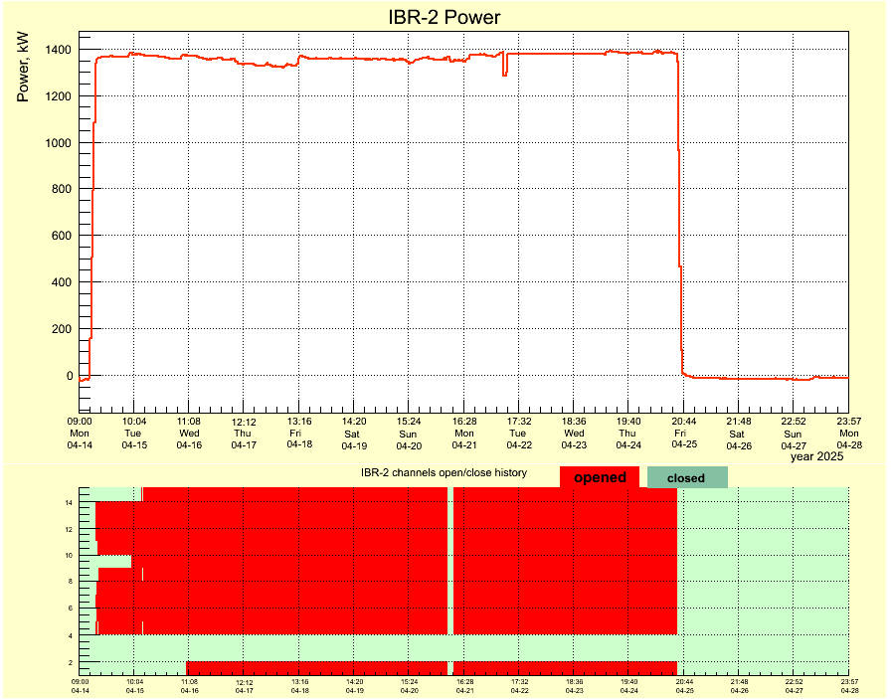
II cycle 2025: March, 17 – 24 (28) 2025
III cycle 2025: April, 14 - 25 2025
Emergency stop due to broken air blower electromotor (100kW)
In cycle III, both cryogenic moderators operated regular way.
The autumn cycles of reactor operation are planned from October 13, 2025

Slide 5
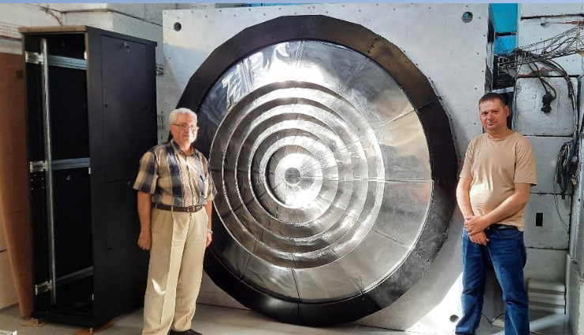
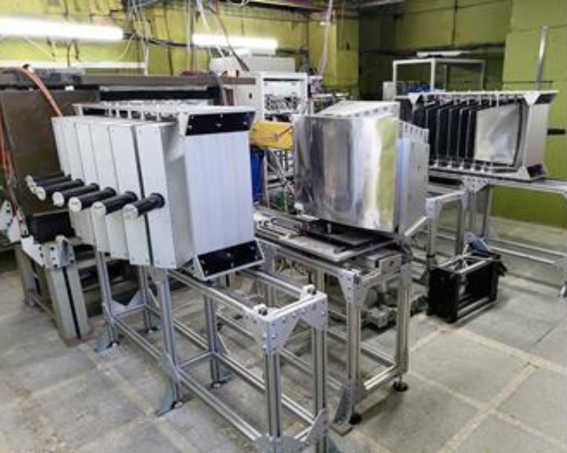
Results of testing neutron instruments
All instruments were tested during the cycles. The first experiments were performed in cycles I-III (by internal users and 4 external experiments via the rapid access system).
As a result of testing, it was found that the new detectors on HRFD and FSD are highly effective, but the new electronics overloaded with signal flow and require modernization.
The EPSILON diffractometer is in the process of adaptation to texture measurements, and this work is not finished yet.
Thus, due to technical reasons, operation of three instruments (HRFD, FSD and EPSILON) for external users is temporarily suspended.
We expect these three instruments to return to the User Program in the spring 2026 call.

Slide 6
Resumption of User Program
Country | New users
Armenia | 9
Bangladesh | 1
Belarus | 3
Cuba | 3
Egypt | 7
India | 2
Kazakstan | 2
Mongolia | 1
Russia | 56
South Africa | 2
Turkey | 1
China | 2
Serbia | 1
Syria | 1
Azerbaijan | 1
Germany | 1
 | 92
2025/03/24 the Call was open for the second part 2025 with deadline April 30, 2025
Data for 2025 for proposals that have passed only technical review.

Slide 7
Resumption of User Program
Results of the first call for proposals after a long shutdown
SCIENCE

Slide 8
Resumption of User Program
Our scientific expert groups:
Nanosystems and SoftMatter (GRAINS, REFLEX, REMUR, YuMO) – 9 experts (RF, GB, HU, DE, SK)
Atomic and Magnetic Structure and Neutron Imaging (RTD, DN-6, DN-12, SKAT, NRT) – 9 experts (BG, RF, LV, PL, FR, DE, KZ)
Lattice and Molecular Dynamics (NERA) – 3 experts (BG, RF)
Neutron Activation Analysis (REGATA) – 8 experts (MKD,VN, AU, BR, AR, UZ, ZA, RO)
For the first two groups, it is advisable to add 6 more experts.
Taking this opportunity, I again ask the members of the PAC with a request to help us with search of experts.
I would like to thank Prof. Alexander Ivanov for his assistance in this matter.

Slide 9
Conclusions on the status of the reactor:
the reactor has started operating in regular cycles after long shutdown;
the reactor's condition has not deteriorated during the long shutdown;
most instruments are ready for measurements (three instruments are temporarily closed for external users for technical reasons);
92 new users have been registered in IBR-2 User Club;
user activity during submitting applications for the autumn-winter period is not lower than the activity before the reactor shutdown;
the reactor's autumn cycles are planned to begin in the middle of October.

Slide 10
Final report on subproject “Construction of a complex of cryogenic moderators at the IBR-2 facility”
57th meeting of the PAC for Condensed Matter Physics (15/06/2023)
A unique type of moderator was developed based on pelletized frozen hydrocarbons cooled by flowing cold gaseous helium at FLNP. It was reported many times at PAC meetings.

Slide 11
Final report on subproject “Construction of a complex of cryogenic moderators at the IBR-2 facility”
Expected results upon completion of the subproject:
Operation of the complex of cryogenic moderators at the IBR-2 nuclear facility, comprising three moderators CM-201, CM-202, CM-203 covering most of the neutron experimental beamlines of the IBR-2 facility. Reliable and trouble-free operation of the complex will allow maintaining and strengthening the leading position of the IBR-2 reactor among the world's most high-intensity research neutron sources used for condensed matter investigations by neutron scattering methods.
Expected results of the subproject in the current year:
Continuation of work on the optimization of the system of automatic control and regulation of parameters, system of charging/discharging and transportation of the moderator material (frozen mesitylene pellets) in the working chambers and pipelines of the cryogenic complex with the simultaneous use of two cryogenic moderators CM-201 and CM-202 for physics experiments.
In order to ensure the most efficient use of the suite of IBR-2 instruments in working with cold neutrons, it is planned to put into operation the second Linde AG cryogenic refrigerator with a cooling power of 1800 W at 10 K (KGU 1800/10). Until the end of 2025, it is planned to carry out the optimization of the operation of the cryogenic complex, develop requirements specification and project documentation for the moderator for beamlines 2 and 3.

Slide 12
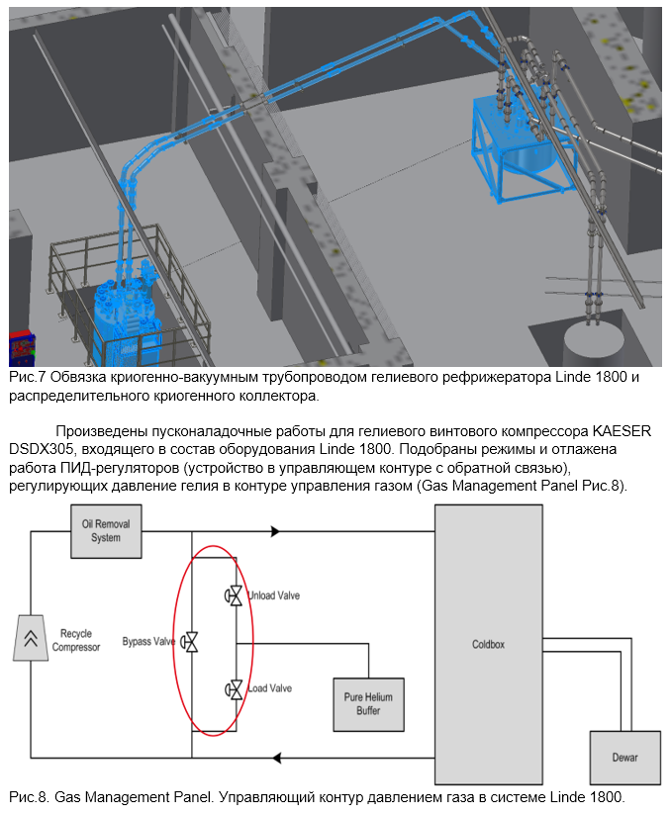
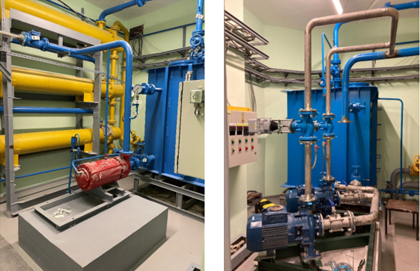
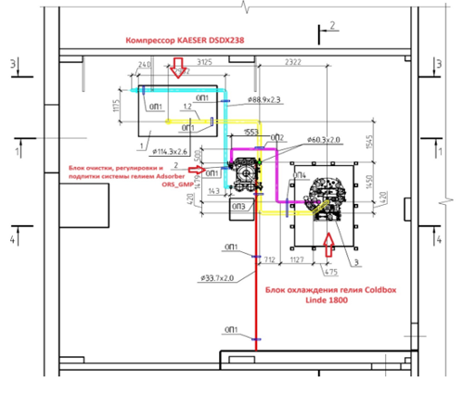
2023
The distilled water-cooling system has been modernized:
the old pump has been dismantled,
a new pumping station has been installed.
In accordance with the project, the installation of a Linde 1800/10 refrigerator, compressor, helium purification and replenishment units, pressure control unit, units for measurements, monitoring and control was carried out.
Commissioning of the compressor has been carried out, and the operating modes of the pressure regulator have been selected.
old pump
new pumping station

Slide 13
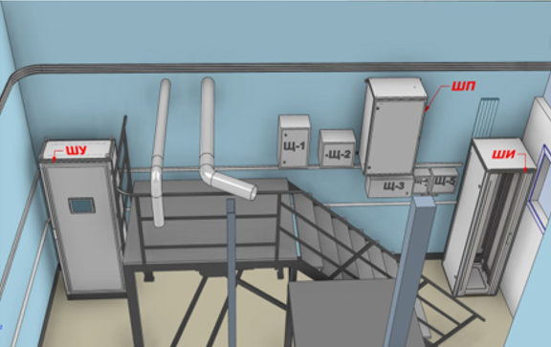
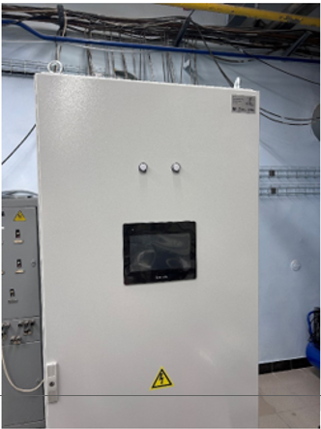
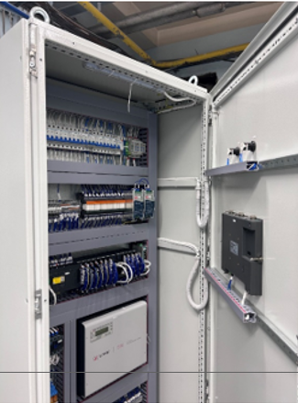
2024
Several test runs of CM201 and CM202 without the reactor power were carried out. The equipment operation was checked as in the normal operation mode as with the simulation of emergency situations on Linde 1200.
The installation of the Linde 1800 refrigerator elements was completed, and its test starts were carried out.
Test runs of the CM201 and CM202 operation with a cryogenic system based on both refrigerators Linde 1200 and Linde 1800 were carried out.
It was achieved:
Reducing the temperature of the moderators by 10K with the new KGU 1800 machine allows to increase the gain factor of the cold neutrons’ flux from the surface of the cold moderators by 15-20%.
Reducing the full load time of the moderator’s chamber by 3-4 times (30 min) due to using of the new type of the charging device.
Work has begun on the creation of an industrial control system for CM201 with plans to extend it to CM202
Drawing and elements of the system

Slide 14
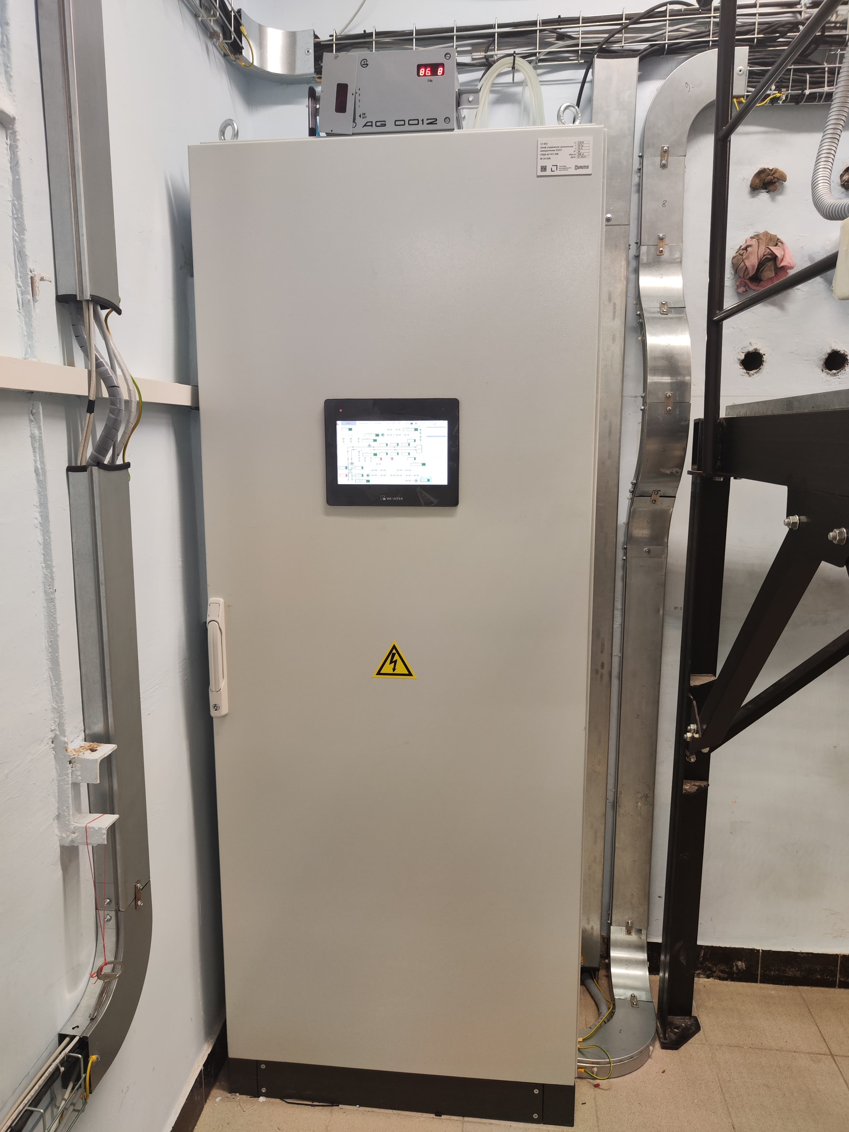
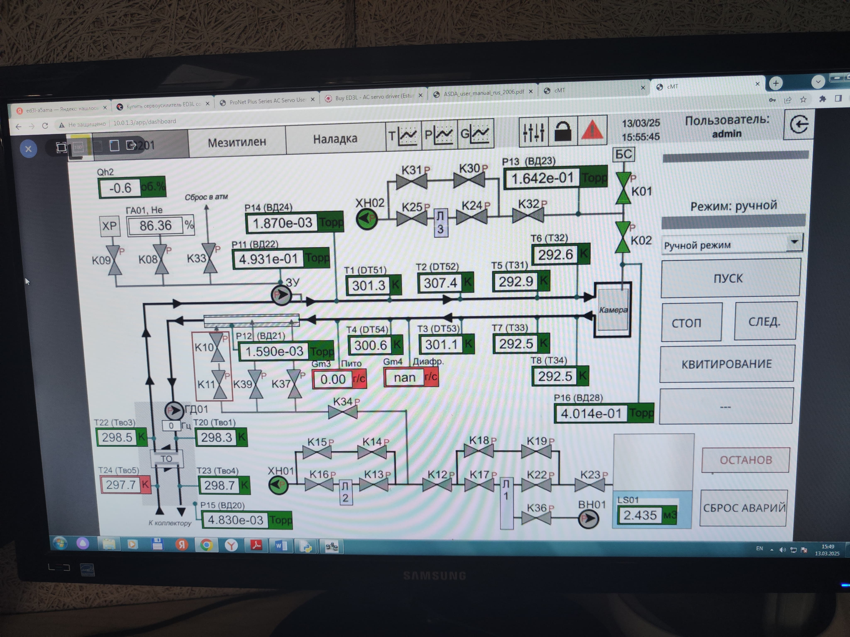
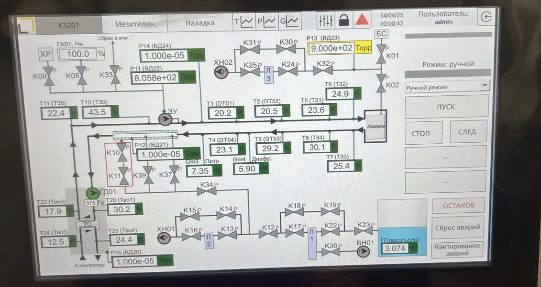
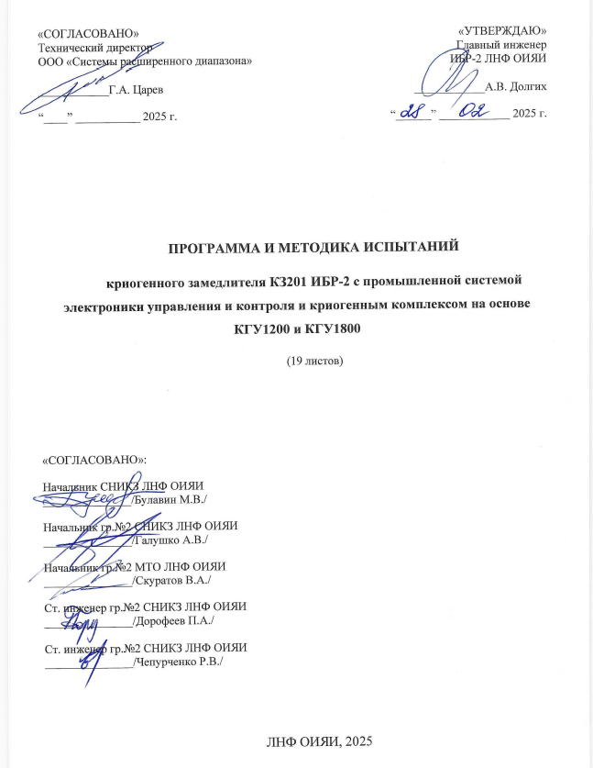
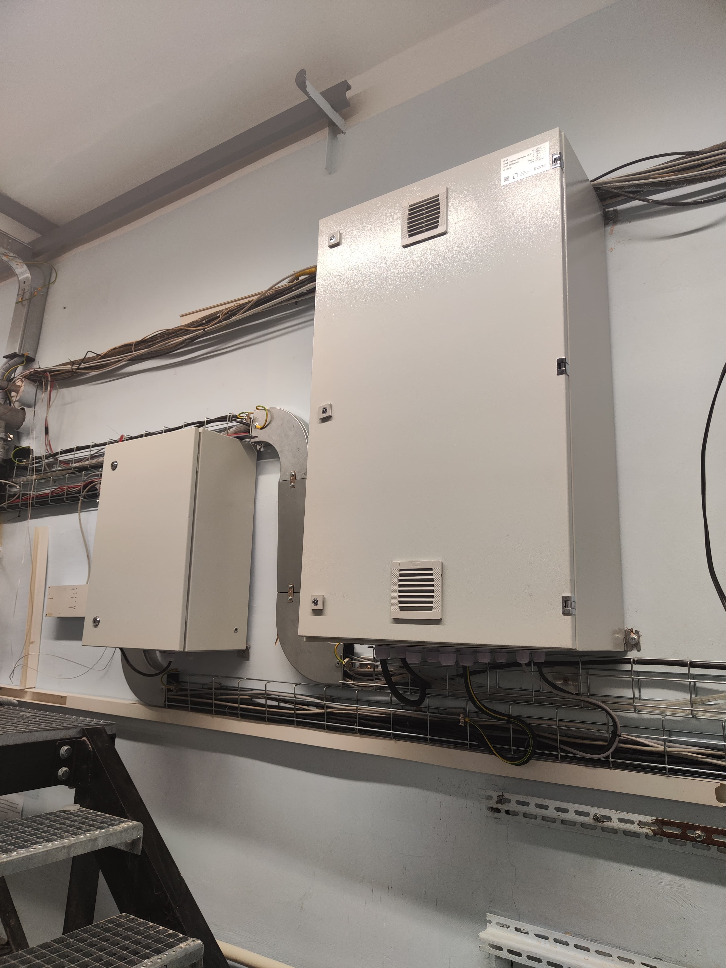
2025
PROGRAM AND METHODOLOGY FOR TESTING
the cryogenic moderator CM201 with an industrial electronic control and monitoring system and a cryogenic complex based on KGU1200 and KGU1800.
PMT for CM201 with a new industrial IECMS was performed at 03.03.-30.04.2025. During the tests minor comments were identified that do not affect the overall performance of the system. The system can be recommended for the routine operation of CM201 in each cycle of IBR-2 and for checking the fault tolerance (control of abnormal situations as increase in pressure, radioactivity etc.).
The entire complex of moderator equipment operated in normal mode during the 3rd cycle of 2025 and ensuring the smooth operation of both moderators.

Slide 15
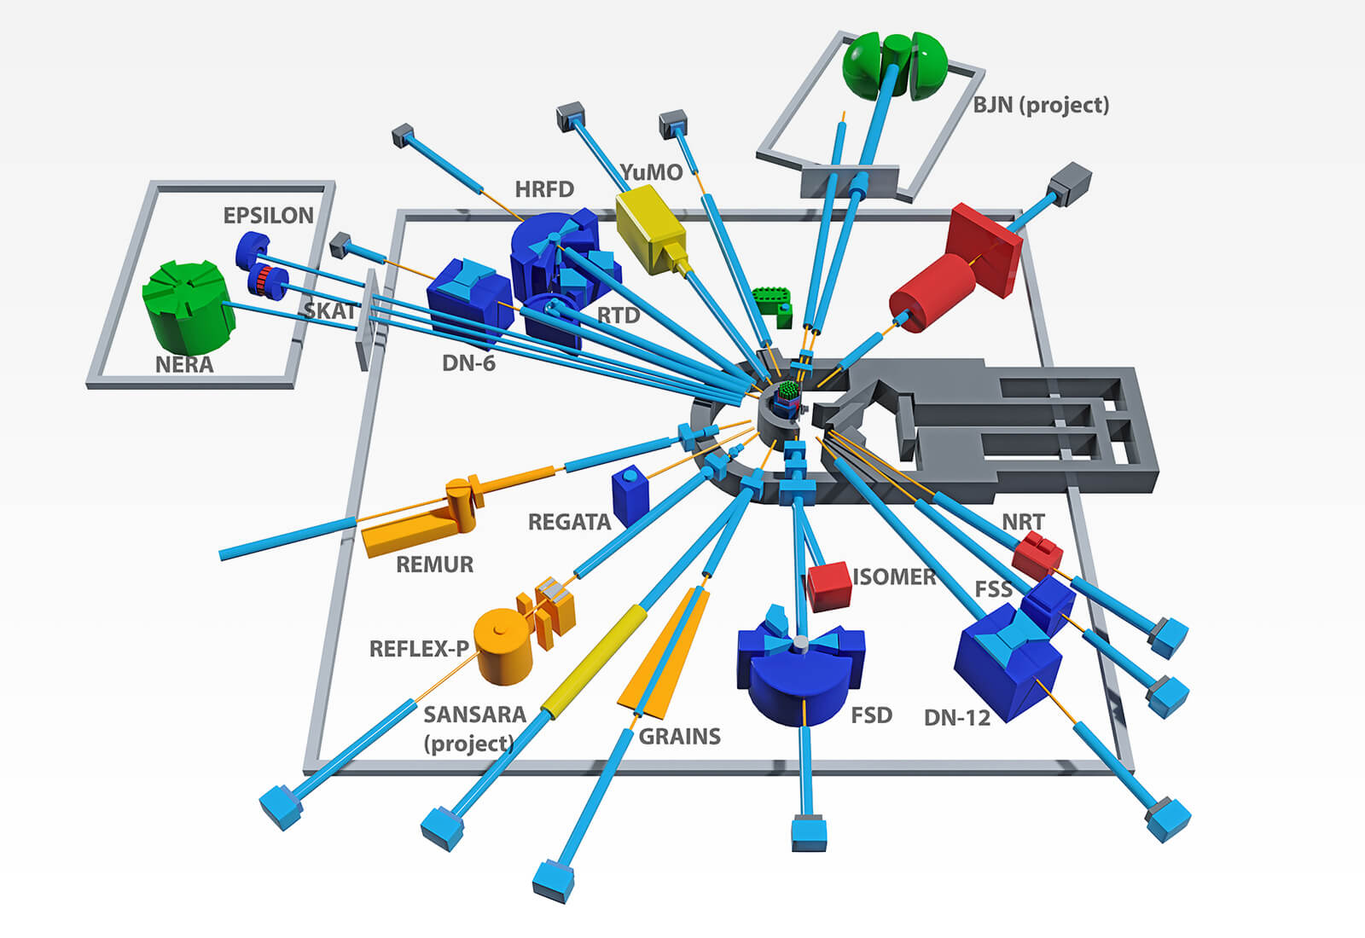
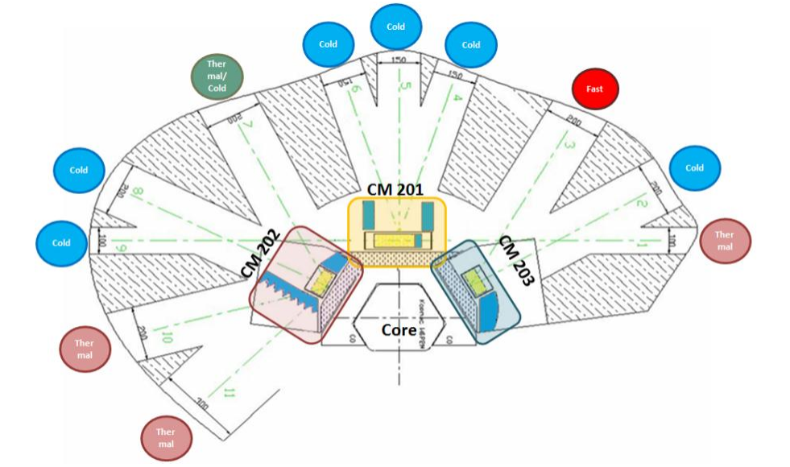
Thus, today a complex of two moderators has been created, the operation of which is provided by two Linde refrigerators.
The two existing moderators provide cold neutrons to 7 directions and 10 instruments.
5
4
2
7
1
6
3
7
Cold
Cold
3
Cold
Bi
5
Th
6
4
8
2
8
Cold
Th
10
11
Th
1
9
14
9
Cold
12
???
13
10
Bi
Th
12-14
11
Th

Slide 16
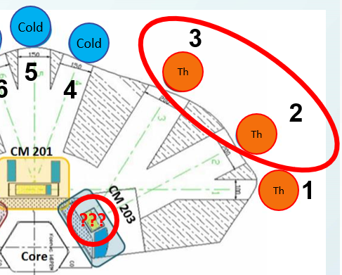
When considering the concept of a cold moderator in the direction of channels 2 and 3, it turned out that:
the BJN spectrometer developing on the channel 2 will not get a significant gain from a cold moderator, the potential range of tasks for which it would be useful is very narrow;
the irradiation facility on the channel 3 will not receive a gain from installing a cold moderator;
the UCN channel project, which potentially considers the channel 3 as its location, requires a specific cold source that must move together with the neutron guide and its development cannot be started until the source design is approved.
After long discussions, it was decided to postpone the issue of creating this cold moderator for the future.

Slide 17
Conclusion on the subproject report:
to date the cryogenic moderator complex have been formed and it include two moderators and a set of equipment based on two Linde cryogenic refrigerators and industrial-level system of management and control;
the creation of new moderators is not planned in the near future, in connection with which it is proposed to close this project.
modernization and improvement of the moderator complex will be carried out within the reactor exploitation, for this purples the corresponding resources will be redirected.

Slide 18
Closing of the project
“Development of the IBR-2 nuclear facility with a complex of cryogenic moderators”
Some history:
Opening of the project was done at 57th meeting of the PAC for Condensed Matter Physics (15/06/2023)
Was done
Routine exploitation
Routine exploitation

Slide 19
Closing of the project
“Development of the IBR-2 nuclear facility with a complex of cryogenic moderators”
TOPICAL PLAN FOR JINR RESEARCH AND INTERNATIONAL COOPERATION
JINR Larg Research Infrastructure
Pulsed Neutron Source and the Complex of Spectrometers
Within the framework of the scientific project, a complex of 2 moderators has been created in full and it is currently in the normal operation mode.
Development of the…
Investigations of functional materials
and nanosystems using neutron scattering
Scientific and methodological research
and developments for condensed matter
investigations with IBR-2 neutron beams
New advanced neutron source
at JINR
Construction of a complex of cryogenic
moderators
Exploitation and modernization of developed and existed systems
IBR-2
exploitation

Slide 20
Conclusion on the issue of closing the project:
after the completion of the process of obtaining a license, the only scientific task of the project was the development of a cryogenic moderator complex;
other tasks related to the reactor should be solved within the framework of its routine exploitation;
to date the cryogenic moderator complex have been created and its configuration was fixed;
subproject “Construction of a complex of cryogenic moderators at the IBR-2 facility” could be closed;
we propose close project “Development of the IBR-2 nuclear facility with a complex of cryogenic moderators” because do not plan change configuration of the reactor systems and the moderator complex in nearest future.

Slide 21
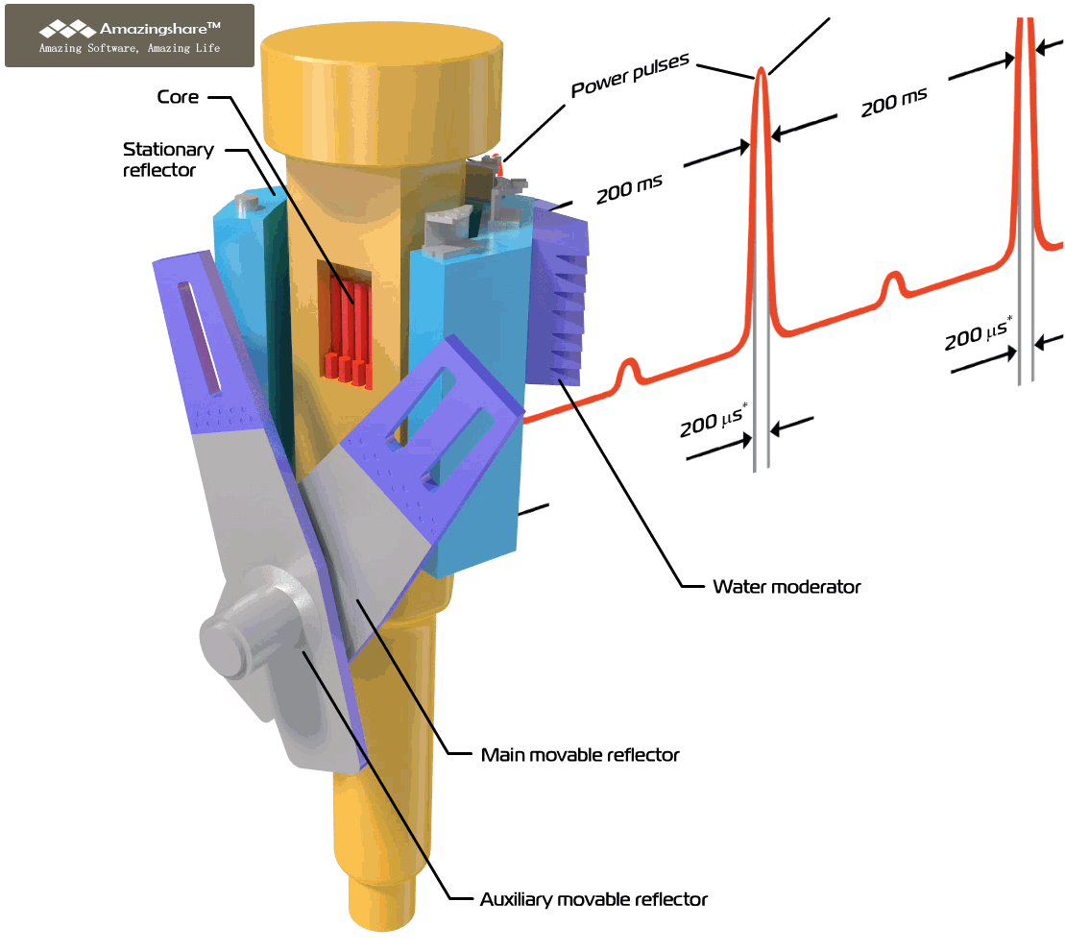
Thank you for attention

