Slide 1
First outcome of spectrometer complex operation after restart of the IBR-2 reactor
D.P. Kozlenko
Frank Laboratory of Neutron Physics, Joint Institute for Nuclear Research, 141980 Dubna, Russia

Slide 2
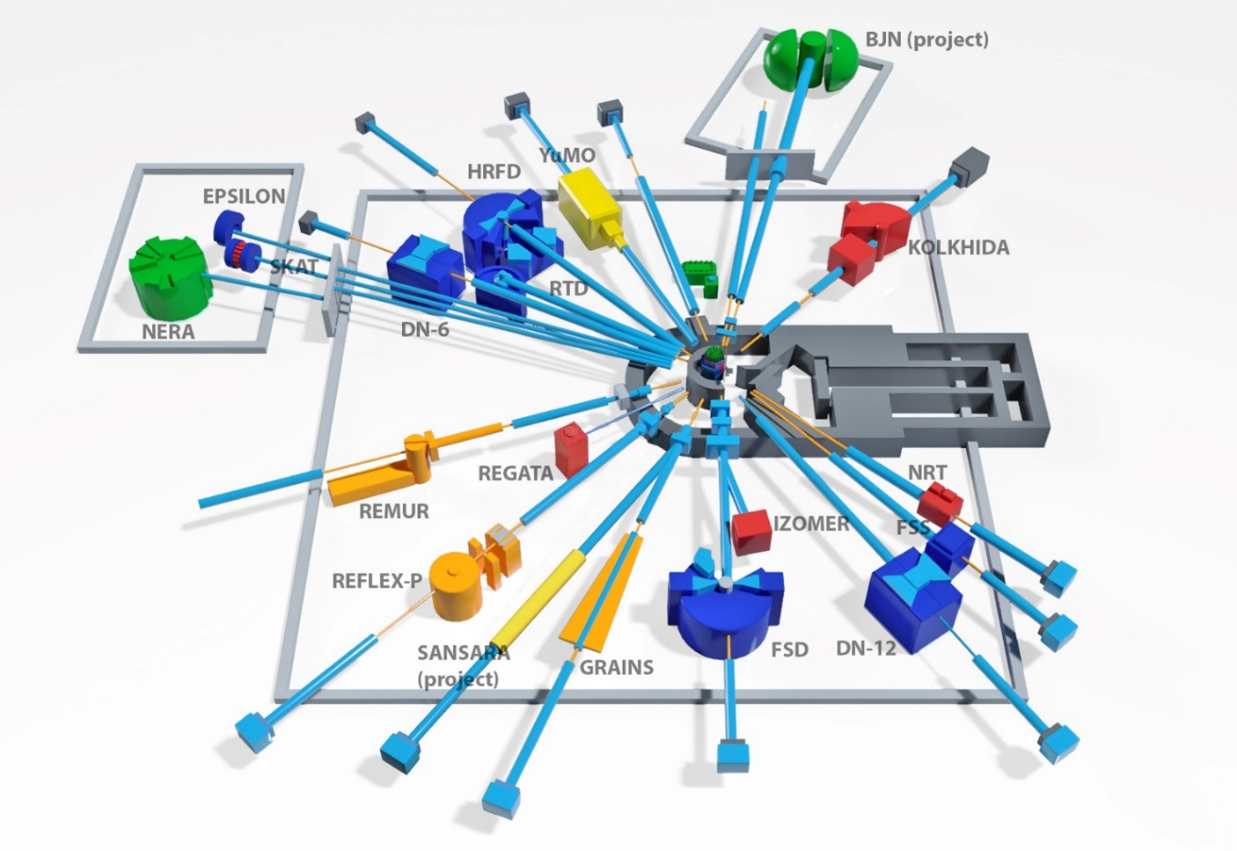
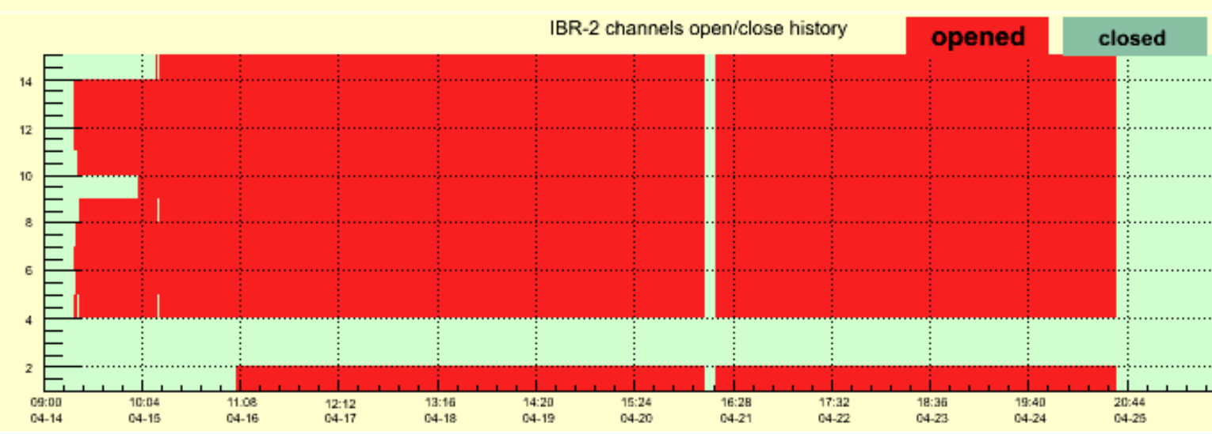
SPECTROMETER COMPLEX OF IBR-2
Three test cycles of reactor operation
17 February – 07 March 2025;
17 – 28 March 2025;
14 – 25 April 2025 (with cryogenic moderator).
First experiments at all of 14 instruments for condensed matter research were performed
Methodical experiments aimed at putting into operation newly installed and upgraded elements of instruments being in modernization and determination of current technical parameters;
Realization of the first scientific experiments.

Slide 3
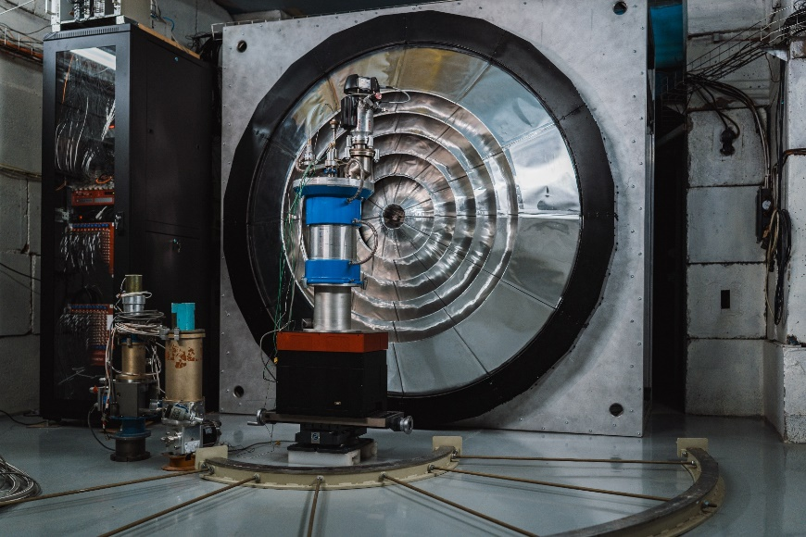
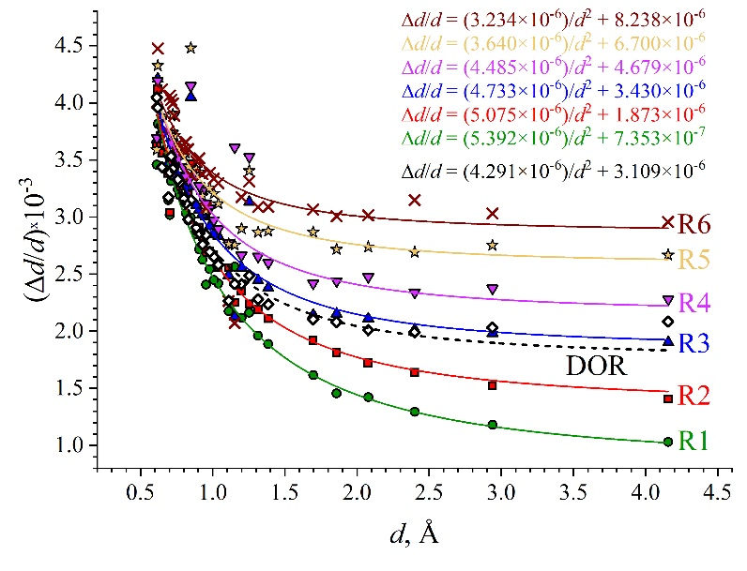
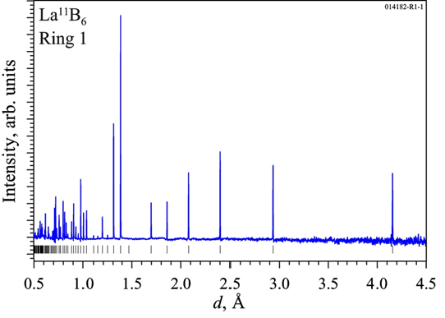
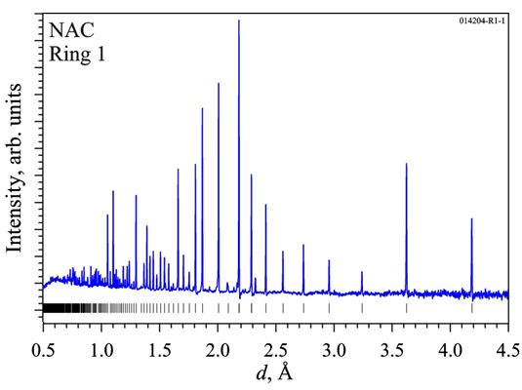
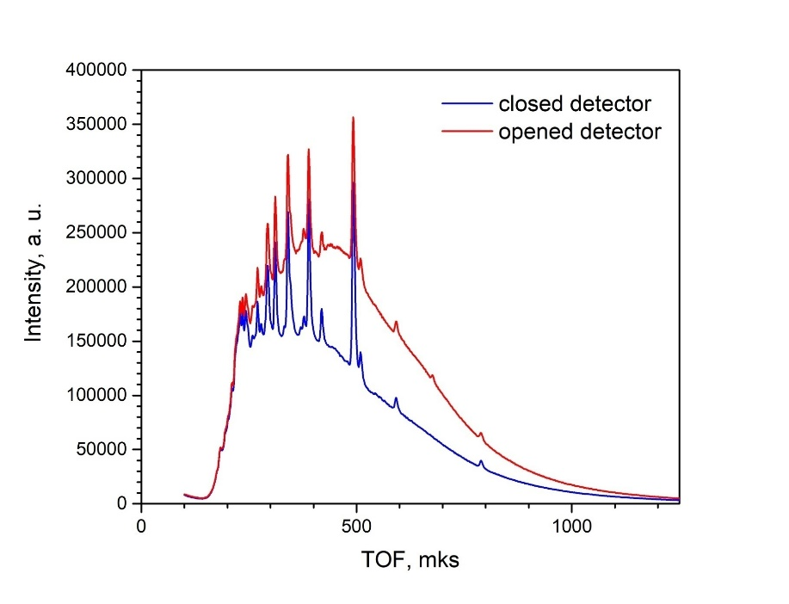
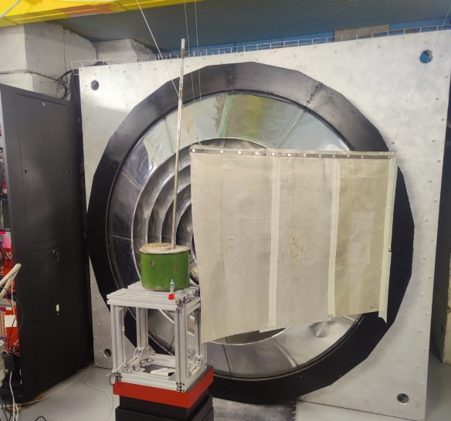
High resolution Fourier Diffractometer
For precise studies of crystal structure and microstructure of materials
Neutron diffraction patterns for standard samples (La¹¹B₆, Na₂Al₂Ca₃F₁)
New wide-aperture backscattering detector 2θ = (133−175)°, solid angle ~ 2 sr
Resolution functions for detector sectors 1-6 (for Ω _{max} = 2500 rpm)
The expected increase in the intensity of registered neutrons up to ~ 5 times.
Further works
Available data acquisition electronics needs to be changed to CAEN digitizer system for proper detector operation;
Detector schielding is under development to improve background conditions.
Evaluation of background reduction by detector schielding

Slide 4
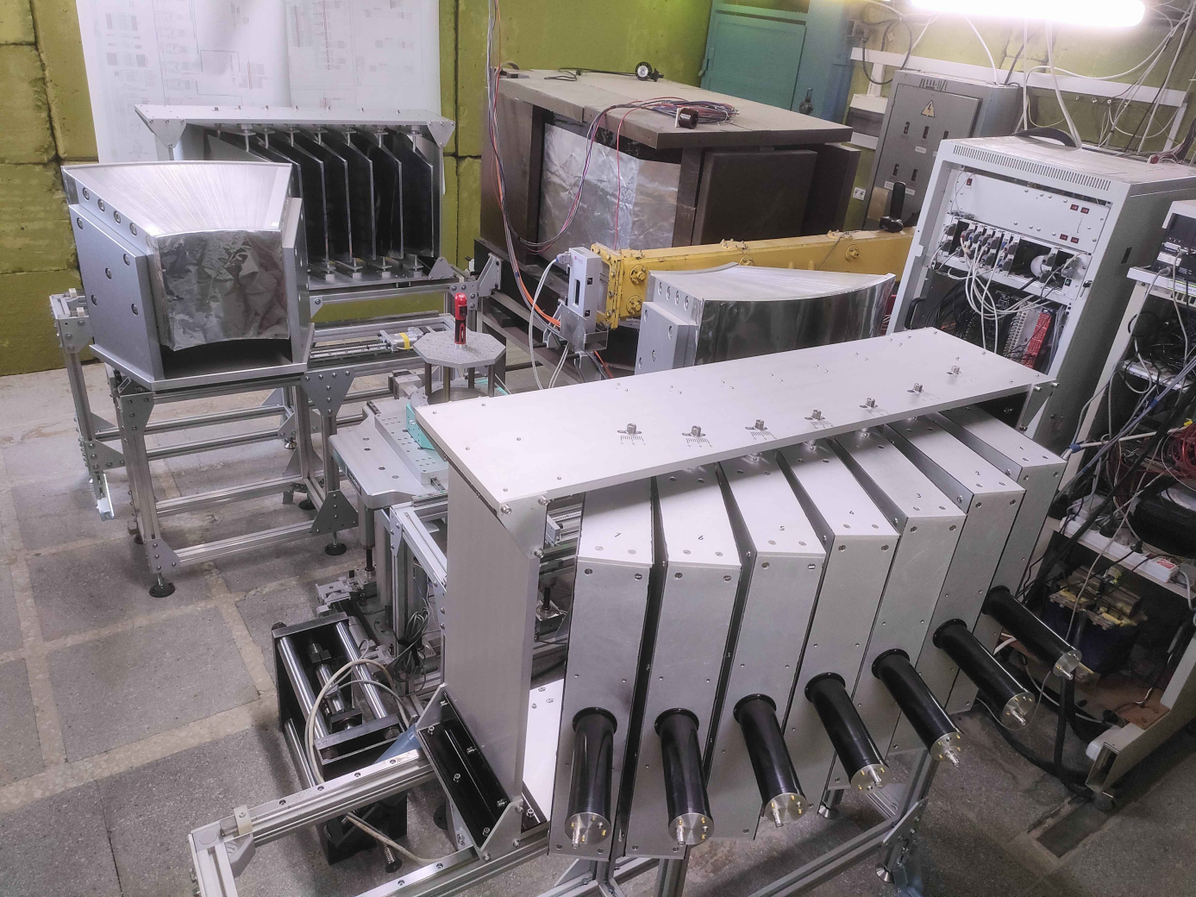
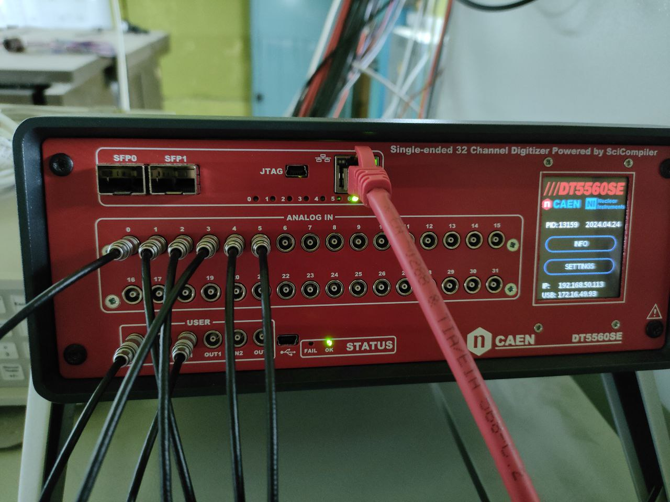
Fourier Stress Diffractometer
for studies of internal stresses in constructional materials and industrial products
ASTRA detector system: 14 new modules were installed at scattering angles 2θ = ±90°. Solid angle increase in ~ 2 times
High-resolution diffraction spectra measured with ASTRA-Left (top) and ASTRA-Right (bottom) detectors
Resolution functions for FSD detector
Testing of new DAQ system based on CAEN digitizer
New DAQ system: CAEN digitizer (model DT5560SE)
Arrangement of sensitive ZnS(Ag) layers of the ASTRA 90°-detector in the horizontal scattering plane
Intensity gain with new DAQ: 1.5 times
Comparison of diffraction spectra measured with old (MPD unit) and new (CAEN digitizer) DAQ systems

Slide 5
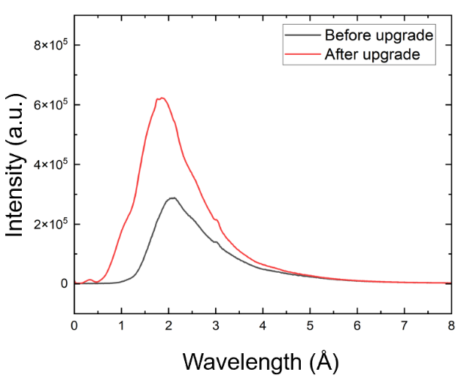
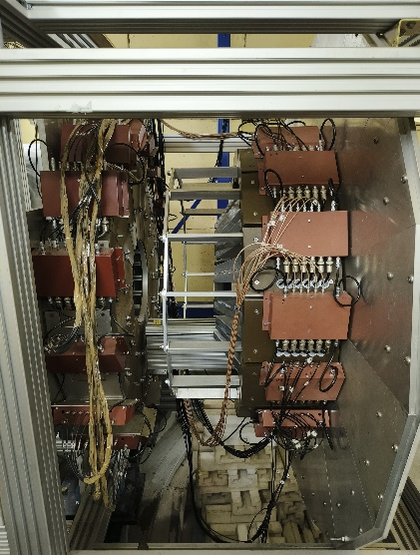
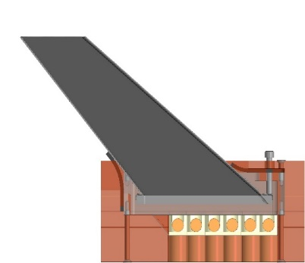
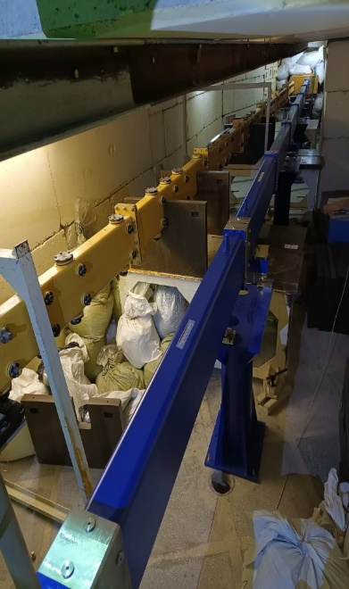
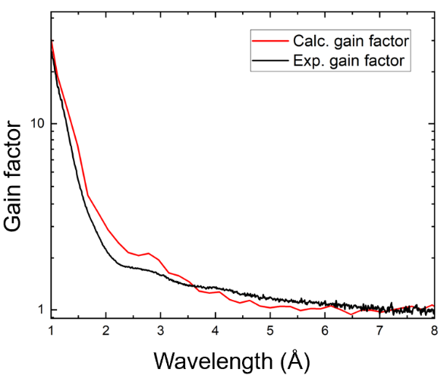
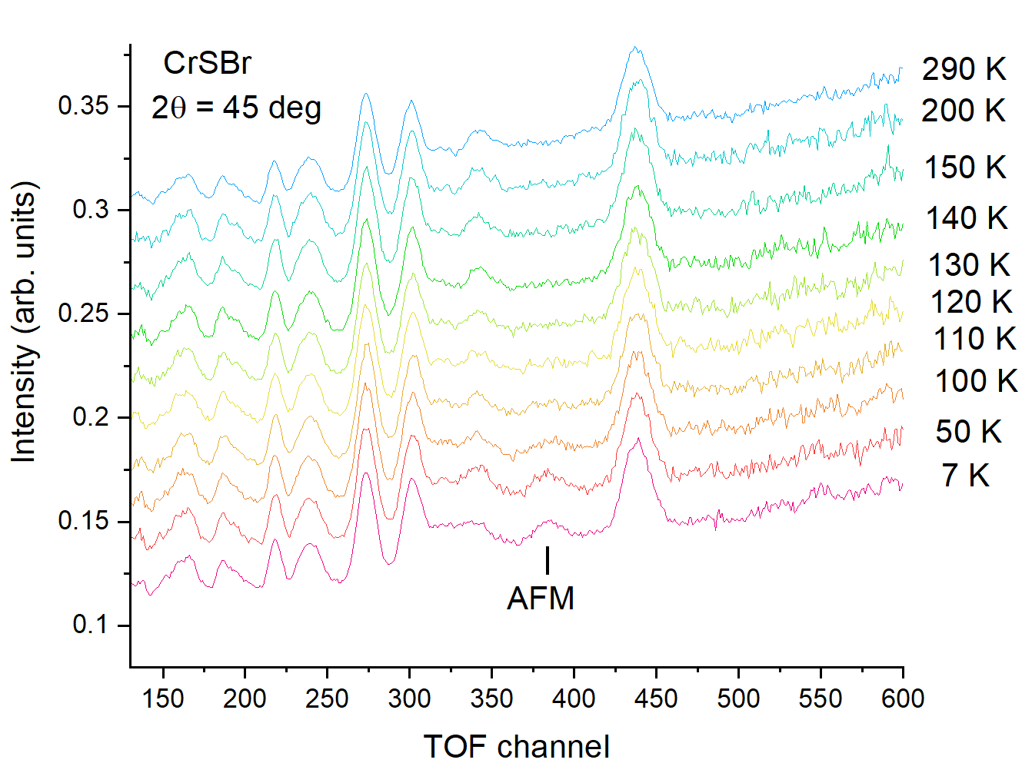
DN-6 Diffractometer
for studies of crystal and magnetic structure of materials at ultrahigh pressures up to 40 GPa
Replacement of the central part of the neutron guide (from m = 1 to m = 3, made by SwissNeutronics)
Upgrade of the detector system: new forward scattering bank (2θ=32-54°)
General view of the upgraded detector system, the new detector bank on the right . It contains 15 independent sections arranged in a ring. Design of one section composing of 6 independent ³He neutron counters
New central part of curved neutron guide
section with m=3 side coating
Neutron diffraction patterns of van der Waals quasi-2D magnetic material CrSBr measured with new detector module for 2θ = 45°.
Spectral distribution of incident neutron flux measured with vanadium sample (top) and calculated gain factor (bottom)
With the new detector modulus, the accessible d-spacing range is extended to d_{hkl} = 0.8 – 12 Å
Average intensity gain ≈ 2 times

Slide 6
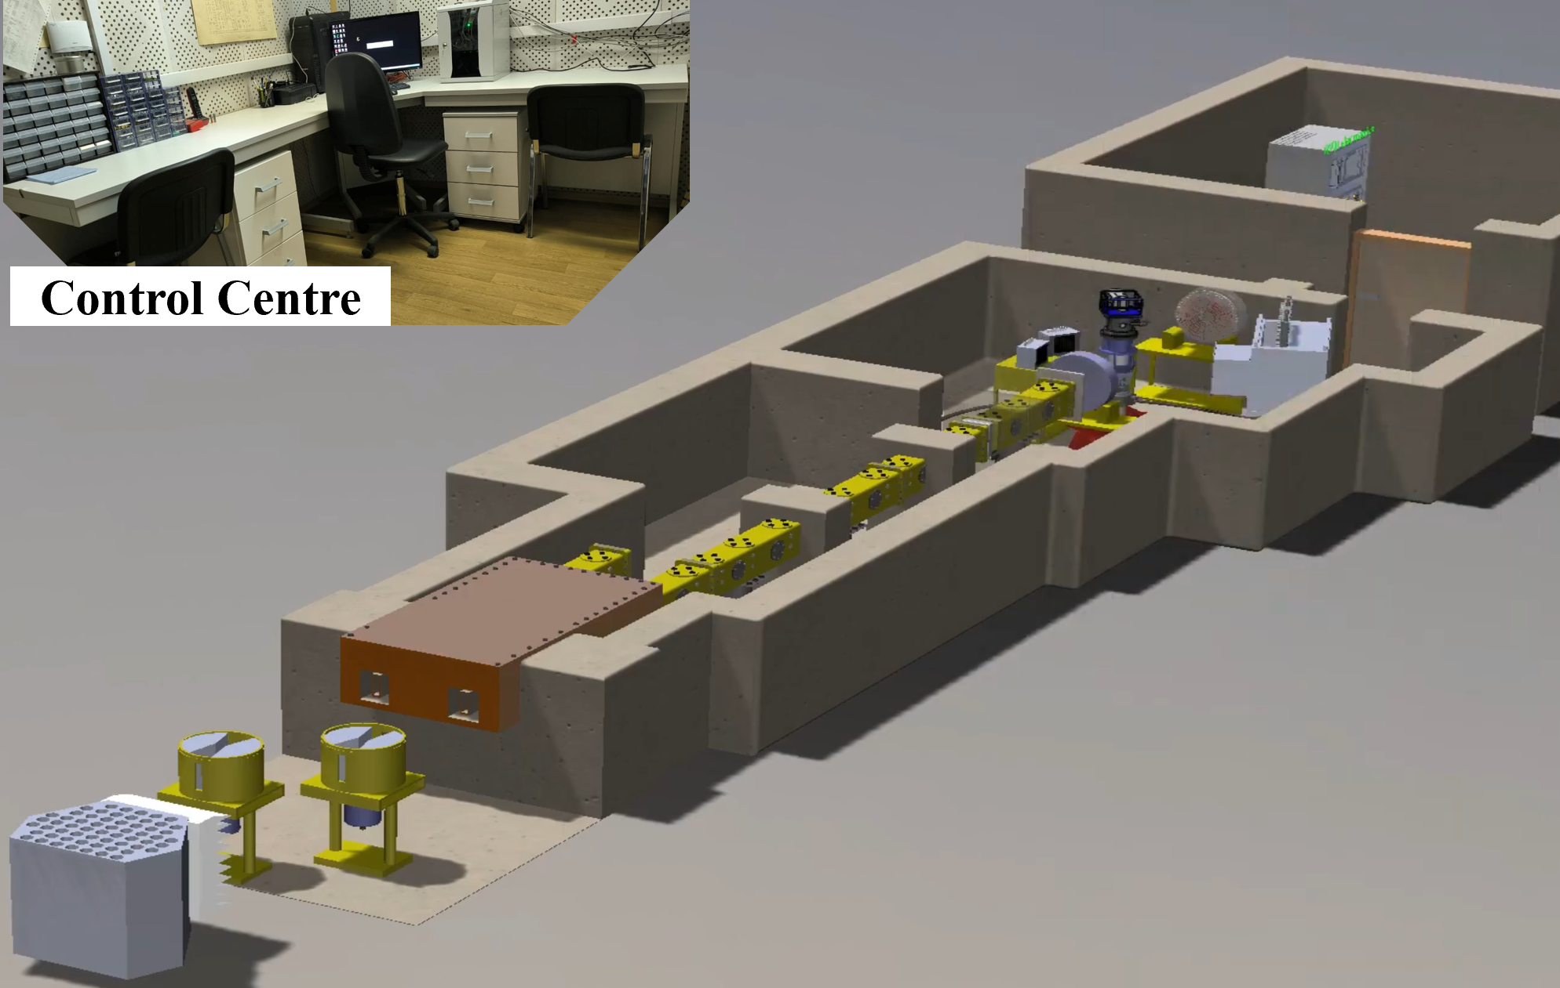
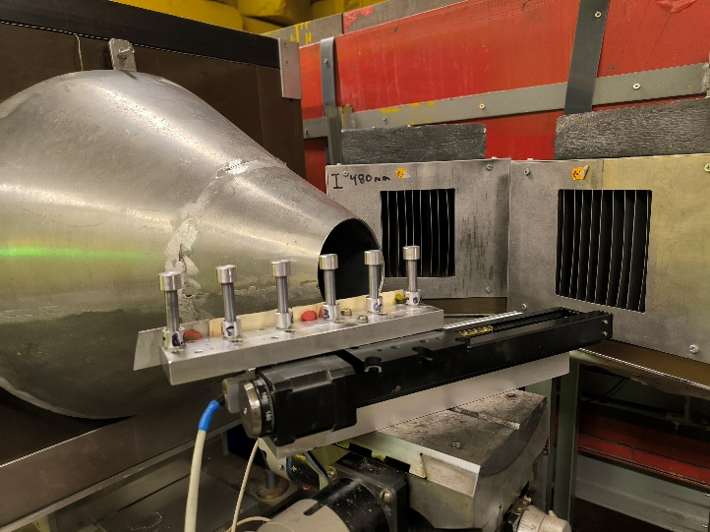
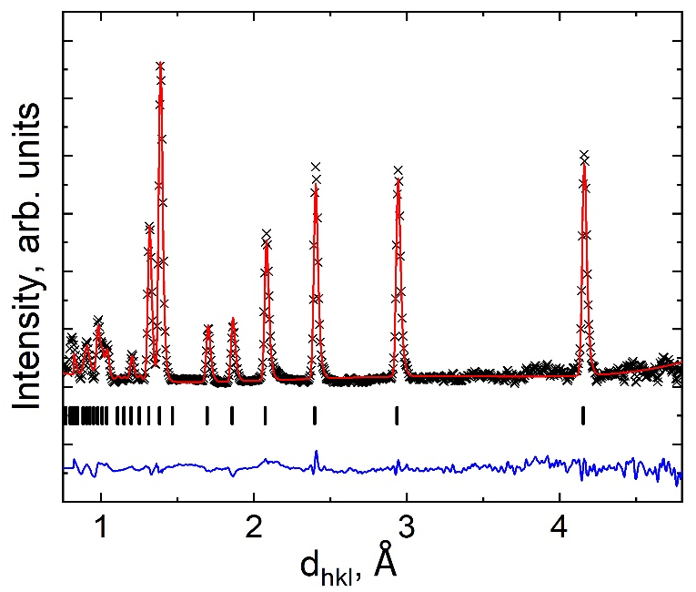
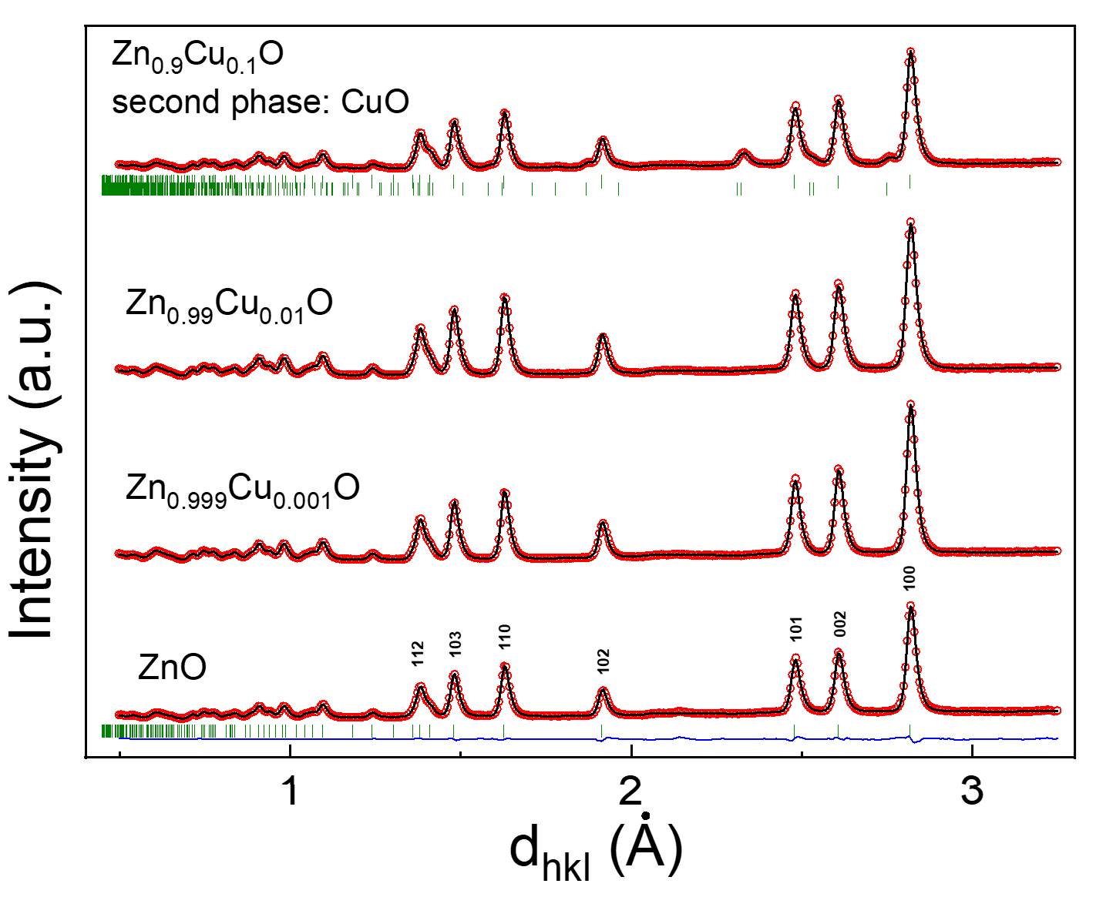
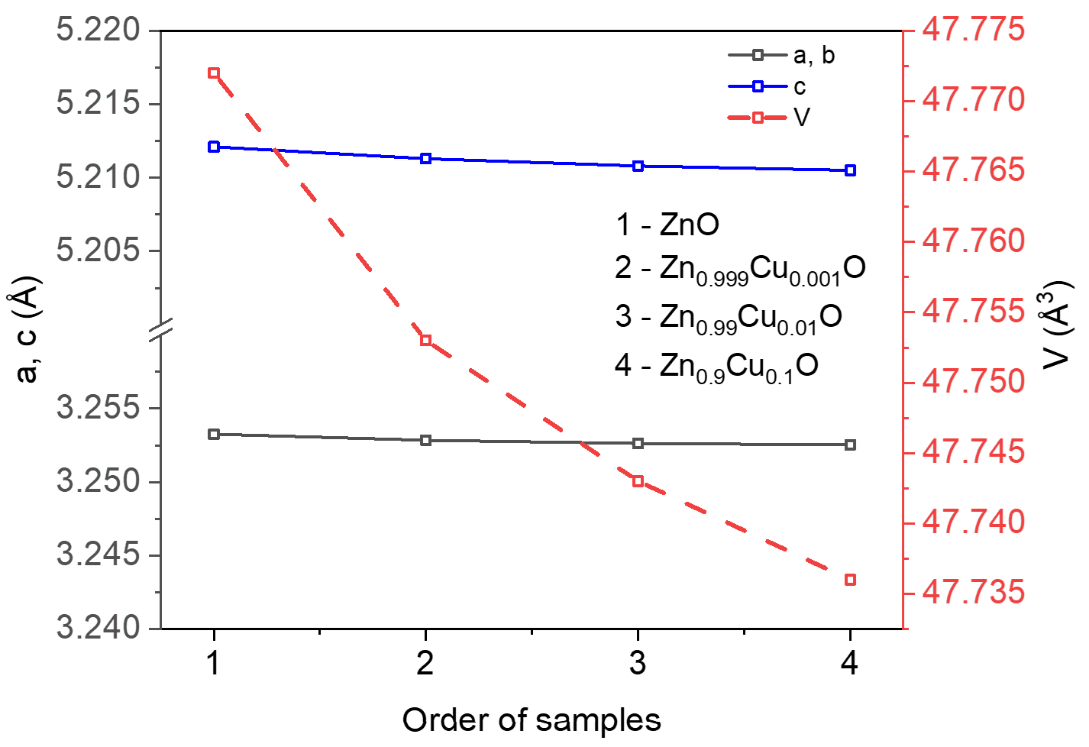
RTD diffractometer for real-time studies
Upgrade of automated sample changer - vanadium containers for liquid and powder samples have been manufactured.
General view of the RTD diffractometer (left) and automated sample changer with vanadium containers (right).
LaB₆
Neutron diffraction pattern of the reference sample LaB₆.
Neutron diffraction patterns of nanostructured ZnO partially substituted by Cu ions (left) and concentration dependence of unit cell parameters (right).
Notes:
Проведены комплексные исследования влияния температурного фактора на структурные особенности сегнетоэлектрика BaTiO3.
планируется сравнить значения температур структурных изменений определенные методами рентгеновской и нейтронной дифракции со значениями определенными с помощью собранной измерительной системы на основе R&S LCR-метра HM8118 для тестирования емкостных свойств и значений импеданса керамических образцов в интервале температур от 100 К до 650 К.
Comprehensive studies of the influence of the temperature factor on the structural features of the ferroelectric BaTiO3 have been conducted.It is planned to compare the values ​​of the temperatures of structural changes determined by X-ray and neutron diffraction methods with the values ​​determined using an assembled measuring system based on the R&S LCR meter HM8118 for testing the capacitive properties and impedance values ​​of ceramic samples in the temperature range from 100 K to 650 K.
Рис.1. Изменение структуры BaTiO₃ наблюдаемые методом рентгеновской (a) и нейтронной (b) дифракции и изменение диэлектрических свойств (с) от температуры.

Slide 7
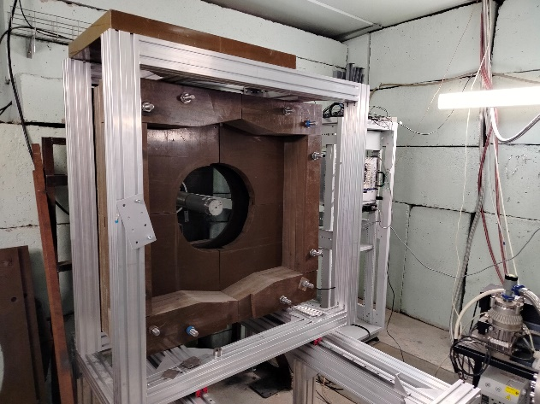
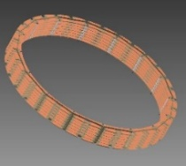
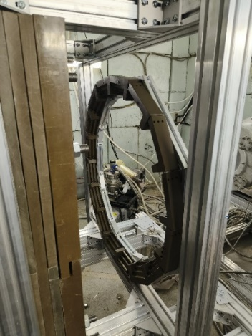
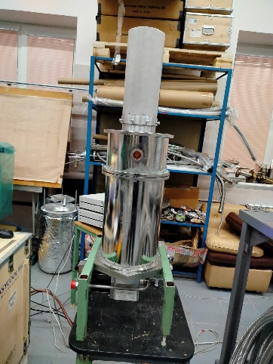
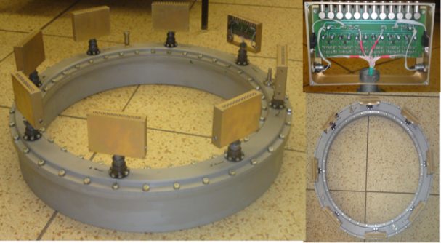
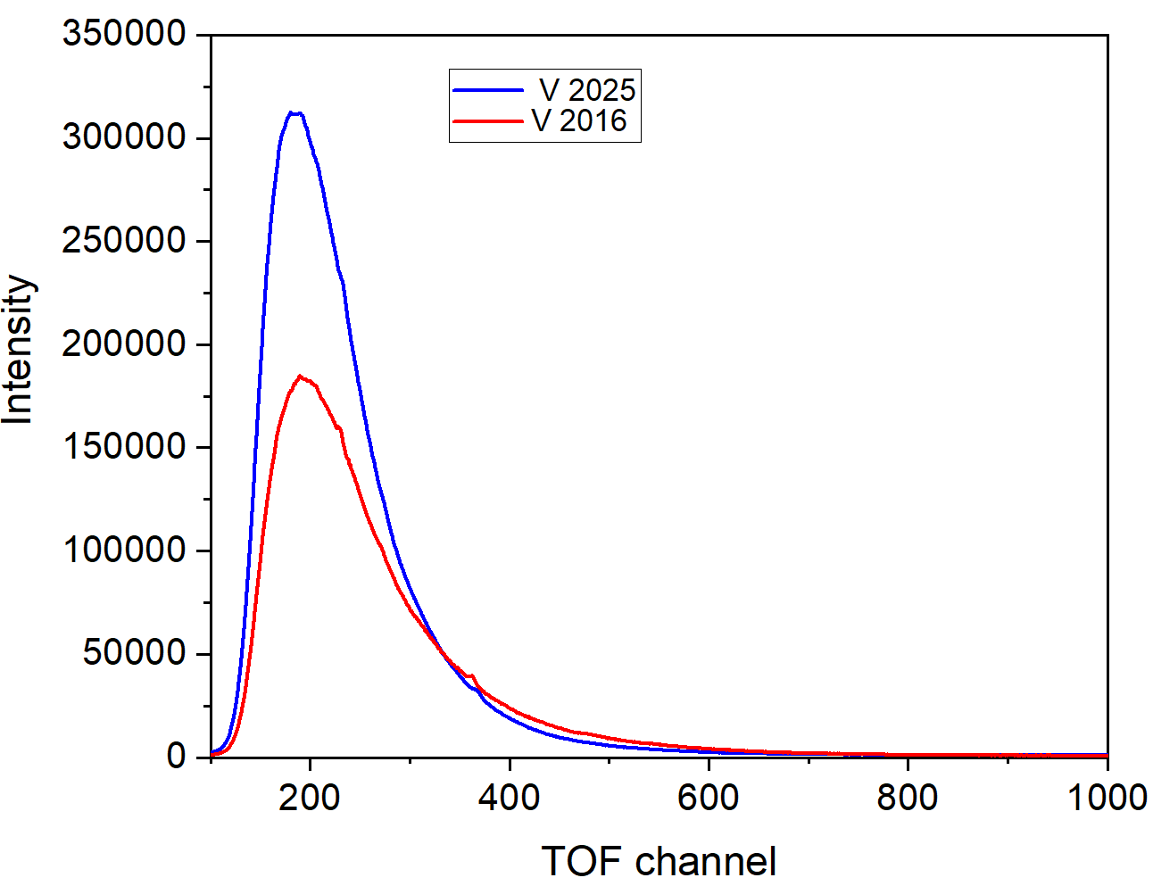
DN-12 Spectrometer
for studies of crystal and magnetic structure of materials at high pressures up to 7 GPa and microsamples
Upgrade of the detector system and sample environment:
Multisectional ³He detector module (2θ=90°), consisting of 96 independent counting elements in the common gas volume.
Detector system of DN-12
Detector module (2θ=45°) consisting of 3 circular arrays of individual ³He counters (16 counters in each array), development in progress
New cryostat
The expected increase in the intensity of registered neutrons is up to 3 times (2θ=90°) and 2-3 times (2θ=45°).
The expected increase in the accessible pressure range from 7 to 10-12 GPa.
The expected reduction of the minimal sample volume from 1.0 to 0.2-0.5 mm³.
Spectral distribution of incident neutron flux measured with vanadium sample with the old and new detector module for 2θ=90°.
Neutron diffraction patterns of nanostructured Fe₃O₄ doped with rare earth metals (2.5 %).

Slide 8
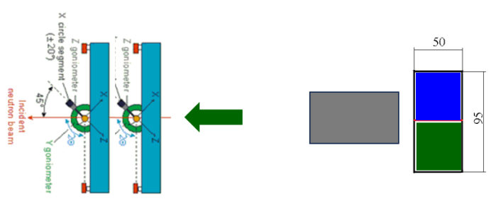
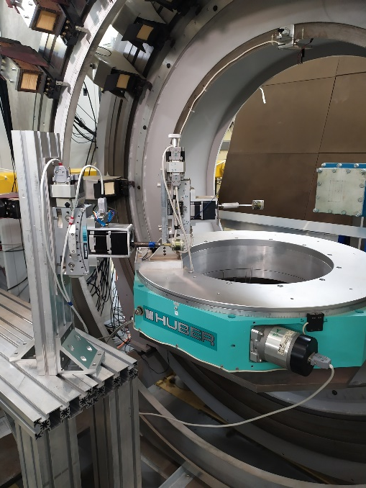
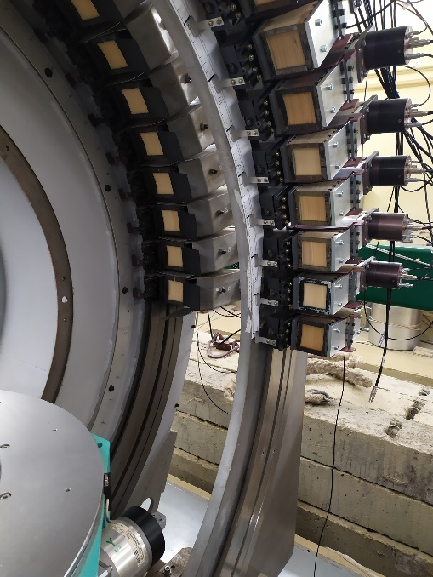
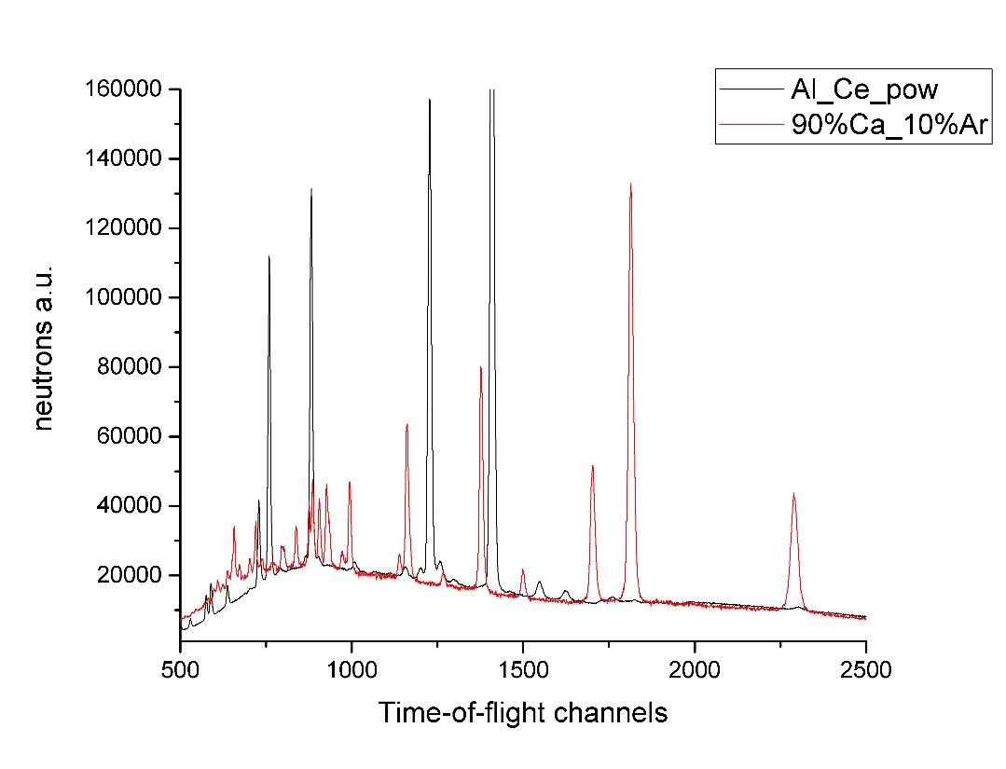
SKAT Diffractometer
for texture analysis of earth rocks, materials, biological and paleontological objects
Putting into operation of an additional detector module installed behind the existing one with the same scattering angle and geometry using the split of neutron beam into two parts.
Putting into operation of the second goniometer unit installed.
Two samples could be measured simultaneously in two experimental positions.
The number of experiments will be increased in 2 times.
Comparison of two diffraction patterns simultaneously measured at two sample positions demonstrates their full independence and no contamination effects from each other.

Slide 9
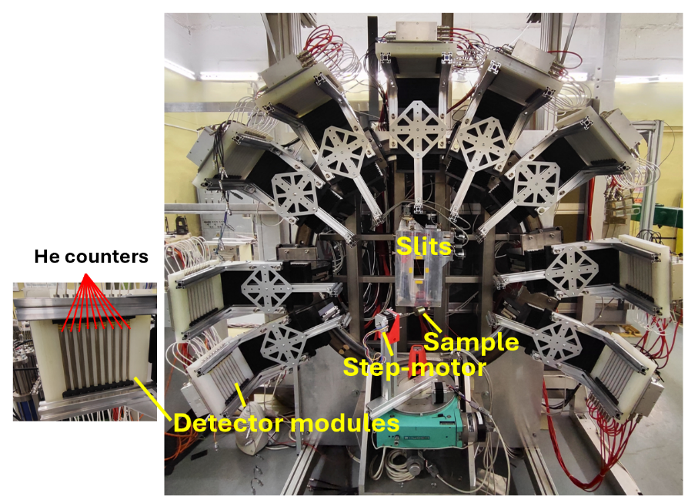
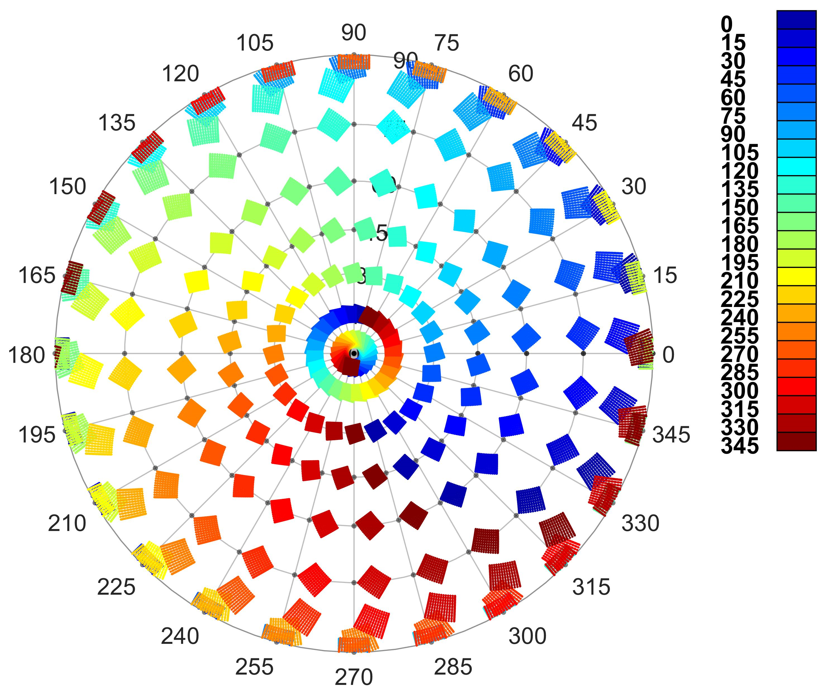
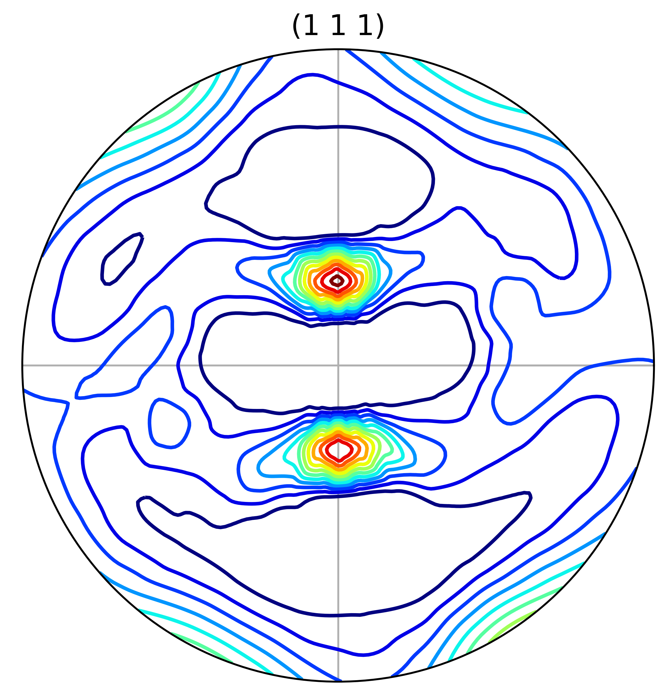
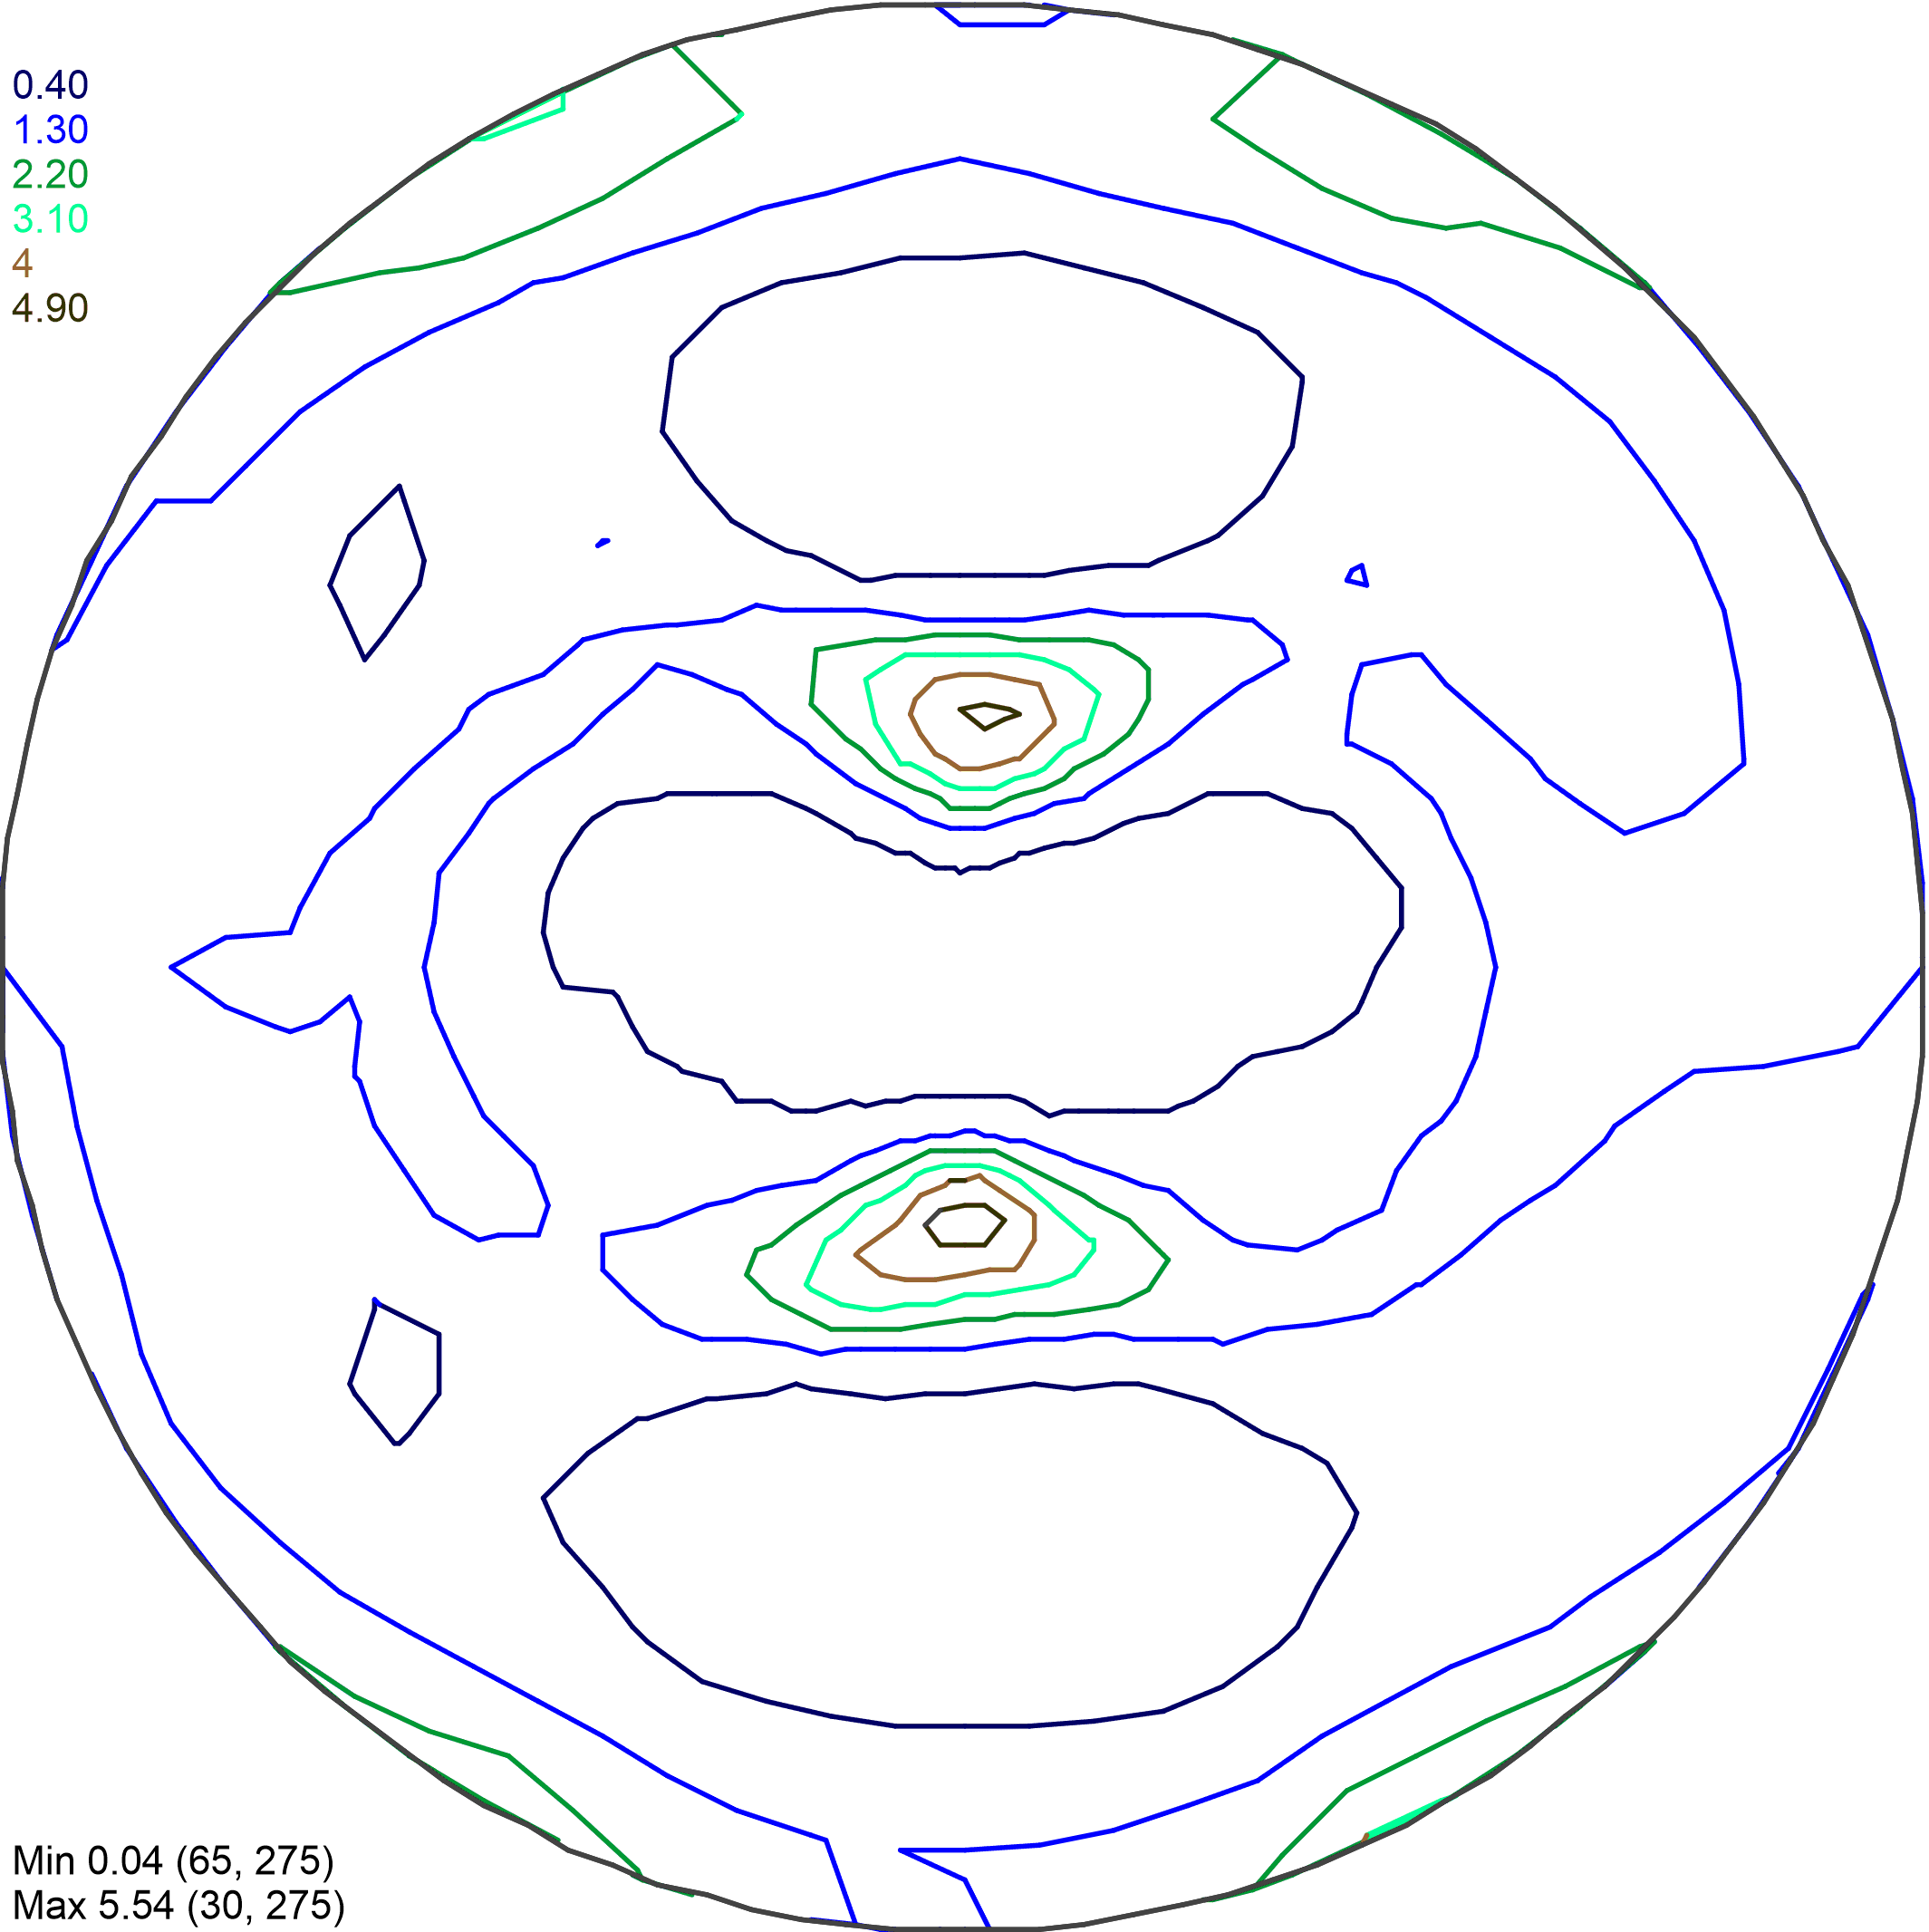
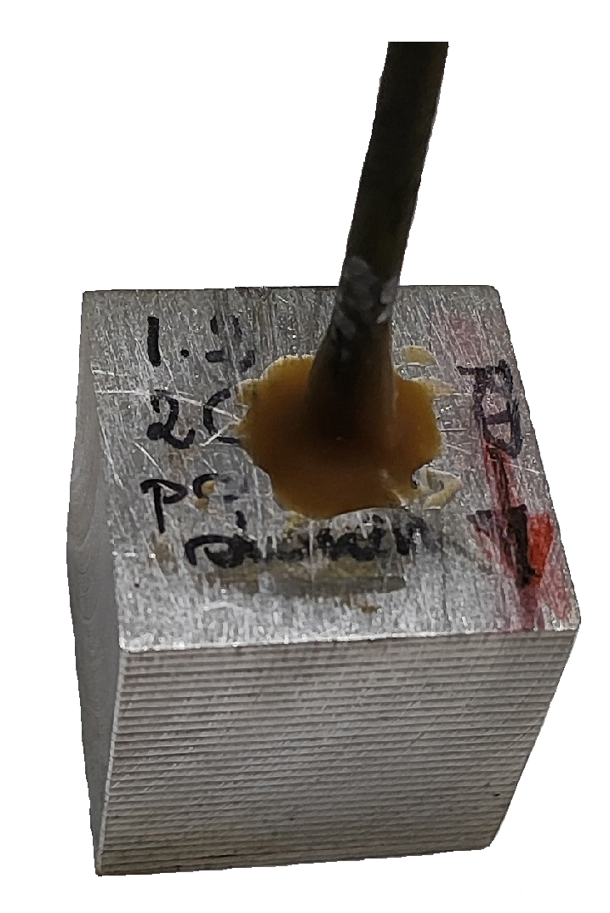
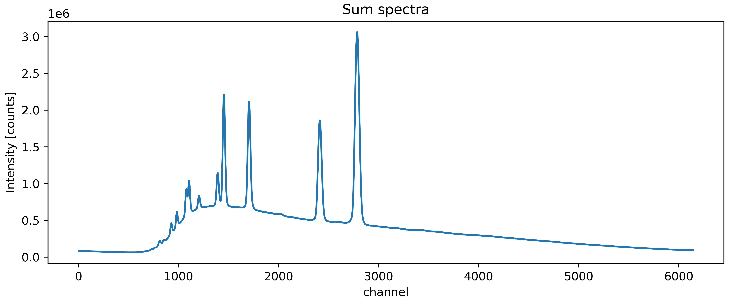
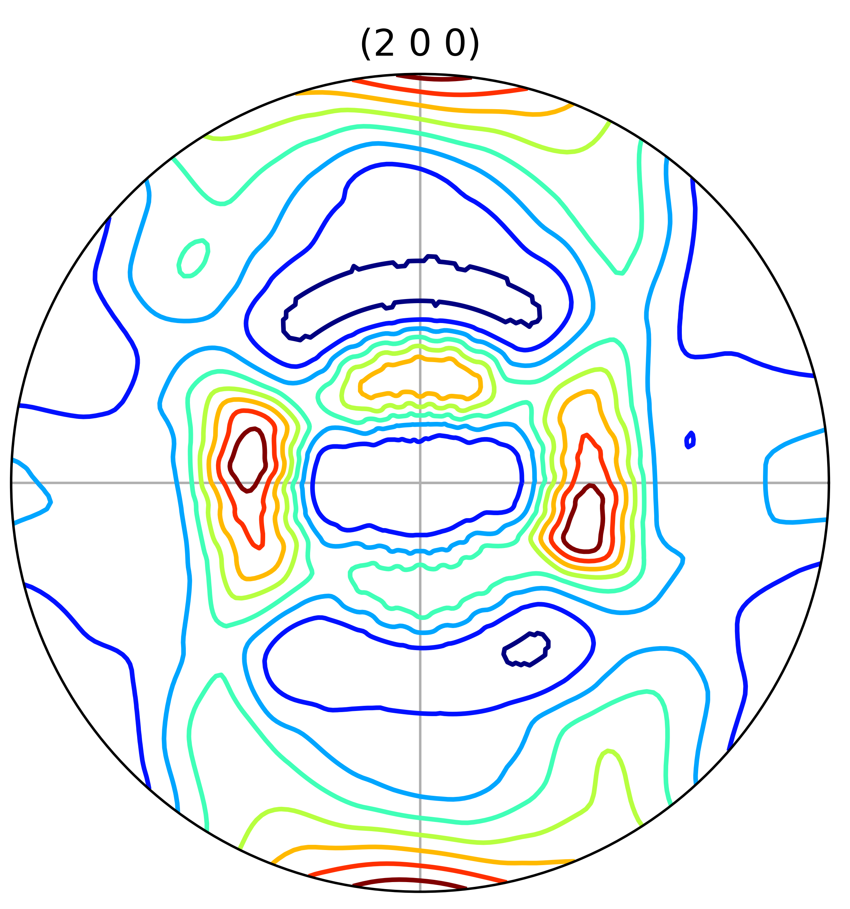
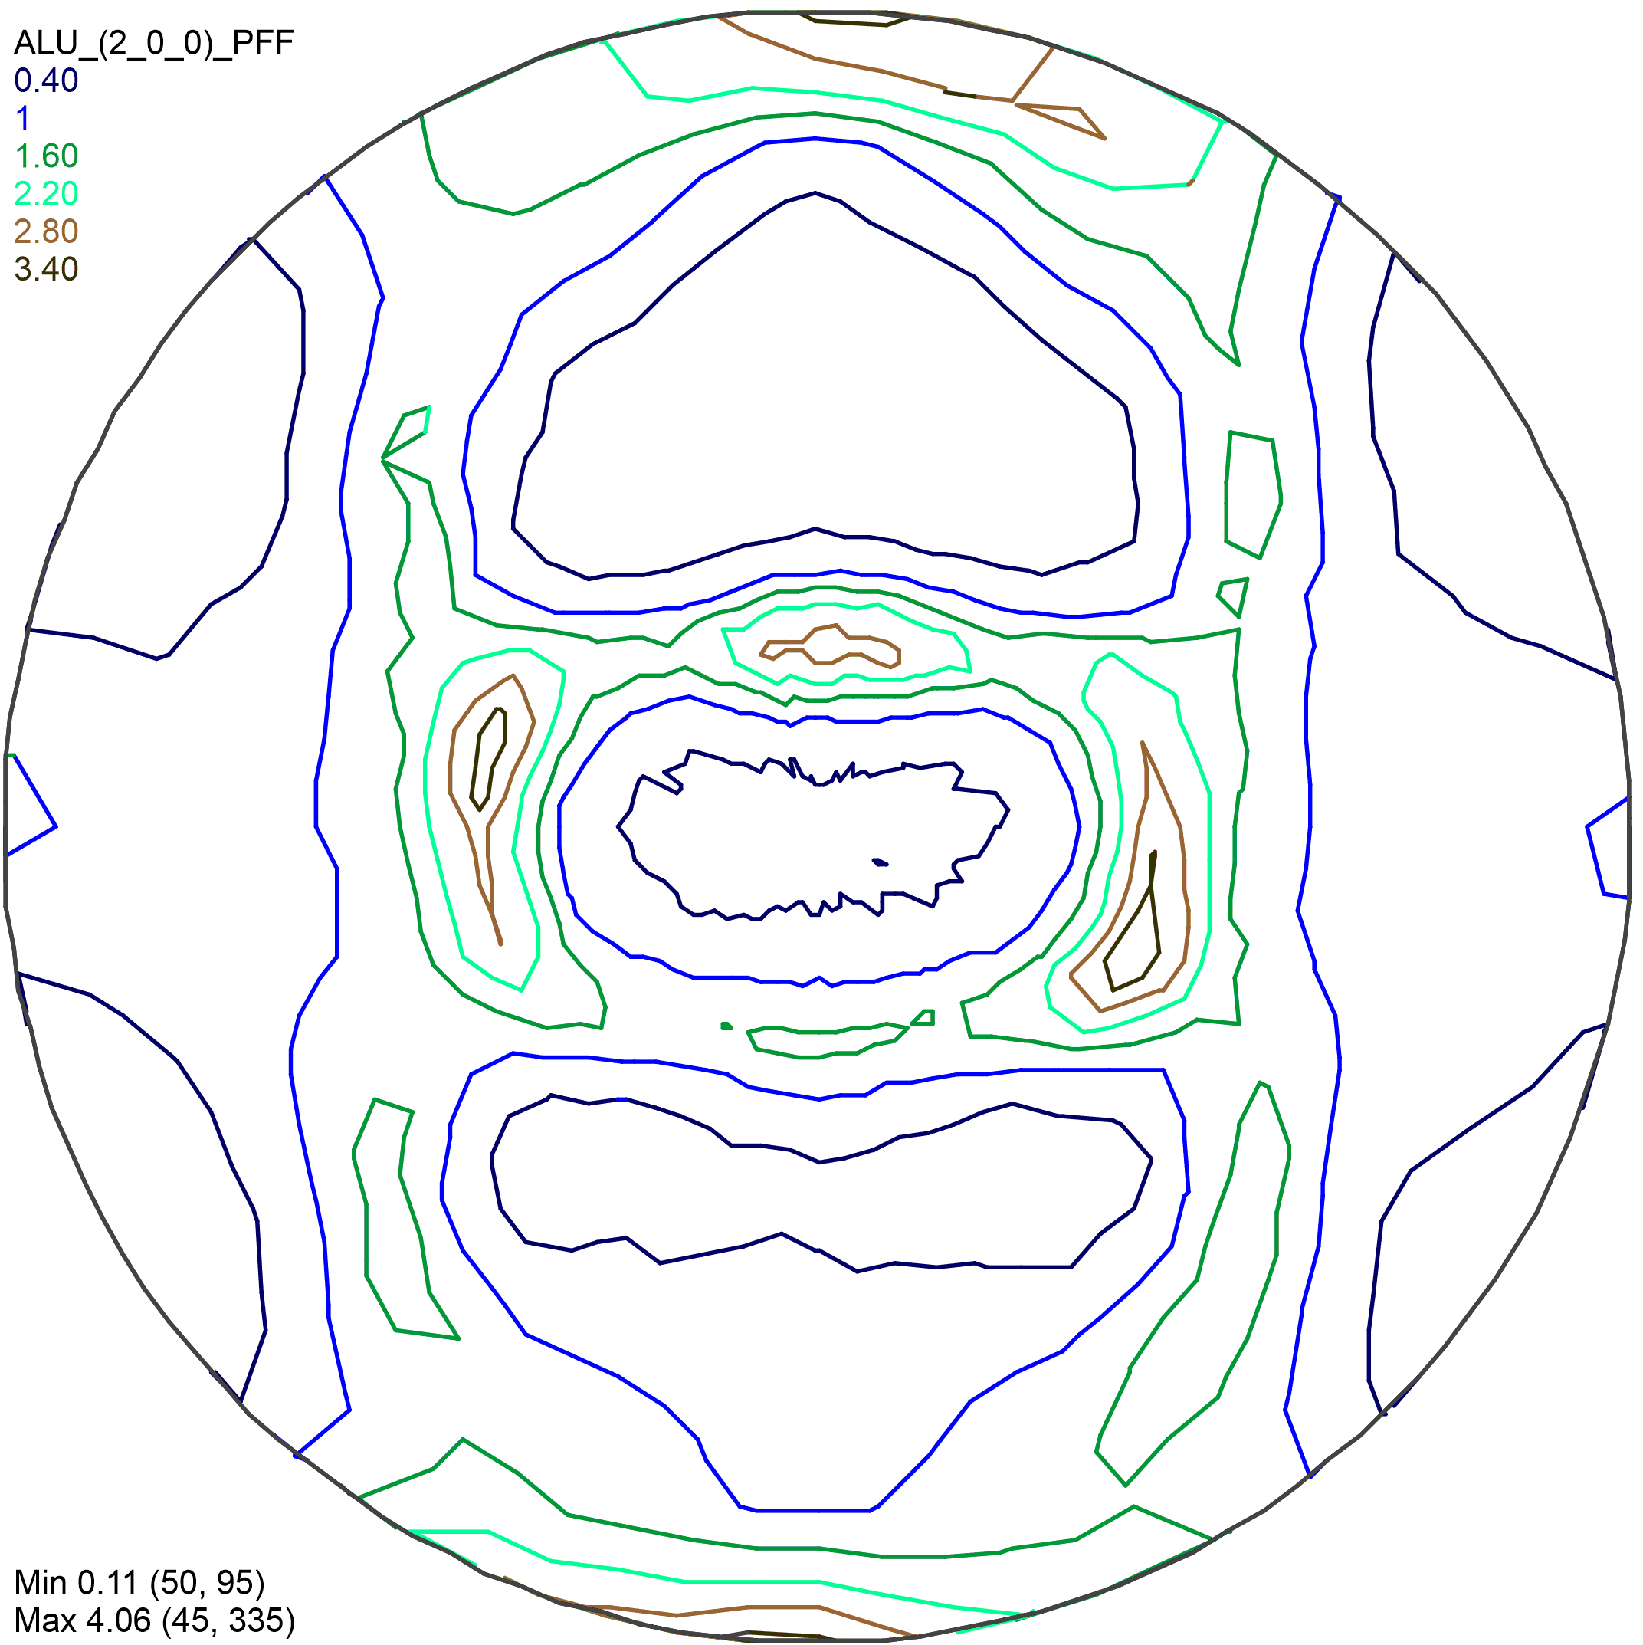
EPSILON Diffractometer
Upgrade for texture analysis
The detector aluminum frame was modified;
New ³He counters, 81 pcs, were installed into available 9 detector modules;
New sample motor was installed;
Detector modules were moved to new positions for pole figures measurements with a grid of 15 x 15 deg.
EPSILON
SKAT
Current view of the detector system and sample position (left). Pole figure coverage by the detector modules (right).
exposition: 20 min
sample rotations: 23
angular step: 15 deg
measur. time: 8 h
(1 1 1)
(2 0 0)
Al alloy sample
(asymmetric rolling)
The neutron diffraction pattern of Al alloy sample.
Pole figures (111) and (200) of Al alloy measured at Epsilon and comparison with SKAT data.

Slide 10
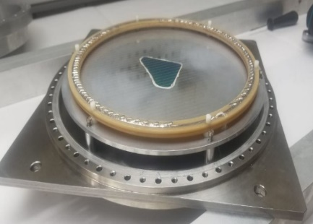
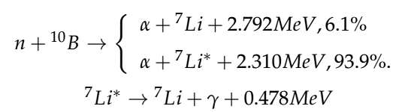

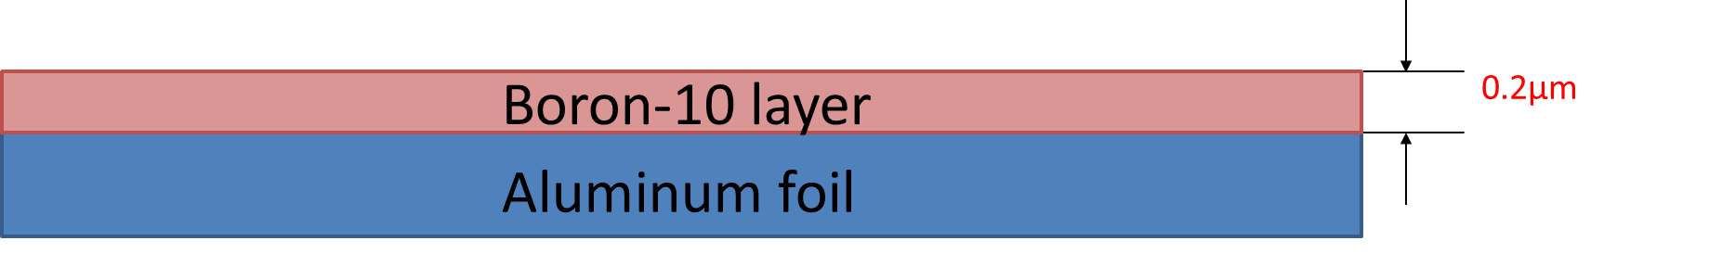
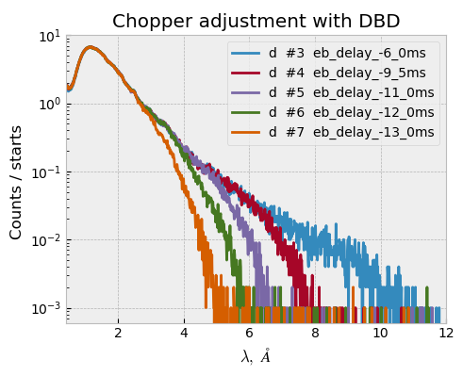
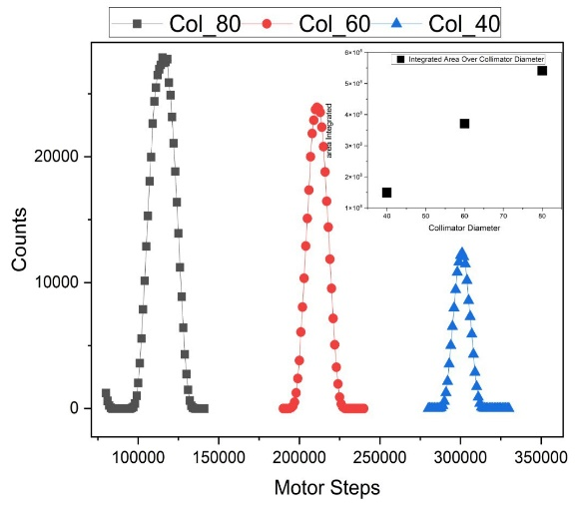
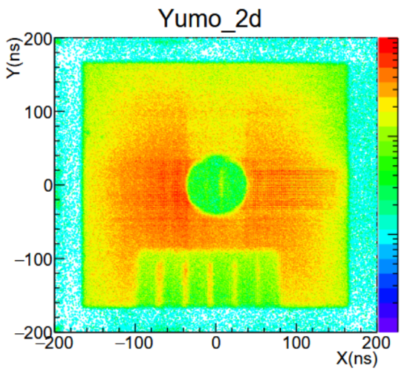
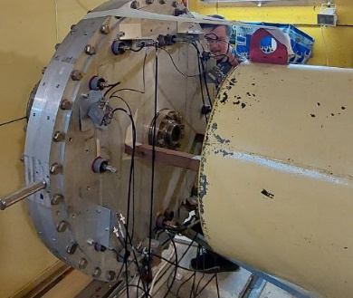
YuMO Small Angle Scattering Spectrometer
For structural studies of biological objects and nanosystems
Upgrade of Direct Beam Detector
New B¹⁰ converter with sensitive area Ø=80 mm, h=200 μm
Methodical experiments and works were performed:
The instrument electronics commissioning after instrument long shutdown;
Implementation of upgraded Direct Beam Detector;
The collimator system and chopper adjustment;
Tests of the new electronics for the Position Sensitive Detector.
In addition, scientific experiments in the framework of internal research programme as well as fast proposal experiments were done.
Testing of new data acquisition electronics for YuMO PSD Detector
Chopper and Collimators adjustment for optimization of neutron wavelength range

Slide 11
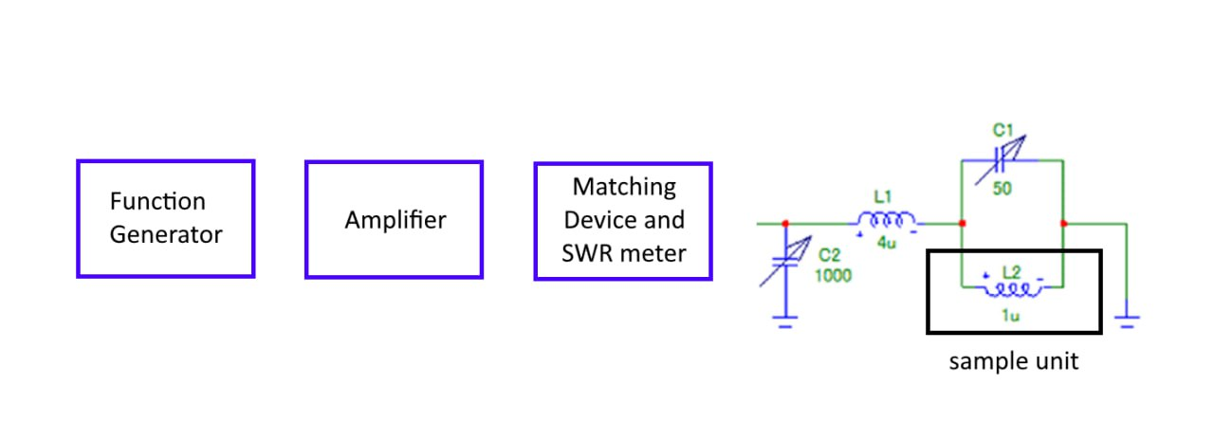
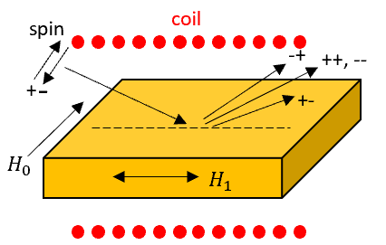
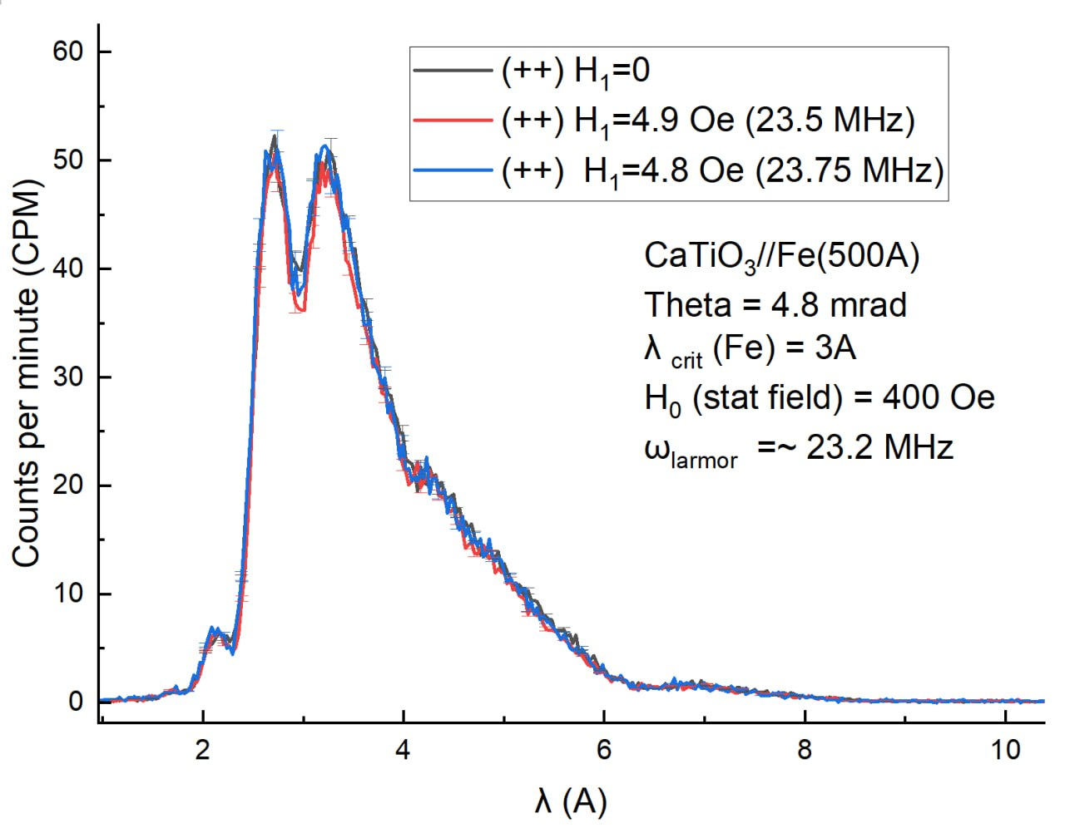
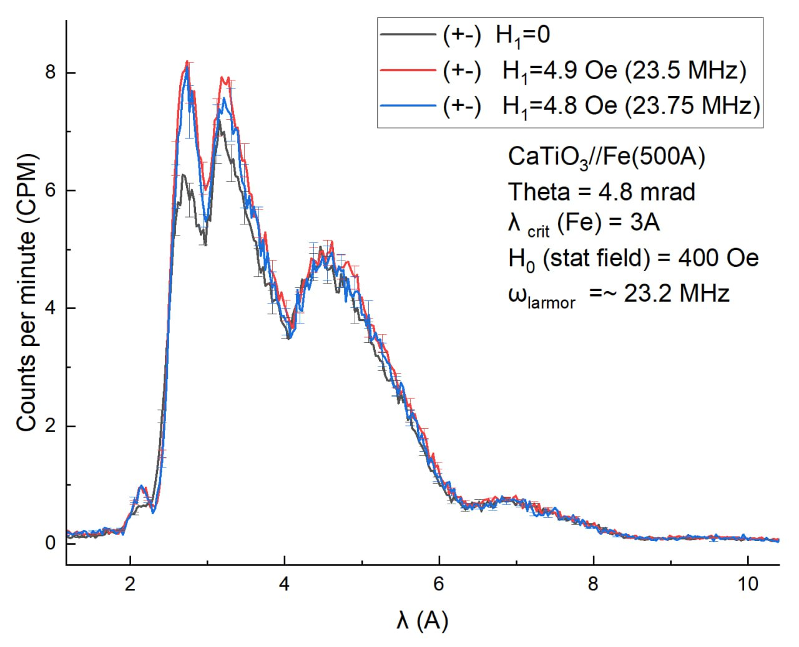

REMUR Reflectometer with Polarized Neutrons
For studies of magnetic and structural properties of layered nanostructures and thin films
The new prototype system for reflectometric studies in static and oscillating magnetic fields was manufactured and tested.
The neutron reflection spectra in static and oscillating fields for a model ferromagnetic sample were measured.
Neutron spectra obtained with the new module for Fe(500 Å)//CaTiO3 nanostructure.
Influence of RF magnetic field

Slide 12






REFLEX Reflectometer with Polarized Neutrons
For studies of structural and magnetic properties of thin films and layered nanostructures
Methodical experiments and works were performed
Direct beam measurements
Polarization measurements
Calibration measurements with a reference sample [Ni(84Å)Ti(70Å)]x4/Si
Test measurements of detection system ¹⁰B-RPC + digitizer СAEN N6730
¹⁰B - RPC
³He-MWPC
Two beam profiles obtained by the prototype and the ³He-MWPC are compared:
- bin size of prototype 0.16 mm
- bin size of ³He-MWPC 1.24 mm
Operating characteristics were determined:
- efficiency 1.88 %
- time resolution 2.6 ns
- spatial resolution 1.46 mm
Direct beam profile measurement by two types of detectors
Time resolution is the standard deviation of the sum of the arrival times of signals at both ends of the delay line
Spatial resolution determination by shifting of the cadmium slit

Slide 13




GRAINS Reflectometer
For structural studies of soft and liquid interfaces
Methodical experiments and works were performed
Optimization of chopper mode
Calibration measurements: [Ni_{0.9}Mo_{0.1} 6 nm/Ti 6 nm]₈ /float glass
Studies of thin silicate films doped with Pt/Pd nanoparticles
Collaboration with IMC PNPI NRC KI, St.-Petersburg
Z
d = 37±2 nm
σ = 2.1±0.3 nm
TOF

Slide 14


NERA Inelastic Neutron Scattering Spectrometer in Inverted Geometry
For studies of vibrational dynamics of materials
Studies of vibrational dynamics of ibuprofen and ketoprofen were performed
Spectra of inelastic neutron scattering of ketoprofen (C₁₆H₁₄O₃) measured on NERA spectrometer at temperatures of 5K, 25K, 50K, 100K, 150K and 200K in the form of dynamical susceptibility χ"(ω).
χ”(ω) = S(ω)*(1 – exp(-ω/k_{B}T))

Slide 15










Spectrometer for Neutron Radiography and Tomography
Studies of cultural heritage objects were performed (in cooperaton with IA RAS)
Photo of the spearhead, 3D model and longitudinal section reconstructed from the neutron tomography data (dated to VI - II century BC, Greek urban necropolis Volna-1, Taman peninsula)
Notes:
После запуска реактора ИБР-2, установка НРТ работает в штатном режиме. Продолжаются исследования объектов культурного наследия с различных археологических раскопок Российской Федерации. В качестве примера приводятся результаты нейтронной томографии навершия копья, обнаруженном на могильнике Волна-1 (пос. Волна, Темрюкский район Краснодарского края), принадлежавшем древнегреческому и местному населению Тамани VI–II вв. до н. э. Это один из наиболее исследованных некрополей античного мира эпохи архаики и классики. Представлены фотография навершия (острия) копья, восстановленная из данных нейтронной томографии 3Д модель и продольный срез этой модели.

Slide 16
Thank You for Your Attention!

