Slide 1
MAGNETISM AND SUPERCONDUCTIVITY IN PERIODIC AND QUASI-PERIODIC LOW-DIMENSIONAL LAYERED SYSTEMS
Zhaketov V.^{1,2,3,*},
Zaky A. Zaky E.^{1,4}, Norov D.^{1,5}, Dubkova E.³, Sadradze R.³, Kopytov G.⁶,
Kolupaev E.D.^{1,5}, Devyaterikov D.I.⁷, Chernikov A.N.¹, Kravtsov E.A.⁷, Nikitenko Yu.V.¹
¹ Joint Institute for Nuclear Research, Dubna, Russia
² Moscow Institute of Physics and Technology, Dolgoprudny, Russia
³ Dubna State University, Dubna, Russia
⁴ Beni-Suef University, Egypt
⁵ Lomonosov Moscow State University, Moscow, Russia
⁶ Tomsk Polithechnic University, Tomsk, Russia
⁷ M.N. Mikheev Institute of Metal Physics of Ural Branch of RAS, Ekaterinburg, Russia
* zhaketov@nf.jinr.ru
61st meeting of the PAC for Condensed Matter Physics,
Dubna, June 26, 2025

Slide 2
OUTLINE
Polarized neutron reflectometry
Secondary radiation registration
Enhanced neutron wave field
Periodic supelattice
Fibonacci layered systems

Slide 3
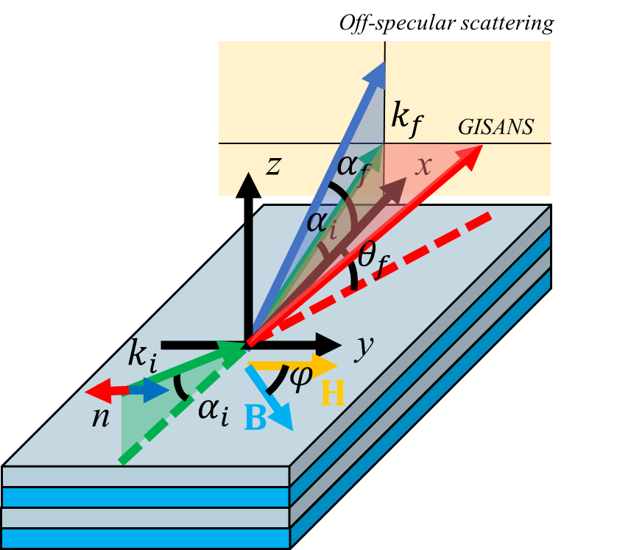
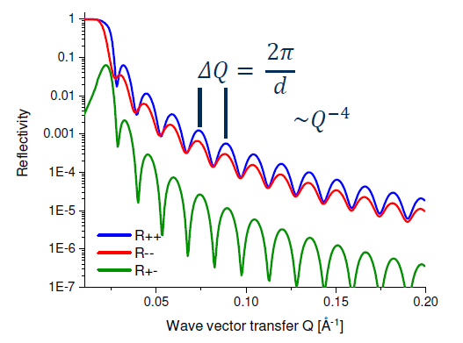


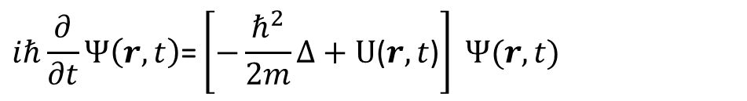
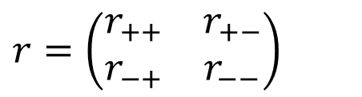
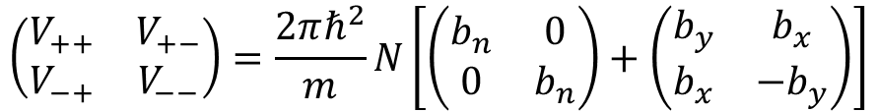


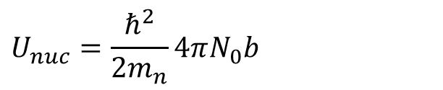
POLARIZED NEUTRON REFLECTOMETRY
$$i\text{ℏ}\frac{∂}{∂t}Ψ\left(r,t\right)\text{=}\left[−\frac{{\text{ℏ}}^{2}}{2m}Δ+\text{U}\text{(}r,t\text{)}\right] Ψ(r,t)$$
$$\left(−\frac{∂^{2}}{{∂x}^{2}}+u_{0}θ\left(x>0\right)+2σBθ\left(x>0\right)−k^{2}\right)\left|\left.Ψ\left(x\right)\right\rangle \right.=0$$
$$U_{nuc}=\frac{{\text{ℏ}}^{2}}{2m_{n}}4πN_{0}b$$
$$U=U_{nuc}+U_{mag}$$
$$U_{mag}=−μB=\left|μ_{n}\right|σB$$
$$r=\left(\begin{matrix}r_{++} & r_{+−} \\ r_{−+} & r_{−−}\end{matrix}\right)$$
$$\left(\begin{matrix}V_{++} & V_{+−} \\ V_{−+} & V_{−−}\end{matrix}\right)=\frac{2πℏ^{2}}{m}N\left[\left(\begin{matrix}b_{n} & 0 \\ 0 & b_{n}\end{matrix}\right)+\left(\begin{matrix}b_{y} & b_{x} \\ b_{x} & −b_{y}\end{matrix}\right)\right]$$
$$R^{±±}\sim SLD(z)±B\left(z\right)cos⁡[φ(z)]$$
$$R^{+−}\sim B\left(z\right)sin⁡[φ(z)]$$
3 / 28

Slide 4


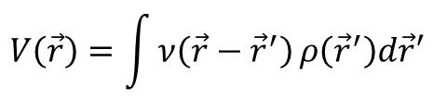


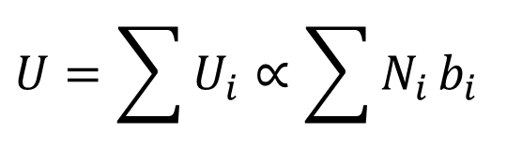
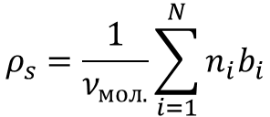






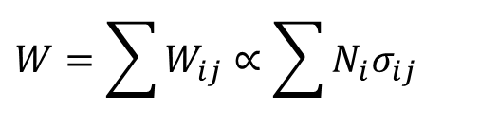
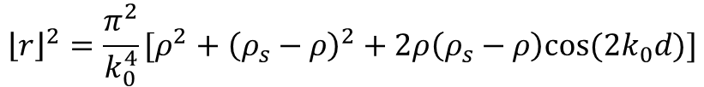


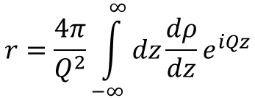
POTENTIAL OF INTERACTION OF NEUTRON WITH MEDIA AT PNR
The determined potential is
the sum for all isotopes
$$V\left(\vec{r}\right)=\int{ν\left(\vec{r}−{\vec{r}}^{′}\right)}ρ\left({\vec{r}}^{′}\right)d\vec{r}′$$
$$U=\sum{U_{i}}∝\sum{N_{i}}b_{i}$$
$$V\left(\vec{r}\right)=\frac{2πℏ}{m_{n}}bδ(\vec{r})$$
$$θ_{0}$$
$$θ_{1}$$
$$ρ_{s}=\frac{1}{ν_{мол.}}\sum_{i=1}^{N}{n_{i}b_{i}}$$
$$r=\frac{4π}{Q^{2}}\int_{−∞}^{∞}{dz\frac{dρ}{dz}e^{iQz}}$$
Experiment geometry
$${\left\lfloor r\right\rfloor }^{2}=\frac{π^{2}}{k_{0}^{4}}[ρ^{2}+{\left(ρ_{s}−ρ\right)}^{2}+2ρ\left(ρ_{s}−ρ\right)cos⁡(2k_{0}d)]$$
$$U$$
$$N_{1}\left(z\right)−?$$
$$N_{2}\left(z\right)−?$$
$$J\left(z\right)−?$$
$$U=U_{nuc}+U_{mag}$$
Possible to use spin-flip signal or products of neutron absobtion to get signal from separate element (isotopes)
F
S
$$U_{nuc}=V−iW$$
$$W={10}^{−5}÷{10}^{−3}\text{​ }V$$
$$z$$
But we need
increase signal
$$W=\sum{W_{ij}}∝\sum{N_{i}σ_{ij}}$$
$$ΔU(z)⇔ΔN_{i}(z) ?$$
4 / 28

Slide 5


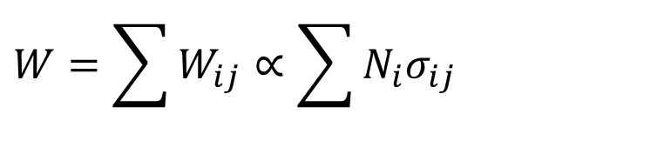


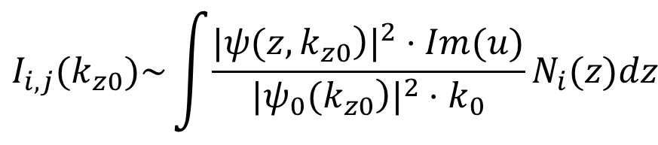
REGISTRATION OF SECONDARY RADIATION
$$W=\sum{W_{ij}}∝\sum{N_{i}σ_{ij}}$$
detector of secondary radiation
i – isotope, j – type of secondary radiation
Neutron
detector
$$n$$
Сharacteristic secondary radiation
Charged particles (n, α); (n, t); (n, p)
Gamma-quanta (n, γ)
Fission fragments (n, f)
sample
Some secondary processes
Spin-flip neutrons
Noncoherent scattered neutrons by nuclei
Inelastically scattered neutrons
Diffusely scattered neutrons on medium inhomogeneities
    $$I_{i,j}(k_{z0})\sim \int{\frac{{|\left.ψ(z,k_{z0}\right)|}^{2}⋅Im(u)}{{|\left.ψ_{0}(k_{z0}\right)|}^{2}⋅k_{0}}}N_{i}(z)dz$$
$$Im\left(b\right)=\frac{σ(λ)}{2∙λ}$$
$$λ↑$$
$$σ(λ)↑$$
$$Im\left(b\right)=const$$
Registration of secondary radiation in neutron reflectometry makes it possible to determine the isotopic profiles of elements.
Aksenov V.L. et al. // Physics of Particles and Nuclei, Vol. 54, No.4, pp. 756-775 (2023)
Zhaketov V.D. et al. // Journal of Surface Investigations, vol. 15, no. 3, pp. 549-562 (2021)
Zhaketov V.D. et al. // Journal of Surface Investigations, vol. 13, no. 3, pp. 478-487 (2019)
5 / 32
5 / 28

Slide 6

Wave function calculation
i-layer
r'
r''
t'
surface
X
substrate
Calculation of each i-layer:
each $i$ - layer, divide at $N_{i}$ points, with step $∆z$
$$Ψ(0<x<d)=[(exp(ik^{′}(x−d))+exp(−ik^{′}(x−d))⋅r^{″}]⋅X$$
$$X=exp(ik^{′}d)⋅t^{′}+exp(ik^{′}d)⋅r^{′}⋅exp(ik^{′}d)⋅r^{″}⋅X$$
$$X={\left(I_{0}−exp(ik^{′}d)⋅r^{′}⋅exp(ik^{′}d)⋅r^{″}\right)}^{−1}⋅exp(ik^{′}d)⋅t^{′}$$
Let us now consider in more detail the calculation of the coefficients ${ r}^{″}$, $r^{′}$, $t^{′}$
6 / 32
6 / 28

Slide 7


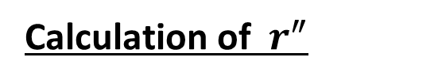
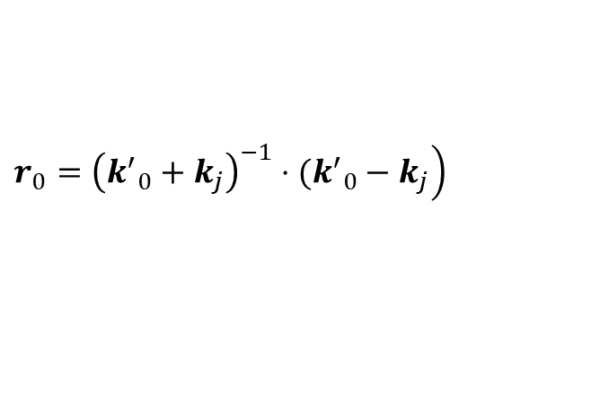
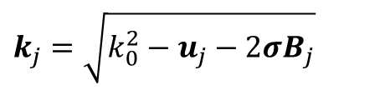
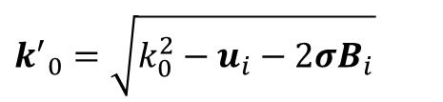
Calculation of ${ r}^{″}$
i-layer
r'
r''
t'
1
2
3
…
surface
X
substrate
How calculate $r^{″}$: set first layer – layer i+1, second i+2 etc., “substrate” – the real substrate of the sample, recurrently calculate the reflection coefficient for such a structure, in the calculations I consider that a neutron falls on the structure from a medium with a potential $u_{i}$
$$k_{j}=\sqrt{k_{0}^{2}−u_{j}−2σB_{j}}$$
For each layer:
- wave-vector at media
$$r_{j}=r_{0}−{t^{′}}_{0}⋅exp(ik_{j}d)⋅r_{0}⋅{\left(I_{0}−exp(ik_{j}d)⋅r_{0}⋅exp(ik_{j}d)⋅r_{0}\right)}^{−1}⋅exp(ik_{j}d)⋅t_{0}$$
- reflection amplitude from layer
$$t_{j}={t^{′}}_{0}⋅{\left(I_{0}−exp(ik_{j}d)⋅r_{0}⋅exp(ik_{j}d)⋅r_{0}\right)}^{−1}⋅exp(ik_{j}d)⋅t_{0}$$
- transmission amplitude
where
$$\left.r_{0}={\left({k^{′}}_{0}+k_{j}\right)}^{−1}⋅({k^{′}}_{0}−k_{j}\right)$$
$$t_{0}={\left({k^{′}}_{0}+k_{j}\right)}^{−1}⋅2⋅{k^{′}}_{0}$$
$${t^{′}}_{0}={\left({k^{′}}_{0}+k_{j}\right)}^{−1}⋅2⋅k_{j}$$
$${k^{′}}_{0}=\sqrt{k_{0}^{2}−u_{i}−2σB_{i}}$$
7 / 32
Further recursive calculation :
$$R_{j,j−1}=r_{j}+t_{j}⋅r_{j−1}⋅{\left(I_{0}−r_{j}⋅r_{j−1}\right)}^{−1}⋅t_{j}$$
7 / 28

Slide 8
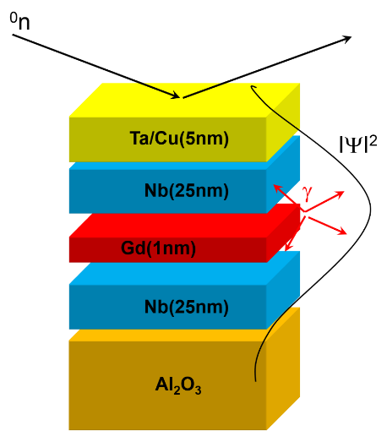
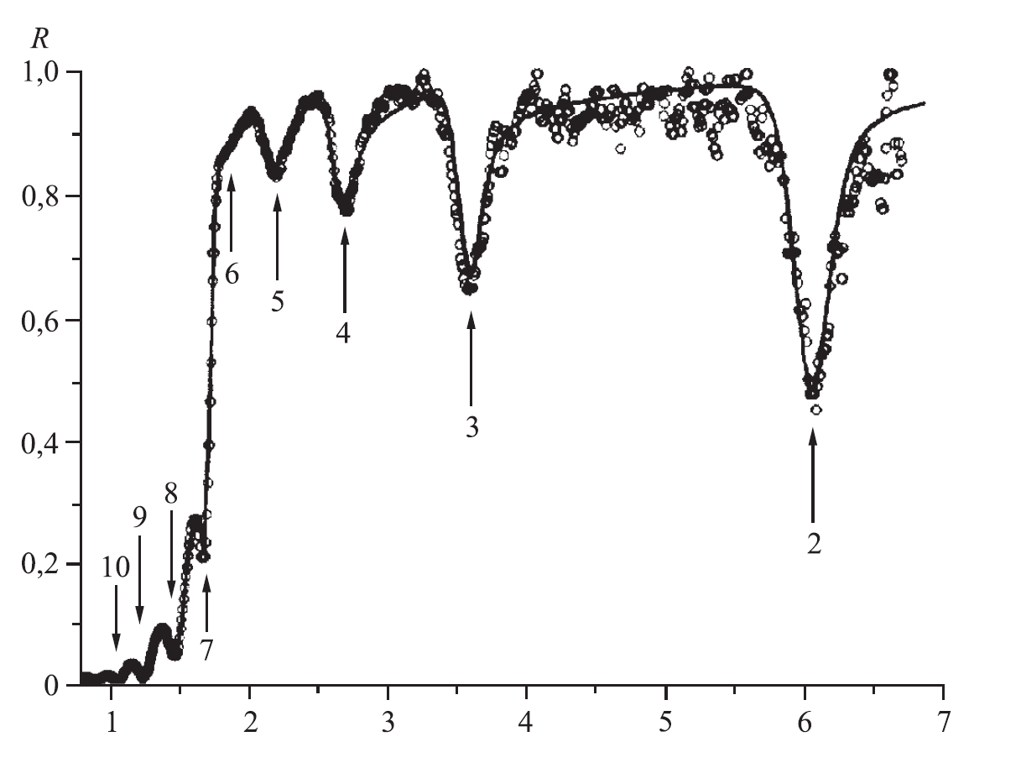





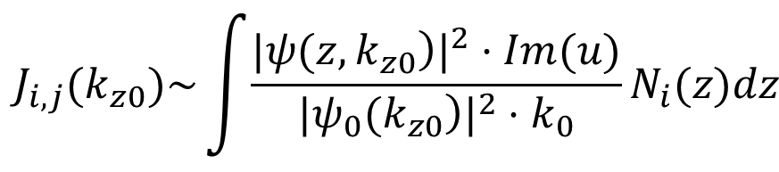

NEUTRON RESONATORS
$${\left|ψ\right|}^{2}$$
$$k_{Res_0}$$
$${\left|ψ(z,k)\right|}^{2}={\left|ψ_{d}(z,k)+ψ_{b}(z,k)\right|}^{2}$$
$$k_{Res_1}$$
$$γ\left(k_{0z}\right)=2k_{2z}d+\arg\left(R_{21}\right)+\arg\left(R_{23}\right)=2πn$$
$$η_{max}(nucl. density)≈{10}^{5}$$
$$k_{Res_2}$$
S
F
n
$$z$$
$$W={10}^{−5}÷{10}^{−3}\text{​ }V$$
Possible strong
signal enhancement
Secondary radiation calculation:
    $$J_{i,j}(k_{z0})\sim \int{\frac{{|\left.ψ(z,k_{z0}\right)|}^{2}⋅Im(u)}{{|\left.ψ_{0}(k_{z0}\right)|}^{2}⋅k_{0}}}N_{i}(z)dz$$
⁶$LiF(19nm)/Ti(200nm)/Cu(100nm)/glass$
8 / 32
8 / 28
V.L. Aksenov et al. // Physica B 276-278 (2000) 946-947.

Slide 9
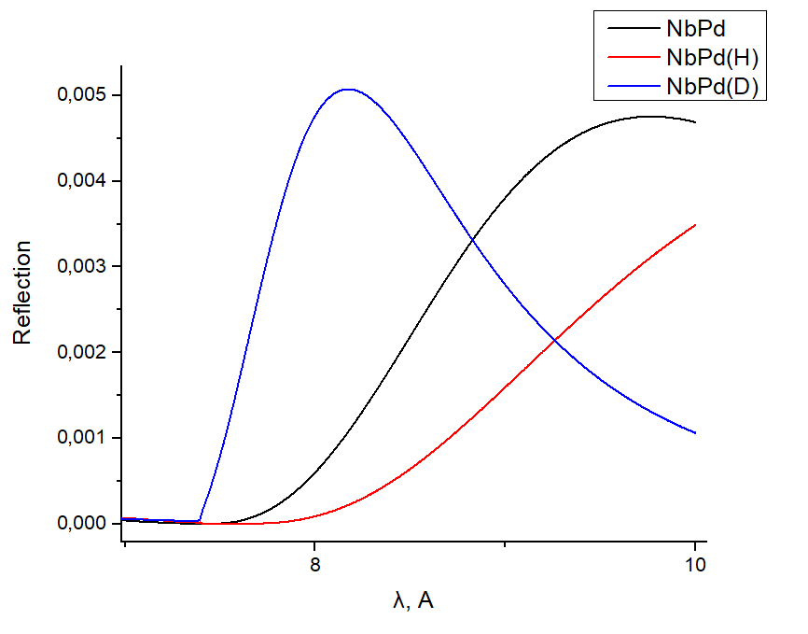
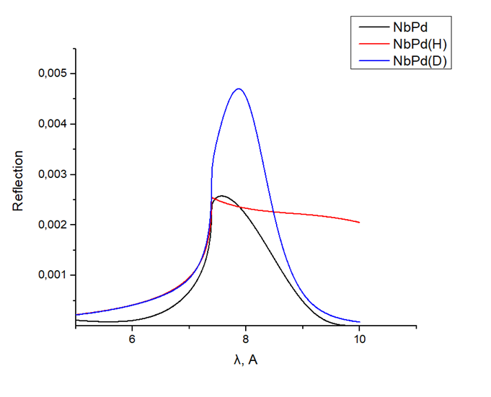
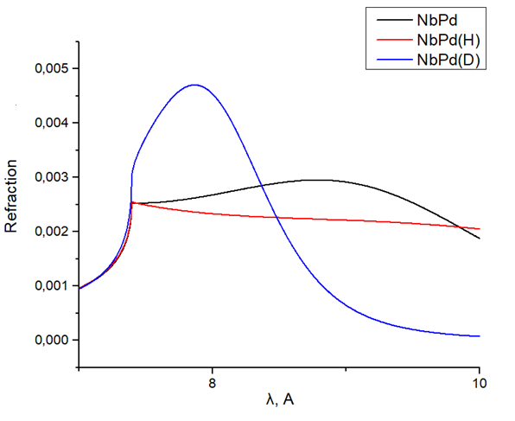
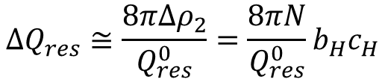
RESONANCE NEUTRON REFLECTOMETRY FOR HYDROGEN DETECTION (THROUGH SPIN-FLIP)
Middle of the structure
Secondary radiation
Surface of the structure
Secondary radiation
On substrate
Secondary radiation
$$\arg\left(r_{21}\right)+\arg\left(r_{23}\right)+2Re\left(k_{2}\right)d_{2}=2πn$$
$$ΔQ_{res}≅\frac{8πΔρ_{2}}{Q_{res}^{0}}=\frac{8πN}{Q_{res}^{0}}b_{H}c_{H}$$
L. Guasco, Yu.N. Khaydukov, S. Pütter, L. Silvi, M.A. Paulin, T. Keller, B. Keimer // Nature Communications, Vol. 13, No. 1, pp. 1-8 (2022)

Slide 10

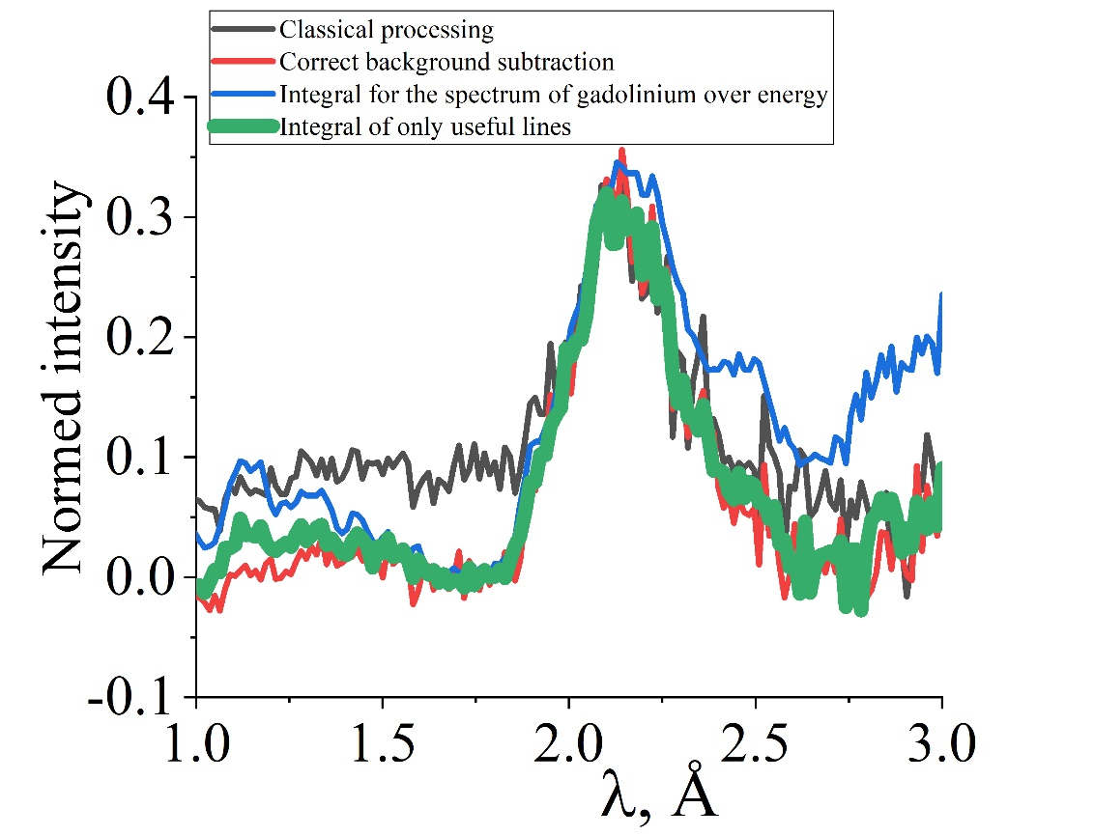
GAMMA RADIATION SIGNAL FROM AN ULTRATHIN LAYER OF GADOLINIUM
A gamma radiation signal was obtained from an ultrathin (1 nm) layer of gadolinium placed in a neutron resonator. The mass of gadolinium used in the experiment (3 micrograms) is 25 times less than in the previous experiment (Zhang et al., PRL 72 (1994)).
The work was performed on the REMUR spectrometer (IBR-2, Dubna) in collaboration with colleagues from JINR (Dubna), IPM RAS (Yekaterinburg), and MPI FKF (Stuttgart)
10 / 28
Khaydukov Yu.N. et al. // Physics of Particles and Nuclei Letters, Vol. 21, No. 5, pp. 1065-1068 (2024)

Slide 11
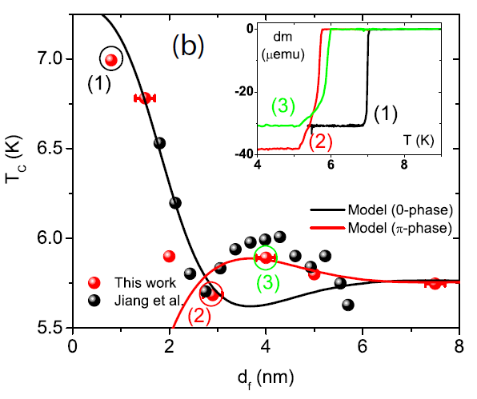
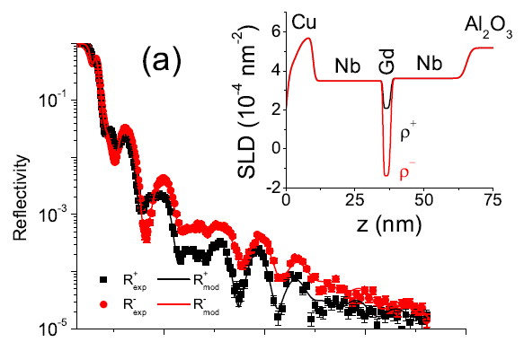
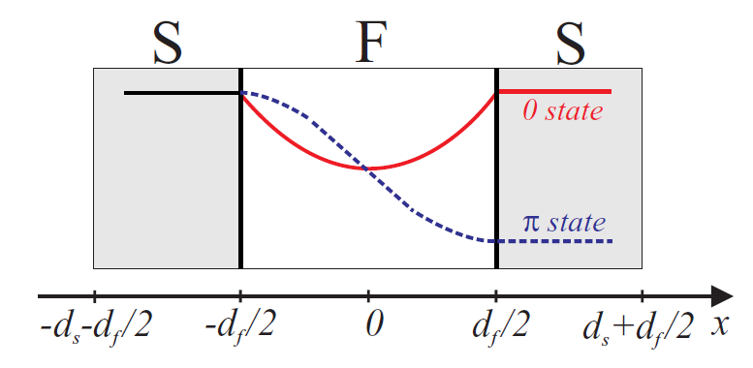






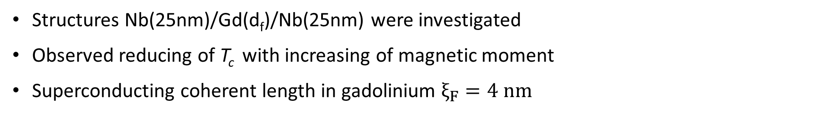

EFFECT OF MAGNETISM ON SUPERCONDUCTIVITY IN NB/GD/NB TRILAYERS
Structures Nb(25nm)/Gd(d_{f})/Nb(25nm) were investigated
Observed reducing of T_{c} with increasing of magnetic moment
Superconducting coherent length in gadolinium $ξ_{F}=4 nm$
$$T_{c}\sim M_{F}^{−1}$$
$$M_{F}=d_{F}∙B_{F}$$
$$T=6.2 К$$
$$H=4 кЭ$$
Dependance $T_{c}=f(d_{f})$
$$ξ_{F}=4 nm$$
Q(nm⁻¹)
$$d_{F}<ξ_{F}$$
11 / 28
Khaydukov Yu.N. et al. // Phys. Rev. B, 97, 144511 (2018)

Slide 12
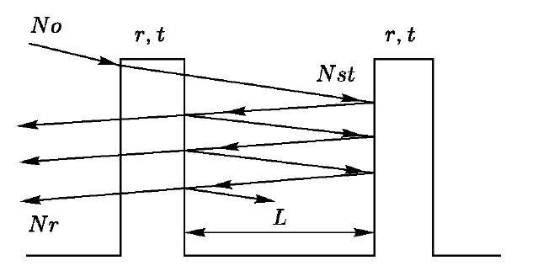
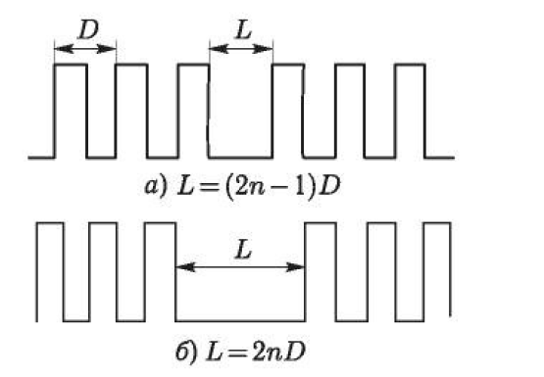
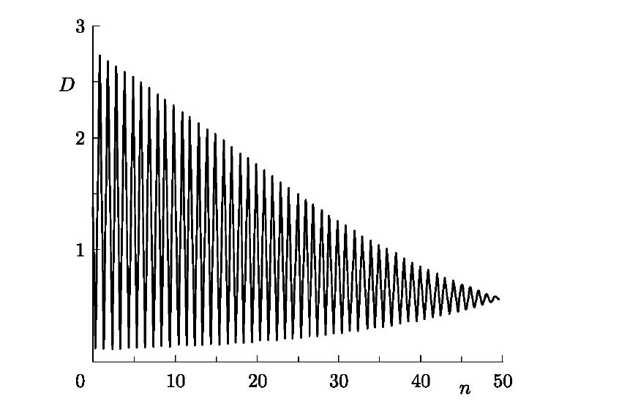
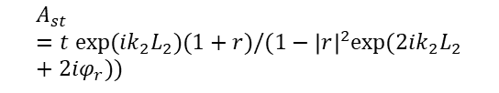

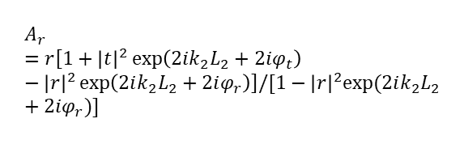
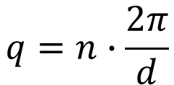

PERIODIC SUPERLATTICES
Bragg peaks
Wolfe-Bragg Law :
$$q=n∙\frac{2π}{d}$$
$$nλ=2d∙sin θ$$
$$n=1, 2, 3 …$$
Keising
oscillations
SLD
Fe
Fe
Fe
$$A_{r}=r\left[1+{\left|t\right|}^{2}\exp\left(2ik_{2}L_{2}+2iφ_{t}\right)−{\left|r\right|}^{2}\exp\left(2ik_{2}L_{2}+2iφ_{r}\right)\right]/[1−{\left|r\right|}^{2}exp⁡(2ik_{2}L_{2}+2iφ_{r})]$$
}
Cr
Cr
Si substrate
Cr
•••
$$A_{st}=t exp⁡(ik_{2}L_{2})(1+r)/(1−{\left|r\right|}^{2}exp⁡(2ik_{2}L_{2}+2iφ_{r}))$$
Bilayer thickness d
d = 32.8 Å + 30 Å = 62.8 Å
Total: 20 bilayers
12 / 28

Slide 13
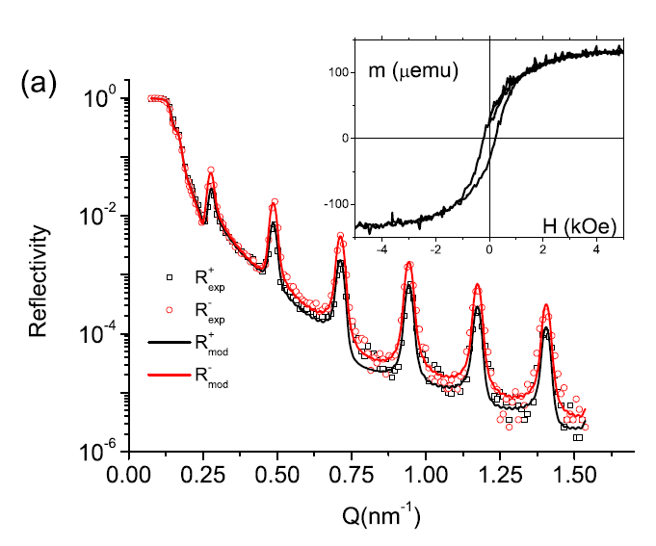
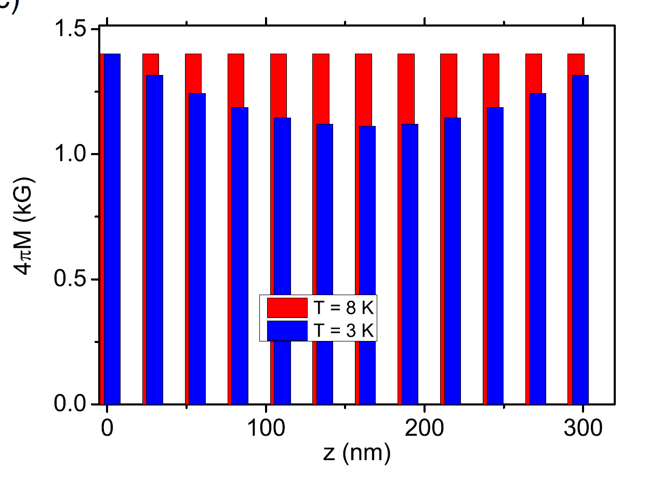



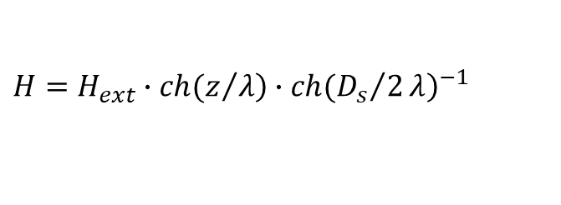

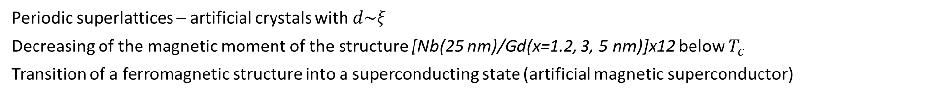





DIAMAGNETISM OF PERIODIC FERROMAGNETIC-SUPERCONDUCTING STRUCTURE
Periodic superlattices – artificial crystals with $d\sim ξ$
Decreasing of the magnetic moment of the structure [Nb(25 nm)/Gd(x=1.2, 3, 5 nm)]х12 below $T_{c}$
Transition of a ferromagnetic structure into a superconducting state (artificial magnetic superconductor)
$$H=H_{ext}∙\left.ch(z/λ\right)∙{\left.ch({D_{s}}/2λ\right)}^{−1}$$
$$d_{f}=3 nm$$
$λ=180±10 nm$ > $λ(Nb)=120 nm$
$$T=7 К, H=4.5 kOe$$
Gd($d_{f}$)
Nb(25nm)
x 12
$$S=\frac{R_{+}−R_{−}}{R_{+}+R_{−}}\sim M$$
Al₂O₃
$$H=661 Oe$$
$$n∙λ=2∙d∙\sin{θ}$$
$$λ↑$$
$$θ↑$$
$$d\sim ξ$$
Results of experimental data fitting
13 / 28
Khaydukov Yu.N. et al. // Phys. Rev. B, 99, 140503 (2019)

Slide 14
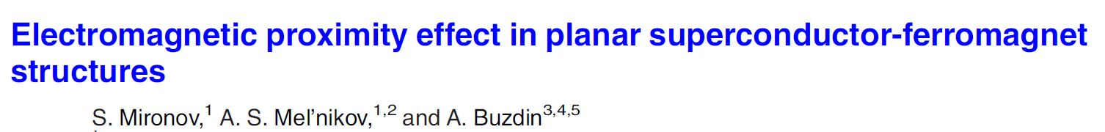
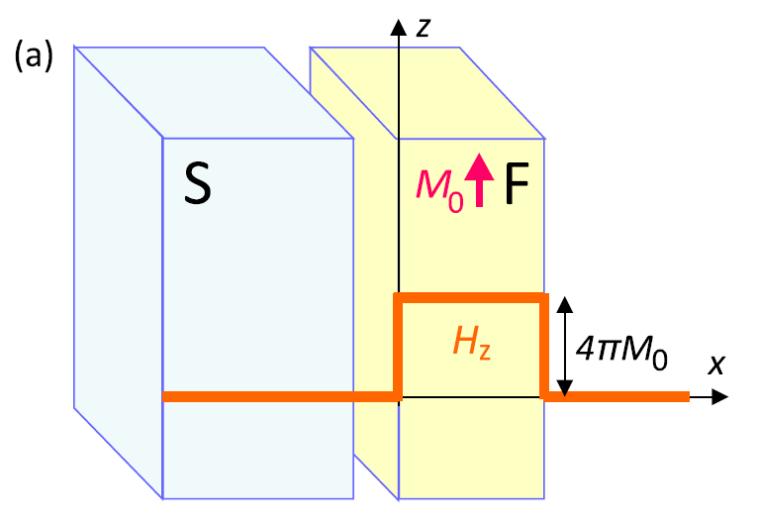
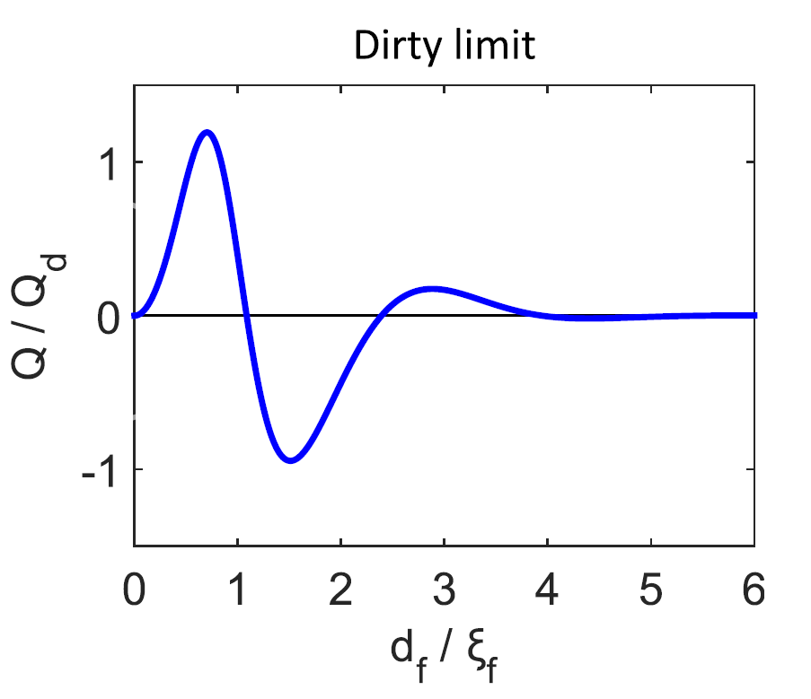
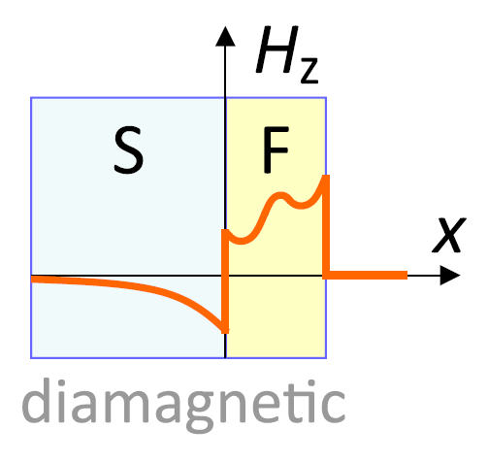
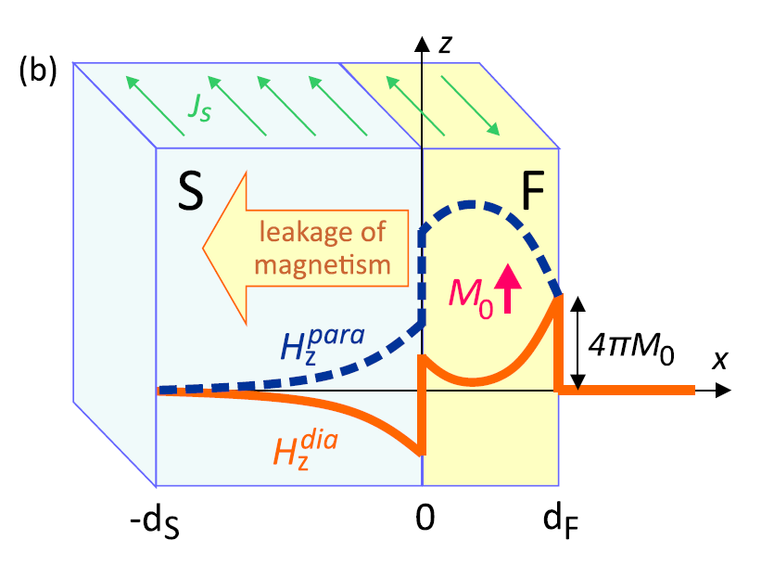
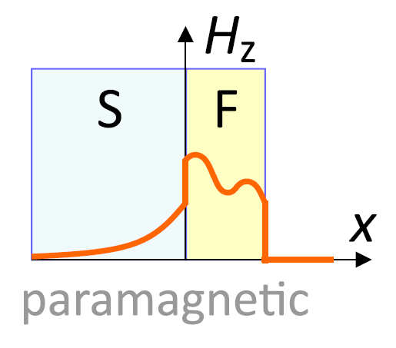



ELECTROMAGNETIC PROXIMITY EFFECT
Recently, a new proximity effect has been described in ferromagnetic-superconducting layered nanostructures, which is characterized by a large scale (10 nm) of the interaction of superconductivity and magnetism, and which takes place for any ferromagnets.
Giant electromagnetic proximity effect in
superconductor/ferromagnet superlattices
A.V. Putilov, S.V. Mironov, A.S. Mel’nikov, A.I. Buzdin
2018
Appl. Phys. Lett. 113, 022601 (2018)
Phys. Rev. B 105, 064510
2022
$$rot rot A= \frac{4π}{c}(j_{s}+j_{m})$$
$$B_{z}\sim −4πM_{0}exp⁡(x/λ_{0})$$
$$B_{xn}\left(x\right)\sim \frac{M_{0}}{n}\sin\left(n\right)exp⁡(−n)$$

Slide 15
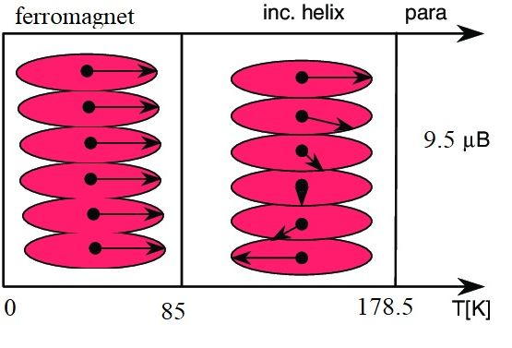
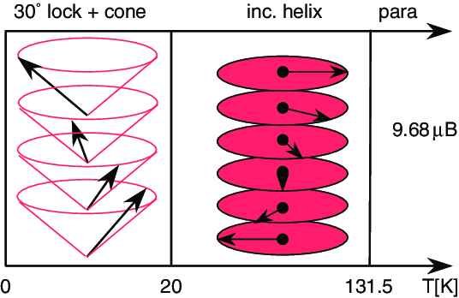
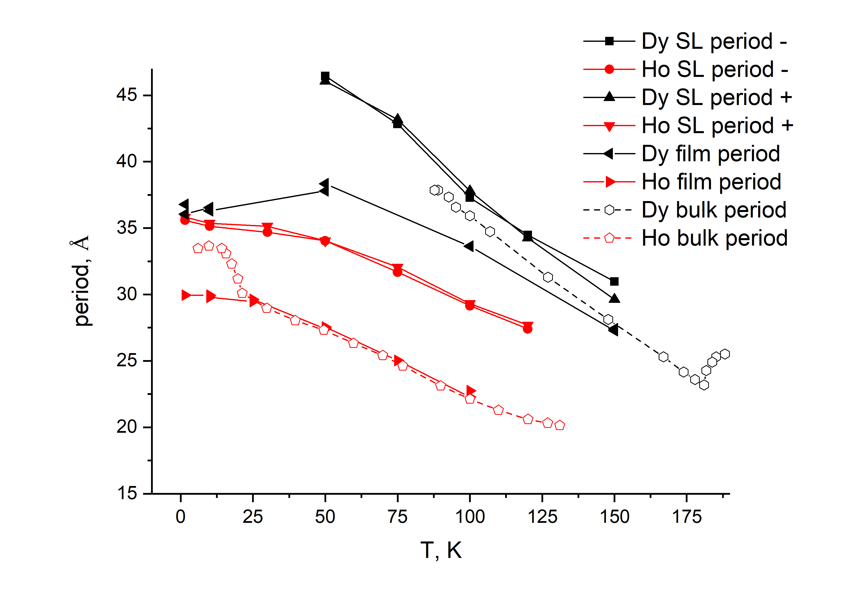
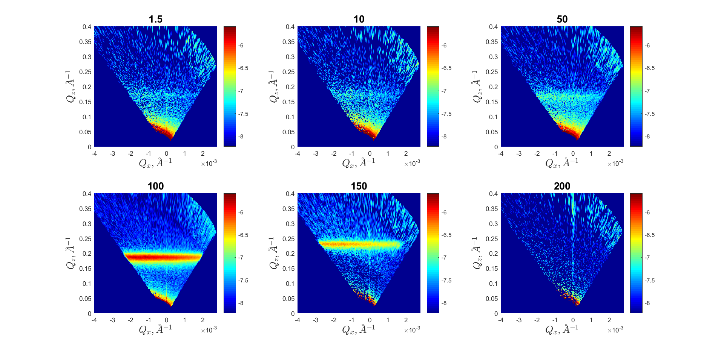



FURTHER PERSPECTIVE – RARE EARTH METALS DYSPROSIUM AND HOLMIUM
Investigated structures:
1) Dy (2000 Å)
2) Ho (2000 Å)
3) [Dy (60 Å)/Ho (60 Å)]×34
Dy
Ho
T=
T=
[Dy (60 Å)/Ho (60 Å)]×34
Dy (2000 Å)
Dy (2000 Å)
Ho
Dy
Systems with nontrivial magnetic ordering are promising for studies of proximity effects, since they have low phase transition temperatures
Devyaterikov D.I. et al. // Journal of Surface Investigations, Vol. 16, No. 5, pp. 839-842 (2022)
Devyaterikov D.I. et al. // Physics of Metals and Metallography, Vol. 122, No. 5, pp. 465-471 (2021)
15 / 28

Slide 16





NEUTRON REFLECTIVITY FOR HELICOID
Mz
Dy / Ho
60A
z
R++ for an incoherent spiral
R++ for coherent spiral (6 layers)
R++ for an incoherent fan
R++ for coherent fan

Slide 17






EXPERIMENT AT CSNS
Proposal # P0224072800043 at CSNS. 18-22 December 2024
Samples: Al₂O₃ // [Nb(250Å)/RE(d_{F})]x12/ Nb(50Å), RE=Dy,Ho, d_{F} =2,4,6 nm
17 / 28

Slide 18


CRYSTAL
QUASICRYSTAL
DISORDERED MEDIA
(Penrouz mosaic)
Long range order
Periodicity
Long range order
Periodicity
Long range order
Periodicity
→ Quasicrystals are non-periodic but deterministic
→ Quasicrystals have long-range order and Bragg diffraction is possible
Electron diffraction patterns of the icosahedral phase Al_{69.5}Pd₂₁Mn_{9.5}:
(a) along the axis of symmetry of the second order,
(b) along the third order symmetry axis,
Vekilov Yu.Kh., Chernikov M.A. Quasicrystals //
// Physics–Uspekhi, volume 180, no. 6 (2010).
18 / 28

Slide 19








LAYERED QUASIPERIODIC SYSTEMS (FIBONACCI)
$F\left(k\right)=\lim_{N→∞}{N^{−1}\sum_{z_{n}}{exp(ikz_{n})}}$
$N$ – number of layers,
$z_{n}$ – spatial position of layers,
$k$ – wave-vector.
B
A
$$Q_{hh′}=\frac{2π}{L_{B}}\frac{τ^{2}}{τ^{2}+1}\left(h+\frac{h^{′}}{τ}\right)$$
$$\left[−\frac{d^{2}}{{dz}^{2}}−q^{2}\right]E\left(z\right)=2q\sum_{G}{exp⁡(iG∙z)P_{G}E(z)}$$
$$A→B$$
Periodic structure:
BABABABABABA…
Disordered structure:
BBBABABAABAAA
Quasiperiodic structure:
BABBABABBABBABABBABAB
$$B→BA$$
$S_{0}=A$,
$S_{1}=B$,
$S_{2}=BA$,
$S_{3}=BAB$,
$S_{4}=BABBA$,
$S_{5}=BABBABAB$,
$S_{6}=BABBABABBABBA$,
$S_{7}=$BABBABABBABBABABBABAB
The figure shows: the quasiperiodic structure obtained for the Fibonacci series member $S_{7}$; periodic structure; and an disordered structure obtained using a random number generator.
This talk about system like one-dimentional Penrose mosaic
19 / 28

Slide 20





PHOTOLUMICESCENCE AT PHOTONIC CRYSTAL
Razdolski, T. Murzina, O. Aktsipetrov et al . // arXiv:0902.2644v1
Z. Valy Vardeny et al. // Nature Photonics, Vol. 7, pp. 177-187 (2013)
P. Vinogradov, Yu. E. Lozovik, A. M. Merzlikin. // PHYSICAL REVIEW B 80, 235106, 2009

Slide 21











MODELING OF TECHNICAL ERRORS DURING SPUTTERING
thickness deviations
skip random layer
roughness
$$C_{mn}\left(q_{x},q_{z}\right)=\frac{2∙σ_{0}^{2}∙ξ_{mn}}{{(q_{z}^{2}∙σ_{0}^{2}+1)}^{2}+{(q_{x}{∙ξ}_{0})}^{2}}$$
$$ξ_{mn}=ξ_{0}∙\exp\left[−\frac{\left|m−n\right|}{Λ_{0}}\right]$$
Конформные шероховатости
Некореллированные шероховатости
$$С_{mn}(ρ)≠0$$
$$Λ_{0}≠0$$
$$С_{mn}\left(ρ\right)=0$$
$$Λ_{0}=0$$

Slide 22



SUPERCONDUCTIVITY OF QUASICRYSTALS
Work describes the observation of a superconducting transition in a bulk Al-Zn-Mg quasicrystal at a temperature Tc<0.05 K. Thus, the authors showed the possibility of the existence of superconducting correlations in quasi-ordered systems, and called this type of superconductivity “fractal”.
Kamiya K. et al. // Nature Communications, 9:154 (2018)
Shiro Sakai, Nayuta Takemori, Akihisa Koga, and Ryotaro Arita //
PHYSICAL REVIEW B 95, 024509 (2017)

Slide 23


FAR MAGNETIC ORDERING AT QUASICRYSTALS
Speaking about the magnetic behavior in a number of quasicrystals, a spin glass state was observed, but in it was shown that “exotic” long-range magnetic order is possible in Au–Ga–Gd and Au–Ga–Tb quasicrystals. At the same time, the characteristic Curie temperatures for these materials are relatively low TCurie<25 K.
Ryuji Tamura et al. // J. Am. Chem. Soc. 2021, 143, 19938−19944

Slide 24





NEUTRON REFLECTIVITY FOR QUASIPERIODIC LAYERED SYSTEM
In figure shown the neutron reflectivity for quasiperiodic, periodic and disordered layered structures. The calculation is given for a layered structure of the Gd(2 nm)/Nb(25 nm) type. A calculation is presented for a quasiperiodic structure of the Fibonacci order F₉; this structure is characterized by 34 layers of Gd, which is the optimal value for deposition of the structure. The calculations took into account that the total thickness of gadolinium and niobium was the same for all three types of structures. It is shown that for a disordered structure no equidistant peaks are observed, while characteristic Bragg peaks for a periodic structure are visible. For a quasi-periodic structure, more pronounced “quasi-Bragg” peaks are observed.
Square under peak
Fibonacci order
In figure shown calculations of the neutron reflectivity for a layered quasiperiodic structure of the Gd(2 nm)/Nb(25 nm) type; a similar periodic system was studied in [7]. Calculated dependencies for various Fibonacci orders are shown. The thickness of the ferromagnetic layer is equal to half the correlation length of superconductivity in gadolinium $d\left(Gd\right)=0.5{∙ξ}_{F}\left(Gd\right)=0.5∙4nm=2nm$. The grazing angle of the neutron beam on the sample is 5 mrad. Magnetic induction in this calculation was assumed to be zero. In the calculations, it was assumed that the structure was deposited on a sapphire substrate. It can be seen that the neutron reflectivity ceases to change, starting from the Fibonacci order F₁₀.
Quasicrystall
Periodic structure
Random
24 / 28

Slide 25



CRYOSTATE WITH HTSC MAGNET FOR REMUR REFLECTOMETER
@ A.N. Chernikov
Cryocooler, 2 pulse tubes,
0.8 W at 4.2 К
3He refrigerator (0.5k), or a 3He dilution refrigerator in 4He (50 mK), with a vertical shaft with a diameter of 30 mm to load the sample
built-in liquefier of
helium-3 and helium-4,
2.2 К – final temperature
Y
Sample 25х25х2 mm³
1-main flange; 5,6,11,12,13,14 -heat exchangers; 15 – throttle, 18- activated carbon; T1,T2 – thermistors
A.N. Chernikov / REFRIGERATOR ³Hе BASED ON CLOSED CYCLE CRYOCOOLER COOLING// CONDENSED MATTER RESEARCH AT THE IBR-2, International conference, Dubna, April 25-29, 2022, Abstract book, p.47- 48
By 0-3 T
Bx 0-1 T
nx
Vector magnet, HTSC
γ− detector
25 / 28
Altynov A.V. et al. // Journal of Surface Investigation, Vol.18, No.4, pp. 900-907 (2024)

Slide 26







RF MAGNETIC FIELD MODULE
The first working prototype for reflectometric studies in static and oscillating magnetic fields was manufactured and installed
The first demonstration TOF spectra of neutron reflection in static and oscillating fields for a simple ferromagnetic sample were obtained
Protection was improved, the influence of the parasitic neutron beam was significantly reduced (fast neutrons, direct visibility to the AZ)
New spin-flipper drivers manufactured by PNPI were connected
The detector's electromagnetic protection from interference was improved
The cooling of the electromagnet was modernized
spin
coil
-+
++, --
-
+
+-
2D spectra with RF field
for PN polarization
$$H_{0}$$
$$H_{1}$$
Data for new module
Influence of RF magnetic field
the parasitic neutron beam
was significantly reduced

Slide 27

CONCLUSION
The mode of recording secondary radiation at PNR realized: charged particles, gamma quanta and neutrons with spin flip, which allows determining the spatial profile of individual isotopes. Resolution $δ=1 nm$ and less.
Superconductivity affects magnetism in layered systems, recent works relate to the possibility of superconductivity influencing a spiral helimagnet.
It is proposed to study Fibonacci layered systems, which is due, firstly, to methodological interest, and secondly, to the problems of superconductivity and magnetism, dynamics of light atoms.
27 / 28

Slide 28
THANK YOU FOR YOUR ATTENTION !

