Slide 1
Conformational dynamics of amyloid-β42 in liposome under varying pH conditions: a combined spectroscopic and computational approach
Y. Arynbek, K.A.A. Abdeljawaad, H.D. Le, K. Mamatkulov, G. Arzumanyan
Department of Raman Spectroscopy, FLNP, JINR
yersultan@jinr.ru
61st meeting of the PAC for Condensed Matter Physics
26/06/2025
Notes:
*

Slide 2
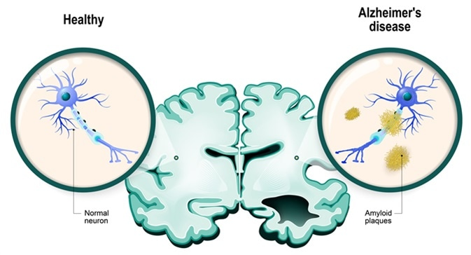
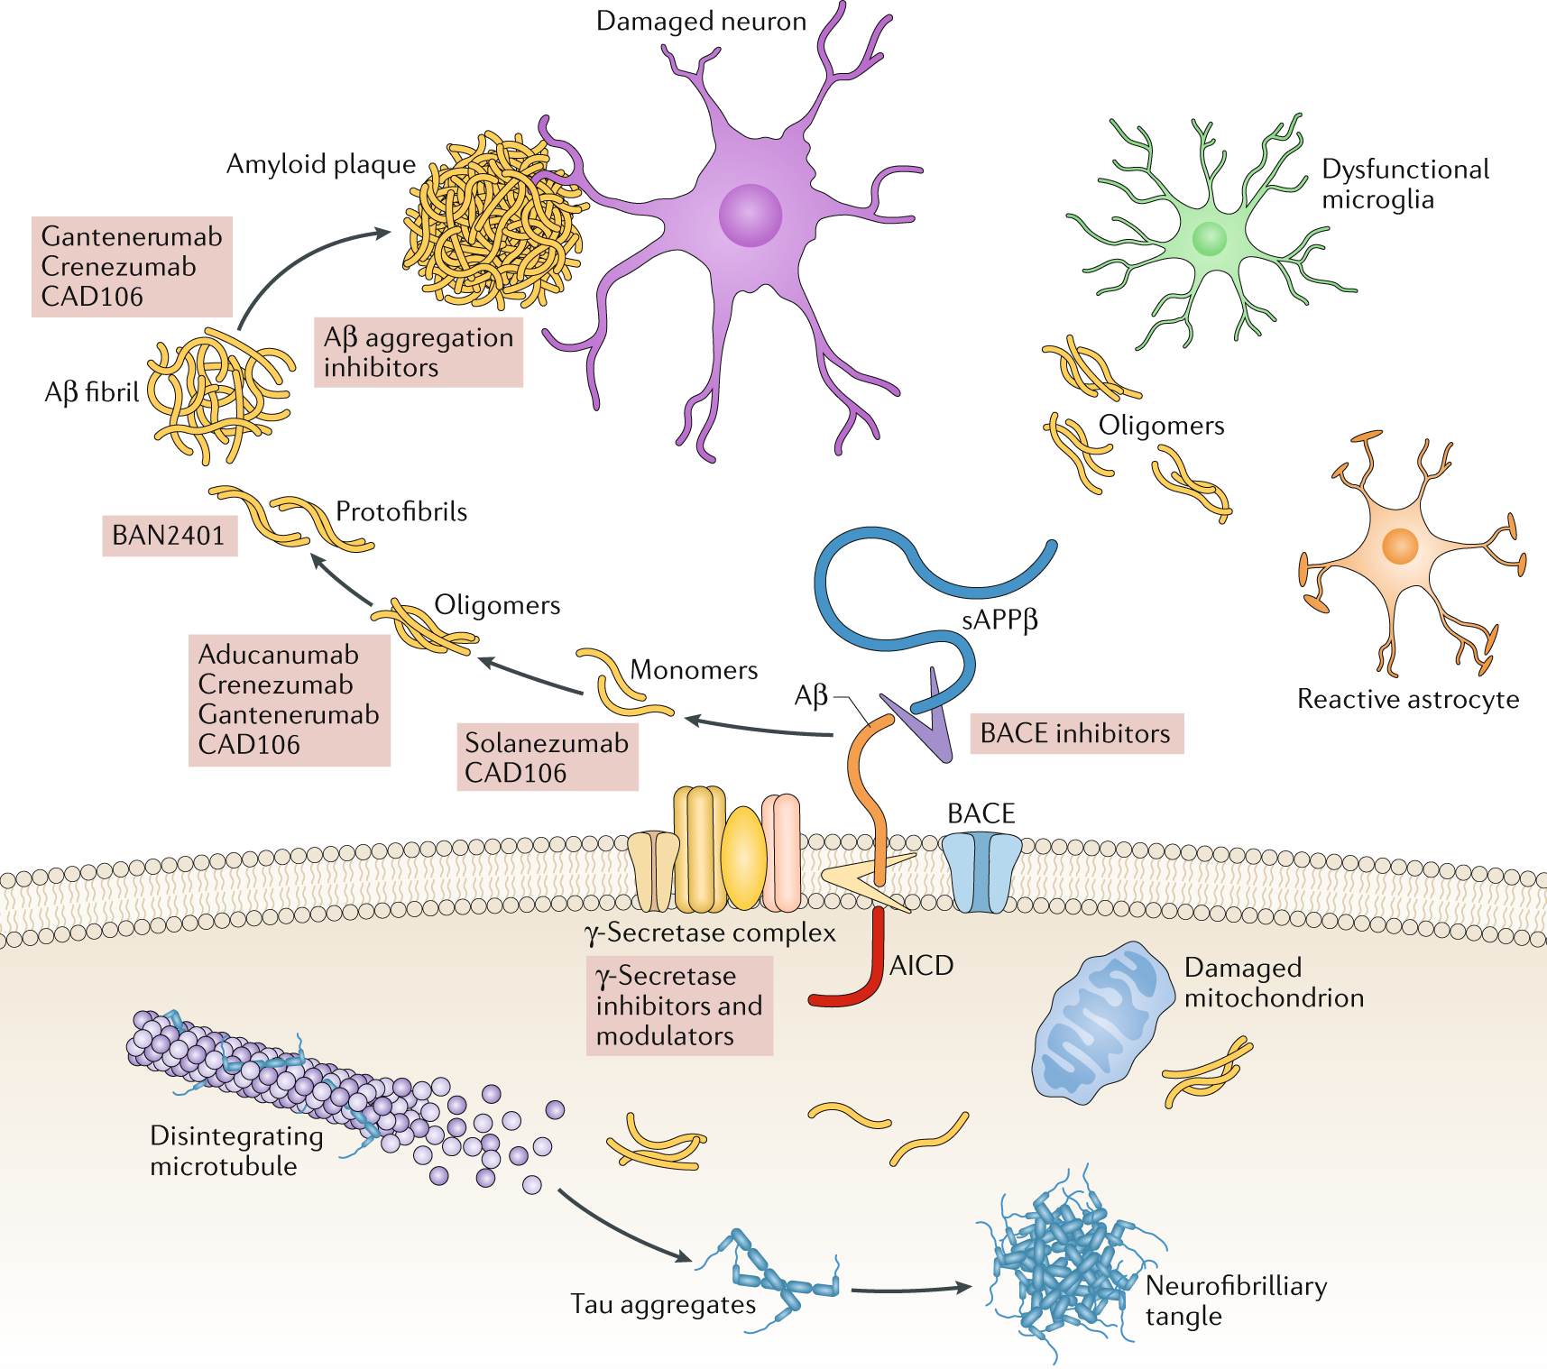
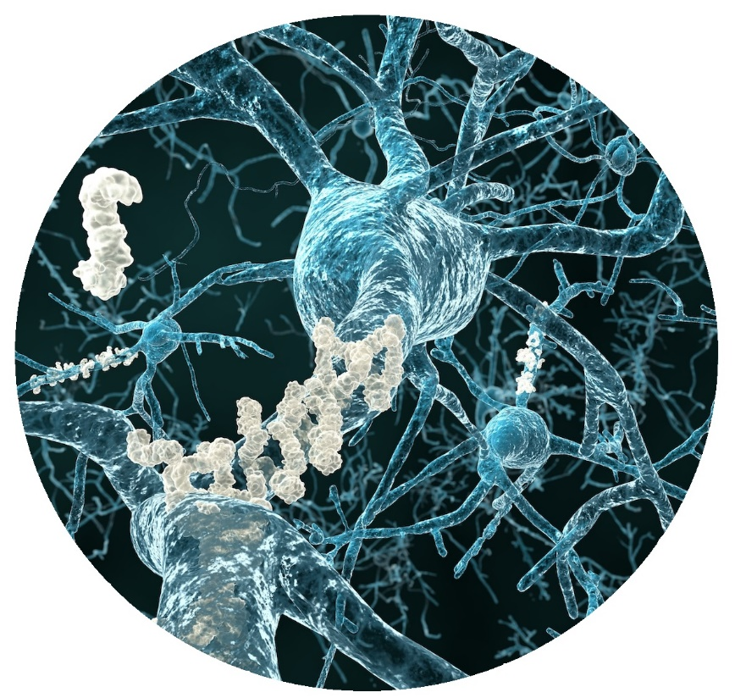
Why do we investigate the amyloid-β42? Alzheimer Disease. Amyloid Hypothesis.
Genetic, biochemical, histopathological, biomarker and cognitive studies have suggested that brain accumulation of the amyloid-β (Aβ) peptide is the initial event in the Alzheimer disease (AD) process.
As accumulation of Aβ in the brain starts 15–20 years before the onset of clinical symptoms, drugs are now being tested in preclinical or asymptomatic stages of AD and in cognitively healthy individuals at risk of AD.
2
https://www.nature.com/articles/s41582-018-0116-6

Slide 3
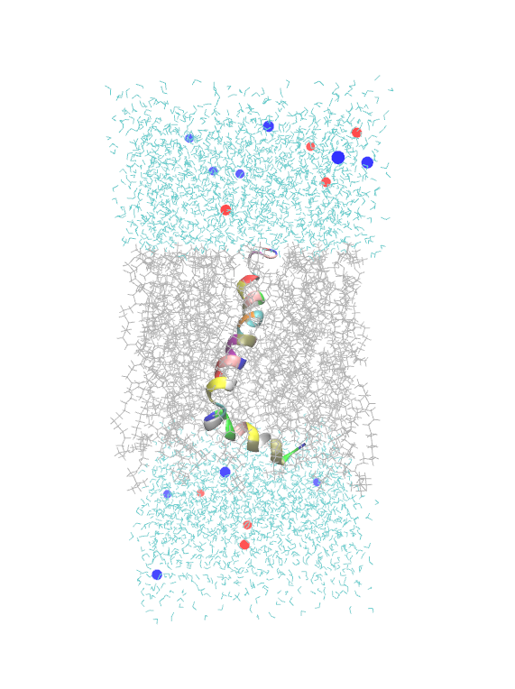
Why do we investigate the amyloid-β42? Alzheimer Disease. Amyloid Hypothesis.
water
sodium
Lipid
bilayer
chlorine
water
liposome
3
https://www.nature.com/articles/s41582-018-0116-6

Slide 4
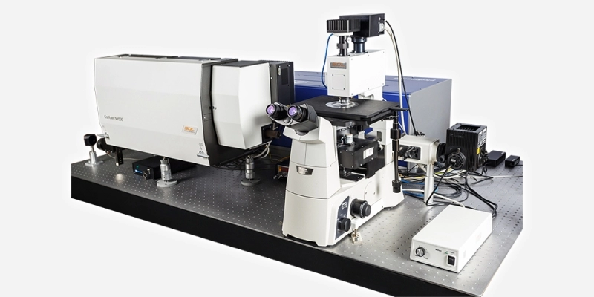
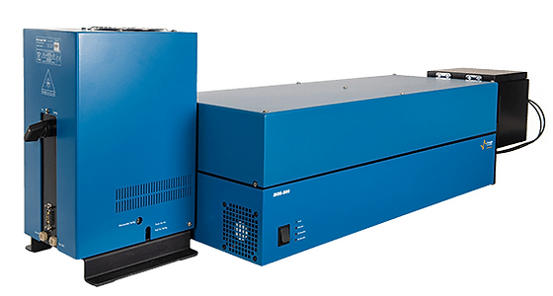
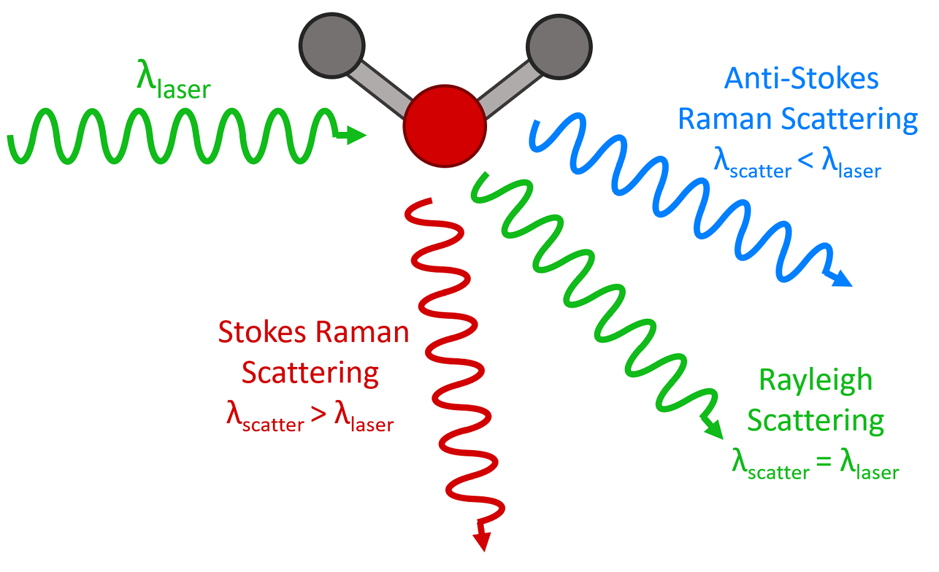
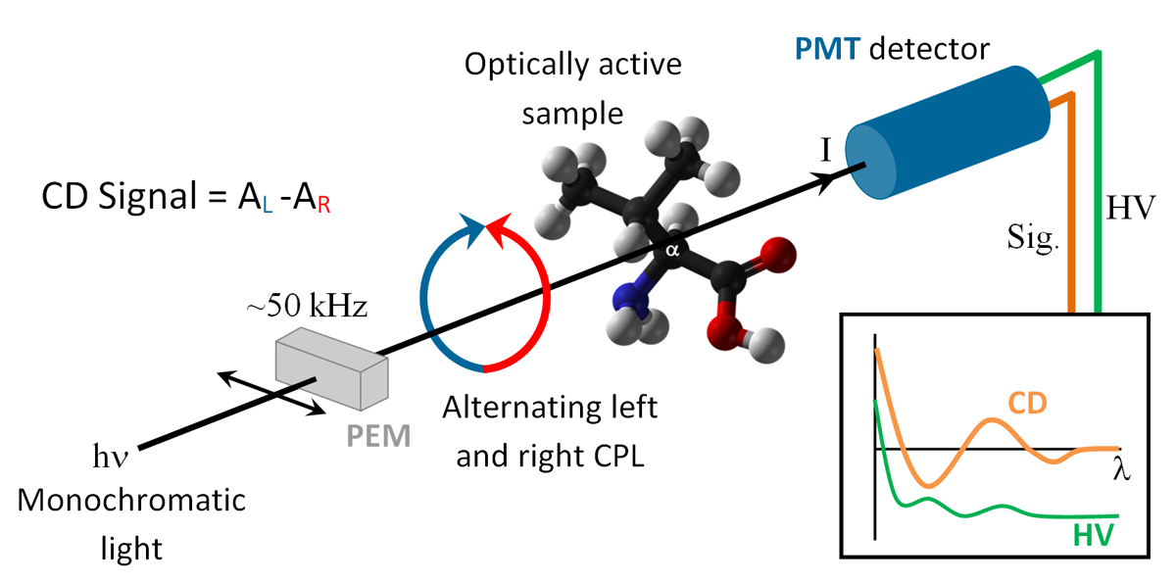
Application of Raman spectroscopy and Circular dichroism(CD)
Confotec CARS from SOL instruments
MOS 500 from BioLogic
4

Slide 5
Raman spectra of Aβ42 in liposome/peptide system
C-H2 bend
C-C stretch
C-H2 twist
Raman spectra of Aβ42 in liposome/peptide system in
pH=5.5 (black line),
pH=7.4 (red line),
pH=9.5 (blue line).
Red line – fitted curve, filled areas – deconvolved spectra by Gaussian function.
βs – β-strand (in yellow),
αh – α-helix (in pink),
rc – random coil (in gray), βt – β-turn (in dark cyan).
5

Slide 6
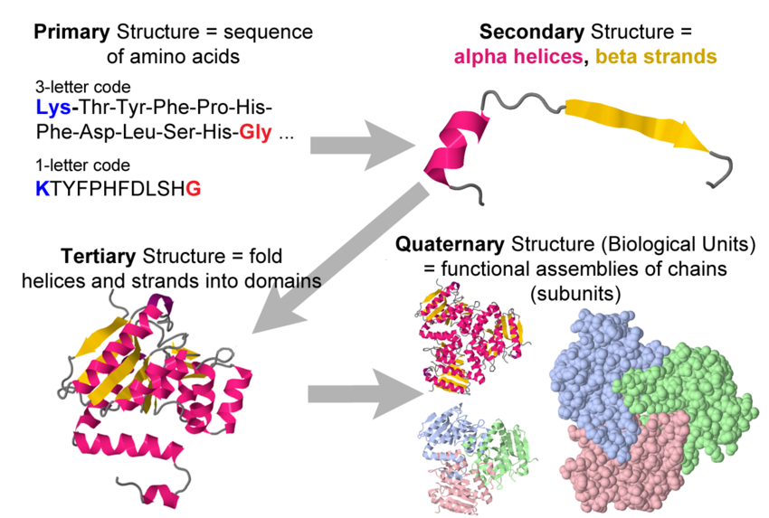
Structure of protein
6

Slide 7
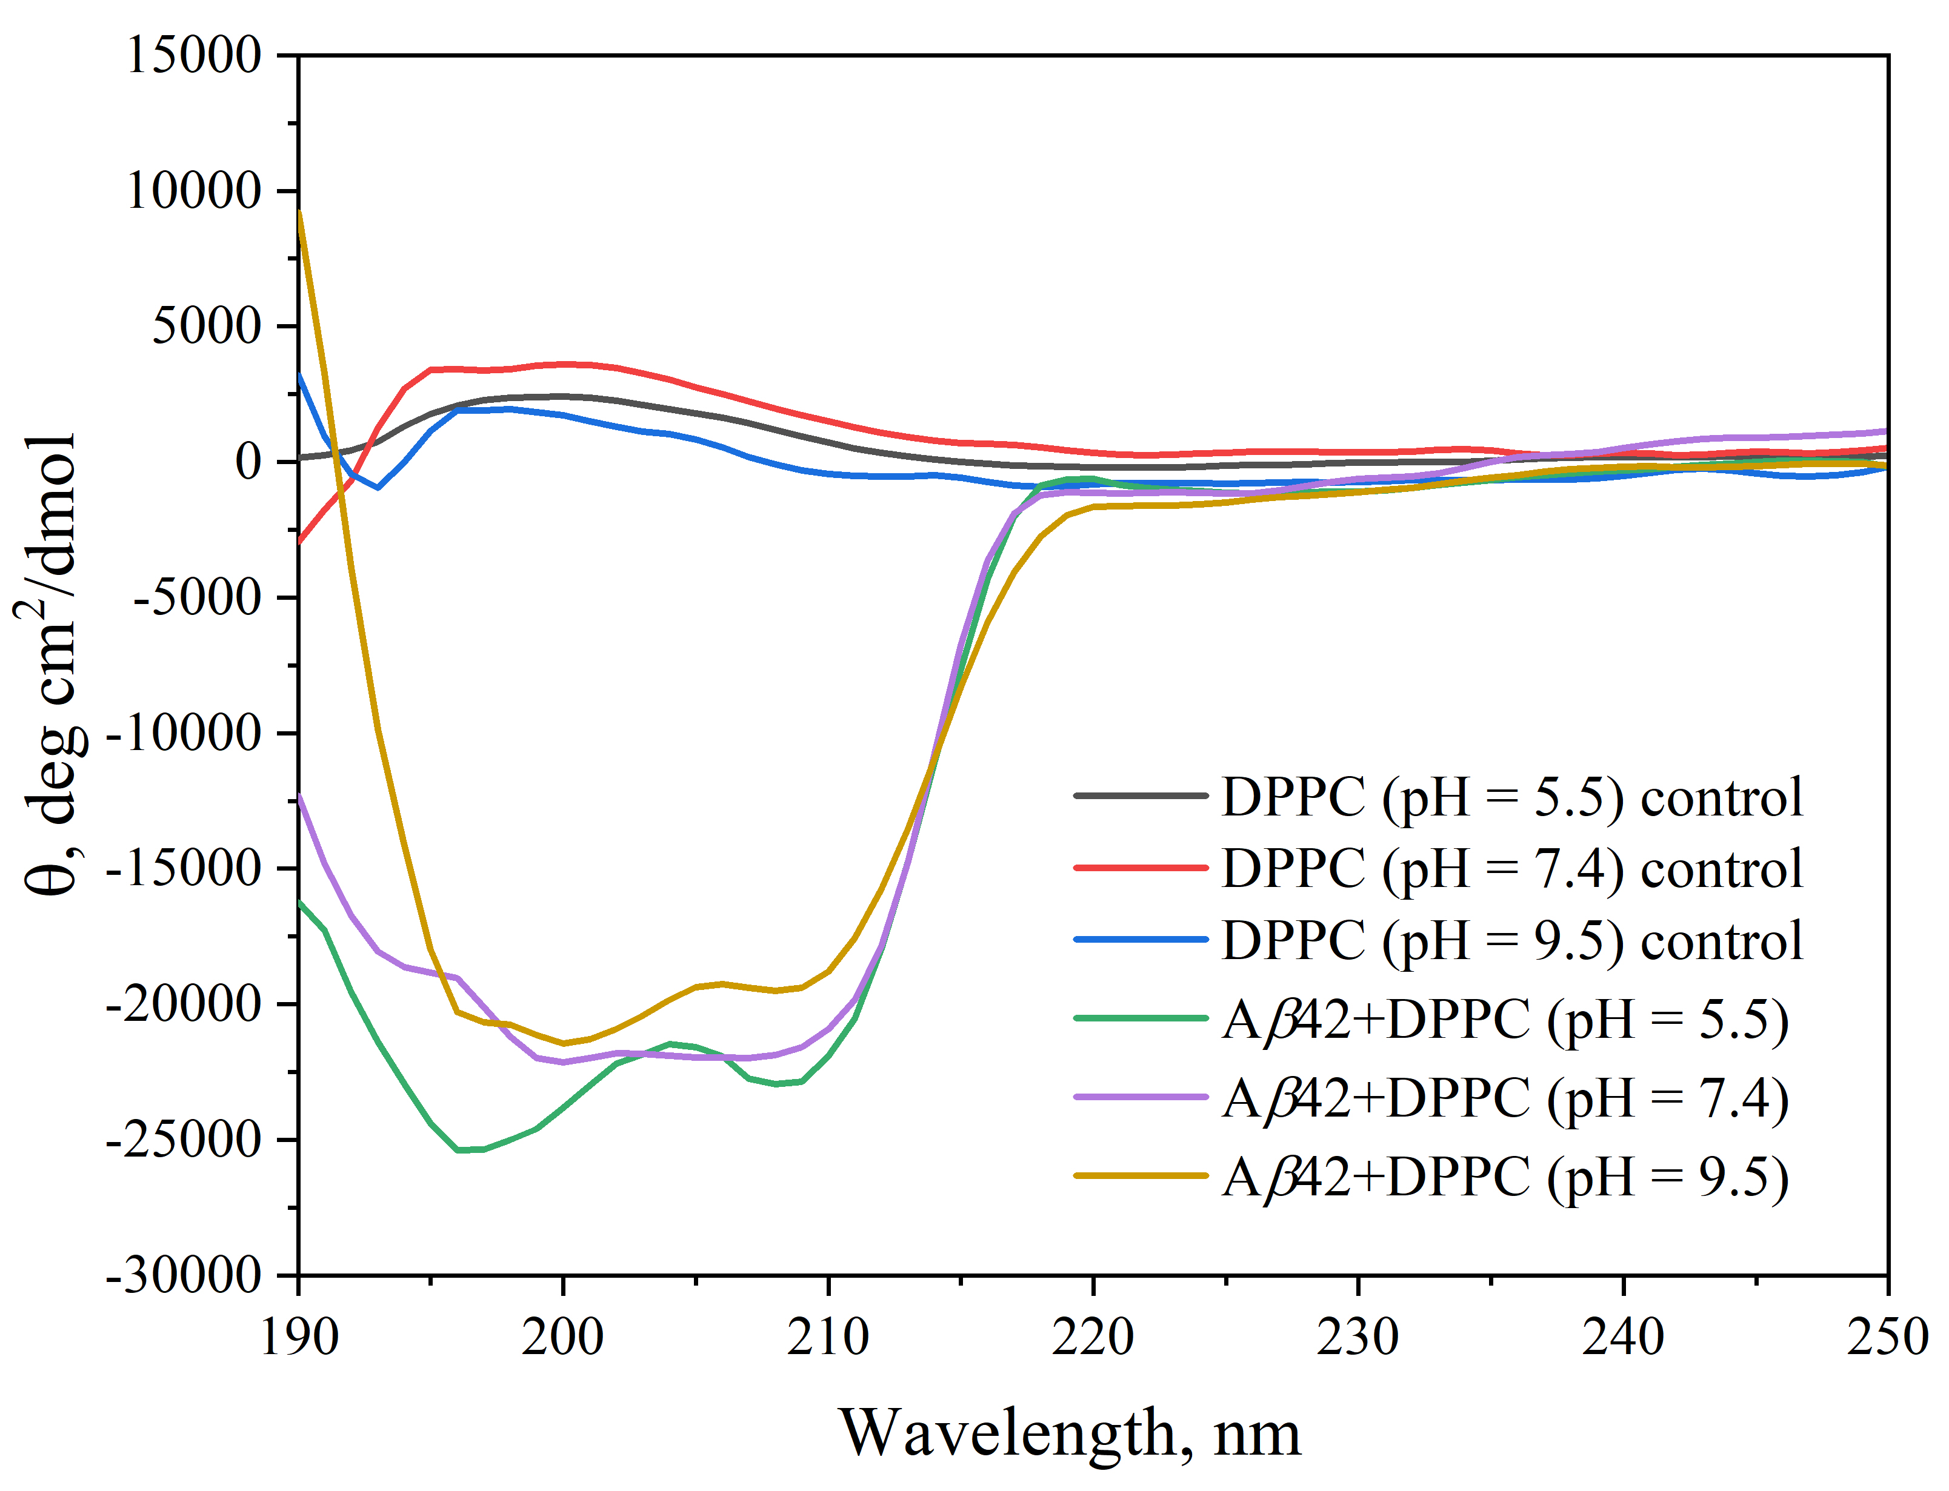
Circular dichroism spectra of DPPC and Aβ42+DPPC liposomes
The current study reportы characteristic CD peaks for as following:
α-helices at 190-195 and 208 nm,
β-strands at 217-218 nm and 195-197 nm,
random coils below 200 nm
the percentage of secondary structure motifs of Aβ42 in DPPC at various pH conditions was estimated by the CONTIN/LL, SELCON3, and CDSSTR programs.
7

Slide 8
Molecular Dynamics: Secondary structure timeline for Aβ42 in DPPC bilayer
a) pH = 5.5
b) pH = 7.4
c) pH = 9.5
8

Slide 9
Main results
The secondary structure percentage of the Aβ42 liposome/peptide system in different pH based on the Raman, CD, and MD simulations results
Secondary Structure | pH 5.5 |  |  | pH 7.4 |  |  | pH 9.5
 | Raman | CD | MD | Raman | CD | MD | Raman | CD | MD
α-helix | 74,7 | 79,1 | 80,15 | 48,1 | 57,9 | 54,0 | 44,4 | 46,4 | 47,76
β-strand | 9,4 | 10,1 | 0 | 14,2 | 15,2 | 0 | 10,8 | 9,1 | 0
β-turn | 7,5 | 9,9 | 6 | 17,4 | 10,4 | 20,43 | 20,6 | 10,5 | 16,48
rc | 8,4 | 17,5 | 13,95 | 20,2 | 17 | 25,58 | 24,2 | 35,9 | 35,76
9

Slide 10
Conclusion
Raman spectroscopy, Circular dichroism and MD are in a good agreement and complementary to each other in the case of studying the structural dynamics of Aβ42 and its interaction with lipid membranes in the context of Alzheimer's disease.
All above mentioned methods show that the high αh content observed at low pH suggests that the peptide adopts a more ordered conformation under acidic conditions.
In contrast, as the pH increases, the peptide exhibits greater structural flexibility and disorder, reflected by a higher proportion of rc conformations.
10

Slide 11
Thank you for your kind attention!
11
Notes:
*

Slide 12
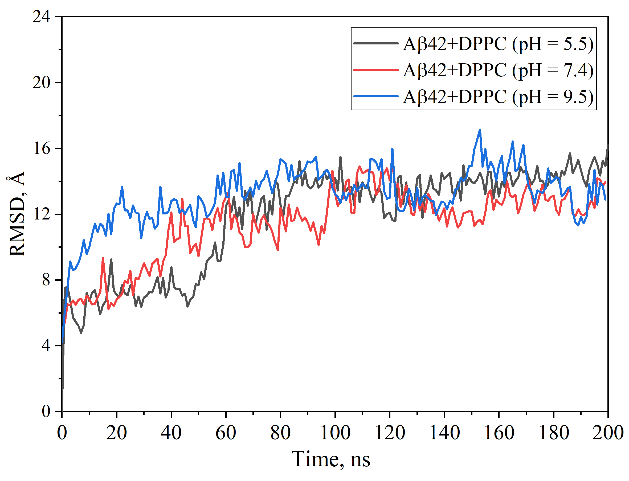
Additional slides: Molecular Dynamics: RMSD
12

