Slide 1
Relativistic Heavy Ion Physics and Spin Physics
Sub-group of the JINR Strategy Long Range Plan International Working Group
Status report
Notes:
Tittle page and out line

Slide 2
Mandate of the WG:
Based on a broad consultation with the JINR member states and with wide international physics community, the SLRP WG is asked to:
    Identify physics scientific venture, priorities and research infrastructure that should be pursued by JINR and that would ensure continuous JINR global scientific leadership.
    Formulate a coherent plan of the best way to develop the institute in period beyond the running JINR 7-years Plan and include a look ahead to 2030.
    Prepare a set of recommendations directed to JINR scientists and to JINR governing bodies of member States.

Slide 3
Core research areas of the JINR scientific programme and SLRP sub-groups
Particle Physics
Relativistic Heavy-Ion and Spin Physics
Nuclear Physics
Condensed Matter Physics
Theoretical Physics
Nuclear Biophysics
Information Technologies & High Performance Computing
Education
Nuclear Physics Applications and Societal Benefits

Slide 4
Relativistic Heavy-Ion and Spin Physics sub-group
Alexander Kovalenko (LHEP JINR)
Alexander Sorin (JINR)
Gennady Zinovjev (LTP JINR)
Horst Stoecker (GSI)
Itzhak Tserruya (Weizmann Inst.)
Luisa Cifarelli (INFN Bologna)
Oleg Teryaev (LHEP JINR)
Richard Lednicky (JINR)
Roumen Tsenov (LHEP JINR) – local coordinator
Sergey Shmatov (LHEP JINR)
Vladimir Kekelidze (LHEP JINR) - chairman
More experts to be involved!

Slide 5
Strategy of the Laboratory of High Energy Physics
Locally developed document by a group of ~30 people under the coordination of R. Tsenov and after a laboratory-wide discussion (June – Dec. 2017)
Web site (also with audio records) https://indico.jinr.ru/conferenceDisplay.py?confId=296, passwd: lhepstrategy.

Slide 6
Structure of the document
Introduction
A table over the basic directions and per each 7-year period
2017-2023 | 2024-2030 | 2031-2037 | 2038-2044 | 2045-2051
1 | Construction, start-up and operation of the NICA complex and experiments there
2 | Participation in R&D and in joint experiments in other world laboratories
3 | Operation, upgrade and further development of the LHEP accelerator complex
4 | Main physics goals
5 | Development of the accelerator technology and radiation detection methods
6 | Applications
Clarifications of some of the points in the table and ideas that need future discussions

Slide 7
NICA accelerator complex
1
2017-2023 | 2024-2030 | 2031-2037 | 2038-2044
2020 – commissioning of the basic configuration, 2023 – design configuration. Symmetric heavy ion collisions, L=10²⁵ cm⁻²s⁻¹ | Symmetric heavy ion collisions, L=10²⁷ cm⁻²s⁻¹ . Polarized proton and deuteron collisions, L=10³⁰⁻³² cm⁻²s⁻¹ | Asymmetric heavy ion collisions, L=10²⁷ cm⁻²s⁻¹. Polarized proton and deuteron collisions, L=10³² cm⁻²s⁻¹ | Electron-nuclei head-on and co-moving collisions

Slide 8
Development of the LHEP accelerator complex
 |  | 2017-2023 | 2024-2030 | 2031-2037 | 2038-2044 | 2045- 2051
1e | Development of the LHEP accelera-tor complex | Achieving of the results foreseen in the Seven-year plan. | Achieving design beam parameters of the full-scale NICA configuration. Upgrade of the Nuclotron beam extraction channels based on superconducting technology. | Feasibility and design studies for: - acceleration of twisted states of particles and of states with a large orbital momentum. - electron accelerator and start of its construction | Experiments with intersecting electron-ion beams. Feasibility and design studies for: - generation of a high-energy photon beam based on backward Compton scattering of a laser beam off a few GeV electron beam; - search for proton and deuteron EDM with the NICA storage rings. | Studies with head-on photon-nucleus collisions. Search for proton and deuteron EDM at NICA.

Slide 9
Tasks for our sub-group
We should produce a concise document containing physics potential and feasibility of the research directions below:
Symmetric and asymmetric heavy ion collisions at center-of-mass energy of 4 – 11 AGeV;
Electron-ion collisions at a similar center-of-mass energy;
Photon-ion collisions in GeV energy range;
Nucleon spin structure measurements;
Twisted states and states with large angular momentum;
Search for proton and deuteron EDM with the NICA storage rings;
What else?...

Slide 10
A suggestion who works on which item:
Symmetric and asymmetric heavy ion collisions at center-of-mass energy of 4 – 11 AGeV: A. Sorin, G. Zinoviev, H. Stoecker, I. Tserruya, S. Shmatov, V. Kekelidze;
Electron-ion collisions at a similar center-of-mass energy: A. Kovalenko, L. Cifarelli, R. Lednicky, R. Tsenov;
Photon-ion collisions in GeV energy range: L. Cifarelli, O. Teryaev, R. Tsenov, S. Shmatov;
Nucleon spin structure measurements: A. Kovalenko, O. Teryaev, R. Lednicky, R. Tsenov;
Twisted states and states with large angular momentum: O. Teryaev, S. Shmatov;
Search for proton and deuteron EDM with the NICA storage rings: A. Kovalenko, volunteers?;
What else?...: H. Stoecker, I. Tserruya, V. Kekelidze et al.

Slide 11
Timeline
First Vidyo meeting was held last Friday,15.06.2018, 15:00
Next meeting (in person) – a day before or after the JINR Scientific Council meeting 20-21 September 2018;
Drafts along the lines a)-g) ready by January 2019;
Discussion of the drafts and setting up the timeline for drafting the final document – at a meeting along with the JINR Scientific Council meeting in February 2019;
Final document submitted to the SLRP IWG – May 2019.

Slide 12



2030
We have a strategy!
Some concerns have been expressed…

Slide 13
Add-ons

Slide 14
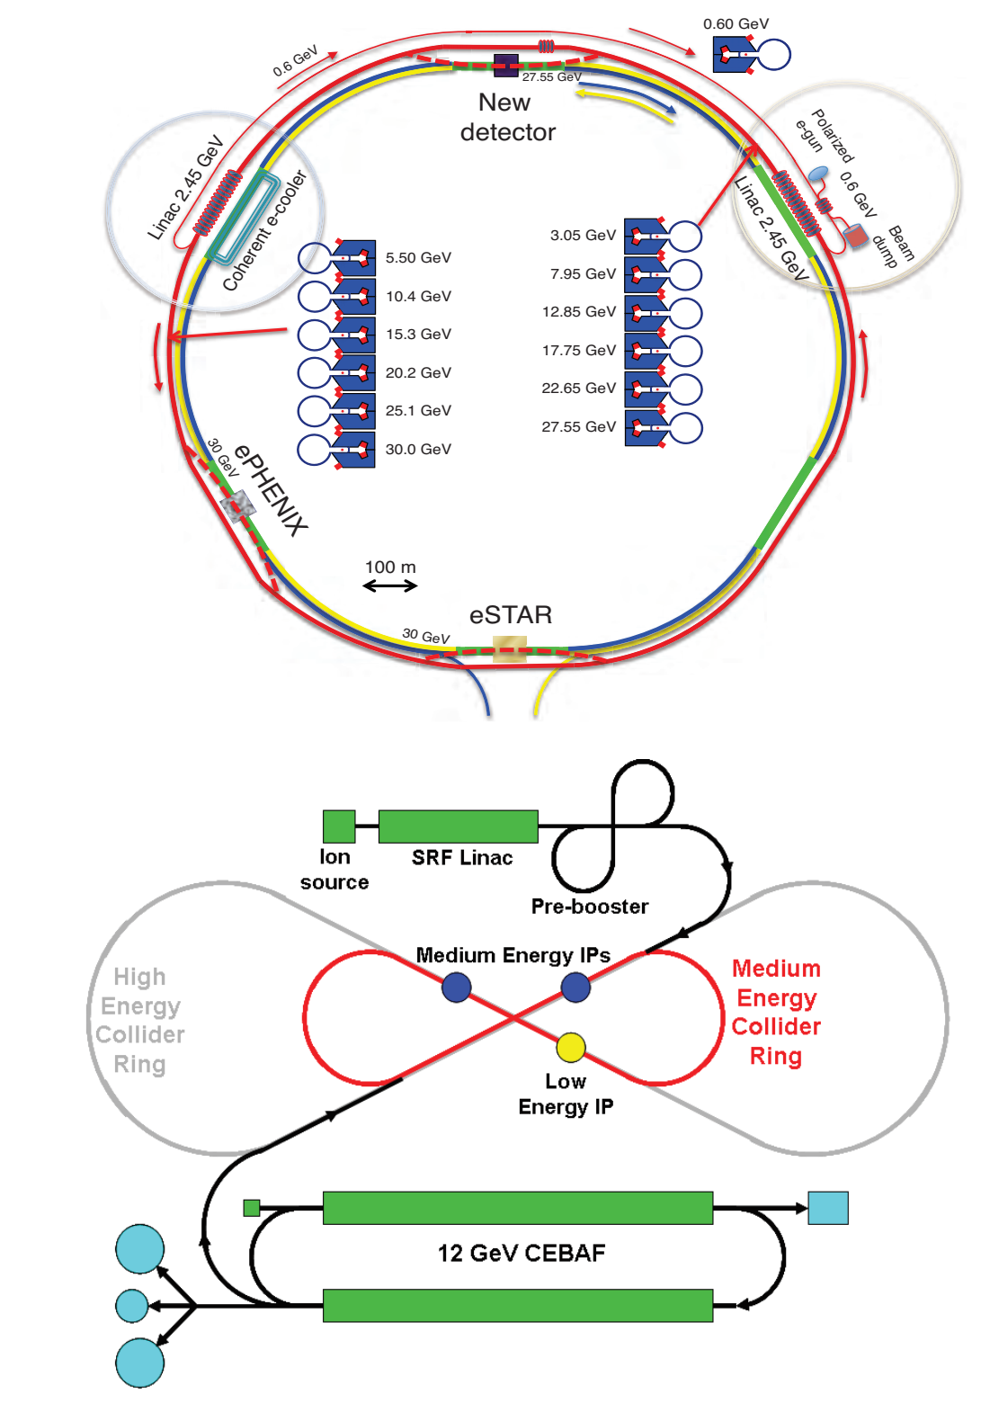
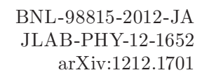

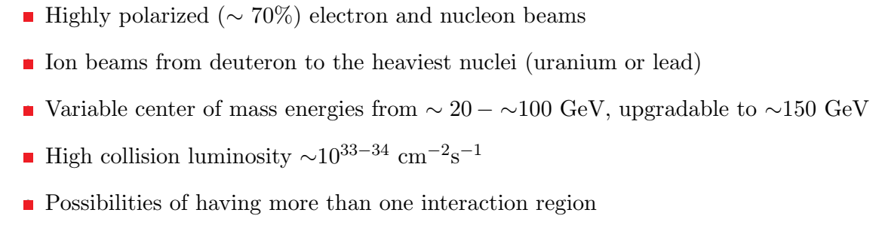
Electron-ion collider: USA projects
BNL
JLab

Slide 15
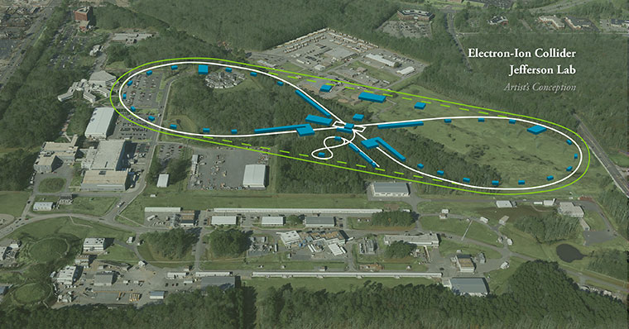

Slide 16
Electron-ion collider: China plans…

Slide 17
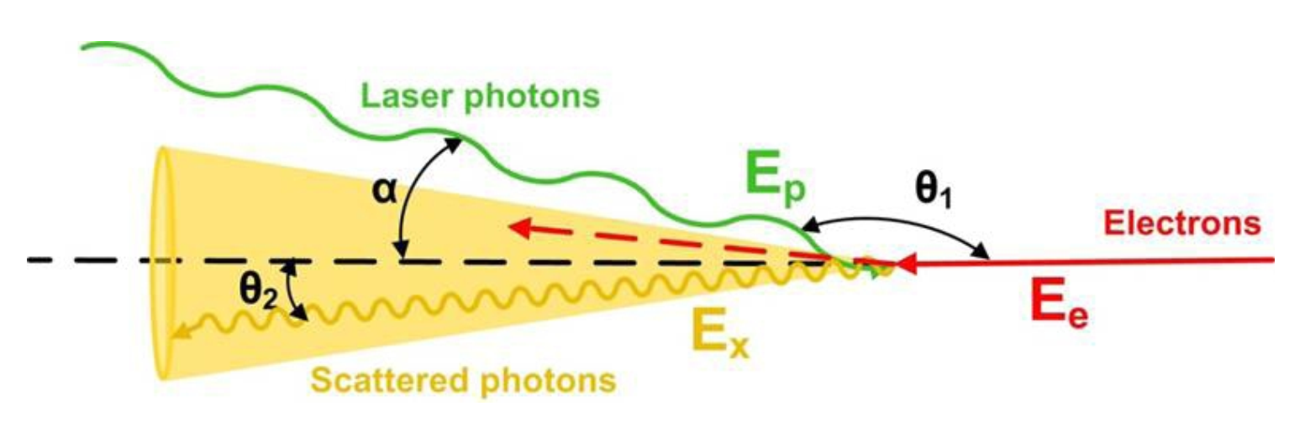
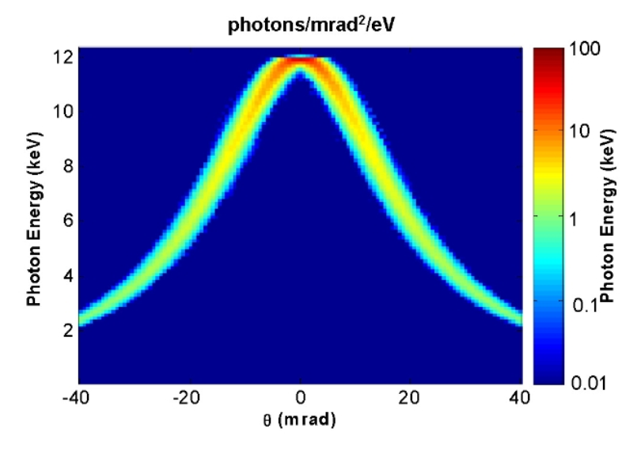
Backward Compton Scattering Source

Slide 18
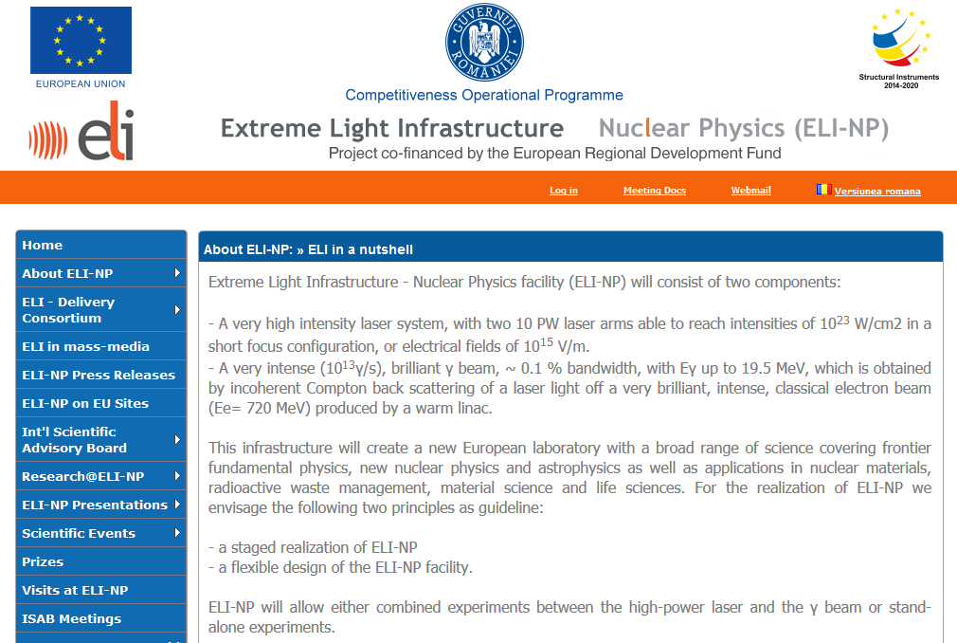
ELI-NP in Romania

Slide 19
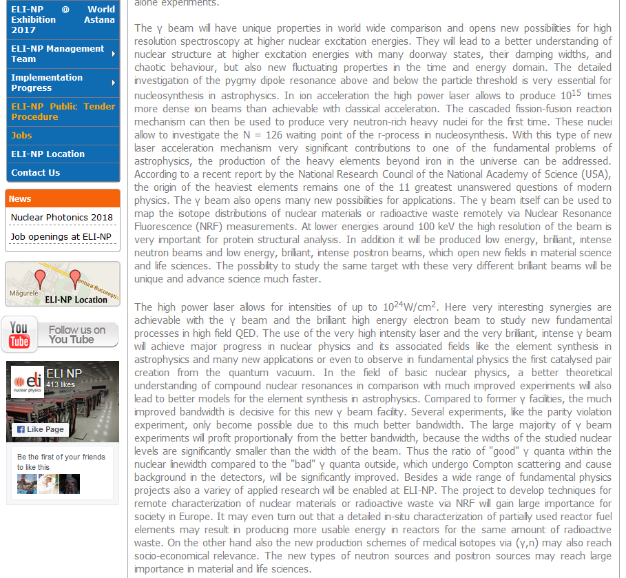
ELI-NP in Romania

