Slide 1
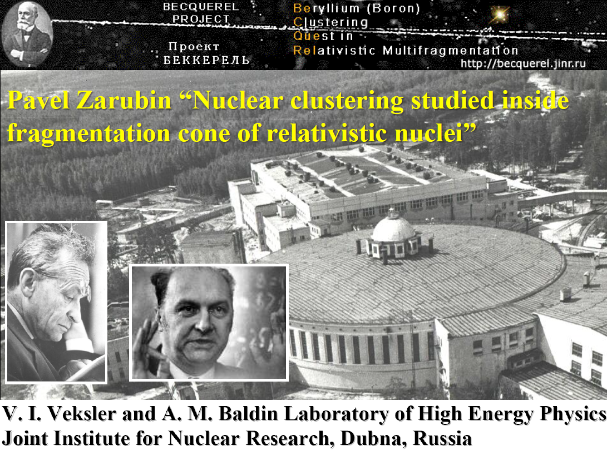
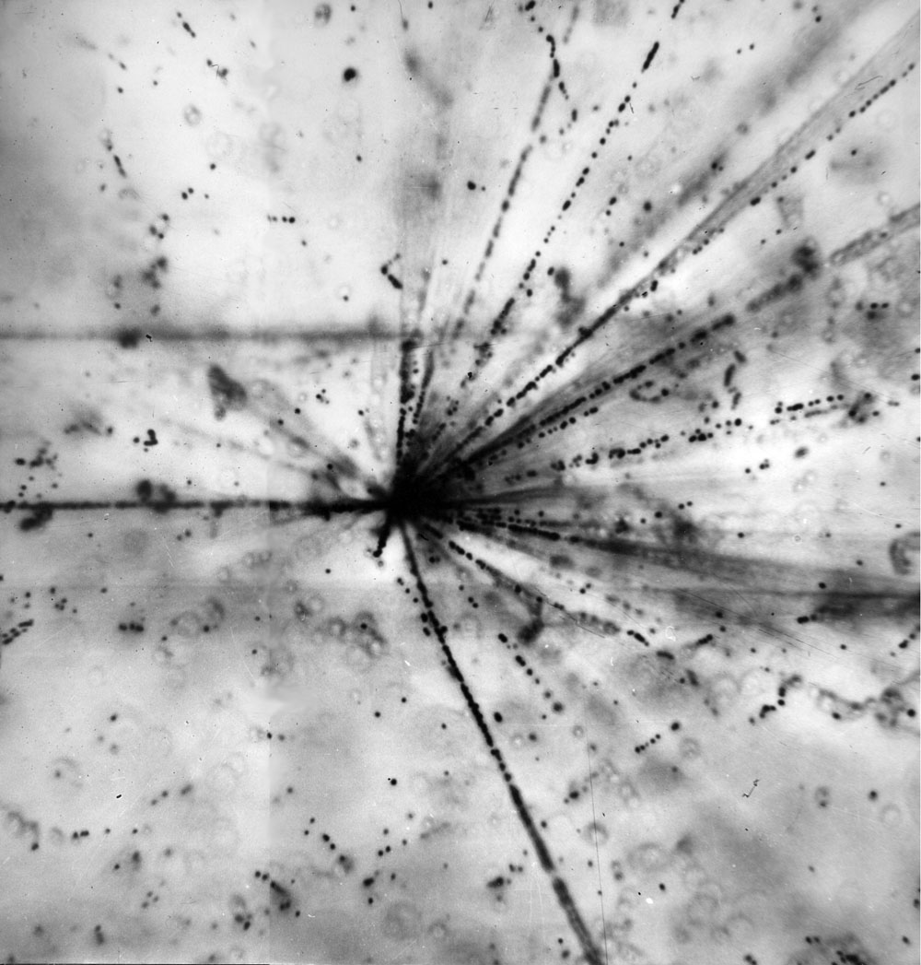
Pavel Zarubin “Highlights of Unstable States in Relativistic Dissociation of Light Nuclei”
V.I. Veksler and A.M. Baldin Laboratory of High Energy Physics
Joint Institute for Nuclear Research, Dubna

Slide 2
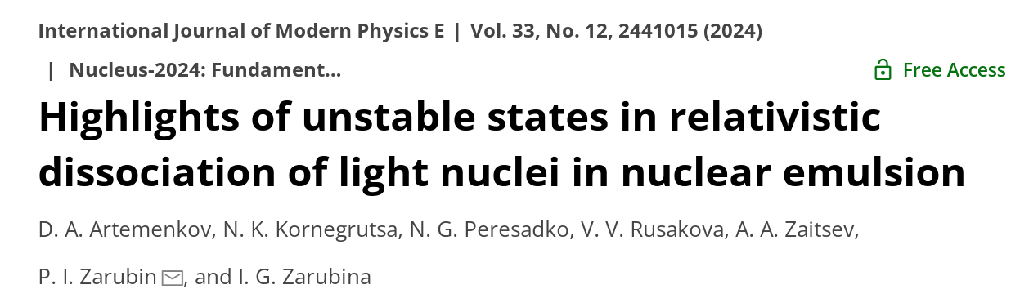
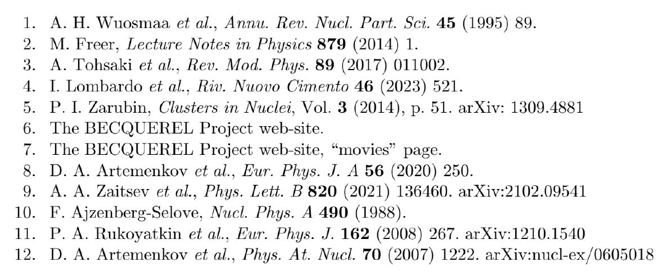
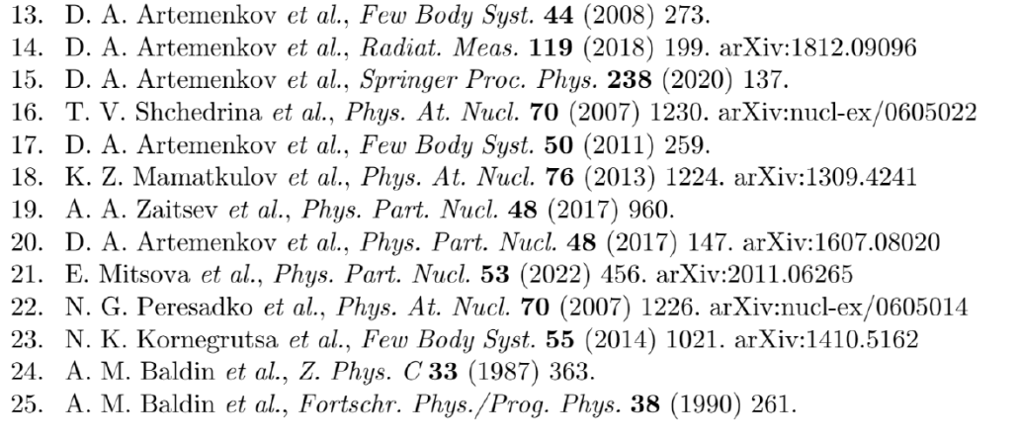
https://www.worldscientific.com/doi/10.1142/S0218301324410155 https://arxiv.org/abs/2409.14814

Slide 3
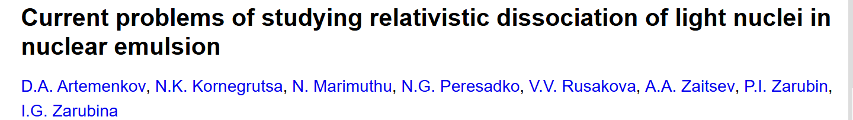

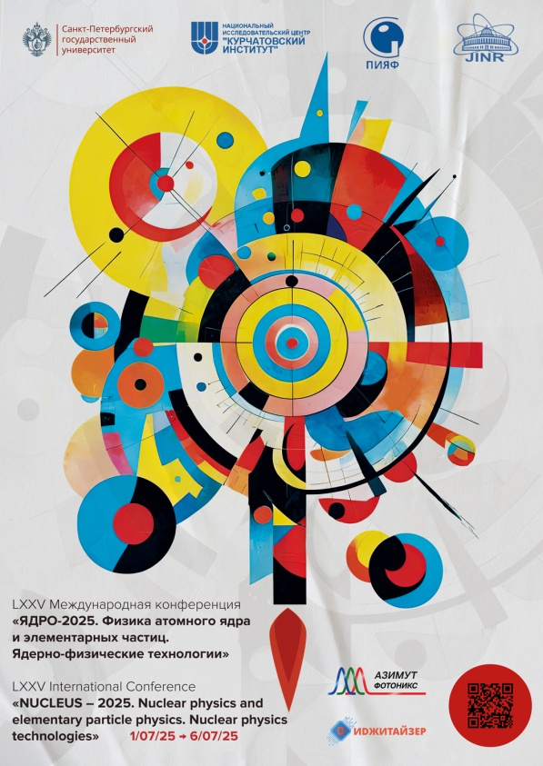
https://arxiv.org/abs/2509.09636

Slide 4
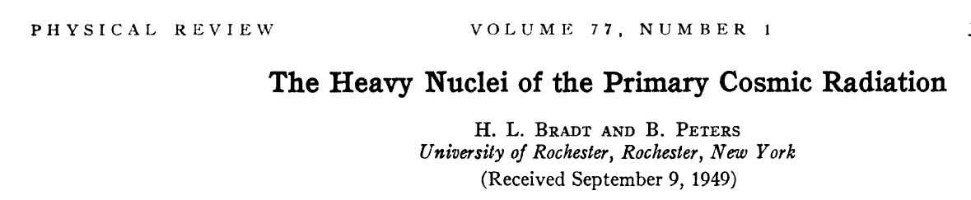
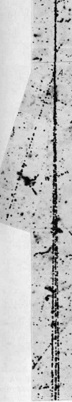
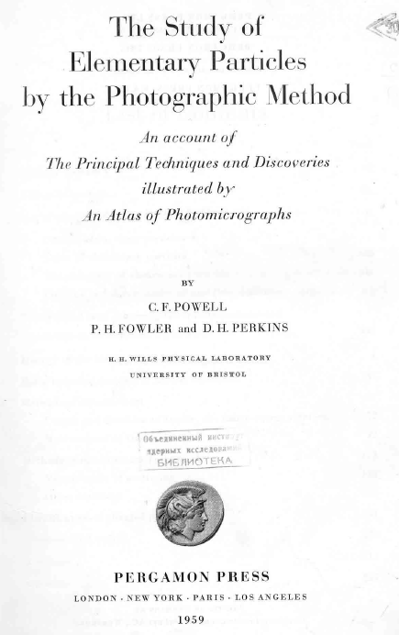
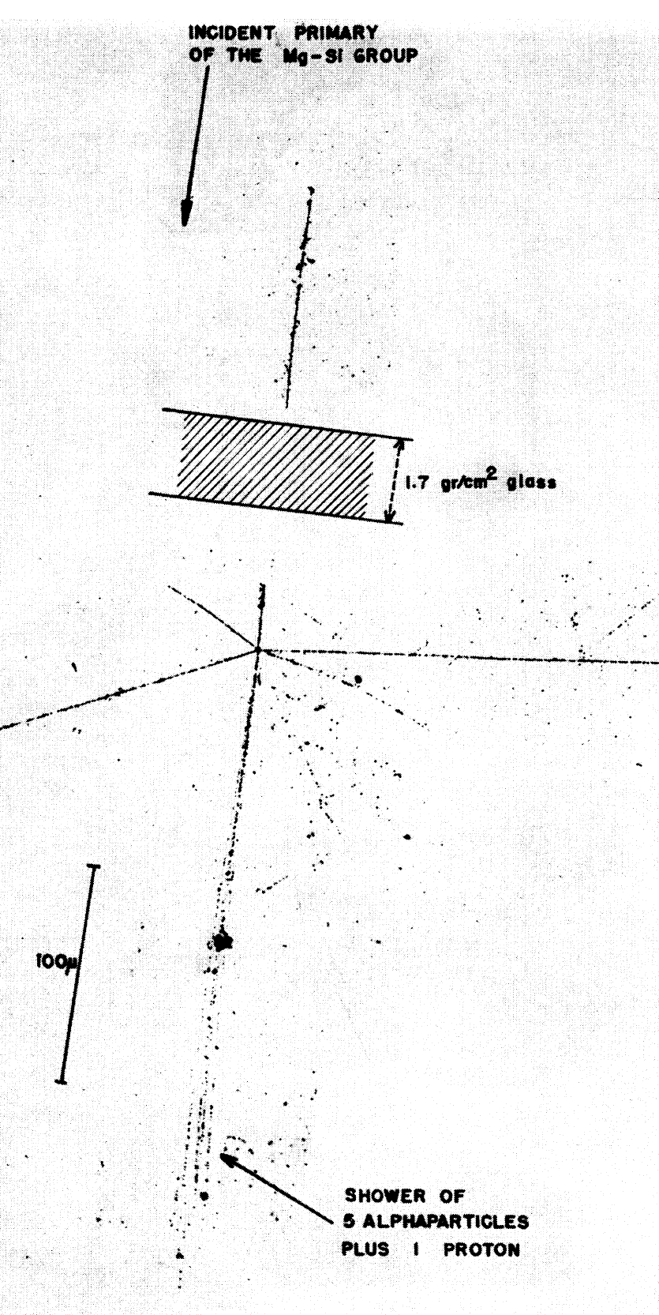
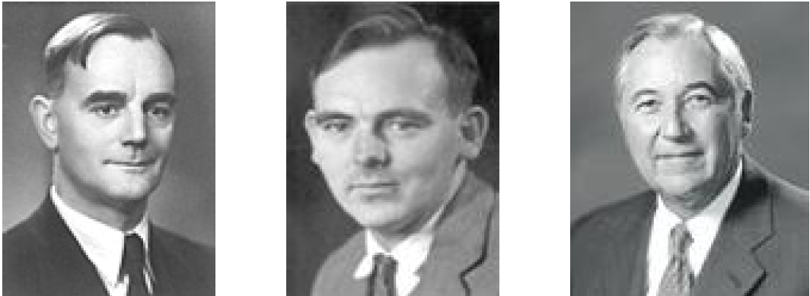

Slide 5
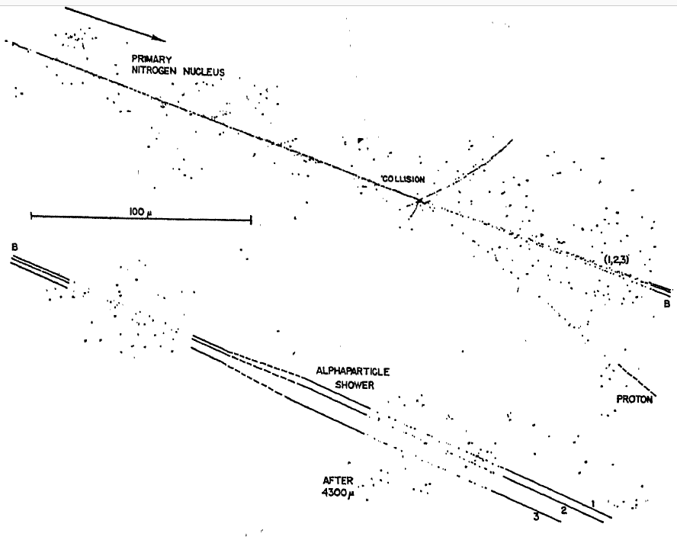
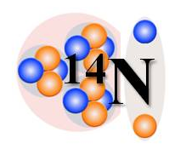
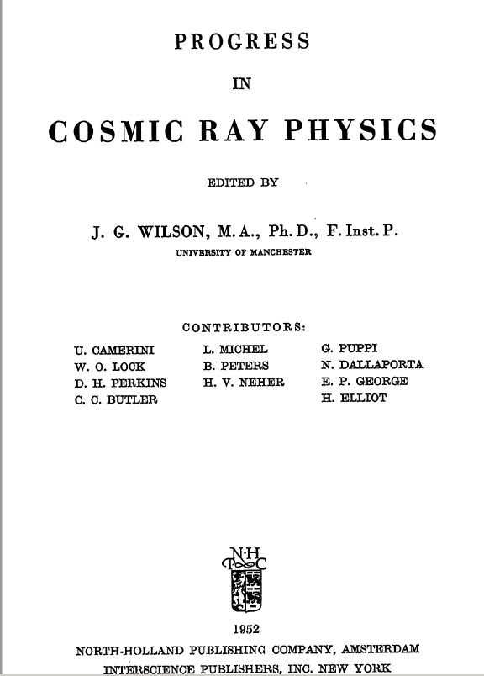

Slide 6
As a key aspect of the light nucleus structure and nucleosynthesis reactions, nucleon clustering remains the focus of experiments in the range of incident nuclei up to several tens of MeV per nucleon.
At the same time, the region of limiting fragmentation of nuclei, which seems very remote from this topic, contains the potential for applying the established concepts of clustering and their extraordinary expansion.
With the attainment of energies of several GeV per nucleon, the kinematic regions of fragmentation of colliding nuclei are clearly separated, and the duration of collisions is minimal. These factors can facilitate the interpretation of the final states of relativistic fragments that remain internally non-relativistic.
However, it is difficult to take advantage of these advantages due to the radical reduction in ionization produced by fragments, as well as their magnetic rigidity, often poorly distinguishable from the primary beam.

Slide 7
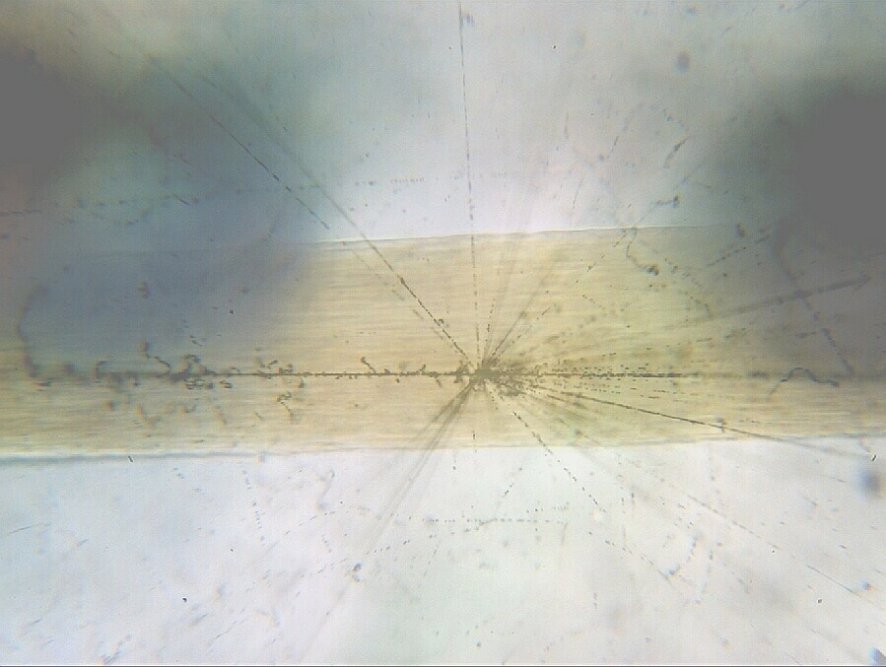
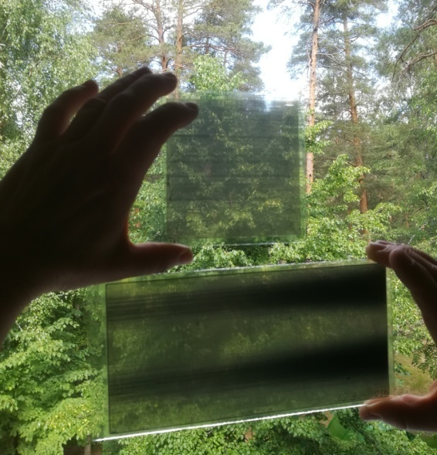
Hair - 60 μm
AgBr Crystal - 0.2 μm
Atom - 10⁻⁴ μm
Proton - 10⁻⁹ μm

Slide 9
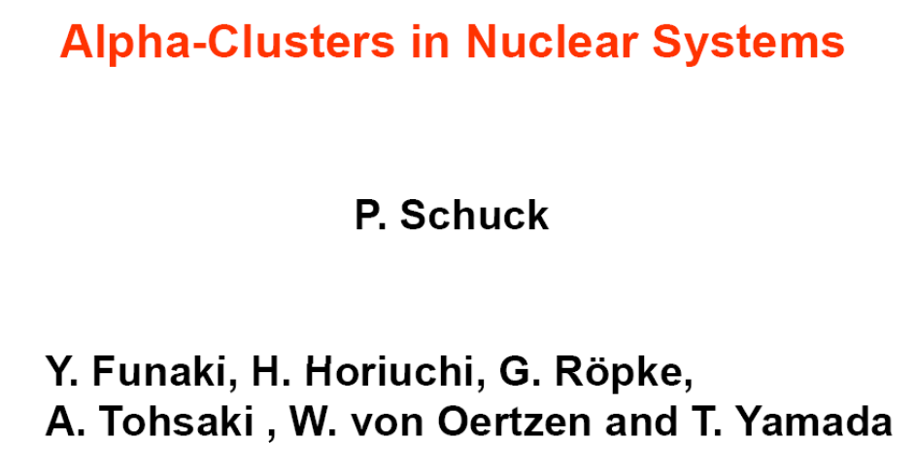
A current focus is on the concept of α-particle Bose-Einstein condensate (αBEC) – the S-wave α-particle state right above threshold. ⁸Be(0⁺) is being described as 2αBEC, and the ¹²C(0⁺₂) or Hoyle as 3αBEC. Suggesteded as 4αBEC ¹⁶O(0⁺₆) at 660 keV can sequentially decay via α¹²C(0⁺₂) or 2⁸Be(0⁺).

Slide 10
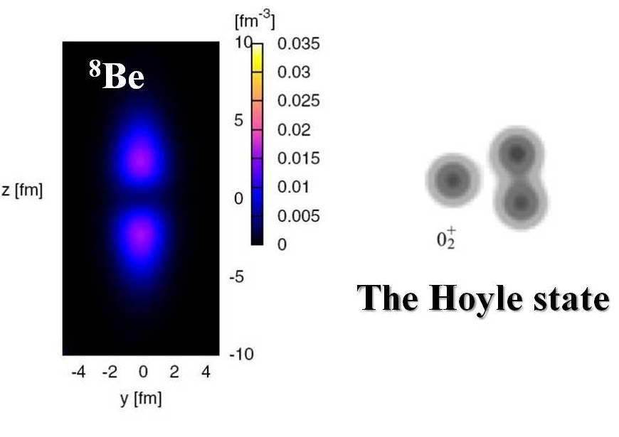
⁸Be(0⁺) ¹²C(0⁺₂) ¹⁶O(0⁺₆)

Slide 11
The nuclei ⁸Be and ⁹B and a number of excitations of light isotopes unstable near the thresholds of binding to the emission of α-particles and nucleons have lifetimes of the order of fs or widths from eV to keV.
Unusually long-lived on a nuclear scale, they can be defined as a special class at the lower limit of nuclear density and temperature.
In the concepts of molecular-like or α-condensate structures, these unstable states are represented as spatially separated groups of nucleons bound into clusters. Their occurrence in the final states of collisions of light nuclei may indicate the realization of conditions corresponding to extremely low-energy reactions of nucleosynthesis.
Reconstructions of the decays of known states of this type make it possible to search for analogs decaying into them.
The exotically large sizes of unstable states allow us to propose a scenario for their formation in the resonant interaction of pairs of fragments with minimal values ​​of invariant Lorentz factors of relative motion, and then the subsequent pickup of other fragments.

Slide 12
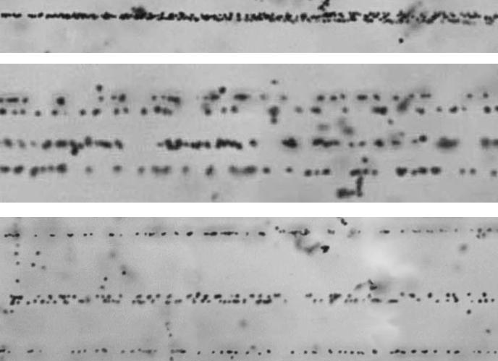
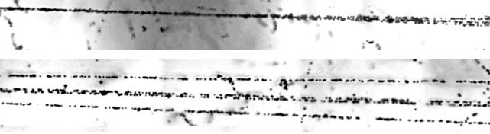
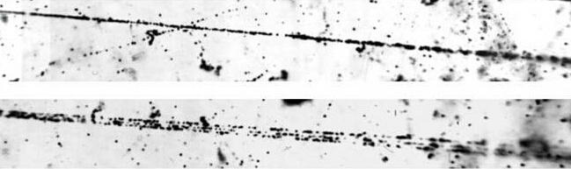
²⁴Mg → 6α
The fragmentation of relativistic nuclei observed in its entirety only in nuclear emulsion (NTE) serves as a source of ensembles of the lightest nuclei of interest to modern nuclear physics and nuclear astrophysics. NTE allows one to study such ensembles with record angular resolution and identification He and H isotopes.
Electronic experiments in this direction run into fundamental difficulties due to the quadratic dependence of ionization on the charges of the nuclei, extremely small angular divergence of relativistic fragments, and, often, an approximate coincidence in magnetic rigidity with the beam nuclei. Therefore, the NTE method retains its uniqueness in the relativistic fragmentation cone.
The intense “tracks” in the photos splits into the He track pairs with the opening angles of about 2⋅10⁻³ rad corresponding to decays of the unstable ⁸Be nucleus. Their observation testify to the completeness of observations across the spectrum of cluster excitations.
²²Ne → 5α
¹⁶O → 4α
¹²C → 3α

Slide 13
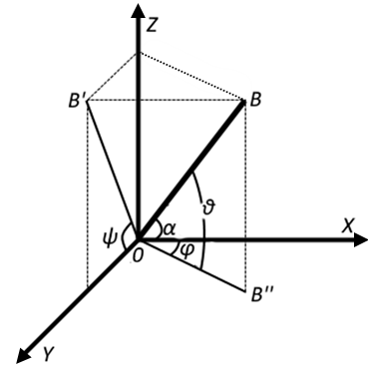
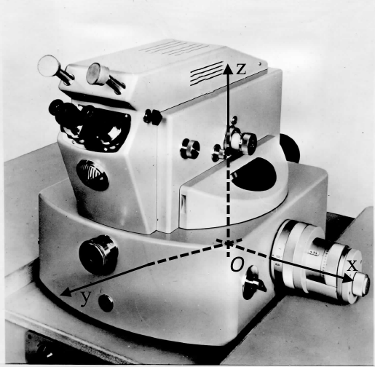
In general, energy of a few-particle system Q is Q = M* - M. M* is the invariant mass defined by the sum of all products of 4-momenta P_{i,k} fragments M^{*2} = ∑(P_{i}∙P_{k}). Subtraction of mass M is a matter of convenience. The 4-momenta P_{i,k} are determined in the approximation of conservation of the initial momentum per nucleon. Then, the definition of Q comes down to determining the angles between the fragment emission directions.

Slide 14
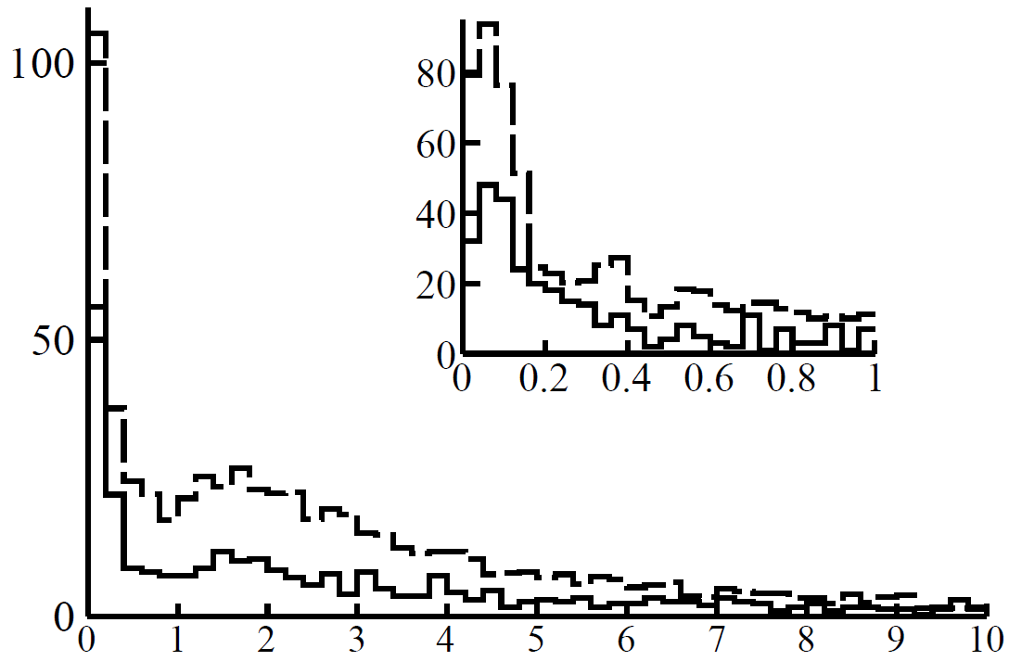
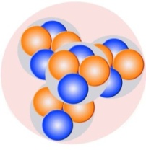
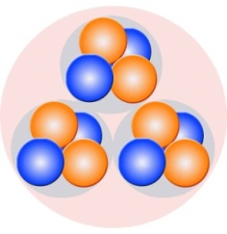
⁸Be(0⁺) in 510 ¹²C → 3α
and 641 ¹⁶O → 4α
at 3.65 GeV per nucleon
“White” stars
Q_{2α}(⁸Be) < 0.2 MeV:
45 ± 4% in ¹²C
62 ± 3% in ¹⁶O
Q_{2α}, MeV
Q = M* - M. M* is defined by the sum of all products of 4-momenta M^{*2} = ∑(P_{i}∙P_{k}).

Slide 15
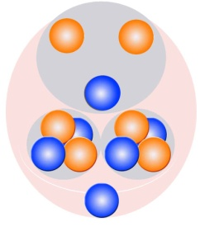

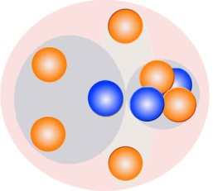
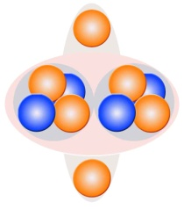
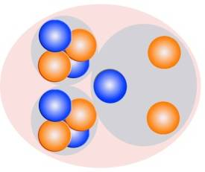
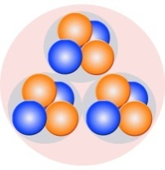
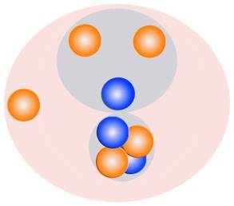
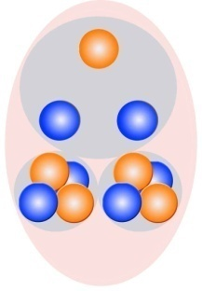
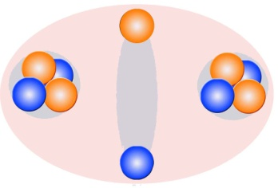

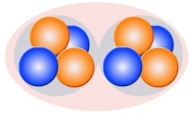
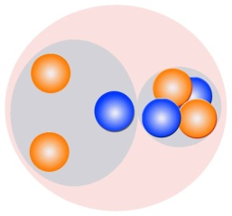

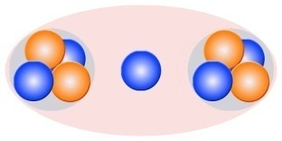
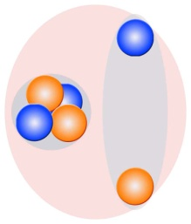
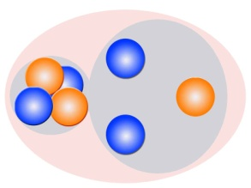
¹²N 11.0 ms
⁹C 0.1265 s
¹⁰C 19.2 s
¹¹C 20.38 m
¹²C 98.89 %
⁸B 0.769 s
¹⁰B 19.8%
¹¹B 80.2 %
⁹B 540 eV
⁷Be 53.3 d
⁸Be 6.8 eV
⁹Be 100%
Since 2000s nuclear track emulsion is used to study clustering of light stable and radioactive nuclei in the relativistic approach in the BECQUEREL experiment at the JINR Nuclotron. The features of the nuclei ^{7.9}Be, ^{8,10,11}B, ^{10,11}C, ^{12,14}N appeared in the probabilities of their dissociation channels. In dissociation of isotopes ¹⁰B, ¹⁰C, and ¹¹C, decays ⁹B → ⁸Be are identified
⁶Li 7.5 %
⁷Li 92.5 %

Slide 16
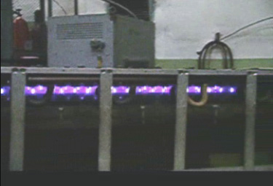
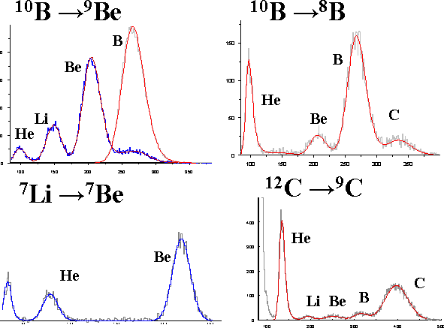
CO2 laser
SYNCHROPHASOTRON
Internal
target
Experimental hall 205
NUCLOTRON – 6 GeV/n
Experimental hall
Experimental hall 1B

Slide 17
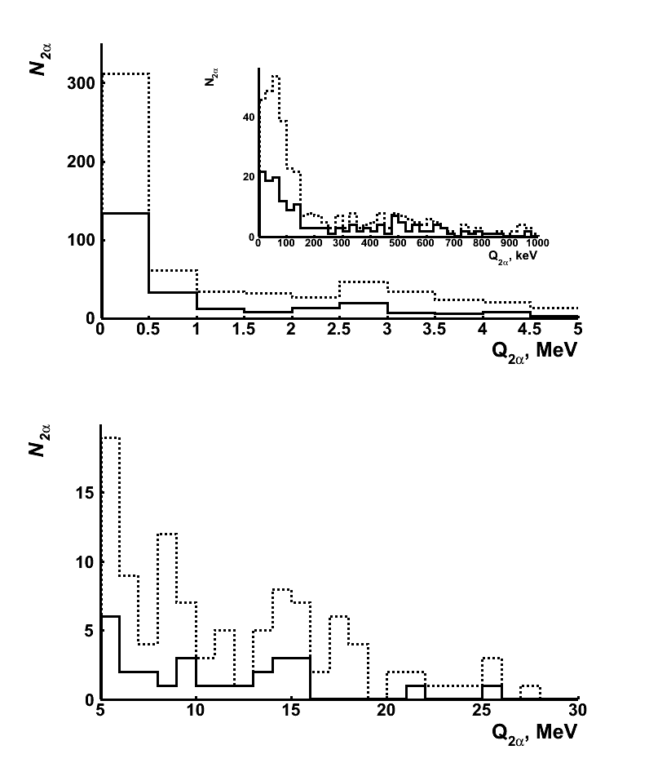
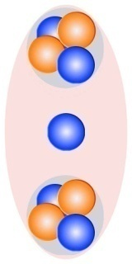
712 ⁹Be → 2α at 1.2 GeV per nucleon
⁸Be(0⁺)
⁸Be
⁹Be(2.43)
⁸Be(2⁺)
Q_{2α}, MeV

Slide 18
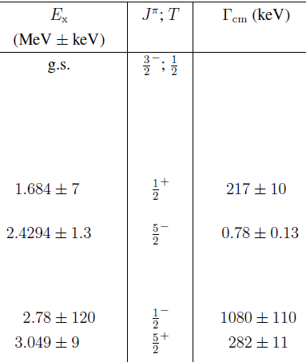
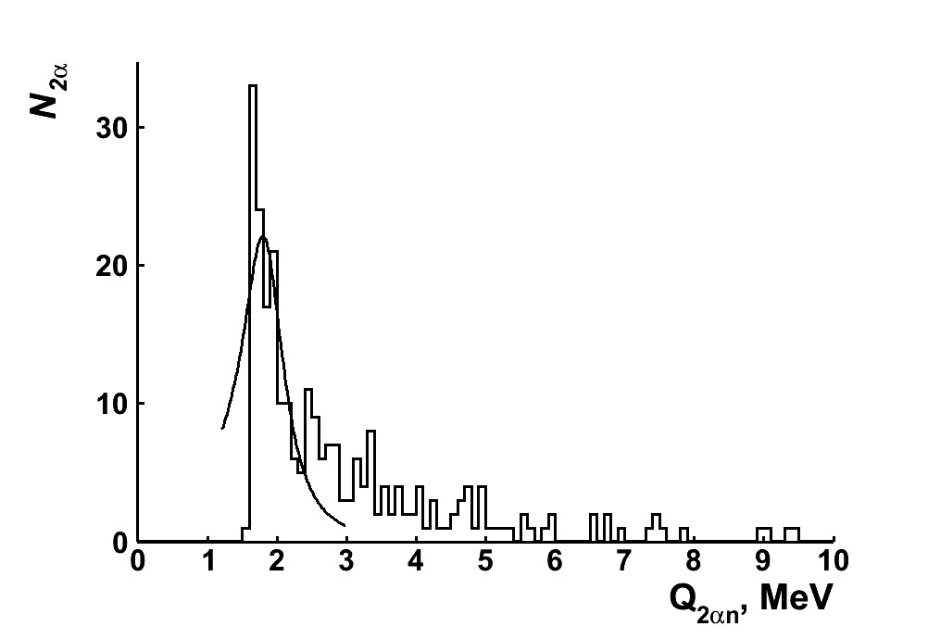

⁹Be∗(1.684) in ⁹Be → 2α
⁸Be(0⁺)n 1.665 MeV
Q_{2αn}, MeV
〈P_{T2α}〉in ⁹Be → 2α is about 10 MeV/c per nucleon is several times less than the Fermi momentum (100-200 MeV/c). P_{Tn} carried away by neutrons can be estimated and, then, Q_{2αn}. The resonance 1.80 ± 0.01 MeV consistent with ⁹Be∗(1.684). contributing 33 ± 4% to ⁹Be → ⁸Be(0⁺). ⁹Be(2.43) is than 4% of ⁹Be → 2α.

Slide 19
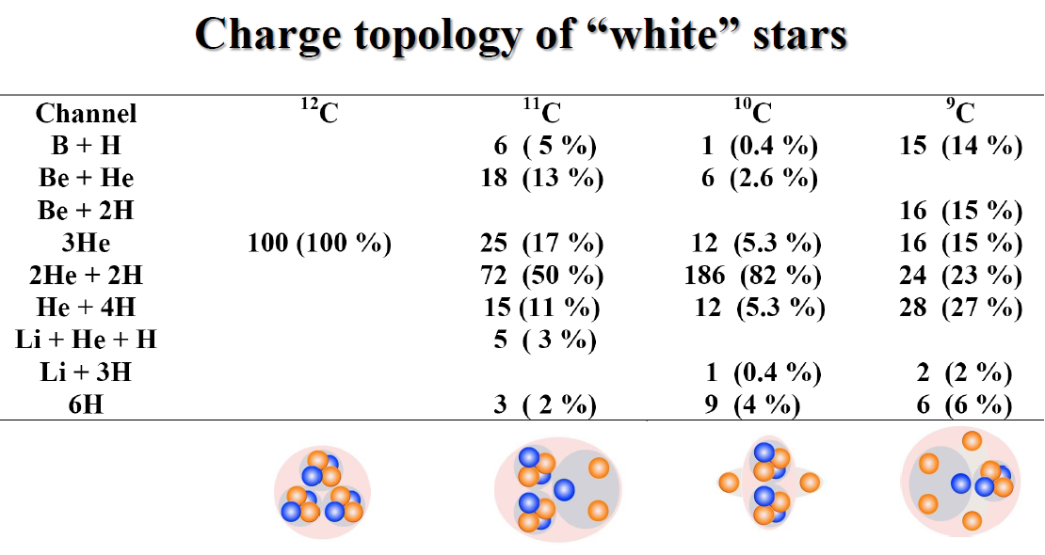
Coherent dissociation (or “white” stars)
at 1.2 GeV per nucleon

Slide 20

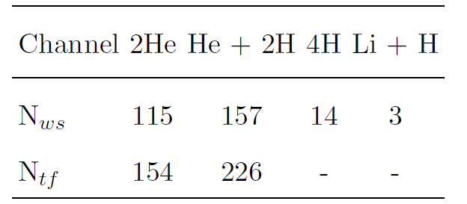
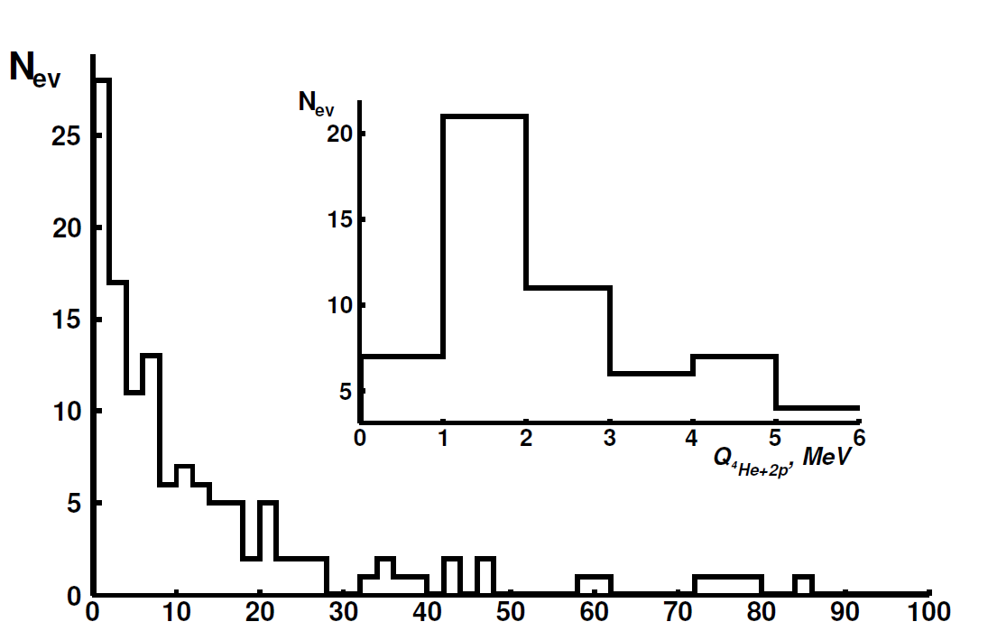
⁶Be(1.37) in ⁷Be dissociation at 1.2 GeV per nucleon
Q_{α2p}, MeV

Slide 21
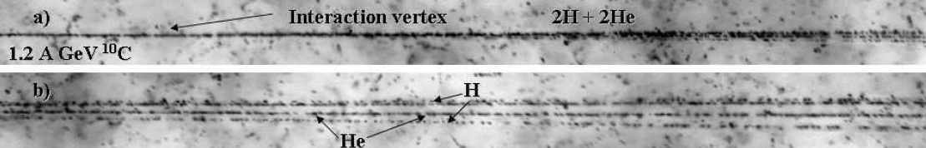
⁹B(0.185) in dissocaition of ¹⁰C, ¹¹C and ¹⁰B
Of 186 ¹⁰C “white” stars 2He + 2H. at 1.0 GeV per nucleon 30 ± 4% satisfy Q_{2αp}(⁹B) < 0.5 MeV.
〈Q_{2αp}〉 = 254 ± 18 keV RMS 96 keV.
In 318 ¹⁰B → 2He + H stars, 20 decays of Q_{2αp}(⁹B) < 0.5 MeV (50% ⁸Ве) and 22 in 154 ¹¹C → 2He + 2H (66% ⁸Ве) were identified.
Q_{2αp}, MeV

Slide 22

The Hoyle state
The Hoyle state is the second excited state ¹²C(0⁺₂) at 378 keV above the 3α threshold. The ⁸Be(0⁺) inevitably appears in ⁹B and Hoyle state decays. The isolated position of ¹²C(0⁺₂) at the beginning of the excitation spectrum and the width of 9.3 eV indicate it as a 3α analogue ⁸Be(0⁺).

Slide 23




Slide 24


¹²C(0⁺₂) and ¹²C (3⁻) in 510 ¹²C → 3α
Q_{2α}(⁸Be) < 200 keV
Q_{3α}, MeV
7.275 3α
The 1st peak〈Q_{3α}〉(RMS) = 417 ± 27 (165) keV is ¹²C(0⁺₂), and the 2nd σ (Q_{3α}) = 2.4 ± 0.1 MeV – ¹²C(3⁻).
The contributions of ⁸Be(0⁺), ¹²C(0⁺₂) and ¹²C(3⁻) are 43 ± 4, 11 ± 2, 19 ± 2%.
The contribution to ⁸Be(0⁺) of ¹²C(0⁺₂) is 26 ± 4%, and ¹²C(3⁻) is 44 ± 6% and their ratio is 0.6 ± 0.1.

Slide 25

¹²C(0⁺₂) in 641 “white” stars ¹⁶O → 4α
N_{HS}(¹²C)/N_{8Be}(¹²C) = 0.36 ± 0.06
N_{HS}(¹⁶O)/N_{8Be}(¹⁶O) = 0.35 ± 0.04
Q_{3α}, MeV
Distribution of the number of 3α-triples N_{3α} over the invariant mass Q_{3α} of 316 “white” stars ¹²C → 3α (solid) and 641 “white” stars ¹⁶O → 4α (dashed) at 3.65 A GeV. The α-particle enhancement ⁸Be(0⁺) and ¹²C(0⁺₂) allows to assume the fusion 2α → ⁸Be(0⁺)α → ¹²C(0⁺₂)α → ¹⁶O(0⁺₆).

Slide 26


Q_{4α,} MeV

Slide 27


15.095 keV Γ = 165 keV
Just 296 keV !
The search for the decay ¹⁶O(0⁺₆) → ¹²C(0⁺₁)α is important in the context of nuclear astrophysical synthesis of the isotope ¹²C. It can serve as an alternative to the fusion ⁸Be(0⁺)α → ¹²C(0⁺₂) with the formation of e⁺e⁻ pairs or 2γ-decay 0⁺ → 2⁺ → 0⁺ with a probability of 1/2500. In the case of ¹⁶O(0⁺₆) → ¹²C(0⁺₁)α one of the α-particles in the quartet serves as a kind of catalyst, removing the need for an electromagnetic transition. The coexistence of the decays ¹²C(0⁺₂)α and ¹²C(0⁺₁)α within the 165 keV width of ¹⁶O(0⁺₆) cannot be ruled out.

Slide 28


¹⁶ O(0⁺₆) in ¹⁶O (4.5 GeV/c per nucleon) → ¹²Cα?
〈 Q_{12Cα}〉 = 15.1 ± 0.2 MeV RMS 0.6 MeV
Q_{12Cα}, MeV

Slide 29

A 1-meter liquid hydrogen bubble chamber of JINR placed in a magnetic provided measured 11000 interactions of ¹⁶O nuclei at P₀ = 3.25 GeV/c per nucleon with protons. To determine the charges of fragments, the equality to 9 of the sum of the charges is sufficient. Due to the approximate quantization P_{fr}, their mass numbers are determined by the ratios P_{fr}/ P₀.

Slide 30

The assumption of the dominance of the ¹²C(0⁺₁)α pair in the C + He topology is verified on the events C + He (+p). The contribution of the ¹³C + ³He events with a threshold of 22.8 MeV is negligible. In the P_{С}/P₀ projection, there are no signals of lighter C isotopes, and in the P_{He}/ P₀ projection, there are no signals of ³He, the formation of which would correspond to channels with thresholds above 30 MeV. The excitation of ¹²C(2⁺₁) can broaden of the P_{С}/P₀ distribution. Thus, the ¹²Cα channel dominates, which allowing neglecting the others.
Figure d shows the invariant mass distribution of Q_{12Cα} pairs for the events highlighted in Fig. a, in the approximation of conservation of the initial momentum per nucleon P0 by fragments. It contains events both near threshold resonances and in the ¹⁶O(0⁺₆) region.

Slide 31

Search for ⁹B and ¹²C(0⁺₂)
in 128 ¹⁴N → 3αp at 2 GeV per nucleon
The channel ¹⁴N → 3αp presents a half of peripheral interactions with the transfer of the primary charge to the fragmentation cone. It is a common source of ⁸Be(0⁺), ⁹B and ¹²C(0⁺₂). Transverse scanning of emulsion layers found 226 ¹⁴N → 3αp stars which 128 are measured including 29 “white” stars.

Slide 32

⁹B or ¹²C(0⁺₂): <Q_{3αp}> = 2.5 ± 0.1 MeV RMS 0.6 MeV

Slide 33

Au 10 GeV per nucleon

Slide 34



Slide 35


n_{α}

Slide 36



⁸⁴Kr 1 GeV per nucleon
Target Fragments: 3 Mesons: 5 Progectile Fragment Charge > 23 (He – 7, H - 9)

Slide 37


Projectile neutrons in ⁸⁴Kr fragmentation
near 1 GeV per nucleon
σ_{py} = 35 ± 7 MeV/c
Y, mm
X, mm
P_{y}, MeV/c

Slide 38

Nuclotron December 2022
¹²⁴Xe 3.8 GeV per nucleon

Slide 39


Nuclotron
December
2022
¹²⁴Xe
3.8 A GeV
Baryon fraction
Baryon density, Fermi⁻³

Slide 40

















¹²B 20 ms
¹²Be 23 ms
¹⁰Be 1510000 y
¹¹Be 13.8 s
⁸Li 838 ms
⁹Li 178 ms
0⁺
0⁺
¹¹Li 8.5 ms
⁶He 807 ms
⁸He 119 ms

Slide 41



f6
3v
f5
VP-1
f4
VP-1
f3
Target: 5-8 g/cm², polyeth.

Slide 42

(Charge Exchange)²

Slide 43
Highlights of Highlights
Productivity of the nuclear emulsion method in studies nuclear clustering and states of the lowest density and temperature is confirmed.
Determination of the invariant masses from the fragment emission angles assuming conservation of momentum per nucleon of the parent nucleus allowed identifying the decays of ⁸Be(0⁺), ⁸Be(2⁺), ⁹Be(1.7), ⁹B, ⁶Be, ¹²С(0⁺₂), and ¹²C(3⁻).
The observations of ⁸Be(0⁺) and ¹²С(0⁺₂) points out that conditions of nuclear astrophysics can be reproduced in the relativistic fragmentation.
Despite relativistic scale unstable states may emerge in final state interactions of lowest energy nuclear physics.
Progress in microscope image analysis opens up new horizons to the method in nuclear structure studies.
Such a development stays on foundations laid in cosmic ray physics more than seven decades ago.

Slide 44



Slide 45

Trento 2019

Slide 46

2025 https://start.jinr.ru/

Slide 47


Slide 48



2.0 A GeV ¹¹B→⁴Не+⁷Be
The number of events with target fragments in the ¹⁴N→3He + H channel is twice the statistics of the ¹⁴N→3He channel, coinciding with the ¹⁰B→2He (+H) case, indicating a broader spatial distribution of neutrons compared to protons. This observation deserves to be applied to the fragmentation of neutron-rich nuclei, starting from ¹¹B, to explore effects induced by a neutron halo in them.

Slide 49

2006 Nuclotron ¹¹B at 2 GeV per nucleon

Slide 50


¹⁶O (3.65 & 14.4 GeV per nucleon) → ¹²Cα

