Slide 1
Jets and quarks at the NICA collider
A.I. Malakhov
The XXVIth International Baldin Seminar on High Energy Physics Problems “Relativistic Nuclear Physics and Quantum Chromodynamic”
September 15-20, 2025 г.

Slide 2
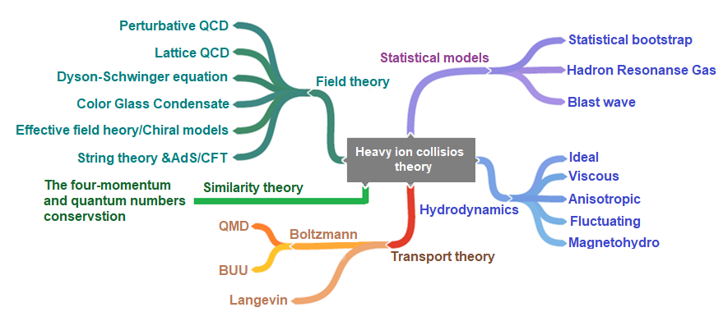
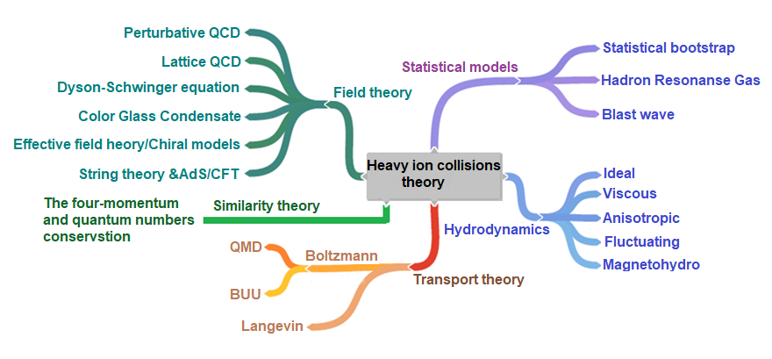

Slide 3
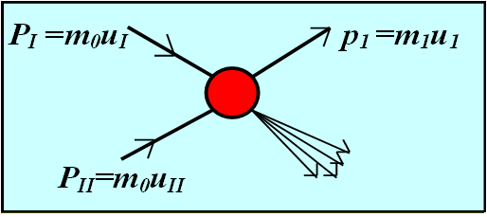
I + II→1 + …
(N_{I}P_{I} + N_{II}P_{II} – p₁)² = (N_{I}m₀ +N_{II}m₀ + M)²
N_{I} and N_{II} are the parts of the transferred
four-momenta of nucleons participating in nuclei I and II.
M is the mass of the particle providing conservation of quantum numbers.

Slide 4
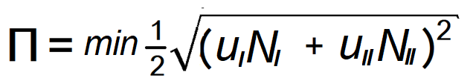
A.M. Baldin, A.A. Baldin.Phys. Particles and Nuclei,
29(3), 1998, 232
I + II→1 + …
u_{I} and u_{II} are four velocities of the nuclei I and II.

Slide 5
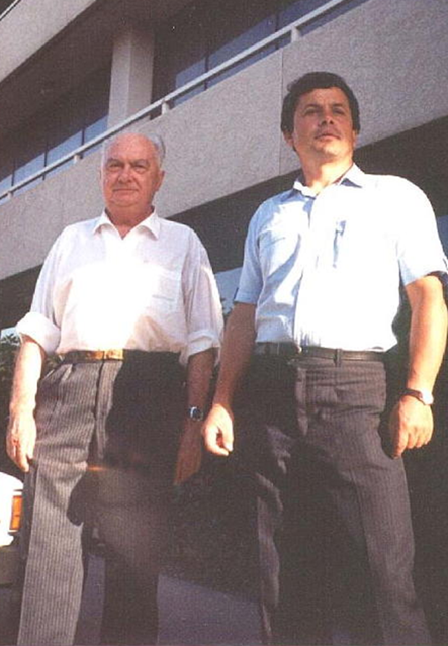
A.M. Baldin, A.I. Malakhov. Relativistic Multiparticle Processes in the Central Rapidity Region at Asimptotically High Energies. JINR Rapid Communications, 1 [87]-98 (1998) 5-12.
An analytical solution has been obtained for the similarity parameter in the central rapidity region (y =0):
Rapidity of interacting nuclei
Similarity Parameter
П = N∙ChY
Part of the transferred
four-momentum
(The Baldin-Malakhov equation)

Slide 6
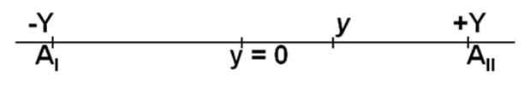
In the mid-rapidity region (y=0, y is the rapidity of particle 1) the analytical form for П was found:
In this case N_{I} and N_{II} are equal to each other: N_{I} = N_{II} = N.
N = [1 + (1 +Ф_{М} /Ф²)^{1/2}]Ф,
where
Ф = (m_{1t} chY +M)/2m₀sh²Y,
Ф_{м} = (M² − m²₁)/(4m²₀· sh²Y )
m_{1t} = (m²₁+p_{t}²)^{1/2},
Y – rapidity of interacting nuclei.
П = N∙ChY

Slide 7
Ratio of antiparticle to particle yields

Slide 8
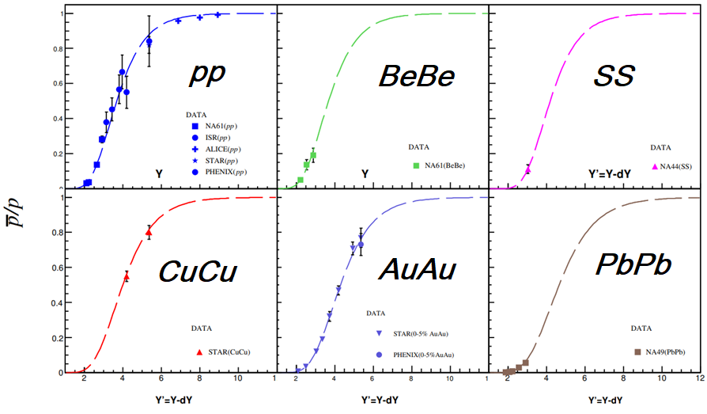
Description of the yield ratios of anti-p/p with one value of constant C₂=0.146 taking into account dY (Y) dependences.

Slide 9
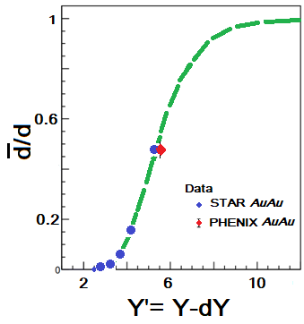
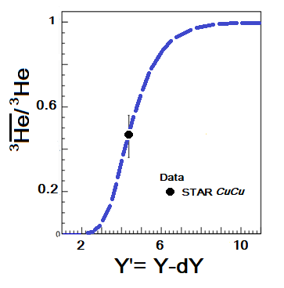
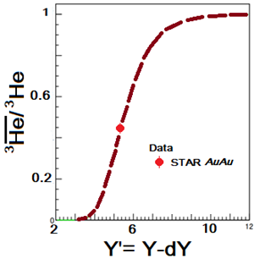
Description of the yield ratios of anti-d/d, anti-He³/He³ with one value of constant C₂=0.146.
A.I. Malakhov and A.A. Zaitsev. Journal of Experimental and Theoretical Physics, 2022, Vol. 135, No. 2, pp. 209–214.

Slide 10
Description of the spectra of secondary particles depending on P_{T} in a wide range of energies

Slide 11
E∙(d³σ/dp³) = (1/π) d³σ /(dm_{1t}²dy)=
= [φ_{q}(y,p_{t}) + φ_{g}(y,p_{t})∙(1- σ_{nd}/g(s/s₀)∆)]∙g(s/s₀)∆
σ_{nd} – cross-section of hadron production by the exchange of n-pomerons.
g – constant (~20 mbarn), S₀ ~ 1 GeV²,
∆ = [α_{p}(0)-1] ~ 0,08
G.I.Lykasov proposed to use functions depending on the similarity parameter П as functions φ(y,p_{t}) :

Slide 12
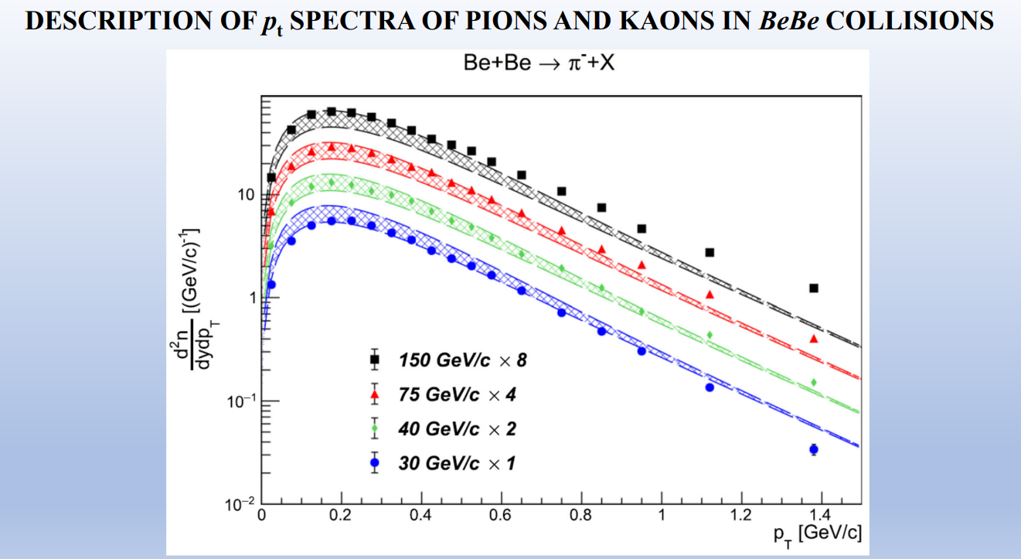
G. I. Lykasov, A. I. Malakhov, A. A. Zaitsev. Ratio of kaon-to-pion production cross-sections in BeBe collisions as a function of √s. Eur. Phys. J. A (2022) 58:112

Slide 13
Energy dependence of the slope parameter on energy

Slide 14
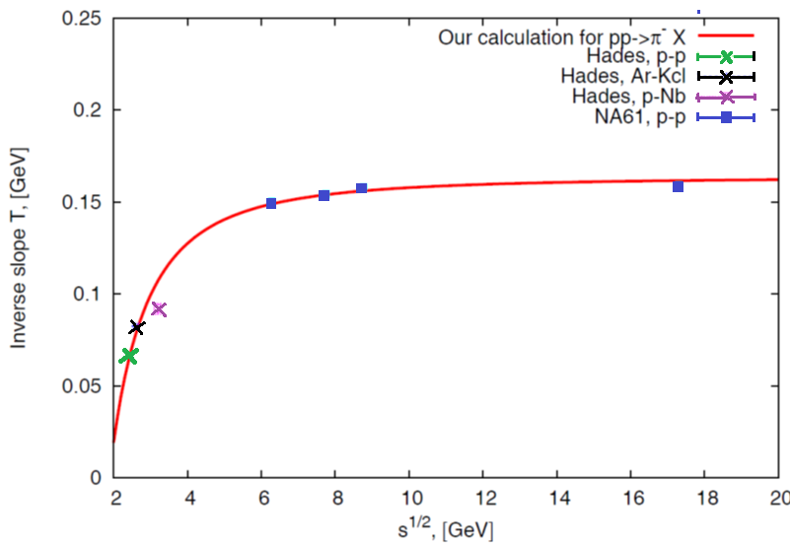

E(d³σ/dp³) ~ exp (-m_{t} /T) , T=Const
E(d³σ/dp³) ~ exp(- П/С₂) = exp(-m_{1t}/[С₂m₀(1-4m₀²/s)]
T = С₂m₀(1-4m₀²/s)
A. A. Abgrall et al. Eur.Phys.J., C74 (2014)
2794 (NA61).
G. Agakishiev et al. arXiv:1512.07070v1 [nucl-ex]
22 Dec 2015 (HADES).
G.I. Lykasov, A.I. Malakhov. Self-consistent analysis of hadron production in pp and AA collisions at mid-rapidity. Eur.Phys.J.A 54 (2018) 11, 187.

Slide 15
The ratio of the strange kaon yield to the pion yield

Slide 16
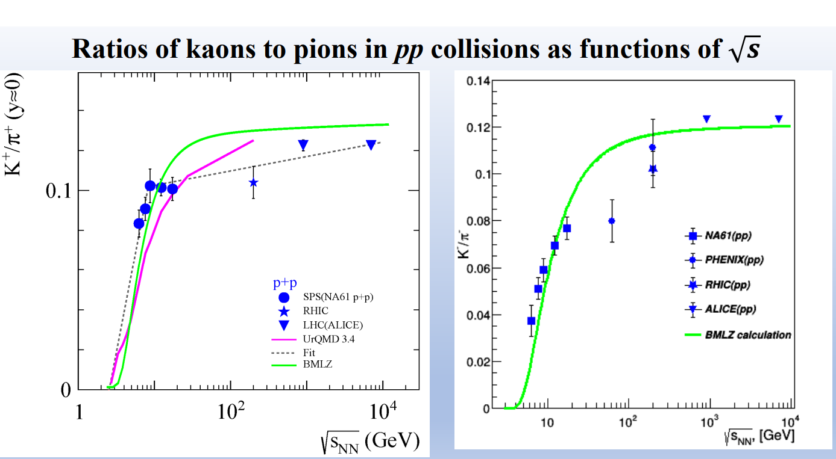
BMLZ – Baldin-Malakhov-Lykasov-Zaitsev model.
G.I. Lykasov, A.I. Malakhov, A.A. Zaitsev. Ratio of cross-sections of kaons to pions produced in pp collisions as a function of √s. Eur.Phys.J.A 57 (2021) 3, 91.

Slide 17
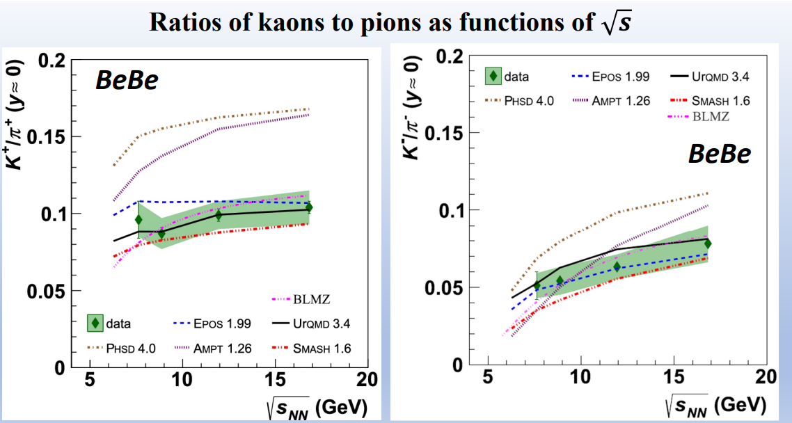
BMLZ (Baldin-Malakhov-Lykasov-Zaitsev) model:
Lykasov, G.I., Malakhov, A.I. and Zaitsev, A.A. Ratio of kaon-to-pion production cross-sections in BeBe collisions as a function of √s. Eur. Phys. J. A 58, 112 (2022).

Slide 18
Quarks

Slide 19
L.S.Schroeder et al. Phys. Rev. Lett., v.43, No.24, 1979, p.1787
р + Cu → π± + …
E·d³σ/dp³ = C·exp(-T/T₀),
T_{p} – kinetic energy of the proton
T – kinetic energy of the peony
b_{ik} = -(u_{i} – u_{k})²
b_{ik} = -(u_{p} – u_{Cu})² = - (p_{p}/m_{p} –p_{Cu}/m_{Cu})²= - (1- 2p_{p}p_{Cu}/m_{p}m_{Cu} + 1) =
= - 2(1-E_{p}E_{Cu}/m_{p}m_{Cu} + p_{p}p_{Cu}/m_{p}m_{Cu}) = -2(1- E_{p}/m_{p}) = 2(E_{p}/m_{p}-1) ≈
≈ 2(3,5-1) = 5
b_{ik} ≥ 5

Slide 20
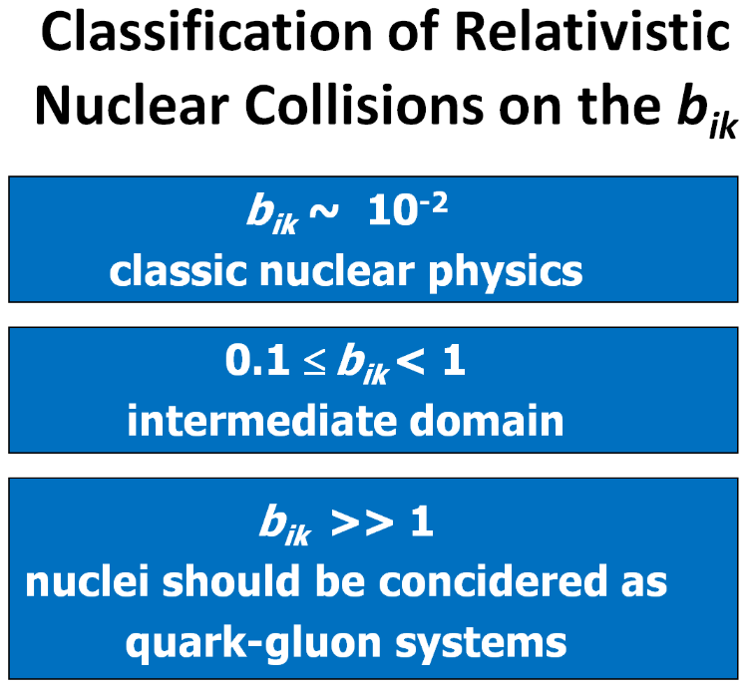

Slide 21
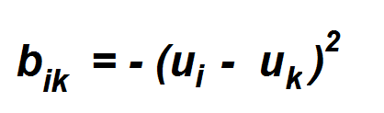
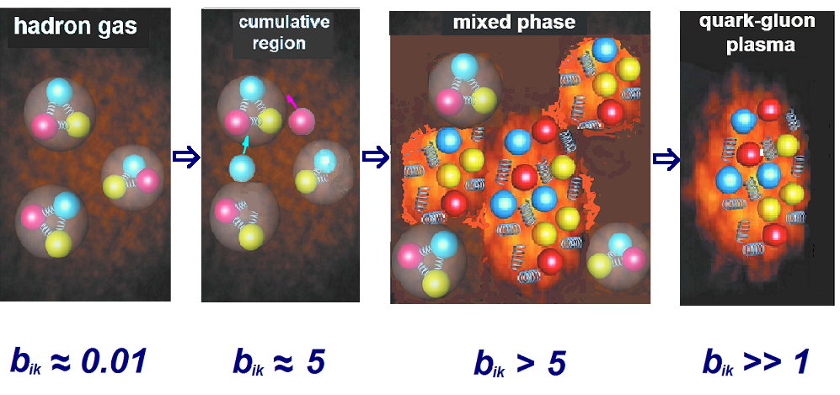

Slide 23
dσ/db_{I1} = A· exp(-b_{I1}/B)
As it possible see in figure asymptotic regime is beginning with pion momentum p_{π} ∼ 20 GeV.
b_{I II} = - (u_{π} – u_{p})² = - (1 - 2u_{π}u_{p} – 1)
= 2(u_{π}u_{p} -1) = 2(E_{π}/m_{π} – 1) = 2T_{π} /m_{π}
≅ 2∙ 20/0.139 ≅ 300.
A.I.Malakhov, G.L.Melkumov. JINR Rapid Commun., No.19-86 (1986) pp.32-39).

Slide 24
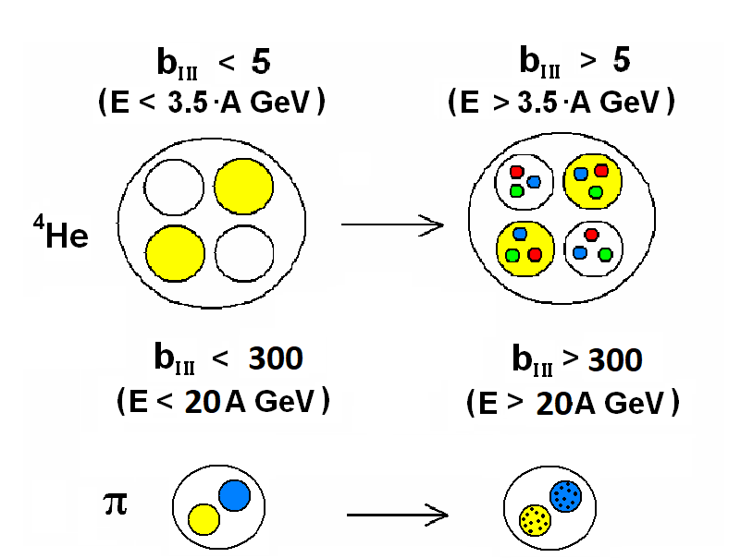
A. Malakhov. Internal degrees of the freedom of the nuclear matter. Nucl.Phys.B Proc.Suppl. 219-220 (2011) 281-283.

Slide 25
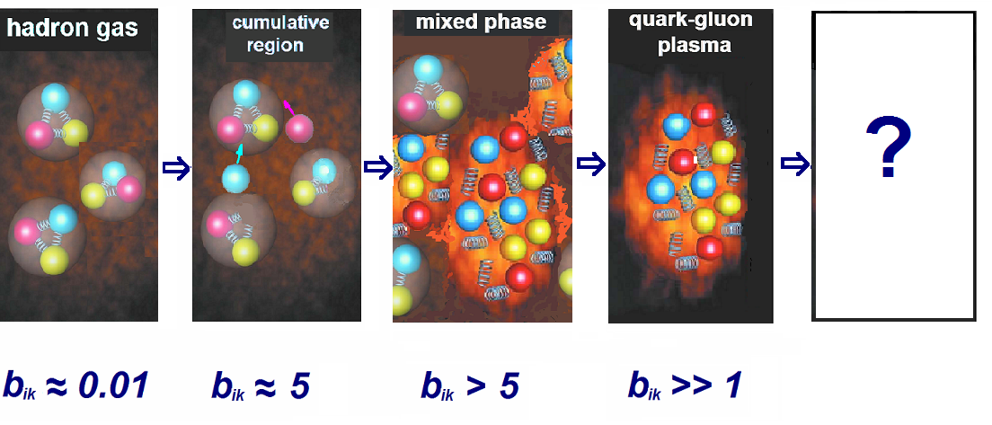

Slide 26
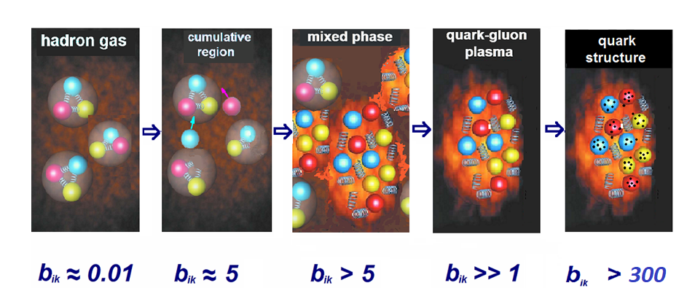

Slide 27




Consider the process:
We will consider protons to be composed of quarks:
M = 0 for π meson

Slide 28
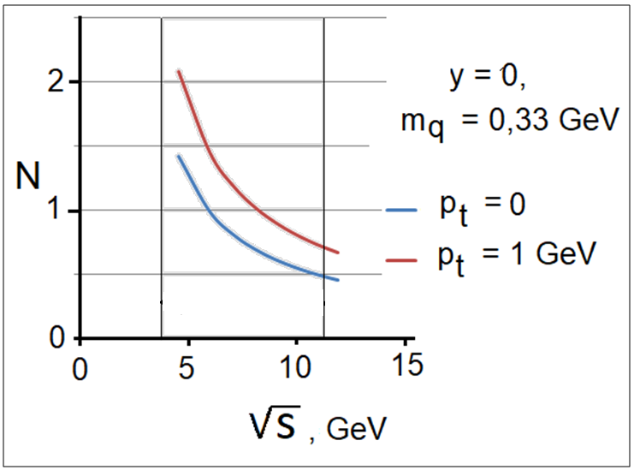
Let's perform calculations for N for a quark mass equal to the constituent m_{q}= 0.33 GeV, as a function of energy at p_{πt} = 0 (Fig. 1). The dependence is quite strong in the region of not very high energies. The energy region where N >1 appears to correspond to the capture of the gluon field of the neighboring quark. The energy region with N<1 corresponds to the interaction of a quark with the connection of some part of its gluon field.
Fig. 1. N vs. energy for a constituent quark (m_{q} = 0.33 GeV).

Slide 29
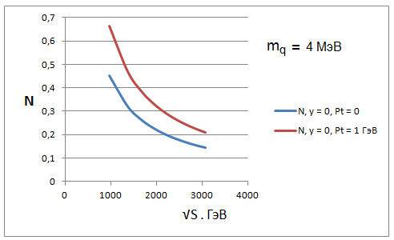
Let's calculate N for a quark mass equal to the mass of the "undressed" quark m_{q}=4 MeV, as a function of energy (Fig. 2). The "undressed" quark appears at higher energies, and the calculations are presented in the range of 1000 GeV < √S< 3000 GeV. The energy dependence of N in the region where N<1 can be interpreted as indicating that the quark is composite.
Fig. 2. N vs. energy for a «undressed» quark (m_{q} = 4 MeV).

Slide 30
In the energy region between the energies shown in Fig.1 and Fig.2 (from hundreds of MeV to thousands of MeV), the quarks gradually shed their gluon field ("undress"). In other words, the mass changes from 0.33 GeV to 4 MeV.

Slide 31
Jets

Slide 32
Invariant definition of hadron jets
In this approach, the jet is considered as a group (cluster) of hadrons with small relative four-dimensional velocities b_{ik}.
The axis of the jet is a single four-dimensional vector V(V₀, V):
The summation is performed for all particles belonging to the selected group of particles (cluster).
The four-dimensional velocity of a particle relative to the jet axis:
b_{k} = - (V – u_{k})² .

Slide 33
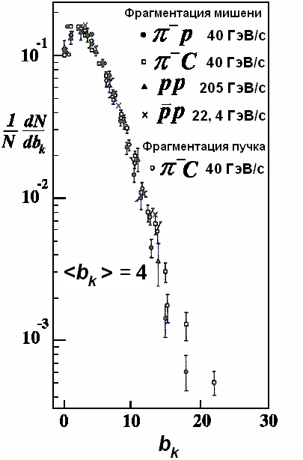
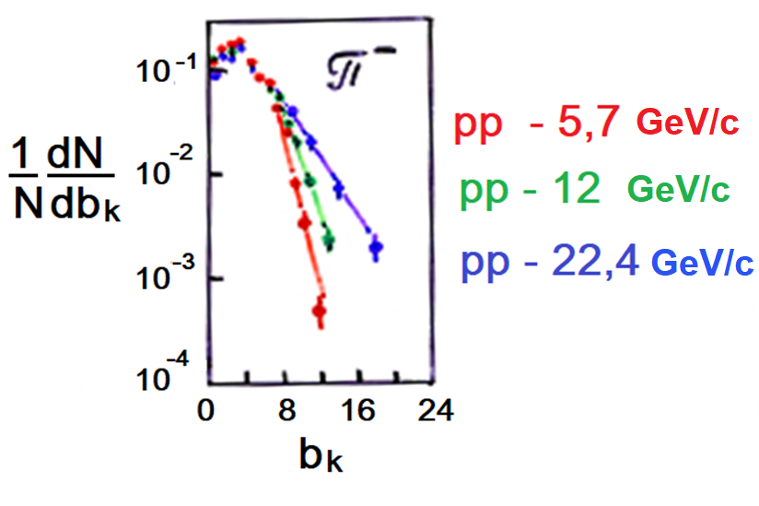
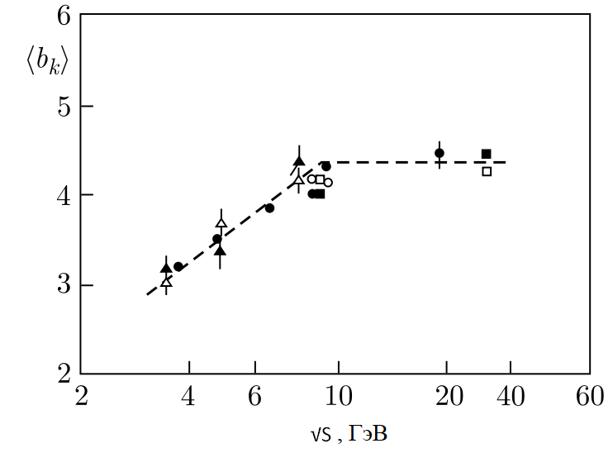
A.M. Baldin, B.V. Batiunja et al. Four-dimensional jets as universal characteristics of multiple particle production. JINR Rapid Comm. No.16-86, 1986, p. 24-32.

Slide 34
A.M. Baldin and L.A. Didenko. Asymptotic Properties of Hadrton Matter in Relative Four-Velocity Space. Fortschr.Phys. 38 (1990) 4. 261-332.
The discovered universality of the properties of four-dimensional hadron jets points out that the hadronization of quark systems is defined by the dynamics of interaction of a color charge with QCD vacuum.

Slide 35
Н.Н. Боголюбов о подходе А.М. Балдина.

Slide 36




Consider a hadron jet as a cluster of hadrons with small relative four-dimensional velocities b_{ik}.
Then, for a jet produсed in the central rapidity region, we can use the formulas obtained for the production of particles in nuclear interactions:
m_{jet} - mass of the hadron jet
m_{jet(t)} - transverse mass of the hadron jet
p_{jet(t)} - transverse momentum of the hadron jet

Slide 37




Consider a hadron jet as a cluster of hadrons with small relative four-dimensional velocities b_{ik}.
If the jet consists of π-mesons alone. Then M = 0.
If A₁ = A₂ = A in the central region of the speed:
С₁ = 1,9∙10⁴ mbGeV⁻²с³ , С₂ = 0,146

Slide 38
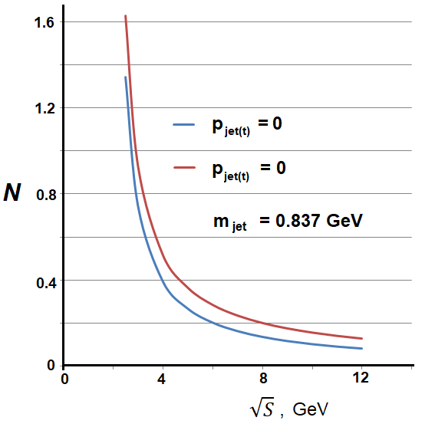

Slide 39
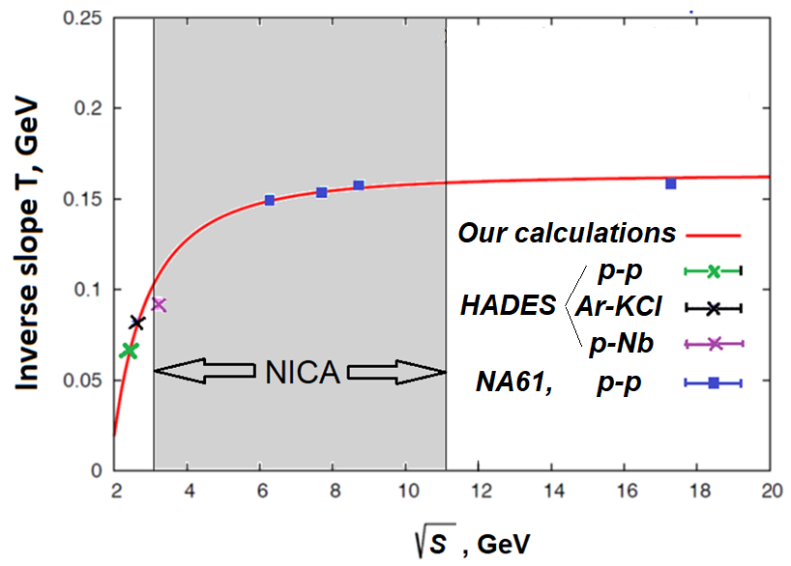
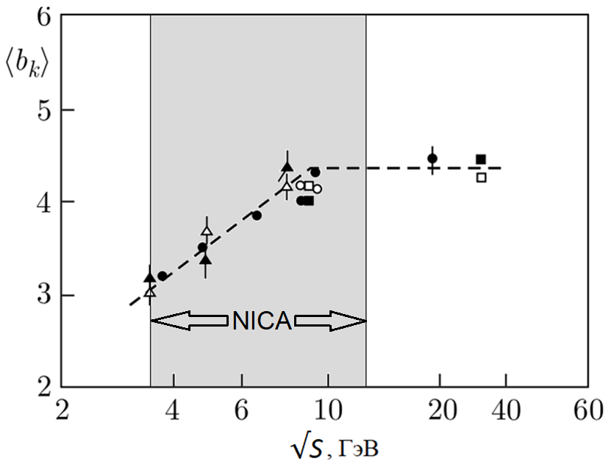
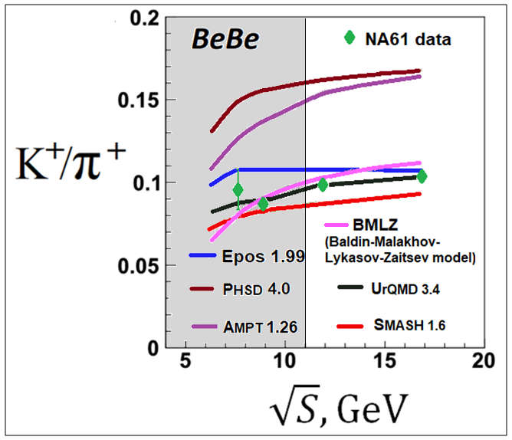
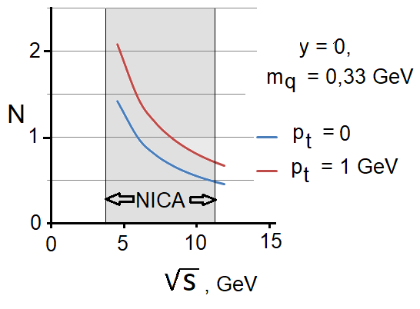
All the interesting effects lie in the energy range of the NICA collider

Slide 40
Thank you for the attention!

Slide 41
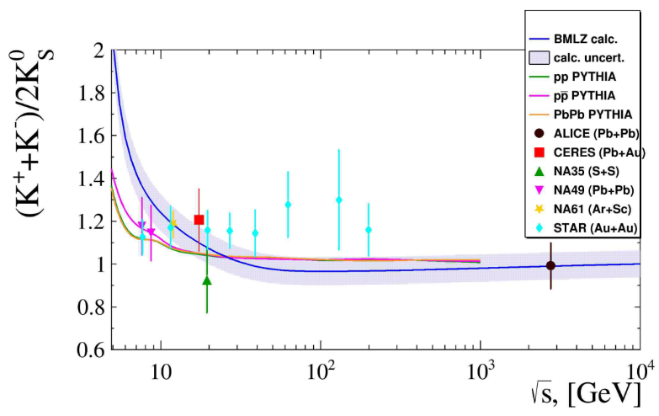
The production of K⁺ meson in pp and AA collisions appears together with Λ₀ baryon due to the strangeness conservation (M = m_{Λ}�− m₀). K⁻ meson is produced together with K⁺ (M = m_{K}).
Gennady Lykasov. K-mesons production and isospin-symmetry in pp and AA collisions. Report on September 19 at the current Baldin Seminar.

Slide 42
