Slide 1


EXACT SOLUTIONS IN KINETIC THEORY OF THE VACUUM PARTICLE PRODUCTION IN SF QED AND GRAPHENE
D. V. Churochkin, V. V. Dmitriev,
S. A. Smolyansky, and V. A. Tseryupa.
Institute of Physics, Saratov State University, Russia
DUBNA, 15 – 20 September 2025.

Slide 2
Contents
Preamble
Exact Solution Method (ESM)
Direct Diagonalization Method (DDM)
Summary

Slide 3
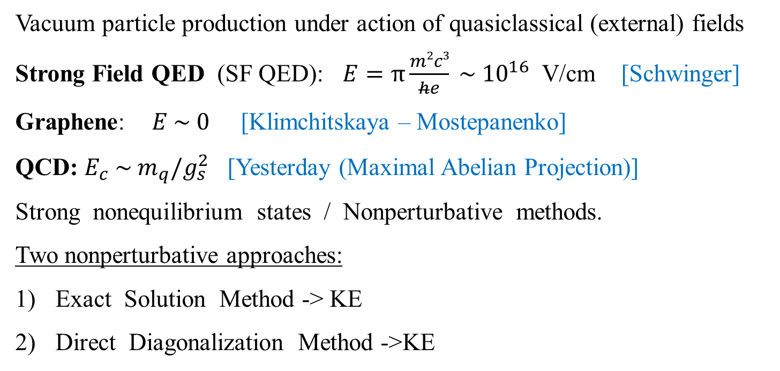
1. Preamble
Vacuum particle production under action of quasiclassical (external) fields
Strong Field QED (SF QED): $E=π\frac{m2c3}{he} \sim {10}^{16}$ V/cm [Schwinger]
Graphene: $E \sim 0$ [Klimchitskaya – Mostepanenko]
QCD: $E_{c} \sim { m}_{q}/g_{s}^{2}$ [Yesterday (Maximal Abelian Projection)]
Strong nonequilibrium states / Nonperturbative methods.
Two nonperturbative approaches:
Exact Solution Method -> KE
Direct Diagonalization Method ->KE

Slide 4
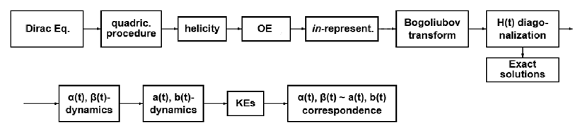
1. Preamble. Common Scheme
Exact Solution Method
Direct Diagonalization Method

Slide 5




1. Preamble. Graphene. Dirac Equation
Graphene in the space homogeneous time-dependent electric ﬁeld described by the vector potential
Dirac Equation
where - Fermi velocity
- are the Pauli matrices

Slide 6





2. ESM. Quadrical procedure
The corresponding quadrical equation allows the complete separation of variables and leads to the next set of particular solutions of the equation
where
and are the eigenvalue and eigenmatrix of the spectral problem where is helicity and

Slide 7




2. ESM. Oscillator equation
The function obeys following oscillator equation with depending on time complex-valued frequency
where the quasienergy is
To avoid overdetermination of solutions with fixed helicity and separated positive and negative energy states we replace

Slide 8





2. ESM. Helicity
Asymptotic behavior of oscillator Eq. solution
where
As result, in the asymptotic limit, the helicity simultaneously defines a state with either positive or negative
energy.

Slide 9




2. ESM. in-representation
The occupation number in-representation with time-independent creation and annihilation operators of the electrons and holes and the stationary vacuum state |0⟩ in-representation can be introduced on the basis of the functions . The corresponding field operator will be equal
Hamiltonian in the momentum representation

Slide 10




2. ESM. Bogoliubov transformation
Transition from in-representation to the adiabatic number representation with time-dependent creation and annihilation operators of the electrons and holes defined on time-dependent vacuum state perform with help of Bogoliubov transformation
with condition

Slide 11




2. ESM. Hamiltonian diagonalization
Transition to the quasiparticle representation (QPR) based on diagonalization of the Hamiltonian in the adiabatic number representation. It brings to the condition in the form of the quadratic equation
Using the identity one obtains the spectral
Density Finally, the relation with the sign «+», corresponding to the asymptotic brings to the Hamiltonian in QPR

Slide 12


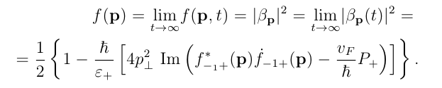

2. ESM. Exact solutions
Exact solutions of the primordial problem can be obtained now by means of the equalization of the distribution function
in the out-state and the special density in the out-state
It is assumed that the asymptotic solutions
of the oscillator Eq. are well known for different fields models.

Slide 13
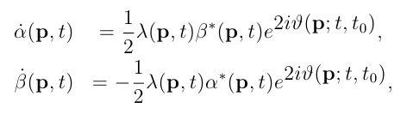


2. ESM. Dynamics in QPR
Acting by analogy with SFQED we obtain the equations of motion of the Heisenberg type
where
There is a definite correspondence exists between the dynamical description of the system in the algebraic space F of the creation and annihilation operators in the ANR and in the Bogoliubov space B of the canonical transformation coefficients

Slide 14






2. ESM. Kinetic Equation
The equations of motion in the F-space
leads to the basic KE in the integrodifferential form
or equivalent system of three ODEs

Slide 15

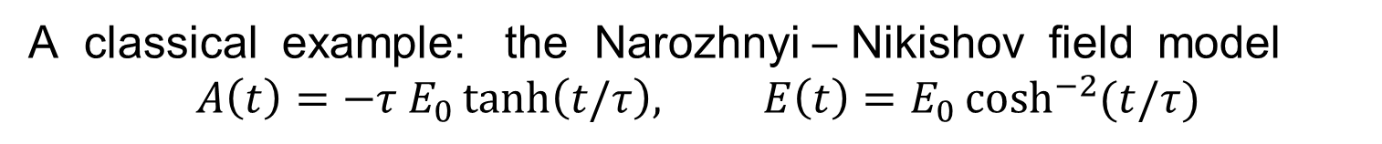
2. ESM. Example
A classical example: the Narozhnyi – Nikishov field model
$$A\left(t\right)=−τ E_{0}\tanh\left(t/τ\right), E\left(t\right)=E_{0}\cosh^{−2}{(t/τ)}$$
The exact solution in Graphene [Klimchitskaya – Mostepanenko]
$$f(\vec{p},t)={\left\lfloor β_{p}\left(t\right)\right\rfloor }^{2}=\frac{P+2p_{∥}}{2P}−\frac{4ℏ}{v_{F}}\frac{p_{⊥}^{2}}{P}Im(f_{−1}^{∗}f_{1})$$
where

Slide 16
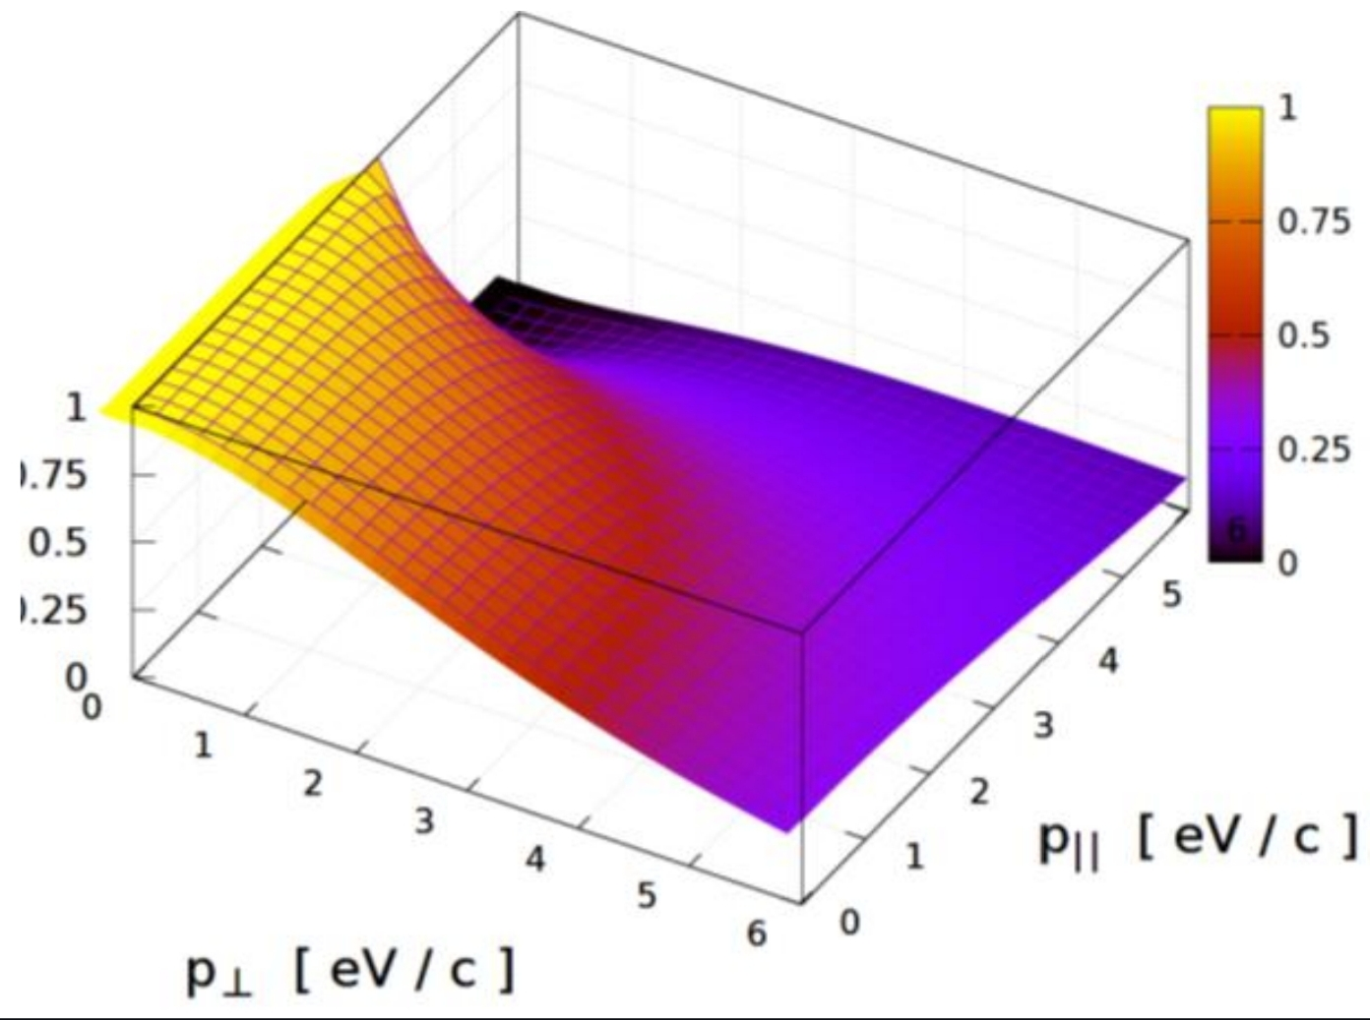
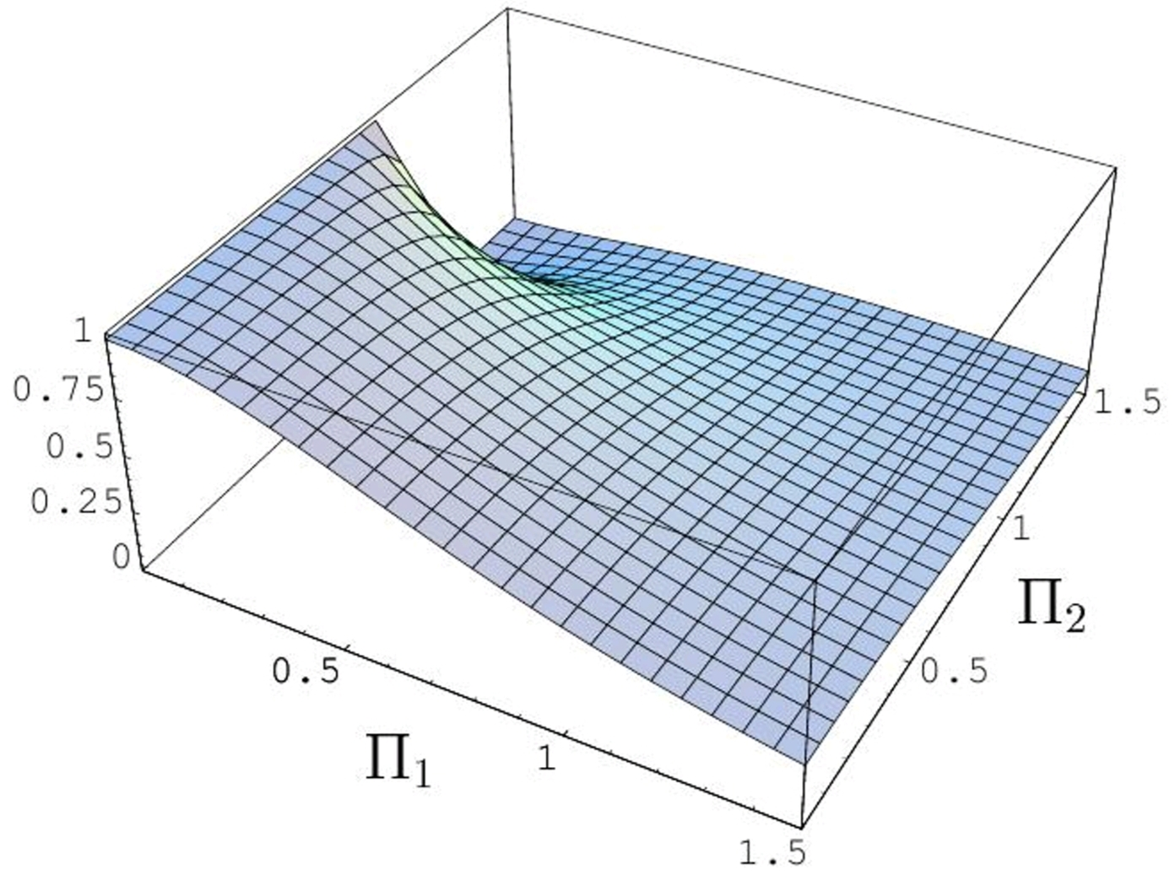
2. ESM. Example
Distribution function of electrons in out-state (as function of electron momentum):
$f_{out}\left(\vec{p}\right)=$

Slide 17
3. Direct diagonalization method (DDM)
The alternative approaches in the kinetic theory of particle vacuum production are consequences of some unobvious assumptions of ESM. [Schubert, Li et al].
DDM is an essentially independent approach in the strong field kinetics which leads to the canonical KE.
DDM was introduced in [Dora, Meisner] for description of the graphene conductivity in the non-analytical domain.
Then the method was used for construction of the strong field kinetic theory (SF KT) in the graphene in the work [Blaschke, Dmitriev, Smolyansky et. al].

Slide 18






3. DDM. Plane wave decomposition
The Hamiltonian function in the graphene
where The plane wave decomposition of the spinor
translates the Hamiltonian in the momentum representation
where

Slide 19





3. DDM. Diagonalization
On this stage it is proposed to fulfil diagonalization of the matrix . by means of the unitary transformation
The structure of r.h.s. of this equation is postulated. Then it can to find this unitary transformation
where

Slide 20


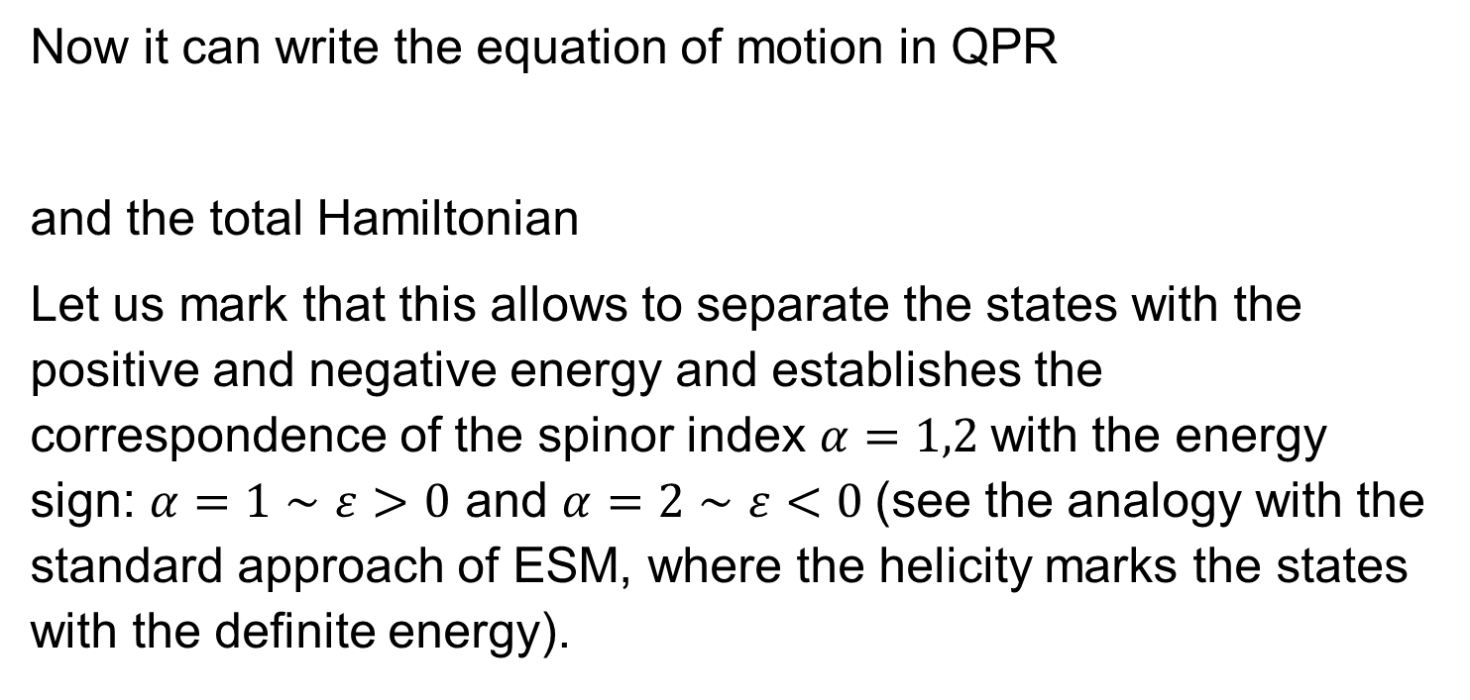
3. DDM. Energy sign
Now it can write the equation of motion in QPR
and the total Hamiltonian
Let us mark that this allows to separate the states with the positive and negative energy and establishes the correspondence of the spinor index $α=1,2$with the energy sign: $α=1∼ε>0$ and $α=2∼ε<0$(see the analogy with the standard approach of ESM, where the helicity marks the states with the definite energy).

Slide 21


3. DDM. Occupation number representation
This remark permits to introduce the dependent occupation number representation
and the corresponding orthonormalized eigenfunction system
that is analogue of solution of quadrical Eq. It leads to the standard form of the field operator and the Hamiltonian ESM, supplemented by the system of the anticommutation relations.

Slide 22
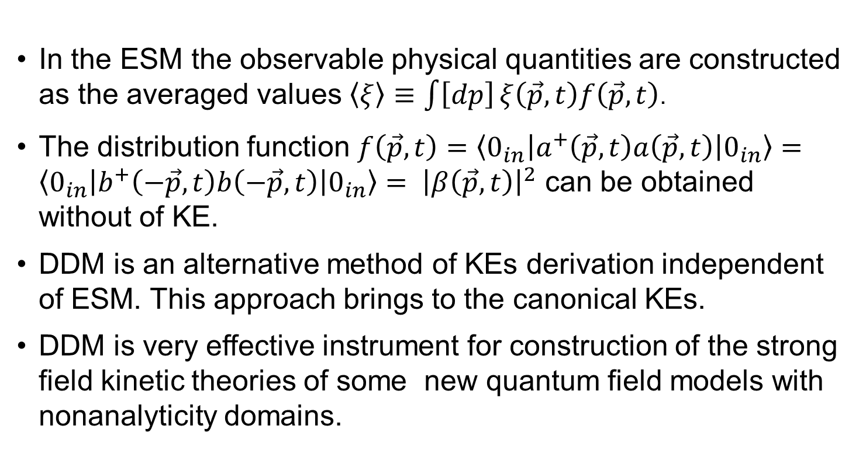
4. Summary
In the ESM the observable physical quantities are constructed as the averaged values $\left\langle ξ\right\rangle ≡\int{\left[dp\right]}ξ\left(\vec{p},t\right)f\left(\vec{p},t\right)$.
The distribution function $f\left(\vec{p},t\right)=\left\langle 0_{in}\left|a^{+}\left(\vec{p},t\right)a\left(\vec{p},t\right)\right|0_{in}\right\rangle =\left\langle 0_{in}\left|b^{+}\left(−\vec{p},t\right)b\left(−\vec{p},t\right)\right|0_{in}\right\rangle = {\left|β\left(\vec{p},t\right)\right|}^{2}$ can be obtained without of KE.
DDM is an alternative method of KEs derivation independent of ESM. This approach brings to the canonical KEs.
DDM is very effective instrument for construction of the strong field kinetic theories of some new quantum field models with nonanalyticity domains.

Slide 23

THANK YOU FOR ATTENTION !

Slide 24
References
J. Schwinger. Phys. Rev., 82, 664, 1951.
2. A.I. Nikishov. Problems of the external field in Quantum Electrodynamics. QED phenomena in an intense field. In Proceedings of the Lebedev Phys. Inst, 1979.
3. A.A. Grib, S.G. Mamaev, V.M. Mostepanenko. Vacuum Quantum Effects in Strong External Fields, 1994.
4. B. Dora, R. Moessner. Phys Rev. B, 81, 165431, 2010.
5. G.L. Klimchitskaya, V.M. Mostepanenko. Creation of quasiparticles in graphene by a time-dependent electric field. Phys. Rev. D 87, 125011, 2013.
6. Z.L. Li, Y.J. Li. Nonadiabatic quantum Vlasov equation in spinor QED. Physical Review D 110, 116029, 2024.

