Slide 1
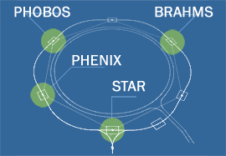
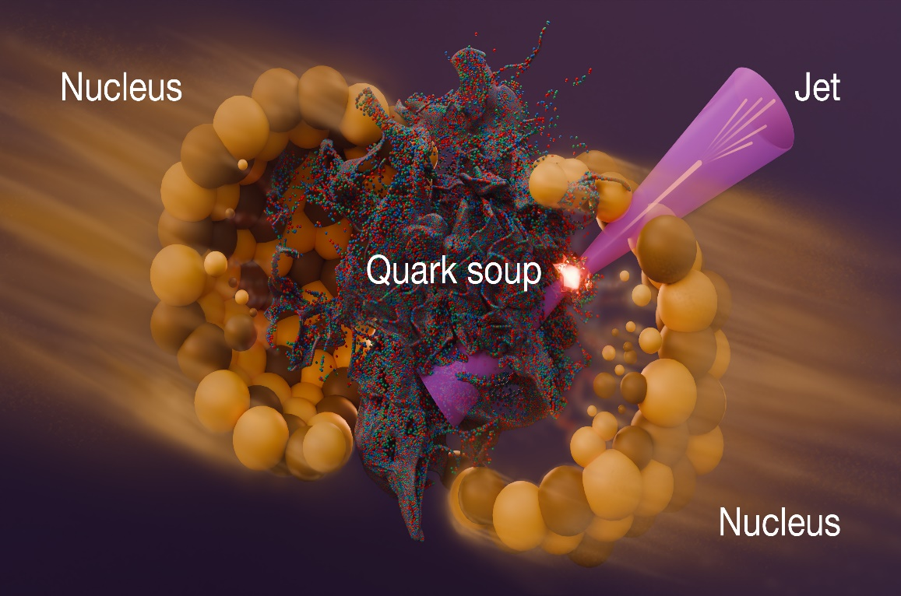
25 years of Heavy-Ion Physics at the RHIC
Arkadiy Taranenko ( ataranenko@jinr.ru)
The XXVIth International Baldin Seminar on High Energy Physics Problems "Relativistic Nuclear Physics and Quantum Chromodynamics", JINR, September 15-20, 2025

Slide 2
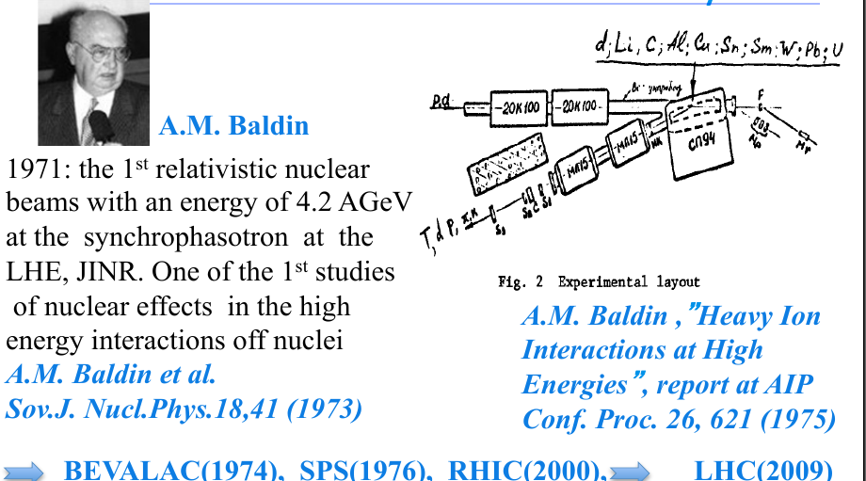
Relativistic Nuclear Physics: born in JINR
QGP
>100000 of times
hotter than the Sun’s core !

Slide 3
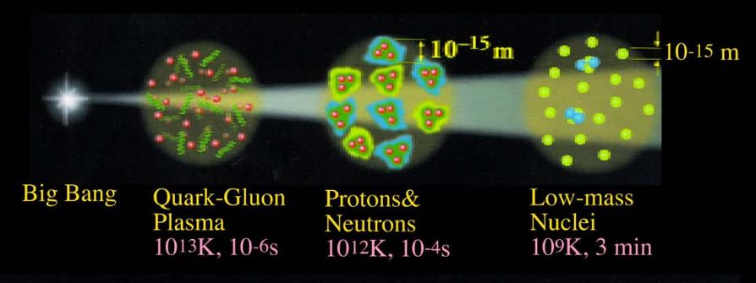
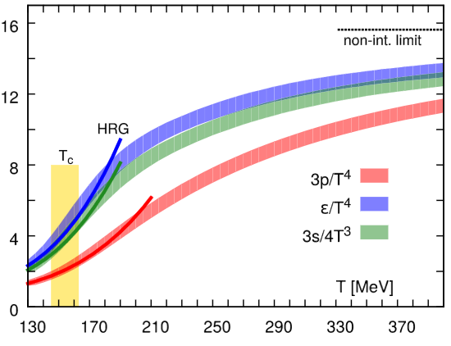
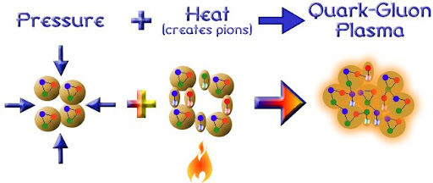
Quark Gluon Plasma (QGP) and Relativistic Heavy-Ion Collisions
[PRD 90 094503 (2014)]
Energy density ε
Pressure p
Entropy density s
QGP is the primordial form of QCD matter at high temperature or baryon density.
It was present during the first few microseconds of the Big Bang.
It can provide important insights on the origin of mass for matter, and how quarks are confined into hadrons.
It provides an example of phase transitions which may occur at a variety of higher temperature scales in the early universe.
Temperature T_{C} = 156 +/- 9 MeV
and energy density ~2 GeV/fm³ (10¹⁵ g/cm³)
M. Gyulassy, Nucl. Phys. A750, 30-63, 2005

Slide 4
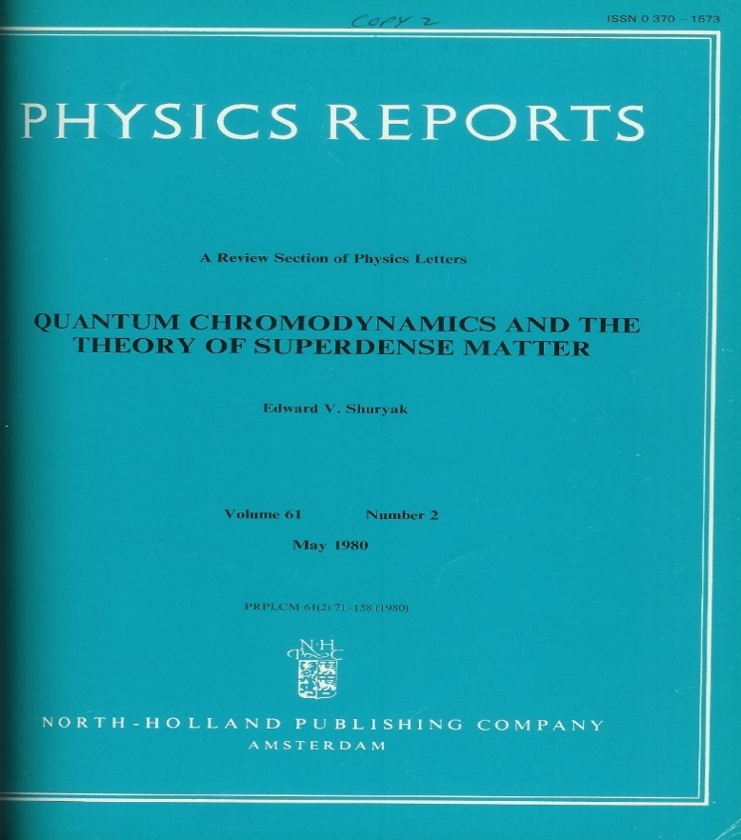
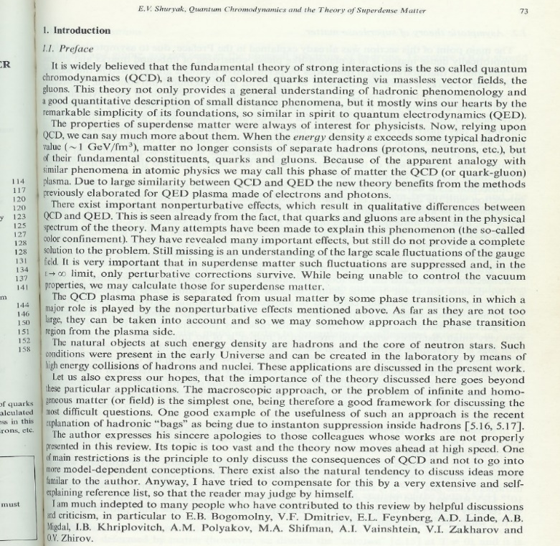

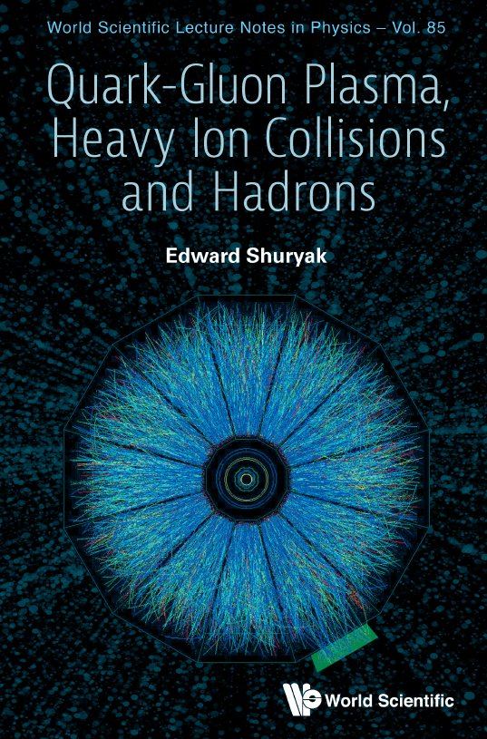

Quark Gluon Plasma – coining of a name
First review on QCD at extreme density conditions,
Physics Reports 1980
“Because of the apparent analogy with similar
phenomena in atomic physics, we may call this
phase of matter the QCD
(or quark-gluon) plasma.”
QGP
>100000 of times
hotter than the Sun’s core !

Slide 5
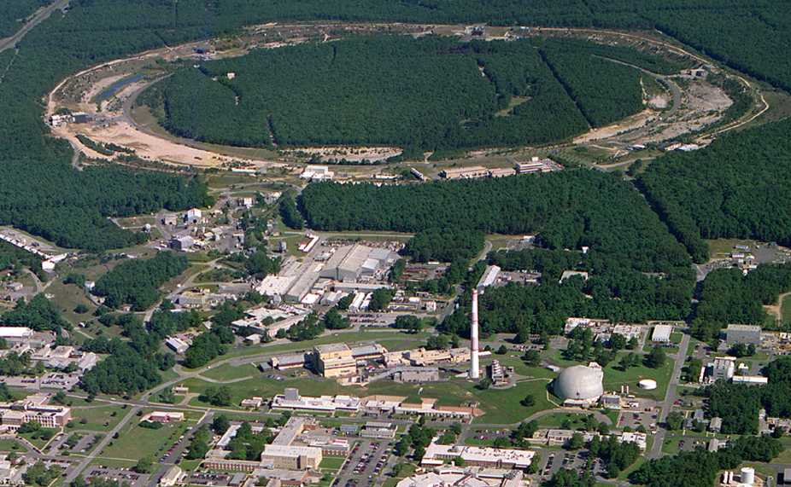

Relativistic Heavy Ion Collider (RHIC): 2000-2025
PHOBOS
1 mile
RHIC
BRAHMS
PHENIX
Au+Au @ √s_{NN}=200 GeV
STAR
v = 0.99995⋅c
AGS
TANDEMS
2005: Quark-Gluon Matter (Plasma) is a “perfect liquid”
11

Slide 6
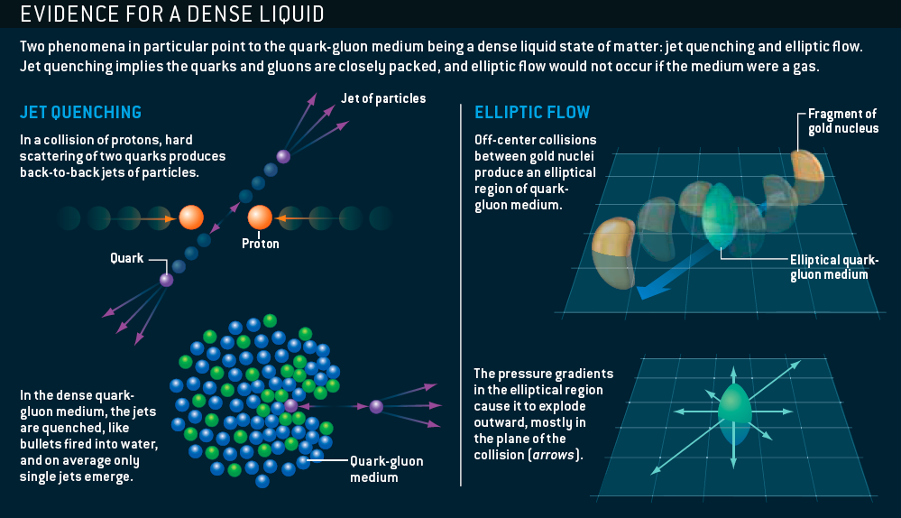
Perfect Liquid Discovered at RHIC: 2005
M. Roirdan and W. Zajc,
Scientific American, May 2006

Slide 7
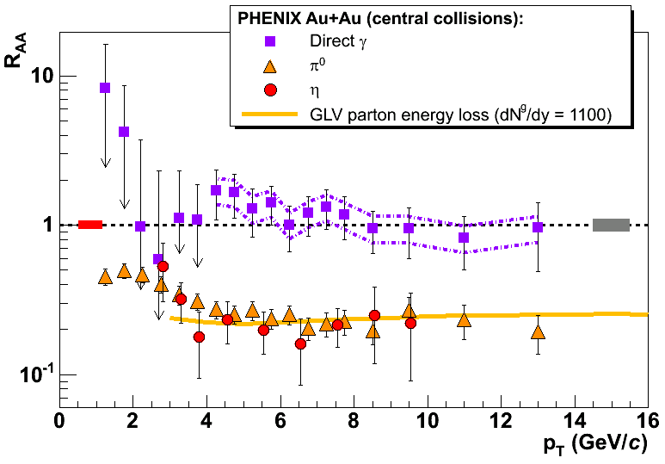
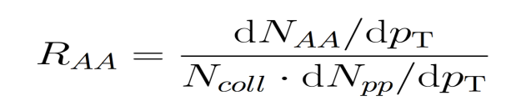
PHENIX: The nuclear modification factor: R_{AA}
If R_{AA}< 1 at high p_{T}
→ the medium is opaque to the passage of partons
→ parton-medium final state interactions, energy loss, modification of fragmentation in the medium
R_{AA} = 1 at high p_{T}
→ the medium is transparent to the passage of partons
reference process
photons
Phys.Rev.Lett.88:022301,2002
The meson yield in central Au-Au is 5 times lower than expected from
pp collisions
the direct photons are not affected by the dense medium

Slide 8
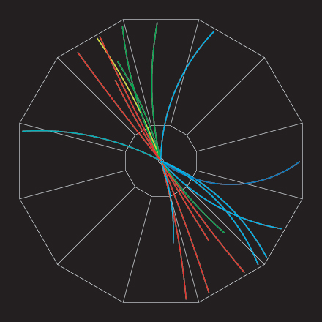
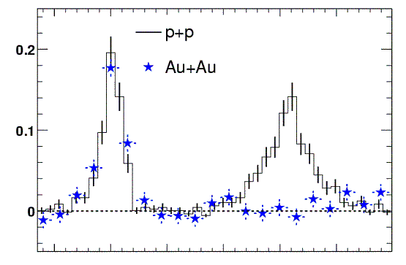
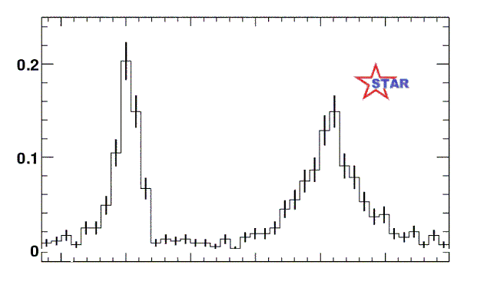
STAR experiment: “Disappearance of away-side “jet”
”
proton-proton jet event
Analyze by measuring (azimuthal) angle between pairs of particles
Number of pairs
0º
180º
Phys.Rev.Lett.90:082302,2003
Angle between high energy particles
In Au-Au collisions we see only one “jet” at a time !
How can this happen ?
Jet quenching!
q
q
8

Slide 9
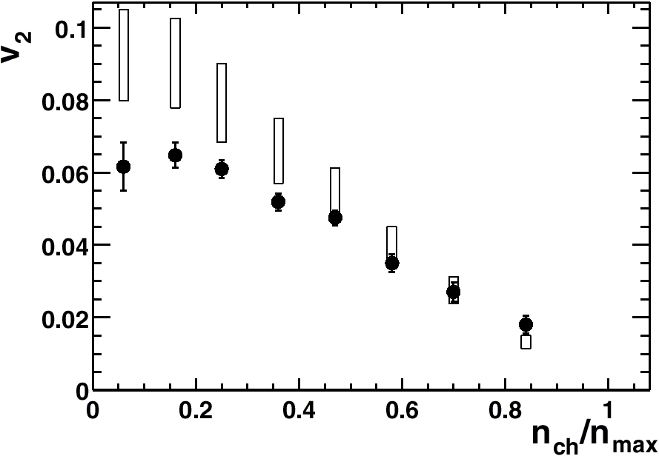
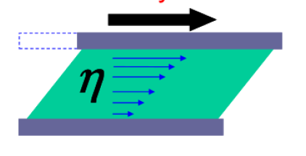
Perfect Liquid at RHIC
Hydrodynamic
STAR
PHOBOS
RQMD
R. Lacey , A. Taranenko, PRL 98 092301 (2007)
Shear Viscosity – resistance to deformation, flow
Data approaching Hydro for central collisions
viscosity extracted close to the lowest value set by quantum limit.

Slide 10
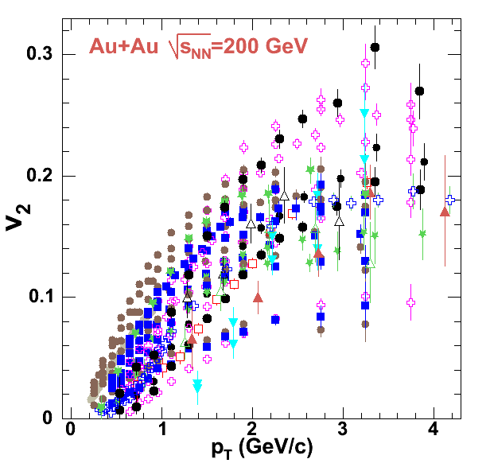
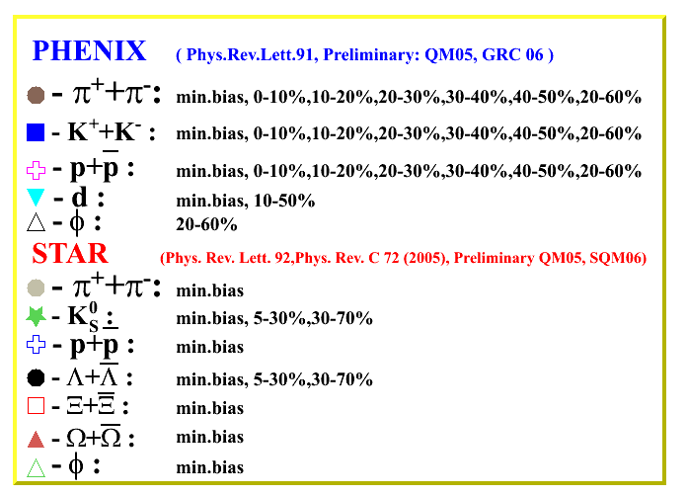
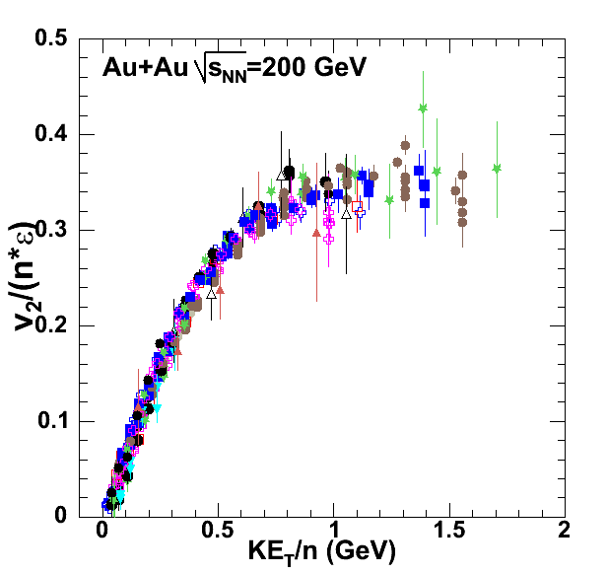
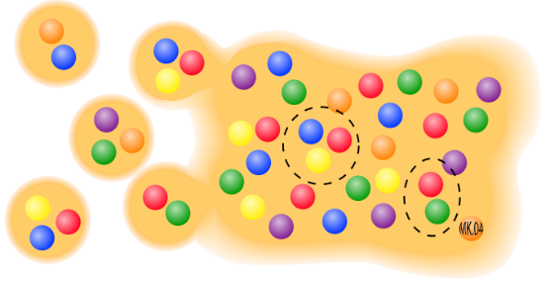

Anisotropic Flow at RHIC – partonic?
= m_{T} – m
n=2 for mesons and
n=3 for baryons
R. Lacey , A. Taranenko
PoS 2006 (2006) 021

Slide 11
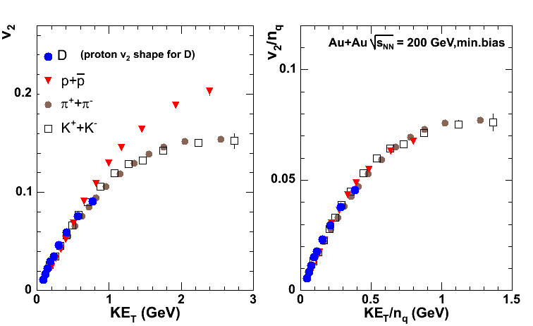
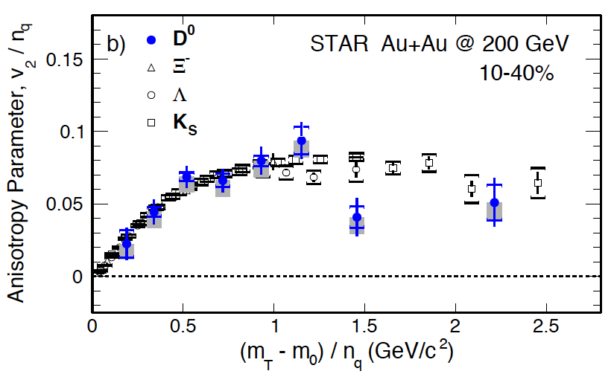
Elliptic flow of D meson in 2006-2017
PoS 2006 (2006) 021
STAR, PRL118 (2017) 212301
PHENIX
The D meson not only flows, it scales over the measured range

Slide 12
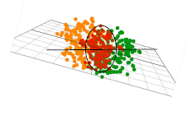
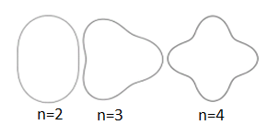


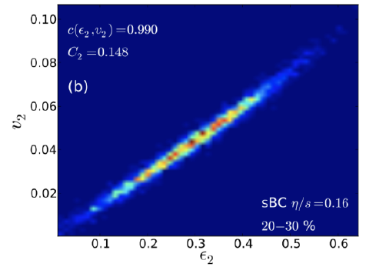
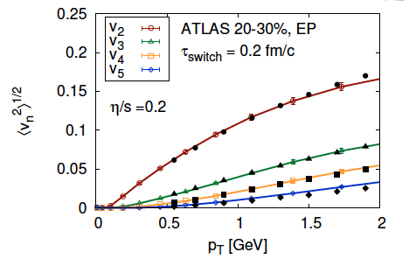
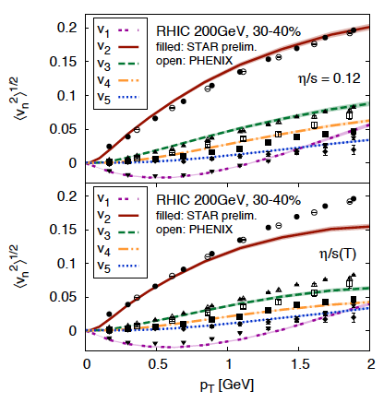
Anisotropic Flow at RHIC-LHC
Gale, Jeon, et al., Phys. Rev. Lett. 110, 012302

Slide 13
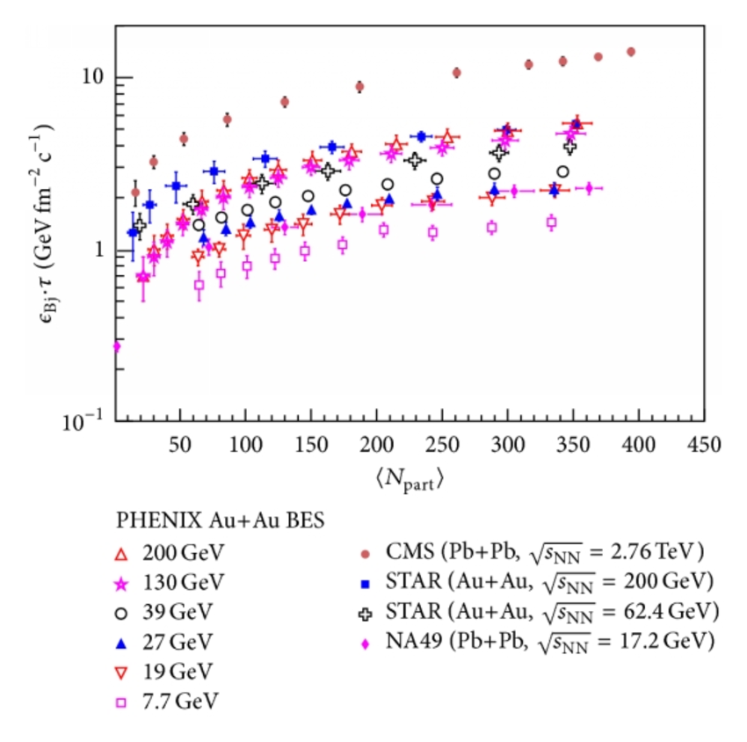
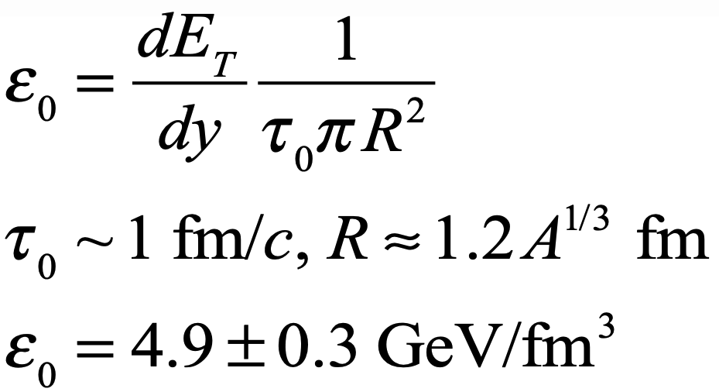
Energy Density
Phys. Rev. C 93, 024901 (2016)
Critical condition for QGP satisfied.

Slide 14
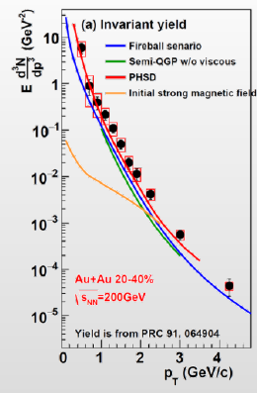
Thermal photons in A+A collisions
PoS CPOD 2017 079 (2018)
Measure the spectrum of thermal photons (non-interacting) emitted from the source.
The spectrum will display the average temperature over the full lifetime of the partonic source.
Determining the initial temperature requires modeling.
p_{T} slope ⇒ Temperature
PHENIX: T = 221±19±19 MeV
Critical condition for QGP satisfied.

Slide 15
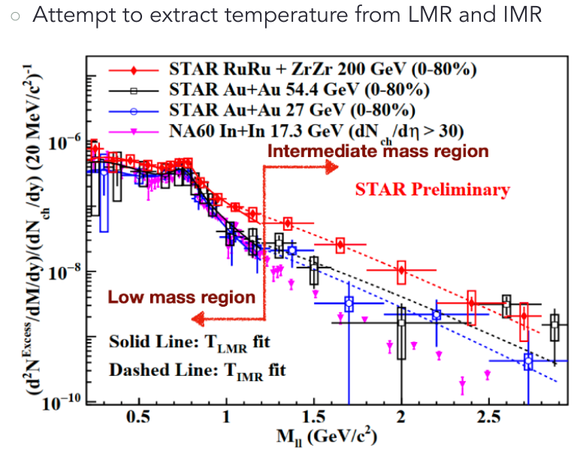
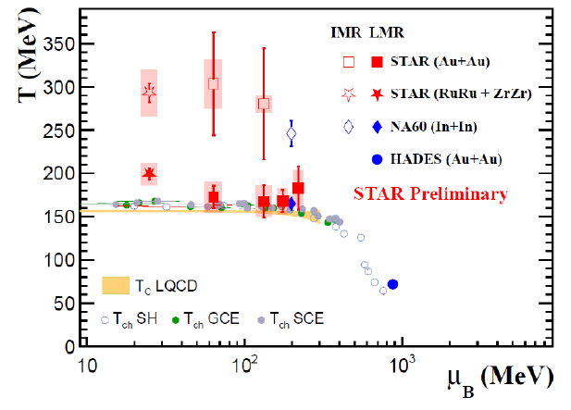
STAR: Thermal dileptons
LMR – Thermal radiation from HG
IMR - Thermal radiation from QGP

Slide 16
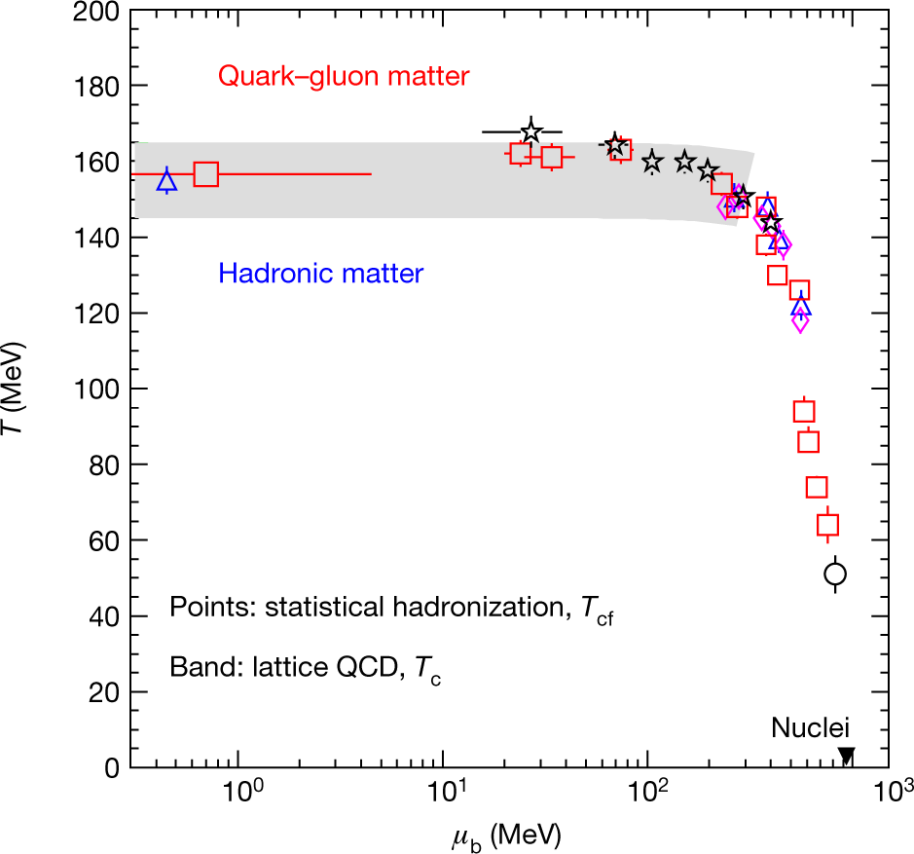
Chemical and Thermal Equilibrium?
STAR, NPA 757 102 (2005)
Nature volume 561, pages 321–330 (2018)
Particle ratios described very well by statistical model assuming thermal and chemical equilibrium
The experimental result that the chemical freeze-out temperature turns out to be close to 𝑇𝑐 has a fundamental reason: because of the very rapid temperature and density change across the phase transition and afterwards due to the rapid expansion, the resulting low hadron densities in the fireball combined with its size cause inelastic
interaction between hadrons to cease within a narrow temperature interval of a few MeV after hadron formation.

Slide 17

Evolution of the system created in RHIC
Fireball is ~10⁻¹⁵ meters across and lives for ~10⁻²³ seconds
Initial state
QGP as a relativistic
fluid
Pre-equilibrium
dynamics
Hadronization
Transport/Freezeout
~20 fm/c
Time fm/c
0 fm/c
~1 fm/c
~10 fm/c
  Initial state (heavy Au+Au or Pb+Pb nuclei Lorentz contracted by ɣ~100 – RHIC, ɣ~ 1400 – LHC )
Pre-equilibrium state: hard parton scattering & jet production
Quark-gluon plasma formation: thermalization (viscous hydrodynamics)
Hadronization
Transport/Freeze-out: Rescattering & chemical freeze-out, Kinetic freeze-out (stop interacting)
~400 nucleons in 10⁻²² seconds = 1000-30000 hadrons

Slide 18
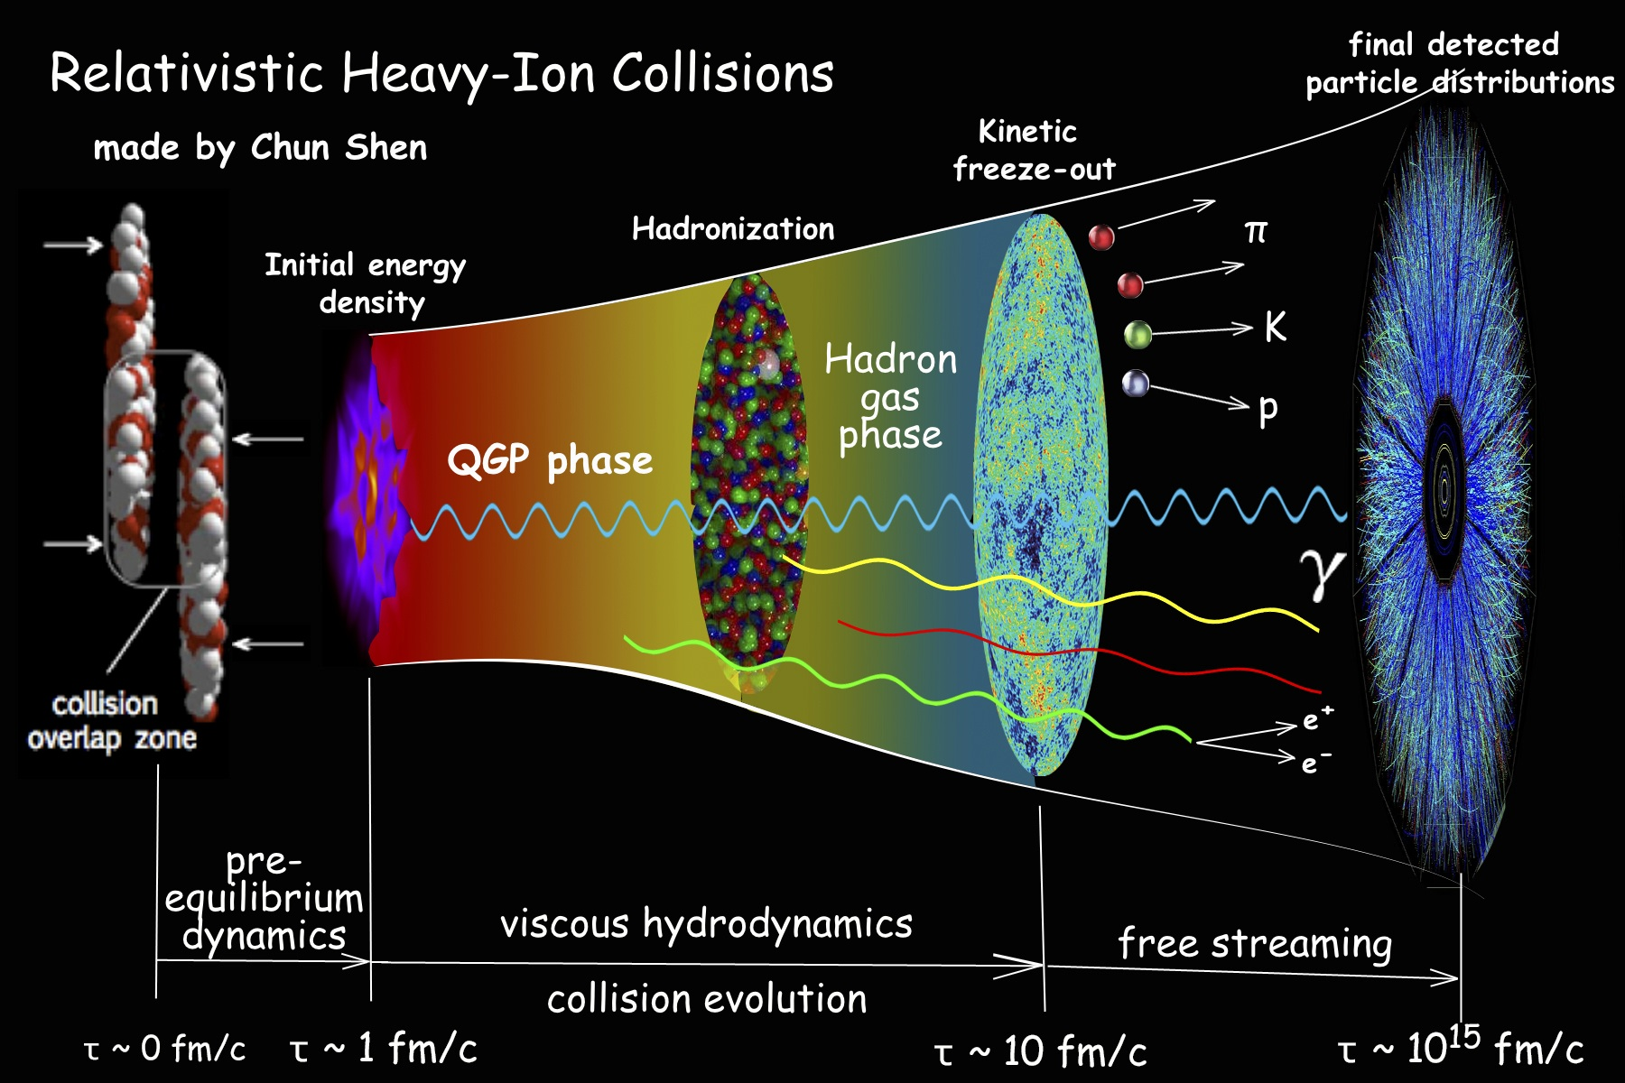
QGP
>100000 of times
hotter than the Sun’s core !
~200+200 nucleons in 10⁻²² seconds = 1000-30000 hadrons
Understanding RHIC/LHC is hard. Many-body physics across many scales; strongly interacting, relativistic, and very, very small

Slide 19
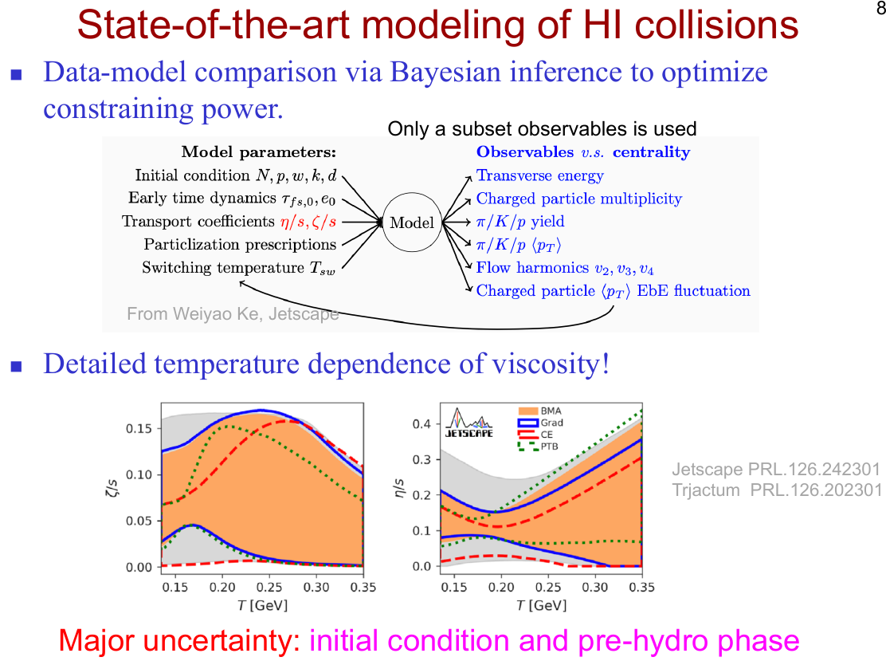

Slide 20
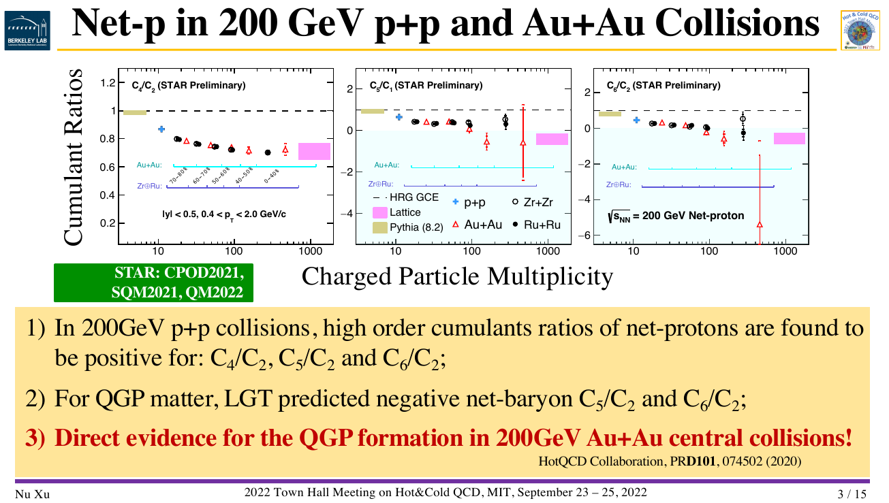
20

Slide 21
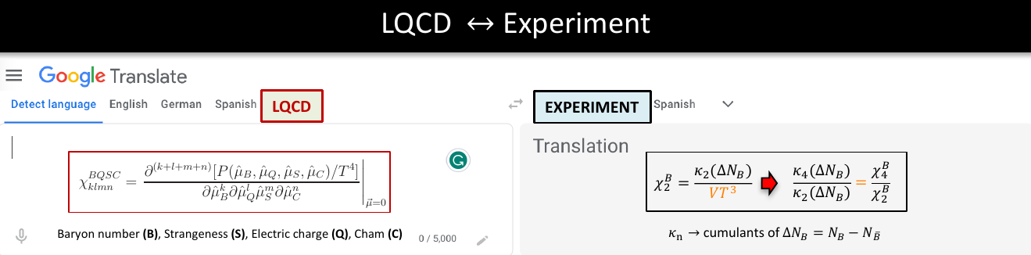
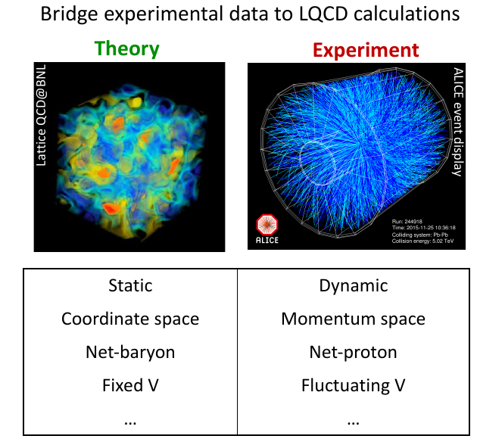
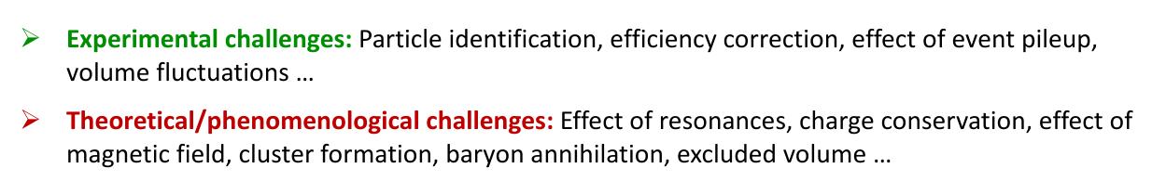
21

Slide 22
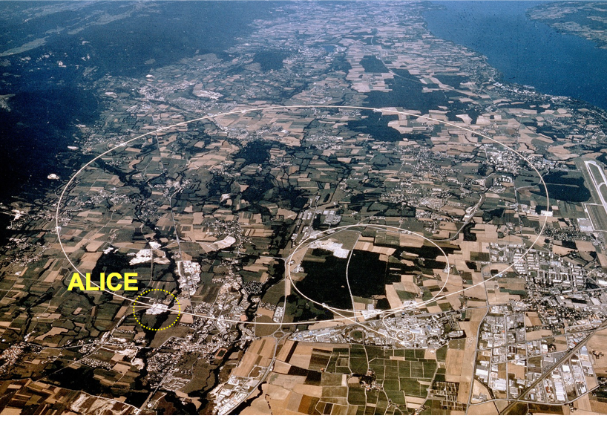
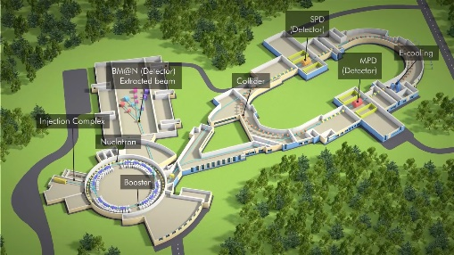
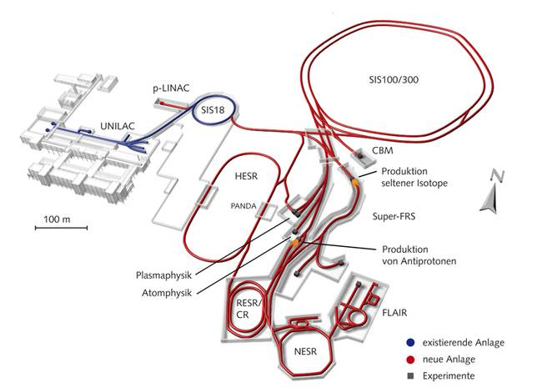

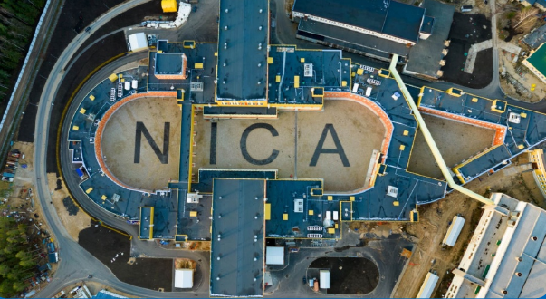
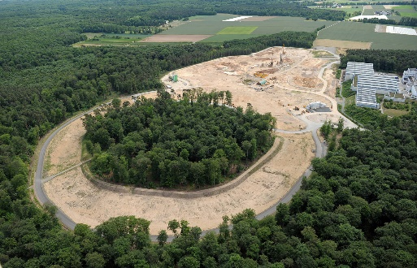
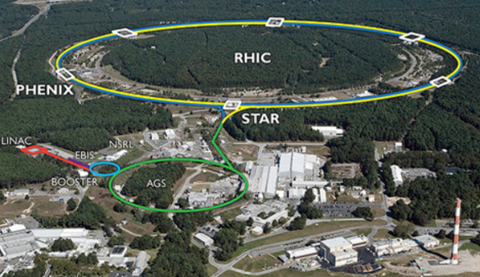
Relativistic Heavy-ion experiments
Low energy frontier: RHIC (BES), SPS
→ future facilities: FAIR (GSI), NICA
High energy frontier: LHC
CMS
NA-61
LHCb
FAIR
ATLAS
→ By now all major LHC experiments have a heavy-ion program: LHCb took Pb-Pb data for the first time in November 2015.
RHIC

Slide 23
Lessons from RHIC

Slide 24
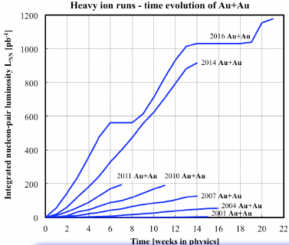
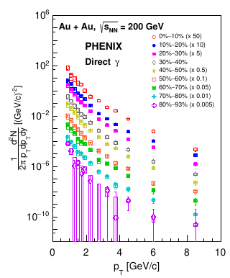
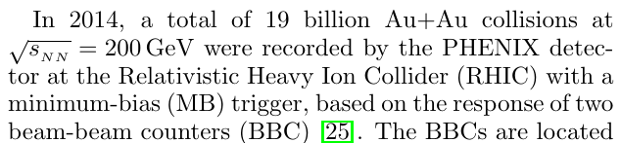
Heavy-Ion runs in PHENIX
Phys. Rev. C 109, 044912 (2024)

Slide 25



Direct-Photon Production at RHIC: STAR vs PHENIX

Slide 26




Elliptic Flow at RHIC v₂(p_{T}, centrality): PHOBOS/PHENIX
EP: 1.0<|η|<2.8
from PHOBOS QM06 proc. J. Phys. G34 S887 (2007)‏
η
EP{1}
EP{2}
EP: 3.1<|η|<3.7
PHOBOS EP: 2.05<|η|<3.2
Overall good agreement between differential flow measurements

Slide 27



Elliptic Flow at RHIC v₂(p_{T}, centrality): STAR vs PHENIX
2005: The only published STAR data for inclusive charged hadrons from Au+Au at 200 GeV (in the last 20 years !!!)
For 0-20% central collisions STAR V₂ > PHENIX V₂ : do we have the same centrality definition between experiments?

Slide 28




Relativistic Heavy Ion Collision Experiments
MPD, BM@N competitors:
Present:
RHIC/STAR (USA) 3-200 GeV
NA61/SHINE (CERN): 5.1-17.3 GeV
SIS18/HADES (Germany) 2.4-2.55 GeV
Future:
HIAF/CEE (China) 2.1-4.5 GeV (2026-?)
FAIR/CBM (Germany) 2.4-4.9 GeV (2029-?)
JPARC-HI (Japan) 2-5 GeV (2030-?)
NA60+(CERN) 6.1-16.4 GeV (2029-?)
region of max.
baryonic density
BM@N: $\sqrt{s_{NN}}$ = 2.3 - 3.3 GeV MPD: $\sqrt{s_{NN}}$ = 4 - 11 GeV
BM@N and MPD are both in the collision energy range of the predicted CEP location.

Slide 29

STAR: Beam Energy Scan programs at RHIC

Slide 30







System size scan at top RHIC energy ($\sqrt{s_{NN}}$= 200 GeV)
Au+Au
200 GeV
2001-2005
Ψ₀
Ψ₀
2005-2011
2011-2012
Odd harmonics ≠ 0
30

Slide 31



2011-2016
Nucleon substructure matters
2020-2025
31

Slide 32


Slide 33


Slide 34


Slide 35



Beam Energy Dependence of Elliptic Flow (v₂)
Au+Au collisions ? nu-nu
Passage time: 2R/(β_{cm}γ_{cm})
Expansion time: R/c_{s}
c_{s}=c√dp/dε - speed of sound
Strong energy dependence of v₂ at √s_{NN} = 3-11 GeV
  v₂≈0 at √s_{NN} = 3.3 GeV and negative below

Slide 36


Beam Energy Dependence of Elliptic Flow (v₂)
Strong energy dependence of v₂ at √s_{NN} = 3-11 GeV
  v₂≈0 at √s_{NN} = 3.3 GeV and negative below

Slide 37



3D scan: Beam Energy / System size / Rapidity Scan at NICA
Rapidity dependence of cumulant observables can
enhance the prospect of discovering a CEP
J.Li, L.Du and S.Shi,
Rapidity scan approach for net-baryon cumulants''
Phys. Rev. C 109, no.3, 034906 (2024)
J. Brewer et al., Phys. Rev. C 98, 061901 (2018)
Rapidity-dependent yields offers an extra method to
explore the EoS at finite chemical potentials.
L.Du,`Bulk medium properties of heavy-ion collisions from the beam energy scan with a multistage hydrodynamic model,''
Phys. Rev. C 110 (2024) no.1, 014904
Thermodynamic properties, especially the baryon
chemical potential ${(μ}_{B}$) , undergo significant variations across rapidity,
L.Du, H.Gao, S.Jeon and C.Gale,
Rapidity scan with multistage hydrodynamic model,
Phys. Rev. C 109, no.1, 014907 (2024)
Rapidity dependence of anisotropic flow provides
provides sensitivity to (T,$μ_{B}$) dependence of
specific shear (η/s) and bulk (ζ/s) viscosities
S.A.Jahan, H.Roch and C.Shen,
Bayesian analysis of (3+1)D relativistic nuclear dynamics
with the RHIC data, Phys.Rev.C 110 (2024) 5, 054905

Slide 38
Conclusions
The RHIC “perfect liquid” paradigm has prevailed.
The discoveries have continued to ``flow” from RHIC.
Quantitative precision has increased enormously.
Understanding RHIC physics is hard. Many-body physics across many scales; strongly interacting, relativistic, and very, very small
3D scan: Beam Energy – System size – Rapidity will be important for NICA

Slide 39


Кинематические переменные
кинематические распределения образовавшихся частиц обычно выражаются как функции
y – быстроты частицы (rapidity) и p_{T} – поперечного импульса (transverse momentum)
p_{T}: Лоренц-инвариантный по отношению к ускорению в направлении пучка
p_{T} генерируется при столкновении ( p_{z} = присутствует «до столкновения»)
y: не лоренц-инвариант, а аддитивный закон преобразования → y’=y-y_{β} (y_{β} быстрота реф. cистемы) o
y
θ
φ
x
z
y~η for relativistic particles

Slide 40



Azimuthal distributions of hadrons at RHIC
b ≈ 6.5 fm
b ≈ 4 fm
“central” collisions
STAR, PRL90 032301 (2003)
midcentral collisions
40

Slide 41

Anisotropic flow of particles at HIC
STAR, PRL90 032301 (2003)
b ≈ 10 fm
𝜑 - Ψ_{RP}
b ≈ 6.5 fm
b ≈ 4 fm
4*v₂
Sergei Voloshin, Y. Zhang, Z. Phys. C70,(1996), 665
The sinus terms are skipped by symmetry arguments
From the properties of Fourier’s series one has
Fourier coefficients V_{n} quantify anisotropic flow:
v₁ is directed flow, v₂ is elliptic flow, v₃ is triangular flow, etc.
Term “flow” does not mean necessarily “hydro” flow – used only to emphasize the collective behavior of particles in event or multiparticle azimuthal correlation

Slide 42







Equation of state (EoS) for high baryon density matter
pressure
energy per nucleon
isospin
asymmetry
Symmetric matter
Symmetry energy
Neutron matter
E_{sym}
Symmetric matter
Sorensen et. al.,
Prog.Part.Nucl.Phys. 134 (2024) 104080
42
EOS describes the relation between density (n_{B}), pressure (P), temperature (T), energy (E), and isospin asymmetry (n_{p}-n_{n})/n_{B}
42
Notes:
So lets start.
Understanding the equation of state is one of the main goals in nuclear physics.
The binding energy per nucleon can be expanded in a Teylor series by the powers of the isospin asymmetry. The first term is responsible for the behavior of symmetric matter, meaning that the matter has equal densities of neutrons and protons, while the next term, called the symmetry energy, takes into account the isospin asymmetry and characterizes the energy difference between neutron-rich and symmetric systems.
There are a number of papers aimed at constraining the parameters of the models based on the existing data. A summary of these results for symmetric matter is given in the middle of this slide, while such a summary for the symmetry energy is given on the right.

Slide 43




Nuclear incompressibility from collective proton flow
P. Danielewicz, R. Lacey, W.G. Lynch, Science 298 (2002) 1592
Soft EOS
Stiff EOS
Transverse in-plane flow:
Elliptic flow:
F = d(p_{x}/A)/d(y/y_{cm})
43
dN/dΦ ∝ (1 + 2v₁ cosΦ + 2v₂ cos2Φ)

Slide 44


Directed flow of protons and EOS of symmetric matter
P. Senger, PoS CPOD2021 (2022) 033
BM@N agrees with STAR
Nuclear incompressibility from collective proton flow
P. Danielewicz, R. Lacey, W.G. Lynch, Science 298 (2002) 1592
44
Both STAR and BM@N results for directed flow prefer stiff EOS

Slide 45
Backup slides

Slide 46
Beam Energy Dependence of Elliptic Flow (v₂)

Slide 47



2005: Quark-Gluon Matter (Plasma) is a “perfect liquid”

Slide 48


Current Perspective - 2000 CERN Press Release
”Good” news
(from the RHIC perspective):
It did not directly claim discovery
of the quark-gluon plasma.
Bad news:
  Was not linked to publication of
  peer-reviewed findings.
  Nonetheless stated
    “the experiments on CERN's Heavy Ion programme presented compelling evidence for the existence of a new state of matter in which quarks, instead of being bound up into more complex particles such as protons and neutrons, are liberated to roam freely.”
An assessment of the insights gained from the heavy-ion program at the CERN SPS during the 1980s and 1990s [48] concluded that compelling evidence for the creation of “a new form of matter” had been found but stopped short of claiming unambiguous discovery of the quark-gluon plasma, nor did it comment on its perfectly liquid collective dynamical properties. The latter became only obvious after theory had progressed to a quantitative understanding of the bulk of the very comprehensive and precise experimental data collected at RHIC.

