Slide 1
Status of the SCAN-3 at the Nuclotron internal targets
“Creation of a precision magnetic spectrometer SCAN-3 and research of non nucleon degrees of freedom in nuclei, nucleon correlations and nuclear fragmentation”
Dryablov Dmitry, ISHEPP XXVI

Slide 2
Advantages of thin targets installed inside synchrotrons or storage rings:
Efficient use of the particle beams from the accelerator.
Possibility of using different beam energies during the acceleration cycle (in the case of one energy for the extracted beam).
High luminosities and count rates.
High energy and angular resolutions.
No background from target container or beam dump.
Possibility for use of special targets.
…

Slide 3
SCAN3: general aims of the project
This project is aimed at studies of highly excited nuclear matter formed in nuclei by the high energy beam. The matter will be studied through observation the pairs of energetic particles emitted at the angle close to 180 degree.
The new 3-arm precision hybrid magnetic spectrometer SCAN-3 is installation for detecting charged particles (π±, K±, p) and neutrons produced at the Nuclotron internal target. Spectrometry of such pairs will enable to studies of
low-energy ηA interaction and a search for η-bound states (η-mesic nuclei);
the Δ-isobar produced and stopped inside the nuclear matter;
np and pp correlations;
cumulative processes;
heavy nuclei fragmentation to low-energy fragments.

Slide 4
Physics motivation
The discovery of η-mesic bound systems give unique possibility for better investigation of the elementary meson-nucleon interaction in nuclear medium for low energy region. It would provide information:
about nucleon N*(1535) resonance [ D. Jido, H. Nagahiro, S. Hirenzaki, Phys. Rev. C 66, p. 045202 (2002).],
about properties of η meson in nuclear medium [ T. Inoue, E. Oset, Nucl. Phys. A 710, 354–370 (2002).]
as well as about the η and η` meson structure [ S. D. Bass, A. W. Thomas, Acta Phys. Polon. B 45, 627–638 (2014).].
mass difference between the nucleon and the N∗(1535) in a nuclear medium [S. Hirenzaki and H. Nagahiro, Acta Phys. Pol. B 45, 619 (2014).]
The η bound states in nuclei are sensitive to the singlet component in η and can be used as a probe of flavor-singlet dynamics [ S.D. Bass and A.W. Thomas, Phys. Lett. B 634, 368 (2006); Acta Phys. Pol. B 45, 627 (2014).].
in general for studies of the chiral and axial U(1) symmetry breaking in low energy QCD
[S. D. Bass, A. W. Thomas, Acta Phys. Polon. B45 (2014)], [S. Hirenzaki et al., Acta Phys. Polon. B41, 2211 (2010)],
[S. D. Bass, A. W. Thomas, Phys. Lett. B634, 368 (2006)]

Slide 5
Current status of reserch
The bound states have been searched in several experiments. There were discovered the signals that can be interpreted as the η-Mesic nucleus.
First of such experiment devoted to the search for η-mesic nuclei was performed at BNL [R. E. Chrien et. al., Phys. Rev. Lett. 60, 2595–2598 (1988).] with the positively charged pion beam scattered on lithium, carbon, oxygen and aluminium targets (π⁺+A → p+(A - 1)_{η}). A new experiment with pion beam is planned at J-PARC [H. Fujioka, J. Phys. Conf. Ser. 374, p. 012015 (2012).] for (π⁻; n) with the most optimal kinematic conditions.
The first evidence for the existence of an η-mesic bound states was claimed by the LPI group [ G. A. Sokol, et al., arXiv:nucl-ex/9905006 (1999).] which carried out the measurement of photoproduction processes: γ+¹²C → N + (A -1)η→ N + π+ + n + X and
γ+¹²C → N + (A -1)η → N + p + n + X, where (A-1) is ¹¹C or ¹¹B nuclei.

Slide 6
The invariant mass distribution of the correlated π+n pairs for the first process shows a narrow peak structure below the η meson production threshold which is in agreement with the theoretical prediction supporting the η-mesic nuclei formation via N*(1535) resonance excitation and its decay into π-nucleon pair. The upper limit of the photoproduction cross section for reaction was determined and is equal to 10 μb.
The COSY-GEM measurement of recoil-free p(²⁷Al;³He)π⁻ p`X process observed of an enhancement of the ³He in the missing mass spectrum. This result could be interpreted as a signal from ²⁵Mg_{η} bound state [A. Budzanowski et al., Phys. Rev. C 79, p. 012201 (2009).]. However, it is important to confirm the result with higher statistics. Therefore, the upper limit of the total cross section for the η-mesic magnesium production was determined and is equal to 0.46±0.16(stat)±0.06(syst) nb.

Slide 7
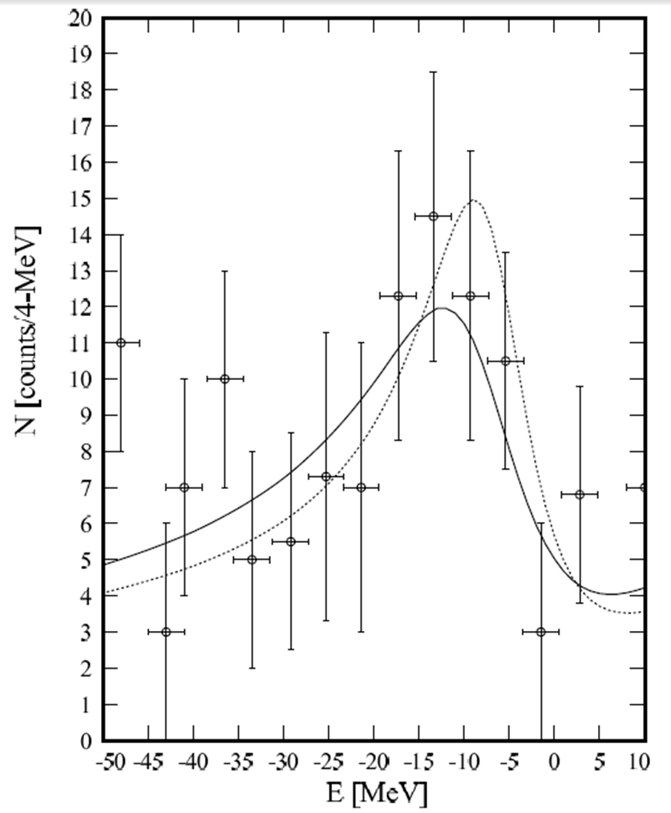
The data are shown in Fig. where E represents the real part of the η binding energy for events having E < 0. The experimental spectrum exhibits a peak structure centered at E=−13.13±1.64MeV with a half-width Γ/2 ≃ 5.1±1.5 MeV. The significance of the peak is 5.3σ, indicating the existence of an η−²⁵Mg bound state, the mesic nucleus ²⁵Mg_{η}.
Another recoil-free experiment dedicated to search for η-mesic nuclei was carried out at GSI [33]( A. Gillitzer, Acta. Phys. Slovaca 56, 269–277 (2006).). The (d,³He) reaction was measured on ⁷Li and ¹²C targets at GSI Fragment Separator System (FRS).

Slide 8
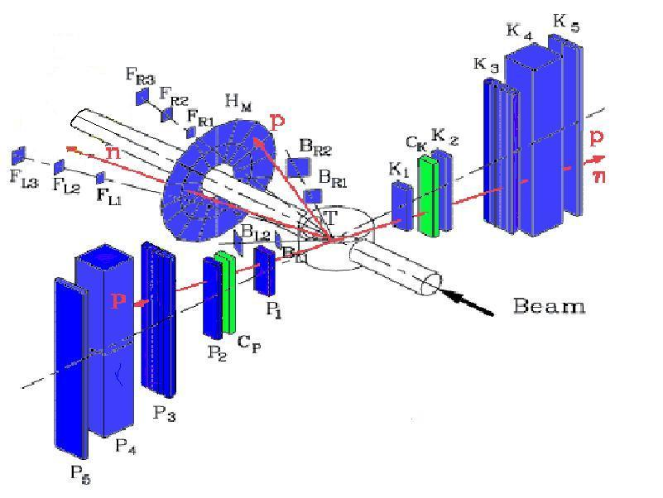
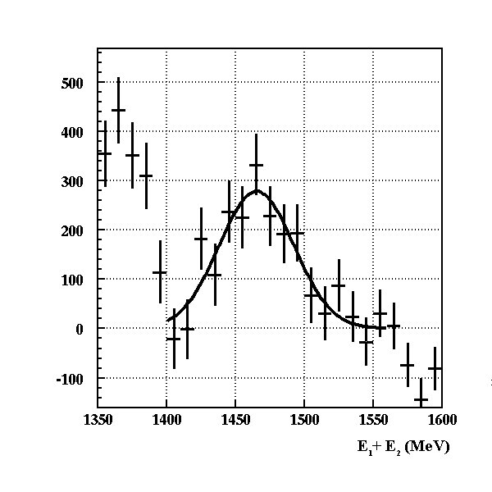
The JINR measurement performed the search for back-to-back π p pairs related to the η-mesic bound states in d + ¹²C →π + p + X process [S. V. Afanasiev et al., Nucl. Phys. B (Proc. Suppl.) 219-220, 255–258 (2011).].
Nuclotron based measurement of eta-nucleai.
Best fit is Gaussian + constant
Mean 1465.1 MeV
Sigma 27.2 MeV
Constant 1310
Δ
Δ≈20 MeV
S₁₁
S₁₁
_{In medium}
Distribution after rejection of the background

Slide 9
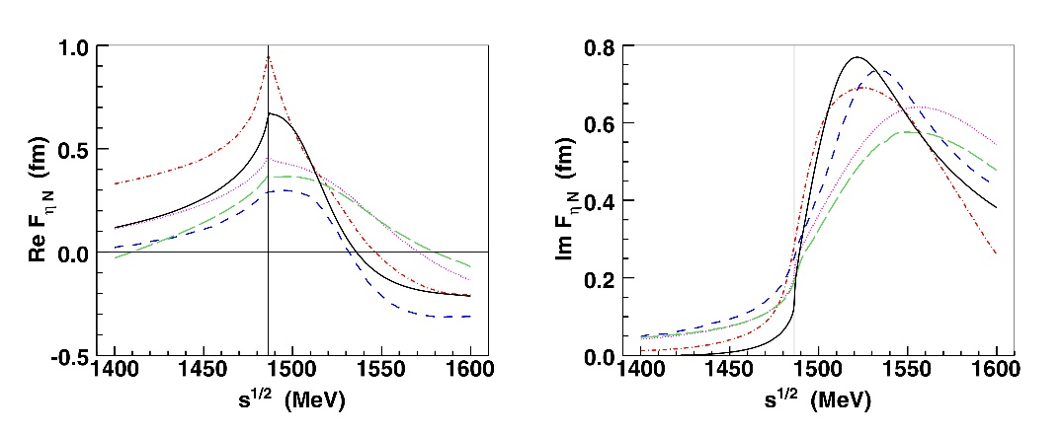
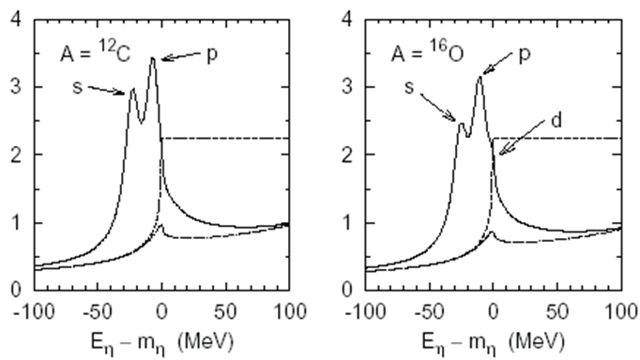
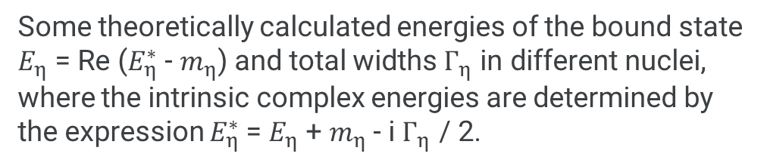
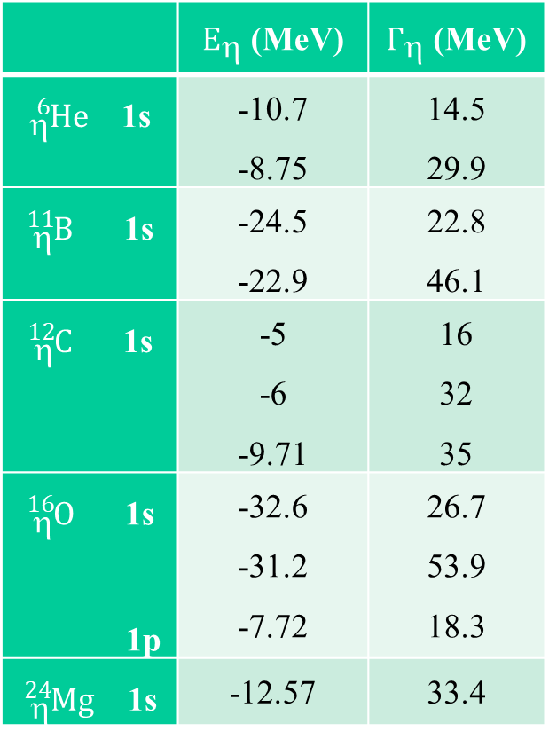
Some theoretically calculated energies of the bound state $E_{η}$ = Re ($E_{η}^{∗}$ - $m_{η}$) and total widths $Г_{η}$ in different nuclei, where the intrinsic complex energies are determined by the expression $E_{η}^{∗}$= $E_{η}$ + $m_{η}$- i $Г_{η}$ / 2.
ηN scattering amplitude
 | $E_{}$ (MeV) | $Г_{}$ (MeV)
${}_{}^{6}{He}$ 1s | -10.7 -8.75 | 14.5 29.9
${}_{}^{11}B$ 1s | -24.5 -22.9 | 22.8 46.1
${}_{}^{12}C$ 1s | -5 -6 -9.71 | 16 32 35
${}_{}^{16}O$ 1s 1p | -32.6 -31.2 -7.72 | 26.7 53.9 18.3
${}_{}^{24}{Mg}$ 1s | -12.57 | 33.4
A. I. L'VOV nucl-th/9809054
PRODUCTION AND DECAY OF ETA
-MESIC NUCLEI

Slide 10
What we are looking for?
During the formation of the η - nucleus, the slow η interacts with the nucleus's nucleon d + A → η(A − 1) + X and can form an intermediate S11 resonance, which is just 49 MeV above the ηN threshold.
In general, the following correlated final pairs of particles can be obtained from the decay of the eta-meson nucleus:
(ηp) → π⁰p
(ηp) → π⁺n
(ηn) → π⁰n
(ηn) → π⁻p
(ηpp) → pp
(ηpn) → pn
(ηnn) → nn

Slide 11
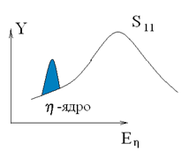
What we are looking for?
The interaction of the η-meson with a nucleon near threshold is mainly determined by the S₁₁, J^{P}= ½⁻ resonance N*(1535), which is just 49 MeV above the ηN threshold (1486 MeV) and has a width Γ=150 MeV, thus covering the whole low energy region of the ηN interaction. As the S₁₁-resonance also decays to πN, γN and ππN channels involves its coupling to all these channels.
It is important to recognize that if we register πN pair with approximately equal but opposite momentum components, even with some suitable total energy Eπ + E_{N} ≈ m_{η} + m_{N} = 1486 MeV, it does not necessarily mean that we have registered the decay products of the η-mesic nucleus.
The criterion of a bound η-meson is the condition
for the πN pair's total energy, which should be
below the threshold: E_{π} + E_{N} <1486 MeV
η + N_{i} → S₁₁ → π + N.
Next criterion of a bound η-meson is the width of
the peak in the distribution of πN pairs which is
not related to the width of the resonance S₁₁ (1535).

Slide 12
Expected characteristics of pairs from decay of η-nuclei and requirements to precisions of their measurements
The task of the experiment is the allocation and measurement of the narrow peaks in the energy distribution of pairs, which are products of η-nucleus decay.
Apparently, future experiments should assume that the peak width will be about 10 MeV, and therefore they should provide precise energy measurements of particles. The energy resolution should be not worse than ~ 3.5 MeV, so that the accuracy of the total energy of the pair will be at least 5-7 MeV. The intra nuclear motion expand the observable peak. This dispersion increases width of peak by to ~20 MeV. This moment is reduce the accuracy of spectrometer to the level of 10 MeV.
If we consider the process η + N_{i} → π + N with initial particles at rest, the kinetic energy, momentum and velocity of the secondary particles can be estimated:
T_{π} = E_{π} − m_{π} = (W² + m_{π}² − m_{N}²)/(2W) − m_{π} = 313 MeV,
T_{N} = E_{N} − m_{N} = (W² + m_{N}² − m_{π}²)/(2W) − m_{N} = 94 MeV,
p_{π} = p_{N} = [E_{π}² − m_{π}²] ^{1/2} = [E_{N}² − m_{N}²] ^{1/2} = 431 MeV/c,
β_{π} = p_{π}/ E_{π} = 0.95,
β_{N} = p_{N}/ E_{N} = 0.42.
Here W = m_{η} + m_{N} ⁼ 1486 MeV, also were used masses m_{π}= 140 MeV, m_{N} = 939 MeV, m_{η} = 547 MeV.

Slide 13
Besides the πN mode, η-nuclei can decay with emission of NN pairs due to the reaction
η + N_{i} + N_{j} → N₁ + N₂
The rate of this decay channel is expected to be compatible with the rate of the channel π⁻p.
Isotopic contents of the emerging NN system is
≈5% pp, ≈5% nn, ≈90% pn
Such pn pairs having the kinetic energies
T_{p} ≈ T_{n} ≈ 270 MeV
P_{p} = P_{n} ≈ 767 MeV/c
The πp pair requires a kinetic energy measurement accuracy
of 1% for pions and 3% for nucleons.
The NN pair requires an energy accuracy of 1%.

Slide 14
Estimates of the effect yield
The estimates are based on the parameters of the Nuclotron and the spectrometer setup: ∅8 µm internal carbon target and the number of inelastic d¹²С collisions N_{inel} ~ 10⁸ s⁻¹ gives the luminosity :
L = N_{inel} / σ_{inel} = 2.5·10³² cm⁻² s⁻¹
the total d¹²С inelastic cross section σ_{inel} = 0.4 barn);
the solid angle of the M arm Ω_{M} ~ 2 ⋅ 10⁻² sr;
the solid angle of the P and K arms Ω_{P} ~ 3 ⋅ 10⁻² sr.
Using theoretical estimates of the total cross section of η-nuclei formation based on one-pion-exchange model (σ_{η} ~ 2 µb), we expect the following yields of events with formation and decay of η-nuclei:
Y(π⁻p) ~ 40 hour⁻¹, Y(π⁺n) ~ 12 hour⁻¹,
Y(pn) ~ 12 hour⁻¹, Y(pp) ~ 2 hour⁻¹.
Concerning events of the Δ formation we expect:
Y(π±n) ~ 280 hour⁻¹

Slide 15
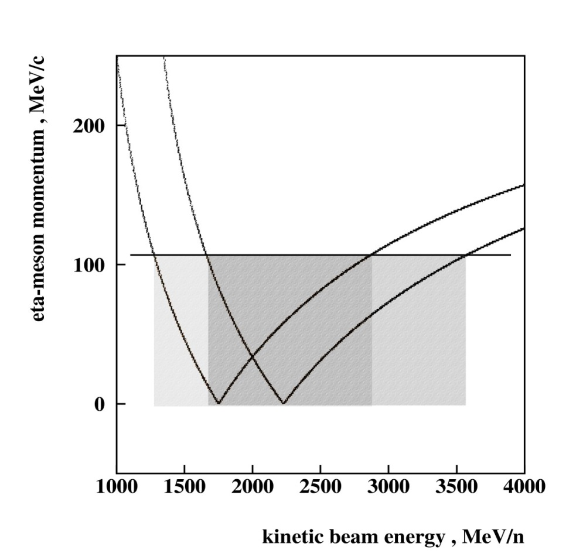
Recoil-free transfer reactions are most acceptable to the successful formation of the η-nuclei.
d+A→ t+η _{p=0} +(A-1)_{p=0}
¹³C(p,d)¹²C
P_{p} = P_{d}
E_{d} = 2.22MeV
¹³C(d,t)¹²C
¹³C +d= ¹²C+t+η+Q
Q=1.3 MeV
p+A→ d+η _{p=0}+(A-1)_{p=0}
P_{d} = P_{t}
E_{t} = 6.25MeV

Slide 16
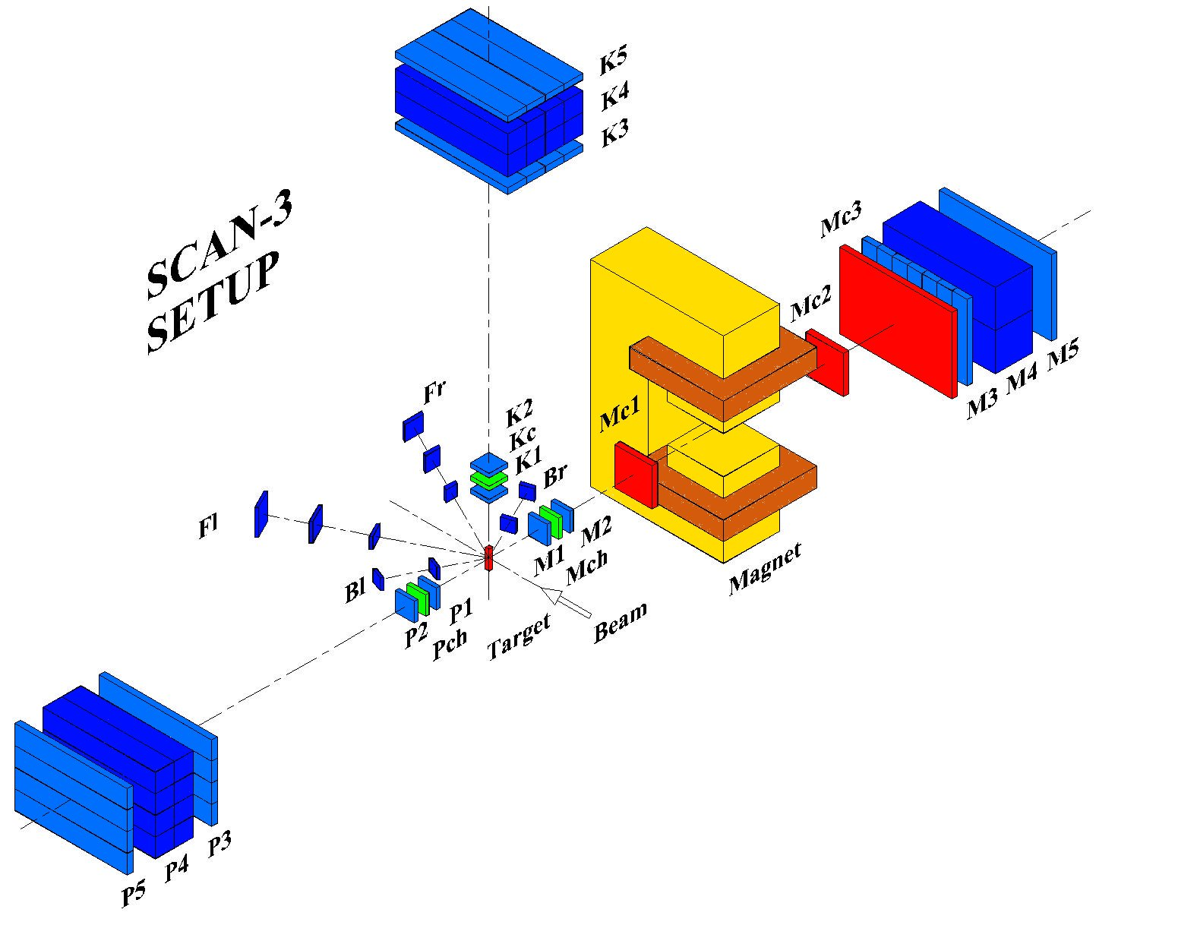
Experimental setup
significant improvement of the energy resolution (better than 10 MeV)
simultaneous recording of the effect and background significantly reduces systematic errors

Slide 17
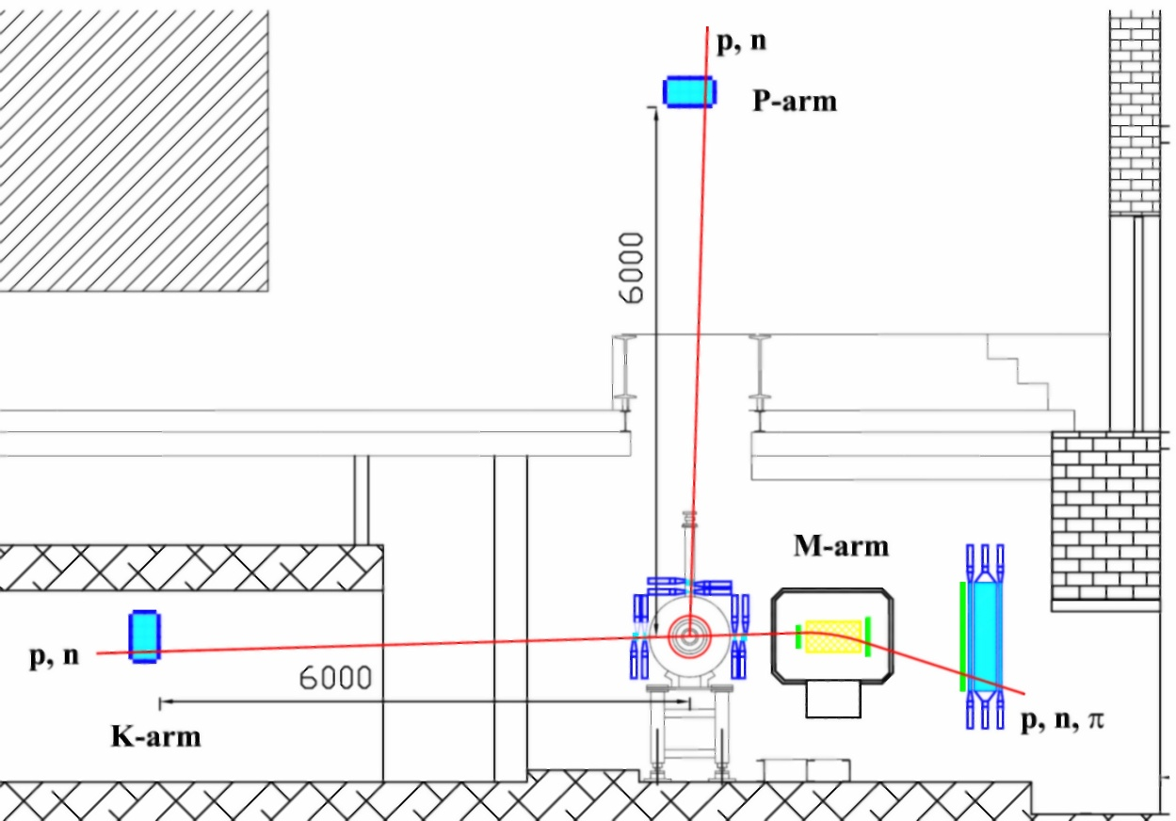
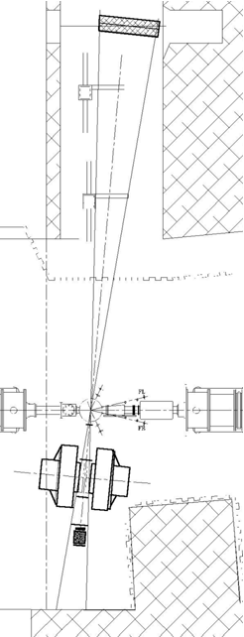
Location of spectrometer
K-arm
shaft
M-arm
Radial tunnel
P-arm

Slide 18
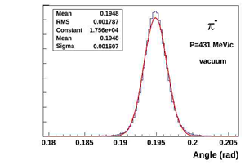
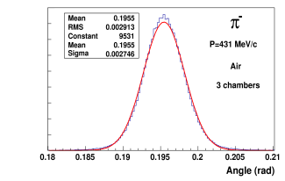
GEANT simulation
A study of the accuracy of the rotation angle of pions in a magnetic field (B=7 kGs) depending on the thickness of the detectors, the number of the coordinate cameras and gas environment.
Data analysis showed:
the passage of pions with kinetic energy 313 MeV.
counters minimum thickness meters and 4 cameras 0.82 % (2.6 MeV)
3 cameras resolution 1.28 % (4 MeV)
for protons with kinetic energy of 270 MeV
- in the first case, the accuracy of determination of the angle is 1.17% (3.2 МэВ)
In the second case, the accuracy of determination of the angle is 2.4% (6.5 МэВ)

Slide 19
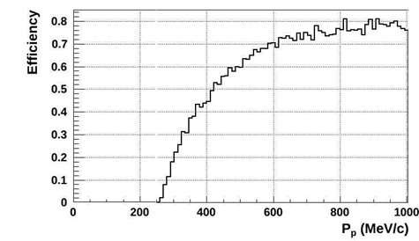
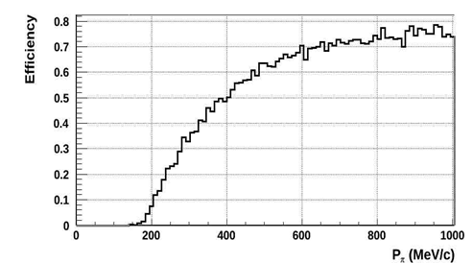
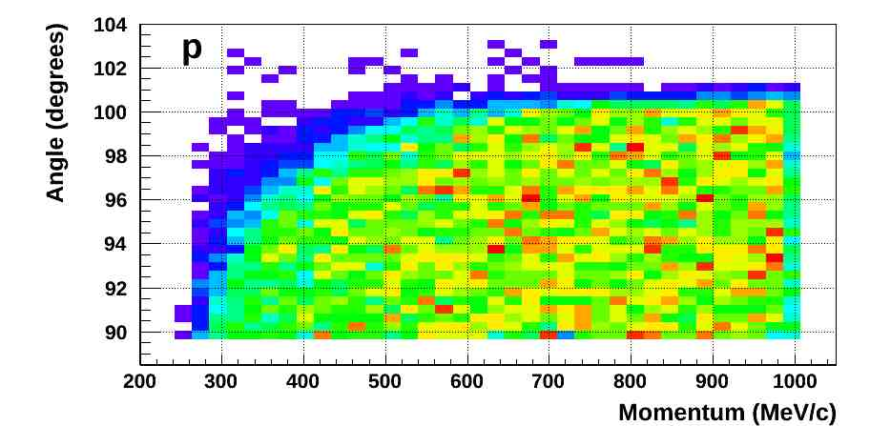
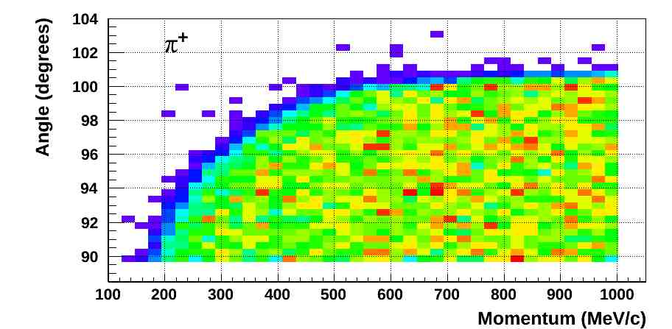
Acceptance

Slide 20
TOF and trigger system
TOF system
_{M1-M3}

Slide 21
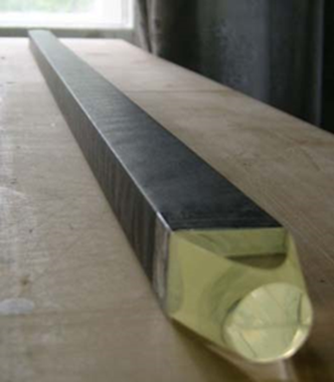
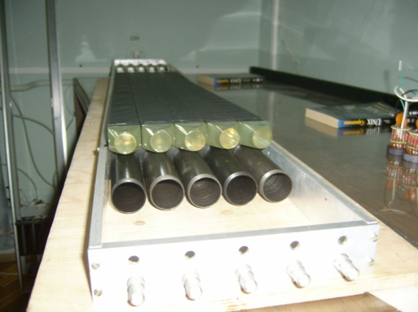
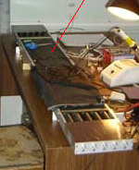
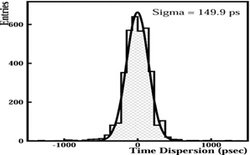
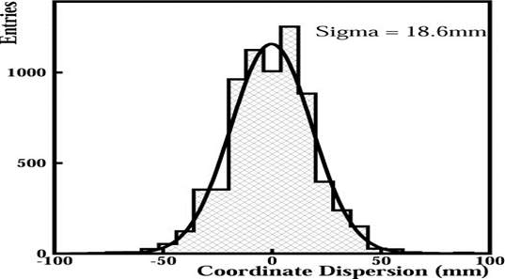
TOF
Time of flight hodoscope M-arm, before assembly
Timing and coordinate distribution for elements of the third detector, M-arm.

Slide 22
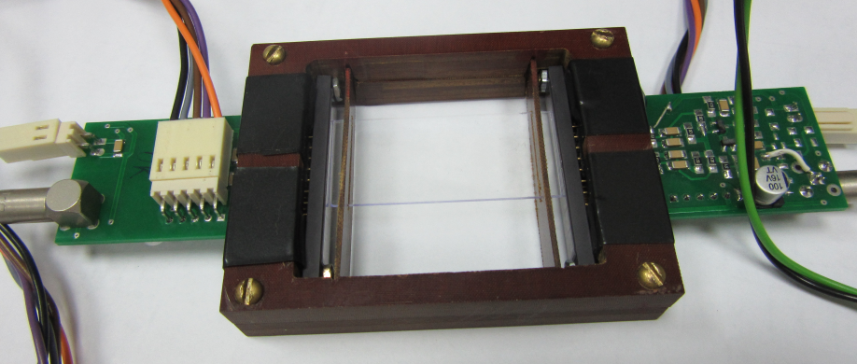
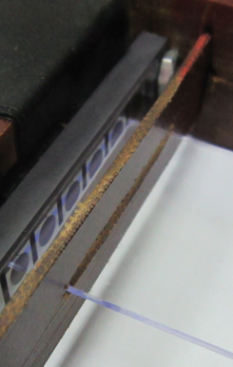
The forward TOF detector has been prepared. The detector is based of SiPM matrix and fast plastic scintillator. The technology was created for thin scintillation plates production. This technology allow to obtain uniformity in thickness at the level of 1% for scintillators with thickness from 0.1 mm to 1.5 mm. A fast preamplifier for the SiPM matrix was developed and manufactured
SiPM matrix

Slide 23
Tracking
Tracking
_{Mch,Mc1,Mc2,Mc3}

Slide 24
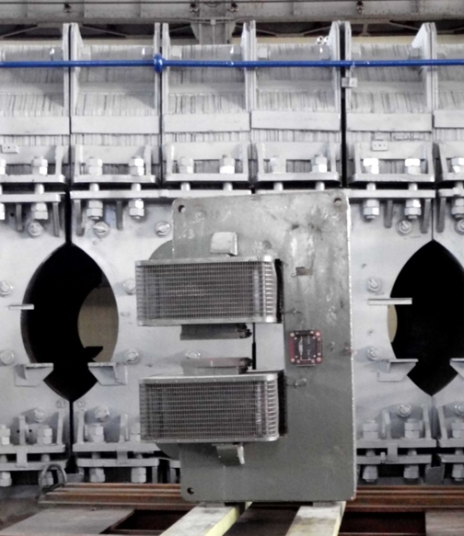
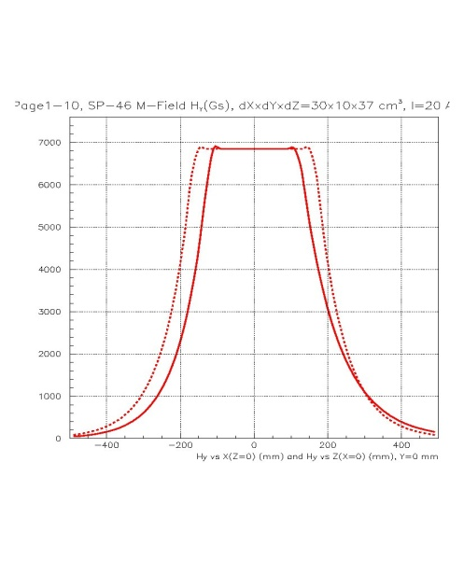
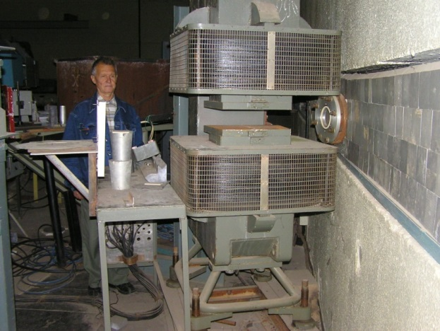
Analyzing magnet SP-46 for the magnetic arm.
SP-46
Magnetic volume - 100x300x420mm
Magnetic field - 7kGs
SP46 is delivered from LPI RAS to
LHEP JINR in Jun 2013

Slide 25
SP-46 is installed & tested in the M-arm of SCAN-3
It was found that the magnet could operate (7 kGs) for at least 30 hours without violating the specified conditions.

Slide 26
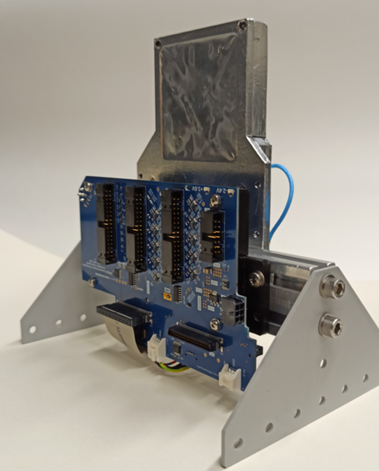
Vertex detector
The silicon vertex detector has been designed and assembled for position measurement of the point interaction internal nuclotron beam and target. This detector is part of the SCAN tracing system and should increase spatial resolution in two times.
The detector has single coordinate silicon module with 640 strips. It is assembled on a mechanical frame and placed in a box which is light and electromagnetic shielding.
Sensitive area of detectors is 61 × 61 mm², and the thickness of detectors is 300 μm.
The pitch of strips is 95 μm.

Slide 27
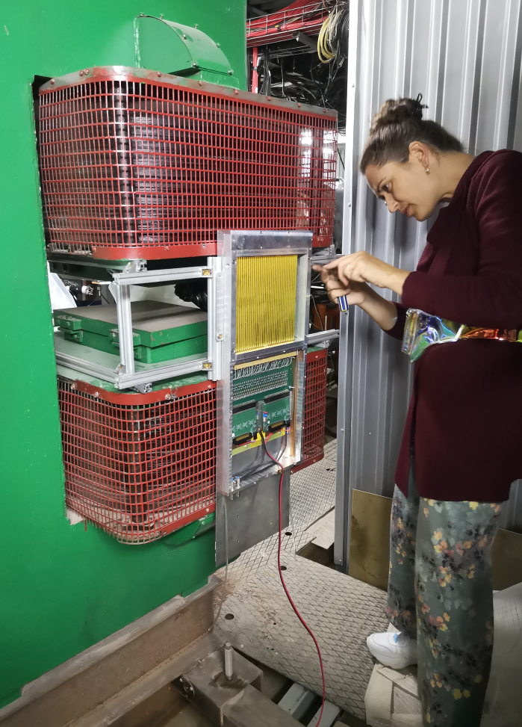
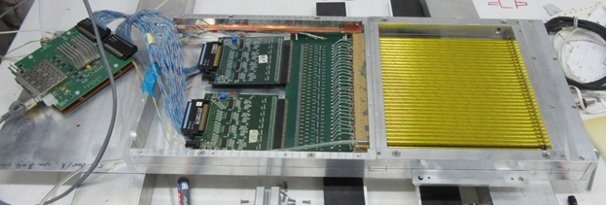
Coordinate detectors
Drift chambers based on drift tubes
Two drift chambers based on drift tubes have been manufactured. Their design consists of 64 tubes with a diameter of 6 mm glued into a single block.
A gas control panel was created for automated gas supply and control of coordinate Straw detectors, which are part of the magnetic spectrometer of the SCAN-3 installation. A photo of the gas control panel located in Bld. No. 1

Slide 28
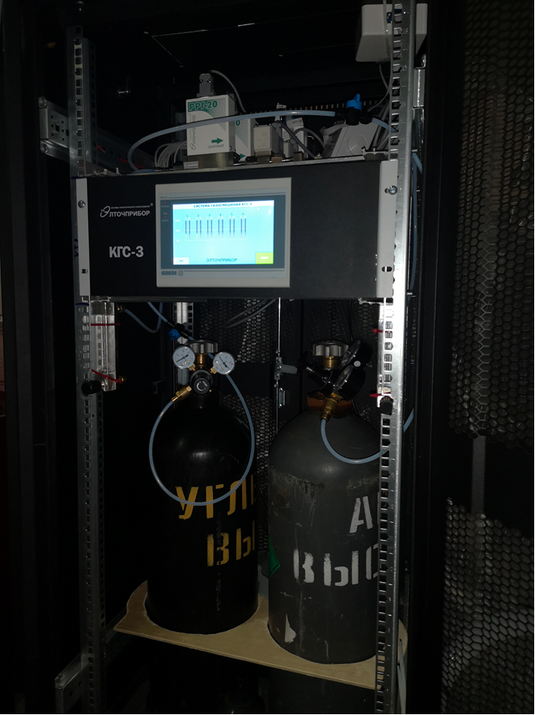
A gas control panel was created for automated gas supply and control of coordinate Straw detectors.
A photo of the gas control panel located in Bld. No. 1
Gas supply control based on the «ЭЛТОЧПРИБОР»'s development: eltochpribor.ru/

Slide 29
We have concluded an agreement with the group, which develops, produces (in LHEP) and tests coordinate straw detectors
In particular, their detectors are used in the NA-64 experiment.
V.Yu.Volkov, P.V.Volkov, T.L.Enik, G.D.Kekelidze, V.A.Kramarenko, V.M.Lysan, D.V.Peshekhonov, A.A.Solin, A.V.Solin

Slide 30
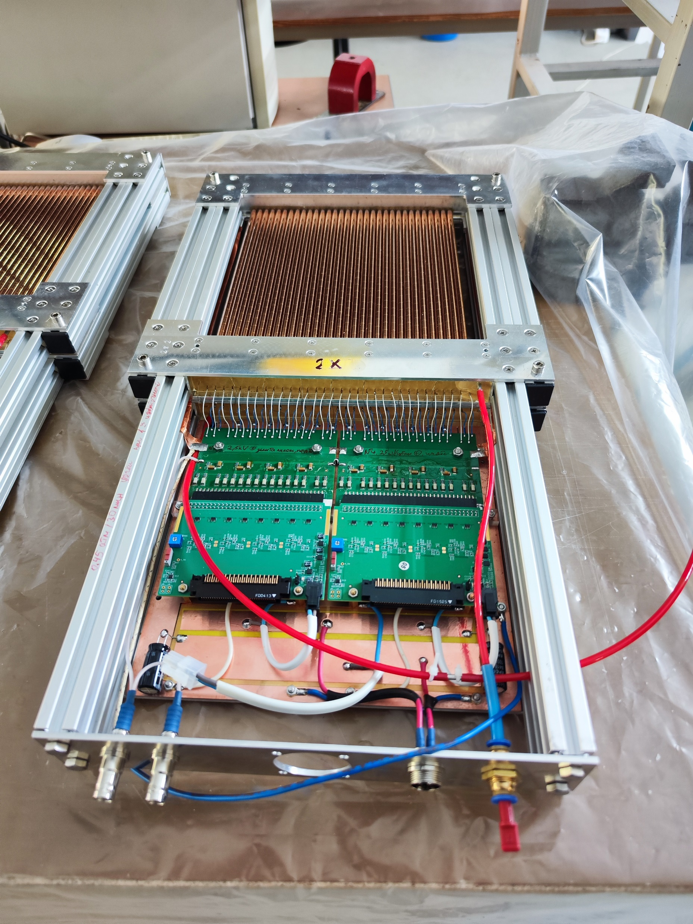
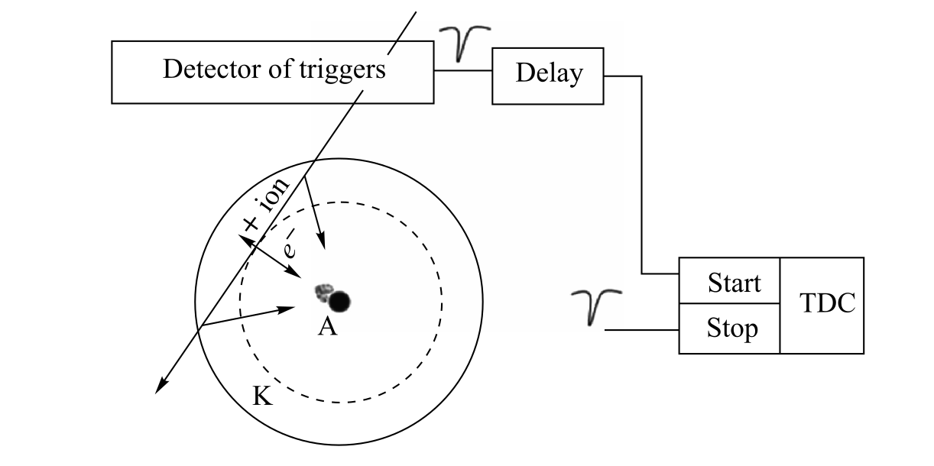
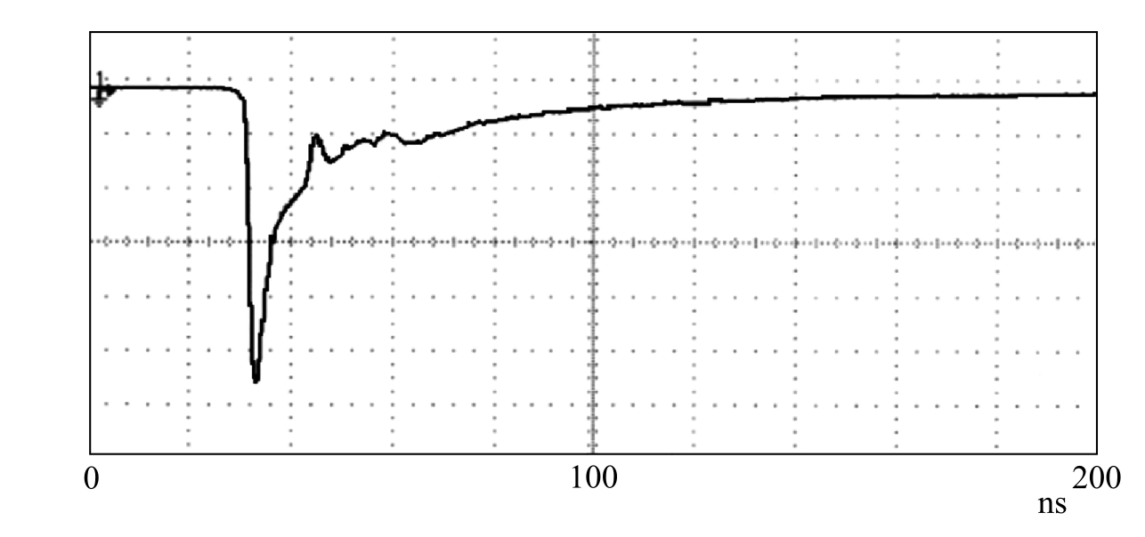
Interest in straw detectors is determined by their spatial resolution of approximately 100 micrometers, high radiation resistance, and ability to operate under conditions of high particle fluxes.
20 cm x 20 cm,
40 cm x 20 cm
D = 6 mm

Slide 31
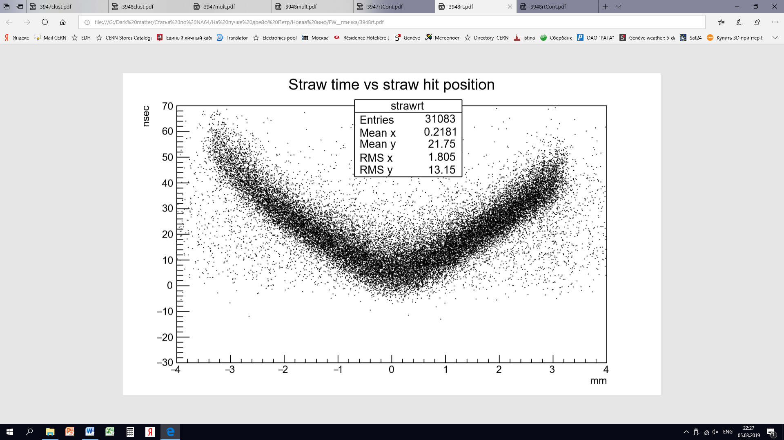
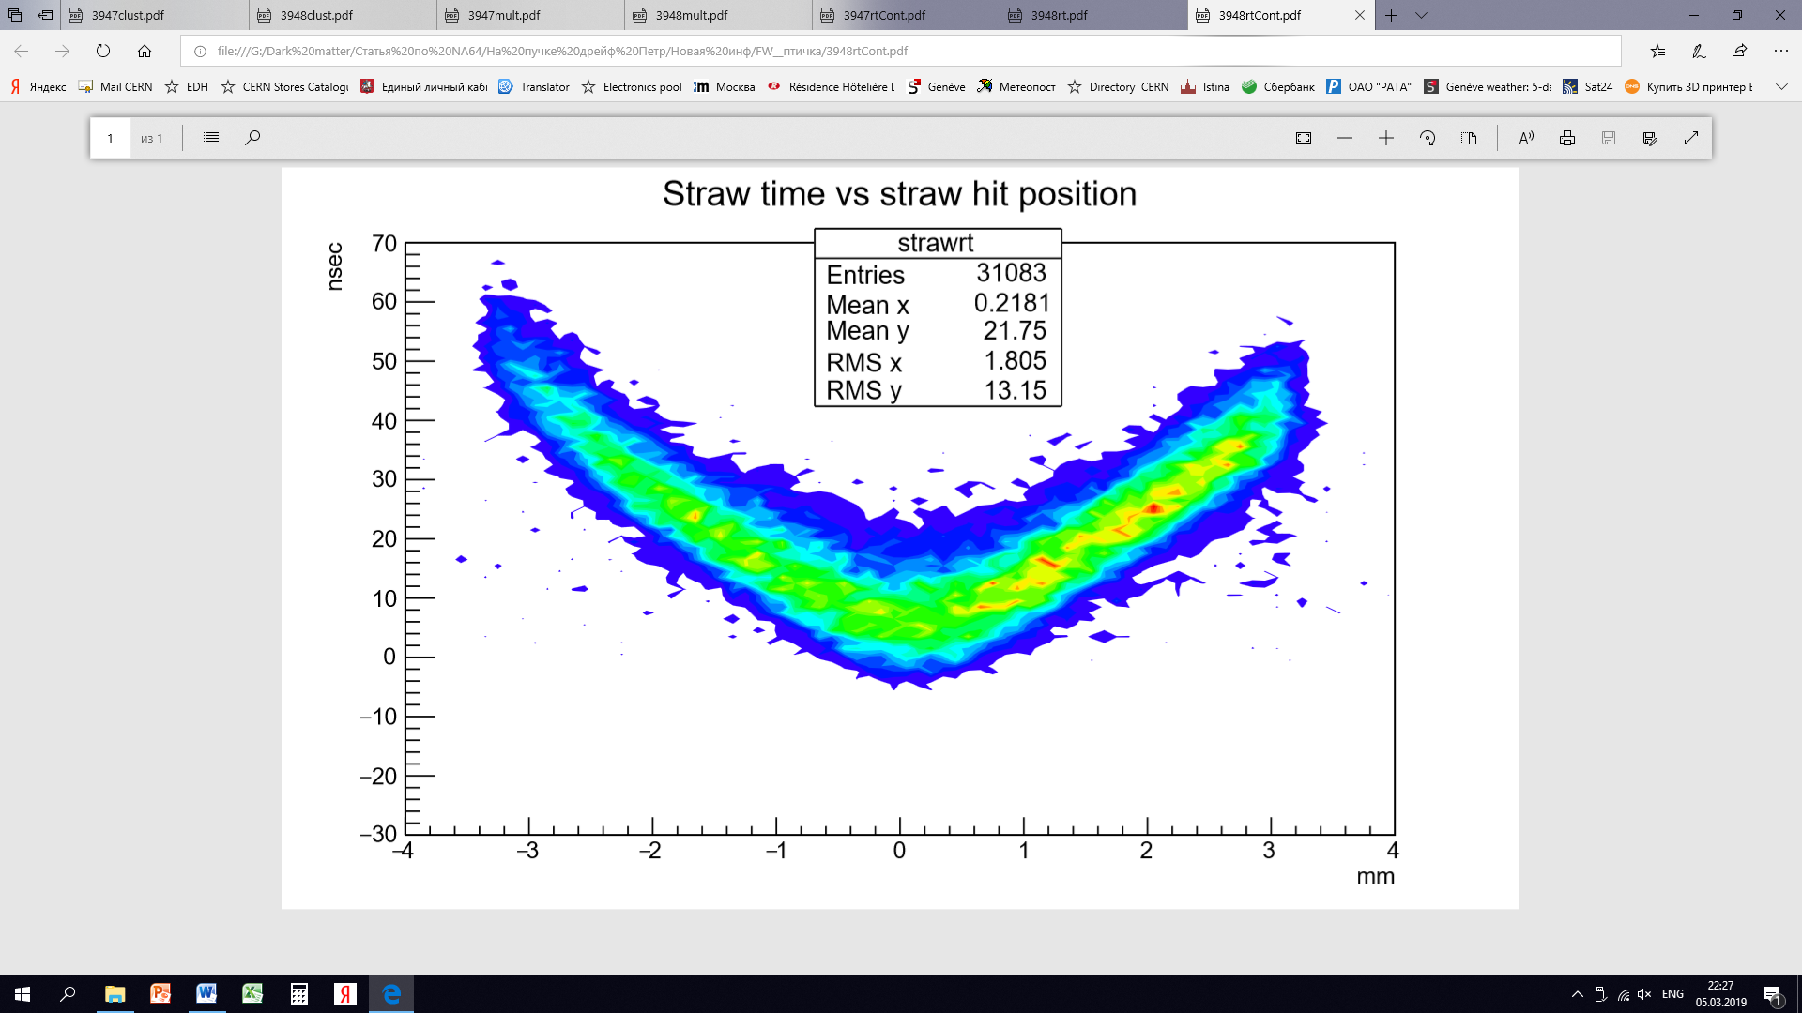
R-T dependence of the straw (6 mm, Ar/CO2) obtained by reconstructing tracks using Micromegas detectors: «Straw-chambers for the NA-64 experiment».
The possibility of linear interpolation of the dependence over a large region is evident. This dependence needs to be verified on the setup.

Slide 32
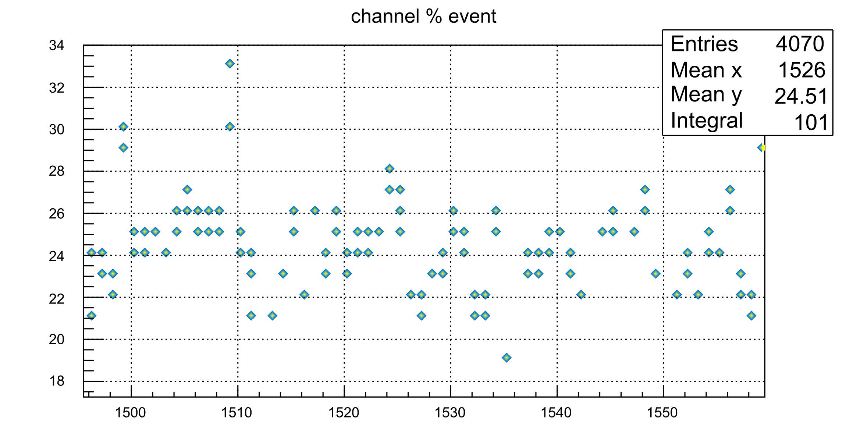
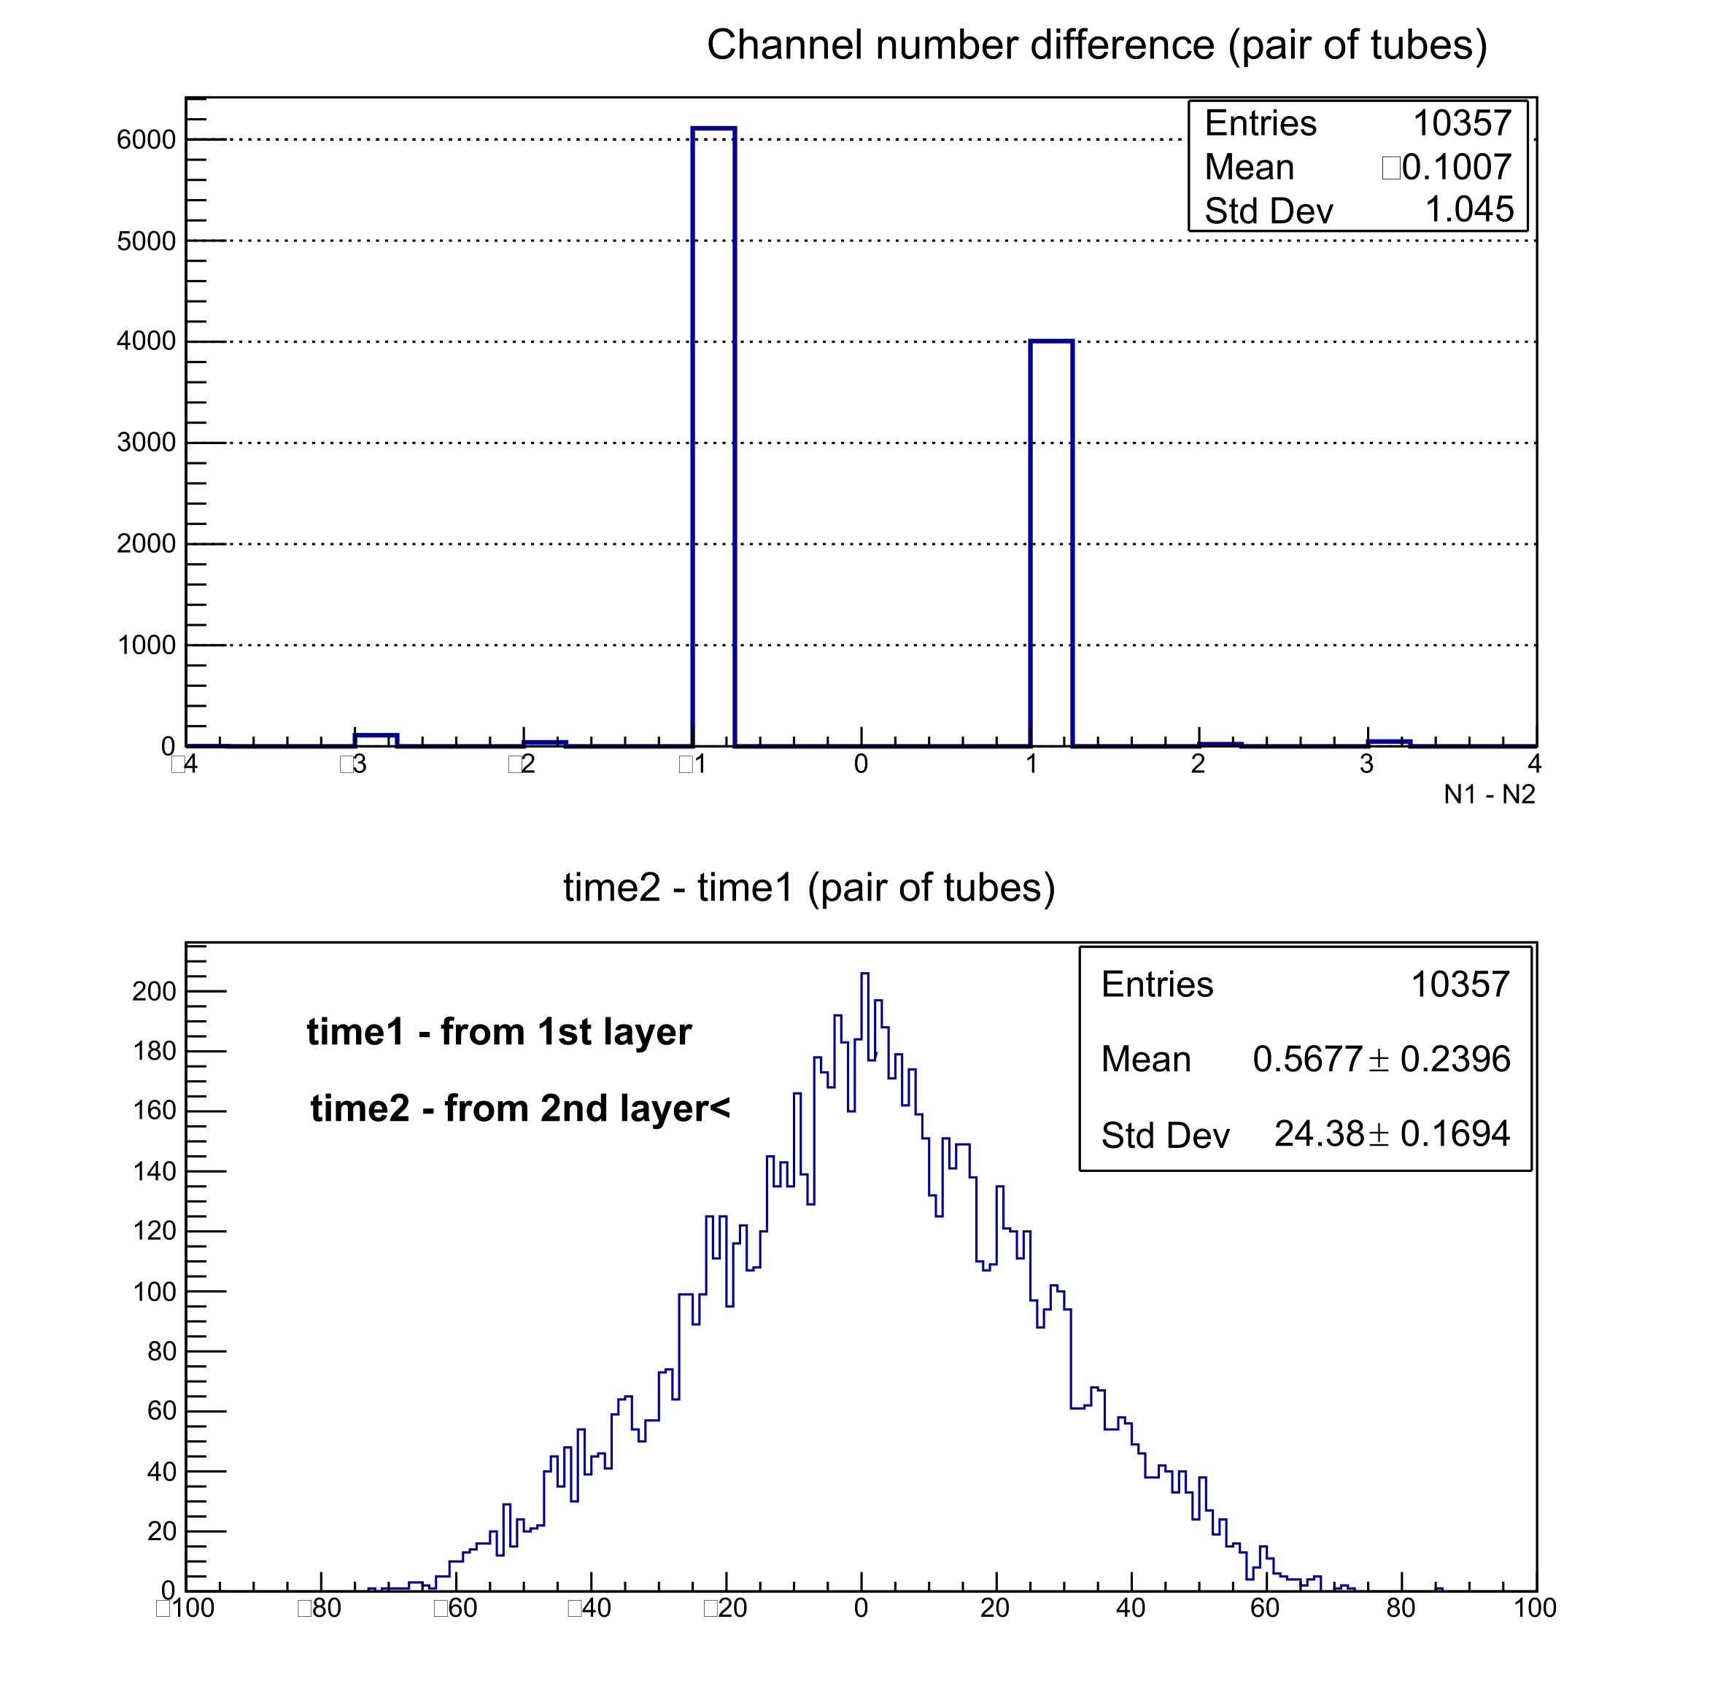
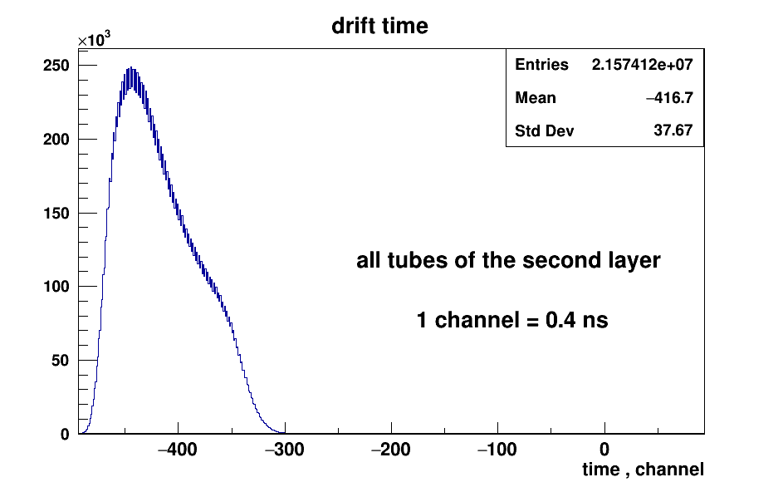
Studies on cosmic rays and on a radiation source have shown that the average drift velocity for our detectors is about 5 cm/μs.

Slide 33
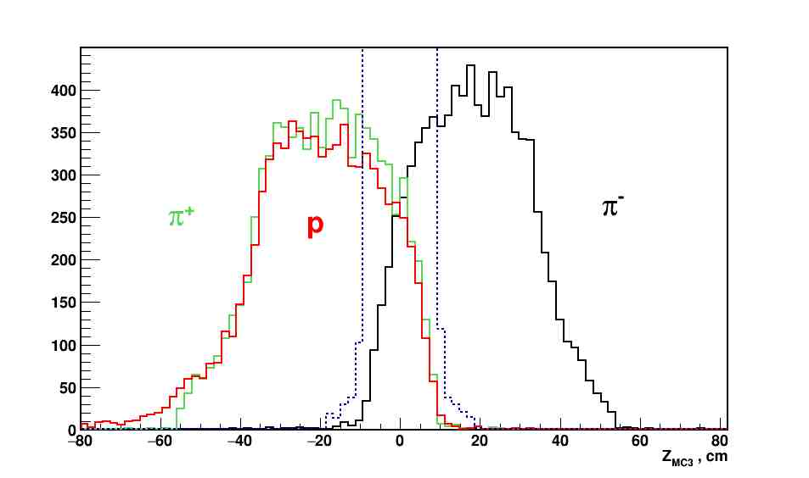

Slide 34
Neutron arms
Neutron detectors
_{P4, K4 and} _{M4}
12

Slide 35
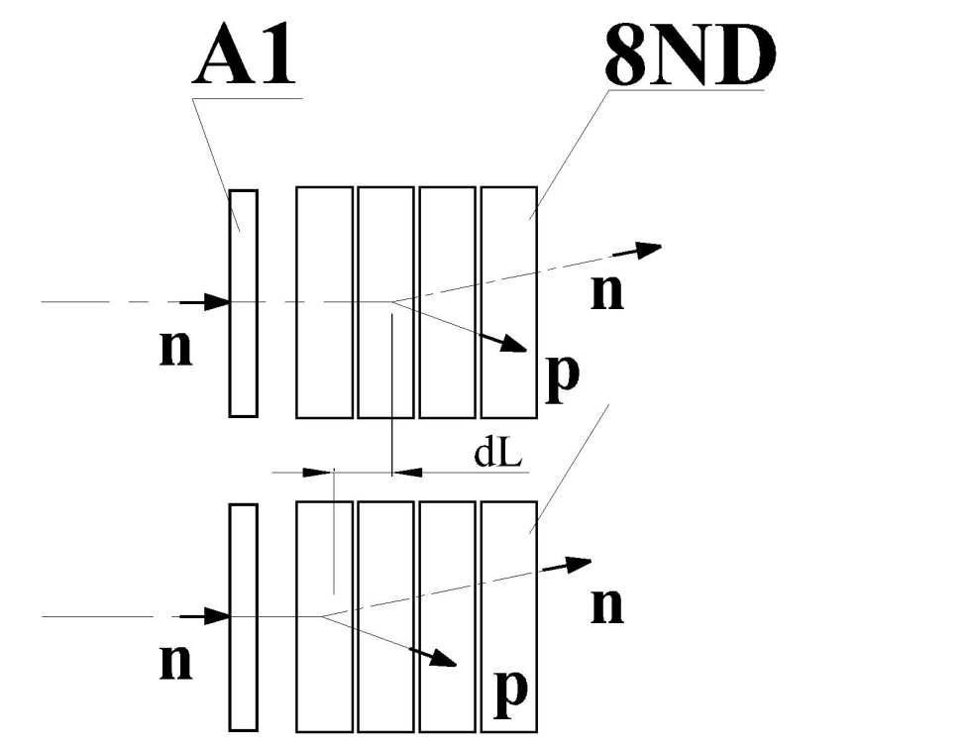
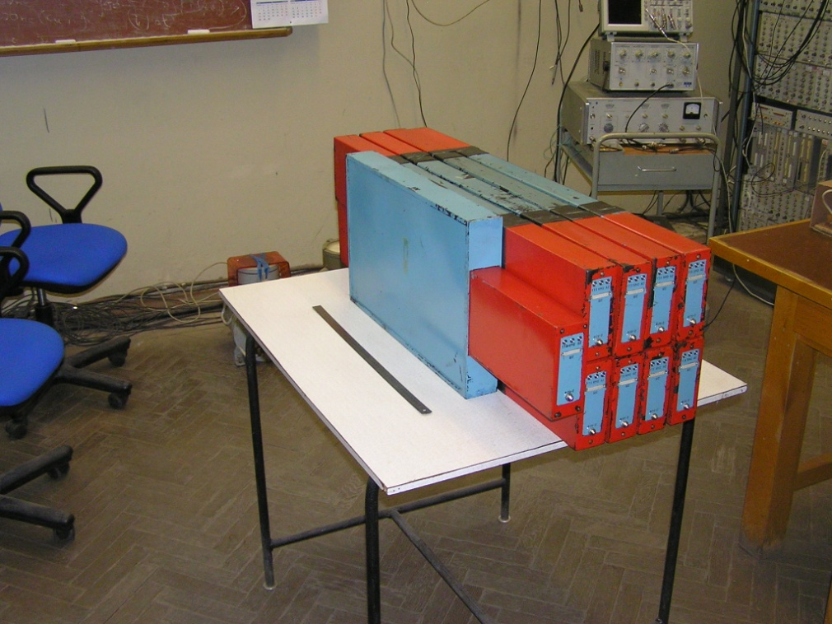
Neutron detectors (P-arm)
Multi layers neutron counter
For first run test.
Scintillator 500x130x50mm
Summary from beam test:
TOF resolution vary from 0.27ns to 0.4ns with mean value is 0.31ns

Slide 36
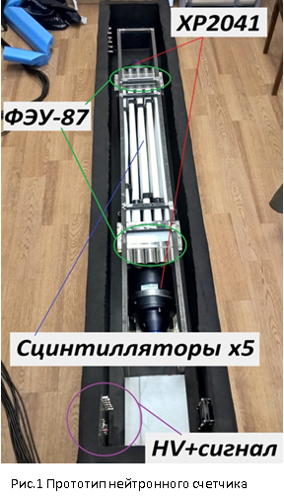
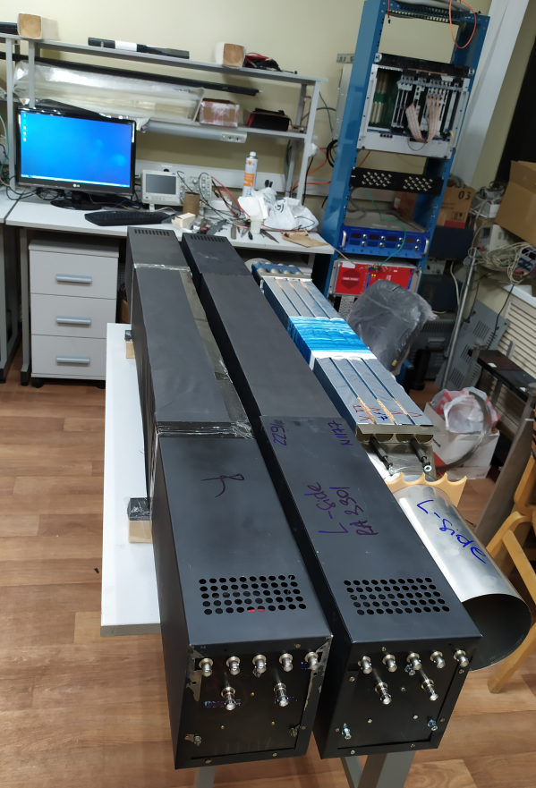
The design of the multilayer neutron detector has been modified, the counters are being assembled.
K4
M4
TOF resolution
is around
0.2 ns

Slide 37
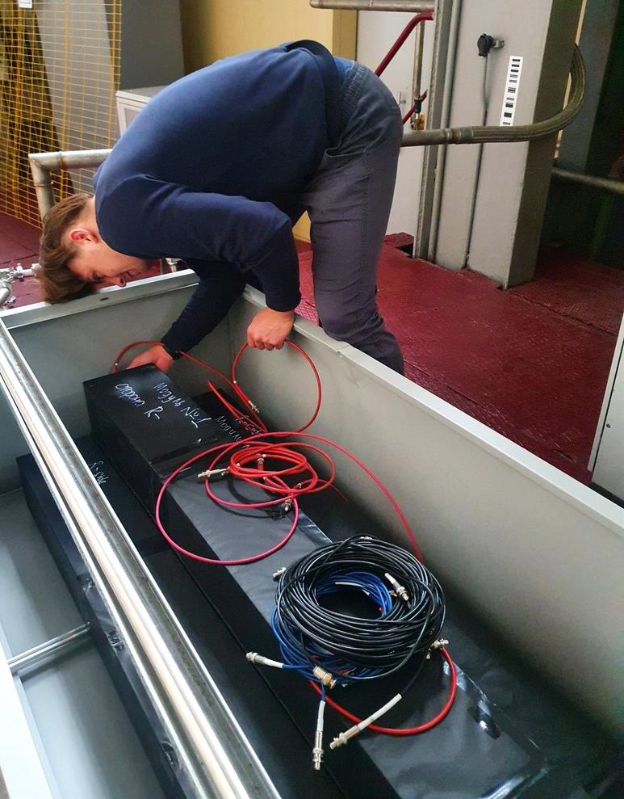
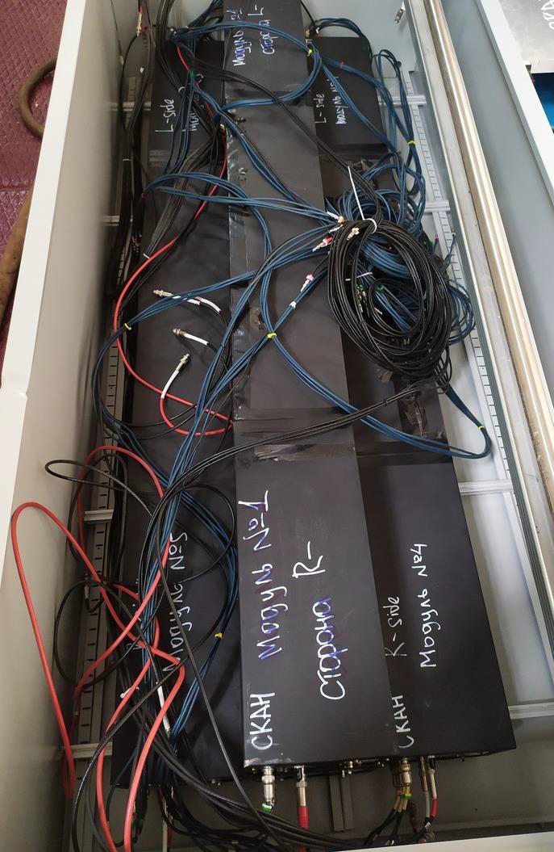
Installation of the neutron arm in the experimental area in 2022.

Slide 38
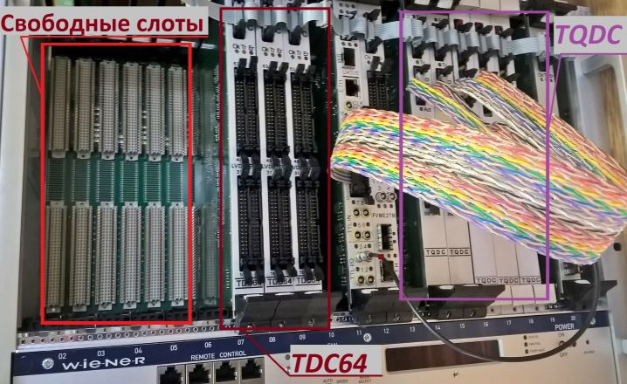
DAQ
The data acquisition system is built on the VME platform and includes a set of modules serving experimental setup. Basis of DAQ is VME modules , which are produced in VBLHEP JINR. DAQ consist of:
FVME – VME crate controller;
FVME2TM – trigger module;
TQDC-16 - 16-channel converter of time and charge, the total number – 64 channels;
TDC64V - 64-channel TDC with a resolution of 100ps, total - 128 channels;

Slide 39
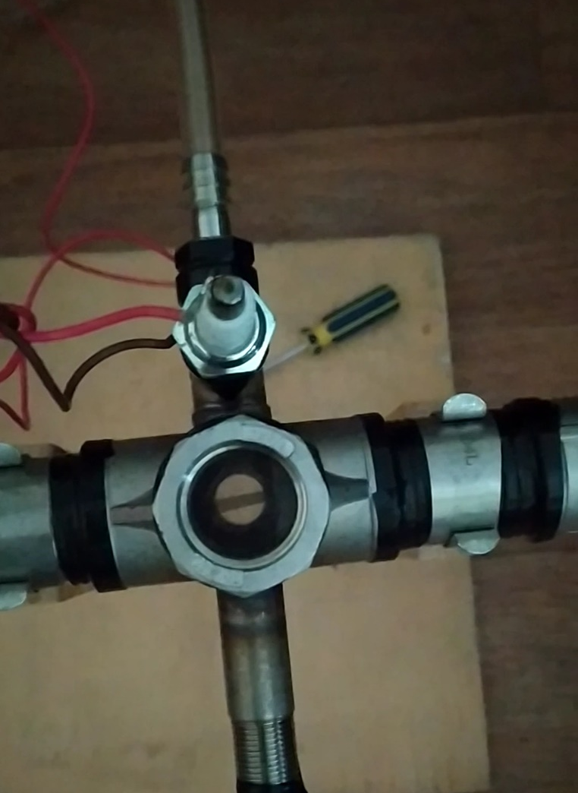
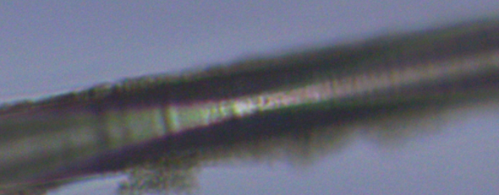

¹³C target preparation
Carbon synthesized by pulsed-arc plasma
The results of carbon deposition on the substrate
during plasma destruction of butane.
Raman spectroscopy

Slide 40
Summary
Have been observed πp back-to-back correlation coming from a target, which may be associated with decay of S₁₁ resonance.
The resonance is shifted to small masses an shift has value around 20 MeV. The width of the resonance is around 60 MeV.
Was estimated the value of the total cross-section (≈10μb).
As a result of project implementation we plan:
to create a precision magnetic spectrometer for the measurement of correlated pairs with an energy resolution up to 4-5 MeV;
to investigate the behavior of S₁₁ resonances in the nuclear medium:
  to determine the cross-section of η-nuclei formation σ(_{η}A);
  determine the bound energy of eta-mesons in nucleus;
  to measure the relationship of outputs (π⁻p) and (pN) events;

Slide 41
Thank you for attention!

Slide 42
Publication
Сухов Е.В., «Многослойный нейтронный счетчик на основе пластического сцинтиллятора», XXIV научно-практическоая конференция студентов, аспирантов и молодых специалистов Государственного университета «Дубна».
Сухов Е.В., доклад «Стартовый счетчик для проекта СКАН-3» на XXV научно-практической конференции студентов, аспирантов и молодых специалистов, г. Дубна, 16-26 апреля 2018.
Сухов Е.В., «Многослойный нейтронный счетчик на основе пластического сцинтиллятора», Международный молодежный научный форум «ЛОМОНОСОВ-2018», секция «Физика», изд-во «Москва, Физический факультет МГУ», 2018 – страницы 140-142.
Д.К.Дряблов, З.А.Игамкулов, Т.Т. Рахмонов, и др.«Погрешность в определении эффективной массы пары частиц от распада S11-резонанса в установке SCAN-2» Uzbek Journal of Physics, Изд:АН Республики Узбекистан , т.5 , №19,2018, с.249-257.
С.В.Афанасьев, Д.К.Дряблов, Б.В.Дубинчик, и др. «Creation of a precision magnetic spectrometer SCAN-3»,
S.V.Afanasiev, “The influence of collective effects on the eta-mesic nucleus”. XXIV International Baldin Seminar on High Energy Physics Problems "Relativistic Nuclear Physics and Quantum Chromodynamics", September 2018.
K.Michalickova “η-nuclei in the SCAN experiment”. XXIV International Baldin Seminar on High Energy Physics Problems "Relativistic Nuclear Physics and Quantum Chromodynamics", September 2018.

Slide 43
8. D.K. Dryablov , “Search for eta-mesic nuclei the SRC/BM@N experiment at the nuclotron.” XXIV International Baldin Seminar on High Energy Physics Problems "Relativistic Nuclear Physics and Quantum Chromodynamics» September 2018.
9. С.В.Афанасьев ,и др. «Исследование нейтронного детектора на выведенном пучке Нуклотрона», Письма в ЭЧАЯ, т.16, №4 (223) , 2019. стр. 310-316
10. S.V.Afanasiev, et. all,”Test of the Neutron Detector in the Nuclotron Extraction Beamline”, Physics of Particles and Nuclei Letters, v.16, №4 (223) , 2019. p. 327–332
11. Sakulin.D.G. et. all. "Investigation of the electromagnetic calorimeter response function by cosmic muons", XXIV International Baldin Seminar on High Energy Physics Problems "Relativistic Nuclear Physics and Quantum Chromodynamics" (Baldin ISHEPP XXIV), EPJ Web Conf. Volume 204, 2019
12. S.V.Afanasiev, et. all,”«Search for eta-mesic nuclei in the SRC/BM@N experiment at the Nuclotron» , XXIV International Baldin Seminar on High Energy Physics Problems “Relativistic Nuclear Physics and Quantum Chromodynamics” (Baldin ISHEPP XXIV), EPJ Web of Conferences, ISSN:2100-014X, v.204, p.09002
13. K. Michaliˇckov´a et.all, “Eta-nuclei in the SCAN experiment”, Relativistic Nuclear Physics and Quantum Chromodynamics” (Baldin ISHEPP XXIV), EPJ Web of Conferences, ISSN:2100-014X, v.204, p.09001
14. K. Michaliˇckov´a et.all, “SEARCH FOR ETA-NUCLEI IN THE d+C REACTION IN THE RANGE OF THE BEAM ENERGY 0.6 - 2.3 GeV/nucl.” International Workshop "Relativistic Nuclear Physics: from Hundreds of MeV to TeV" -- RNP- 2019 .Stara Lesna, Slovakia
15. K. Michaliˇckov´a et.all, “Determination of the reaction for eta-nuclei creation”, Conference of Slovak physicists: Zilina, Slovakia, 2-5. September 2019

Slide 44
16. Ustinov V.V., доклад «Investigation of the radiation hardness of plastic scintillators in IBR-2 reactor» // HGCAL Workshop 2019-3, CERN, Женева, Швейцария, 11 ноября 2019.
17 Ustinov V.V., доклад «The Radiation Hardness of the Plastic Scintillators and Reflectors» // HGCAL Workshop 2019-1, CERN, Женева, Швейцария, 11 марта 2019.
18. Устинов В.В., доклад «Стенд для исследования пластических сцинтилляторов на радиационную стойкость» // XXVI Международная конференция студентов, аспирантов и молодых специалистов по фундаментальным наукам "Ломоносов-2019", МГУ, Москва, Россия, 11 апреля 2019.
19. Устинов В.В., доклад «Радиационная стойкость пластических сцинтилляторов и отражающих покрытий» // VIII Межинститутская молодежная конференция «Физика элементарных частиц и космология 2019», МФТИ, Москва, Россия, 12 апреля 2019.
20. Устинов В.В., секционный доклад «Исследование влияния радиационного поля на светосбор пластических сцинтилляторов» // XХVI Научно- практическая конференция студентов, аспирантов и молодых специалистов, Государственный университет «Дубна», Россия, подсекция «Физико- технические системы», 15 апреля 2019.
21. Устинов В.В., пленарный доклад «Исследование влияния радиационного поля на светосбор пластических сцинтилляторов» // XХVI Научно-практическая конференция студентов, аспирантов и молодых специалистов, Государственный университет «Дубна», Россия, 25 апреля 2019.

Slide 45
22. Устинов В.В., пленарный доклад «Исследование влияния радиационного поля на светосбор пластических сцинтилляторов» // XХVI Научно-практическая конференция студентов, аспирантов и молодых специалистов, Государственный университет «Дубна», Россия, 25 апреля 2019.
23. Сухов Е.В., доклад «Исследование световыхода пластических сцинтилляторов в зависимости от светоотражателя» // XXVI Международная конференция студентов, аспирантов и молодых специалистов по фундаментальным наукам "Ломоносов-2019", МГУ, Москва, Россия, 2019.
24. Сухов Е.В., доклад «Исследование светосбора пластических сцинтилляторов в зависимости от производителя, формы и размера» // VIII Межинститутская молодежная конференция "Физика элементарных частиц и космология 2019", МФТИ, Москва, Россия 2019.
25. Сухов Е.В., секционный доклад «Исследование световыхода пластических сцинтилляторов в зависимости от их производителя, формы и размера, оболочки» // XХVI Научно-практическая конференция студентов, аспирантов и молодых специалистов, Государственный университет «Дубна», Россия, подсекция «Физико-технические системы», 15 апреля 2019.
26. Устинов В.В., Афанасьев С.В., Сухов Е.В., доклад «Investigation of the radiation hardness of plastic scintillators» на Всероссийской научно- практической конференции «ПРИРОДА. ОБЩЕСТВО. ЧЕЛОВЕК», Государственный университет «Дубна», Россия, 2019.

Slide 46
27. V. Ustinov, S. Afanasiev, V. Baskov, V. Bekirov, D. Dryablov, B. Dubinchik, A. L’vov , A. Malakhov, K. Michalickova, V. Polyansky, D. Sakulin, E. Sukhov “Multilayer neutron detector based on a plastic scintillator”, AIP Conference Proceedings, ISSN:0094-243X, eISSN:1551-7616, Изд:American Institute of Physics, Vol: 2377, 030018 (2021)
28. Устинов В. В., Афанасьев С. В., Басков В. А., Бекиров В. И., Дряблов Д. К., Дубинчик Б. В., Кречетов Ю. Ф., Кутинова О. В., Львов А. И., Малахов А. И., Михаличкова К., Полянский В. В., Сакулин Д. Г., Сухов Е. В.
«Разработка детекторов нейтронов для спектрометра СКАН-3 в ОИЯИ»
Труды Московского физико-технического института, ISSN:ISSN 2072-6759, том 13, №8, стр 122-132.

Slide 47



Slide 48



Neutron detectors
Energy resolution δE_{N} ≤ 10 МэВ.
δE = γ³ mc² β δβ,
E_{N}=270 МэВ (β = 0.63 и γ = 1.29) L = 6м
{ δt <0.4 нс
{ δL < 8 см
δβ = 0.8*10⁻²
R&D for neutron counter
Preliminary data gave a time resolution is better then 300 ps for neutron detection.
1

Slide 49

K. Tsushima
Nuclear Physics A670 (2000) 198c-201 c ,
“Study o f ω, η, η' and D⁻⁻mesic nuclei”
K. Tsushima , D.H. Lu , A.W. Thomas, K. Saito Physics Letters B 443 1998 26–32,
“Are η- and ω-nuclear states bound.”
A. I. L'VOV nucl-th/9809054
PRODUCTION AND DECAY OF ETA
-MESIC NUCLEI
Resulting energy shift of η+N pair in the nuclear medium,
ΔE(η+N ) = (24÷30)_{η} + (8)_{N} =30-40 MeV

Slide 50


p
p
The dependence of energy resolution (MeV) for the PC π-mesons and protons of various energies from its relative momentum resolution (%).
Energy resolution of the TOF-system depending on the base of passage for a discrete set of time resolution of the detectors (black-0.1ns, red-0.2ns, green-0.3ns, blue-0.4ns, yellow-0.5 ns) .
afanasev@lhe.jinr.ru

Slide 51




Decays of resonances and the background are recorded at the same time !
The number of pairs with the energy of 1535±30МэВ registered from random coincidences depending on the energy of the beam.
effect
N
background
N
background
S₁₁
N
Expansion angle of the products decay of S₁₁– resonance for the reaction N+A→ S₁₁+X.

Slide 52


Dipole Magnet
LV

Slide 53


Distortion of π⁺ and p of energy range of 200 – 425 МэВ in the magnetic field of SP-46 magnet.
Distortion of track in magnetic field as a function of particle type, kinetic energy and two values of the magnetic field Нмах=7 and 10 кГс.
Energy resolution (FWHM) for protons are 21,5 and 15 MeV, for pions – 8 and 5,6 MeV at the magnetic field 7 and 10 kHs accordingly.

Slide 54


Test Setup
“MARUSIA”-area
afanasev@lhe.jinr.ru

Slide 55




Energy deposition in layers
neutrons
Charged particles
afanasev@lhe.jinr.ru

Slide 56

afanasev@lhe.jinr.ru

Slide 57
R&D for neutron counter
Preliminary date gave a time resolution is better then 200 ps for neutron detection.
afanasev@lhe.jinr.ru

Slide 58

Estimates of the effect yield
Y(p,π ⁻)= L • σ_{η}(N¹²C→N₁N₂n_{η}(A-1)) • Br(πN) • ξ • Ω_{π} • n_{c} • f(Ω_{p}/Ω_{π})
σ_{η} ⁻ total cross section of eta-nuclei formation;
L - luminosity;
Ω_{π} - the solid angle;
ξ - the probability to have the πp pair
f(Ω_{p}/Ω_{π}) - a geometric fraction;
Br(πN) - the branching ratio of S₁₁(1535) decay;
n_{c} - accelerator cycles per hour;
Production of η-mesons in nucleon-nucleon collisions
V. Baru,
PHYSICAL REVIEW C 67, 024002 (2003)
Y(pπ) ≈ 140 events/hour
Y(pp) ≈ 2-3 events/hour
Y(pn) ≈ 100 events/hour
afanasev@lhe.jinr.ru

