Slide 1
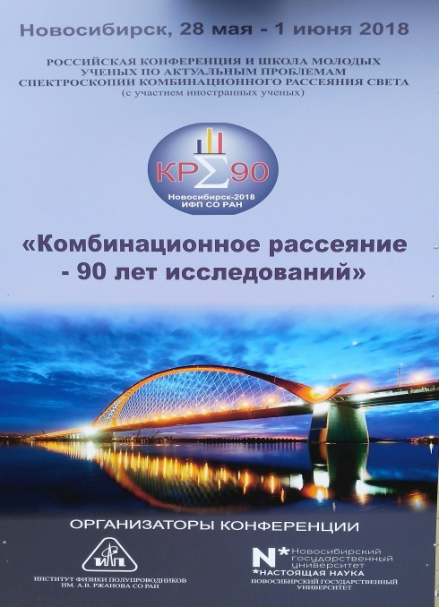
90 years of Raman effect:
surface-enhanced micro-CARS mapping of organic molecules
Grigory Arzumanyan
FLNP, Sector of Raman spectroscopy
48th meeting of the PAC for Condensed Matter Physics
14 – 15 June 2018

Slide 2
OUTLINE
Foreword
90-years of Raman effect: history in brief and key milestones
3. Current results on surface-enhanced coherent
antistokes raman scattering (SECARS).
4. Summary
2
2

Slide 3
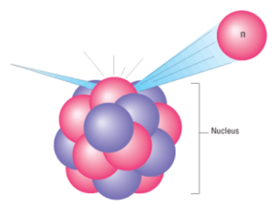
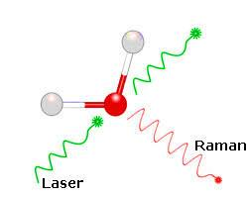
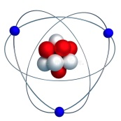
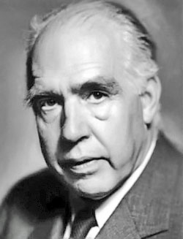
Science is united
“You can not draw a line between large and small, as both are equally important for a single whole”
Niels Bohr
Discovery of the Raman effect – 1928, Nobel prize, 1930
Discovery of the neutron by James Chadwick – 1932, Nobel prize, 1935

Slide 4
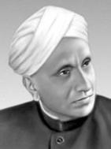
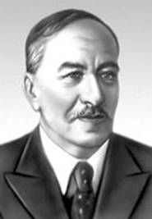
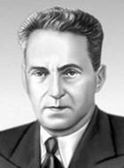
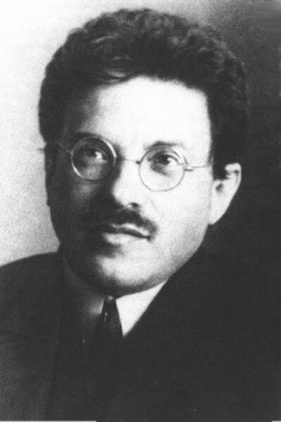
90 YEARS of RAMAN EFFECT
C.V. Raman
L.I. Mandelstam
G.S. Landsberg
A. Smekal
Discovered by C.V. Raman and K.S. Krishnan (student of C.V. Raman) in liquids (Calcutta, 28 Feb., 1928),
and independently by
G.S. Landsberg and L.I. Mandelstam in crystals (Moscow, MSU, 21 Feb., 1928)
The effect was predicted theoretically by Adolf Smekal in 1923
C.V. Raman – Nobel Prize in Physics, 1930
4

Slide 5
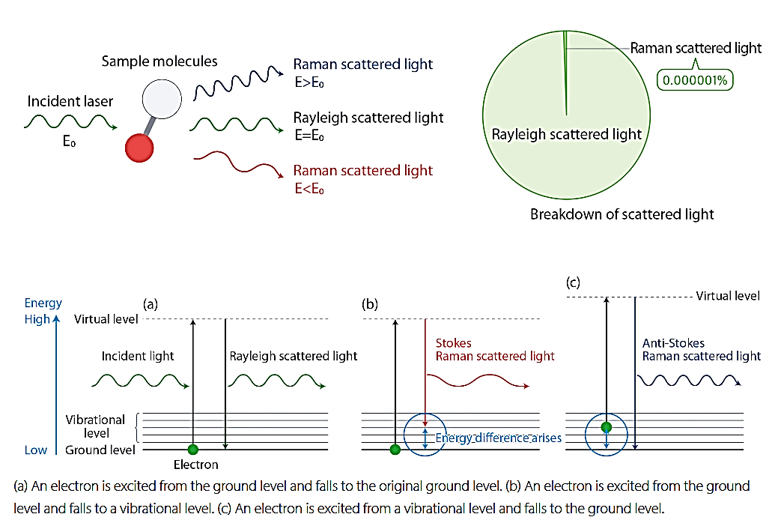
Scattering of light by molecules
Raman is based on the inelastic scattering of incident radiation on molecular vibrations/rotations
Diagram of the Rayleigh and Raman Scattering Processes

Slide 6
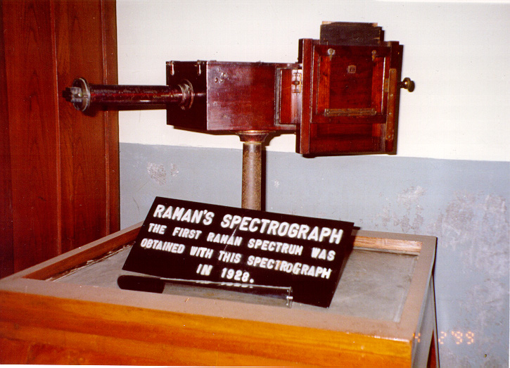
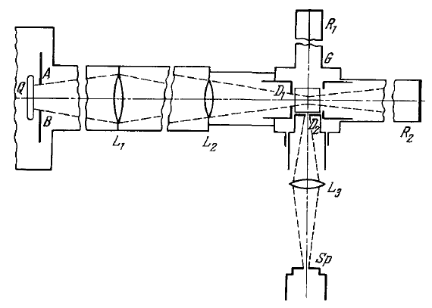
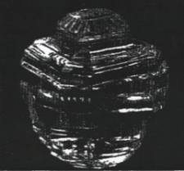
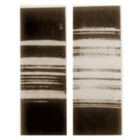
Historical photos of discovery (1928)
Raman - Krishnan
Landsberg - Mandelstam
incident light
scattering spectrum,
benzene
scattering spectrum,
quarts seal (rhinestone)

Slide 7
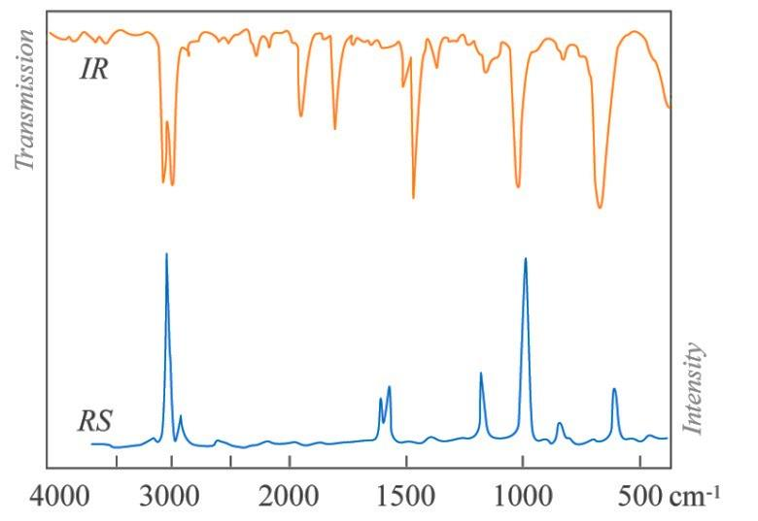
The main specificity distinguishing Raman/IR spectroscopy from other spectroscopic methods – both of them are molecular vibrational spectroscopy
Although the spectral features of Raman and infrared spectra can be interpreted in a similar way the selection rules are different.
Infrared absorption is sensitive to the change of the dipole moment µ during the vibration.
A Raman active vibration is sensitive to the change of polarizability during the vibration.
Raman scattering is also known as a “fingerprint spectroscopy”
7

Slide 8
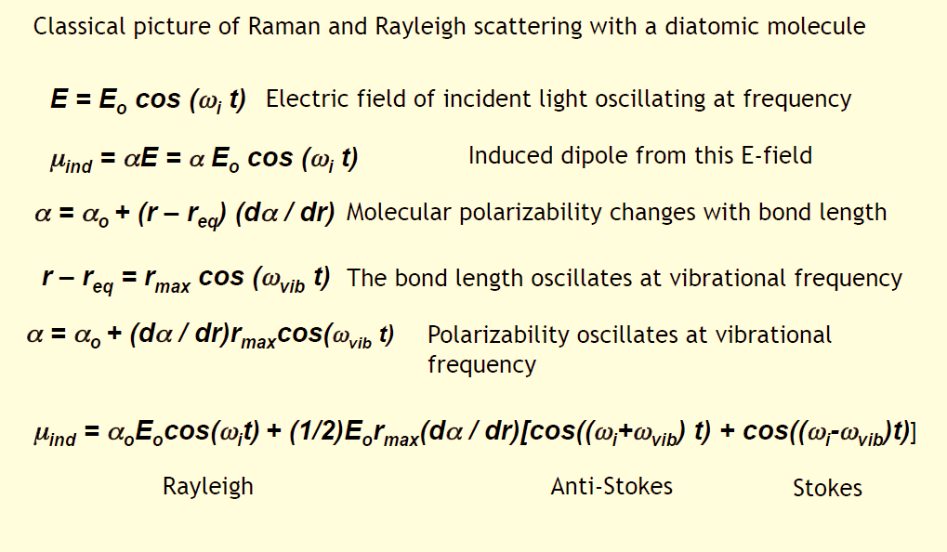
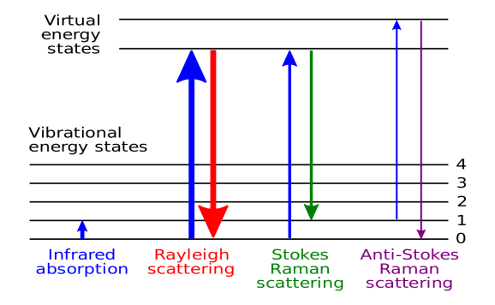
Classical Raman Physics
Polarizability induced dipole equation
Scattering at the combination frequencies (Raman effect)
8

Slide 9
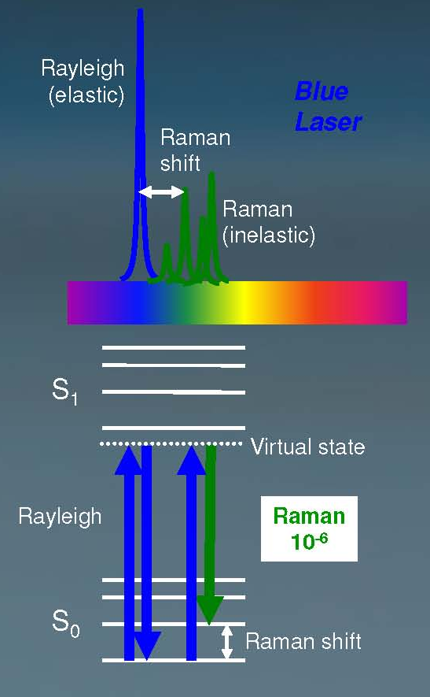
Raman signal is very informative – vibrational frequencies are characteristic of chemical bonds (chemical structure) in a specific molecule: normal modes
Raman scattering is weak:
1 in 10⁶ incident photons are Raman scattered
9

Slide 10
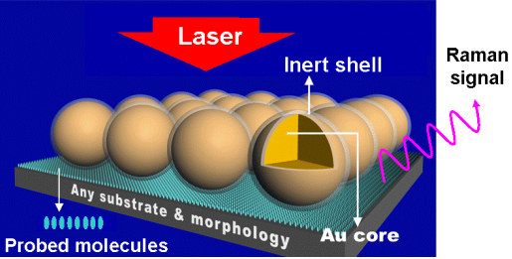
90-years of Raman effect: key milestones
1961 – invention of lasers, a new generation of light excitation sources – Nobel Prize in Physics (1964), A.M. Basov, A.M. Prokhorov, C.H. Townes
1966 – CARS: Coherent Anti-Stokes Raman Scattering,
first recordings by P. D. Maker and R. W. Terhune, Ford Motor company
1974 – SERS: Surface-Enhanced Raman Scattering, first demonstration by M. Fleischmann – a technique which provides many orders of magnitude increases in Raman intensity
1985 – TERS (or nano-Raman): Tip-Enhanced Raman Scattering - the concept was first proposed by Wessel in 1985, and was experimentally realized in 2000 (nanoscale resolution imaging)
From the 80s to the present: improvement of the optics, filters (especially notch filters) , detectors (PMT, CCD), soft, etc.
Modern trends:
combination of CARS with SERS – SECARS
Shell-Isolated NP Enhanced Raman Spectroscopy – SHINERS
10

Slide 11
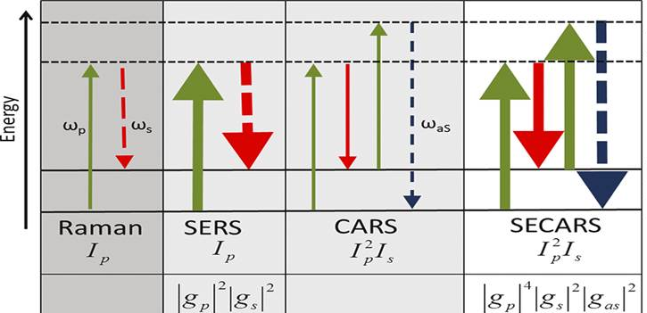
Surface Enhanced micro-CARS from Gold Nanoparticle-Immobilized Organic Molecules at a Nanostructured CeO₂/Al Film
SECARS
11

Slide 12
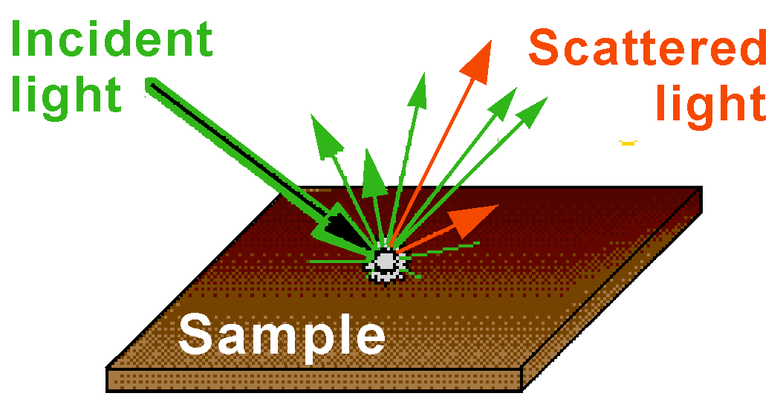
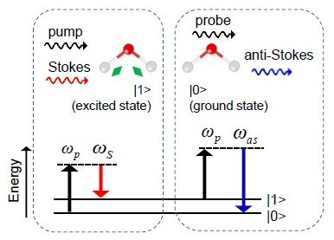
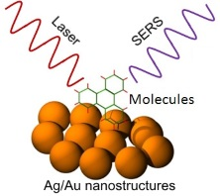
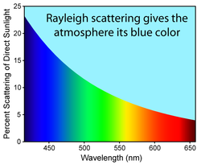
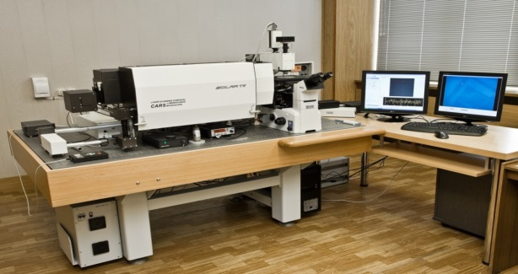
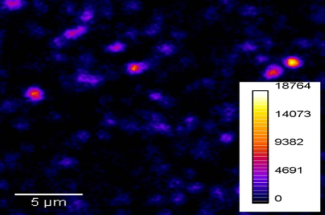
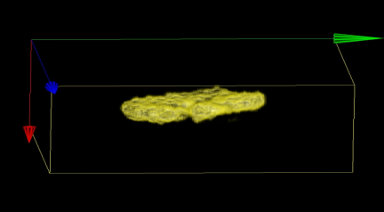
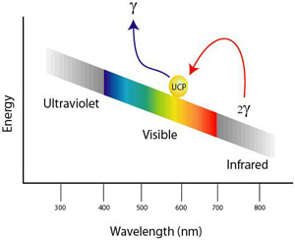
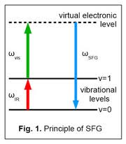
Multimodal optical platform at JINR
Raman
F-CARS, E-CARS, P-CARS
SERS
Transmitted and reflected channels
SECARS
“CARS” microscope
Up-conversion luminescence
SHG, SONICC
Second harmonic &
sum frequency
generation
12

Slide 13
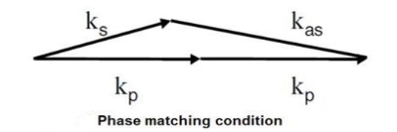
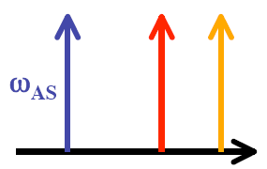
Physical background of CARS
CARS is a third-order nonlinear process that involves a pump beam at a frequency ω_{p} and a Stokes beam at a frequency of ω_{s}. The signal at the anti-Stokes frequency of ω_{as} = 2ω_{p}- ω_{s} is generated in the phase-matching direction.
ω_{vib} = ω_{pump} - ω_{Stokes}
The sample is stimulated through a four-wave mixing parametric process.
I_{CARS}(ω) ~ |χ_{CARS}⁽³⁾|² x I_{p}² I_{S} x N²
χ⁽³⁾ – third-order nonlinear susceptibility
The vibrational contrast in CARS is created when the pump-Stokes frequency difference matches molecular vibration of a particular chemical bond Δω = ω_{vib} and the oscillations of molecules with that bond are driven coherently. Thus, CARS provides a chemically specific signature of various molecules.

Slide 14
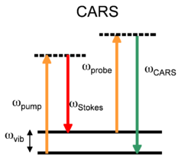
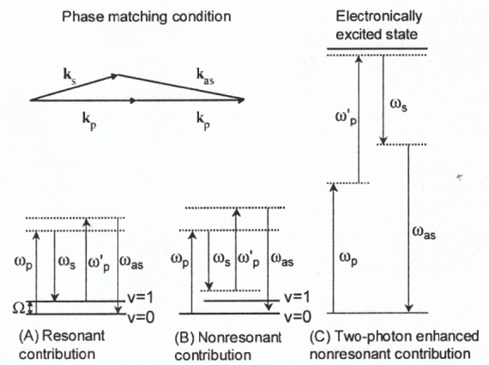
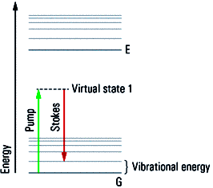
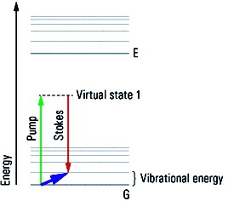
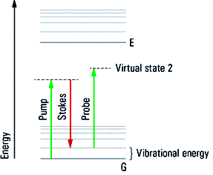
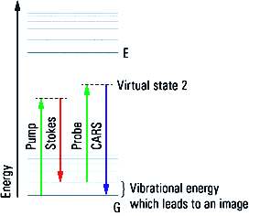
The CARS process in details
CARS microscopy is a coherent imaging method
in which the induced polarization assumes a
well-defined phase relation with the excitation fields.
CARS energy diagram
I_{CARS}(ω) ~ |χ_{CARS}⁽³⁾|² x I_{p}² I_{S} x N²
Non-resonant component arises from
the electronic contributions to χ⁽³⁾ : a) off-resonance transitions, b) two-photon non-resonant contribution.
χ⁽³⁾ – third-order nonlinear susceptibility
a
b
c
d
ω_{AS} = 2ω_{p}- ω_{St}
Notes:
Fig.a Step 1: Shine (intense) light onto the molecules to create (many) virtual states. This light will pump many molecules and is called the pump beam (ω_{P}).
+
Step 2: Shine (intense) light onto the molecules with appropriate energy to “to stimulate the depopulation” of the virtual state. This energy is the Stokes energy (less than excitation). Hence, the light is the Stokes beam (ω_{S}).
Fig.b The consequence of this double illumination is the dense population of a vibrational sub-state of the ground state, which is very specific to the chemical properties. The selection is tuned by the tunable pump beam.
Fig.c In order to visualize the populated vibrational state, we use the pump beam as a probe to elevate the molecule to a new virtual state. (No action needed, light is still on).
Fig.d The molecules will relax from this virtual state to the ground state, the energy is now larger than the pump, consequently “bluer” than the pump and hence called “anti-Stokes”. This is the detected signal.
In CARS microscopy, the electronic contributions to χ(3) are exhibited as a nonresonant background signal with no vibrational contrast and need to be minimized. By taking advantage of the Raman depolarization ratio of certain modes, thr resonant signal can be separated from the nonresonant background when polarization sensitive detection is employed. P-CARS significantly enhances the image quality and contrast.

Slide 15
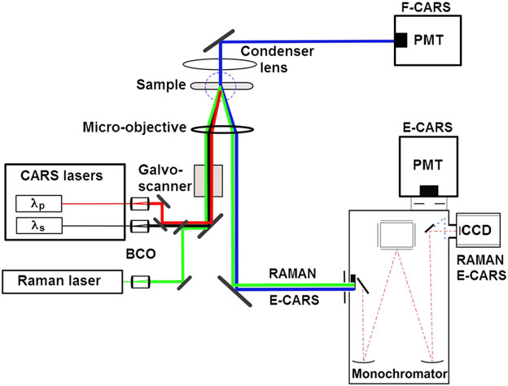
Оptical layout of SECARS experiments
Nikon TE2000S
SECARS
H7844, Hamamatsu
Fast mapping
Fast mapping
Slow mapping
HS 101H, PROSCAN, Belarus
Slow mapping
SECARS
SECARS
15

Slide 16
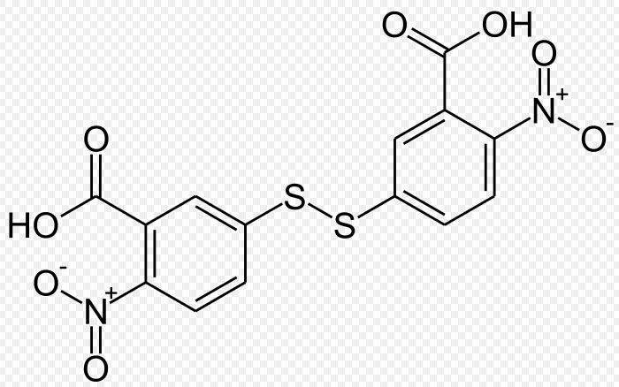
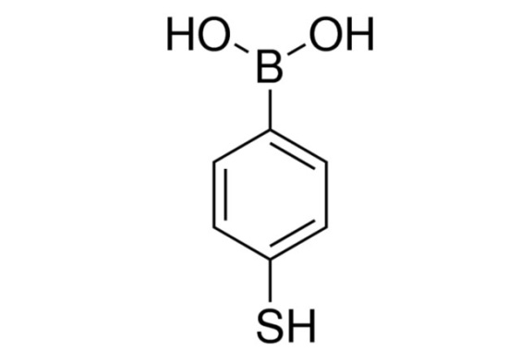
Analyte/reporter molecules
Al/CeO₂/AuNP/DTNB 1900 nm-thick film
Dithionitrobenzoic acid (DTNB)
Al/CeO₂/AuNP/mPBA 1900 nm-thick film
mercaptoPhenylBoronic acid (mPBA)
16

Slide 17
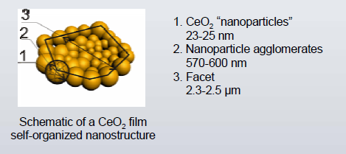
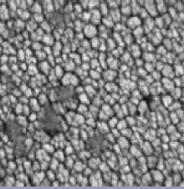
SERS-active substrates*: Al/CeO₂/AuNP
0.5 mm thick
29×29 μm
Microphotography
SEM images of a CeO2/Al/Al₂O₃ sample surface with the TNB-modified Au‐NPs:
(a) ~7.5 µm × 4.5 µm , (b) ~0.6 µm × 0.4 µm
* [1] I. Kurochkin, I. Ryzhikov, A. Lagarkov, et al//Advanced Electromagnetics 2014, 3, 57
[2] I. N. Kurochkin, I. A. Ryzhikov, A. N. Lagarkov, et al//MSU Chem. Bull. 2015, 70, 102
17

Slide 18
Preliminary to SECARS
test-control measurements
18

Slide 19
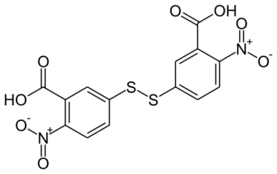
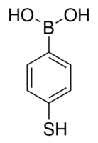
SERS spectra from: Al/CeO₂/Au/DTNB и Al/CeO₂/Au/MPBA 633 nm laser excitation
SERS (DTNB)
SERS (MPBA)
SERS spectrum of DTNB is dominated by the strong peaks at 1338cm⁻¹ and 1555cm⁻¹ assigned as the symmetric stretch of the nitro group ν_{s}(NO₂) and the aromatic ring stretch, respectively.
SERS spectrum of MPBA is dominated by the strong bands at 1073cm⁻¹ and 1585cm⁻¹ assigned to the in-plane bending and stretching modes β_{CCC}+ν_{CS} and ν_{CC}, respectively.
19

Slide 20
Comparison of the spatial distribution of DTNB 1338 см⁻¹ and 1555 см⁻¹ lines intensities, and 450 см⁻¹ CeO₂ Excitation: 532 nm
Camera
450 cm⁻¹
SERS substrate
CeO₂
1338 cm⁻¹
1555 cm⁻¹
DTNB
DTNB
Scan area: 23 х 18 µm
20

Slide 21
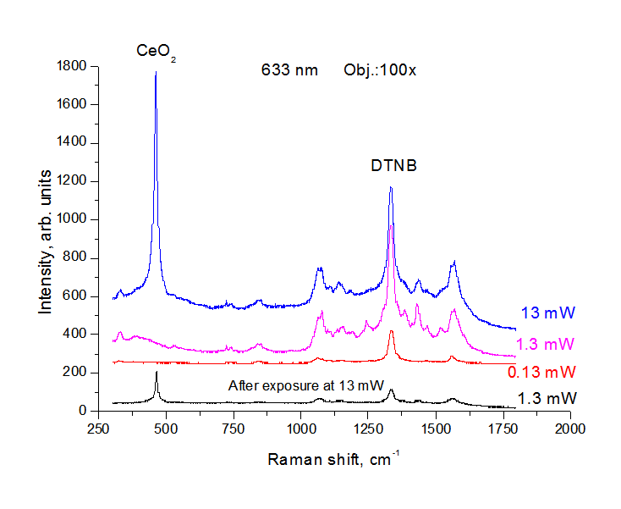
Definition of optical damage threshold of the sample
Safe operation: I_{L}<200-300 kW/cm²
(or 2-3mW/µm²)
~ 6x10¹⁵ photons/µm²/s
450 cm⁻¹
1338 cm⁻¹
21

Slide 22
Direct SECARS measurements
22

Slide 23
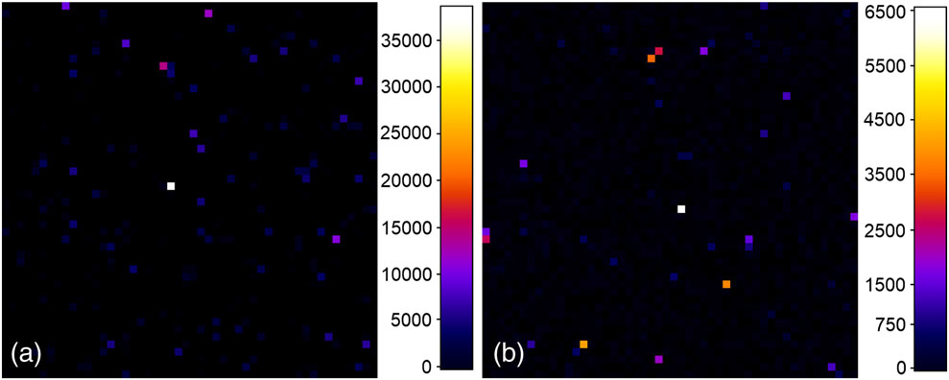
Spatial distribution of epi-CARS (epi-TCFWM) signal for unmodified Au-NPs on CeO₂ film surface
λ_{p} = 932 nm (1338 cm⁻¹)
TNB resonance line
(λ_{aS} = 828 nm)
λ_{p} = 900 nm (1714 cm⁻¹)
Nonresonance
(λ_{aS} = 780 nm)
CARS laser powers: P_{p} ≈ 30 µW и P_{S} ≈ 52 µW
40 µm × 40 µm, 51 х 51 pixels, slow mapping with step ~ 0.8 µm
The numbers in the look-up tables (LUT) correspond to ADC counts
SECARS imaging contrast of signal-generating Au-NP structures lies in the range of 250-700, normalized by the product P²_{p} × P_{S} are ~ 0.15–0.87 counts/µW³ (relation ~ 6).
23
23

Slide 24
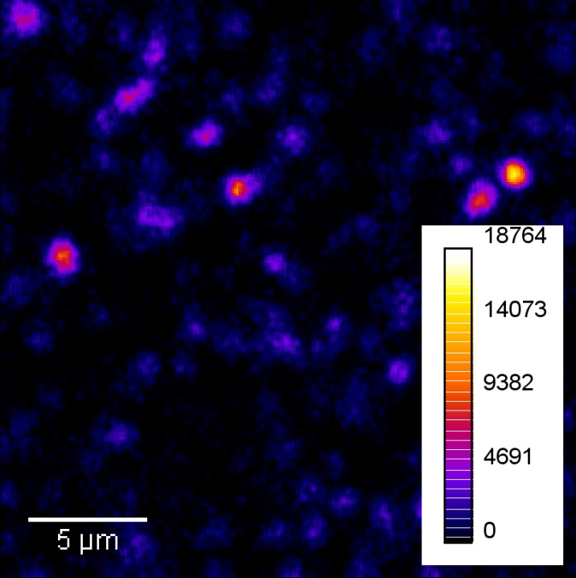
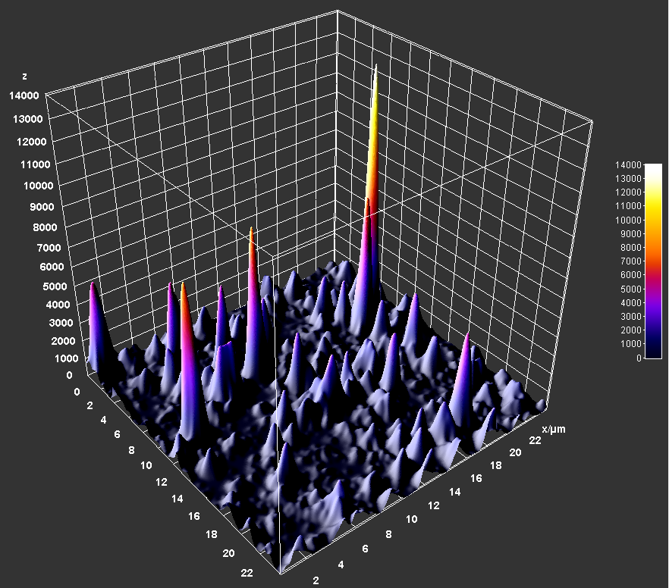
Highly-contrast SECARS resonant micro-image of a sample surface area modified with TNB/Au-NPs conjugates
1338cm⁻¹
Scan area: 24 х 24 µm, resolution: 251 х 251 pl
λ_{p} = 932 nm (≈300 µW), λ_{S} = 1,064 nm (≈1,000 µW), λ_{aS} = 828 nm
fast-mapping, step 0.1 µm, 1s/image
Background signal ~ 45 counts
Contrast of the SECARS image of TNB/Au-NPs ~ 400
24

Slide 25
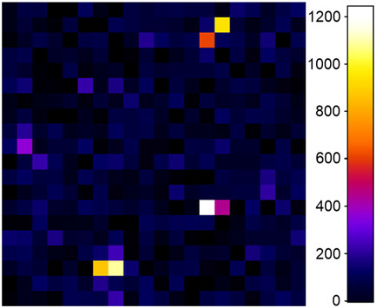
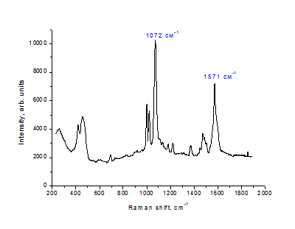
SECARS resonant image of a sample surface area modified by CeO₂/Al/Al₂O₃/Au-NP/mPBA
1571 сm⁻¹
19.3×19.3 µm, 20×20 pl
λ_{p} = 912 nm (≈900 µW), λ_{S} = 1064 nm (≈1200 µW)
λ_{aS} ≈ 798 nm
Slow scan with a step of 1.0 µm, 1s/pl
Background signal ~ 25 counts
Imaging contrast is ~ 50 ,
Normalized by the product P²_{p} × P_{S} is ~ 1.3·10⁻⁶ counts/ µW³
25

Slide 26
Comparison/correlation of SECARS и SERS signals distribution from CeO₂/Au-NP/mPBA
SECARS, 1571 сm⁻¹
SERS, 1571 сm⁻¹
Scan area 29×29 µm, slow mapping with a step of 1 µm, 1s/pl
SERS: 785nm, 1 mW, 1571 сm⁻¹ - 4·10¹⁵ photons/µ²/s, (λ_{S} = 895 nm)
CARS: λ_{p} = 912 nm (1571cm⁻¹), 0.3 mW (λ_{p}) +1.2 мВт (λ_{S}) – totally ~ 8·10¹⁵ photons/µ²/s
Imaging contrasts ~ 50 (SECARS) и 7 (SERS)
26

Slide 27
Comparison/correlation of SECARS и SERS signals distribution from CeO₂/Au-NP/mPBA in 3D performance
SERS
SECARS
27

Slide 28
Resonant and nonresonant SECARS micro-images of TNB/Au-NPs on CeO₂ film surface
Resonance
λ_{p} = 932 nm
(1338 cm⁻¹)
Nonresonance
λ_{p} = 900 nm
(1714 cm⁻¹)
P_{p} ≈ 30 µW
P_{S} ≈ 52 µW
40 × 40 µm
51 х 51 pl
Resonance
Counts ~ 6000
Backgr. ~ 25
Contrast ~ 240
(Norm. 0.13)
Nonresonance
Counts ~ 160
Backgr. ~ 5
Contrast ~ 30
(Norm. 3.6х10⁻³)
resonance/nonresonance ratio:
≈ 35 with TNB modified molecules
≈ 6 without TNB
28

Slide 29
SUMMARY
The very first experiments on SECARS mapping have been done in Russia, FLNP, JINR.
Nonlinear CARS microscopy is an efficient and fast technique for imaging with much stronger signal and chemical contrast without using tags.
The excellent chemical imaging contrast and ultrasensitive detectability of the reporter molecules can be achieved by SECARS.
Results are published in JRS (IF ~ 3.0)
G. Arzumanyan, K. Mamtkulov, V. Fabelinsky, V. Smirnov, et al// JRS, 2018, 1-10, https://doi.org/10.1002/jrs.5333
and
recently presented (G. Arzumanyan) at the jubilee conference dedicated to the 90-years of the Raman effect in Novosibirsk, 27 May – 01 June 2018
29

Slide 30
Thank You!
30

Slide 31
“CARS” microscope parameters
31

Slide 32
Tip Enhanced Raman Scattering (TERS) or nano-Raman –
brings Raman spectroscopy into nanoscale resolution imaging
TERS combines the chemical sensitivity of surface-enhanced Raman spectroscopy (SERS) with high spatial resolution of scanning probe microscopy (SPM) and enables chemical imaging of surfaces at the nanometer length-scale.
TERS imaging is performed with an AFM-Raman spectrometer, a SPM integrated with an optical micro-spectrometer.
TERS image of single wall carbon nanotubes with spatial resolution of ~ 30 nm
TERS signals are not strong enough because
there is only one tip working as a signal amplifier.
32

Slide 33
SHINERS – a new generation of Raman technique
Shell-Isolated Nanoparticle Enhanced Raman Spectroscopy
Au or Ag NPs are employed with a layer of ultrathin inert silica shell.
Each Au core-inert shell nanoparticle can be considered as a TERS tip.
Under a laser spot, the shell-isolated nanoparticles monolayer is equal to thousands of tips, thus the obtained Raman signal is very strong.
The ultrathin shell is used to avoid the direct contact of molecules with Au or Ag NPs, thus the obtained signal is just from the interested species adsorbed on the substrate.
33

