Slide 1

Investigations of Structural and Dynamic Features of Lipid Membranes using Neutron and X-Ray Scattering Methods
Dr. Dmitry Soloviov,
senior scientist FLNP JINR
Notes:
Dear colleagues, dear chairman. My name is Dmitry Soloviov. I’m senior scientist in FLNP and co-responsible for YuMo spectrometer. This is a great honor for me present here this short report. This talk will be about investigations of lipid membranes using Neutron and X-ray scattering methods.

Slide 2
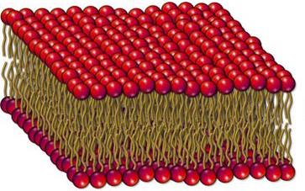
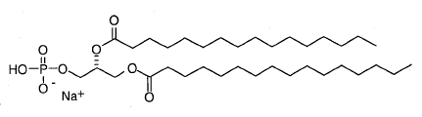
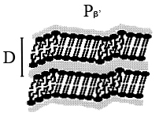
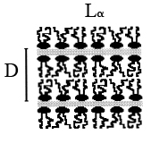
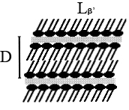
Lipid membrane
DPPC - Dipalmitoylphosphatidylcholine
35°C 41°C
The main phase transition
Notes:
Few words about membranes. A biological membrane serves as a selective barrier between the internal compartment of the cell and the cell’s surroundings. Because it mediates a variety of processes, its structure and composition are necessarily complex. Biological membranes are dynamic, fluid system whose constituents are able to move within the membrane’s plane. One of the membrane’s main constituents is the lipid, which serves as the basis for the membrane’s structure.
One of the most common lipid in biological membrane is DPPC. Each DPPC molecule consists of one polar head group and two hydrophobic hydrocarbon tails. That’s why they can spontaneously form multilayers in aqueous environments.
Depending on temperature lipids can be in different phases.
For example for pure DPPC lipid the most common lamellar phases are:
Gel phase – when all tails are in trans conformations, molecules are well ordered
Ripple phase – some intermediate phase, when small quantity of lipid tails change their conformations from trans to cis. Lipid bilayers become ripple
Liquid crystal phase – all tails are in cis conformation. Transition between ripple and liquid crystal phases is called the main phase transition or lipid melting.
After melting thickness of lipid bilayer decreases, but area per one lipid molecule increases.

Slide 3
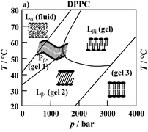
DPPC phase diagram
“Narrow” transition
“Broad” transition
Notes:
We started our work from investigating of the main phase transition of DPPC. Structures of different lipid phases were well studied. We decided to complement these studies with some thermodynamical experiments. Because if this is phase transition, we must observe changes in some thermodynamical parameters, for example isothermal compressibility.
On this slide the DPPC phase diagram in Temperature-Pressure coordinates is presented. Here is line of coexistence of liquid and ripple phases.
There are two ways of investigating phase transition
The first way is fix pressure and change temperature
The second way is fix temperature and change pressure.
We chose the second way, because the width of phase transition in temperature coordinates is 1-2 degrees. At the same time in pressure coordinates width is about 50 bars. It is more easier change pressure for a few bars and stay inside phase transition than change temperature for 0.1 degrees and each time wait for temperature stabilization. Pressure stabilization is much more faster.

Slide 4
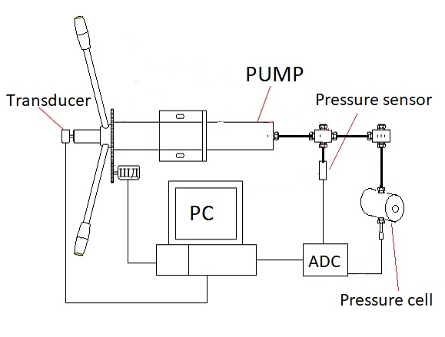
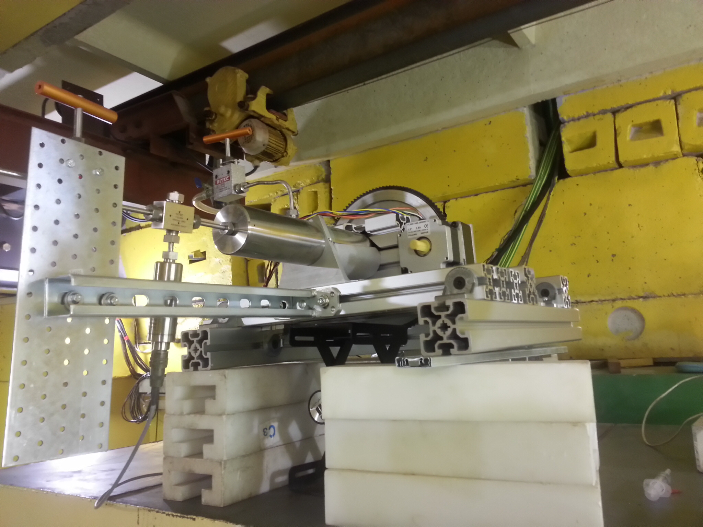
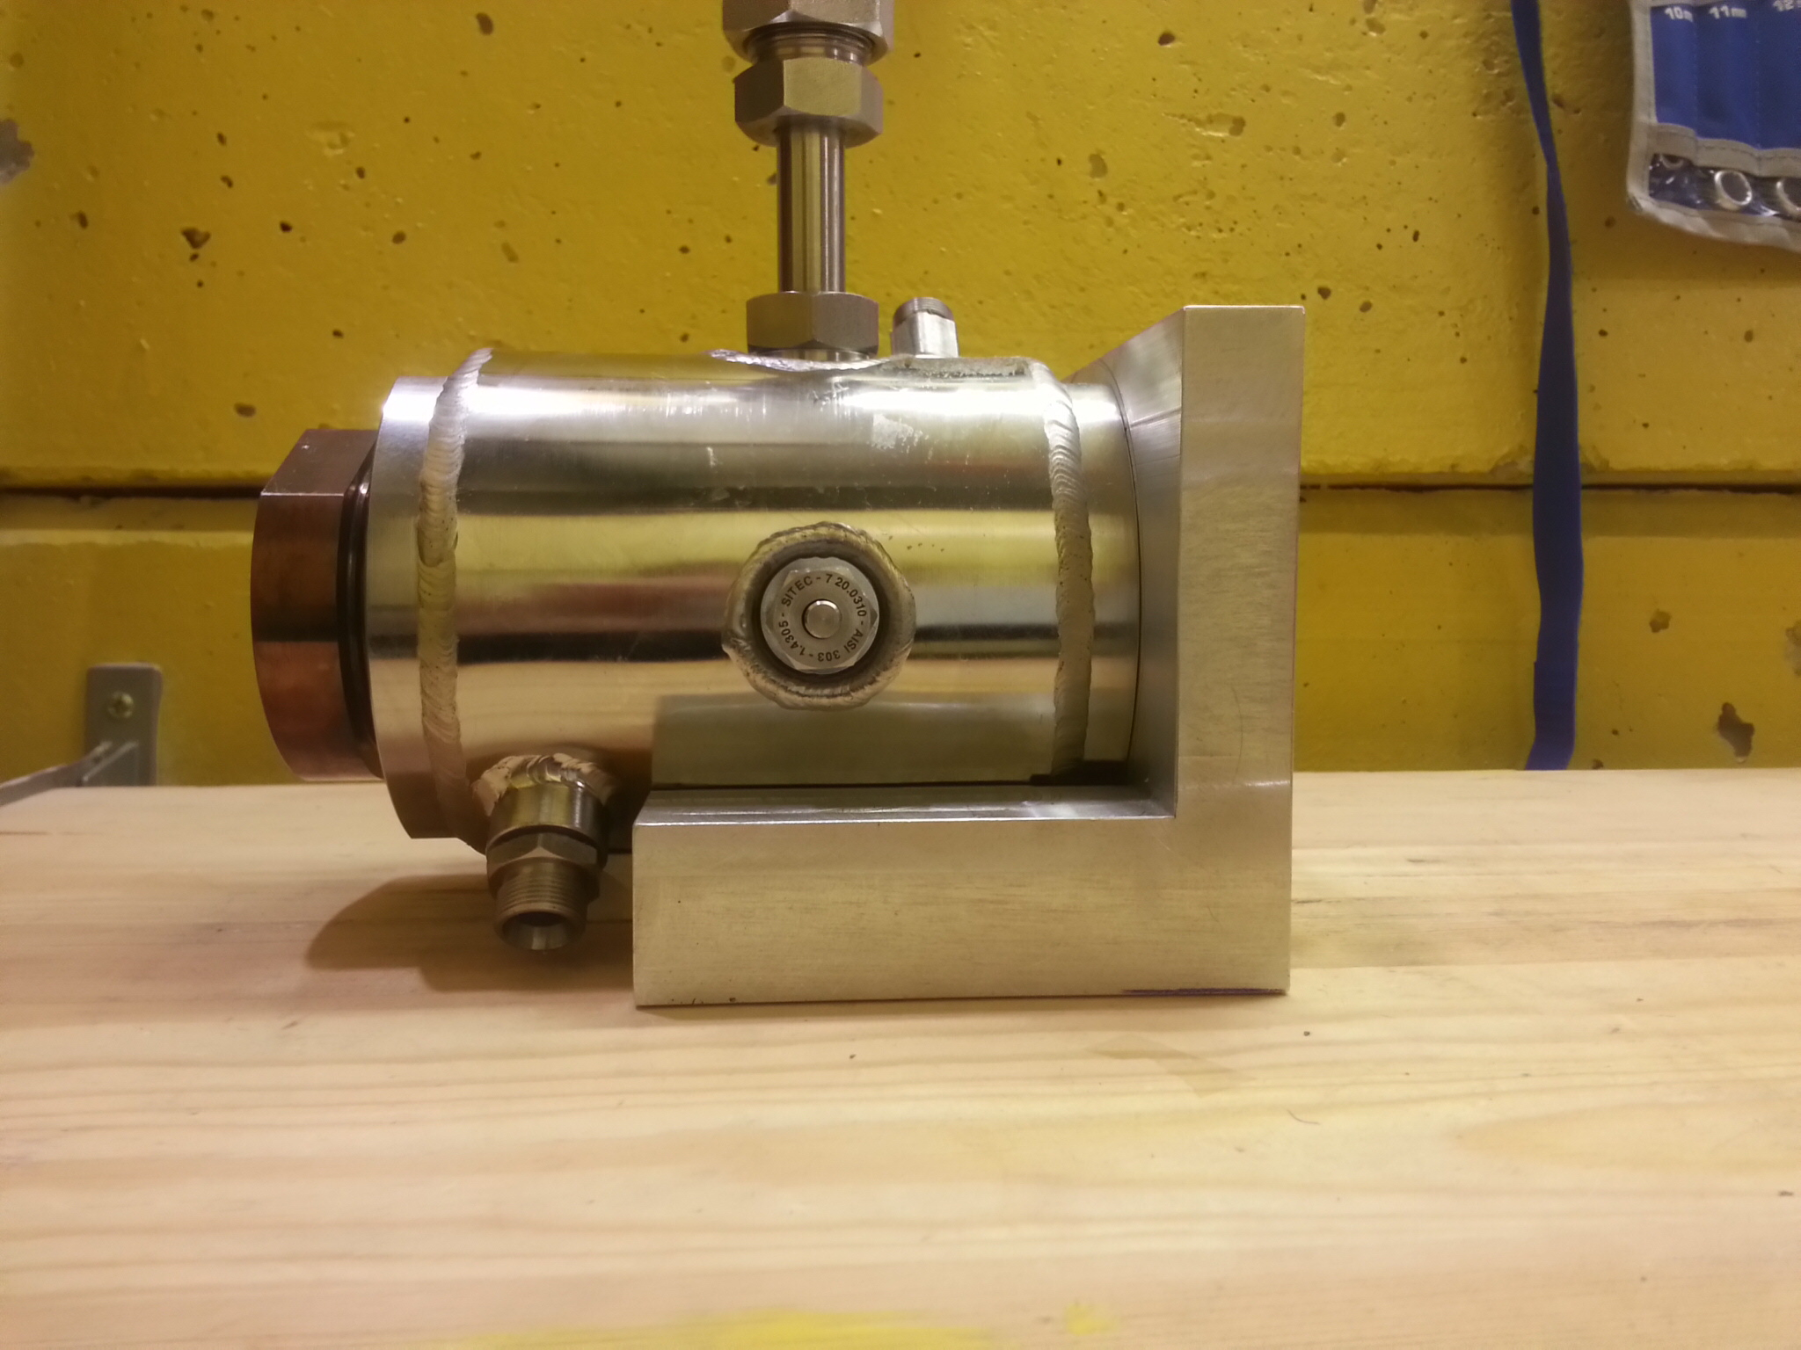
High pressure setup
The main feature - simultaneous measurements!
Notes:
So, for our experiments we constructed special setup. Photo and scheme are presented here. The main components of this setup are:
High precise rotating hand pump. High precision means that each rotation of the pump changes volume of full system for a definite value.
For measuring volume changes we use special transducer, which monitors absolute rotation angle of the pump. This allows us measure volume changes with resolution 2*10 up to minus 6.
The next component is pressure sensor, which measures pressure with resolution 1 bar.
The main part of our setup is pressure cell, which was special developed for us in Swiss. Here you can see photo. The cell has big sapphire windows which are clear for neutrons. Working fluid here is water, that’s why we also need special separator, which splits sample from the rest volume. The cell connects to the thermostat, which controls temperature of the sample.
All components of the setup controls via computer. Measurement process is fully automated.
The main feature of this setup is possibility to provide simultaneous SANS and thermodynamic measurements.

Slide 5
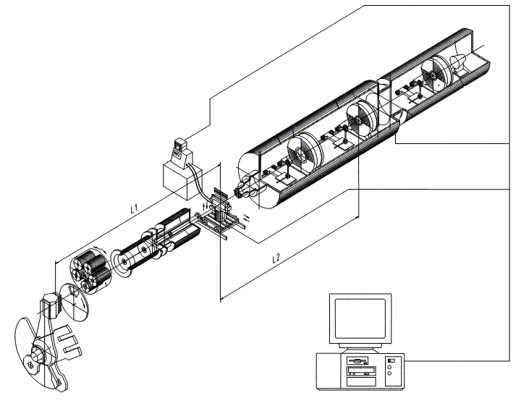
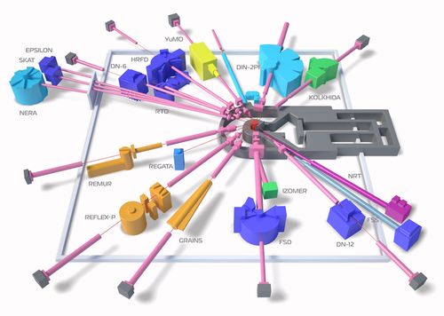
YuMO spectrometer
Direct beam detector
Scattering detectors
Sample holder
Collimation system
Chopper
Cold moderator
Remote computer
Notes:
All measurements were performed here in Dubna, at small angle neutron scattering spectrometer YuMO.
Spectrometers scheme is presented here. This is collimation system, here sample position and scattering detectors.
The main feature of our spectrometer is two detector system, which gives possibility to measure SANS curve in wide dynamic q-range. Due to thissystem, as well as due to high neutron fluxes, it is possible to measure the samples for a short time. This is the reason, why about 40% of all proposals of our user program perform on YuMO spectrometer.
In our case, this was also extremely important, because we were able to provide a series of experiments as correctly as possible and without wasting time.

Slide 6
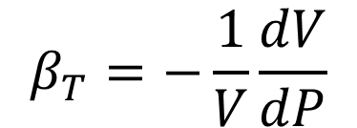
SANS and volumetric experiments
Setting pressure
Measuring SANS curve (for 5 minutes)
Recording Pressure and Volume changes
Next point, steps 1-3
$$β_{T}=−\frac{1}{V}\frac{dV}{dP}$$
Notes:
Coming back to the experiment. The algorithm of our measurements presented here.
First of all we set temperature. After thermostabilisation we set the first pressure point. Than we measure SANS spectra. As I said before, due to high fluxes and two detector system we measure each point only 5 minutes. After measurements we record current volume change and pressure. Than we go to the next pressure point and do these three steps.
As the result of the experiment we have set of SANS curves and pressure vs volume dependence.
Because our sample is lipids multilayer solution, our SANS curves have diffraction peak, which characterize periodicity of lipid multilayer. Peak position changes with pressure changing. Using this simple formula we can calculate value of this repetition distance D at each pressure point. Q in this formula is peak position.
Using volumetric measurements and this formula we can calculate isothermal compressibility.

Slide 7
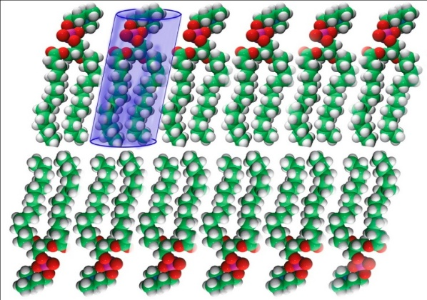
Results
L
(V₂ - V₁) - calculated from P(V) dependence (volumetric data)
L₁ and L₂ - calculated from Guinier plot (SANS data)
ΔS ≈ 6 Å²
Soloviov, D.V., Y.F. Zabashta, L.A. Bulavin, O.I. Ivankov, V.I. Gordeliy, and A.I. Kuklin, Changes in the Area per Lipid Molecule by P–V–T and SANS Investigations. Macromolecular Symposia, 2014. 335(1): p. 58-61.
Notes:
Comparing pressure dependences of repetition distance and isothermal compressibility, one can see good agreement of our two methods. Repetition distance changes between 180 and 220 bar, isothermal compressibility extremely increases at 200 bars.
The next step was calculation of changes in area per lipid molecule during the main phase transition. We used simple model, where each molecule is a cylinder. In this case we can use this formula for our calculations.
All variables with index 1 concern to ripple phase, with index 2 concern to liquid crystal phase.
We used volumetric data for determining volume changing, and Guinier plot of SANS data for determining lipid molecule lengths. This was possible only in case of simultaneous measurements.
Our value of 6 square angstroms is in a good agreement with calculations from literature.
We’ve published this result in Macromolecular symposia journal.
The next question was how these 6 square angstorms changes the properties of lipid bilayer?

Slide 8
Inelastic X-Ray Scattering Method
Brookhaven National Laboratory, USA
Institute Laue-Lagevin, France
The main goal – understand how structure changes affects on lipid molecules dynamics
Notes:
To answer this question we decided to use inelastic X-ray scattering technique.
Here is the scheme of the IXS experiment. We have oriented lipid multilayer deposited on diamond substrate. Incident x-ray beam is parallel to diamond and bilayer surface. We used detector for scanning energy changes between incident and scattered beams. And we provided such energy scans at different angels. But each time scattering vector Q was oriented inplane of the bilayer.
In such geometry all energy changes are caused only by collective dynamics of lipid tails.
This work was performed in collaboration with our colleagues from Brookhaven National Laboratory (USA) and Institute of Laue-Langevin (France).

Slide 9
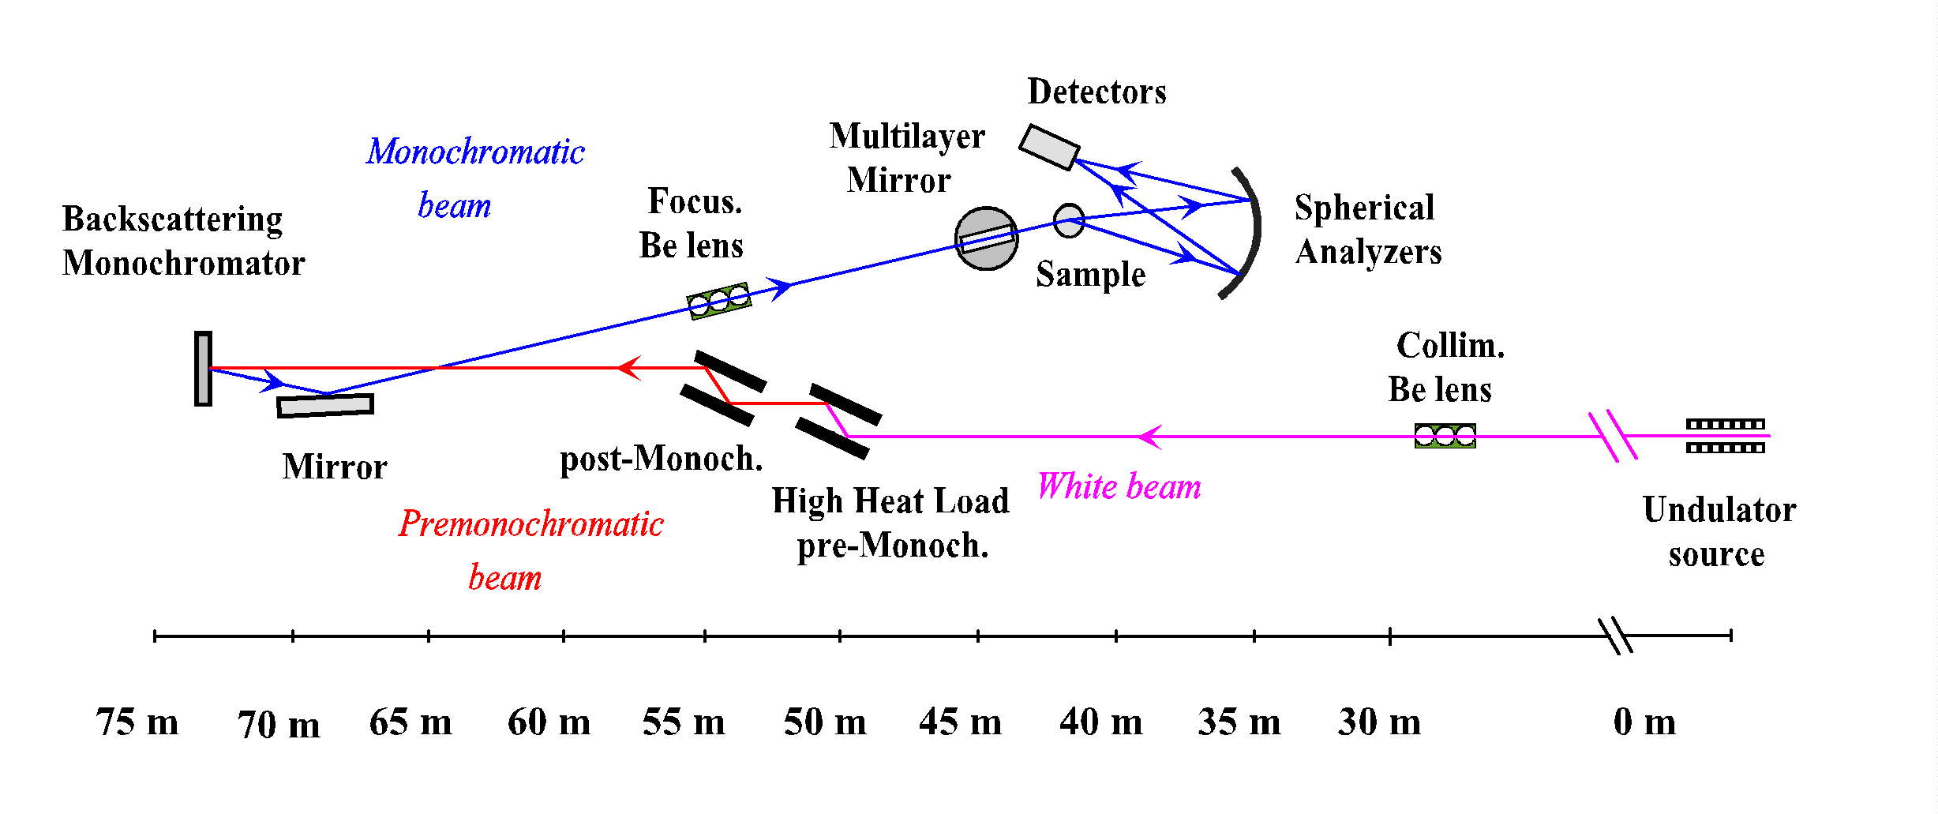
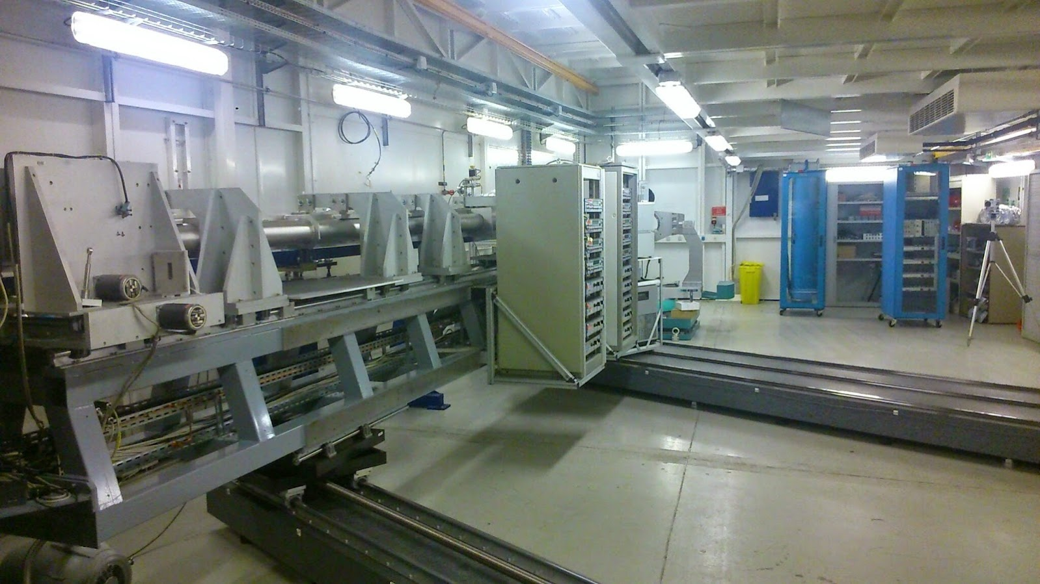
IXS spectrometer, beamline ID-28, ESRF, France
Notes:
All measurements were provided at ESRF, on beamline ID-28. Here is the scheme of the IXS instrument. They have 8 detectors, which scan energy ate the same time at different angels. This is the photo of detector shoulder of the IXS machine, which is movable.

Slide 10
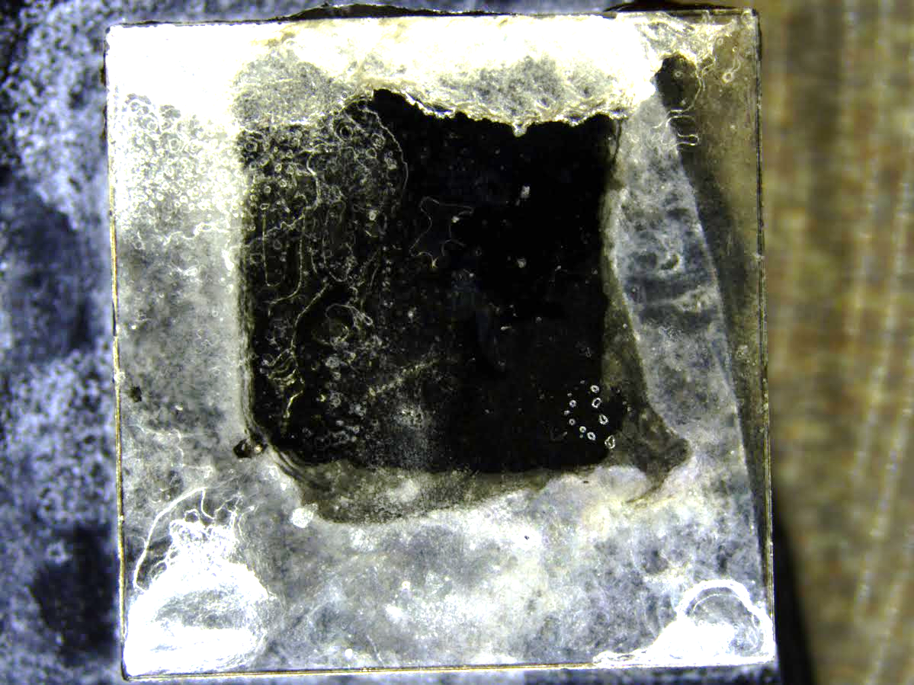
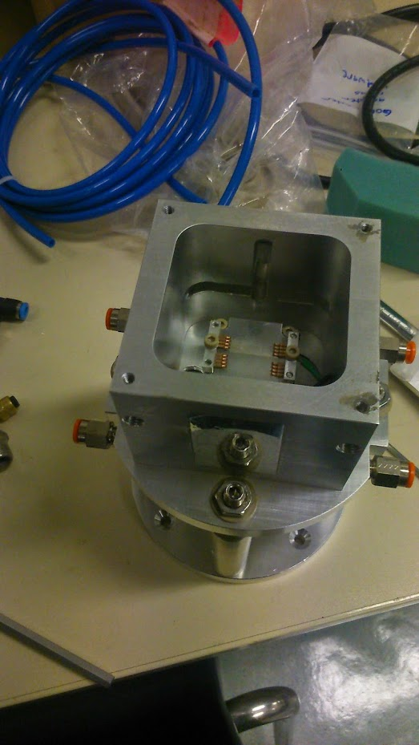
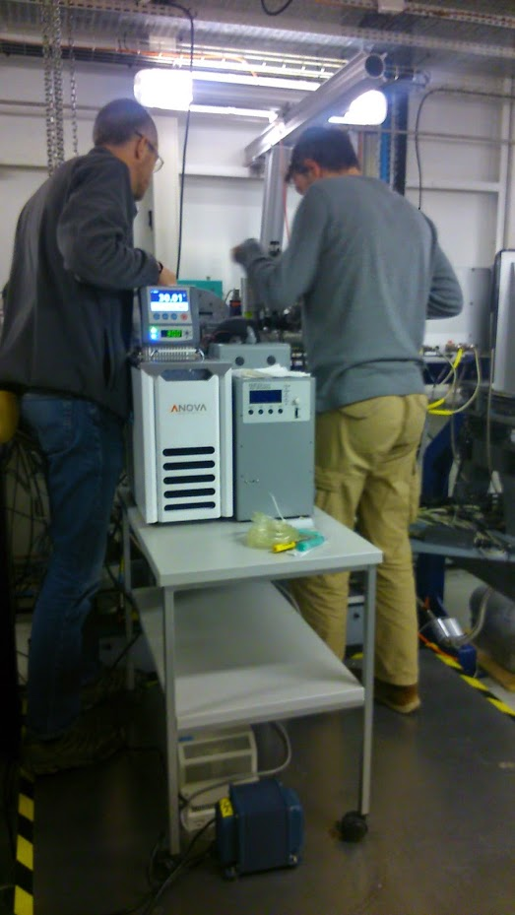
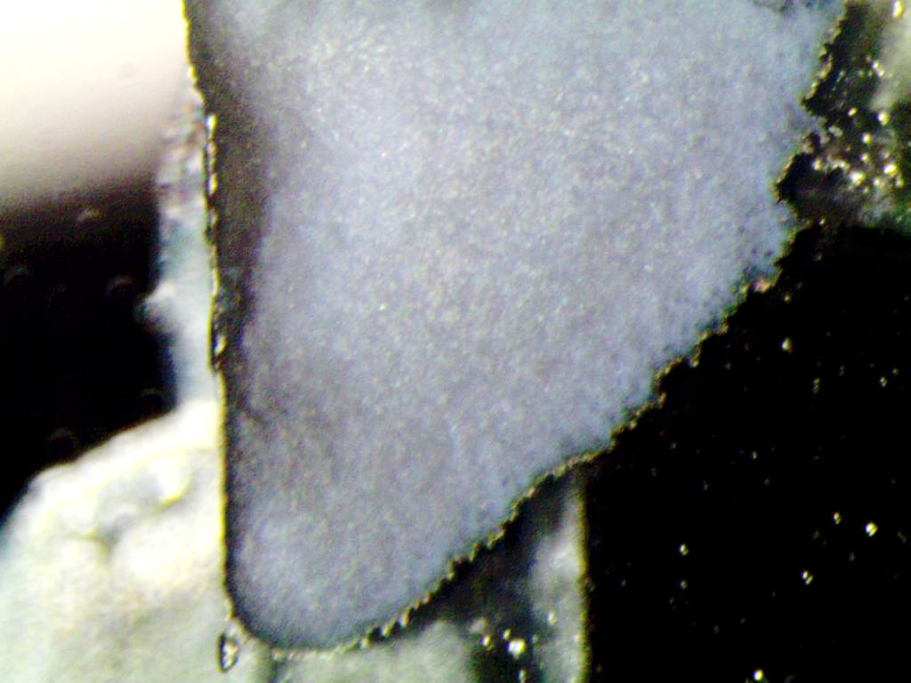
Sample preparation
All measurements were provided at R.H. 97%
Notes:
Here are photos of our sample which is deposited on diamond substrate. Substrate dimentions are 5 per 5 mm.
Because DPPC phase diagram is valid with excess of water, we did all measurements at high relative humidity – near 97%.
We used special sample environment – cell with connected humidiator and thermostat for humidity and temperature stabilization.
X-Ray beam size was about 50 microns, and sample thickness was about 80-100 microns.

Slide 11
IXS spectras
Notes:
We measured lipids at two temperatures – at 20C and 45C – before and after the main phase transition.
As the result we obtain number of energy scans on different angels.
After that each curve was fitted using resolution function of the IXS instrument (elastic peak, green lines) and number of symmetric excitation curves. Positive and negative energies correspond to the creation and annihilation of propagating phonons.
During data treatment we found that all IXS spectras at 20C (gel phase) need two excitations for a good fit. At the same time at 45C (liquid phase) for small q values we need only 1 excitation and for the rest curves we need two excitations.

Slide 12
Dispersion curves
 | T = 20C | T = 45C
S_{L} | 55,6 Å² | 65,4 Å²
V_{S} | 2532 ± 190 m/s | 2241 ± 437 m/s
Low energy phonon mode was observed for the first time. Considering that it very similar to longitudinal mode, we sure that it corresponds to in-plane transverse phonons.
Notes:
When all experimental curves were fitted, we used excitation energies to build dispersion curves, which are presented here. Filled and open symbols correspond to dispersions curves for 20 and 45 C, respectively. The solid lines are shown to guide eyes only.
Red and black lines corresponds to longitudinal phonon modes. Longitudinal phonons could be observed in each material and they corresponds to classic sound propagation. For DPPC lipid longitudinal phonons were measured earlier.
Minimum on these curves corresponds to the boundary of quasi Brilluene zone. In case of lipid it is tail-to-tail distance. Than we increase temperature, this minimum moves to the lower Q, which means increasing of tail-to-tail distance. This q values were used for calculations of square per one lipid molecule in both phases. These values are presented here. As you can see deference between them is about 6 square angstroms, which is in a good agreement with our previous experiment.
The dashed lines extrapolate the longitudinal phonon dispersions to Q=0. The behavior of the longitudinal phonon dispersions is linear at low Q and its slopes define the high-frequency sound speed in the DPPC lipid for a given temperature. Values are presented here.
In contrast to longitudinal phonons routinely observed in lipids, the second phonon mode have not been experimentally observed in such systems before. As one can see, these low energy mode behavior is similar to the longitudinal mode: similar softerning upon crossing the phase transition, minimum changing and so on. That’s why we are sure that this mode is in-plane propagating transverse phonons. Such transverse phonons are similar to transverse phonons which were observed in water.

Slide 13
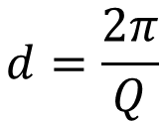
IXS results
$$d=\frac{2π}{Q}$$
Notes:
At the high temperature, we also observe the low-Q phononic band gap, which can be identified as the disappearance of the transverse phonons at Q less that 5nm⁻¹. It means that there are two mechanisms of sound propagation and heat transfer in lipid membranes.
The first mechanism is characterized by the short and intermediate length. The other mechanism is originated from highly diffusive dynamics due to heavily damped phonons at long-length scales. And this Q-gap value is related to the characteristic length-scale of a local ‘order’, or clustering.
Such local ‘clustering’ is partial chain ordering in the lipid bilayer in a planar direction which is also characterized by the increased surface density of lipid molecules. Importantly, the observed clustering cannot be considered as a coexistence two phases: because the IXS measures only ultra-fast lipid dynamics (on the picosecond time scale), such local ordering should be considered as short time phonon-triggered density fluctuations. Consistently, low-Q phononic gaps were not observed at 25 degrees, where the packing of the lipid tails is much tighter and transverse phonon propagating in all measured Q-range.
Using this formula we can estimate cluster size. It is about 15 angstroms, which means the size of few lipid molecules
And what we have in summary? There are short living local domains in DPPC lipid membrane. It means that we potentially can find short-lived volume voids around domains. These thermally triggered pores formation can explain the mechanism of passive transport of small particles through lipid membranes.

Slide 14
Results
We reveal for the first time, the existence of propagating transverse phonon modes in DPPC lipid membrane
We also observe phononic gaps in the transverse phonon dispersion and evidence gap opening with increasing temperature. This band gap is related to the diffusion and relaxation processes occurring in the lipid membrane.
Formation of short-lived local domains and voids in DPPC liquid phase could be an explanation of the mechanism of passive transport of small particles through lipid membranes.
Zhernenkov, M., D. Bolmatov, D. Soloviov, K. Zhernenkov, B.P. Toperverg, A. Cunsolo, A. Bosak, and Y.Q. Cai, Revealing the mechanism of passive transport in lipid bilayers via phonon-mediated nanometre-scale density fluctuations. Nature Communications, 2016. 7.
Notes:
These results were published in Nature communication journal in 2016.

Slide 15
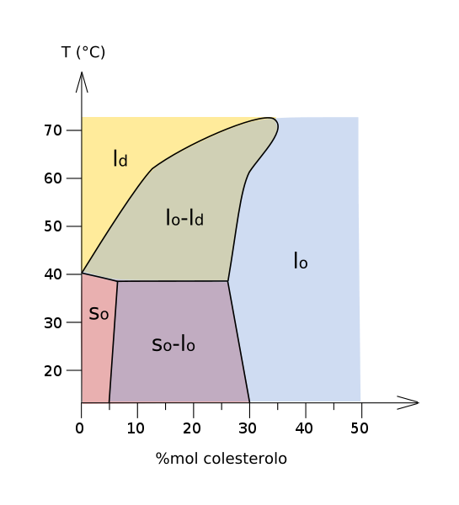
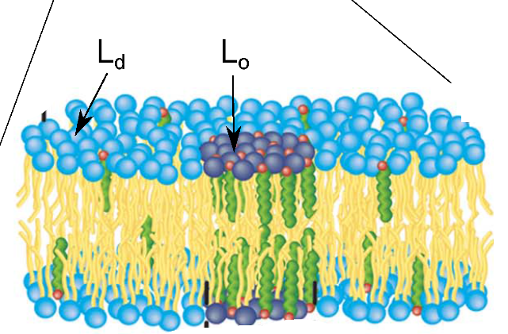
DPPC with Cholesterol
- Experiments, provided at ESRF, France
- Experiments, provided at SPRING-8, Japan
Notes:
After such interesting results we decided to continue our investigations. Its well known that real biological membrane is multicomponent. And each new component could dramatically change lipid properties, including the mechanism of pores formation. On of the most interesting and well known component of biological membrane is cholesterol. This is hydrophobic molecule, which is situated between lipid tails. It increases the packing density of lipid molecules, making the membrane more rigid.
Here you can see phase diagram of DPPC-Cholesterol system. Vertical axis is temperature, horizontal is molar ratio of cholesterol. Solid ordered is something like pure DPPC gel phase, liquid disordered looks like DPPC liquid crystal phase. And liquid ordered phase is liquid DPPC with cholesterol between lipid tails. There is coexistence of two phases here and here.
For investigating DPPC Cholesterol binary system, we prepared several concentration points and measured them at two temperatures using IXS method. Red stars –these points were measured at ESRF, yellows stars – measured at SRING-8 synchrotron in Japan. Green – measured in ESRF too, but not so long ago, they have not treated yet.

Slide 16
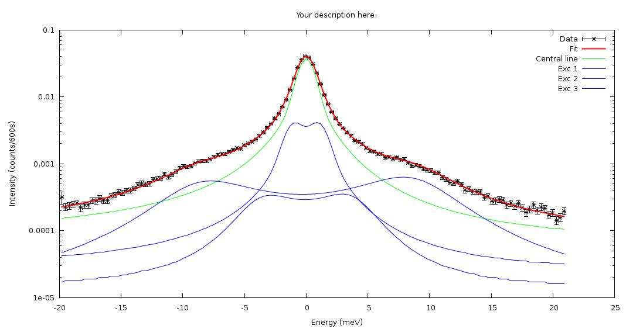
Typical IXS curve for DPPC-Cholesterol solution
Notes:
Here presented typical IXS spectra of DPPC-Cholesterol. Data treatment procedure was the same. But for fitting we used 3 excitations. It means one new phonon branch on the dispersion curve.

Slide 17
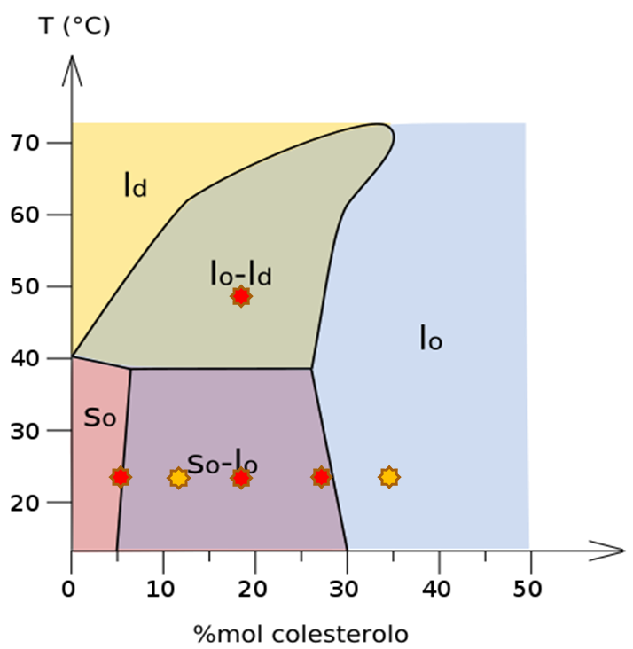
T= 25C
T= 50C
1
2
q₀=3.5nm⁻¹
3
4
q₀=4.5nm⁻¹
q₀=5nm⁻¹
5
q₀=5.5nm⁻¹
Notes:
Here presented dispersion curves for each concentration.
As I said before, there are three phonon branches on each picture. The first one is longitudinal phonons, this is transversal phonons. And for this red line- we apologize (and it was predicted by molecular dynamics calculations) that this is optical phonon branch. In principle optical branch should be independent from angle. We have some dependence, but it could be due to fitting error. Now we are going to provide additional investigations using Raman spectroscopy method to check if this branch is optical
Starting from about 20 molar % of cholesterol this optic branch has gap. Gap position – is size of domain. But if this is optical phonon mode, domains are not short living, as it was in pure lipid. They are constant it time, probably it is phase coexistence. Looking on phase diagram, one can see that gap position moves to highest q with cholesterol concentration increasing.
In the nearest future we’ll finish with additional experiments and data treatment. After that we’ll summarize our work in the article.

Slide 18

Thank you for your attention

