Slide 1
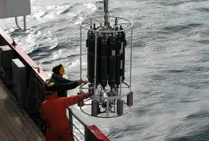
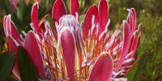
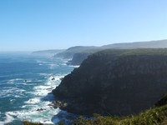
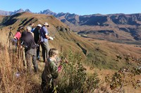
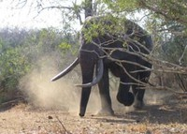
Global change research and data applications
Egagasini Node
(Marine Offshore)
Fynbos Node
Arid Lands Node
uLwazi Node: Data and Information Systems
Elwandle (Coastal) Node
Grasslands, Forests, Wetlands Node
Ndlovu Node
Leo Chiloane
National Research Foundation-South African Environmental Observation Network (NRF-SAEON)
South Africa Days at JINR
16 June 2025

Slide 2
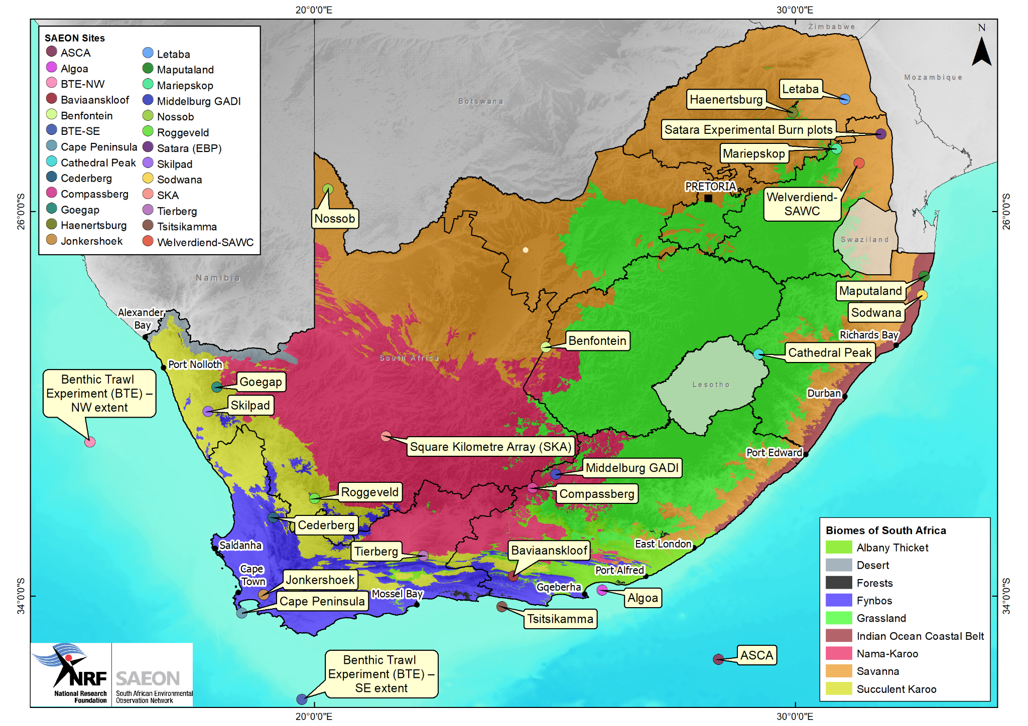
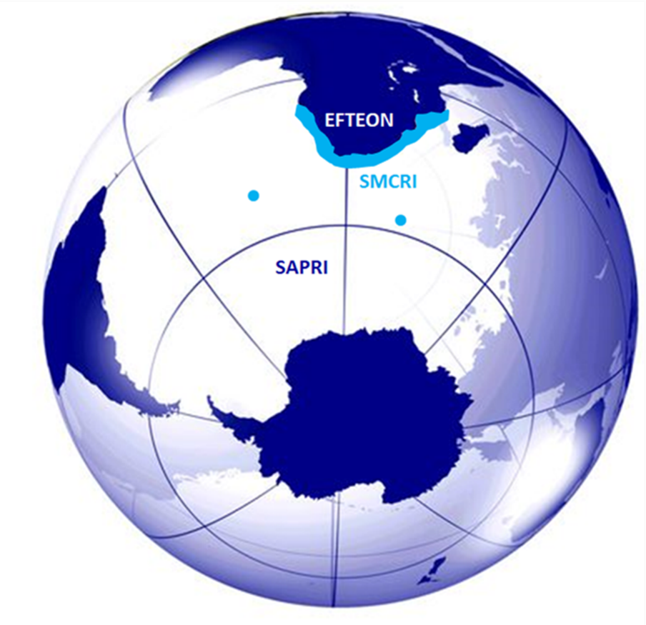
Organisational context: South African Environmental Observation Network
Established in 2002 within the National Research Foundation (NRF)
Vision “Environmental research platforms for a sustainable society”
A dedicated institution for enabling long-term, in situ Global Change Research
7 Nodes: 4 focused terrestrial sciences, 2 on marine and ocean sciences, and 1 on data infrastructure
3 Research Infrastructures (South African Research Infrastructure Roadmap)
Expanded Freshwater and Terrestrial Environmental Observation Network (EFTEON)
Shallow Marine and Coastal Research Infrastructure (SMCRI)
South African Polar Research Infrastructure (SAPRI)
Complexity:
Heterogeneity: data from multiple science disciplines produced within the same organisation
Open access to data, in decision ready format, essential to respond to global change
Difficult to implement a universal solution (i.e. different systems, tools required to cater for different stakeholders)
Areas of operation include Prince Edward Islands and Antarctica

Slide 3
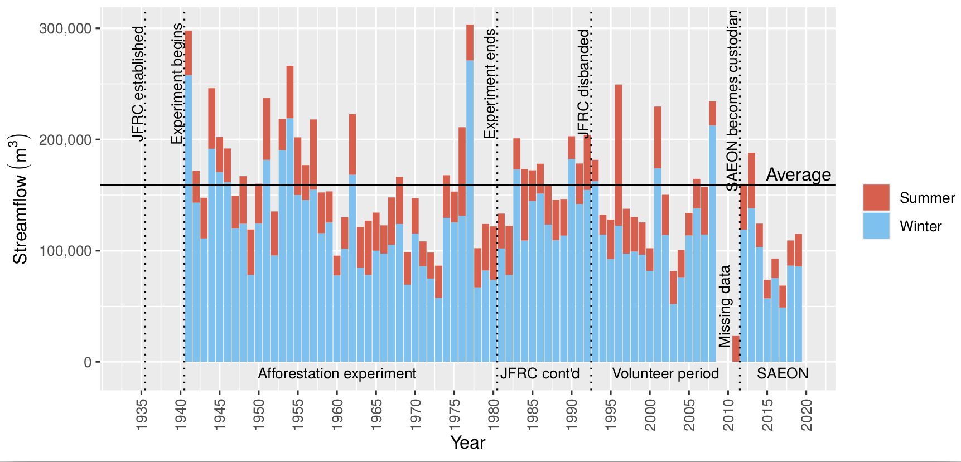
SAEON’s long-term environmental research approach
SAEON and its Research Infrastructure sites enable detailed long-term research within defined geographic locations
The intention is not a national footprint but rather detailed case studies in representative areas
Valuable for calibration of remote sensing products
Scale in terrestrial systems is more discrete than the scale of observation in the marine system
Measurements co-located where possible to enable integration between biodiversity, biogeochemical and meteorological and hydrological (includes water, energy and carbon fluxes) variables.
Host for some of Africa’s longest time-series observations (e.g. Jonkershoek Research Catchments)
Extension of long-term record for rainfall and streamflow
Monitoring and maintenance of multiple rain and stream gauges
Calibration between rainfall, land use, runoff, biodiversity and fire return intervals (hazard)
Slingsby, Jasper A., et al. "Jonkershoek: Africa's oldest catchment experiment‐80 years and counting." Hydrological Processes 35.4 (2021): e14101.

Slide 4
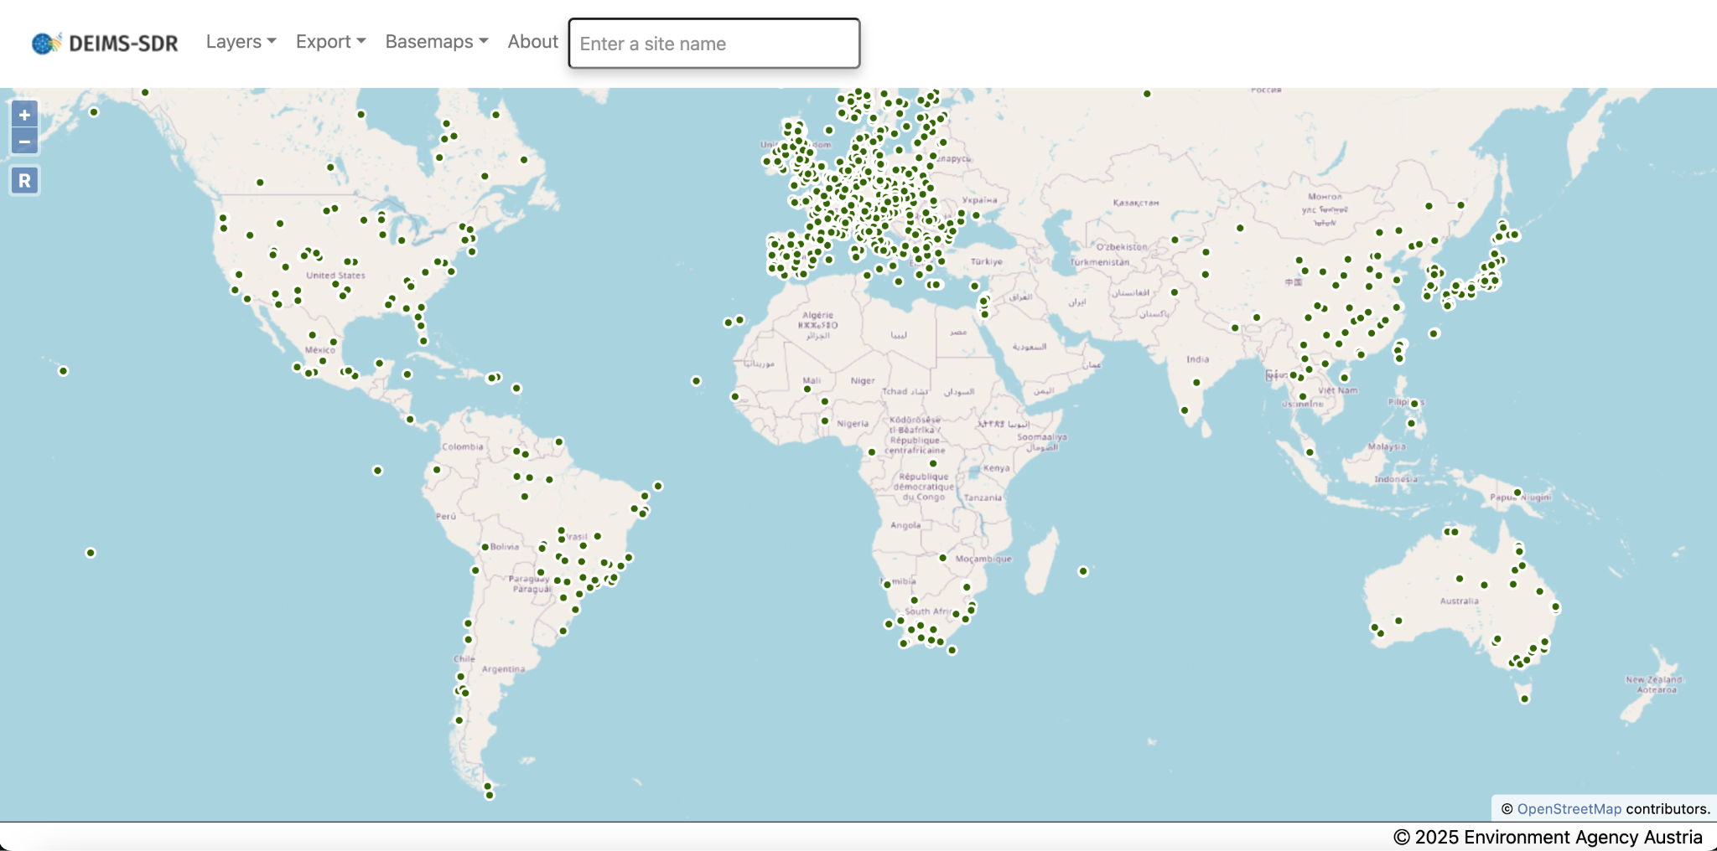
Scaling up: Links to global in situ observations network
Offers an opportunity to create globally harmonised data products
Links to other networks with similar functions
Member of the International Long Term Ecological Research (ILTER) network
SAEON is a founding member of the Global Ecosystem Research Infrastructure (GERI)
Deshpande, K., Hagen, C., Bornman, T., Chiloane, L., Feig, G., Girola, E., Guru, S., Laney, C., Loescher, H., Mirtl, M., Morris, B., Mabee, P., Salmon, E., SanClements, M., Ruddell, B., Sullivan, P., Smith, M., Kutsch, W., Yu, X., and Zacharias, S.: Towards Globally Harmonized Environmental Datasets: a Proof of Concept Using Ecological Drought Data and the Global Ecosystem Research Infrastructure (GERI) Framework, EGU General Assembly 2025, Vienna, Austria, 27 Apr–2 May 2025, EGU25-13612, https://doi.org/10.5194/egusphere-egu25-13612, 2025.
SAEON in relation to ILTER and GERI
Notes:
GERI is an integrated network of site-based research infrastructures dedicated to improving our understanding of the function of – and change in – indicator ecosystems across global biomes.

Slide 5
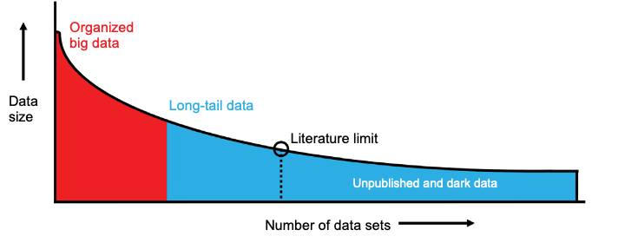
Challenges and opportunities: Modern science is data-driven, but there are persistent problems with long-tail data
Big data
Massive datasets produced through large science projects, large corporations, etc. Easier to standardise, but often require High Performance Computing and/or large volumes of storage.
Long-tail data
Large amounts of small-to-medium size datasets from very heterogeneous sources. Not too demanding on computing resources, but exist in greater varieties and larger quantities. Often poorly curated due to lack of standardisation, if curation is applied at all.
Literature limit
Many data files are never published catalogued or even explicitly mentioned in scientific literature. They become “dark data”.
Distributed data systems offer a promising approach to address the challenges of large-scale, complex data in global change research
A.R- Ferguson et al. (2014), Big data from small data: data-sharing in the 'long tail' of neuroscience.“ Nature neuroscience, 17(11), 1442-1447.

Slide 6
Research data infrastructure to support the curation, publication, discovery and application of open data for science
Notes:
SAEON data is ultimately intended to inform and promote action towards a sustainable society: open access for impact

Slide 7
What if we worked on a research data infrastructure that is completely domain agnostic?
The diverse nature of in-situ data necessitates significant investment of resources in its curation and archiving to ensure its usability and accuracy for specific user applications.
Significant data management efforts in terms of standardisation, harmonisation, and interoperability are also critical to effectively consolidate different datasets to fulfil the needs of users.
SAEON’s core backend infrastructure was developed to address the aforementioned challenges, based on five information modelling perspectives:
Data preservation
Data publication
Authentication services and access control
Ontologies (vocabulary brokering services)
Interoperability (integration)
Refining the current approach requires testing of case studies from different domains, so it opens an opportunity for collaboration.

Slide 8
Open Data Platform: Information modelling perspective of the platform
System engineering process is based on developing independent, scalable and interoperable components. Using existing tools (where possible) lowers development and maintenance cost

Slide 9
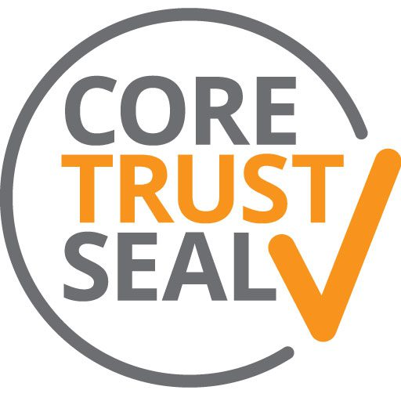
Requires commitment to sustainability - independent audit
The platform is certified by the CoreTrustSeal as a Trustworthy Data Centre
Organisational infrastructure
Mission, licenses and continuity of access
1
16 requirements
Digital object management
Ethics, organisational infrastructure, expert guidance, data integrity, appraisal, documented procedures, reusability
2
Reflecting on 3 characteristics
of a sustainable and trustworthy repository
3
Technology
Technical infrastructure and security
Lin, D., Crabtree, J., Dillo, I. et al. The TRUST Principles for digital repositories. Sci Data 7, 144 (2020). https://doi.org/10.1038/s41597-020-0486-7

Slide 10
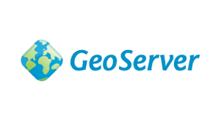
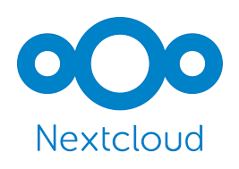
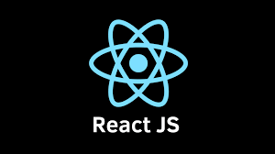
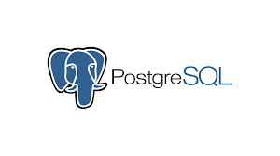
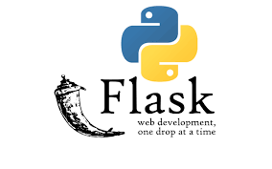
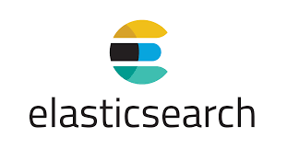
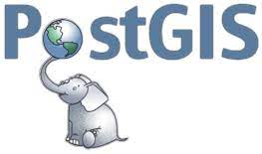
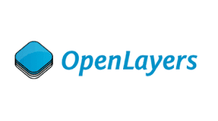
Technology components
THREDDS Data Server
Data formats:
NetCDF
GeoTiff
Shapefiles
CSV
…
Standard data services
OGC (WMS, …)
OpenDAP
…
Data Portals | Metadata Search Catalogues | Data Infrastructure Services I Data Standardisation, Storage and Dissemination

Slide 11
Technical team comprises four focus areas
Infrastructure Management
A team managing data centre infrastructure hosted in three locations (including a disaster recovery site)
Current storage: 1.6 PB but projected to expand
Data Curation
Responsible for data standardisation and publication, including data governance processes and sustainability metrics for SAEON’s data infrastructure.
Systems Development
Responsible for overall system architecture of the SAEON Open Data Platform
Data Science
Conceptualisation, design, and development of data products to assist with the interpretation of data and its translation into knowledge

Slide 12
Data applications to advance global change research and societal engagement: Current initiatives involving early career data scientists and modellers
Notes:
The South African Risk and Vulnerability Atlas is an initiative of the Department of Science, Technology and Innovation and forms a 10-year Global Change Grand Challenge. It is currently in its third phase of implementation with this phase focusing on data access and value-added products for decision-making that assist municipalities in managing the risks associated with global change.

Slide 13
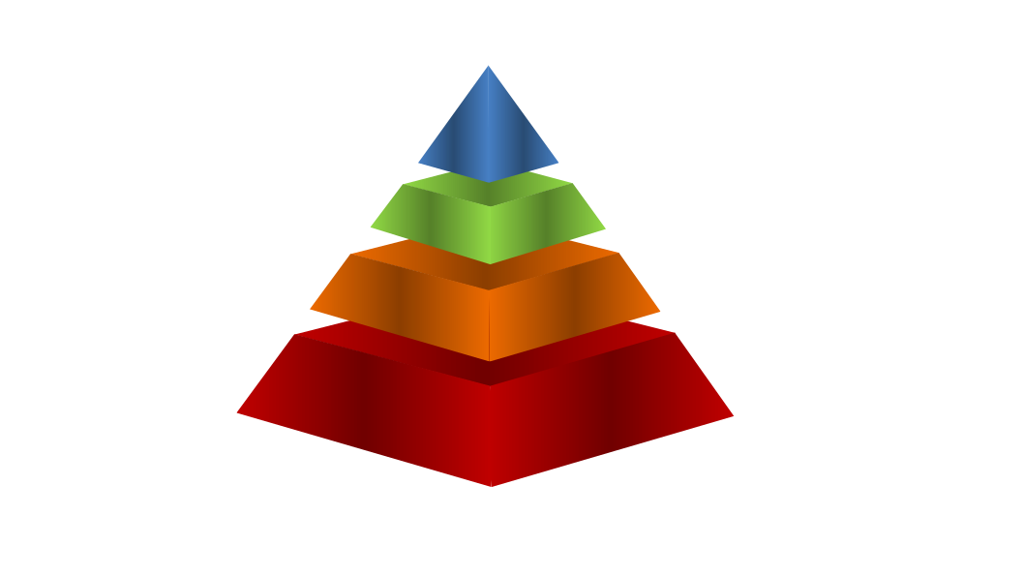
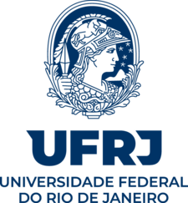
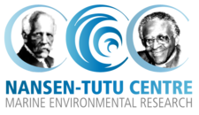
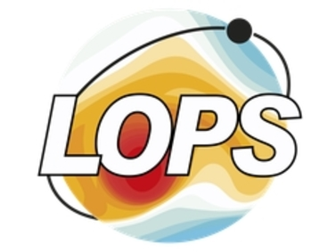
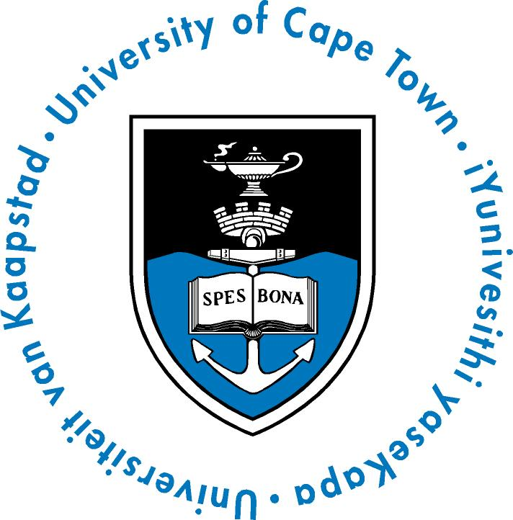
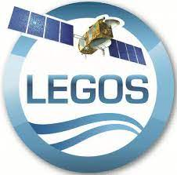
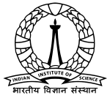
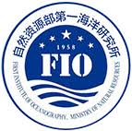
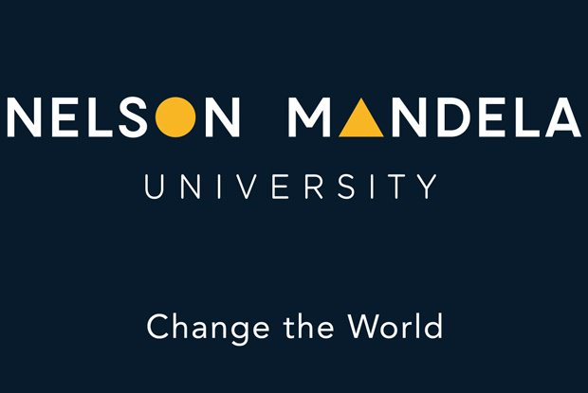
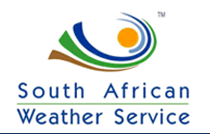
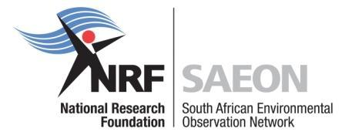
SOMISANA:
A Sustainable Ocean Modelling Initiative, A South African Approach
SOMISANA:
‘to work together’
A sustained and transformed critical mass of internationally recognized
South African numerical ocean modelling experts who provide accurate
information about the changing state of the ocean for enhanced impact
VISION
An ocean modelling hub and platform that promotes the inclusive
development of local expertise and that produces and provides
state-of-the-art ocean information, tools and research that is
visible and accessible to all
MISSION
1. Model Development
✦ Limited domain OFSs
✦ Optimized hindcast/reanalysis
2. Capacity Development
GOALS
COORDINATION
COLLABORATIONS
Slide provided by Dr Jennifer Veitch

Slide 14
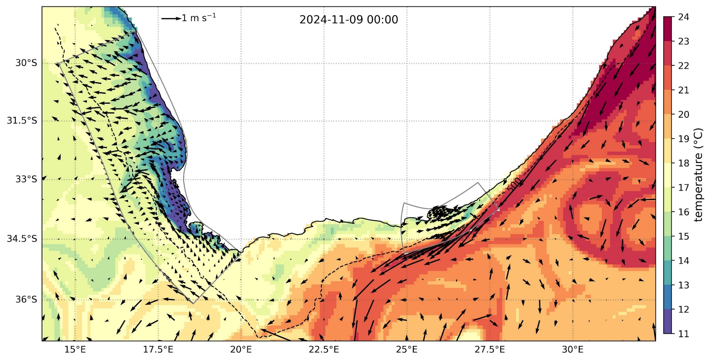
Operational downscaling of global models
Each domain is initialised once a day, providing a 5 day forecast of the ocean temperature, salinity, water levels and currents
Hourly output files (raw and regridded CF compliant) archived to a public facing file server: https://somisana.ocean.gov.za/
Interactive visualisation platform: https://explore.somisana.ac.za/
MERCATOR
Notes:
The SOMISANA team have developed two domains which are running operationally, which downscale coarse resolution global models to high resolution (<1 km) at the coast, to address specific user needs.
We have one small domain in the southeast, focussed on Algoa Bay, where there’s a particular focus on bunkering operations i.e. the ship to ship transfer of fuel oil.
And then we’ve developed a west coast domain which is focussed on simulating the southern Benguela upwelling system.
Each domain is initialised once a day, and provides a 5 day forecast of the ocean temperature, salinity, water levels and currents
Hourly output files (raw and regridded CF compliant) archived to a public facing file server: https://somisana.ocean.gov.za/
We have a very nice interactive visualisation platform, which unfortunately is a little bit out of date seeing as the developer who was working on it left us, so it doesn’t include the new west coast domain: https://explore.somisana.ac.za/

Slide 15
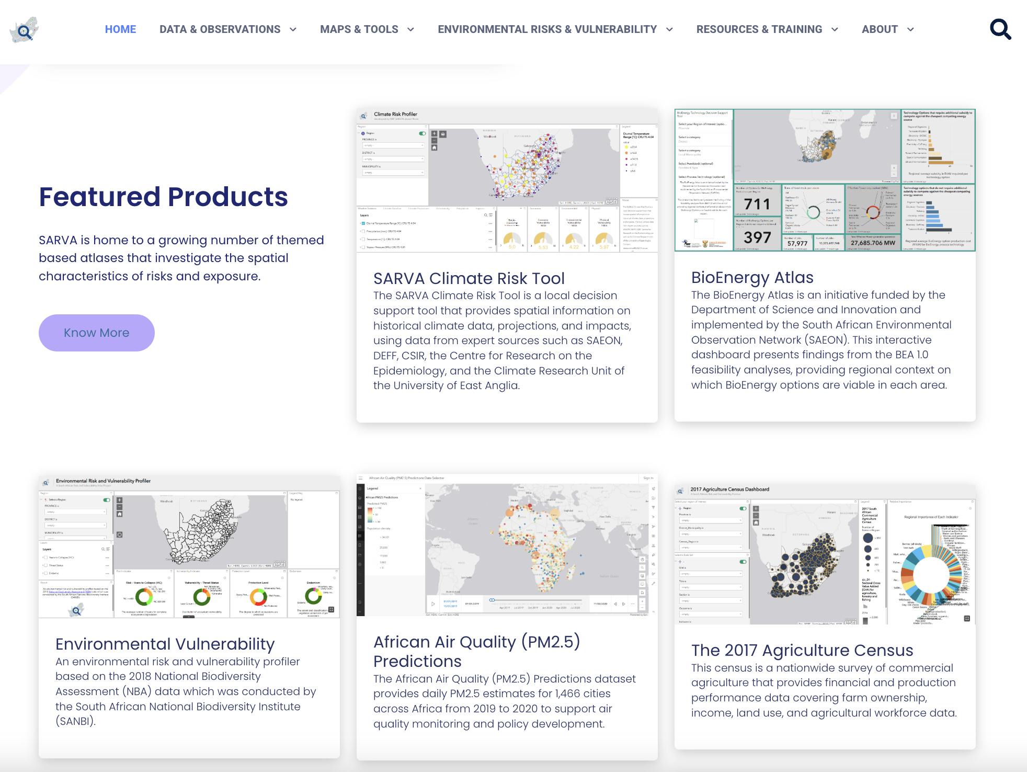
South African Risk and Vulnerability Atlas
Open access to data, in decision ready format, is essential to respond to global change. Users may not have the means to interpret data directly from a cataloguing system, so data products are often required to fulfil that gap
The South African Risk and Vulnerability Atlas (SARVA) was established in 2008 as part of South Africa’s Department of Science, Technology and Innovation Global Change Grand Challenge.
Currently hosted by NRF-SAEON
Open data access and the development of decision-support tools.
Platform to preserve and provide access to risk data for South Africa.
https://sarva.saeon.ac.za/

Slide 16
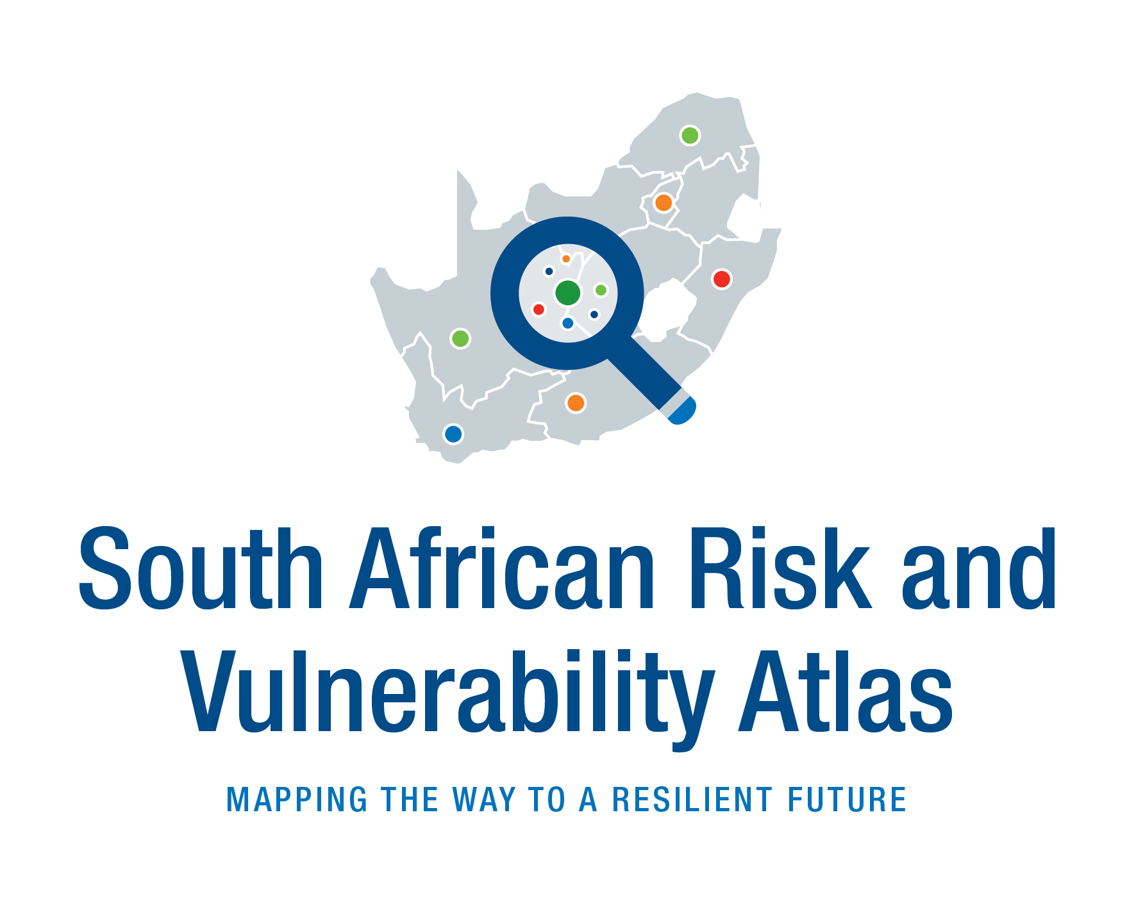
Collaboration with Centres for Global Change at South African universities + other partners
SARVA and the CGC’s are both initiatives of the DSTI’s Global Change Grand Challenge Flagship.
Both responsible for generating and disseminating risk and vulnerability knowledge on Global Change Grand Challenges to local municipalities and other potential users.
Benefits and Objectives of the Collaboration:
Data access & distribution - Initial phase of generating CGC profiles:
Provide a link to the local municipalities in which they operate
Multi-platform posting
Knowledge generation and dissemination
Central point of data access
2. Develop and Curate Data Products
Develop tailored data products and tools, such as risk and vulnerability municipal profiles, municipal disaster dashboards, and localised SDG indicator for evidence-based decision-making.
3. Enhance Capacity Building
Provide training and knowledge-sharing opportunities to students.
Provide local municipal employees with technical training on the use and functions of SARVA
Possibility to co-host/co-develop a CGC symposium with the centres - bring together diverse stakeholders.

Slide 17
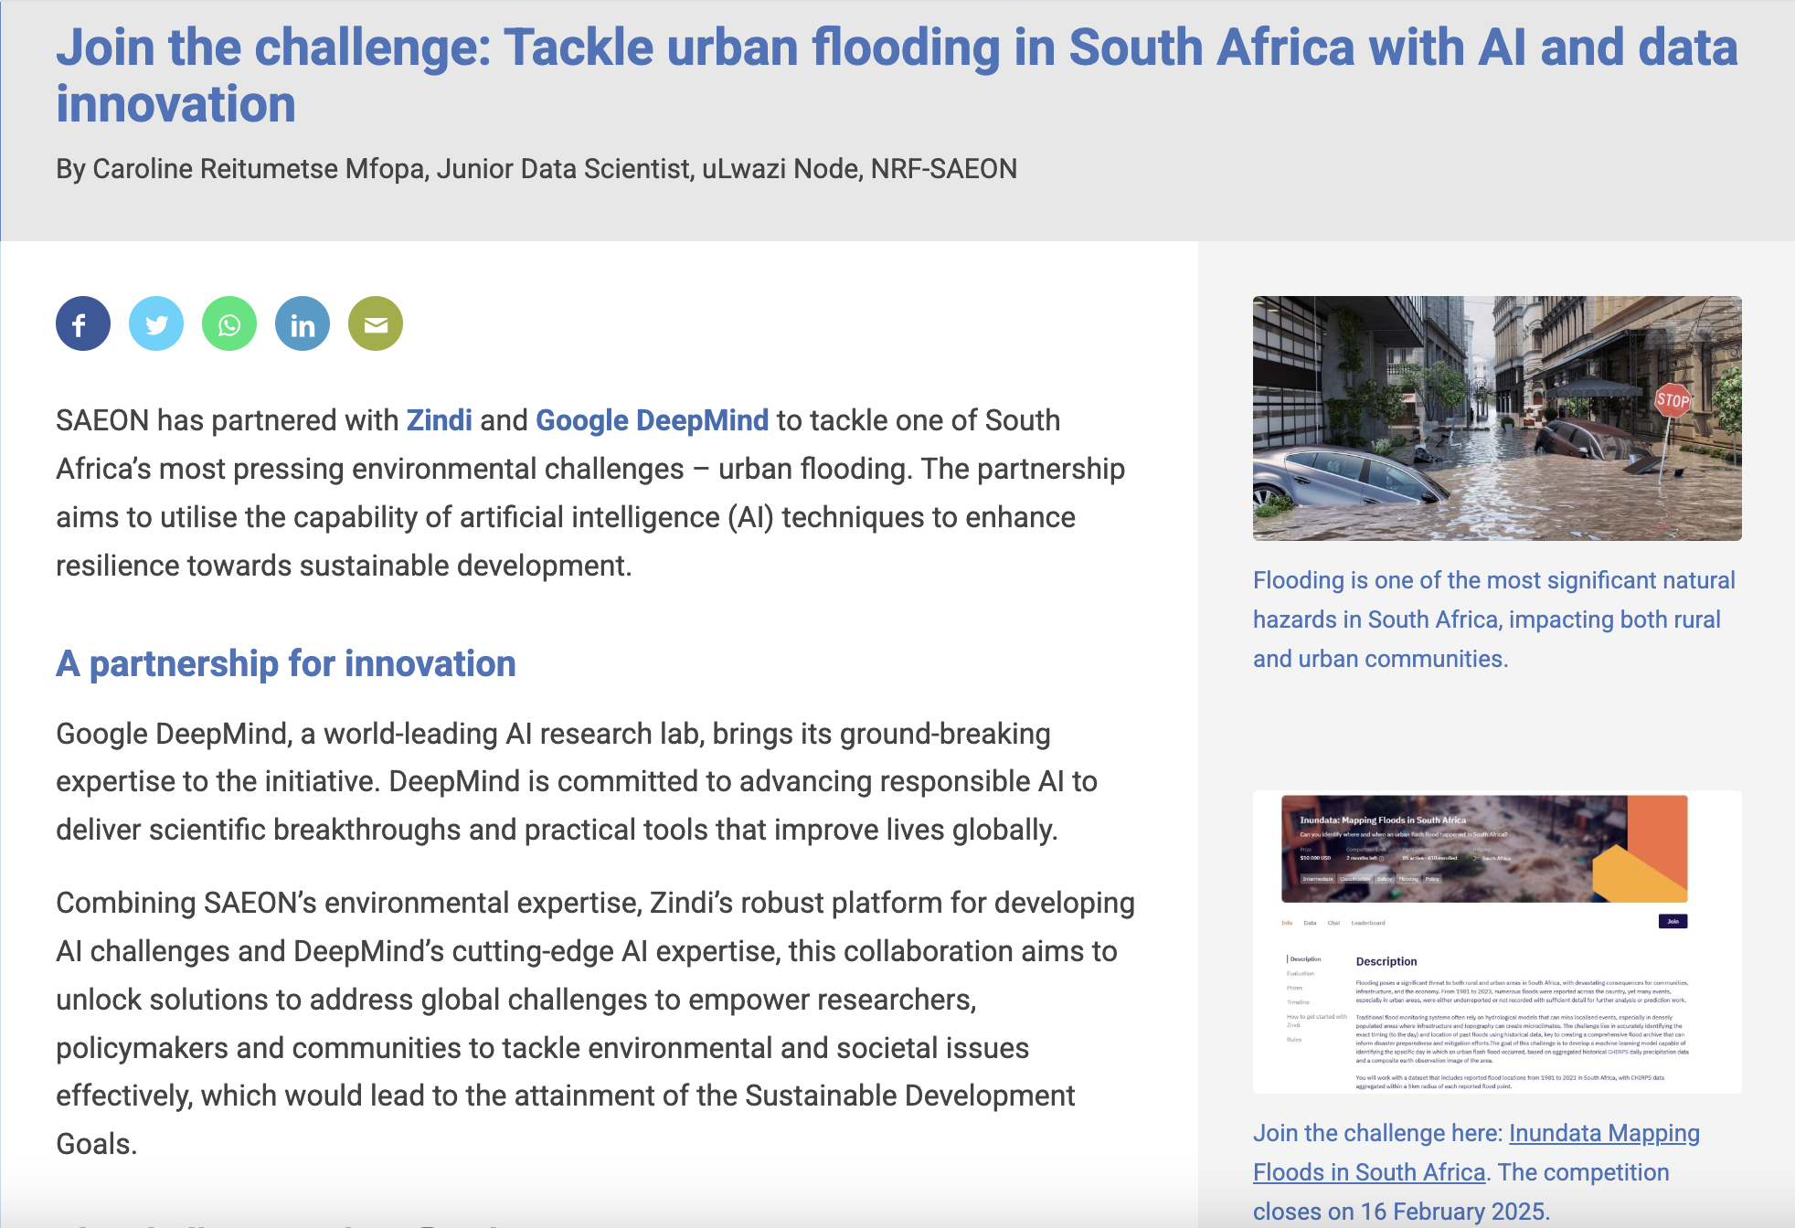
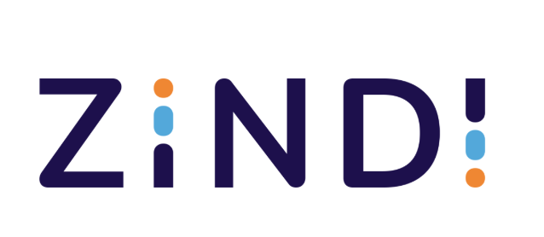
Leveraging new technologies for Disaster Risk Reduction related activities
Current partnership with Zindi Africa:
Zindi hosts the largest community of African data scientists, working to solve the world’s most pressing challenges using machine learning and AI
They connect data scientists with organisations and provide a place to learn and connect

Slide 18
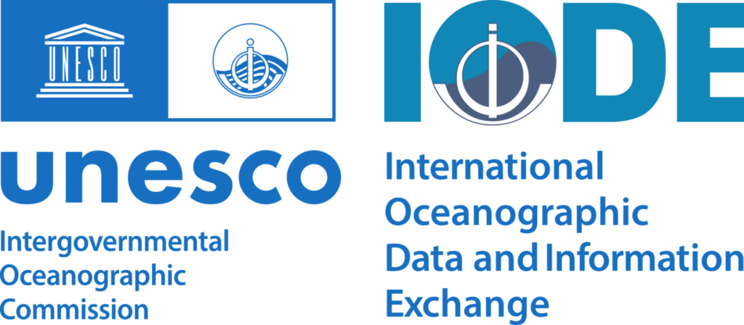
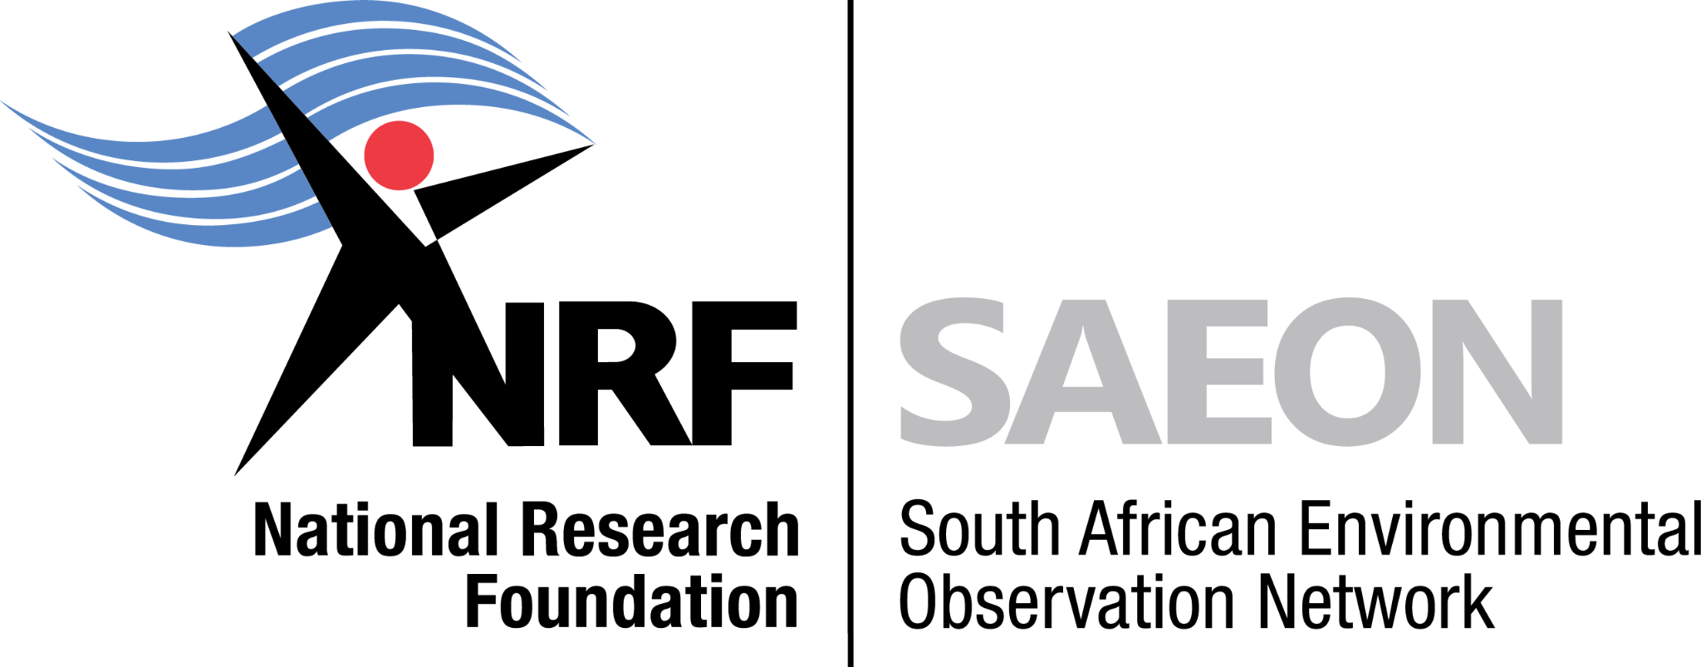
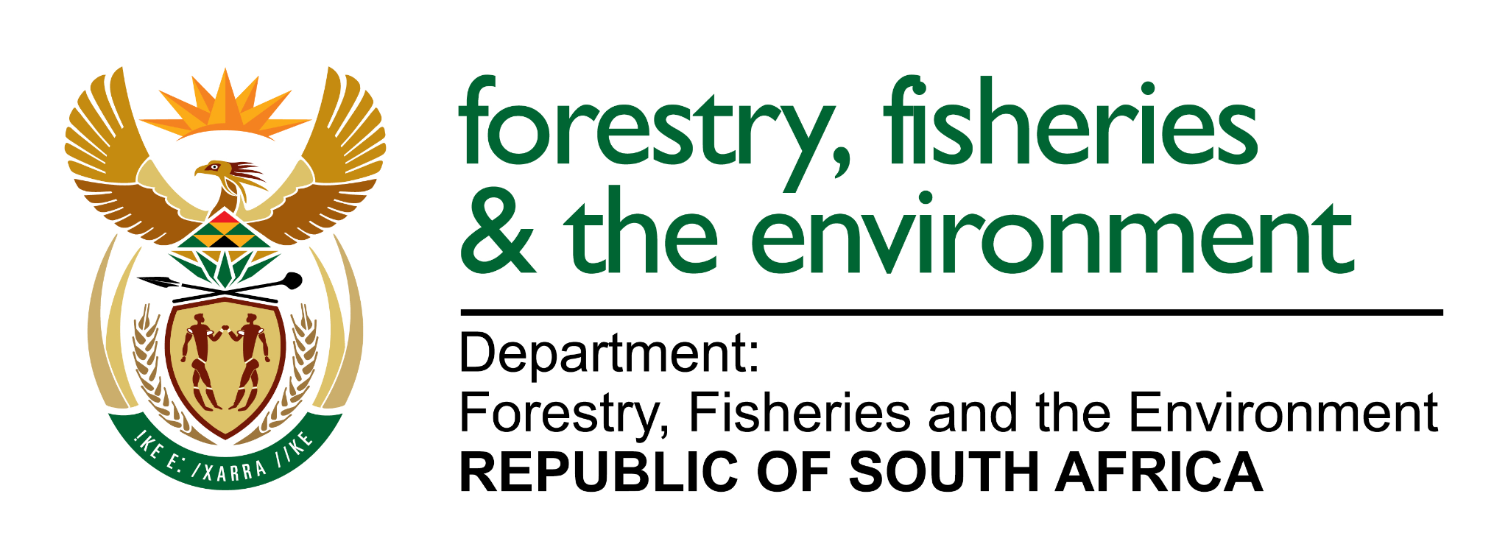
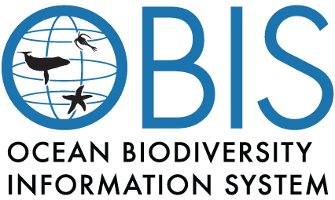
Concluding remarks
Global change data is ultimately intended to inform and promote action towards a sustainable society: SAEON is open to collaboration on developing tools to advance data sharing and management
Some work has been done to establish core platforms that other initiatives can use to share their data or harvest metadata collections
Improvements in Cross-Domain Interoperability still required: testing of current data management approach requires use cases from other domains
Downscaling of global models raises the need for us to collaborate with other institutions around issues related to High Performance Computing
FAIR data systems should integrate with other data aggregators to mitigate against siloed approaches to data management

Slide 19
Thank you
Leo Chiloane
Manager: uLwazi Node
South African Environmental Observation Network
Enquiries: curation@saeon.nrf.ac.za
8th Floor, The Towers South
Hertzog Blvd, Foreshore, Cape Town, 8001
Map: https://goo.gl/maps/aopjjsJgX4o
Website: https://ulwazi.saeon.ac.za/
Notes:
Repository:
https://github.com/SAEONData/Profiler

