Slide 1

National Research Foundation
JINR
Angus Paterson
Deputy CEO: National Research Infrastructure Platforms

Slide 2
NRF Mandate
The object of the NRF is to contribute to National Development by:
Supporting, promoting and advancing research and human capacity development, through through funding and the provision of the necessary research infrastructure, in order to facilitate the creation of knowledge, innovation and development in all fields of science and technology, including humanities, social sciences and indigenous knowledge;
Developing, supporting and maintaining national research facilities;
Supporting and promoting public awareness of, and engagement with science; and
Promoting the development and maintenance of the national science system and support of Government priorities.

Slide 3
National Research Facility | Science Domain / Discipline | NRF Cluster
iThemba Laboratory for Accelerator-based Sciences (iThemba LABS) | Nuclear sciences | Nuclear sciences
South African Astronomical Observatory (SAAO) | Optical & Infra-red Astronomy | Astronomy & Geodetic Sciences
South African Radio Astronomical Observatory (SARAO) | Radio Astronomy, Geodesy & Very Long-Base Interferometry | Astronomy & Geodetic Sciences
South African Environmental Observation Network (SAEON) | Long-term Ecological Monitoring & Research | Biodiversity & Environmental Sciences
South African Institute for Aquatic Biodiversity (SAIAB) | Freshwater & Marine (Aquatic) Science | Biodiversity & Environmental Sciences

Slide 4
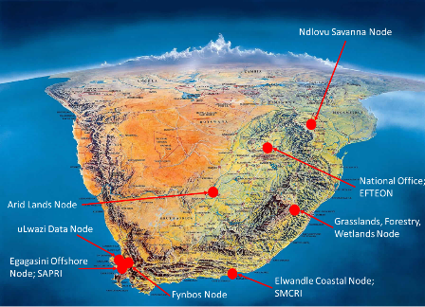
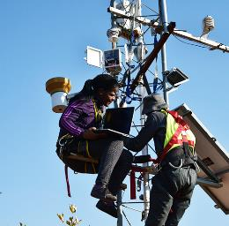
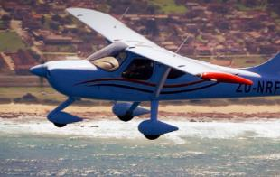
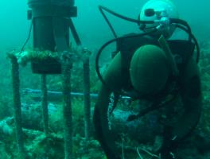
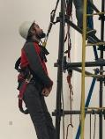
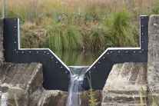
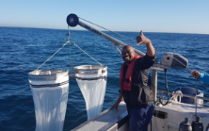
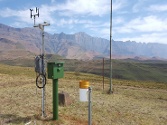
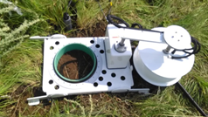
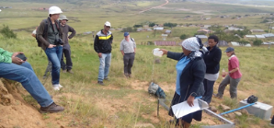
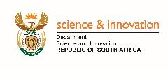

South African Environmental Observation Network (SAEON)

Slide 5
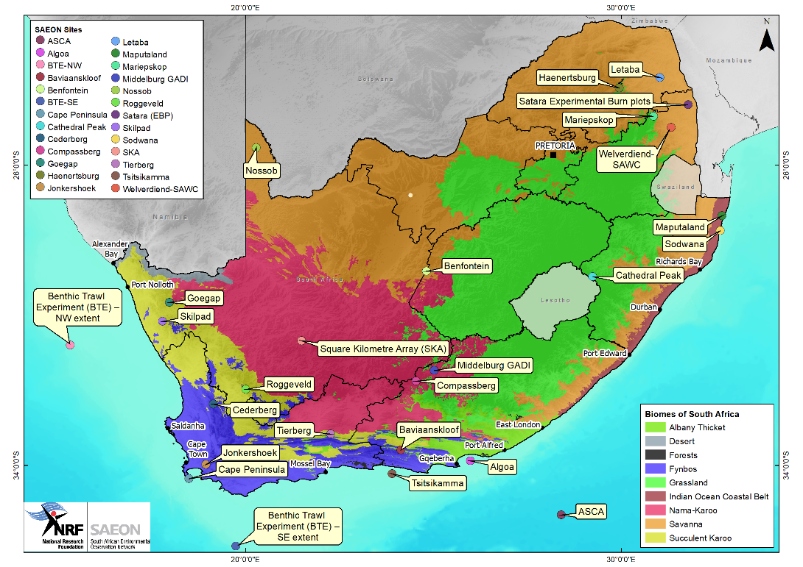
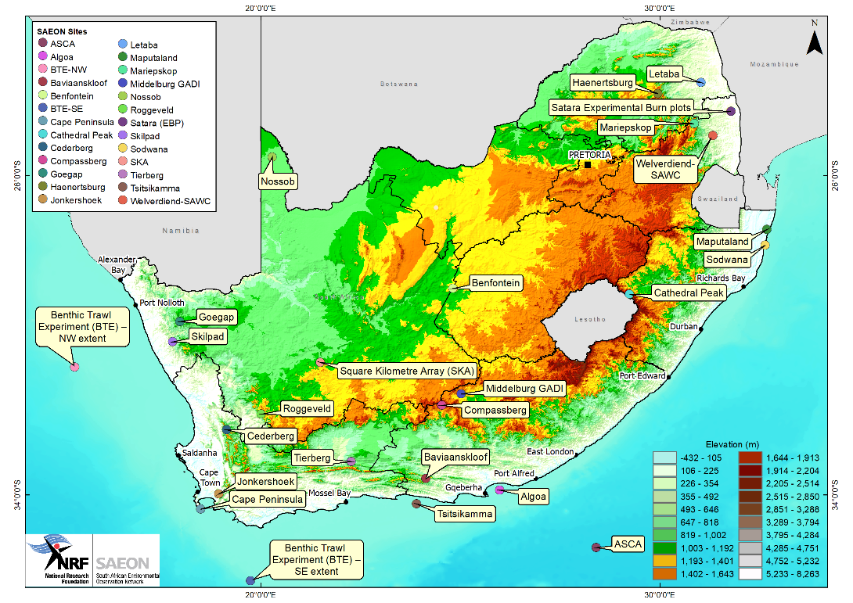
Topography
Biomes
Notes:
SAEON has country wide coverage with 6 nodes across the country spanning major terrestrial biomes as well as coastal and ocean systems
Our work is multidisciplinary and multiscale and spans a number of thematic areas at the broadest level including earth system science, hydrology and ecology. Sow tiing SAEON we have a melting pot of specialist expertise
So unlike some other intentional initiatives which focus either on atm processes or biodiversity we are trying to developed integrated research platforms
So just to emphasis that while some of our sites are in mountains our work is much broader then mountain landscapes
We also host three additional research in fractures one of which is the Expanded Freshwater and Terrestrial Environmental Observation Network , which also has several mountain based sites
SAEOn is well placed to facilitate multi institutional collaborations and catalase GC research and part of this is through the provision of detailed in situ data which can be used for analysis modeling and RS
And our sites are used by other academic initiations and students to advance their research and skills development

Slide 6
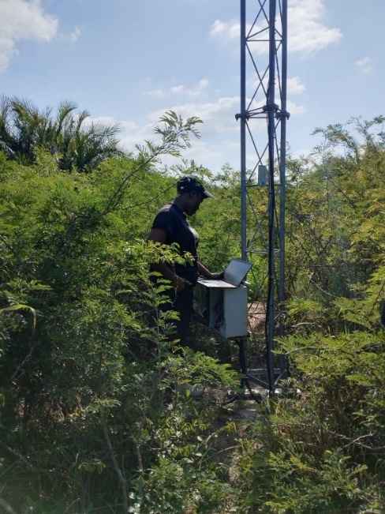
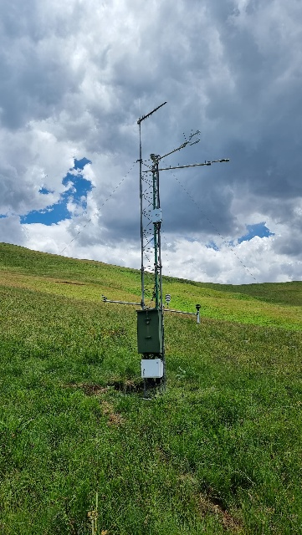
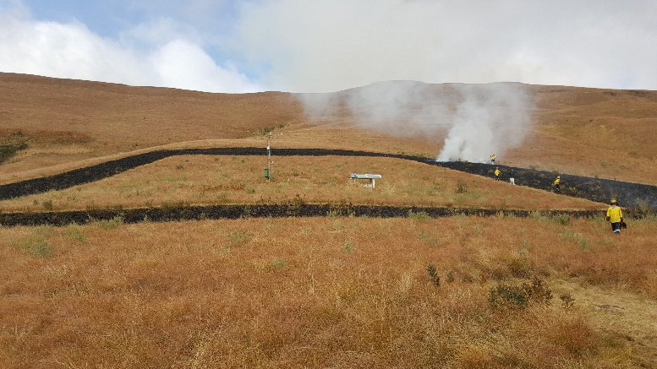
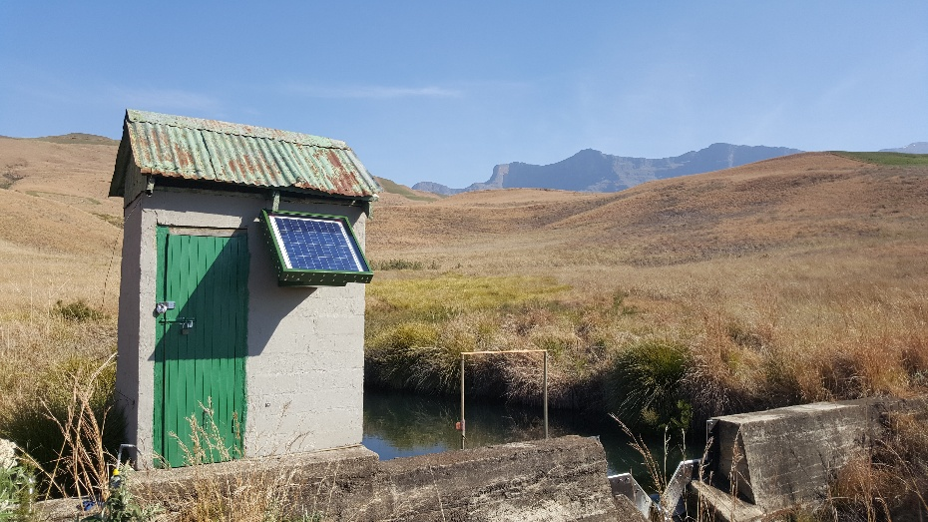
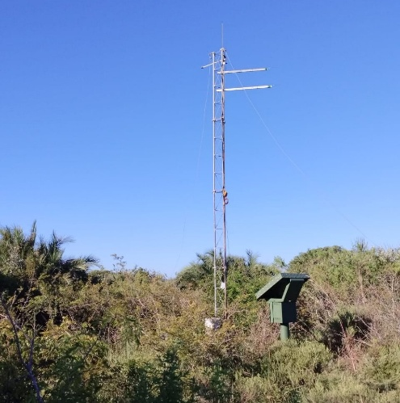
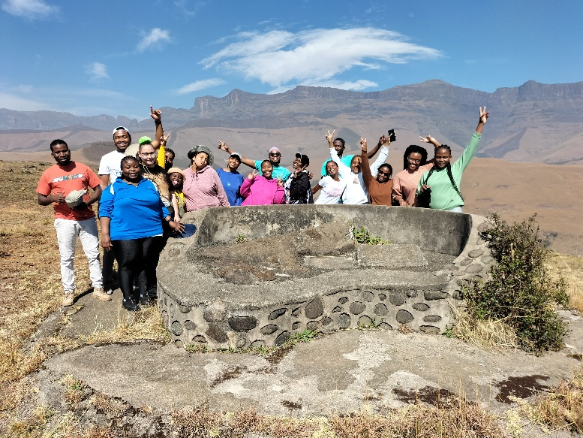
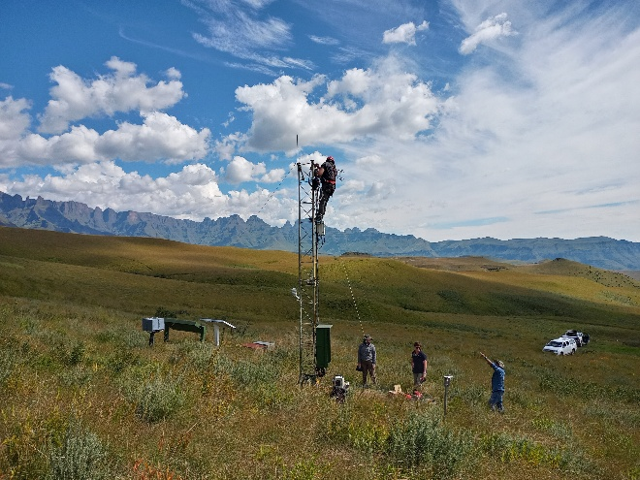
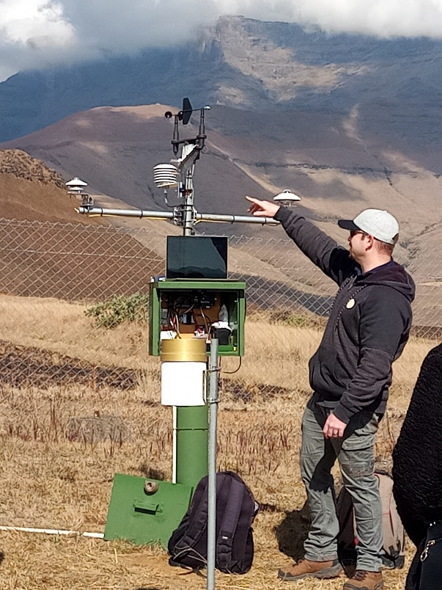
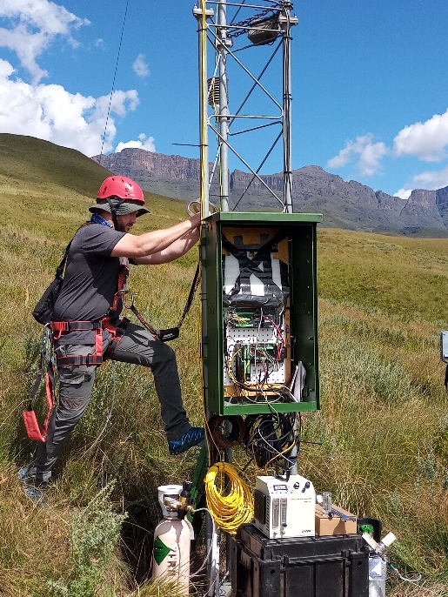
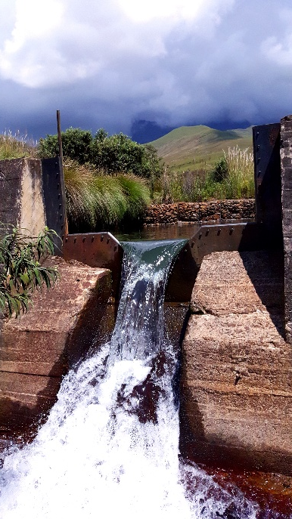
SAEON Terrestrial Landscapes

Slide 7
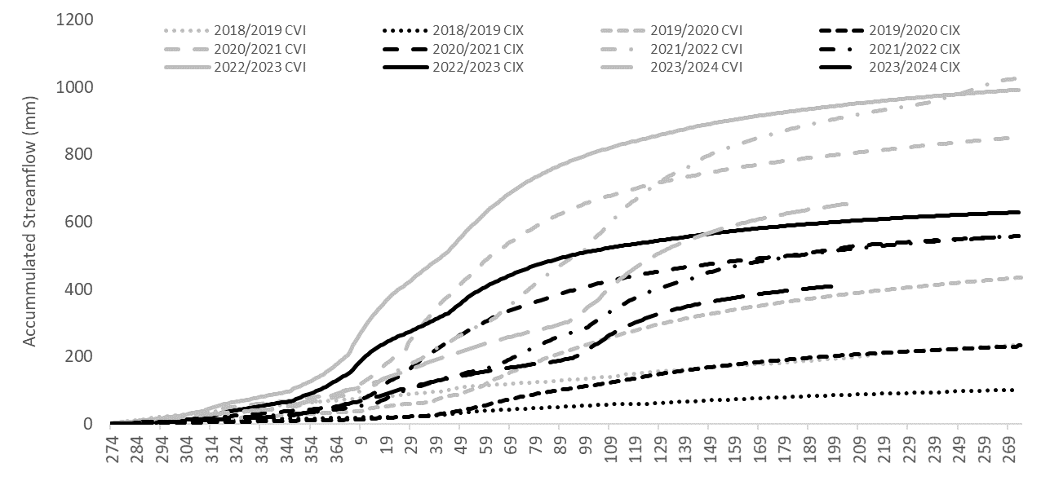
Impacts of woody vegetation on Streamflow
Climate Change and Sustainability
Climate change and variability studies
Impact of biomes on water security
Figure shows grasslands are better for streamflow water
In the process of getting instruments from Russian Academy of Sciences – for testing in sites in South Africa
Working with Institute of Numerical Mathematics, Moscow State University on Land Surface Modelling
Grass
Woody encroachment

Slide 8
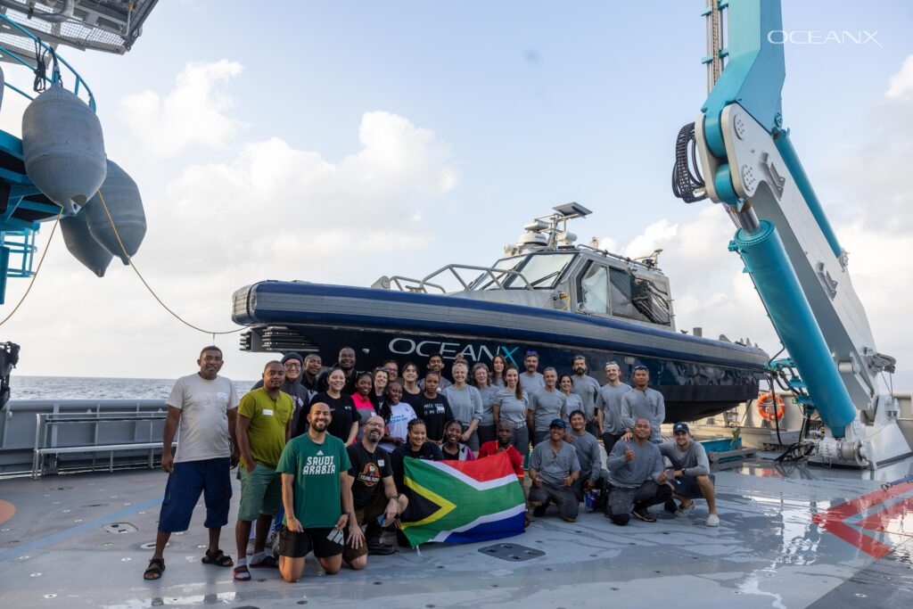
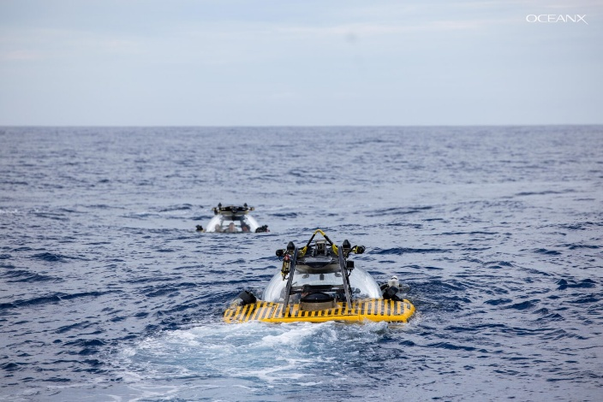
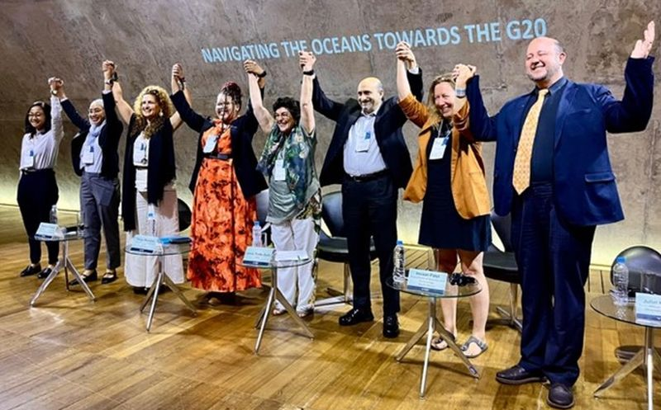
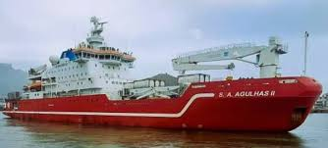
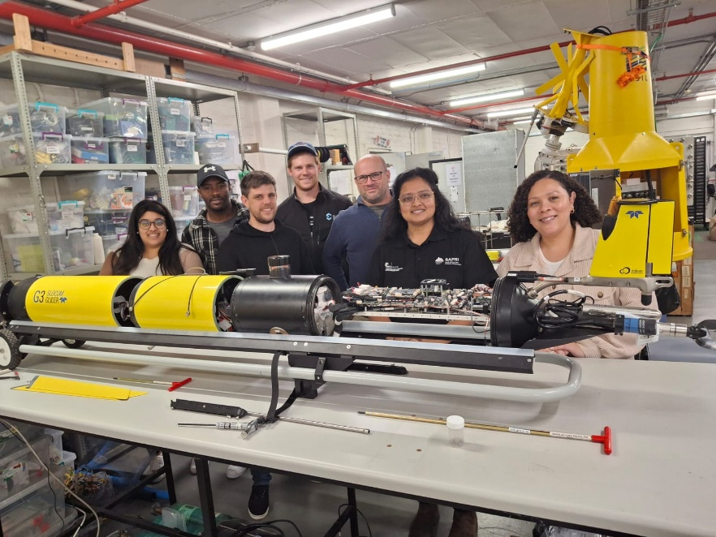
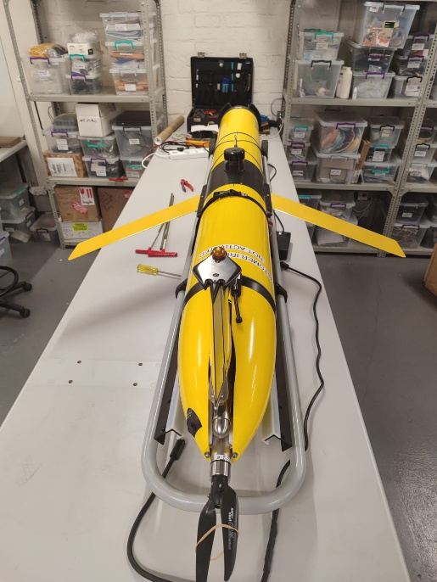
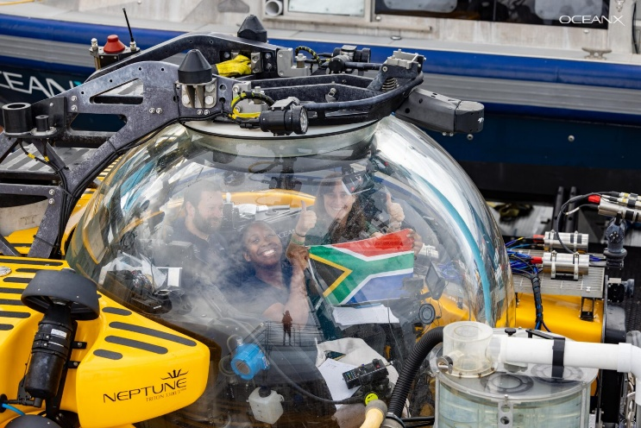
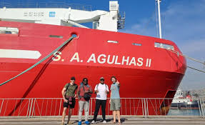
SAEON MARINE
Leading Ocean20 work for South Africa – a reflection of leadership in the space
Collaborated with OceanQuest/OceanX for Indian Ocean expedition

Slide 9



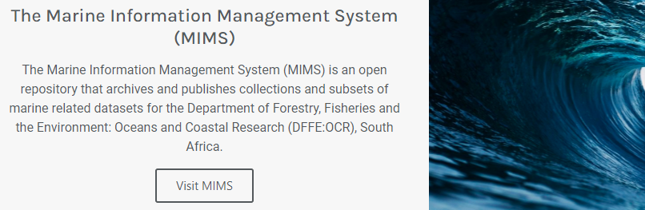

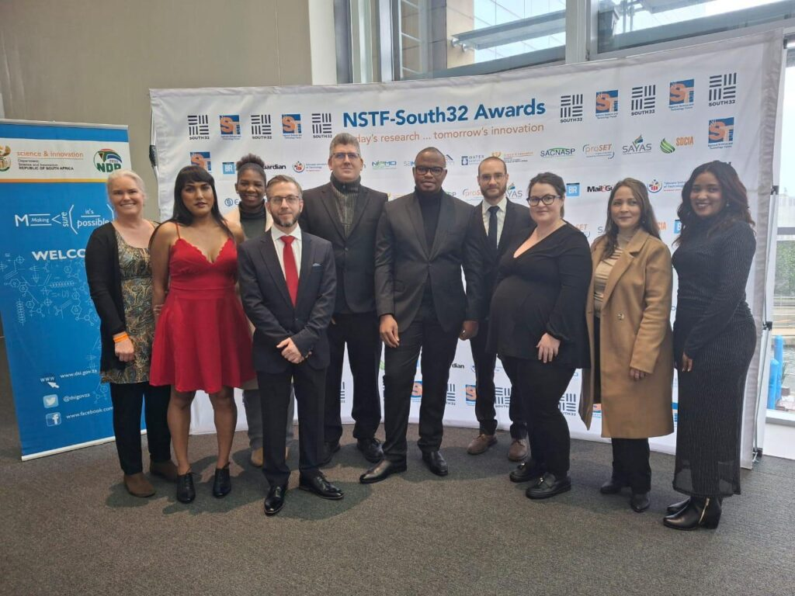
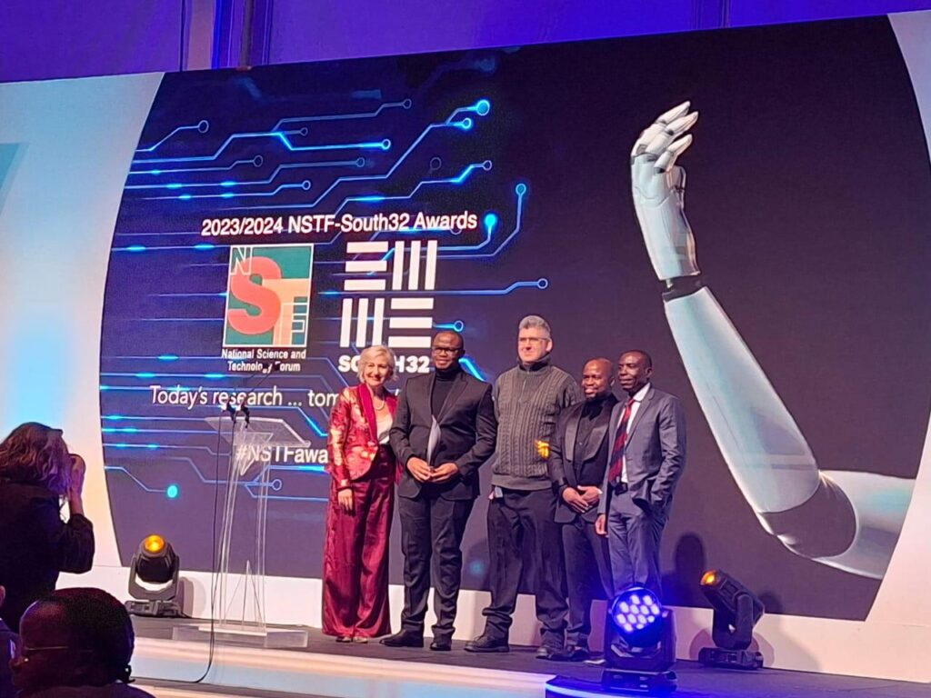
  Data Management Systems:
  https://catalogue.saeon.ac.za/
The NSTF-South32 Data for Research Award was awarded to the uLwazi Node Manager, Leo Chiloane, for the South African Environmental Observation Network (SAEON) Open Data Platform (ODP) at a gala dinner held in Cape Town on Thursday 11 July 2024.

Slide 10
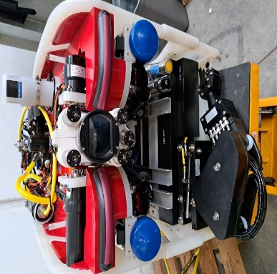
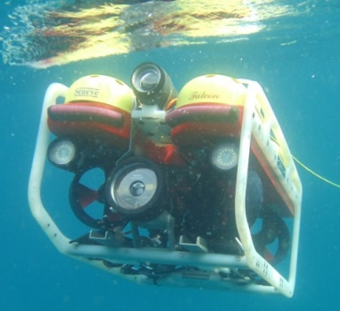
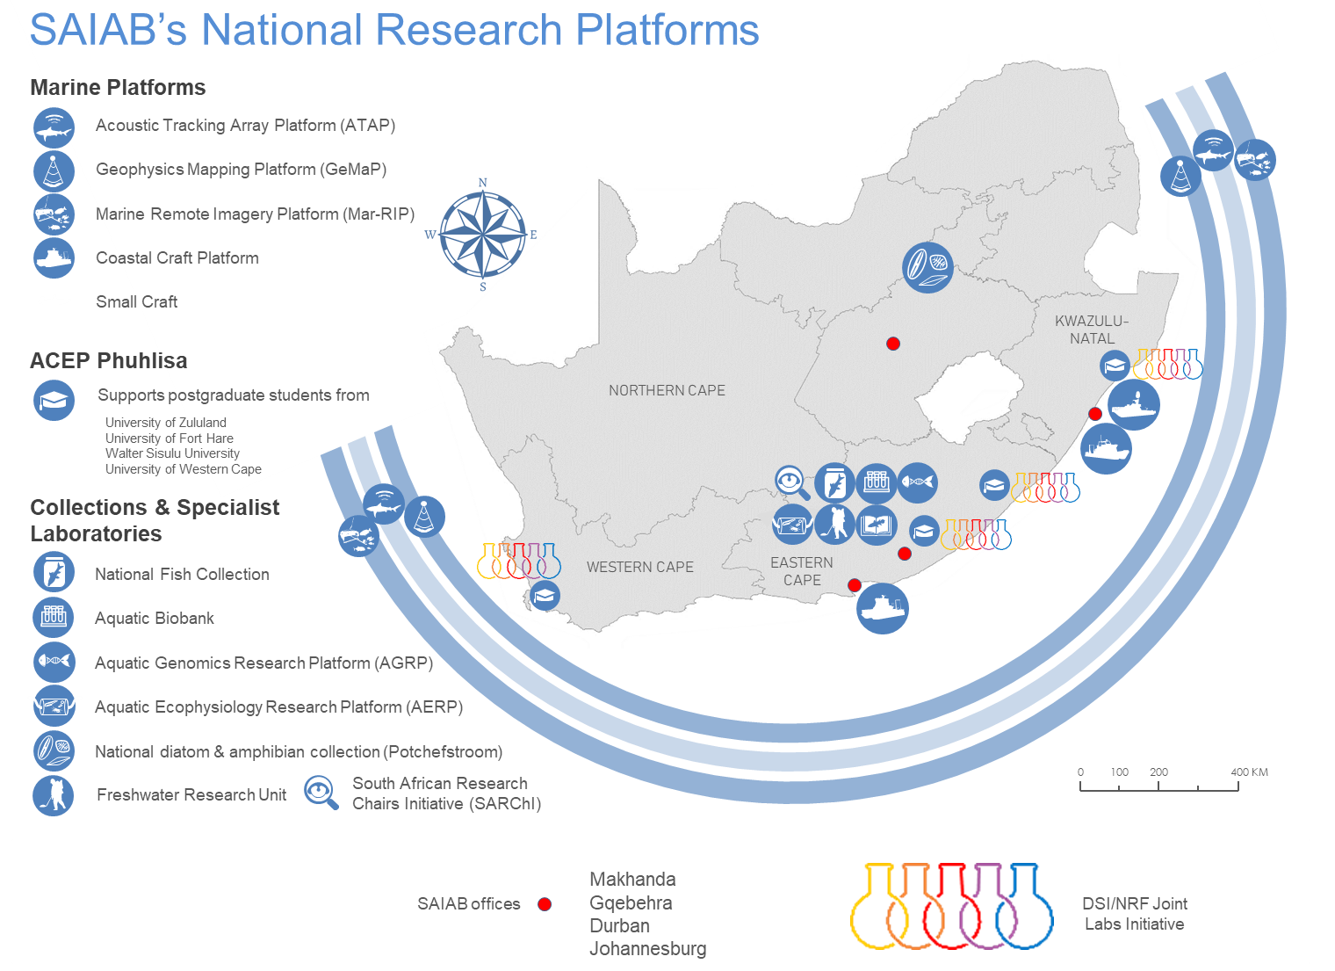
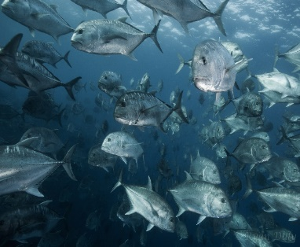
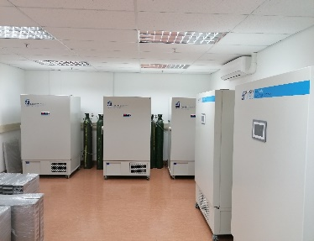
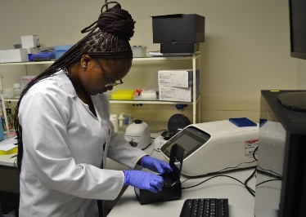
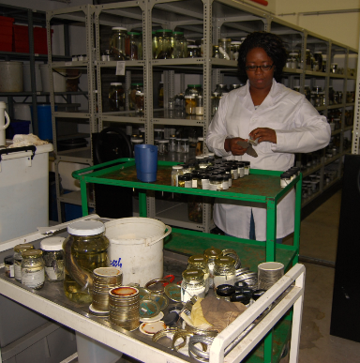
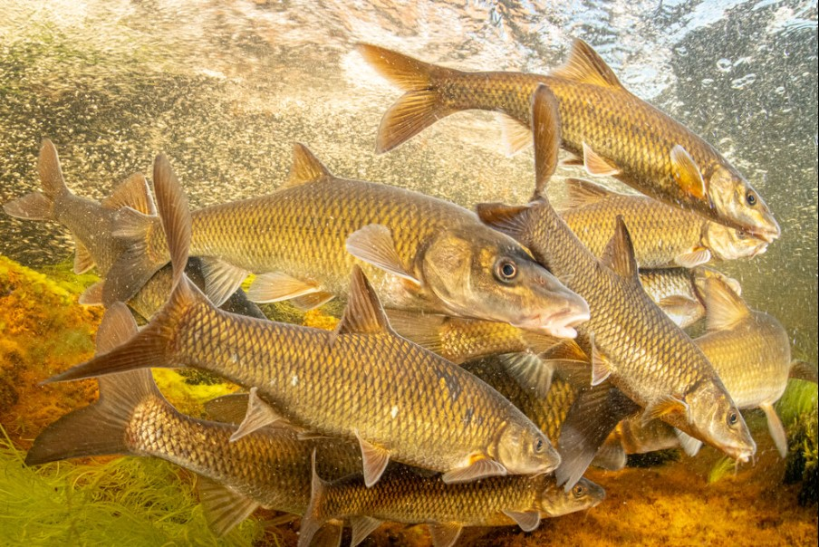
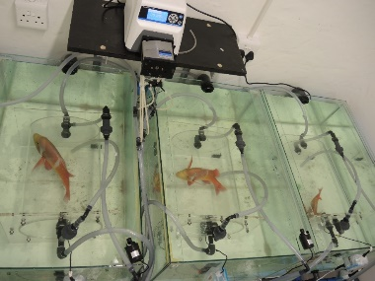
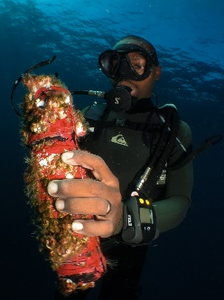
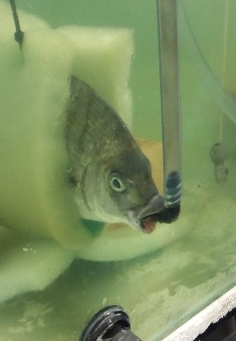
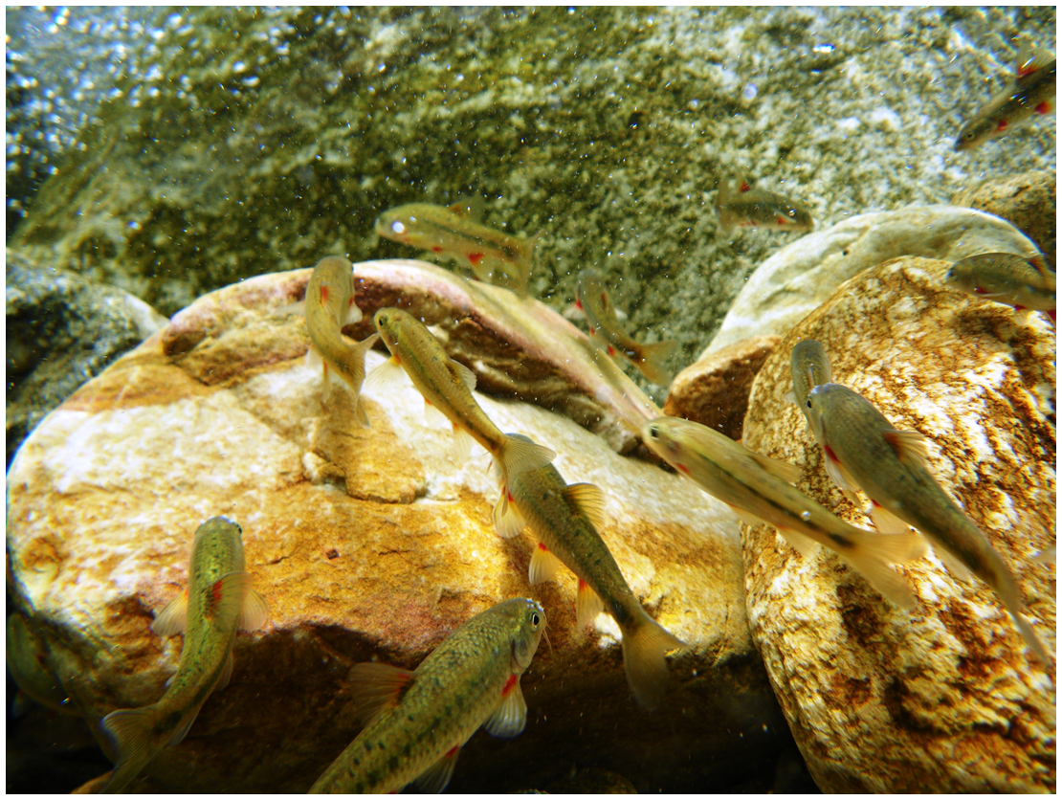
SAIAB

Slide 11
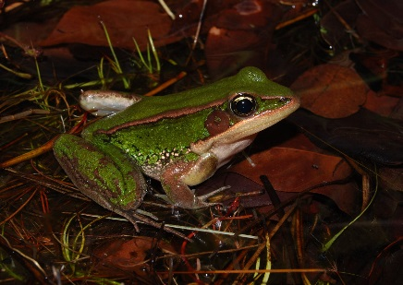
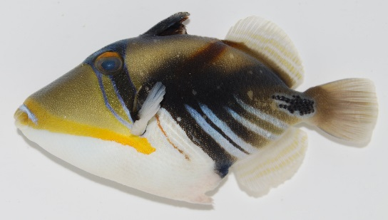
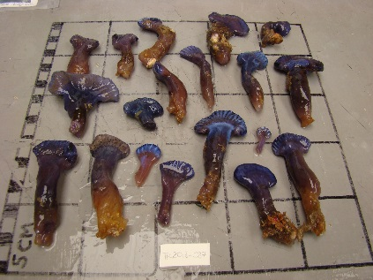








Collections and biobank – the backbone for bio-discovery

Slide 12









End-to-end platforms for collecting, mapping, monitoring, bioprospecting and capacity development
https://www.nps.gov/articles/aps-19-1-6.htm

Slide 13



Overview
  Assessing physiology of aquatic organisms under changing climatic conditions
Pollution
  Assess various pollutants including microplastics and pharmaceuticals, impacts on aquatic organisms
Invasions
  Monitor biological invasions helps in understanding their effects on native species and ecosystem health
Ocean Acidification
  Provide vital insights into species resilience and ecosystem balance

Slide 14

Advancing fish identification and abundance estimates using intelligent applications

Slide 15
SARAO
Design, construct and operate radio astronomy facilities
Protected areas for radio astronomy
Technology Research and Development
Commercialisation
Human Capital Development
Communications & Science Engagement
Development of astronomy infrastructure and capacity in Africa
Vision: Delivering scientific and technical solutions for global astronomy
Approximately 500 engineering, scientific and related staff
Delivering a range of high impact programs
  Positioning SARAO as a reliable partner to global astronomy community
  Ensuring impact from investments in research infrastructure
15
Notes:
SARAO’s vision is to deliver scientific and technical solutions to the global astronomy community
It has approximately 550 staff, located across 4 locations, with the engineering division accounting for approximately 35% of the staff complement
It delivers a range of high impact, strategic programs that seek to not only position SARAO as a reliable and strategic partner to astronomy, and more generally research infrastructure, but also ensure real impact from investments in research infrastructure

Slide 16
Establishment of a World-class Protected Site
Astronomy Advantage Area
  4 million hectares protected in terms of Astronomy Geographic Advantage (AGA) Act
Meerkat National Park
  140,000 hectares declared as environmental conservation area
Karoo Site
  Established in 2007 as world-class, protected site for radio astronomy
  Hosts local and international radio astronomy facilities
    MeerKAT, SKA-MID, HERA and HIRA

Slide 17


SARAO Astronomical and Geodetic Facilities
MeerKAT is a South African design and constructed ‘best in class’, next-generation facility
Has enabled ground-breaking science, and will be integrated with SKA-MID telescope
Hartebeesthoek Radio Astronomy Observatory (HartRAO)
64 Dish MeerKAT
Notes:
SARAO operates a range of facilities, from its legacy Hartebeesthoek Radio Astronomy Observatory – which has been operated as a radio astronomy facility for the last 50 years and is a critical element in the European VLBI Network – to the next-generation, MeerKAT facility.
MeerKAT is South African designed instrument etc…
Given the scientific qualities of the site, we also host a range of international guest instruments, such as HERA and, of course, the SKA

Slide 18

MeerKAT: Groundbreaking Scientific Discoveries
Scientific discoveries from MeerKAT have captured the minds of the scientific community, and general public, and enhanced South Africa’s scientific and technical reputation

Slide 19

International Partnership & Cooperation
Scientific
  International participation in MeerKAT scientific program
Technical
  Engineering capacity makes SARAO a reliable collaborator for new technology developments and instruments
Skills Development
  Proven models for international cooperation on skills development initiatives, not only in South Africa but across the African continent
International participation in MeerKAT scientific programs (OT1, OT2, OT3 and OT4)
Notes:
Significant international and EU participation in the MeerKAT science program, represented by the diagram to the right
Engineering capacity of SARAO has established it as a reliable collaborator for development of new technologies and instruments. Apart from the partnership with SKAO, we have collaborative arrangements with other partners include INAG and MPG

Slide 20




International Partnership & Cooperation
Collaborating with Africa
  Development of Ghana Radio Astronomy Observatory
  Deployment of TART training telescopes
  International cooperation on human capital development through DARA
TART telescopes deployed in Mauritius and Kenya
Ghana Radio Astronomy Observatory
DARA – funded by UK government in partnership with NRF to provide training in radio astronomy and related disciplines (Big Data)

Slide 21



Doing amazing things
Tracking cosmic ripples in spacetime and proving Einstein right
Discovery of new giant radio galaxy – ‘Inthakazo’, 32 times the size of our own Milky Way galaxy

Slide 22


South Africa & the Square Kilometre Array
Global endeavour to build largest radio telescope in history
  €1 billion construction cost (2021 – 2030)
  Catalyst for development of next-generation technologies and skills for 4th Industrial Revolution
SKA Observatory launched as inter-governmental treaty organization in 2021
  South Africa a Founding Member and host of SKA MID
SKA is a realization of long term strategic vision (circa 1996) to establish South Africa as an international hub for astronomy, and exploit its strategic geographic advantage
Global Headquarters (United Kingdom)
Africa
Mid-Telescope Array
Australia
Low-Telescope Array

Slide 23





SARAO: Changing the face of scientific & technical talent

Slide 24


The South African Astronomical Observatory
Exploring the Universe for the benefit of all society
National facility for optical & near-infrared astronomy under the NRF
Headquarters in Observatory, Cape Town; ~120 staff; research telescopes 400 km away on the dark, high-altitude Sutherland plateau (sky brightness ≈ 22 mag arcsec⁻²)
200-year heritage of research, technology, human-capital development and public engagement
The Southern African Large Telescope(SALT)

Slide 25


Research excellence & talent pipeline
Core focus areas
Transient & time-domain astronomy
Stellar astrophysics
Galaxy formation & evolution
Exoplanets & Solar-System bodies
Astronomical instrumentation
120 refereed papers & conference contributions per year
Partnerships: 7-nation SALT consortium, SKAO pathfinders, AfAS secretariat
Training via the National Astrophysics and Space Science Programme (NASSP)
~5 Honours + 10-20 MSc/PhD students in residence annually; hands-on observing & outreach experience
Annual NASSP Winter School for students from HDIs

Slide 26

World-class platforms at Sutherland
A unique astronomical hub
Southern African Large Telescope (SALT),
  20ᵗʰ anniversary this year – 11 m segmented mirror, largest optical telescope in southern hemisphere; fully queue-scheduled; SA covers ~50 % of operating costs
Three SAAO-owned telescopes (1m, 1.9 m, modern 1 m Lesedi), range of instrumentation for high speed imaging, spectroscopy and polarimetry
15 hosted facilities: PRIME 1.8 m, IRSF 1.4 m, KMTNet 1.6 m, ATLAS, MeerLICHT, LCO network, ASAS-SN, MASTER, SOLARIS, OSR debris-tracking, etc.
Robust site infrastructure – fibre connectivity, remote/robotic operations, on-site engineering workshops and accommodation

Slide 27



Technology development & innovation
Building the tools of tomorrow
Recent instrument and telescope upgrades: e.g.Laser Frequency Comb enabling high precision calibration for exoplanet detection, Slit-mask Integral Field Unit enabling spatially resolved spectroscopy.
Intelligent Observatory (IO) – AI-enabled, networked, autonomous observing system linking African telescopes for rapid transient follow-up .
Fibre astro-photonics laboratory
Precision mechanical workshop
Detector & control-system design
Industry & academic collaborations fostering high-tech skills and technology transfer across South Africa.
The SAAO Remote Observing Station
High precision mechanical engineering and fibre developments

Slide 28

Research and Training at iThemba LABS
Rudzani Nemutudi
Rudolph Nchodu

Slide 29

iThemba LABS is a research platform for pure and applied research, development and training in Accelerator Based Sciences
Research Focus
Fundamental studies of nuclear phenomena;
Applications of ion beams and associated (IBA) techniques in materials and nanoscience research;
Accelerator mass spectrometry (AMS);
Nuclear Medicine – Diagnostic Radionuclides
Radiation Biophysics - Radiobiology

Slide 30







iThemba LABS: Laboratories for Accelerator Based Science
Subatomic Physics and Applications, Nuclear Medicine
K11 Cyclotron
K8 Injector Cyclotron 2
K200 Separated Sector Cyclotron
K8 Injector Cyclotron 1
Radioisotope Production
6 MV Tandem
IBA C70 Cyclotron
3 MV Tandetron
Materials Research and Accelerator Mass Spectrometry (AMS)
Materials Research and Nanoscience

Slide 31
Nuclear Medicine
Products supplied globally for clinical and research application
Product | Application | T½
⁶⁸Ge/⁶⁸Ga generator | ⁶⁸Ge/⁶⁸Ga generators used for the PET diagnosis of neuroendocrine tumours (NET’s). | ⁶⁸Ge: 271 days ⁶⁸Ga: 68 min
¹²³I products | ¹²³I API, capsules, solution and mIBG injection. SPECT tracers used for tumour localisation and for observing heart, kidney, thyroid and brain function. | 13.2 h
¹⁸F-FDG | PET radiopharmaceutical used for oncology, cardiac and neurological applications | 1.83 h
⁸²Sr | Irradiated Rb targets (unprocessed) used to prepare ⁸²Sr API. ⁸²Sr/⁸²Rb generators used for myocardial perfusion PET imaging. | 25.6 days
²²Na solution & source | ²²Na ultra-high vacuum positron sources used for scientific research purposes (positron annihilation studies). | 2.6 years

Slide 32
iThemba LABS – JINR Collaboration
Accelerator Technology
Ion Sources
  Beam Monitoring Systems/Devices
  Materials Irradiation Facility
Engineering
  Data Acquisition System for SPD at NICA –
  Radiation Hardness Testing of electronic components for space applications (Presentation Dr Arno Barnard)
  Detector development, with associated high-speed electronics for data processing
Basic and Applied Research (iThemba LABS and SA Institutions)
  Nuclear Physics and Material science
  Radiochemistry (Presentation by Prof Jan Rijn Zeevaart)
  Radiobiology (Presentation by Dr Neo Seane)
Virtual Laboratory

Slide 33


iThemba LABS Team:
Software Engineering Division
T. Mokoena
A. Sook
C. Callaghan
K. Machethe
This partnership supports global research in spin structure studies of protons and deuterons at the NICA collider.
iThemba LABS contributions focus on:
  Development of DAQ control software, online filter, online monitoring, and data quality tools.
  Optimisation of data processing using machine learning techniques
Future Plans: Extend contributions in Artificial Intelligence and machine learning-based event reconstruction and data quality control.
JINR – Team
Alexey Zhemchugov
Oleynik Danila.
Alexey Guskov
Acknowledgement of Slides Adoption
V. Riabov
Nikita Greben, MLIT
Notes:
* iThemba LABS is an active member of the spin physics detector (SPD) Collaboration at JINR.
* iThemba LABS is responsible for designing and developing key elements of the data acquisition (DAQ) control software, implementing online filtering and monitoring, and ensuring data quality through innovative tools.
Additionally, iTL contributes to optimising data processing workflows, integrating machine learning techniques to enhance performance.
* iTL Team participates in biweekly software computing meetings with the international collaboration, ensuring alignment and technical synergy.
iThemba LABS aims to deepen its contributions by extending work in artificial intelligence and machine learning — particularly for event reconstruction and automated data quality control.

Slide 34

SA-JINR Irradiation Project
Project Benefits
Exchange of knowledge between JINR and iThemba LABS Benefits to the research projects that focus on the bigger area, near-surface modification of different solid materials for different industrial applications
Following a successful test of the scanning system and chamber prototypes, preparation for the new beamline is underway, e.g:
Beamline design, draft drawing below,
Identification and testing of the available beamline components, such as Quadrupoles, Steerers, etc..
iThemba LABS and the JINR team during the installation of the irradiation scanning system and chamber prototypes
Notes:
Project was initiated in 2019
In 2022, the development and manufacturing of the irradiation station and beam monitoring unit prototype in JINR
In 2023 - installation and alpha particle beam testing were done at iThemba LABS
In 2024 – setting up and testing irradiation chamber and scanning system prototypes, using alpha particles
In 2025 – Designing of the new beamline that will be used for irradiation projects, and testing of the components to be used in the proposed new irradiation beamline construction

Slide 35

Information Centre
Promotion of the SA-JINR Collaboration in Universities and Science Councils in SA and the rest of the African Continent.
Postgraduate Training
  INTEREST (International Remote Student Training at JINR) – ideal for honours students
  START (STudent Advanced Research Training)
    8 week program) programs for MSc and PhD students (formerly called JINR Summer Programme)
  SA students registered in JINR partner universities in Russia e.g. Dubna University
Science Engagement and Promotion
Facilitate participation of SA-based students in the Young Scientists Conference organised by the JINR (AYSS)
Webinars
School Teachers program
School Children

Slide 36
Growing our own timber: Human Capacity Development through research infrastructure platforms
South African Institute for Nuclear Technology & Sciences (SAINTS) at iThemba LABS
Postgraduate Student Bursary Programme at SARAO
Artisan Training Programme at SARAO
Professional Development Programme (Graduate Engineer Training Programme) at SARAO
African Coelacanth Ecosystem Programme – Phuhlisa (ACEP-Phuhlisa) at SAIAB
Stobie-SALT Scholarship Programme at SAAO
National Astrophysics & Space Sciences Programme (NASSP)
Research Infrastructure Professionals Development Programme (under development in partnership with RIISA)
SAEON’s Graduate Student Network
Terrestrial, Atmospheric, Weather & Climate Science Capacity Development Programme (under development by SAEON)

Slide 37





Advancing & Fostering Innovation
SARAO Compute & Data Solutions
Optical & Detector Technology Solutions at SAAO
Accelerator technology
solutions at iThemba LABS
Sensing & Metrology at SAEON
Marine AI Vision & Machine Learning at SAIAB

Slide 38

The ‘Intelligent Observatory’
Notes:
This is definitely going ahead already.

Slide 39




Management of access to global research infrastructure platforms
  High Energy Stereoscopic System (SA-GAMMA, Namibia)
  Cherenkov Telescope Array (SA-GAMMA, La Palma & Chile)
  South Africa- Joint Institute for Nuclear Research (SA-JINR)
  South Africa - European Organization for Nuclear Research (SA-CERN, Switzerland)
  South Africa – European Synchrotron Radiation Facility (SA-ESRF, France)
  Southern African Large Telescope (SAAO-SALT, South Africa)
  Square Kilometre Array (SARAO-SKA, SA & Australia)

Slide 40


Pan African Engagement
Access to international facilities
13 African Countries
16 SA Universities
SAIAB Africa Engagement
iThemba LABS Africa Engagement

Slide 41







Enkosi, Thank you,
Re a leboga, Siyabonga, Dankie

