Slide 1



South Africa Republic Days in JINR
16-19 June 2025
Dubna
Present status and prospects for cooperation
Grigory V. TRUBNIKOV, academician, JINR DG

Slide 2
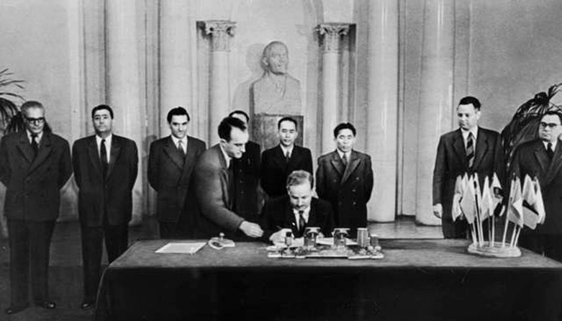
























JINR – international intergovernmental research organization
Fundamental physics of elementary particles and astrophysics, atomic nucleus, condensed matter, applied research in materail and life sciences, ecology
1956
JINR is a very large multi-disciplinary research infrastructure that implements a deeply integrated model to manage global international scientific cooperation
15 member states,
5 associated member states
2 partner states (agreement on coordination with Government)
800+ partner research organizations and universities from 60+ countries and international organizations
2025:
7 laboratories, 5100+ employees from 30+ countries
budget ~ 250 M$ (2025)
2023:
2024:
2025:

Slide 3
JINR’s position among international intergovernmental scientific organizations (IISO)
2 in terms of the number of personnel among all IISO
5 in terms of budget size among IISO in the field of natural sciences
8 in terms of budget size among all IISO
No. | International intergovernmental scientific organization | Annual budget 2023, kUS$ | Personnel 2023
1 | CERN | 1 452 280 | 12 370
2 | JINR | 204 200 | 5200
3 | Joint Research Centre | 650 260 | 2 700
4 | European Space Agency | 8 073 593 | 2 547
5 | ITER* | 827 250 | 1 069
6 | UNESCO | 654 558 | 2 200
7 | European Molecular Biology Laboratory | 375 541 | 1 996
8 | European Southern Observatory | 329 816 | 750
9 | European Synchrotron Radiation Facility | 139 766 | 675
10 | European Spallation Source | 147 016 | 551
11 | Institut Laue-Langevin | 126 564 | 527
12 | Square Kilometer Array | 239 719 | 271
2017-2023 Scopus | JINR | JINR RIA
Total | 10 944
2023 | 1407 | 1754
2022 | 1347 | 1463
2021 | 1435 | 1472
1113+1015+280+34 = 2442
https://bi.siscern.org/superset/dashboard/annual-reports/

Slide 4

JINR International Scientific Council and Programme Advisory Committees – 2024
Latvia
Russia
Germany
Belarus
Mongolia
Czech Rep.
Poland
Ukraine
Kazakhstan
USA
Hungary
Moldova
France
Serbia
Romania
CERN
Georgia
Azerbaijan
Italy
South
Korea
Bulgaria
Uzbekistan
Armenia
China
Israel
Cuba
Egypt
Mexico
India
Vietnam
Brazil
South Africa
Chile
SC members
PAC members
Argentina

Slide 5
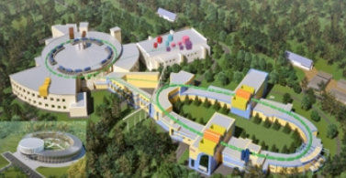
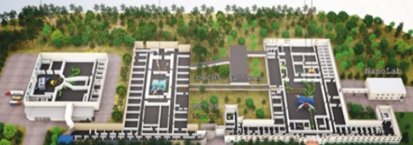
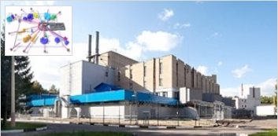
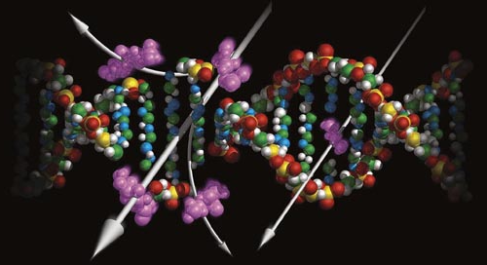
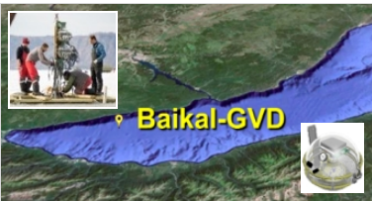
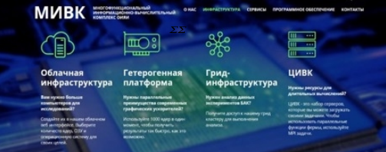
Main LRIs at JINR (+ JINR-Th: Bogoliubov Laboratory of Theoretical Physics)
Relativistic Heavy Ion & Spin Physics
NICA complex
Low Energy Nuclear Physics
SHEF& DRIBS-III project
Condensed matter research
and Neutron physics (IBR-2М)
Neutrino & Astroparticle physics
Baikal-GVD
IT and High Power Computing
MIC complex
Life Sciences
RadioBiology, AstroBio, BioMed
Notes:
5

Slide 6
Monitoring Performance Indicators
Total amount of data in the JINR storage system (PB)
Breakdown of number of basic facilities
by age
> 60 years
 | 2021 | 2022 | 2023 | 2024
Number of publications by Scopus | 1454 | 1352 | 1418 | 1443
35 – 60 years
< 35 years
Number of JINR University Centre programmes participants
Number of staff with academic degrees

Slide 7
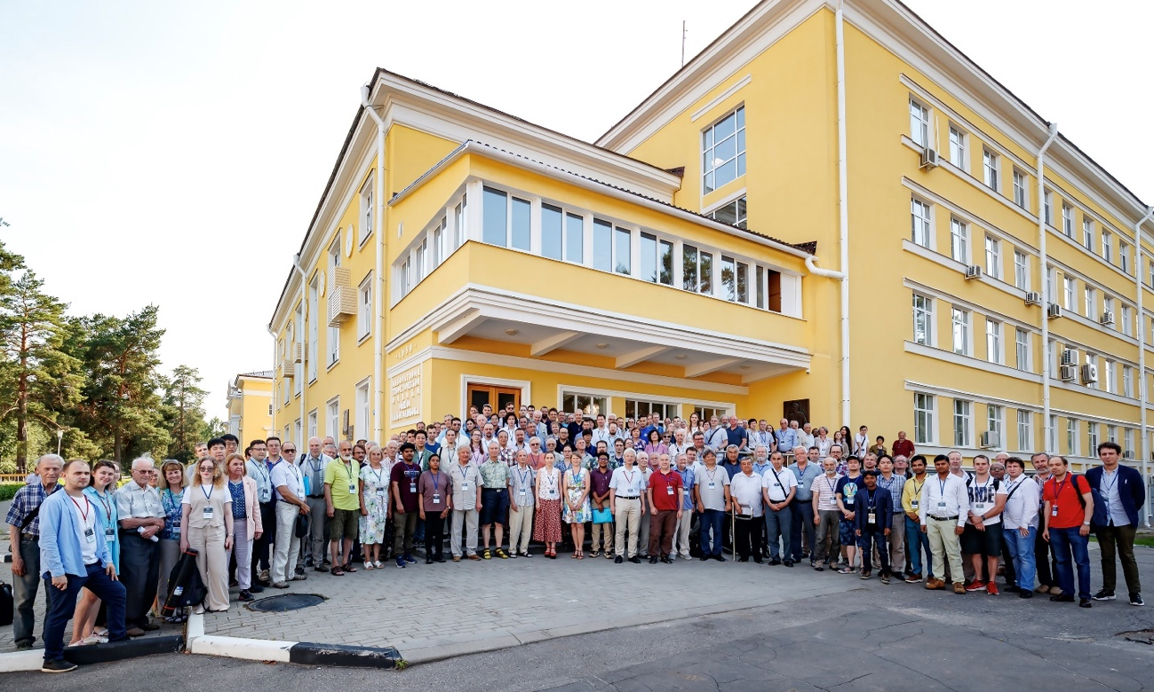
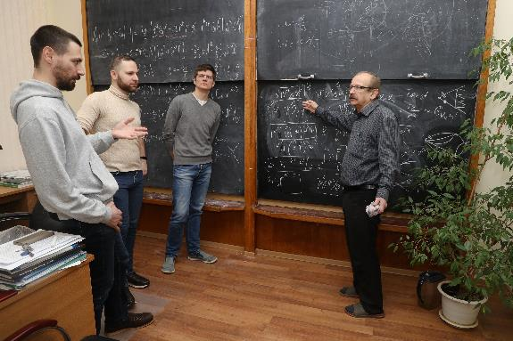
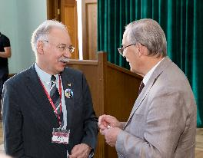
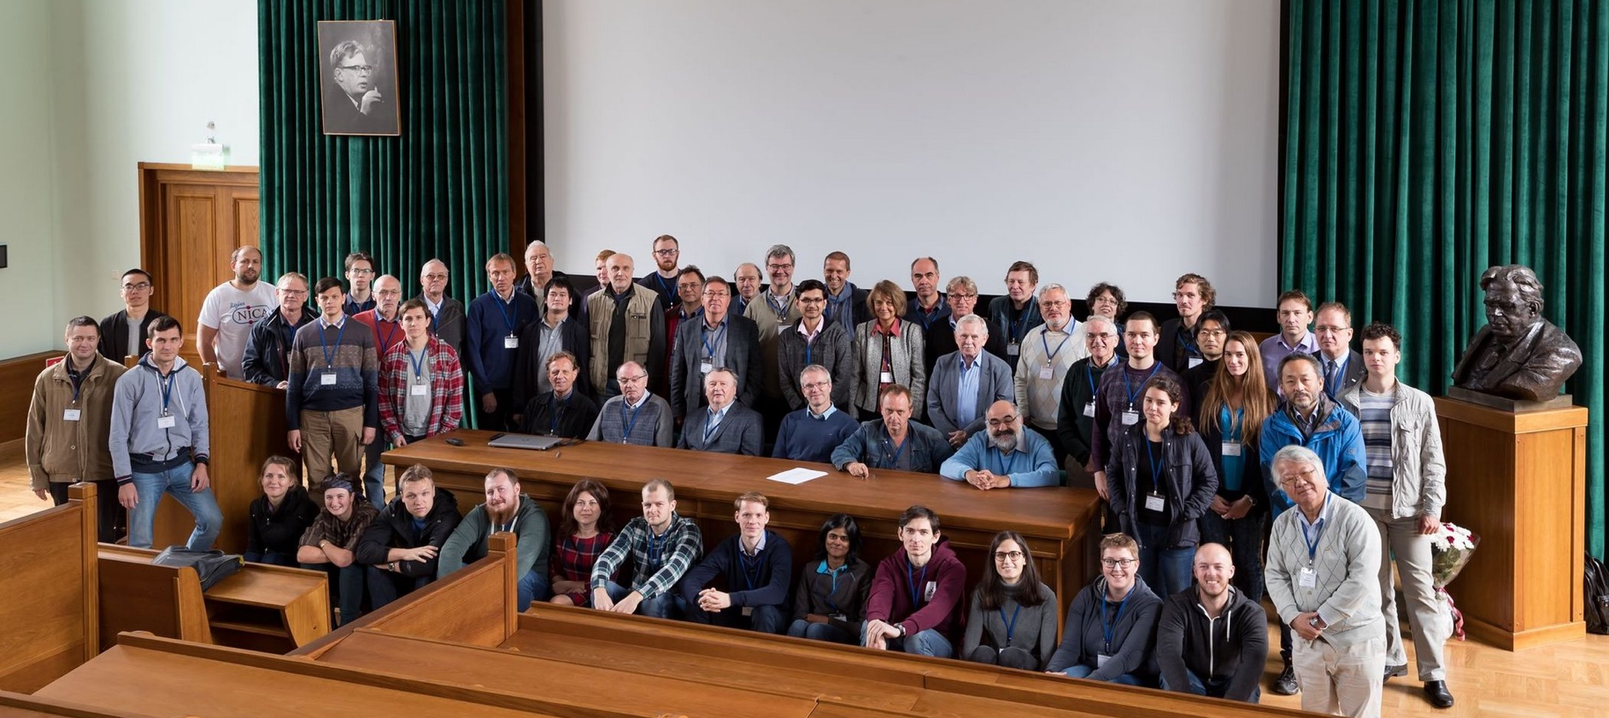
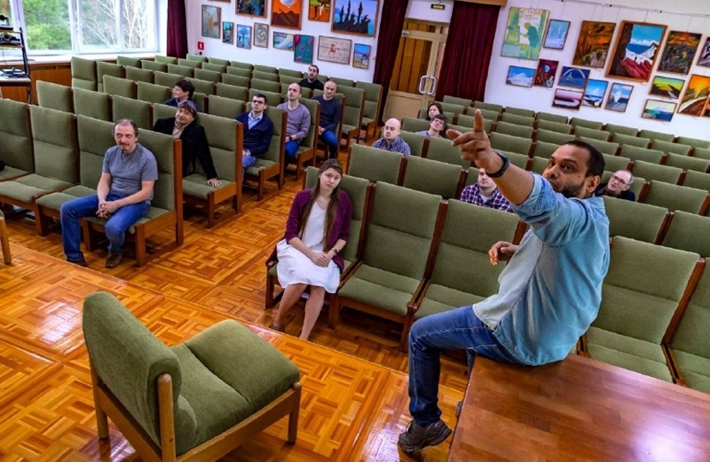
Theoretical Physics at JINR
A unique laboratory with 230 researchers from more than 20 countries conducting multidisciplinary research.
7

Slide 8
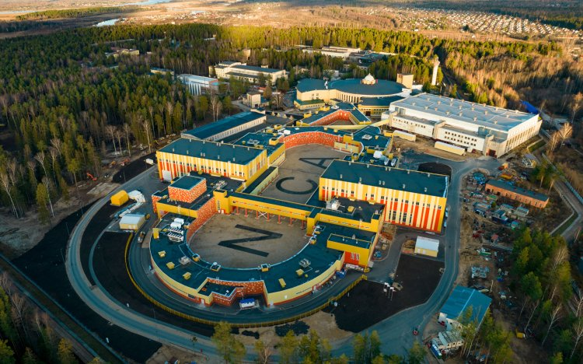
NICA
(Nuclotron based Ion Collider fAcility)
Achieving the maximum density of nuclear matter, inaccessible to other laboratories in the world: the nature of neutron stars, the early Universe, spin effects.
MPD covers this interesting region providing powerful combination of large luminosity, collision energy and system size scan (including isobars), large and consistent acceptance, full centrality range.
NICA is complementary to existing and planned world facilities (FAIR, SPS), and will be a necessary continuation and significant expansion of studies at RHIC BES.
Notes:
Advantages of the MPD & NICA
NICA covers an energy range where most important an interesting physics appears to take place - transition from hadronic to partonic effect dominance, possible appearance of first order phase transition in QCD phase diagram, transition from baryon to meson dominance in particle production. All of this is also connected to astrophysical studies which are strongly developing now and may pose additional questions for us. In summary there are a lot of interesting open questions and MPD has the capabilities to answer many of them.
MPD covers this interesting region providing powerful combination of large luminosity, collision energy and system size scan (including isobars), large and consistent acceptance, full centrality range.
NICA is complementary to existing and planned world facilities (FAIR, SPS), and will be a natural and necessary continuation and significant expansion of studies at RHIC BES.
Other facilities:
HADES and SIS18 provide energies below 3 GeV;
FAIR is not going to provide data before 2028 - so it will not provide data in timescale comparable to NICA;
SPS operates at higher energies, and is fixed target (and also mostly limited to highest centralities);
STAR BES (Beam Energy Scan) covered the energy range of 3-20, however:
- the data taking is finished,
- data sample of 100M at most energies may be
enough to "pose interesting questions", or
highlight the region of interest, but not provide
"definite answers",
- data below 8 GeV is in fixed-target mode,
- no collision system size scan was done,
- isobar run of RHIC showed new interesting physics
that may be explored at NICA.
BM@N
Baryonic Matter at Nuclotron (BM@N) experiment is focused on measurement of Au+Au collisions up to a kinetic beam energy of 3.8·A GeV in order to investigate the equation-of-state (EOS) and the microscopic degrees-of-freedom of QCD matter at neutron star core densities, as EOS defines relation between density, pressure, temperature, energy and isospin asymmetry of nuclear matter.
The “hot” topics of the experiment are:
Study isospin symmetric matter EOS at densities of ρ=3-5 ρ₀ (saturation density) by the following measurements:
- elliptic and direct flows of protons, mesons and hyperons,
- sub-threshold production of multi-strange hyperons and
anti-hyperons.
Constrain symmetry energy E_{sym} - difference between binding energy of isospin symmetric and asymmetric matter by the following measurements:
- collective flow of neutrons vs protons,
- sub-threshold production of particles with opposite isospin.
Searches for quark degrees-of-freedom and the critical endpoint of the first order phase transition at high baryonic densities.
Role of hyperons in neutron stars (ΛN and ΛNN interactions) by measurements of yields and lifetime of light hyper-nucleus at high baryonic densities.
О возможности изучения на NICA столкновений изобарных ядер, имеющих тот же атомный номер, но разный заряд: в частности - не можем ли мы столкнуть свинец-208 и висмут-208?
RICH закончил набор данных, но на последнем рабочем совещании (закрытом) они говорили об интересных результатах, которые могут быть очень важны для понимания структуры ядра. В этом плане низкие
энергии NICA могут быть дополнительным преимуществом. Если столкновения идут с большим прицельным параметром, то возникают
сильные электромагнитные поля и соответствующая физика - Chiral Magnetic Effect.
Есть давние работы по теме. Например, С.Волошин (Phys.Rev.Lett.105 (2010) 17230) предлагает сталкивать Ru-44 и Zr-40 (A=96).

Slide 9
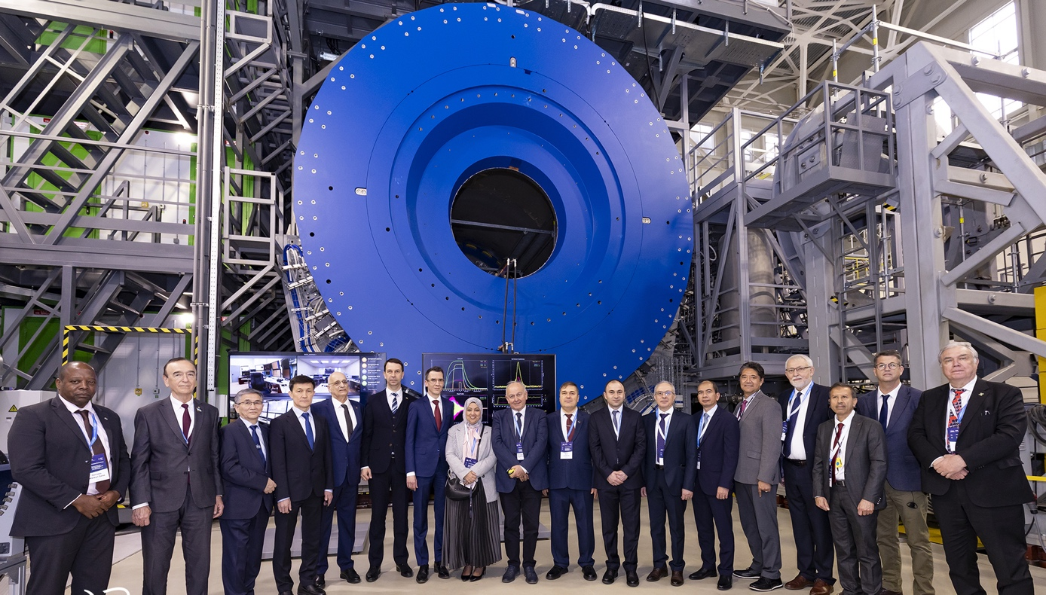
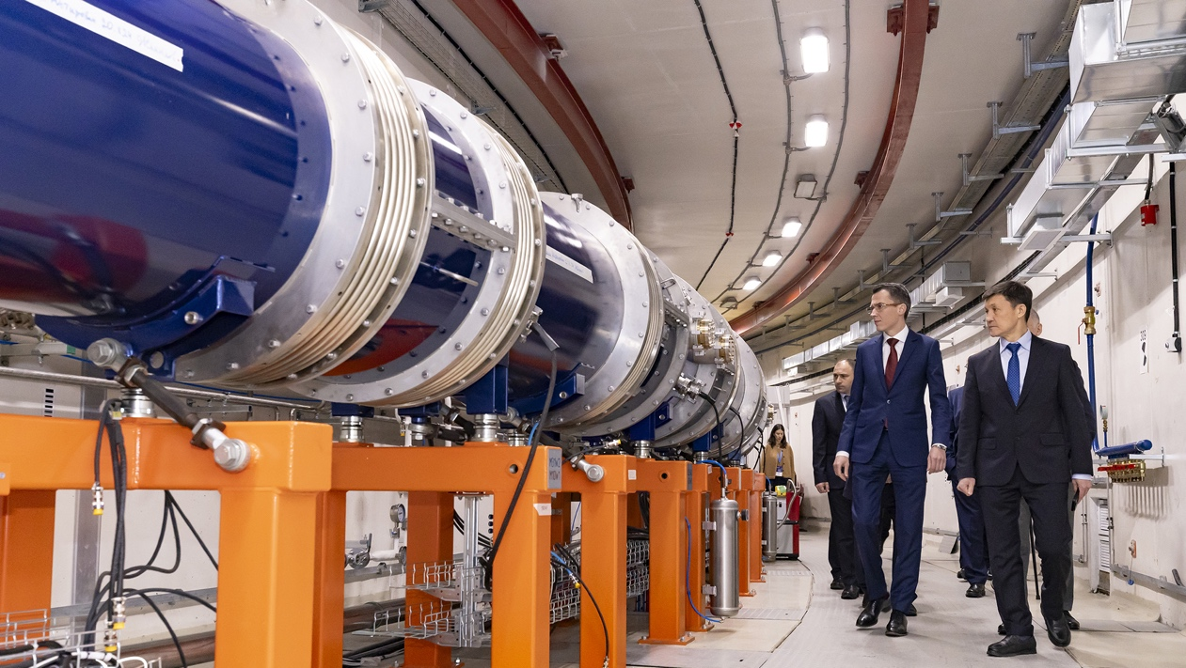
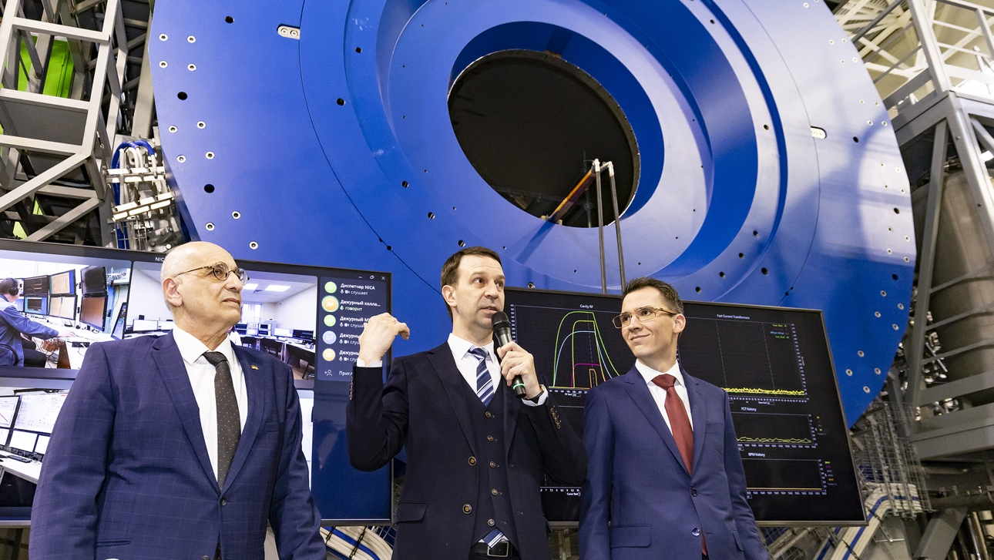
First run at NICA Accelerator Complex
On 25 March 2025, run 1 at the NICA Accelerator Complex was initiated at the Laboratory of High Energy Physics at the Joint Institute for Nuclear Research.
The ceremony took place alongside a session of the Committee of Plenipotentiaries of the Governments of the JINR Member States in the presence of representatives of 20 Member and Associate Member States as well as partners of the Joint Institute.
Collider is expected to be ready for beam tests in Aug 2025

Slide 10


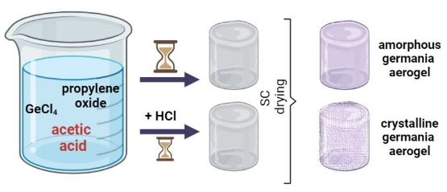
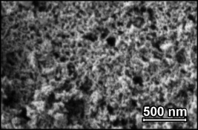
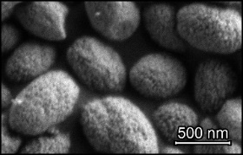
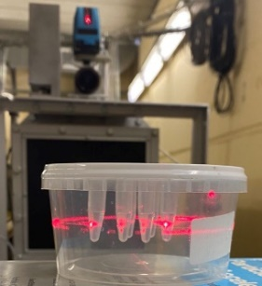
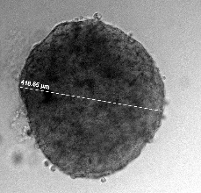
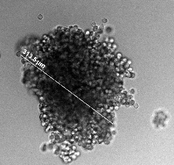
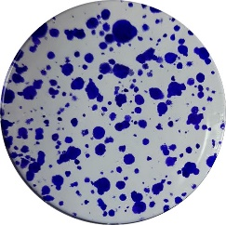
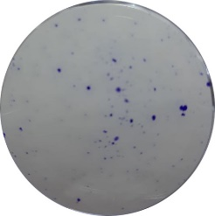
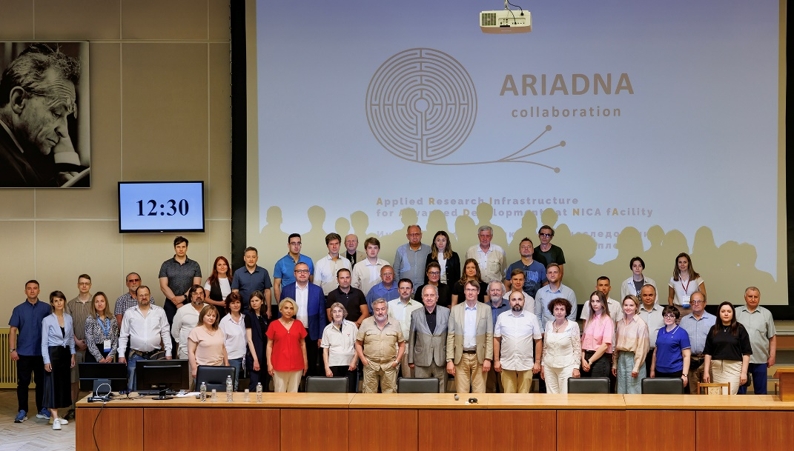
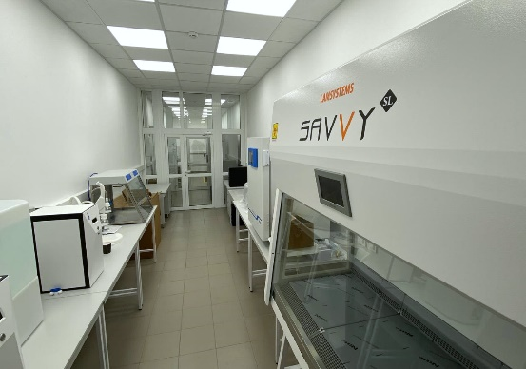
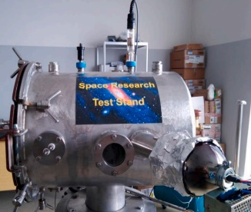
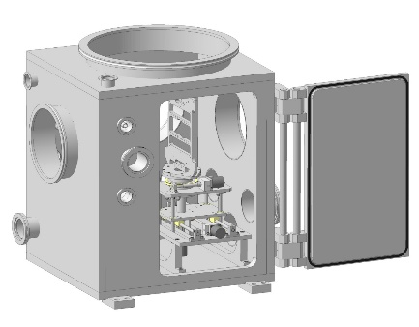
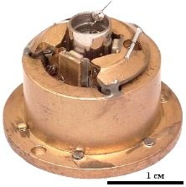
ARIADNA Collaboration for applied research at NICA:
Status and brief overview of activities
2024:
31
23
2
4
papers in peer-reviewed journals
Preparing for NICA beamtime
1. Synthesis of sample materials for further experiments with NICA ion beams
reports at conferences
and scientific meetings
(within the NICA Support Programmes)
patents
new partner organizations
2. Preparatory experiments in Life Sciences with obtaining reference data for experiments with heavy ions
ARIADNA Collaboration Meetings
31 May 2024 4–6 September 2024
The programme of applied
research @ NICA was formulated
3. Development of sample environment for ARIADNA
target stations; preparation of user laboratories
ARIADNA BIoLab
MaterialsLab
Notes:
In 2024, ARIADNA Collaboration entered in its active phase of operation, combining preparation for NICA beamtime with obtaining high-quality scientific results. Within the NICA Support Programmes, launched by JINR itself and by Russian Ministry of Science and Higher Education, ARIADNA Collaboration published 31 papers in peer-reviewed journals, obtained 2 patents as well as presented 23 reports at conferences and scientific meetings. 4 new organizations initiated process of entering the collaboration. 2 meetings of collaboration was held in 2024, which were focused mainly on formulating the programme of applied research at NICA.
The major activities, which ARIADNA collaboration was focused on in 2024, included (1) synthesis of sample materials of different properties for further experiments with NICA ion beams, (2) preparatory experiments in Life Science with obtaining reference data on the effects of sparsely ionizing radiations for experiments with heavy ions, (3) development of sample environment systems for ARIADNA target stations and preparation of analytical laboratory and sample preparation area for users.

Slide 11
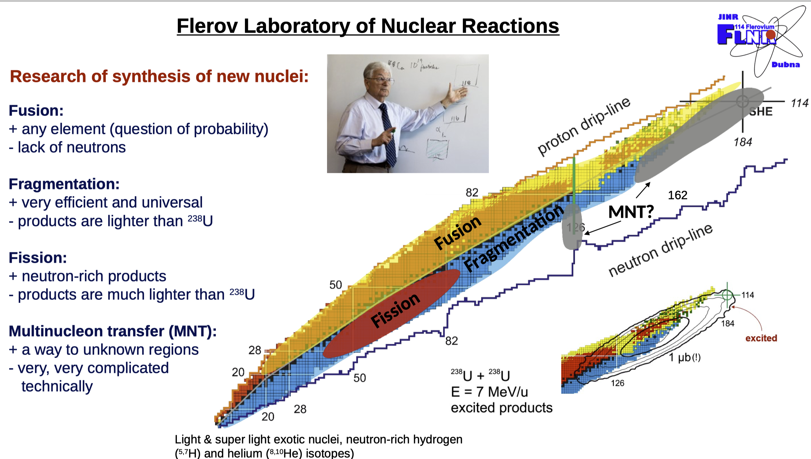
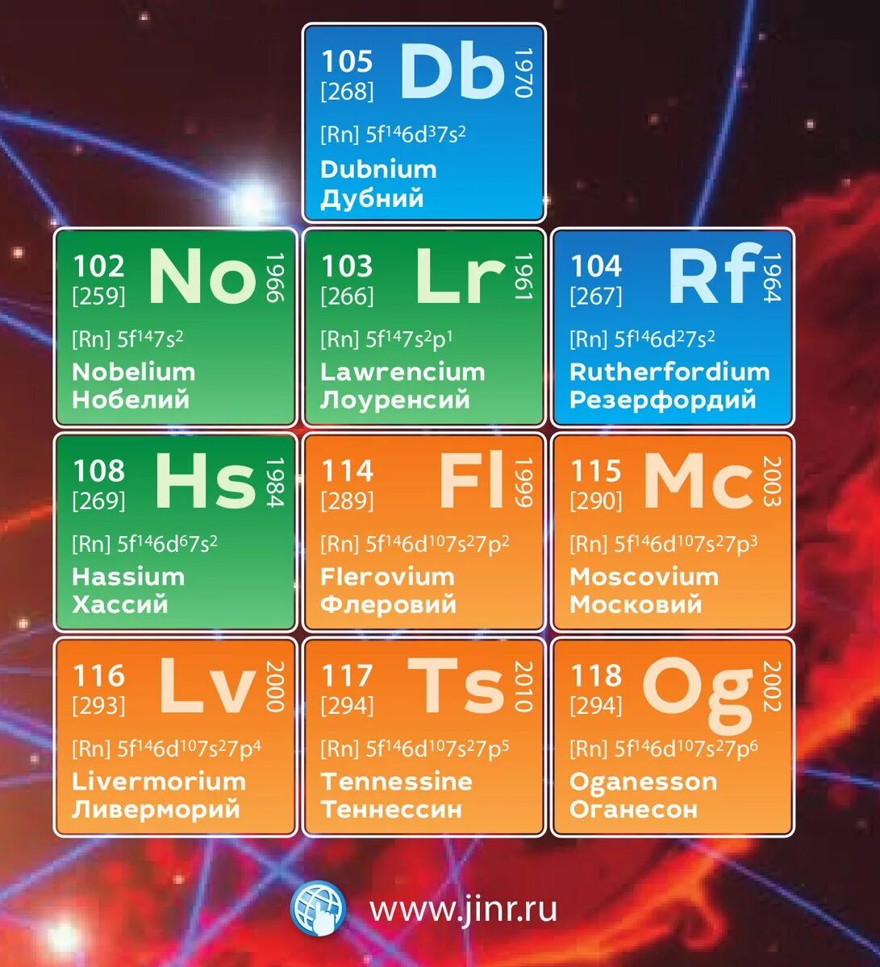

Slide 12
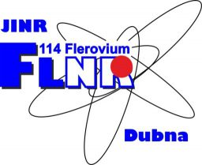
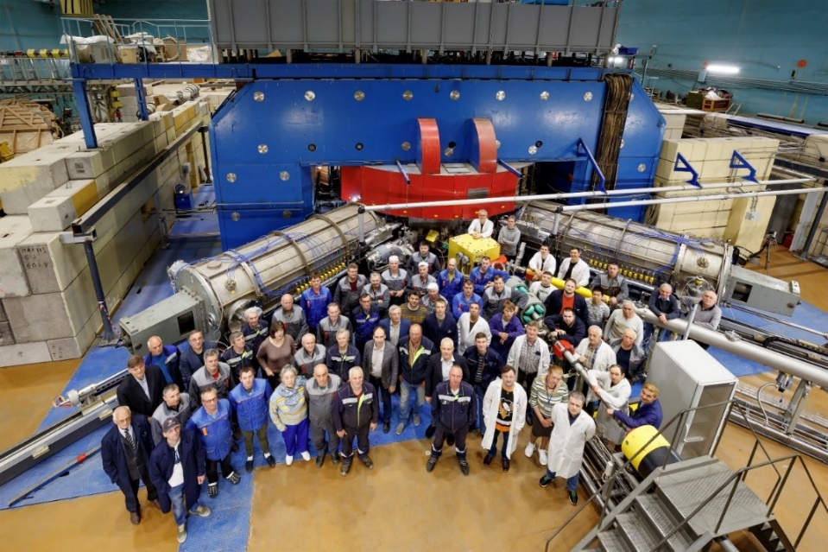
FLNR Accelerator Complex
U-400M cyclotron: radioactive ion-beam research
Commissioning works are continued on U-400M with the purpose of optimizing different regimes of acceleration and production of secondary beams.
In the fall of 2024, the first test experiments were carried out with the beams of ⁶He and ⁸He at the energy of 25÷35 AMeV. The full-scale launch of the experimental program in the field of studying light nuclei at the boundaries of nucleon stability is expected in the second half of 2025
Obtained intensity of primary beam
¹⁵N (E=51.4 MeV/n): 1pµA
of secondary beams ⁶He: 1.8x10⁶ pps
⁸He: 2.0x10⁴ pps
¹²Be: 5.0x10⁴ pps
DC-140 cyclotron: applied research
Construction and repair works in the hall of the new DC-140 cyclotron is being completed;
The installation of accelerator systems will start in the first half of 2025;
Commissioning works are expected to be carried out by the end of 2025.

Slide 13


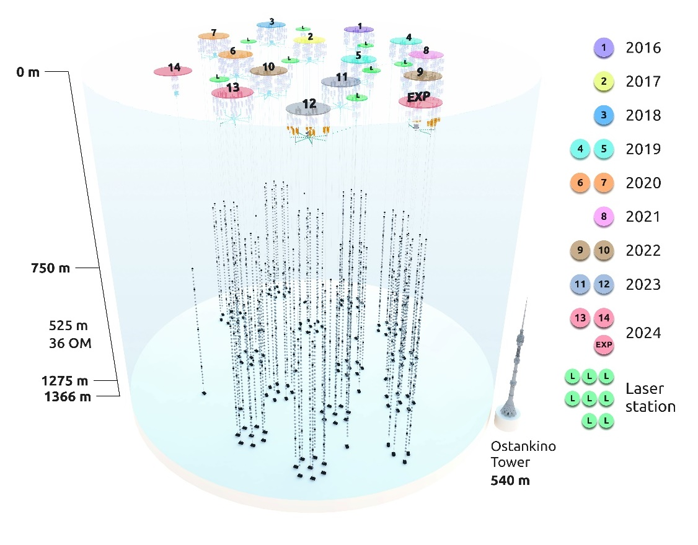
Status of the Neutrino Detector Baikal-GVD
Currently, the deployment of the Baikal-GVD neutrino telescope is successfully underway. 13 full clusters are installed. The underwater structure of the installation contains just over 4,100 photodetectors;
The production and technical base of the Baikal project ensures the deployment of two clusters annually;
GVD has developed shore infrastructure: control centre, laboratories, workshops, deployment tools, living quarters and continues it expansion;
GVD is testing ground for the development the systems for next-generation telescope:
4 strings with fiber-optic DAQ,
4 inter-cluster strings,
1 prototype string with new optical modules and new DAQ system in direction of the next generation detector development together with IHEP (Beijing).
Nearest plans:
660 optical modules were prepared in DLNP to be installed in 2025;
The collaboration was ready to install additional 2 new clusters, 2 additional inter-cluster strings and one full prototype string. But the weather and bad ice conditions correct our deployment plans each day for this season. The expedition team will do their best.
FO string
Intercluster string
Total: 4,104 OM + 8 laser stations
Notes:
Currently, the deployment of the Baikal-GVD neutrino telescope is successfully underway in Lake Baikal.
The view of the telescope in configuration 2024 is shown in the figure.
Telescope now comprises 13 clusters. The underwater structure of the installation contains just over 4,100 photodetectors.
The year of installation of each cluster is shown in the right part of the figure.
The production and technical base of the Baikal project ensures the deployment of two clusters each year.
GVD has developed shore infrastructure: control center, laboratories, workshops, comfortable living quarters for about 50 peoples with independent power supply and we are continuing it expansion.
GVD is a testing ground for the development the systems for next-generation installation:
Currently, the installation includes four strings with fiber-optic DAQ system, four inter-cluster strings and one prototype string with new optical modules and new DAQ system for development of the next generation project together with IHEP (Beijing, China)
The effective volume of the array exceeds 0.6 km^3 for high energy astrophysical neutrino events. GVD is the biggest neutrino telescope in the north hemisphere and it complements the celestial covering of the IceCube’s one.
Baikal-GVD is the first array to confirm the astrophysical diffuse neutrino flux IceCube with a significance above of 5σ
Cascade data analysis for period 2018-2023 shows the visibility of the Galactic component of the astrophysical neutrino flux at energies exceeding 200 TeV with significance of 2.5 σ. Joint analysis of Baikal-GVD data and public IceCube data in cascade and track analysis in the same energy range confirms significance of the visibility of the galactic component at the level 3.6 σ.
Nearest plans:
660 optical modules were prepared in DLNP to be installed in 2025;
The collaboration was ready to install additional 2 new clusters, 2 additional inter-cluster strings and one full prototype string. But the weather and bad ice conditions correct our deployment plans each day for this season. The expedition team will do their best.
----------------------------------------------------------------------------------------------------------------------
В настоящее время на озере Байкал успешно ведется развертывание нейтринного телескопа «Байкал-ГВД».
Вид телескопа в конфигурации 2024 показан на рисунке.
Телескоп состоит на данный момент из 13 кластеров. Текущая подводная структура содержит немногим более 4100 оптических модулей.
Год установки каждого кластера указан в правой части рисунка.
Производственно-техническая база проекта «Байкал» обеспечивает развертывание двух кластеров ежегодно.
В ГВД развита береговая инфраструктура: центр управления, лаборатории, мастерские, комфортабельные жилые помещения примерно на 55 человек с автономным электроснабжением. Коллаборация постоянно развивает береговую и производственную инфраструктуру для оптимизации развертывания возможностей текущего проекта и возможных будущих реализаций.
ГВД является полигоном для разработки систем установки нового поколения:
В настоящее время в состав установки входят четыре гирлянды с оптоволоконной системой сбора данных и четыре межкластерные гирлянды. Кромке того, в последнюю экспедицию, совместно с китайскими коллегами из Пекина (Китай) в структуру «оптоволоконного» кластера был установлен прототип стринга с новыми оптическими модулями и новой системой сбора данных, для изучения возможностей такой конфигурации для установки следующего поколения.
Эффективный объем установки уже превысил 0,6 км^3 для астрофизических нейтринных событий высоких энергий.
GVD — самый большой нейтринный телескоп в северном полушарии, дополняющий небесное покрытие IceCube.
Байкал-ГВД — первая установка, подтвердившая астрофизический диффузный поток нейтрино IceCube со значимостью выше 3σ.
Каскадный анализ данных за период 2018-2023 гг. показывает видимость галактической компоненты потока астрофизических нейтрино при энергиях, превышающих 200 ТэВ, со значимостью 2,5 σ. Совместный анализ данных Baikal-GVD и общедоступных данных IceCube в каскадном и трековом анализе в том же энергетическом диапазоне подтверждает значимость видимости галактической компоненты на уровне 3,6 σ..
Ближайшие планы:
660 оптических модулей были подготовлены в DLNP для установки в 2025 году;
Коллаборация была готова установить дополнительно 2 новых кластера, 2 дополнительных межкластерных гирлянды и одну полную прототипную гирлянду. Но погода и плохие ледовые условия корректируют наши планы развертывания каждый день в этом сезоне. Экспедиционная команда сделает все возможное.

Slide 14
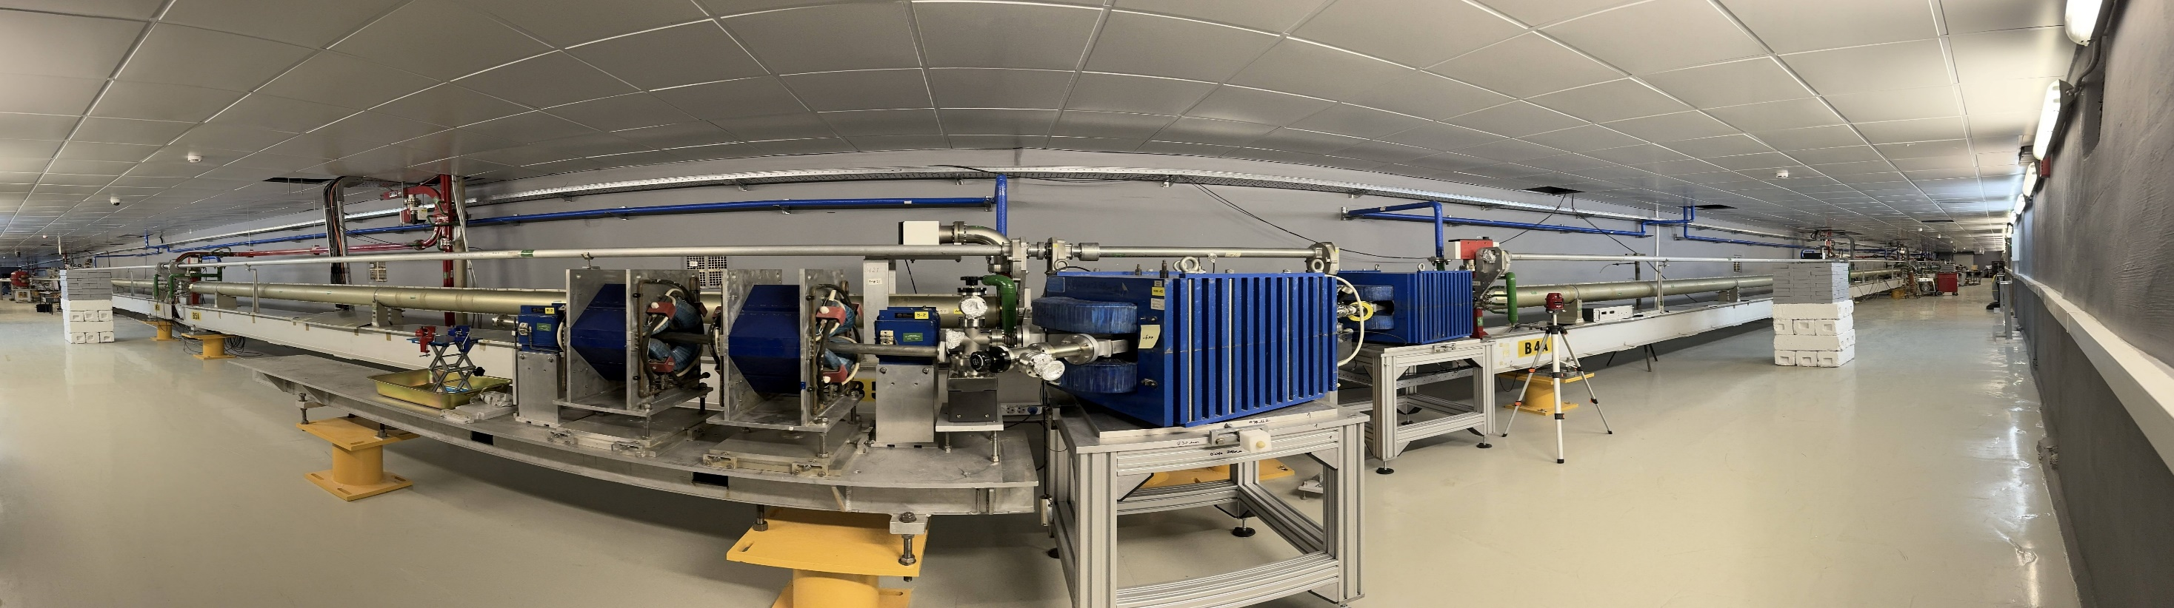

On 12 February, the beam was successfully passed through the LINAC-200 sections.
The commissioning runs are in progress.
Particle detectors R&D
(NICA, COMET, DLNP, FLNR, Serbia, Egypt, Sarov, Novosibirsk, Tomsk)
Electron beams for various tasks
Education
(JINR University Centre)
Nuclear physics experiments
(DLNP, FLNR…)
Electron beam diagnostics, R&D
and fundamental tasks
Applied research and Life Sciences
(LRB)
Notes:
First stage (200 MeV) commissioning is starting in January 2025
LINAC status report presented at PAC for Nuclear Physics 2025
- Further accelerator assembly is ongoing: 400 MeV part will be finished in 2026

Slide 15

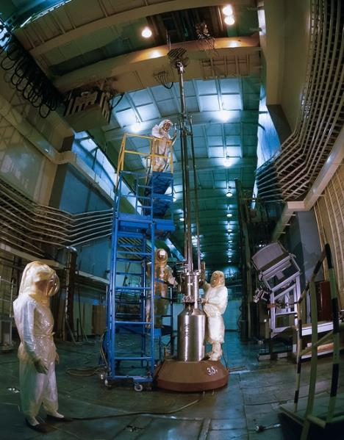
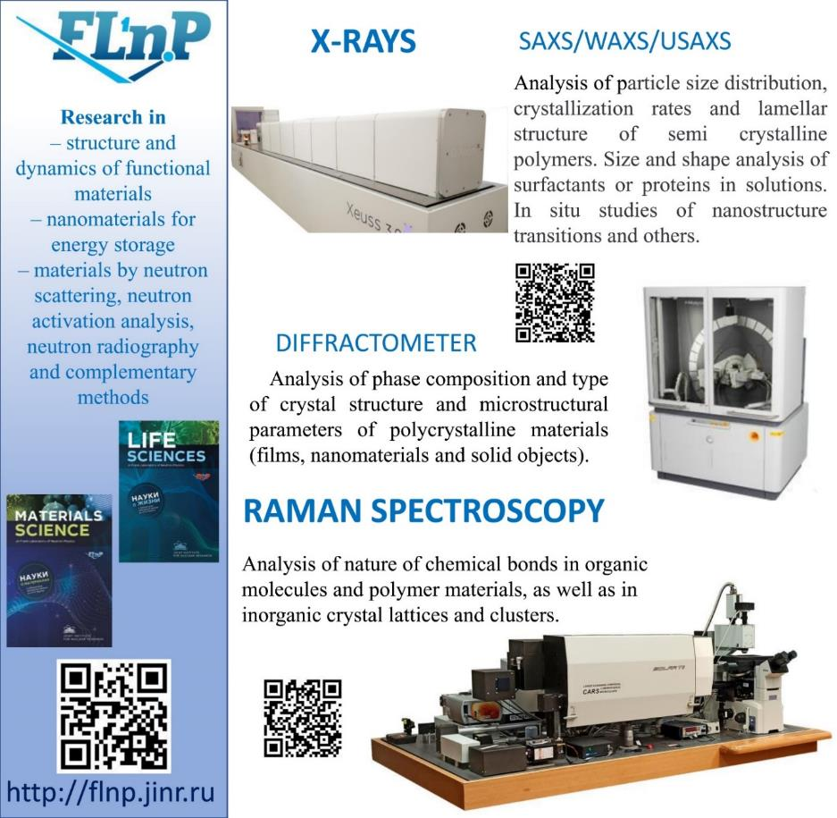
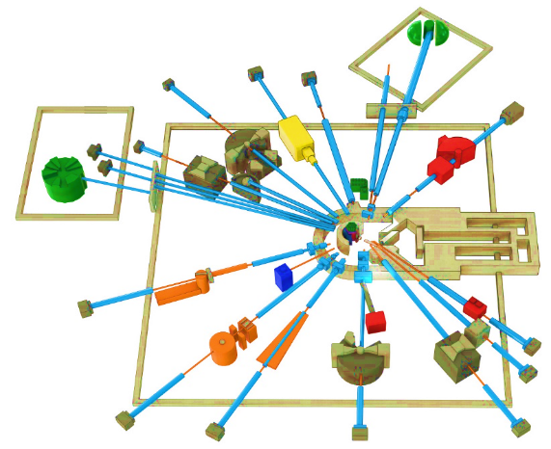
Condensed Matter Physics, Neutron Physics. Priority research in 2024-2030
IBR-2M pulsed neutron reactor and Complex of Spectrometers
BJN
(project)
HRFD
YuMO
EPSILON
DN-6
SKAT
RTD
KOLKHIDA
NERA
NRT
REMUR
FSS
REFLEX
DN-12
GRAINS
FSD
Modernization and reconstruction of spectrometers HRFD, YuMO, RTD, DN-6, DN-12, FSD, NERA, REMUR, REFLEX, SKAT, EPSILON, FSS, NRT, focused on improvement of technical parameters and extension of research capabilities.
Development of laboratory equipment for samples characterization and physical properties measurements.
Support and modernization of the complex of cryogenic moderators. New operating reliable Ultra Cold Neutrons (UCN) channel.
Notes:
Эксплуатационный проектный ресурс установки ИБР-2, как одного из лучших нейтронных импульсных источников заканчивается в 2032-35 годах. В настоящее время в ЛНФ изучается возможность продления кампании реактора до 2040 года. Для этого, в частности, необходимо изготовить дополнительную партию свежего топлива с аналогичными характеристиками до 2025 года.
Учитывая существующие тенденции, после 2030 года в Европе для проведения исследований будет доступно 5 источников, включая три действующих: ISIS (Didcot, UK), SINQ (PSI, Villigen, Switzerland), FRM II (TU Munich, FRG), и два новых, начало эксплуатации которых планируется в 2023- 2024 годах: (ESS (Lund, Sweden) and steady-state reactor PIK (PNPI NRC KI, Gatchina, Russia). Ввод в эксплуатацию 2-х мишенной станции на источнике (STS SNS) of Oak Ridge National Laboratory (USA) планируется в 2037 году. Таким образом, потребность в новом поколении высокопоточных источников нейтронов возрастает на фоне общего уменьшения их количества в мире.
Приоритетными задачами развития комплекса спектрометров реактора ИБР-2 будут являться:
Разработка и создание элементов основной конфигурации нового спектрометра неупругого рассеяния нейтронов в обратной геометрии BJN.
Завершение работ по разработке и созданию основной конфигурации спектрометра малоуглового рассеяния и имиджинга.
Модернизация и реконструкция действующих установок HRFD, YuMO, RTD, DN-6, DN-12, FSD, NERA, REMUR, REFLEX, SKAT, EPSILON, FSS, NRT, направленная на улучшение технических параметров и расширение экспериментальных возможностей.
Развитие лабораторного оборудования для характеризации образцов и измерений физических свойств.
Поддержка и модернизация комплекса криогенных замедлителей

Slide 16

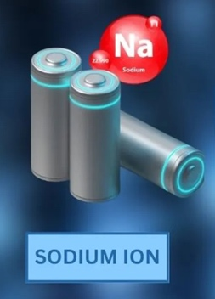
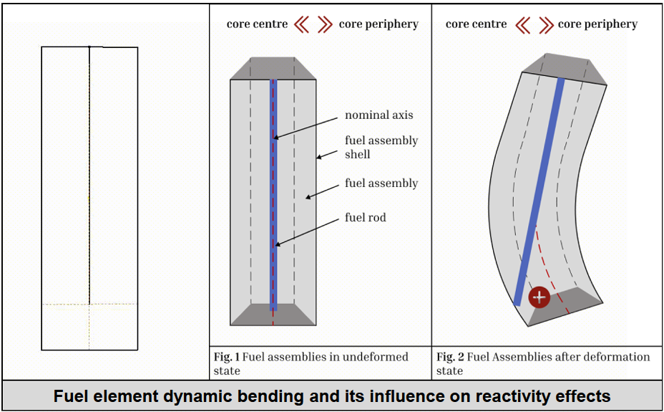
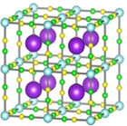
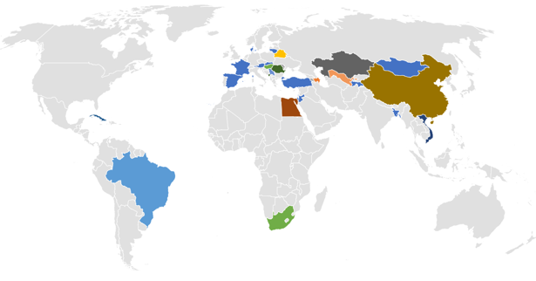
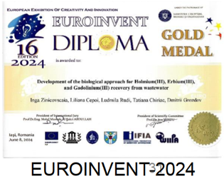
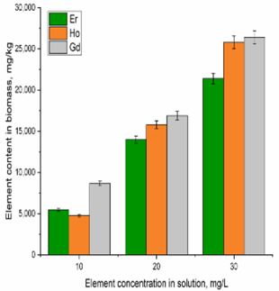
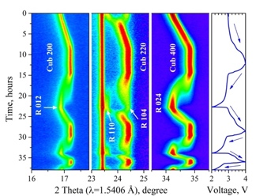
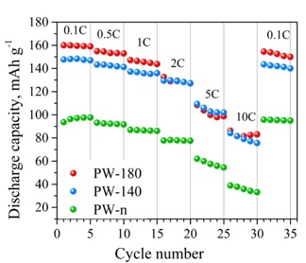
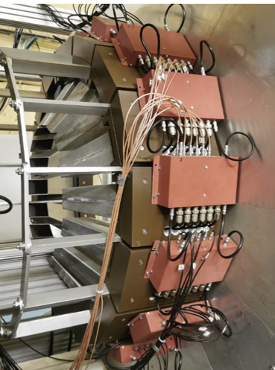
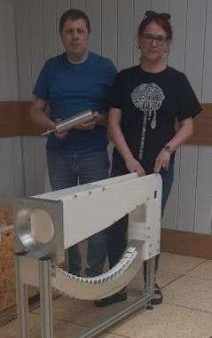
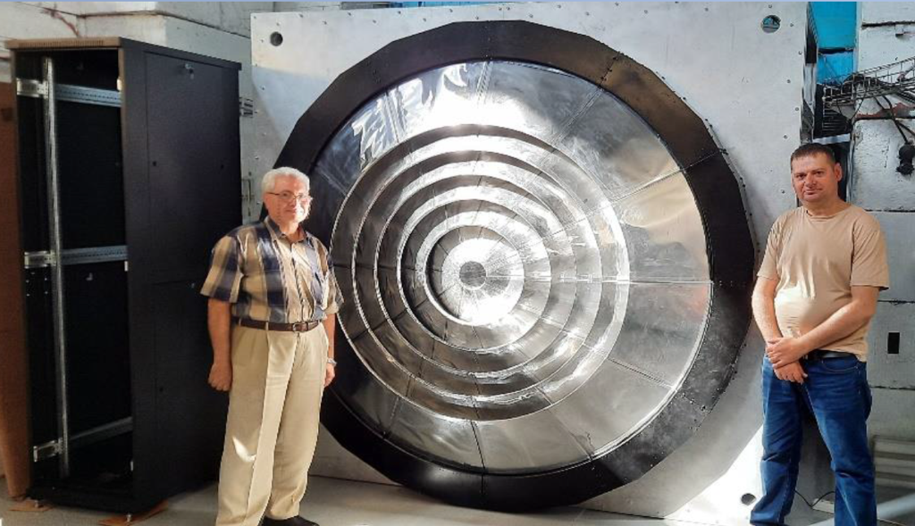
Scientific program using existing X-ray equipment, laboratories and facilities outside JINR
Personnel and Coo[eration
Applied Sciences
Life sciences
New results of studying physical processes in pulse reactors
3 new candidates of science 2 new doctors of science + 25 new foreign scientists
Development of new promising types of batteries
Development of biological approaches to the extraction of rare earth elements from wastewater
237 visits
Progress in new spectrometers @ IBR-2
JINR provides Feasibility Studies for new neutron source IBR-3. The goal is to have the best pulsed neutron source in the world by end of 2030-s: with brightness of 7*10^15 (for TN), and 9*10^14 (for CN)
A new large aperture ZnS scintillation detector system covering the scattering angle range 2 = 133-175, mounted on the FDVR diffractometer.
New detector module covering the range of scattering angles 2 = 32-54, installed on the DN-6 diffractometer.
The BJN spectrometer prototype is ready for test measurements.
Notes:
В 2024 году 25 иностранных сотрудников прибыло на работу в ЛНФ (новые сотрудники представляют Египет, Вьетнам, Казахстан, Кубу, Болгарию, Боливию, Иран). Сотрудниками лаборатории в текущем году защищено 4 кандидатских и одна докторская диссертация. За год совершено 237 зарубежных поездок на эксперименты, совещания и для участия в конференциях. Основные направления поездок представлены на карте. В первую очередь это Казахстан, Египет, Азербайджан, Узбекистан, Беларусь, Китай, Сербия, Вьетнам и др. Организовано совещание по нейтронной ядерной физики в Египте с широким международным участием, рабочее совещание в Дубне с учёными из китайского центра с импульсным источником нейтронов CSNS (филиал IHEP).
Задачи научной программа Лаборатории нейтронной физики в силу обстоятельств решались с использованием имеющегося рентгеновского оборудования, лабораторного оборудования, нейтронных и рентгеновских установок за пределами ОИЯИ, установок ИРЕН и ТАНГРА. Как обычно за год получено большое количество результатов, относящихся к широкому спектру научных направлений: изучение новых свойств материалов, свойств многослойных систем, свойств биологических систем, изучение вопросов экологии, археологических объектов, уникальных образцов культурного наследия. Получены новые ядерные данные в реакциях с быстрыми нейтронами.
Из всех результатов лаборатория выделила две работы. Первая – это исследования натрий-ионных аккумуляторов. Они вызывают большой интерес как более дешевая альтернатива источникам тока на основе лития.
Было показано, что одним из эффективных способов улучшения свойств материала, содержащего ионы натрия является удаление из его структуры молекул воды, адсорбируемых из воздуха. В результате емкость электродов существенно возрастает по отношению к исходной.
Вторая работа посвящена разработке биоремедиационой технология извлечения редкоземельных элементов из сточных вод биологическими объектами. Эта работа была отмечена золотой медалью на международной выставке изобретений, которая проходила с в июне 2024 года в Яссах, Румыния.
Лаборатория готовится к запуску реактора и активно ведет модернизацию инструментов. Проведены работы по монтажу нового сцинтилляционного ZnS детектора обратного рассеяния с большим телесным углом на установке ФДВР, который позволит увеличить интенсивность регистрируемых нейтронов более чем на порядок.
Завершены работы по созданию и установке в рабочее положение нового модуля детекторной системы дифрактометра ДН-6 для регистрации спектров нейтронной дифракции в диапазоне углов рассеяния 2θ = 32 – 54°. Использование данного модуля позволит существенно улучшить светосилу установки при регистрации дифракционных спектров в указанном диапазоне углов рассеяния, что позволит расширить возможности исследования магнитных структур.
Готовится к тестам прототип новой установки для изучения неупругого рассеяния нейтронов – спектрометра BJN. Реализация этого проекта позволит в ~400 раз поднять светосилу по сравнению с имеющимся инструментом.
В конце апреля этого года была получена лицензия, позволяющая эксплуатировать реактор до 2031-го года. Она позволила начать ремонтные работы на реакторе. Были заменены теплообменники второго контура, завершаются работы по реконструкции кровли помещения с этими теплообменниками. Для вывода реактора на мощность требуется выполнить требования Ростехнадхора, записанные в условия действия лицензии. Пробные пуски реактора и работа на физиков ожидаются весной 2025 года.
В рамках изучения возможности создания нового перспективного реактора получены новые результаты, позволяющие объяснить наблюдаемое поведение ИБР-2 исходя из описания набора физических процессов в активной зоне.

Slide 17

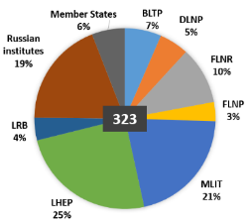






Laboratory of Information Technologies
“Govorun” supercomputer
DIRAC platform
JINR Grid
Total peak performance: 1.7 PFlops DP;
Hyperconverged software-defined system;
Hierarchical data processing and storage system;
Storage performance >300 GB/s.
A heterogeneous computing environment (Tier1, Tier2, Govorun, cloud/, etc.), based on the DIRAC, was created for processing and storing data of experiments conducted at JINR.
The JINR Tier1 site takes a leading position in terms of performance among other Tier1 sites for the CMS experiment in the world. Since 2021, JINR Tier1 is also used for the MPD, BM@N and SPD experiments.
The JINR Tier2 is the best in RDIG.
Total number of users : 323
Used by MPD, SPD, BM@N, Baikal-GVD.
> 250 user papers (two in Nature Physics)
Network
More than 950 publications on the development of numerical methods, algorithms and software for modeling complex physical systems, mathematical support for experiments carried out at JINR basic facilities and about 700 papers within international collaborations.
Notes:
Несмотря на быстро меняющиеся запросы пользователей и ИТ-технологии, ЛИТ не только выполнил все обязательства по 7-летнему плану, но и за счет поддержки в виде грантов дирекции ОИЯИ запустил суперкомпьютер «Говорун» для удовлетворения потребностей пользователей из ОИЯИ и стран-участниц в вычислительных ресурсах для решения задач, связанных с высокопроизводительными вычислениями. СК «Говорун» обладает инновационной гиперконвергентной программно-определяемой архитектурой с уникальными свойствами по гибкости настройки под задачу пользователя. В состав СК «Говорун» входят GPU- и CPU-компоненты, а также иерархическая система обработки и хранения данных со скоростью чтения/записи 300 Гбит/с. Общая производительность – 1,7 Пфлопс для операций с двойной точностью. В настоящее время ресурсы СК «Говорун» используются научными группами из всех Лабораторий Института. Результаты, полученные с использованием ресурсов СК «Говорун» с момента ввода его в эксплуатацию с июля 2018 года по сентябрь 2023 года, отражены более чем в 250 публикациях пользователей, при этом две из них – в журнале Nature Physics.
Для обработки и хранения данных экспериментов, проводимых в ОИЯИ, создана гетерогенная вычислительная среда на базе платформы DIRAC, объединившая все компоненты МИВК, NICA кластер, кластер Национального автономного университета Мексики (UNAM), вычислительный кластер Института математики и цифровой технологии Монгольской академии наук (IMDT MAS), а также Национальную исследовательскую компьютерную сеть России. Основными пользователями распределенной платформы являются эксперименты MPD, SPD, BM@N, Baikal-GVD. 8-й физический сеанс BM@N стал первым случаем в ОИЯИ, когда вся вычислительная инфраструктура, объединенная DIRAC, использовалась для полной реконструкции необработанных экспериментальных данных.
Грид-сайт Tier1 ОИЯИ по производительности вышел на лидирующие позиции среди Tier1 сайтов для эксперимента CMS. C 2021 года Tier1 ОИЯИ также используется для экспериментов MPD, BM@N и SPD.
Реализован проект увеличения пропускной способности телекоммуникационного канала Москва ‒ ОИЯИ со 100 Гбит/с до 3x100 Гбит/с, пропускная способность опорной магистрали локальной вычислительной сети Института увеличена до 2x100 Гбит/с, и построена распределенная вычислительная кластерная сеть между площадками ЛЯП и ЛФВЭ емкостью 400 Гбит/с с двойным резервированием для повышения надежности оптической транспортной магистрали.
Продолжалось развитие численных методов, алгоритмов и программных комплексов для моделирования сложных физических систем, математической поддержки экспериментов, проводимых на базовых установках ОИЯИ и в рамках международных коллабораций.
****************************************************************************
Despite the rapidly changing demands of users and IT technologies, MLIT not only fulfilled all obligations in compliance with the Seven-Year Plan, but also, owing to support in the form of grants from the JINR Directorate, launched the “Govorun” supercomputer to meet the needs of users from JINR and its Member States in computing resources for solving tasks related to high-performance computing. The “Govorun” supercomputer has an innovative hyperconverged software-defined architecture with unique properties for the flexibility of customization for the user’s task. The “Govorun” supercomputer comprises a GPU component, a CPU component and a hierarchical data processing and storage system with a read/write speed of 300 Gb/s. Its total peak performance is 1.7 PFlops DР. At present, the resources of the “Govorun” supercomputer are used by scientific groups from all the Laboratories. The results obtained using the resources of the “Govorun” supercomputer since its commissioning from July 2018 to September 2023 are reflected in more than 250 user publications, two of them are published in the Nature Physics journal.
A heterogeneous computing environment, based on the DIRAC platform, was created for processing and storing data of experiments conducted at JINR. It integrates all MICC components, the NICA cluster, the cluster of the National Autonomous University of Mexico (UNAM), the computing cluster of the Institute of Mathematics and Digital Technology of the Mongolian Academy of Sciences (IMDT MAS), as well as the National Research Computer Network of Russia. The main users of the distributed platform are the MPD, SPD, BM@N, Baikal-GVD experiments. The 8th BM@N physics run was the first time at JINR when the entire computing infrastructure, integrated by DIRAC, was used for the complete reconstruction of raw experimental data.
The JINR Tier1 site takes a leading position in terms of performance among other Tier1 sites for the CMS experiment in the world. Since 2021, JINR Tier1 is also used for the MPD, BM@N and SPD experiments.
A project to increase the capacity of the JINR – Moscow backup channel with a bandwidth from 100 Gb/s to 3x100 Gb/s was implemented, the capacity of the local area network was increased to 2x100 Gb/s, and a distributed computing cluster network was built between the DLNP and VBLHEP sites with a capacity of 400 Gb/s, with double redundancy to enhance the reliability of the optical backbone.
The development of numerical methods, algorithms and software systems for modeling complex physical systems, mathematical support for experiments carried out at JINR basic facilities and within international collaborations was underway.

Slide 18








JINR Multifunctional Information and Computing Complex
Number of tasks
completed on the MICC
via the DIRAC platform
Tier1 – leading place among Tier1 centers for CMS LHC
Tier2 – the most productive in RDIG
(90.7% of the total RDIG processor time)
20096
cores
15 PB
10364
cores
5,65 PB
cores
4,3 PB
10,6 PB
130 PB
4
In 2024, the neutrino computing platform (Baikal-GVD, JUNO, NOvA), which is a segment of the JINR cloud infrastructure, provided 12,125,668 CPU hours.
In 2024, Govorun supercomputer users successfully computed
6.2 million tasks, which corresponds to 32 million core-hours.
Selected statistics of the most resource intensive projects
Current total capacity of the
Hierarchical Storage: 10.6 PB
Notes:
In 2024, the successful operation and development of the JINR Multifunctional Information and Computing Complex (MICC), including the “Govorun” supercomputer, continued. In 2024, “Govorun” supercomputer users successfully computed 6.2 million tasks, which corresponds to 32 million core-hours. The JINR Tier1 center is ranked first among Tier1 world centers for the CMS experiment in terms of the CPU time for data processed. Tier2 is the most productive in the Russian Data Intensive Grid consortium. In 2024, the cloud infrastructure provided users with about 5,500 CPU cores. The main users is the neutrino platform: Baikal-GVD, JUNO, NOvA. About 500 thousand tasks were completed on the MICC resources via the DIRAC platform in 2024.
В 2024 году продолжились успешная эксплуатация и развитие МИВК ОИЯИ, в том числе суперкомпьютера «Говорун». В 2024 году пользователи СК «Говорун» успешно посчитали 6,2 млн задач, что соответствует 32 млн ядро-часов. Центр Tier1 ОИЯИ занимает лидирующее место в мире по суммарному времени ЦПУ, затраченному на обработку данных, среди центров Tier1 для эксперимента CMS, Tier2 наиболее производительный в российском консорциуме RDIG. В 2024 году облачная инфраструктура предоставила пользователям порядка 5500 CPU-ядер. Основной потребитель облачной инфраструктуры – нейтринная программа: Baikal-GVD, JUNO, NOvA. Через платформу DIRAC на ресурсах МИВК в 2024 году выполнено около 500 тыс. задач.

Slide 19






Laboratory of Radiation Biology: Research Infrastructure
Hi-end research infrastructure to be launched in first half of 2025
KUBTEC XCELL 320
X-ray irradiator for total irradiation of small animals and research on radioprotective drugs
Upgrade of Vivarium
CYTEK Aurora CS
Cell Sorter | Flow Cytometer
An Advanced and Adaptable Cell Sorting System Driven by Full Spectrum Profiling Technology
Notes:
Исследовательская инфраструктура ЛРБ в этом году пополнится новым оборудованием мирового уровня. Также будет значительно расширен виварий.
CYTEK AURORA (~800 k$) — проточный цитометр-сортировщик клеток, работающий по наиболее передовому принципу анализа полных спектров флюоресценции (* поясняющие примечания).
*В отличие от других мировых брендов, до сих использующих фильтры в ограниченных диапазонах для стандартных флюоресцентных красителей. Это позволит нам работать с любыми синтетическими молекулами-маркерами, а также с высокой степенью точностью извлекать даже редкие популяции клеток — стволовые клетки, микроокружение опухолей и др. Это путь к развитию наиболее передовых методов клеточной и иммунотерапии в сочетании с облучением.
KUBTEC XCELL (~400 k$) — установка для тотального облучения мелких лабораторных животных
*Покупка такого прибора вызвана большим числом проектов со странами участницами, направленными на исследование радиозащитных препаратов на моделях животных.
19

Slide 20










JINR Innovation Initiatives Competition 2025
First CALL – February 2025
Summing Up – June 2025
5–10 Teams
200-400 k$ / team
Development of gamma-visors and micro-SPECT systems
Plans:
Support for innovative product-oriented R&D;
International, Interlaboratory and Interdisciplinary teams;
Technology agenda relevant for member states;
Development of HR: young leaders, students and postgraduates involved (leader & 70% of Team members – under 39 years old);
Annual reporting (a brochure).
Back Office of the Competition (DIIP & AYSS)
Organization of Competition;
Assistance in preparation of applications;
Transfer of results;
IP protection;
Monitoring of projects implementation.
Accumulation and toxicity assessment of rare earth element based X-ray contrast agents
Expert Committee
Integrating algorithms and neural networks into FPGA for low latency data preprocessing
Special Criteria:
Increase of TRL;
Prospects for technology transfer (Market, IP, Industrial partner, etc.);
International, interlaboratory and interdisciplinary nature of using JINR LRI in R&D;
Importance for HR development.
Competition rules;
Stage of face-to-face presentations;
Summing Up;
Project performance evaluation.
Expert Committee
Development of portable chillers
Boris Gikal
Sergey Kostromin
Alexander Uzhinsky
Igor Lensky
Elena Kravchenko
Vladimir Chausov
Pavel Apel
Sergey Mertz
Valery Shevtsov
Ayagoz Baymukhanova
Konstantin Mukhin
Design and development of
a spherical modular muon detector
Alexey Zhemchugov
Vasily Semin

Slide 21



Slide 22
Draft expenses of the Seven-Year Plan for 2024-2030
by fields of research
Nuclear physics (20.9%)
Elementary particle physics and high-energy heavy-ion physics
(38.6%)
1 940.3 М$
Condensed matter physics (12.8%)
Radiation research in life sciences (3.8%)
Theoretical physics (4.8%)
Information technology (6.8%)
Physics and technology of charged particle accelerators (5.1%)
Applied innovation activity (5.6%)
Organization of scientific activity. Educational programme (1.6%)

Slide 23



February 16, 2023: Mexico and JINR signed an intergovernmental agreement:
Joint Coordination Committee established
27 May – 4 June, 2023. Visit of the JINR delegation to Mexico for the kick-off meeting of the JINR-Mexico JCC, co-chaired by JINR Director G. Trubnikov and CONACYT Director M. E. Álvarez-Buylla Roces.

Slide 24



International Cooperation
Strengthening Partnerships
21 August 2024
The Joint Institute for Nuclear Research and the Ministry of Science and Technology of People’s Republic of China signed an agreement at the House of the Government of the Russian Federation.
The document provides for JINR and the Ministry of Science of China to jointly finance collaborative fundamental research projects at large scientific facilities. The parties identified eight joint projects:
The “Joint Programme on Theoretical Physics” project ‒ the Institute of Theoretical Physics, Chinese Academy of Sciences;
The “R&D of high-energy Underwater Neutrino Telescope” project ‒ the Institute of High Energy Physics, Chinese Academy of Sciences;
The “Neutron Scattering Technology and Multi-disciplinary Research” project ‒ the Institute of High Energy Physics, Chinese Academy of Sciences;
The “Monolithic Si-Pixel Detector for Collider Experiments and Other Applications” project ‒ Central China Normal University;
The “Key Technology Research on Superconducting Components of Heavy Ion Accelerators” project ‒ the Institute of Modern Physics, Chinese Academy of Sciences;
The “Radiochemistry of Superheavy Elements” project ‒ the Institute of Modern Physics, Chinese Academy of Sciences;
The “The synthesis of nuclei in the superheavy region” project ‒ the Institute of Modern Physics, Chinese Academy of Sciences;
The “Physics studies at the JUNO experiment” project ‒ the Institute of High Energy Physics, Chinese Academy of Sciences.
The document was signed alongside the 29th Regular Meeting between Chinese and Russian Heads of Governments. The aim of the new agreement is to develop cooperation between JINR and China in fundamental research, facilitate personnel exchange, and expand research opportunities.
On the Chinese side, the agreement was signed by Minister of Science and Technology of China Yin Hejun. Russian Prime Minister Mikhail Mishustin and Premier of the State Council of the People’s Republic of China Li Qiang attended the ceremony.

Slide 25





International Cooperation
Deepening Ties with Latin America
28 February 2024
A Brazilian delegation headed by Prof. Marcia Barbosa, State Secretary for Policy and Strategic Programmes at the Brazilian Ministry of Science, Technology and Innovation visited JINR.
Main points of the meeting with the Directorate:
mutual interest in cooperation in almost every research area in accordance with the JINR Seven-Year Plan;
BRICS countries could use the Institute as a platform to collaborate multilaterally to advance national science and technology and train highly skilled specialists.
On 8 May 2025, the Joint Institute for Nuclear Research and the Ministry of Science, Technology and Innovation of the Federative Republic of Brazil (MCTI) signed a Memorandum of Understanding at the Bauman Moscow State Technical University, Russia. The document is aimed at strengthening cooperation between the parties in fundamental and applied research. The agreement provides for the creation of a JINR–Brazil Joint Coordinating Committee (JCC) at high governmental level.

Slide 26






JINR−South Africa: Maintaining Close Cooperation
9 December 2024
JINR’s first Information Centre (IC) in the Southern Hemisphere was opened at NRF: iThemba LABS.
The centre’s objective is to strengthen scientific ties and expand cooperation with research and educational organisations of the Republic of South Africa and its neighbouring countries.
The workshop dedicated to the opening brought together leading scientists and top managers from JINR, iThemba LABS, South African and Russian universities. On the sidelines of the workshop, two Memoranda of Understanding were signed: one for the participation of the Republic of South Africa in the NICA SPD Collaboration and one between Dubna State University (Russia) and the University of Zululand (RSA).
9 December 2024
23rd JINR-South Africa Joint Coordination Committee at NRF: iThemba LABS (South Africa)
The co-chairman of the JCC were JINR Director Grigory Trubnikov and Deputy Director of the National Research Foundation of South Africa (NRF) Angus Paterson. Members of the JCC discussed the programme of events aimed at further strengthening the partnership in view of the upcoming 20th anniversary of South Africa’s associate membership in JINR and the 70th anniversary of the Institute’s foundation, as part of which Days of South Africa at JINR are planned for June 2025.
11 December 2024
On the sidelines of the IC opening, JINR representatives visited the University of the Western Cape, the Cape Peninsula University of Technology, and the University of Cape Town to hold meetings with the leadership of scientific faculties and specialised departments and discuss matters of current and potential cooperation.
Along with representatives of JINR and director of the new IC Richard Newman, the delegation included Dean of the Faculty of Physics and Technology of the North Ossetian State University A.Daurova, Director of the Irkutsk State University Research Institute of Applied Physics A.Tanaev, and Vice-Rector of Dubna State University O.Anisimova.
9–13 December 2024
Second International African Symposium on Exotic Nuclei (IASEN-2024)
Organised by the South African accelerator centre NRF: iThemba LABS and the Joint Institute for Nuclear Research, IASEN-2024 was held in Cape Town. The main focus of the event was modern research of atomic nuclei in extreme states, in particular, at the boundaries of nuclear stability. More than 120 specialists from Europe, Africa, Asia, North and South America took part in the symposium.
Notes:
December of 2024 was an action-packed month for the JINR-South Africa partnership. On the 9th we opened the first JINR information centre in the Southern Hemisphere at iThemba LABS in Cape Town, with participation of other information centres and an intensive workshop on science engagement. Also a Memorandum of Understanding on NICA SPD Collaboration was signed. That very same day, the JINR-South Africa Joint Coordination Committee held its 23rd meeting. Among other matters, ways of expanding of collaboration and future events where discussed. including Days of South Africa at JINR, to be organised as part of the celebratory events on the occasion of the 20th anniversary of South Africa’s associate membership in JINR and the 70th anniversary of the Institute.
The Second International African Symposium on Exotic Nuclei (IASEN-2024), jointly organised by iThemba LABS and the Flerov Laboratory of Nuclear Reactions, was also held in Cape Town and brought together over in person 120 scientists from all around the world. It has attracted also a large on-line auditorium. The workshop dedicated to the opening of the information centre also served to strengthen working relationships – the JINR delegation, as well as participants of the workshop from Dubna University, North Ossetian, and Irkutsk State Universities took the opportunity to visit several South African Universities to exchange expertise and build ties for potential future collaboration.

Slide 27


Thank you for your attention!

