Slide 1
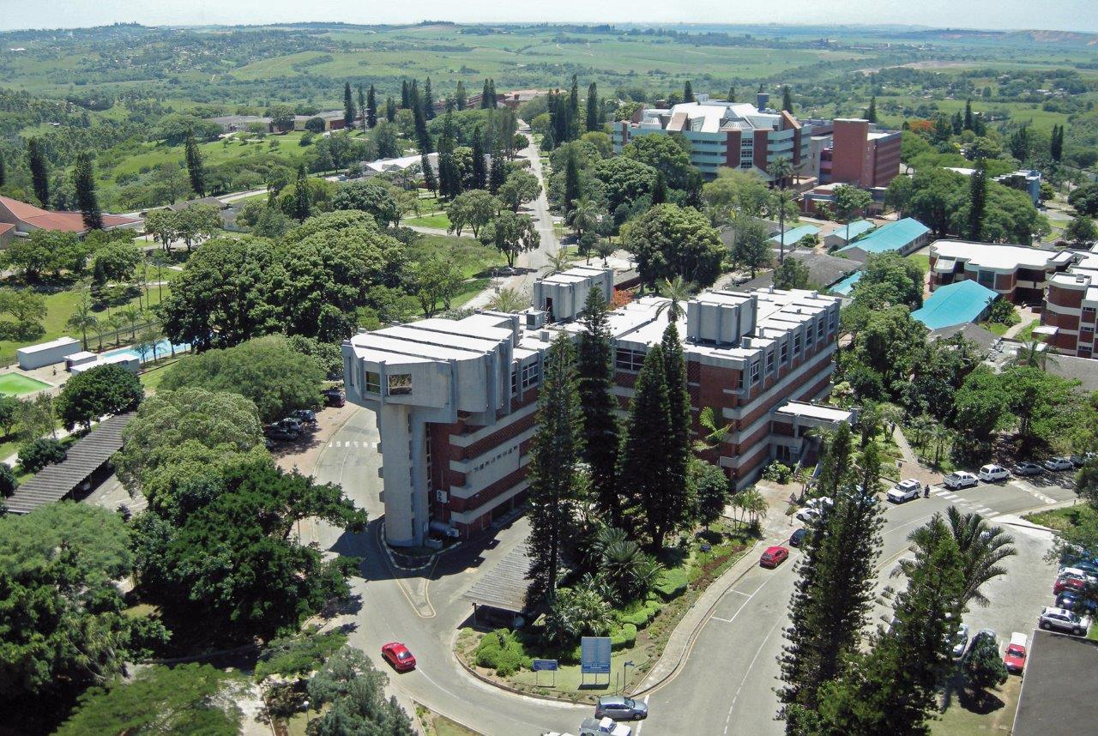
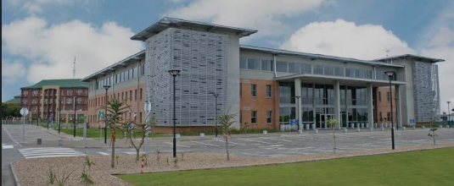
UNIVERSITY OF ZULULAND
UNIZULU-DUBNA-JINR
Empowering Sustainable Futures: Innovation Driven
Science at the University of Zululand aligned to DUBNA-JINR
Prof KC Lehloenya
17 June 2025
SA Days in JINR

Slide 2
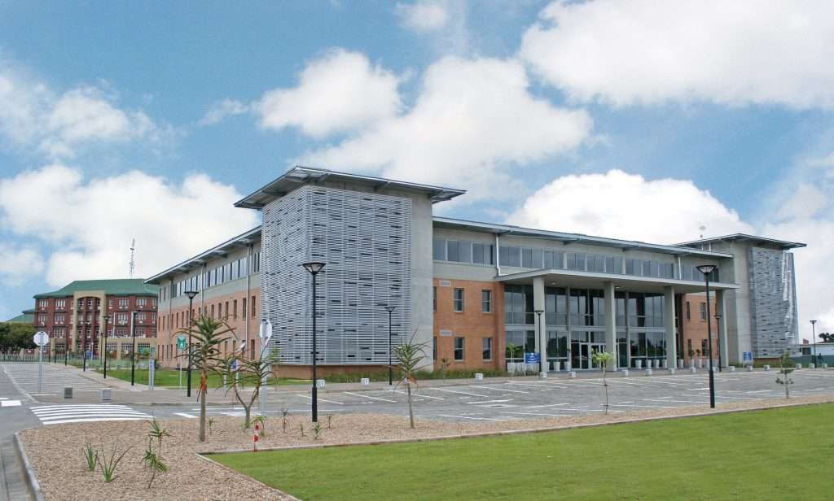
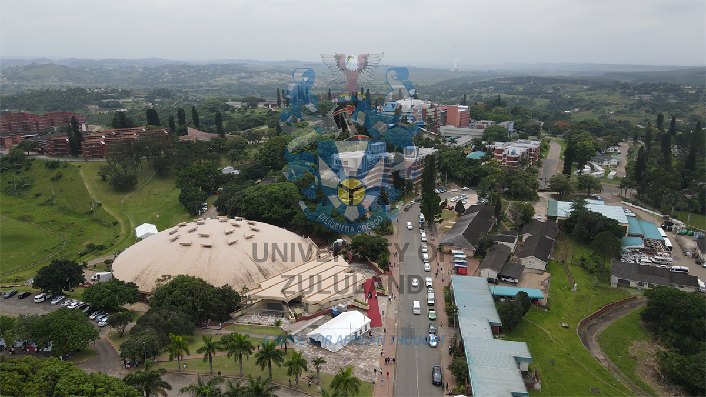
Richards Bay Campus
KwaDlangezwa Main Campus

Slide 3
2025 UNIZULU Student Population
UNIZULU Faculties
HUMANITIES & SOCIAL SCIENCES
COMMERCE, ADMINISTRATION & LAW
EDUCATION
SCIENCE, AGRICULTURE & ENGINEERING
STUDENT TYPE | NUMBER OF STUDENT
Undergraduates | 18476
Postgraduates | 1356
TOTAL STUDENTS | 19832

Slide 4
2025 FACULTY OF SCIENCE, AGRICULTURE & ENGINEERING
STUDENT POPULATION
STUDENT TYPE | NUMBER OF STUDENTS
First Time Entering Students | 2122
Returning Undergraduates | 3962
Postgraduates – New Registrations | 285
Postgraduates – Returning Registrations | 226
TOTAL REGISTRATIONS | 6595

Slide 5
FACULTY OF SCIENCE, AGRICULTURE AND ENGINEERING ACADEMIC DEPARTMENTS
Body copy starts here

Slide 6
3. Doctoral
2025 UNDERGRADUATES OFFERED PROGRAMMES…
Double majors (37)
BSc Applied Mathematics & Computer Science
BSc Applied Mathematics & Hydrology
BSc Applied Mathematics & Mathematics
BSc Applied Mathematics & Physics
BSc Applied Mathematics & Statistics
BSc Biochemistry & Botany
BSc Biochemistry & Chemistry
BSc Biochemistry & Human Movement Science
BSc Biochemistry & Microbiology
BSc Biochemistry & Zoology
BS Botany & Geography
BSc Botany & Hydrology
BSc Botany & Microbiology
BSc Botany & Zoology
BSc Chemistry & Computer Science
BSc Chemistry & Hydrology
BSc Chemistry & Mathematics
BSc Chemistry & Physics
BSc Chemistry & Zoology
BSc Computer Science & Hydrology
BSc Computer Science & Mathematics
BSc Computer Science & Physics
BSc Computer Science & Statistics
BSc Geography & Hydrology
BSc Geography & Physics
BSc Geography & Statistics
BSc Geography & Zoology
BSc Human Movement Science & Physics
BSc Human Movement Science &Zoology
BSc Hydrology & Microbiology
BSc Hydrology & Physics
BSc Hydrology & Statistics
BSc Hydrology & Zoology
BSc Mathematics & Physics
BSc Mathematics & Statistics
BSc Micrology & Zoology
BSc Micrology & Human Muman Science
37 Double major programmes = 11 fields

Slide 7
2025 UNDERGRADUATES OFFERED PROGRAMMES
05 FOCUSED PROGRAMMES
Agriculture
Animal Science
Agribusiness
Plant Science
Consumer Science
Extension and rural development
Hospitality
Engineering
Electrical Engineering
Mechanical Engineering
Mechatronic Engineering
Electrical and Computer Engineering
Nursing Sciences
Diploma Programmes​
Sports Science & Exercise Technology​
Hospitality​ Management
Nursing

Slide 8
3. Doctoral
16. B Sc Augmented (Chemistry and Mathematics)
17. B Sc Augmented (Chemistry and Physics)
18. B Sc Augmented (Chemistry and Zoology)
19. B Sc Augmented (Computer Science and Hydrology)
20. B Sc Augmented (Computer Science and Mathematics)
21. B Sc Augmented (Computer Science and Physics)
22. B Sc Augmented (Computer Science and Statistics)
23. B Sc Augmented (Geography and Hydrology)
24. B Sc Augmented (Geography and Physics)
25. B Sc Augmented (Geography and Statistics)
26. B Sc Augmented (Geography and Zoology)
27. B Sc Augmented (Human Movement Science and Physics)
28. B Sc Augmented (Hydrology and Microbiology)
29. B Sc Augmented (Hydrology and Physics)
30. B Sc Augmented (Hydrology and Statistics)
31. B Sc Augmented (Hydrology and Zoology)
32. B Sc Augmented (Mathematics and Physics)
33. B Sc Augmented (Mathematics and Statistics)
34. B Sc Augmented (Microbiology and Human Movement Science)
35. B Sc Augmented (Microbiology and Zoology)
2025 SCIENCE ACCESS PROGRAMMES…
1. Augmented (35)
B Sc Augmented (Applied Mathematics and Computer Science)
B Sc Augmented (Applied Mathematics and Hydrology)
B Sc Augmented (Applied Mathematics and Mathematics)
B Sc Augmented (Applied Mathematics and Physics)
B Sc Augmented (Biochemistry and Botany)
B Sc Augmented (Biochemistry and Chemistry)
B Sc Augmented (Biochemistry and Human Movement Science)
B Sc Augmented (Biochemistry and Microbiology)
B Sc Augmented (Biochemistry and Zoology)
B Sc Augmented (Botany and Geography)
B Sc Augmented (Botany and Hydrology)
B Sc Augmented (Botany and Microbiology)
B Sc Augmented (Botany and Zoology)
B Sc Augmented (Chemistry and Computer Science)
B Sc Augmented (Chemistry and Hydrology)
2. Foundation(13)
4FSC03-Applied Mathematics & Mathematics
4FSC04 – Applied Mathematics & Physics
4FSC06 – Biochemistry & Botany
4FSC07 – Biochemistry & Chemistry
4FSC09 – Biochemistry & Microbiology
4FSC10 – Biochemistry & Zoology
4FSC13 – Botany & Microbiology
4FSC14 – Botany & Zoology
4FSC17 – Chemistry & Mathematics
4FSC18 – Chemistry & Physics
4FSC19 – Chemistry & Zoology
4FSC34 – Mathematics & Physics
4FSC36 – Microbiology & Zoology

Slide 9
3. Doctoral
POSTGRADUATES FSAE PROGRAMMES
BSc Applied Mathematics (Honours)
BSc Biochemistry (Honours)
BSc Biokinetics (Honours)
BSc Botany (Honours)
BSc Chemistry (Honours)
BSc Computer Science(Honours)
B. Consumer Science (Honours)
BSc Geography (Honours)
BSc Hydrology (Honours)
BSc Mathematics (Honours)
BSc Microbiology (Honours)
BSc Physics (Honours)
BSc Statistics (Honours)
BSc Zoology (Honours)
2. Masters (16)
M.Sc in Applied Mathematics
M.Sc in Biochemistry
M.Sc in Botany
M.Sc in Chemistry
M.Sc in Computer Science
M. Consumer Science
M.Sc in Geography
M.Sc in Hydrology
M.Sc in Microbiology
M.Sc in Physics
M.Sc in Human Movement Science
M.Sc in Zoology
M.Sc in Agriculture (Animal Science)
M.Sc in Agriculture (Agribusiness and Management)
M.Sc in Agriculture (Plant Science)
M. Nursing
3. Doctoral (15)
Ph.D in Biochemistry
Ph.D in Botany
Ph.D in Chemistry
Ph.D in Computer Science
Ph.D in Geography
Ph.D in Hydrology
Ph.D in Mathematics
Ph.D in Microbiology
Ph.D in Physics
Ph.D in Human Movement Science
Ph.D in Zoology
D. Agric (Animal Science)
D. Agric (Agribusiness and Management)
D. Agric (Plant Science)
D. Nursing
14

Slide 10
CURRENT UNIZULU-JINR-DUBNA

Slide 11
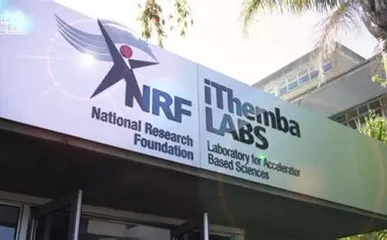
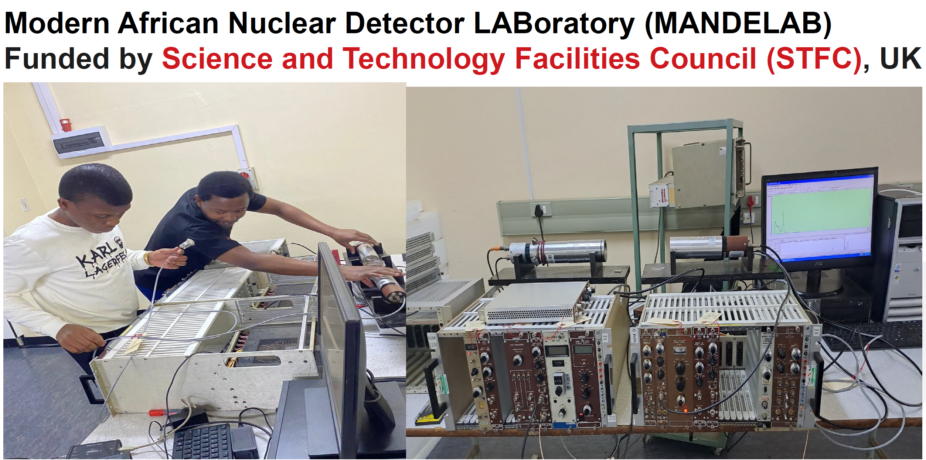
Physics

Slide 12
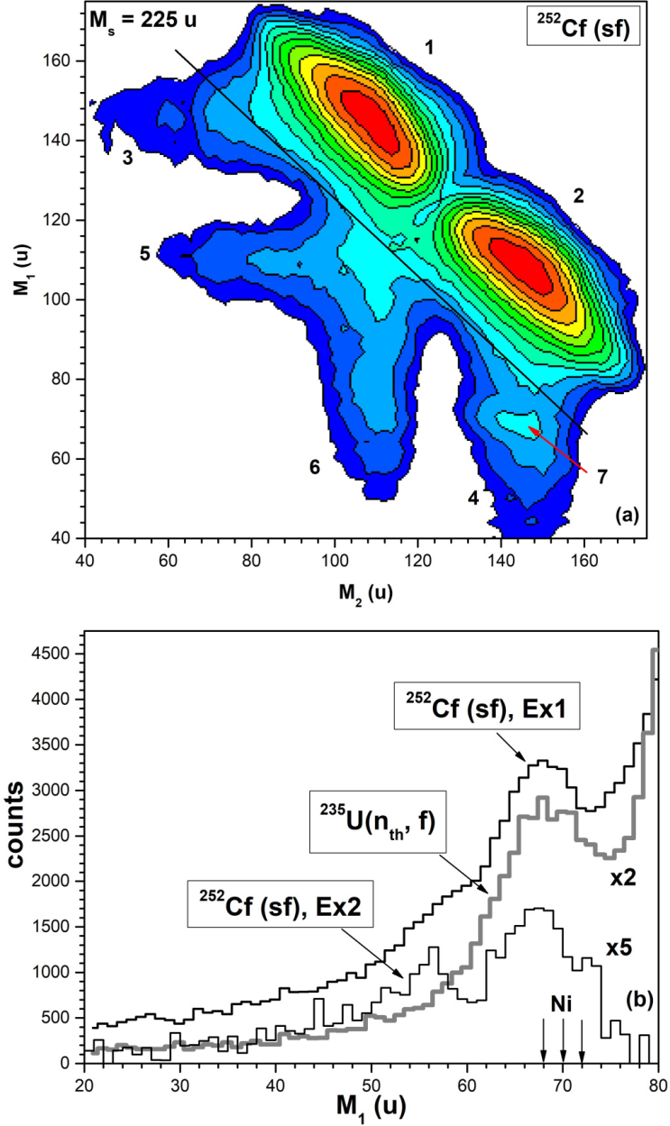
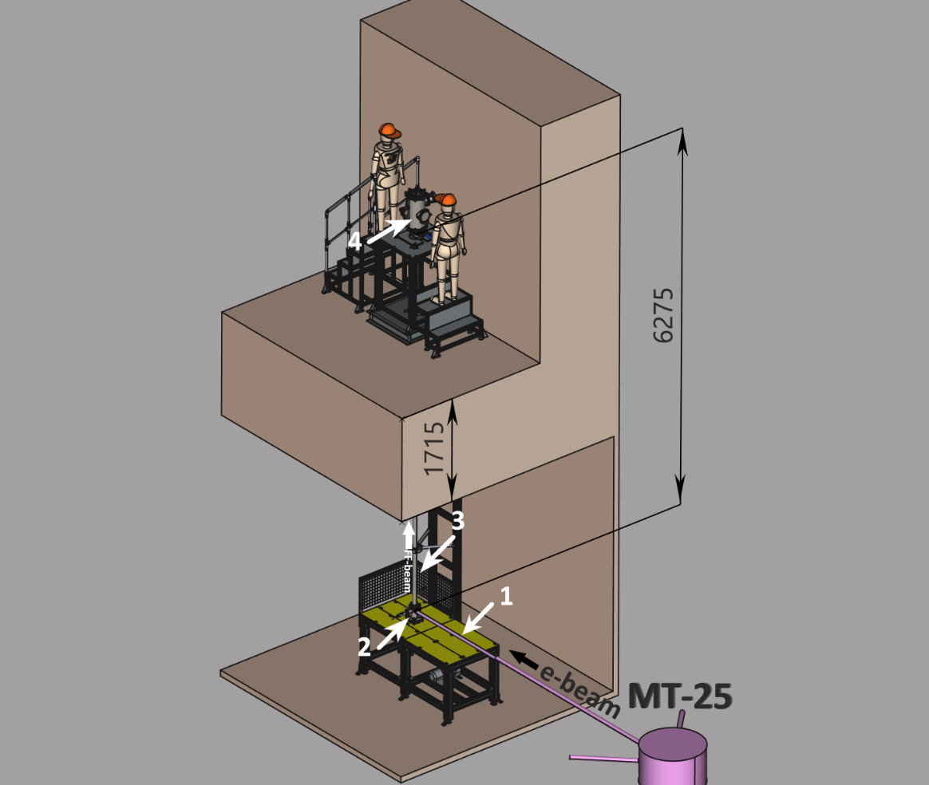
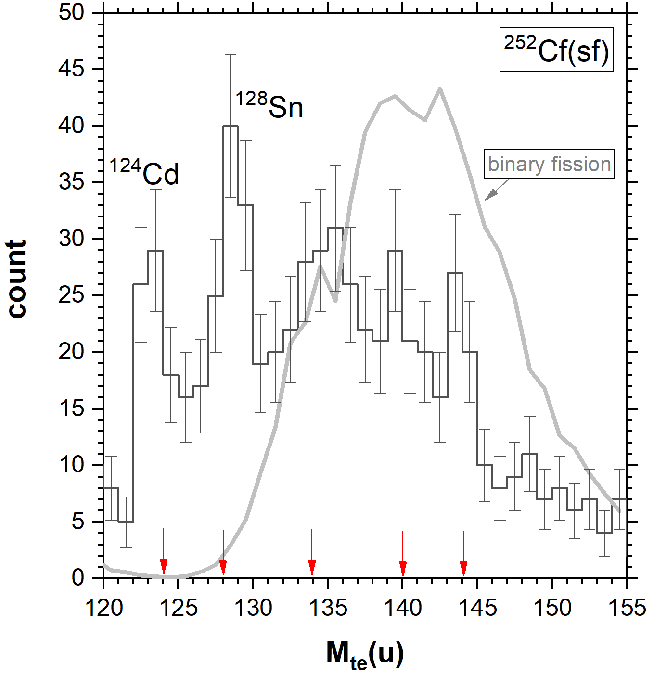
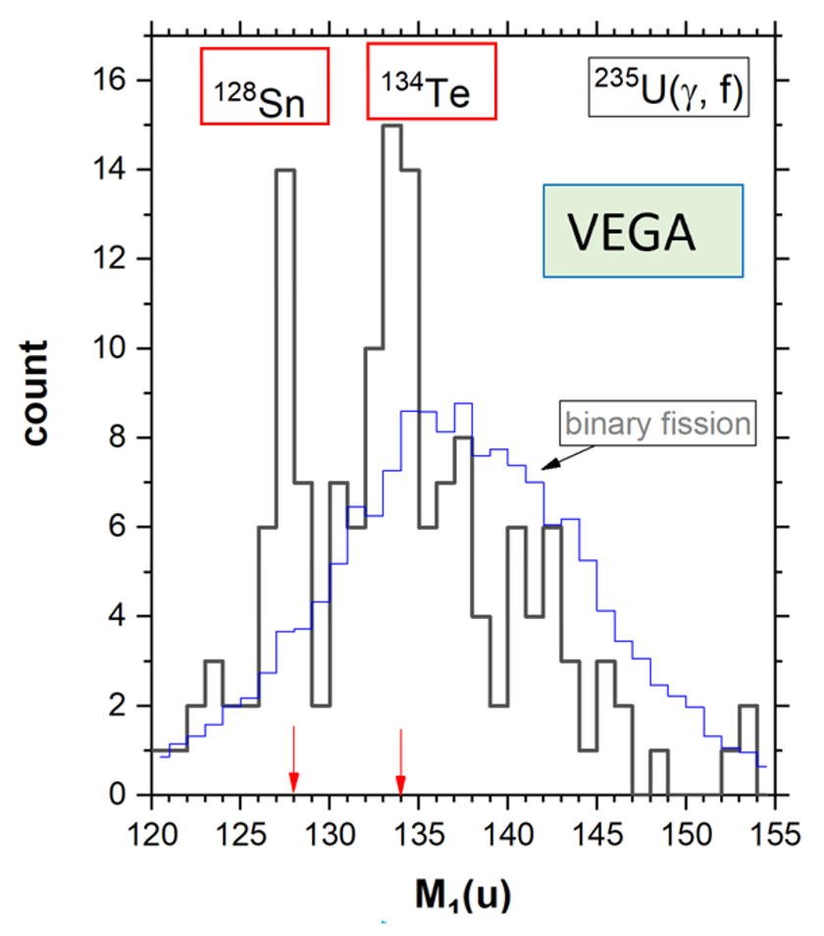
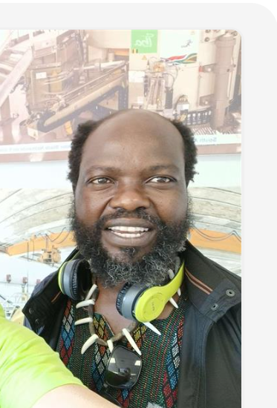
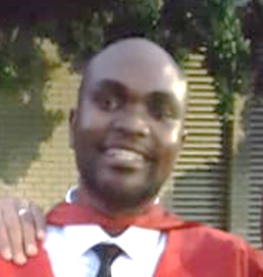
Flerov Laboratory of Nuclear Reactions (FLNR) JINR; discovery of the CCT & fission isomers in fission fragments
Long lived history
Current stage: fission isomers under study
Nearest future
VEGA-m setup
Ni-bump
8 times lower
noise background
First observation of the break-up of fission fragments in solid-state foils with more then 400ns delay from the binary fission. Bright manifestation of clustering in the cold nuclear matter.
Collinear Cluster Tripartition (CCT): break-up of fission fragment while it passes through a solid-state foil.
The products fly apart almost collinearly;
Magic nucleon composition of al least one of them.
SA - JINR project
African Principal
Investigator
Phumlani Zipho
Ngcobo
Vusi David Malaza
Doctor of Philosophy
(Nuclear Physics)
2018
THEMBI HOPE VILANE
MASTER OF SCIENCE in the subject PHYSICS (2025)
The study investigates the long-lived isomers to understand some rare decay mode and hope to achieve technology transfer as well.

Slide 13
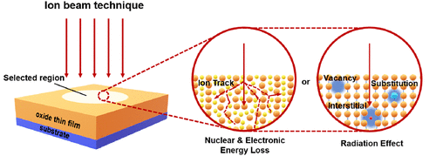
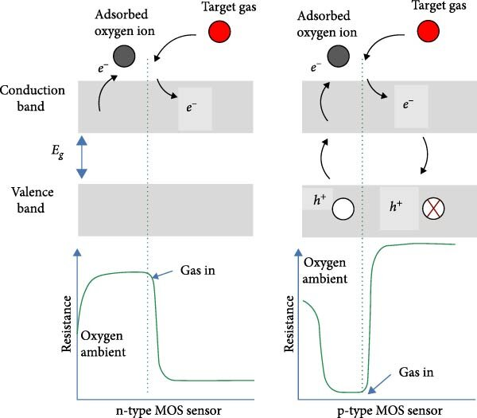
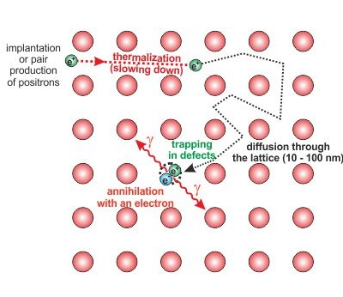
1. Irradiate samples synthesised @UNIZULU to create defects @ JINR
4. Study impact of defects on samples electric properties @UNIZULU
2. Study defects by positron annihilation spectroscopy @ JINR
3. Expose irradiated sample to poisonous gas @UNIZULU
This study investigates the performance of semi-conductors synthesised at UNIZULU and the defects are created at JINR and irradiate with positrons to characterise the types of defects. Lastly electric and magnetic properties are then studied.

Slide 14
Department of Agriculture & Geography and Environmental Studies
Current research studies at UNIZULU
Disaster Risk and Vulnerability Identifying and mitigating risks from natural disasters (i.e., landslides, soil erosion, flooding). Waste and Environmental Management Monitoring air pollution, mapping air pollution hotspots using geospatial technology (i.e., Remote sensing, GIS). Applied Geomorphology Understanding landforms and processes shaping the Earth’s surface, land degradation. Ocean-atmosphere interactions and seasonal climate predictions Understanding oceanic influences on climate and weather. Climate change projections Modeling and anticipating long-term climate shifts. Mapping and predicting geohazards Identifying and forecasting geological hazards (shallow landslides, gullies, rockfall, etc.).

Slide 15
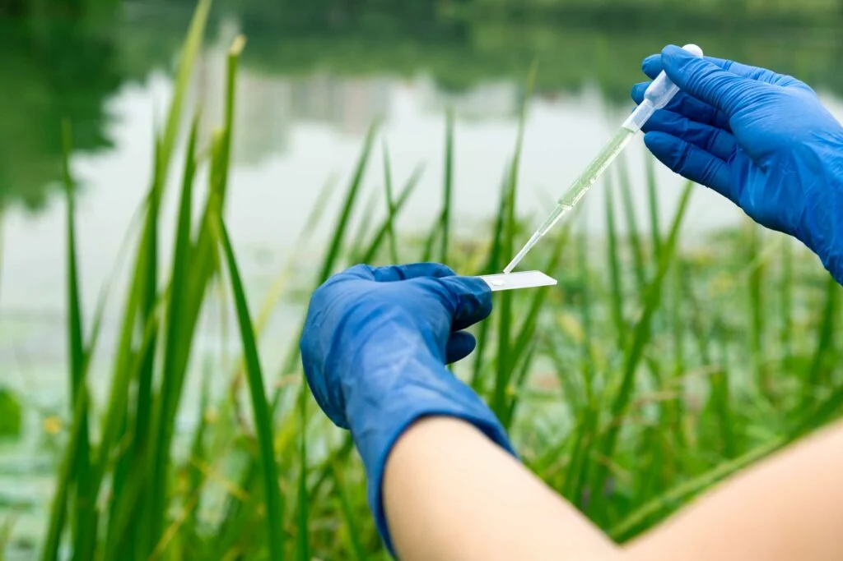
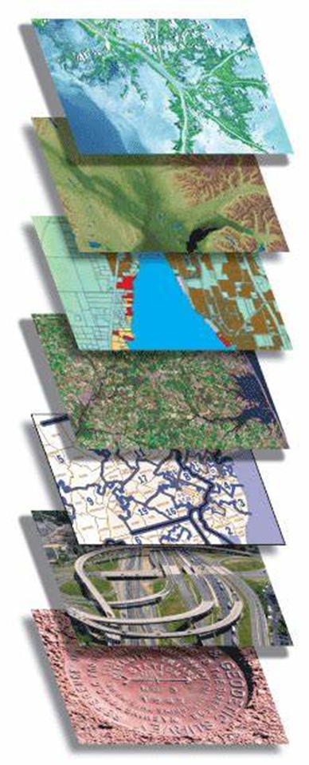
Potential research collaboration projects (UNIZULU-DUBNA-JINR)
UNIZULU Departments of Agriculture + Geography and Environment Studies proposes the following collaboration with Dubna State University and JINR)
Earth observation technology for land reform progress and impact (UNIZULU-DUBNA)
Using AI and geo-intelligent systems for resilient climate smart food systems ((UNIZULU-DUBNA)
Detection of toxic metals on animals and plants plus their impacts on safety for humans using Neutron Activation Analysis at JINR
To explore the land reform perceptions and progress [surveys/ FDGs will be geo-coded]
To detect temporary changes in land use/ cover over time owing to land reform [Satellite imaging using GIS software (e.g., ArcGIS etc.), drone footage]
To determine the implications of land use changes as a result of land reform on food systems [Satellite imaging pre and post]
To assess climate change vulnerability and adaptive capacity using geospatial modeling [vulnerability indices].
To predict pasture quality and estimate the carrying capacity for sustainable livestock production [using earth observation and machine learning models; remote sensing-based indices/ hyper spectral images].
To monitor livestock foraging patterns & impacts on greenhouse gas emissions [using earth observation/ machine learning models].
To use AI to monitor the impact of nanoparticles application in animal nutrition, health and environmental pollution.
To map and predict food insecurity hotspots in urban and rural areas [geo-coded data and ML models].
Imagery/
Spatial Data
Smart
Farming
GIS Intelligent Systems
Artificial
Intelligence
Email address: SibandaM@unizulu.ac.za
Tel: 035 902 6068

Slide 16
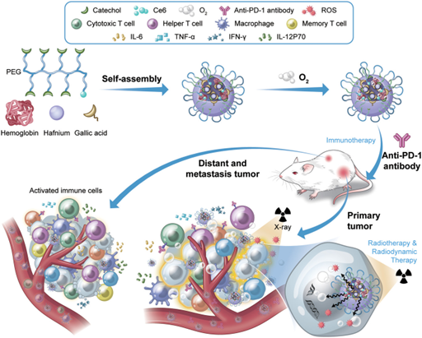
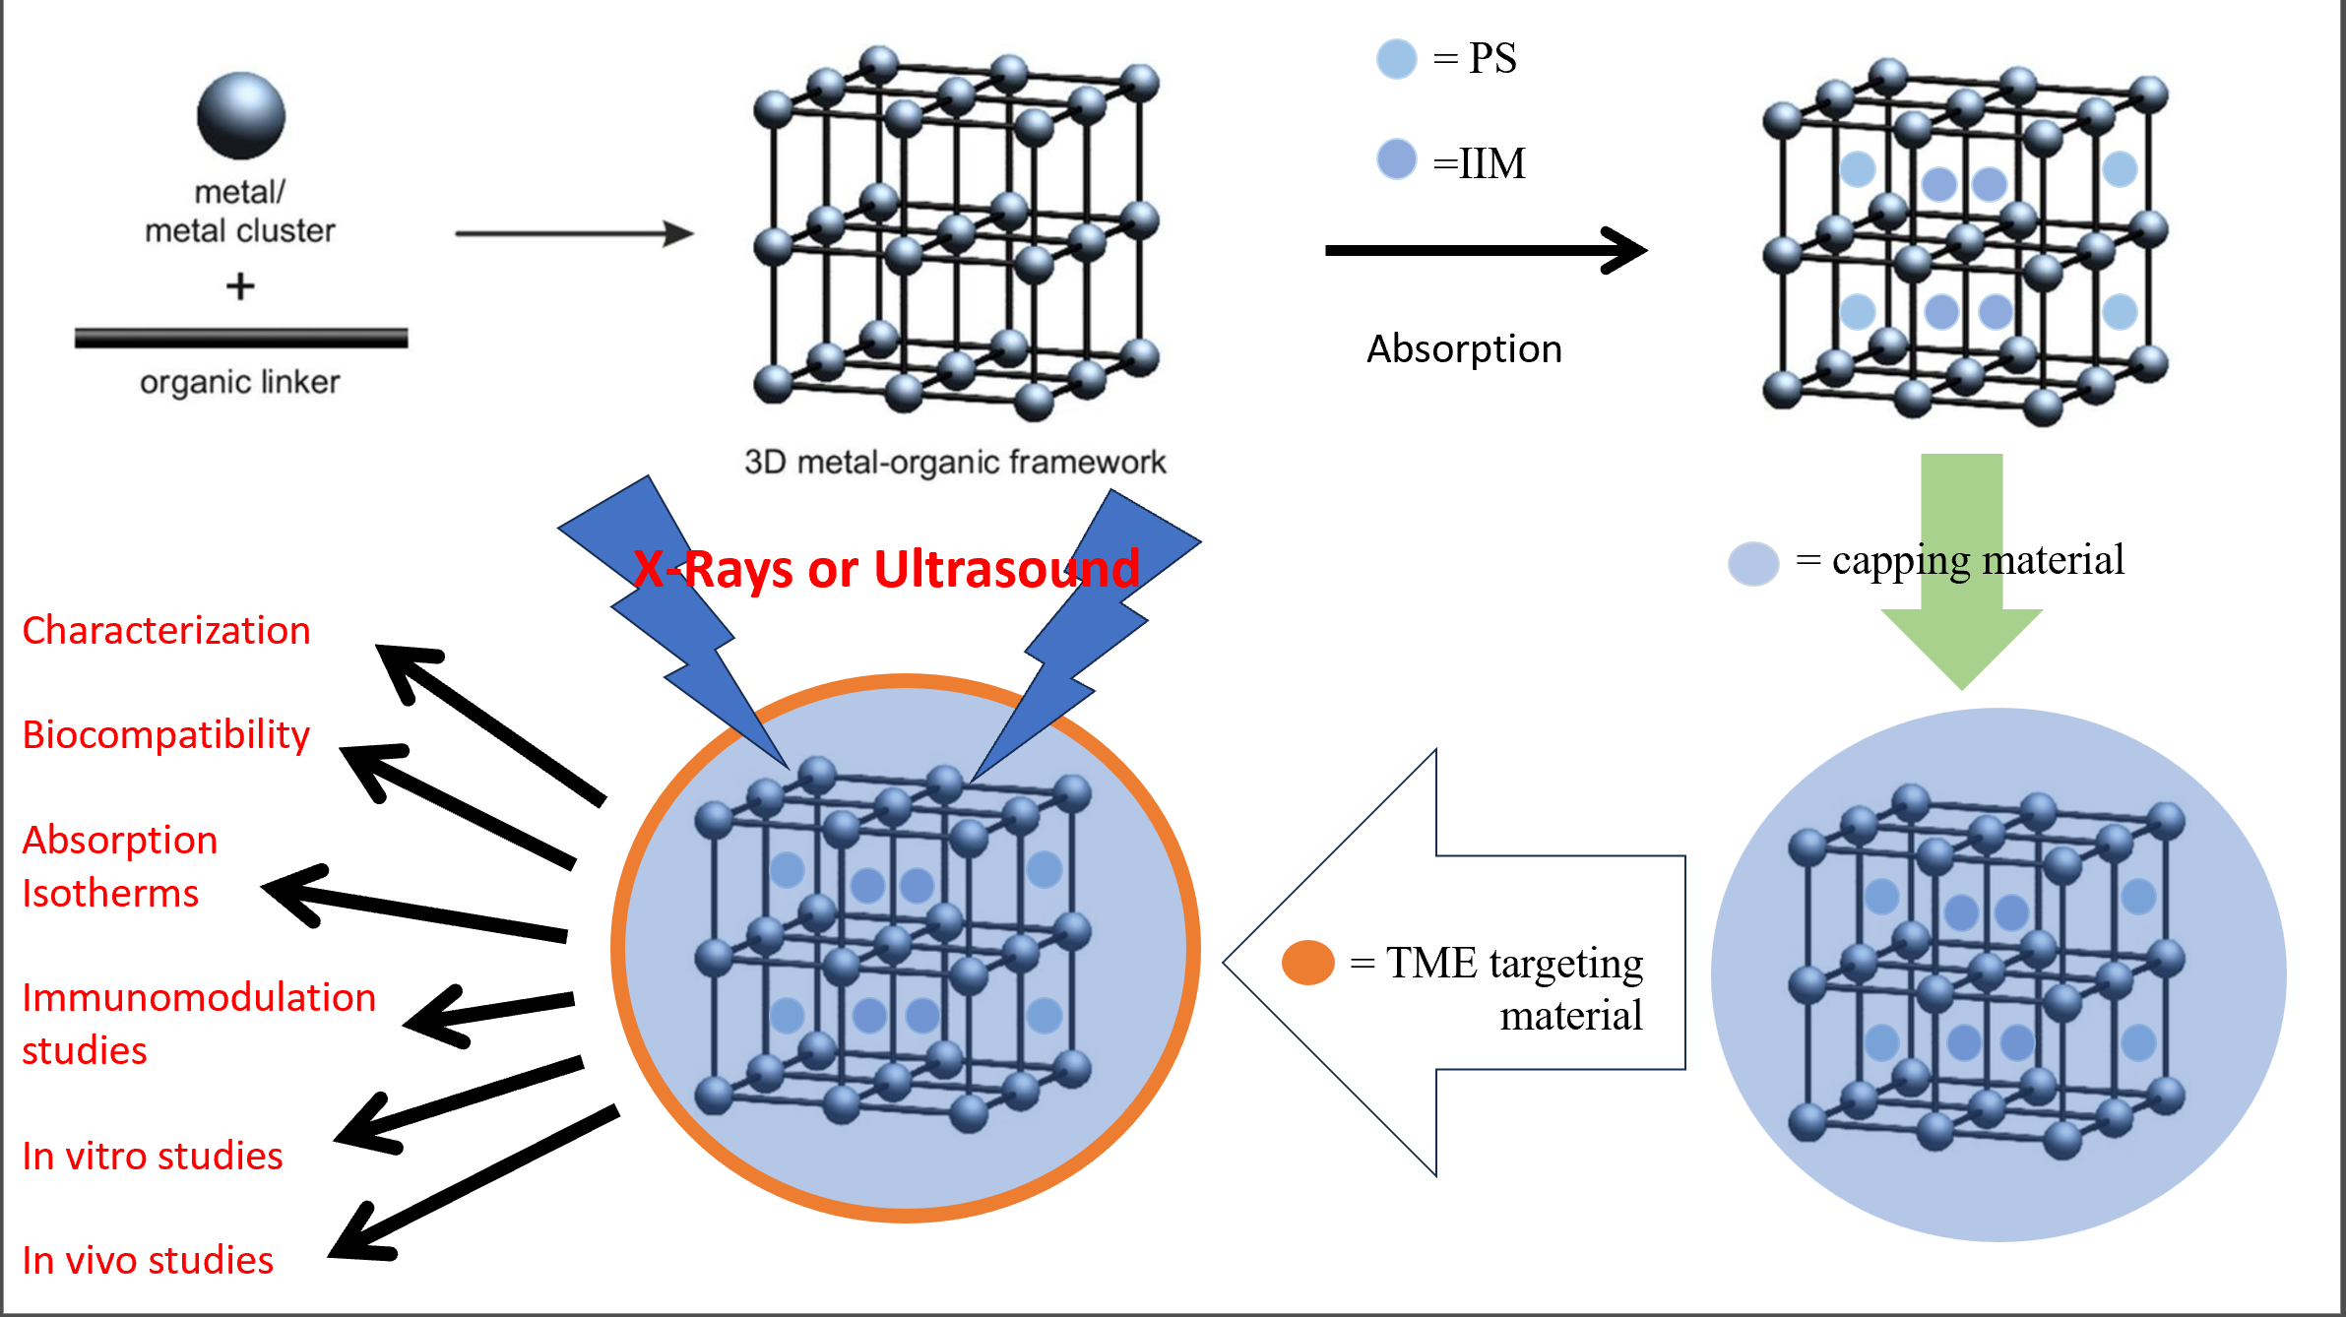
1) UNIZULU- JINR
Development of the radiodynamic therapy approach based on photodynamic therapy technologies. Application of NICA heavy ion beams to study activation of compounds used in the photodynamic therapy, which generate singlet oxygen upon excitation.
Life science research
Investigation of Metal organic frameworks (MOFs) consisting of metal atoms or clusters, coordinated to organic ligands to form macromolecular super structures, with pores large enough to host free drug molecules, including photodynamic therapy (PDT) photosensitizers.
2) UNIZULU_JINR
Search for new antioxidants having radioprotective properties against biological effects generated by heavy ions with their particular application as protectors against the brain radiation injury.

Slide 17
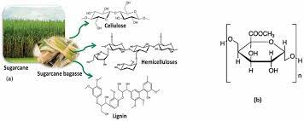
UNIZULU material science research
Synthesis of nanomaterials
Investigations of polymeric materials
Synthesise of high-quality intermetallic materials for potential applications in energy generation and storage, supercapacitance, photocatalysis and drug delivery. The type of materials include:
Hematite, Tungstate and Zinc Selenide nanoparticles synthesized as powder and as thin film.
Main group and transition metal chalcogenide nanomaterials synthesized as thin films.
The development of novel synthetic organic material, membranes, hydrogels and aerogels for potential application in wastewater treatment and energy storage.
Preparation of metal oxide for gas sensors
Development of hybrid nanocomposites material containing inorganic (ZnO, SnO₂, Fe₂O₃, WO₃) and organic materials (polyaniline, polypyrole) for potential application in gas sensing.
.

Slide 18
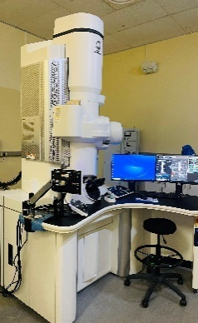
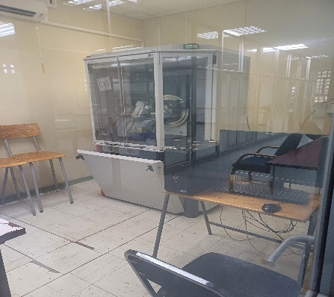
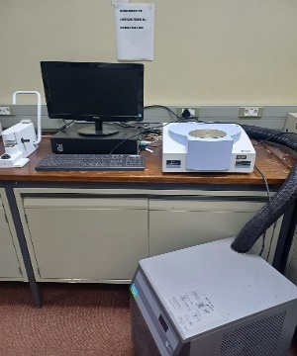
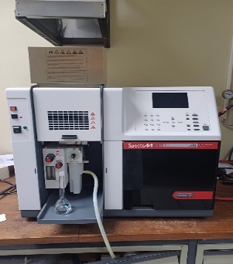
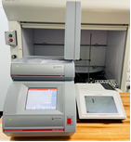
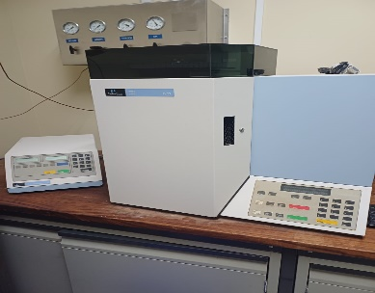
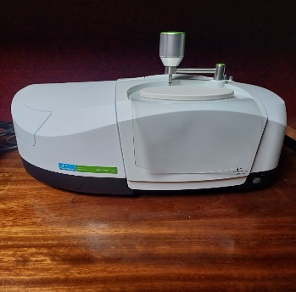
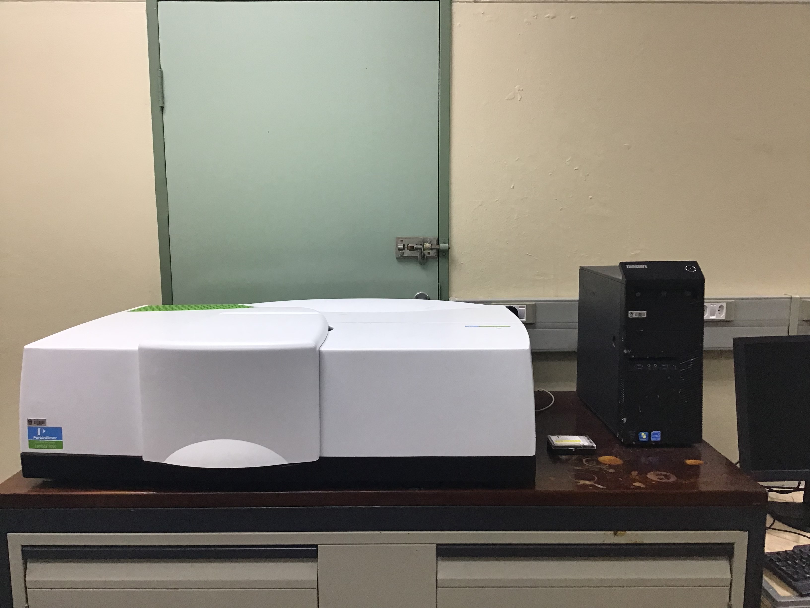
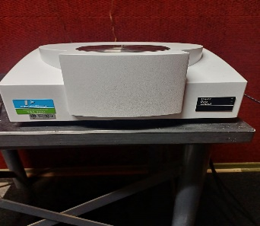
UNIZULU: Synthesis and characterizations of samples (Physical and Chemical analytical properties).
UNIZULU-DUBNA-JINR projects: 1) Heavy-ion modification of new polyethylene and polypropylene derivatives; and 2) development of nanomaterial for gas sensing and water splitting applications.
XRD
DSC
AA
UV-Vis
HR-TEM
RAMAN
CHN
FTIR
UV-Vis
TGA
DUBNA-JINR: The prepared samples will be sent to JNIR and bombarded with proton beam, alpha particles or heavy ions at deferent fluences for further analysis.

Slide 19
UNIZULU Switchboard: +27 (35) 902 6000
Faculty of Science, Agriculture & Engineering: +27 (35) 902 6649
Department of Science Access: +27 (35) 902 6868
UNIZULU FSAE Website: https://www.science.unizulu.ac.za/
UNIZULU Website: http://www.science.unizulu.ac.za
Contact details

Slide 20
Thank you!
FACULTY OF SCIENCE, AGRICULTURE & ENGINEERING

