Slide 1




Radiation Hardness Testing of Electronics
at the JINR and iThemba LABS
by Arno Barnard
For
South Africa Days in JINR
17 July 2025
© Stellenbosch University, All rights reserved.

Slide 2
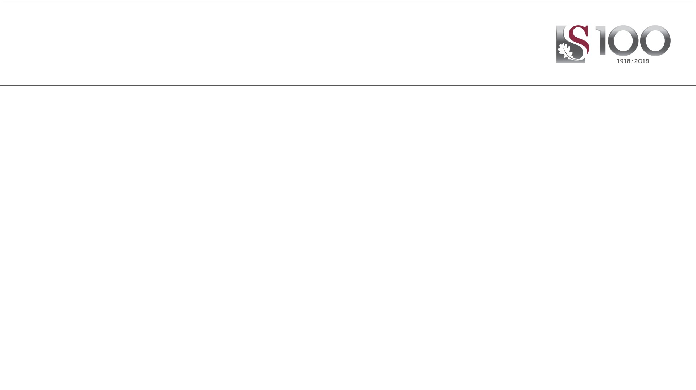

Presentation Overview
The Satellite Arena
Radiation Hardness Assurance Overview
iTL Proton Testing Setup
Dosimetry importance
SEE Testing Results from A-line and NTV-line
SEE Testing setups at FLNR

Slide 3
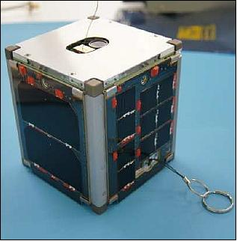
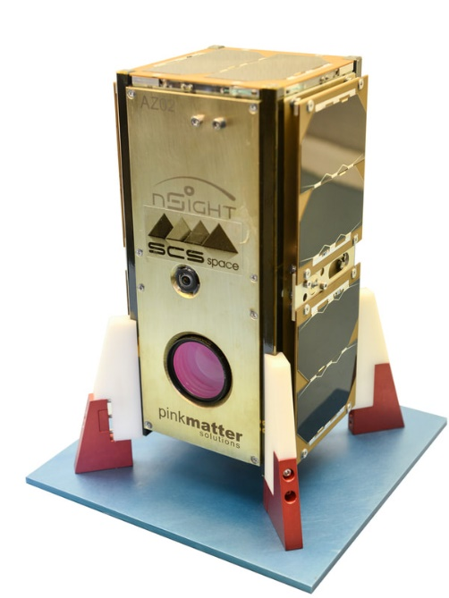
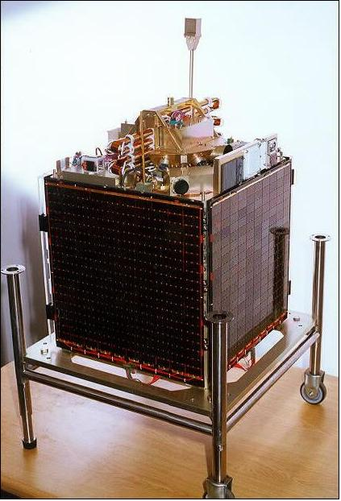
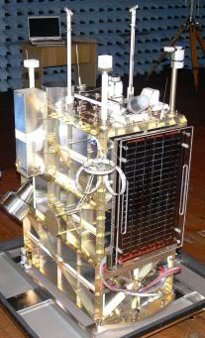
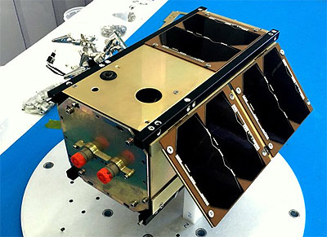
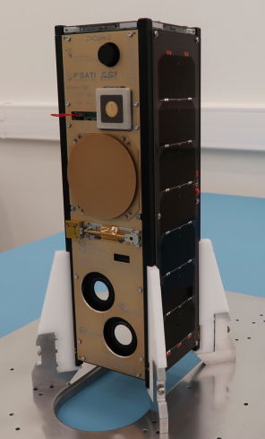
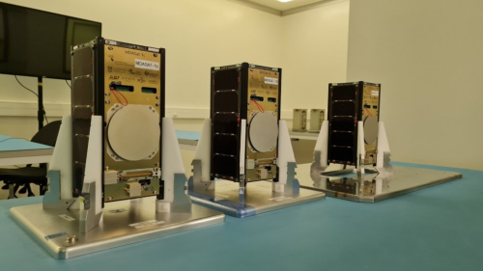
South African satellites 1999 - 2022
Semi-Old Space projects
New Space projects

Slide 4
South African Space System Context
Old Space approach:
  Large government sponsored projects
  Centralized national test facilities
  Long development cycles >3-10 years
  Radiation hardened components developed
  Domain of technology developed industrialized countries
New Space Approach (current RSA):
  Driven by commercial companies
  Leveraging economy of scale
  Making access to space affordable for everyone
  Smaller, disposable satellite platforms
  Best‐of-COTS Electronics selection
  Short development cycles using cutting edge technology

Slide 5
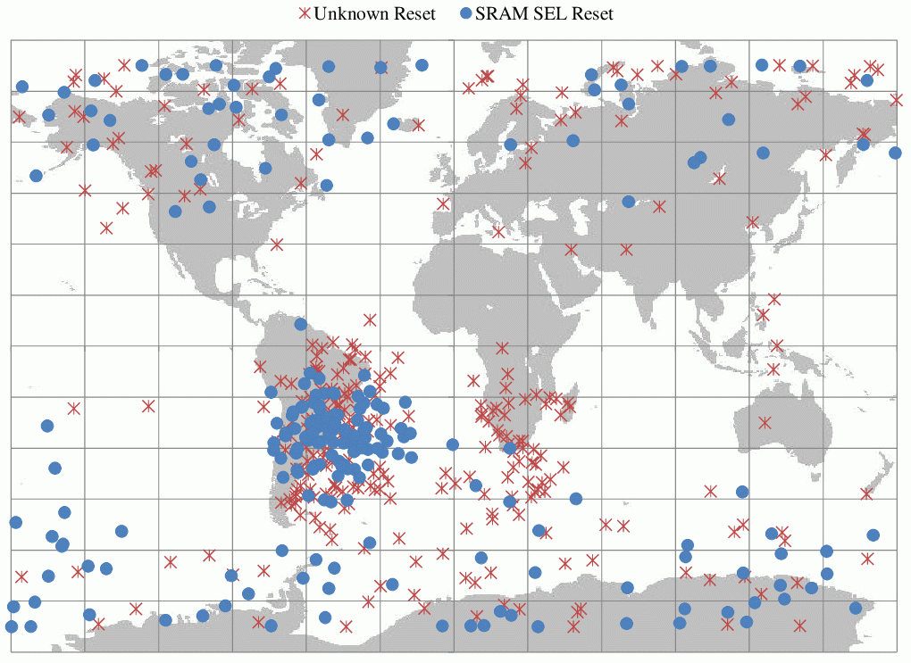
Satellite Issues with Radiation
South African satellites and radiation testing
1992-1999 – SUNSAT – ”well known” Commercial-off-the-shelf (COTS) parts used – no radiation testing
2005-2009 – Sumbandila Satellite – COTS parts, TID testing of major parts – no SEE testing
Current trend – Cubesats – Tshepisosat – ZA-Aerosat – nSight – ZA-Cube 2 - MDASats – all COTS parts
SEE problem history
SUNSAT – SRAM upsets – OBC code re-write to get operational
Sumbandila Satellite – Micro-SEL in SRAM
Barnard, A. and Nwosa, C.: COTS Based On-Board-Computer on South Africa’s Sumbandilasat: A Radiation and In-Orbit Performance Analysis. In: 2011 IEEE Radiation Effects Data Workshop, pp. 1–4. IEEE, jul 2010. ISBN 978-1-4577-1281-4. ISSN 2154-0519.

Slide 6
Radiation Environment: Models
Radiation Source | Models | Effects of Solar Cycle | Variations | Types of Orbits Affected
Trapped Protons | AP8-MIN; AP8-MAX | Solar Min - Higher; Solar Max - Lower | Geomagnetic Field; Solar Flares; Geomagnetic Storms | LEO; HEO; Transfer Orbits
Galactic Cosmic Ray Ions | CREME; CHIME; Badhwar & O'Neill | Solar Min - Higher; Solar Max - Lower | Ionization Level | LEO; GEO; HEO; Interplanetary
Solar Flare Protons | SOLPRO; JPL92 | Large Numbers During Solar Max; Few During Solar Min | Distance from Sun Outside 1 AU; Orbit Attenuation; Location of Flare on Sun | LEO (I>45°); GEO; HEO; Interplanetary
Solar Flare Heavy Ions | CREME; JPL92; CHIME | Large Numbers During Solar Max; Few During Solar Min | Distance from Sun Outside 1 AU; Orbit Attenuation; Location of Flare on Sun | LEO; GEO; HEO; Interplanetary
Source: http://radhome.gsfc.nasa.gov/radhome/papers/seeca3.htm

Slide 7
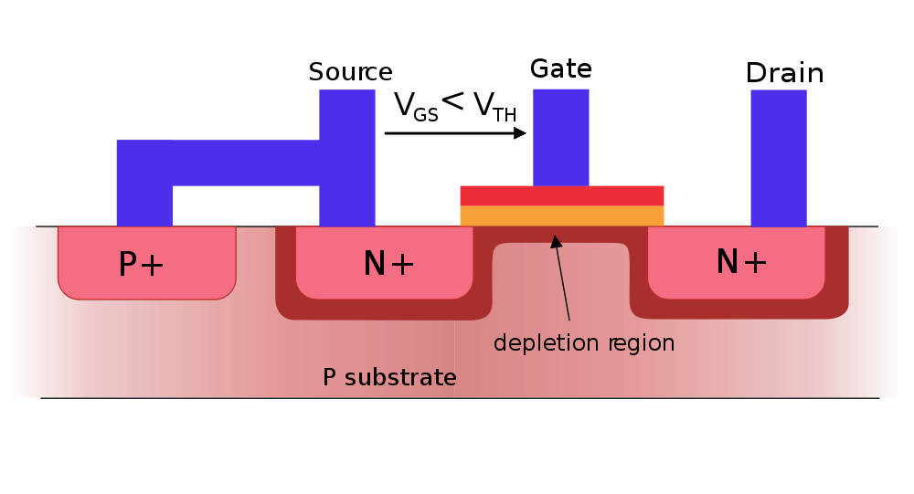
Example radiation effect
Mechanism in MOSFETs
High-energy
Radiation
Image: modified from http://en.wikipedia.org/wiki/File:MOSFET_functioning_body.svg

Slide 8
Radiation Hardness Assurance - I
Sources
Direct Solar Irradiation
Galactic Cosmic Rays
Trapped Particles
Damaging Radiation
Effects
Single Event Effects
Total Ionizing Dose
Displacement damage

Slide 9
Radiation Hardness Assurance - II
Main particles to test for SEE’s:
Heavy Ions – from He to Ni
  Primarily direct ionization
  Some indirect ionization from collisions with other particles
Protons
  Predominantly indirect ionization from collisions with other heavy nuclei
  Some direct ionization in new very sensitive devices
Neutrons
  Entirely indirect ionization from collisions with other nuclei

Slide 10
Radiation Hardness Assurance - III
Mission Design
Proton Testing
Heavy Ion Testing
Neutron Testing
Displacement damage
Total Ionizing Dose Testing
Proton Cross section
Heavy-Ion Cross section
Neutron Cross section
Orbit Specification
Device Cross section
Radiation Environment Model
SEE, TID, NIEL Prediction
RSA capability
Device Selection
FLNR capability
Future/Other capability
3rd Party Tools

Slide 11
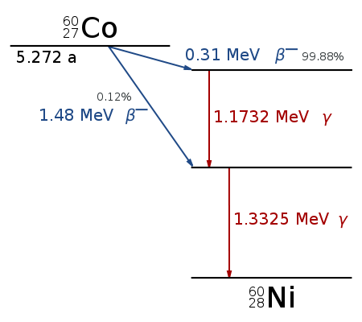
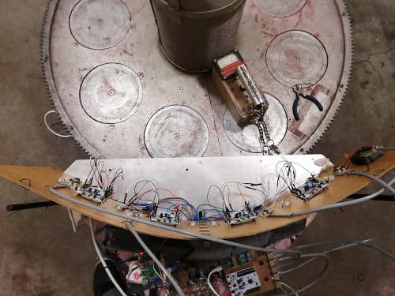
TID Testing
Can do pre-post measurement tests or full in-situ testing
Co-60 has a half-life of 5.26 years
No other energy required to create radiation
Testing is fairly inexpensive
Dose rates of up to 10kRad(Si)/hr (100Gy/hr) can be acceptable
ELDRS requires long testing times at low dose rates
ESL has tested over 30 different devices starting 2004
Accurate dosimetry required
Gamma rays have enough energy to cause ionization in materials
Co-60 decays ejecting gamma rays with known energies
Image: http://commons.wikimedia.org/wiki/File:Cobalt-60_Decay_Scheme.svg

Slide 12
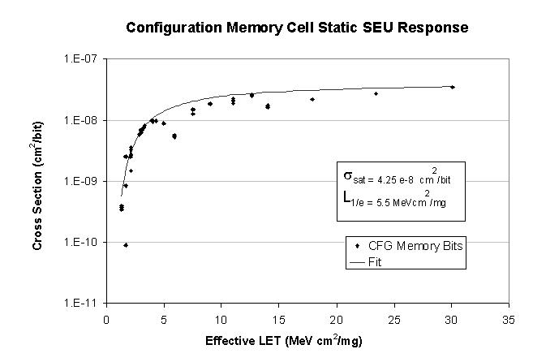
SEE/DD Testing
Three interesting facts:
  Space radiation environment changes and we are still learning
  We cannot simulate (in foreseeable future) full range of space environment particles at reasonable rate/schedule
  Semiconductor industry creates new technologies at high rate
SEE / DD testing is done using high energy particles – usually accelerator based
  Characterize device sensitivity(Cross section curve)
  Verify mitigation techniques
SEE Cross Section Curve

Slide 13
Proton-Beam based SEE Testing - II
Viable locations at iTL
A-line (up to 2017)
NTV-line (2016-2019)
iTL SEE test options
SEU with 20MeV to 200MeV protons
MBU with 20MeV to 200MeV protons
SET with 20MeV to 200MeV protons
SEFI with 20MeV to 200MeV protons
SEL with >180MeV protons
Practical changes to historic approaches at iTL
Change to in-air testing
Use passive beam spreading and collimation to create a uniform intensity beam spot
Develop an accurate, affordable, easy to use dosimetry system
Use collimators to provide the required beam spot size and shadow area to protect other devices
Change to multi-DUT test capability
Use SRIM simulation software for configuration design

Slide 14
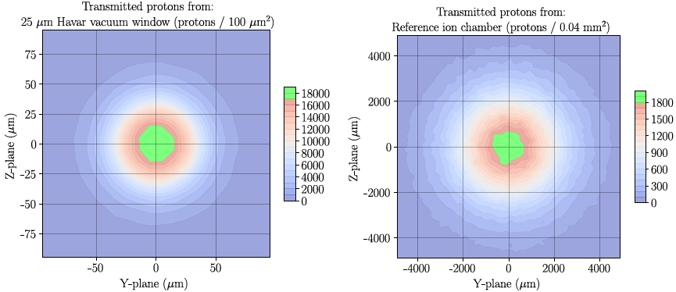
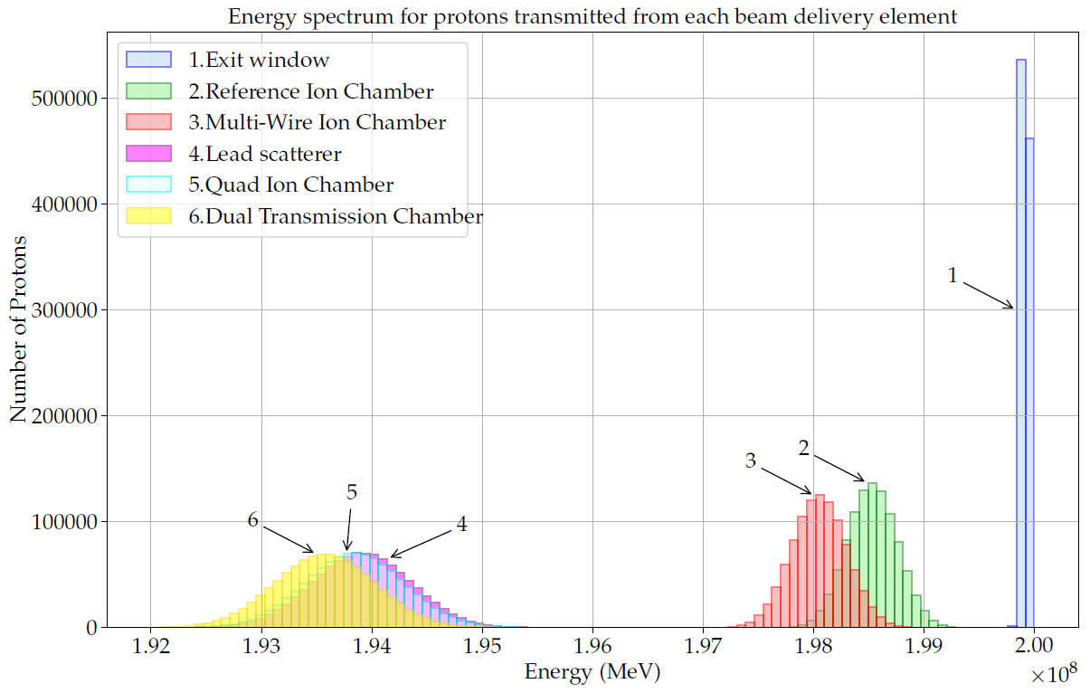
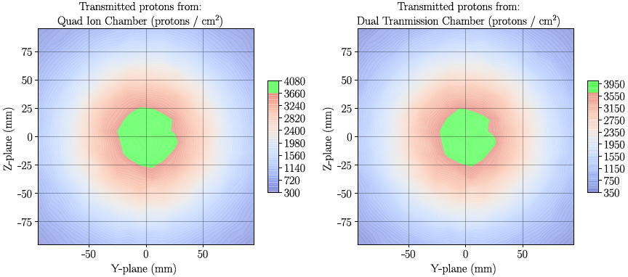
Exploring the new iTL test setup - I
Energy spectrum and Beam spot size simulation

Slide 15
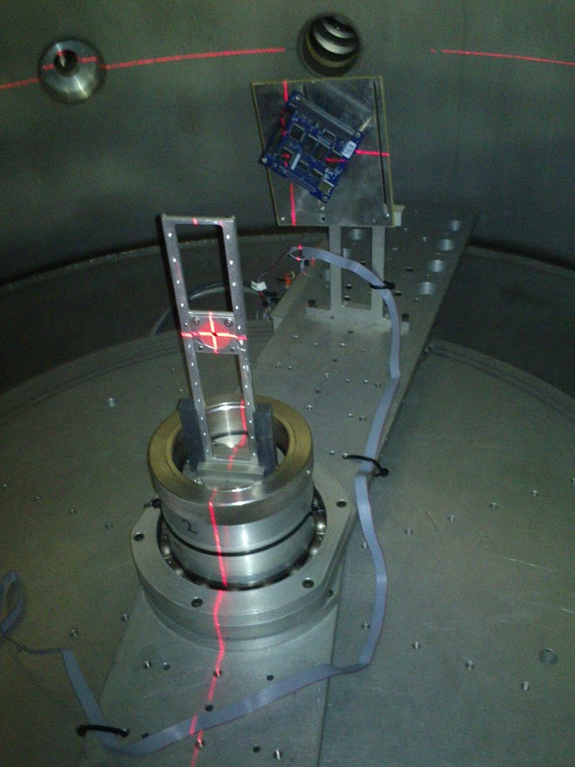
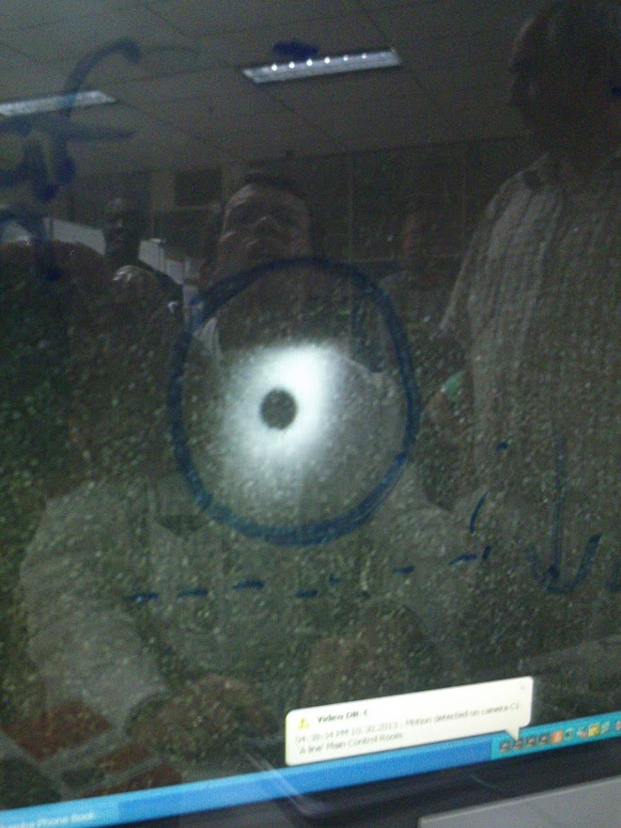
A-line setup in vacuum with Ruby target

Slide 16
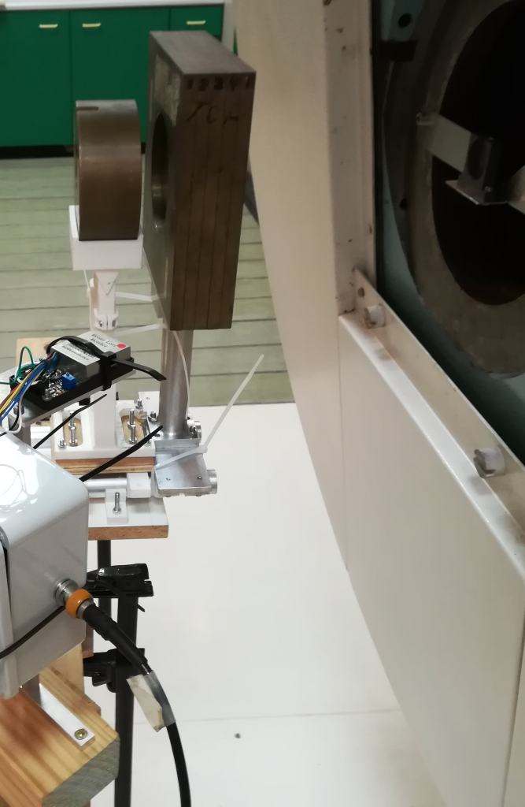
Dosimeter selection and analysis – I
Dual Beam Loss Monitor as novel solution
Not designed as dosimeter, but:
Good spatial resolution – 7.34mm² square area
Good sensitivity for protons – designed to detect MIPs
Produces TTL pulses – easy to interface with
Small physical size – easy to mount and move
Limitations
Pulse bandwidth – ~100ns recovery time, thus 10MHz limit
Fixed area, although small has saturation with high flux density
Need to investigate effectiveness as dosimeter/beam monitor

Slide 17
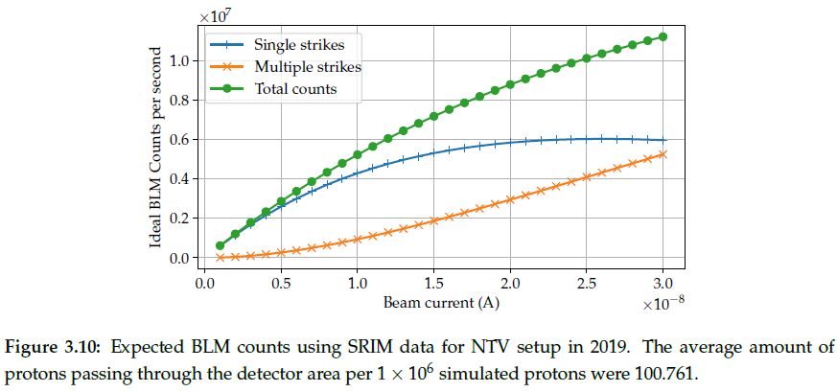
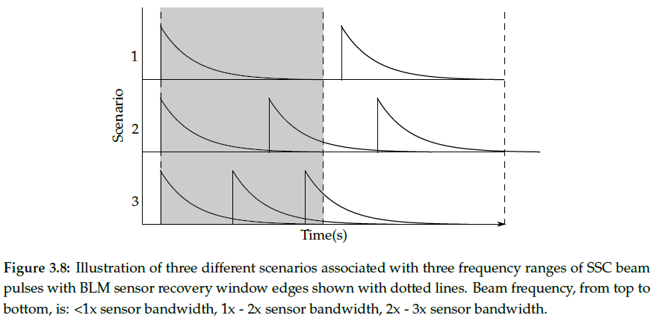
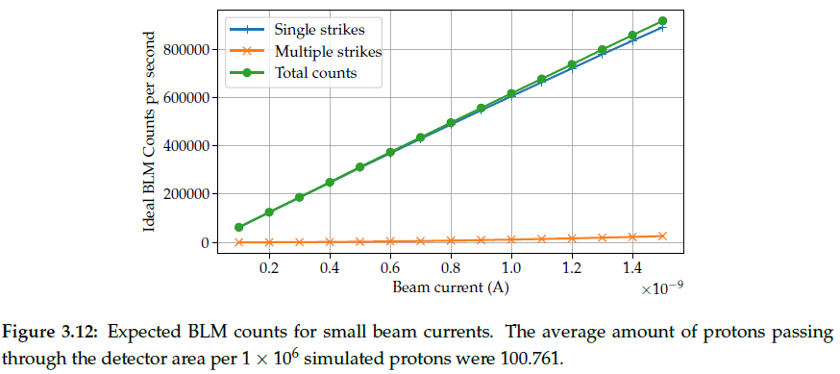
Dosimeter selection and analysis - II
BLM Saturation effects
Two sources of saturation
Beam bunch frequency (bandwidth limit)
Beam bunch density (flux over detector area)
Use Bernoulli trials to calculate probabilities

Slide 18
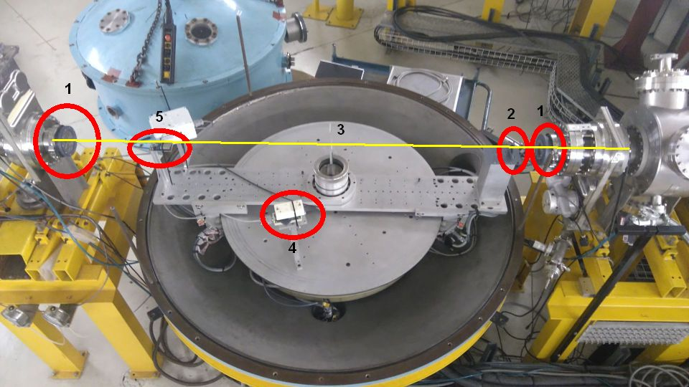
A-line conversions
A-line (In air)
Removal of scattering chamber walls
Installation of vacuum windows
Reconfiguration of vacuum system
Installation of DUT positioning platform
Mounting of BLMs
Mounting of passive beam spreader sheet
Two scintillating targets for pencil beam alignment
Support electronics for positioning platform and BLMs

Slide 19
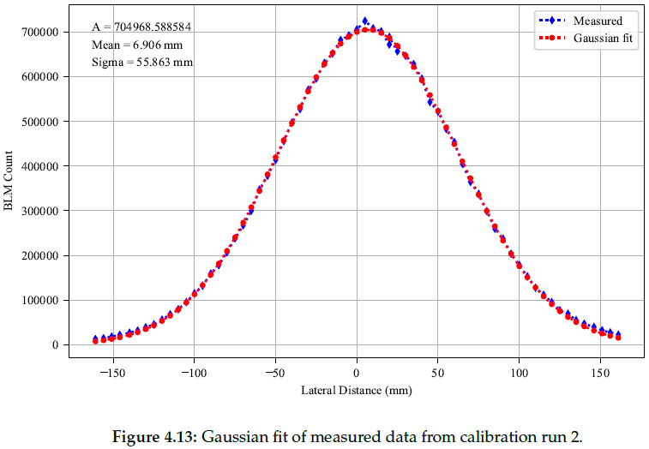
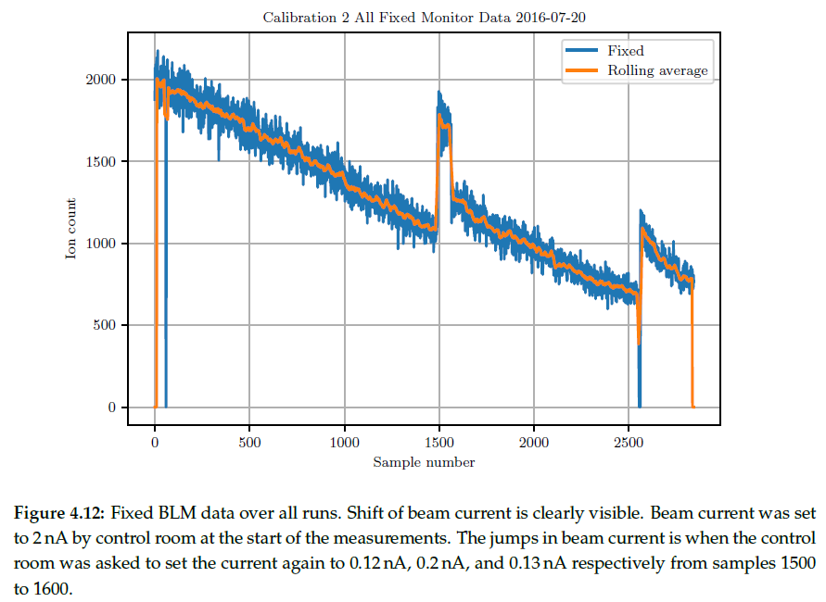
Results from A-line
A-line verification – 2016
Aims:
Verify in-air test methodology, compared to the in-vacuum testing
Verify SRIM simulation accuracy, compared to the measured data
Verify BLM as dosimetry system, compared to previous approaches
Results:
Simulated and measured beam spreading compared well: σ = 58.96mm vs σ = 57.16mm
BLM interfacing verified and saturation observed – optimal beam current selection required at start of test
Non-availability of vault prohibited further development at A-line

Slide 20
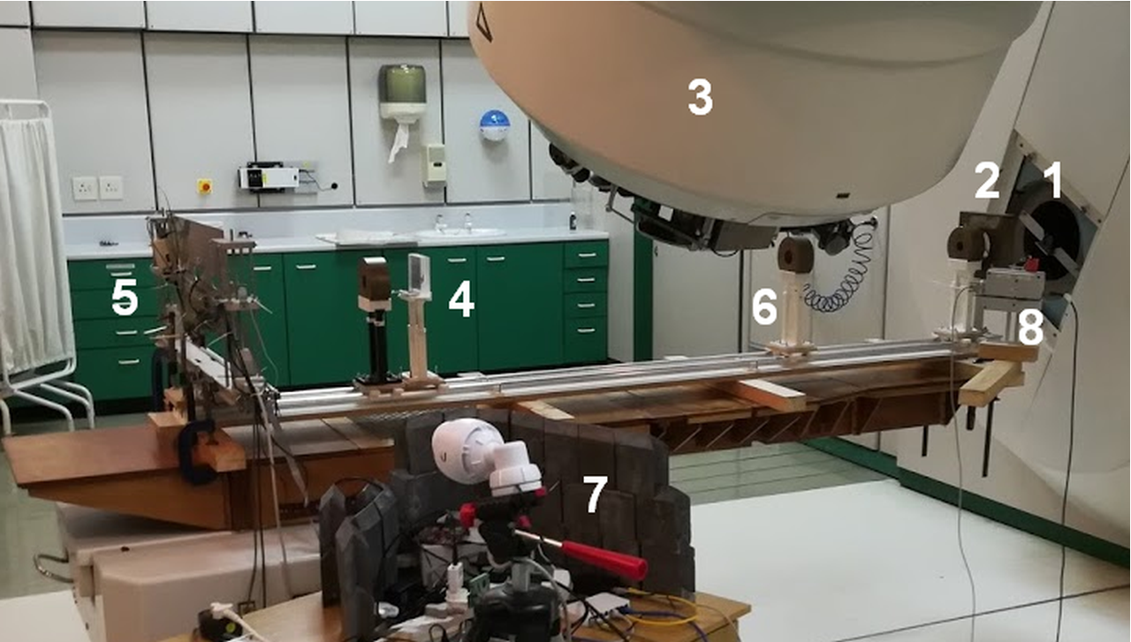
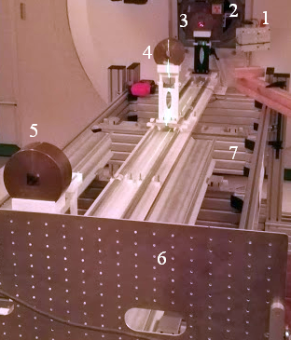
NTV-line conversions
NTV-line
Removal of gantry angle indicator
Mounting of passive beam spreader
Mounting of collimators
Mounting of DUT positioning platform
Mounting of degrader sheet holder
Mounting of BLMs
Installation of support electronics
2018 addition of PRaVDA bench

Slide 21
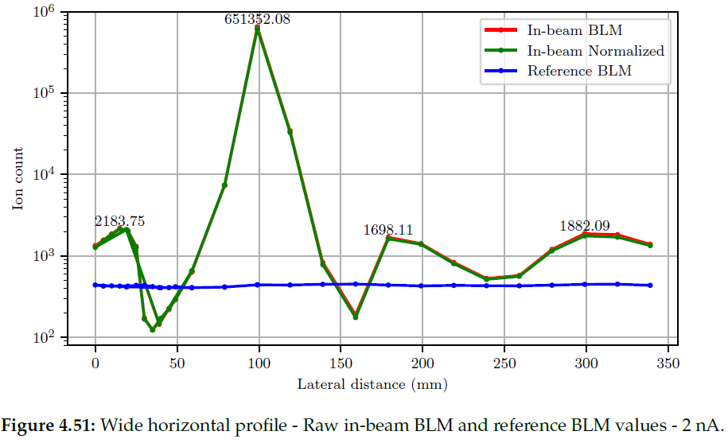
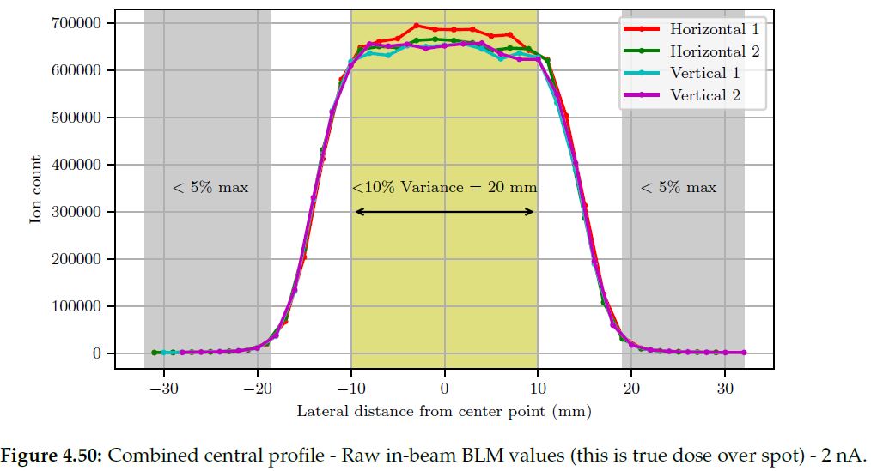
Results NTV-line
NTV-line 66MeV 2019 – Development Aims
Measure the beam spot profile using the new independent DAQ interface to the BLMs.
Create a better quality shadow compared to the 2017 NTV 66MeV experiment and measure the shadow intensity profile.
NTV-line 66MeV 2019 – Results

Slide 22
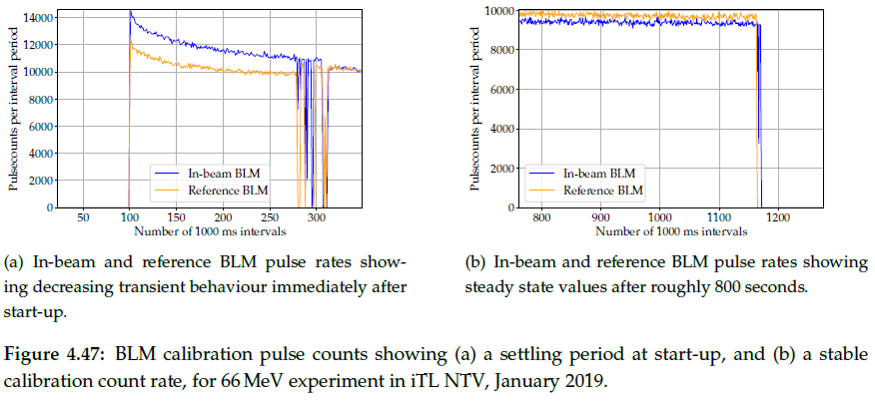
Results from NTV-line - II
NTV-line 66MeV 2019 – Results II
Startup transient in BLM measurements

Slide 23
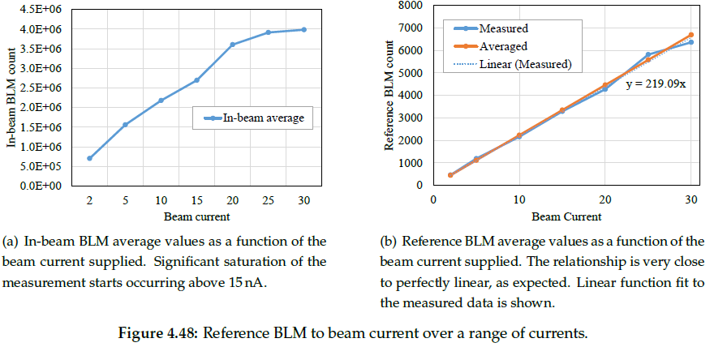
Results from NTV-line - III
NTV-line 66MeV 2019 – Results III
Linearity of reference BLM measurements is very good, in-beam shows expected saturation
New BLM logger produced much higher accurate count rates

Slide 24
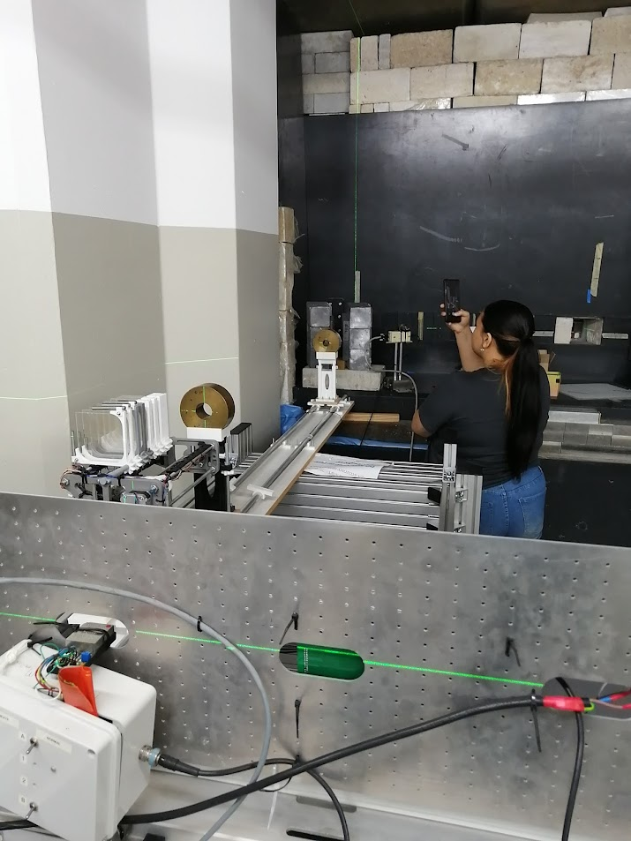
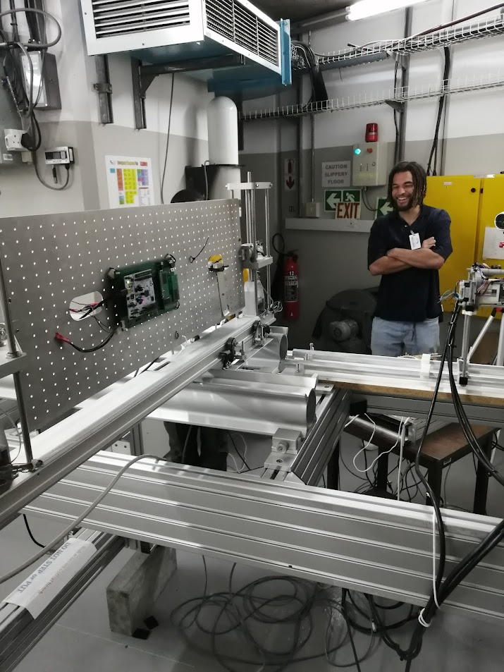

D-Line SEE Test setup at iTL

Slide 25
HCD achieved at iThemba LABS
Multiple users were accommodated for SEE testing
At iThemba LABS:
3 Master’s students and one researcher at the A-line
2 Master’s students, one industry partner, and one researcher at NTV line
5 Master’s students at D-line
4 Undergraduate students-in-training

Slide 26
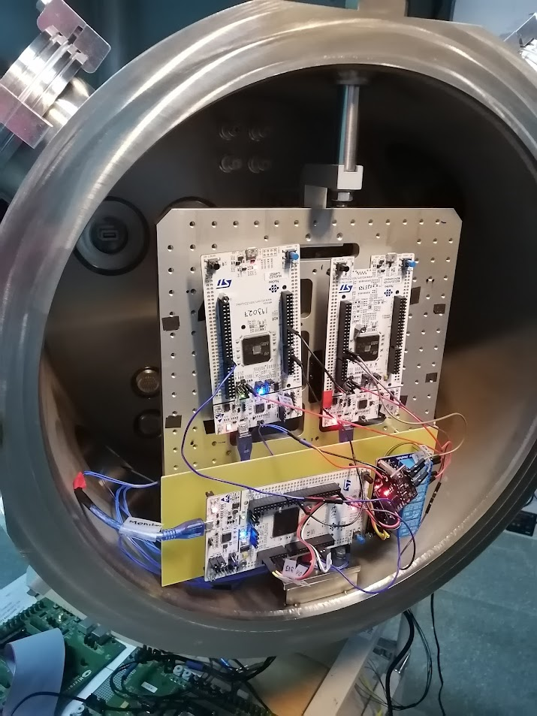
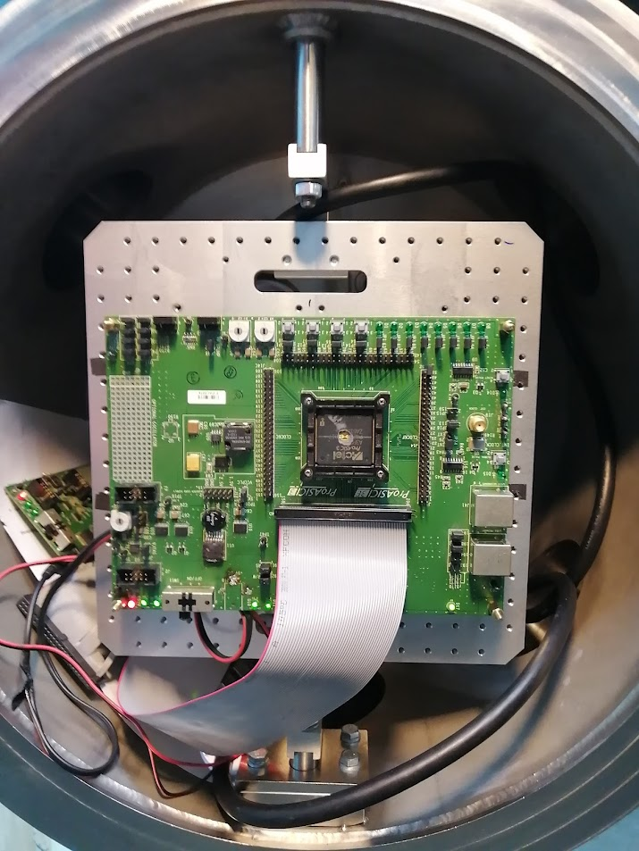
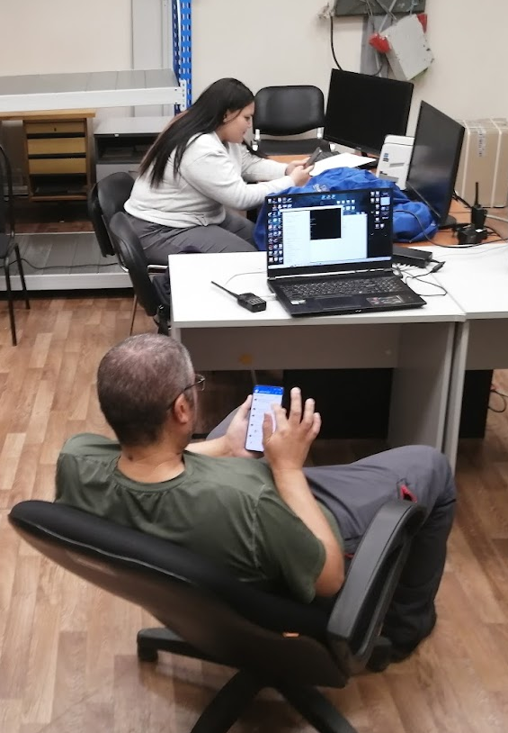
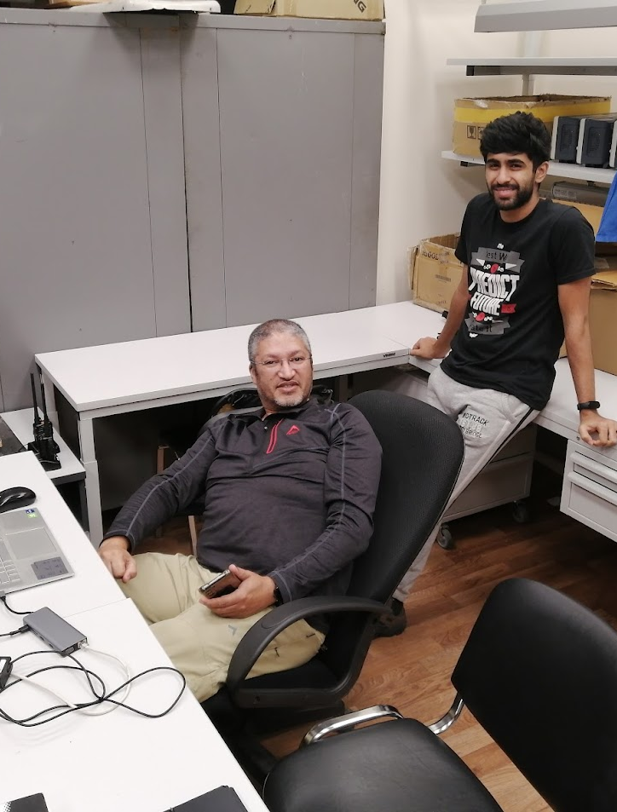
SEE Heavy Ion Setup - FLNR

Slide 27
SEE testing at FLNR
Practical challenges
Devices must be de-capsulated
Test setups must be small and mobile
Most support electronics must be transported to FLNR
Unknown device response requires adaptive design approach – i.e. must be able to CHANGE test configuration between different Ion specie runs – typically 1-2 days
Current funding till 2026
Mobility for 4 persons to FLNR per year
Project options
  Mitigation in processors
  Protection circuit verification
  Refinement/Adaptation of FPGA mitigation schemes

Slide 28
SEE testing at FLNR, beams and HCD
Tests started in December 2022
2 SA researchers experiments
  FPGA mitigation schemes
  1 Processor investigation
Using Bi, Xe, Kr, Ar, Ne beams
1 student-in-training
December 2023
2 SA researchers experiments
  FPGA mitigation schemes
  2 Processor comparisons
Using Xe, Kr, Ar beams
1 student-in-training
December 2024
2 SA researchers experiments
  FPGA mitigation schemes
  2 Processor comparisons
Using Bi, Xe, Kr, Ar, Ne beams
3 students-in-training
November/December 2025 planned
1 SA researchers experiments
  Comparative architectures
2-3 SA MEng/PhD student experiments
Using Xe, Kr, Ar, Ne beams?
1 student-in-training

Slide 29
Topics researched
The research conducted by South African researchers through access to SEE testing includes:
Test the effectiveness of mitigation techniques applied on a CubeSat OBC,
Successfully provided a degraded energy environment for FPGA device characterisation,
Recreate and observe similar device behaviour as observed with on-orbit devices,
Screened candidate spacecraft processors and imaging sensors,
And investigate failure modes and sensitivity of multiple devices
  Mainstream Intel Atom
  Embedded STM, Cygnal processors
  Microchip FPGAs
  Memories as radiation sensors for space
Evaluate SET mitigation techniques applied in Xilinx and Microsemi FPGAs resulting in a Patent

Slide 30
Contributing Funding
Multiple funding mechanism contributed to the success – from 2007 to 2025 (almost 20 years)
NRF iThemba LABS
  Providing staff assisting during test setup design and implementation phases
  Providing beam time, both via formal PAC application and discretionary routes
  Allowing the re-purpose of available equipment for this purpose
NRF Thuthuka – funding multiple student projects and research efforts
SA-JINR program
  Providing mobility grants that provide for researchers and students to come to Dubna
  Providing hosting and subsistence support during the research visits
  Providing access to JINR facilities for test preparation
  Providing beam time at FLNR for heavy-ion testing

Slide 31


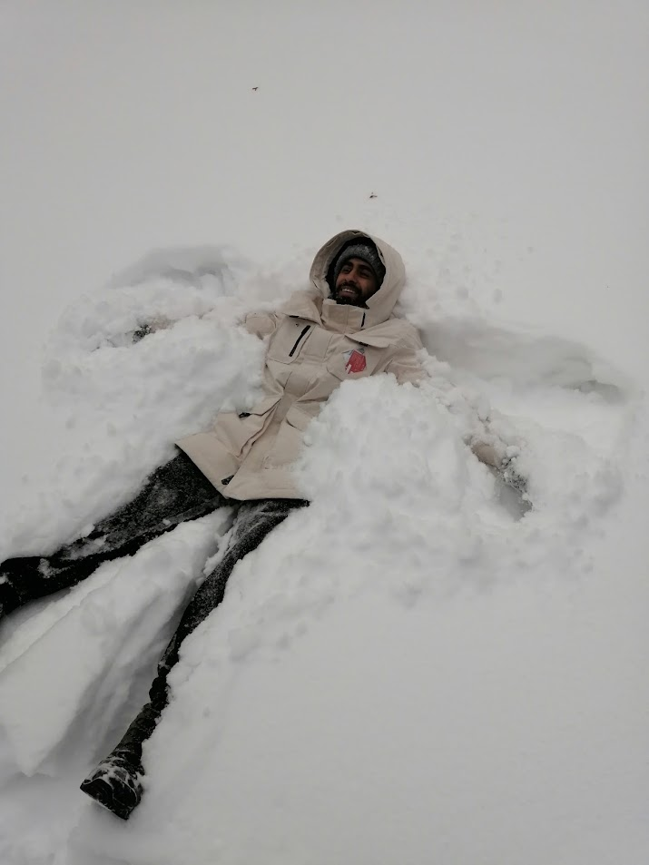
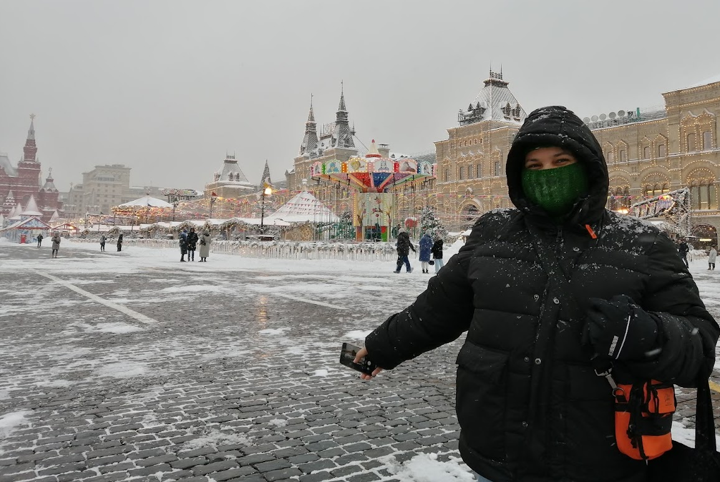
Not all work …

Slide 32
Thank you
South Africa Days in JINR
17 July 2025
© Stellenbosch University, All rights reserved.

