Slide 1
Teaching programmes and Research activities at the Centre for Applied Radiation Science and Technology and at Nuclear Engineering North-West University
JINR, Dubna, June 2025

Slide 2
Content
1 OVERVIEW
2 PROGRAMMES AT CARST
3 PROGRAMMES AT NUCLEAR ENGINEERING
4 RESEARCH ACTIVITIES AT CARST
5 RESEARCH ACTIVITIES AT NUCLEAR ENGINEERING

Slide 3
NWU
FENG
Potchefstroom Campus
Next Slide
OTHER
FNAS
Other
CARST
Mahikeng Campus

Slide 4
FENG
SME
UETS
NE
Other
Ms
SLPs
Research
PhDs
SEECE
SIE
SCME
Other
PGDIP

Slide 5
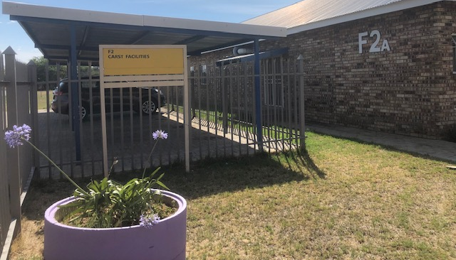
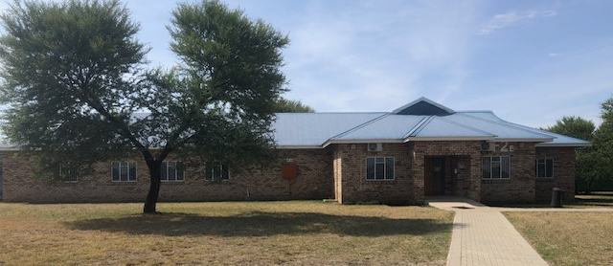
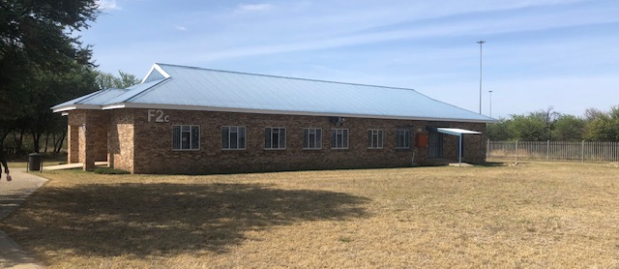
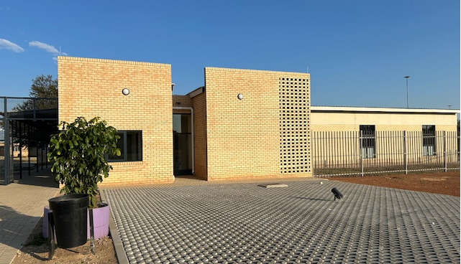

Slide 6
CARST Overview
CARST was started in 1998
Aim: To develop the Centre for Applied Radiation Science and Technology into a national and regional training institution for the Applied Radiation Sciences and to support the development needs of the nuclear and related industries in line with the latest international standards and best practices.
Collaborative effort between North-West University (NWU), Mahikeng Campus and Nuclear industries stakeholders:
South African Nuclear Cooperation of South Africa (NECSA)
ESKOM, Koeberg
iThemba Laboratory for Base Accelerator Science (iThemba Labs)
National Nuclear Regulator (NNR)
Department of Mineral Resources and Energy (DMRE)
Pebble Bed Modular Reactor (PBMR)

Slide 7
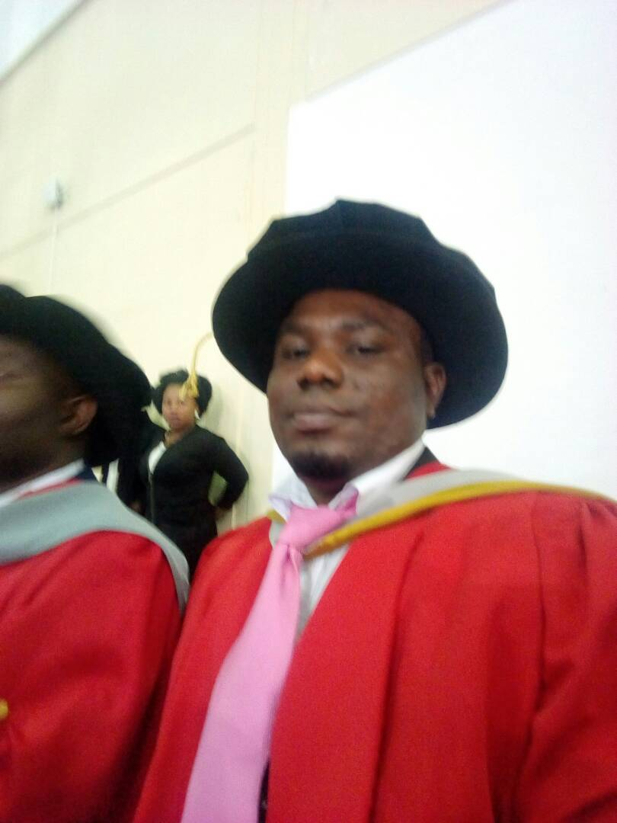
^{Teaching Curriculum at CARST}
BSc Hons - A minimum of one year of full-time study
Coursework
Nuclear Physics includes
Nuclear Chemistry
Radiation and the Environment
Radioactive waste minimization, and
Research Project
MSc ARST -- A minimum of two years of full-time
Coursework and dissertation
Radio-analytical applications,
Industrial applications,
Environmental applications,
Radioactive waste management,
Science and technology management, and
Research module (for three semesters leading to mini-dissertation)
PhD -- A minimum of three years of full-time study Thesis
BSc Hons
BACHELOR OF HONOURS IN APPLIED RADIATION SCIENCE & TECHNOLOGY
MSc ARST
MASTERS IN APPLIED RADIATION SCIENCE & TECHNOLOGY
PhD - Thesis

Slide 8
Teaching Curriculum at CARST Cont…
Bachelor of Science Honours in Applied Radiation Science and Technology (ARS)
HONOURS BACHELOR OF SCIENCE IN RADIATION SCIENCE AND TECHNOLOGY
TITLE OF MODULE | CREDITS
Nuclear Chemistry | 24
Nuclear Physics | 24
Radiation and the Environment | 24
Radioactive Waste Minimisation and Management | 24
Project | 32
Total | 128
ADMISSION REQUIREMENTS
Good Bachelor Science Degree with majors in Chemistry, Physics, Mathematics, Bio-Chemistry, Biology or Engineering Sciences.
DURATION
A minimum of one year of full-time

Slide 9
Teaching Curriculum at CARST Cont…
Master of Science in Applied Radiation Science and Technology (ARS)
MASTER OF SCIENCE IN APPLIED RADIATION SCIENCE AND TECHNOLOGY
TITLE OF MODULE | CREDITS
Radioanalytical Application | 12
Environmental Application | 12
Radioactive Waste Management | 12
Industrial Application | 12
Technology Management | 12
Research Dissertation | 120
Total | 180
ADMISSION REQUIREMENTS
BSc Hons Degree in Science/
BSc Engineering.
DURATION
A minimum of two years full time

Slide 10
Teaching Curriculum at CARST Cont…
Doctor of Philosophy in Science with Radiation Science
PhD in Science with Radiation Science
TITLE OF MODULE | CREDITS
Thesis | 320
Total | 320
ADMISSION REQUIREMENTS
MSc Degree in Science/
MSc Engineering.
DURATION
A minimum of three years full time

Slide 11
CARST graduates

Slide 12
Student Diversity

Slide 13
Graduates Employment Opportunities
Academia
Medical field
National Nuclear Regulator
Mining industry
Government departments (e.g. DMRE, DST, DTIC, etc)
Eskom
South African Health Products Regulatory Authority (SAHPRA)
Necsa
iThemba LABS
National Metrology Institute of South Africa (NMISA)
South African Police Services (SAPS)
National Radioactive Waste Disposal Institute (NRWDI)
International Atomic Energy Agency (IAEA)

Slide 14
Nuclear Engineering

Slide 15
Nuclear Engineering
Teaching
PGDIP
Nuclear Science and Technology
PGDIP – NTM
Nuclear Science and Technology
Specialization in Nuclear Technology Management
M.Sc.
Nuclear Engineering
Ph.D.
Nuclear Engineering
Research
Computational Nuclear Engineering Analysis

Slide 16
NE: PGDIP and PGDIP(NTM)
NQF 8
Equivalent to B.Sc.(Hons) or B.Eng.
Used to be contact classes
In the process of become distance learning modules
Course content is Nuclear Engineering
PGDIP (NTM): Includes Nuclear Technology Management Modules

Slide 17
PGDIP | PGDIP (NTM)
Nuclear Engineering I
Radiation and the Environment
Nuclear Project Management | Nuclear Project Management
Reactor Safety | Reactor Safety
 | PWR Technology
 | Nuclear Reactor Technology
 | Nuclear Energy Policy and Business
 | Research Methodology
Mathematics for Nuclear Engineers
Introduction to Thermal-Fluid Sciences
Nuclear Engineering II
Nuclear Engineering Project
Reactor Analysis

Slide 18
Short Learning Programs: Set One
For students who want to complete PGDIP, M.Sc. or Ph.D.
Approved
Introduction to Nuclear Engineering
Reactor Safety
Radiation Protection: Workers, Public and Environment
Will be developed
Radiation and the Environment
Nuclear Reactor Technology

Slide 19
SLPs Set Two: Specialist Courses - Examples
 | Eleven NNR SLPs
 | Thermal Hydraulics: Two Phase Flow (to be prepared)
 | Computational Methods of Neutron Transport I
 | High-level radioactive waste (HLW) in South Africa: Characterisation, storage, shielding and road transport.
 | Intermediate-level radioactive waste (ILW) in South Africa: Characterisation, immobilisation, storage, shielding, road transport and final disposal.
 | Transport and shielding of ionising radiation (computational radiation protection) (Part A).
 | Transport and shielding of ionising radiation (computational radiation protection) (Part B).
 | Computational radiation protection for normally occurring radioactive material (NORM)encountered in mining and minerals extraction.

Slide 20
SLPs: Set Three: Gap Knowledge
Workers at Nuclear Institutions either have scientific or engineering qualifications
ESKOM, NNR, Necsa, Mines
Scientists and Engineers
Regulatory Staff
Analysts
Surveyors
Inspectors
Knowledge gap exists
Physics or Engineering
The knowledge gaps can be removed through the SLPs.

Slide 21
CARST Research Focus
Environmental applications
Radon monitoring around the uranium mines
Radiological assessment (U, Th, K, Ra, etc.) - Lifetime cancer risk due to gamma radioactivity
Nuclear security and Nuclear forensics
Contribute to the development of nuclear forensics database for South Africa
Develop nuclear forensics signatures such as uranium (U), lead (Pb), rare-earth elements (REE), and others
Develop radiological crime scene management capabilities
Radioactive waste minimization
Radiation shield design verification for radioactive waste containers
Our students learn different techniques to treat waste
Develop waste forms (e.g. glass, ceramics) to immobilize and encapsulate (e.g. cement) radioactive waste for final disposal

Slide 22
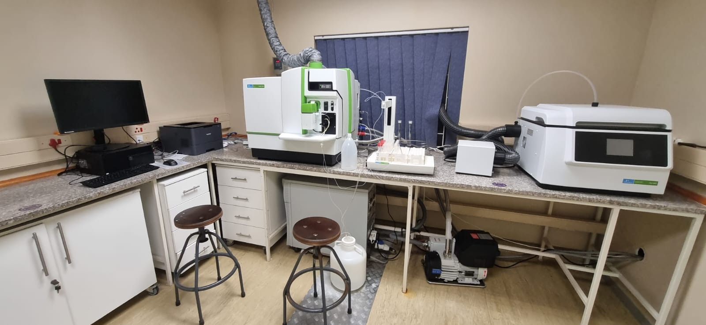
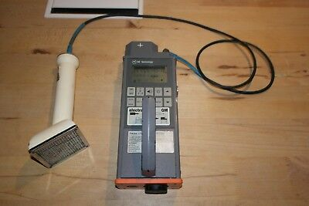
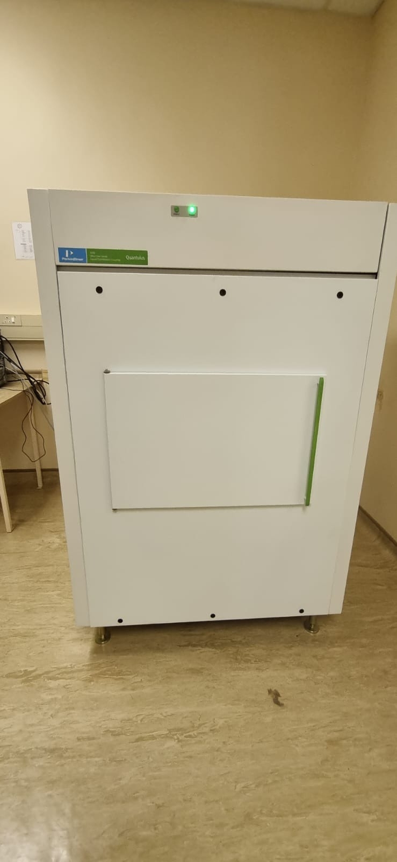
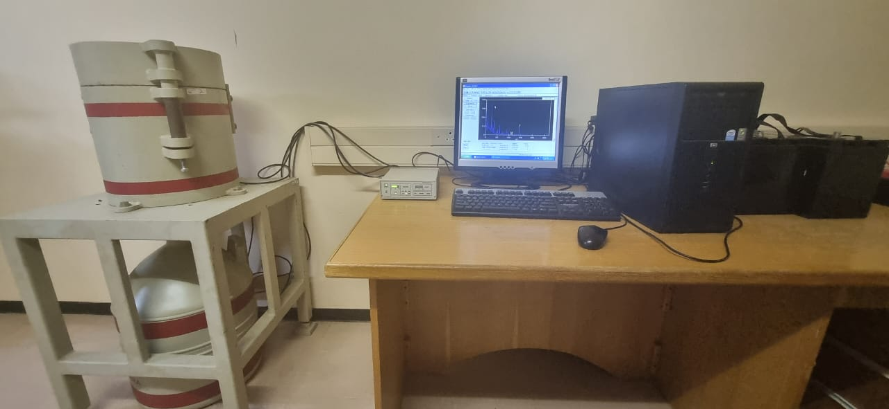
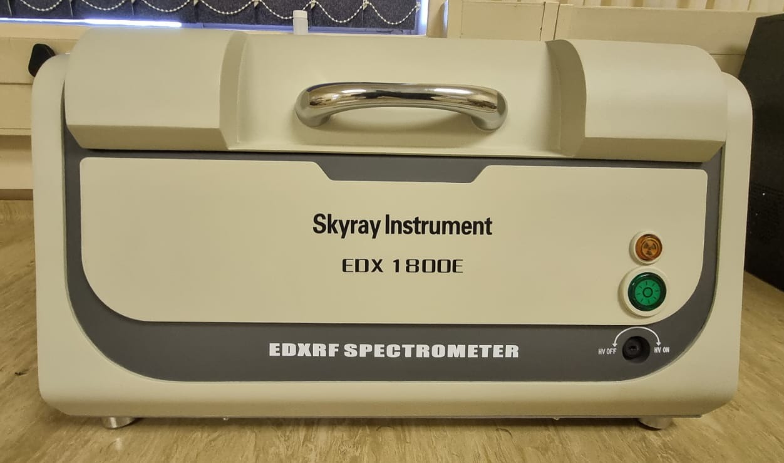
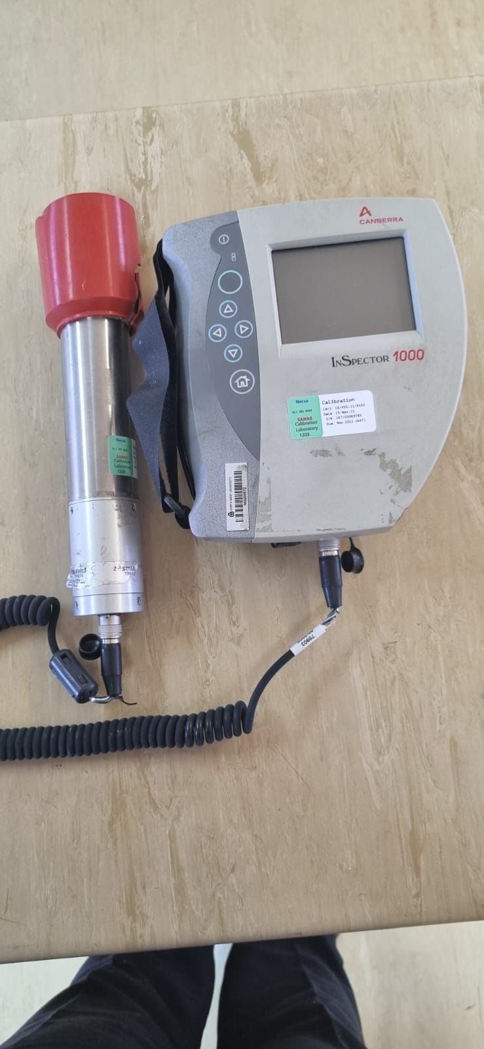
Equipment at CARST
ICP-MS NexION2000
Liquid Scintillation Detection
HPGe Detector

Slide 23
Research Collaboration
CARST
Animal Sciences
NWU
Chemistry
NWU
Environmental Sciences
NWU
Physics
NWU
Biological Sciences
NWU
Nuclear Industry
MoU
(Org)

Slide 24
MoU/MoA/SLA
Council for Geoscience
Ghana - Ghana Atomic Energy Authority, University of Ghana
Namibia - Regulator, Namibia University of Science and Technology (Polytechnic of Namibia), University of Namibia
Serbia - University of Novi Sad
South African Nuclear Energy Corporation (Necsa)
National Radioactive Waste Disposal Institute Of South Africa (NRWADI)
iThemba Labs
Border Management Authority - Radiation portal monitoring
JINR?

Slide 25
CARST Recent projects
Awarded NNR Funding for developing Radon Calibration Laboratory at CARST Facilities (2023 -2026).
Participation in;
IAEA CRP 20215: Radiation Portal Monitoring, (2024 -2027)
IAEA CRP 2020: Nuclear Forensics Science to Bridge the Radiological Crime Scene to the Nuclear Forensics Laboratory, (2024 – 2026).
IAEA WICO Isotope Hydrology Interlaboratory Comparisons Project (2024)
IAEA Proficiency Test Exercise (2024)
IAEA Galaxy Serpent for Desktop Nuclear forensics (2024)

Slide 26
NE: RESEARCH FIELDS
Computational Nuclear Engineering Analysis
Multiphysics Analysis
Uncertainty Propagation
Regulatory Analysis
Decommissioning Studies
Techno-economic Studies
Neutronic and Thermal Hydraulics
Fuel Performance
Regulatory Analysis
Accident Tolerant Fuel Design
Thorium Fuel Design

Slide 27
NE: Nuclear Systems Studied
PWRs:
North Anna, TMI, Watts-Bar, EPR, TPR, BEAVRS, Kosloduy
SMRs
NuScale, ACP100
RRs:
Safari, SPERT III, SPERT IV
HTGRs:
MHTR-350, HTTR, PBR-350, HTR-PM
SFP:
AP1000

Slide 28
NE: Computer Codes Expertise
Serpent
used in almost all neutronic studies, including burnup
SCALE
Used in Nuclear Data Uncertainty Studies
NESTLE
used with NEWT for MG studies – North Anna
CTF
Core Analysis
Relap5
Core Analysis
FLOWNEX
Fuel Pin and Fuel Assembly Calcs
STAR CCM+
Starting with FP codes

Slide 29
Recent Significant Projects
Awarded contract with NNR for
June 2022 - ongoing
Three major research projects
12 SLPs
Awarded contract with NNR for study on Accident Tolerant Fuel
2020 - ongoing
Participation in IAEA Uncertainty Propagation Benchmark
2016 – 2019
Participation in NEA/OECD Benchmarks for Uncertainty Analysis in Modelling (UAM) for the Design, Operation and Safety Analysis of LWRs
2016 - present

Slide 30
THANK YOU
North-West University
Private Bag X 2046, Mmabatho, 2735
North West Province
South Africa
www.nwu.ac.za

