Slide 1
Impact of the Collaboration on HCD - UNIZULU perspective
Exploring Long-Lived Shape Isomers in Photofission Fragments Using the upgraded VEGA spectrometer at the FLNR of the JINR..
Ngcobo PZ, Kamanin DV, Pyatkov Y. V.
Department of Physics, University of Zululand, Private Bag x1001, DLANGEZWA - 3886

Slide 2
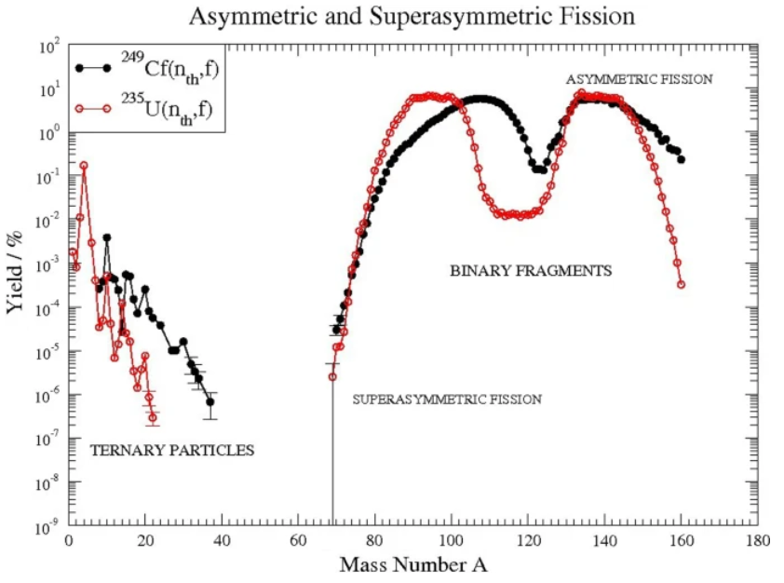
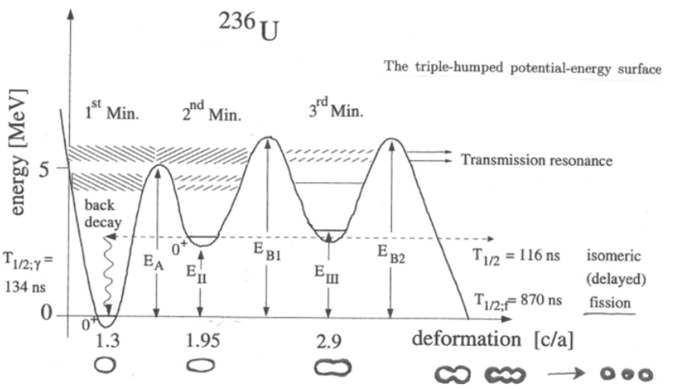
1…ternary binary fission factors: by Garrido [1],[2]
Figure 1: Mass distribution of ternary particle and binary fragments in the 249Cf(nth,f) and 235U(nth,f) reactions as a function of fragment mass. The shell model explains the two hump distribution with enhanced yields for masses around A=80 – 110 and A=120–140. The left side of the figure shows the yields of lighter third fragments in coincidence with two binary fission fragments, for two systems as indicated [3]
Figure 2: The potential energy as function of deformation for a hyper-deformed nuclear shape, which shows the double humped fission barrier suggesting a path to the collinear ternary fission decay in 236U, [4]

Slide 3
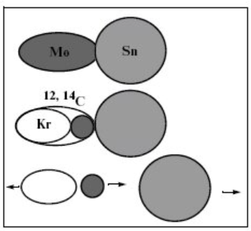
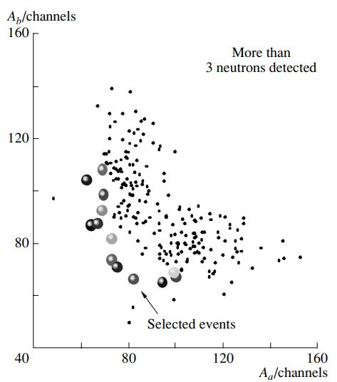
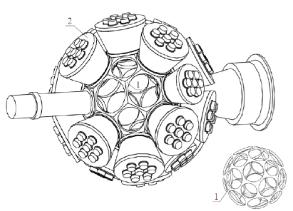
1.1 …collinear cluster tri-partition (CCT)
the ²⁵⁶Cf(sf) reaction [6]
collinear cluster tri-partition
4π spectrometer FOBOS
Figure 3. Illustration of the scenario of collinear cluster tri-partition accompanied by the emission of the light ion [5].
Figure 4. Amplitude distribution Y (A_{a}, A_{b}) of the complementary fragments under the condition that at least four neutron counters were fired

Slide 4
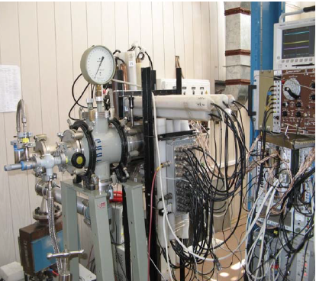
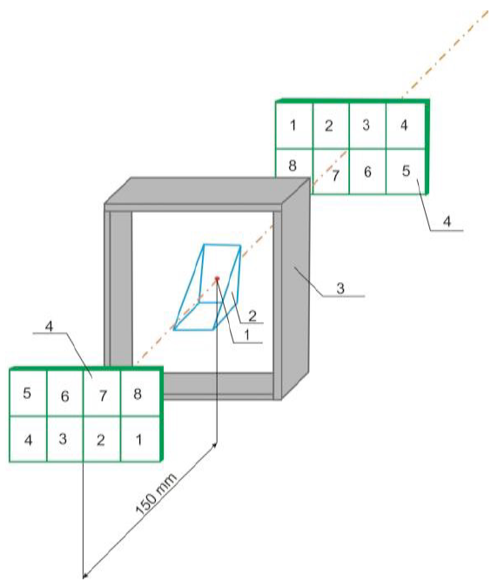
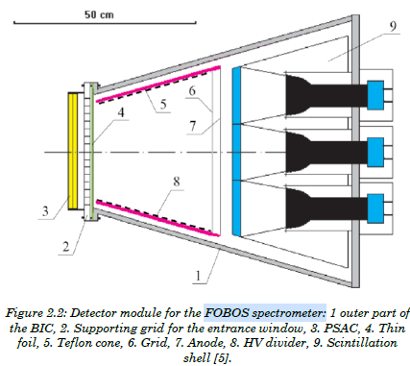
1.2…from FOBOS – COMETA - to enhanced VEGA spectrometer, V. Malaza [7]
The Enhanced VEGA Spectrometer at FLNR, JINR, is a cutting-edge tool for studying nuclear reactions. It enables precise measurements of fragment properties such as mass, charge, and kinetic energy. The spectrometer's high resolution and sensitivity allow for detailed investigations of nuclear structure and dynamics.

Slide 5
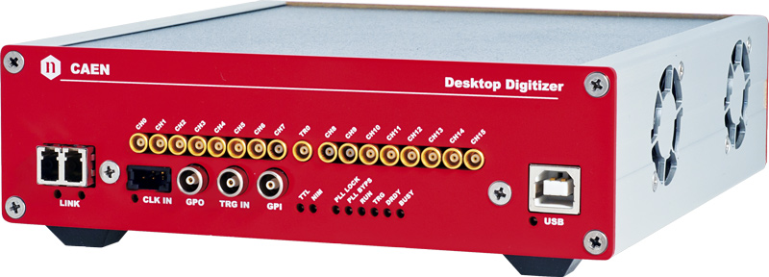
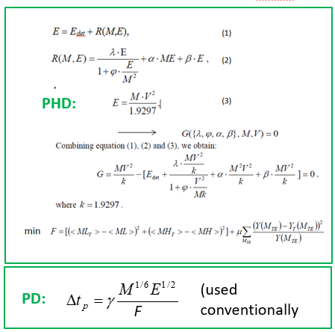
2 …challenges
Mosaics of PIN and MCP
Event by event processing of correlated masses
Mass of each fragment from V&E
Using of thick materials
Pile-up and base line controlled

Slide 6
Figure 6. Schematic view of the LIS-SA setup. [7]

Slide 7
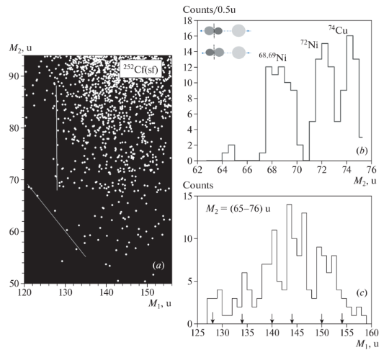
3 …contemporary observations
At least some fraction of the heavy FFs is supposed to be born in the shape isomer state with the life-times exceeding 400 ns. [8]
Figure 7 :FFs mass correlation distribution from 252Cf (sf) (a). Projection of the distribution onto M₂ axis (c), and onto M₁ axis (c), both projections are under condition that M₂=(65–76) u [8]

Slide 8
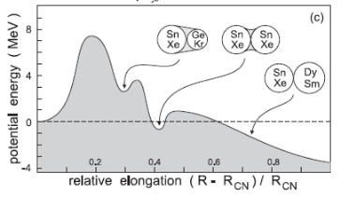
4 …Shape Isomeric States in Super-Heavy Nuclei
Are there fission isomers in the mass range of fission fragments?
Figure 8:Three-humped barrier calculated along the fission path of 296 ¹¹⁶Lv (Livermorium). [9]

Slide 9
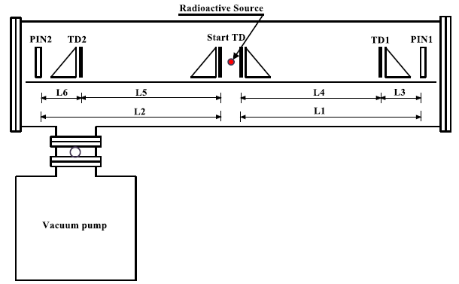
5 …Light Ion Spectrometer for South Africa (LIS-SA) [7].
Highlighted deliverables to the NRF, Russia grant
Figure 6. Schematic view of the LIS-SA setup. [7]

Slide 10
6 …conclusive remarks [10]
1. In the framework of the different experimental approaches, the induced fission (breakup) of a certain part of fission fragments through the shape-isomer states was discovered.
2. The life-time of at least some of such states exceeds 400 ns.
3. The shape-isomer state in fission fragment manifests itself via delayed break-up of the fragment in a solid-state foil.

Slide 11
7 …References
[1] E. Garrido, D.V. Fedorov, A.S. Jensen, H.O.U. Fynbo, Nucl. Phys. A 748, 27 (2005)
[2] E. Garrido, D.V. Fedorov, A.S. Jensen, H.O.U. Fynbo, Nucl. Phys. A 766, 74 (2006)
[3] F. Gönnenwein, Nucl. Phys. A 734, 213 (2004)
[4] M. Csatlós, A. Krasznahorkay, P.G. Thirolf, D. Habs, Y. Eisermann, T. Faestermann, G. Graw, J. Gulyás, M.N Harakeh, R. Hertenberger,
M. Hunyadi, H.J. Maier, Z. Máté, O. Schaile, H.-F. Wirth, Phys. Lett. B 615, 175 (2005)
[5] Kamanin, D.V. et al. (2013). Collinear Cluster Tri-Partition as a Probe of Clustering in Heavy Nuclei. In: Greiner, W. (eds)
Exciting Interdisciplinary Physics. FIAS Interdisciplinary Science Series. Springer, Heidelberg.
https://doi.org/10.1007/978-3-319-00047-3_10
[6] Pyatkov, Y.V., Kamanin, D.V., Alexandrov, A.A. et al. New indications of collinear tripartition in 252Cf(sf) studied at the modified
FOBOS setup. Phys. Atom. Nuclei 66, 1631–1635 (2003) https://doi.org/10.1134/1.1611571
[7] Malaza V.D., PhD Dissertation, Stellenbosch University, South Africa, 2018.
[8] Pyatkov, Y.V., Kamanin, D.V., Solodov, A.N. et al. New Modes of Collinear Cluster Tri-Partition. Phys. Atom. Nuclei 85, 763–769
(2022). https://doi.org/10.1134/S1063778823010477
[9] V. ZAGREBAEV, W. GREINER Proc. Int. Symp. on Atomic Cluster Collisions (ISACC07), GSI, Darmstadt, 2007, (Imperial
College Press, London, 2008), Eds. J.-P. Connerade and A. V. Solov'yov, p. 23
[10] D.V. Kamanin, Yu.V. Pyatkov, A.N. Solodov, V.E. Zhuchko, Z.I. Goryainova, O.V. Strekalovsky, E.A. Kuznetsova, A.O. Zhukova,
OBSERVATION OF FISSION ISOMERS AMONG FRAGMENTS OF SPONTANEOUS AND INDUCED FISSION OF HEAVY NUCLEI

