Slide 1
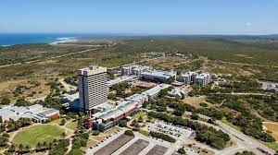
Reflections on the SA NMU-JINR Research Collaboration
Dr Zikhona Tywabi-Ngeva
17 June 2025

Slide 2
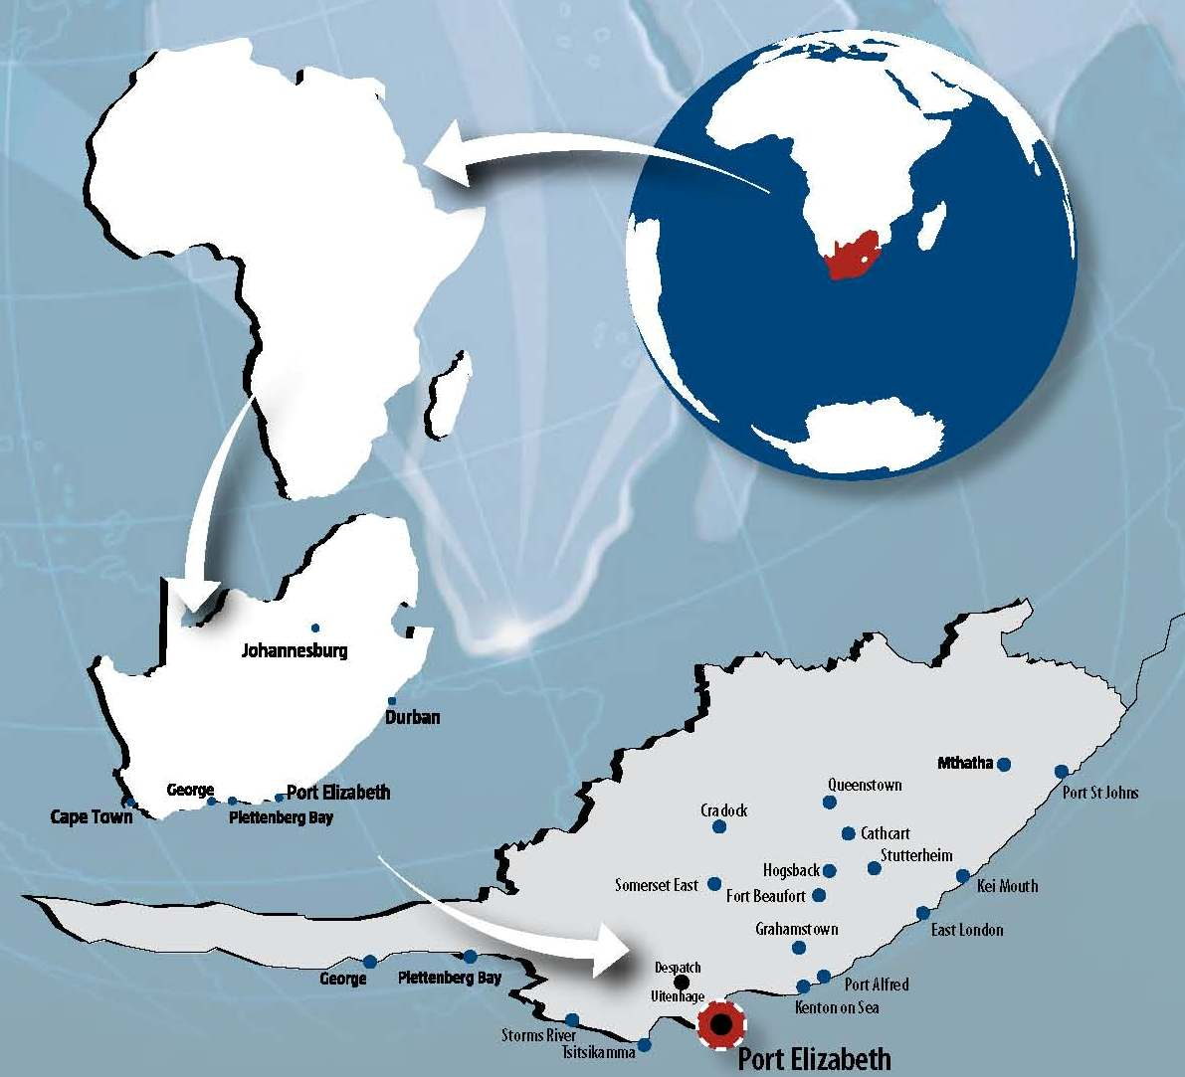
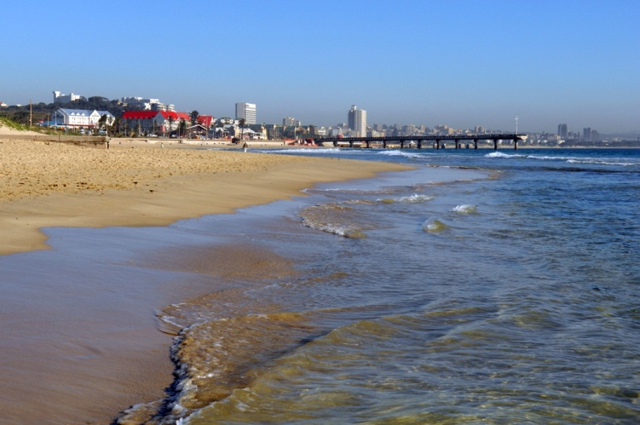
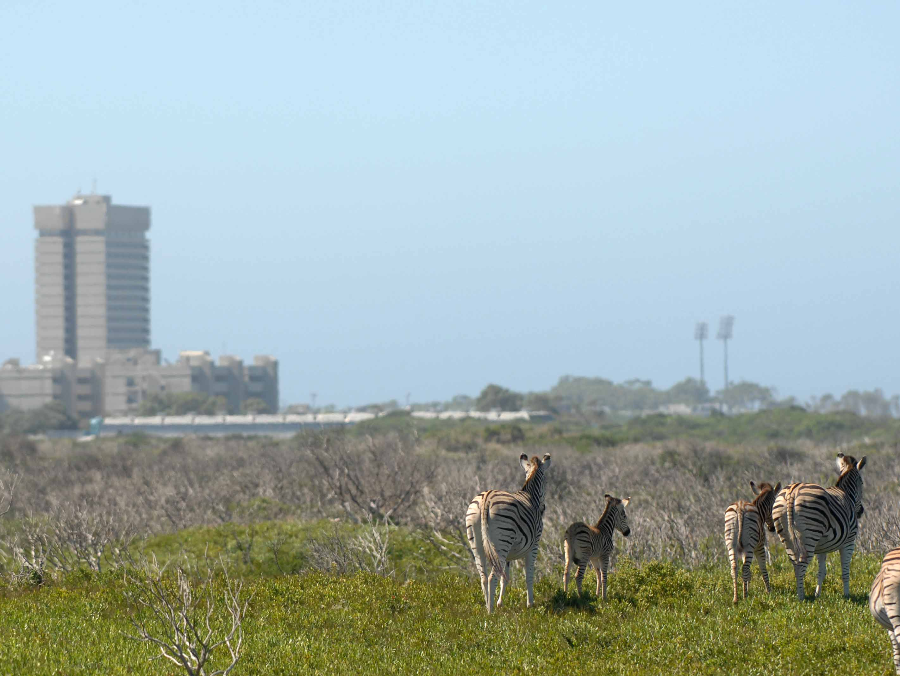
NELSON MANDELA UNIVERSITY
Few meters from the beach…
Nature Reserve on campus

Slide 3
Faculty profile

Slide 4
Our institutional research themes
Ocean and coastal sciences
Social justice and democracy
Environmental stewardship and sustainable livelihoods
Innovation and the digital economy
Origins, culture, heritage and memory and
Humanising pedagogies

Slide 5
RESEARCH PROJECT DETAILS
To synthesize various green cyclodextrin derivatives for the removal of pesticides and heavy metals from surface water, wastewater, soil, sediment, and sewage sludge collected from selected contaminated sites in the Port Elizabeth City North End Lake and the Harbour.
Prof Wael Badway JINR -assessment of the ecological situations based on the heavy metals compositions and Naturally Occurring Radioactive Material (NORM) using nuclear and related analytical techniques.

Slide 6
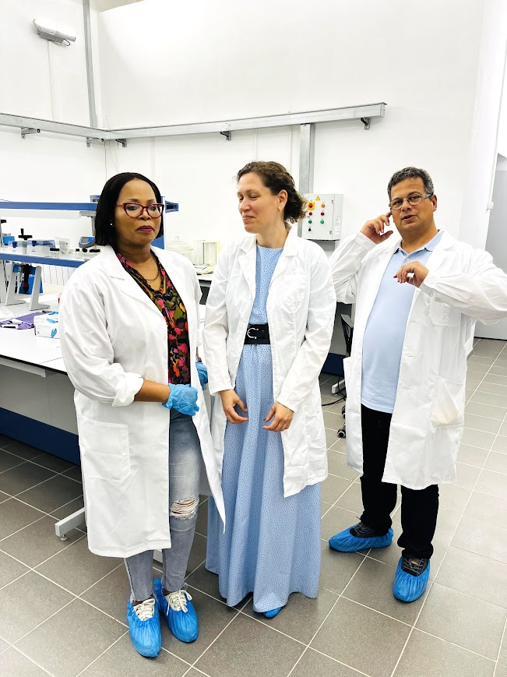
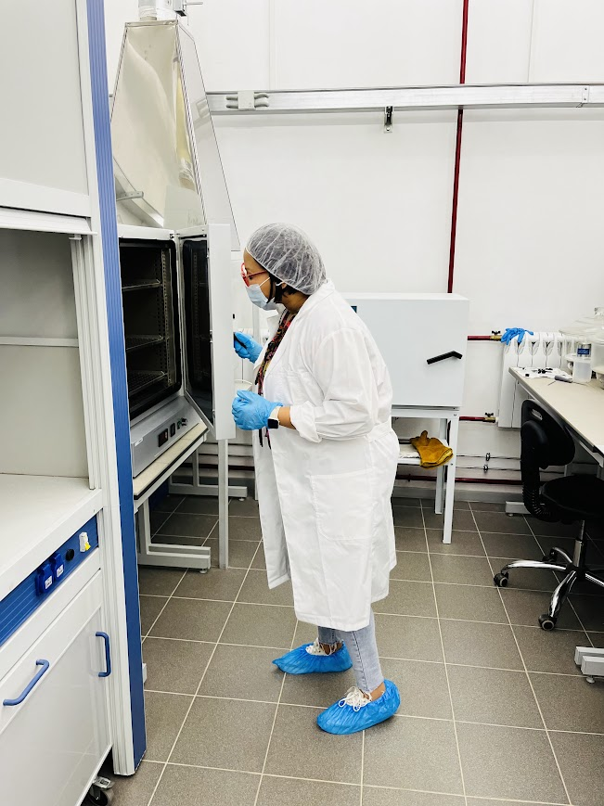
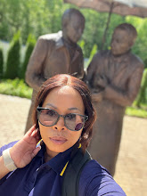
First visit to JNIR_June 2024
Getting lost but… a pic first ☺

Slide 7
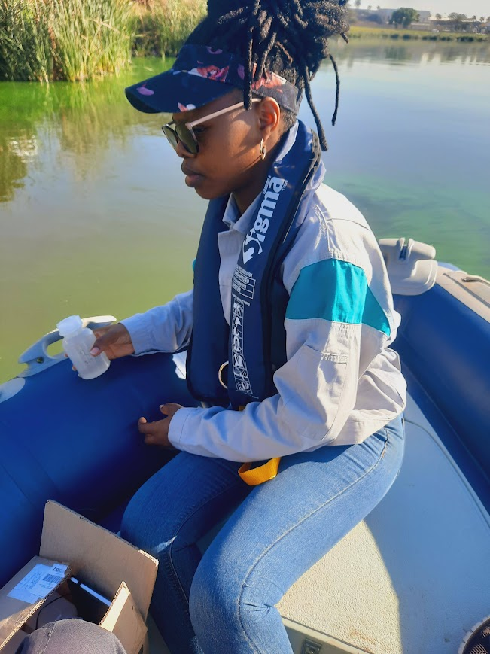
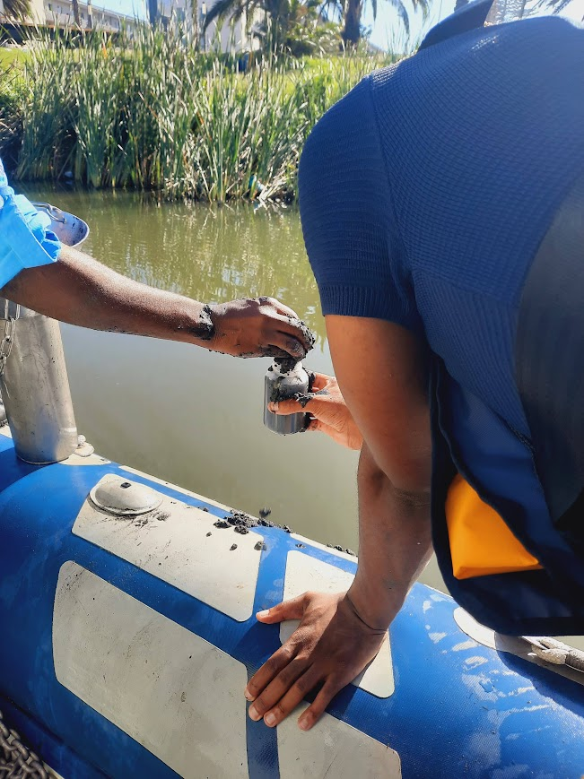
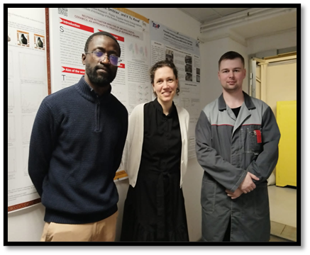
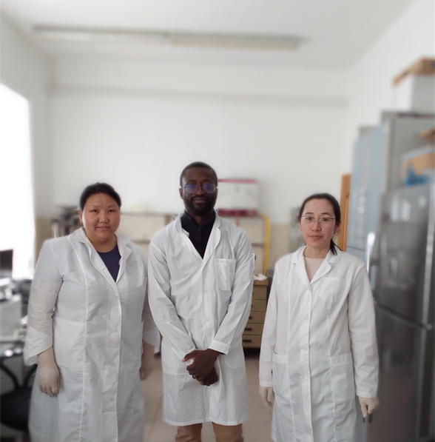
MILESTONES IN THE COLLABORATION
Human capital development

Slide 8
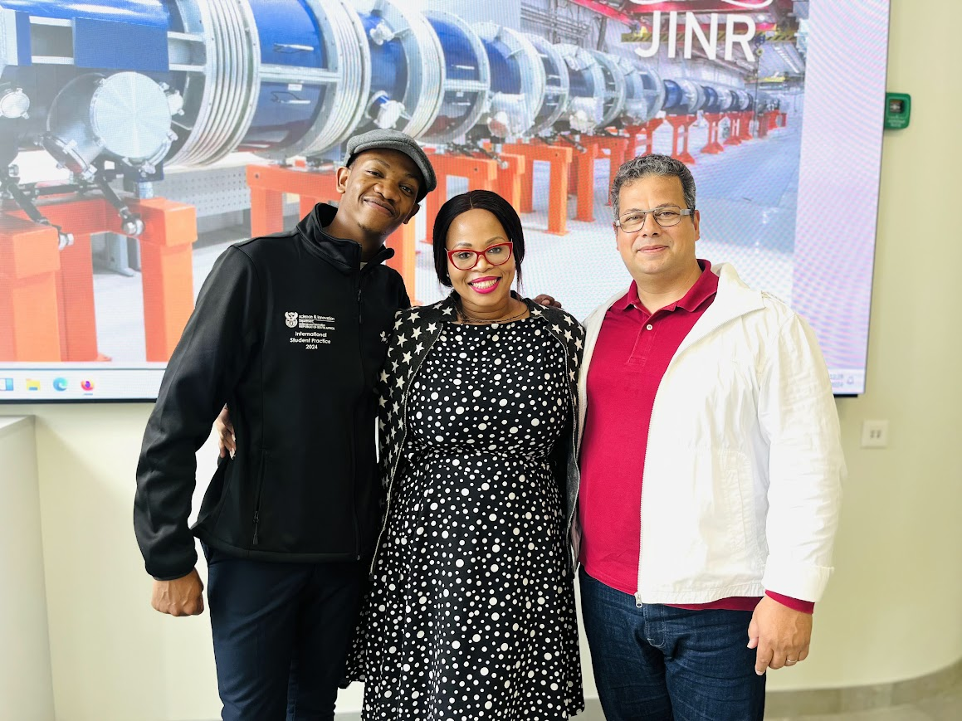
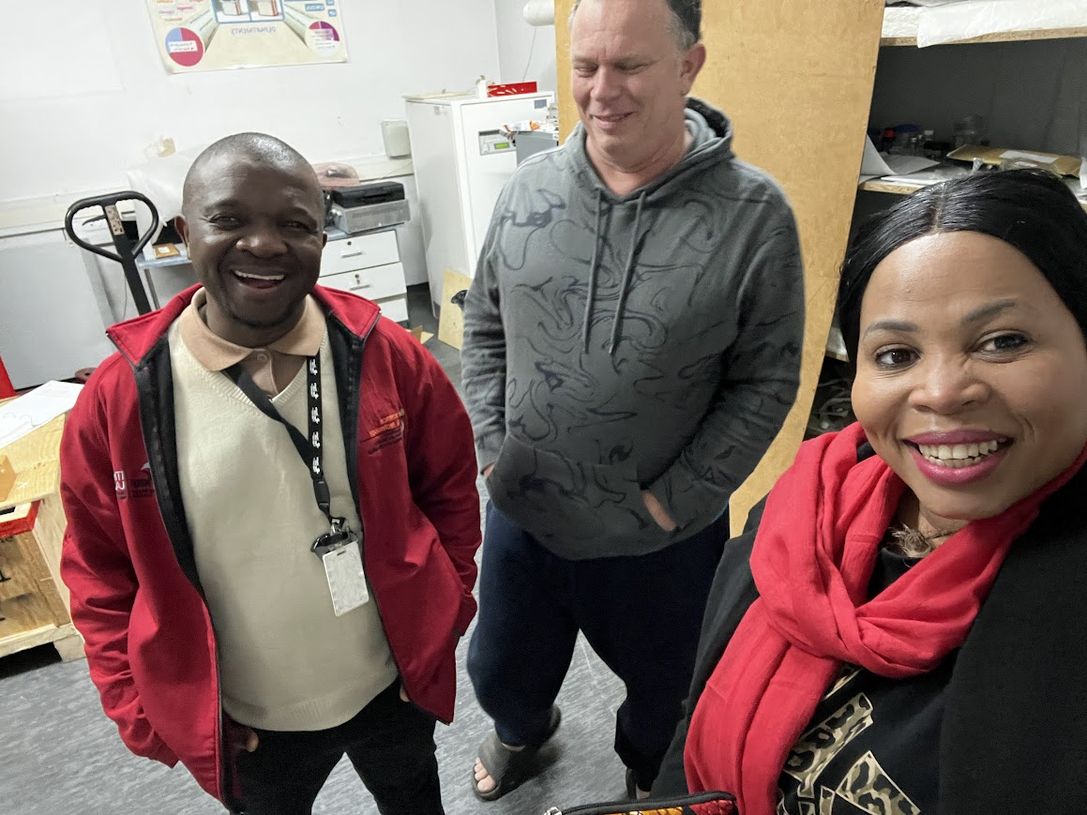
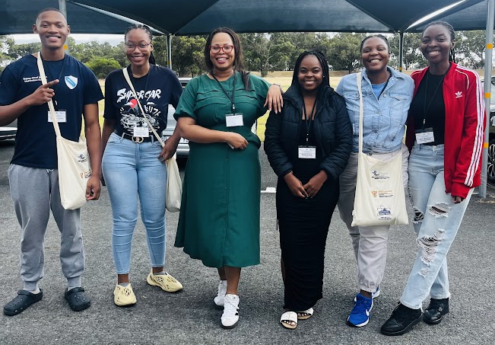
MILESTONES IN THE COLLABORATION

Slide 9
Conclusions
Collaboration- hands-on experience in neutron physics (interdisciplinary research)
Assess to specialized equipment
Enhancing international collaboration and capacity building in the scientific community
Pairing established researchers with emerging researchers is effective- knowledge and skills transfer, career guidance, networking opportunities etc.

Slide 10
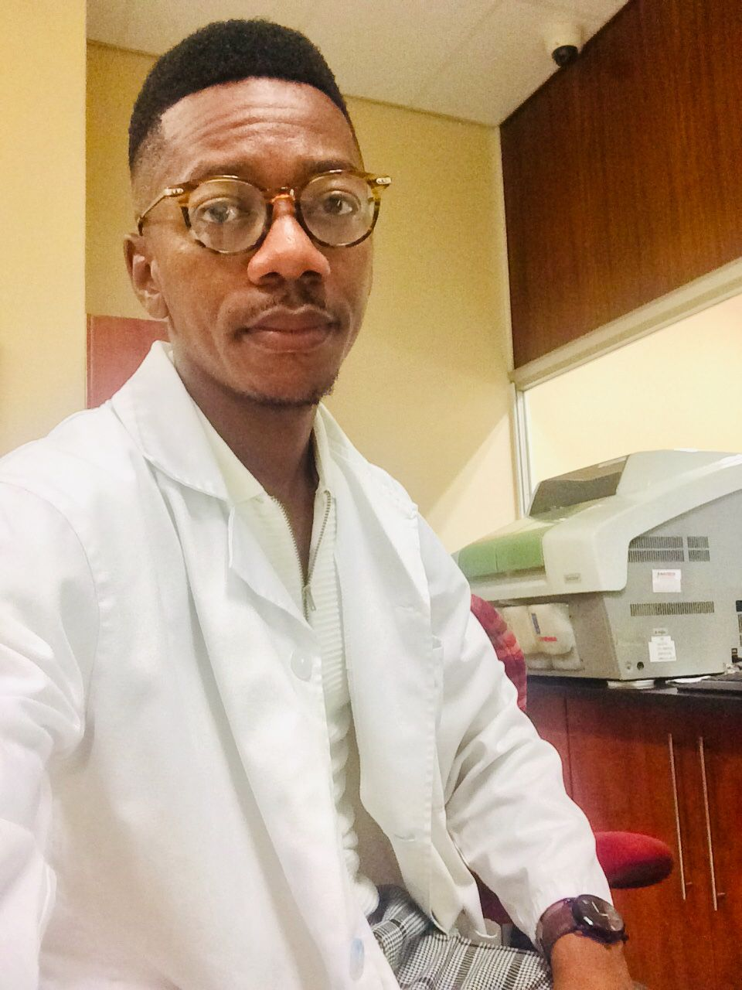
Meet the TEAM
Overall, I would say I had a successful visit at JINR. I have learned the different work conducted at the institute, the different member state affiliated with the institute. Once in South Africa, I will be able to speak to other scientist about JINR and the work they do so that whoever is interested for collaboration will contact the institute directly. I look forward as well to have more projects that will make use of the NAA and maintain a collaboration with Prof Wael.
Gael

Slide 11
zikhonatn@mandela.ac.za
WhatsApp: +27 (0) 78 619 7804
https://chem.mandela.ac.za/Staff/Zikhona-Tywabi-Ngeva
ORCID: https://orcid.org/my-orcid?orcid=0000-0002-5290-6942
Google Scholar: https://scholar.google.co.za/citations?user=73BWHmIAAAAJ&hl=en
uture Work

