Slide 1

Fabrication of semiconductors using SiNPs synthesized from SiO₂ extracted from agricultural waste
Ntombizonke Kheswa

Slide 2
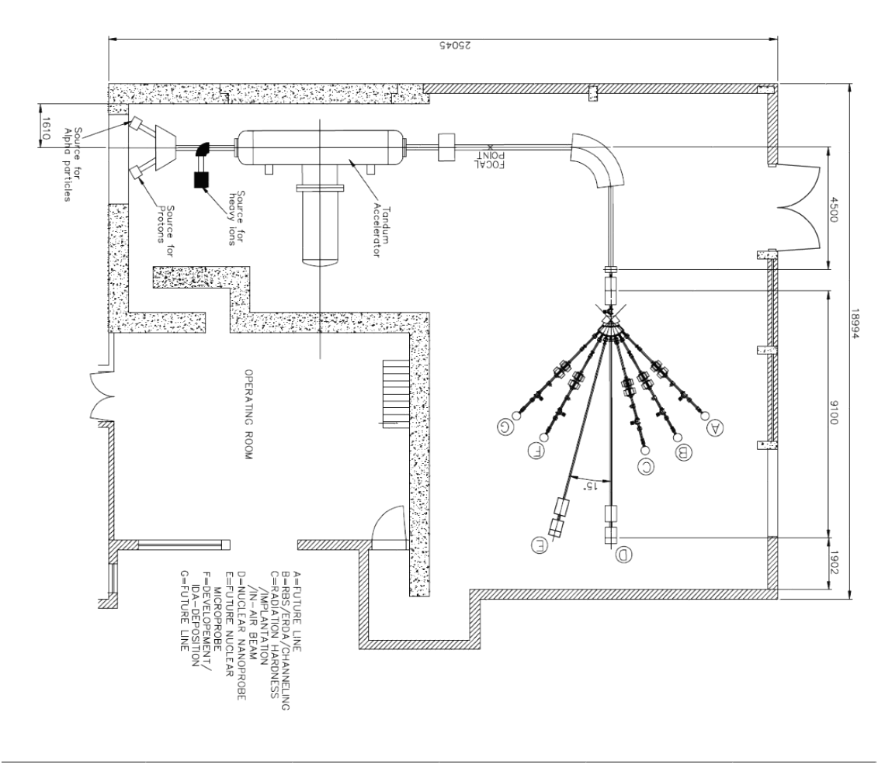
3 MV Tandetron Accelerator Layout
Nanoprobe
RBS/ERDA
NMP/RBS

Slide 3
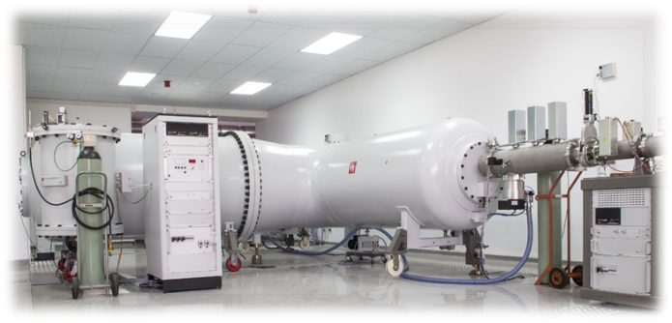
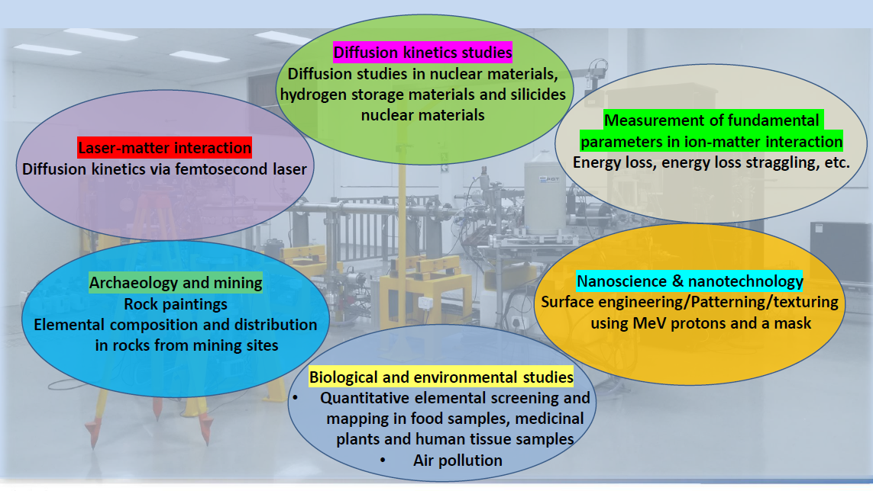
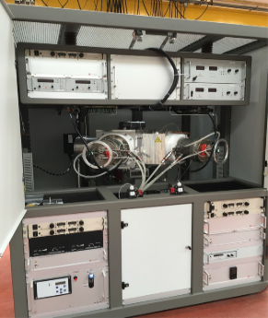
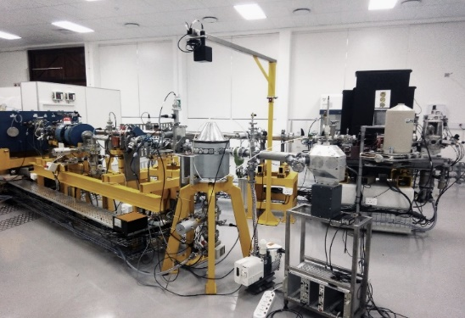
Tandetron Laboratory: Research Focus
Research themes

Slide 4
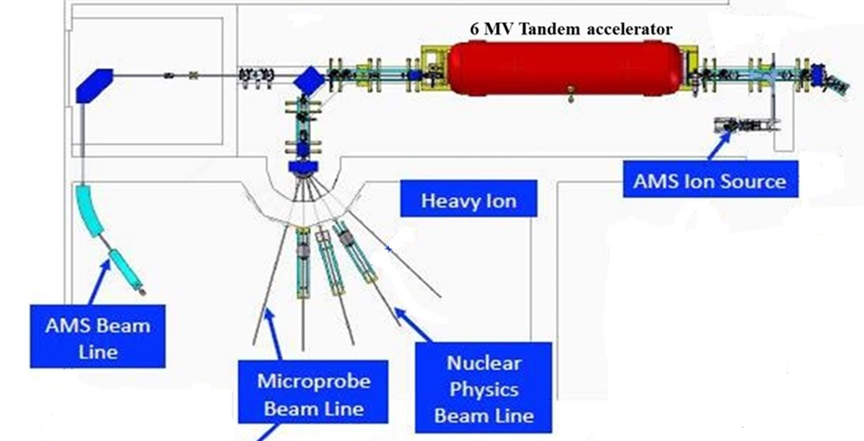
Layout of the 6 MV Tandem Accelerator

Slide 5
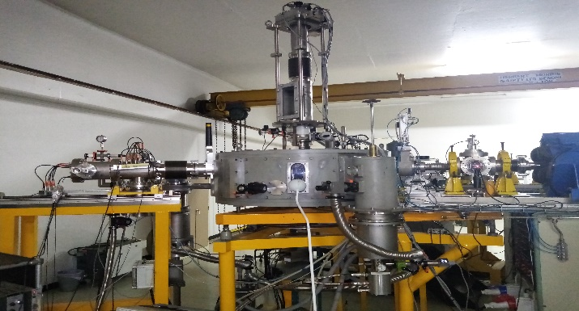
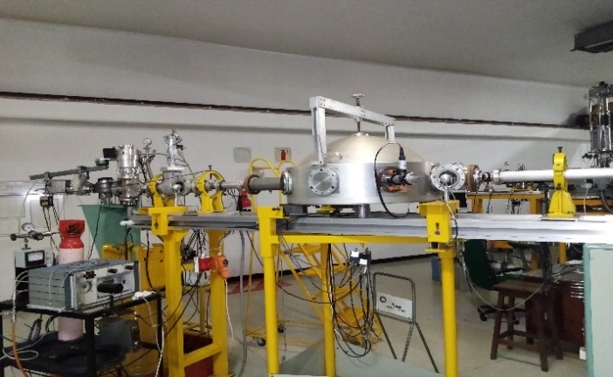
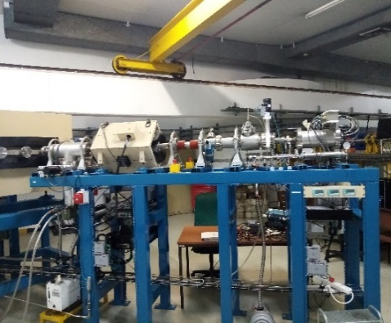
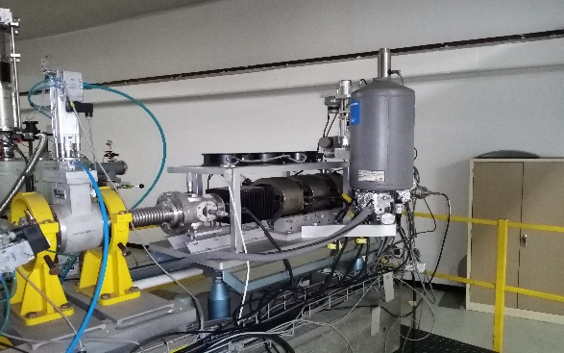
TAMS Laboratory: Research Focus
Accelerator Mass Spectrometry (AMS),
Materials engineering and research using Ion Beam Analysis (IBA) techniques,
Ion Implantation,
Environmental Radioactivity,
Stable light isotope analyses, and
Low energy Nuclear Physics.

Slide 6
Renewable materials research
Agricultural waste to:
Extract SiO₂ and thermal-reduction to Si
Use this to make value added materials like:
Dye-sensitised solar cells
Perovskite solar cells
Make Biochar to use as anodes
Magnetic semiconductors for spintronics

Slide 7
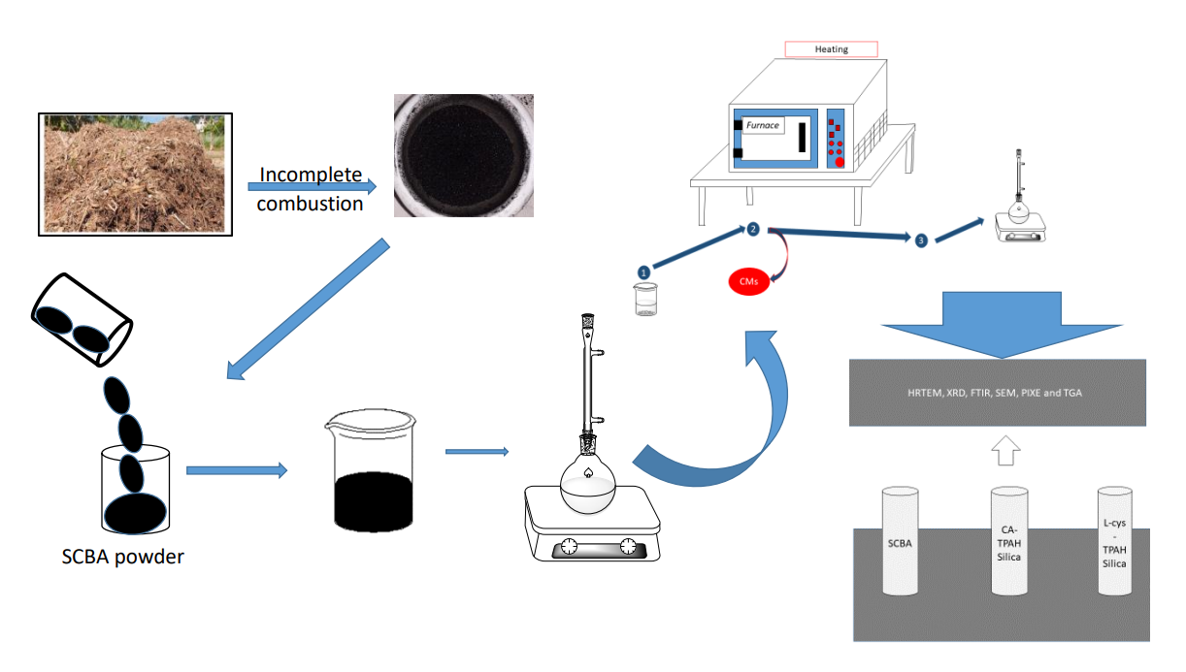
Synthesis of SiO₂NPs from SCBA

Slide 8
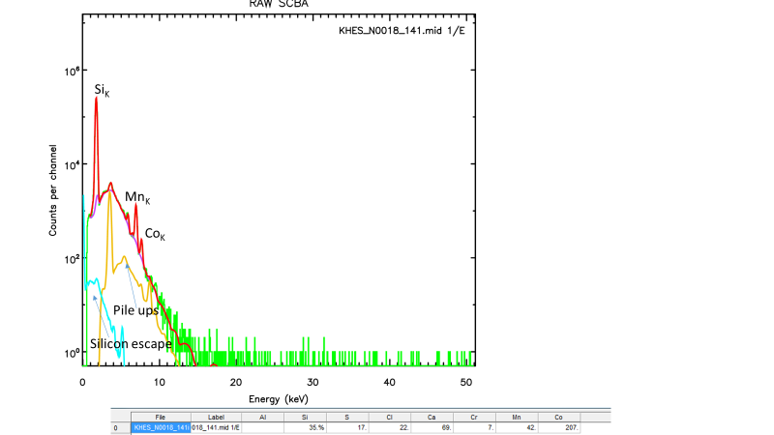
PIXE analysis of SCBA

Slide 9
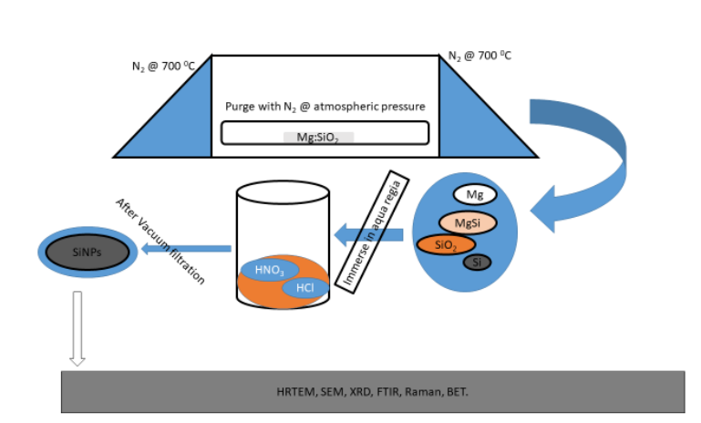
SiNPs

Slide 10
Thin film deposition for n-p type cell fabrication
EBEAM vacuum evaporation systems was used to deposit thin film solar cells.
Substrate-ITO
Si n-type layer was created by depositing bismuth on Si.
Si p-type lay was created by depositing boron on Si layer
Ag deposited as a contact layer
The thicknesses were verified using AFM and RBS

Slide 11
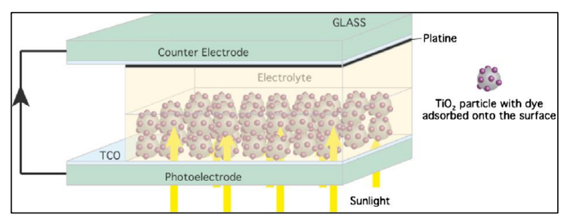
Dye Sensitised Solar Cell
General design
Our construction
TCO- ITO
SiNPs thin film made by EBEAM
Electrolyte –KI
Dye-metallic dye
Counter electrode-polymer

Slide 12
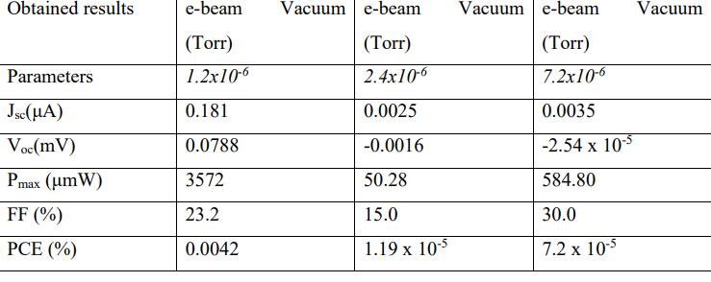
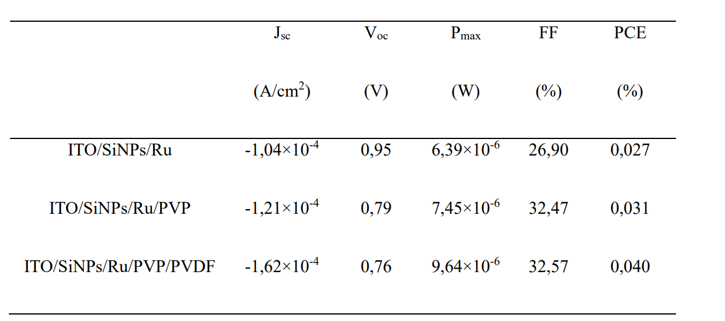
cell performance testing
DSSC
P-n type Si SC

Slide 13
Projects in the pipeline
Perovskite cells and magnetic semiconductors using SiNPs from biomass conversion.
Notes:
111

Slide 14
Thank you for your attention.
Ngiyabonga!

