Slide 1
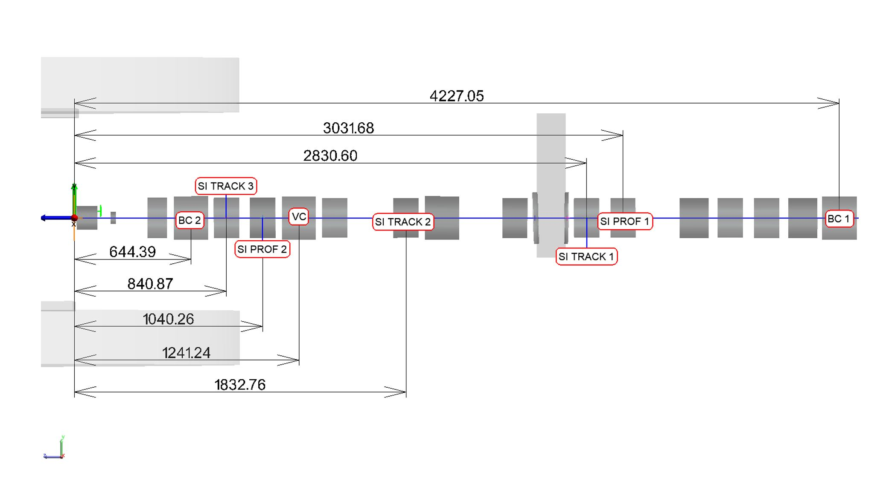
Status of the Si-detectors on BM@N
N. Zamyatin on behalf of Si-detectors team, 14÷16 October 2025, 15th – CM/BM@N, Dubna
- Beam Profilometer;
- Beam Tracker (BT1 ÷ BT3);
- Forward Si-Tracker (FSD)
*Отчет 26.01.2024г
« Измерение фактического положения детекторов установки BM@N и их юстировка в проектное положение относительно пучка.»
ООО «Промышленные измерения»

Slide 2


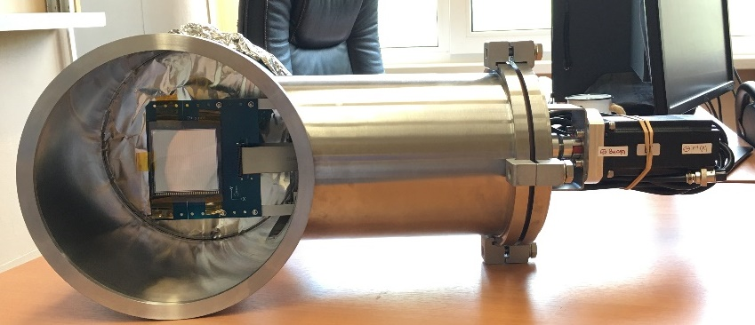
Beam profilometer is necessary for beam tuning in self trigger mode (alignment of the center beam with the center of the target)
1. New beam profilometer for heavy ions (Xe, Au, Bi)
working position
Beam profilometer inside beam vacuum station
detector: DSSD, (128p⁺×128n⁺), strips pitch = 475 μm, thickness (Si) -175 μm, active area (61 × 61) mm². Strips are combined in pairs on detector board. Total have (64p⁺×64n⁺), pitch = 950 μm
mechanical design: the plane of the profilometer is automatically removed from the beam zone to the parking position
FEE based on two VA32HDR11 ASICs. Total number of channels are 64 for X and 64 for Y coordinate. Dynamic range of signals: -35pC ÷ +25pC. Charge of ionization for heavy ions Xe(10.8 pC/175 μm-Si), Au (20.9 pC/175 μm-Si), Bi) corresponded of ∆E-signals (240÷500 MeV/175 μm-Si).
Peaking time 800 ns.
Self trigger mode based on TA32cg2 ASICs
current status:
FEE have been designed, manufactured and tested with Si detector placed in flanges with alpha-source (²²⁶Ra) and standalone DAQ subsystem, Need to install and to align on beam pipe

Slide 3


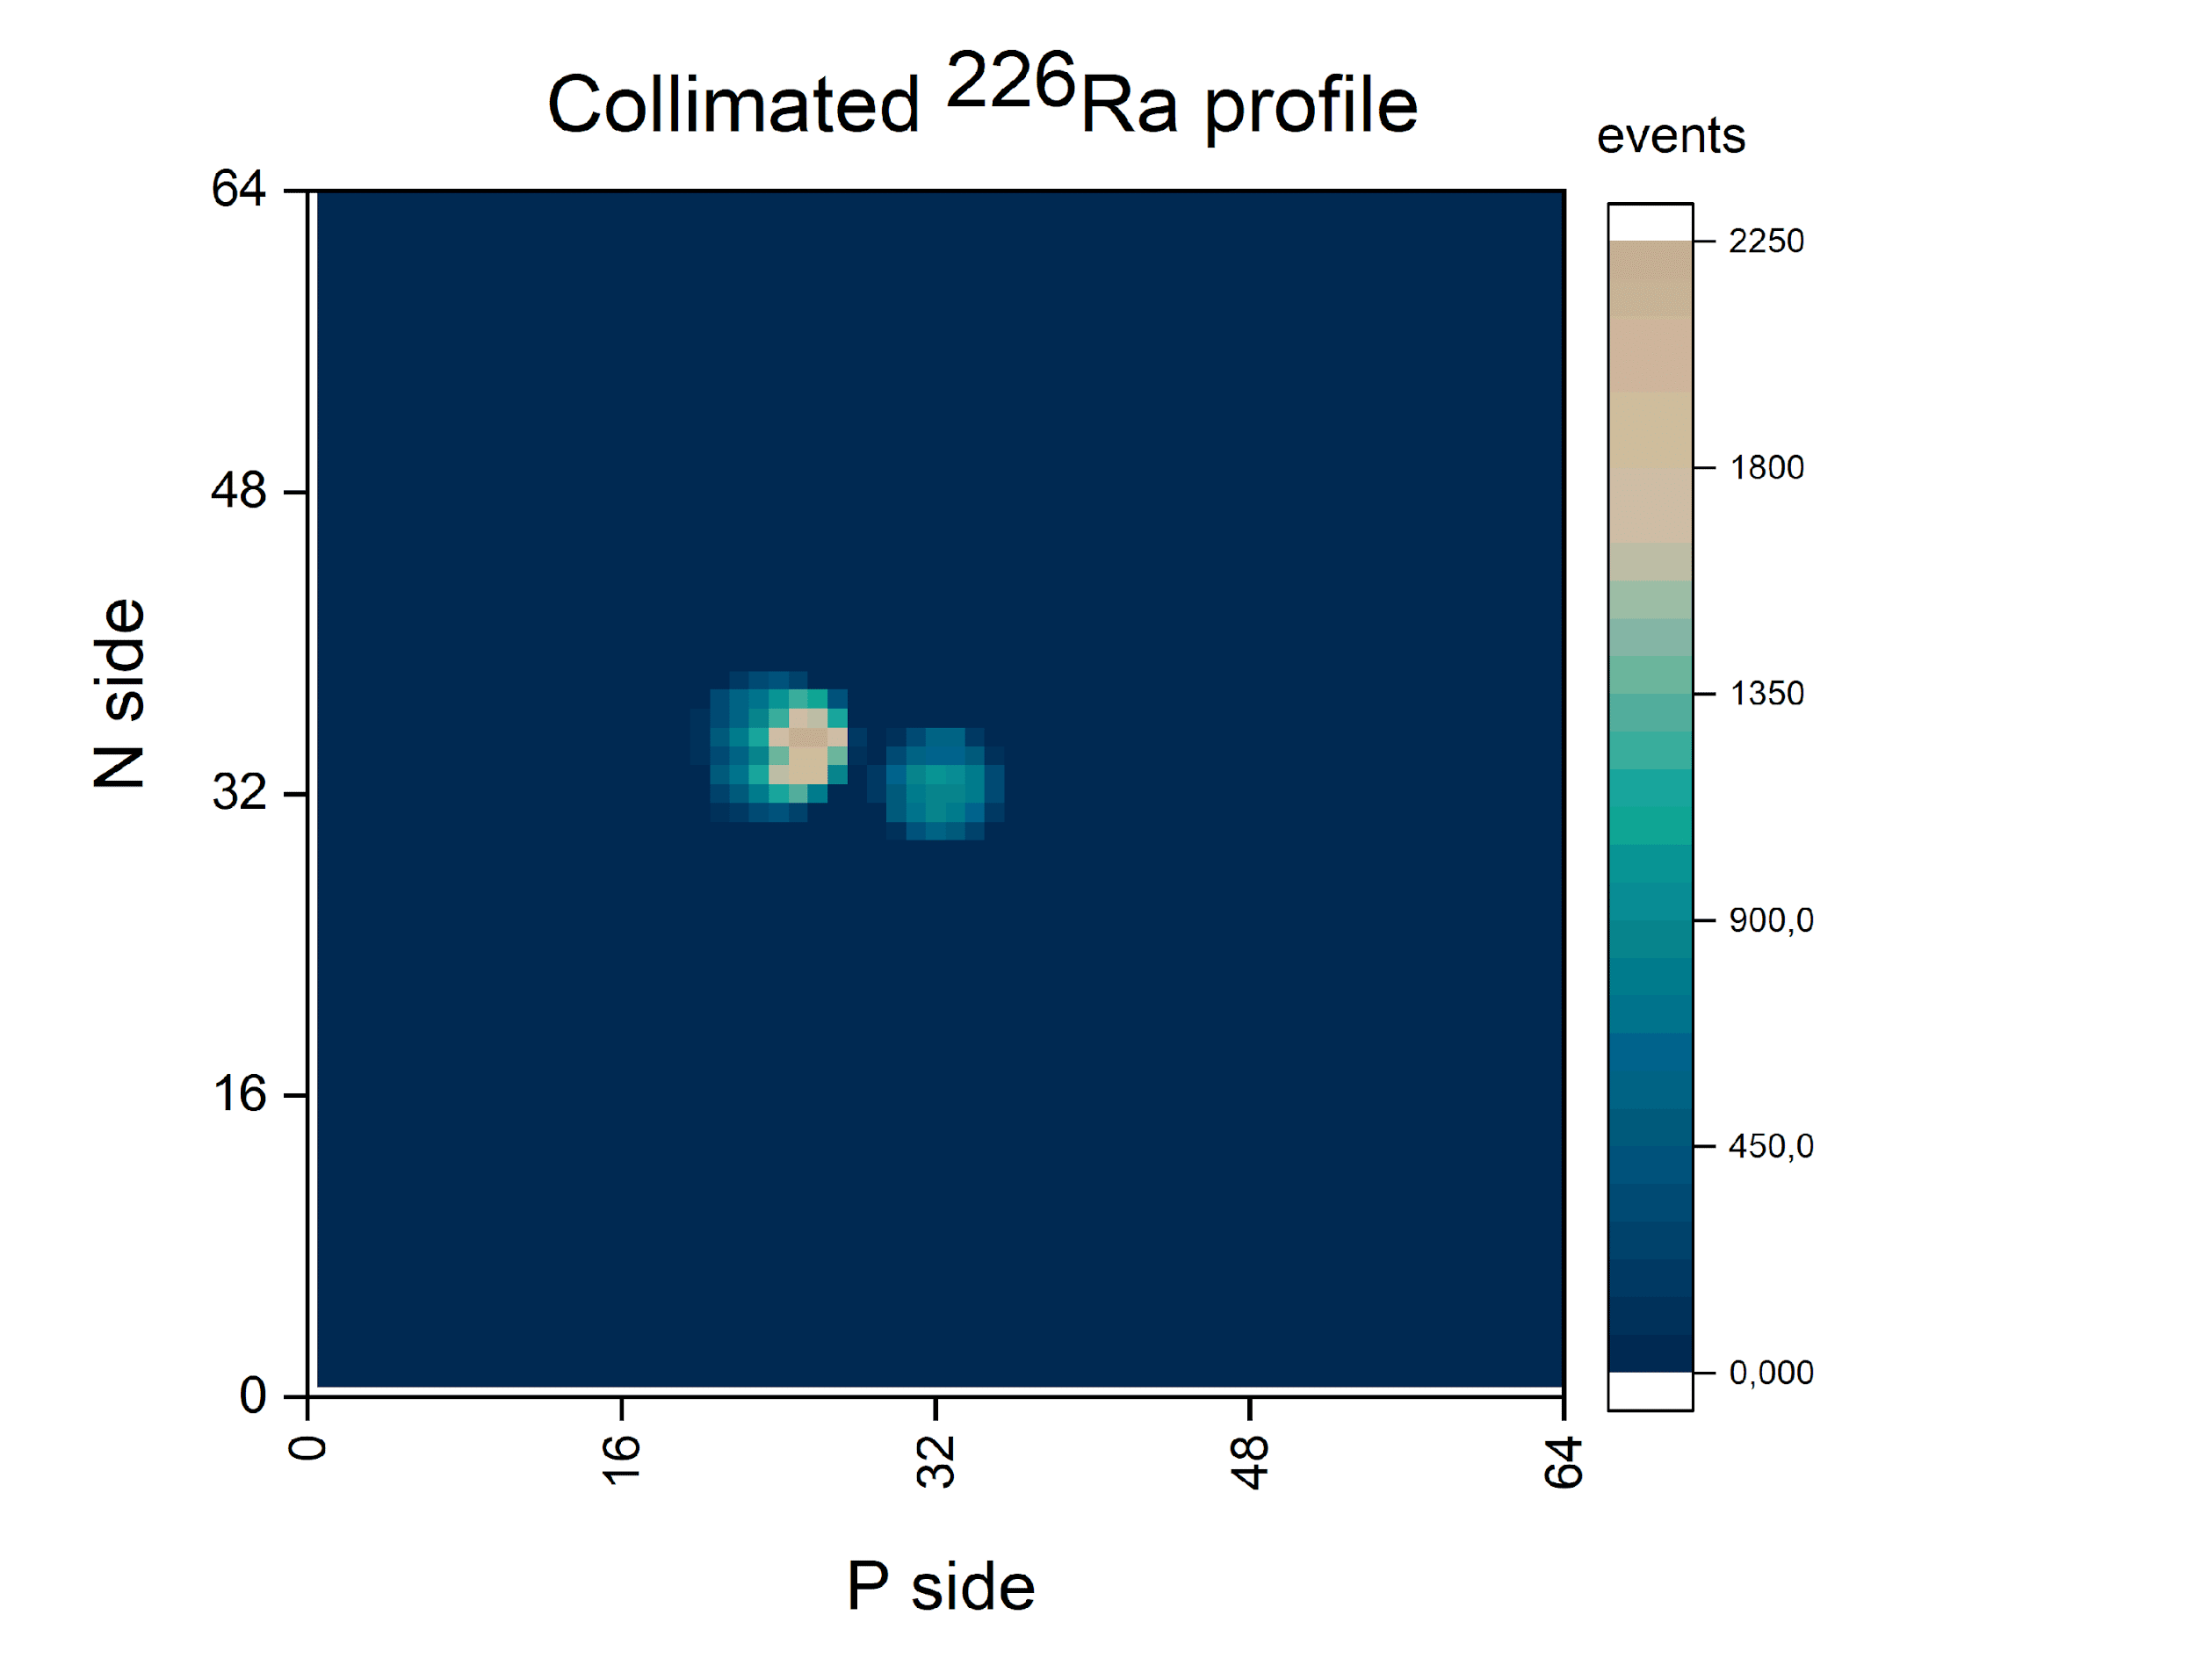
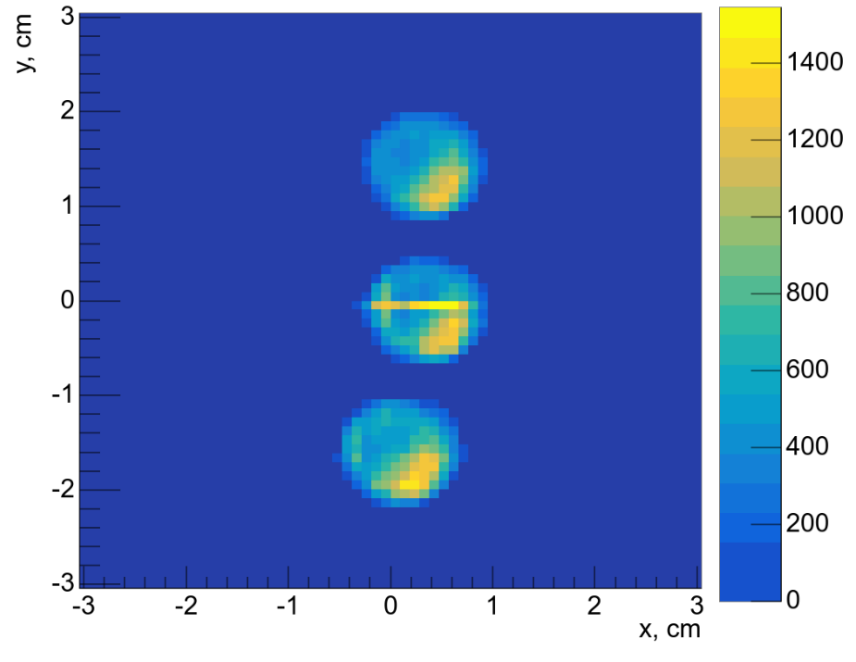
- a new coordinate plane (Fig.2) has been developed and manufactured for run 2025: DSSD with (128x128) strips, 175 µm thickness has been converted into a (64x64) strips configuration (combining the strips in pairs, for a total of 128 channels); - a new FEE variant based on the VA32HDR11 + TA32cg2 ASICs (there are ASICs available) has been developed, manufactured and tested with an alpha source, a large signal range of +/-20 pC/dE≈500 MeV (for more detail see report by D.Chemezov)
Status of the new beam profilometer (64×64) strips for heavy ions (Xe, Au, Bi)
Fig.1.
- Fig.1 shows the results of the 2022 tests Si profilometer version–1 with an alpha (4.5-7.6) MeV source; - the same results were expected when working with a ¹²⁴Xe beam (dE/175 µm ≈ 245 MeV), but failed due to signal overlap (self trigger mode) and exceeding the dynamic range (ASIC-VA163/750 fC), both profilometers were removed to the "parking" position and were not used in the 2022-2023 run, in the future they can be used for light ions up to Ar;
Fig.2.
²²⁶Ra in three different positions

Slide 4
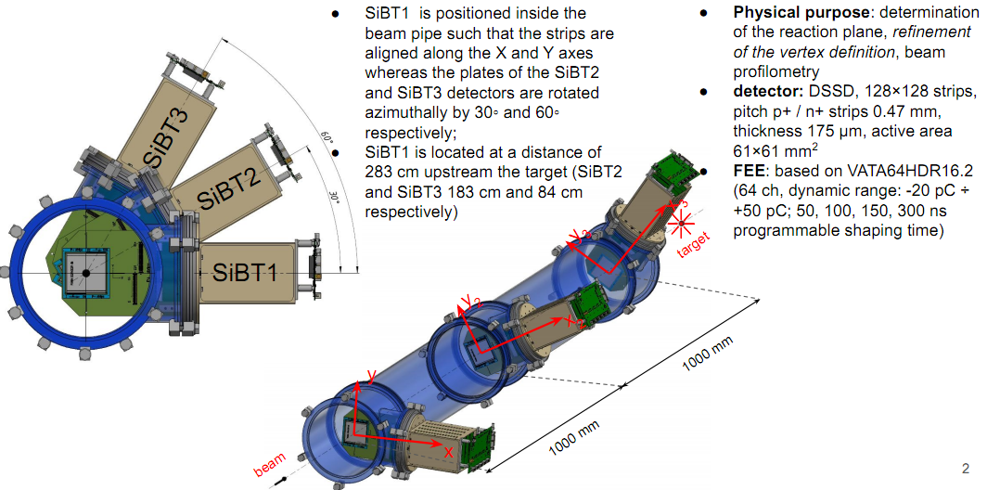
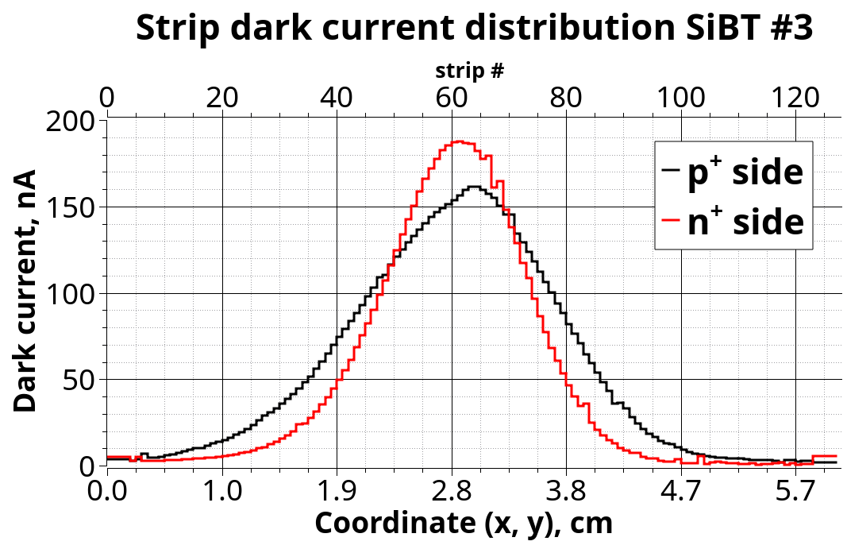
2. Beam Tracker (BT1÷BT3) for Run-2025
Radiation autograph of the ¹²⁴Xe beam(3.8 AGeV) from the 2022-2023 run.

Slide 5
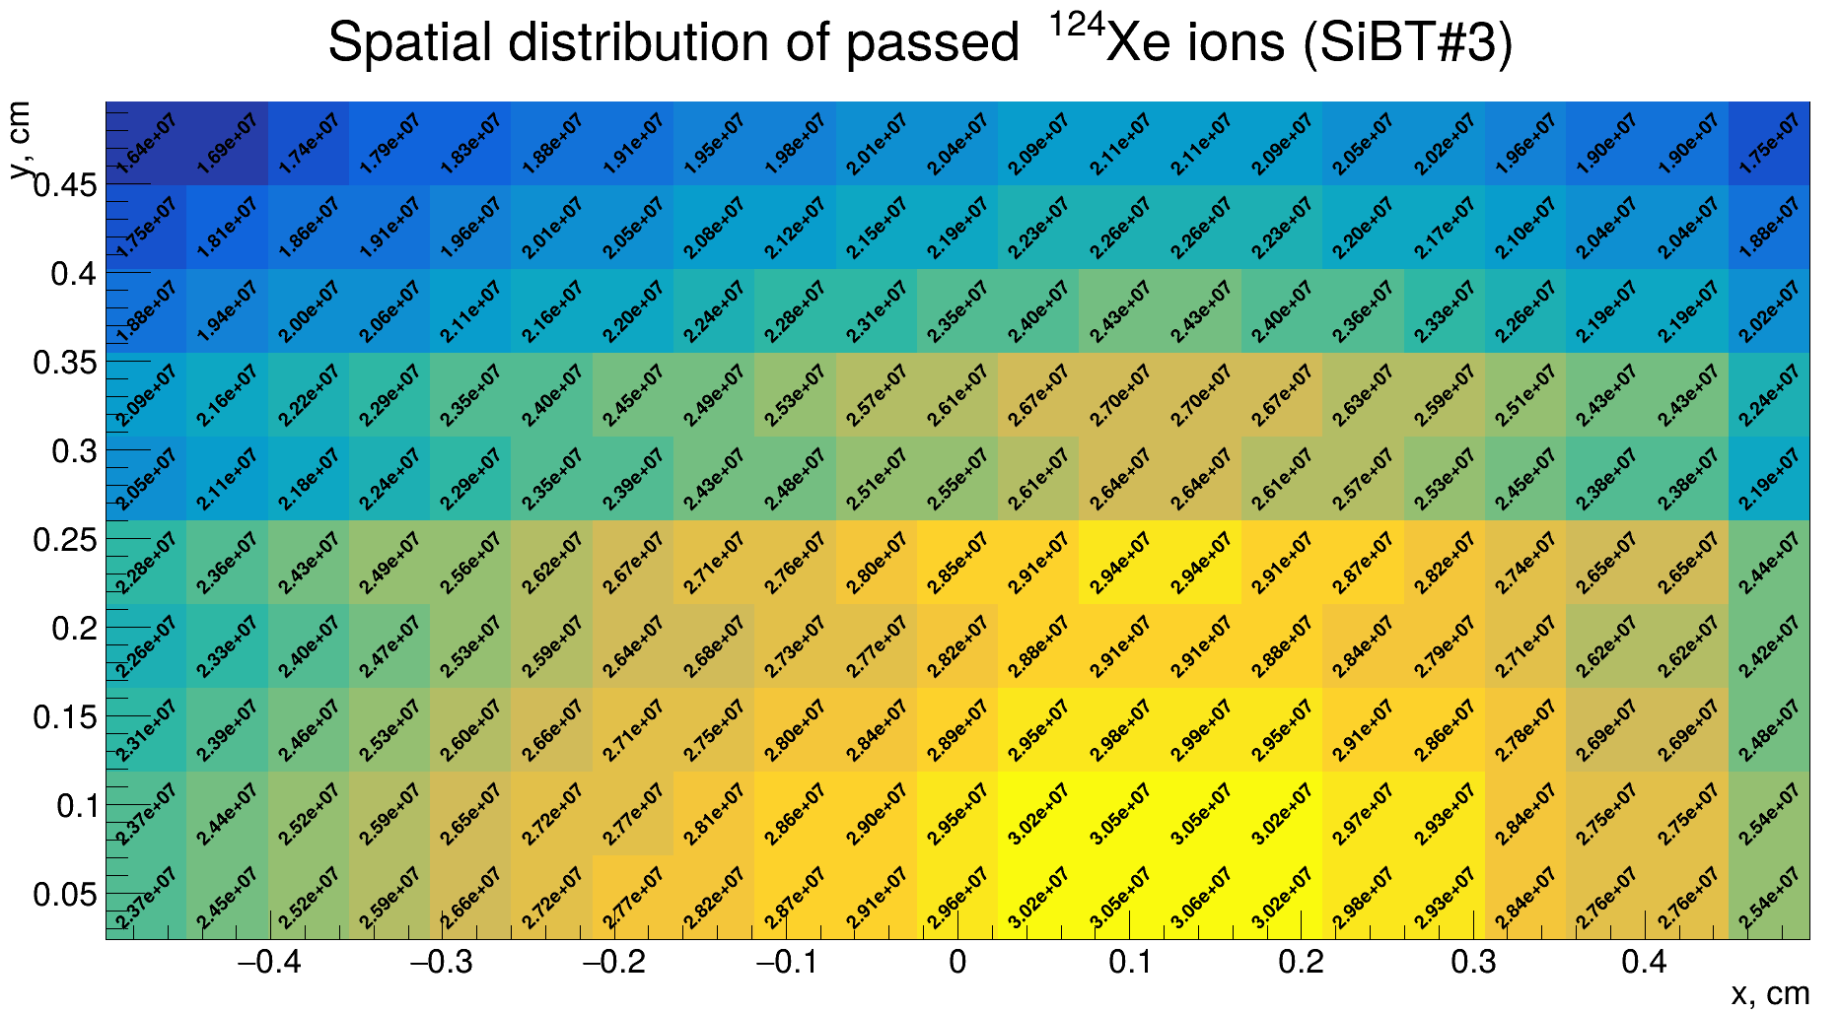
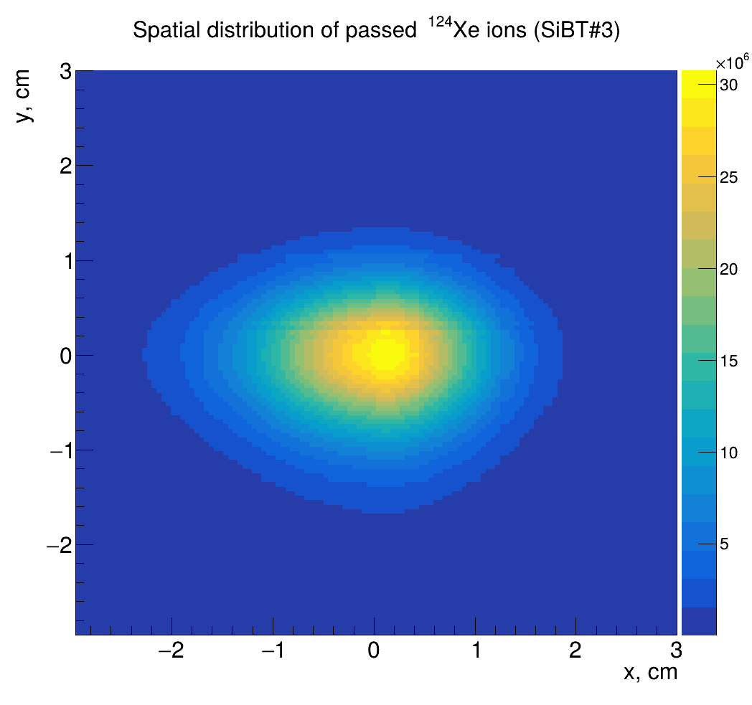
Prediction of radiation resource for Si detectors of SiBT with N = 4.44×10¹⁰ ions per run:
¹²⁴Xe(3,8 AGeV): 10 runs (N_{Xe} = 4.44×10¹¹), I_{strip}(max) = 2 µА;
¹⁹⁷Au(3,8 AGeV): 5 runs, I_{strip}(max) = 2 µА;
²⁰⁹Bi(3,8 AGeV): 4 runs, I_{strip}(max) = 2 µА .
D.Chemezov

Slide 6

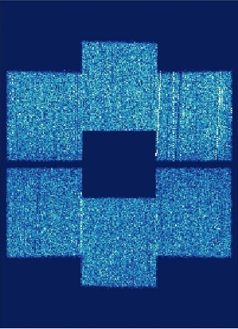
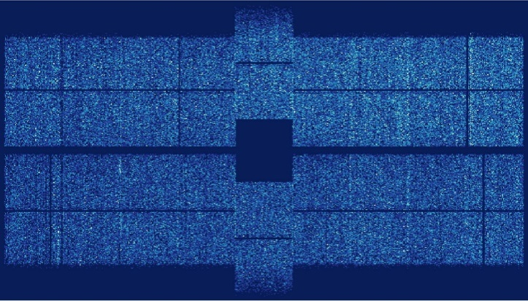
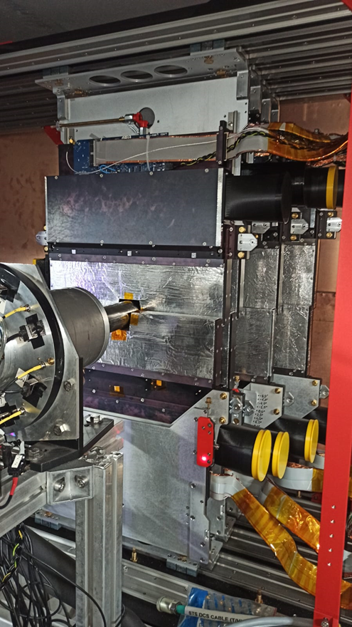
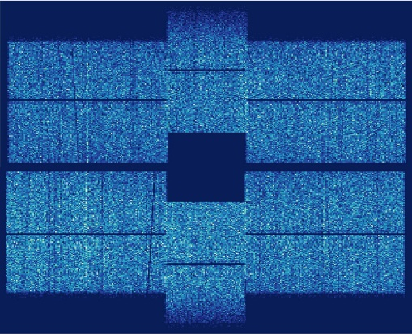
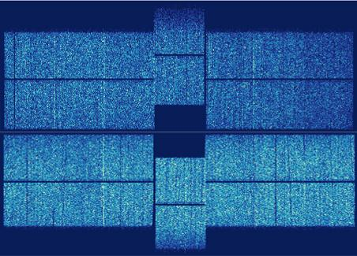
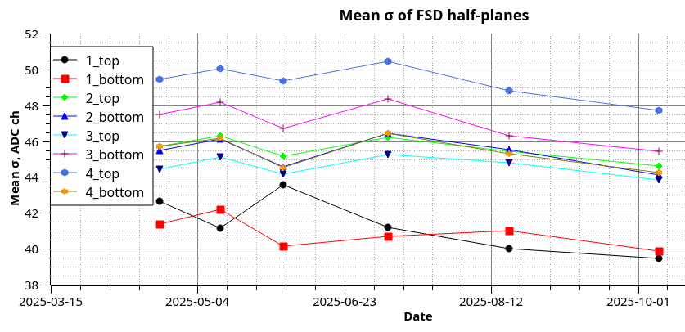
3. Forward Si-Tracker (FSD) for Run-2025
station 1
station 4
93643 hit entries
124789 hit entries
111664 hit entries
138624 hit entries
station 2
station 3
201548 hit entries
165513 hit entries
198035 hit entries
319725 hit entries
Mean noise of FSD half-stations from April 2025 up to November 2025

Slide 7
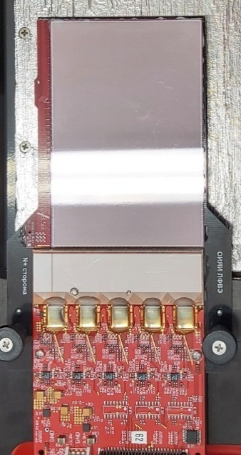
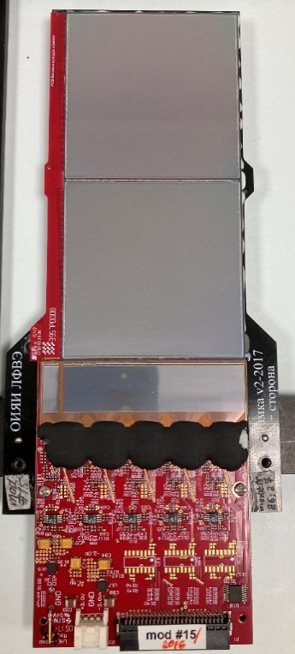
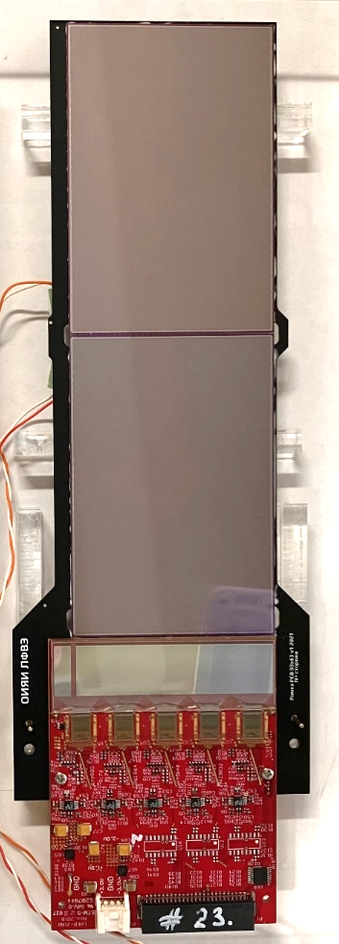
Three type of Si-modules for Forward Si detector
63
63
63
Station1
DSSD 63x93mm²
6 modules
63
Station 2,3,4
DSSD 63x63mm²
42 modules
New Station 5*
DSSD 63x93mm²
22 modules
93
93
126
186
FEE board
FEE board
Detectors size: 63×93×0,3 mm³ (on 6” – FZ-Si-n wafers)
Topology: double sided microstrip (DSSD)
(DC coupling)
Pitch p⁺ strips: 95 μm;
Pitch n⁺ strips 107,1 μm;
Stereo angle between p⁺/n⁺ strips: 2.5⁰
Number of strips/DSSD:
640 (p⁺)×603(n⁺)
Number of strips/module:
640 (p⁺)×603(n⁺)
Detectors size: 63x63x0,3 mm³ (on 4” – FZ-Si-n wafers)
Topology: double sided microstrip (DSSD)
(DC coupling)
Pitch p⁺ strips: 95 μm;
Pitch n⁺ strips 103 μm;
Stereo angle between p⁺/n⁺ strips: 2.5⁰
Number of strips/DSSD:
640 (p⁺)×614(n⁺)
Number of strips/module:
640 (p⁺)×640(n⁺)
FEE board
Detectors size: 63x93x0,3 mm³ (on 6” – FZ-Si-n wafers)
Topology: double sided microstrip (DSSD)
(DC coupling)
Pitch p⁺ strips: 95 μm;
Pitch n⁺ strips: 107,1 μm;
Stereo angle between p⁺/n⁺ strips: 2.5⁰
Number of strips/DSSD: 640 (p⁺)×603(n⁺)
Number of strips/module: 640 (p⁺)×640(n⁺)
For more details see report by Yu. Kopylov

Slide 8
Plans and new developments on 2025-2027 years:
1. To develop and create 5th FSD station:
* DSSD/(93×63) mm² – available;
* Pitch-adapters/640ch – available;
* ASIC-128ch/ENC₀=150 rmse (JINR-Minsk) - manufacturing
stage of the 1st version;
* Station design – development stage;
* Si-module design – done;
* Pilot module – designed, manufactured, testing stage;
* FEE-PCB-640ch/new chip –development stage

Slide 9
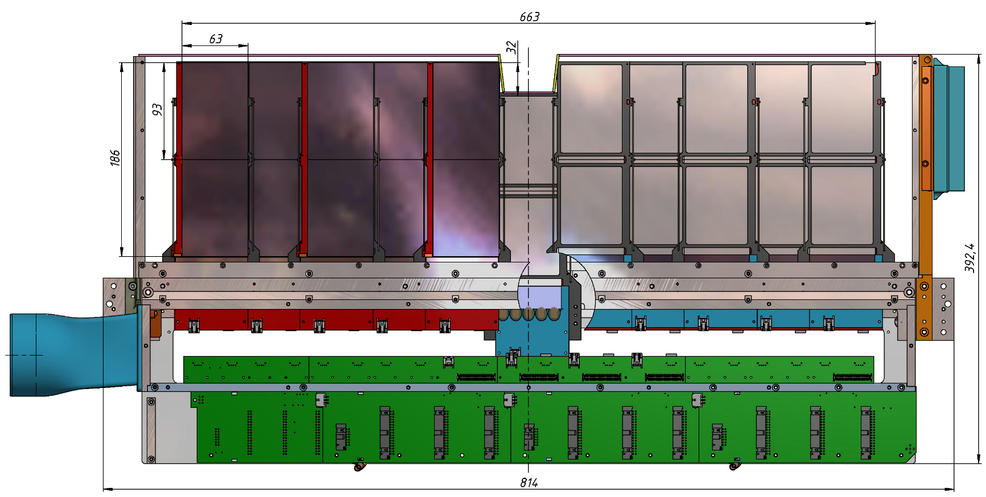
Half-plane of the new FSD-station #5 on the BM@N (11 modules with two Si-sensors (93х63)mm² each)
Light-tight cooling air outlet
Si-detectors 93х63 mm
Tooling Hole for measuring the position of half-plane Si sensors
Tooling Hole for measuring the position of half-plane Si sensors
Cooling air inlet. t=+10°C
FEE cross-board

Slide 10
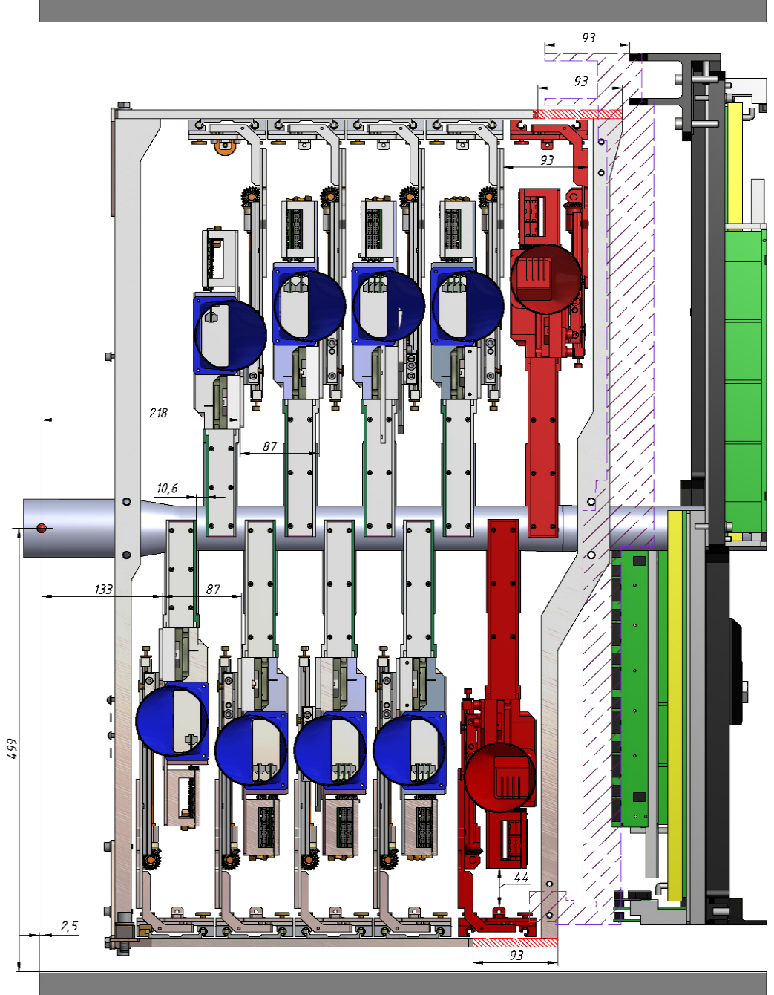
Position of the new FSD-station #5 on the BM@N
Current position of GEM stations
Shifted position of GEM stations (Z+93 мм)

Slide 11
Back up slides

Slide 12
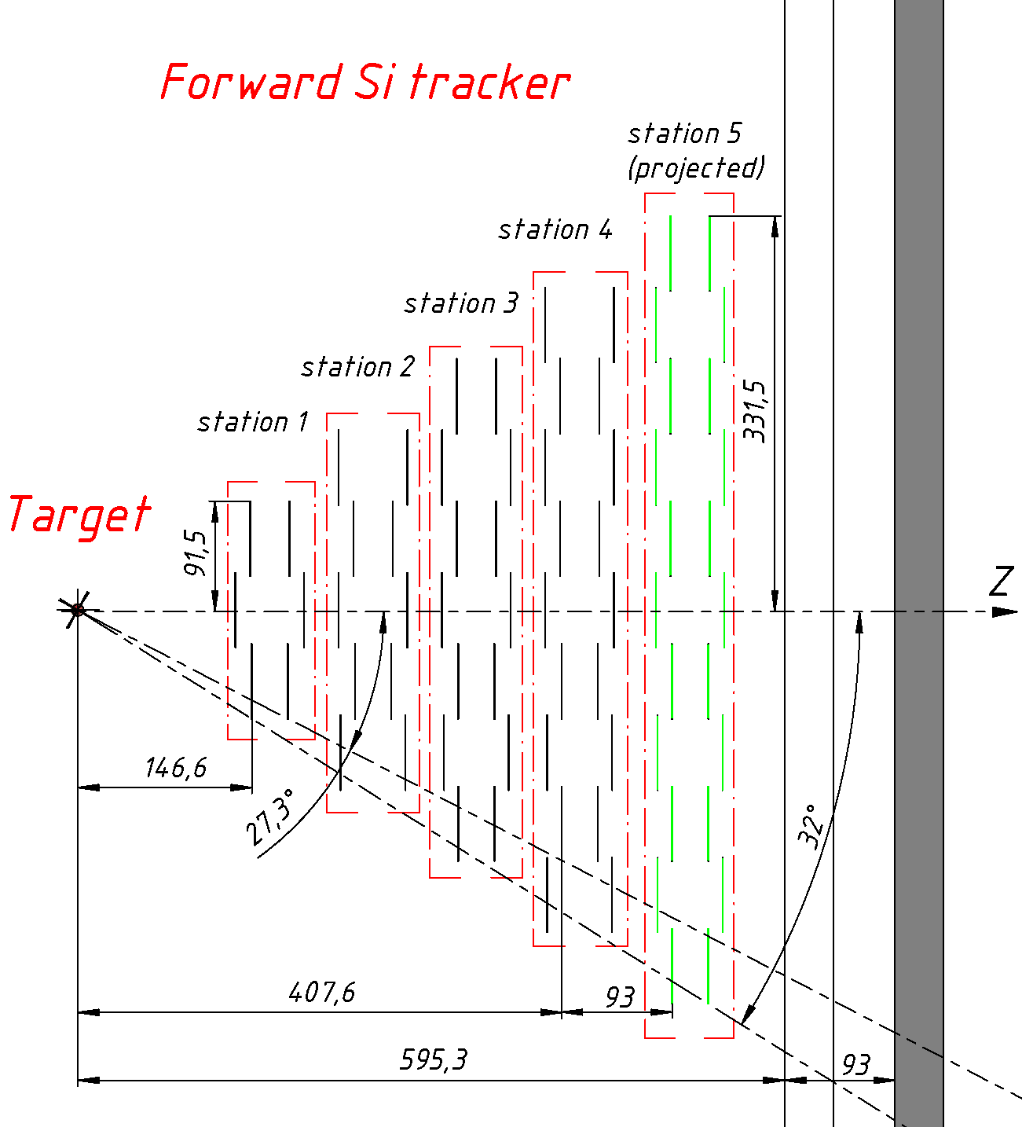
X-Z cross section of central tracker
Current position of GEM stations
Position of GEMs after shift (Z+93 мм)

Slide 13
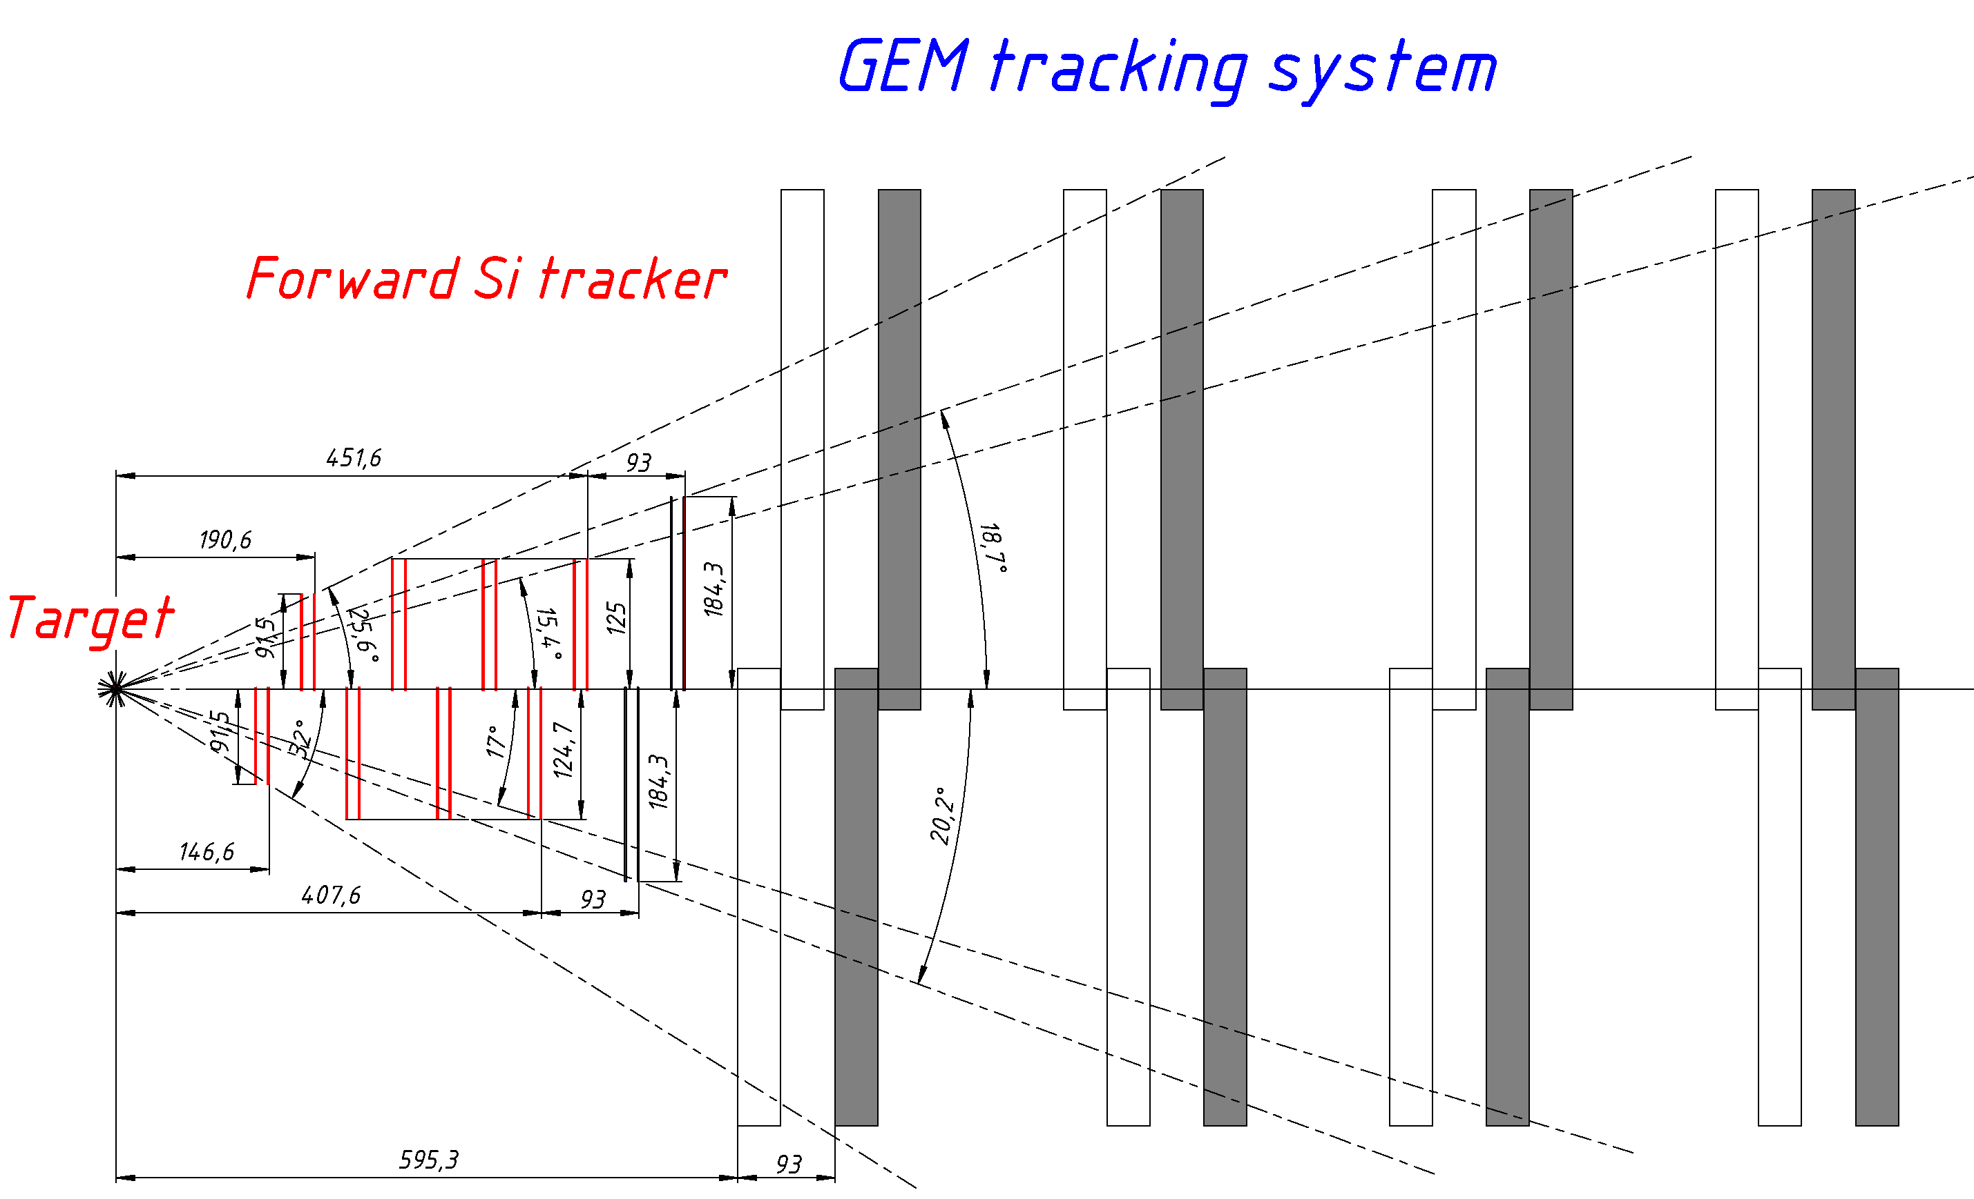
Текущее положение
станций GEM
Смещенное положение
станций GEM (Z+93 мм)

