Slide 1



Status of the BM@N
Slow Control System
15th Collaboration Meeting of the BM@N Experiment at NICA
I. Osokin, V. Dronik, V. Shutov, R. Nagdasev, D. Egorov
14.05.2025

Slide 2

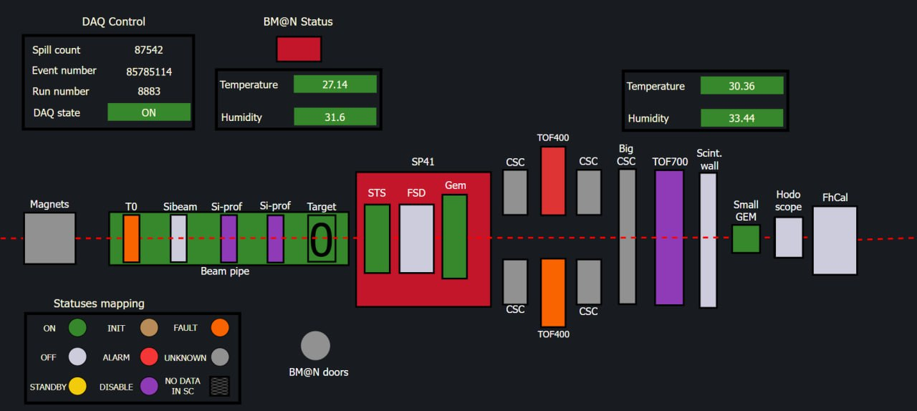
Preparation for the BM@N beam run
New additions
New features
New additions
Tested & updated
BM@N detectors dashboard
2/11
Notes:
At the moment all of the BM@N detector systems are connected to the SC system according to the current BM@N setup and were tested. Next, I will discuss about progress of modifying the SC system and preparing for the upcoming beam run.

Slide 3

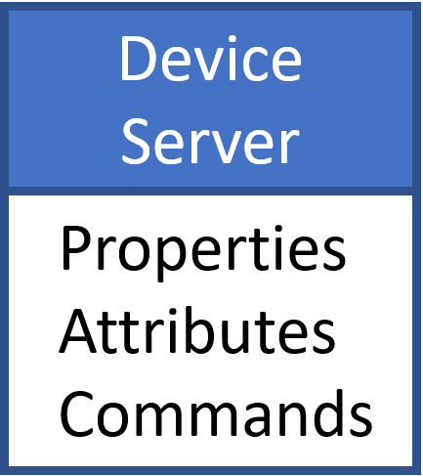

Si Tracking System
TANGO based standalone SCS
TANGO event subscriber server
TANGO HDB configurator
TANGO device server
Historical
DataBase
Graphical
User
Interface
The main part of the work was to create a connection between the standalone STS device servers and the SC BMN database via the «event subscriber»
3/11
Notes:
First, the new STS detector for BMN was connected to the SC. This detector has a standalone control system developed on TANGO CONTROLS, by STS group. The main part of the work was to create a connection between the standalone STS tango device servers and the SC BMN database via the «event subscriber».

Slide 4
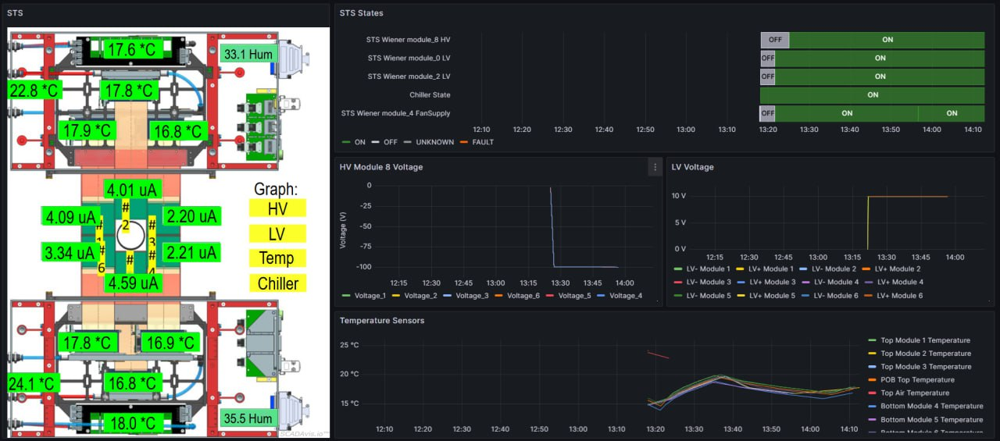
Si Tracking System
STS detector has its own slow control system, which was connected to the general slow control system with historical data base
.
STS monitoring dashboard in Grafana
4/11
Notes:
So STS detector was connected to the general slow control system with historical data base and alarm systems

Slide 5
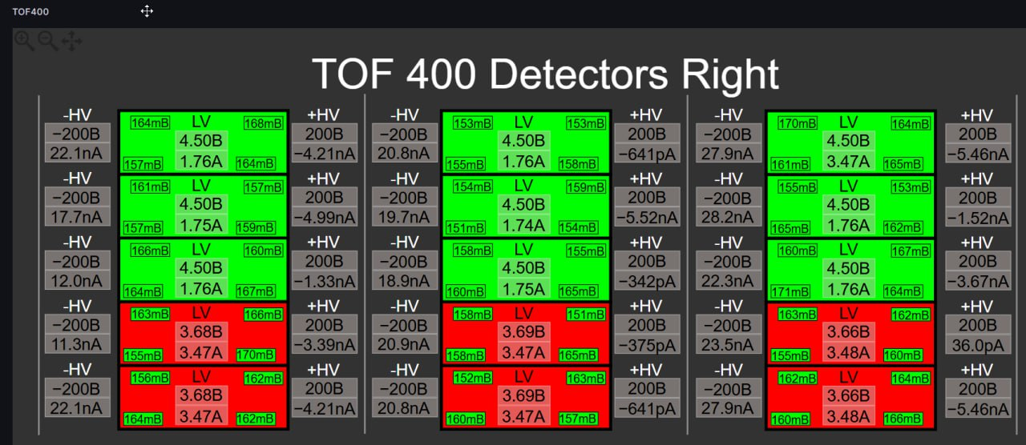
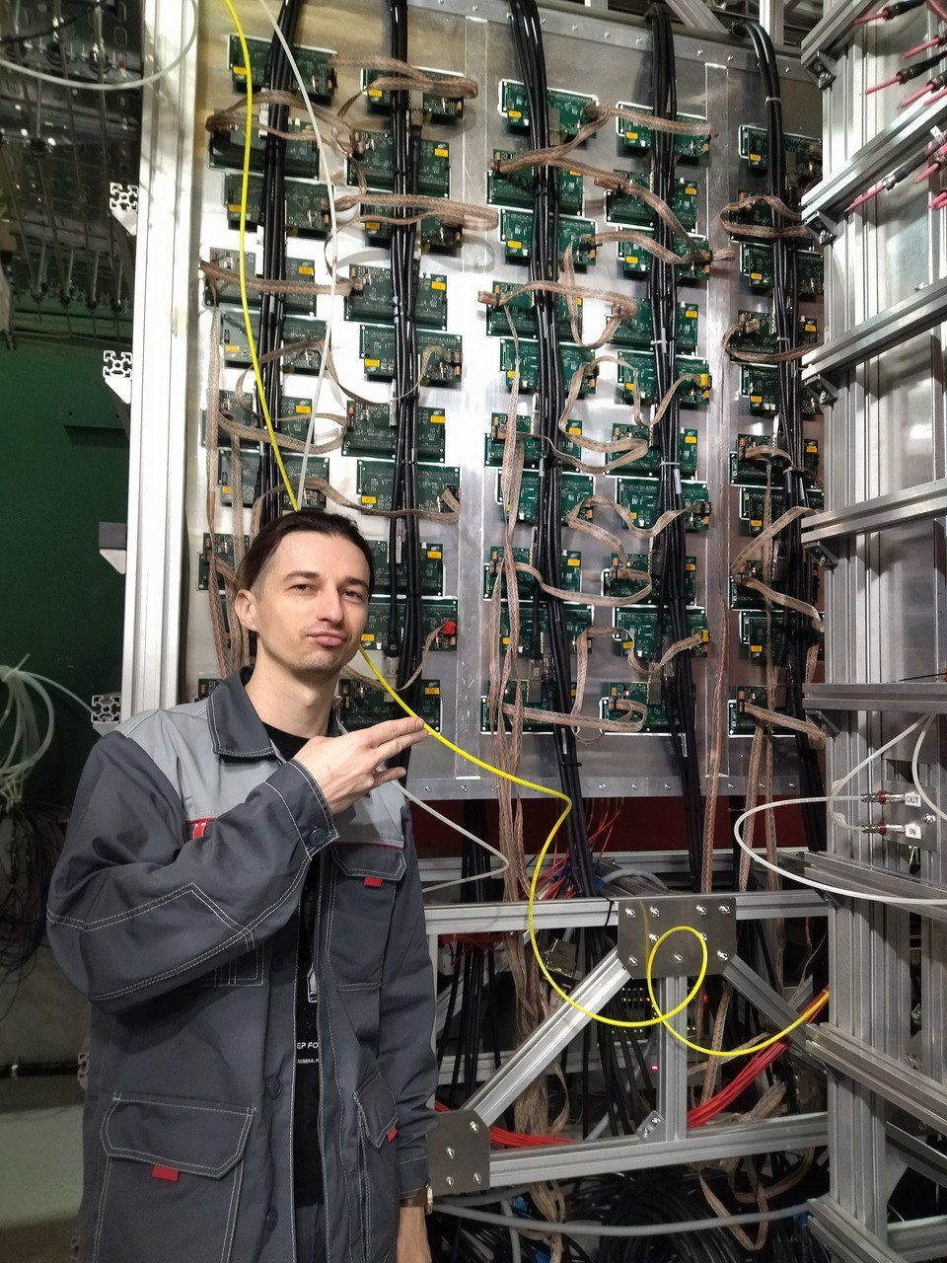
TOF400 upgrade
HV, LV, FEE and Gas systems are tested and integrated in the Slow Control System
5/11
Notes:
Due to the increase in the acceptons of the tof400 detector of one and a half times, detector configuration has changed, according to this the SC system has also changed. TOF`s equipments ,like HV, LV and gas system and FFE has been tested according to the new detector mappings.
On the slide, you can see a new dashboard displaying data about working TOF detector.

Slide 6
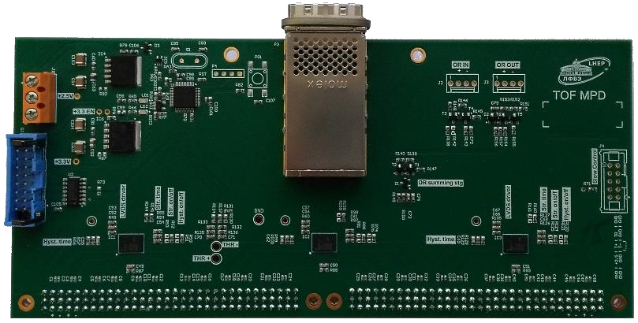
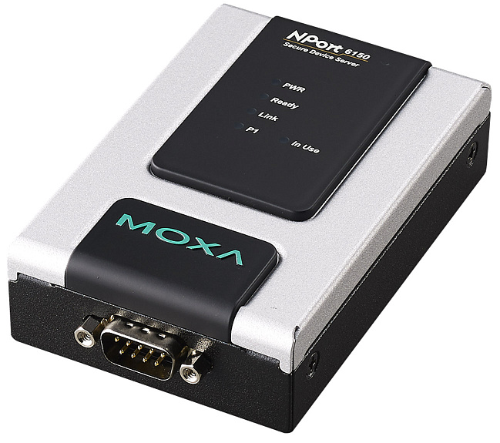
TOF400 upgrade
HDB
TCP/IP
Socket
RS - 485
x20 Preamps per each detector
Spill
Control
Due to the topological feature of the preamplifier’s PCB, electrical interference affects on the signal lines when SC read temperatures. This is not the most common case, but for better operation, it is necessary to match the TOF400 slow control with the spill time of the beam from the DAQ
electrical interference
ZMQ
TOF400
Detectors
DAQ
Planned work
6/11
Notes:
The tof400 plans also include the modernization of the preamplifier reading process.
Due to the topological feature of the old preamplifier’s PCB, electrical interference affects on the signal lines when SC read temperatures. This is not the most common case, but for better data collection, it is necessary to match the tof400 slow control with the beam spill time from the DAQ
This work is planned to be completed before the next beam run

Slide 7
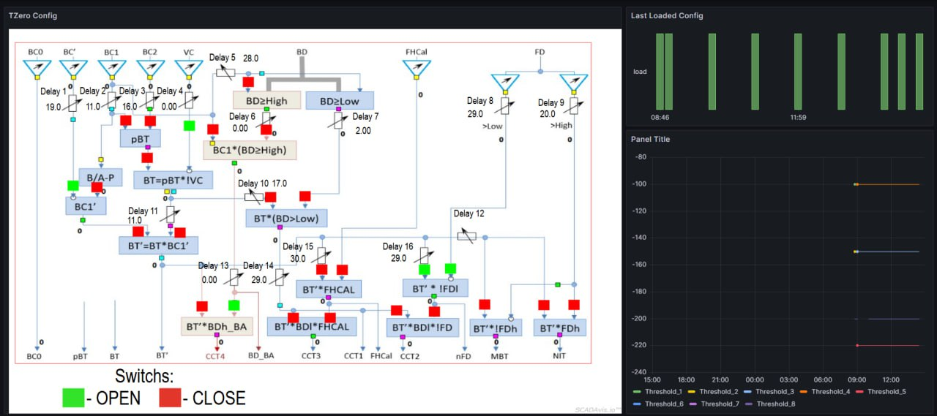
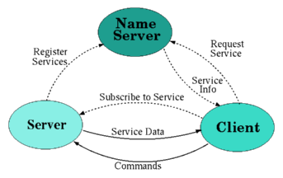
T0 trigger system
DIM Structure
TO trigger detector system, which is based on the DIM communication system. During the work, it was necessary to develop a connection between the DIM and TANGO device servers.
7/11
Notes:
Another standalone control system exists in the TO trigger detectors, which is based on the DIM communication system. And the DCS performed well during previous acceleration beam runs. During the work, it was necessary to develop a connection between the DIM and TANGO device servers.
Now information about Tzero power sources and configuration of the trigger is sent to the general slow control system HDB
The server device was tested on the DIM emulator. Thank for your cooperation to the TO group

Slide 8
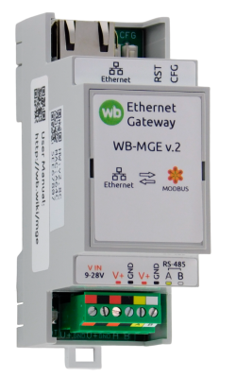

BM@N Alarm System
Historical
DataBase
TCP/IP
WB Electric Relay
TANGO cumulative server
device server that collects statuses from other tango device server
BM@N TANGO
Device
Servers
Sound Alarm
8/11
Notes:
In addition to online monitoring in the grafana web page, has also been created an sound alarm for BM@N control room.
It is a simple system consisting of a device server that collects statuses from other tango device servers. If there are any problems, the wirendoard electrical relay is switched, which is connected to the sound speaker

Slide 9
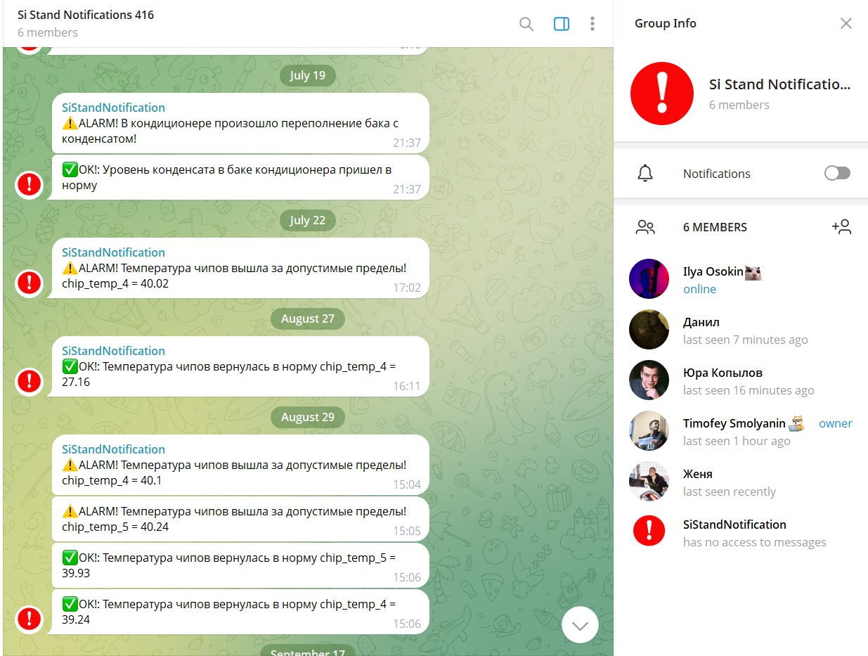
BM@N Alarm System echance
Currently, FSD, STS, and TOF detectors are connected to this telegram notifications feature.
We are going to expand this feature to another detector if there are requests from other detector groups
9/11
Notes:
The control system has been enhanced with warning notifications about the status of the experimental equipment in Telegram. Currently, FSD, STS, and TOF detectors are connected to this feature. And we are going to expand this feature to another detector if there are requests from other detector groups

Slide 10
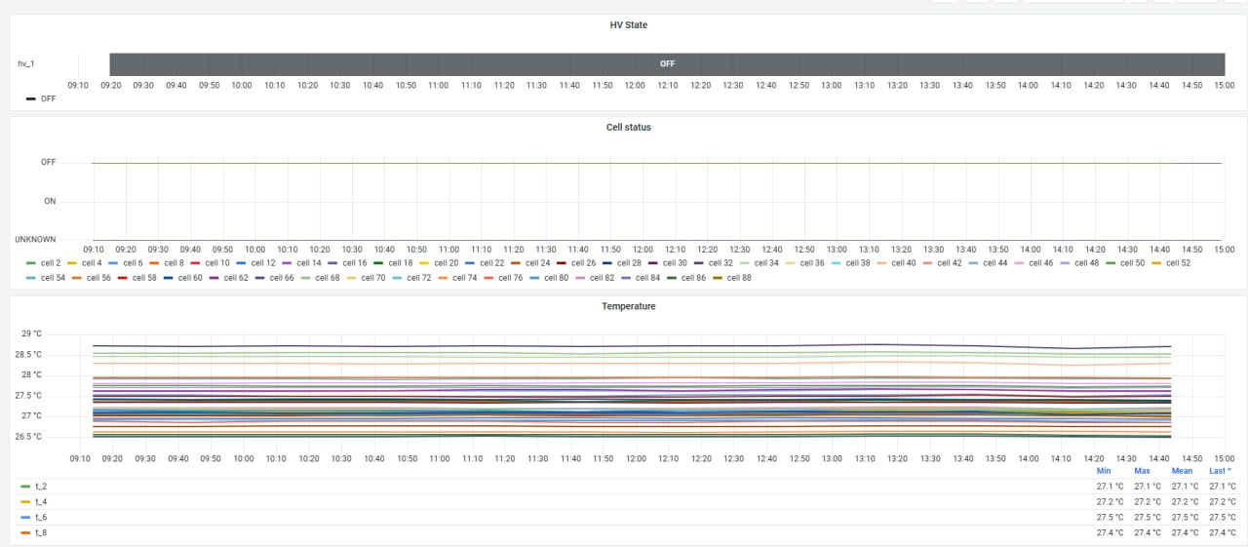
FhCal historical data base fix
Due to the large number of controlled attributes in the FHCal detector, the BM@N SC database could become overloaded with a large number of requests, causing the database to crash
The data structure for this task has been redesigned and optimized for the detector
10/11
Notes:
A small but important change. Until recently, due to the large number of controlled attributes in the FhCal detector, the BM@N database could become overloaded with a large number of requests, causing the database to crash
The data structure for this task has been redesigned and optimized for the detector

Slide 11
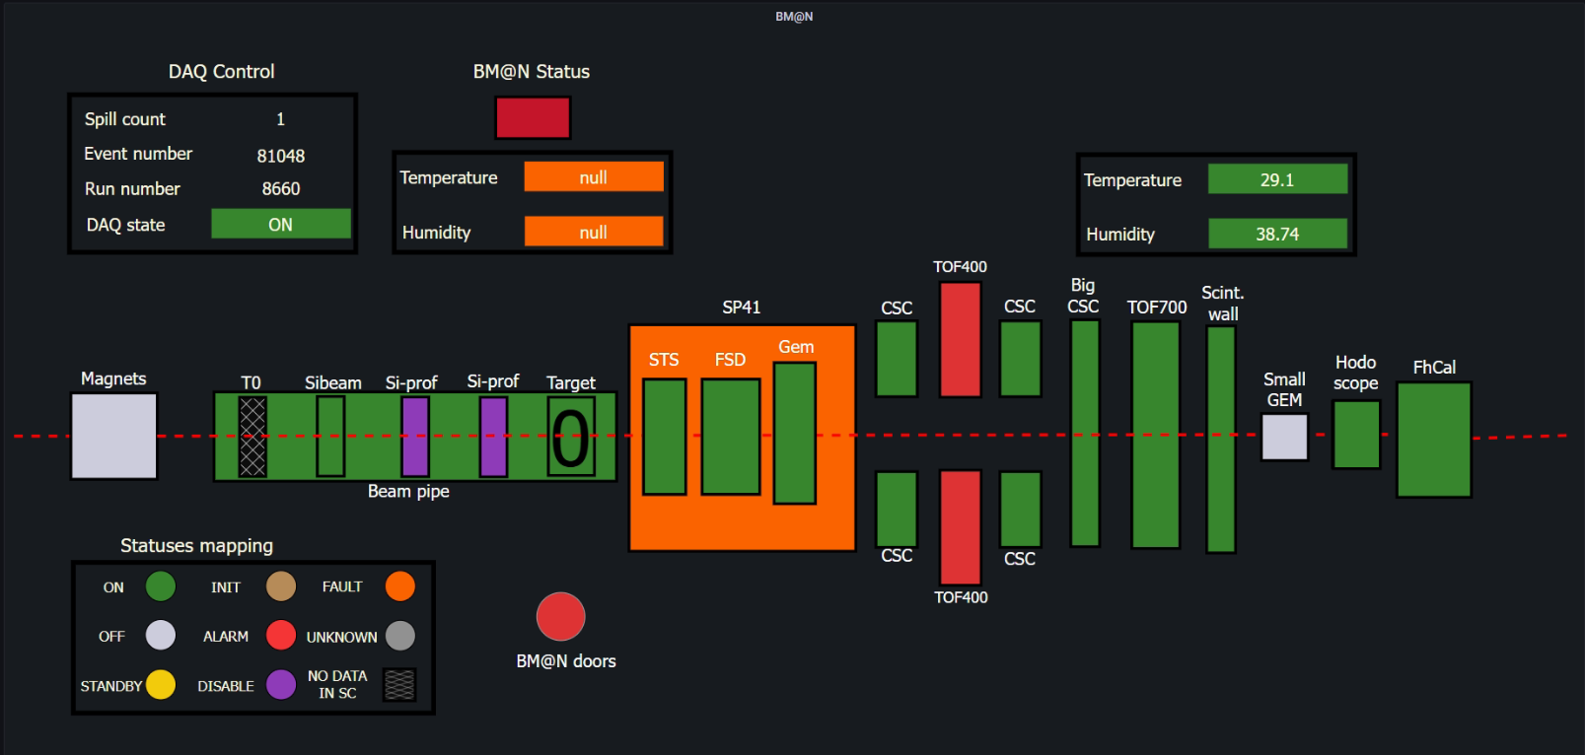
Thank You for attention
Notes:
All of the BM@N detector systems, such as FSD, Sibeam, GEM, tof, FhCal and others, are connected to the SC system and were tested during the preparation work for upcoming beam run.

