Slide 1
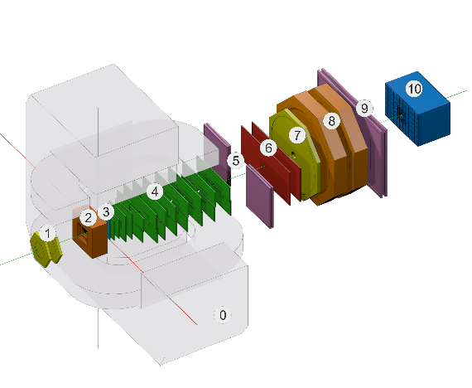



Status of the BM@N Data Quality Monitoring system design and implementation
Igor Alexandrov, Evgeny Alexandrov,Alexander Chebotov, Konstantin Gertsenberger
JINR, MLIT, LHEP
14-16 October 2025, Dubna, JINR
15th BM@N Collaboration Meeting2025
Joint Institute for Nuclear Research

Slide 2

Outlines
Goals of the system creation
General architecture
Object model of the histogram producer and analyzer
DQM processes and data flow
DQM configuration description
DQM tree and example of the possible DQM configuration
Database schema
Alarms behavior description
Possible view for DQM shifter WEB GUI
Conclusion and next steps

Slide 3
Data Quality Monitoring (DQM) and Quality Assurance (QA) : Goals of the systems
Data Quality Monitoring and Quality Assurance system for the BM@N experiment should be developed to provide control histograms in the same way in 3 modes
  for online decoding and reconstruction (online data monitoring)
  for qualitative assessment of new BmnRoot versions (after MRs)
  for manual run to check user versions of the software
The BM@N DQA architecture must ensure predefined checks and graphical representation of control histograms on a central Web service, which receives the displayed data distributions from the BM@N histogram producer (DQA central manager)
The DQA system must provide the ability to easily add new control histograms with predefined checks and alerts in a user-friendly format (suitable for physicists and detector team, who are not developers), for instance, using JSON-description
Notes:
Система мониторинга и обеспечения качества данных для эксперимента BM@N должна быть разработана для предоставления контрольных гистограмм одинаковым образом в 3 режимах
для онлайн-декодирования и реконструкции (онлайн-мониторинг данных)
для качественной оценки новых версий BmnRoot (после MR)
для ручного запуска для проверки пользовательских версий программного обеспечения
Архитектура BM@N DQA должна обеспечивать предопределенные проверки и графическое представление контрольных гистограмм на центральном веб-сервисе, который получает отображаемые распределения данных от производителя гистограмм BM@N (центральный менеджер DQA)
Система DQA должна предоставлять возможность легко добавлять новые контрольные гистограммы с предопределенными проверками и оповещениями в удобном для пользователя формате (подходящем для физиков и команды детекторов, которые не являются разработчиками), например, с использованием JSON-описания

Slide 4
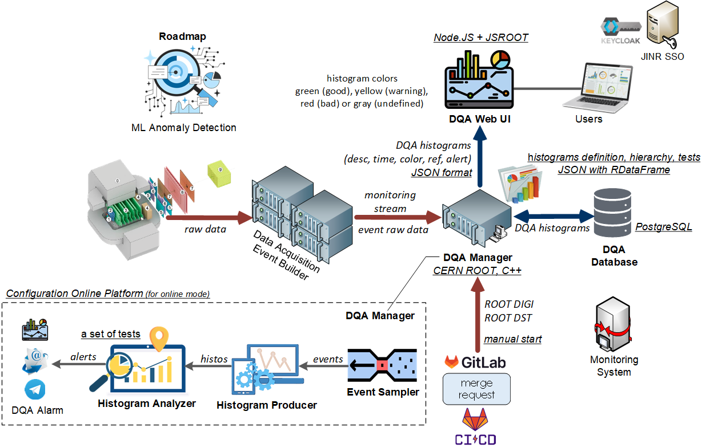
The DQM General architecture

Slide 5
Object model of the histogram creator and analyzer classes
DataQuality (enumeration)
(good, bad, warning, undefined, disable)
Histogram
string tree_path
bool is_cumulative
string produce_algorithm
string analyze_algorithm
int period_number
int run_number
int event_number
HistogramInfo
string name
string title
int dimension
string X title
string Y title
map<string,string> options
AnalysisResult
int period_number
int run_number
int event_number
int sampler_rate
string histogram_path
bool is_cumulative
string produce_ algorithm
string analysis_ algorithm
TH1D/TH2D histogram_object
DataQuality quality_result
string alert_message
Sampler
string configuration
inputStream input_data_addr
outputStream producer_addr
int sampler_rate
uses
creates
checks
sends
produces
BMNEvent
BMNEvent
int periodNember
int runNumber
int eventNumber
TTree data
Producer
Map<string, ProduceAlgorithm> produce_algorithms
string configuration
inputStream sampler_addr
outputStream analyzer_addr
TTree event_data
TH1D/TH2D createHistogram(HistogramInfo hinfo)
TH1D/TH2D fillHistogram(HistogramInfo hinfo,TTree event_data)
gets
DataBase
Analyzer
string configuration
Map<string, AnalyzeAlgorithm> analize_algorithms
string database_name
inputStream producer_addr
outputStream database_addr
outputStream webui_addr
TH1D/TH2D event_histogram
map<string, TH1D/TH2D> cumulative_histograms
AnalysisResult analysis_result
AnalysisResult checkHistogram(TH1D/TH2D rootHisto)
analisesisResult
analisesisResult
analisesisResult
histogram
analisesisResult
implements
ProduceAlgorithm
fillHistogram(TH1D/TH2D &histo,TTree event_data)
analisesisResult
WEB UI
AnalizeAlgoritnm
AnalysisResult checkHistogram(TH1D/TH2D rootHisto)
implements

Slide 6

The DQM processes and data flow
events
events
Histogram producer
Sampler
Histogram producer
histograms
Histogram analyzer
ZeroMQ
Histogram producer
Histogram analyzer
ZeroMQ
ZeroMQ
Histogram analyzer
DQM result
DQM DB
DQM result
stores cumulative histograms DQM result for each run
stores non-cumulative histograms only for DQM result BAD
WEB UI

Slide 7
DQM configuration description
The configuration for running DQM is stored in JSON format in a file that contains all the information concerning
  sampler (event selector for data quality assurance) and histogram producer
  addresses of the database and Web interface
  analyzers to be applied to the histograms
The description of the histograms is stored in JSON format and is splitted into separate files so that:
  each detector group can describe histograms only related to their tasks
  histograms not related to the group will not be contained in their configuration file
  all JSON-files with the description of the histograms are loaded when the DQM system starts
The content of the JSON files corresponds to the given object model

Slide 8



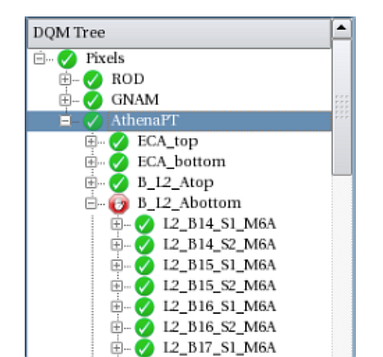
The DQM tree
    DQM Configuration keeps set of DQM Tree in
    JSON format.
  DQ Tree
      Histogram producer library (plugins)
      Analizer library (plugins)
    DQ Region … DQ Region
      DQ summary maker
      DQ Parameter
        Input from sampler
        Histogram producer
          Algorithm for histogram creation (name of plugin to be loaded and used to produce histograms)
          Output with histogram produced - histogram input for tester
        Analyzer (quality tester)
          histogram input (from previous output)
          Algorithm (quality checker algorithm)
          Threshold (numbers to understand if histogram good or bad)
          Output
            result (good, bad, undefined, disable)
            DQ Tree path
            histogram
DQ Tree
DQ Region
DQ Region
DQ Region
DQ Parameter
DQ Region
DQ Parameter

Slide 9
Example of the possible DQM configuration
{ "DQM_SETUP": "setup1",
"histogram_lib": "lib/histograms_produce_alg",
"analyzer_lib": "lib/dqm_analis_alg",
"tasks": [
{
"task_gem" : {
"producer_input" : "host1:20001",
"analyzer_input" : "host2:20002",
"database “ : “host3:20000”,
“web” : “host4:8000”,
"histogram": {
"tree_path" : "GEM/Silicon",
“alg_name" : "statistics",
//"cumulative": : "true",
"info": {
"name": "statistics_gems",
"title": "Statistics GEM Silicon",
"xtitle": "Number of digits in event silicon",
"ytitle": "Number of digits in event GEM",
“dimension" : "2" , "//comment1":"TH2D in use",
"Options" : { "//comment2" : "draw options,
color options, text options, SURFace options etc",
"c_opt" : "c",
"arr_opt" : "arr",
"line_color" : "red",
"fill_color" : "grey“
}
}:wq
"analyzers" {
[ {
"analize1" : {
“alg_name": “kolmogorov_alg",
"cumulative" : true,
//"parameters" : {
"threshouldMin" : 10,
"threshouldMax” : 15
// }
}
},{ “analize2” : {
“alg_name”: “empty_check2”,
“cumulative” : false,
// “parameters” : {
“threshouldMin” : 1,
“threshouldMax” : 4
//}
}
} ] }
} , “//comment3” : “END task_gem“
},{
“task_gem_station” : { “histogram”: {
“producer_input”: “host1:20004”,
“etc” : “……” }
} } ]
, "sampler" : {
"input": "host1:20000",
“outData” : [ {“out”:“host1:20001", “rate”:10 },
{“out”: “host2:20004“, “rate”:5} ]
// "out" : //["host1:20001","host2:20004"],
// "rate" : [ "10", "5" ]
}
}

Slide 10
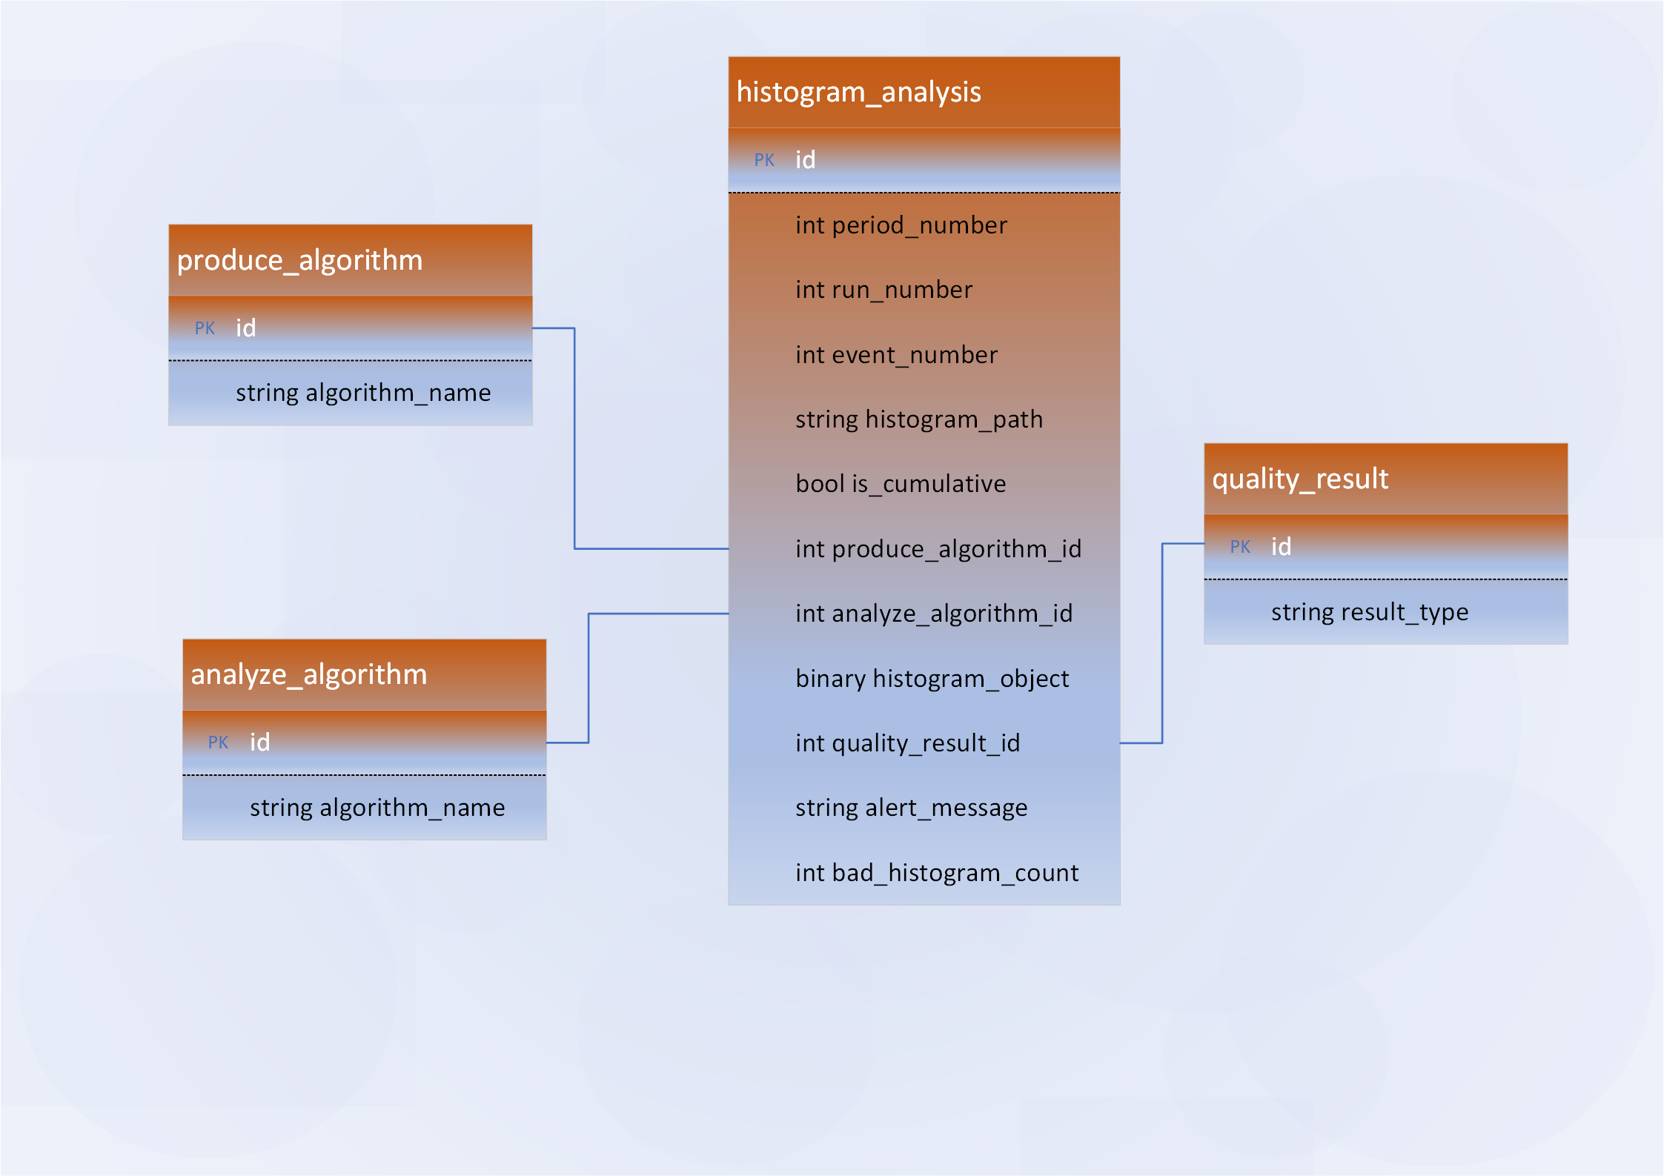
DQM database schema

Slide 11
Alarms description
Alarm is displayed in Web UI
Alarm is raised when DQM result value is BAD
GREEN color is used to display the data quality value when the DQM value is GOOD, RED color – if the value is BAD
DQM tree colors in Web UI
  If all children of some DQM root are GOOD, then the name of this root is displayed in GREEN
  If any child of DQM tree directory is BAD
    the name of this child element is displayed in RED
    all parents' names are displayed in ORANGE

Slide 12
Possible view for DQM shifter WEB GUI
Time: 15:04:07 Run Number: 2900
Run State: RUNNING Event Number: 150036
State: GOOD
Root TREE
GEM Station
  Module 0
    Layer 0
    Layer 1
  Module 1
  Module 2
  ……..
GEM Silicon
HISTOGRAMS
ALAM LOG

Slide 13
Current status of implementation
  Creation of the system prototype was just started
    classes to keep all configuration is implemented
    load configuration from json file and print its data is done
    save loaded configuration in json format also implemented (to be used for configuration creation in future GUI tools)
    sampler implementation is in progress

Slide 14
Conclusion and next steps
  Design including items below is finished
    general architecture
    object models
    DB schema
    configuration structure finished
  GUI design in progress
  Creation of the system prototype is in progress
  First NEXT steps
  System prototype creation
    Sampler prototype implementation
    Histogram Producer and Histogram Analyzer prototypes implementation
    implement sampler, producer and analyzer applications
      start applications, activate interactions etc.

Slide 15
BACKUP

Slide 16
DQM & QA systems in LHC experiments
Some interesting ideas in the LHC experiments:
  produce some sampling (events go to the DQM depending on their frequency after trigger system)
    message passing technique, scalability (ALICE)
    set the rate for DQM input
    produce histograms as main input for the DQM
      but not only histograms can be used for quality check
  moving as much as possible to automation of data quality assurance
  flexibility in using check algorithms (storing sources of algorithms, their names and parameters, what to be on output, destination and other in DQM database)
    loading from its library the check algorithm as implementation of interface (ATLAS)
    some interfaces have thresholds as parameters in order to create results: bad or good event
  some of check algorithms
    empty histogram (a threshold)
    counters of subdetector responses by sectors
    Kolmogorov-Smirnov test
  moving to rich shifter GUI, mostly web GUI
    different base tools/languages for implementation (python as an example in ALICE, C++ in ATLAS)
    alarms in case of high probability that events have bad quality
  ALL these experiments suppose to use ML-based (machine learning) quality assessment in Run 4

Slide 18
DQM & QA systems in LHC experiments: ATLAS
ATLAS: light, flexible (input-output-configuration interfaces, algorithms as plugins)
  DQM Core: executes DQ Algorithms (any common operation like histogram comparison, histogram fitting, thresholds application, etc.); has three abstract interfaces for the communication with the external systems
    DQM Input (receives histograms, messages, counters)
    DQM Output (way of publishing DQ Results produced by the DQ algorithms)
    DQM Configuration interface (way of reading configuration info which defines behavior of the DQM Core in a specific environment)
  DQ Configuration is described as a hierarchical tree of objects of two different types: DQ Regions and DQ Parameters.
  DQ Region
    Children (DQ Region or DQ Parameter)
    DQ Summary Maker
  DQ Parameter
    location of the monitoring information (represents the state of a particular detector element)
    weight
    DQ Algorithm that has to be used
    specific parameters and thresholds
    reference values or histograms
    the actions which have to be taken depending on the results

Slide 19
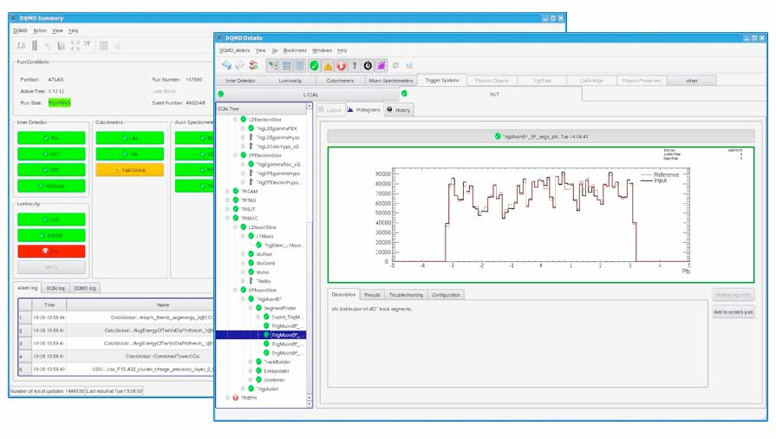
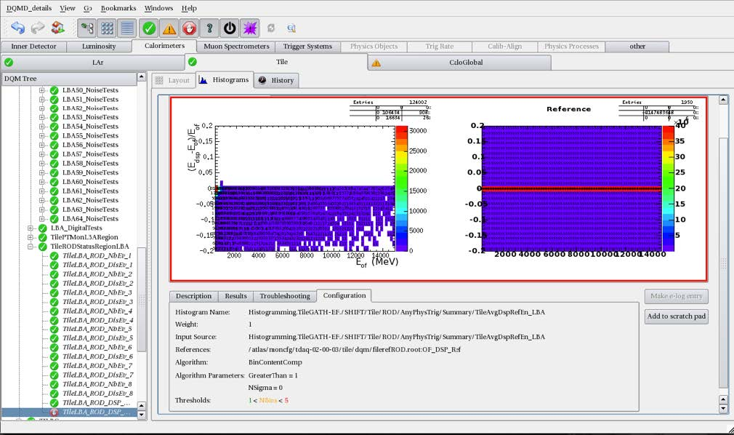
DQM & QA systems in LHC experiments : ATLAS (2)
DQ Algorithm
  DQM Framework (DQMF) provides a number of predefined DQ Algorithms
  DQ Algorithms are integrated into the DQMF in a dynamic plug-in manner
      allows adding new algorithms on the fly without modifying the core software
  each DQ Parameter has at least one DQ Algorithm associated with it
  executed whenever a piece of info which is associated with that DQ Parameter becomes available
DQ Summary Maker
  special implementation of the DQ Algorithm interface that evaluates the DQ Result for a given DQ Region
DQMF Agent
  instantiates appropriate implementations of the DQMF generic interfaces (i.e. DQM Input, DQM Output and DQM Configuration)
  takes care of starting and stopping the DQM Core engine in appropriate moments
    In the online environment the DQ assessment has to be started at start of run event and stopped when the run is finished
  DQMF may contain one or more DQMF Agents with each of them responsible for a well defined subset of the whole ATLAS system.
DQ Result
  consist of a colored tag and any output that the algorithms might want to attach
    If some areas of the detector are disabled, then the corresponding dq results will be black
    otherwise, results might be
      green (good), yellow (warning), red (bad) or gray (undefined)

Slide 20
Data Quality Monitoring (DQM) and Quality Assurance (QA) : Goals of the systems
Main goals
online and offline data quality check and results visualization
fast automation reaction on data quality problems
histogram creation tool
  interface for histograms creation
  library with simple implementations of this interface
create flexible tool for online creation, filling, transport and archival of histogram and other monitor elements
create flexible online tool to perform algorithms for automated quality and validity tests
keep the results of the DQM process
create GUI for DQM user
  visualization of the histograms and quality test results
  alarms in case of bad quality data

Slide 21
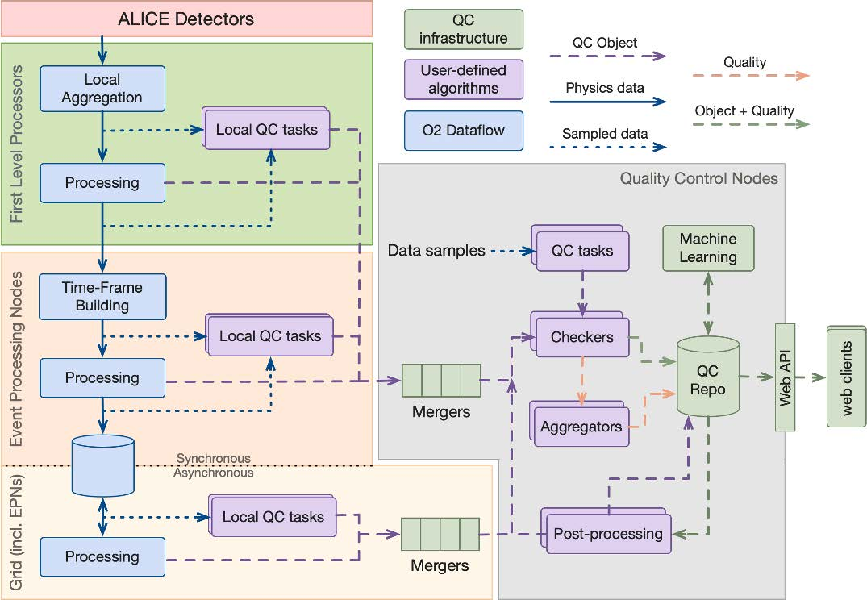
DQM & QA systems in LHC experiments : ALICE
ALICE: DQM + QA = Data Quality Control (DQC)
  largest DQC systems worldwide
  first in the high energy physics community to leverage the message passing technique and the actor model to such an extent
  high-level quality assessment of the 3.5 TB/s data produced by the detector
QC system
  multi-step process
    sampling the data, usually at a rate of 1%
    QC Tasks will then execute user-defined algorithms to process it and generate a QC Object, often a histogram
    Given the parallel nature of this processing, with a copy of the task running on each of the hundreds of nodes, these histograms are then merged
    merged results are evaluated by a series of Checks to determine one or several Qualities, which can themselves be aggregated to give a general assessment of the health of the data
  based on a message passing paradigm where data flows asynchronously through a set of devices connected via buffered channels
  channels use ZeroMQ by passing either the whole message payloads or just pointers to the shared memory region
  QC Objects and Qualities are stored in Conditions Database

Slide 22
DQM & QA systems in LHC experiments : LHCb
LHCb: collected data are grouped together in runs
  LHCb DQ workflow
    small subset of the data selected by the trigger is fully-reconstructed on the LHCb Online computing farm
    reconstruction produces sets of histograms which allow the (sub-)detector performance to be assessed
    these histograms are presented by the Data Quality Monitoring(DQM) software to the DQ shifter
    shifter compares whether the run is suitable for physics analysis or not, by comparing it to a reference run previously set by experts.
    software package previously used in DQM shifts, was based on dedicated custom C++ code and X Window System. Now implemented “Monet” which is a python based web application that supersedes the Presenter.
  Update
    using Python as the primary language allows the usage of rich set of libraries provided in the large ecosystem of third-party Python packages. This simplifies both development, as common functionality has already been implemented elsewhere, and maintainability, as the size of the required LHCb specific code is reduced.
    for plotting Bokeh libraries provide interactive plots in web browsers, has pythonic interface
  RoboShifter: automatic problem detection
    predicts probability of given run being bad
    decisions made by each tree are summed with weights, representing the importance of each tree
    each tree corresponds to a single histogram
    possible to compute, for each histogram, its contribution to the probability of the run being bad
    histograms with the highest contributions can be presented to DQ shifter as potentially problematic ones.
  Machine learning at LHCb: vector Kolmogorov-Smirnov distances btw histograms and their references; AdaBoost algorithm,
    track pattern recognition
    long track reconstruction
    downstream Track Reconstruction (reconstruction of the daughters of long-lived particles)
    fake track rejection
    topological trigger (HLT2)
    jet tagging
    charged particle identification

Slide 23
DQM & QA systems in LHC experiments : CMS
CMS: The DQM software is a central tool in the CMS experiment. High-level goal of the system is to discover and pin-point errors - problems occurring in detector hardware or reconstruction software
  tools for
    creation, filling, transport and archival of histogram and scalar monitor elements
    standardized algorithms for performing automated quality and validity tests on value distributions
  monitoring systems live online for
    the detector, the trigger, and the DAQ hardware status and data throughput,
    the online reconstruction
    validating calibration results, software releases and simulated data
  visualization of the monitoring results
  certification of datasets and subsets thereof for physics analyses
  retrieval of DQM quantities from the conditions database
  standardization and integration of DQM components in CMS software releases
  organization and operation of the activities, including shifts and tutorials

Slide 24
The DQM tree
    DQM Configuration keeps set of DQM Tree in
    JSON format.
  DQ Tree
      Histogram producer library (plugins)
      Analizer library (plugins)
    DQ Region … DQ Region
      DQ summary maker
      DQ Parameter
        Input from sampler
        Histogram producer
          Algorithm for histogram creation (name of plugin to be loaded and used to produce histograms)
          Output with histogram produced - histogram input for tester
        Analyzer (quality tester)
          histogram input (from previous output)
          Algorithm (quality checker algorithm)
          Threshold (numbers to understand if histogram good or bad)
          Output
            result (good, bad, undefined, disable)
            DQ Tree path
            histogram
DQ Tree
DQ Region
DQ Region
DQ Region
DQ Parameter
DQ Region
DQ Parameter

Slide 25

The DQM framework
digitized events
Configuration manager start correspond DQ setup
Sampler
Histogram creator
Histogram analyzer
DQ configuration
DQ configuration
DQA database
DQ result
Events with correspond rate (ZeroMQ)
Histograms (ZeroMQ)
DQ result
Alerts
Web GUI
DQ configuration

Slide 26
Example of the possible DQM configuration
{
"DQM_SETUP": "setup1",
"histogram_library": "lib/histograms",
"analizer_library": "lib/dqm_analiz",
"tasks": [
{
"task_gem" : {
"histogram": {
"tree_path" : "GEM/Silicon",
"plugin_name" : "statistics",
"cumulative": : "true",
"input": "host1:20001",
"output1": "host2:20002",
"output2": "host2:20003",
"info": {
"name": "statistics_gems",
"title": "Statistics GEM Silicon",
"x title": "Number of digits in event silicon",
"y title": "Number of digits in event GEM",
"category" : "D", "//comment1":"C,S,I,L,F,D",
"Dimensions" : {
"XDim" : { "xbin":"40", "xlow": "-3", "xup" : "100" },
"YDim" : { "ybin" : "50", "ylow" : "0", "yup" : "60" }.
"ZDim" : { "zbin" : "0", "zlow" : "0", "zup" : 0 }
},
"Options" : { "//comment2" : "draw options,
color options, text options, CONT options, LEGO options, SURFace options etc",
"opt_lego" : "lego",
"c_opt" : "c",
"arr_opt" : "arr",
"line_color" : "red",
"fill_color" : "grey"
}
}
}
"analize" {
dbase": "db:sql2000",
[ {
"analize1" : {
"plugin_name": "empty_check",
"cumulative" : "true",
"parameters" : {
"threshould1" : "10",
"threshould2" : "15"
}
"draw_out": "DQMmonitoring1.html"
}
},{ "analize2" : {
"plugin_name": "empty_check",
"cumulative" : "false",
"parameters" : {
"threshould1" : "1",
"threshould2" : "4"
}
"draw_out": "DQMmonitor2.html"
} } ] }
} , //comment3" : "END task_gem"
}, { "task_gem_station" : {
"input": "host1:20004",
"etc" : "......" }
}, {
"sampler" : {
"input": "host1:20000",
"out" : ["host1:20001","host2:20004" ],
"rate" : [ "10", "5" ]
}
} ]
}

